Slide 1
MCB 3421 – lecture 19
Bayesian Thinking
Supertree versus supermatrix approaches for
genome trees
Intro to population genetics

Slide 2
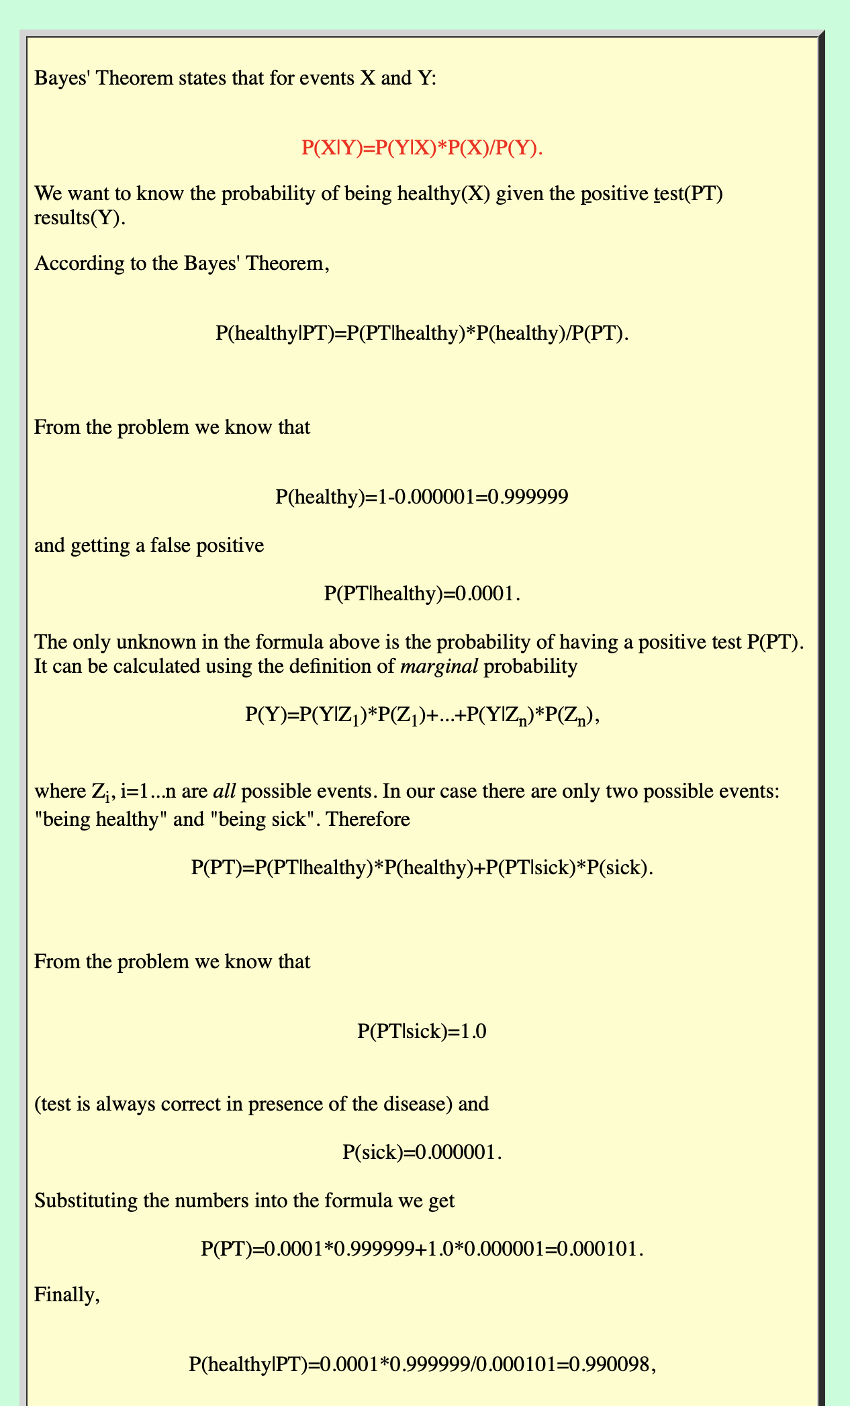
only one in a million people carry it
false positive result only 0.01% of the time

Slide 3
only one in a million people carry it

Slide 4
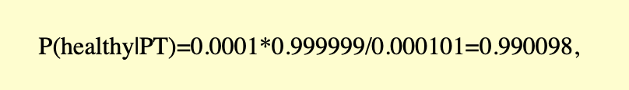

Slide 5
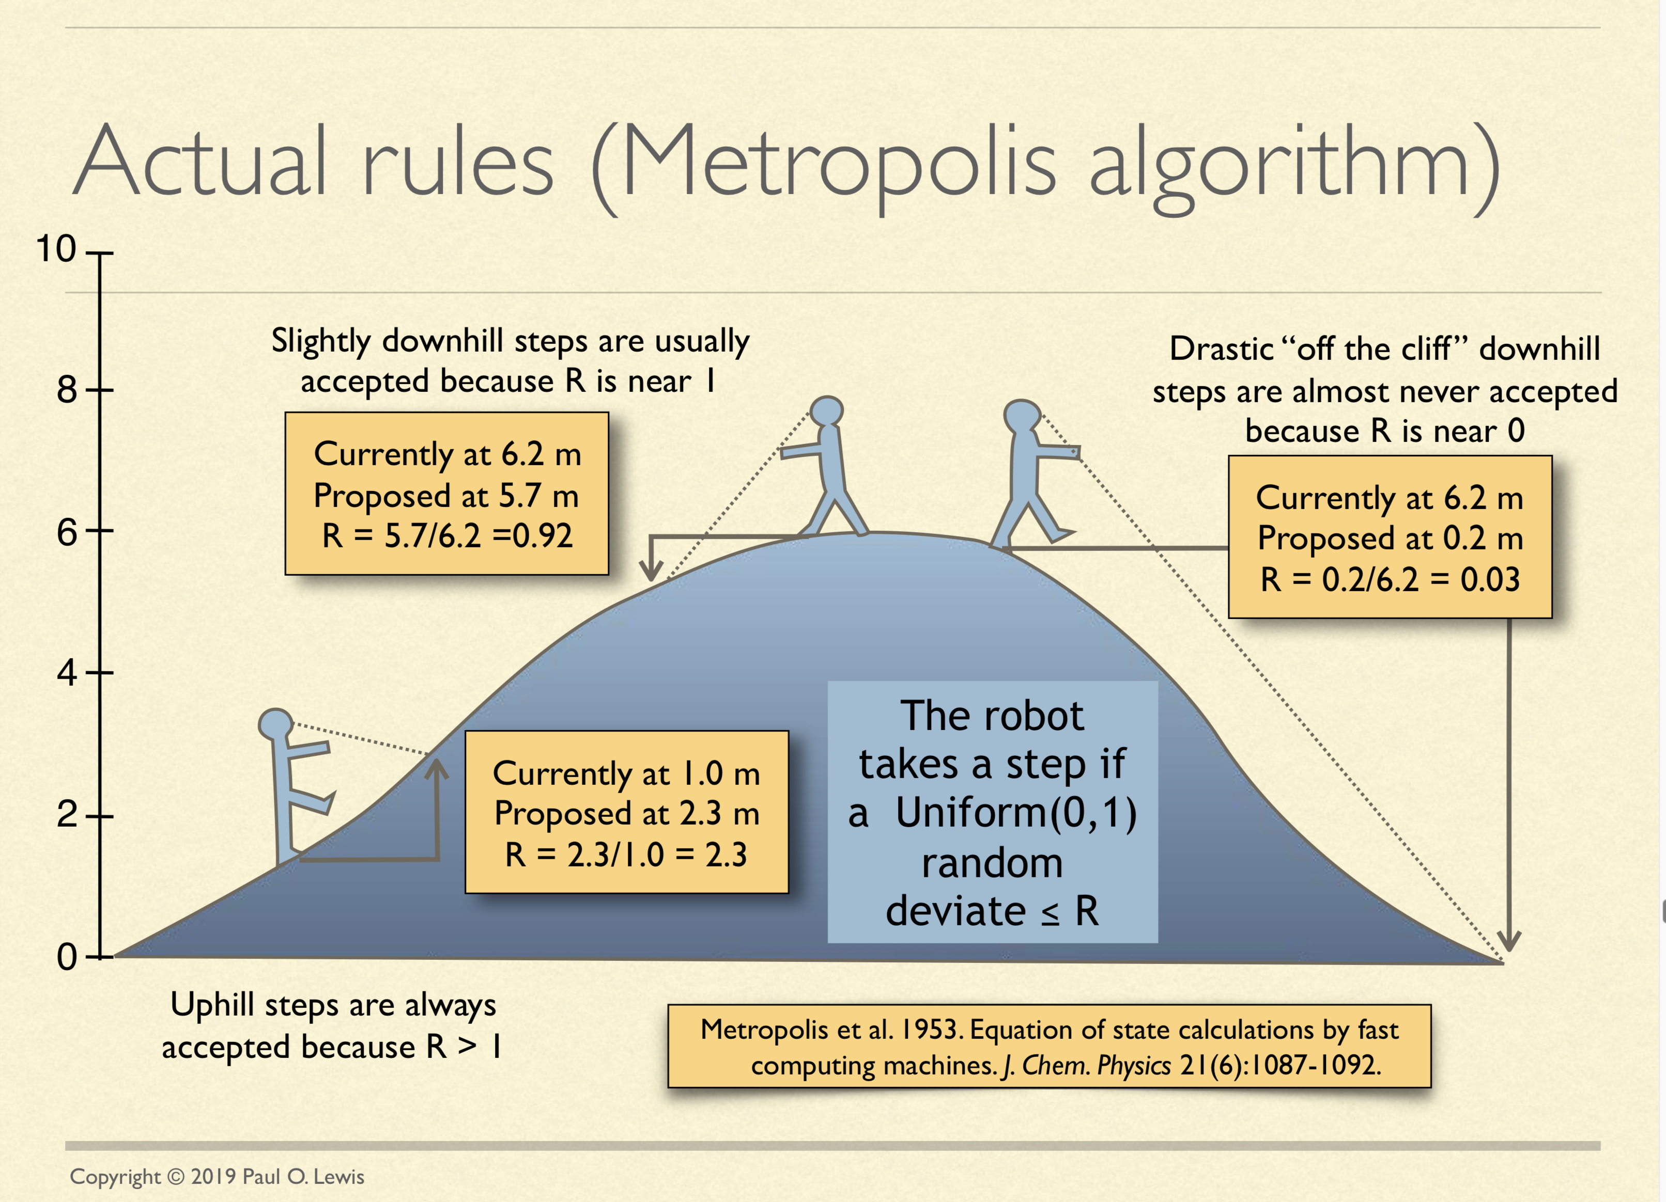
See: http://hydrodictyon.eeb.uconn.edu/people/plewis/downloads/wh2019/lewis-bayesian-part1.pdf

Slide 6
Question: How does one know a robot has travelled/mapped the whole probability landscape? Is this just assumed after a certain cutoff? How do we know if a robot is stuck in a local optimum?
The problem is one does not. Heated chains, and repeated runs (MrBayes is doing 2 independent analyses) increase the chance that one has run the chains long enough. Also, looking at the Log Likelihood trace will reassure one that the chain oscillates around some likelihood. If there are sudden jumps this would be an indication that some corners of the probability landscape have not yet been explored.
But there is no guarantee that the chains ran long enough. Some reassurance is that in phylogenetic reconstruction very sharp and narrow peaks do not seem to exist.
An image of a failure to find the sharp narrow peaks is on the next slide, but this may be hypothetical. (I used Paul Lewis's robot, 4 chains, but reduced step-size)

Slide 7
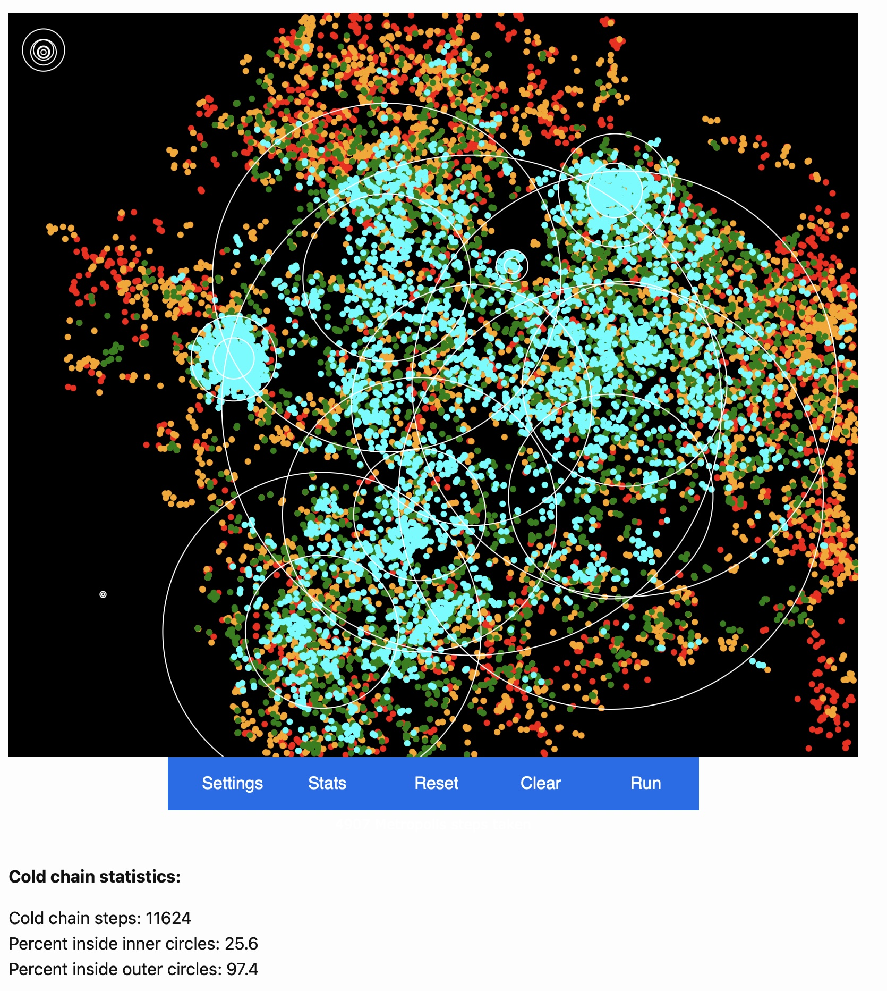

Slide 8
Bottomline:
Bayesian analyses make it easy to describe parameters governing the evolution of molecules
Intein have a less extreme ASRV compared to exteins
Inteins have a higher (three times for Sce_vma1) substitution rate than exteins
Tracer (or Excel) makes it easy to obtain 95% high probability intervals for parameter values.
It is more time consuming, but in case of inteins, one should analyze intein and extein as different dataset, not partitions, because inteins and exteins often have different evolutionary histories.

Slide 9
Interlude
Recapitulation on trees and quartet trees
https://j.p.gogarten.uconn.edu/mcb3421_2024/treesSameOrNot.htm

Slide 10
From Gene Trees to Whole Genome Trees
For more divergent groups this may be a fools errant – its not a tree that reflects shared ancestry, aka the tree of cells!
Tree of Cells (ToC): the tree that would result, if one could trace the history of cell divisions to back to the most recent common cellular ancestor.

Slide 11
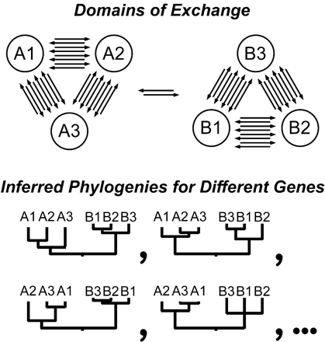

Fig. 1.—Gene transfer will obliterate patterns of vertical descent within groups that exchange genes at high ...
A consensus phylogeny may represent the frequency of genetic exchange, and not shared ancestry.
Deep branching lineages might be those who no longer participate in frequent genetic exchange.
Notes:
Fig. 1.—Gene transfer will obliterate patterns of vertical descent within groups that exchange genes at high frequency, producing discordant relationship among genes with different ancestries within the same cells
Unless provided in the caption above, the following copyright applies to the content of this slide:

Slide 12
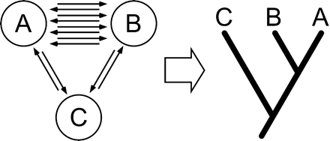
Fig. 2.—Gene transfer can create patterns of similarity and difference that mimic patterns produced by ...
Heretical thought: The species tree might reflect the frequency of HGT, and not shared ancestry.
The good news is that genes are more frequently transferred between close relatives, thus HGT will reinforce patterns due to shared ancestry, but this might not always be the case.
In particular, organisms that do not participate in HGT might be recovered as deeper branching lineages.
Notes:
Fig. 2.—Gene transfer can create patterns of similarity and difference that mimic patterns produced by vertical descent. If taxa A and B successfully exchange genetic information (by homologous recombination or HGT) more frequently with each other than with taxon C, they will come to resemble each other more closely than they do C, both in gene content and gene sequence. Treelike patterns based on gene content or sequence will reflect these different frequencies, not some underlying organismal phylogeny. Frequency of successful exchange between taxa will depend on (1) propinquity, (2) metabolic compatibility, (3) adaptations to their abiotic environment, (4) gene expression systems, and (5) gene transfer mechanisms. As these factors change, patterns of relationship (apparent organismal phylogeny) based on gene content or sequence will also change. Deep branching (as of taxon C) may reflect genetic isolation, not early divergence. Conversely, “distantly related” taxa that begin to exchange genes very frequently will ultimately resemble “sister” taxa
Unless provided in the caption above, the following copyright applies to the content of this slide:

Slide 13
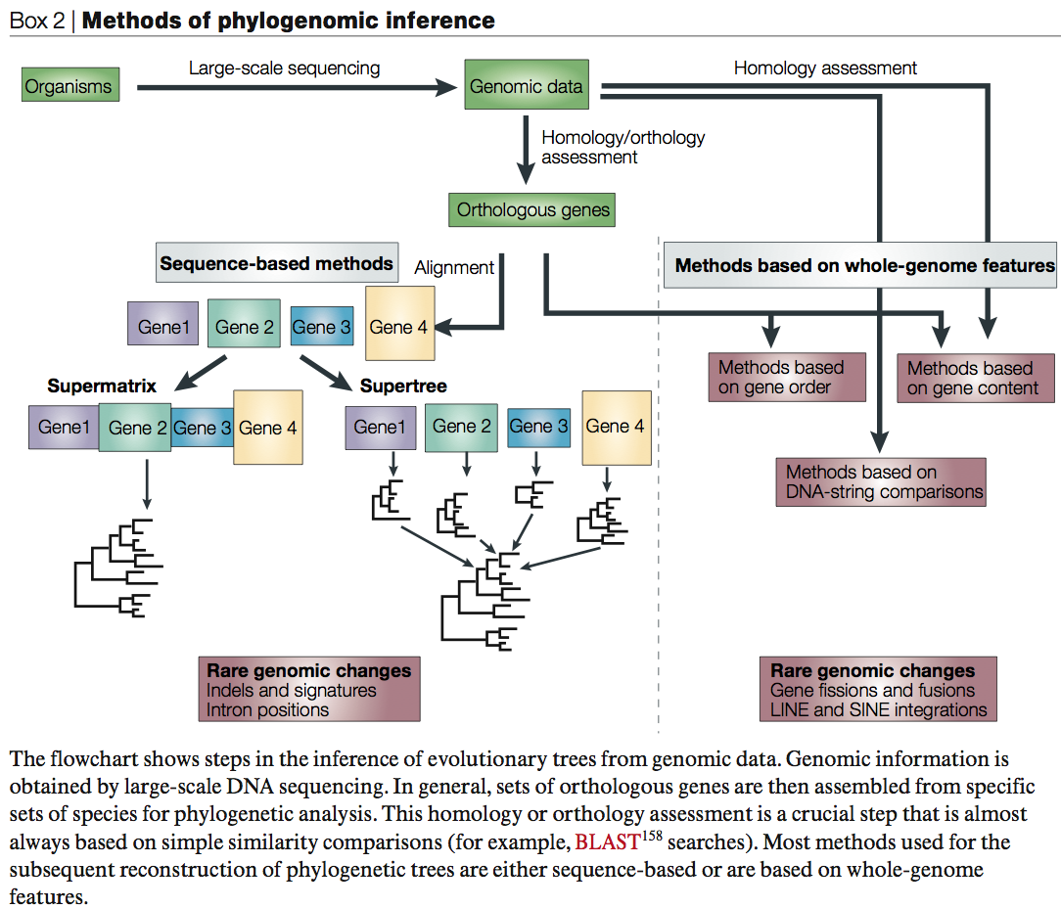
From Gen Tree to Genome Phylogeny
From:
Delsuc F, Brinkmann H, Philippe H.
Phylogenomics and the reconstruction of the tree of life.
Nat Rev Genet. 2005 May;6(5):361-75.

Slide 14
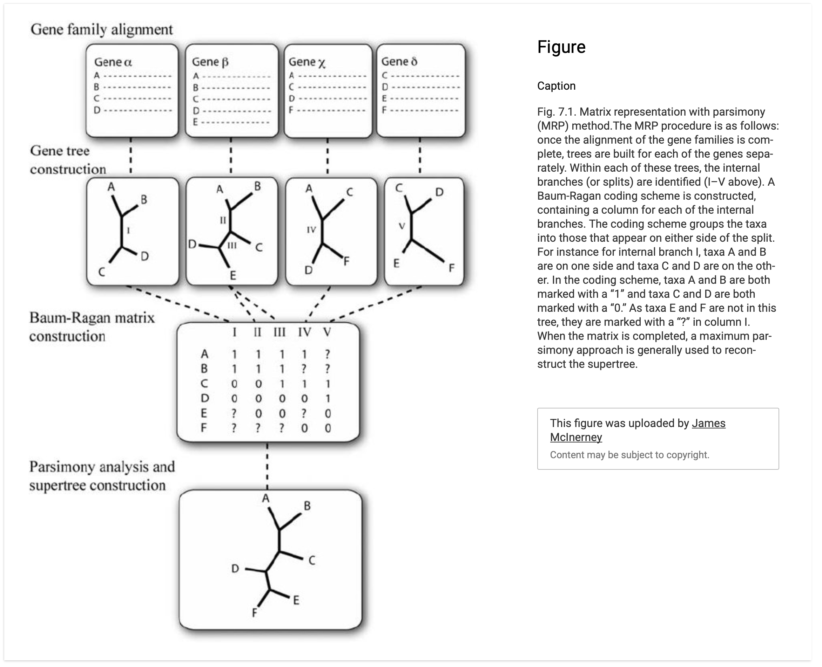
Supertree using
Matrix Representation
using Parsimony (MRB)
https://www.researchgate.net/profile/James-Mcinerney-2

Slide 15
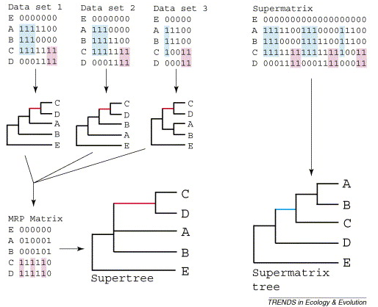
Supertree vs. Supermatrix
From:
Alan de Queiroz John Gatesy:
The supermatrix approach to systematics
Trends Ecol Evol. 2007 Jan;22(1):34-41
Schematic of MRP supertree (left) and parsimony supermatrix (right) approaches to the analysis of three data sets. Clade C+D is supported by all three separate data sets, but not by the supermatrix. Synapomorphies for clade C+D are highlighted in pink. Clade A+B+C is not supported by separate analyses of the three data sets, but is supported by the supermatrix. Synapomorphies for clade A+B+C are highlighted in blue. E is the outgroup used to root the tree.

Slide 16
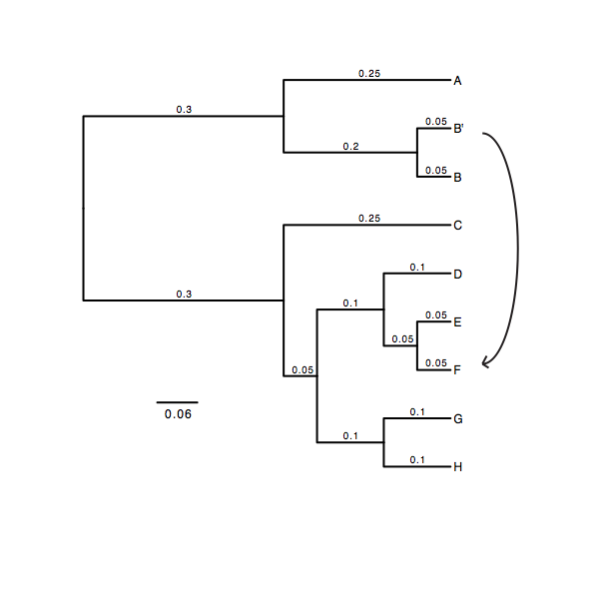
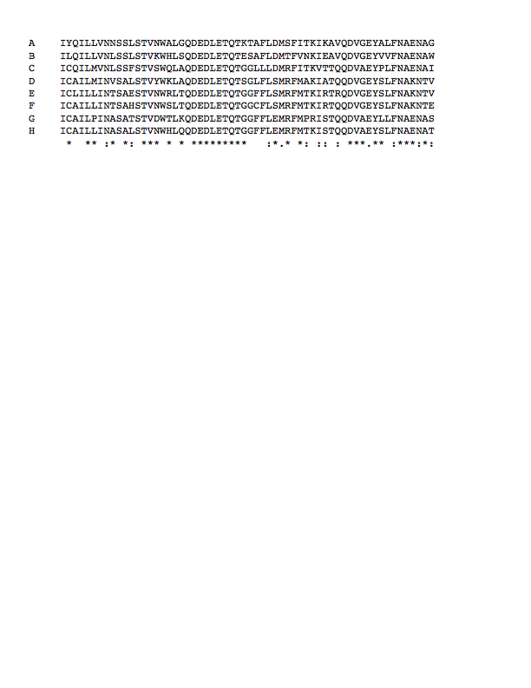
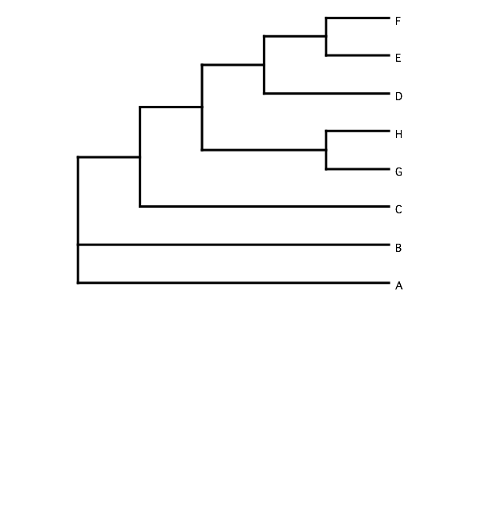
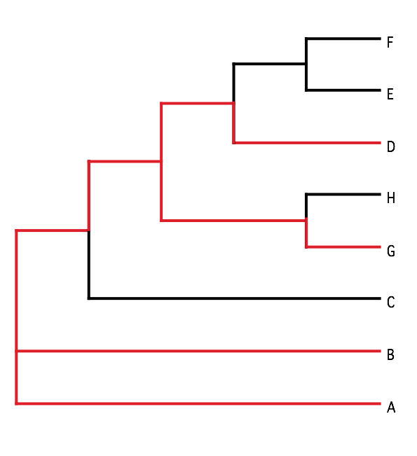
B) Generate 100 datasets using Evolver with certain amount of HGTs
A) Template tree
C) Calculate 1 tree using the concatenated dataset or 100 individual trees
D) Calculate Quartet based tree using Quartet Suite
Repeated 100 times…

Slide 17
Supermatrix versus
Quartet based Supertree
inset: simulated phylogeny

Slide 18
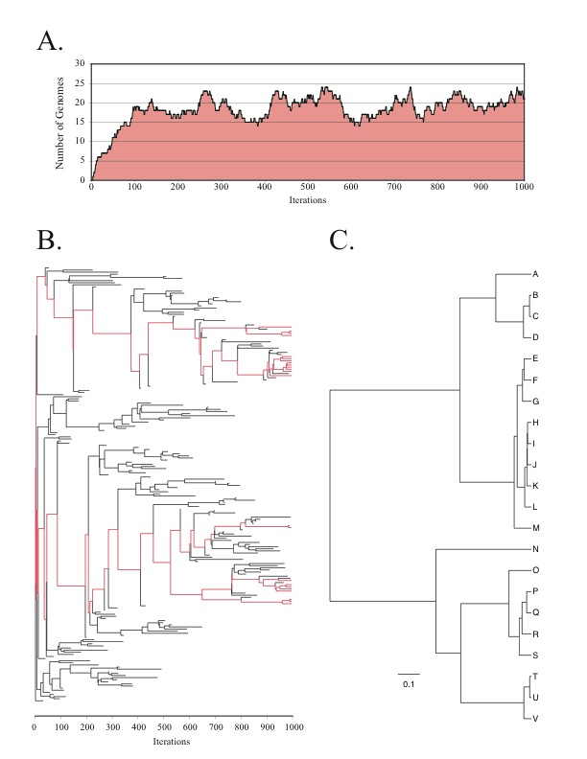
Note : Using same genome seed random number will reproduce same genome history
From: Lapierre P, Lasek-Nesselquist E, and Gogarten JP (2012)
The impact of HGT on phylogenomic reconstruction methods
Brief Bioinform [first published online August 20, 2012] doi:10.1093/bib/bbs050

Slide 19
HGT EvolSimulator Results

Slide 21
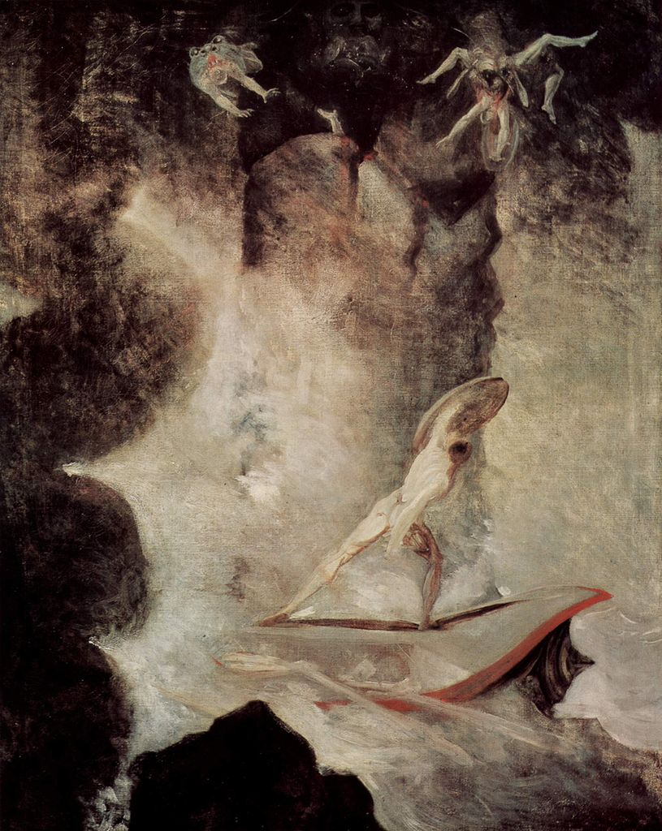
With little phylogenetic information (very divergent sequences, or very similar ones), one needs to concatenate sequences to make use of the information present in very dilute form in the individual datasets.
The problem is that the analysis becomes sensitive to HGT. A gene acquired from outside the group under analysis will pull the recipient towards the base of the phylogeny.
In case individual gene trees are well resolved, supertree approaches are much more robust towards HGT.
Odysseus vor Scilla und Charybdis
Johann Heinrich Füssli

Slide 22
Population Genetics
Drift versus Selection
A) In a population of infinite size in which allele frequencies follow a differential equation a mutation with a selective advantage will be fixed

Slide 23
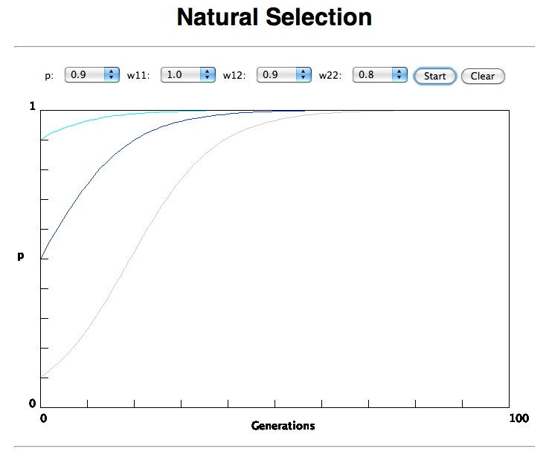

Slide 24
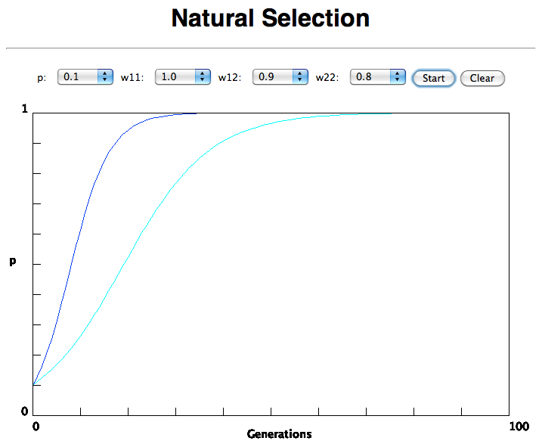
In the deterministic model, the time till fixation depends on the selective advantage, but fixation is guaranteed.

Slide 25
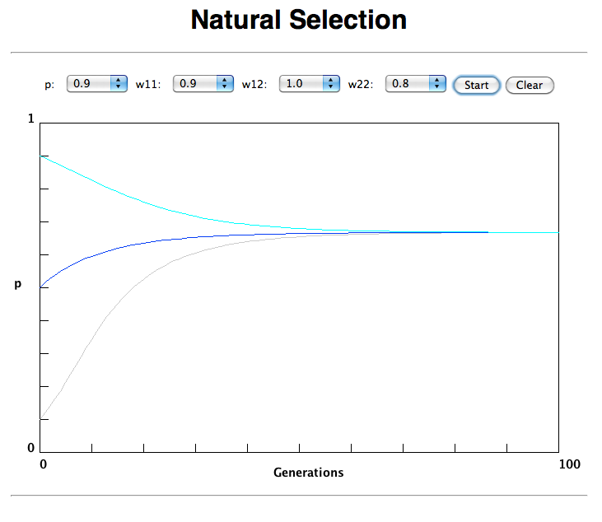
Only in case the heterozygote has an advantage (=balancing
selection) do both alleles coexist in a population.

Slide 26
(Kimura’s) Neutral theory:
The vast majority of observed sequence differences between members of a population are neutral (or close to neutral). These differences can be fixed in the population through random genetic drift. Some mutations are strongly counter selected (this is why there are patterns of conserved residues). Only very seldom is a mutation under positive selection.
The neutral theory does not say that all evolution is neutral and everything is only due to to genetic drift.

Slide 27
Modern synthesis:
Evolution occurs within populations where the fittest organisms have a selective advantage. Over time the advantageous genes become fixed in a population and the population gradually changes.
Why is this not a contradiction to the theory of neutral evolution. (which says what ?)

Slide 28
Nearly Neutral theory:
Even synonymous mutations do not lead to random composition but to codon bias.
Small negative selection might be sufficient to produce the observed codon usage bias.

Slide 29
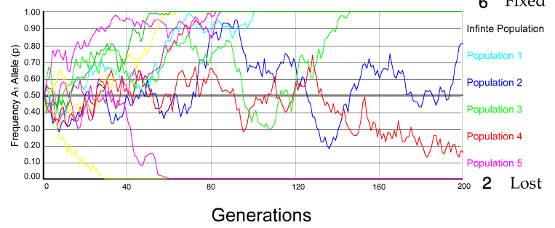
Genetic Drift: The law of the Gutter:
N=50 s=0
10 replicates

Slide 30
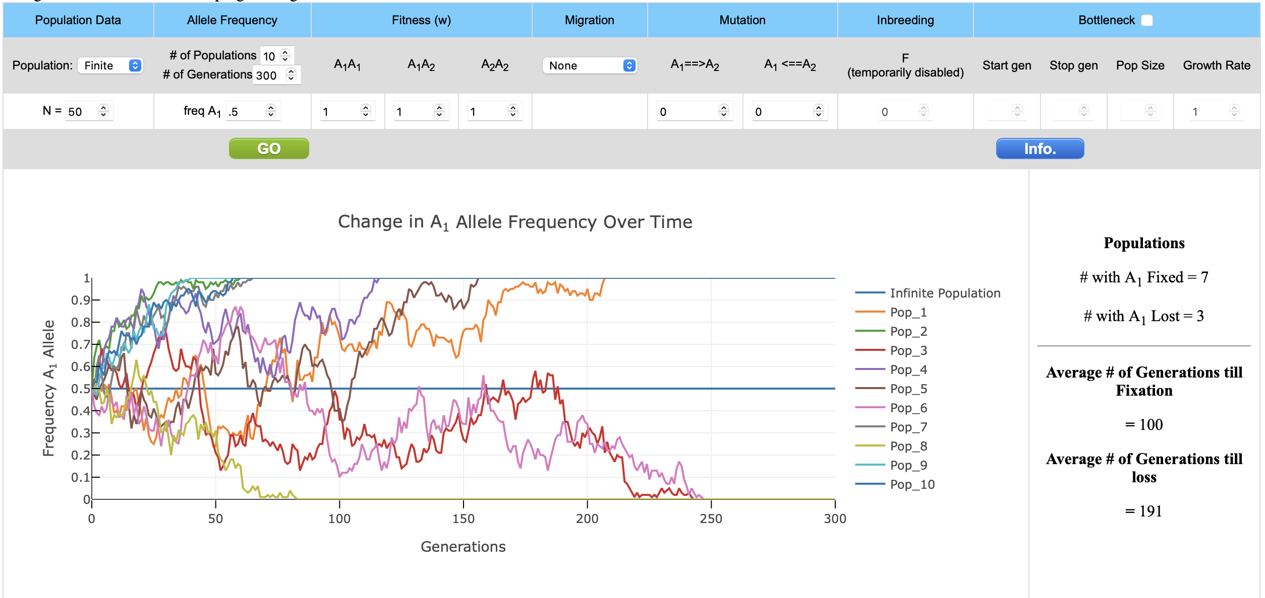

Slide 31
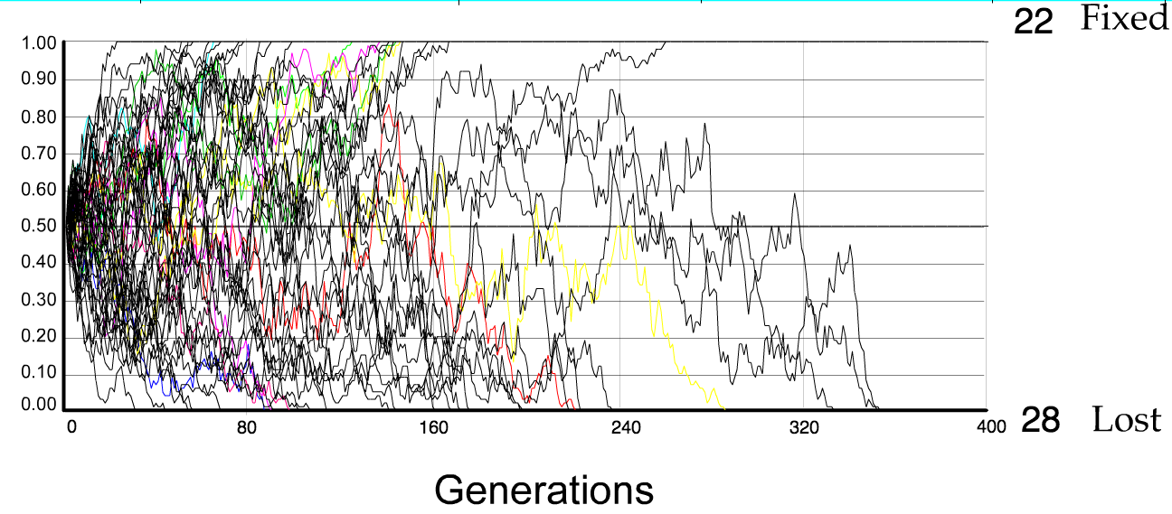
N=50 s=0
50 replicates

Slide 32
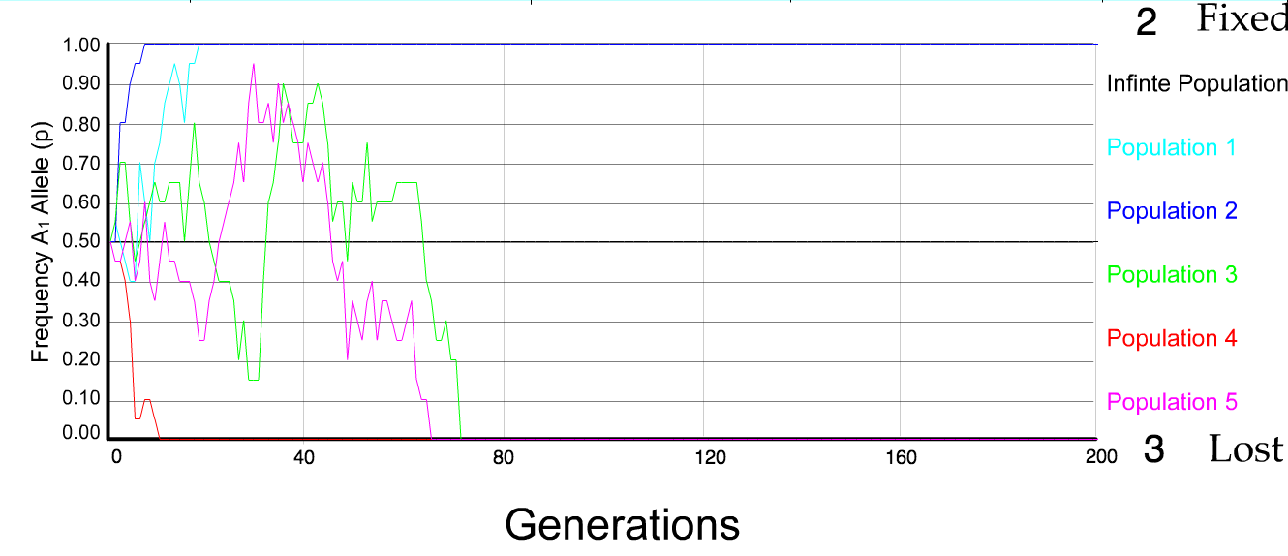
N=10 s=0
5 replicates

Slide 33
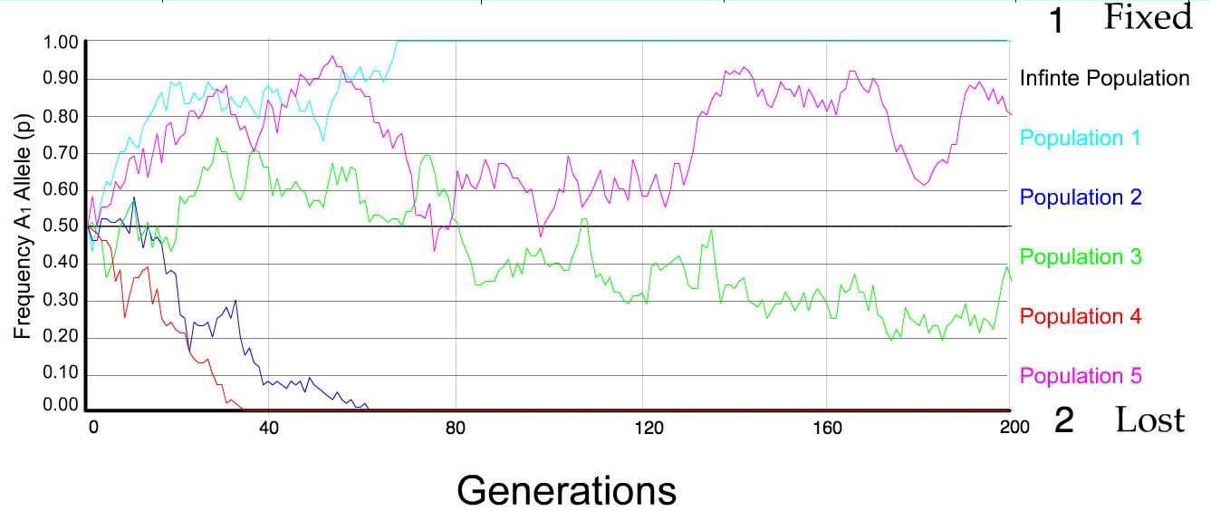
N=50 s=0
5 replicates

Slide 34
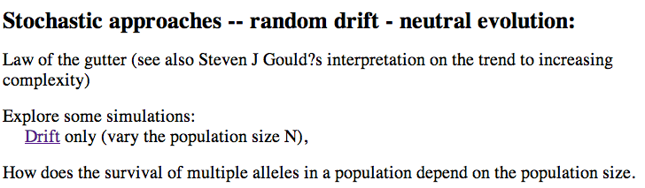
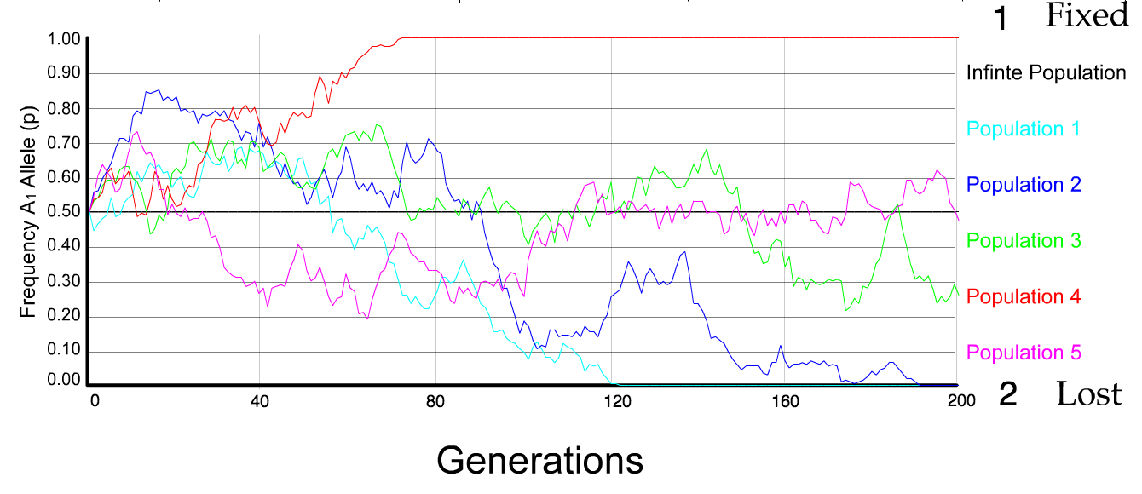
N=100 s=0
5 replicates

Slide 35
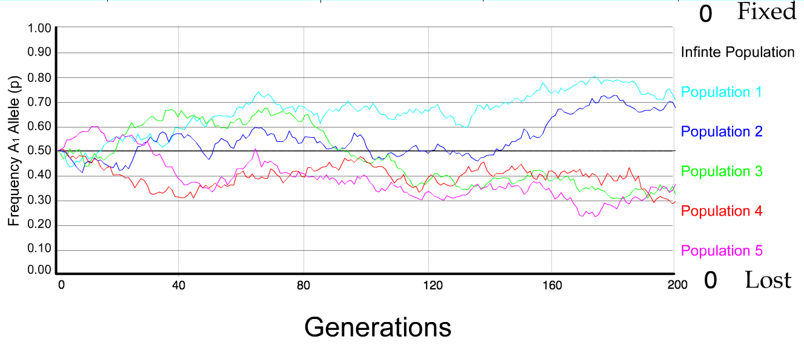
N=500 s=0
5 replicates

Slide 36
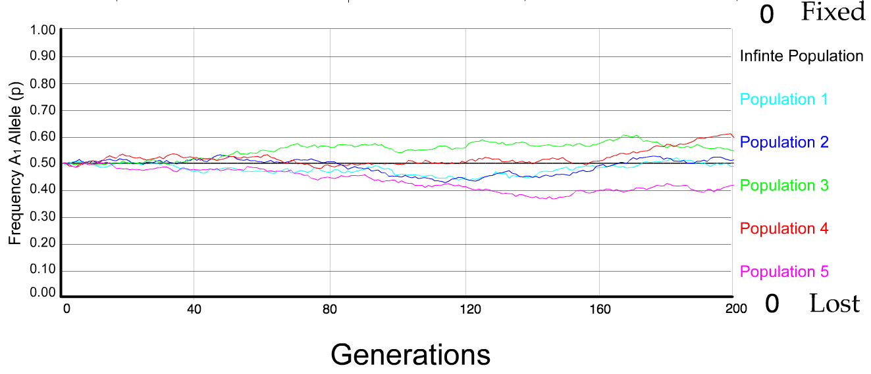
N=5000 s=0
5 replicates

Slide 37
s=0 -- neutral mutation
The probability of fixation, P, is equal to frequency of allele in population. Mutation rate (per gene/per unit of time) = u ;
freq. with which allele is generated in diploid population size N =u*2N
Probability of fixation for each allele = 1/(2N)
Substitution rate =
frequency with which new alleles are generated * Probability of fixation= u*2N *1/(2N) = u = Mutation rate
Therefore:
If f s=0, the substitution rate is independent of population size, and equal to the mutation rate !!!! (NOTE: Mutation unequal Substitution! )
This is the reason that there is hope that the molecular clock might sometimes work.
Fixation time due to drift alone:
t_{av}=4*N_{e} generations
(N_{e}=effective population size; For n discrete generations
N_{e}= n/(1/N₁+1/N₂+…..1/N_{n})

Slide 38
s>0
Time till fixation on average:
t_{av}= (2/s) ln (2N) generations
(how come that this is also true for mutations with negative “s” ! discuss among yourselves)
N=10⁴,
s=0: average time to fixation: 40.000 generations
s=0.01: average time to fixation: 1.900 generations
N=10⁶,
s=0: average time to fixation: 4*10⁶ generations
s=0.01: average time to fixation: 2900 generations
N=10¹¹ (100 billion – size of the Prochlorococcus population),
s=0: average time to fixation: 2*10¹¹ generations (about .5 billion years)
s=0.01: average time to fixation: 5200 generations (about 14 years)
Probability of fixation, P, is approximately equal to 2s;
e.g., if selective advantage s = 1% then P = 2%

Slide 39
Positive selection (s>0)
A new allele (mutant) confers some increase in the fitness of the organism
Selection acts to favour this allele
Also called adaptive selection or Darwinian selection.
NOTE: Fitness = ability to survive and reproduce
Modified from from www.tcd.ie/Genetics/staff/Aoife/GE3026/GE3026_1+2.ppt

Slide 40
Random Genetic Drift
Selection
100
advantageous
Allele frequency
disadvantageous
0
Modified from from www.tcd.ie/Genetics/staff/Aoife/GE3026/GE3026_1+2.ppt

Slide 41
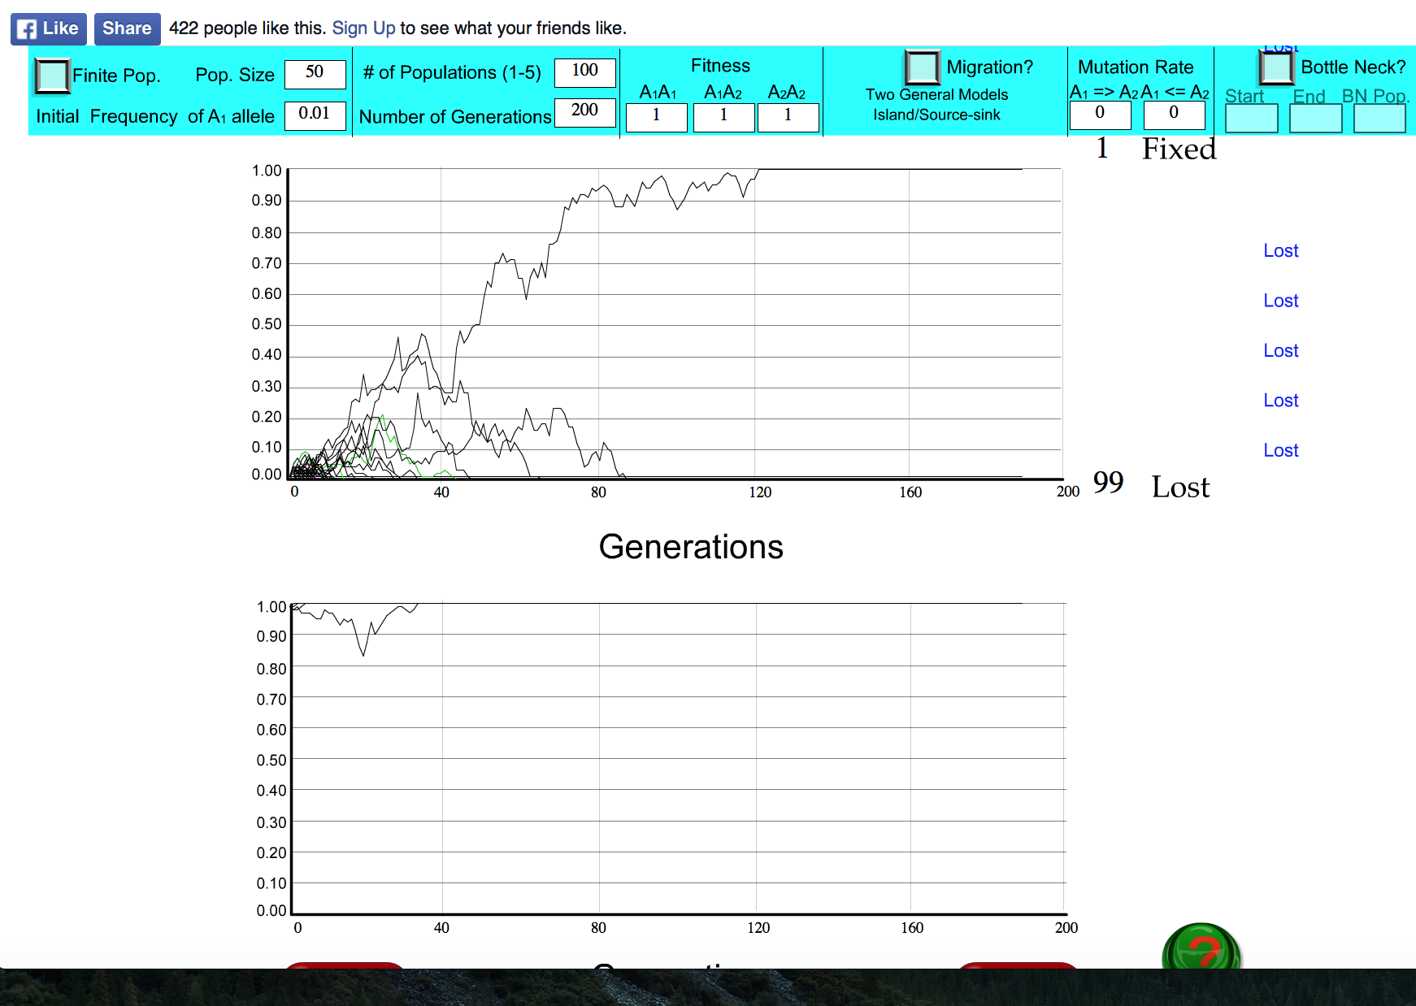
s=0

Slide 42
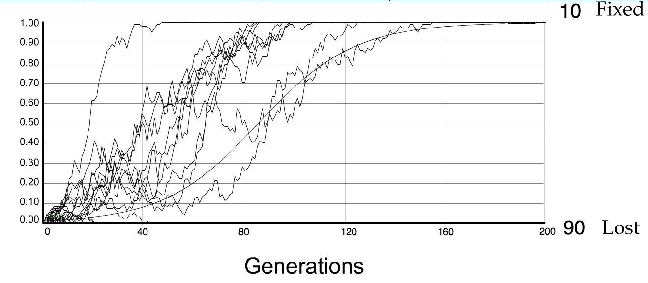
For advantageous mutations:
Probability of fixation, P, is approximately equal to 2s;
e.g., if selective advantage s = 5% then P = 10%
tav=2/s*log2N generations = 40*log100= 80

Slide 43
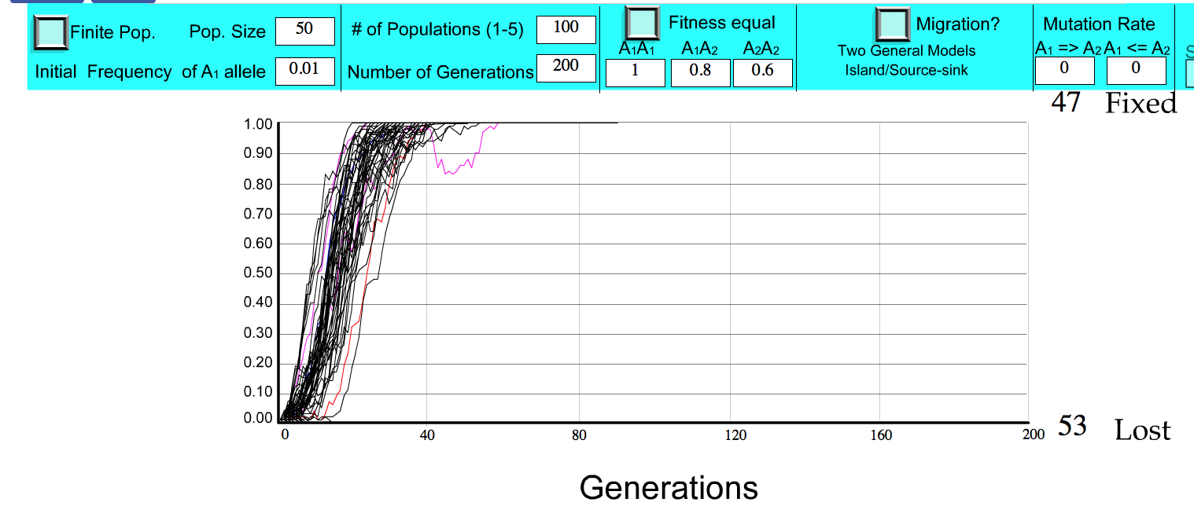
S=.2 => shorter fixation time.

Slide 44
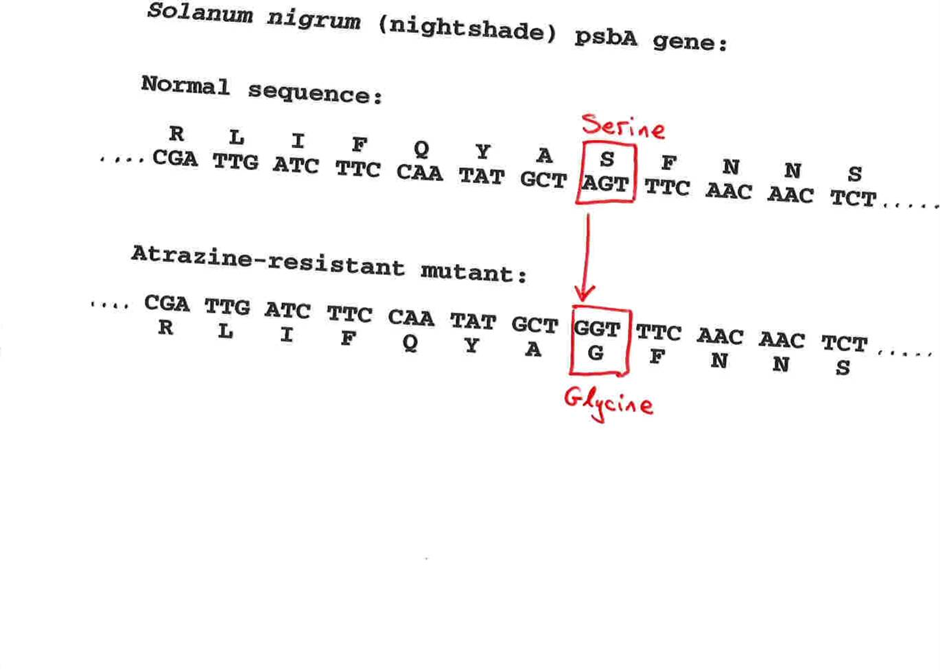
Advantageous allele
Herbicide resistance gene in nightshade plant
Modified from from www.tcd.ie/Genetics/staff/Aoife/GE3026/GE3026_1+2.ppt

Slide 45
selection versus drift
The larger the population the longer it takes for an allele to become fixed.
Note: Even though an allele conveys a strong selective advantage of 10%, the allele has a rather large chance to go extinct.
Note#2: Fixation is faster under selection than under drift.
Question: Can you think of genes that have a higher fixation probability? (Hint: HGT)

Slide 46
Negative selection (s<0)
A new allele (mutant) confers some decrease in the fitness of the organism
Selection acts to remove this allele
Also called purifying selection
Modified from from www.tcd.ie/Genetics/staff/Aoife/GE3026/GE3026_1+2.ppt

Slide 47
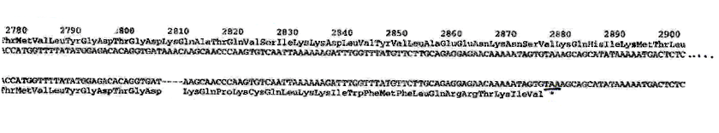
Deleterious allele
Human breast cancer gene, BRCA2
5% of breast cancer cases are familial
Mutations in BRCA2 account for 20% of familial cases
Normal (wild type) allele
Mutant allele
(Montreal 440
Family)
Stop codon
4 base pair deletion
Causes frameshift
Modified from from www.tcd.ie/Genetics/staff/Aoife/GE3026/GE3026_1+2.ppt

Slide 48
Neutral mutations
Neither advantageous nor disadvantageous
Invisible to selection (no selection)
Frequency subject to ‘drift’ in the population
Random drift – random changes of allele frequency in small populations

Slide 49
Types of Mutation-Substitution
Replacement of one nucleotide by another
Synonymous (Doesn’t change amino acid)
  Rate sometimes indicated by Ks
  Rate sometimes indicated by d_{s}
Non-Synonymous (Changes Amino Acid)
  Rate sometimes indicated by Ka
  Rate sometimes indicated by d_{n}
(this and the following 4 slides are from
mentor.lscf.ucsb.edu/course/ spring/eemb102/lecture/Lecture7.ppt)

Slide 50
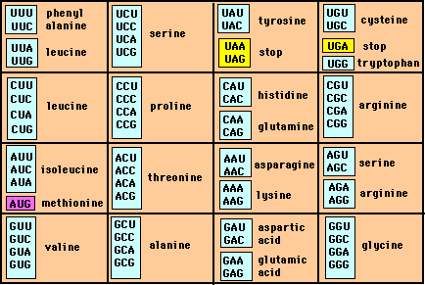
Genetic Code – Note degeneracy of 1st vs 2nd vs 3rd position sites

Slide 51
Genetic Code
Four-fold degenerate site – Any substitution is synonymous
From: mentor.lscf.ucsb.edu/course/spring/eemb102/lecture/Lecture7.ppt

Slide 52
Genetic Code
Two-fold degenerate site – Some substitutions synonymous, some
non-synonymous
From: mentor.lscf.ucsb.edu/course/spring/eemb102/lecture/Lecture7.ppt

Slide 53
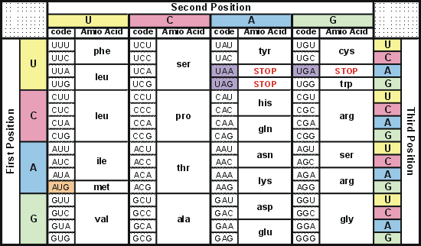
Degeneracy of 1st vs 2nd vs 3rd position sites results in 25.5% synonymous changes and 74.5% non synonymous changes (Yang&Nielsen,1998).
Genetic Code
Notes:
An inspection of the genetic code table suggests most changes at the first position are nonsynonymous, all changes at the second codon position are nonsynonymous and only some changes at the third position are synonymous. As a result we do not expect to see equal proportions of synonymous and nonsynonymous mutations even if there is no selection at protein level. Indeed, if mutations from any one nucleotide to any other occur at the same rate , we expect 25.5% of mutations to be synonymous and 74.5% mutations to be nonsynonymous.

Slide 54
Measuring Selection on Genes
Null hypothesis = neutral evolution
Under neutral evolution, synonymous changes should accumulate at a rate equal to mutation rate
Under neutral evolution, amino acid substitutions should also accumulate at a rate equal to the mutation rate
From: mentor.lscf.ucsb.edu/course/spring/eemb102/lecture/Lecture7.ppt

