Slide 1
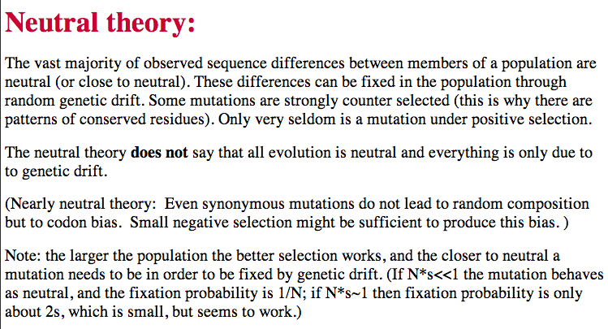

Slide 2
Neutral theory:
The vast majority of observed sequence differences between members of a population are neutral (or close to neutral). These differences can be fixed in the population through random genetic drift. Some mutations are strongly counter selected (this is why there are patterns of conserved residues). Only very seldom is a mutation under positive selection.
The neutral theory does not say that all evolution is neutral and everything is only due to to genetic drift.

Slide 3
Nearly Neutral theory:
Even synonymous mutations do not lead to random composition but to codon bias. Small negative selection might be sufficient to produce the observed codon usage bias.

Slide 4
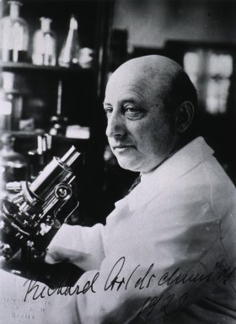
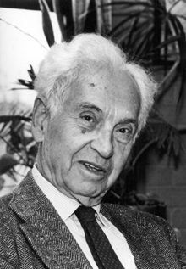
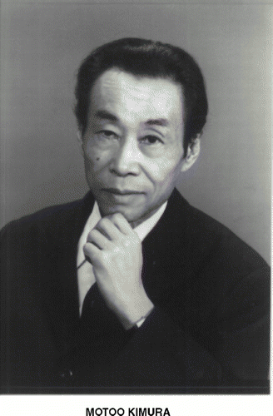
How do you define evolution?
Richard Goldschmidt 1940
hopeful monsters
Mutationism HGT/WGD!
Punctuated Equilibrium
Few genes / large effect
Vilified by Mayr, celebrated 1977 Gould & Evo-devo
Ernst Mayr 1942
NeoDarwinian Synthesis
Natural Selection
Gradualism
Many genes/small effect
Dario – “Fisher right”
Motoo Kimura 1968
Neutral Theory
Genetic Drift is main force for changing allele frequencies
Slide from Chris Pires
Notes:
Goldschmitdt,R. (1940). The Material Basis of Evolution
Mayr, Ernst (1942). Systematics and the origin of species, from the viewpoint of a zoologist

Slide 5
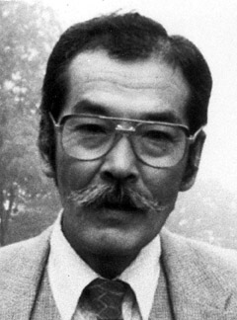
Duplications and Evolution
Ohno postulated that gene duplication plays a major role in evolution
Small scale duplications (SSD)
Whole genome duplications (WGD)
Polyploid: nucleus contains three or more copies of each chromosome
Autopolyploid: formed within a single species
Diploids AA and A’A’ Polyploid AAA’A’
Allopolyploid: formed from more than one species
Diploids AA and BB Polyploid AABB
Susumu Ohno 1970
Evolution by gene duplication
1R and 2R hypothesis
“Junk DNA” 1972
Slide from Chris Pires

Slide 6
What is it good for?
Gene duplication events can provide an outgroup that allows rooting a molecular phylogeny.
Most famously this principle was applied in case of the tree of life – the only outgroup available in this case are ancient paralogs (see http://gogarten.uconn.edu/cvs/Publ_Pres.htm for more info).
However, the same principle also is applicable to any group of organisms, where a duplication preceded the radiation (example).
Lineage specific duplications also provide insights into which traits were important during evolution of a lineage.

Slide 7
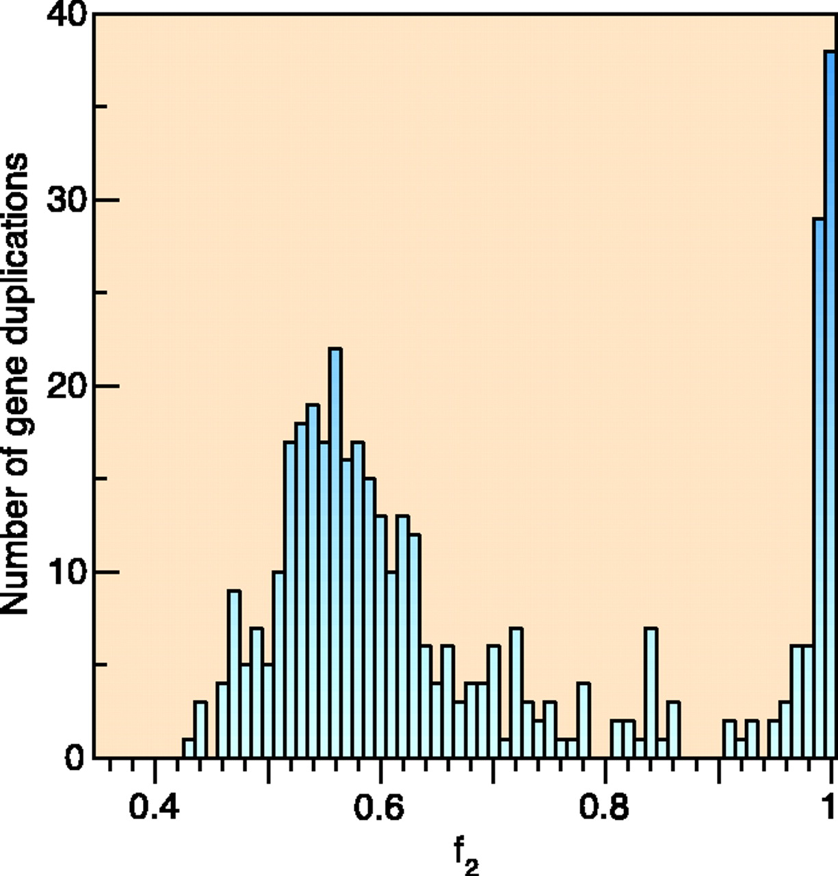
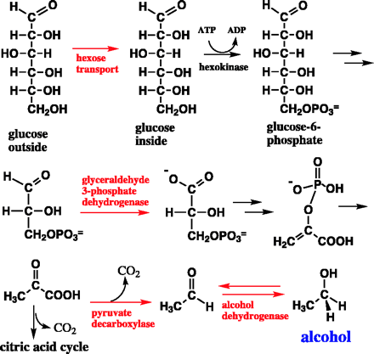
e.g. gene duplications in yeast
from Benner et al., 2002
Figure 1. The number of duplicated gene pairs (vertical axis) in the genome of the yeast Saccharomyces cerevisiae versus f₂, a metric that models divergence of silent positions in twofold redundant codon systems via an approach-to-equilibrium kinetic process and therefore acts as a logarithmic scale of the time since the duplications occurred. Recent duplications are represented by bars at the right. Duplications that diverged so long ago that equilibrium at the silent sites has been reached are represented by bars where f₂ 0.55. Noticeable are episodes of gene duplication between the two extremes, including a duplication at f₂ 0.84. This represents the duplication, at ~80 Ma, whereby yeast gained its ability to ferment sugars found in fruits created by angiosperms. Also noticeable are recent duplications of genes that enable yeast to speed DNA synthesis, protein synthesis, and malt degradation, presumably representing yeast's recent interaction with humans.
The chemical pathway that converts glucose to alcohol in yeast arose ~80 Ma, near the time that fermentable fruits became dominant. Gene families that suffered duplication near this time, captured in the episode of gene duplication represented in the histogram in Fig. 1 by bars at f₂ 0.84, are named in red. According to the hypothesis, this pathway became useful to yeast when angiosperms (flowering, fruiting plants) began to provide abundant sources of fermentable sugar in their fruits.

Slide 8
the gradualist point of view
Evolution occurs within populations where the fittest organisms have a selective advantage. Over time the advantages genes become fixed in a population and the population gradually changes.
Note: this is not in contradiction to the the theory of neutral evolution. (which says what ?)
Processes that MIGHT go beyond inheritance with variation and selection?
  Horizontal gene transfer and recombination
  Polyploidization (botany, vertebrate evolution) see here or here
  Fusion and cooperation of organisms (Kefir, lichen, also the eukaryotic cell)
  Targeted mutations (?), genetic memory (?) (see Foster's and Hall's reviews on directed/adaptive mutations; see here for a counterpoint)
  Random genetic drift
  Gratuitous complexity
  Selfish genes (who/what is the subject of evolution??)
  Parasitism, altruism, Morons
  Evolutionary capacitors
  Hopeless monsters (in analogy to Goldschmidt’s hopeful monsters)

Slide 9
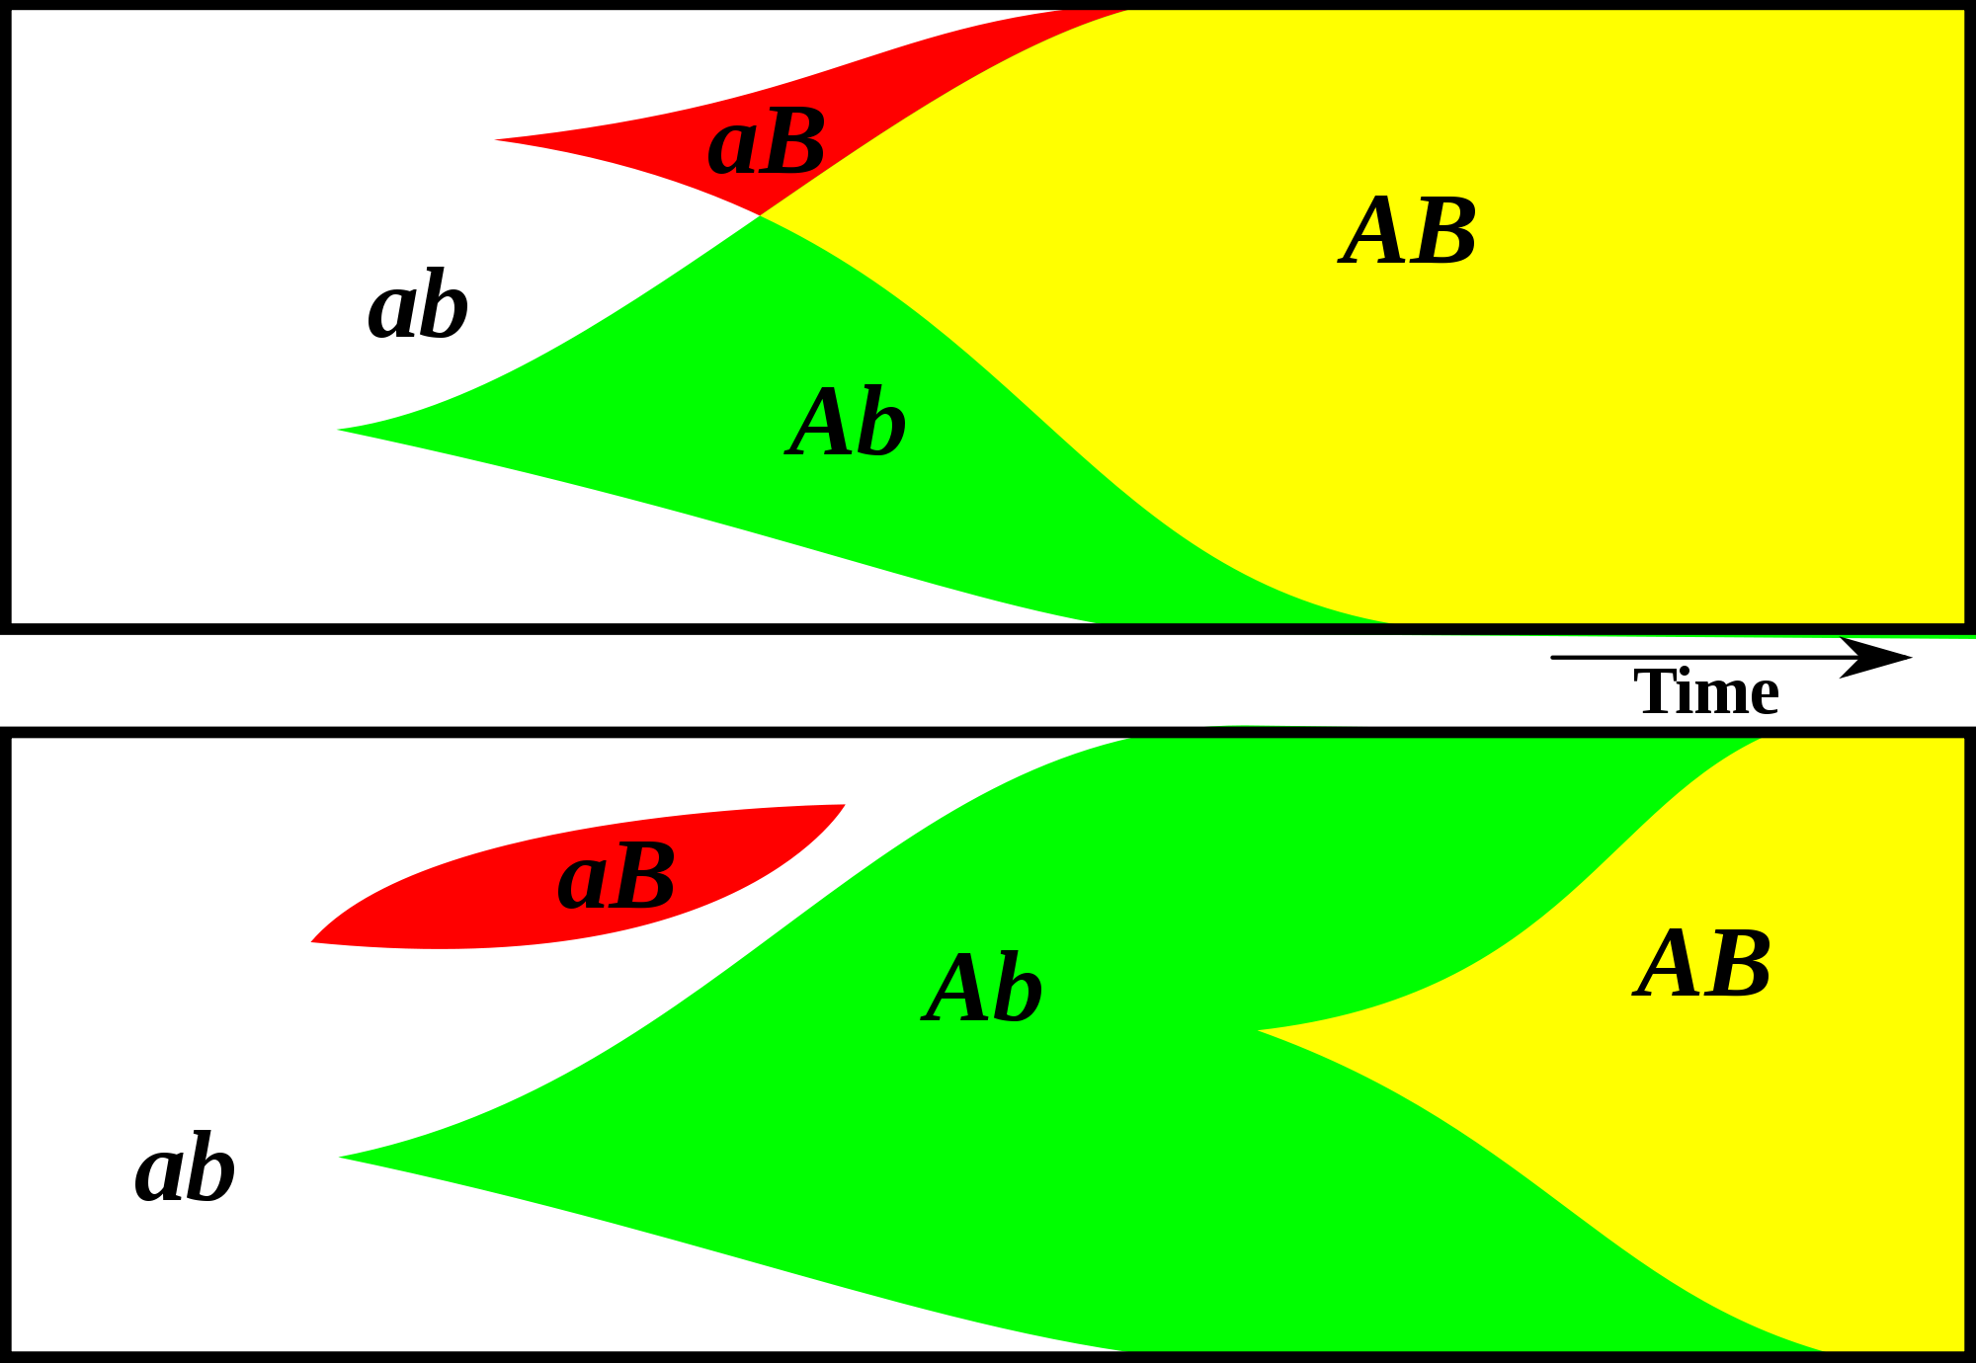
Gene Transfer, Sex, and Recombination:
Inventions do not need to be made sequentially
Gene transfer, followed by homologous or non-homologous recombination, allows inventions to be shared across the tree of life

Slide 10
Aside: Gene and genome duplication versus
Horizontal Gene Transfer
Autochtonous gene/genome
duplication are rare
in prokaryotes
Gene family expansion through horizontal gene transfer –
the most common process in prokaryotes

Slide 11
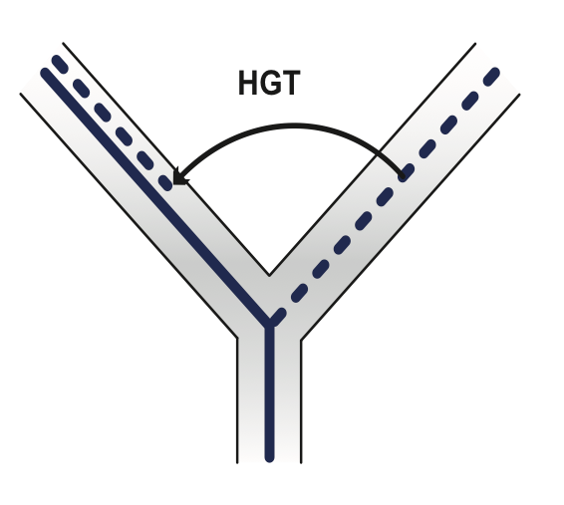
Horizontal Gene Transfer (HGT) and the
Acquisition of New Capabilities
Most important process to adapt microorganisms to new environments.
E.g.: Antibiotic and heavy metal resistance,
pathways that allow acquisition and breakdown of new substrates.
Creation of new metabolic pathways.
HGT not autochthonous gene duplication is the main
process of gene family expansion in prokaryotes.
Also important in the recent evolution of multicellular eukaryotes
(HGT between fish species and between grasses).
Selection acts on the Holobiont (= Host + Symbionts)
To adapt to new conditions, new symbionts can be acquired, or existing symbionts can acquire new genes through HGT.

Slide 12
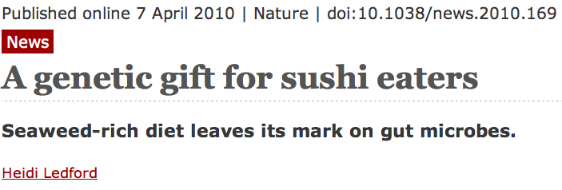
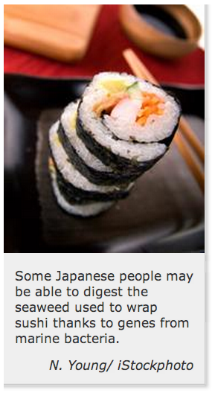
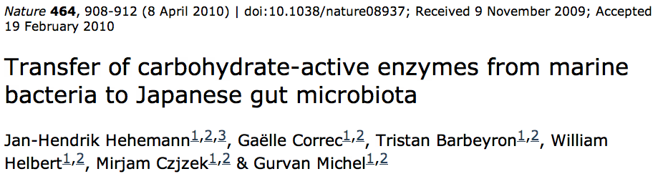
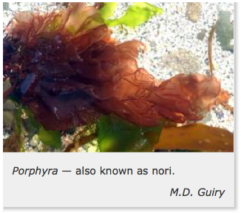

Gene Transfer in Eukaryotes
Bacterial parasites on red algae
HGT
Human gut symbiont

Slide 13
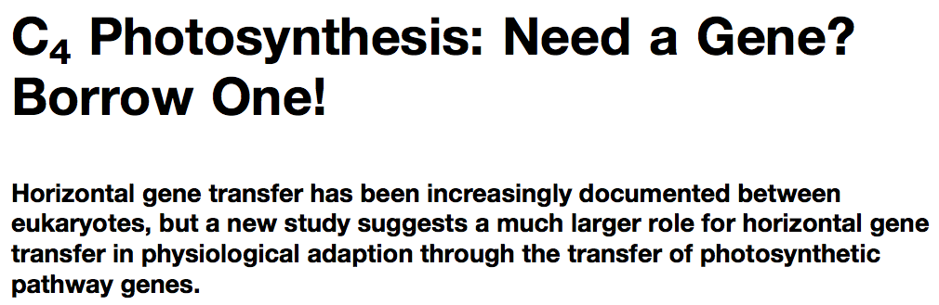
Gene Transfer in Eukaryotes – Example 2
Highlights
Key genes for C₄ photosynthesis were transmitted between distantly related grasses
These genes contributed to the adaptation of the primary metabolism
Their transmission was independent from most of the genome
Curr Biol. 2012 Mar 6;22(5):445-9. Epub 2012 Feb 16.
Adaptive Evolution of C(4) Photosynthesis
through Recurrent Lateral Gene Transfer.
Christin PA, Edwards EJ, Besnard G, Boxall SF, Gregory R, Kellogg EA, Hartwell J, Osborne CP.
Eric H. Roalson Current Biology Vol 22 No 5 R162

Slide 14
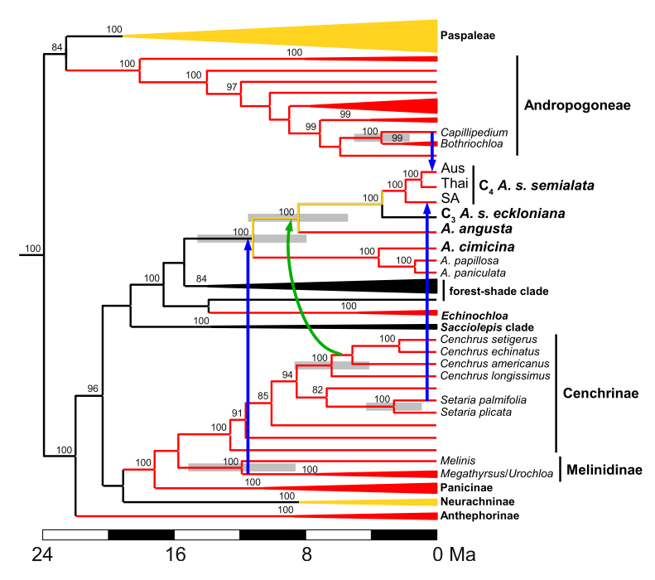
Gene Transfer in Eukaryotes – Example 2
From: Christin PA, Edwards EJ, Besnard G, Boxall SF, Gregory R, Kellogg EA, Hartwell J, Osborne CP.
Adaptive Evolution of C(4) Photosynthesis
through Recurrent Lateral Gene Transfer. Curr Biol. 2012 Mar 6;22(5):445-9. Epub 2012 Feb 16.

Slide 15
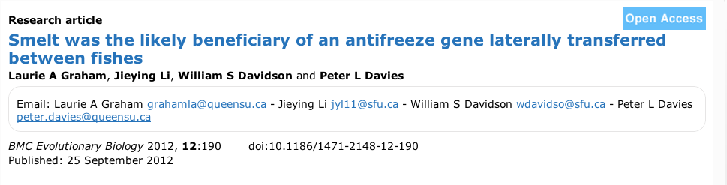
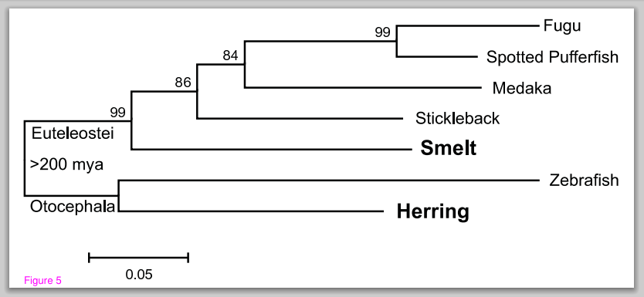
Gene Transfer in Eukaryotes – Example 3

Slide 16
HGT as a force creating new pathways

Slide 17
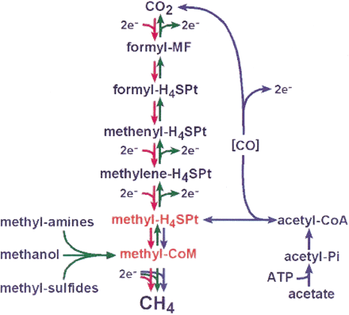
HGT as a force creating new pathways – Example I
Acetoclastic Methanogenesis
Unique to subset of Archaea
Energy production via reduction of multiple carbon substrates to CH₄
900 Million metric tons of biogenic methane produced annually.
Over 66% of biogenic methane is produced from acetate, mostly by Methanosarcina genera.
From: Galagan et al., 2002
Fournier and Gogarten (2008) Evolution of Acetoclastic Methanogenesis in Methanosarcina via Horizontal Gene Transfer from Cellulolytic Clostridia. J. Bacteriol. 190(3):1124-7

Slide 18
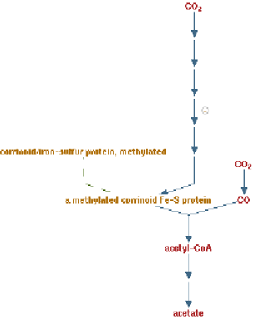
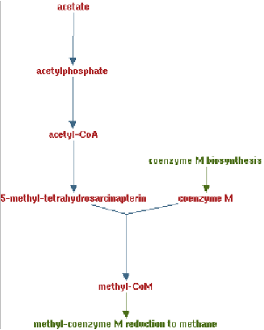
Clostridia acetigenic pathway
Methanosarcina
acetoclastic pathway
AckA
HGT
PtaA
PtaA
AckA
Figures drawn with Metacyc (www.metacyc.org)

Slide 19
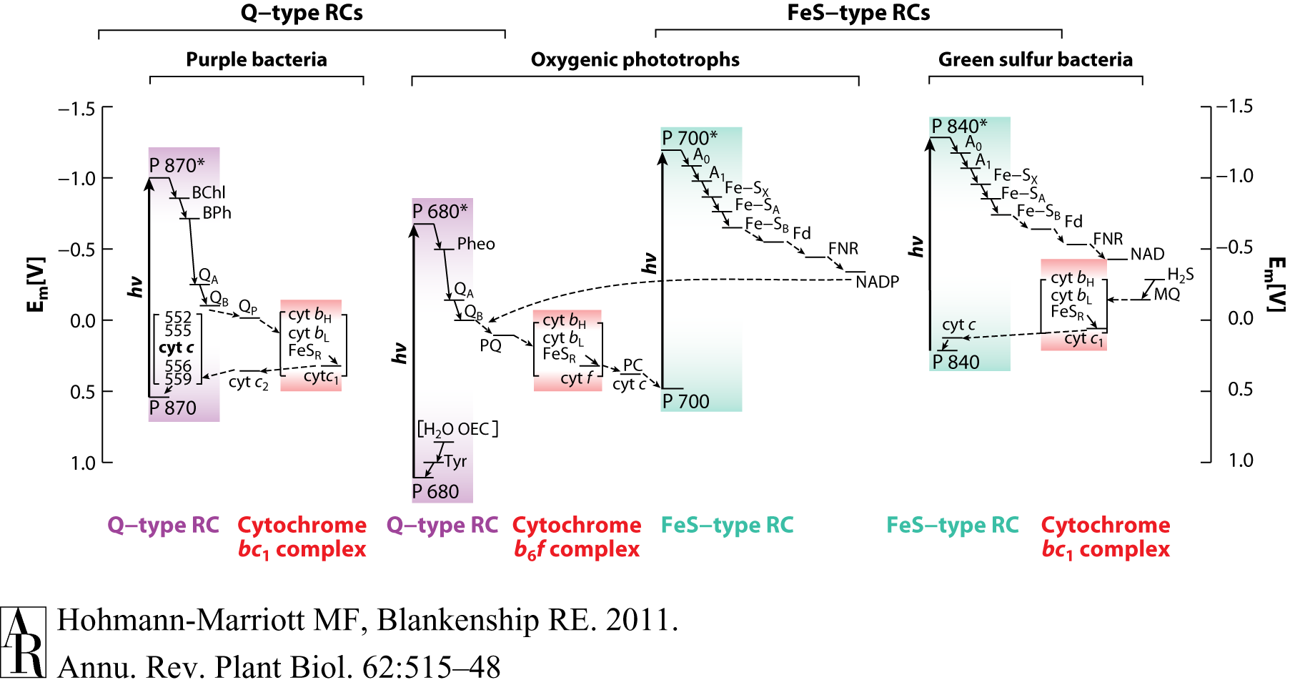
HGT as a force creating new pathways – Example 2
Oxygen producing photosynthesis

Slide 20
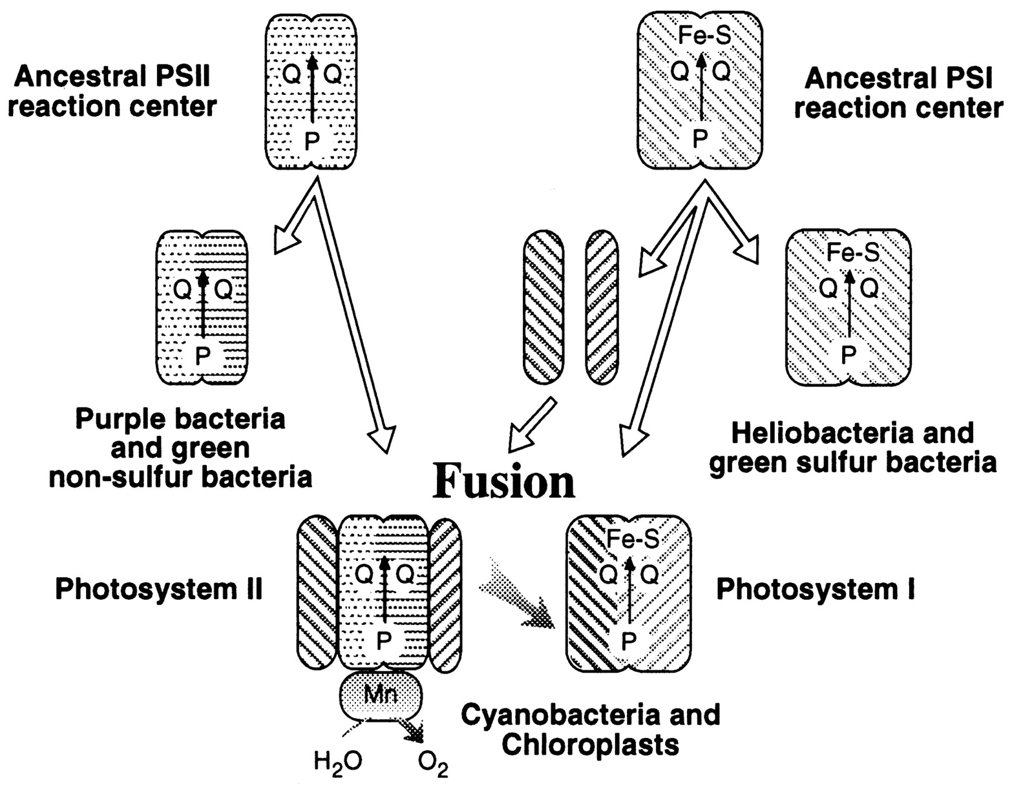
A heterologous fusion model for the evolution of oxygenic photosynthesis based on phylogenetic analysis.
Xiong J et al. PNAS 1998;95:14851-14856
©1998 by National Academy of Sciences
Notes:
A heterologous fusion model for the evolution of oxygenic photosynthesis based on phylogenetic analysis. Details of the model are provided in the text.

Slide 21
HGT as a force creating new pathways – Example 3
Acetyl-CoA Assimilation: Methylaspartate Cycle
Acetate
Alcohols
Polyhydroxybutyrate
Fatty acids
acetyl-CoA
Lysine, leucine
oxaloacetate
citrate
malate
isocitrate
CO
2
fumarate
acetyl-CoA
2-oxoglutarate
Poly-γ -glutamate
succinate
glutamate
Proteins
glyoxylate
γ-Glutamylcystein
succinyl-CoA
methylaspartate
CO
Osmoadaptation
2
propionyl-CoA
mesaconate
3-methylmalyl-CoA
mesaconyl-CoA
Khomyakova, Bükmez, Thomas, Erb, Berg, Science, 2011

Slide 22
Comparison of different anaplerotic pathways
acetyl-CoA
acetyl-CoA
acetyl-CoA
acetyl-CoA
crotonyl-CoA
oxaloacetate
citrate
oxaloacetate
citrate
CO
2
malate
isocitrate
acetyl-CoA
ethylmalonyl-CoA
CO
2
fumarate
acetyl-CoA
2-oxoglutarate
malate
isocitrate
methylsuccinyl-CoA
glyoxylate
succinate
glutamate
CO
2
mesaconyl-CoA
glyoxylate
2-oxoglutarate
3-methylmalyl-CoA
succinyl-CoA
methylaspartate
fumarate
CO
propionyl-CoA
glyoxylate
2
propionyl-CoA
mesaconate
CO
2
CO
2
acetyl-CoA
succinate
succinyl-CoA
3-methylmalyl-CoA
mesaconyl-CoA
succinyl-CoA
malate
Citric acid cycle and
Glyoxylate cycle
Ethylmalonyl-CoA
pathway
Methylaspartate cycle
Bacteria, Eukarya and some Archaea
α-Proteobacteria, streptomycetes
haloarchaea

Slide 23
HGT as a force creating new pathways – Example 3
Acetyl-CoA Assimilation: methylaspartate cycle
Haloarchaea
Haloarcula marismortui,
Natrialba magadii
Glutamate fermentation,
Bacteria
Propionate assimilation
Acetate
assimilation, Bacteria
Khomyakova, Bükmez, Thomas, Erb, Berg, Science, 2011

Slide 24
selection versus drift
The larger the population the longer it takes for an allele to become fixed.
Note: Even though an allele conveys a strong selective advantage of 10%, the allele has a rather large chance to go extinct.
Note#2: Fixation is faster under selection than under drift.

Slide 25
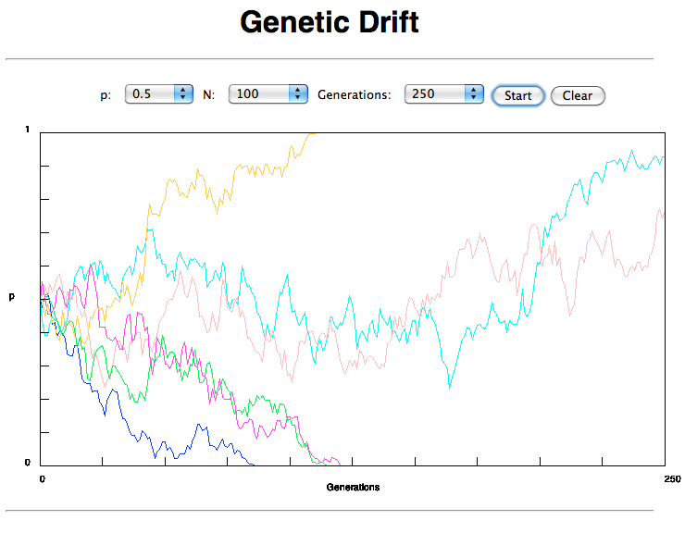
If one waits long enough, one of two alleles with equal fitness will be
fixed

Slide 26
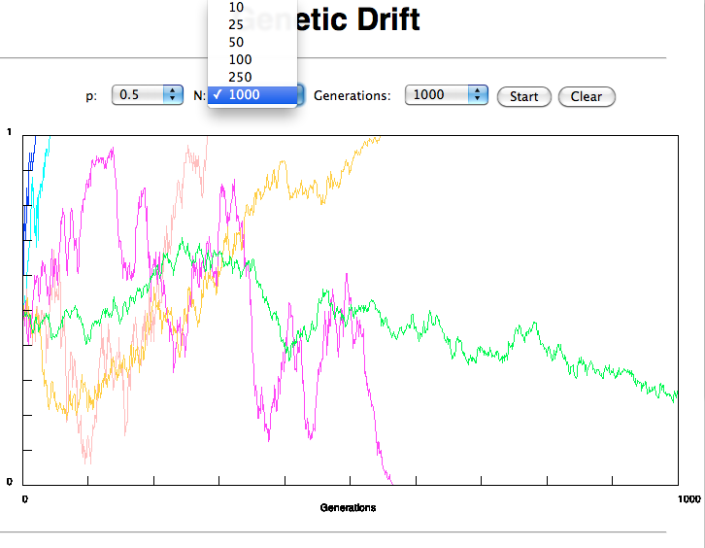
Time till fixation depends on population size

Slide 27
s=0
Probability of fixation, P, is equal to frequency of allele in population. Mutation rate (per gene/per unit of time) = u ;
freq. with which allele is generated in diploid population size N =u*2N
Probability of fixation for each allele = 1/(2N)
Substitution rate =
frequency with which new alleles are generated * Probability of fixation= u*2N *1/(2N) = u = Mutation rate
Therefore:
If f s=0, the substitution rate is independent of population size, and equal to the mutation rate !!!! (NOTE: Mutation unequal Substitution! )
This is the reason that there is hope that the molecular clock might sometimes work.
Fixation time due to drift alone:
t_{av}=4*N_{e} generations
(N_{e}=effective population size; For n discrete generations
N_{e}= n/(1/N₁+1/N₂+…..1/N_{n})

Slide 28

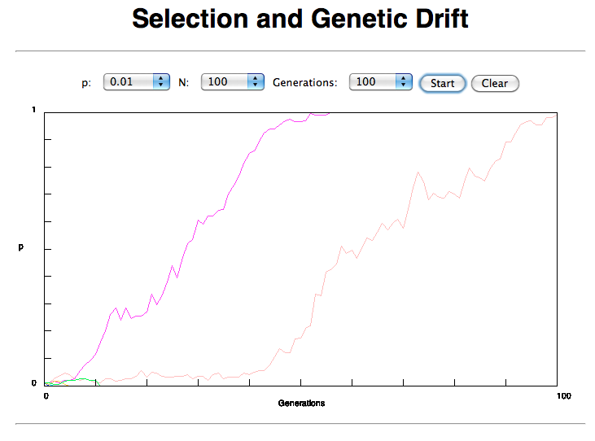

Slide 29
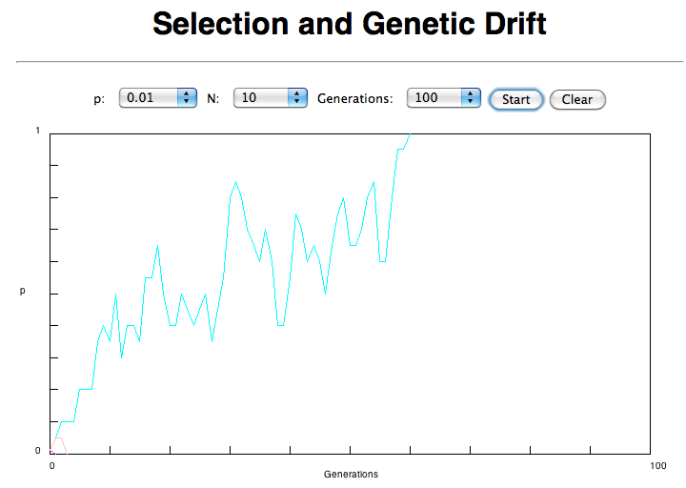


Slide 30
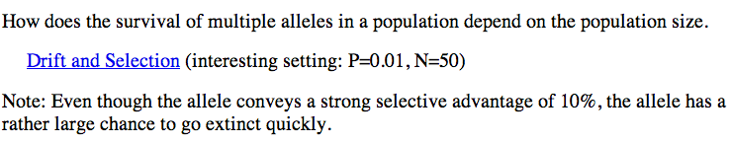
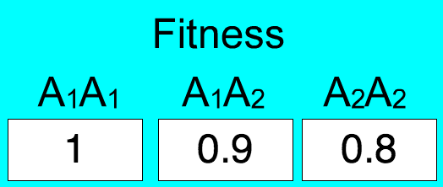
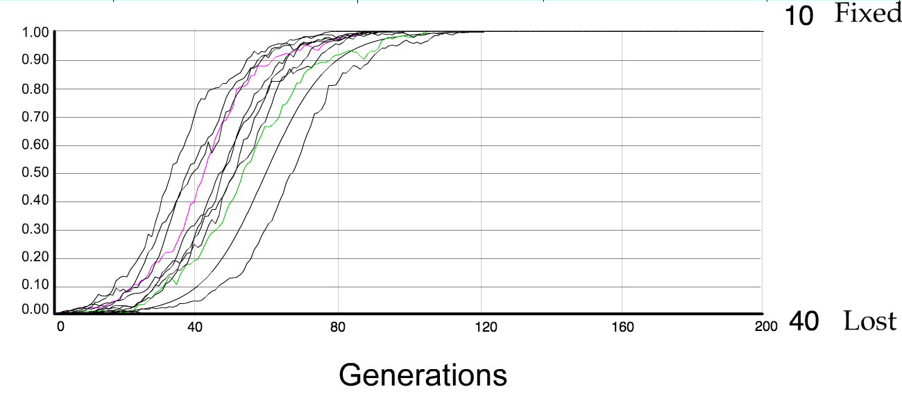
N=50 s=0.1
50 replicates

Slide 31
s>0
Time till fixation on average:
t_{av}= (2/s) ln (2N) generations
(also true for mutations with negative “s” ! discuss among yourselves)
E.g.: N=10⁶,
s=0: average time to fixation: 4*10⁶ generations
s=0.01: average time to fixation: 2900 generations
N=10⁴,
s=0: average time to fixation: 40.000 generations
s=0.01: average time to fixation: 1.900 generations
=> substitution rate of mutation under positive selection is larger than the rate wite which neutral mutations are fixed.

Slide 32
Random Genetic Drift
Selection
100
advantageous
Allele frequency
disadvantageous
0
Modified from from www.tcd.ie/Genetics/staff/Aoife/GE3026/GE3026_1+2.ppt

Slide 33
Positive selection (s>0)
A new allele (mutant) confers some increase in the fitness of the organism
Selection acts to favour this allele
Also called adaptive selection or Darwinian selection.
NOTE: Fitness = ability to survive and reproduce
Modified from from www.tcd.ie/Genetics/staff/Aoife/GE3026/GE3026_1+2.ppt

Slide 34
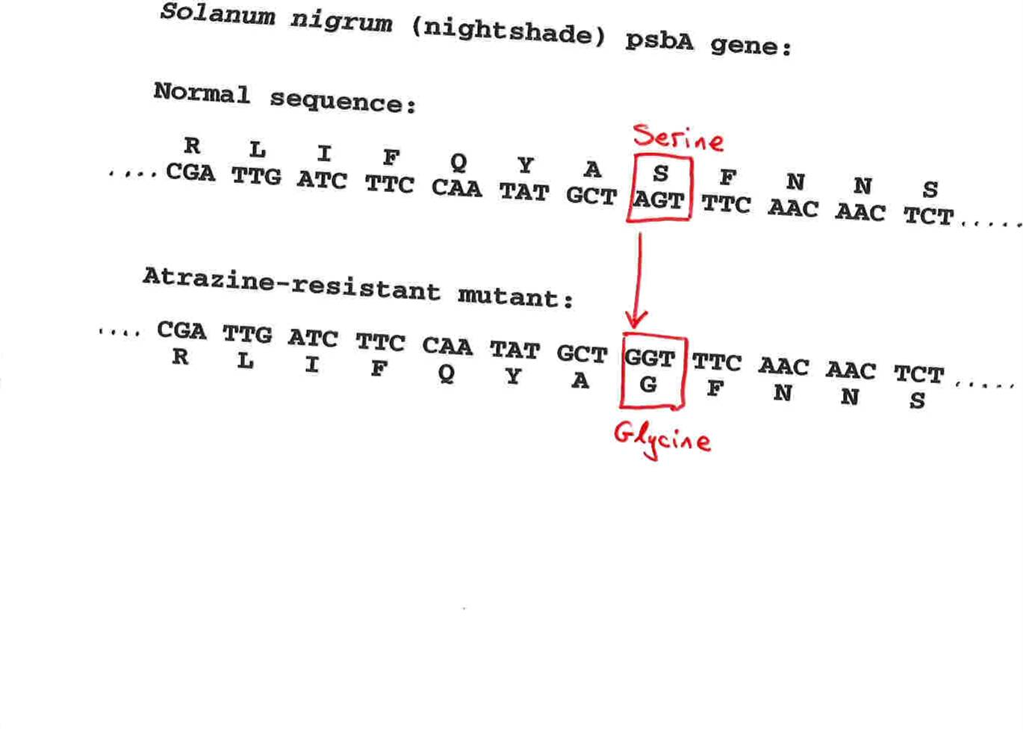
Advantageous allele
Herbicide resistance gene in nightshade plant
Modified from from www.tcd.ie/Genetics/staff/Aoife/GE3026/GE3026_1+2.ppt

Slide 35
Negative selection (s<0)
A new allele (mutant) confers some decrease in the fitness of the organism
Selection acts to remove this allele
Also called purifying selection
Modified from from www.tcd.ie/Genetics/staff/Aoife/GE3026/GE3026_1+2.ppt

Slide 36
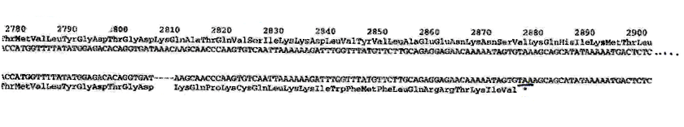
Deleterious allele
Human breast cancer gene, BRCA2
5% of breast cancer cases are familial
Mutations in BRCA2 account for 20% of familial cases
Normal (wild type) allele
Mutant allele
(Montreal 440
Family)
Stop codon
4 base pair deletion
Causes frameshift
Modified from from www.tcd.ie/Genetics/staff/Aoife/GE3026/GE3026_1+2.ppt

Slide 37
Neutral mutations
Neither advantageous nor disadvantageous
Invisible to selection (no selection)
Frequency subject to ‘drift’ in the population
Random drift – random changes in small populations

Slide 38
Types of Mutation-Substitution
Replacement of one nucleotide by another
Synonymous (Doesn’t change amino acid)
  Rate sometimes indicated by Ks
  Rate sometimes indicated by d_{s}
Non-Synonymous (Changes Amino Acid)
  Rate sometimes indicated by Ka
  Rate sometimes indicated by d_{n}
(this and the following 4 slides are from
mentor.lscf.ucsb.edu/course/ spring/eemb102/lecture/Lecture7.ppt)

Slide 39
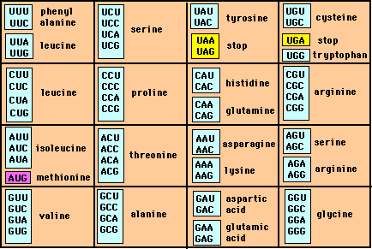
Genetic Code – Note degeneracy of 1st vs 2nd vs 3rd position sites

Slide 40
Genetic Code
Four-fold degenerate site – Any substitution is synonymous
From: mentor.lscf.ucsb.edu/course/spring/eemb102/lecture/Lecture7.ppt

Slide 41
Genetic Code
Two-fold degenerate site – Some substitutions synonymous, some
non-synonymous
From: mentor.lscf.ucsb.edu/course/spring/eemb102/lecture/Lecture7.ppt

Slide 42
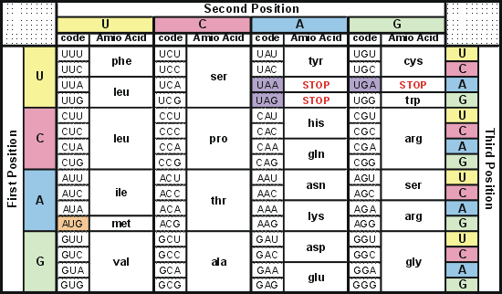
Degeneracy of 1st vs 2nd vs 3rd position sites results in 25.5% synonymous changes and 74.5% non synonymous changes (Yang&Nielsen,1998).
Genetic Code
Notes:
An inspection of the genetic code table suggests most changes at the first position are nonsynonymous, all changes at the second codon position are nonsynonymous and only some changes at the third position are synonymous. As a result we do not expect to see equal proportions of synonymous and nonsynonymous mutations even if there is no selection at protein level. Indeed, if mutations from any one nucleotide to any other occur at the same rate , we expect 25.5% of mutations to be synonymous and 74.5% mutations to be nonsynonymous.

Slide 43
Measuring Selection on Genes
Null hypothesis = neutral evolution
Under neutral evolution, synonymous changes should accumulate at a rate equal to mutation rate
Under neutral evolution, amino acid substitutions should also accumulate at a rate equal to the mutation rate
From: mentor.lscf.ucsb.edu/course/spring/eemb102/lecture/Lecture7.ppt

Slide 44
Counting #s/#a
Ser Ser Ser Ser Ser
Species1 TGA TGC TGT TGT TGT
Ser Ser Ser Ser Ala
Species2 TGT TGT TGT TGT GGT
#s = 2 sites
#a = 1 site
#a/#s=0.5
To assess selection pressures one needs to calculate the rates (Ka, Ks), i.e. the occurring substitutions as a fraction of the possible syn. and nonsyn. substitutions.
Things get more complicated, if one wants to take transition transversion ratios and codon bias into account. See chapter 4 in Nei and Kumar, Molecular Evolution and Phylogenetics.
Modified from: mentor.lscf.ucsb.edu/course/spring/eemb102/lecture/Lecture7.ppt

Slide 45
Testing for selection using dN/dS ratio
dN/dS ratio (aka Ka/Ks or ω (omega) ratio) where
dN = number of non-synonymous substitutions / number of possible non-synonymous substitutions
dS =number of synonymous substitutions / number of possible non-synonymous substitutions
dN/dS >1 positive, Darwinian selection
dN/dS =1 neutral evolution
dN/dS <1 negative, purifying selection
Notes:
The synonymous and non-synonymous rates dN and dS are defined as the numbers of synonymous and nonsynonymous substitutions per site. The ratio of the two rates omega=dN/dS then measures selective pressure at the protein level. If selection level has no effect on fitness, nonsynonymous mutations will be fixed at the same rate as synonymous mutations so that dN=dS and omega=1. If nonsynonymous mutations are deleterious purifying selection will reduce their fixation rate so that dN<dS and omega<1. If nonsynonymous mutations are favored by Darwinian selection, they will be fixed at a higher rate than synonymous mutations resulting in dN>dS and omega>1.

Slide 46
dambe
Two programs worked well for me to align nucleotide sequences based on the amino acid alignment, One is seaview, the other is DAMBE (only for windows). This is a handy program for a lot of things, including reading a lot of different formats, calculating phylogenies, it even runs codeml (from PAML) for you.
The procedure is not straight forward, but is well described on the help pages. After installing DAMBE go to HELP -> general HELP -> sequences -> align nucleotide sequences based on …->
If you follow the instructions to the letter, it works fine.
DAMBE also calculates Ka and Ks distances from codon based aligned sequences.

Slide 47
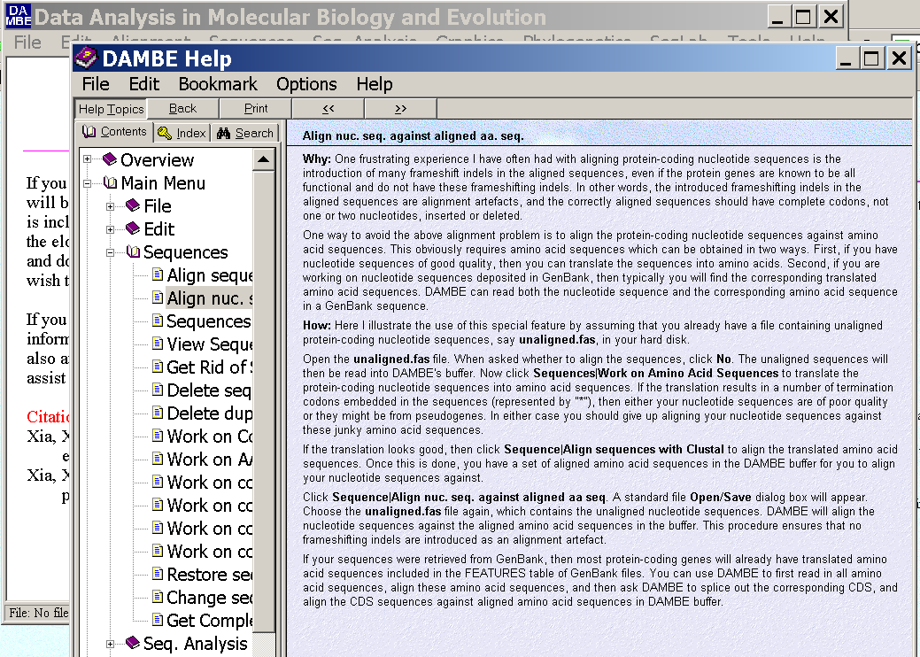
dambe (cont)

Slide 48
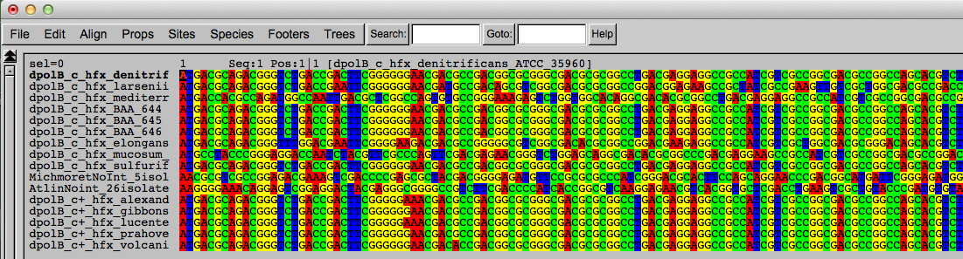
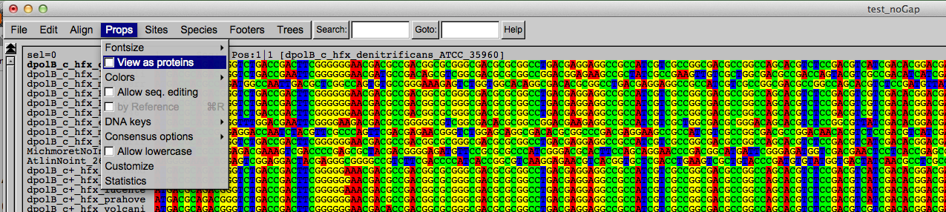
Codon based alignments in Seaview
Load nucleotide sequences (no gaps in sequences, sequence starts with nucleotide corresponding to 1st codon position)
Select view as proteins

Slide 49
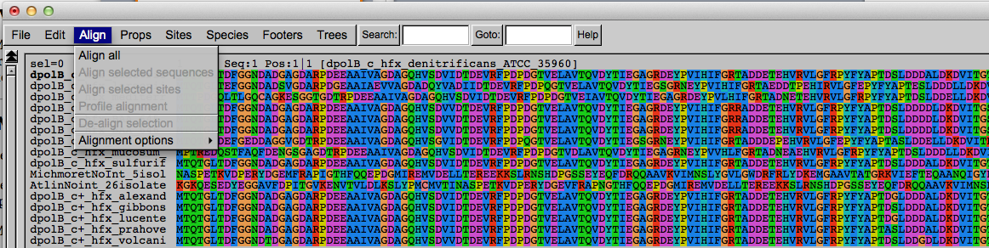
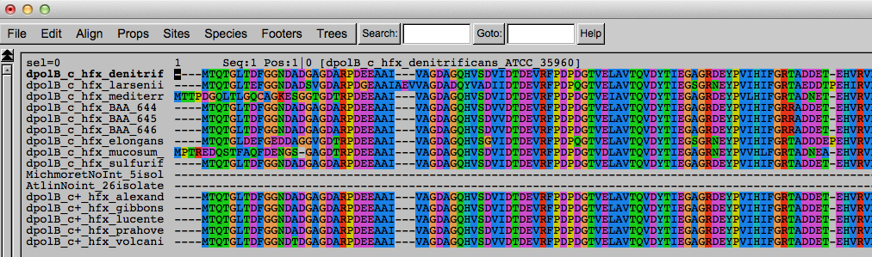
Codon based alignments in Seaview
With the protein sequences displayed, align sequences
Select view as nucleotides

Slide 50
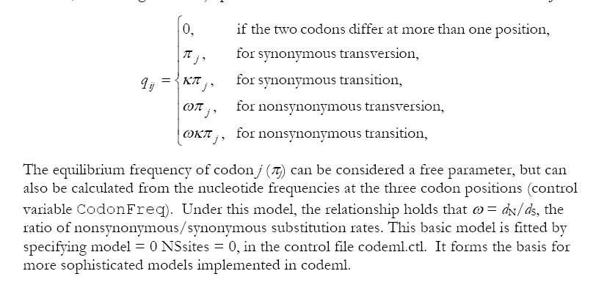
PAML (codeml) the basic model

Slide 51

sites versus branches
You can determine omega for the whole dataset; however, usually not all sites in a sequence are under selection all the time.
PAML (and other programs) allow to either determine omega for each site over the whole tree, ,
or determine omega for each branch for the whole sequence,
.
It would be great to do both, i.e., conclude codon 176 in the vacuolar ATPases was under positive selection during the evolution of modern humans – alas, a single site does not provide much statistics ….

Slide 52
Sites model(s)
work great have been shown to work great in few instances.
The most celebrated case is the influenza virus HA gene.
A talk by Walter Fitch (slides and sound) on the evolution of
this molecule is here .
This article by Yang et al, 2000 gives more background on ml aproaches to measure omega. The dataset used by Yang et al is here: flu_data.paup .

Slide 53
sites model in MrBayes
The MrBayes block in a nexus file might look something like this:
begin mrbayes;
set autoclose=yes;
lset nst=2 rates=gamma nucmodel=codon omegavar=Ny98;
mcmcp samplefreq=500 printfreq=500;
mcmc ngen=500000;
sump burnin=50;
sumt burnin=50;
end;

Slide 54
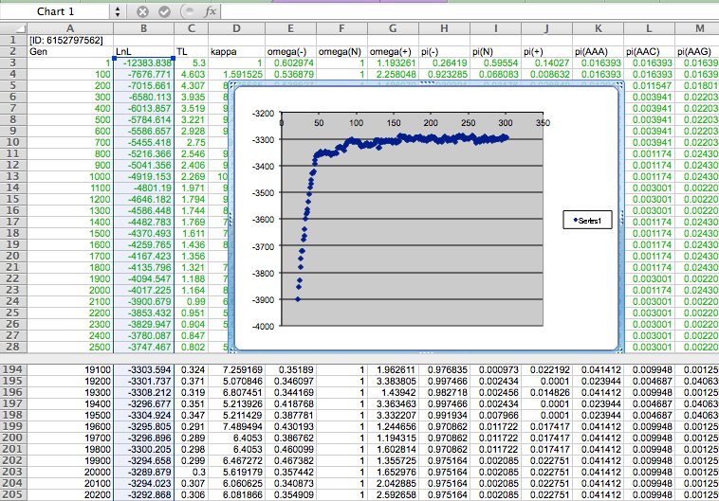

Slide 55
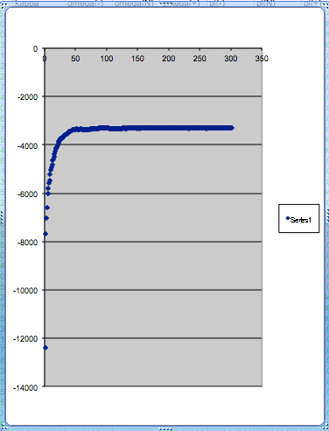
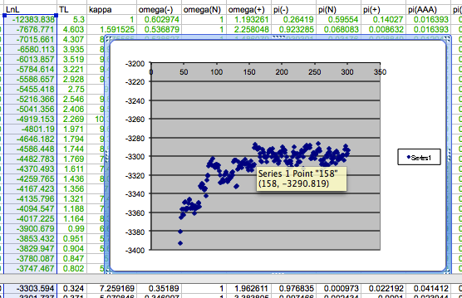
plot LogL to determine which samples to ignore
the same after rescaling the y-axis

Slide 56
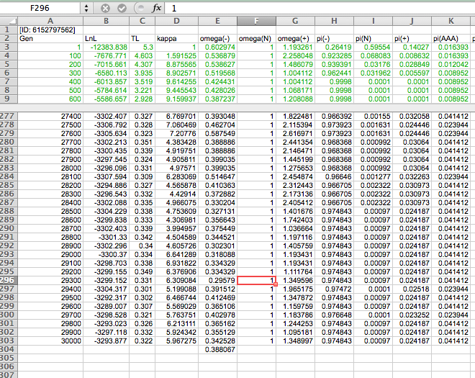

Slide 57
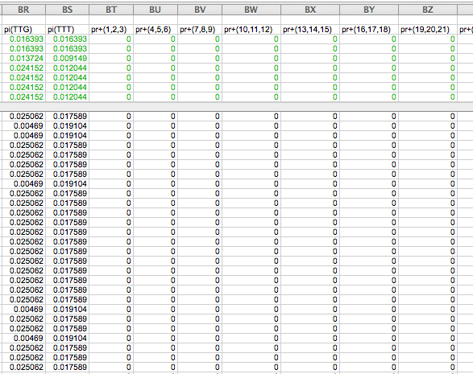

Slide 58
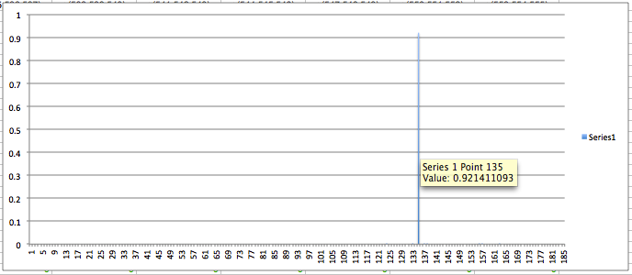
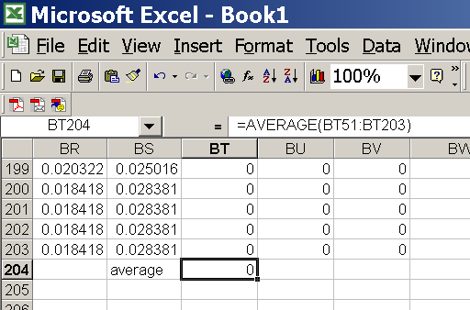
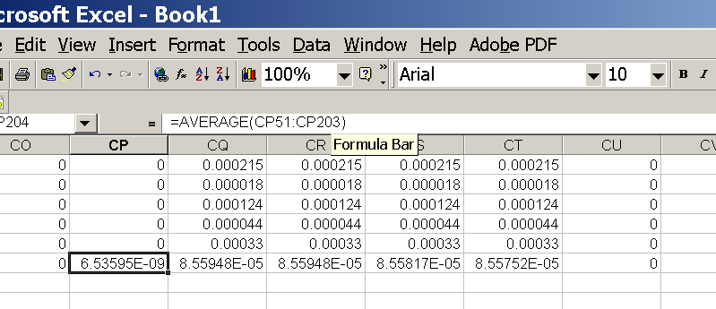
for each codon calculate the the average probability
copy paste formula
plot row
enter formula

Slide 59
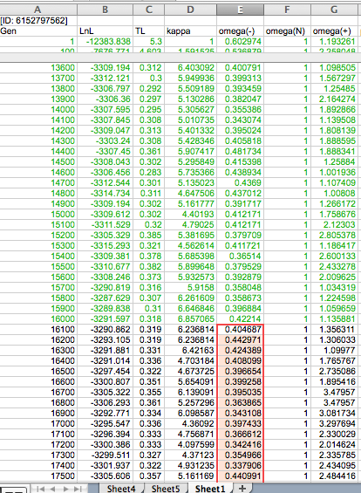
To determine credibility interval for a parameter (here omega<1):
Select values for the parameter, sampled after the burning.
Copy paste to a new spreadsheet,

Slide 60
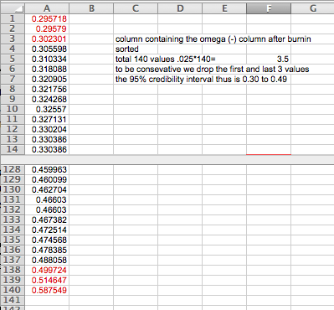
Sort values according to size,
Discard top and bottom 2.5%
Remainder gives 95% credibility interval.

Slide 61
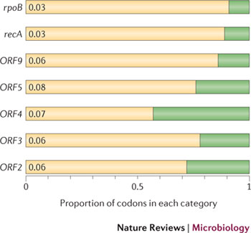

Purifying selection in GTA genes
dN/dS <1 for GTA genes has been used to infer selection for function
GTA genes
Lang AS, Zhaxybayeva O, Beatty JT. Nat Rev Microbiol. 2012 Jun 11;10(7):472-82
Lang, A.S. & Beatty, J.T. Trends in Microbiology , Vol.15, No.2 , 2006
Notes:
The ratio of non-synonymous-to-synonymous (dN/dS, or ω) codon substitution rates can be used as an indication of the selective pressure acting on a protein-coding gene. If a gene (or gene segment) is under purifying selection, non-synonymous mutations (that is, mutations resulting in a change of the encoded amino acid) will be selected against, resulting in ω < 1. In neutrally evolving proteins, synonymous and non-synonymous mutations will be fixed at approximately the same rate, resulting in ω = 1. Because different regions of a protein-coding gene may be under different selective constraints, codons can be divided into two categories: those with ω < 1 (yellow; the estimated ω is indicated on the bar) and those with ω fixed to 1 (green); the estimated proportion of codons in each category is given on the horizontal axis.

Slide 62
Purifying selection in E.coli ORFans
dN-dS < 0 for some ORFan E. coli clusters seems to suggest they are functional genes.
Gene groups | Number | dN-dS>0 | dN-dS<0 | dN-dS=0
E. coli ORFan clusters | 3773 | 944 (25%) | 1953 (52%) | 876 (23%)
Clusters of E.coli sequences found in Salmonella sp., Citrobacter sp. | 610 | 104 (17%) | 423(69%) | 83 (14%)
Clusters of E.coli sequences found in some Enterobacteriaceae only | 373 | 8 (2%) | 365 (98%) | 0 (0%)
Adapted after Yu, G. and Stoltzfus, A. Genome Biol Evol (2012) Vol. 4 1176-1187

Slide 63

Vincent Daubin and Howard Ochman: Bacterial Genomes as New Gene Homes: The Genealogy of ORFans in E. coli. Genome Research 14:1036-1042, 2004
The ratio of non-synonymous to synonymous substitutions for genes found only in the E.coli - Salmonella clade is lower than 1, but larger than for more widely distributed genes.
Increasing phylogenetic depth
Fig. 3 from Vincent Daubin and Howard Ochman, Genome Research 14:1036-1042, 2004

Slide 64

Vertically Inherited Genes Not Expressed for Function

Slide 65


Counting Algorithm
Calculate number of different nucleotides/amino acids per MSA column (X)
Calculate number of nucleotides/amino acids substitutions (X-1)
Calculate number of synonymous changes
S=(N-1)nc-N
assuming N=(N-1)aa
X=2 1 nucleotide substitution
1 non-synonymous change
X=2 1 amino acid substitution

Slide 66
Simulation Algorithm
Calculate MSA nucleotide frequencies (%A,%T,%G,%C)
Introduce a given number of random substitutions ( at any position) based on inferred base frequencies
Compare translated mutated codon with the initial translated codon and count synonymous and non-synonymous substitutions

Slide 67




Evolution of Coding DNA Sequences Under a Neutral Model
E. coli Prophage Genes
Count distribution
Probability distribution
n=90
Non-synonymous
n= 90
k= 24
p=0.763
P(≤24)=3.63E-23
Observed=24
P(≤24) < 10⁻⁶
n=90
Synonymous
n= 90
k= 66
p=0.2365
P(≥66)=3.22E-23
Observed=66
P(≥66) < 10⁻⁶

Slide 68




Evolution of Coding DNA Sequences Under a Neutral Model
E. coli Prophage Genes
Count distribution
Probability distribution
n=375
Synonymous
n= 375
k= 243
p=0.237
P(≥243)=7.92E-64
Observed=243
P(≥243) < 10⁻⁶
n=723
Synonymous
n= 723
k= 498
p=0.232
P(≥498)=6.41E-149
Observed=498
P(≥498) < 10⁻⁶

Slide 69
Evolution of Coding DNA Sequences Under a Neutral Model
E. coli Prophage Genes
 |  | OBSERVED |  | SIMULATED |  | Dnapars | Simulated | Codeml
Gene | Alignment Length (bp) | Substitutions | Synonymous changes* | Substitutions | p-value synonymous (given *) | Minimum number of substitutions | dN/dS | dN/dS
Major capsid | 1023 | 90 | 66 | 90 | 3.23E-23 | 94 | 0.113 | 0.13142
Minor capsid C | 1329 | 81 | 59 | 81 | 1.98E-19 | 84 | 0.124 | 0.17704
Large terminase subunit | 1923 | 75 | 67 | 75 | 7.10E-35 | 82 | 0.035 | 0.03773
Small terminase subunit | 543 | 100 | 66 | 100 | 1.07E-19 | 101 | 0.156 | 0.25147
Portal | 1599 | 55 | 46 | 55 | 1.36E-21 | *64 | 0.057 | 0.08081
Protease | 1329 | 55 | 37 | 55 | 4.64E-11 | 55 | 0.162 | 0.24421
Minor tail H | 2565 | 260 | 168 | 260 | 1.81E-44 | 260 | 0.17 | 0.30928
Minor tail L | 696 | 30 | 26 | 30 | 1.30E-13 | 30 | 0.044 | 0.05004
Host specificity J | 3480 | 723 | 498 | 723 | 6.42E-149 | *773 | 0.137 | 0.17103
Tail fiber K | 741 | 41 | 28 | 41 | 1.06E-09 | 44 | 0.14 | 0.18354
Tail assembly I | 669 | 39 | 33 | 39 | 3.82E-15 | 40 | 0.064 | 0.07987
Tail tape measure protein | 2577 | 375 | 243 | 375 | 7.92E-64 | 378 | 0.169 | 0.27957
Our values well under the p=0.01 threshold suggest we can reject the null hypothesis of neutral evolution of prophage sequences.

Slide 70
Evolution of Coding DNA Sequences Under a Neutral Model
B. pseudomallei Cryptic Malleilactone Operon Genes and
E. coli transposase sequences
 |  | OBSERVED |  | SIMULATED
Gene | Alignment Length (bp) | Substitutions | Synonymous changes* | Substitutions | p-value synonymous (given *)
Aldehyde dehydrogenase | 1544 | 13 | 3 | 13 | 4.67E-04
AMP- binding protein | 1865 | 9 | 6 | 9 | 1.68E-02
Adenosylmethionine-8-amino-7-oxononanoate aminotransferase | 1421 | 20 | 12 | 20 | 6.78E-04
Fatty-acid CoA ligase | 1859 | 13 | 2 | 13 | 8.71E-01
Diaminopimelate decarboxylase | 1388 | 7 | 3 | 7 | 6.63E-01
Malonyl CoA-acyl transacylase | 899 | 2 | 1 | 2 | 4.36E-01
FkbH domain protein | 1481 | 17 | 9 | 17 | 2.05E-02
Hypothethical protein | 431 | 3 | 2 | 3 | 1.47E-01
Ketol-acid reductoisomerase | 1091 | 2 | 0 | 2 | 1.00E+00
Peptide synthase regulatory protein | 1079 | 10 | 5 | 10 | 8.91E-02
Polyketide-peptide synthase | 12479 | 135 | 66 | 135 | 4.35E-27
 |  | OBSERVED |  | SIMULATED
Gene | Alignment Length (bp) | Substitutions | Synonymous changes* | Substitutions | p-value synonymous (given *)
Putative transposase | 903 | 175 | 107 | 175 | 1.15E-29

Slide 71



Trunk-of-my-car analogy: Hardly anything in there is the is the result of providing a selective advantage. Some items are removed quickly (purifying selection), some are useful under some conditions, but most things do not alter the fitness.
Could some of the inferred purifying selection be due to the acquisition of novel detrimental characteristics (e.g., protein toxicity, HOPELESS MONSTERS)?

Slide 72
Other ways to detect positive selection
Selective sweeps -> fewer alleles present in population
(see contributions from archaic Humans for example)
Repeated episodes of positive selection -> high dN

Slide 73

Variant arose about
5800 years ago

Slide 74

The age of haplogroup D was found to be ~37,000 years

Slide 75



