Slide 1
selection versus drift
The larger the population the longer it takes for an allele to become fixed.
Note: Even though an allele conveys a strong selective advantage of 10%, the allele has a rather large chance to go extinct.
Note: Fixation is faster under selection than under drift.

Slide 2
s=0
Probability of fixation, P, is equal to frequency of allele in population. Mutation rate (per gene/per unit of time) = u ;
freq. with which allele is generated in diploid population size N =u*2N
Probability of fixation for each allele = 1/(2N)
Substitution rate =
frequency with which new alleles are generated * Probability of fixation= u*2N *1/(2N) = u = Mutation rate
Therefore:
If f s=0, the substitution rate is independent of population size, and equal to the mutation rate !!!! (NOTE: Mutation unequal Substitution! )
This is the reason that there is hope that the molecular clock might sometimes work.
Fixation time due to drift alone:
t_{av}=4*N_{e} generations
(N_{e}=effective population size; For n discrete generations
N_{e}= n/(1/N₁+1/N₂+…..1/N_{n})

Slide 3
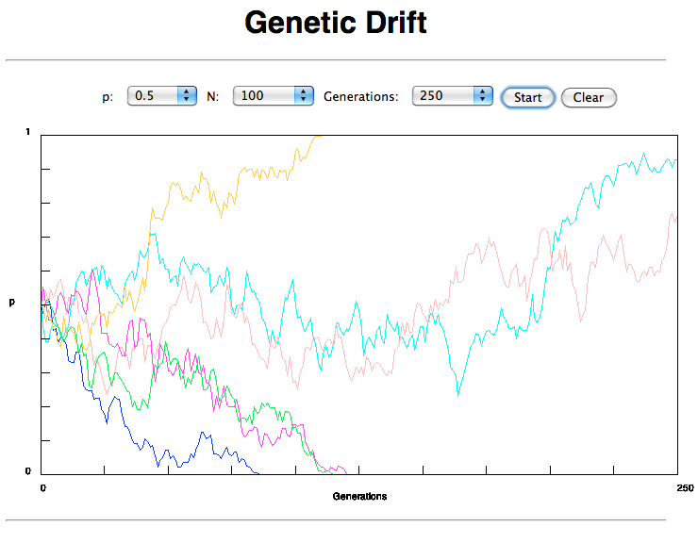
If one waits long enough, one of two alleles with equal fitness will be
fixed

Slide 4
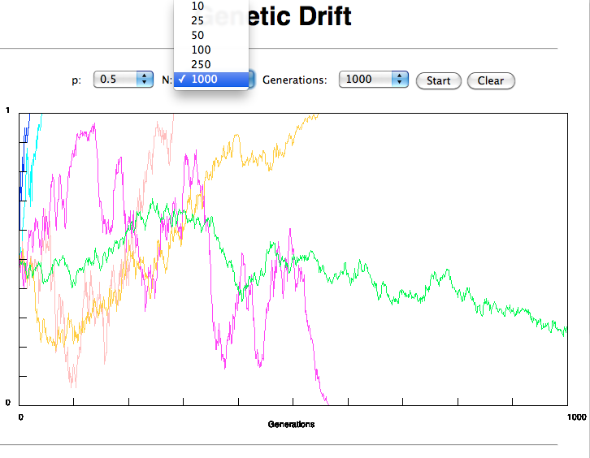
Time till fixation depends on population size

Slide 5

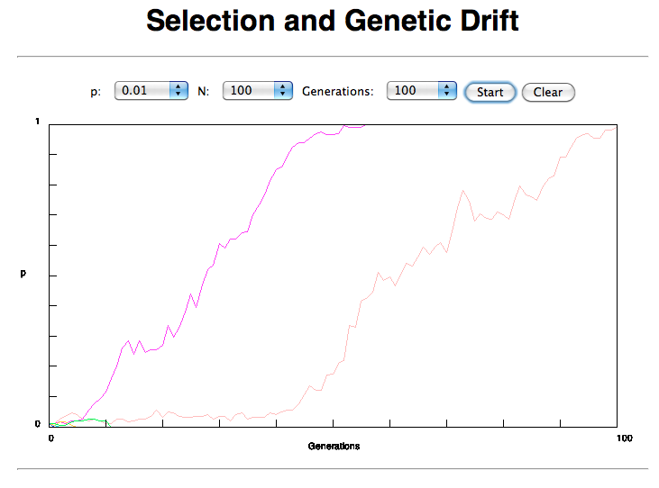

Slide 6
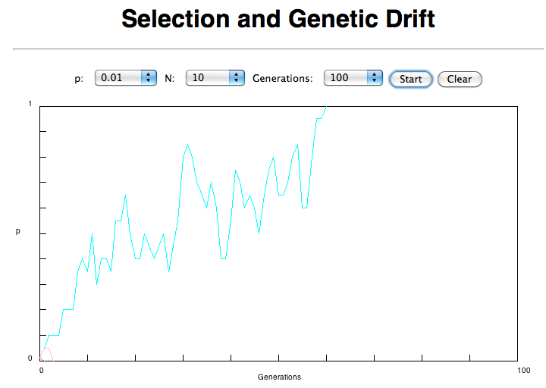


Slide 7
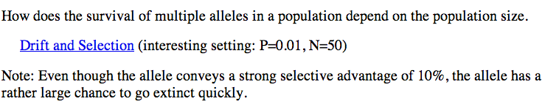
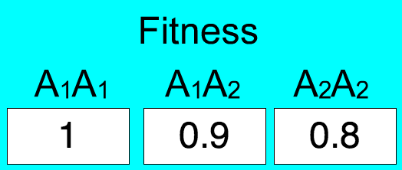
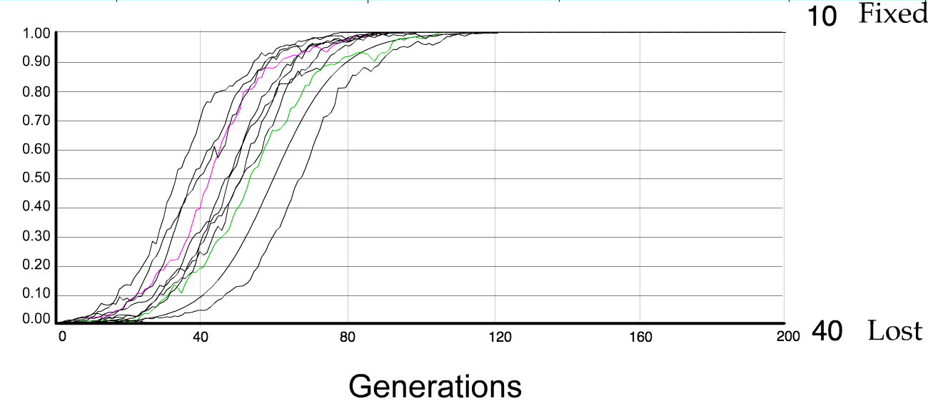
N=50 s=0.1
50 replicates

Slide 8
s>0
Time till fixation on average:
t_{av}= (2/s) ln (2N) generations
(also true for mutations with negative “s” ! discuss among yourselves)
E.g.: N=10⁶,
s=0: average time to fixation: 4*10⁶ generations
s=0.01: average time to fixation: 2900 generations
N=10⁴,
s=0: average time to fixation: 40.000 generations
s=0.01: average time to fixation: 1.900 generations
=> substitution rate of mutation under positive selection is larger than the rate wite which neutral mutations are fixed.

Slide 9
Random Genetic Drift
Selection
100
advantageous
Allele frequency
disadvantageous
0
Modified from from www.tcd.ie/Genetics/staff/Aoife/GE3026/GE3026_1+2.ppt

Slide 10
Positive selection (s>0)
A new allele (mutant) confers some increase in the fitness of the organism
Selection acts to favour this allele
Also called adaptive selection or Darwinian selection.
NOTE: Fitness = ability to survive and reproduce
Modified from from www.tcd.ie/Genetics/staff/Aoife/GE3026/GE3026_1+2.ppt

Slide 11
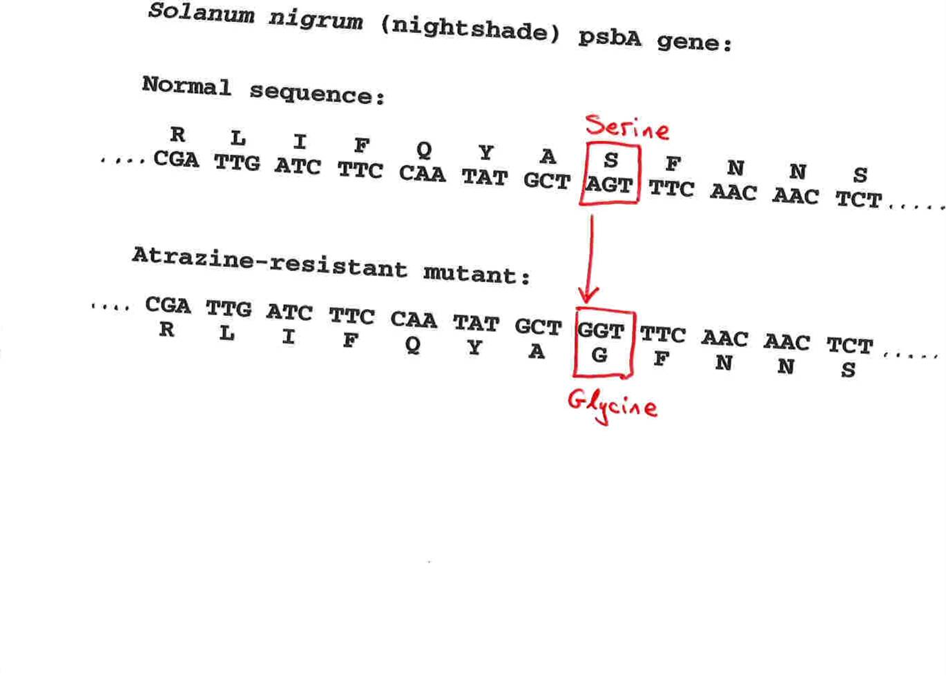
Advantageous allele
Herbicide resistance gene in nightshade plant
Modified from from www.tcd.ie/Genetics/staff/Aoife/GE3026/GE3026_1+2.ppt

Slide 12
Negative selection (s<0)
A new allele (mutant) confers some decrease in the fitness of the organism
Selection acts to remove this allele
Also called purifying selection
Modified from from www.tcd.ie/Genetics/staff/Aoife/GE3026/GE3026_1+2.ppt

Slide 13
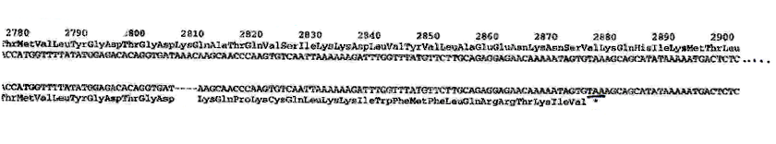
Deleterious allele
Human breast cancer gene, BRCA2
5% of breast cancer cases are familial
Mutations in BRCA2 account for 20% of familial cases
Normal (wild type) allele
Mutant allele
(Montreal 440
Family)
Stop codon
4 base pair deletion
Causes frameshift
Modified from from www.tcd.ie/Genetics/staff/Aoife/GE3026/GE3026_1+2.ppt

Slide 14
Neutral mutations
Neither advantageous nor disadvantageous
Invisible to selection (no selection)
Frequency subject to ‘drift’ in the population
Random drift – random changes in small populations

Slide 15
Types of Mutation-Substitution
Replacement of one nucleotide by another
Synonymous (Doesn’t change amino acid)
  Rate sometimes indicated by Ks
  Rate sometimes indicated by d_{s}
Non-Synonymous (Changes Amino Acid)
  Rate sometimes indicated by Ka
  Rate sometimes indicated by d_{n}
(this and the following 4 slides are from
mentor.lscf.ucsb.edu/course/ spring/eemb102/lecture/Lecture7.ppt)

Slide 16
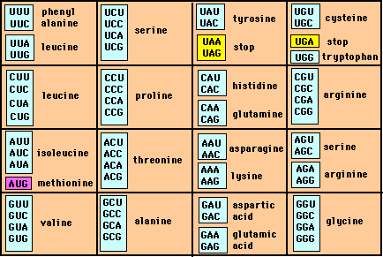
Genetic Code – Note degeneracy of 1st vs 2nd vs 3rd position sites

Slide 17
Genetic Code
Four-fold degenerate site – Any substitution is synonymous
From: mentor.lscf.ucsb.edu/course/spring/eemb102/lecture/Lecture7.ppt

Slide 18
Genetic Code
Two-fold degenerate site – Some substitutions synonymous, some
non-synonymous
From: mentor.lscf.ucsb.edu/course/spring/eemb102/lecture/Lecture7.ppt

Slide 19
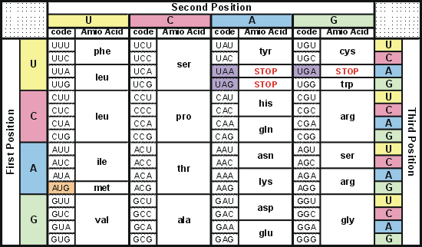
Degeneracy of 1st vs 2nd vs 3rd position sites results in 25.5% synonymous changes and 74.5% non synonymous changes (Yang&Nielsen,1998).
Genetic Code
Notes:
An inspection of the genetic code table suggests most changes at the first position are nonsynonymous, all changes at the second codon position are nonsynonymous and only some changes at the third position are synonymous. As a result we do not expect to see equal proportions of synonymous and nonsynonymous mutations even if there is no selection at protein level. Indeed, if mutations from any one nucleotide to any other occur at the same rate , we expect 25.5% of mutations to be synonymous and 74.5% mutations to be nonsynonymous.

Slide 20
Measuring Selection on Genes
Null hypothesis = neutral evolution
Under neutral evolution, synonymous changes should accumulate at a rate equal to mutation rate
Under neutral evolution, amino acid substitutions should also accumulate at a rate equal to the mutation rate
From: mentor.lscf.ucsb.edu/course/spring/eemb102/lecture/Lecture7.ppt

Slide 21
Counting #s/#a
Ser Ser Ser Ser Ser
Species1 TGA TGC TGT TGT TGT
Ser Ser Ser Ser Ala
Species2 TGT TGT TGT TGT GGT
#s = 2 sites
#a = 1 site
#a/#s=0.5
To assess selection pressures one needs to calculate the rates (Ka, Ks), i.e. the occurring substitutions as a fraction of the possible syn. and nonsyn. substitutions.
Things get more complicated, if one wants to take transition transversion ratios and codon bias into account. See chapter 4 in Nei and Kumar, Molecular Evolution and Phylogenetics.
Modified from: mentor.lscf.ucsb.edu/course/spring/eemb102/lecture/Lecture7.ppt

Slide 22
Testing for selection using dN/dS ratio
dN/dS ratio (aka Ka/Ks or ω (omega) ratio) where
dN = number of non-synonymous substitutions / number of possible non-synonymous substitutions
dS =number of synonymous substitutions / number of possible non-synonymous substitutions
dN/dS >1 positive, Darwinian selection
dN/dS =1 neutral evolution
dN/dS <1 negative, purifying selection
Notes:
The synonymous and non-synonymous rates dN and dS are defined as the numbers of synonymous and nonsynonymous substitutions per site. The ratio of the two rates omega=dN/dS then measures selective pressure at the protein level. If selection level has no effect on fitness, nonsynonymous mutations will be fixed at the same rate as synonymous mutations so that dN=dS and omega=1. If nonsynonymous mutations are deleterious purifying selection will reduce their fixation rate so that dN<dS and omega<1. If nonsynonymous mutations are favored by Darwinian selection, they will be fixed at a higher rate than synonymous mutations resulting in dN>dS and omega>1.

Slide 23
dambe
Two programs worked well for me to align nucleotide sequences based on the amino acid alignment, One is seaview, the other is DAMBE (only for windows). This is a handy program for a lot of things, including reading a lot of different formats, calculating phylogenies, it even runs codeml (from PAML) for you.
The procedure is not straight forward, but is well described on the help pages. After installing DAMBE go to HELP -> general HELP -> sequences -> align nucleotide sequences based on …->
If you follow the instructions to the letter, it works fine.
DAMBE also calculates Ka and Ks distances from codon based aligned sequences.

Slide 24
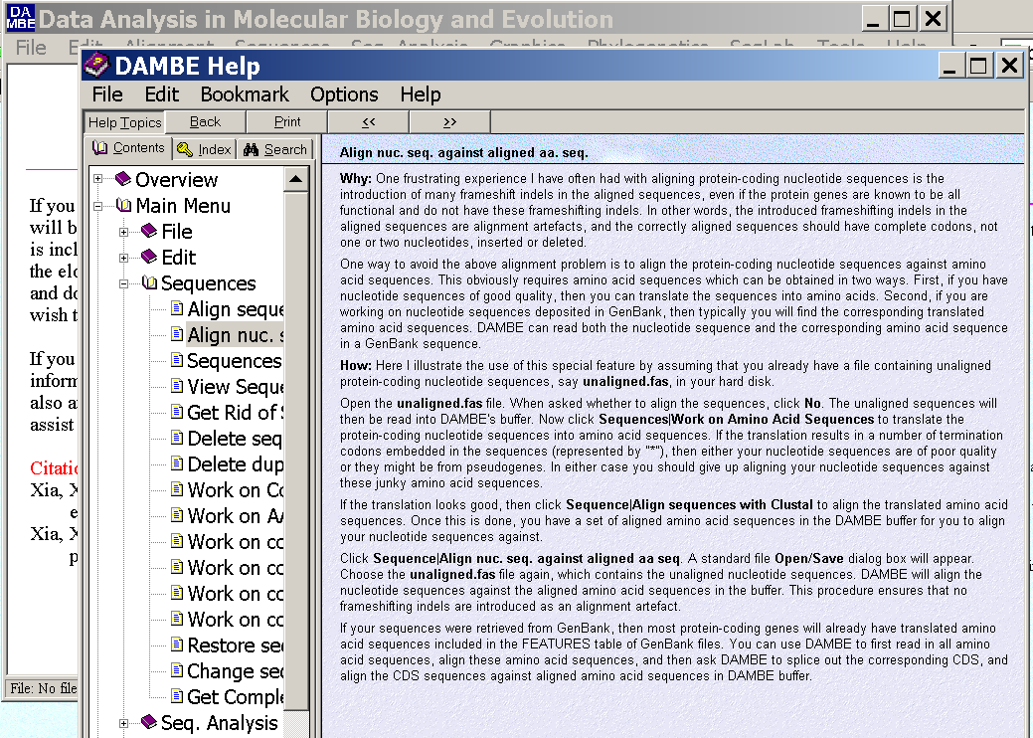
dambe (cont)

Slide 25
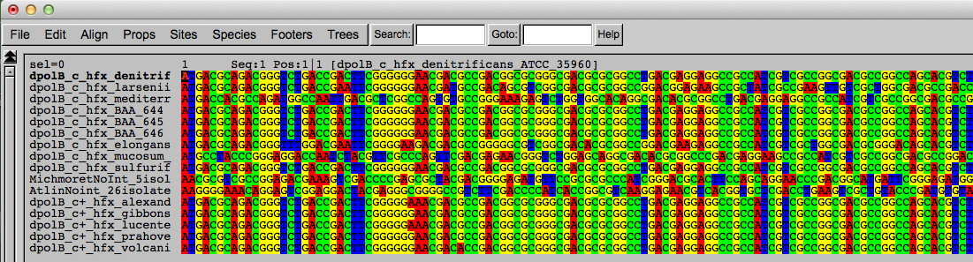
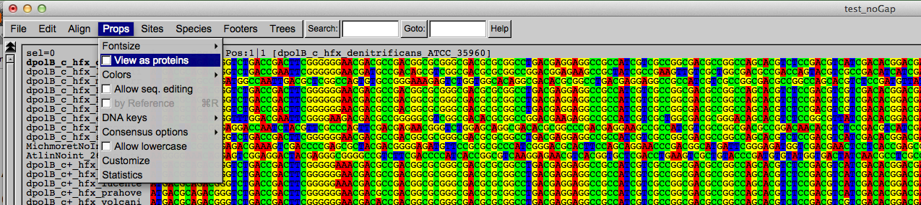
Codon based alignments in Seaview
Load nucleotide sequences (no gaps in sequences, sequence starts with nucleotide corresponding to 1st codon position)
Select view as proteins

Slide 26
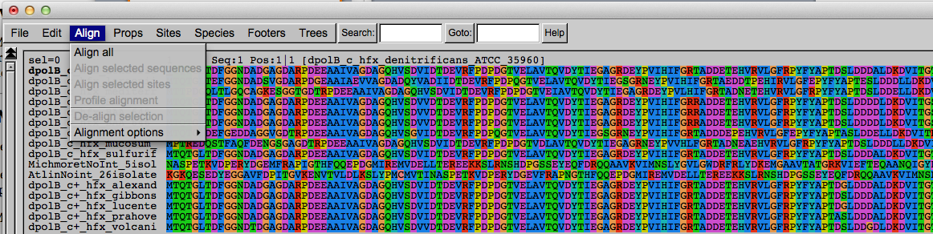
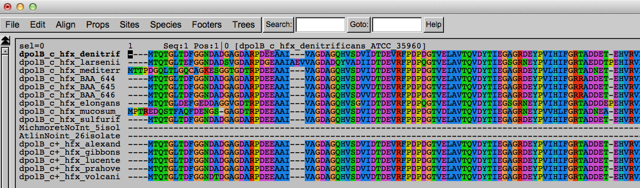
Codon based alignments in Seaview
With the protein sequences displayed, align sequences
Select view as nucleotides

Slide 27
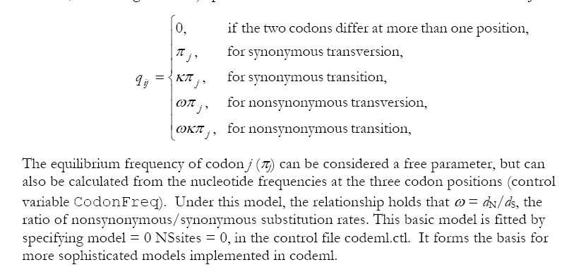
PAML (codeml) the basic model

Slide 28

sites versus branches
You can determine omega for the whole dataset; however, usually not all sites in a sequence are under selection all the time.
PAML (and other programs) allow to either determine omega for each site over the whole tree, ,
or determine omega for each branch for the whole sequence,
.
It would be great to do both, i.e., conclude codon 176 in the vacuolar ATPases was under positive selection during the evolution of modern humans – alas, a single site does not provide much statistics ….

Slide 29
Sites model(s)
work great have been shown to work great in few instances.
The most celebrated case is the influenza virus HA gene.
A talk by Walter Fitch (slides and sound) on the evolution of
this molecule is here .
This article by Yang et al, 2000 gives more background on ml aproaches to measure omega. The dataset used by Yang et al is here: flu_data.paup .

Slide 30
sites model in MrBayes
The MrBayes block in a nexus file might look something like this:
begin mrbayes;
set autoclose=yes;
lset nst=2 rates=gamma nucmodel=codon omegavar=Ny98;
mcmcp samplefreq=500 printfreq=500;
mcmc ngen=500000;
sump burnin=50;
sumt burnin=50;
end;

Slide 31
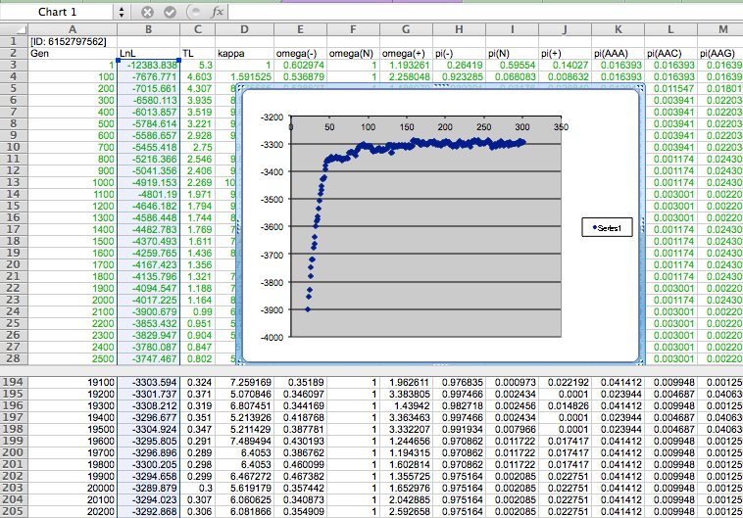

Slide 32
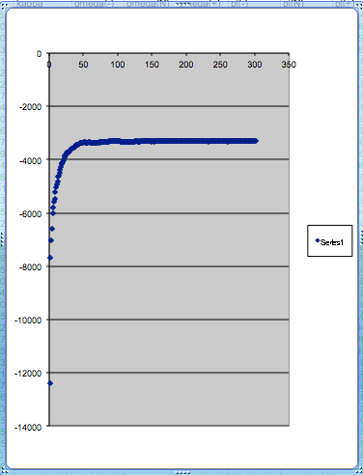
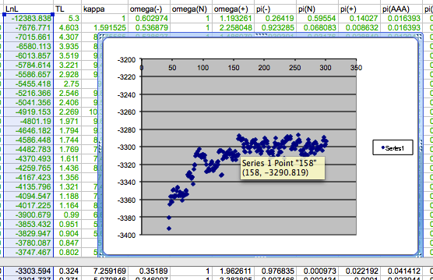
plot LogL to determine which samples to ignore
the same after rescaling the y-axis

Slide 33
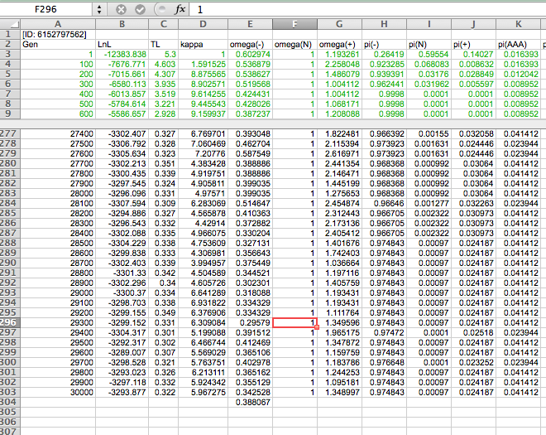

Slide 34
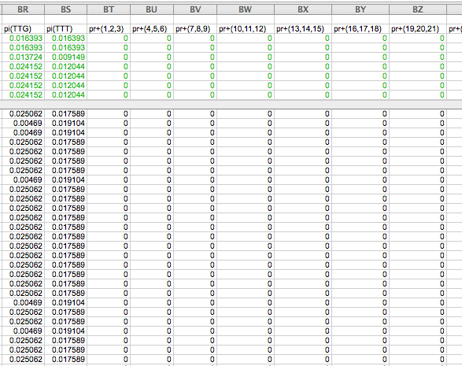

Slide 35
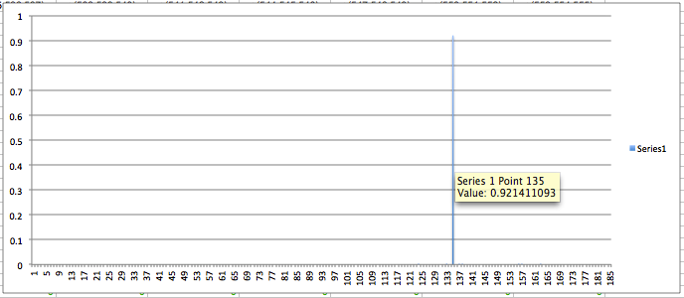
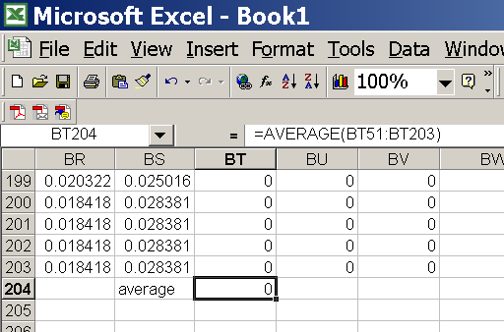
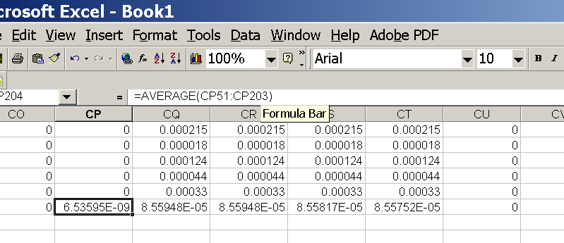
for each codon calculate the the average probability
copy paste formula
plot row
enter formula

Slide 36
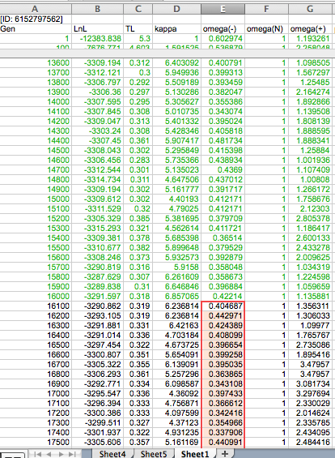
To determine credibility interval for a parameter (here omega<1):
Select values for the parameter, sampled after the burning.
Copy paste to a new spreadsheet,

Slide 37
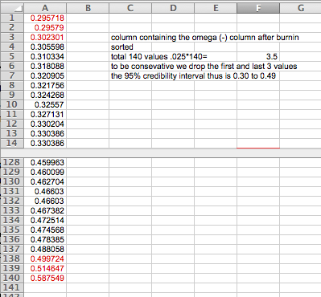
Sort values according to size,
Discard top and bottom 2.5%
Remainder gives 95% credibility interval.

Slide 38
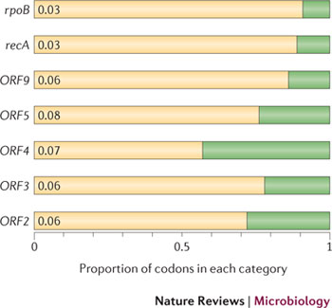
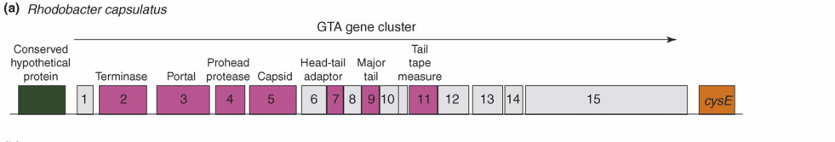
Purifying selection in GTA genes
dN/dS <1 for GTA genes has been used to infer selection for function
GTA genes
Lang AS, Zhaxybayeva O, Beatty JT. Nat Rev Microbiol. 2012 Jun 11;10(7):472-82
Lang, A.S. & Beatty, J.T. Trends in Microbiology , Vol.15, No.2 , 2006
Notes:
The ratio of non-synonymous-to-synonymous (dN/dS, or ω) codon substitution rates can be used as an indication of the selective pressure acting on a protein-coding gene. If a gene (or gene segment) is under purifying selection, non-synonymous mutations (that is, mutations resulting in a change of the encoded amino acid) will be selected against, resulting in ω < 1. In neutrally evolving proteins, synonymous and non-synonymous mutations will be fixed at approximately the same rate, resulting in ω = 1. Because different regions of a protein-coding gene may be under different selective constraints, codons can be divided into two categories: those with ω < 1 (yellow; the estimated ω is indicated on the bar) and those with ω fixed to 1 (green); the estimated proportion of codons in each category is given on the horizontal axis.

Slide 39
Purifying selection in E.coli ORFans
dN-dS < 0 for some ORFan E. coli clusters seems to suggest they are functional genes.
Gene groups | Number | dN-dS>0 | dN-dS<0 | dN-dS=0
E. coli ORFan clusters | 3773 | 944 (25%) | 1953 (52%) | 876 (23%)
Clusters of E.coli sequences found in Salmonella sp., Citrobacter sp. | 610 | 104 (17%) | 423(69%) | 83 (14%)
Clusters of E.coli sequences found in some Enterobacteriaceae only | 373 | 8 (2%) | 365 (98%) | 0 (0%)
Adapted after Yu, G. and Stoltzfus, A. Genome Biol Evol (2012) Vol. 4 1176-1187

Slide 40
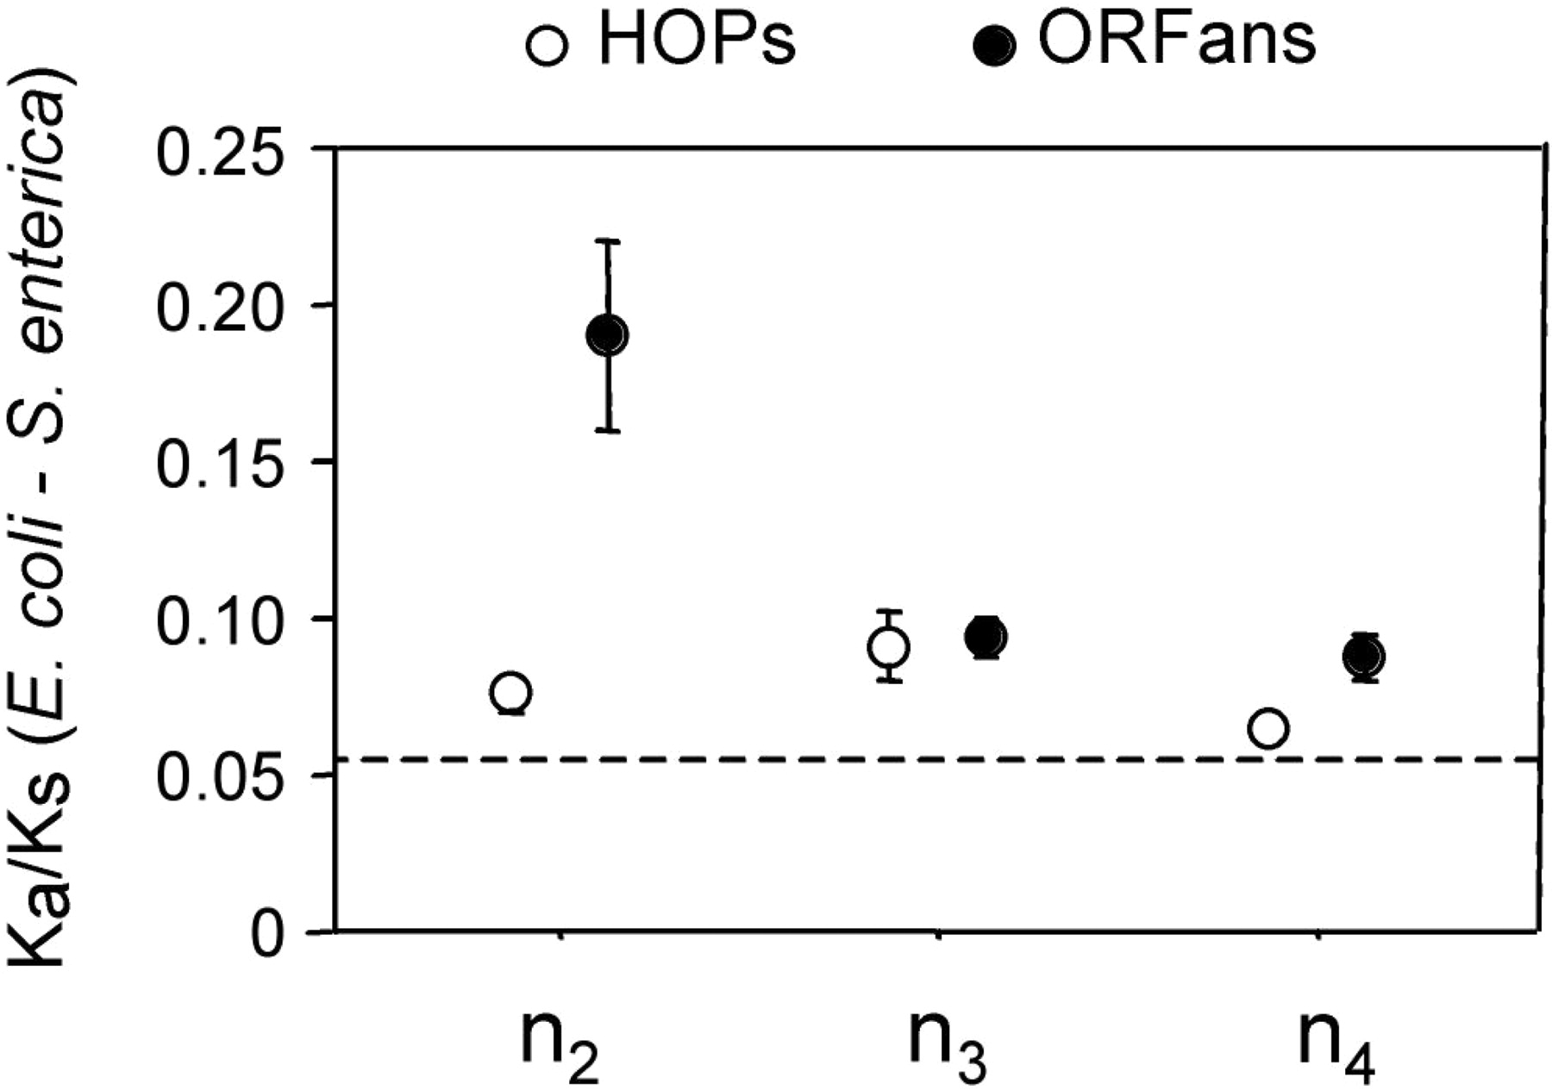
Vincent Daubin and Howard Ochman: Bacterial Genomes as New Gene Homes: The Genealogy of ORFans in E. coli. Genome Research 14:1036-1042, 2004
The ratio of non-synonymous to synonymous substitutions for genes found only in the E.coli - Salmonella clade is lower than 1, but larger than for more widely distributed genes.
Increasing phylogenetic depth
Fig. 3 from Vincent Daubin and Howard Ochman, Genome Research 14:1036-1042, 2004

Slide 41
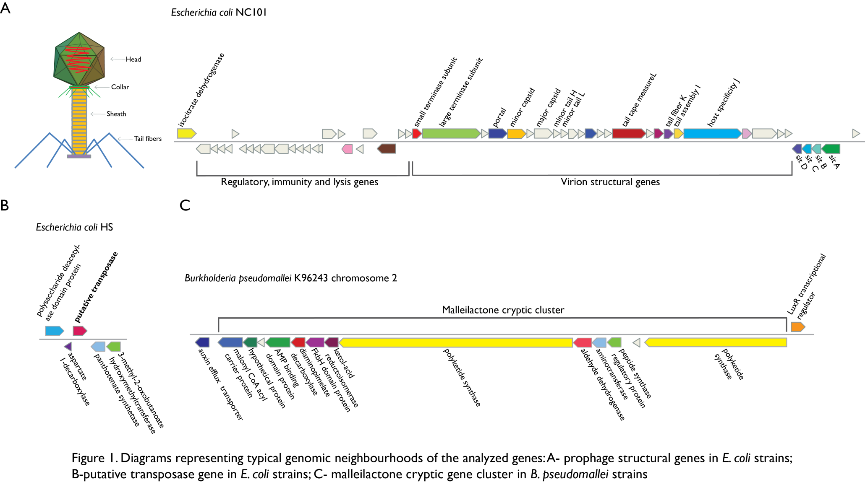
Vertically Inherited Genes Not Expressed for Function

Slide 42
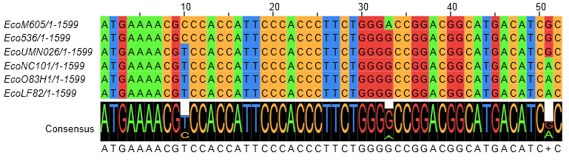
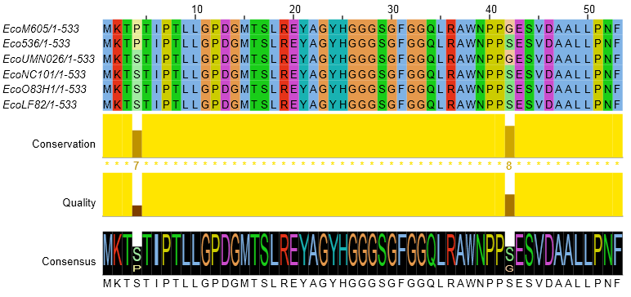
Counting Algorithm
Calculate number of different nucleotides/amino acids per MSA column (X)
Calculate number of nucleotides/amino acids substitutions (X-1)
Calculate number of synonymous changes
S=(N-1)nc-N
assuming N=(N-1)aa
X=2 1 nucleotide substitution
1 non-synonymous change
X=2 1 amino acid substitution

Slide 43
Simulation Algorithm
Calculate MSA nucleotide frequencies (%A,%T,%G,%C)
Introduce a given number of random substitutions ( at any position) based on inferred base frequencies
Compare translated mutated codon with the initial translated codon and count synonymous and non-synonymous substitutions

Slide 44
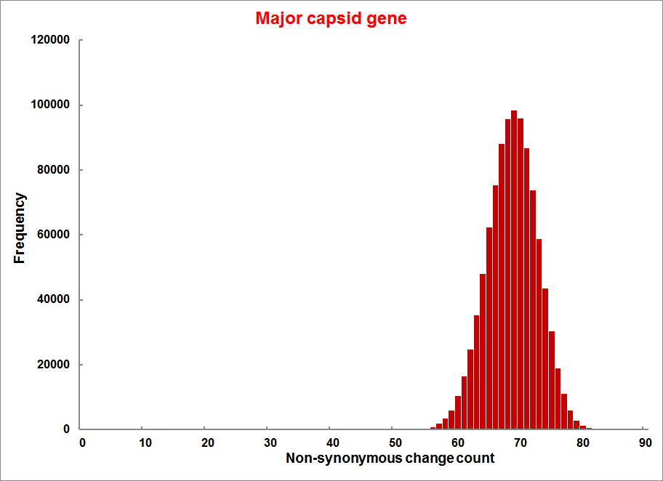
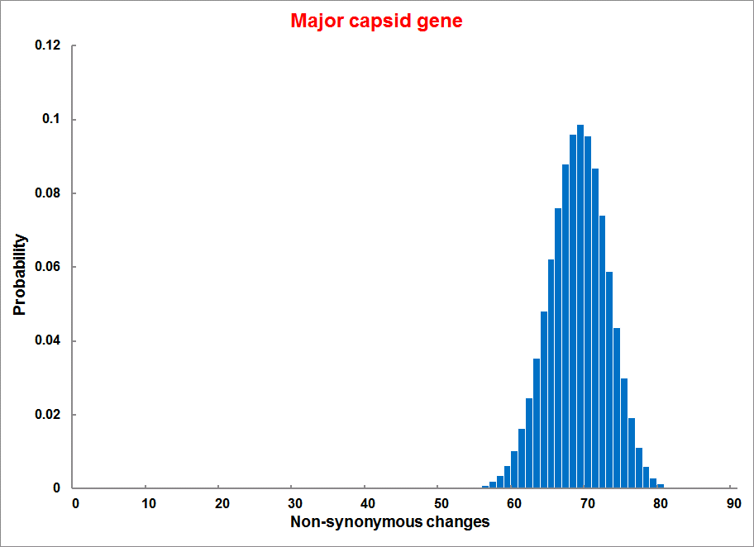
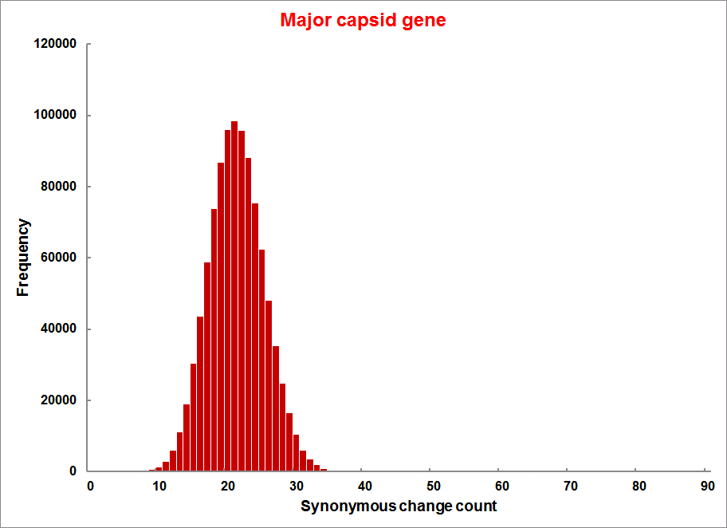
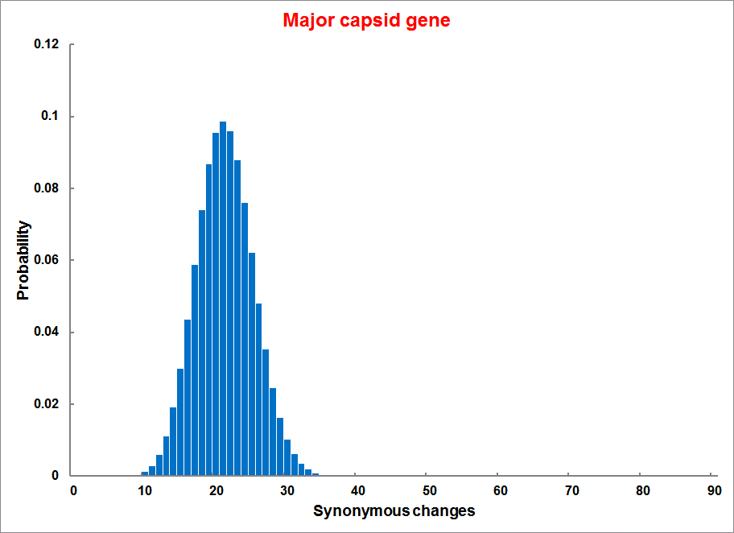
Evolution of Coding DNA Sequences Under a Neutral Model
E. coli Prophage Genes
Count distribution
Probability distribution
n=90
Non-synonymous
n= 90
k= 24
p=0.763
P(≤24)=3.63E-23
Observed=24
P(≤24) < 10⁻⁶
n=90
Synonymous
n= 90
k= 66
p=0.2365
P(≥66)=3.22E-23
Observed=66
P(≥66) < 10⁻⁶

Slide 45
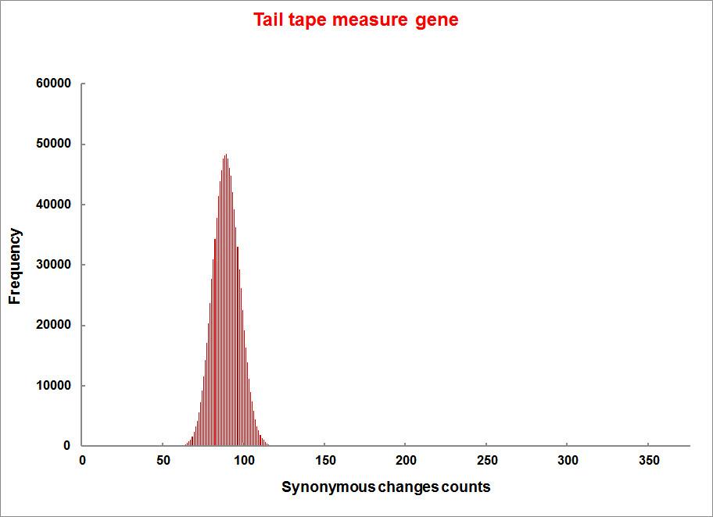
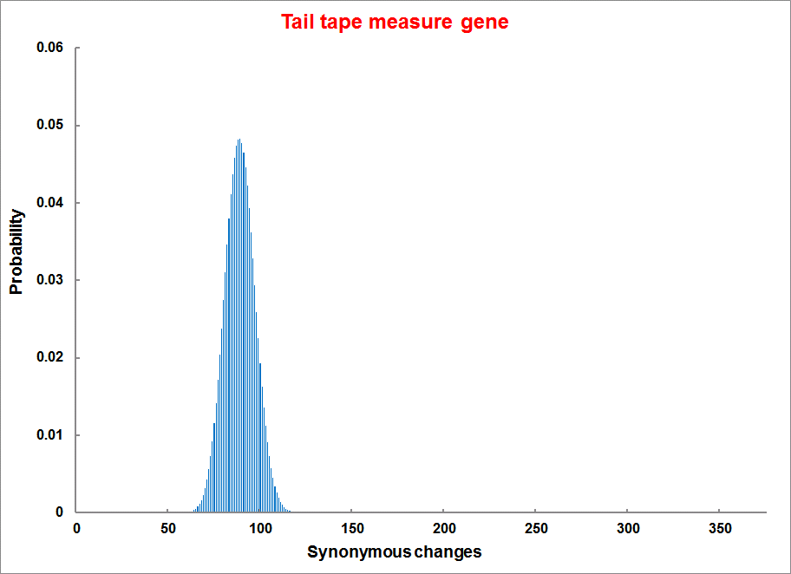
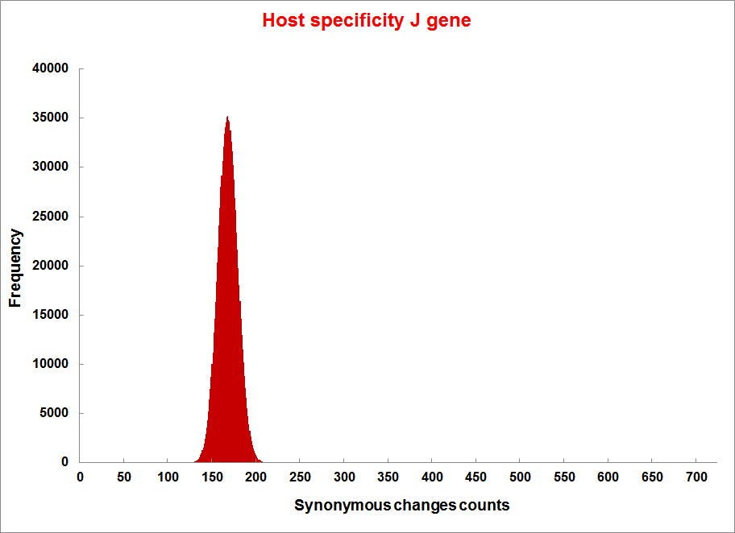
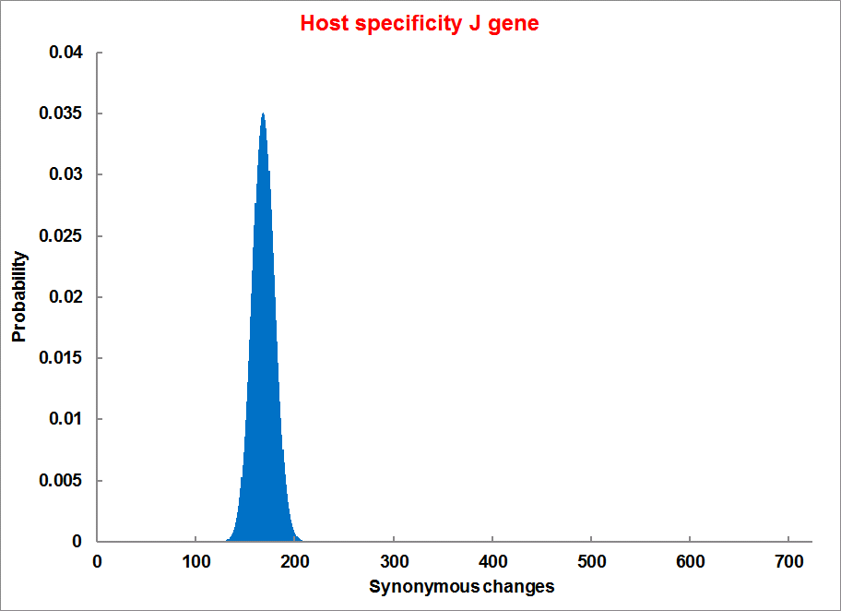
Evolution of Coding DNA Sequences Under a Neutral Model
E. coli Prophage Genes
Count distribution
Probability distribution
n=375
Synonymous
n= 375
k= 243
p=0.237
P(≥243)=7.92E-64
Observed=243
P(≥243) < 10⁻⁶
n=723
Synonymous
n= 723
k= 498
p=0.232
P(≥498)=6.41E-149
Observed=498
P(≥498) < 10⁻⁶

Slide 46
Evolution of Coding DNA Sequences Under a Neutral Model
E. coli Prophage Genes
 |  | OBSERVED |  | SIMULATED |  | Dnapars | Simulated | Codeml
Gene | Alignment Length (bp) | Substitutions | Synonymous changes* | Substitutions | p-value synonymous (given *) | Minimum number of substitutions | dN/dS | dN/dS
Major capsid | 1023 | 90 | 66 | 90 | 3.23E-23 | 94 | 0.113 | 0.13142
Minor capsid C | 1329 | 81 | 59 | 81 | 1.98E-19 | 84 | 0.124 | 0.17704
Large terminase subunit | 1923 | 75 | 67 | 75 | 7.10E-35 | 82 | 0.035 | 0.03773
Small terminase subunit | 543 | 100 | 66 | 100 | 1.07E-19 | 101 | 0.156 | 0.25147
Portal | 1599 | 55 | 46 | 55 | 1.36E-21 | *64 | 0.057 | 0.08081
Protease | 1329 | 55 | 37 | 55 | 4.64E-11 | 55 | 0.162 | 0.24421
Minor tail H | 2565 | 260 | 168 | 260 | 1.81E-44 | 260 | 0.17 | 0.30928
Minor tail L | 696 | 30 | 26 | 30 | 1.30E-13 | 30 | 0.044 | 0.05004
Host specificity J | 3480 | 723 | 498 | 723 | 6.42E-149 | *773 | 0.137 | 0.17103
Tail fiber K | 741 | 41 | 28 | 41 | 1.06E-09 | 44 | 0.14 | 0.18354
Tail assembly I | 669 | 39 | 33 | 39 | 3.82E-15 | 40 | 0.064 | 0.07987
Tail tape measure protein | 2577 | 375 | 243 | 375 | 7.92E-64 | 378 | 0.169 | 0.27957
Our values well under the p=0.01 threshold suggest we can reject the null hypothesis of neutral evolution of prophage sequences.

Slide 47
Evolution of Coding DNA Sequences Under a Neutral Model
B. pseudomallei Cryptic Malleilactone Operon Genes and
E. coli transposase sequences
 |  | OBSERVED |  | SIMULATED
Gene | Alignment Length (bp) | Substitutions | Synonymous changes* | Substitutions | p-value synonymous (given *)
Aldehyde dehydrogenase | 1544 | 13 | 3 | 13 | 4.67E-04
AMP- binding protein | 1865 | 9 | 6 | 9 | 1.68E-02
Adenosylmethionine-8-amino-7-oxononanoate aminotransferase | 1421 | 20 | 12 | 20 | 6.78E-04
Fatty-acid CoA ligase | 1859 | 13 | 2 | 13 | 8.71E-01
Diaminopimelate decarboxylase | 1388 | 7 | 3 | 7 | 6.63E-01
Malonyl CoA-acyl transacylase | 899 | 2 | 1 | 2 | 4.36E-01
FkbH domain protein | 1481 | 17 | 9 | 17 | 2.05E-02
Hypothethical protein | 431 | 3 | 2 | 3 | 1.47E-01
Ketol-acid reductoisomerase | 1091 | 2 | 0 | 2 | 1.00E+00
Peptide synthase regulatory protein | 1079 | 10 | 5 | 10 | 8.91E-02
Polyketide-peptide synthase | 12479 | 135 | 66 | 135 | 4.35E-27
 |  | OBSERVED |  | SIMULATED
Gene | Alignment Length (bp) | Substitutions | Synonymous changes* | Substitutions | p-value synonymous (given *)
Putative transposase | 903 | 175 | 107 | 175 | 1.15E-29

Slide 48

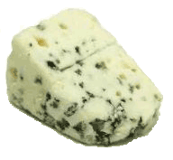
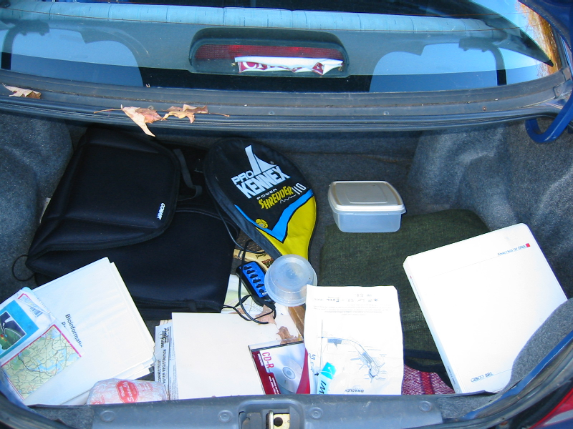
Trunk-of-my-car analogy: Hardly anything in there is the is the result of providing a selective advantage. Some items are removed quickly (purifying selection), some are useful under some conditions, but most things do not alter the fitness.
Could some of the inferred purifying selection be due to the acquisition of novel detrimental characteristics (e.g., protein toxicity, HOPELESS MONSTERS)?

Slide 49
Other ways to detect positive selection
Selective sweeps -> fewer alleles present in population
(see contributions from archaic Humans for example)
Repeated episodes of positive selection -> high dN

Slide 50
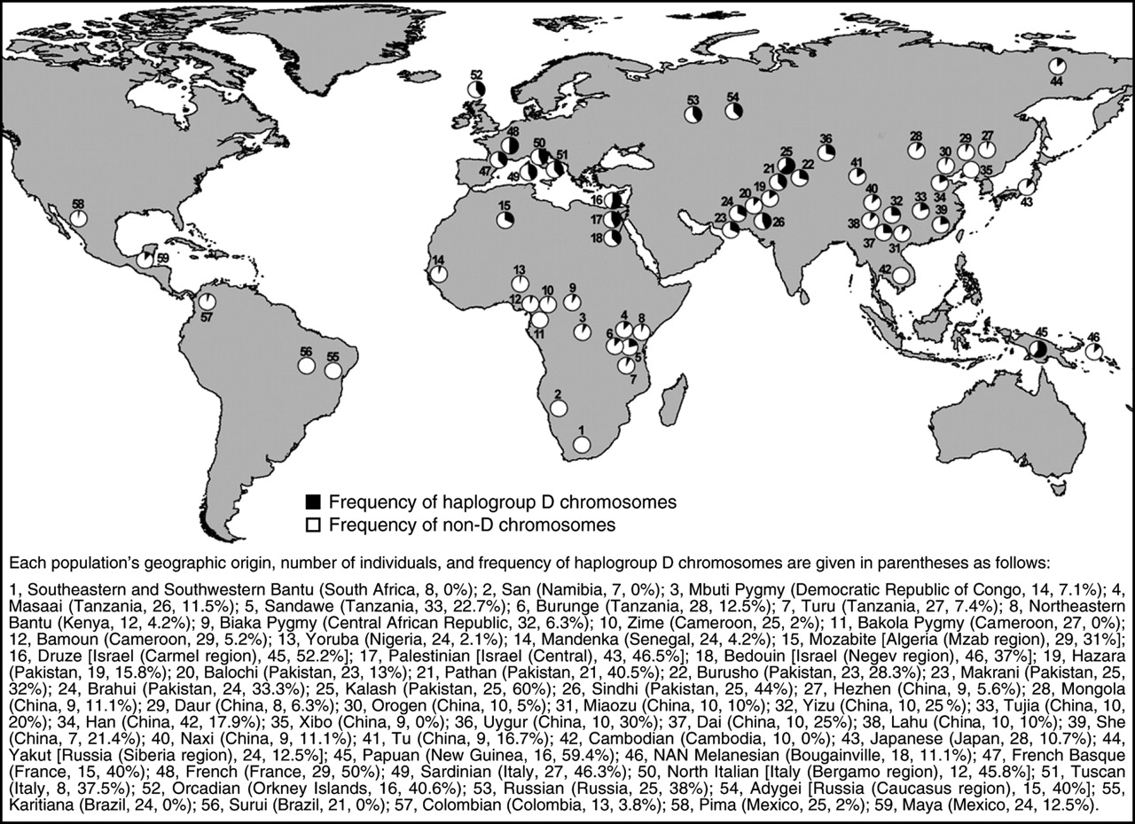
Variant arose about
5800 years ago

Slide 51
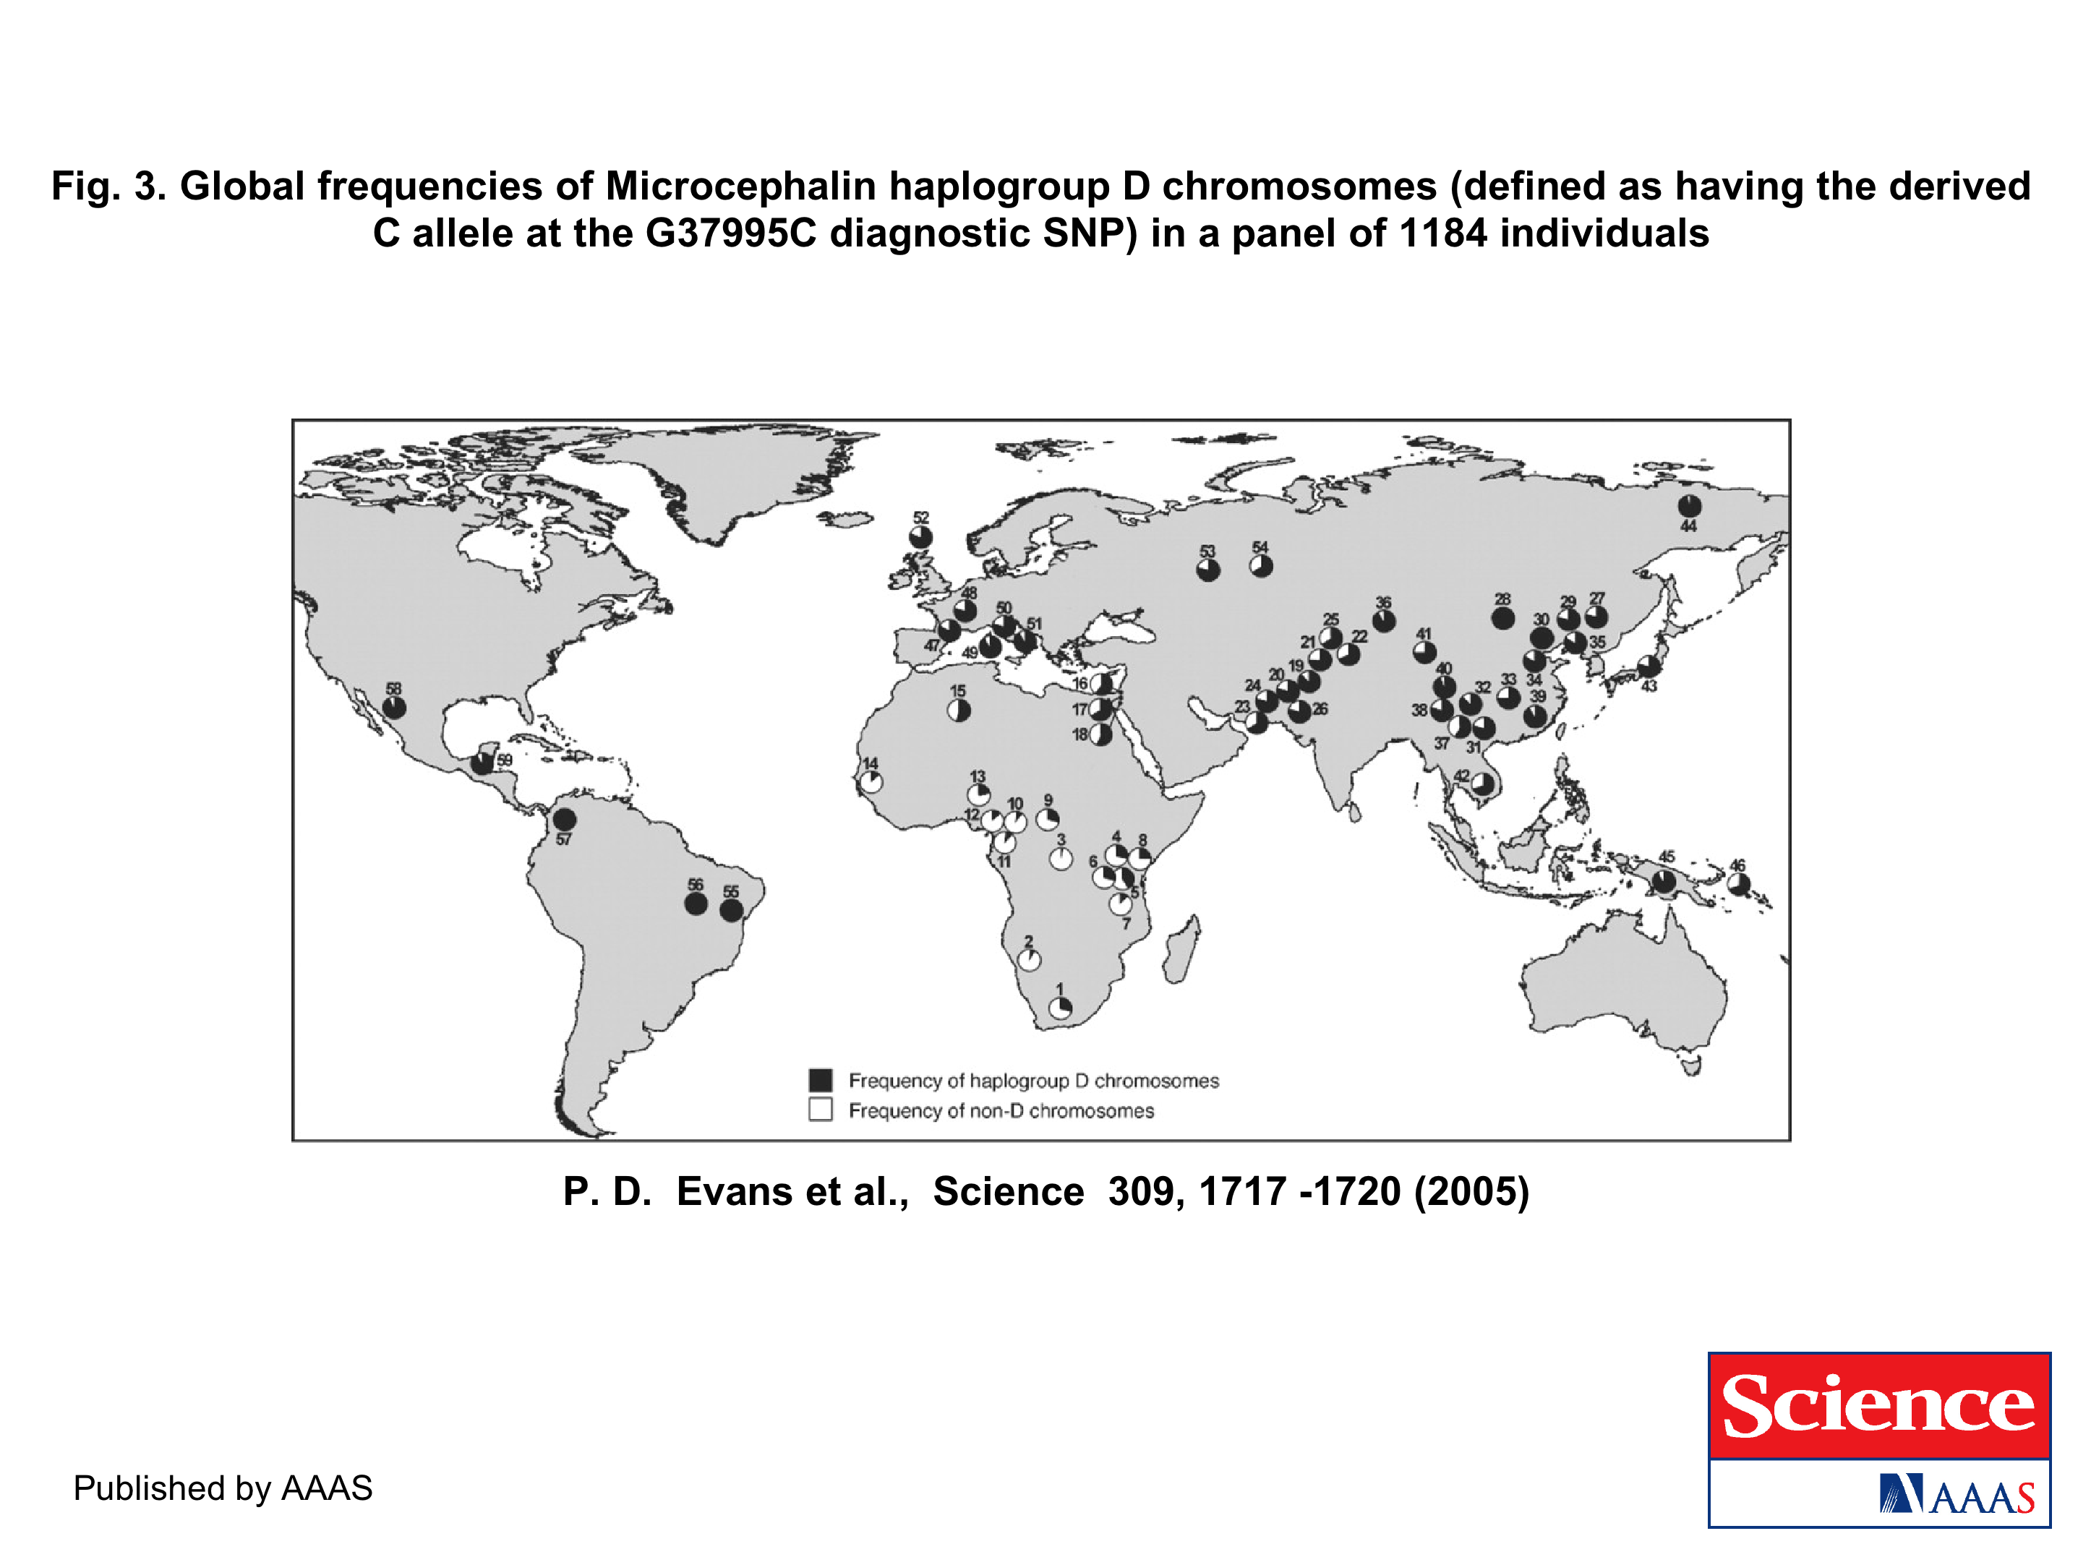
The age of haplogroup D was found to be ~37,000 years

Slide 52
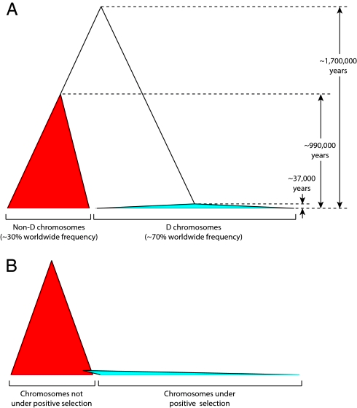
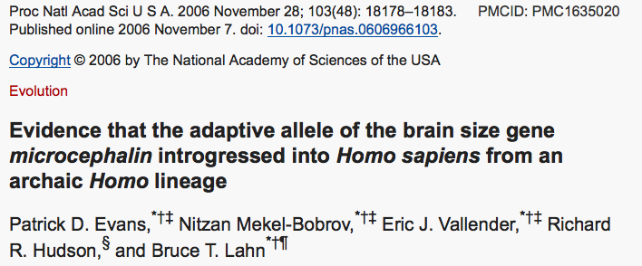

Slide 53
PSI (position-specific iterated) BLAST
The NCBI page described PSI blast as follows:
“Position-Specific Iterated BLAST (PSI-BLAST) provides an automated, easy-to-use version of a "profile" search, which is a sensitive way to look for sequence homologues.
The program first performs a gapped BLAST database search. The PSI-BLAST program uses the information from any significant alignments returned to construct a position-specific score matrix, which replaces the query sequence for the next round of database searching.
PSI-BLAST may be iterated until no new significant alignments are found. At this time PSI-BLAST may be used only for comparing protein queries with protein databases.”

Slide 54
The Psi-Blast Approach
1. Use results of BlastP query to construct a multiple sequence alignment
2. Construct a position-specific scoring matrix from the alignment
3. Search database with alignment instead of query sequence
4. Add matches to alignment and repeat
Psi-Blast can use existing multiple alignment, or
use RPS-Blast to search a database of PSSMs

Slide 55
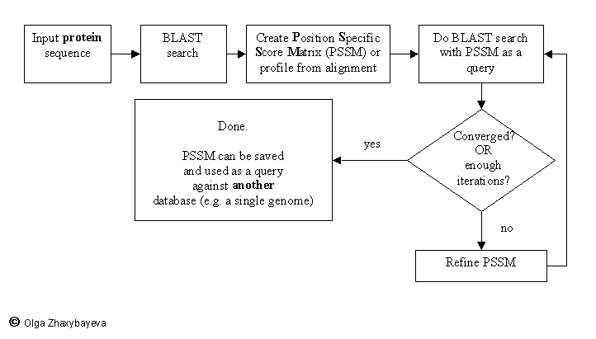
PSI BLAST scheme

Slide 56
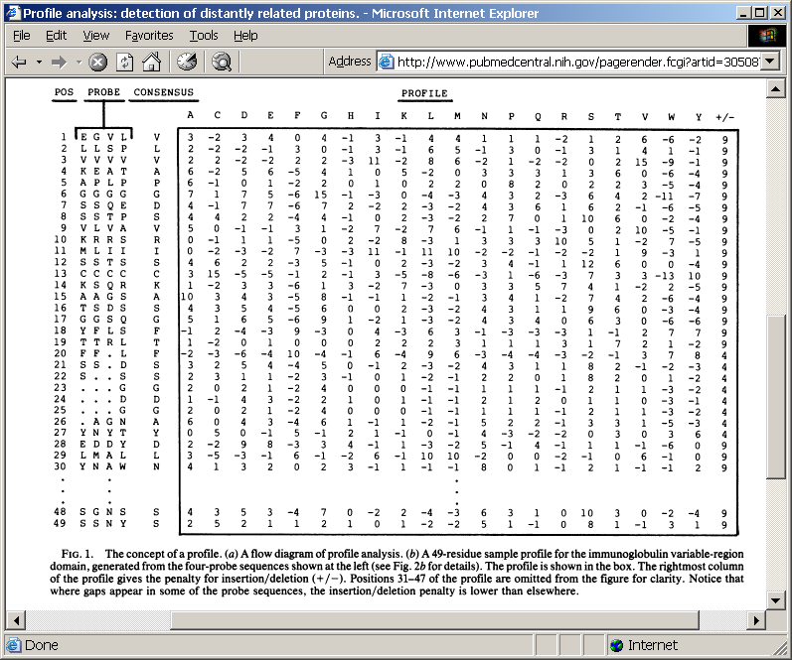
Position-specific Matrix
by Bob Friedman
M Gribskov, A D McLachlan, and D Eisenberg (1987) Profile analysis: detection of distantly related proteins. PNAS 84:4355-8.

Slide 57
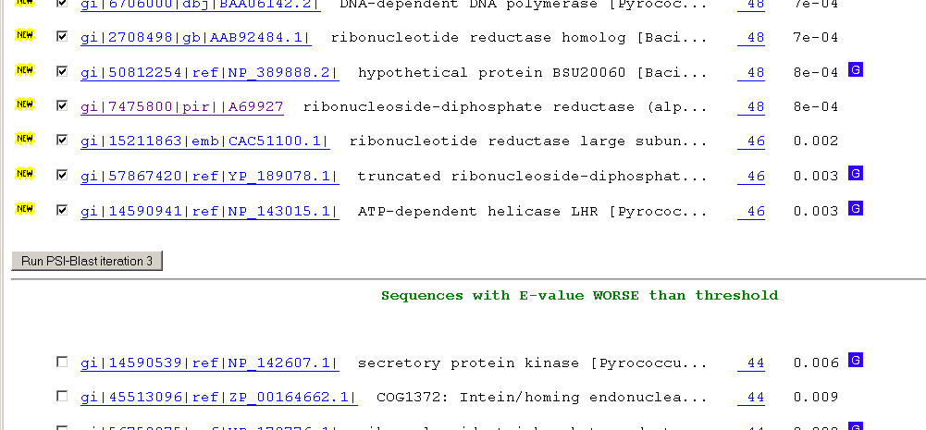
Psi-Blast Results
Query: 55670331 (intein)
link to sequence here, check BLink ☺

Slide 58
PSI BLAST and E-values!
Psi-Blast is for finding matches among divergent sequences (position-specific information)
WARNING: For the nth iteration of a PSI BLAST search, the E-value gives the number of matches to the profile NOT to the initial query sequence! The danger is that the profile was corrupted in an earlier iteration.

Slide 59
PSI Blast from the command line
Often you want to run a PSIBLAST search with two different databanks -
one to create the PSSM, the other to get sequences:
To create the PSSM:
blastpgp -d nr -i subI -j 5 -C subI.ckp -a 2 -o subI.out -h 0.00001 -F f
blastpgp -d swissprot -i gamma -j 5 -C gamma.ckp -a 2 -o gamma.out -h 0.00001 -F f
Runs 4 iterations of a PSIblast
the -h option tells the program to use matches with E <10^-5 for the next iteration,
(the default is 10⁻³ )
-C creates a checkpoint (called subI.ckp),
-o writes the output to subI.out,
-i option specifies input as using subI as input (a fasta formated aa sequence).
The nr databank used is stored in /common/data/
-a 2 use two processors
-h e-value threshold for inclusion in multipass model [Real]
default = 0.002 THIS IS A RATHER HIGH NUMBER!!!
(It might help to use the node with more memory (017)
(command is ssh node017)

Slide 60
To use the PSSM:
blastpgp -d /Users/jpgogarten/genomes/msb8.faa -i subI -a 2 -R subI.ckp -o subI.out3 -F f
blastpgp -d /Users/jpgogarten/genomes/msb8.faa -i gamma -a 2 -R gamma.ckp -o gamma.out3 -F f
Runs another iteration of the same blast search, but uses the databank /Users/jpgogarten/genomes/msb8.faa
-R tells the program where to resume
-d specifies a different databank
-i input file - same sequence as before
-o output_filename
-a 2 use two processors
-h e-value threshold for inclusion in multipass model [Real]
default = 0.002. This is a rather high number, but might be ok for the last iteration.

Slide 61
PSI Blast and finding gene families within genomes
2nd step: use PSSM to search genome:
Use protein sequences encoded in genome as target:
blastpgp -d target_genome.faa -i query.name -a 2 -R query.ckp -o query.out3 -F f
B) Use nucleotide sequence and tblastn. This is an advantage if you are also interested in pseudogenes, and/or if you don’t trust the genome annotation:
blastall -i query.name -d target_genome_nucl.ffn -p psitblastn -R query.ckp

Slide 62
Psi-Blast finds homologs among divergent sequences (position-specific information)
WARNING:
For the nth iteration of a PSI BLAST search, the E-value gives the number of matches to the profile
NOT to the initial query sequence!
The danger is that the profile was corrupted in an earlier iteration.

