Slide 1
Random Genetic Drift
Selection
100
advantageous
Allele frequency
disadvantageous
0
Modified from from www.tcd.ie/Genetics/staff/Aoife/GE3026/GE3026_1+2.ppt

Slide 2
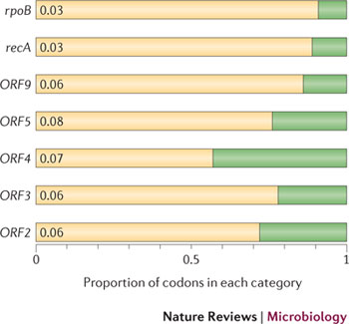
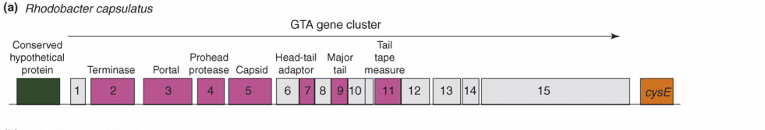
Purifying selection in GTA genes
dN/dS <1 for GTA genes has been used to infer selection for function
GTA genes
Lang AS, Zhaxybayeva O, Beatty JT. Nat Rev Microbiol. 2012 Jun 11;10(7):472-82
Lang, A.S. & Beatty, J.T. Trends in Microbiology , Vol.15, No.2 , 2006
Notes:
The ratio of non-synonymous-to-synonymous (dN/dS, or ω) codon substitution rates can be used as an indication of the selective pressure acting on a protein-coding gene. If a gene (or gene segment) is under purifying selection, non-synonymous mutations (that is, mutations resulting in a change of the encoded amino acid) will be selected against, resulting in ω < 1. In neutrally evolving proteins, synonymous and non-synonymous mutations will be fixed at approximately the same rate, resulting in ω = 1. Because different regions of a protein-coding gene may be under different selective constraints, codons can be divided into two categories: those with ω < 1 (yellow; the estimated ω is indicated on the bar) and those with ω fixed to 1 (green); the estimated proportion of codons in each category is given on the horizontal axis.

Slide 3
Purifying selection in E.coli ORFans
dN-dS < 0 for some ORFan E. coli clusters seems to suggest they are functional genes.
Gene groups | Number | dN-dS>0 | dN-dS<0 | dN-dS=0
E. coli ORFan clusters | 3773 | 944 (25%) | 1953 (52%) | 876 (23%)
Clusters of E.coli sequences found in Salmonella sp., Citrobacter sp. | 610 | 104 (17%) | 423(69%) | 83 (14%)
Clusters of E.coli sequences found in some Enterobacteriaceae only | 373 | 8 (2%) | 365 (98%) | 0 (0%)
Adapted after Yu, G. and Stoltzfus, A. Genome Biol Evol (2012) Vol. 4 1176-1187

Slide 4
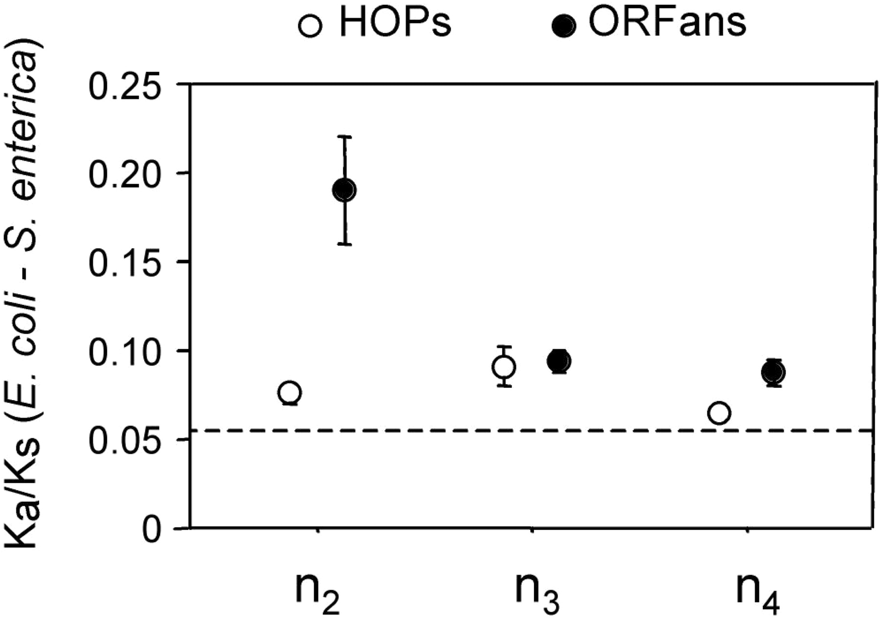
Vincent Daubin and Howard Ochman: Bacterial Genomes as New Gene Homes: The Genealogy of ORFans in E. coli. Genome Research 14:1036-1042, 2004
The ratio of non-synonymous to synonymous substitutions for genes found only in the E.coli - Salmonella clade is lower than 1, but larger than for more widely distributed genes.
Increasing phylogenetic depth
Fig. 3 from Vincent Daubin and Howard Ochman, Genome Research 14:1036-1042, 2004

Slide 5
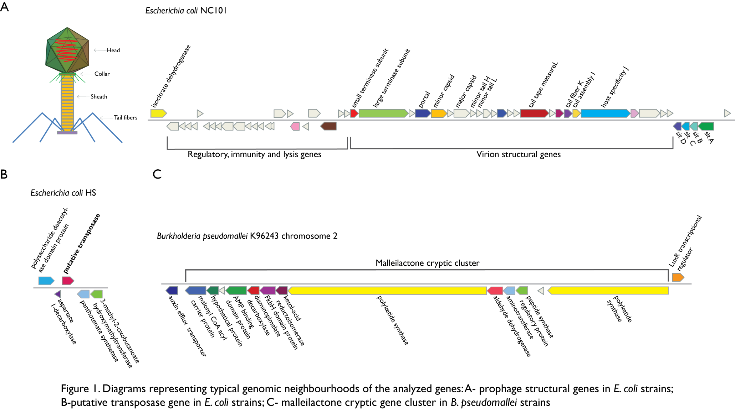
Vertically Inherited Genes Not Expressed for Function

Slide 6
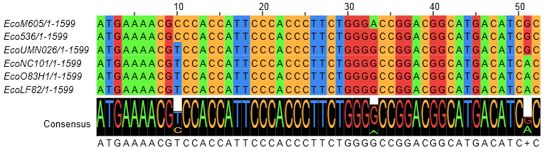
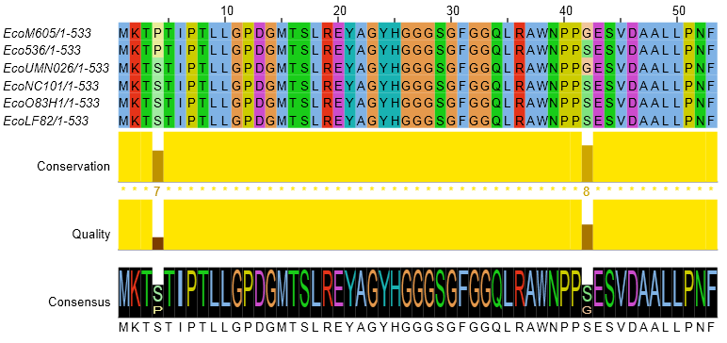
Counting Algorithm
Calculate number of different nucleotides/amino acids per MSA column (X)
Calculate number of nucleotides/amino acids substitutions (X-1)
Calculate number of synonymous changes
S=(N-1)nc-N
assuming N=(N-1)aa
X=2 1 nucleotide substitution
1 non-synonymous change
X=2 1 amino acid substitution

Slide 7
Simulation Algorithm
Calculate MSA nucleotide frequencies (%A,%T,%G,%C)
Introduce a given number of random substitutions ( at any position) based on inferred base frequencies
Compare translated mutated codon with the initial translated codon and count synonymous and non-synonymous substitutions

Slide 8
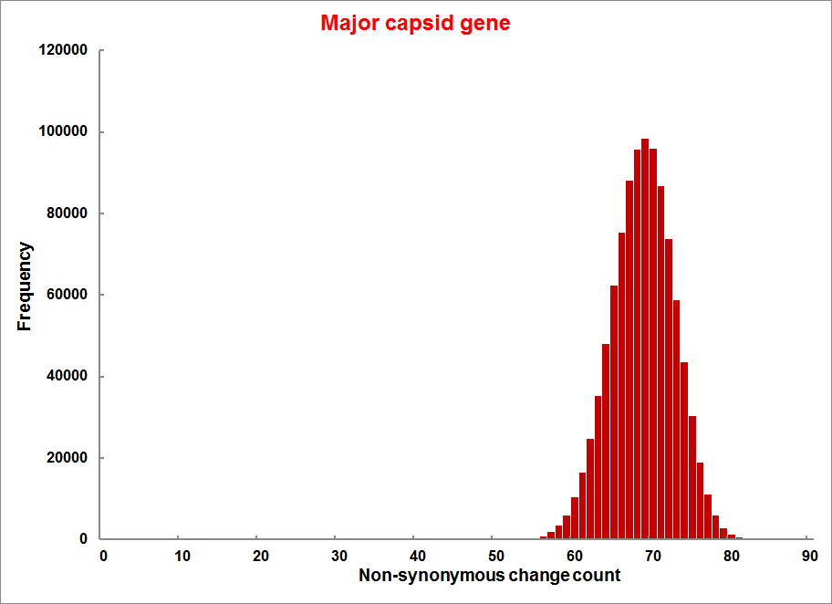
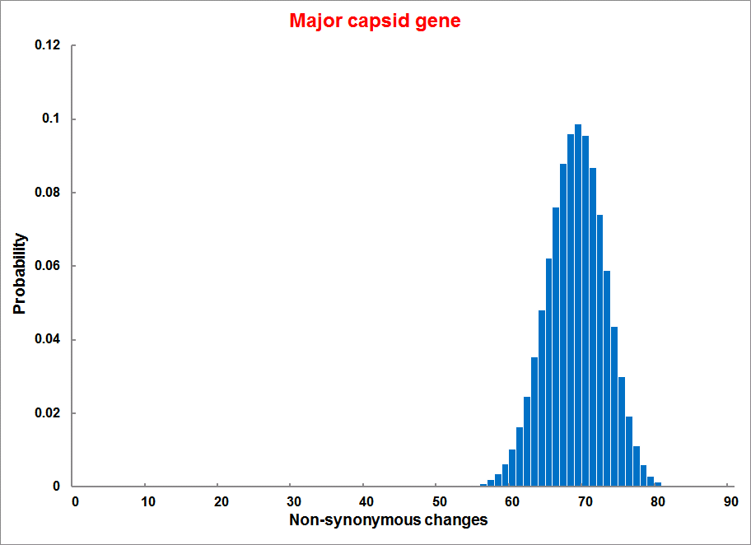
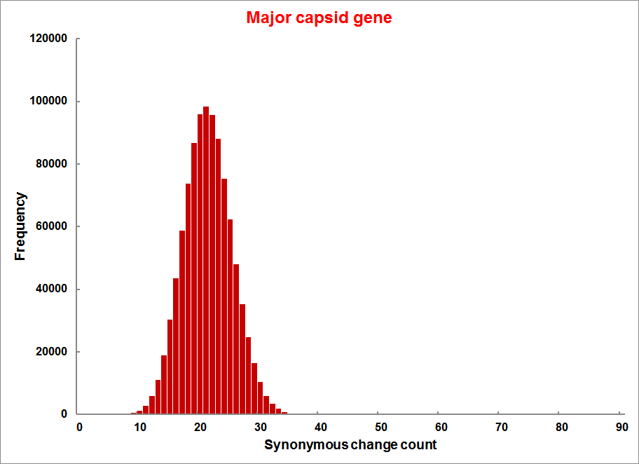
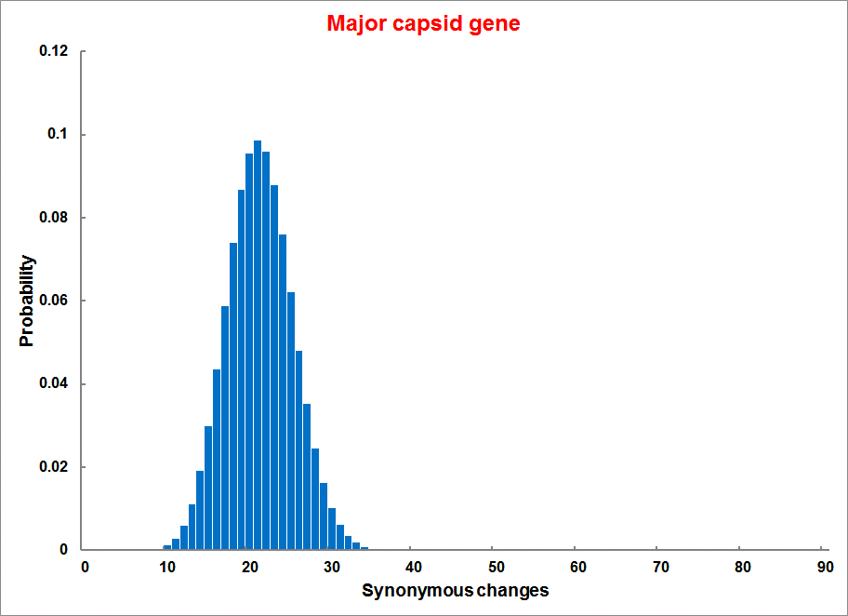
Evolution of Coding DNA Sequences Under a Neutral Model
E. coli Prophage Genes
Count distribution
Probability distribution
n=90
Non-synonymous
n= 90
k= 24
p=0.763
P(≤24)=3.63E-23
Observed=24
P(≤24) < 10⁻⁶
n=90
Synonymous
n= 90
k= 66
p=0.2365
P(≥66)=3.22E-23
Observed=66
P(≥66) < 10⁻⁶

Slide 9
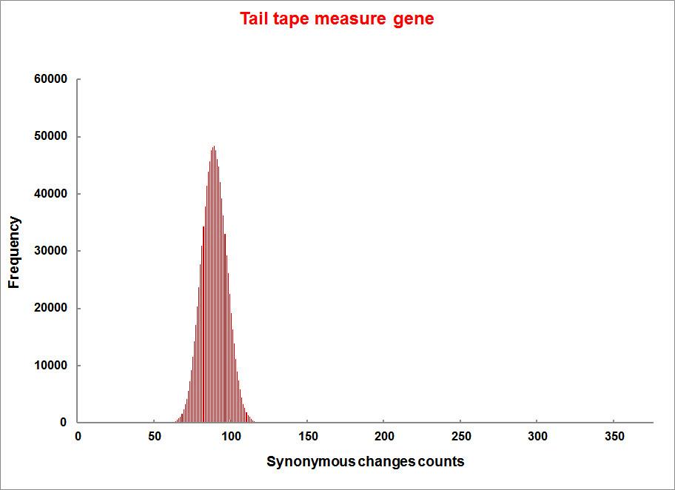
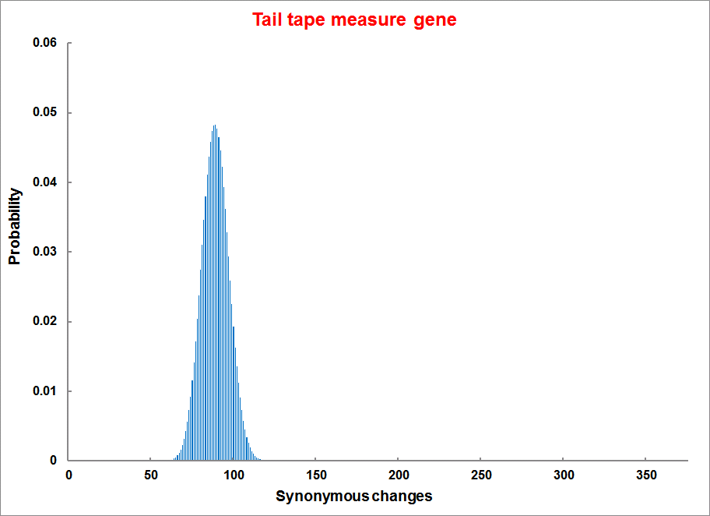
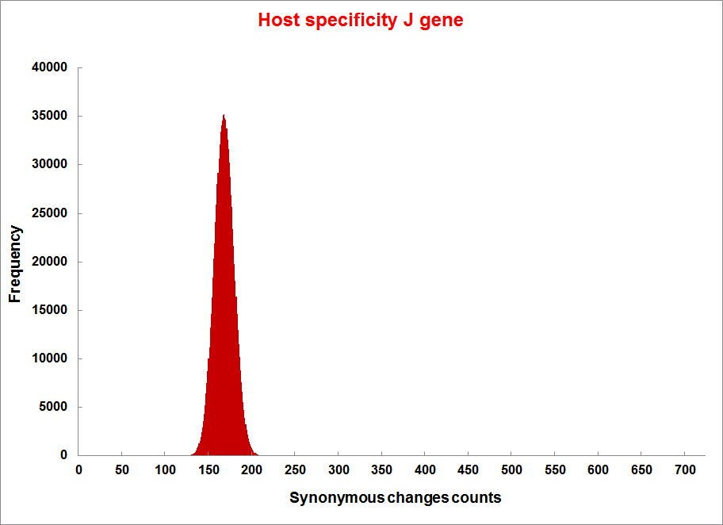
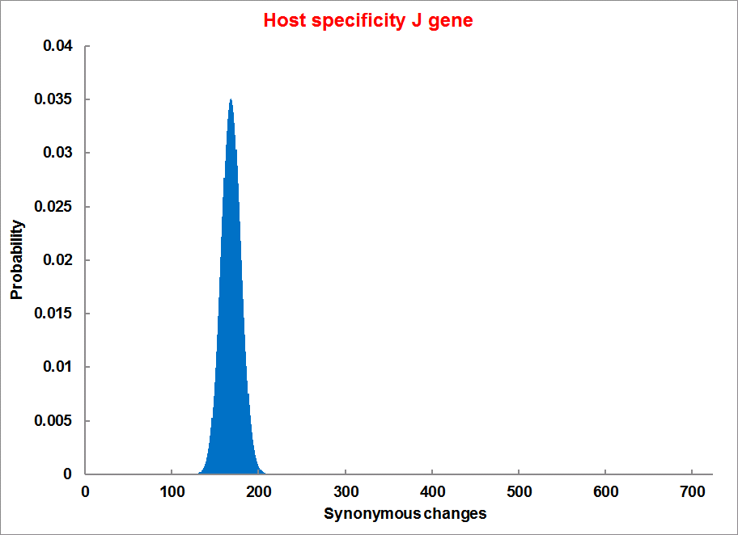
Evolution of Coding DNA Sequences Under a Neutral Model
E. coli Prophage Genes
Count distribution
Probability distribution
n=375
Synonymous
n= 375
k= 243
p=0.237
P(≥243)=7.92E-64
Observed=243
P(≥243) < 10⁻⁶
n=723
Synonymous
n= 723
k= 498
p=0.232
P(≥498)=6.41E-149
Observed=498
P(≥498) < 10⁻⁶

Slide 10
Evolution of Coding DNA Sequences Under a Neutral Model
E. coli Prophage Genes
 |  | OBSERVED |  | SIMULATED |  | Dnapars | Simulated | Codeml
Gene | Alignment Length (bp) | Substitutions | Synonymous changes* | Substitutions | p-value synonymous (given *) | Minimum number of substitutions | dN/dS | dN/dS
Major capsid | 1023 | 90 | 66 | 90 | 3.23E-23 | 94 | 0.113 | 0.13142
Minor capsid C | 1329 | 81 | 59 | 81 | 1.98E-19 | 84 | 0.124 | 0.17704
Large terminase subunit | 1923 | 75 | 67 | 75 | 7.10E-35 | 82 | 0.035 | 0.03773
Small terminase subunit | 543 | 100 | 66 | 100 | 1.07E-19 | 101 | 0.156 | 0.25147
Portal | 1599 | 55 | 46 | 55 | 1.36E-21 | *64 | 0.057 | 0.08081
Protease | 1329 | 55 | 37 | 55 | 4.64E-11 | 55 | 0.162 | 0.24421
Minor tail H | 2565 | 260 | 168 | 260 | 1.81E-44 | 260 | 0.17 | 0.30928
Minor tail L | 696 | 30 | 26 | 30 | 1.30E-13 | 30 | 0.044 | 0.05004
Host specificity J | 3480 | 723 | 498 | 723 | 6.42E-149 | *773 | 0.137 | 0.17103
Tail fiber K | 741 | 41 | 28 | 41 | 1.06E-09 | 44 | 0.14 | 0.18354
Tail assembly I | 669 | 39 | 33 | 39 | 3.82E-15 | 40 | 0.064 | 0.07987
Tail tape measure protein | 2577 | 375 | 243 | 375 | 7.92E-64 | 378 | 0.169 | 0.27957
Our values well under the p=0.01 threshold suggest we can reject the null hypothesis of neutral evolution of prophage sequences.

Slide 11
Evolution of Coding DNA Sequences Under a Neutral Model
B. pseudomallei Cryptic Malleilactone Operon Genes and
E. coli transposase sequences
 |  | OBSERVED |  | SIMULATED
Gene | Alignment Length (bp) | Substitutions | Synonymous changes* | Substitutions | p-value synonymous (given *)
Aldehyde dehydrogenase | 1544 | 13 | 3 | 13 | 4.67E-04
AMP- binding protein | 1865 | 9 | 6 | 9 | 1.68E-02
Adenosylmethionine-8-amino-7-oxononanoate aminotransferase | 1421 | 20 | 12 | 20 | 6.78E-04
Fatty-acid CoA ligase | 1859 | 13 | 2 | 13 | 8.71E-01
Diaminopimelate decarboxylase | 1388 | 7 | 3 | 7 | 6.63E-01
Malonyl CoA-acyl transacylase | 899 | 2 | 1 | 2 | 4.36E-01
FkbH domain protein | 1481 | 17 | 9 | 17 | 2.05E-02
Hypothethical protein | 431 | 3 | 2 | 3 | 1.47E-01
Ketol-acid reductoisomerase | 1091 | 2 | 0 | 2 | 1.00E+00
Peptide synthase regulatory protein | 1079 | 10 | 5 | 10 | 8.91E-02
Polyketide-peptide synthase | 12479 | 135 | 66 | 135 | 4.35E-27
 |  | OBSERVED |  | SIMULATED
Gene | Alignment Length (bp) | Substitutions | Synonymous changes* | Substitutions | p-value synonymous (given *)
Putative transposase | 903 | 175 | 107 | 175 | 1.15E-29

Slide 12

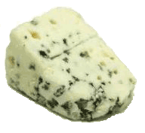
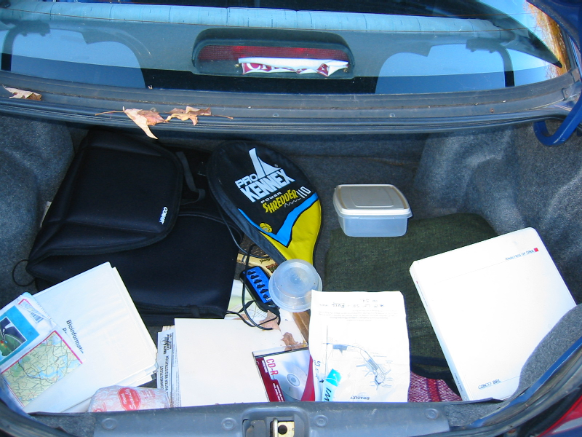
Trunk-of-my-car analogy: Hardly anything in there is the is the result of providing a selective advantage. Some items are removed quickly (purifying selection), some are useful under some conditions, but most things do not alter the fitness.
Could some of the inferred purifying selection be due to the acquisition of novel detrimental characteristics (e.g., protein toxicity, HOPELESS MONSTERS)?

Slide 13
Other ways to detect positive selection
Selective sweeps -> fewer alleles present in population
(see contributions from archaic Humans for example)
Repeated episodes of positive selection -> high dN

Slide 14
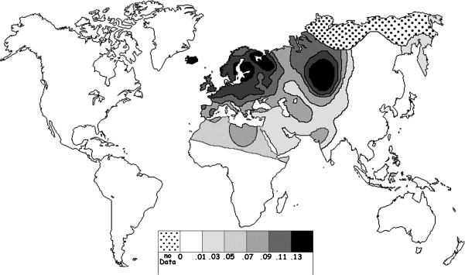
Fig. 1 Current world-wide frequency distribution of CCR5-Δ32 allele frequencies. Only the frequencies of Native populations have been evidenced in Americas, Asia, Africa and Oceania. Map redrawn and modified principally from <ce:cross-ref refid="bib5"> B...
Eric Faure , Manuela Royer-Carenzi
Is the European spatial distribution of the HIV-1-resistant CCR5-Δ32 allele formed by a breakdown of the pathocenosis due to the historical Roman expansion?
Infection, Genetics and Evolution, Volume 8, Issue 6, 2008, 864 - 874
http://dx.doi.org/10.1016/j.meegid.2008.08.007

Slide 15
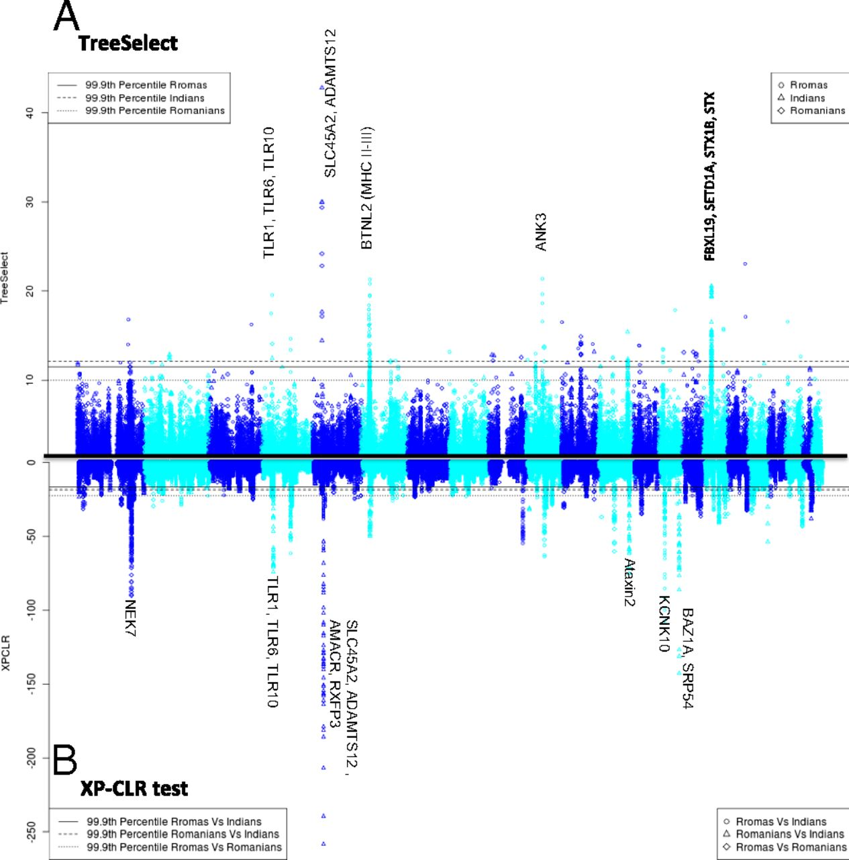
Manhattan plot of results of selection tests in Rroma, Romanians, and Indians using TreeSelect statistic (A) and XP-CLR statistic (B).
Laayouni H et al. PNAS 2014;111:2668-2673
©2014 by National Academy of Sciences
Notes:
Manhattan plot of results of selection tests in Rroma, Romanians, and Indians using TreeSelect statistic (A) and XP-CLR statistic (B). Chromosomes ordered from chromosome 1 to chromosome 22.

Slide 16
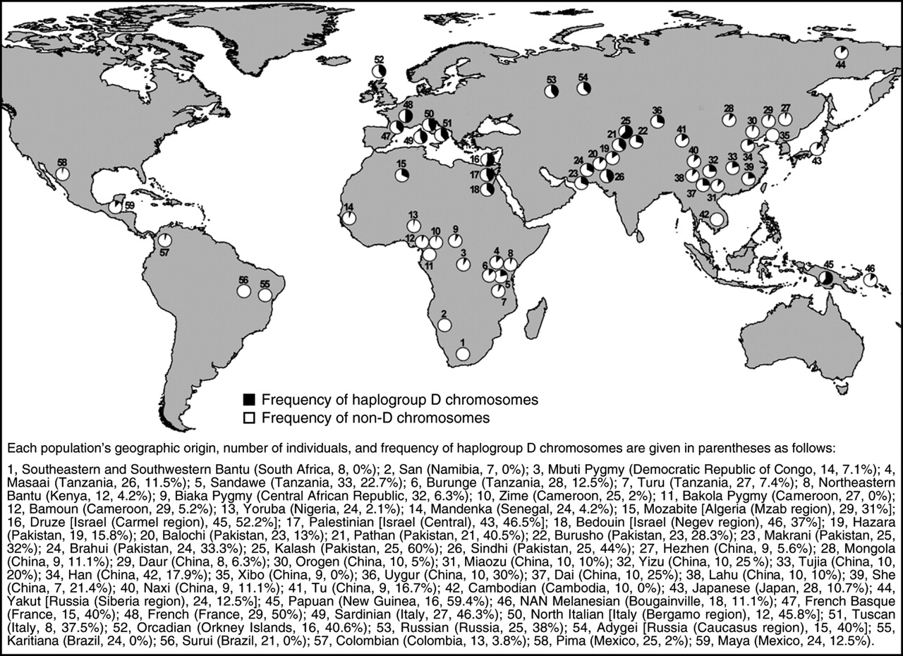
Variant arose about
5800 years ago

Slide 17
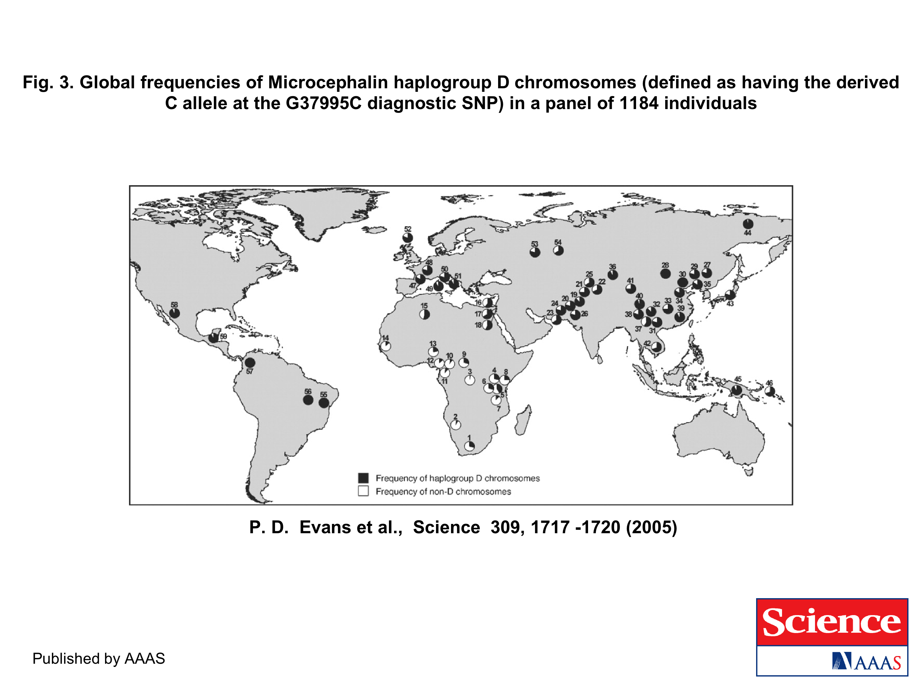
The age of haplogroup D was found to be ~37,000 years

Slide 18
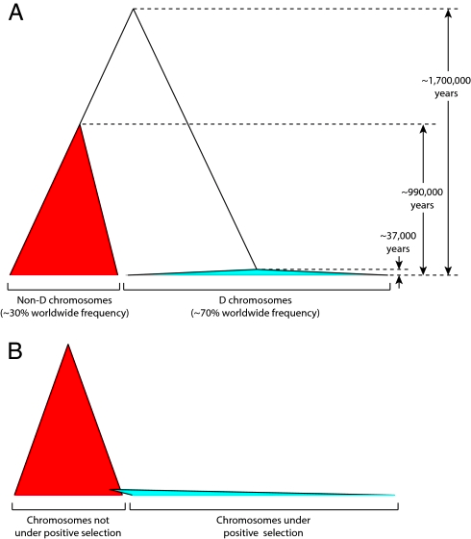
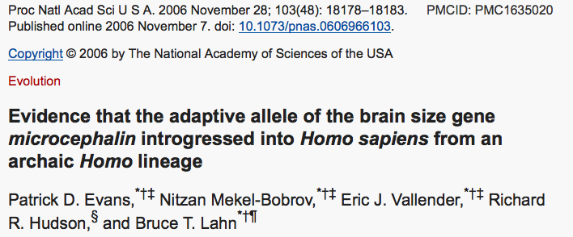

Slide 19
PSI (position-specific iterated) BLAST
The NCBI page described PSI blast as follows:
“Position-Specific Iterated BLAST (PSI-BLAST) provides an automated, easy-to-use version of a "profile" search, which is a sensitive way to look for sequence homologues.
The program first performs a gapped BLAST database search. The PSI-BLAST program uses the information from any significant alignments returned to construct a position-specific score matrix, which replaces the query sequence for the next round of database searching.
PSI-BLAST may be iterated until no new significant alignments are found. At this time PSI-BLAST may be used only for comparing protein queries with protein databases.”

Slide 20
The Psi-Blast Approach
1. Use results of BlastP query to construct a multiple sequence alignment
2. Construct a position-specific scoring matrix from the alignment
3. Search database with alignment instead of query sequence
4. Add matches to alignment and repeat
Psi-Blast can use existing multiple alignment, or
use RPS-Blast to search a database of PSSMs

Slide 21
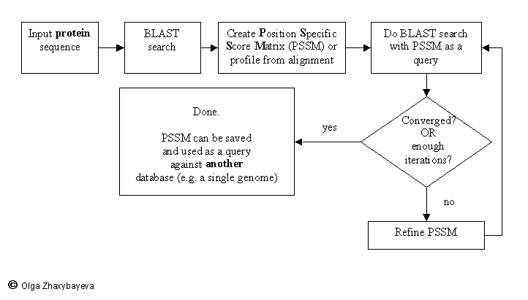
PSI BLAST scheme

Slide 22
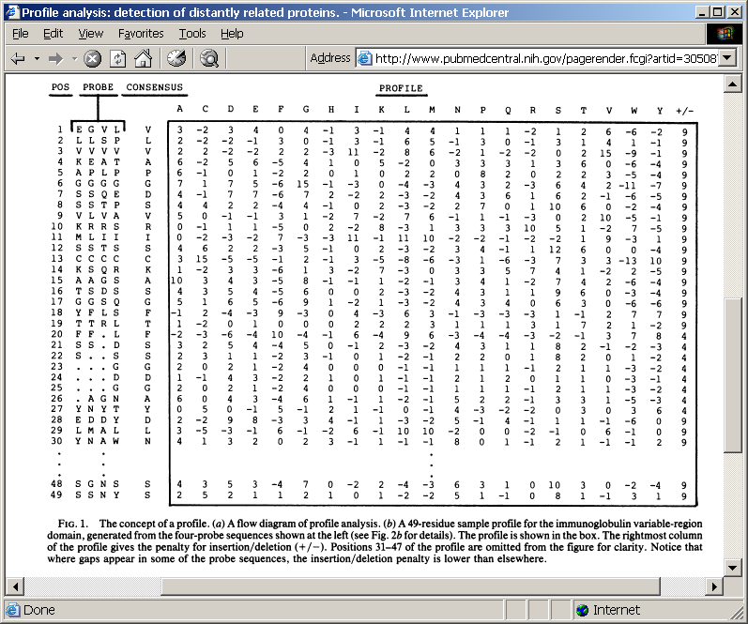
Position-specific Matrix
by Bob Friedman
M Gribskov, A D McLachlan, and D Eisenberg (1987) Profile analysis: detection of distantly related proteins. PNAS 84:4355-8.

Slide 23
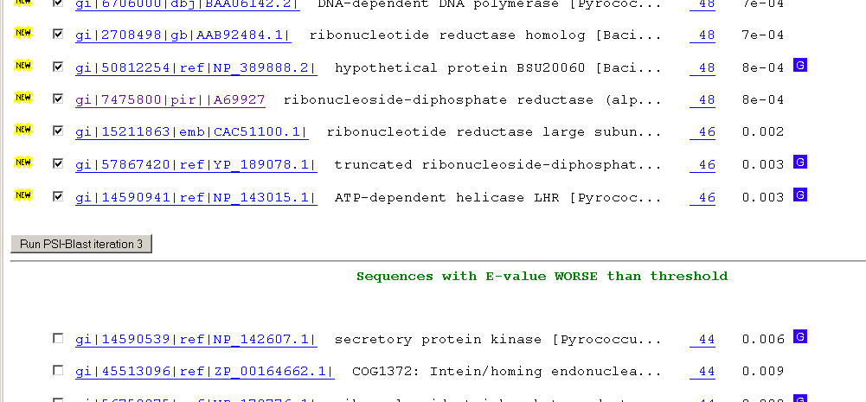
Psi-Blast Results
Query: 55670331 (intein)
link to sequence here, check BLink ☺

Slide 24
PSI BLAST and E-values!
Psi-Blast is for finding matches among divergent sequences (position-specific information)
WARNING: For the nth iteration of a PSI BLAST search, the E-value gives the number of matches to the profile NOT to the initial query sequence! The danger is that the profile was corrupted in an earlier iteration.

Slide 25
PSI Blast from the command line
Often you want to run a PSIBLAST search with two different databanks -
one to create the PSSM, the other to get sequences:
To create the PSSM:
blastpgp -d nr -i subI -j 5 -C subI.ckp -a 2 -o subI.out -h 0.00001 -F f
blastpgp -d swissprot -i gamma -j 5 -C gamma.ckp -a 2 -o gamma.out -h 0.00001 -F f
Runs 4 iterations of a PSIblast
the -h option tells the program to use matches with E <10^-5 for the next iteration,
(the default is 10⁻³ )
-C creates a checkpoint (called subI.ckp),
-o writes the output to subI.out,
-i option specifies input as using subI as input (a fasta formated aa sequence).
The nr databank used is stored in /common/data/
-a 2 use two processors
-h e-value threshold for inclusion in multipass model [Real]
default = 0.002 THIS IS A RATHER HIGH NUMBER!!!
(It might help to use the node with more memory (017)
(command is ssh node017)

Slide 26
To use the PSSM:
blastpgp -d /Users/jpgogarten/genomes/msb8.faa -i subI -a 2 -R subI.ckp -o subI.out3 -F f
blastpgp -d /Users/jpgogarten/genomes/msb8.faa -i gamma -a 2 -R gamma.ckp -o gamma.out3 -F f
Runs another iteration of the same blast search, but uses the databank /Users/jpgogarten/genomes/msb8.faa
-R tells the program where to resume
-d specifies a different databank
-i input file - same sequence as before
-o output_filename
-a 2 use two processors
-h e-value threshold for inclusion in multipass model [Real]
default = 0.002. This is a rather high number, but might be ok for the last iteration.

Slide 27
PSI Blast and finding gene families within genomes
2nd step: use PSSM to search genome:
Use protein sequences encoded in genome as target:
blastpgp -d target_genome.faa -i query.name -a 2 -R query.ckp -o query.out3 -F f
B) Use nucleotide sequence and tblastn. This is an advantage if you are also interested in pseudogenes, and/or if you don’t trust the genome annotation:
blastall -i query.name -d target_genome_nucl.ffn -p psitblastn -R query.ckp

Slide 28
Psi-Blast finds homologs among divergent sequences (position-specific information)
WARNING:
For the nth iteration of a PSI BLAST search, the E-value gives the number of matches to the profile
NOT to the initial query sequence!
The danger is that the profile was corrupted in an earlier iteration.

