Slide 1
MCB 3421 class 26

Slide 2
student evaluations
Please follow this link to the on-line surveys
that are open for you this semester.

Slide 3
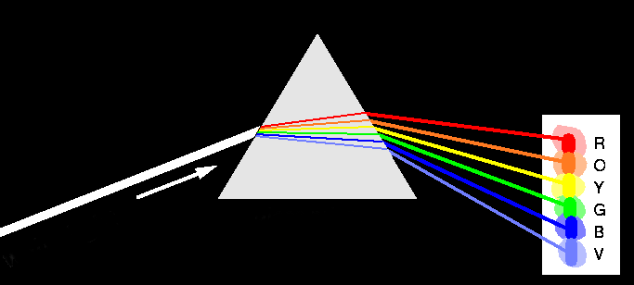
Decomposition of Phylogenetic Data
Phylogenetic information
present in genomes
Break information
into small quanta
of information
(bipartitions or
embedded quartets)
Analyze spectra to detect transferred genes and plurality consensus.

Slide 4
BIPARTITION OF A PHYLOGENETIC TREE
Bipartition (or split) – a division of a phylogenetic tree into two parts that are connected by a single branch.
It divides a dataset into two groups, but it does not consider the relationships within each of the two groups.
Yellow vs Rest
* * * . . . * *
95
compatible to illustrated
bipartition
Orange vs Rest
. . * . . . . *
* * * . . . . .
incompatible to illustrated
bipartition

Slide 5
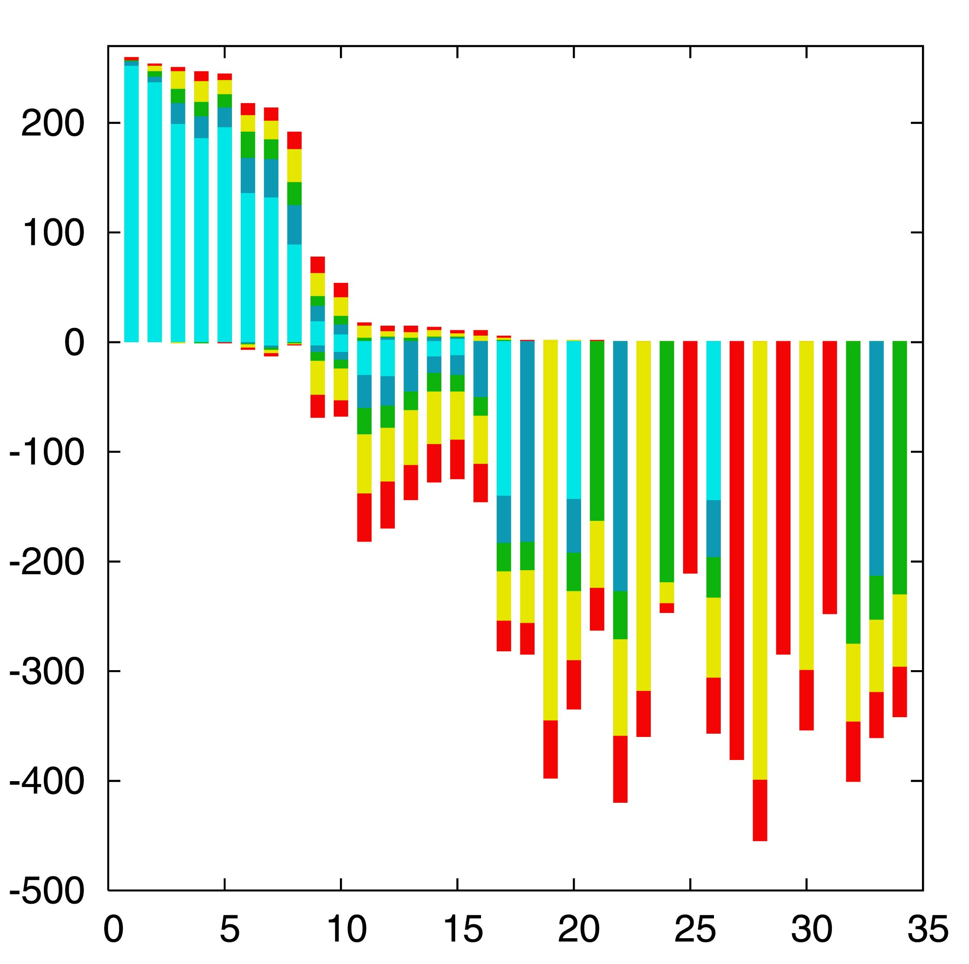

“Lento”-plot of 34 supported bipartitions (out of 4082 possible)
13 gamma-
proteobacterial
genomes
(258 putative
orthologs):
E.coli
Buchnera
Haemophilus
Pasteurella
Salmonella
Yersinia pestis
(2 strains)
Vibrio
Xanthomonas
(2 sp.)
Pseudomonas
Wigglesworthia
There are 13,749,310,575 possible unrooted tree topologies for 13 genomes

Slide 6
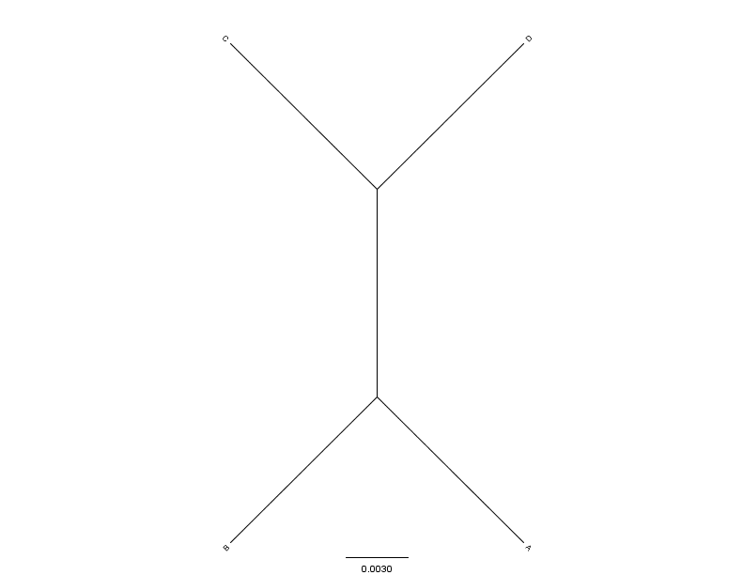
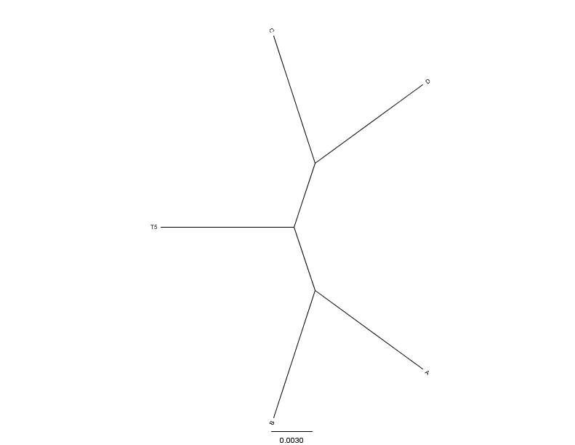
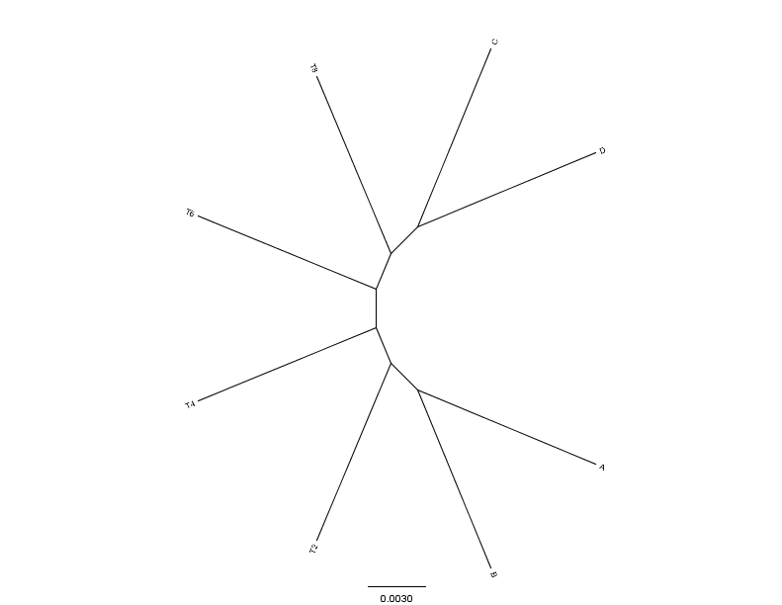
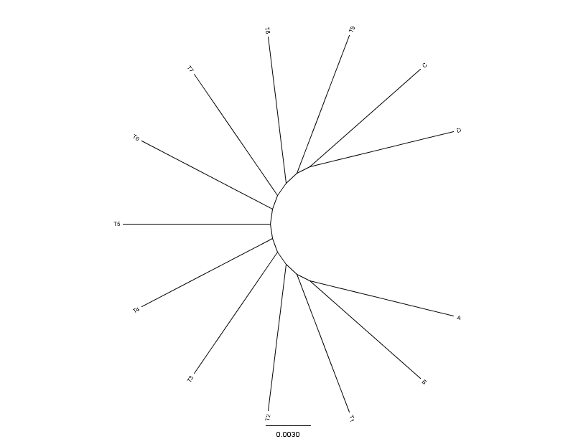
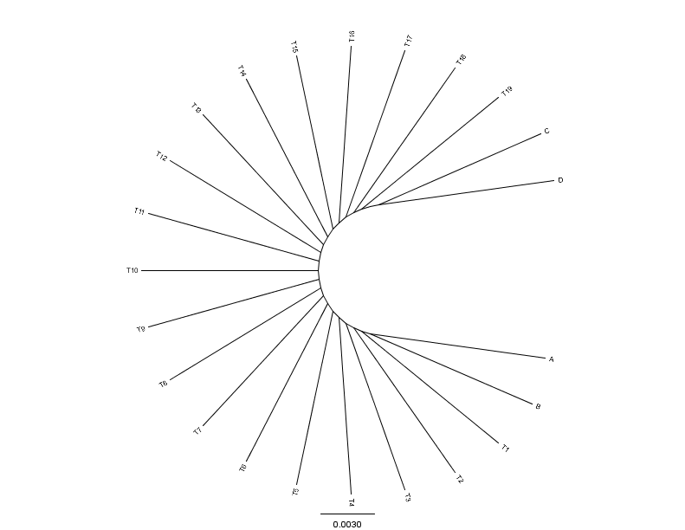
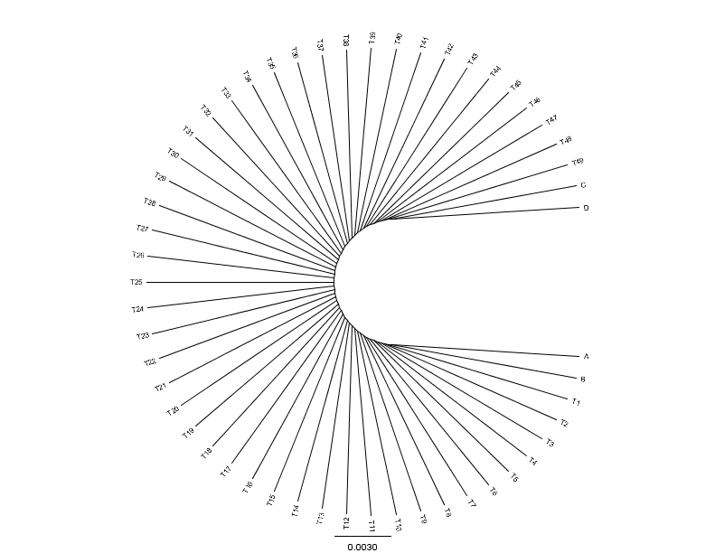
C
D
C
C
D
0.01
0.01
D
N=4(0)
N=5(1)
N=8(4)
0.01
A
0.01
0.01
B
B
B
A
A
B
C
C
D
D
C
D
A
A
A
B
B
B
N=13(9)
N=23(19)
N=53(49)
From: Mao F, Williams D, Zhaxybayeva O, Poptsova M, Lapierre P, Gogarten JP, Xu Y (2012)
BMC Bioinformatics 13:123, doi:10.1186/1471-2105-13-123

Slide 7


Results :
Maximum Bootstrap Support value for Bipartition separating (AB) and (CD)
Maximum Bootstrap Support value
for embedded Quartet (AB),(CD)

Slide 8
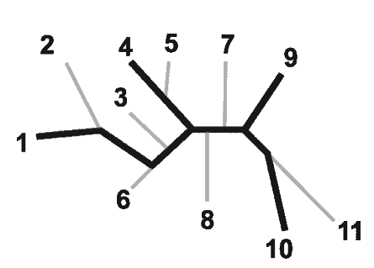
Bootstrap support values for embedded quartets
+
: tree calculated from one pseudo-sample generated by bootstraping from an alignment of one gene family present in 11 genomes
: embedded quartet for genomes
1, 4, 9, and 10 .
This bootstrap sample supports the topology ((1,4),9,10).
1
9
1
9
1
10
4
√
10
10
4
9
4
Zhaxybayeva et al. 2006, Genome Research, 16(9):1099-108
Quartet spectral analyses of genomes iterates over three loops:
Repeat for all bootstrap samples.
Repeat for all possible embedded quartets.
Repeat for all gene families.

Slide 9
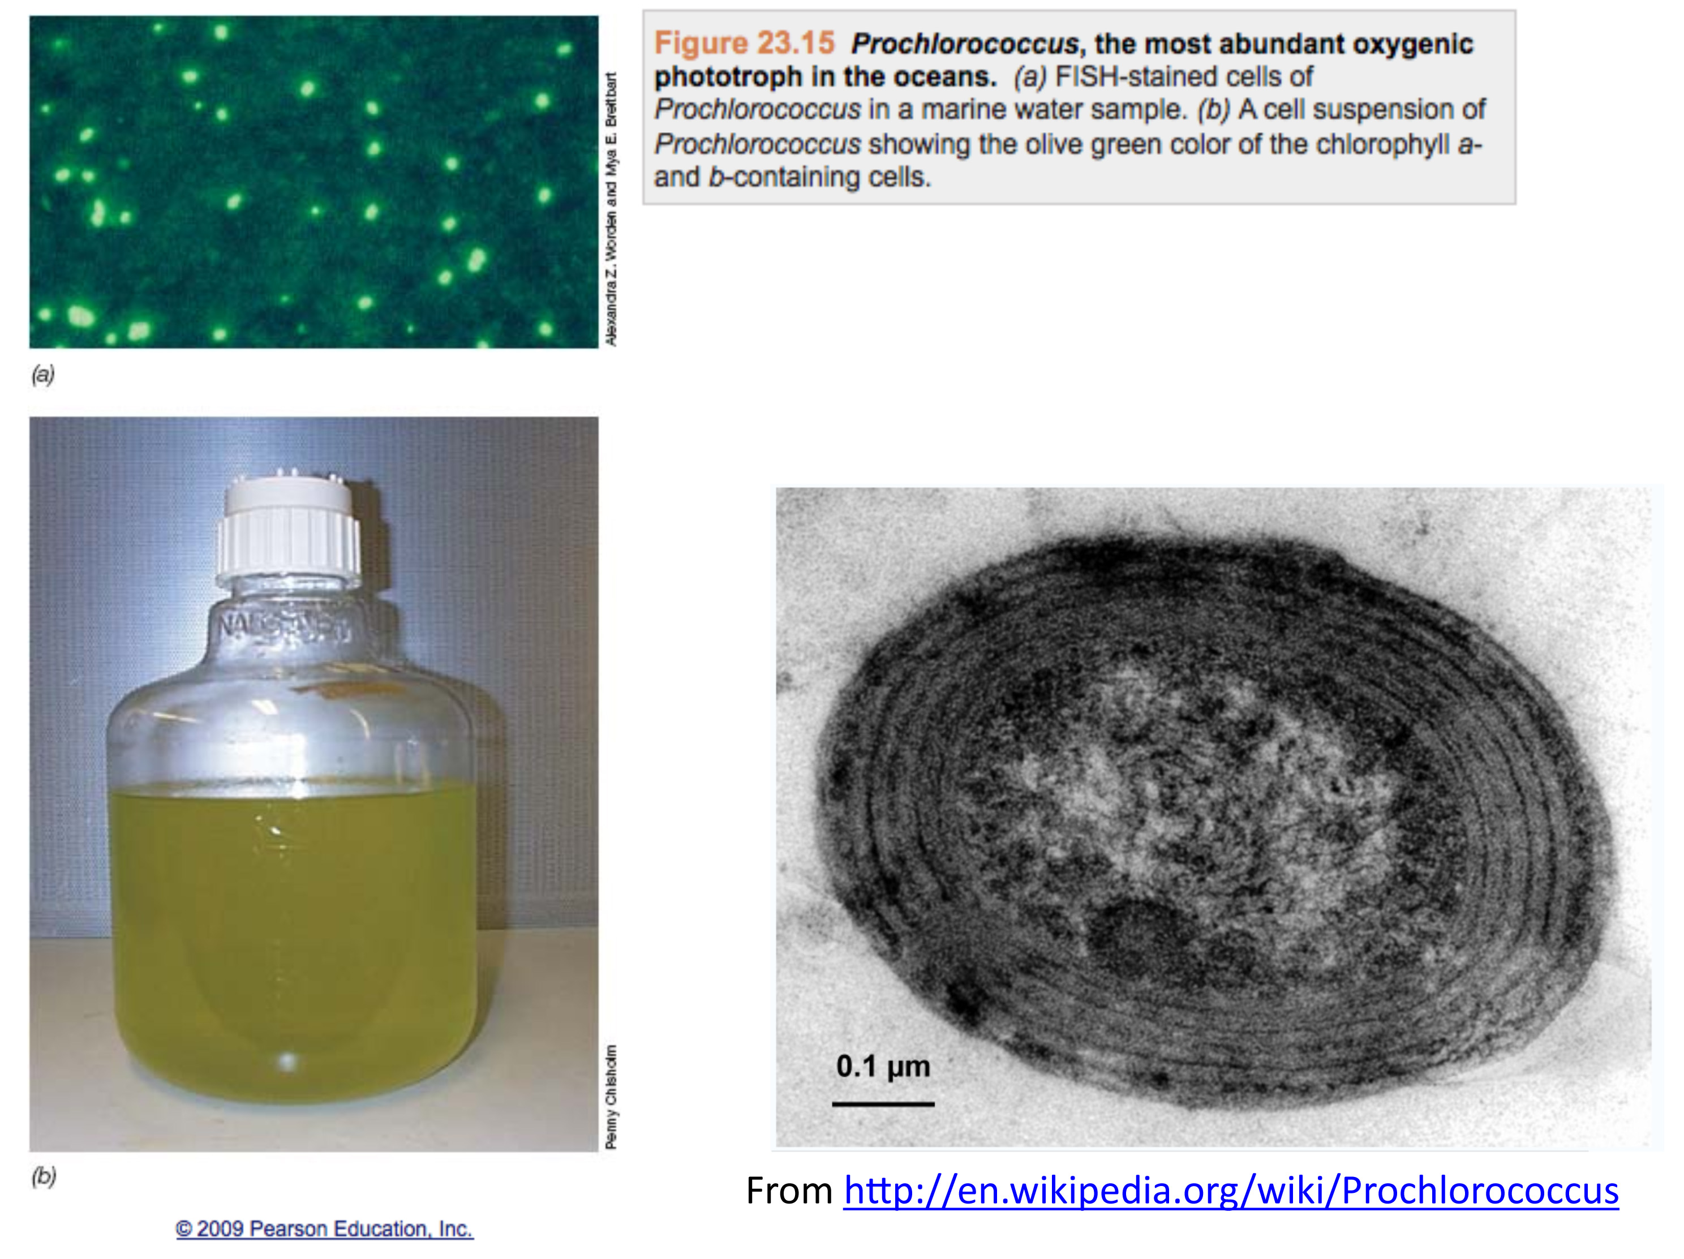
effective population size about 10¹³
2*Ne generations >> 10 billion years

Slide 10
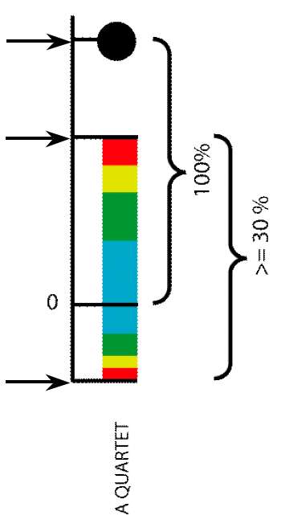
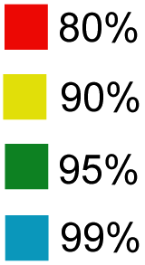
Illustration of one component of a quartet spectral analyses Summary of phylogenetic information for one genome quartet for all gene families
Total number of gene families containing the species quartet
Number of gene families supporting the same topology as the plurality
(colored according to bootstrap support level)
Number of gene families supporting one of the two alternative quartet topologies

Slide 11
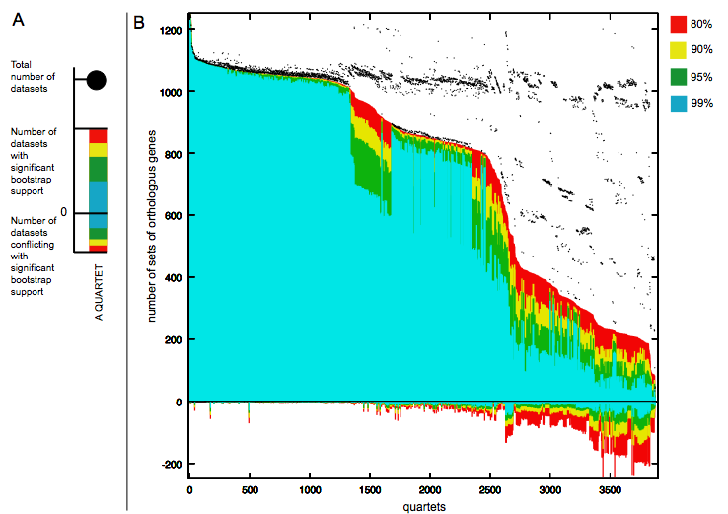
Quartet decomposition analysis of 19 Prochlorococcus and marine Synechococcus genomes. Quartets with a very short internal branch or very long external branches as well those resolved by less than 30% of gene families were excluded from the analyses to minimize artifacts of phylogenetic reconstruction.

Slide 12
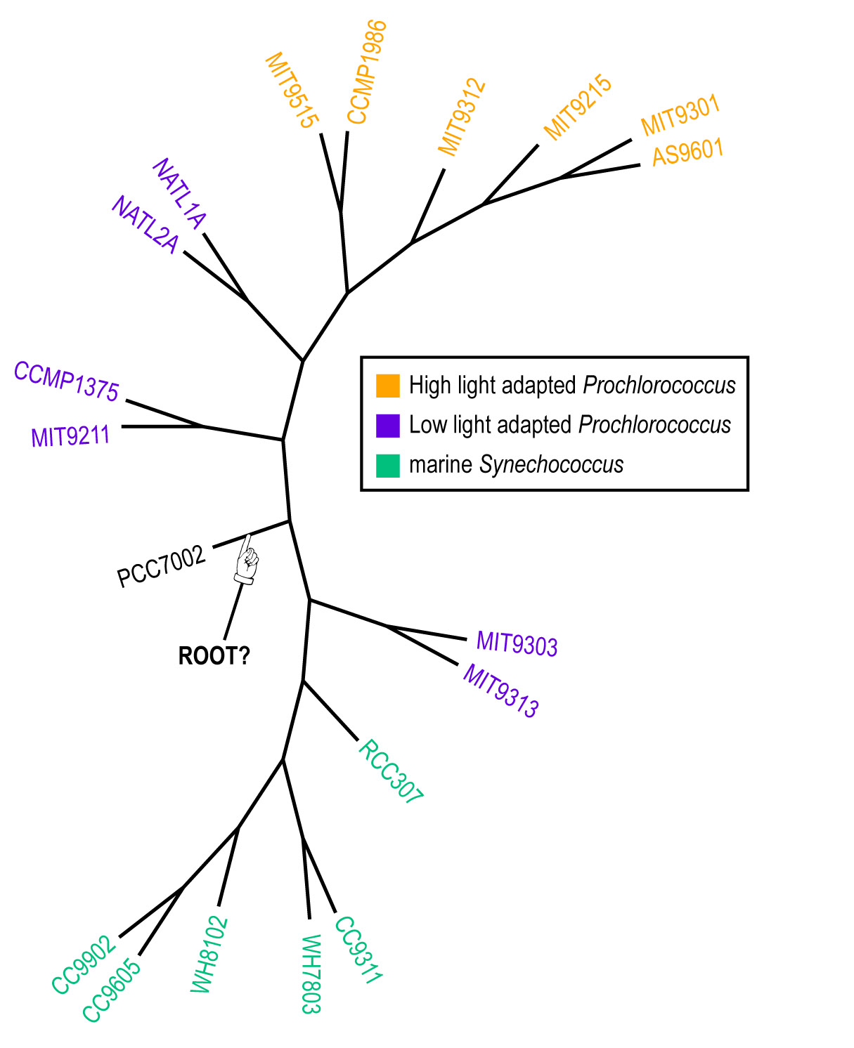
Plurality consensus calculated as supertree (MRP) from quartets in the plurality topology.

Slide 13
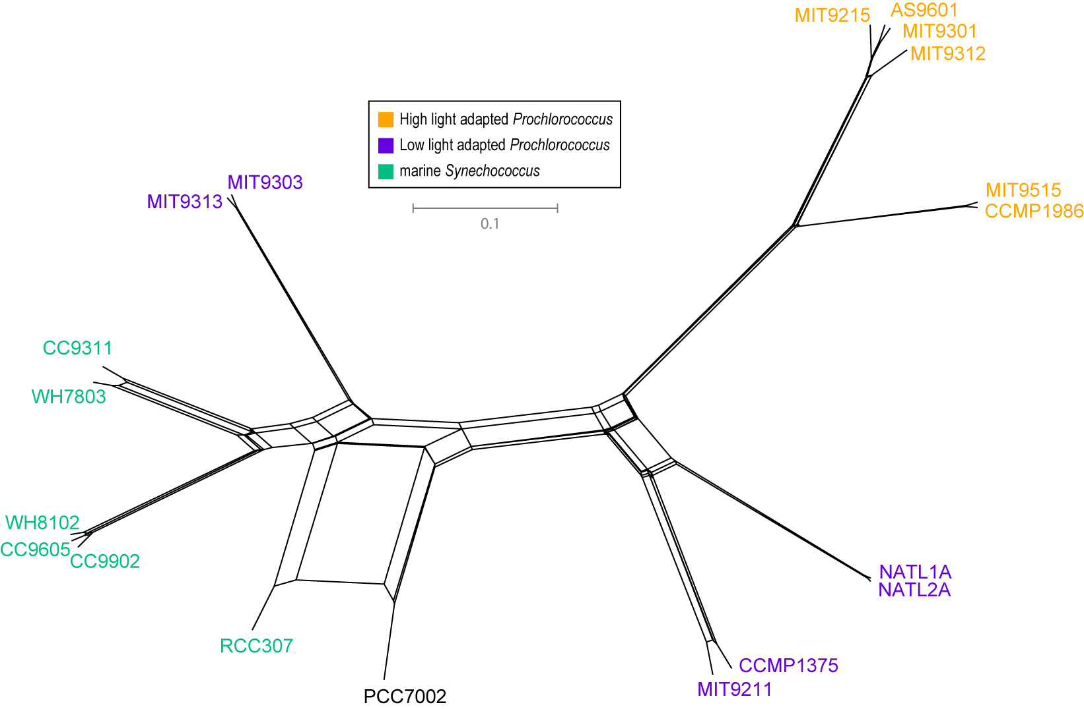
NeighborNet (calculated with SplitsTree 4.0)
Plurality neighbor-net calculated as supertree (from the MRP matrix using SplitsTree 4.0) from all quartets significantly supported by all individual gene families (1812) without in-paralogs.

Slide 14
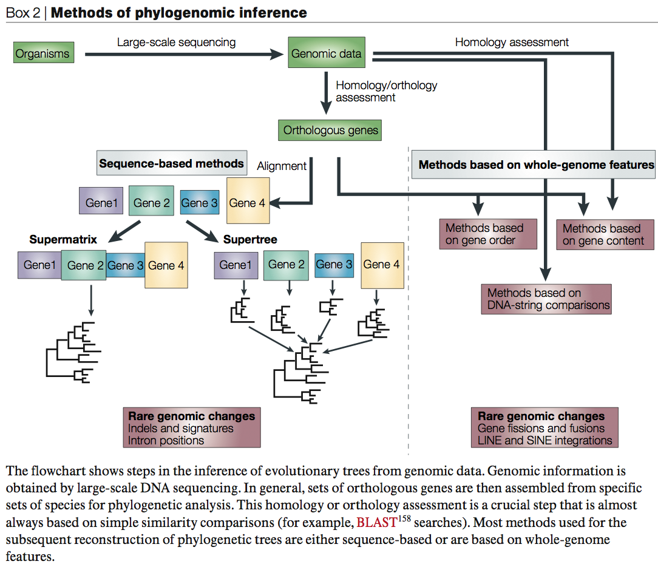
From:
Delsuc F, Brinkmann H, Philippe H.
Phylogenomics and the reconstruction of the tree of life.
Nat Rev Genet. 2005 May;6(5):361-75.

Slide 15
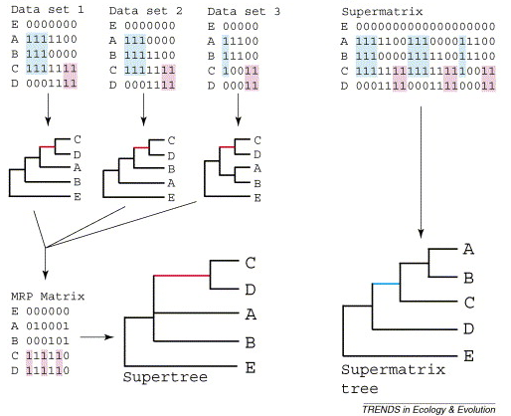
Supertree vs. Supermatrix
From:
Alan de Queiroz John Gatesy:
The supermatrix approach to systematics
Trends Ecol Evol. 2007 Jan;22(1):34-41
Schematic of MRP supertree (left) and parsimony supermatrix (right) approaches to the analysis of three data sets. Clade C+D is supported by all three separate data sets, but not by the supermatrix. Synapomorphies for clade C+D are highlighted in pink. Clade A+B+C is not supported by separate analyses of the three data sets, but is supported by the supermatrix. Synapomorphies for clade A+B+C are highlighted in blue. E is the outgroup used to root the tree.

Slide 16
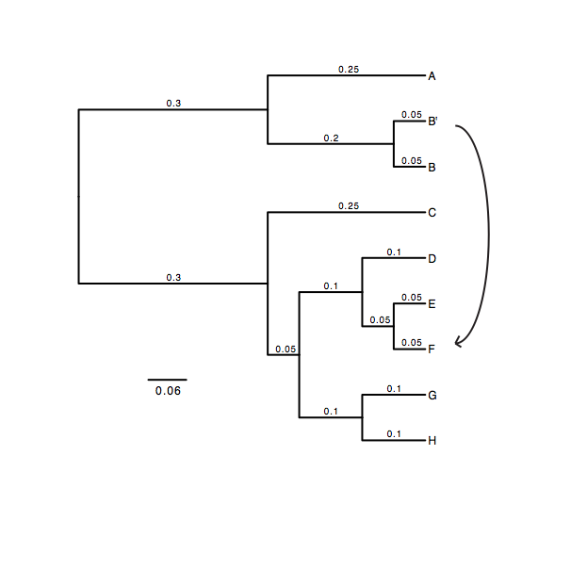
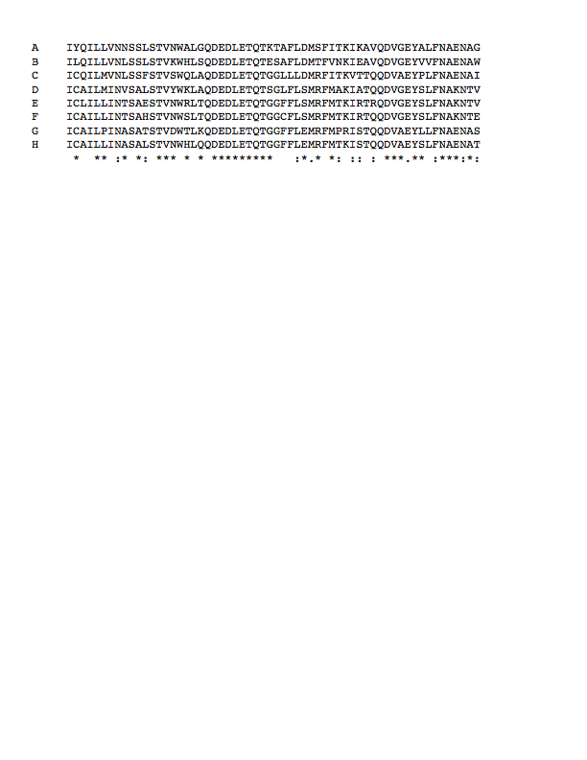
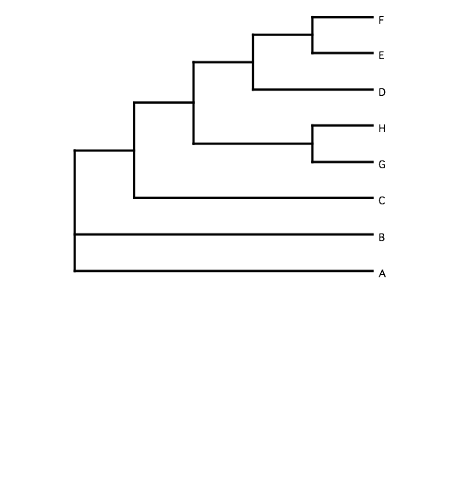
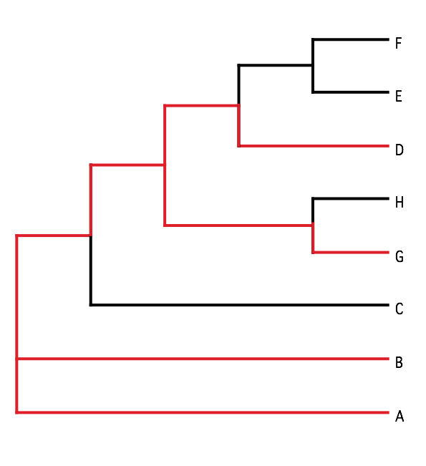
B) Generate 100 datasets using Evolver with certain amount of HGTs
A) Template tree
C) Calculate 1 tree using the concatenated dataset or 100 individual trees
D) Calculate Quartet based tree using Quartet Suite
Repeated 100 times…

Slide 17
Supermatrix versus
Quartet based Supertree
inset: simulated phylogeny

Slide 18
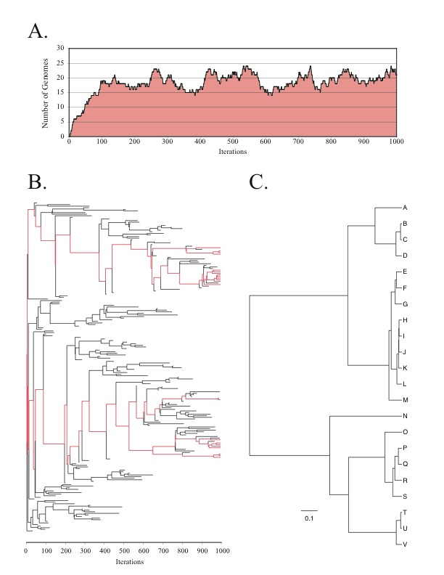
Note : Using same genome seed random number will reproduce same genome history
From: Lapierre P, Lasek-Nesselquist E, and Gogarten JP (2012)
The impact of HGT on phylogenomic reconstruction methods
Brief Bioinform [first published online August 20, 2012] doi:10.1093/bib/bbs050

Slide 19
HGT EvolSimulator Results

Slide 21
See http://bib.oxfordjournals.org/content/15/1/79.full for more information.
What is the bottom line?

Slide 22
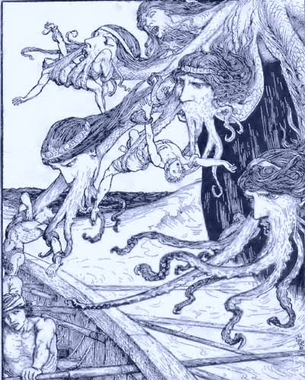
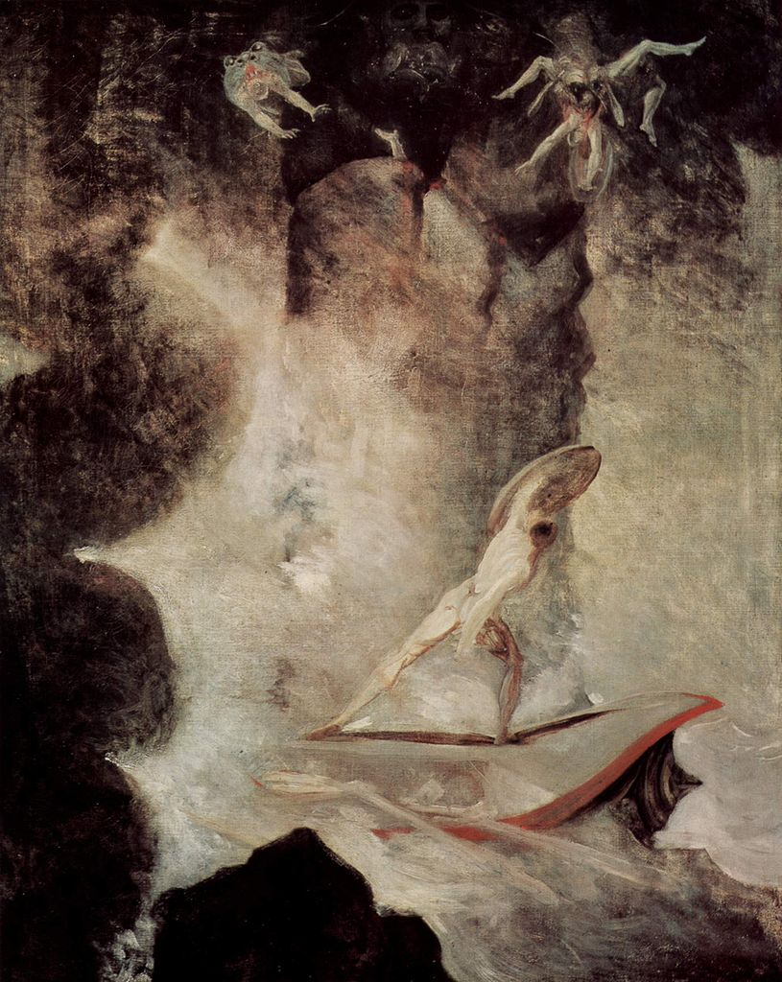

Johann Heinrich Füssli
Odysseus vor Scilla und Charybdis
From: http://en.wikipedia.org/wiki/File:Johann_Heinrich_F%C3%BCssli_054.jpg

Slide 23
Evolution of the Holobiont
Holobiont: Host + all its symbionts (mutualistic, commensal, parasitic)
Microbiome: Sum of all genes contained in the symbionts
Microbiota: Sum of all symbiotic organisms
Hologenome: Microbiome + host genome
Selection acts on the holobiont
The holobiont can adapt through changing it symbionts
To what extend do examples for holobiont evolution represent evolution by natural selection, Lamarckian evolution, or constructive neutral evolution.

Slide 24
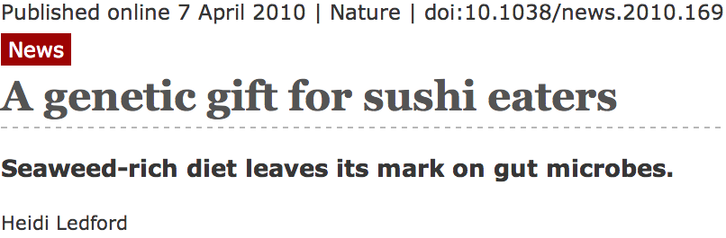
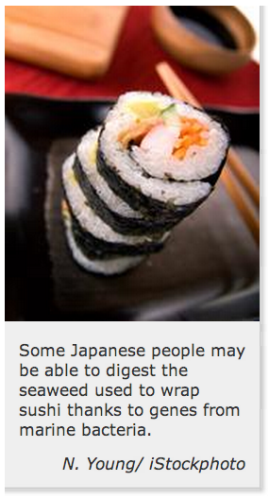
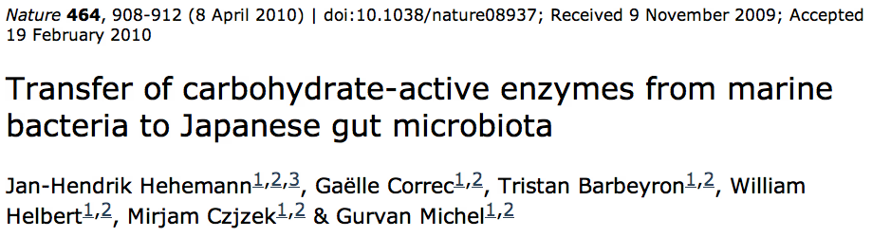
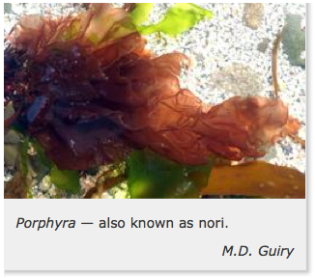

Holobiont evolution – case A
Bacterial parasites on seaweed
HGT
Human gut symbiont

Slide 25
Holobiont Evolution – case B
Hygene / old “friends hypothesis
coevolution / arms race between immune system and parasites
Parasite:
survive in host -> minimize host’s immune response -> produce immune response modulating substances
Host:
Keep immune system effective ->
increase immune response to remain effective in presence of parasites’ (or symbionts’) immune system modulating influence
without parasite/symbiont immune system over reacts

Slide 26
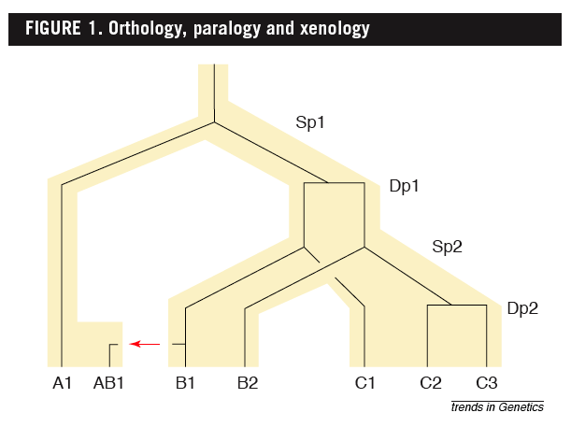
Examples
B1 is an ortholog to C1 and to A1
C2 is a paralog to C3 and to B1;
BUT
A1 is an ortholog to both B1, B2,and to C1, C2, and C3
From: Walter Fitch (2000): Homology: a personal view on some of the problems, TIG 16 (5) 227-231

Slide 27
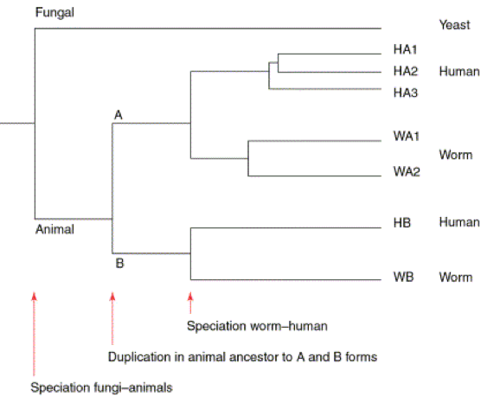
Types of Paralogs: In- and Outparalogs
…. all genes in the HA* set are co-orthologous to all genes in the WA* set. The genes HA* are hence ‘inparalogs’ to each other when comparing human to worm. By contrast, the genes HB and HA* are ‘outparalogs’ when comparing human with worm. However, HB and HA*, and WB and WA* are inparalogs when comparing with yeast, because the animal–yeast split pre-dates the
HA*–HB duplication.
From: Sonnhammer and Koonin: Orthology, paralogy and proposed classification for paralog TIG 18 (12) 2002, 619-620

Slide 28
Selection of Orthologous Gene Families
All automated methods for assembling sets of orthologous genes are based on sequence similarities.
BLAST hits
Triangular circular BLAST significant hits
(COG, or Cluster of Orthologous Groups)
Sequence identity of 30% and greater
(SCOP database)
Similarity complemented by HMM-profile analysis
Pfam database
Reciprocal BLAST hit method

Slide 29
Strict Reciprocal BLAST Hit Method
2’
1
2
1
2
3
4
3
4
1 gene family
0 gene family
often fails in the presence of paralogs

Slide 30
Families of ATP-synthases
Phylogenetic Tree
Family of ATP-A
Sulfolobus solfataricus
ATP-A
Methanosarcina
mazei
Bacillus subtilis
ATP-A
ATP-A
ATP-A
Escherichia coli
Bacillus subtilis
ATP-F
ATP-B
Escherichia coli
ATP-F
Escherichia coli
ATP-B
ATP-B
Bacillus subtilis
ATP-B
Sulfolobus
solfataricus
Family of ATP-F
Methanosarcina
mazei
Family of ATP-B

Slide 31

BranchClust Algorithm
genome 1
genome i
genome 2
BLAST
hits
genome 3
genome N
dataset of N genomes
superfamily
tree
www.bioinformatics.org/branchclust

Slide 32
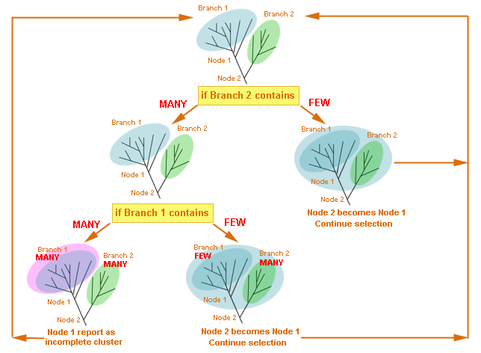
BranchClust Algorithm
www.bioinformatics.org/branchclust

Slide 33
BranchClust Algorithm
Data Flow
Download n complete genomes (ftp://ftp.ncbi.nlm.nih.gov/genomes/Bacteria)
In fasta format (*.faa)
Align with ClustalW
Reconstruct superfamily tree
ClustalW –quick distance method
Phyml – Maximum Likelihood
Put all n genomes in one database
Search all ORF against database, consisting of n genomes
Parse with BranchClust
Gene families
Parse BLAST-output with the requirement that all members of a superfamily should have an E-value better than a cut-off
Superfamilies
www.bioinformatics.org/branchclust

Slide 34
BranchClust Algorithm
Implementation and Usage
The BranchClust algorithm is implemented in Perl with the use of the BioPerl module for
parsing trees and is freely available at http://bioinformatics.org/branchclust
Required:
1.Bioperl module for parsing trees Bio::TreeIO
2. Taxa recognition file gi_numbers.out must be present in the current directory.
For information on how to create this file, read the Taxa recognition file section on the web-site.
3. Blastall from NCB needs to be installed.
www.bioinformatics.org/branchclust

