Slide 1
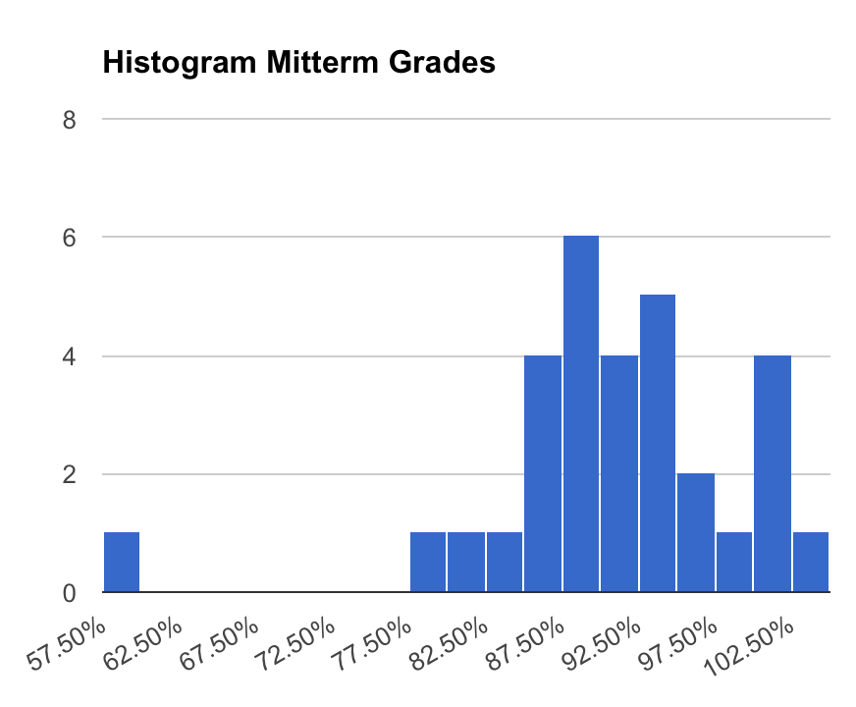
Midterm Grades
Mean: 90
Median: 92
StdDev: 10

Slide 2
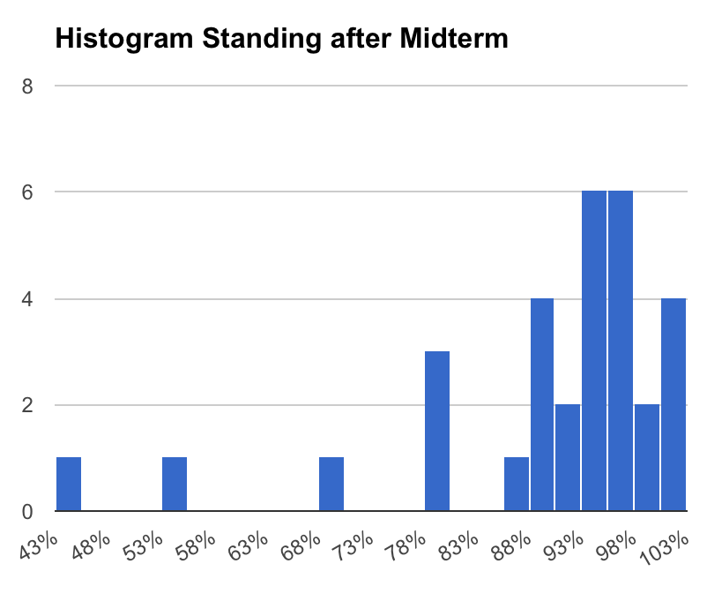
Standing after Midterm
Mean: 88
Median: 94
StdDev: 15
Check the syllabus, if you are not sure how the final grade will be calculated!

Slide 3
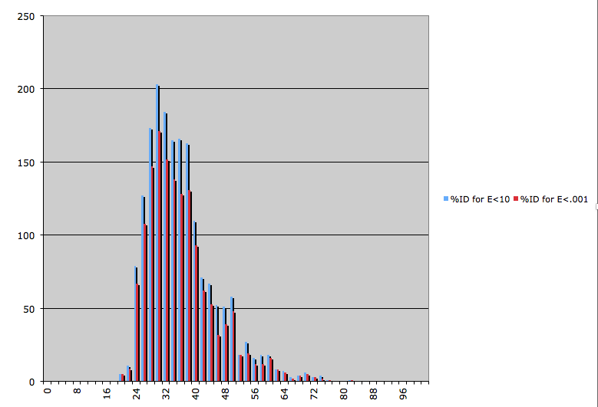
% identity is not a good measure to assess homology
Histogram of %ID values from a blastp search comparing two genomes using two different E-value cut-offs

Slide 4
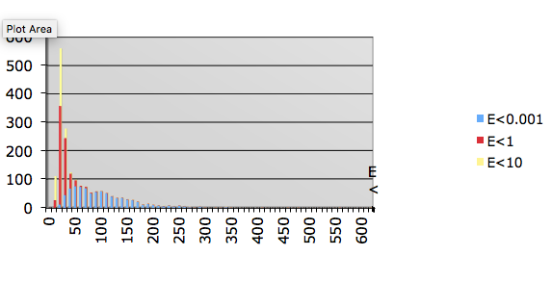
% identity is not a good measure to assess homology
Histogram number of identical residues in matches from a blastp search comparing two genomes using two different E-value cut-offs

Slide 5
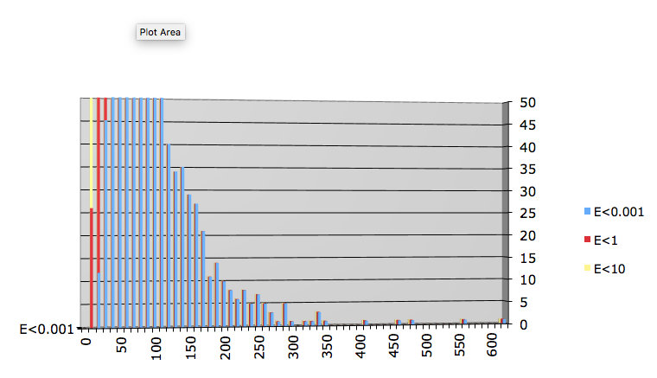
% identity is not a good measure to assess homology
Histogram number of identical residues in matches from a blastp search comparing two genomes using two different E-value cut-offs

Slide 6
Gene plot
Frankia ACN vs Frankia CCI3
More info on these strains at
Philippe Normand, Pascal Lapierre, Louis S. Tisa, Johann Peter Gogarten, Nicole Alloisio, Emilie Bagnarol, Carla A. Bassi, Alison M. Berry, Derek M. Bickhart, Nathalie Choisne, Arnaud Couloux, Benoit Cournoyer, Stephane Cruveiller, Vincent Daubin, Nadia Demange, Maria Pilar Francino, Eugene Goltsman, Ying Huang, Olga R. Kopp, Laurent Labarre, Alla Lapidus, Celine Lavire, Joelle Marechal, Michele Martinez, Juliana E. Mastronunzio, Beth C. Mullin, James Niemann, Pierre Pujic, Tania Rawnsley, Zoe Rouy, Chantal Schenowitz, Anita Sellstedt, Fernando Tavares, Jeffrey P. Tomkins, David Vallenet, Claudio Valverde, Luis G. Wall, Ying Wang, Claudine Medigue, and David R. Benson (2007):
Genome characteristics of facultatively symbiotic Frankia sp. strains reflect host range and host plant biogeography.
Genome Research 17: 7-15

Slide 7
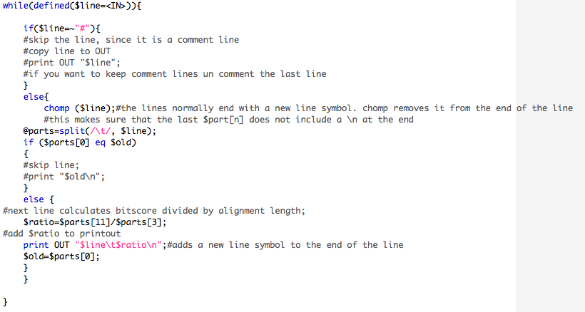
Part of Perl script to keep only top scoring blast hit for each query

Slide 8
Plot blast.out

Slide 9
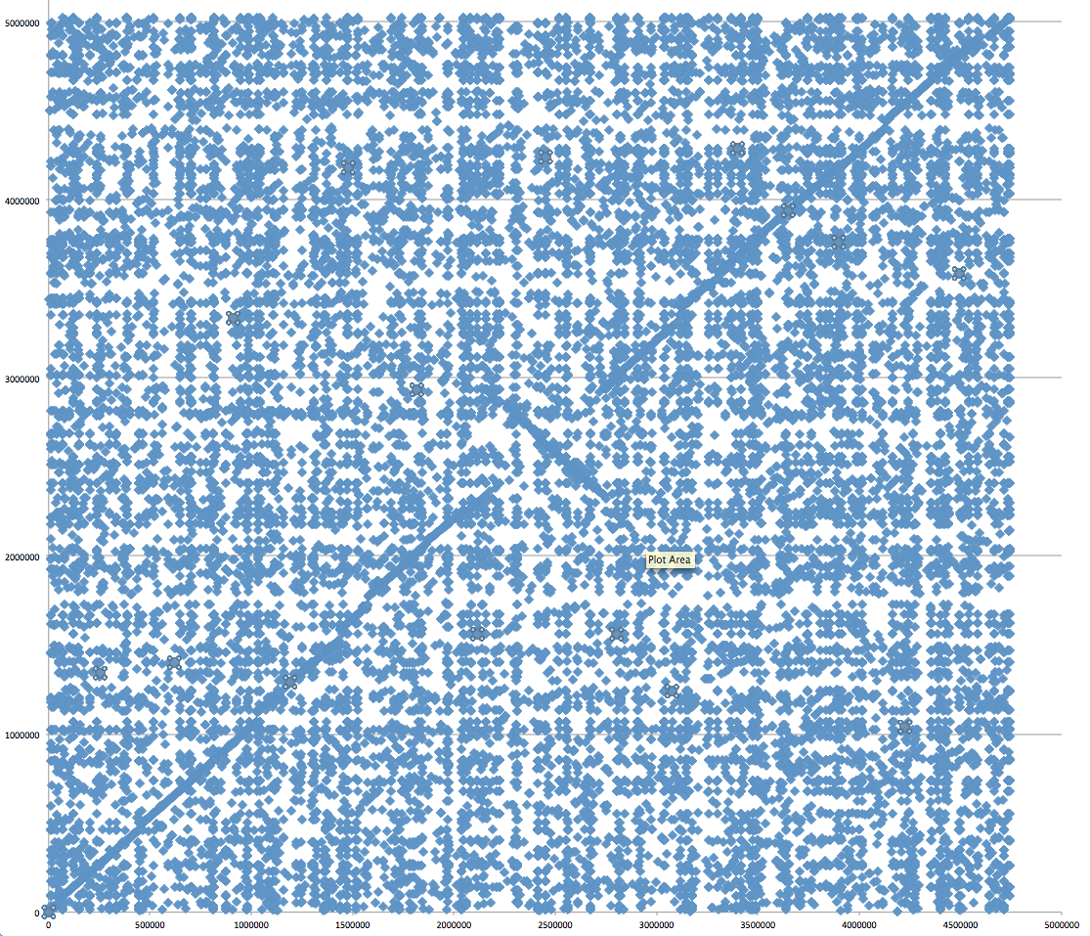
Aeromonas_hydrophila_ATCC_7966_uid58617 versus Aeromonas_hydrophila_ML09_119_uid205540/
Evalue cut off: 10^-4

Slide 10
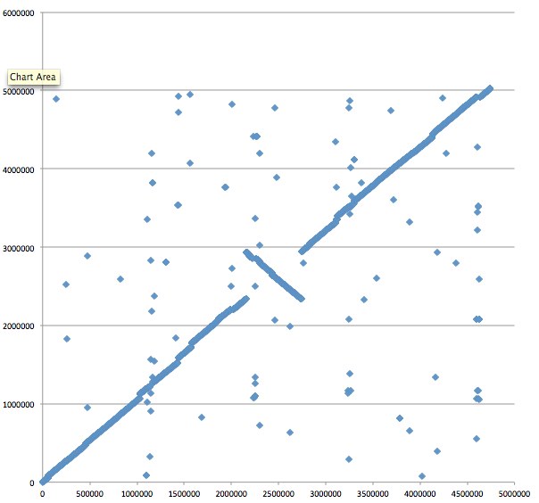
Aeromonas_hydrophila_ATCC_7966_uid58617 versus Aeromonas_hydrophila_ML09_119_uid205540/
E-value cut off: 10^-4
Top-scoring hits only

Slide 11
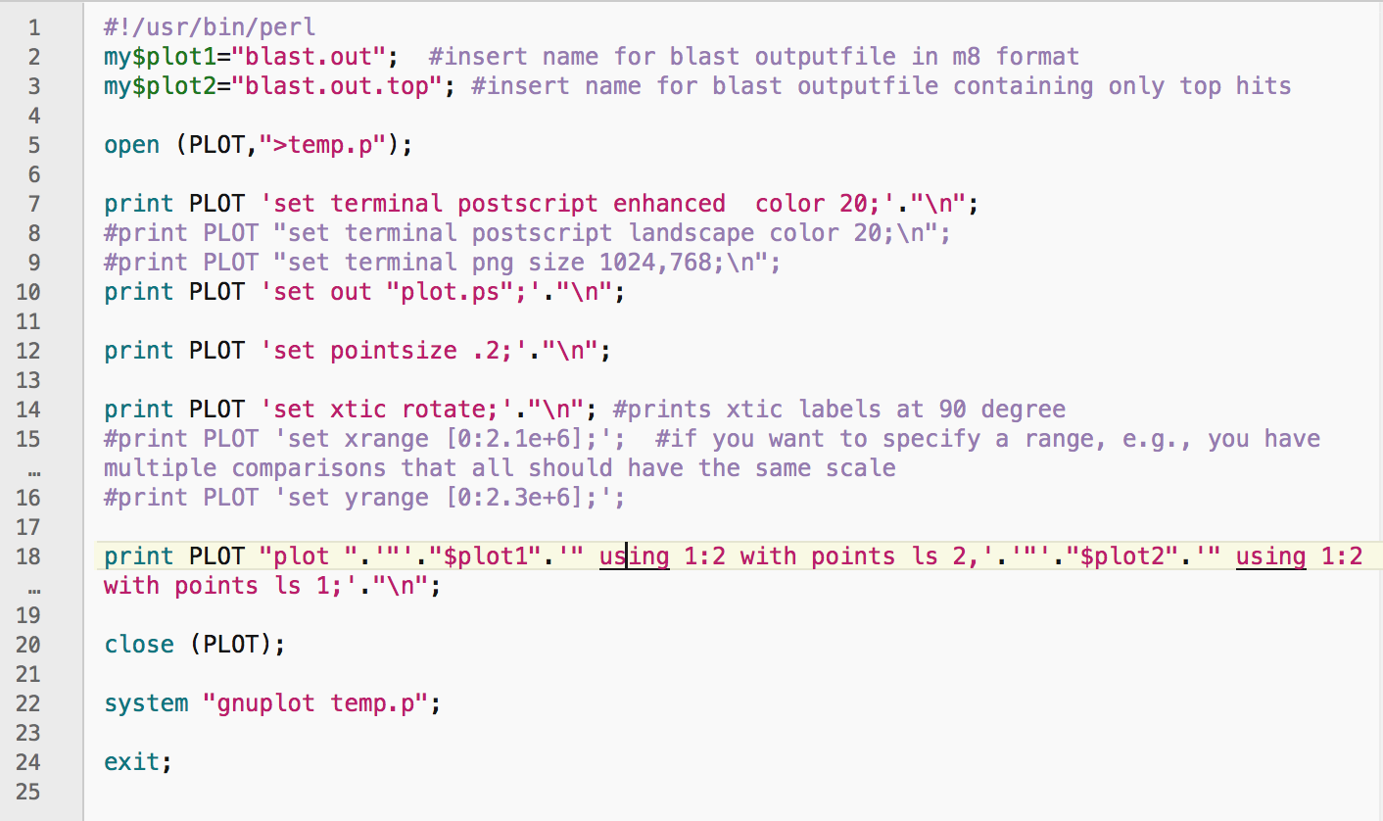
Plot blast.out and blast.out.top using gnuplot

Slide 12
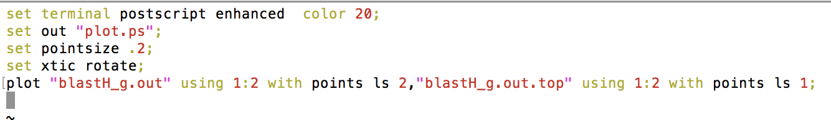
vi temp.p file:

Slide 13
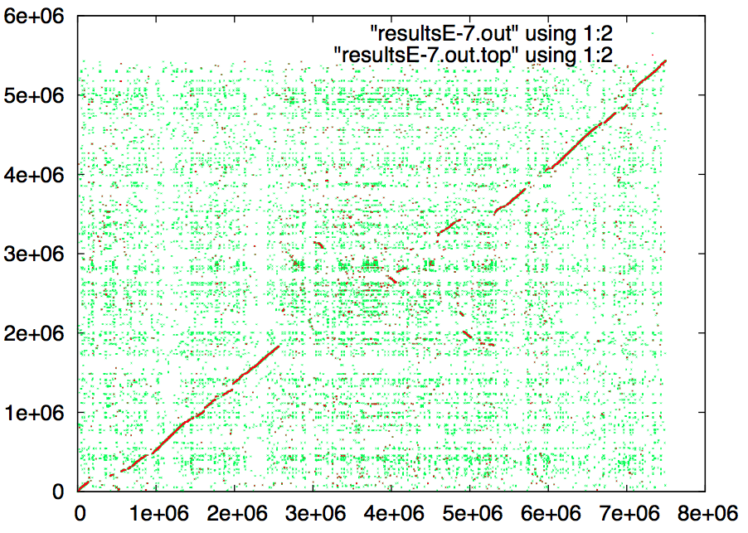
Location of all blast hits in the two genomes and location of all top scoring blast hits in the two genomes E-value <10^-7:

Slide 14
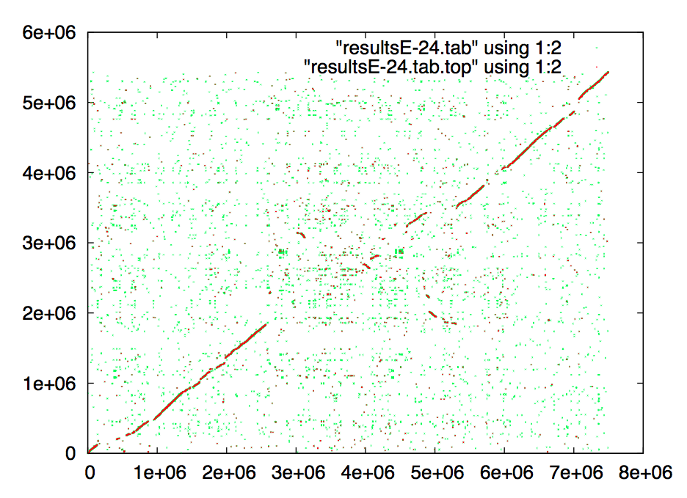
Location of all blast hits in the two genomes and location of all top scoring blast hits in the two genomes E-value <10^-24:

Slide 15
Location of all blast hits in the two genomes and location of all top scoring blast hits in the two genomes E-value <10^-50:

Slide 16
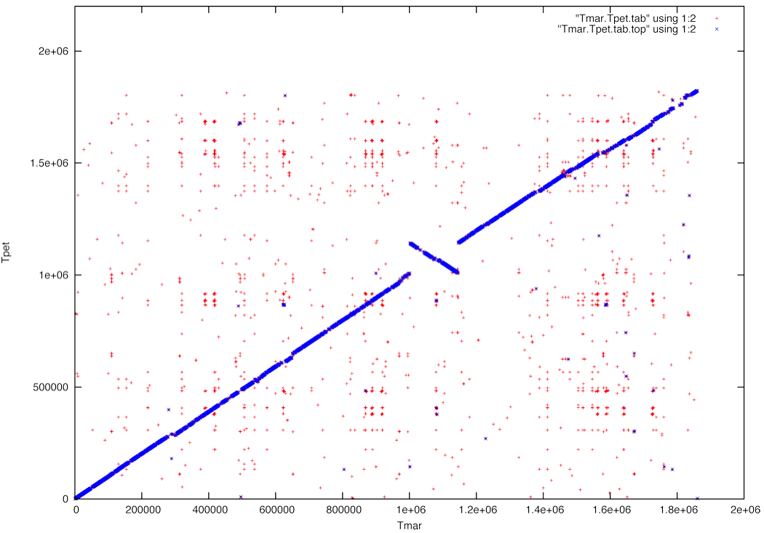
Comparison between Thermotoga petrophila and Thermotoga maritima MSB8

Slide 17
Comparison between two Thermotoga maritima MSB8 genomes

Slide 18
GCBias in a window (G-C/(G+C))

Slide 19
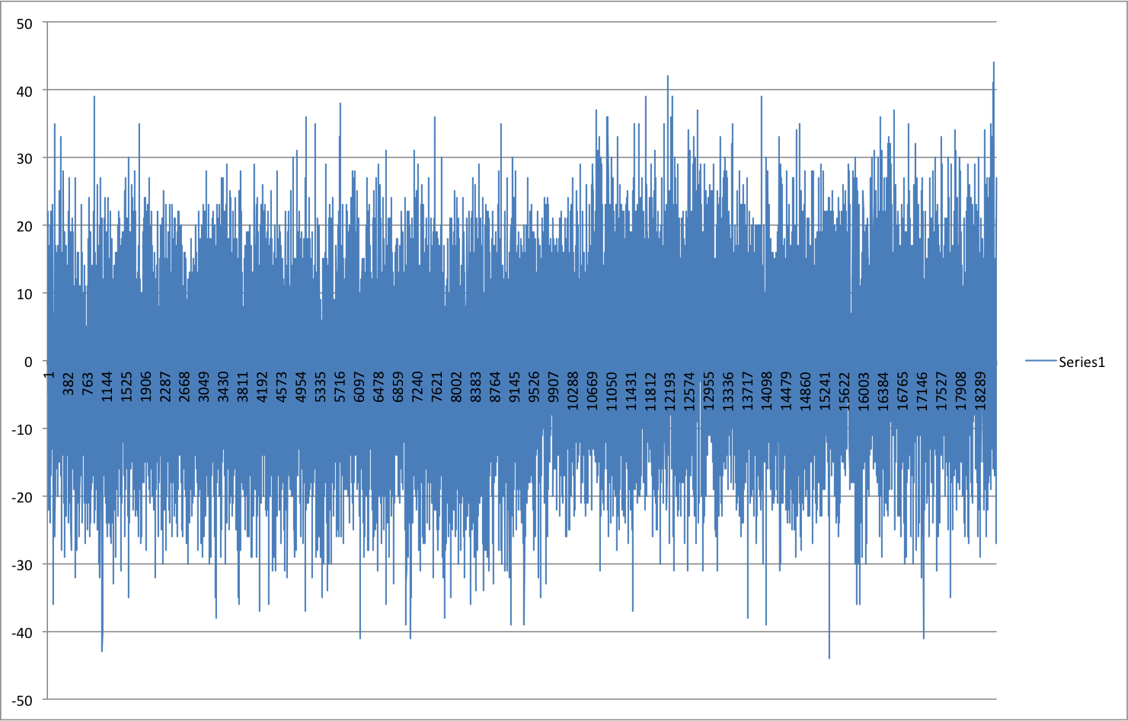
Window=100 , printed every 100

Slide 20
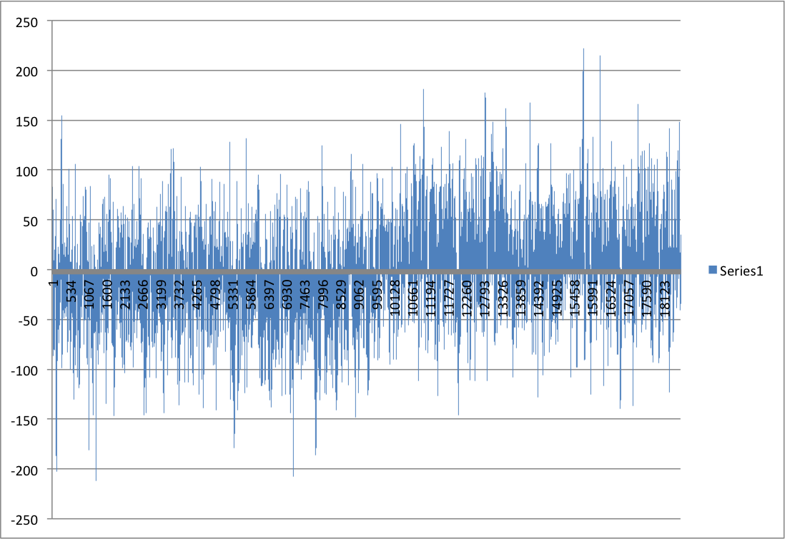
Window=1000 , printed every 100

Slide 21
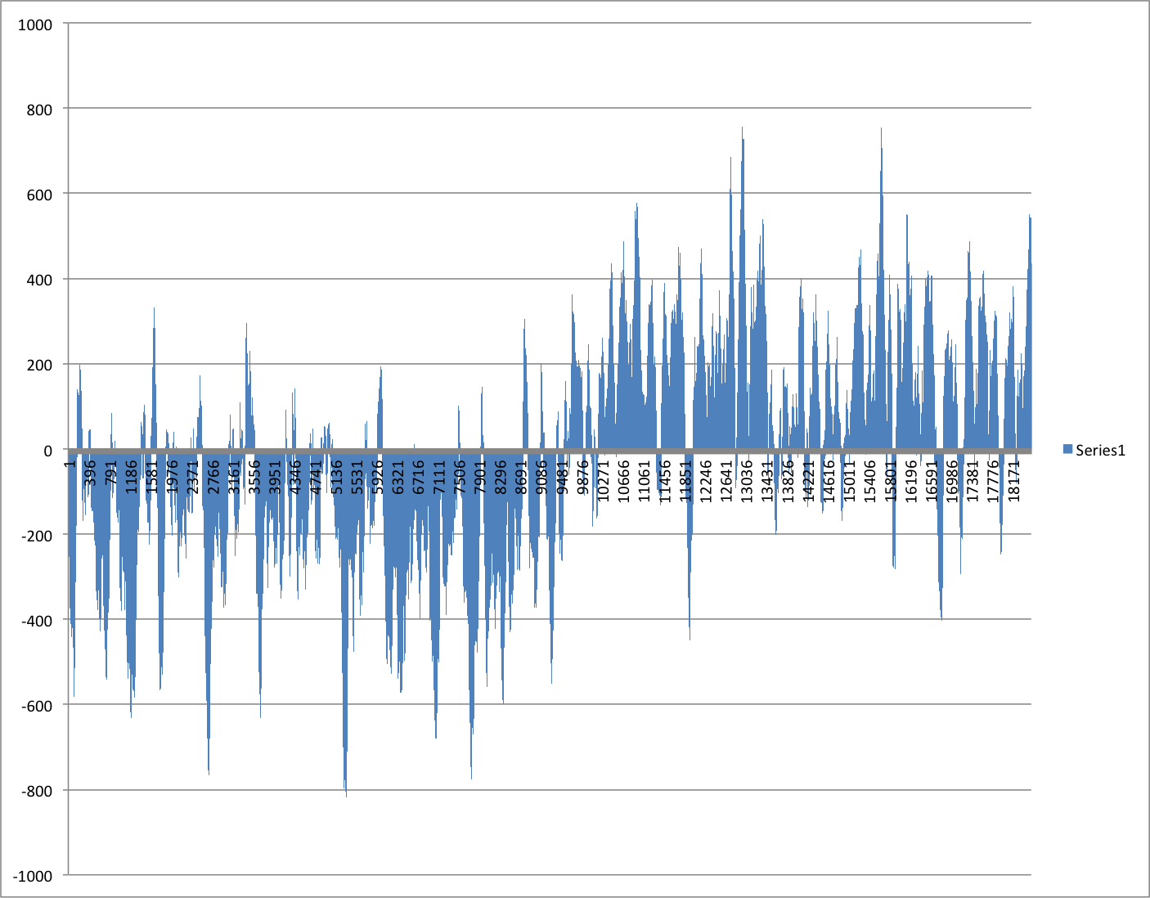
Window=10000 , printed every 100

Slide 22
Cumulative GCSkew
SUM(C-G) measured along the genome from the ORI

Slide 23
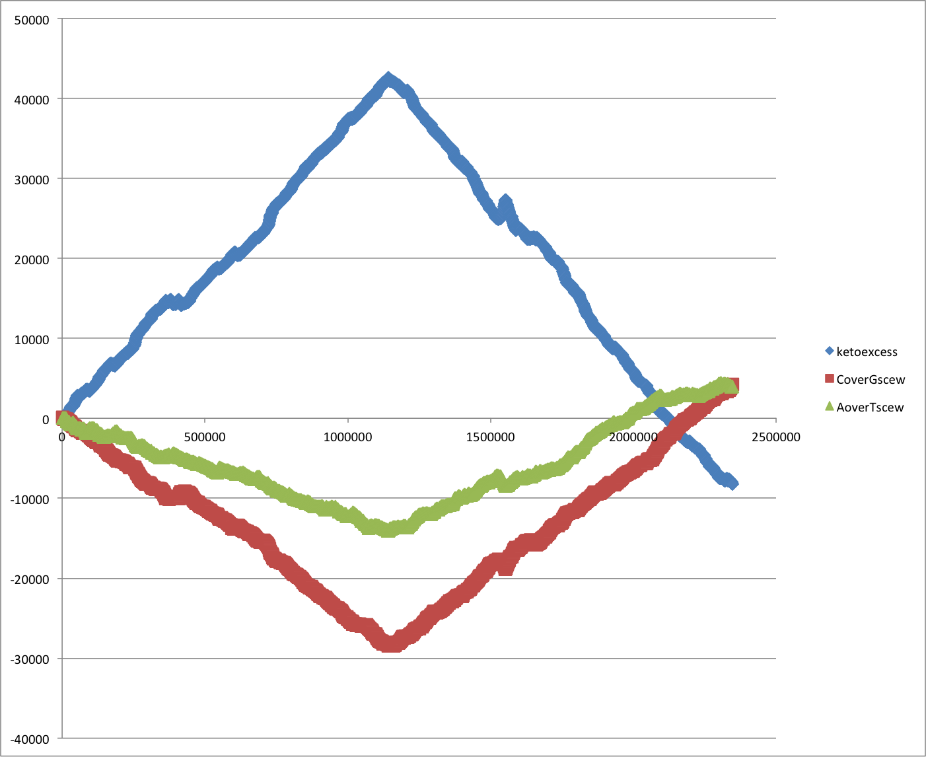
Cumulative Strand Bias SG0

Slide 24
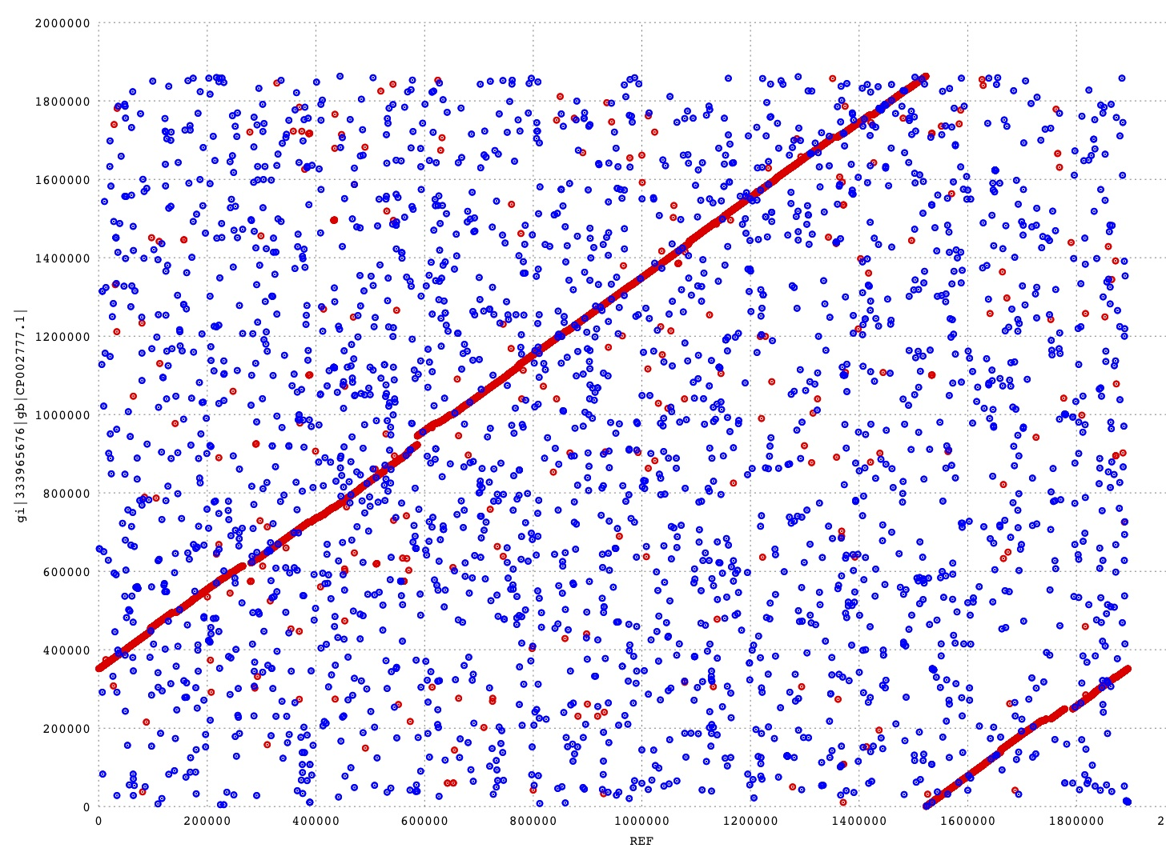
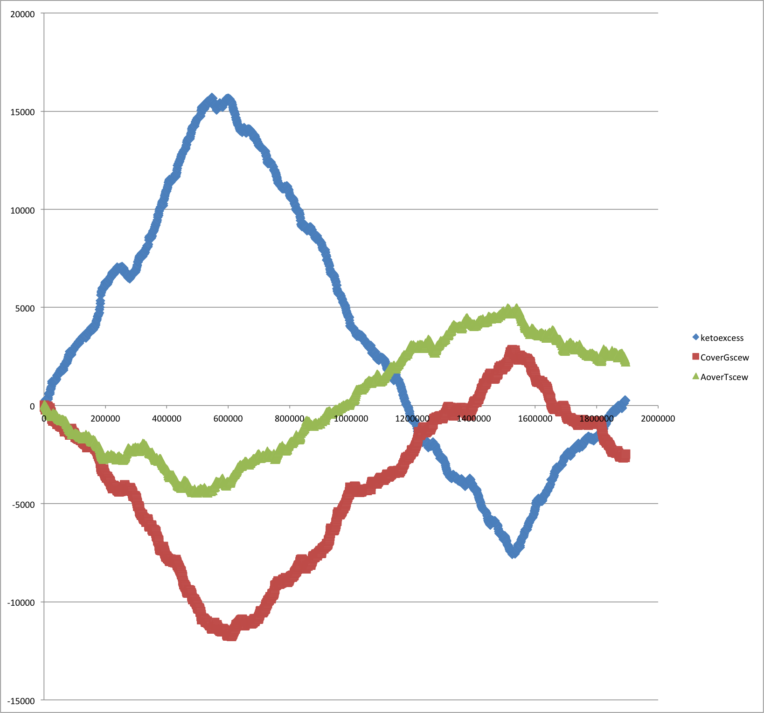
Usually, *.fna files of bacterial genomes start with the origin of replication, and the direction is chosen so that the first encoded protein is DnaA (chromosomal replication initiator protein). Sometimes things go wrong.
Cumulative Strand Bias HB27
Mummer Plot: HB27 versus SG0
Ori
Should be here

Slide 25
Tetramer bias for Thermus thermophilus SG0
The same can be done with oligonucleotide bias (how often does an oligonucleotide occur on one strand minus occurrence on the other strand)

Slide 26
GC bias for Thermotoga maritima MSB8
http://www.sciencedirect.com/science/article/pii/S0168952599018946

Slide 27
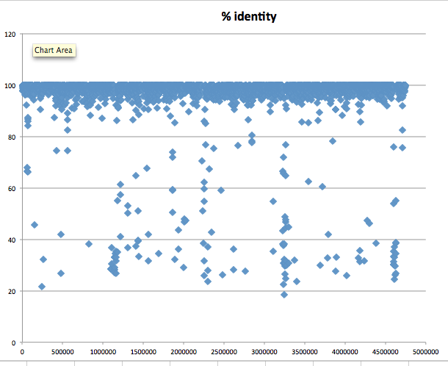
Aeromonas_hydrophila_ATCC_7966_uid58617 versus Aeromonas_hydrophila_ML09_119_uid205540/
Top scoring hit % identity versus position

Slide 28
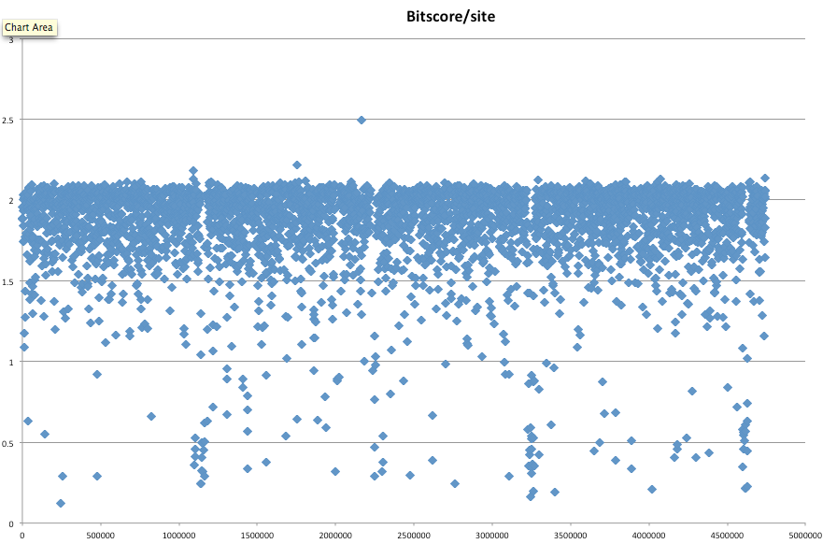
Aeromonas_hydrophila_ATCC_7966_uid58617 versus Aeromonas_hydrophila_ML09_119_uid205540/
Top scoring hit bitscore per aa versus position

Slide 29
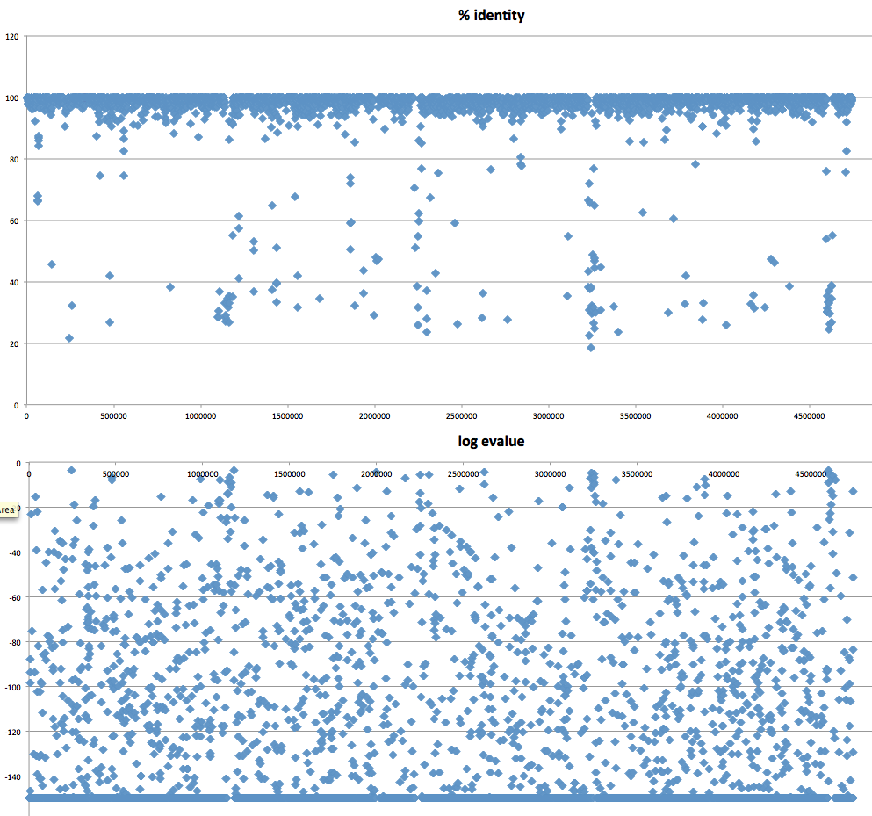
Aeromonas_hydrophila_ATCC_7966_uid58617 versus Aeromonas_hydrophila_ML09_119_uid205540/
Top scoring hit bitscore per aa versus position and log (E-value+10^-150)

Slide 30
Aeromonas_hydrophila_ATCC_7966_uid58617 versus Aeromonas_hydrophila_ML09_119_uid205540/
E-value cut off: 10^-4
Top-scoring hits only

Slide 31
Aeromonas_hydrophila_ATCC_7966_uid58617 versus Aeromonas_hydrophila_ML09_119_uid205540/
Same with Gnuplot

Slide 32
Aeromonas_hydrophila_ML09_119_uid205540 versus Aeromonas_salmonicida A449
Notes:
About 26 recombination events equidistant to the ORI

Slide 33
Aeromonas_hydrophila_ML09_119_uid205540 versus Aeromonas_veronii B565

Slide 34
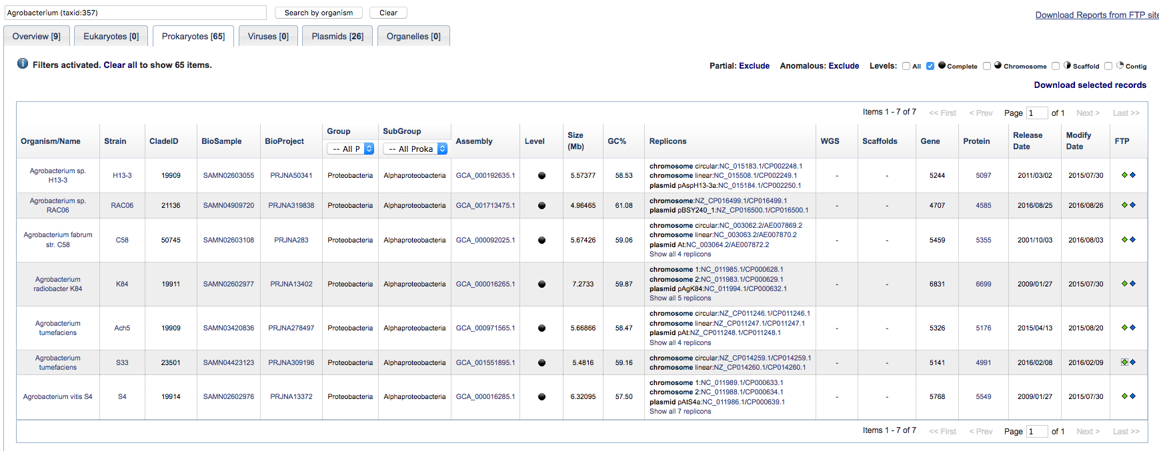
Genome info at NCBI by organism
Example for multiple genomes: Agrobacterium

Slide 35
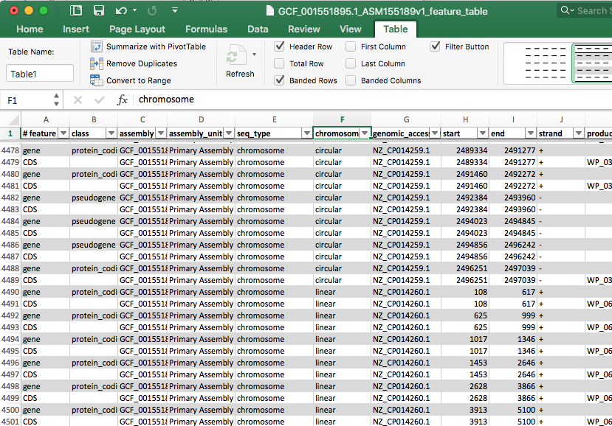
Feature Table from Agrobacterium tumefaciens

Slide 36
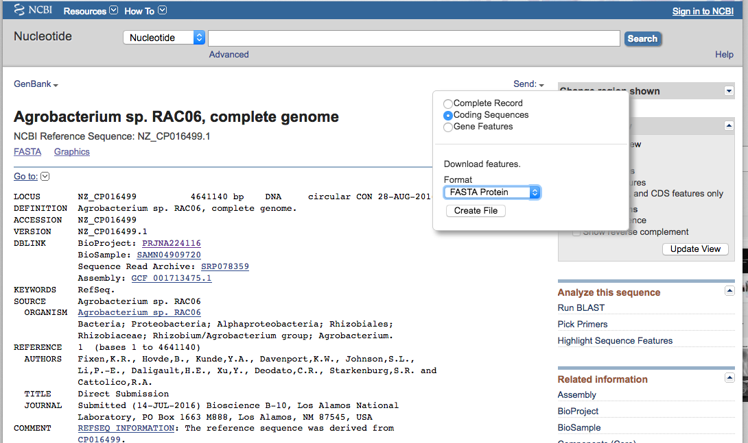
Download proteins from one chromosome only :

Slide 37
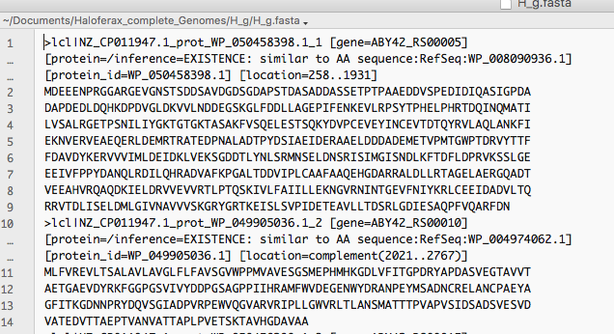
Resulting multiple fasta file:

Slide 38
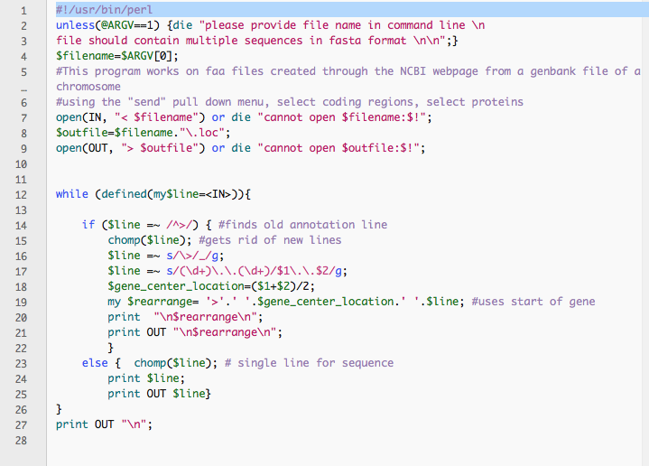
Perl script to rearrange comment line:

Slide 39
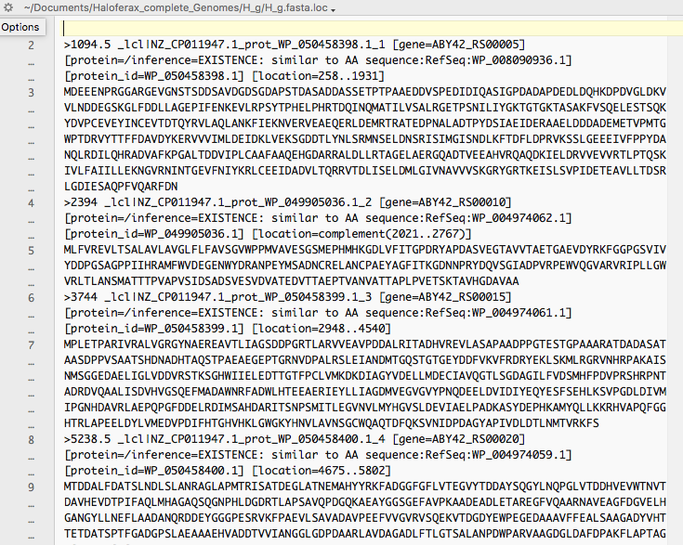
Output from Perl script

Slide 40
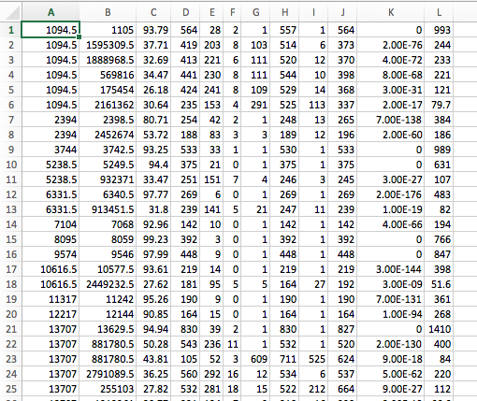
Tabular blast output – all hits

Slide 41
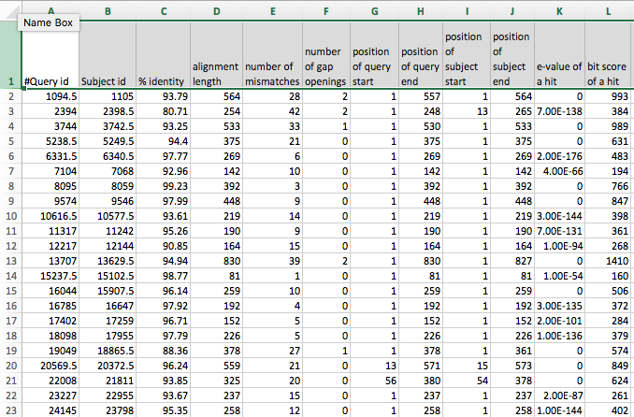
Tabular blast output – top scoring hits

Slide 42
Plot blast.out and blast.out.top using gnuplot

Slide 43
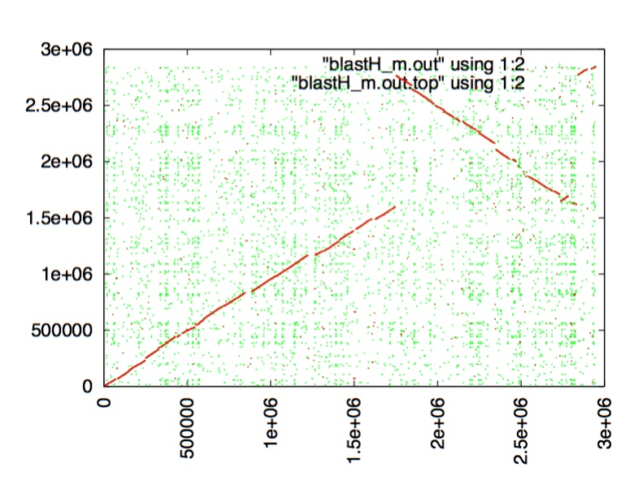
Haloferax volcanii versus Haloferax mediternei

Slide 44
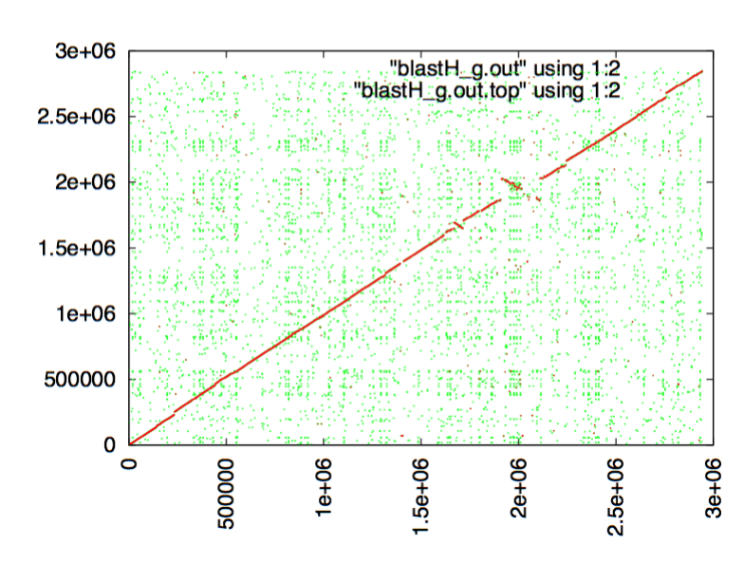
Haloferax volcanii versus Haloferax gibsonii

