Slide 1
Terminology Review
Branches, splits, bipartitions
In a rooted tree: clades (for unrooted trees sometimes the term clann is used)
Mono-, Para-, polyphyletic groups, cladists and a natural taxonomy
The term cladogram refers to a strictly bifurcating diagram, where each clade is defined by a common ancestor that only gives rise to members of this clade. I.e., a clade is monophyletic (derived from one ancestor) as opposed to polyphyletic (derived from many ancestors). (Note: you do need to know where the root is!)
A clade is recognized and defined by shared derived characters (= synapomorphies). Shared primitive characters (= sympleisiomorphies, aternativie spelling is symplesiomorphies) do not define a clade, but a paraphyletic group. Homoplasies define polyphyletic groups (see in class example drawing ala Hennig).
To use these any terms you need to have polarized characters; for most molecular characters you don't know which state is primitive and which is derived (exceptions:....).

Slide 2
homology
Two sequences are homologous, if there existed an ancestral molecule in the past that is ancestral to both of the sequences
Types of Homology
Orthologs: “deepest” bifurcation in molecular tree reflects speciation.
These are the molecules people interested in the taxonomic classification of organisms want to study.
Paralogs: “deepest” bifurcation in molecular tree reflects gene duplication. The study of paralogs and their distribution in genomes provides clues on the way genomes evolved.
Gen and genome duplication have emerged as the most important pathway to molecular innovation, including the evolution of developmental pathways.
Xenologs: gene was obtained by organism through horizontal transfer. The classic example for Xenologs are antibiotic resistance genes, but the history of many other molecules also fits into this category: inteins, selfsplicing introns, transposable elements, ion pumps, other transporters,
Synologs: genes ended up in one organism through fusion of lineages. The paradigm are genes that were transferred into the eukaryotic cell together with the endosymbionts that evolved into mitochondria and plastids
(the -logs are often spelled with "ue" like in orthologues)
see Fitch's article in TIG 2000 for more discussion.

Slide 3
What is in a tree?
Trees form molecular data are usually calculated as unrooted trees (at least they should be - if they are not this is usually a mistake).
To root a tree you either can assume a molecular clock (substitutions occur at a constant rate, again this assumption is usually not warranted and needs to be tested),
or you can use an outgroup (i.e. something that you know forms the deepest branch).
  For example, to root a phylogeny of birds, you could use the homologous characters from a reptile as outgroup; to find the root in a tree depicting the relations between different human mitochondria, you could use the mitochondria from chimpanzees or from Neanderthals as an outgroup; to root a phylogeny of alpha hemoglobins you could use a beta hemoglobin sequence, or a myoglobin sequence as outgroup.
Trees have a branching pattern (also called the topology), and branch lengths.
Often the branch lengths are ignored in depicting trees (these trees often are referred to as cladograms - note that cladograms should be considered rooted).
You can swap branches attached to a node, and in an unrooted you can depict the tree as rooted in any branch you like without changing the tree.

Slide 4
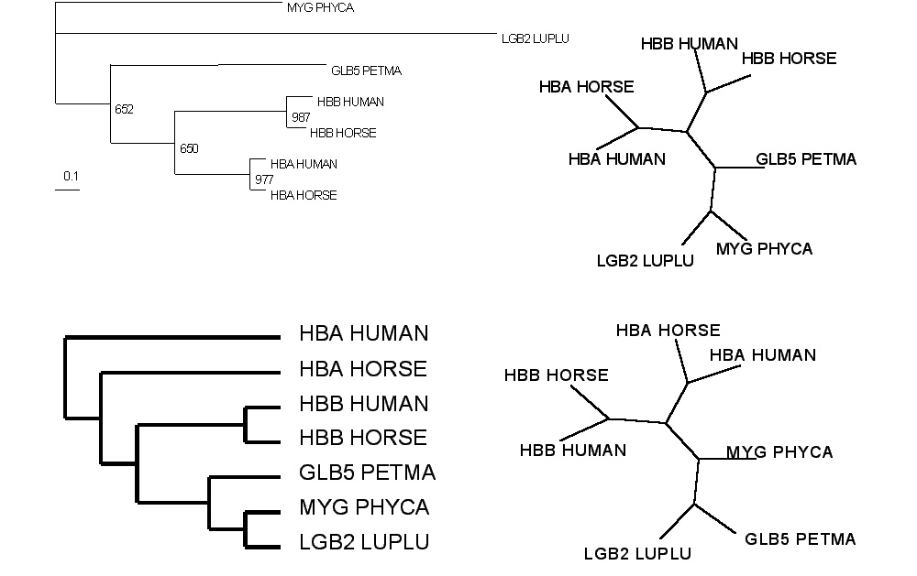
Test:Which of these trees is different?
More tests here

Slide 5
Phylogenetic Reconstruction – Why?
A) Systematic classification of organisms
e.g.: Who were the first angiosperms? (i.e. where are the first angiosperms located relative to present day angiosperms?) Where in the tree of life is the last common ancestor located?
B) Evolution of molecules
e.g.: domain shuffling, reassignment of function, gene duplications, horizontal gene transfer, drug targets,
detection of genes that drive evolution of a species/population
(e.g. influenca virus)
C) Identification of organisms
e.g., phylotyping in microbiome samples,
origin of genes and viruses (e.g., HIV virus, recent ebola outbreak)

Slide 6
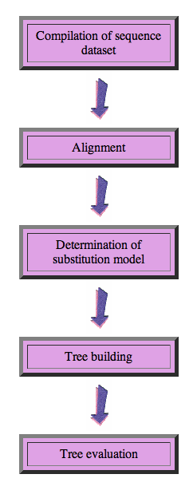
Steps of the phylogenetic analysis
Phylogenetic analysis is an inference of evolutionary relationships between organisms.
Phylogenetics tries to answer the question
“How did groups of organisms come into existence?”
Those relationships are usually represented by tree-like diagrams.
Note: the equation of biological evolution with a tree like process has limited validity at best.

Slide 7
Phylogenetic reconstruction - How
Distance analyses
  calculate pairwise distances
  (different distance measures, correction for multiple hits, correction for codon bias)
  make distance matrix (table of pairwise corrected distances)
  calculate tree from distance matrix
    i) using optimality criterion
    (e.g.: smallest error between distance matrix
    and distances in tree, or use
    ii) algorithmic approaches (UPGMA or neighbor joining)

Slide 8
Phylogenetic reconstruction - How
Parsimony analyses
  find that tree that explains sequence data with minimum number of substitutions
  (tree includes hypothesis of sequence at each of the nodes)
Maximum Likelihood analyses
  given a model for sequence evolution, find the tree that has the highest probability under this model.
  This approach can also be used to successively refine the model.
Bayesian statistics use ML analyses to calculate posterior probabilities for trees, clades and evolutionary parameters. Especially MCMC approaches have become very popular in the last year, because they allow to estimate evolutionary parameters (e.g., which site in a virus protein is under positive selection), without assuming that one actually knows the "true" phylogeny.

Slide 9
Else:
spectral analyses, like evolutionary parsimony, look only at patterns of substitutions,
Another way to categorize methods of phylogenetic reconstruction is to ask if they are using
an optimality criterion (e.g.: smallest error between distance matrix and distances in tree, least number of steps, highest probability), or
algorithmic approaches (UPGMA or neighbor joining)
Packages and programs available: PHYLIP, phyml, MrBayes, Tree-Puzzle, PAUP*, clustalw, raxml, PhyloGenie, HyPhy

Slide 10
Bootstrap ?
See here

Slide 11
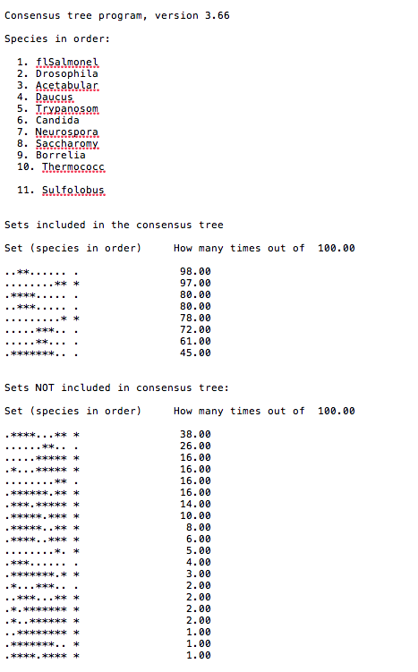
Output from consense

Slide 12
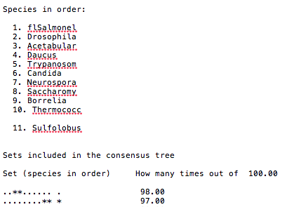
Output from consense

Slide 13
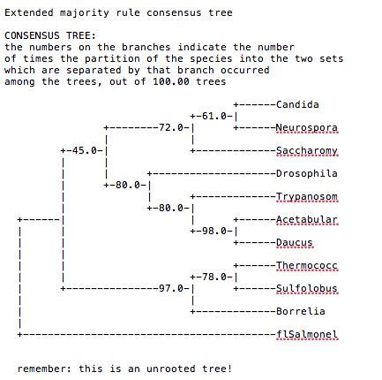
Output from consense

Slide 14
Phylip
written and distributed by Joe Felsenstein and collaborators (some of the following is copied from the PHYLIP homepage)
PHYLIP (the PHYLogeny Inference Package) is a package of programs for inferring phylogenies (evolutionary trees).
PHYLIP is the most widely-distributed phylogeny package, and competes with PAUP* to be the one responsible for the largest number of published trees. PHYLIP has been in distribution since 1980, and has over 15,000 registered users.
Output is written onto special files with names like "outfile" and "outtree". Trees written onto "outtree" are in the Newick format, an informal standard agreed to in 1986 by authors of a number of major phylogeny packages.
Input is either provided via a file called “infile” or in response to a prompt.

Slide 15
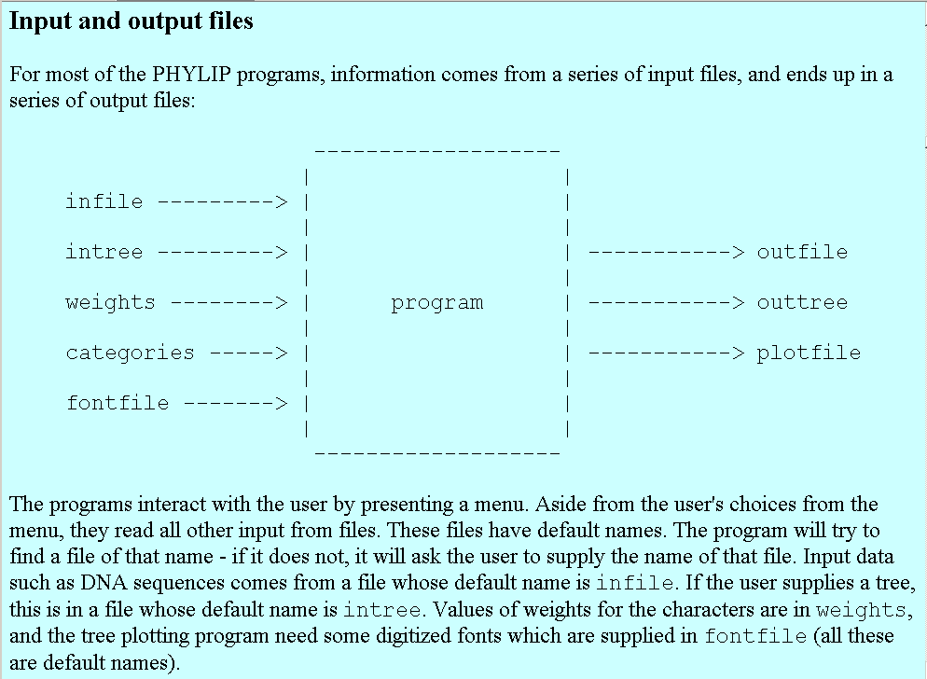
input and output

Slide 16
What’s in PHYLIP
Programs in PHYLIP allow to do parsimony, distance matrix, and likelihood methods, including bootstrapping and consensus trees. Data types that can be handled include molecular sequences, gene frequencies, restriction sites and fragments, distance matrices, and discrete characters.
Phylip works well with protein and nucleotide sequences
Many other programs mimic the style of PHYLIP programs.
(e.g. TREEPUZZLE, phyml, protml)
Many other packages use PHYIP programs in their inner workings (e.g., PHYLO_WIN)
PHYLIP runs under all operating systems
Web interfaces are available

Slide 17
Programs in PHYLIP are Modular
For example:
SEQBOOT take one set of aligned sequences and writes out a file containing bootstrap samples.
PROTDIST takes a aligned sequences (one or many sets) and calculates distance matices (one or many)
FITCH (or NEIGHBOR) calculate best fitting or neighbor joining trees from one or many distance matrices
CONSENSE takes many trees and returns a consensus tree
…. modules are available to draw trees as well, but often people use treeview, figtree, or njplot

Slide 18
The Phylip Manual
is an excellent source of information.
Brief one line descriptions of the programs are here
The easiest way to run PHYLIP programs is via a command
line menu (similar to clustalw). The program is invoked through clicking on an icon, or by typing the program name at the command line.
> seqboot
> protpars
> fitch
If there is no file called infile the program responds with:
[gogarten@carrot gogarten]$ seqboot
seqboot: can't find input file "infile"
Please enter a new file name>

Slide 19
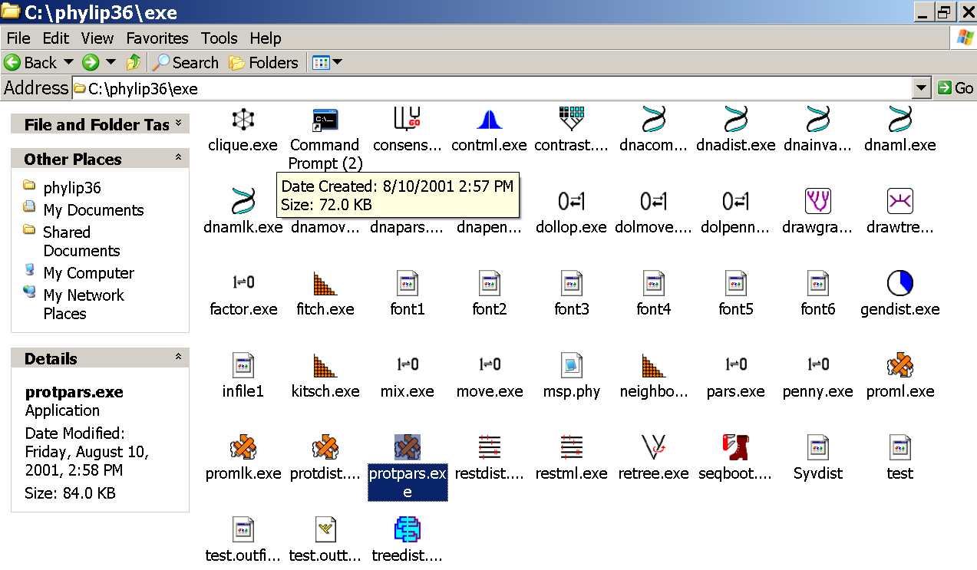
program folder

Slide 20
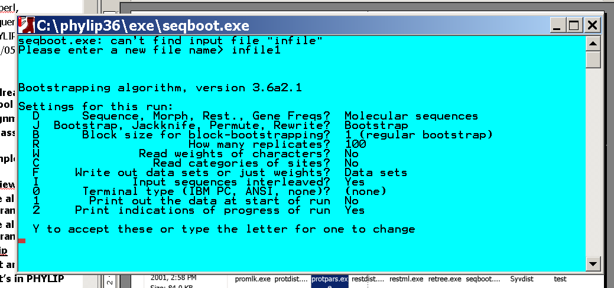
menu interface
example: seqboot and protpars on infile1

Slide 21
Sequence alignment:
CLUSTALW
MUSCLE
Removing ambiguous positions:
T-COFFEE
FORBACK
Generation of pseudosamples:
SEQBOOT
PROTDIST
TREE-PUZZLE
Calculating and evaluating phylogenies:
PROTPARS
PHYML
NEIGHBOR
FITCH
Comparing phylogenies:
CONSENSE
SH-TEST in TREE-PUZZLE
Comparing models:
Maximum Likelihood Ratio Test
Visualizing trees:
ATV, njplot, or treeview
Phylip programs can be combined in many different ways with one another and with programs that use the same file formats.

Slide 22
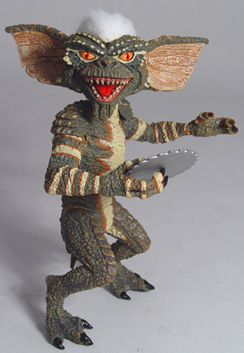
Elliot Sober’s Gremlins
Observation: Loud noise in the attic
?
Hypothesis: gremlins in the attic playing bowling
Likelihood =
P(noise|gremlins in the attic)
P(gremlins in the attic|noise)
?
?

Slide 23
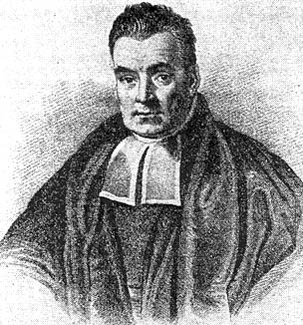
Bayes’ Theorem
Likelihood
describes how well the model predicts the data
P(data|model, I)
P(model|data, I) = P(model, I)
P(data,I)
Posterior
Probability
represents the degree
to which we believe a given model accurately describes the situation
given the available data and all of our prior information I
Prior
Probability
describes the degree to which we believe the model accurately describes reality
based on all of our prior information.
Normalizing
constant
Reverend Thomas Bayes (1702-1761)

Slide 24
Alternative Approaches to Estimate
Posterior Probabilities
Bayesian Posterior Probability Mapping with MrBayes
(Huelsenbeck and Ronquist, 2001)
Problem:
Strimmer’s formula
L_{i}
p_{i}=
only considers 3 trees
(those that maximize the likelihood for
the three topologies)
L₁+L₂+L₃
Solution:
Exploration of the tree space by sampling trees using a biased random walk
(Implemented in MrBayes program)
Trees with higher likelihoods will be sampled more often
N_{i}
p_{i}≈
N_{total}
,where N_{i} - number of sampled trees of topology i, i=1,2,3
N_{total} – total number of sampled trees (has to be large)

Slide 25
Illustration of a biased random walk
Image generated with Paul Lewis's MCRobot
Figure generated using MCRobot program (Paul Lewis, 2001)

Slide 26
Likelihood estimates do not take prior information into consideration:
e.g., if the result of three coin tosses is 3 times head, then the likelihood estimate for the frequency of having a head is 1 (3 out of 3 events) and the estimate for the frequency of having a head is zero.
The probability that both events (A and B) occur
Both sides expressed as conditional probability
If A is the model and B is the data, then
P(B|A) is the likelihood of model A
P(A|B) is the posterior probability of the model given the data.
P(A) is the considered the prior probability of the model.
P(B) often is treated as a normalizing constant.

Slide 27
Why could a gene tree be different from the species tree?
Lack of resolution
Lineage sorting
Gene duplications/gene loss (paralogs/orthologs)
Gene transfer
Systematic artifacts (e.g., compositional bias and long branch attraction)

Slide 28
Trees – what might they mean?
Calculating a tree is comparatively easy, figuring out what it might mean is much more difficult.
If this is the probable organismal tree:
species A
species B
species C
species D
what could be the reason for obtaining this gene tree:
seq. from A
seq. from D
seq. from C
seq. from B

Slide 29
lack of resolution
seq. from A
seq. from D
seq. from C
seq. from B
e.g., 60% bootstrap support for bipartition (AD)(CB)

Slide 30
long branch attraction artifact
the two longest branches join together
seq. from A
seq. from D
seq. from C
seq. from B
e.g., 100% bootstrap support for bipartition (AD)(CB)
What could you do to investigate if this is a possible explanation?
use only slow positions,
use an algorithm that corrects for ASRV

Slide 31
Gene transfer
Organismal tree:
species A
species B
Gene Transfer
species C
species D
molecular tree:
seq. from A
seq. from D
seq. from C
speciation
seq. from B
gene transfer

Slide 32
Lineage Sorting
Organismal tree:
species A
species B
species C
Genes diverge and coexist in the
organismal lineage
species D
molecular tree:
seq. from A
seq. from D
seq. from C
seq. from B

Slide 33
Gene duplication
Organismal tree:
species A
species B
species C
gene duplication
species D
molecular tree:
molecular tree:
molecular tree:
seq. from A
seq. from A
seq. from A
seq. from B
seq. from B
seq. from C
seq. from C
seq. from D
seq. from D
seq. from D
seq.’ from B
seq.’ from B
seq.’ from B
seq.’ from C
seq.’ from C
gene duplication
seq.’ from C
gene duplication
gene duplication
seq.’ from D
seq.’ from D

Slide 34
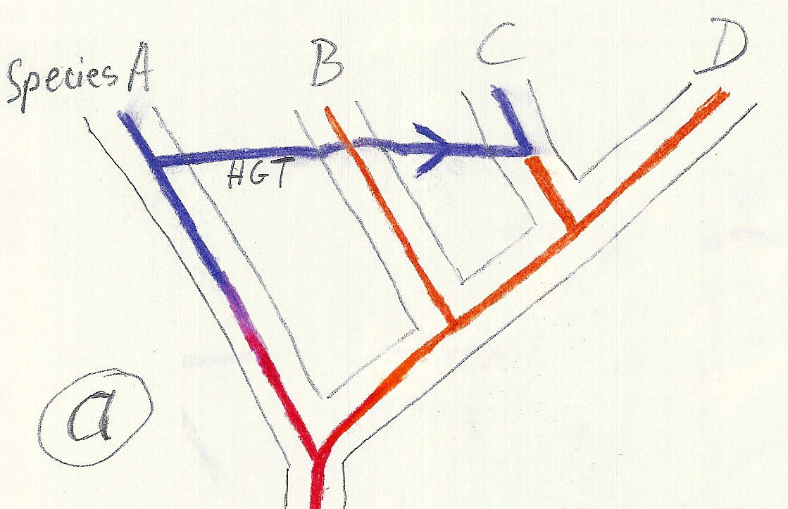
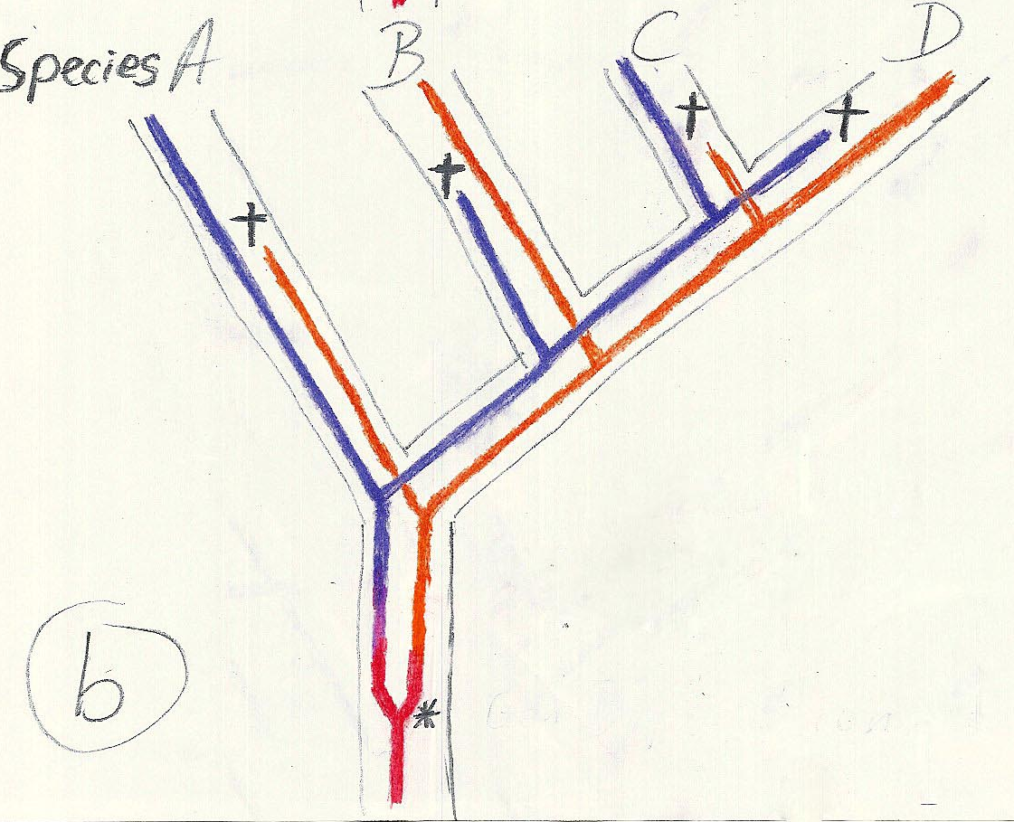
Gene duplication and gene transfer are equivalent explanations.
The more relatives of C are found that do not have the blue type of gene, the less likely is the duplication loss scenario
Ancient duplication followed by gene loss
Horizontal or lateral Gene
Note that scenario B involves many more individual events than A
1 HGT with
orthologous replacement
1 gene duplication followed by 4 independent gene loss events

Slide 35
Function, ortho- and paralogy
molecular tree:
seq. from A
seq.’ from B
seq.’ from C
seq.’ from D
gene duplication
seq. from B
seq. from C
seq. from D
The presence of the duplication is a taxonomic character (shared derived character in species B C D).
The phylogeny suggests that seq’ and seq have similar function, and that this function was important in the evolution of the clade BCD.
seq’ in B and seq’in C and D are orthologs and probably have the same function, whereas seq and seq’ in BCD probably have different function (the difference might be in subfunctionalization of functions that seq had in A. – e.g. organ specific expression)

Slide 36
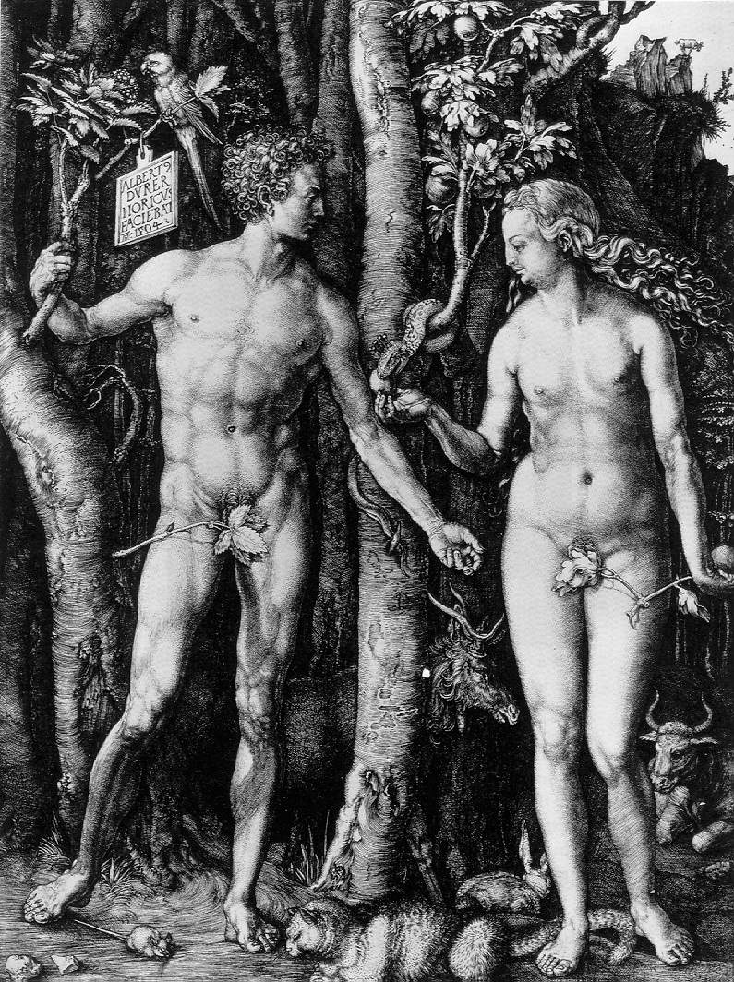
Y chromosome
Adam
Mitochondrial
Eve
Lived
approximately
40,000 years ago
Lived
166,000-249,000
years ago
Thomson, R. et al. (2000) Proc Natl Acad Sci U S A 97, 7360-5
Underhill, P.A. et al. (2000) Nat Genet 26, 358-61
Mendez et al. (2013) American Journal of Human Genetics 92 (3): 454.
Cann, R.L. et al. (1987) Nature 325, 31-6
Vigilant, L. et al. (1991) Science 253, 1503-7
Albrecht Dürer, The Fall of Man, 1504
Adam and Eve never met ☹
The same is true for ancestral rRNAs, EF, ATPases!

Slide 37
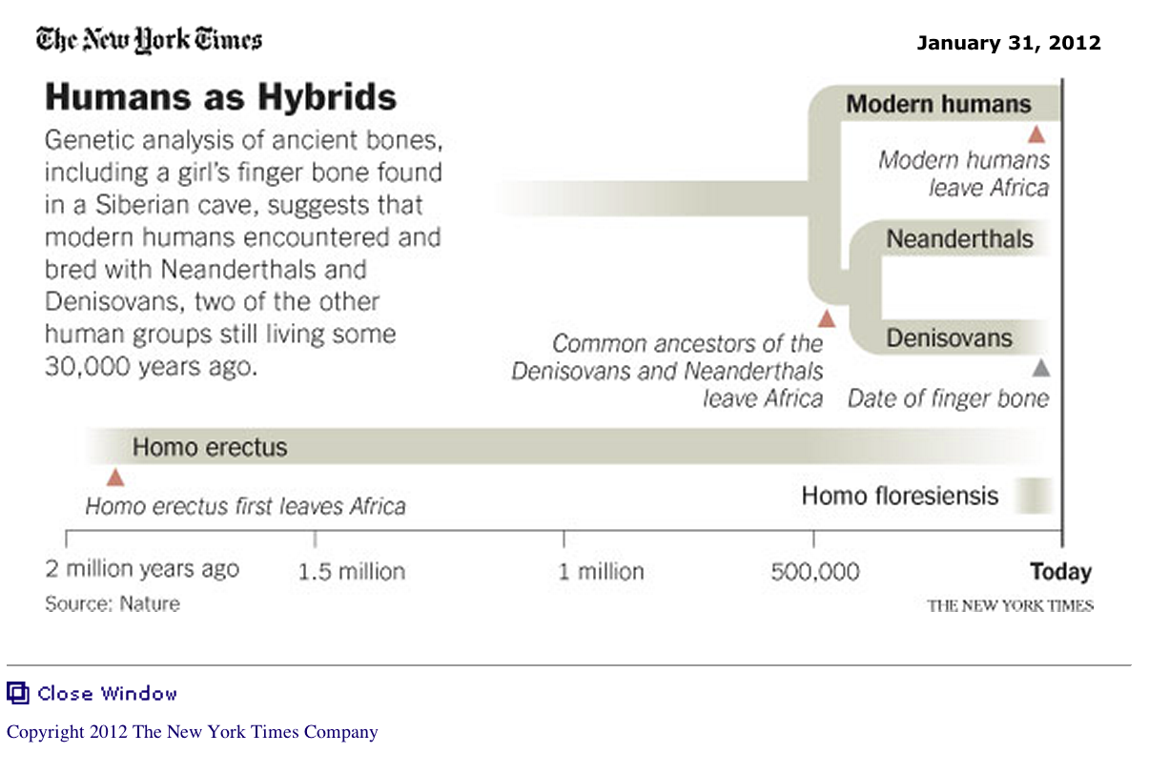
From: http://www.nytimes.com/2012/01/31/science/gains-in-dna-are-speeding-research-into-human-origins.html?_r=1

Slide 38
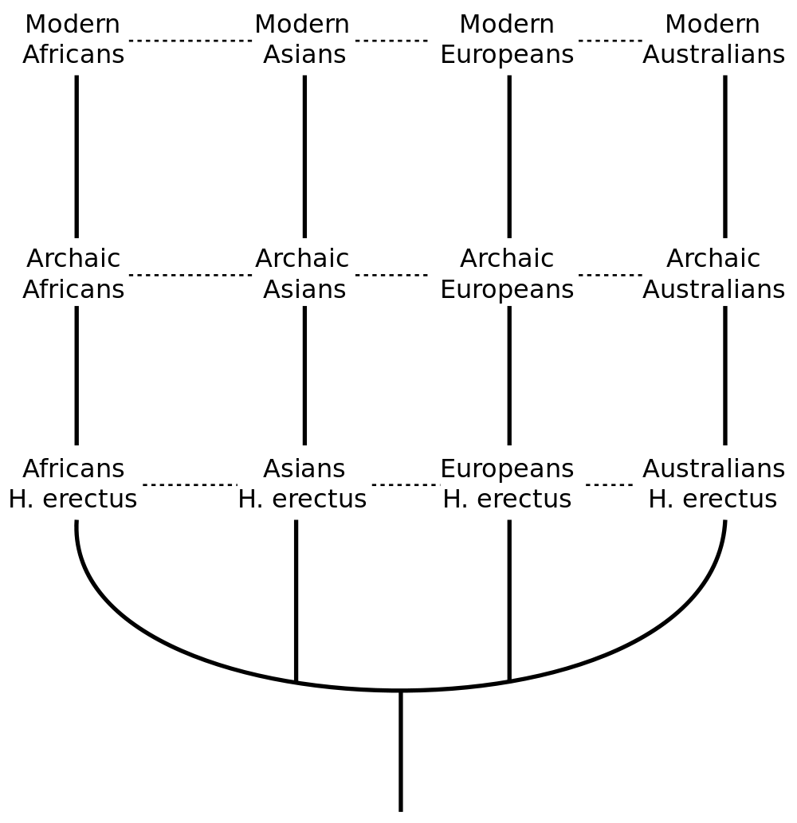
The multiregional hypothesis
From http://en.wikipedia.org/wiki/Multiregional_Evolution

Slide 39
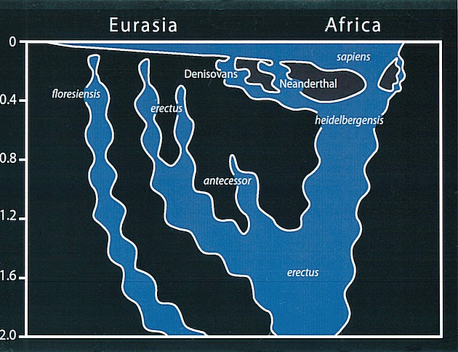
Archaic human admixture with modern Homo sapiens
From: http://en.wikipedia.org/wiki/Archaic_human_admixture_with_modern_Homo_sapiens

Slide 40
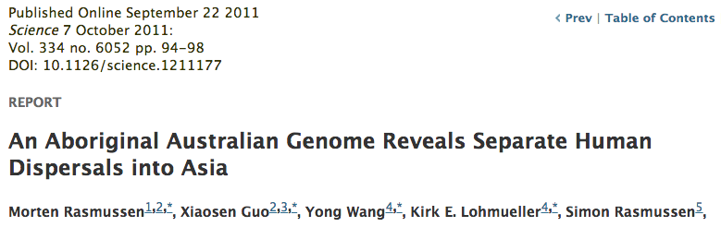
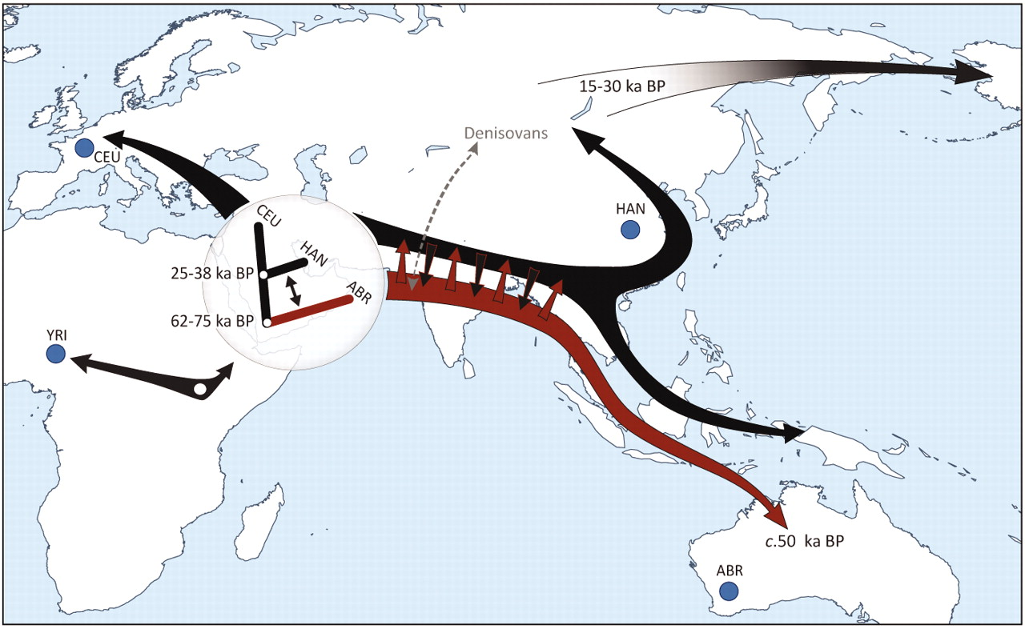

Slide 41
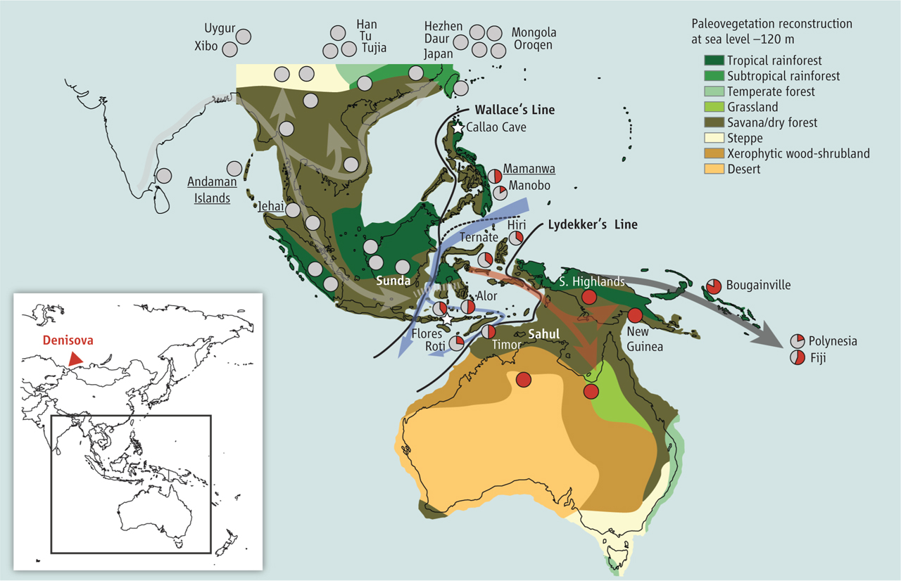
Did the Denisovans Cross Wallace's Line?
Science 18 October 2013:
vol. 342 no. 6156 321-323
Ancient migrations.
The proportions of Denisovan DNA in modern human populations are shown as red in pie charts, relative to New Guinea and Australian Aborigines (3). Wallace's Line (8) is formed by the powerful Indonesian flow-through current (blue arrows) and marks the limit of the Sunda shelf and Eurasian placental mammals.

Slide 42
For more discussion on archaic and early humans see:
http://en.wikipedia.org/wiki/Denisova_hominin
http://www.nytimes.com/2012/01/31/science/gains-in-dna-are-speeding-research-into-human-origins.html
http://www.nytimes.com/2014/10/23/science/research-humans-interbred-with-neanderthals.html?
http://www.sciencedirect.com/science/article/pii/S0002929711003958
http://www.abc.net.au/science/articles/2012/08/31/3580500.htm
http://www.sciencemag.org/content/334/6052/94.full
http://www.sciencemag.org/content/334/6052/94/F2.expansion.html
http://haplogroup-a.com/Ancient-Root-AJHG2013.pdf

