Slide 1
Bootstrap ?
See here ( http://gogarten.uconn.edu/mcb3421_2016/bs.html )

Slide 2
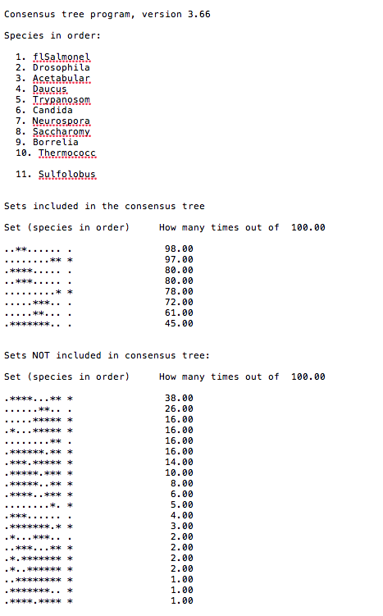
Output from consense

Slide 3
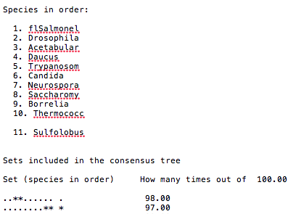
Output from consense

Slide 4
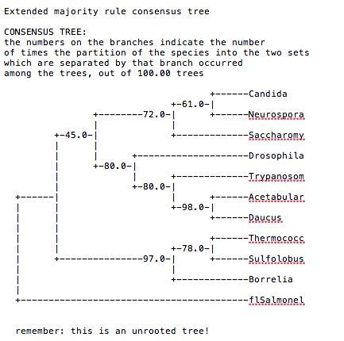
Output from consense

Slide 5
Phylip
written and distributed by Joe Felsenstein and collaborators (some of the following is copied from the PHYLIP homepage)
PHYLIP (the PHYLogeny Inference Package) is a package of programs for inferring phylogenies (evolutionary trees).
PHYLIP is the most widely-distributed phylogeny package, and competes with PAUP* to be the one responsible for the largest number of published trees. PHYLIP has been in distribution since 1980, and has over 15,000 registered users.
Output is written onto special files with names like "outfile" and "outtree". Trees written onto "outtree" are in the Newick format, an informal standard agreed to in 1986 by authors of a number of major phylogeny packages.
Input is either provided via a file called “infile” or in response to a prompt.

Slide 6
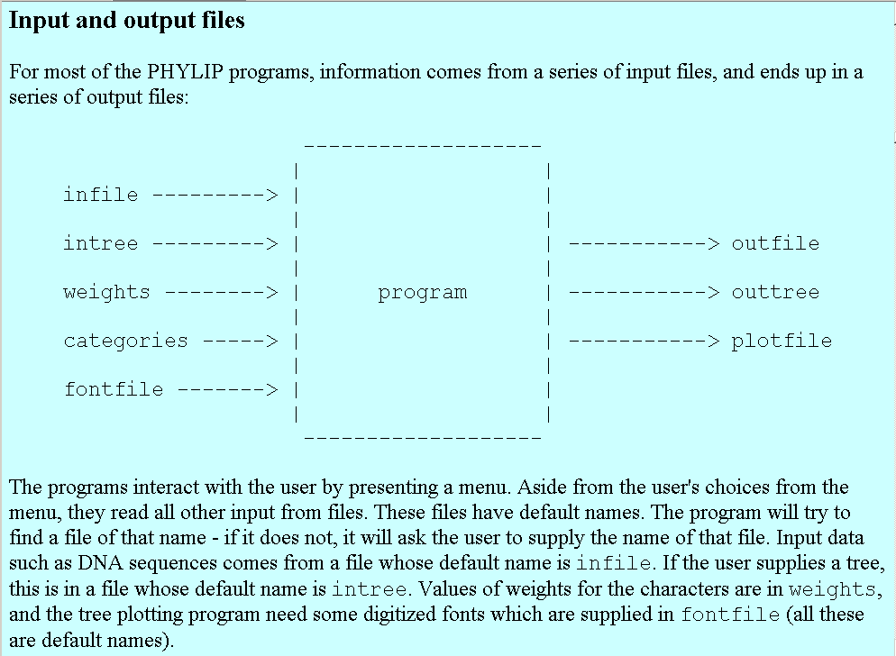
input and output

Slide 7
What’s in PHYLIP
Programs in PHYLIP allow to do parsimony, distance matrix, and likelihood methods, including bootstrapping and consensus trees. Data types that can be handled include molecular sequences, gene frequencies, restriction sites and fragments, distance matrices, and discrete characters.
Phylip works well with protein and nucleotide sequences
Many other programs mimic the style of PHYLIP programs.
(e.g. TREEPUZZLE, phyml, protml)
Many other packages use PHYIP programs in their inner workings (e.g., PHYLO_WIN)
PHYLIP runs under all operating systems
Web interfaces are available

Slide 8
Programs in PHYLIP are Modular
For example:
SEQBOOT take one set of aligned sequences and writes out a file containing bootstrap samples.
PROTDIST takes a aligned sequences (one or many sets) and calculates distance matices (one or many)
FITCH (or NEIGHBOR) calculate best fitting or neighbor joining trees from one or many distance matrices
CONSENSE takes many trees and returns a consensus tree
…. modules are available to draw trees as well, but often people use treeview, figtree, or njplot

Slide 9
The Phylip Manual
is an excellent source of information.
Brief one line descriptions of the programs are here
The easiest way to run PHYLIP programs is via a command
line menu (similar to clustalw). The program is invoked through clicking on an icon, or by typing the program name at the command line.
> seqboot
> protpars
> fitch
If there is no file called infile the program responds with:
[gogarten@carrot gogarten]$ seqboot
seqboot: can't find input file "infile"
Please enter a new file name>

Slide 10
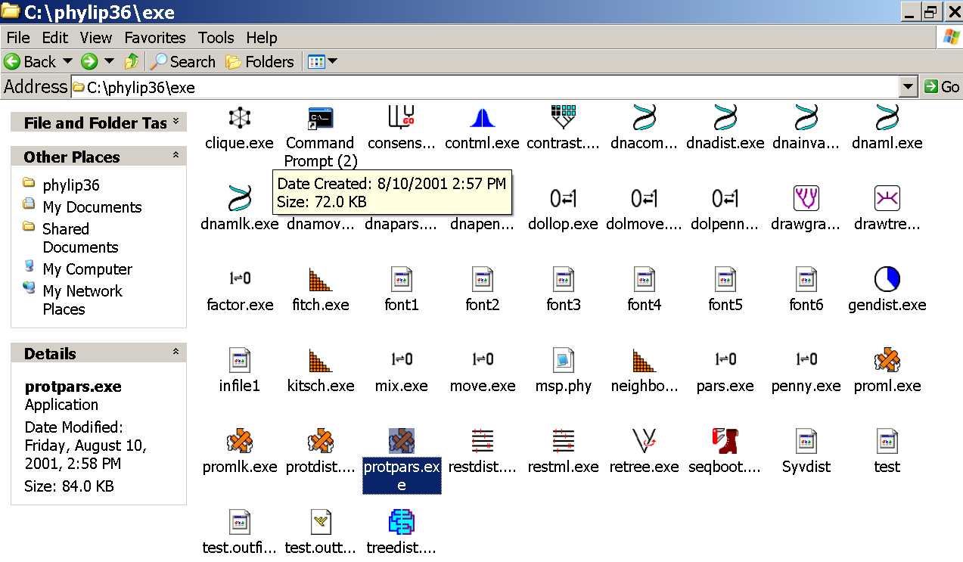
program folder

Slide 11
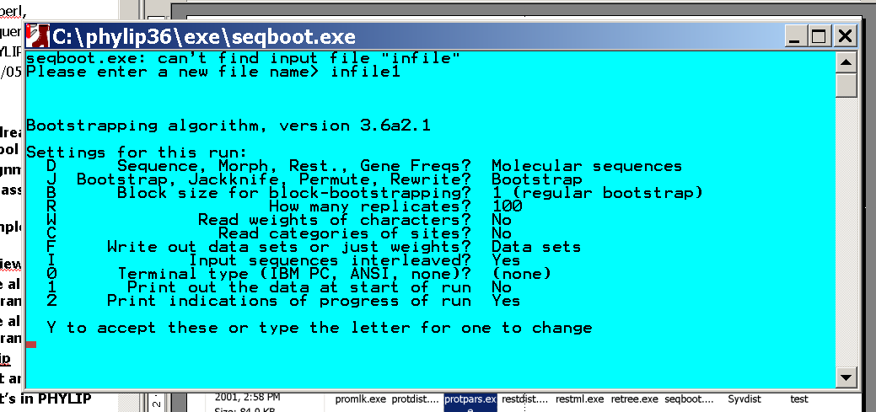
menu interface
example: seqboot and protpars on infile1

Slide 12
Sequence alignment:
CLUSTALW
MUSCLE
Removing ambiguous positions:
T-COFFEE
FORBACK
Generation of pseudosamples:
SEQBOOT
PROTDIST
TREE-PUZZLE
Calculating and evaluating phylogenies:
PROTPARS
PHYML
NEIGHBOR
FITCH
Comparing phylogenies:
CONSENSE
SH-TEST in TREE-PUZZLE
Comparing models:
Maximum Likelihood Ratio Test
Visualizing trees:
ATV, njplot, or treeview
Phylip programs can be combined in many different ways with one another and with programs that use the same file formats.

Slide 13
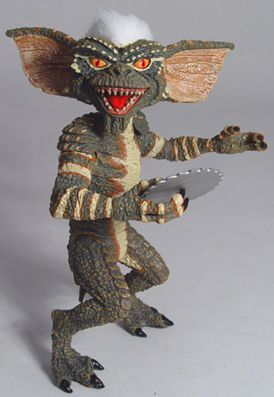
Elliot Sober’s Gremlins
Observation: Loud noise in the attic
?
Hypothesis: gremlins in the attic playing bowling
Likelihood =
P(noise|gremlins in the attic)
P(gremlins in the attic|noise)
?
?

Slide 14
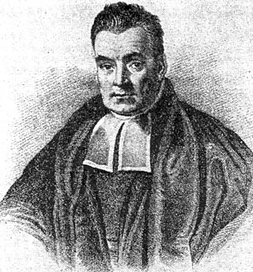
Bayes’ Theorem
Likelihood
describes how well the model predicts the data
P(data|model, I)
P(model|data, I) = P(model, I)
P(data,I)
Posterior
Probability
represents the degree
to which we believe a given model accurately describes the situation
given the available data and all of our prior information I
Prior
Probability
describes the degree to which we believe the model accurately describes reality
based on all of our prior information.
Normalizing
constant
Reverend Thomas Bayes (1702-1761)

Slide 15
Alternative Approaches to Estimate
Posterior Probabilities
Bayesian Posterior Probability Mapping with MrBayes
(Huelsenbeck and Ronquist, 2001)
Problem:
Strimmer’s formula
L_{i}
p_{i}=
only considers 3 trees
(those that maximize the likelihood for
the three topologies)
L₁+L₂+L₃
Solution:
Exploration of the tree space by sampling trees using a biased random walk
(Implemented in MrBayes program)
Trees with higher likelihoods will be sampled more often
N_{i}
p_{i}≈
N_{total}
,where N_{i} - number of sampled trees of topology i, i=1,2,3
N_{total} – total number of sampled trees (has to be large)

Slide 16
Illustration of a biased random walk
Image generated with Paul Lewis's MCRobot
Figure generated using MCRobot program (Paul Lewis, 2001)

Slide 17
Likelihood estimates do not take prior information into consideration:
e.g., if the result of three coin tosses is 3 times head, then the likelihood estimate for the frequency of having a head is 1 (3 out of 3 events) and the estimate for the frequency of having a head is zero.
The probability that both events (A and B) occur
Both sides expressed as conditional probability
If A is the model and B is the data, then
P(B|A) is the likelihood of model A
P(A|B) is the posterior probability of the model given the data.
P(A) is the considered the prior probability of the model.
P(B) often is treated as a normalizing constant.

Slide 18
Why could a gene tree be different from the species tree?
Lack of resolution
Lineage sorting
Gene duplications/gene loss (paralogs/orthologs)
Gene transfer
Systematic artifacts (e.g., compositional bias and long branch attraction)

Slide 19
Long branch attraction (LBA), aka the Felsenstein Zone
True tree
Reconstructed tree

Slide 20
Trees – what might they mean?
Calculating a tree is comparatively easy, figuring out what it might mean is much more difficult.
If this is the probable organismal tree:
species A
species B
species C
species D
what could be the reason for obtaining this gene tree:
seq. from A
seq. from D
seq. from C
seq. from B

Slide 21
lack of resolution
seq. from A
seq. from D
seq. from C
seq. from B
e.g., 60% bootstrap support for bipartition (AD)(CB)

Slide 22
long branch attraction artifact
the two longest branches join together
seq. from A
seq. from D
seq. from C
seq. from B
e.g., 100% bootstrap support for bipartition (AD)(CB)
What could you do to investigate if this is a possible explanation?
use only slow positions,
use an algorithm that corrects for ASRV

Slide 23
Gene transfer
Organismal tree:
species A
species B
Gene Transfer
species C
species D
molecular tree:
seq. from A
seq. from D
seq. from C
speciation
seq. from B
gene transfer

Slide 24
Lineage Sorting
Organismal tree:
species A
species B
species C
Genes diverge and coexist in the
organismal lineage
species D
molecular tree:
seq. from A
seq. from D
seq. from C
seq. from B

Slide 25
Gene duplication
Organismal tree:
species A
species B
species C
gene duplication
species D
molecular tree:
molecular tree:
molecular tree:
seq. from A
seq. from A
seq. from A
seq. from B
seq. from B
seq. from C
seq. from C
seq. from D
seq. from D
seq. from D
seq.’ from B
seq.’ from B
seq.’ from B
seq.’ from C
seq.’ from C
gene duplication
seq.’ from C
gene duplication
gene duplication
seq.’ from D
seq.’ from D

Slide 26
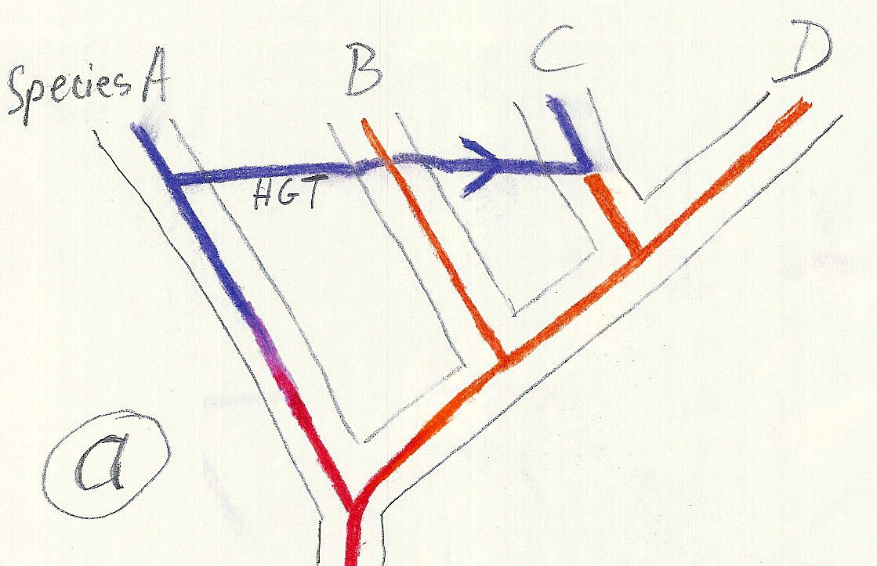
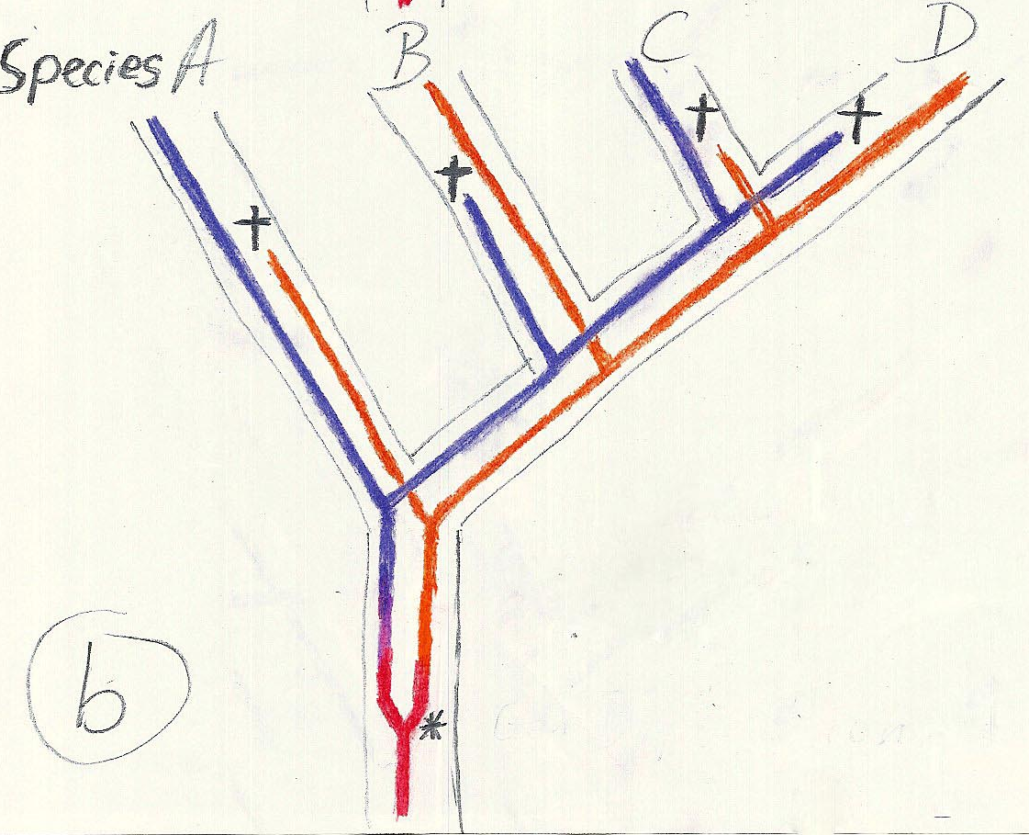
Gene duplication and gene transfer are equivalent explanations.
The more relatives of C are found that do not have the blue type of gene, the less likely is the duplication loss scenario
Ancient duplication followed by gene loss
Horizontal or lateral Gene
Note that scenario B involves many more individual events than A
1 HGT with
orthologous replacement
1 gene duplication followed by 4 independent gene loss events

Slide 27
Function, ortho- and paralogy
molecular tree:
seq. from A
seq.’ from B
seq.’ from C
seq.’ from D
gene duplication
seq. from B
seq. from C
seq. from D
The presence of the duplication is a taxonomic character (shared derived character in species B C D).
The phylogeny suggests that seq’ and seq have similar function, and that this function was important in the evolution of the clade BCD.
seq’ in B and seq’in C and D are orthologs and probably have the same function, whereas seq and seq’ in BCD probably have different function (the difference might be in subfunctionalization of functions that seq had in A. – e.g. organ specific expression)

Slide 28
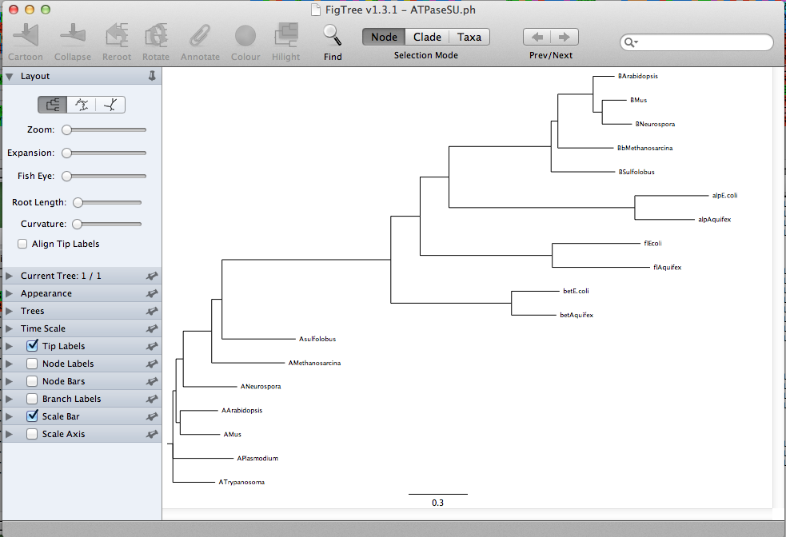
ATPase dataset -> nj in figtree

Slide 29
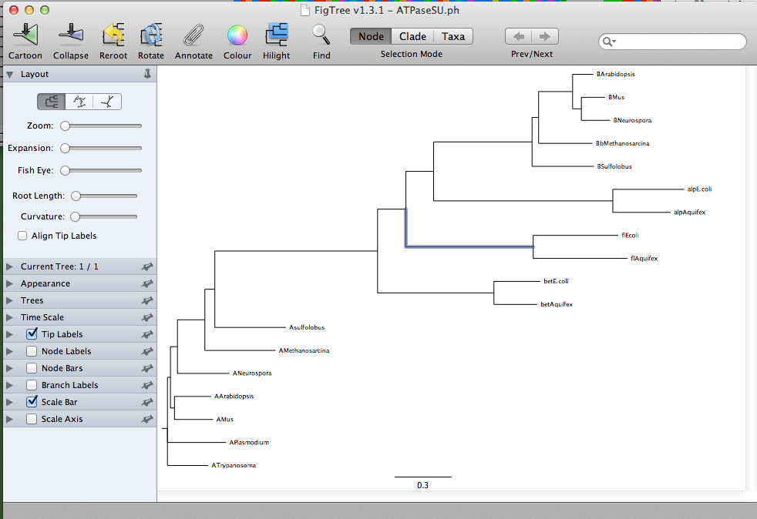
ATPase dataset -> nj in figtree

Slide 30
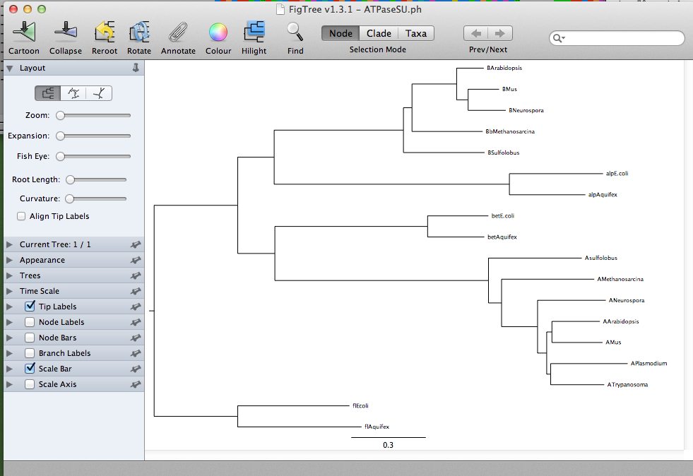
ATPase dataset -> nj in figtree

Slide 31
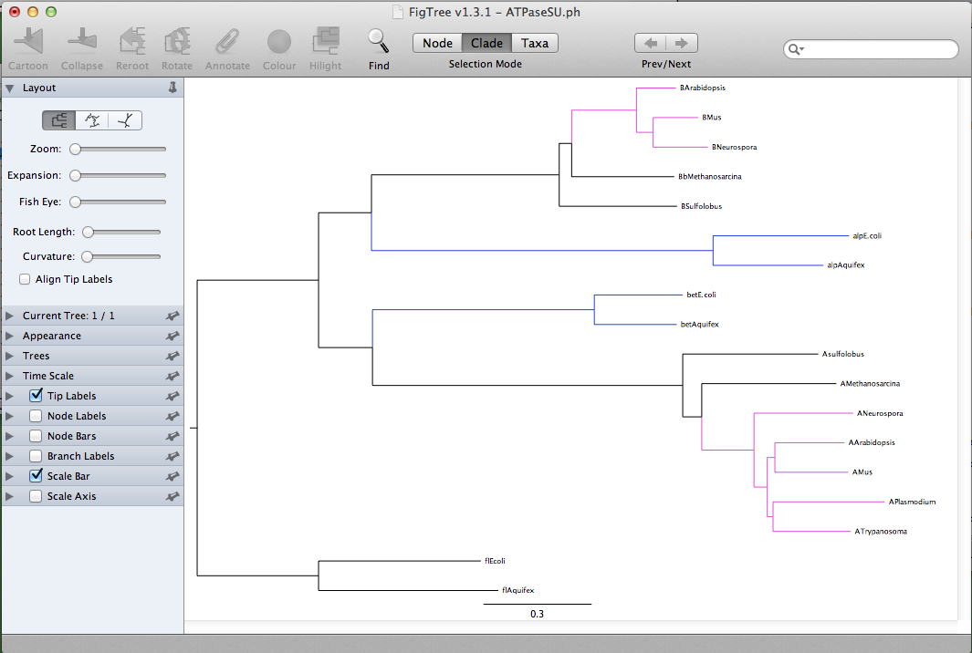
ATPase dataset -> nj in figtree

Slide 32
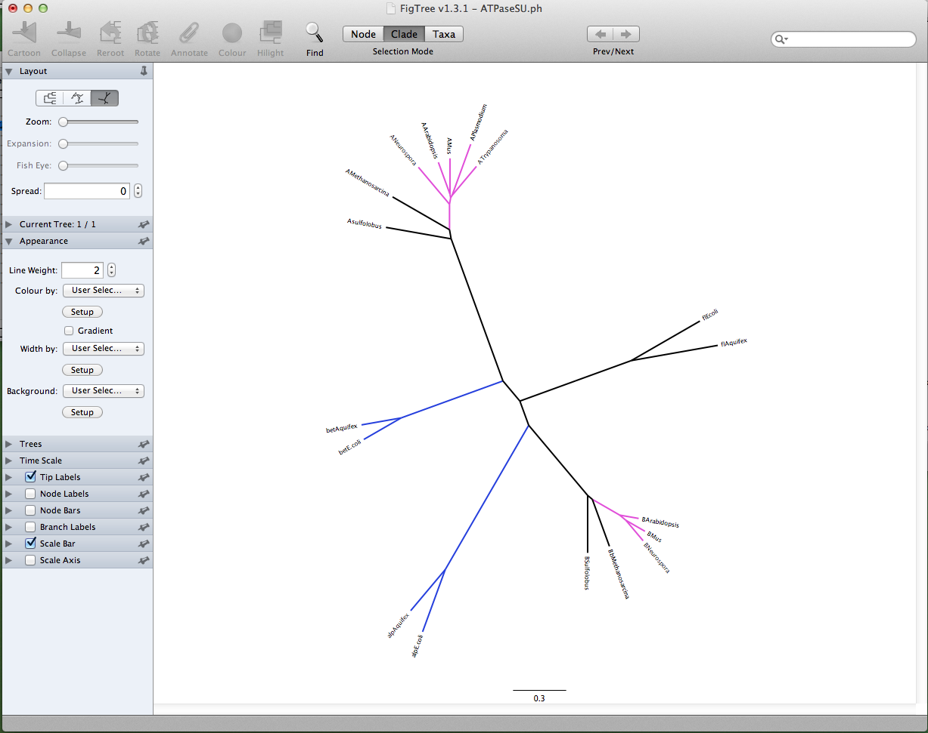
ATPase dataset -> nj in figtree

Slide 33
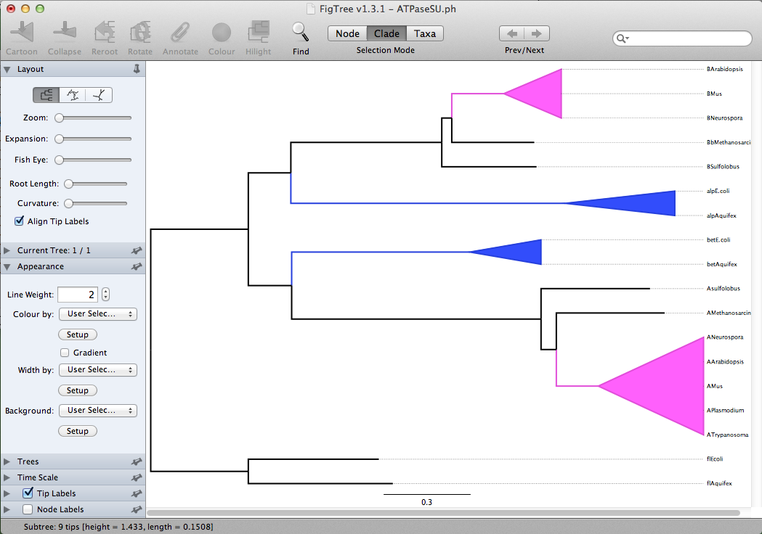
ATPase dataset -> nj in figtree

Slide 34
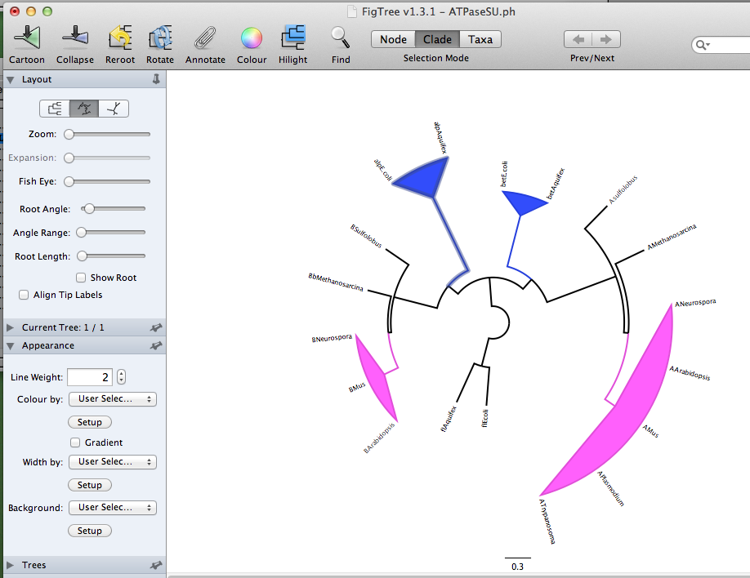
ATPase dataset -> nj in figtree

Slide 35
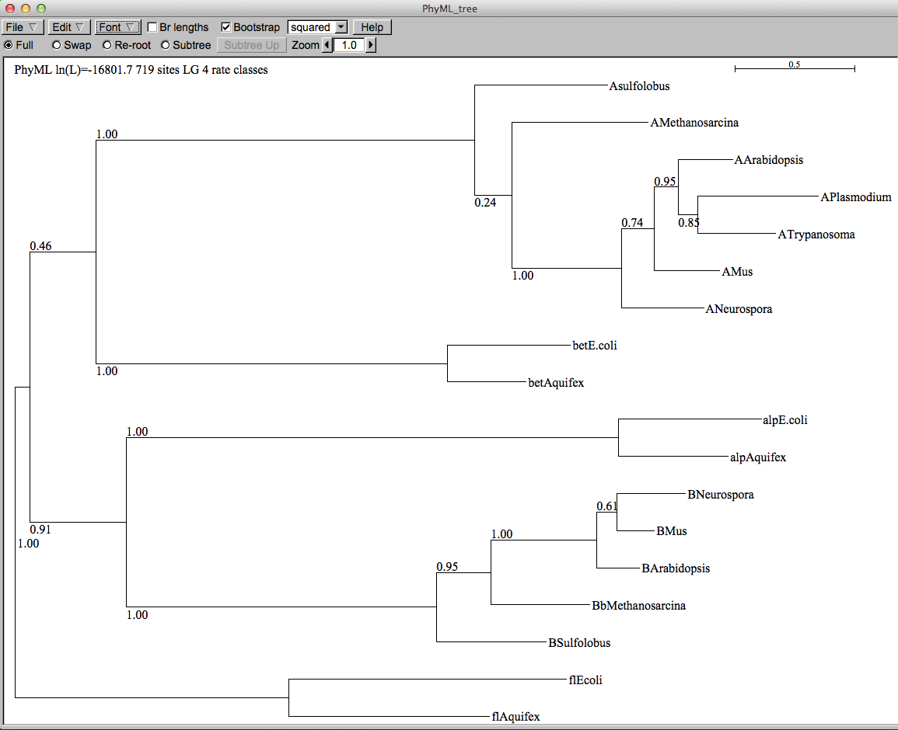
ATPase dataset -> muscle -> phyml (with ASRV)– re-rooted

Slide 36
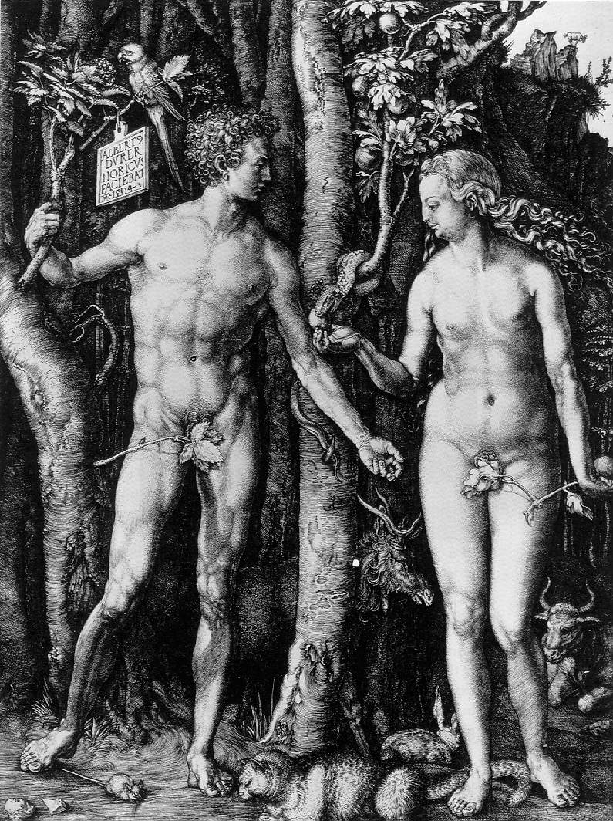
Y chromosome
Adam
Mitochondrial
Eve
Lived
approximately
40,000 years ago
Lived
166,000-249,000
years ago
Thomson, R. et al. (2000) Proc Natl Acad Sci U S A 97, 7360-5
Underhill, P.A. et al. (2000) Nat Genet 26, 358-61
Mendez et al. (2013) American Journal of Human Genetics 92 (3): 454.
Cann, R.L. et al. (1987) Nature 325, 31-6
Vigilant, L. et al. (1991) Science 253, 1503-7
Albrecht Dürer, The Fall of Man, 1504
Adam and Eve never met ☹
The same is true for ancestral rRNAs, EF, ATPases!

Slide 37
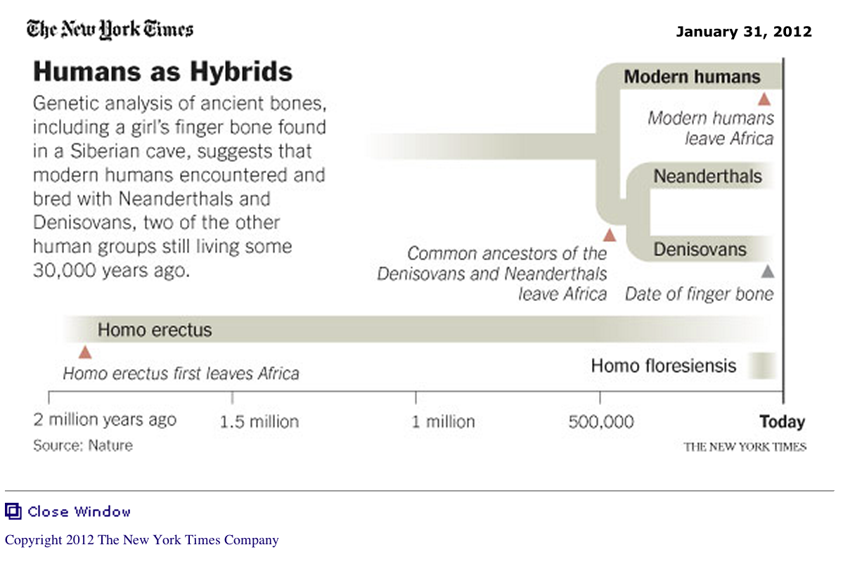
From: http://www.nytimes.com/2012/01/31/science/gains-in-dna-are-speeding-research-into-human-origins.html?_r=1

Slide 38
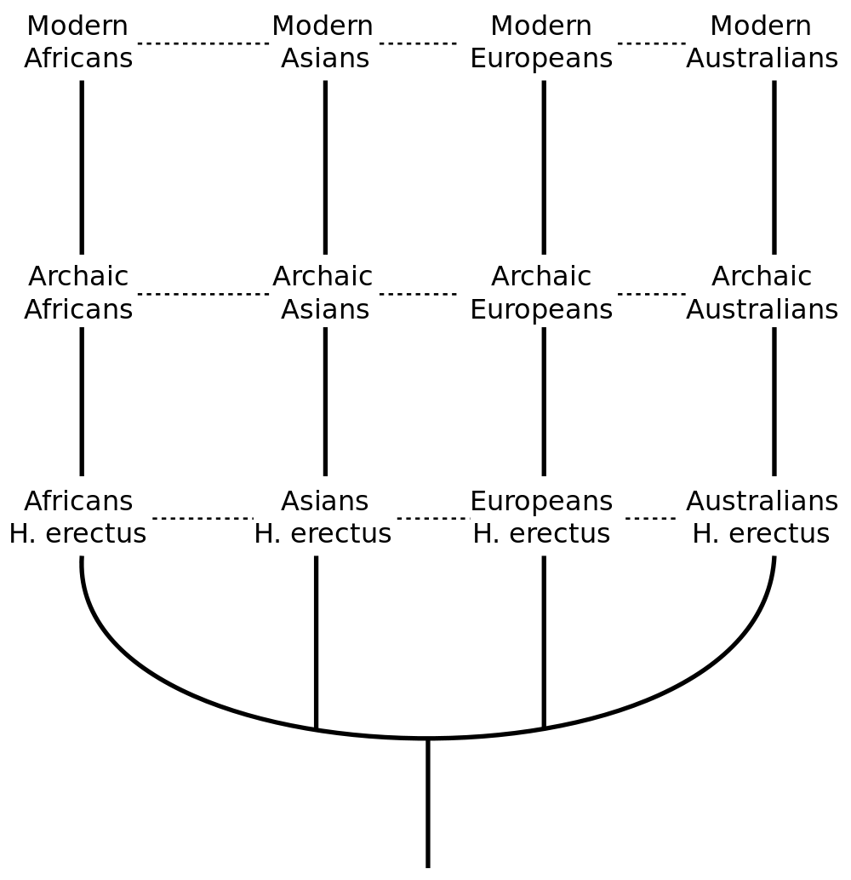
The multiregional hypothesis
From http://en.wikipedia.org/wiki/Multiregional_Evolution

Slide 39
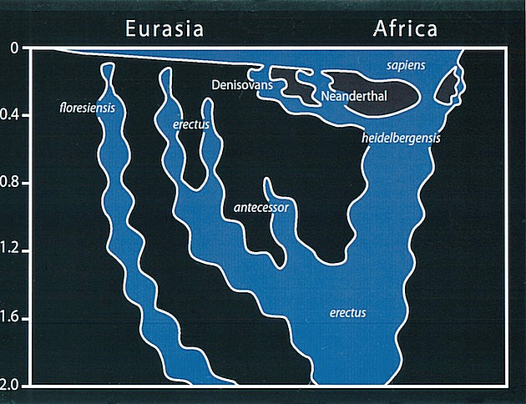
Archaic human admixture with modern Homo sapiens
From: http://en.wikipedia.org/wiki/Archaic_human_admixture_with_modern_Homo_sapiens

Slide 40
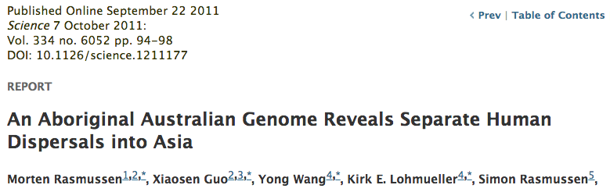
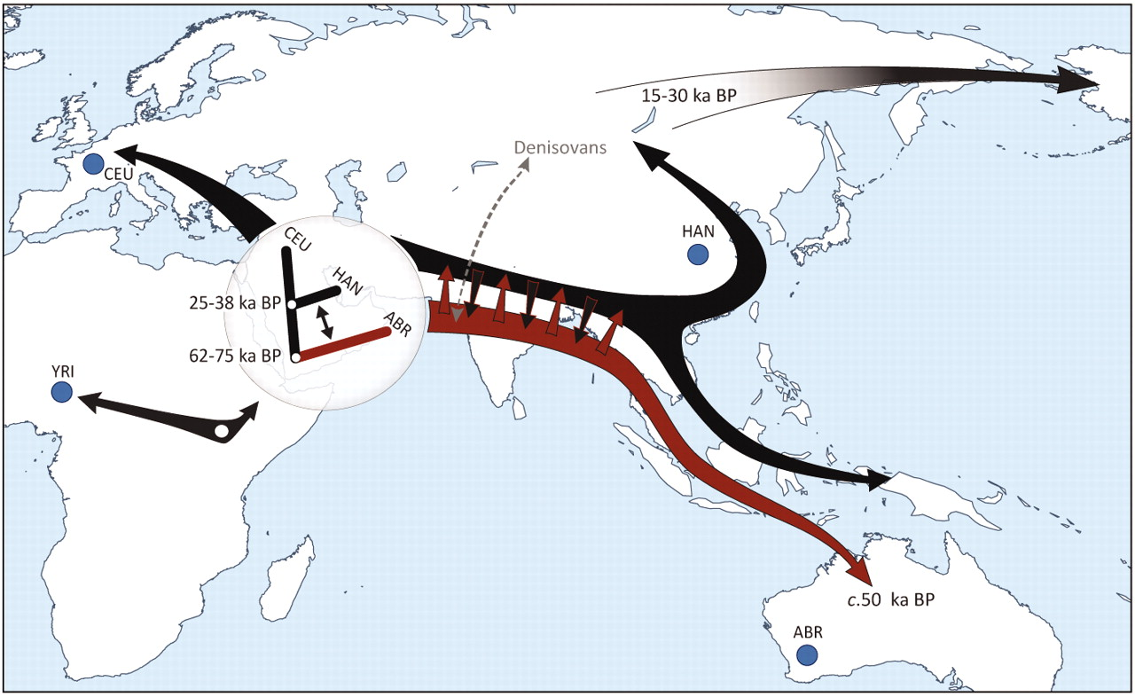

Slide 41
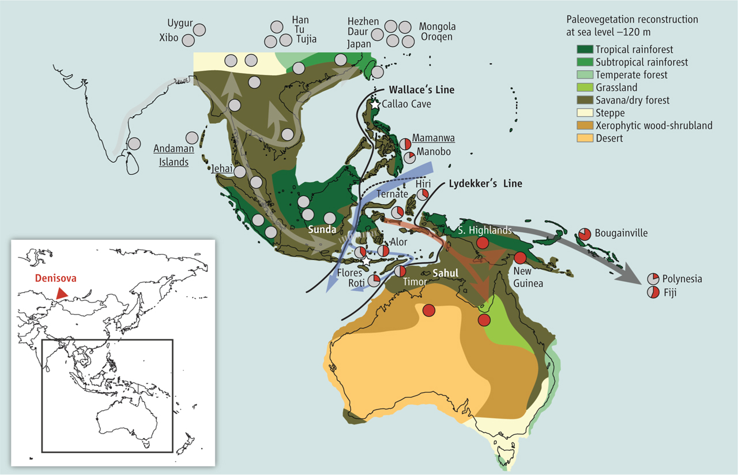
Did the Denisovans Cross Wallace's Line?
Science 18 October 2013:
vol. 342 no. 6156 321-323
Ancient migrations.
The proportions of Denisovan DNA in modern human populations are shown as red in pie charts, relative to New Guinea and Australian Aborigines (3). Wallace's Line (8) is formed by the powerful Indonesian flow-through current (blue arrows) and marks the limit of the Sunda shelf and Eurasian placental mammals.

Slide 42
For more discussion on archaic and early humans see:
http://en.wikipedia.org/wiki/Denisova_hominin
http://www.nytimes.com/2012/01/31/science/gains-in-dna-are-speeding-research-into-human-origins.html
http://www.nytimes.com/2014/10/23/science/research-humans-interbred-with-neanderthals.html?
http://www.sciencedirect.com/science/article/pii/S0002929711003958
http://www.abc.net.au/science/articles/2012/08/31/3580500.htm
http://www.sciencemag.org/content/334/6052/94.full
http://www.sciencemag.org/content/334/6052/94/F2.expansion.html
http://haplogroup-a.com/Ancient-Root-AJHG2013.pdf

