Slide 1
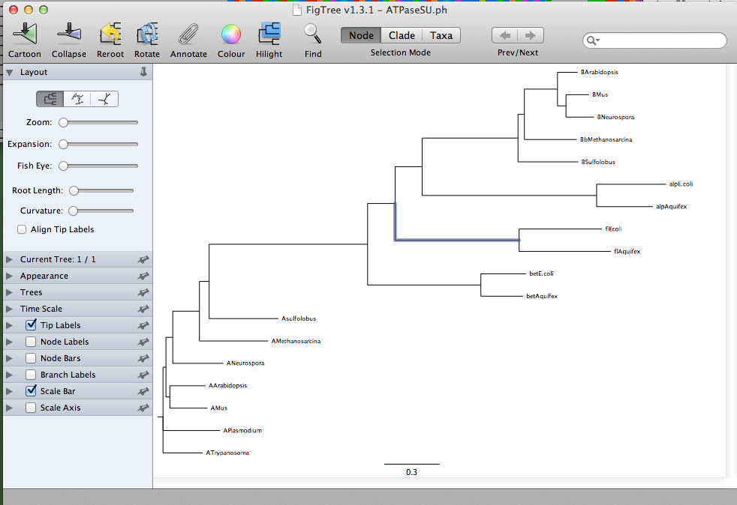
ATPase dataset -> nj in figtree

Slide 2
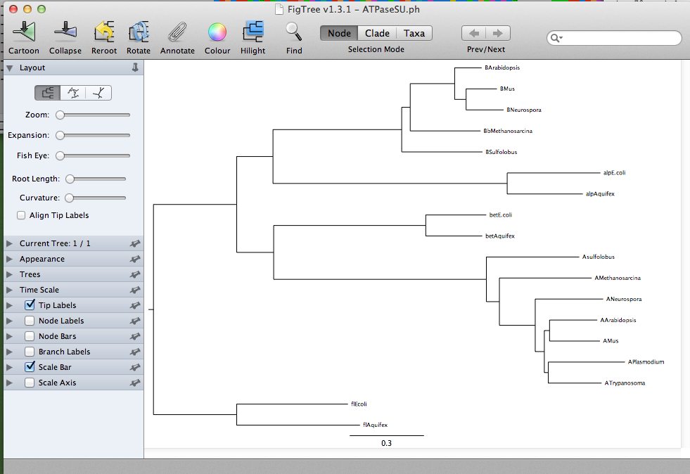
ATPase dataset -> nj in figtree

Slide 3
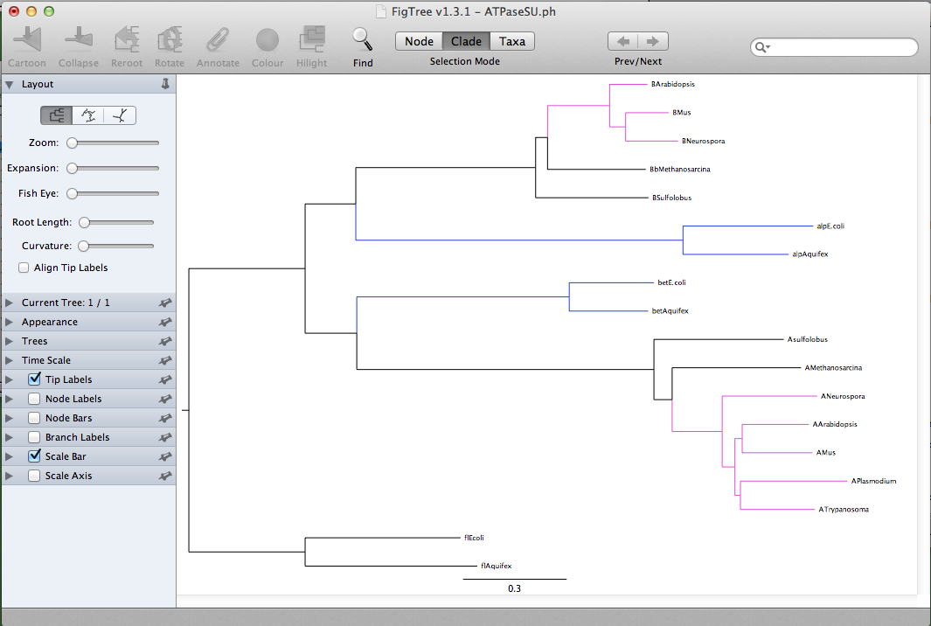
ATPase dataset -> nj in figtree

Slide 4
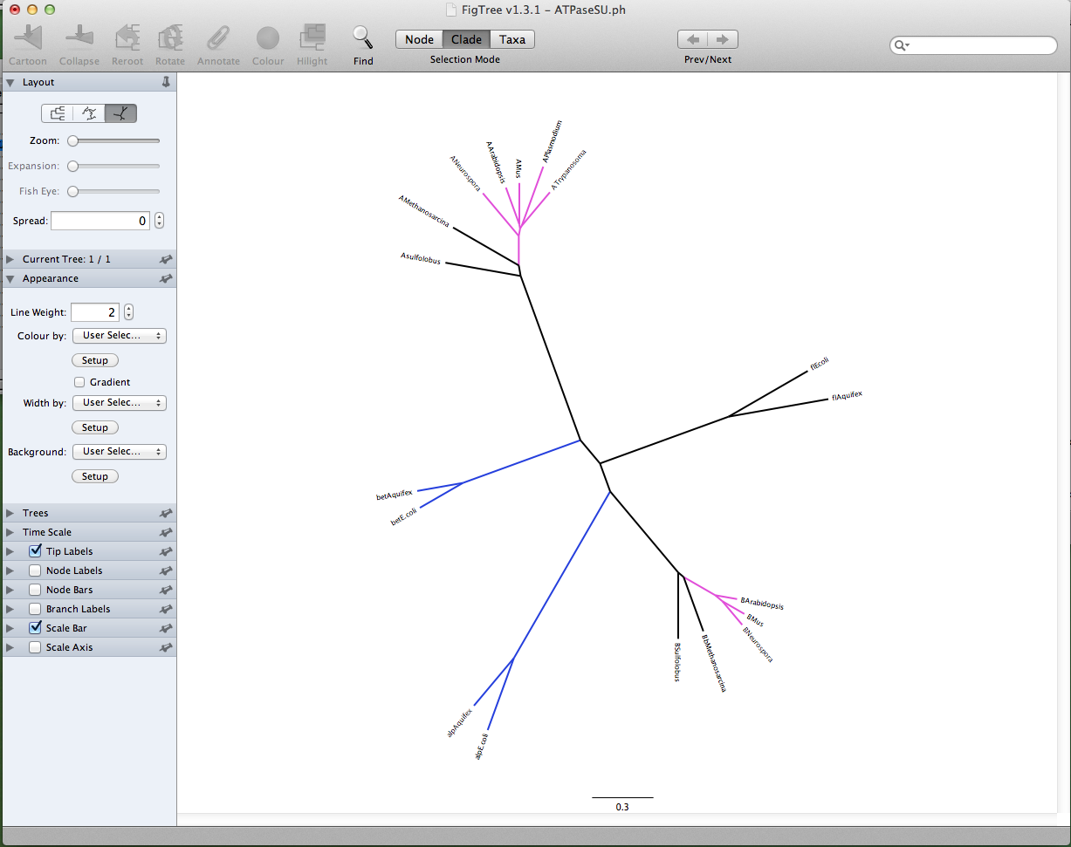
ATPase dataset -> nj in figtree

Slide 5
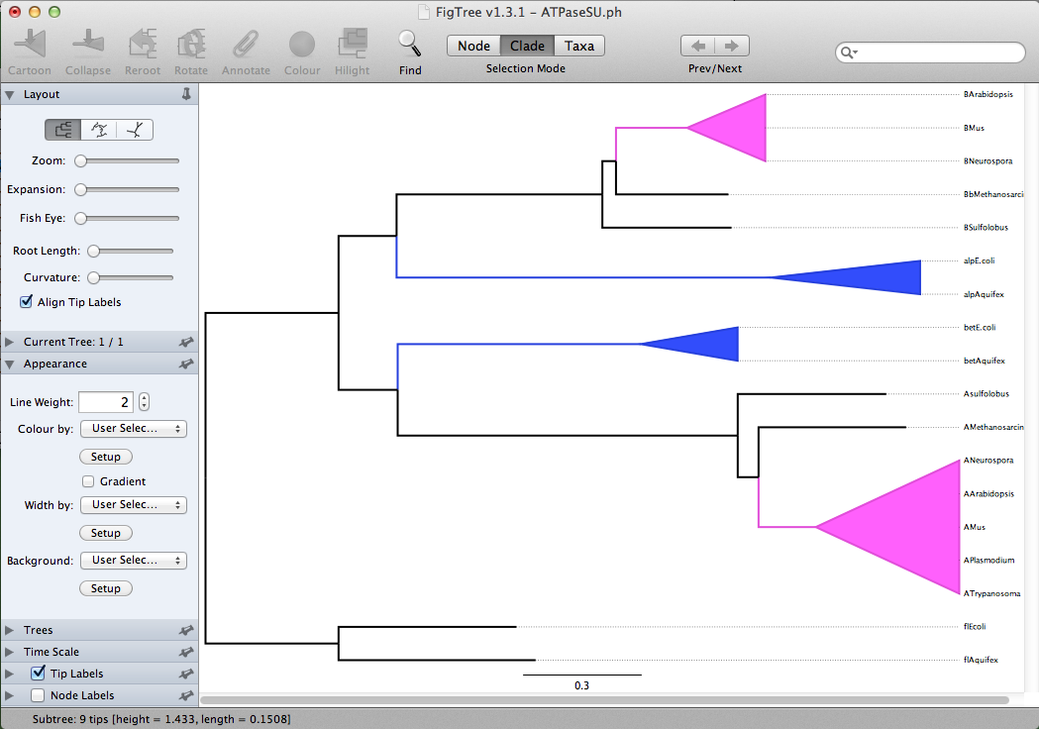
ATPase dataset -> nj in figtree

Slide 6
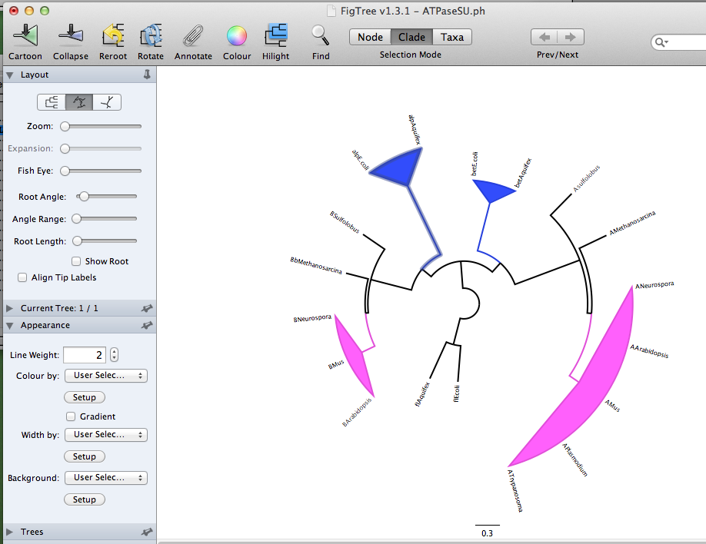
ATPase dataset -> nj in figtree

Slide 7
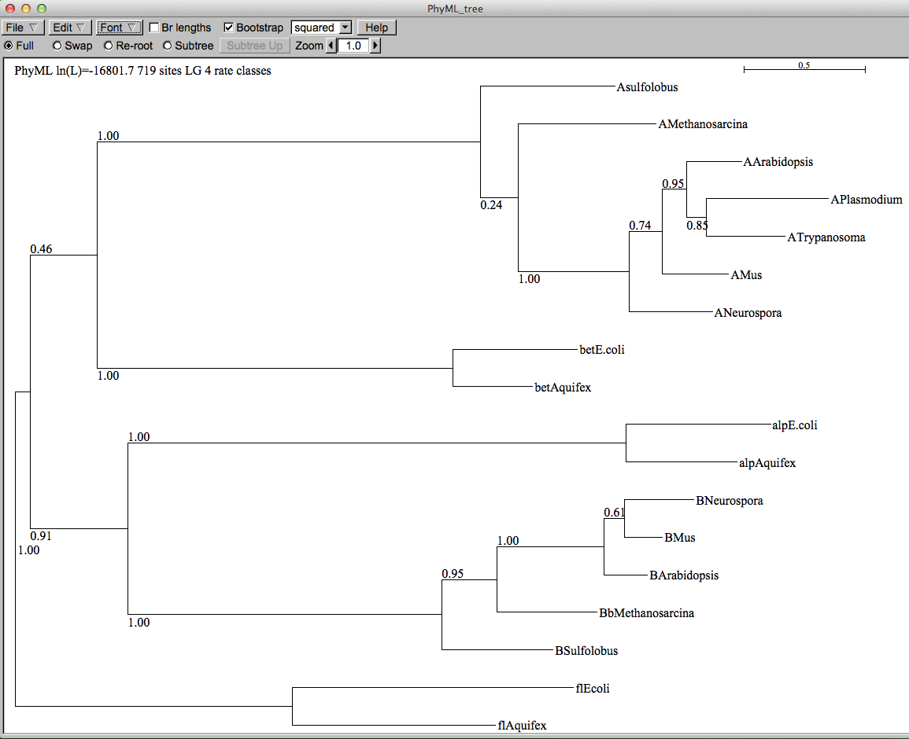
ATPase dataset -> muscle -> phyml (with ASRV)– re-rooted

Slide 8
Catalytic subunits
Non catalytic subunits
Archaea
Eukarya
Bacteria
Bacteria
Archaea
Eukarya
speciation
time
gene duplication
Notes:
Rooting the Tree of Life by an ancient Gene Duplicaiton

Slide 9
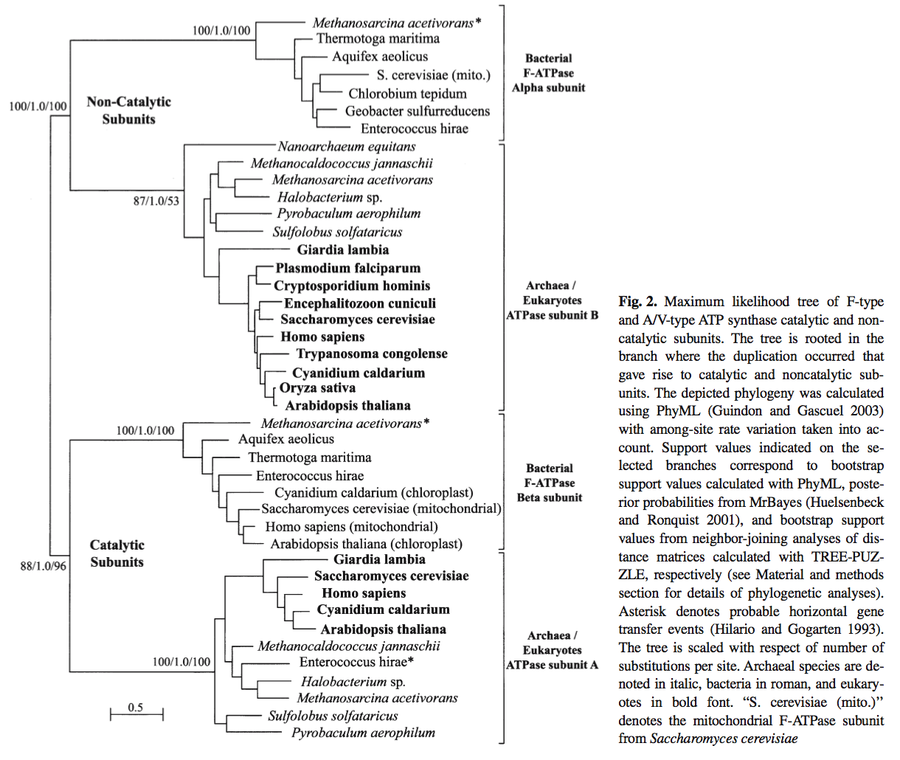

ATPase / ATPsynthase
ATP binding Subunits
Notes:
Zhaxybayeva, O., Lapierre, P., & Gogarten, J. P. (2005). Ancient gene duplications and the root(s) of the tree of life. Protoplasma, 227(1), 53–64. doi:10.1007/s00709-005-0135-1

Slide 10
B
A
B
V-proteolipid
A
A
B
N
C
c
A-proteolipids
V-type ATPase
A-type ATPase
N
N
C
C
α
β
α
Halobacterium
Methanococcus
Methanopyrus
β
β
α
c
F-proteolipid
N
C
F-type ATPase
Notes:
Proton pumping ATPases usually are classified as follows: P-, V- and F-type H⁺-ATPases. The F- and V-type (vacuolar) ATPases possess two major portions: the hydrophilic and the hydrophobic membrane sectors, named as F₁ or V₁ and F₀ or V₀, respectively.
The F-ATPase is present in the plasma membrane of Bacteria, inner membrane of mitochondria and thylakoid membranes of chloroplasts. This enzyme consumes the electrochemical H⁺ gradient to synthesize ATP or hydrolyzes ATP to build up a H+ gradient. The V-ATPase is present in the endomembrane systems of eukaryotes: vacuoles, Golgi apparatus and coated vesicles. The Archaea have an ATPase whose primary structure is very similar to the V-ATPase, but whose function is more similar to F-ATPases. Therefore, the archaeal counterpart of the V-ATPases is called A-ATPase.
The hydrophobic sector F0/V0 is formed by the subunits a, b and c. Subunit c, also called proteolipid, is involved in H⁺ translocation across the membrane. The vacuolar ATPases have 6 proteolipids per enzyme with a molecular weight of 16 kDa each. The V-ATPase proteolipids consist of four membrane spanning helices, while the F-ATPase proteolipids have only two membrane spanning helices.
The number of transmembrane helices of the archaeal ATPase proteolipid vary in size: 2 in Halobacterium, 3 in Sulfolobus and Thermus, and 5 in Methanococcus.
While the gene duplication that gave rise to the catalytic and non catalytic subunits occurred before the divergence of the V/F/A-ATPase, the gene duplication and fusion events that gave rise to the large V-type proteolipid occurred only in the branch leading to vacuolar type ATPase. The resulting protein has four transmembrane helices, and is twice the size of the F-proteolipid, but still possesses only one catalytic residue.

Slide 11
12 proteolipid Ds / 3 catalytic SU =
4H⁺(Na⁺) / ATP
6 proteolipid Ds / 3 catalytic SU =
2H⁺(Na⁺) / ATP
12 proteolipid Ds / 3 catalytic SU =
4H⁺(Na⁺) / ATP
Reversible Enzyme
Dedicated Ion Pump
Reversible Enzyme
12 proteolipid Ds / 3 catalytic SU =
4H⁺(Na⁺) / ATP
Reversible Enzyme
12 proteolipid Ds / 6 catalytic SU =
2 H⁺(Na⁺) / ATP
Dedicated Ion Pump

Slide 12
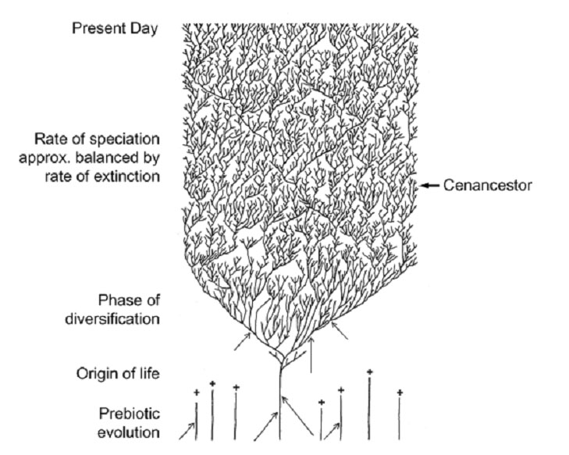
The Coral of Life (Darwin)
ZHAXYBAYEVA and GOGARTEN (2004):
Cladogenesis, Coalescence and the Evolution of the Three Domains of Life.
Trends in Genetics 20 (4): 182- 187
Notes:
The “Coral of Life” and the transfer of characters from now extinct into surviving lineages

Slide 13
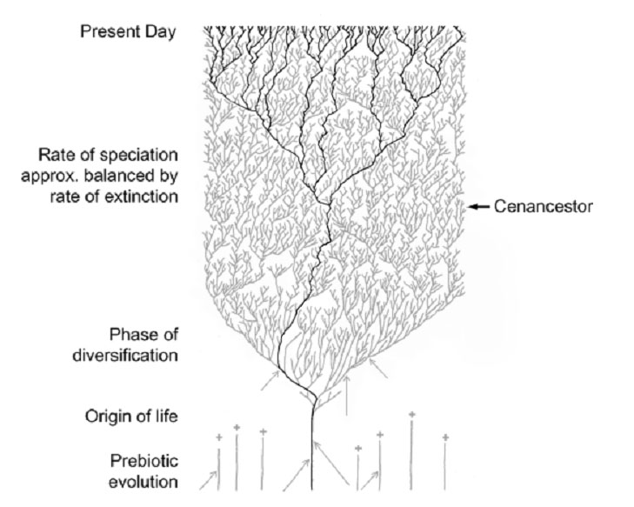
The Coral of Life (Darwin)
ZHAXYBAYEVA and GOGARTEN (2004):
Cladogenesis, Coalescence and the Evolution of the Three Domains of Life.
Trends in Genetics 20 (4): 182- 187
Notes:
The “Coral of Life” and the transfer of characters from now extinct into surviving lineages

Slide 14
The Coral of Life (Darwin)
ZHAXYBAYEVA and GOGARTEN (2004):
Cladogenesis, Coalescence and the Evolution of the Three Domains of Life.
Trends in Genetics 20 (4): 182- 187
Notes:
The “Coral of Life” and the transfer of characters from now extinct into surviving lineages

Slide 15
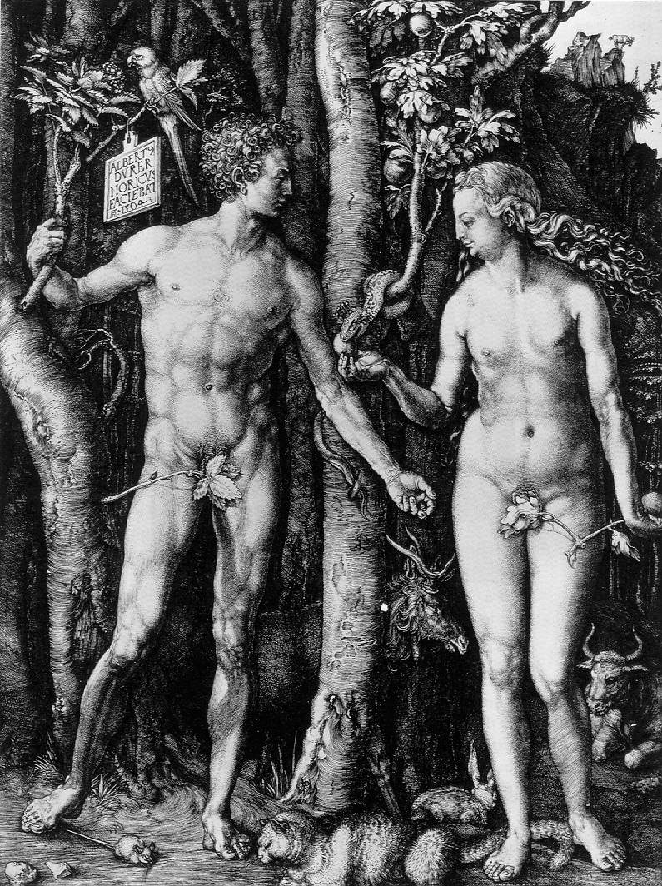
Y chromosome
Adam
Mitochondrial
Eve
Lived
approximately
40,000 years ago
Lived
166,000-249,000
years ago
Thomson, R. et al. (2000) Proc Natl Acad Sci U S A 97, 7360-5
Underhill, P.A. et al. (2000) Nat Genet 26, 358-61
Mendez et al. (2013) American Journal of Human Genetics 92 (3): 454.
Cann, R.L. et al. (1987) Nature 325, 31-6
Vigilant, L. et al. (1991) Science 253, 1503-7
Albrecht Dürer, The Fall of Man, 1504
Adam and Eve never met ☹
The same is true for ancestral rRNAs, EF, ATPases!

Slide 16
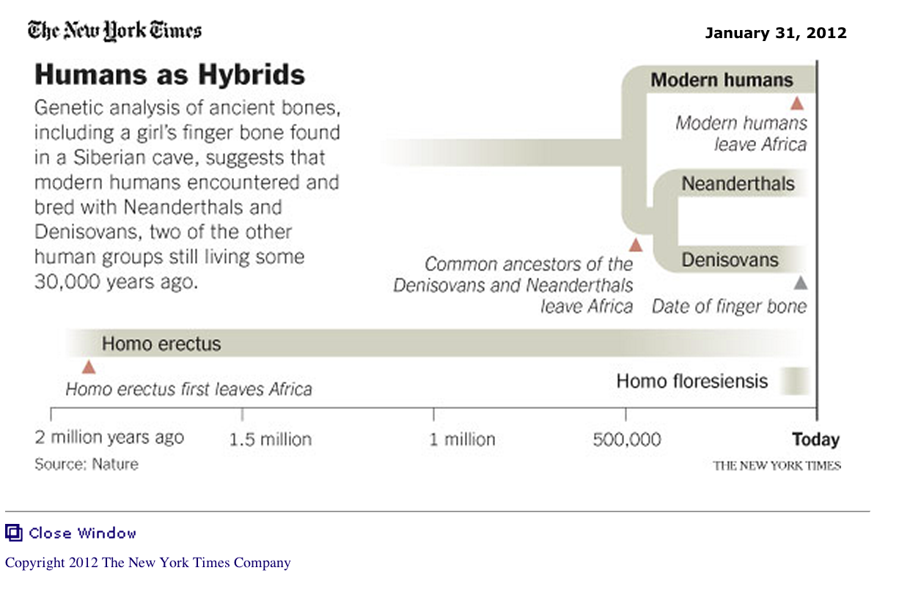
From: http://www.nytimes.com/2012/01/31/science/gains-in-dna-are-speeding-research-into-human-origins.html?_r=1

Slide 17
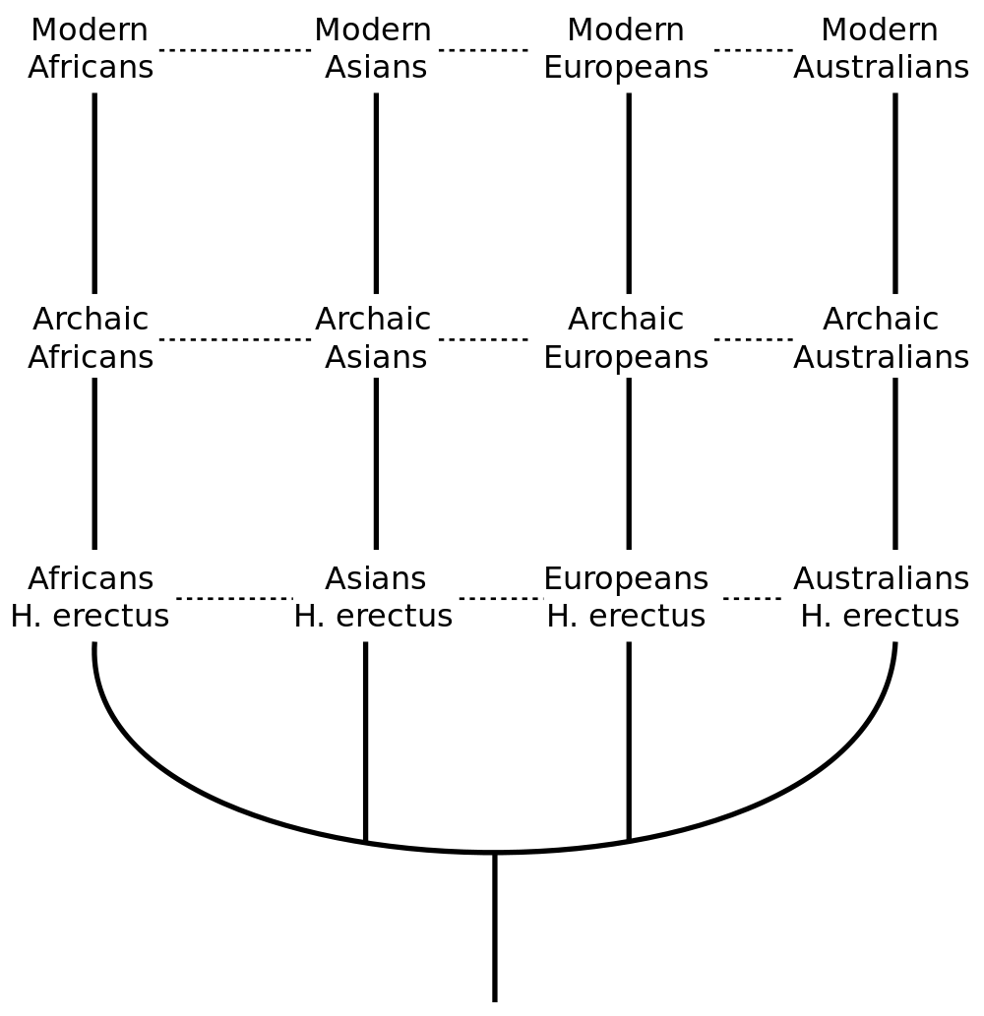
The multiregional hypothesis
From http://en.wikipedia.org/wiki/Multiregional_Evolution

Slide 18
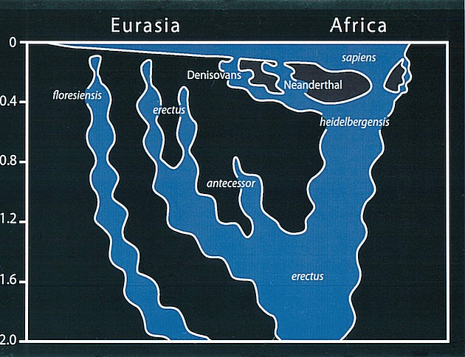
Archaic human admixture with modern Homo sapiens
From: http://en.wikipedia.org/wiki/Archaic_human_admixture_with_modern_Homo_sapiens

Slide 19
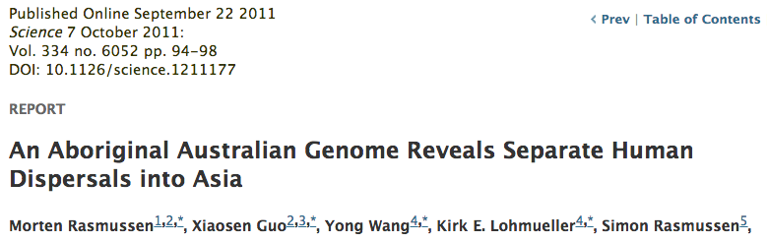
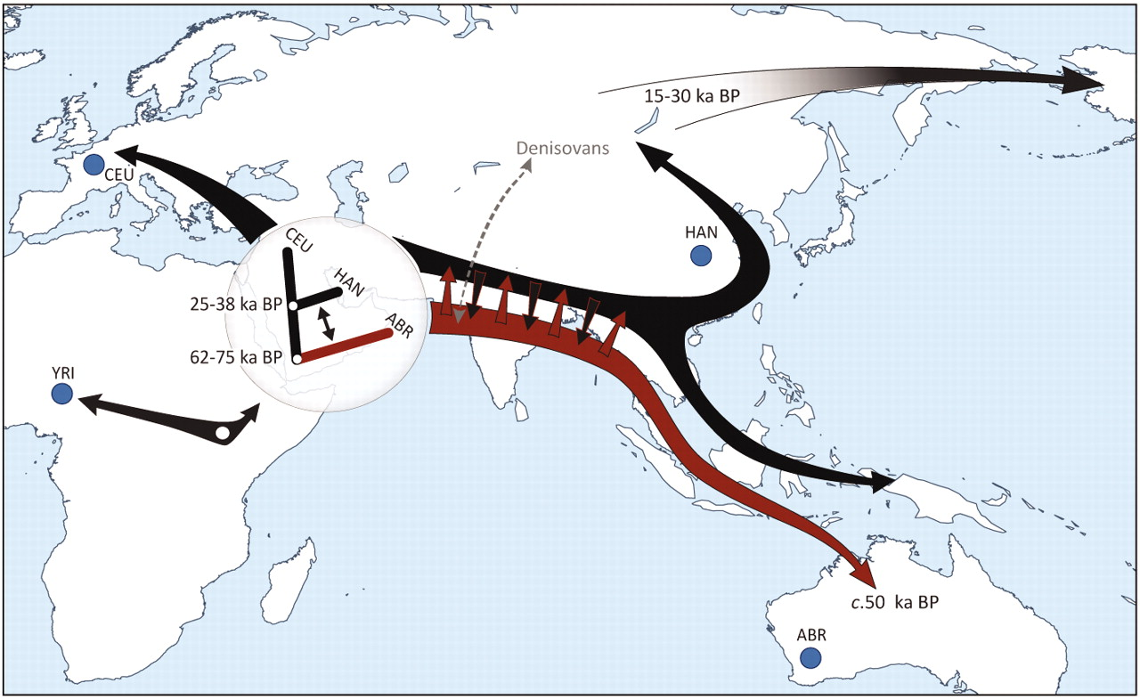

Slide 20
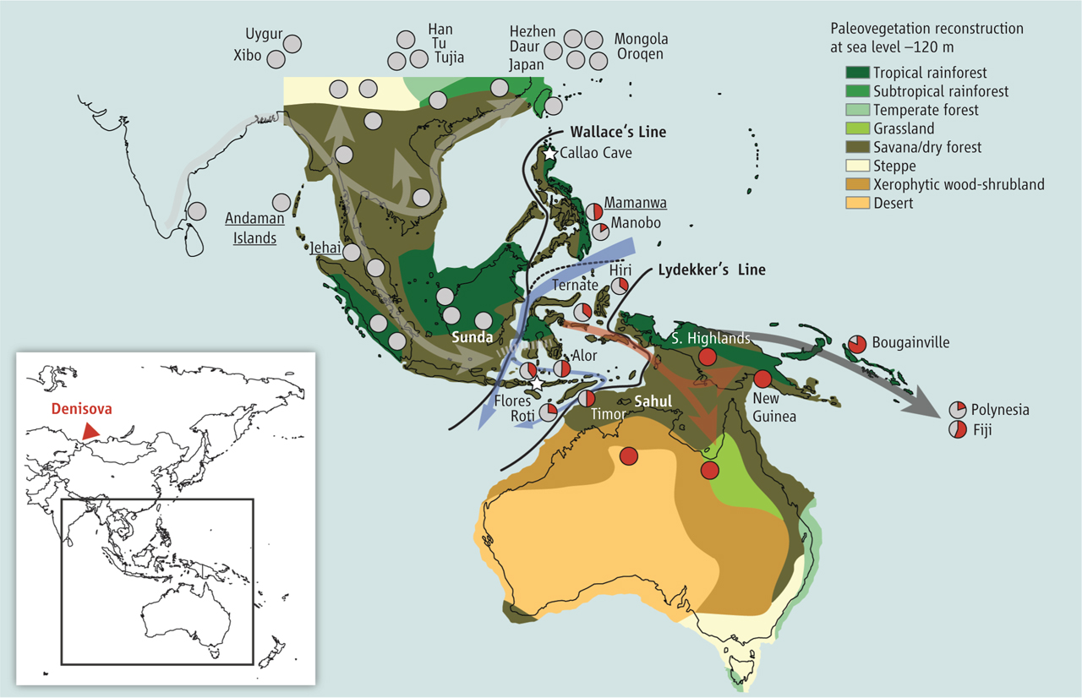
Did the Denisovans Cross Wallace's Line?
Science 18 October 2013:
vol. 342 no. 6156 321-323
Ancient migrations.
The proportions of Denisovan DNA in modern human populations are shown as red in pie charts, relative to New Guinea and Australian Aborigines (3). Wallace's Line (8) is formed by the powerful Indonesian flow-through current (blue arrows) and marks the limit of the Sunda shelf and Eurasian placental mammals.

Slide 21
For more discussion on archaic and early humans see:
http://en.wikipedia.org/wiki/Denisova_hominin
http://www.nytimes.com/2012/01/31/science/gains-in-dna-are-speeding-research-into-human-origins.html
http://www.nytimes.com/2014/10/23/science/research-humans-interbred-with-neanderthals.html?
http://www.sciencedirect.com/science/article/pii/S0002929711003958
http://www.abc.net.au/science/articles/2012/08/31/3580500.htm
http://www.sciencemag.org/content/334/6052/94.full
http://www.sciencemag.org/content/334/6052/94/F2.expansion.html
http://haplogroup-a.com/Ancient-Root-AJHG2013.pdf

Slide 22
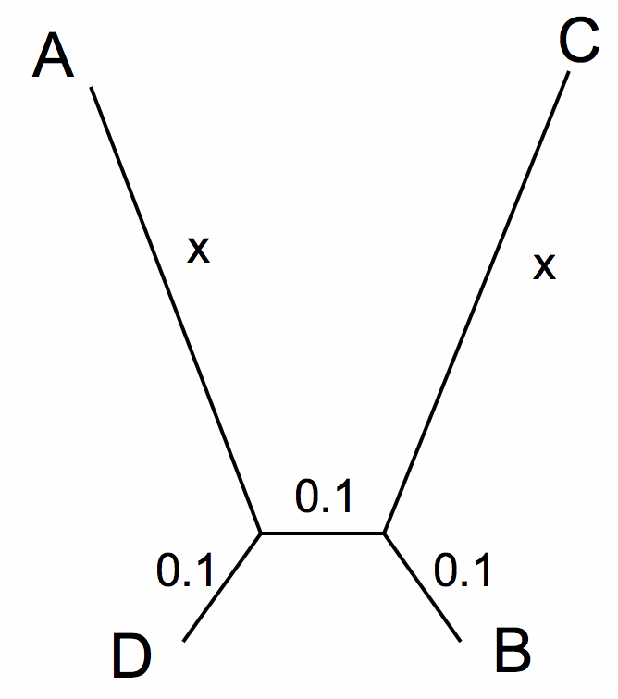
LBA
ProtPars

Slide 23
LBA
Prot Dist no Gamma and no alignment

Slide 24
LBA
Prot Dist with Gamma and no alignment

Slide 25
LBA
Prot Dist with Gamma and alignment

Slide 26
LBA
phyml no-alignment

Slide 27
LBA
phyml Gamma = 1
no alignment – true homologous positions
with muscle alignment
log₁₀(x)

Slide 28
LBA
phyml Gamma = 1
no alignment – true homologous positions
with clustalo alignment
log₁₀(x)

Slide 29
LBA
phyml no-alignment
A
C
still resolved by ml
D
B

Slide 30
Muscle alignment
clustalo

Slide 31
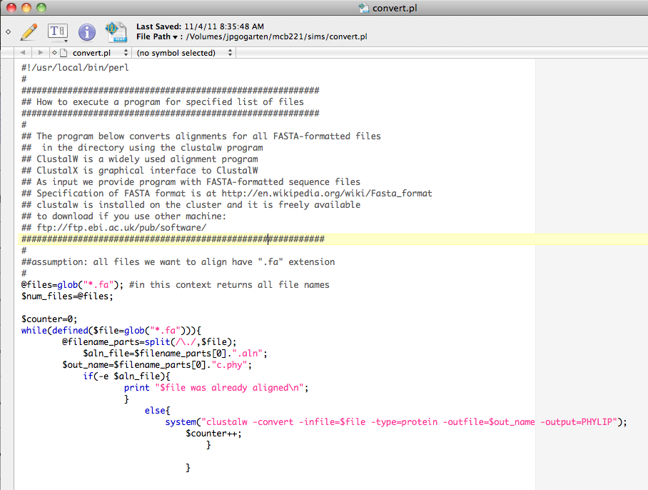

Slide 32
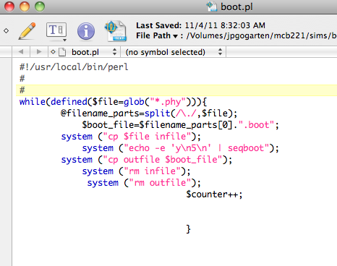

Slide 33
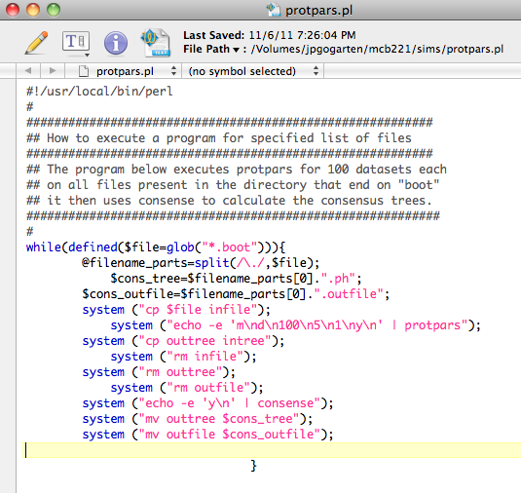

Slide 34
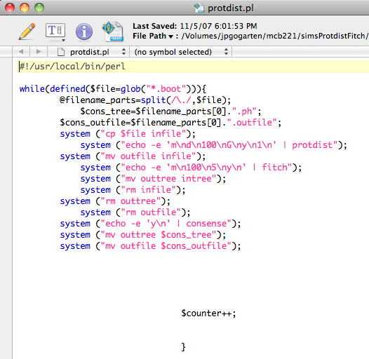

Slide 35
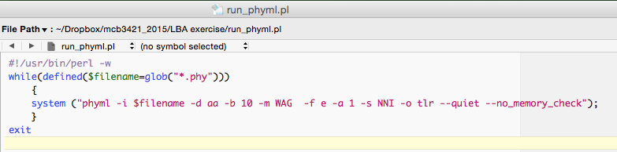
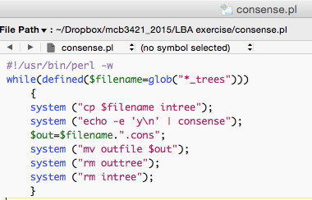

Slide 36
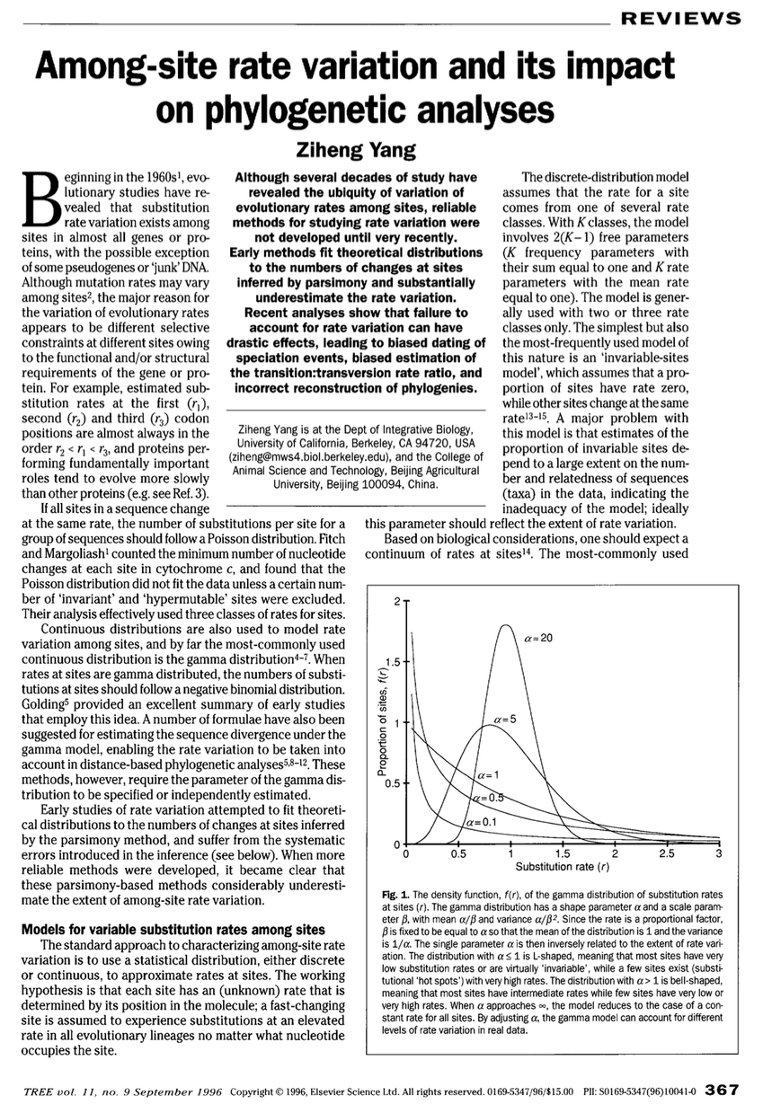

Slide 37
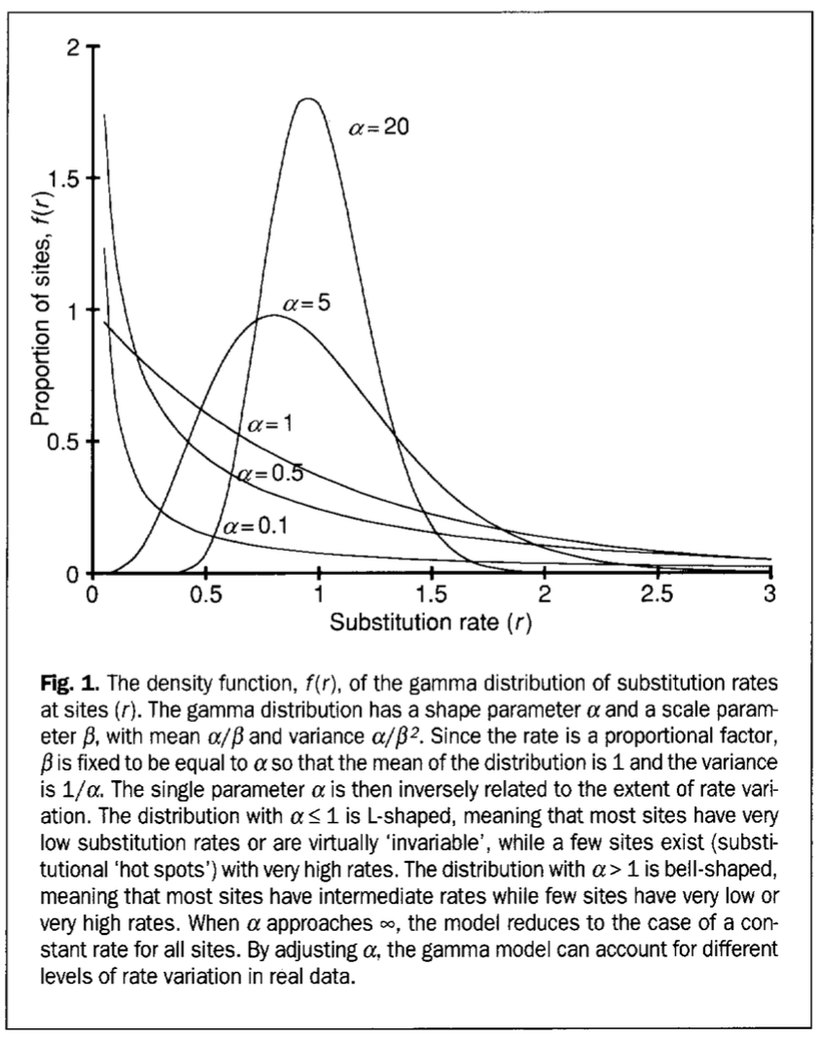

Slide 38
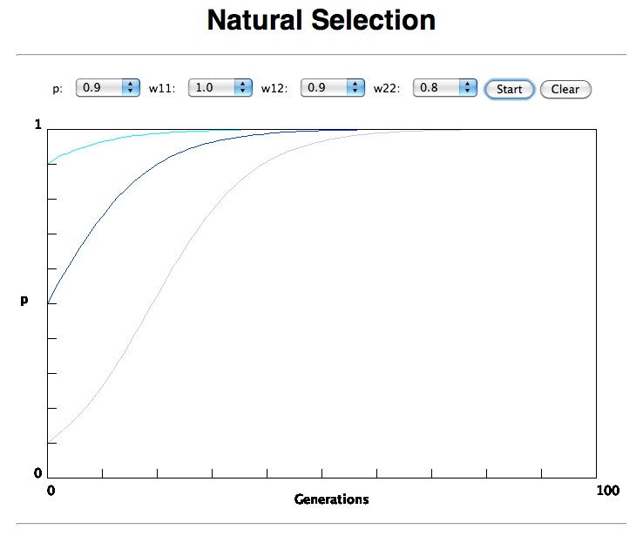

Slide 39
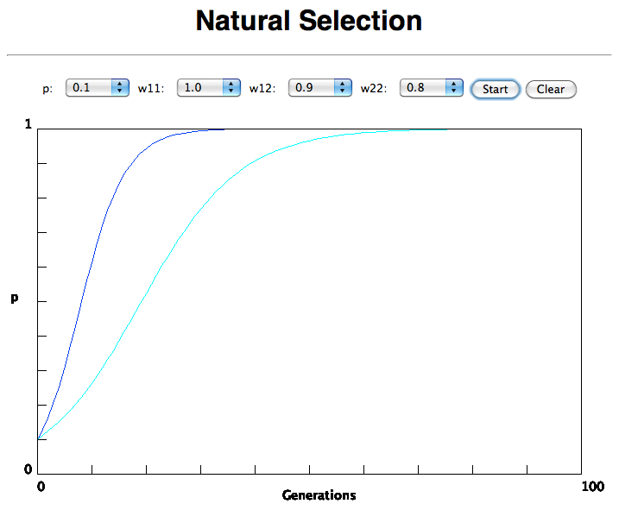
In the deterministic model, the time till fixation depends on the selective advantage, but fixation is guaranteed.

Slide 40
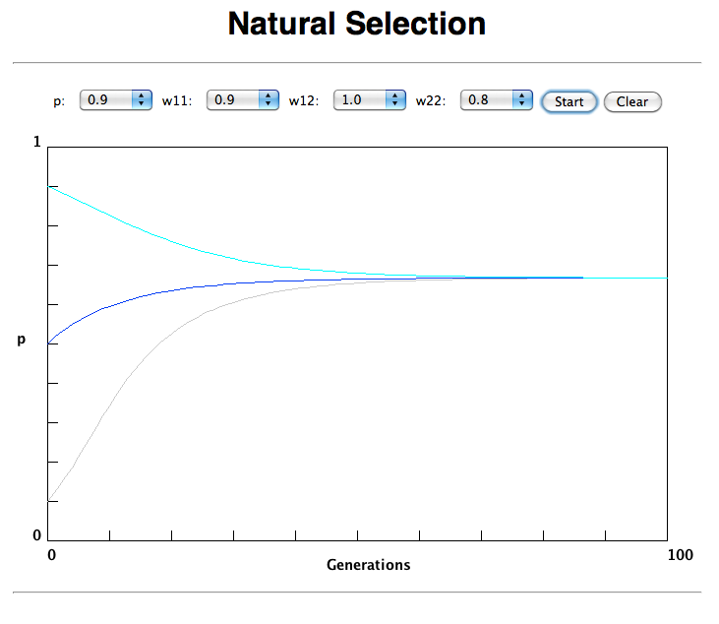
Only in case the heterozygote has an advantage (=balancing
selection) do both alleles coexist in a population.

Slide 41
Neutral theory:
The vast majority of observed sequence differences between members of a population are neutral (or close to neutral). These differences can be fixed in the population through random genetic drift. Some mutations are strongly counter selected (this is why there are patterns of conserved residues). Only very seldom is a mutation under positive selection.
The neutral theory does not say that all evolution is neutral and everything is only due to to genetic drift.

Slide 42
the gradualist point of view
Evolution occurs within populations where the fittest organisms have a selective advantage. Over time the advantages genes become fixed in a population and the population gradually changes.
Note: this is not in contradiction to the the theory of neutral evolution. (which says what ?)
Processes that MIGHT go beyond inheritance with variation and selection?
  Horizontal gene transfer and recombination
  Polyploidization (botany, vertebrate evolution) see here or here
  Fusion and cooperation of organisms (Kefir, lichen, also the eukaryotic cell)
  Targeted mutations (?), genetic memory (?) (see Foster's and Hall's reviews on directed/adaptive mutations; see here for a counterpoint)
  Random genetic drift
  Gratuitous complexity
  Selfish genes (who/what is the subject of evolution??)
  Parasitism, altruism, Morons
  Evolutionary capacitors
  Hopeless monsters (in analogy to Goldschmidt’s hopeful monsters)

Slide 43
Nearly Neutral theory:
Even synonymous mutations do not lead to random composition but to codon bias. Small negative selection might be sufficient to produce the observed codon usage bias.

Slide 44
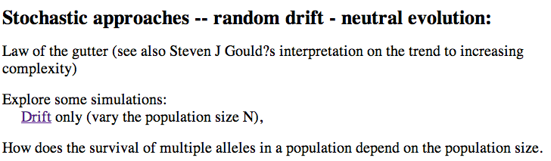
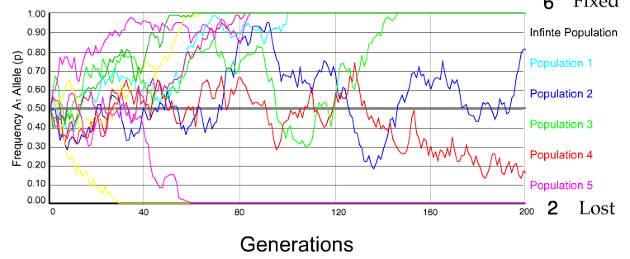
N=50 s=0
10 replicates

Slide 45
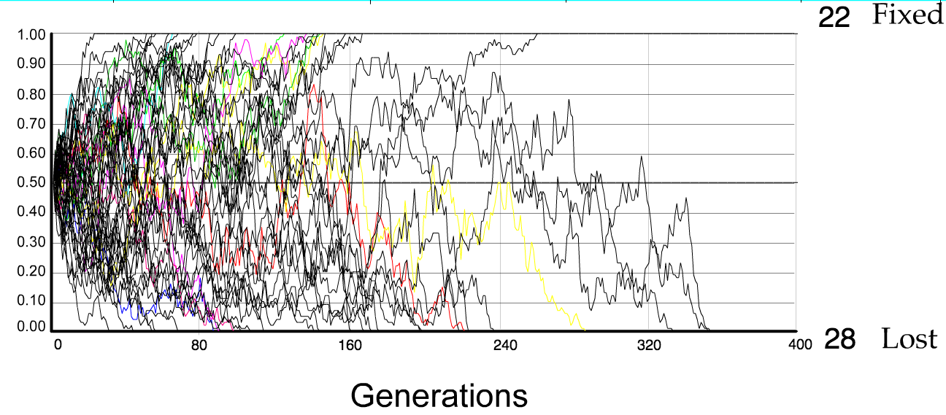
N=50 s=0
50 replicates

Slide 46
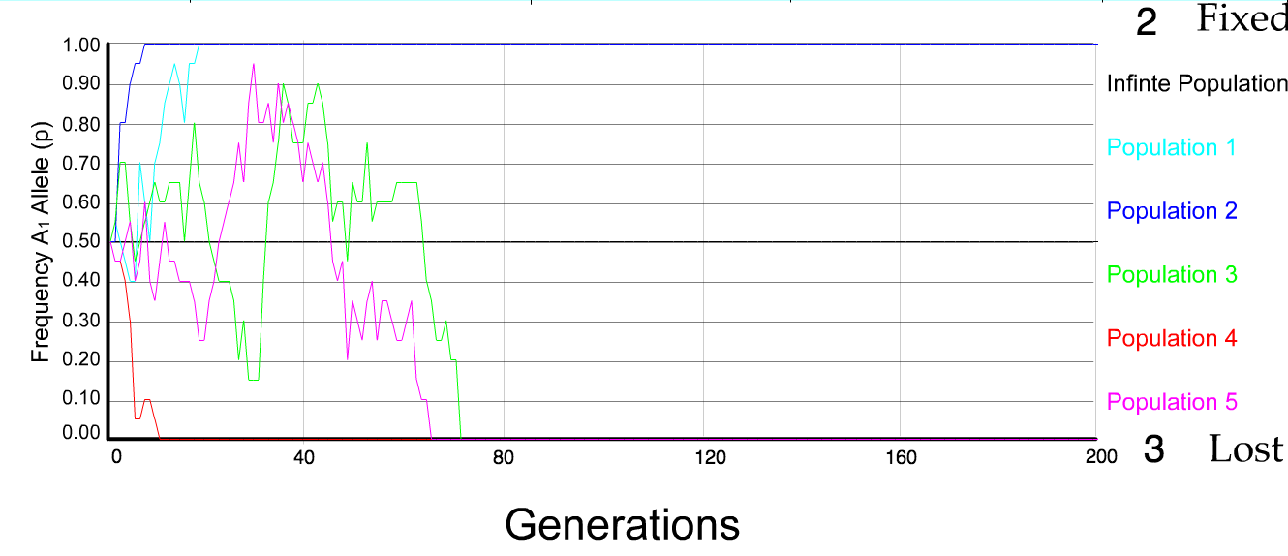
N=10 s=0
5 replicates

Slide 47
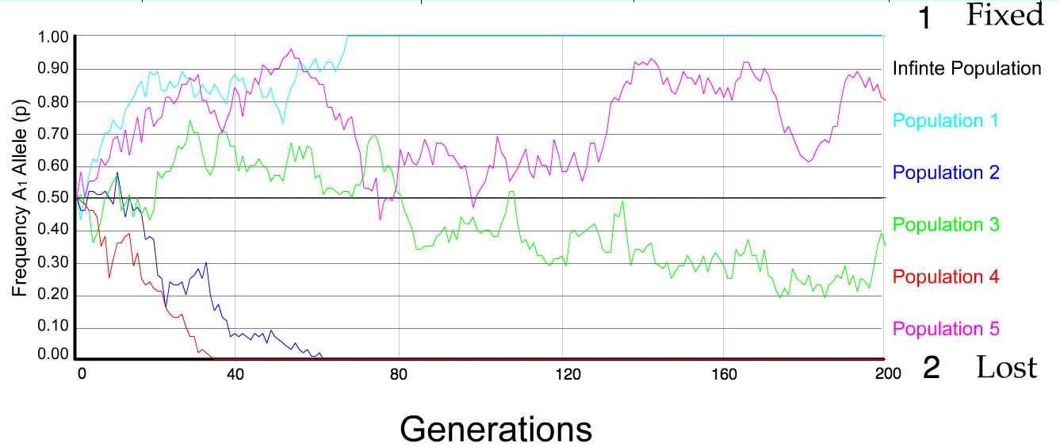
N=50 s=0
5 replicates

Slide 48
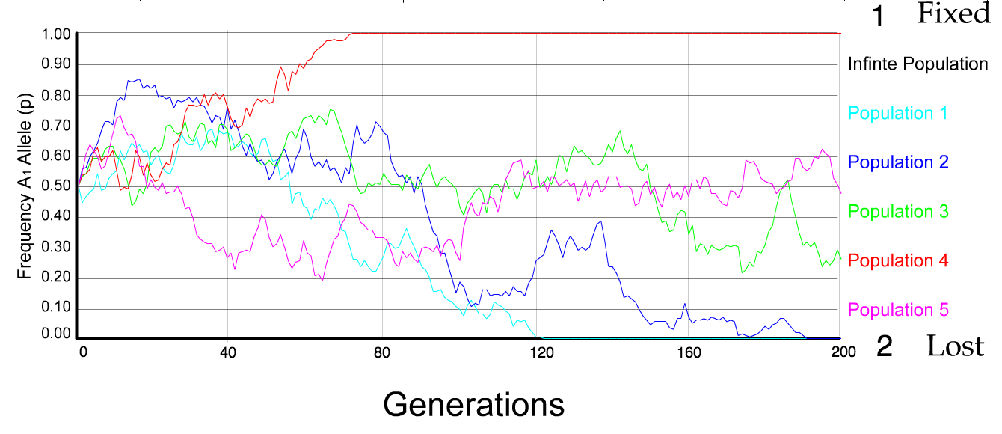
N=100 s=0
5 replicates

Slide 49
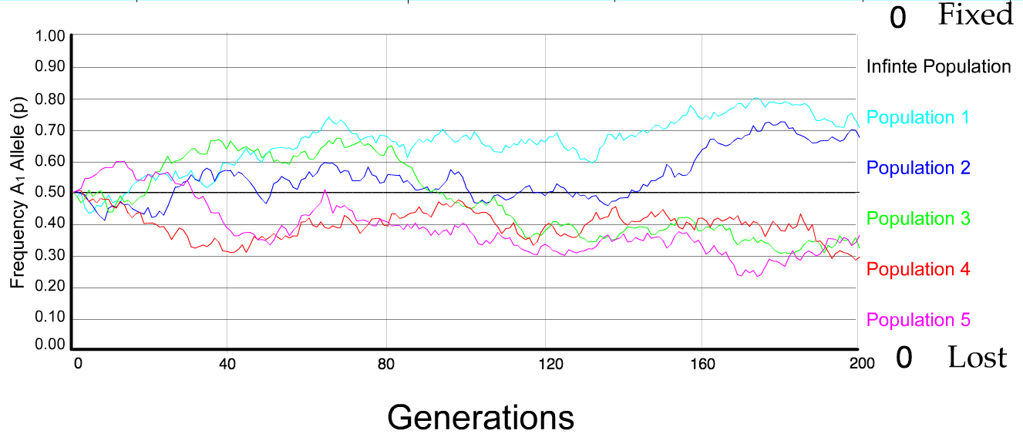
N=500 s=0
5 replicates

Slide 50
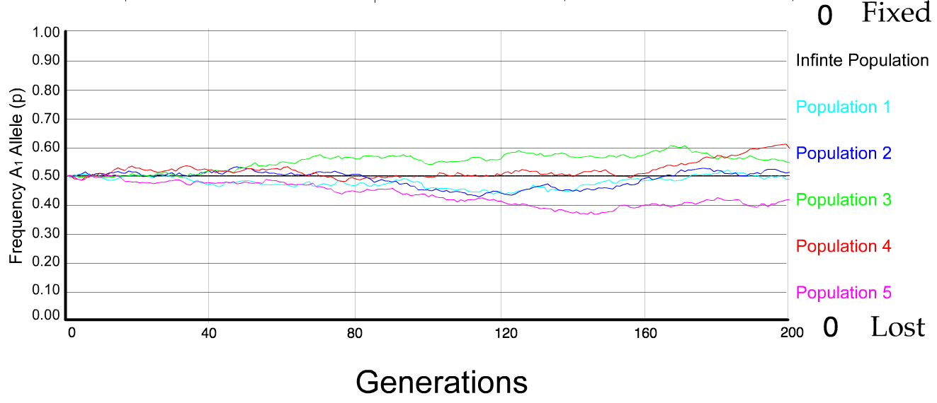
N=5000 s=0
5 replicates

Slide 51
s=0
Probability of fixation, P, is equal to frequency of allele in population. Mutation rate (per gene/per unit of time) = u ;
freq. with which allele is generated in diploid population size N =u*2N
Probability of fixation for each allele = 1/(2N)
Substitution rate =
frequency with which new alleles are generated * Probability of fixation= u*2N *1/(2N) = u = Mutation rate
Therefore:
If f s=0, the substitution rate is independent of population size, and equal to the mutation rate !!!! (NOTE: Mutation unequal Substitution! )
This is the reason that there is hope that the molecular clock might sometimes work.
Fixation time due to drift alone:
t_{av}=4*N_{e} generations
(N_{e}=effective population size; For n discrete generations
N_{e}= n/(1/N₁+1/N₂+…..1/N_{n})

Slide 52
s>0
Time till fixation on average:
t_{av}= (2/s) ln (2N) generations
(also true for mutations with negative “s” ! discuss among yourselves)
E.g.: N=10⁶,
s=0: average time to fixation: 4*10⁶ generations
s=0.01: average time to fixation: 2900 generations
N=10⁴,
s=0: average time to fixation: 40.000 generations
s=0.01: average time to fixation: 1.900 generations
N=10¹¹ (100 billion – size of the Prochlorococcus population),
s=0: average time to fixation: 4*10¹¹ generations (about 1 billion years) s=0.01: average time to fixation: 5200 generations (about 14 years)
Test question: What is the probability of fixation?
=> substitution rate of mutation under positive selection is larger than the rate with which neutral mutations are fixed.

Slide 53
Positive selection (s>0)
A new allele (mutant) confers some increase in the fitness of the organism
Selection acts to favour this allele
Also called adaptive selection or Darwinian selection.
NOTE: Fitness = ability to survive and reproduce
Modified from from www.tcd.ie/Genetics/staff/Aoife/GE3026/GE3026_1+2.ppt

Slide 54
Random Genetic Drift
Selection
100
advantageous
Allele frequency
disadvantageous
0
Modified from from www.tcd.ie/Genetics/staff/Aoife/GE3026/GE3026_1+2.ppt

Slide 55
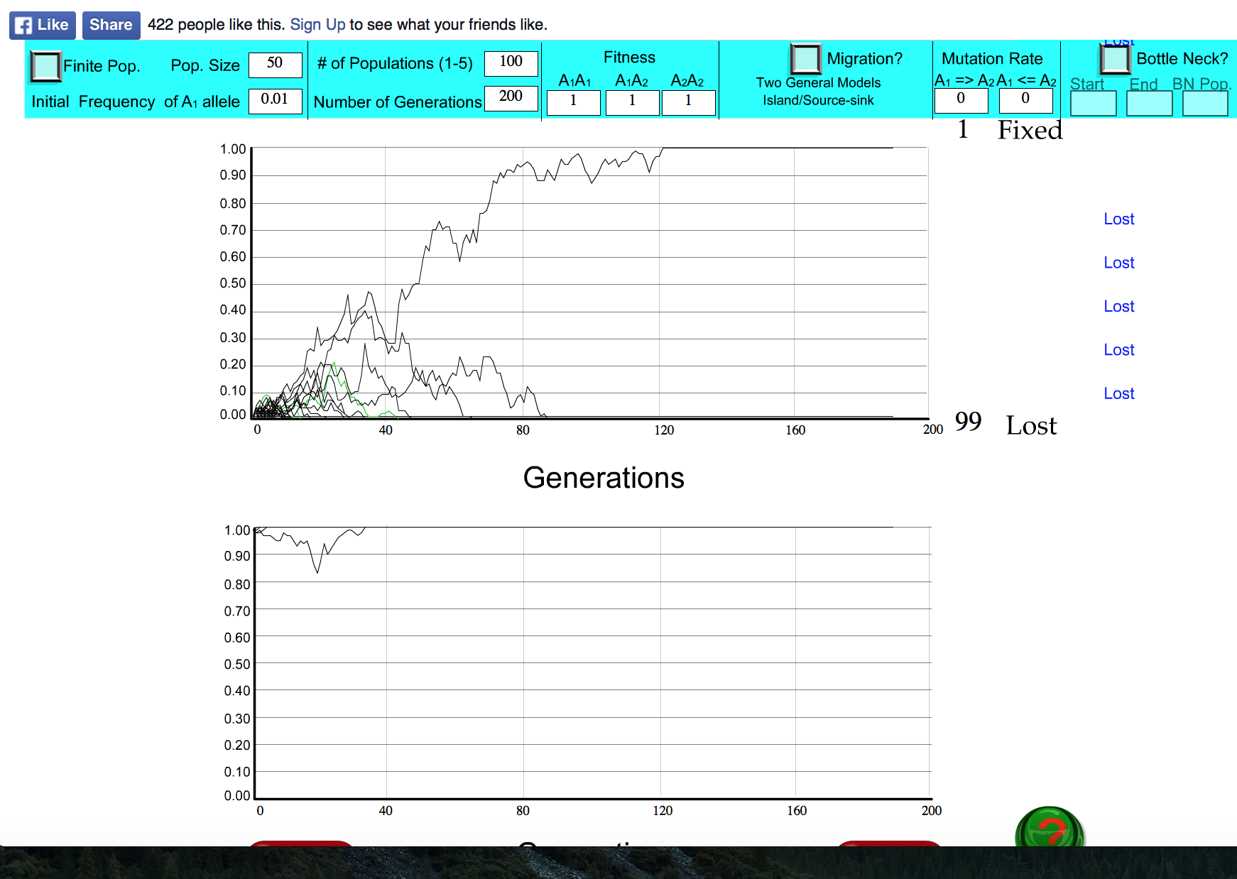
s=0

Slide 56
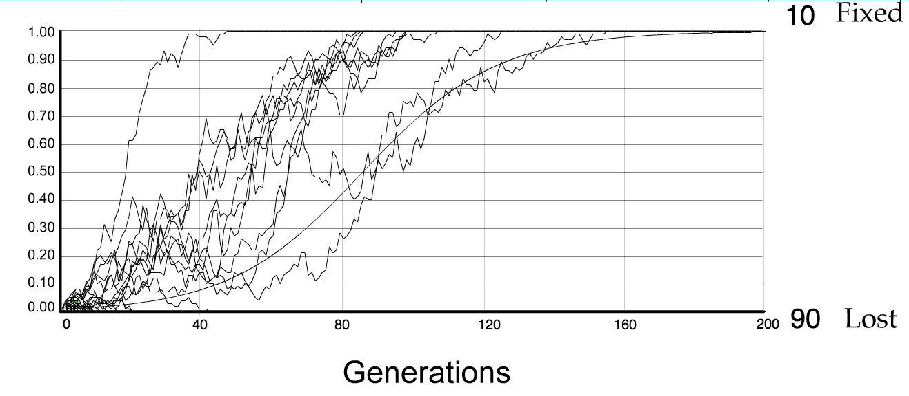
For advantageous mutations:
Probability of fixation, P, is approximately equal to 2s;
e.g., if selective advantage s = 5% then P = 10%
tav=2/s*log2N generations = 40*log100= 80

Slide 57
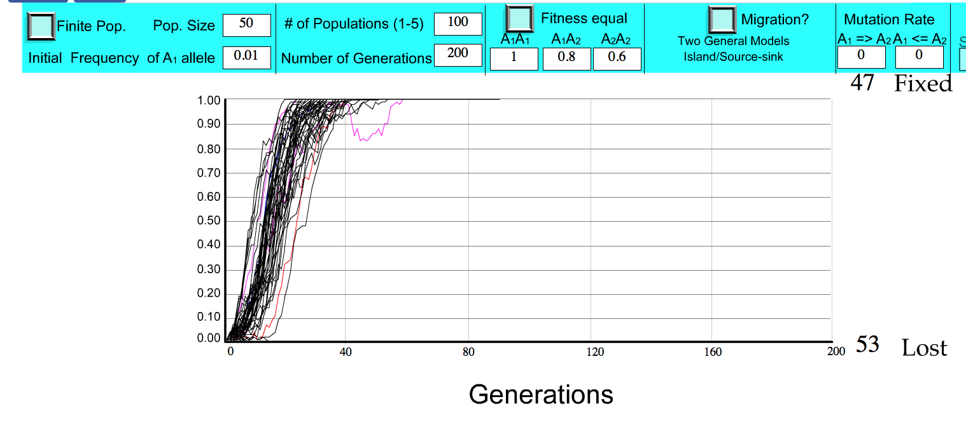
S=.2 => shorter fixation time.

Slide 58
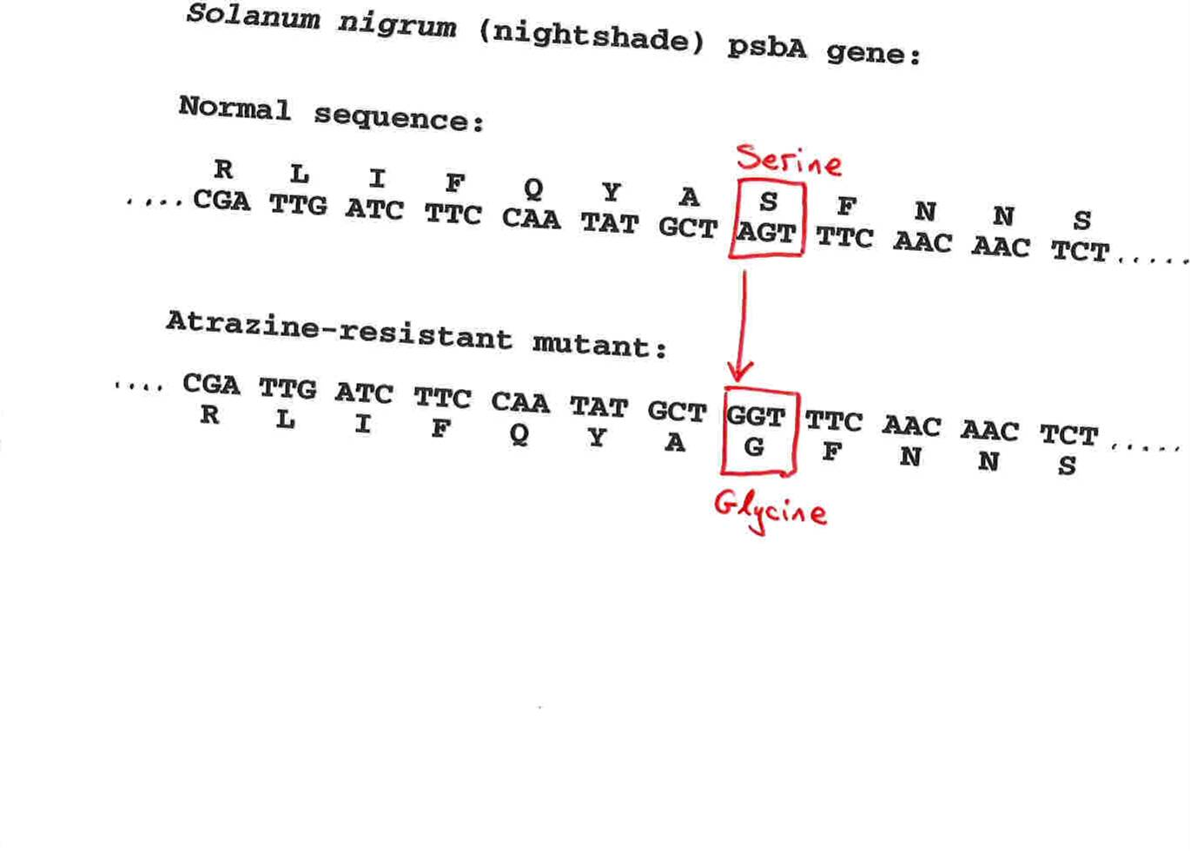
Advantageous allele
Herbicide resistance gene in nightshade plant
Modified from from www.tcd.ie/Genetics/staff/Aoife/GE3026/GE3026_1+2.ppt

Slide 59
selection versus drift
The larger the population the longer it takes for an allele to become fixed.
Note: Even though an allele conveys a strong selective advantage of 10%, the allele has a rather large chance to go extinct.
Note#2: Fixation is faster under selection than under drift.
Question: Can you think of genes that have a higher fixation probability? (Hint: HGT)

Slide 60
Negative selection (s<0)
A new allele (mutant) confers some decrease in the fitness of the organism
Selection acts to remove this allele
Also called purifying selection
Modified from from www.tcd.ie/Genetics/staff/Aoife/GE3026/GE3026_1+2.ppt

Slide 61
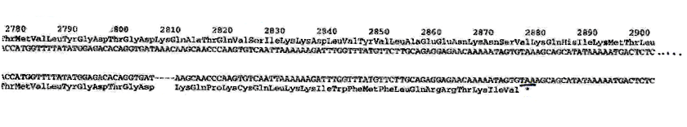
Deleterious allele
Human breast cancer gene, BRCA2
5% of breast cancer cases are familial
Mutations in BRCA2 account for 20% of familial cases
Normal (wild type) allele
Mutant allele
(Montreal 440
Family)
Stop codon
4 base pair deletion
Causes frameshift
Modified from from www.tcd.ie/Genetics/staff/Aoife/GE3026/GE3026_1+2.ppt

Slide 62
Neutral mutations
Neither advantageous nor disadvantageous
Invisible to selection (no selection)
Frequency subject to ‘drift’ in the population
Random drift – random changes in small populations

Slide 63
Types of Mutation-Substitution
Replacement of one nucleotide by another
Synonymous (Doesn’t change amino acid)
  Rate sometimes indicated by Ks
  Rate sometimes indicated by d_{s}
Non-Synonymous (Changes Amino Acid)
  Rate sometimes indicated by Ka
  Rate sometimes indicated by d_{n}
(this and the following 4 slides are from
mentor.lscf.ucsb.edu/course/ spring/eemb102/lecture/Lecture7.ppt)

Slide 64
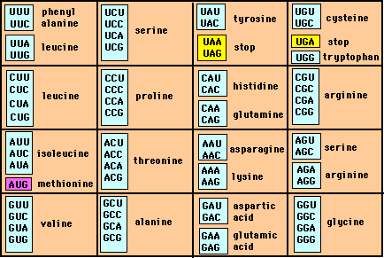
Genetic Code – Note degeneracy of 1st vs 2nd vs 3rd position sites

Slide 65
Genetic Code
Four-fold degenerate site – Any substitution is synonymous
From: mentor.lscf.ucsb.edu/course/spring/eemb102/lecture/Lecture7.ppt

Slide 66
Genetic Code
Two-fold degenerate site – Some substitutions synonymous, some
non-synonymous
From: mentor.lscf.ucsb.edu/course/spring/eemb102/lecture/Lecture7.ppt

Slide 67
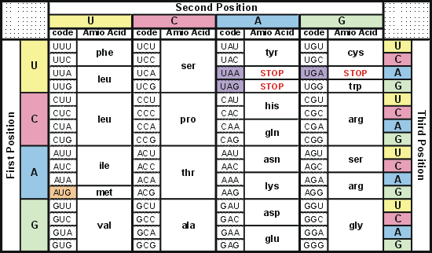
Degeneracy of 1st vs 2nd vs 3rd position sites results in 25.5% synonymous changes and 74.5% non synonymous changes (Yang&Nielsen,1998).
Genetic Code
Notes:
An inspection of the genetic code table suggests most changes at the first position are nonsynonymous, all changes at the second codon position are nonsynonymous and only some changes at the third position are synonymous. As a result we do not expect to see equal proportions of synonymous and nonsynonymous mutations even if there is no selection at protein level. Indeed, if mutations from any one nucleotide to any other occur at the same rate , we expect 25.5% of mutations to be synonymous and 74.5% mutations to be nonsynonymous.

Slide 68
Measuring Selection on Genes
Null hypothesis = neutral evolution
Under neutral evolution, synonymous changes should accumulate at a rate equal to mutation rate
Under neutral evolution, amino acid substitutions should also accumulate at a rate equal to the mutation rate
From: mentor.lscf.ucsb.edu/course/spring/eemb102/lecture/Lecture7.ppt

Slide 69
Counting #s/#a
Ser Ser Ser Ser Ser
Species1 TGA TGC TGT TGT TGT
Ser Ser Ser Ser Ala
Species2 TGT TGT TGT TGT GGT
#s = 2 sites
#a = 1 site
#a/#s=0.5
To assess selection pressures one needs to calculate the rates (Ka, Ks), i.e. the occurring substitutions as a fraction of the possible syn. and nonsyn. substitutions.
Things get more complicated, if one wants to take transition transversion ratios and codon bias into account. See chapter 4 in Nei and Kumar, Molecular Evolution and Phylogenetics.
Modified from: mentor.lscf.ucsb.edu/course/spring/eemb102/lecture/Lecture7.ppt

Slide 70
Testing for selection using dN/dS ratio
dN/dS ratio (aka Ka/Ks or ω (omega) ratio) where
dN = number of non-synonymous substitutions / number of all possible non-synonymous substitutions
dS =number of synonymous substitutions / number of all possible non-synonymous substitutions
dN/dS >1 positive, Darwinian selection
dN/dS =1 neutral evolution
dN/dS <1 negative, purifying selection
Notes:
The synonymous and non-synonymous rates dN and dS are defined as the numbers of synonymous and nonsynonymous substitutions per site. The ratio of the two rates omega=dN/dS then measures selective pressure at the protein level. If selection level has no effect on fitness, nonsynonymous mutations will be fixed at the same rate as synonymous mutations so that dN=dS and omega=1. If nonsynonymous mutations are deleterious purifying selection will reduce their fixation rate so that dN<dS and omega<1. If nonsynonymous mutations are favored by Darwinian selection, they will be fixed at a higher rate than synonymous mutations resulting in dN>dS and omega>1.

Slide 71
dambe
Two programs worked well for me to align nucleotide sequences based on the amino acid alignment,
One is DAMBE (only for windows). This is a handy program for a lot of things, including reading a lot of different formats, calculating phylogenies, it even runs codeml (from PAML) for you.
The procedure is not straight forward, but is well described on the help pages. After installing DAMBE go to HELP -> general HELP -> sequences -> align nucleotide sequences based on …->
If you follow the instructions to the letter, it works fine.
DAMBE also calculates Ka and Ks distances from codon based aligned sequences.

Slide 72
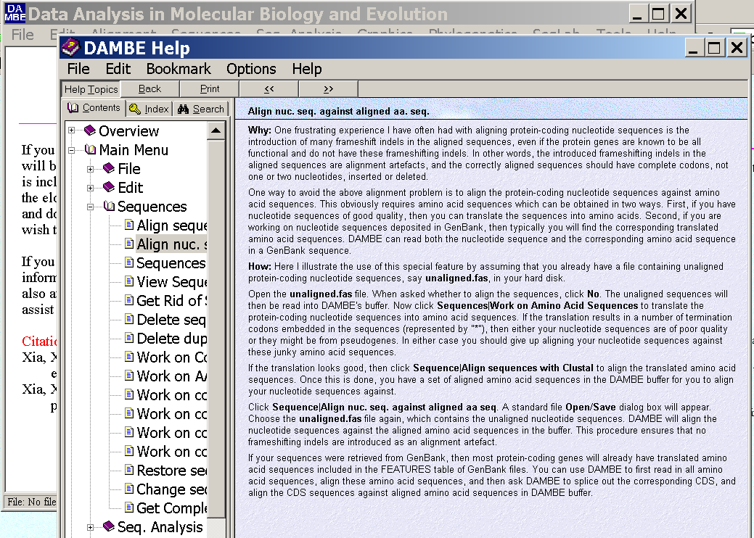
dambe (cont)

Slide 73
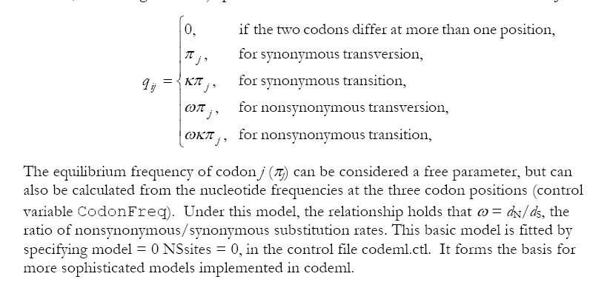
PAML (codeml) the basic model

Slide 74
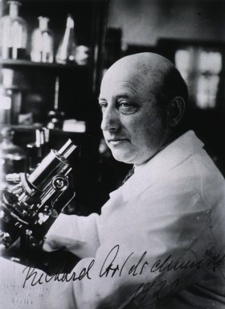
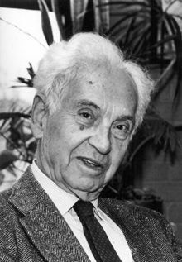
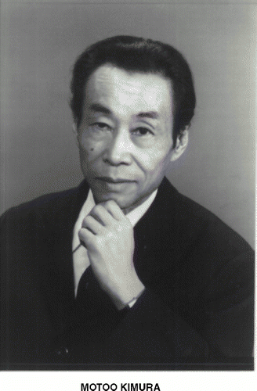
How do you define evolution?
Richard Goldschmidt 1940
hopeful monsters
Mutationism HGT/WGD!
Punctuated Equilibrium
Few genes / large effect
Vilified by Mayr, celebrated 1977 Gould & Evo-devo
Ernst Mayr 1942
NeoDarwinian Synthesis
Natural Selection
Gradualism
Many genes/small effect
Dario – “Fisher right”
Motoo Kimura 1968
Neutral Theory
Genetic Drift is main force for changing allele frequencies
Slide from Chris Pires
Notes:
Goldschmitdt,R. (1940). The Material Basis of Evolution
Mayr, Ernst (1942). Systematics and the origin of species, from the viewpoint of a zoologist

Slide 75
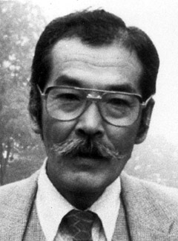
Duplications and Evolution
Ohno postulated that gene duplication plays a major role in evolution
Small scale duplications (SSD)
Whole genome duplications (WGD)
Polyploid: nucleus contains three or more copies of each chromosome
Autopolyploid: formed within a single species
Diploids AA and A’A’ Polyploid AAA’A’
Allopolyploid: formed from more than one species
Diploids AA and BB Polyploid AABB
Susumu Ohno 1970
Evolution by gene duplication
1R and 2R hypothesis
“Junk DNA” 1972
Slide from Chris Pires

Slide 76


e.g. gene duplications in yeast
from Benner et al., 2002
Figure 1. The number of duplicated gene pairs (vertical axis) in the genome of the yeast Saccharomyces cerevisiae versus f₂, a metric that models divergence of silent positions in twofold redundant codon systems via an approach-to-equilibrium kinetic process and therefore acts as a logarithmic scale of the time since the duplications occurred. Recent duplications are represented by bars at the right. Duplications that diverged so long ago that equilibrium at the silent sites has been reached are represented by bars where f₂ 0.55. Noticeable are episodes of gene duplication between the two extremes, including a duplication at f₂ 0.84. This represents the duplication, at ~80 Ma, whereby yeast gained its ability to ferment sugars found in fruits created by angiosperms. Also noticeable are recent duplications of genes that enable yeast to speed DNA synthesis, protein synthesis, and malt degradation, presumably representing yeast's recent interaction with humans.
The chemical pathway that converts glucose to alcohol in yeast arose ~80 Ma, near the time that fermentable fruits became dominant. Gene families that suffered duplication near this time, captured in the episode of gene duplication represented in the histogram in Fig. 1 by bars at f₂ 0.84, are named in red. According to the hypothesis, this pathway became useful to yeast when angiosperms (flowering, fruiting plants) began to provide abundant sources of fermentable sugar in their fruits.

Slide 77

Gene Transfer, Sex, and Recombination:
Inventions do not need to be made sequentially
Gene transfer, followed by homologous or non-homologous recombination, allows inventions to be shared across the tree of life

Slide 78
Aside: Gene and genome duplication versus
Horizontal Gene Transfer
Autochtonous gene/genome
duplication are rare
in prokaryotes
Gene family expansion through horizontal gene transfer –
the most common process in prokaryotes

Slide 79

Horizontal Gene Transfer (HGT) and the
Acquisition of New Capabilities
Most important process to adapt microorganisms to new environments.
E.g.: Antibiotic and heavy metal resistance,
pathways that allow acquisition and breakdown of new substrates.
Creation of new metabolic pathways.
HGT not autochthonous gene duplication is the main
process of gene family expansion in prokaryotes.
Also important in the recent evolution of multicellular eukaryotes
(HGT between fish species and between grasses).
Selection acts on the Holobiont (= Host + Symbionts)
To adapt to new conditions, new symbionts can be acquired, or existing symbionts can acquire new genes through HGT.

Slide 80





Gene Transfer in Eukaryotes
Bacterial parasites on red algae
HGT
Human gut symbiont

Slide 81

Gene Transfer in Eukaryotes – Example 2
Highlights
Key genes for C₄ photosynthesis were transmitted between distantly related grasses
These genes contributed to the adaptation of the primary metabolism
Their transmission was independent from most of the genome
Curr Biol. 2012 Mar 6;22(5):445-9. Epub 2012 Feb 16.
Adaptive Evolution of C(4) Photosynthesis
through Recurrent Lateral Gene Transfer.
Christin PA, Edwards EJ, Besnard G, Boxall SF, Gregory R, Kellogg EA, Hartwell J, Osborne CP.
Eric H. Roalson Current Biology Vol 22 No 5 R162

Slide 82

Gene Transfer in Eukaryotes – Example 2
From: Christin PA, Edwards EJ, Besnard G, Boxall SF, Gregory R, Kellogg EA, Hartwell J, Osborne CP.
Adaptive Evolution of C(4) Photosynthesis
through Recurrent Lateral Gene Transfer. Curr Biol. 2012 Mar 6;22(5):445-9. Epub 2012 Feb 16.

Slide 83


Gene Transfer in Eukaryotes – Example 3

Slide 84
HGT as a force creating new pathways

Slide 85

HGT as a force creating new pathways – Example I
Acetoclastic Methanogenesis
Unique to subset of Archaea
Energy production via reduction of multiple carbon substrates to CH₄
900 Million metric tons of biogenic methane produced annually.
Over 66% of biogenic methane is produced from acetate, mostly by Methanosarcina genera.
From: Galagan et al., 2002
Fournier and Gogarten (2008) Evolution of Acetoclastic Methanogenesis in Methanosarcina via Horizontal Gene Transfer from Cellulolytic Clostridia. J. Bacteriol. 190(3):1124-7

Slide 86


Clostridia acetigenic pathway
Methanosarcina
acetoclastic pathway
AckA
HGT
PtaA
PtaA
AckA
Figures drawn with Metacyc (www.metacyc.org)

Slide 87

HGT as a force creating new pathways – Example 2
Oxygen producing photosynthesis

Slide 88

A heterologous fusion model for the evolution of oxygenic photosynthesis based on phylogenetic analysis.
Xiong J et al. PNAS 1998;95:14851-14856
©1998 by National Academy of Sciences
Notes:
A heterologous fusion model for the evolution of oxygenic photosynthesis based on phylogenetic analysis. Details of the model are provided in the text.

Slide 89
HGT as a force creating new pathways – Example 3
Acetyl-CoA Assimilation: Methylaspartate Cycle
Acetate
Alcohols
Polyhydroxybutyrate
Fatty acids
acetyl-CoA
Lysine, leucine
oxaloacetate
citrate
malate
isocitrate
CO
2
fumarate
acetyl-CoA
2-oxoglutarate
Poly-γ -glutamate
succinate
glutamate
Proteins
glyoxylate
γ-Glutamylcystein
succinyl-CoA
methylaspartate
CO
Osmoadaptation
2
propionyl-CoA
mesaconate
3-methylmalyl-CoA
mesaconyl-CoA
Khomyakova, Bükmez, Thomas, Erb, Berg, Science, 2011

Slide 90
Comparison of different anaplerotic pathways
acetyl-CoA
acetyl-CoA
acetyl-CoA
acetyl-CoA
crotonyl-CoA
oxaloacetate
citrate
oxaloacetate
citrate
CO
2
malate
isocitrate
acetyl-CoA
ethylmalonyl-CoA
CO
2
fumarate
acetyl-CoA
2-oxoglutarate
malate
isocitrate
methylsuccinyl-CoA
glyoxylate
succinate
glutamate
CO
2
mesaconyl-CoA
glyoxylate
2-oxoglutarate
3-methylmalyl-CoA
succinyl-CoA
methylaspartate
fumarate
CO
propionyl-CoA
glyoxylate
2
propionyl-CoA
mesaconate
CO
2
CO
2
acetyl-CoA
succinate
succinyl-CoA
3-methylmalyl-CoA
mesaconyl-CoA
succinyl-CoA
malate
Citric acid cycle and
Glyoxylate cycle
Ethylmalonyl-CoA
pathway
Methylaspartate cycle
Bacteria, Eukarya and some Archaea
α-Proteobacteria, streptomycetes
haloarchaea

Slide 91
HGT as a force creating new pathways – Example 3
Acetyl-CoA Assimilation: methylaspartate cycle
Haloarchaea
Haloarcula marismortui,
Natrialba magadii
Glutamate fermentation,
Bacteria
Propionate assimilation
Acetate
assimilation, Bacteria
Khomyakova, Bükmez, Thomas, Erb, Berg, Science, 2011

