Slide 1
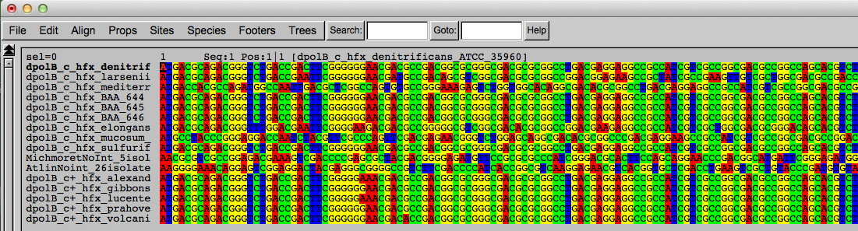
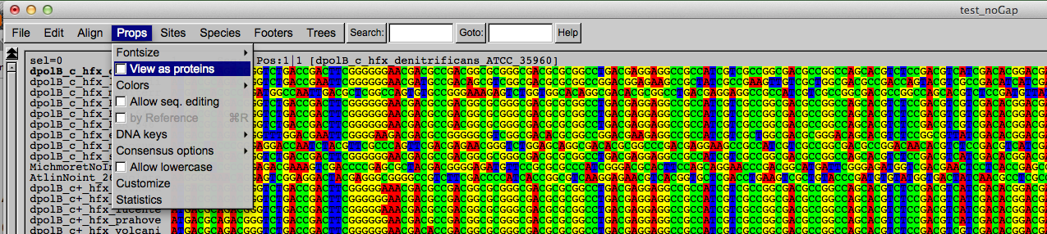
Codon based alignments in Seaview
Load nucleotide sequences (no gaps in sequences, sequence starts with nucleotide corresponding to 1st codon position)
Select view as proteins

Slide 2
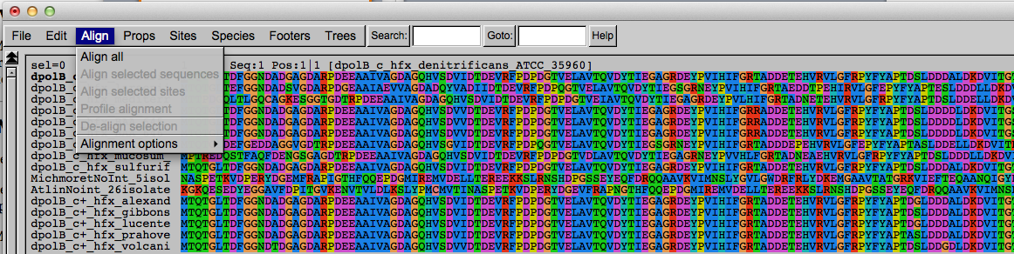
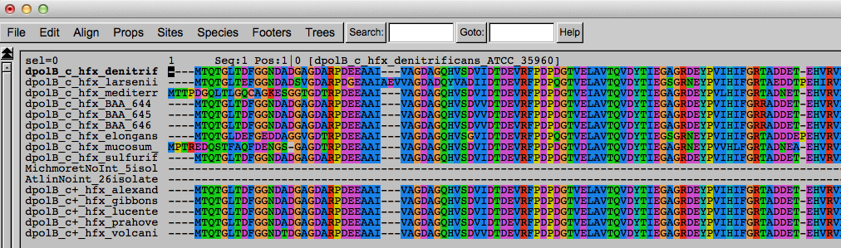
Codon based alignments in Seaview
With the protein sequences displayed, align sequences
Select view as nucleotides

Slide 3
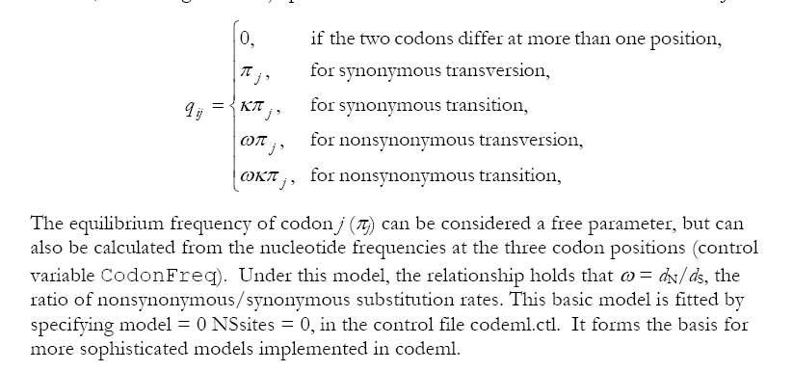
PAML (codeml) the basic model

Slide 4

sites versus branches
You can determine omega for the whole dataset; however, usually not all sites in a sequence are under selection all the time.
PAML (and other programs) allow to either determine omega for each site over the whole tree, ,
or determine omega for each branch for the whole sequence,
.
It would be great to do both, i.e., conclude codon 176 in the vacuolar ATPases was under positive selection during the evolution of modern humans – alas, a single site often does not provide much statistics. PAML does provide a branch site model.

Slide 5
Sites model(s)
have been shown to work great in few instances.
The most celebrated case is the influenza virus HA gene.
A talk by Walter Fitch (slides and sound) on the evolution of
this molecule is here .
This article by Yang et al, 2000 gives more background on ml aproaches to measure omega. The dataset used by Yang et al is here: flu_data.paup .

Slide 6
sites model in MrBayes
The MrBayes block in a nexus file might look something like this:
begin mrbayes;
set autoclose=yes;
lset nst=2 rates=gamma nucmodel=codon omegavar=Ny98;
mcmcp samplefreq=500 printfreq=500;
mcmc ngen=500000;
sump burnin=50;
sumt burnin=50;
end;

Slide 7
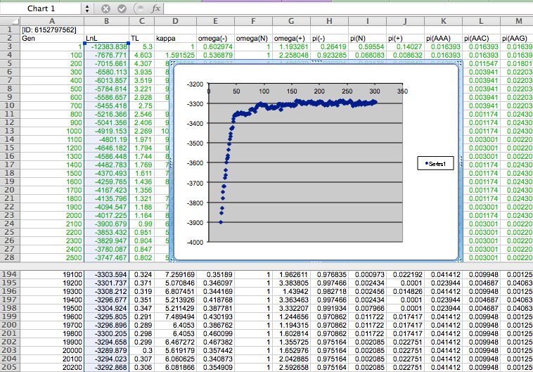

Slide 8
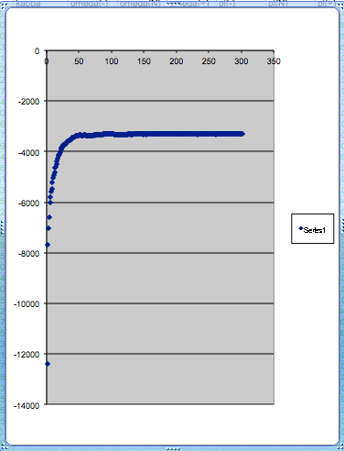
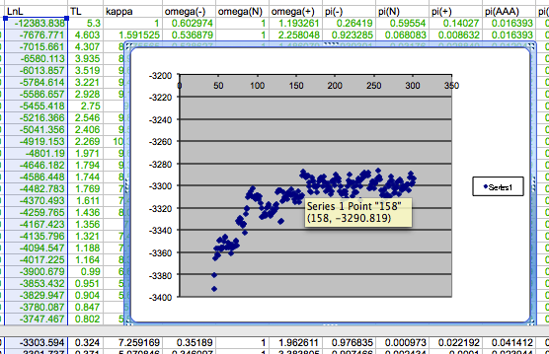
plot LogL to determine which samples to ignore
the same after rescaling the y-axis

Slide 9
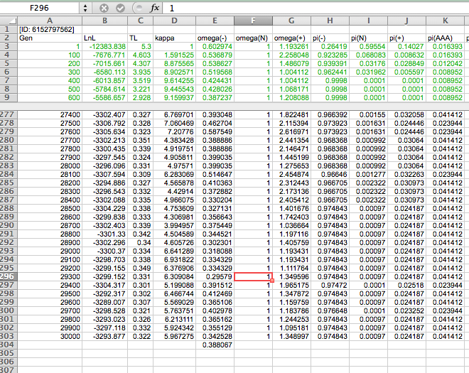

Slide 10
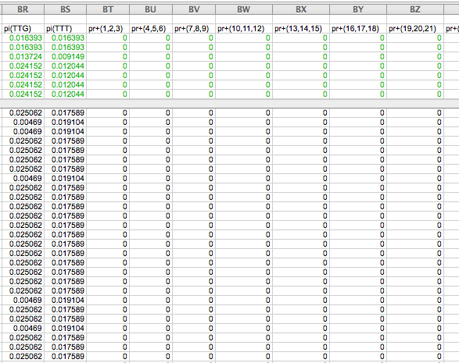

Slide 11
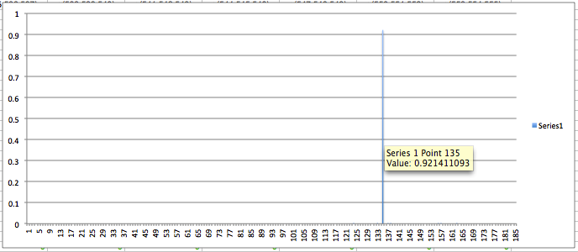
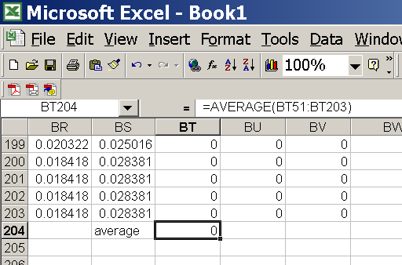
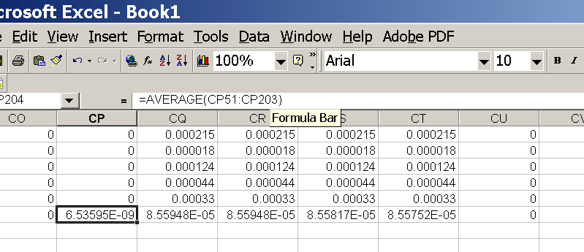
for each codon calculate the the average probability
copy paste formula
plot row
enter formula

Slide 12
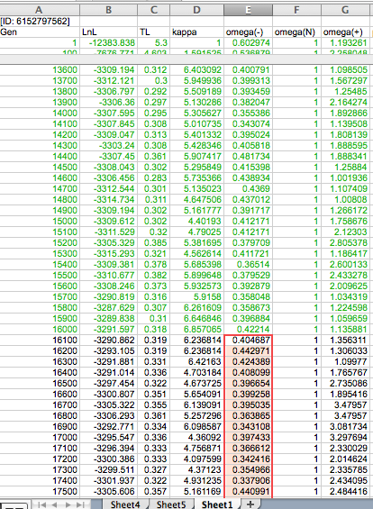
To determine credibility interval for a parameter (here omega<1):
Select values for the parameter, sampled after the burning.
Copy paste to a new spreadsheet,

Slide 13
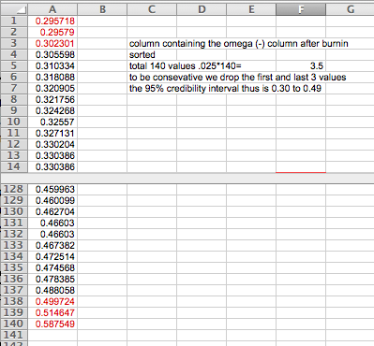
Sort values according to size,
Discard top and bottom 2.5%
Remainder gives 95% credibility interval.

Slide 14
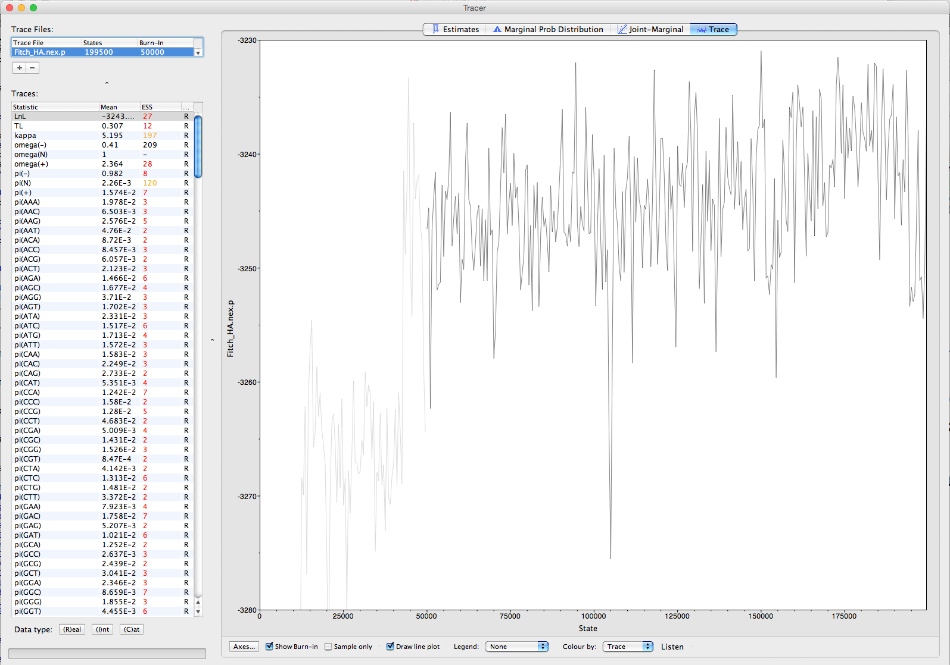
Log(likelyhood) in tracer

Slide 15
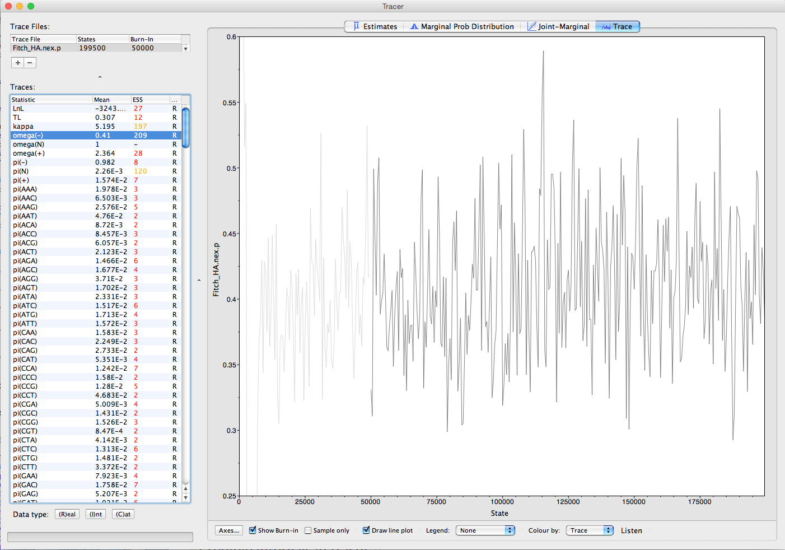
Credible intervals in tracer Trace of Omega -

Slide 16
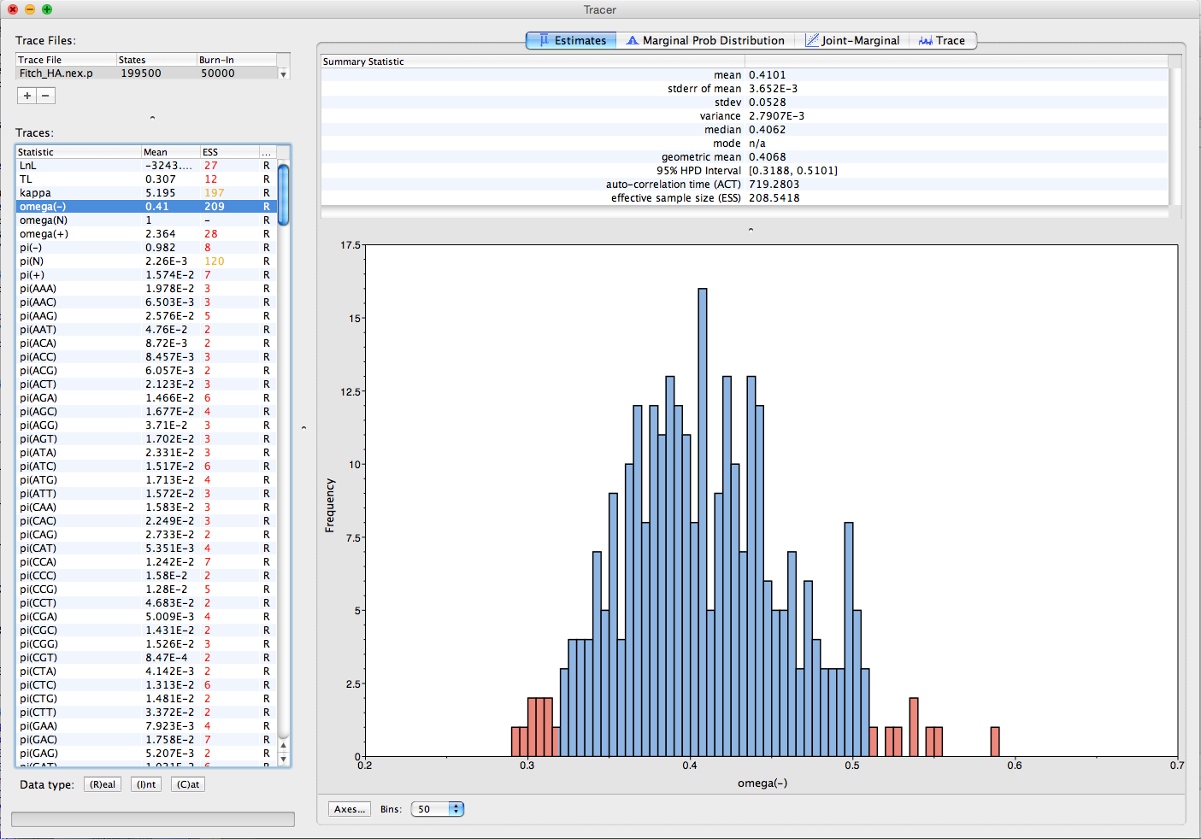
Credible intervals in tracer Esitmates of Mean and 95% credible interval

Slide 17
Purifying selection in E.coli ORFans
dN-dS < 0 for some ORFan E. coli clusters seems to suggest they are functional genes.
Gene groups | Number | dN-dS>0 | dN-dS<0 | dN-dS=0
E. coli ORFan clusters | 3773 | 944 (25%) | 1953 (52%) | 876 (23%)
Clusters of E.coli sequences found in Salmonella sp., Citrobacter sp. | 610 | 104 (17%) | 423(69%) | 83 (14%)
Clusters of E.coli sequences found in some Enterobacteriaceae only | 373 | 8 (2%) | 365 (98%) | 0 (0%)
Adapted after Yu, G. and Stoltzfus, A. Genome Biol Evol (2012) Vol. 4 1176-1187

Slide 18

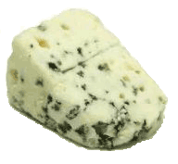
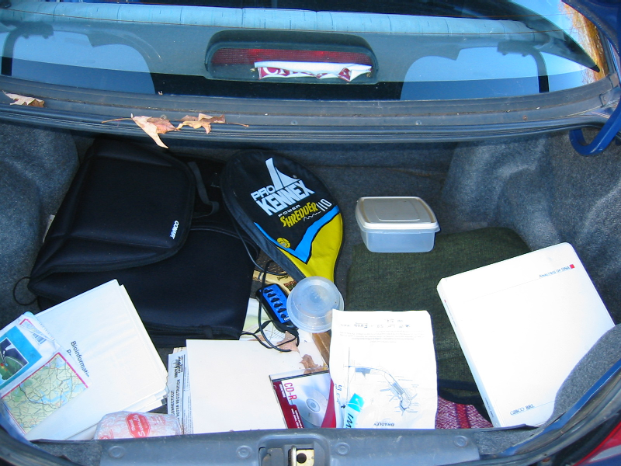
Trunk-of-my-car analogy: Hardly anything in there is the is the result of providing a selective advantage. Some items are removed quickly (purifying selection), some are useful under some conditions, but most things do not alter the fitness.
Could some of the inferred purifying selection be due to the acquisition of novel detrimental characteristics (e.g., protein toxicity, HOPELESS MONSTERS)?

Slide 19
Other ways to detect positive selection
Selective sweeps ->
A) fewer alleles present in population
(allele shows little within allele divergence - see contributions from archaic Humans for example),
B) SNP and neighboring SNPs have not yet been broken up by recombination.
Repeated episodes of positive selection -> high dN
(works well for repeated positive – aka diversifying – selection; e.g. virus interaction with the immunesystem)

Slide 20
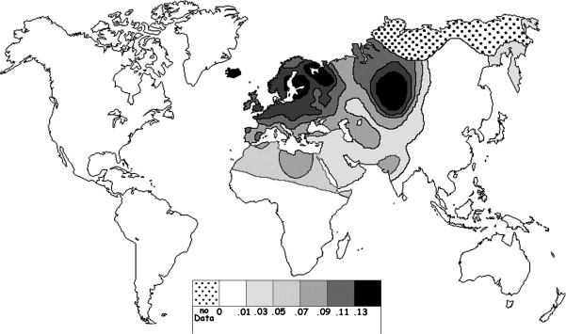
Fig. 1 Current world-wide frequency distribution of CCR5-Δ32 allele frequencies. Only the frequencies of Native populations have been evidenced in Americas, Asia, Africa and Oceania. Map redrawn and modified principally from <ce:cross-ref refid="bib5"> B...
Eric Faure , Manuela Royer-Carenzi
Is the European spatial distribution of the HIV-1-resistant CCR5-Δ32 allele formed by a breakdown of the pathocenosis due to the historical Roman expansion?
Infection, Genetics and Evolution, Volume 8, Issue 6, 2008, 864 - 874
http://dx.doi.org/10.1016/j.meegid.2008.08.007

Slide 21
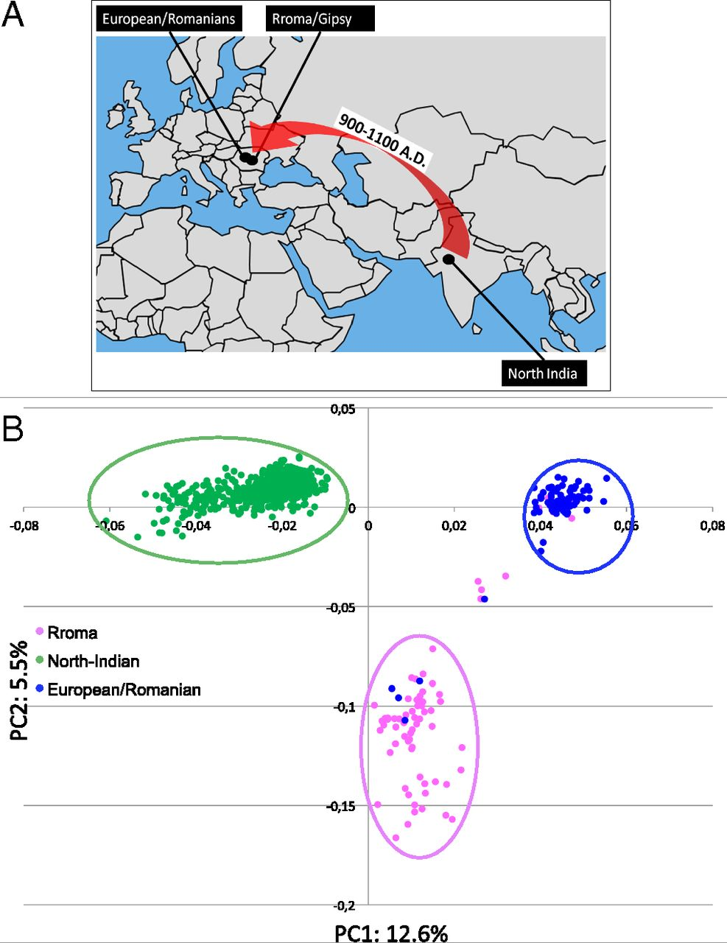
Geographic origin of the three populations studied.
196,524 SNPs
-> PCA
Hafid Laayouni et al. PNAS 2014;111:2668-2673
©2014 by National Academy of Sciences
Notes:
Geographic origin of the three populations studied. (A) European/Romanians and Rroma/Gipsy share the same location, even if the origin of the latter is in North India. (B) Plot of the populations under analysis according to the coordinates to the two main eigenvectors of smartpca (Eigensoft) analysis, in which each dot represents an individual. Individuals within the circles and the same color have been considered for the study; those of different colors represent false population allocation and those intermediate represent admixed individuals. ROM, nongypsy Romanians; INDI, individuals from North India; GYP, Rroma/Gypsies living in Romania.

Slide 22
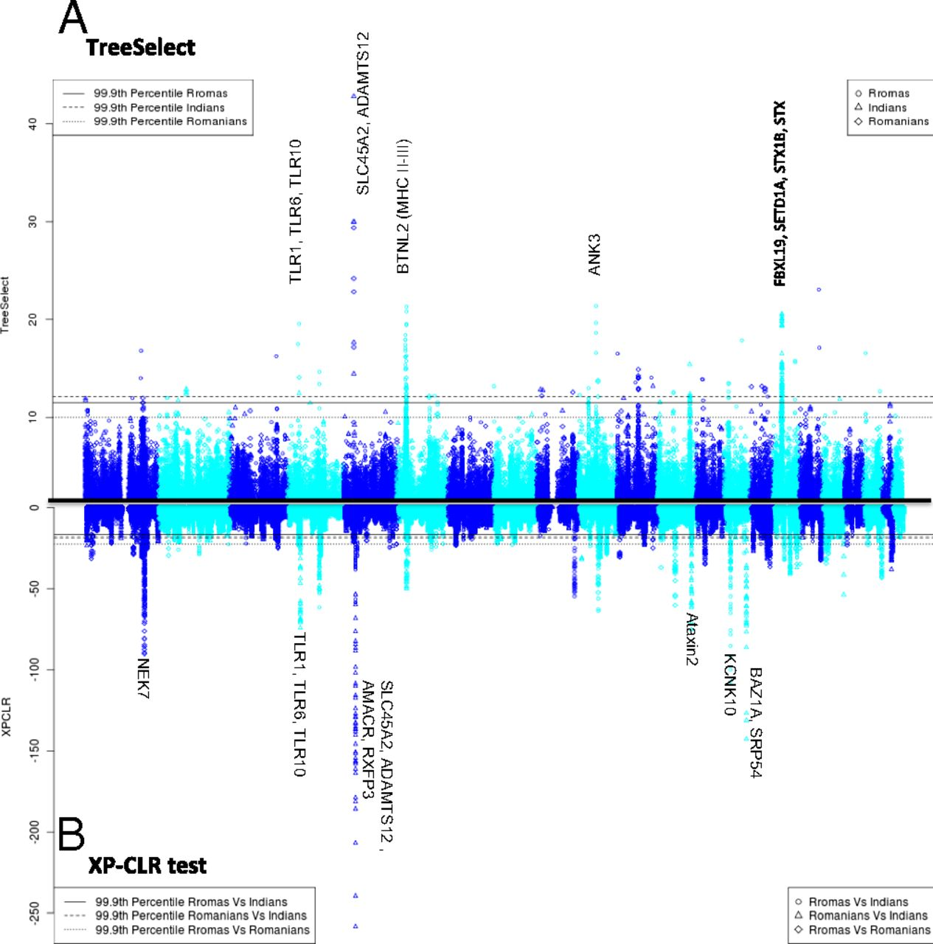
Manhattan plot of results of selection tests in Rroma, Romanians, and Indians using TreeSelect statistic (A) and XP-CLR statistic (B).
SNP frequencies within and between populations
selective sweeps detected through linkage disequilibrium
Laayouni H et al. PNAS 2014;111:2668-2673
Convergent evolution in European and Rroma populations reveals pressure exerted by plague on Toll-like receptors.
©2014 by National Academy of Sciences
Notes:
Manhattan plot of results of selection tests in Rroma, Romanians, and Indians using TreeSelect statistic (A) and XP-CLR statistic (B). Chromosomes ordered from chromosome 1 to chromosome 22.

Slide 23
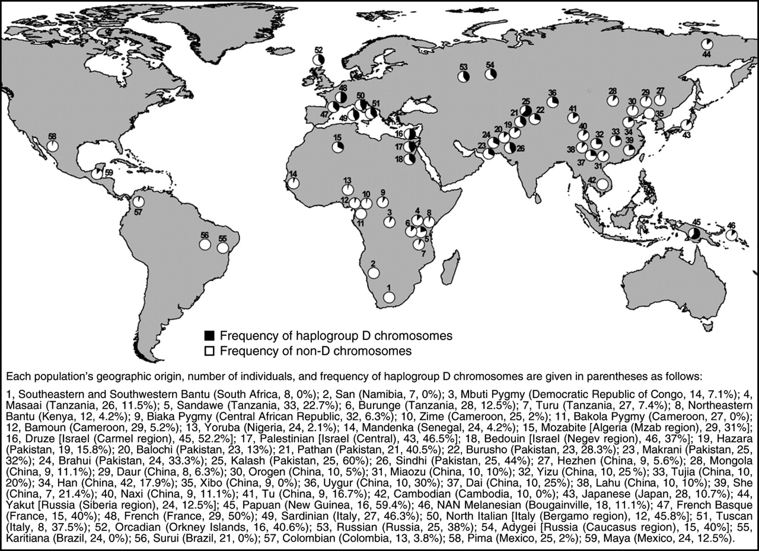
Variant arose about
5800 years ago

Slide 24
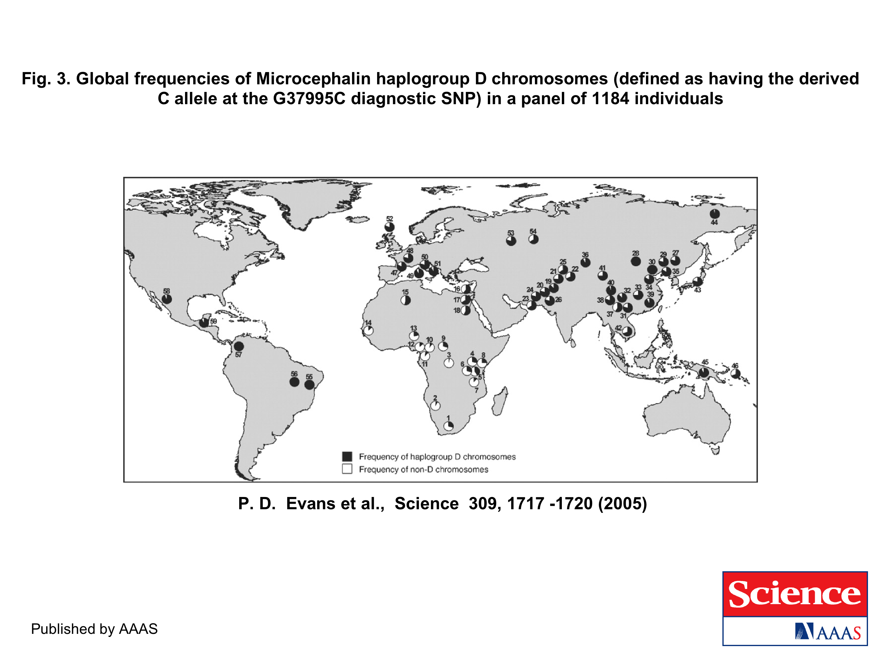
The age of haplogroup D was found to be ~37,000 years

Slide 25
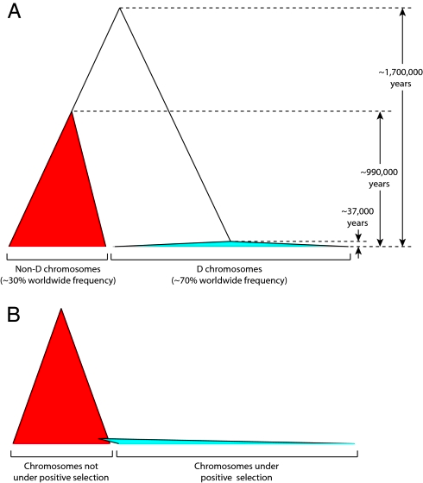
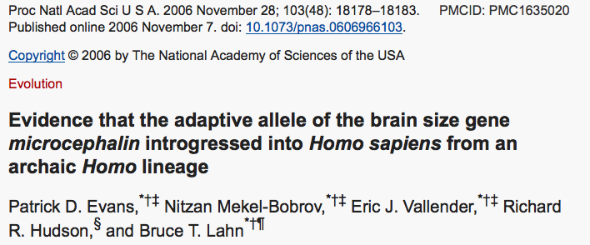

Slide 26

Y chromosome
Adam
Mitochondrial
Eve
Lived
approximately
40,000 years ago
Lived
166,000-249,000
years ago
Thomson, R. et al. (2000) Proc Natl Acad Sci U S A 97, 7360-5
Underhill, P.A. et al. (2000) Nat Genet 26, 358-61
Mendez et al. (2013) American Journal of Human Genetics 92 (3): 454.
Cann, R.L. et al. (1987) Nature 325, 31-6
Vigilant, L. et al. (1991) Science 253, 1503-7
Albrecht Dürer, The Fall of Man, 1504
Adam and Eve never met ☹
The same is true for ancestral rRNAs, EF, ATPases!

Slide 27
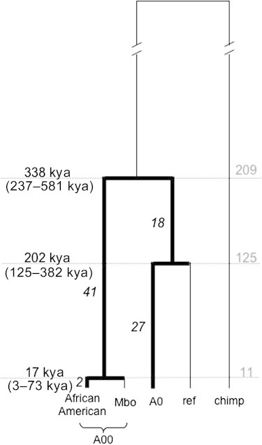
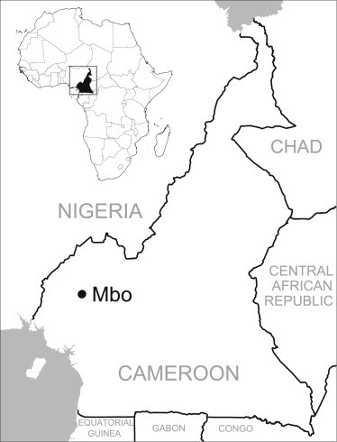
“Genotyping of a DNA sample that was submitted to a commercial genetic-testing facility demonstrated that the Y chromosome of this African American individual carried the ancestral state of all known Y chromosome SNPs. To further characterize this lineage, which we dubbed A00 ...”
Am J Hum Genet. 2013 Mar 7; 92(3): 454–459. doi: 10.1016/j.ajhg.2013.02.002 PMCID: PMC3591855
An African American Paternal Lineage Adds an Extremely Ancient Root to the Human Y Chromosome Phylogenetic Tree
Fernando L. Mendez,1 Thomas Krahn,2 Bonnie Schrack,2 Astrid-Maria Krahn,2 Krishna R. Veeramah,1 August E. Woerner,1 Forka Leypey Mathew Fomine,3 Neil Bradman,4 Mark G. Thomas,5 Tatiana M. Karafet,1 and Michael F. Hammer1,∗

Slide 28
PSI (position-specific iterated) BLAST
The NCBI page described PSI blast as follows:
“Position-Specific Iterated BLAST (PSI-BLAST) provides an automated, easy-to-use version of a "profile" search, which is a sensitive way to look for sequence homologues.
The program first performs a gapped BLAST database search. The PSI-BLAST program uses the information from any significant alignments returned to construct a position-specific score matrix, which replaces the query sequence for the next round of database searching.
PSI-BLAST may be iterated until no new significant alignments are found. At this time PSI-BLAST may be used only for comparing protein queries with protein databases.”

Slide 29
The Psi-Blast Approach
1. Use results of BlastP query to construct a multiple sequence alignment
2. Construct a position-specific scoring matrix from the alignment
3. Search database with alignment instead of query sequence
4. Add matches to alignment and repeat
Psi-Blast can use existing multiple alignment, or
use RPS-Blast to search a database of PSSMs

Slide 30
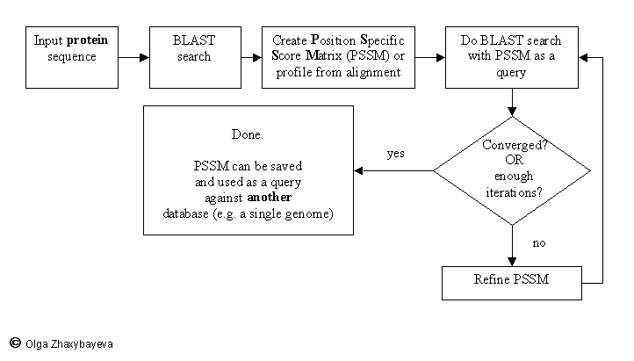
PSI BLAST scheme

Slide 31
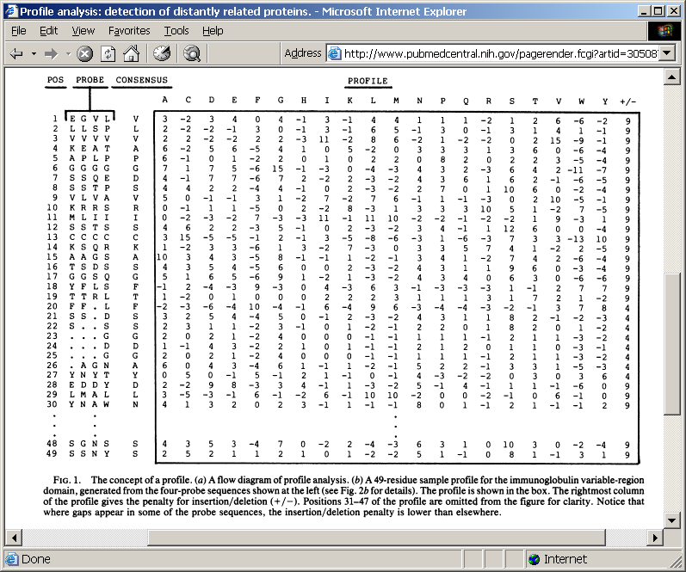
Position-specific Matrix
by Bob Friedman
M Gribskov, A D McLachlan, and D Eisenberg (1987) Profile analysis: detection of distantly related proteins. PNAS 84:4355-8.

Slide 32
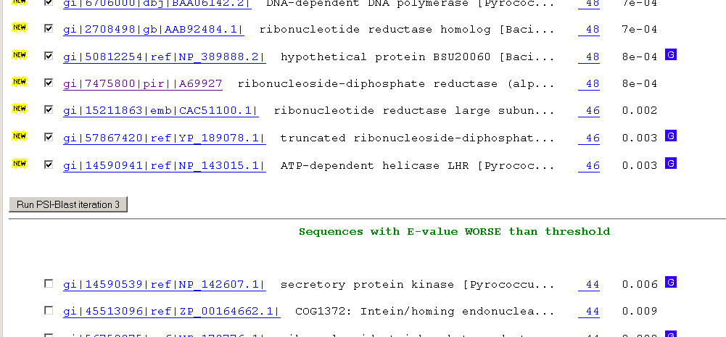
Psi-Blast Results
Query: 55670331 (intein)
link to sequence here, check BLink ☺

Slide 33
PSI BLAST and E-values!
Psi-Blast is for finding matches among divergent sequences (position-specific information)
WARNING: For the nth iteration of a PSI BLAST search, the E-value gives the number of matches to the profile NOT to the initial query sequence! The danger is that the profile was corrupted in an earlier iteration.

Slide 34
PSI Blast from the command line
Often you want to run a PSIBLAST search with two different databanks -
one to create the PSSM, the other to get sequences:
To create the PSSM:
blastpgp -d nr -i subI -j 5 -C subI.ckp -a 2 -o subI.out -h 0.00001 -F f
blastpgp -d swissprot -i gamma -j 5 -C gamma.ckp -a 2 -o gamma.out -h 0.00001 -F f
Runs 4 iterations of a PSIblast
the -h option tells the program to use matches with E <10^-5 for the next iteration,
(the default is 10⁻³ )
-C creates a checkpoint (called subI.ckp),
-o writes the output to subI.out,
-i option specifies input as using subI as input (a fasta formated aa sequence).
The nr databank used is stored in /common/data/
-a 2 use two processors
-h e-value threshold for inclusion in multipass model [Real]
default = 0.002 THIS IS A RATHER HIGH NUMBER!!!
(It might help to use the node with more memory (017)
(command is ssh node017)

Slide 35
To use the PSSM:
blastpgp -d /Users/jpgogarten/genomes/msb8.faa -i subI -a 2 -R subI.ckp -o subI.out3 -F f
blastpgp -d /Users/jpgogarten/genomes/msb8.faa -i gamma -a 2 -R gamma.ckp -o gamma.out3 -F f
Runs another iteration of the same blast search, but uses the databank /Users/jpgogarten/genomes/msb8.faa
-R tells the program where to resume
-d specifies a different databank
-i input file - same sequence as before
-o output_filename
-a 2 use two processors
-h e-value threshold for inclusion in multipass model [Real]
default = 0.002. This is a rather high number, but might be ok for the last iteration.

Slide 36
PSI Blast and finding gene families within genomes
2nd step: use PSSM to search genome:
Use protein sequences encoded in genome as target:
blastpgp -d target_genome.faa -i query.name -a 2 -R query.ckp -o query.out3 -F f
B) Use nucleotide sequence and tblastn. This is an advantage if you are also interested in pseudogenes, and/or if you don’t trust the genome annotation:
blastall -i query.name -d target_genome_nucl.ffn -p psitblastn -R query.ckp

Slide 37
Psi-Blast finds homologs among divergent sequences (position-specific information)
WARNING:
For the nth iteration of a PSI BLAST search, the E-value gives the number of matches to the profile
NOT to the initial query sequence!
The danger is that the profile was corrupted in an earlier iteration.

