Slide 1
PSI (position-specific iterated) BLAST
The NCBI page described PSI blast as follows:
“Position-Specific Iterated BLAST (PSI-BLAST) provides an automated, easy-to-use version of a "profile" search, which is a sensitive way to look for sequence homologues.
The program first performs a gapped BLAST database search. The PSI-BLAST program uses the information from any significant alignments returned to construct a position-specific score matrix, which replaces the query sequence for the next round of database searching.
PSI-BLAST may be iterated until no new significant alignments are found. At this time PSI-BLAST may be used only for comparing protein queries with protein databases.”

Slide 2
The Psi-Blast Approach
1. Use results of BlastP query to construct a multiple sequence alignment
2. Construct a position-specific scoring matrix from the alignment
3. Search database with alignment instead of query sequence
4. Add matches to alignment and repeat
Psi-Blast can use existing multiple alignment, or
use RPS-Blast to search a database of PSSMs

Slide 3
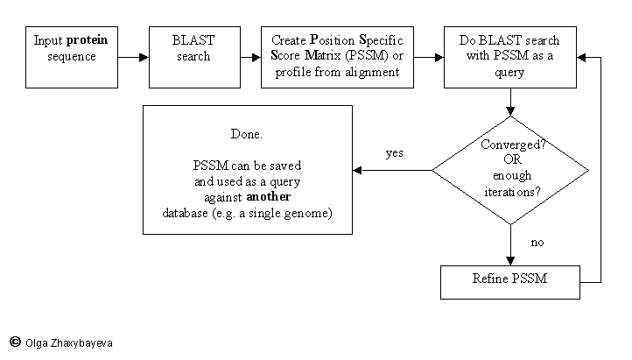
PSI BLAST scheme

Slide 4
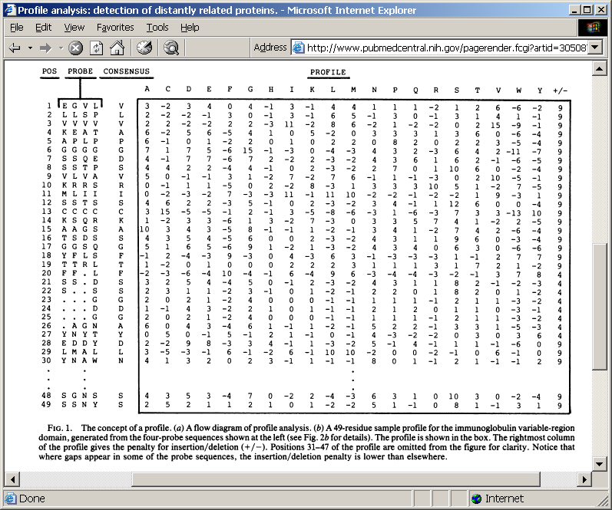
Position-specific Matrix
by Bob Friedman
M Gribskov, A D McLachlan, and D Eisenberg (1987) Profile analysis: detection of distantly related proteins. PNAS 84:4355-8.

Slide 5
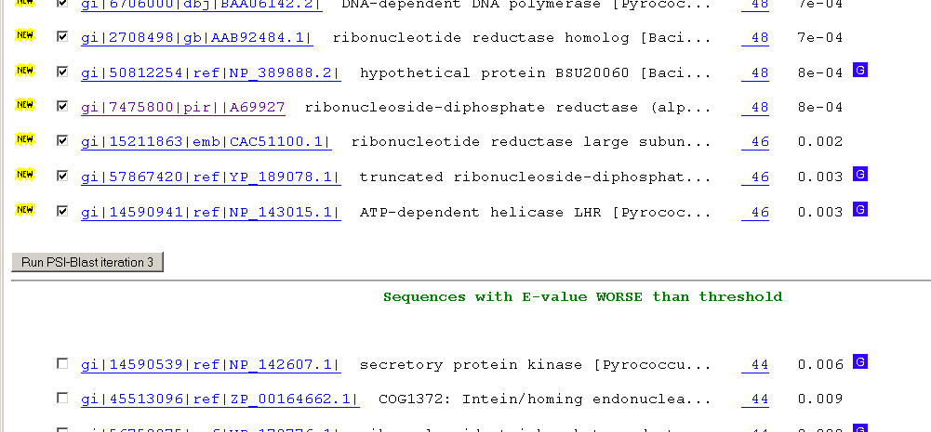
Psi-Blast Results
Query: 55670331 (intein)
link to sequence here, check BLink ☺

Slide 6
PSI BLAST and E-values!
Psi-Blast is for finding matches among divergent sequences (position-specific information)
WARNING: For the nth iteration of a PSI BLAST search, the E-value gives the number of matches to the profile NOT to the initial query sequence! The danger is that the profile was corrupted in an earlier iteration.

Slide 7
PSI Blast from the command line
Often you want to run a PSIBLAST search with two different databanks -
one to create the PSSM, the other to get sequences:
To create the PSSM:
blastpgp -d nr -i subI -j 5 -C subI.ckp -a 2 -o subI.out -h 0.00001 -F f
blastpgp -d swissprot -i gamma -j 5 -C gamma.ckp -a 2 -o gamma.out -h 0.00001 -F f
Runs 4 iterations of a PSIblast
the -h option tells the program to use matches with E <10^-5 for the next iteration,
(the default is 10⁻³ )
-C creates a checkpoint (called subI.ckp),
-o writes the output to subI.out,
-i option specifies input as using subI as input (a fasta formated aa sequence).
The nr databank used is stored in /common/data/
-a 2 use two processors
-h e-value threshold for inclusion in multipass model [Real]
default = 0.002 THIS IS A RATHER HIGH NUMBER!!!
(It might help to use the node with more memory (017)
(command is ssh node017)

Slide 8
To use the PSSM:
blastpgp -d /Users/jpgogarten/genomes/msb8.faa -i subI -a 2 -R subI.ckp -o subI.out3 -F f
blastpgp -d /Users/jpgogarten/genomes/msb8.faa -i gamma -a 2 -R gamma.ckp -o gamma.out3 -F f
Runs another iteration of the same blast search, but uses the databank /Users/jpgogarten/genomes/msb8.faa
-R tells the program where to resume
-d specifies a different databank
-i input file - same sequence as before
-o output_filename
-a 2 use two processors
-h e-value threshold for inclusion in multipass model [Real]
default = 0.002. This is a rather high number, but might be ok for the last iteration.

Slide 9
PSI Blast and finding gene families within genomes
2nd step: use PSSM to search genome:
Use protein sequences encoded in genome as target:
blastpgp -d target_genome.faa -i query.name -a 2 -R query.ckp -o query.out3 -F f
B) Use nucleotide sequence and tblastn. This is an advantage if you are also interested in pseudogenes, and/or if you don’t trust the genome annotation:
blastall -i query.name -d target_genome_nucl.ffn -p psitblastn -R query.ckp

Slide 10
Psi-Blast finds homologs among divergent sequences (position-specific information)
WARNING:
For the nth iteration of a PSI BLAST search, the E-value gives the number of matches to the profile
NOT to the initial query sequence!
The danger is that the profile was corrupted in an earlier iteration.

Slide 11
HGT as a force creating new pathways

Slide 12
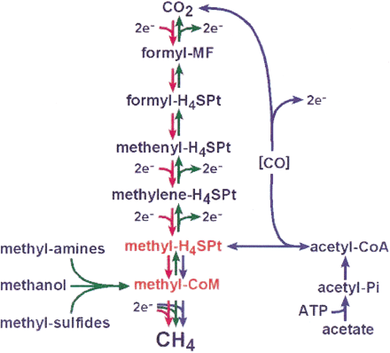
HGT as a force creating new pathways – Example I
Acetoclastic Methanogenesis
Unique to subset of Archaea
Energy production via reduction of multiple carbon substrates to CH₄
900 Million metric tons of biogenic methane produced annually.
Over 66% of biogenic methane is produced from acetate, mostly by Methanosarcina genera.
From: Galagan et al., 2002
Fournier and Gogarten (2008) Evolution of Acetoclastic Methanogenesis in Methanosarcina via Horizontal Gene Transfer from Cellulolytic Clostridia. J. Bacteriol. 190(3):1124-7

Slide 13
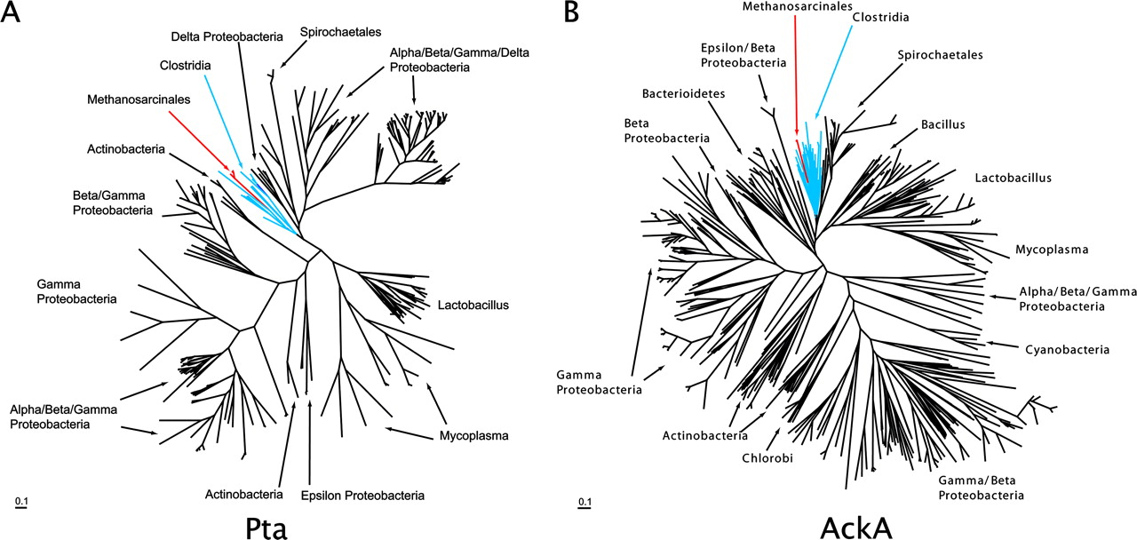
Maximum likelihood phylogenetic trees of Pta and AckA homologs. Homologs found in Methanosarcina are red and in both cases are found in a monophyletic group corresponding to the Clostridia (blue) ... .

Slide 14
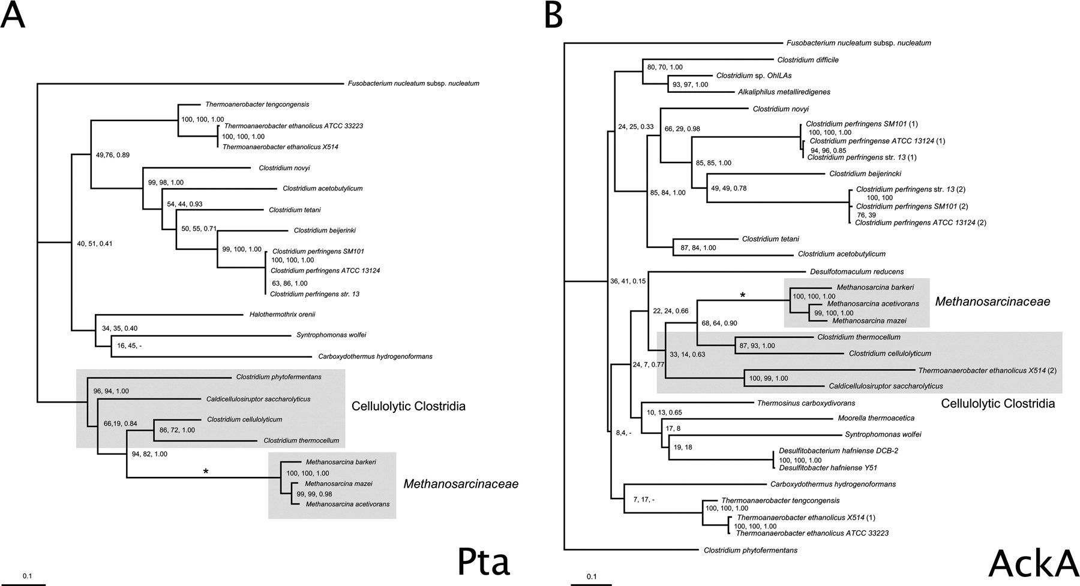
Consensus trees of Pta and AckA homologs within the Clostridia. Branches in which there were postulated horizontal gene transfers to Methanosarcina are indicated by an asterisk. Homologs from the firmicute F. nucleatum were used as outgroups to root the trees. The numbers associated with each clade indicate bootstrap values for maximum likelihood and neighbor joining and the posterior probability from Bayesian inference, respectively. Sequence alignment was ...

Slide 15
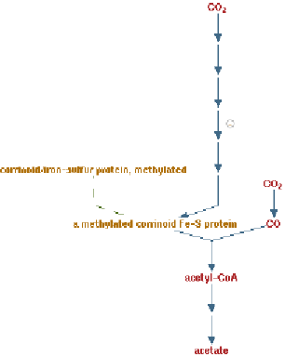
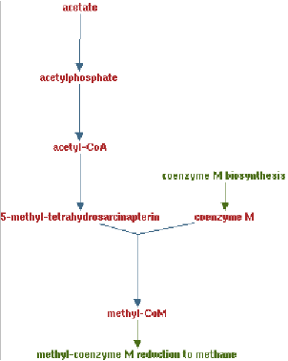
Clostridia acetigenic pathway
Methanosarcina
acetoclastic pathway
AckA
HGT
PtaA
PtaA
AckA
Figures drawn with Metacyc (www.metacyc.org)

Slide 16
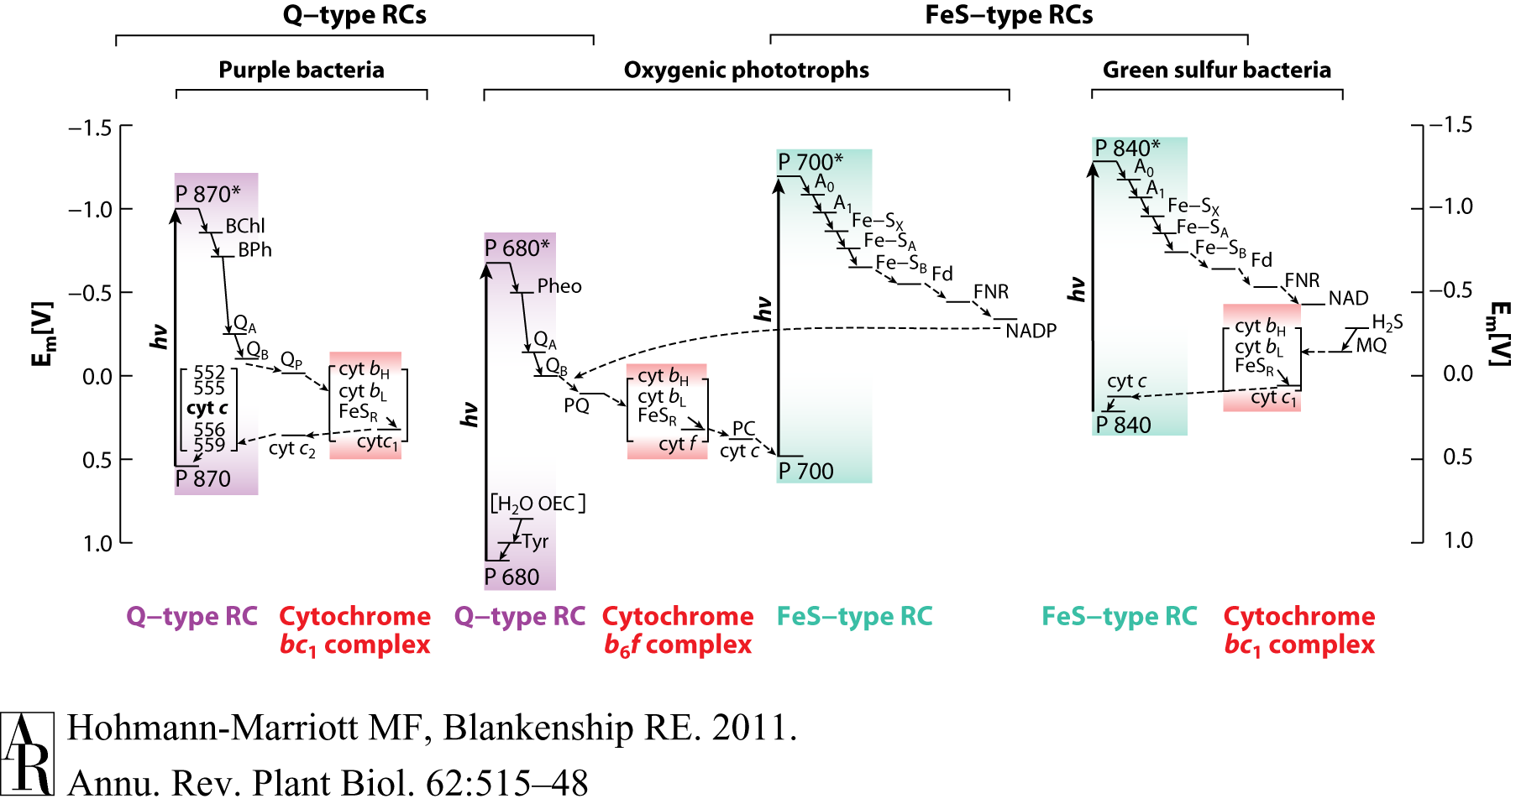
HGT as a force creating new pathways – Example 2
Oxygen producing photosynthesis

Slide 17
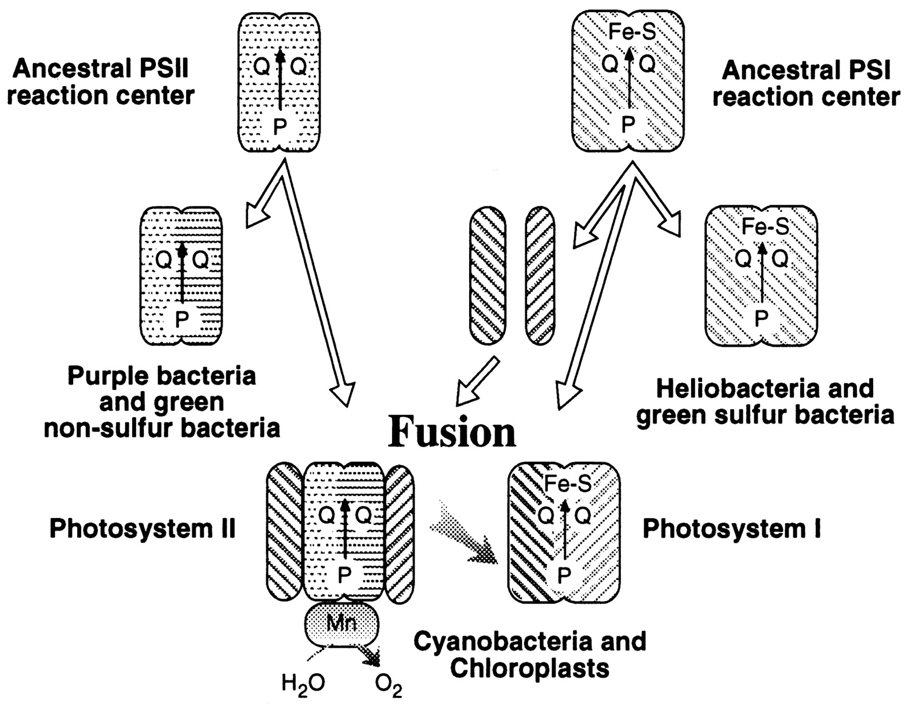
A heterologous fusion model for the evolution of oxygenic photosynthesis based on phylogenetic analysis.
Xiong J et al. PNAS 1998;95:14851-14856
©1998 by National Academy of Sciences
Notes:
A heterologous fusion model for the evolution of oxygenic photosynthesis based on phylogenetic analysis. Details of the model are provided in the text.

Slide 18
HGT as a force creating new pathways – Example 3
Acetyl-CoA Assimilation: Methylaspartate Cycle
Acetate
Alcohols
Polyhydroxybutyrate
Fatty acids
acetyl-CoA
Lysine, leucine
oxaloacetate
citrate
malate
isocitrate
CO
2
fumarate
acetyl-CoA
2-oxoglutarate
Poly-γ -glutamate
succinate
glutamate
Proteins
glyoxylate
γ-Glutamylcystein
succinyl-CoA
methylaspartate
CO
Osmoadaptation
2
propionyl-CoA
mesaconate
3-methylmalyl-CoA
mesaconyl-CoA
Khomyakova, Bükmez, Thomas, Erb, Berg, Science, 2011

Slide 19
Comparison of different anaplerotic pathways
acetyl-CoA
acetyl-CoA
acetyl-CoA
acetyl-CoA
crotonyl-CoA
oxaloacetate
citrate
oxaloacetate
citrate
CO
2
malate
isocitrate
acetyl-CoA
ethylmalonyl-CoA
CO
2
fumarate
acetyl-CoA
2-oxoglutarate
malate
isocitrate
methylsuccinyl-CoA
glyoxylate
succinate
glutamate
CO
2
mesaconyl-CoA
glyoxylate
2-oxoglutarate
3-methylmalyl-CoA
succinyl-CoA
methylaspartate
fumarate
CO
propionyl-CoA
glyoxylate
2
propionyl-CoA
mesaconate
CO
2
CO
2
acetyl-CoA
succinate
succinyl-CoA
3-methylmalyl-CoA
mesaconyl-CoA
succinyl-CoA
malate
Citric acid cycle and
Glyoxylate cycle
Ethylmalonyl-CoA
pathway
Methylaspartate cycle
Bacteria, Eukarya and some Archaea
α-Proteobacteria, streptomycetes
haloarchaea

Slide 20
HGT as a force creating new pathways – Example 3
Acetyl-CoA Assimilation: methylaspartate cycle
Haloarchaea
Haloarcula marismortui,
Natrialba magadii
Glutamate fermentation,
Bacteria
Propionate assimilation
Acetate
assimilation, Bacteria
Khomyakova, Bükmez, Thomas, Erb, Berg, Science, 2011

