Slide 1
MCB 3421 class 25

Slide 2
student evaluations
Please go to husky CT and complete student evaluations !

Slide 3
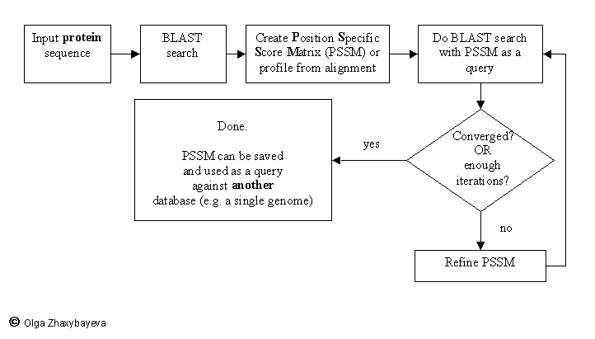
PSI BLAST scheme

Slide 4
PSI BLAST and E-values!
Psi-Blast is for finding matches among divergent sequences (position-specific information)
WARNING: For the nth iteration of a PSI BLAST search, the E-value gives the number of matches to the profile NOT to the initial query sequence! The danger is that the profile was corrupted in an earlier iteration.

Slide 5
PSI Blast and finding gene families within genomes
Build PSSM from query sequence and a large database
(nr is a good choice – if you know the annotation of the query sequences, you don’t need to worry about the annotations in the database)
use PSSM to search a genome:
Use protein sequences encoded in genome as target:
blastpgp -d target_genome.faa -i query.name -a 2 -R query.ckp -o query.out3 -F f
B) Use nucleotide sequence and tblastn. This is an advantage if you are also interested in pseudogenes, and/or if you don’t trust the genome annotation:
blastall -i query.name -d target_genome_nucl.ffn -p psitblastn -R query.ckp

Slide 6
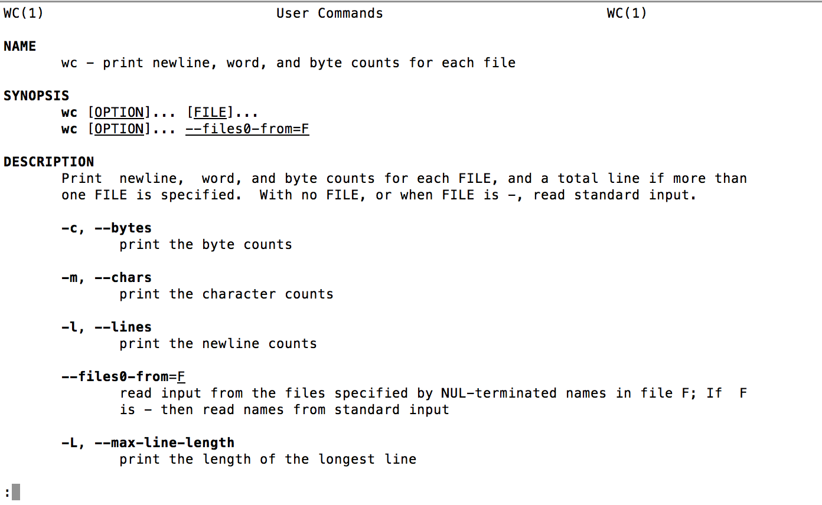
man wc

Slide 7
Comparison of blastp, PSIblastP, and psitblastn
>wc -l blastp.out PSIblastP.out psitblastn.out
34 blastp.out
44 PSIblastP.out
56 psitblastn.out

Slide 8
psiblast -db fiveFrankia.faa.txt
-in_pssm IS605checkpointPSSM
-out PSIblastP.out
-inclusion_ethresh 1e-5 -outfmt 6
-num_threads 2
What might be “wrong” with this command?

Slide 9
Comparison of blastp, PSIblastP, and psitblastn
>wc -l blastp.out PSIblastP.out psitblastn.out
34 blastp.out
44 PSIblastP.out
56 psitblastn.out
What results did you obtains?

Slide 10
BLAST+
Comparison of blastp, PSI-blastP, and psi tblastn
>wc -l blastp.out PSIblastP.out psitblastn.out
34 blastp.out
44 PSIblastP.out
78 psitblastn.out

Slide 11
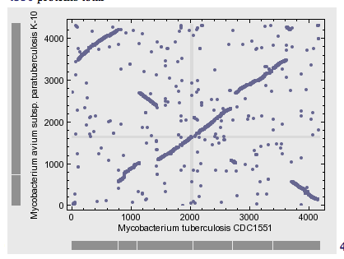
2
7
4
5
6
3
8
1
1
2
3
4
5
6
7
8

Slide 12
5
4
6
3
7
2
1
8
ori

Slide 13
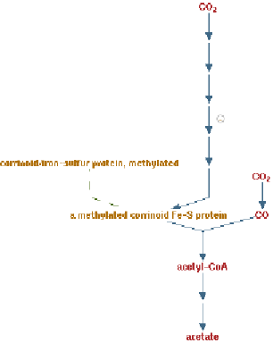
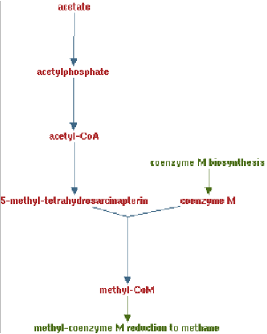
Clostridia acetigenic pathway
Methanosarcina
acetoclastic pathway
AckA
HGT
PtaA
PtaA
AckA
Figures drawn with Metacyc (www.metacyc.org)

Slide 14
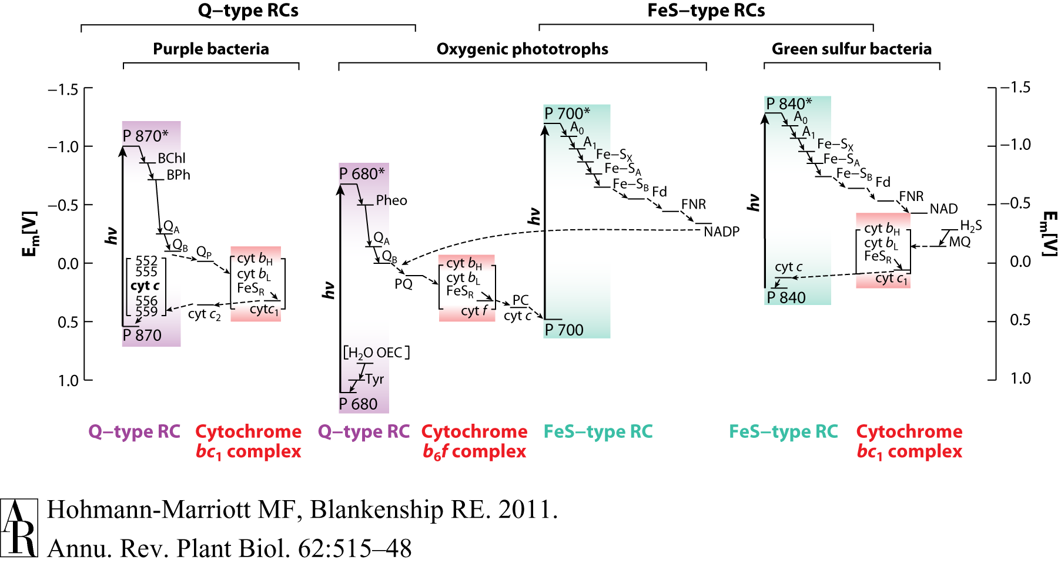
HGT as a force creating new pathways – Example 2
Oxygen producing photosynthesis

Slide 15
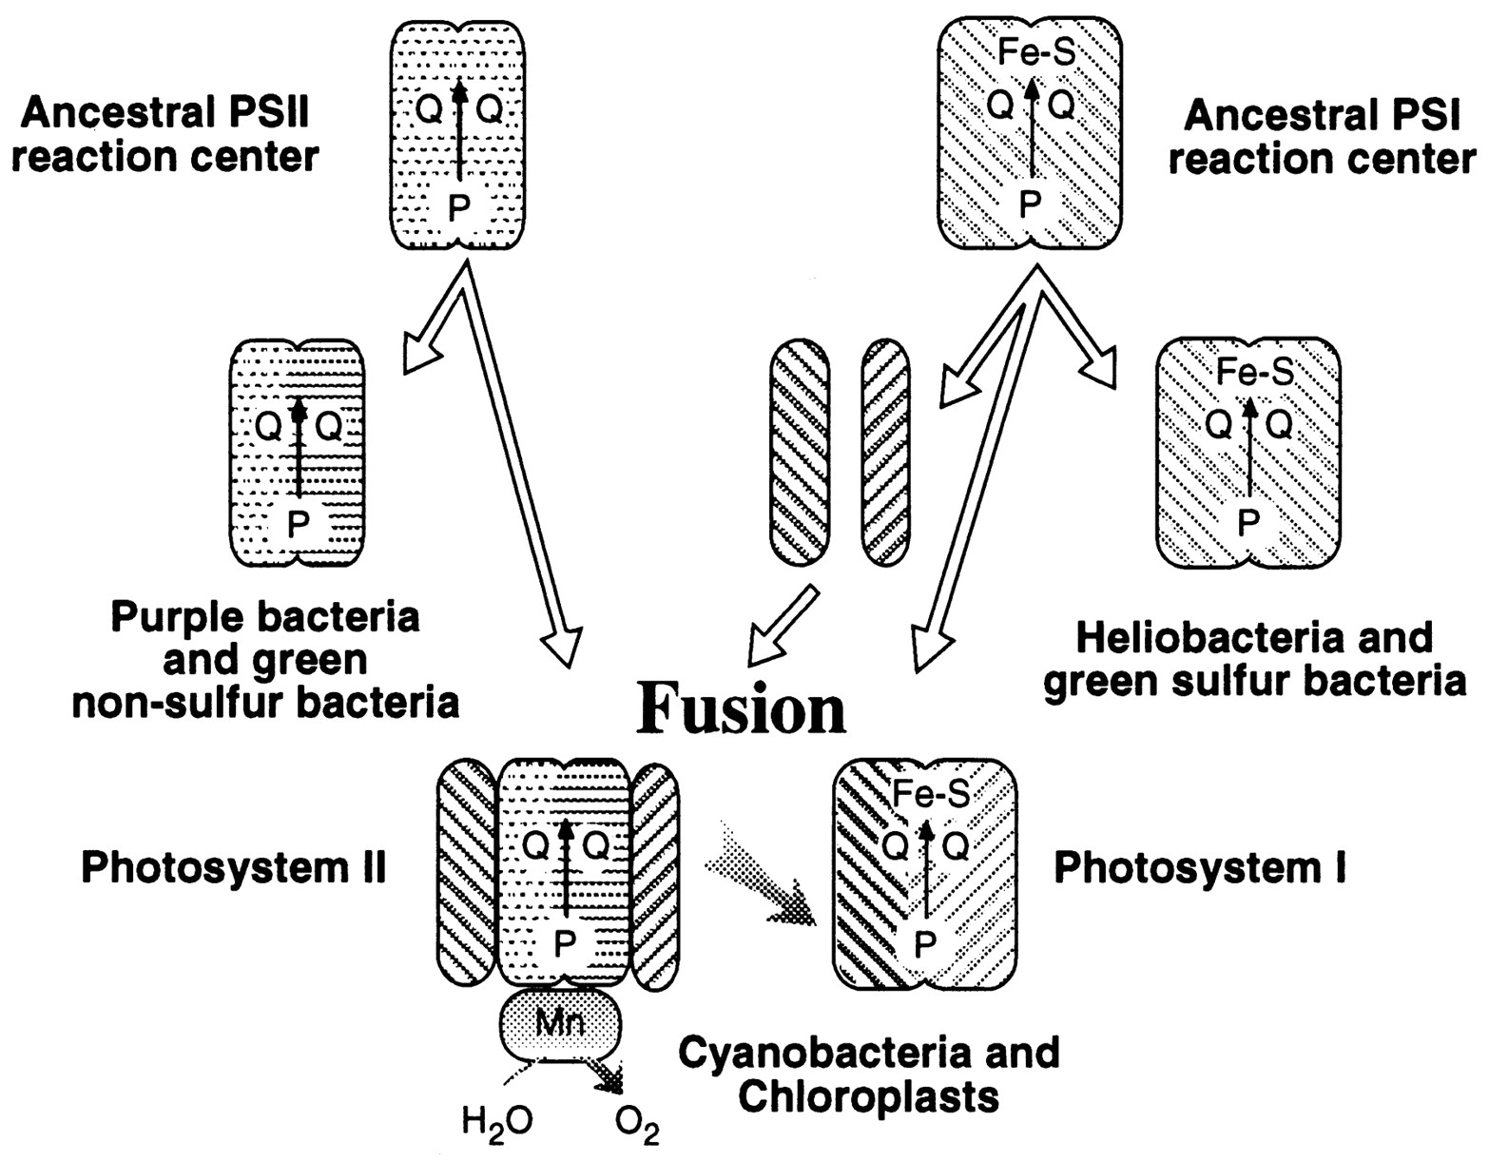
A heterologous fusion model for the evolution of oxygenic photosynthesis based on phylogenetic analysis.
Xiong J et al. PNAS 1998;95:14851-14856
©1998 by National Academy of Sciences
Notes:
A heterologous fusion model for the evolution of oxygenic photosynthesis based on phylogenetic analysis. Details of the model are provided in the text.

Slide 16
HGT as a force creating new pathways – Example 3
Acetyl-CoA Assimilation: Methylaspartate Cycle
Acetate
Alcohols
Polyhydroxybutyrate
Fatty acids
acetyl-CoA
Lysine, leucine
oxaloacetate
citrate
malate
isocitrate
CO
2
fumarate
acetyl-CoA
2-oxoglutarate
Poly-γ -glutamate
succinate
glutamate
Proteins
glyoxylate
γ-Glutamylcystein
succinyl-CoA
methylaspartate
CO
Osmoadaptation
2
propionyl-CoA
mesaconate
3-methylmalyl-CoA
mesaconyl-CoA
Khomyakova, Bükmez, Thomas, Erb, Berg, Science, 2011

Slide 17
Comparison of different anaplerotic pathways
acetyl-CoA
acetyl-CoA
acetyl-CoA
acetyl-CoA
crotonyl-CoA
oxaloacetate
citrate
oxaloacetate
citrate
CO
2
malate
isocitrate
acetyl-CoA
ethylmalonyl-CoA
CO
2
fumarate
acetyl-CoA
2-oxoglutarate
malate
isocitrate
methylsuccinyl-CoA
glyoxylate
succinate
glutamate
CO
2
mesaconyl-CoA
glyoxylate
2-oxoglutarate
3-methylmalyl-CoA
succinyl-CoA
methylaspartate
fumarate
CO
propionyl-CoA
glyoxylate
2
propionyl-CoA
mesaconate
CO
2
CO
2
acetyl-CoA
succinate
succinyl-CoA
3-methylmalyl-CoA
mesaconyl-CoA
succinyl-CoA
malate
Citric acid cycle and
Glyoxylate cycle
Ethylmalonyl-CoA
pathway
Methylaspartate cycle
Bacteria, Eukarya and some Archaea
α-Proteobacteria, streptomycetes
haloarchaea

Slide 18
HGT as a force creating new pathways – Example 3
Acetyl-CoA Assimilation: methylaspartate cycle
Haloarchaea
Haloarcula marismortui,
Natrialba magadii
Glutamate fermentation,
Bacteria
Propionate assimilation
Acetate
assimilation, Bacteria
Khomyakova, Bükmez, Thomas, Erb, Berg, Science, 2011

Slide 19
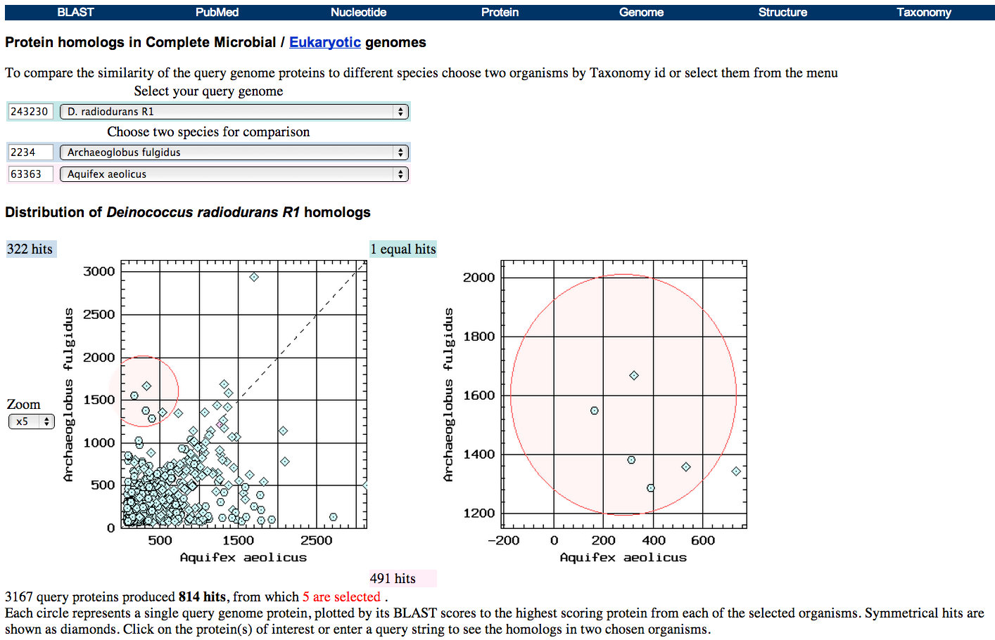
Taxplot at NCBI

Slide 20
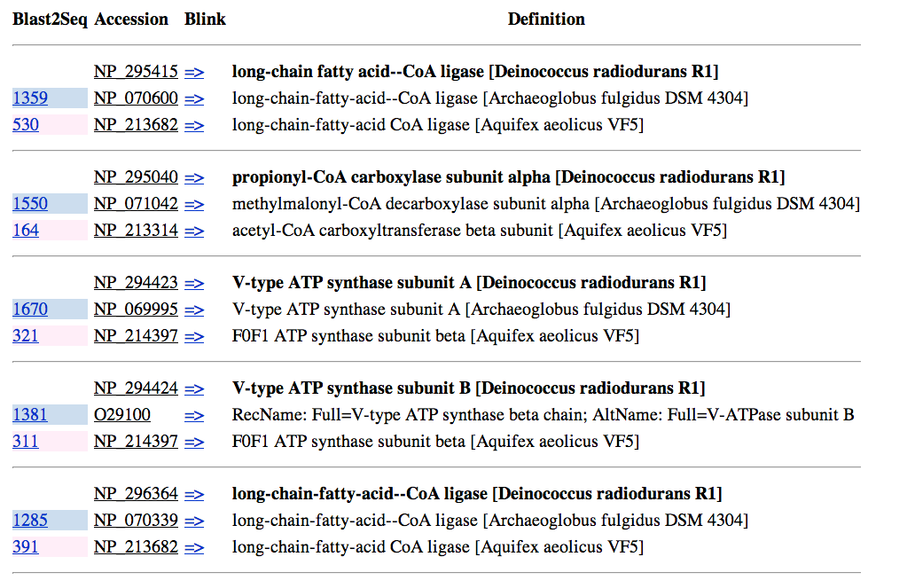
Taxplot at NCBI

Slide 21
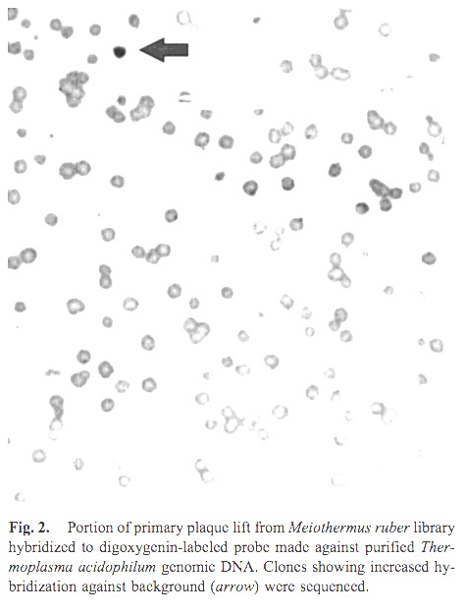
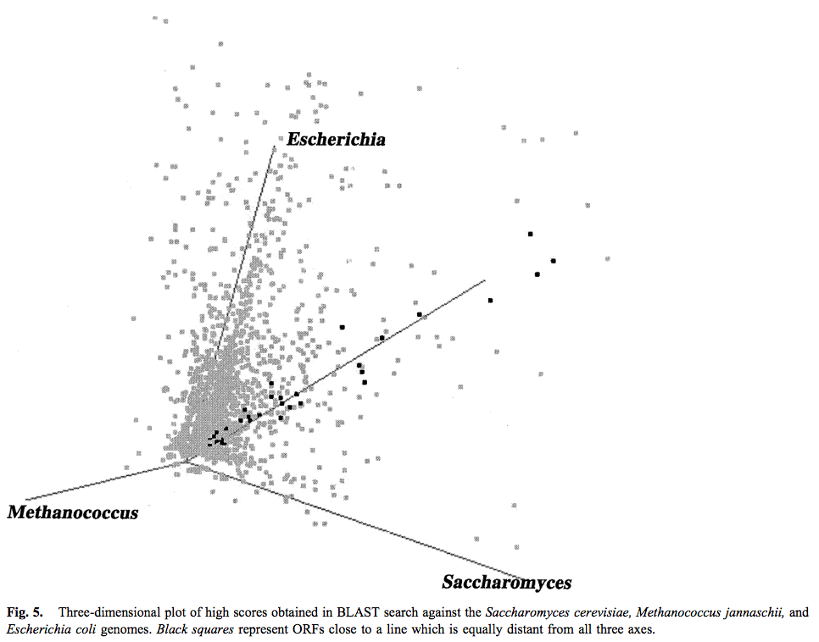
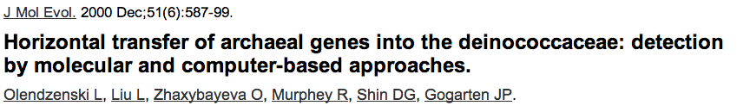
Finding transferred genes
Screening in the wet-lab and in the computer

Slide 22
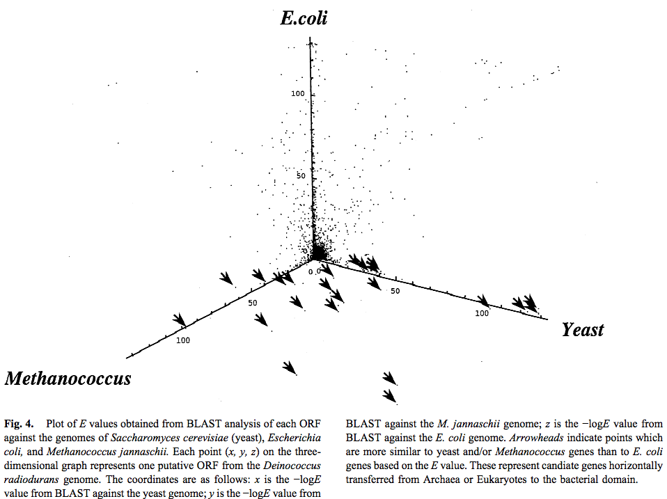
Finding transferred genes

Slide 23
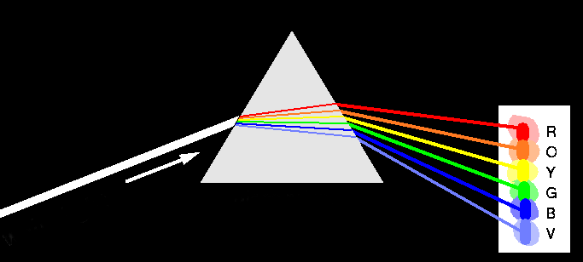
Decomposition of Phylogenetic Data
Phylogenetic information
present in genomes
Break information
into small quanta
of information
Analyze spectra to detect transferred genes and plurality consensus.

Slide 24

TOOLS TO ANALYZE PHYLOGENETIC INFORMATION FROM MULTIPLE GENES IN GENOMES:
Bipartition Spectra (Lento Plots)

Slide 25
BIPARTITION OF A PHYLOGENETIC TREE
Bipartition (or split) – a division of a phylogenetic tree into two parts that are connected by a single branch.
It divides a dataset into two groups, but it does not consider the relationships within each of the two groups.
Yellow vs Rest
* * * . . . * *
95
compatible to illustrated
bipartition
Orange vs Rest
. . * . . . . *
* * * . . . . .
incompatible to illustrated
bipartition

Slide 26
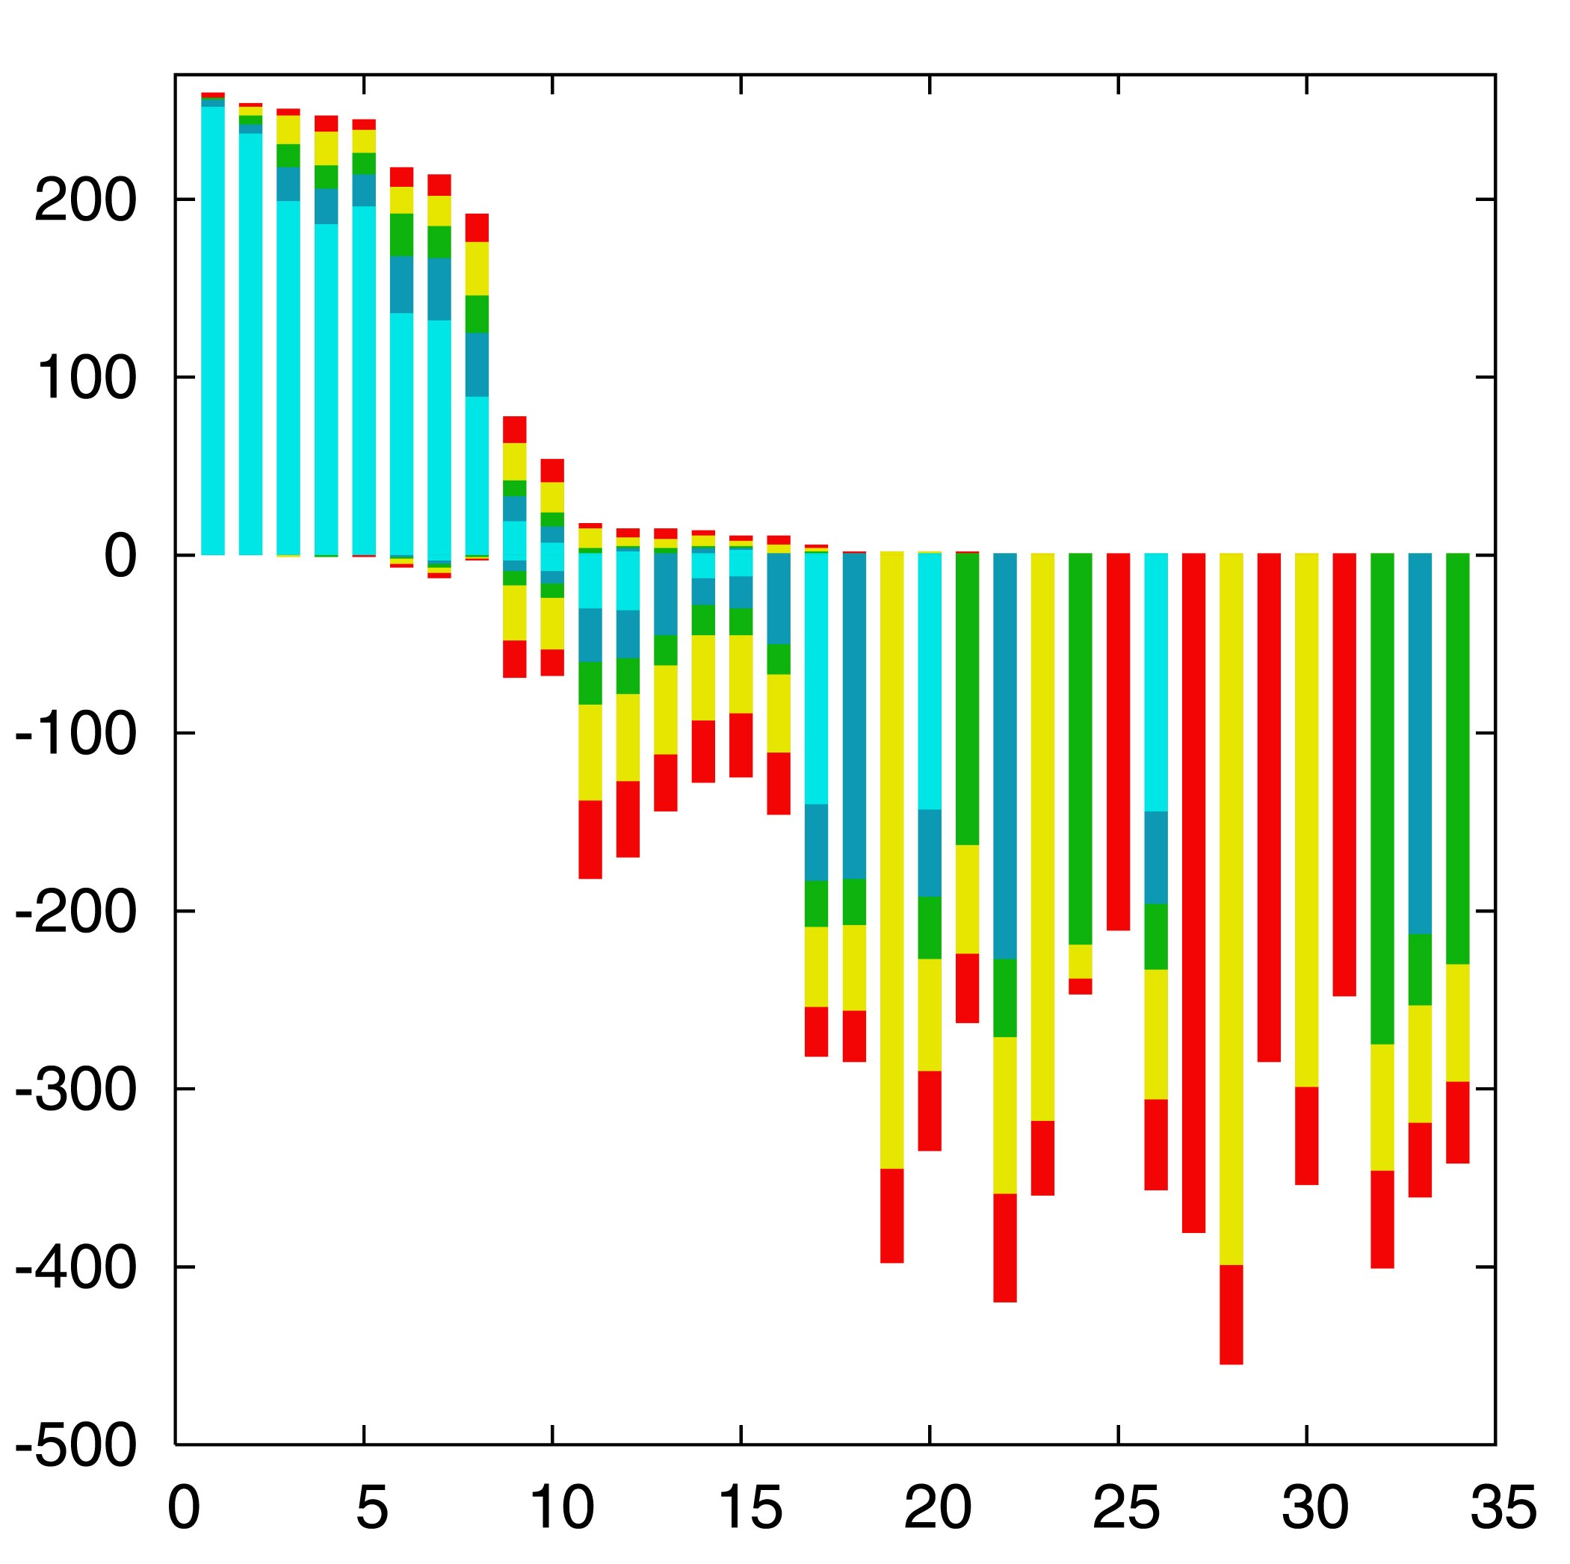

“Lento”-plot of 34 supported bipartitions (out of 4082 possible)
13 gamma-
proteobacterial
genomes
(258 putative
orthologs):
E.coli
Buchnera
Haemophilus
Pasteurella
Salmonella
Yersinia pestis
(2 strains)
Vibrio
Xanthomonas
(2 sp.)
Pseudomonas
Wigglesworthia
There are 13,749,310,575 possible unrooted tree topologies for 13 genomes

Slide 27
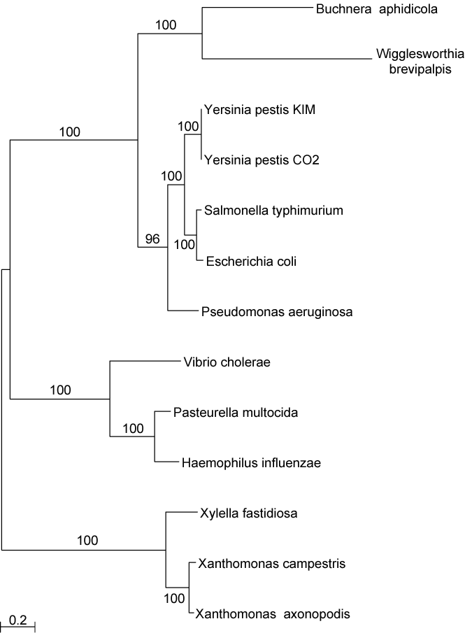
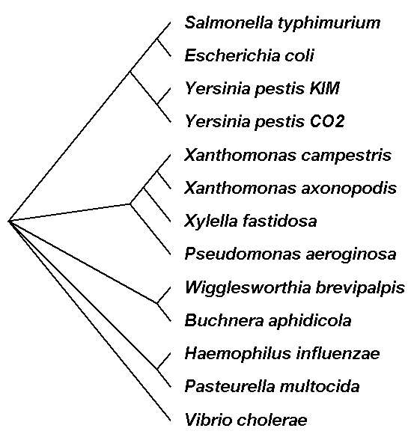
Consensus clusters of eight significantly supported bipartitions
Phylogeny of putatively transferred gene
(virulence factor homologs (mviN))
only 258 genes analyzed

Slide 28
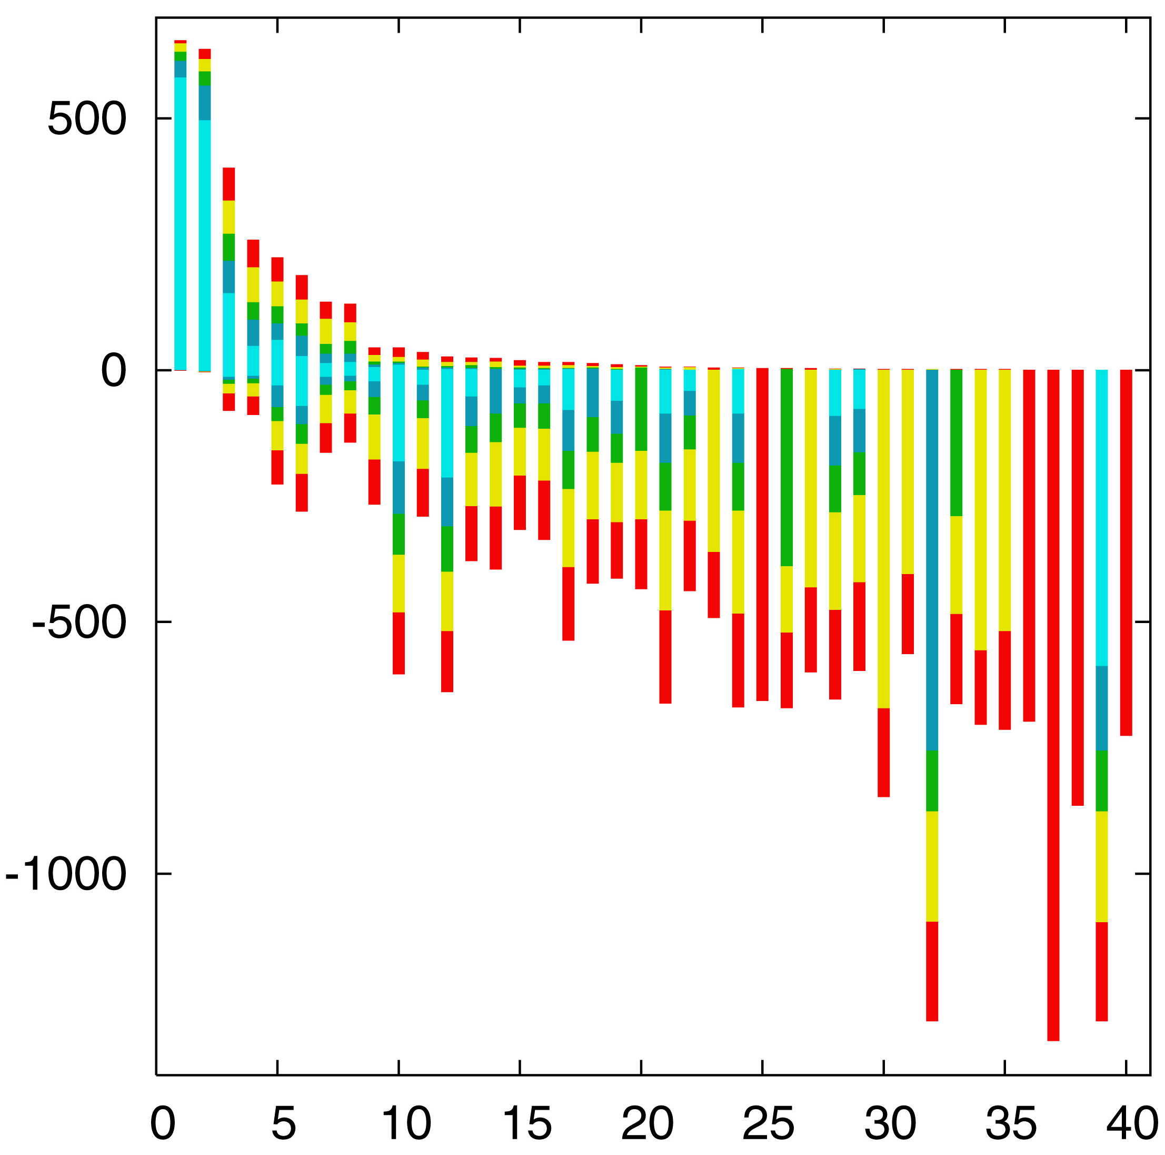

“Lento”-plot of supported bipartitions (out of 501 possible)
10 cyanobacteria:
Anabaena
Trichodesmium
Synechocystis sp.
Prochlorococcus
marinus
(3 strains)
Marine
Synechococcus
Thermo-
synechococcus
elongatus
Gloeobacter
Nostoc
punctioforme
Number of datasets
Based on 678 sets of orthologous genes
Zhaxybayeva, Lapierre and Gogarten, Trends in Genetics, 2004, 20(5): 254-260.

Slide 29
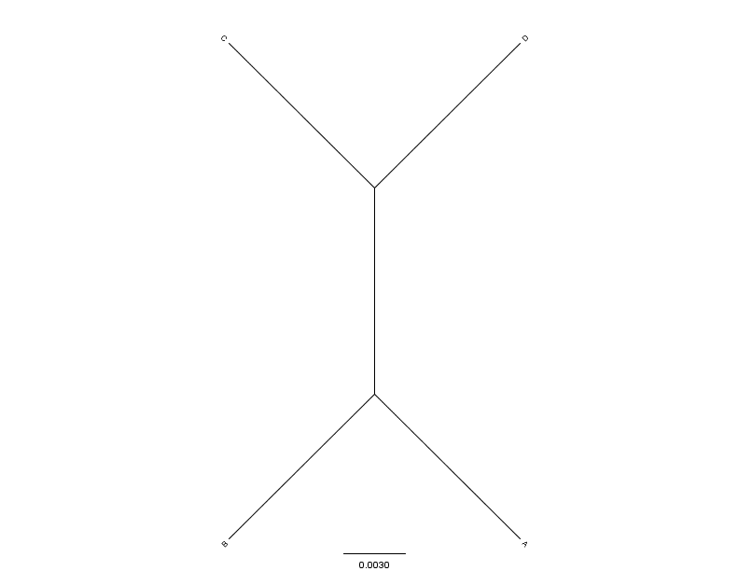
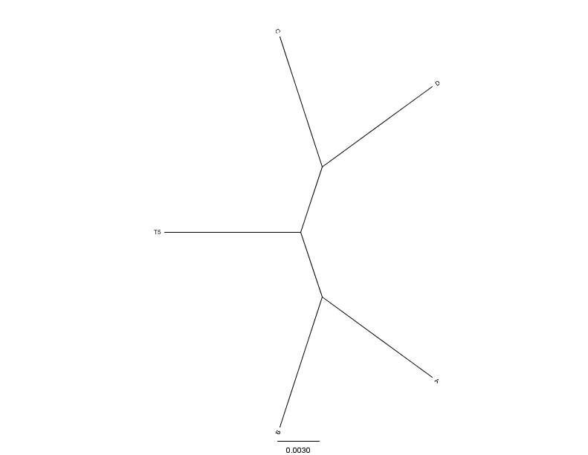
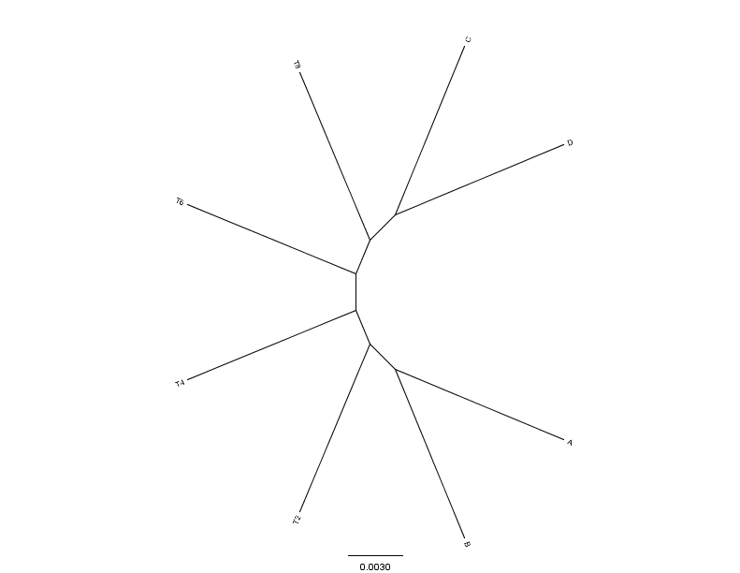
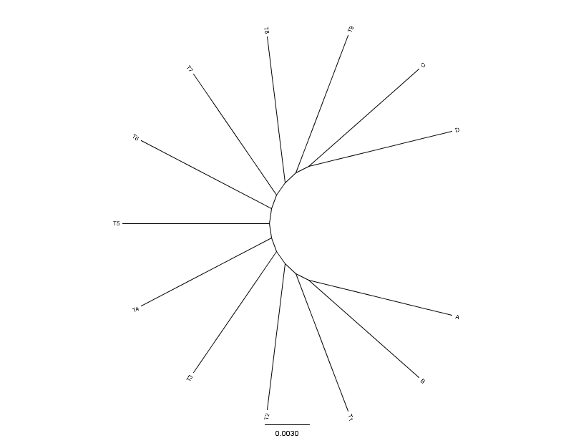
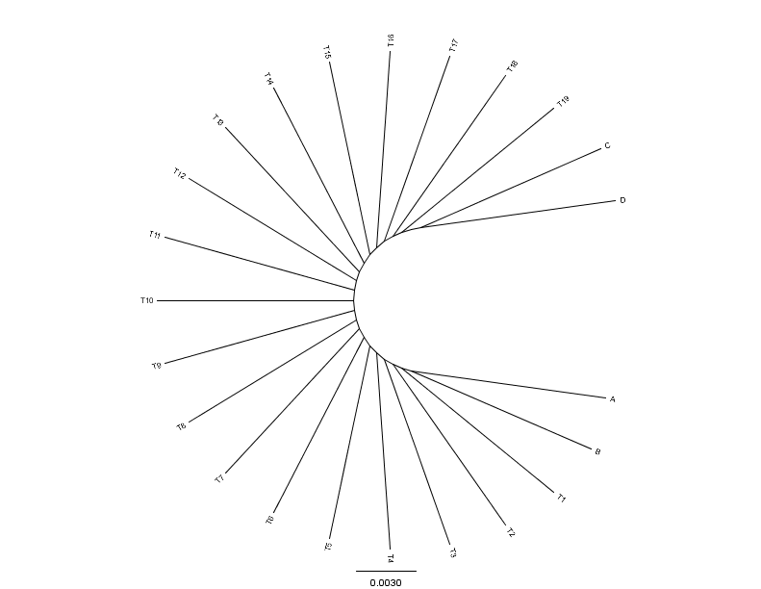
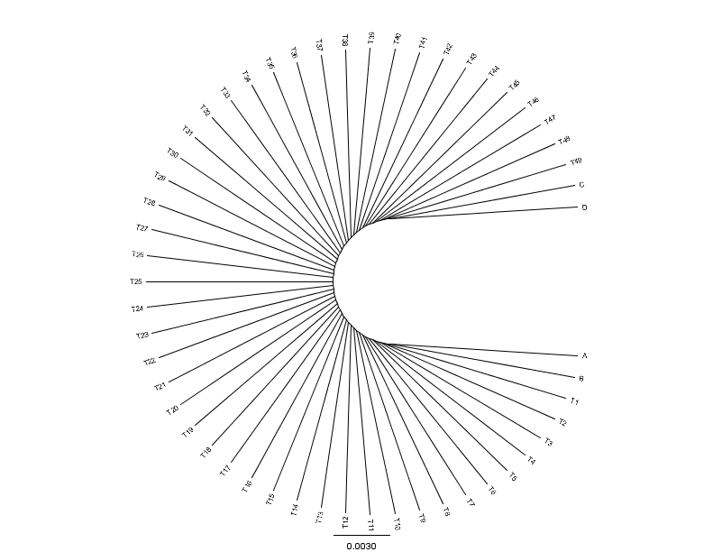
C
D
C
C
D
0.01
0.01
D
N=4(0)
N=5(1)
N=8(4)
0.01
A
0.01
0.01
B
B
B
A
A
B
C
C
D
D
C
D
A
A
A
B
B
B
N=13(9)
N=23(19)
N=53(49)
From: Mao F, Williams D, Zhaxybayeva O, Poptsova M, Lapierre P, Gogarten JP, Xu Y (2012)
BMC Bioinformatics 13:123, doi:10.1186/1471-2105-13-123

Slide 30


Results :
Maximum Bootstrap Support value for Bipartition separating (AB) and (CD)
Maximum Bootstrap Support value
for embedded Quartet (AB),(CD)

Slide 31
Bipartition Paradox:
The more sequences are added, the lower the support for bipartitions that include all sequences. The more data one uses, the lower the bootstrap support values become.
This paradox disappears when only embedded splits for 4 sequences are considered.

Slide 32
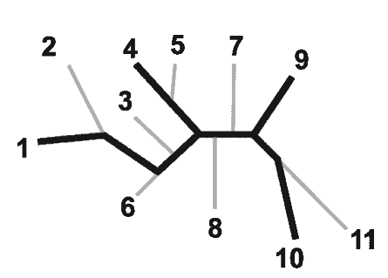
Bootstrap support values for embedded quartets
+
: tree calculated from one pseudo-sample generated by bootstraping from an alignment of one gene family present in 11 genomes
: embedded quartet for genomes
1, 4, 9, and 10 .
This bootstrap sample supports the topology ((1,4),9,10).
1
9
1
9
1
10
4
√
10
10
4
9
4
Zhaxybayeva et al. 2006, Genome Research, 16(9):1099-108
Quartet spectral analyses of genomes iterates over three loops:
Repeat for all bootstrap samples.
Repeat for all possible embedded quartets.
Repeat for all gene families.

Slide 33
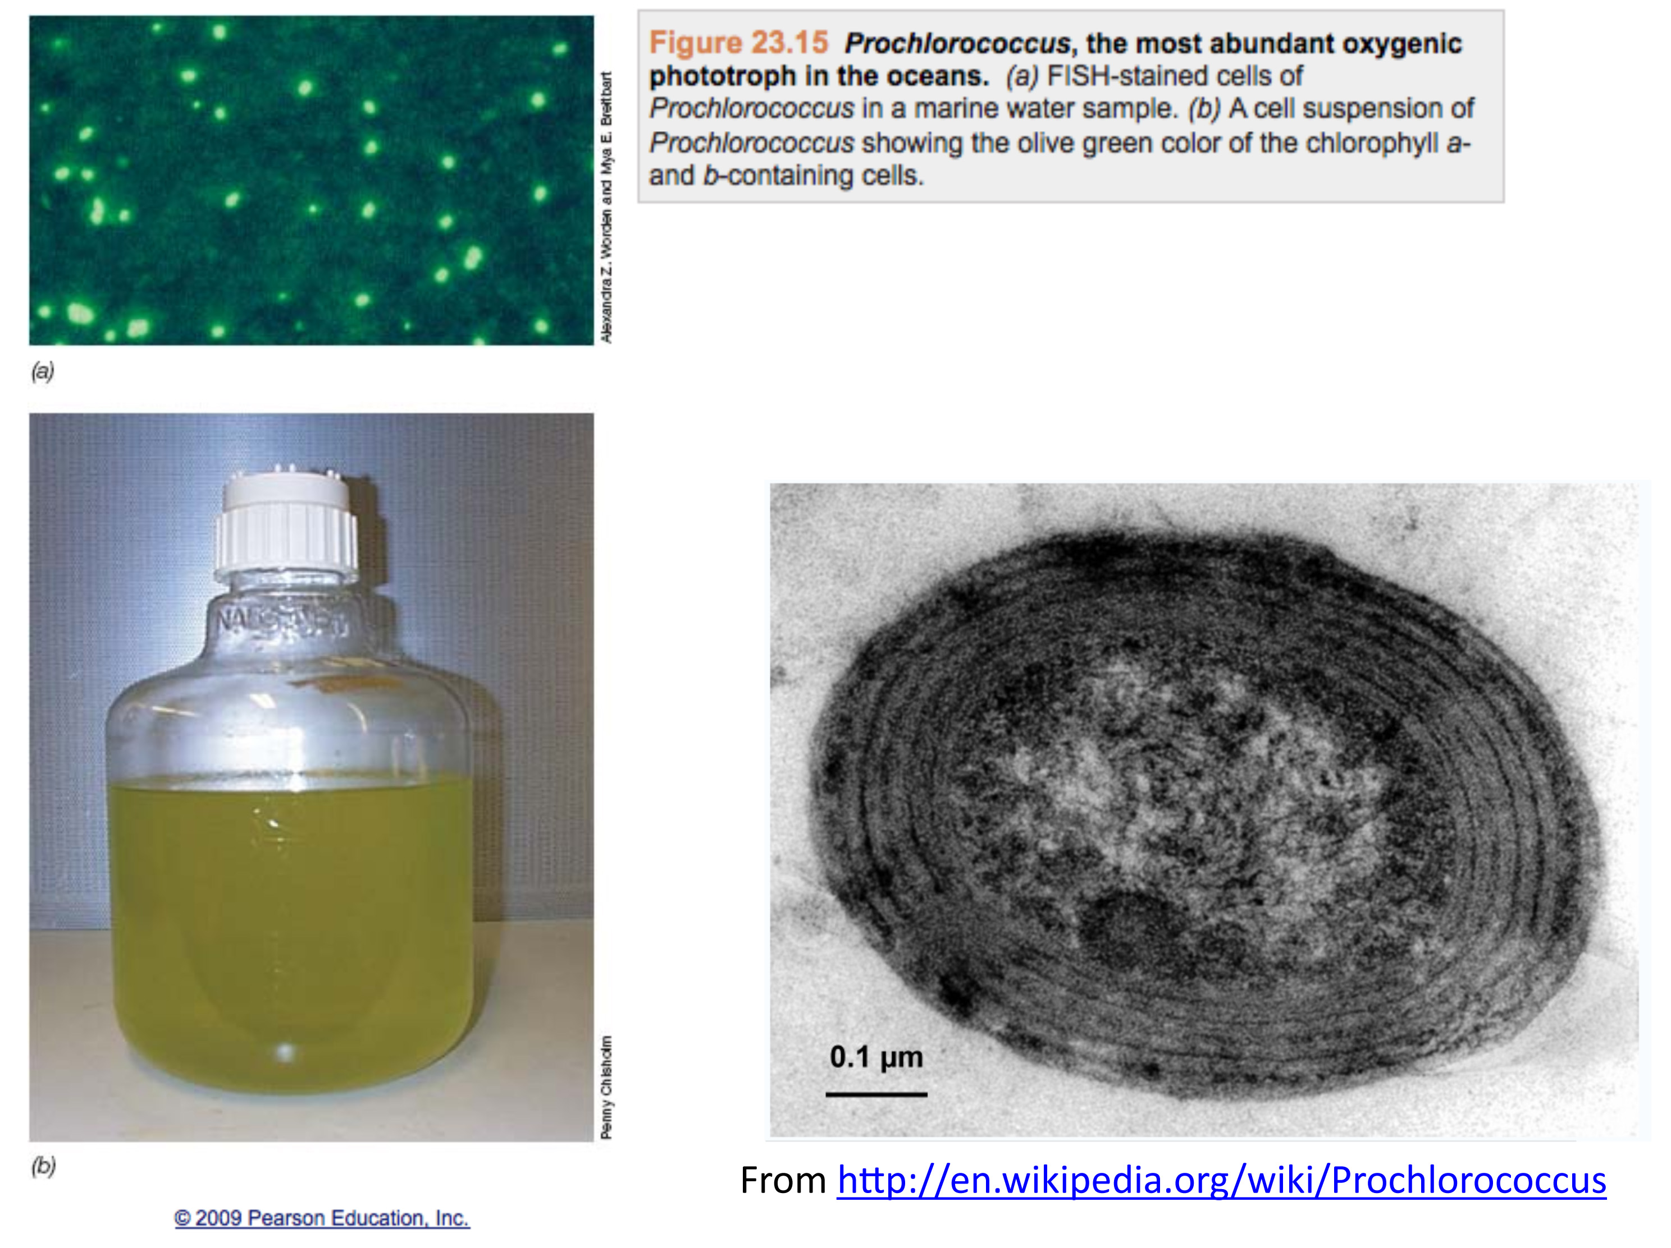

Slide 34
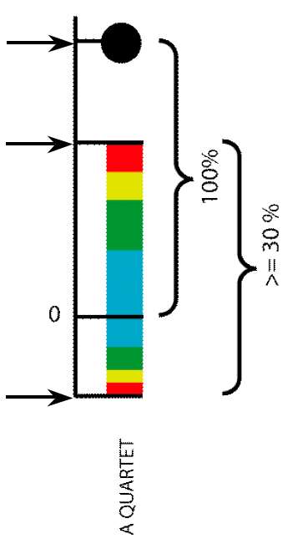
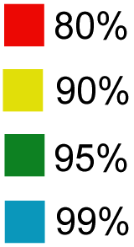
Illustration of one component of a quartet spectral analyses Summary of phylogenetic information for one genome quartet for all gene families
Total number of gene families containing the species quartet
Number of gene families supporting the same topology as the plurality
(colored according to bootstrap support level)
Number of gene families supporting one of the two alternative quartet topologies

Slide 35
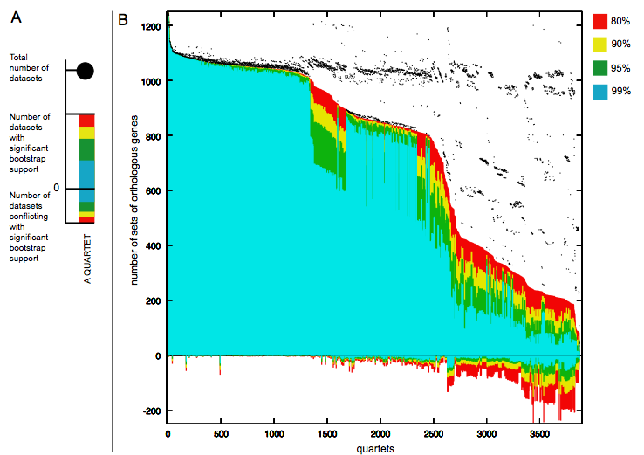
Quartet decomposition analysis of 19 Prochlorococcus and marine Synechococcus genomes. Quartets with a very short internal branch or very long external branches as well those resolved by less than 30% of gene families were excluded from the analyses to minimize artifacts of phylogenetic reconstruction.

Slide 36
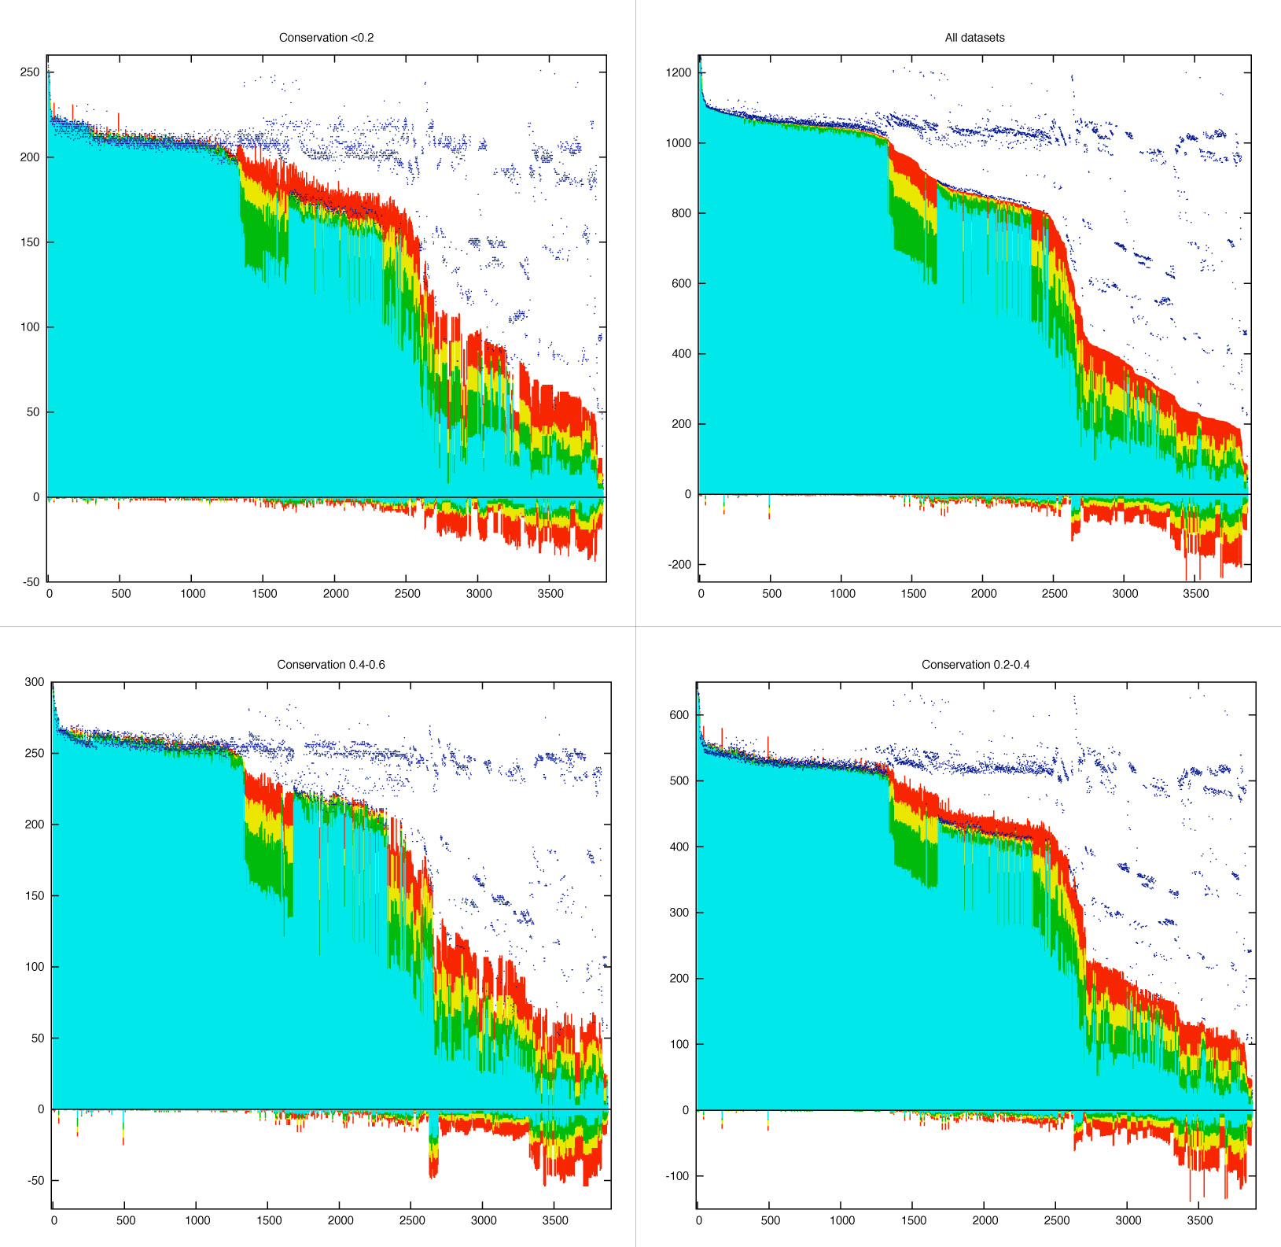
Conservation 0-20%
All Datasets
Conservation 40-60%
Conservation 20-40%

Slide 37
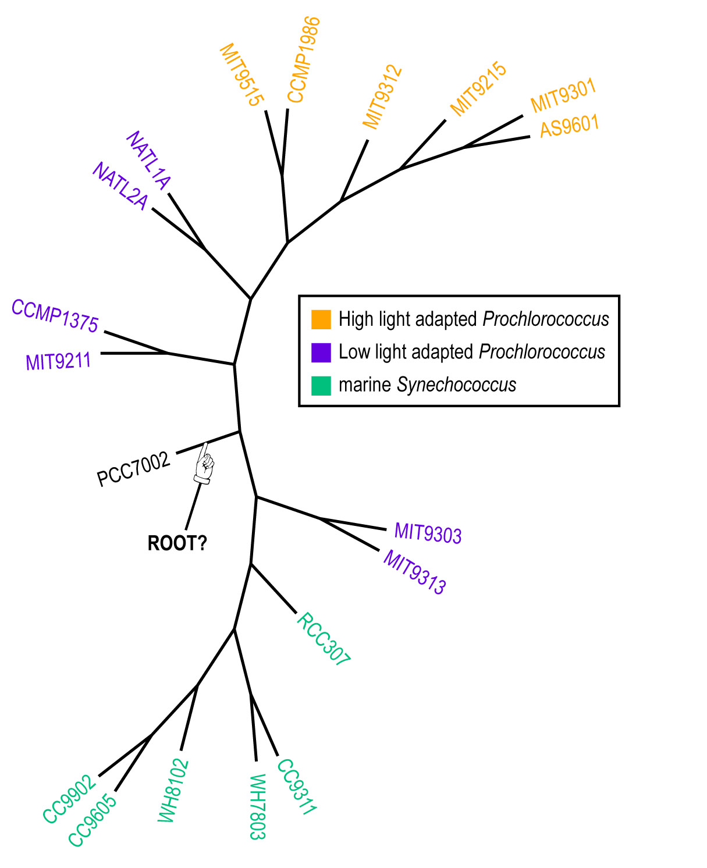
Plurality consensus calculated as supertree (MRP) from quartets in the plurality topology.

Slide 38
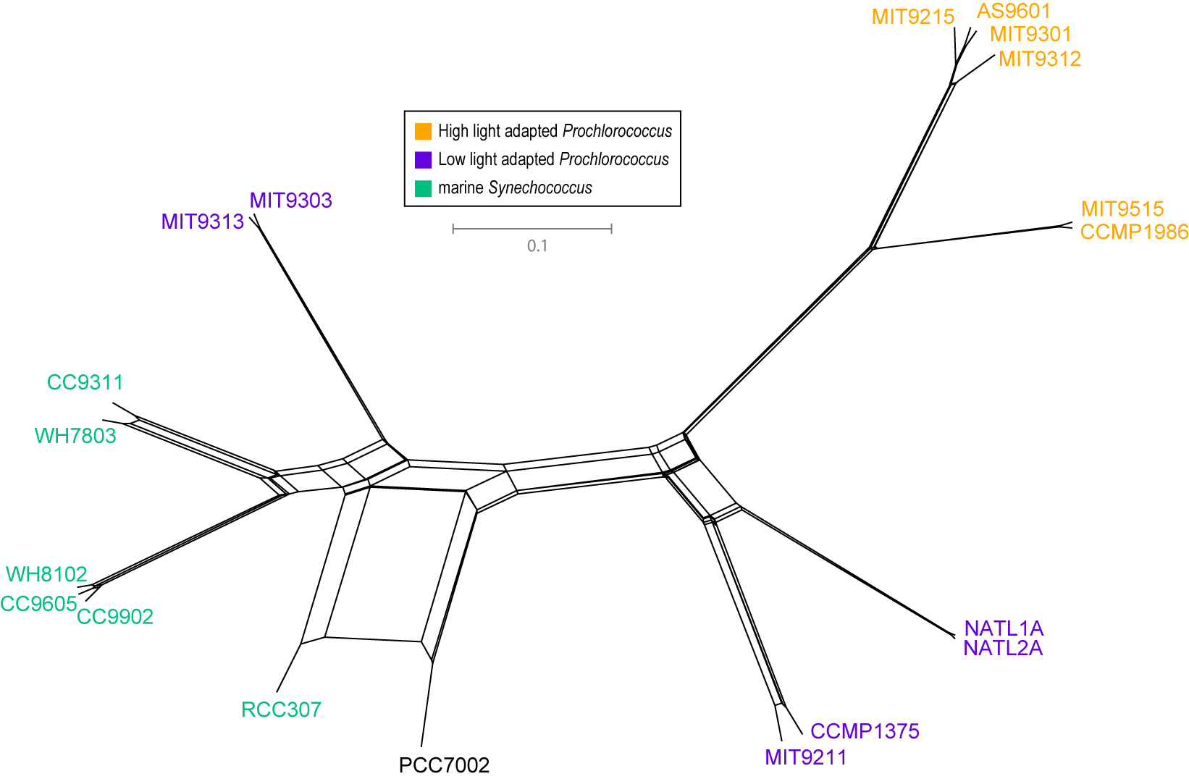
NeighborNet (calculated with SplitsTree 4.0)
Plurality neighbor-net calculated as supertree (from the MRP matrix using SplitsTree 4.0) from all quartets significantly supported by all individual gene families (1812) without in-paralogs.

Slide 39
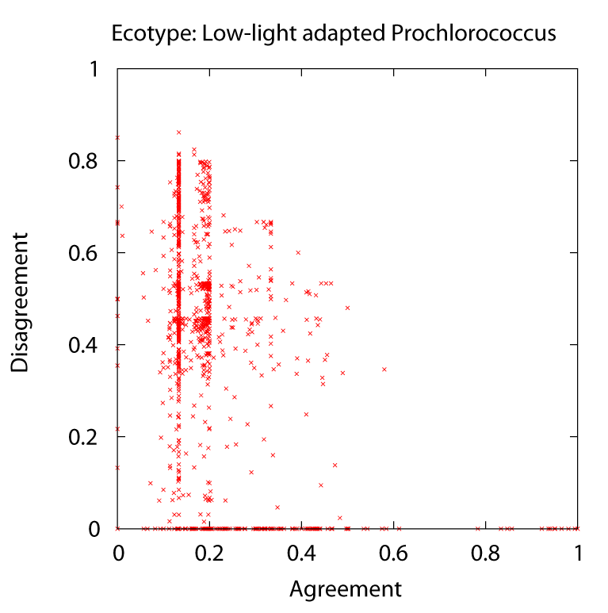
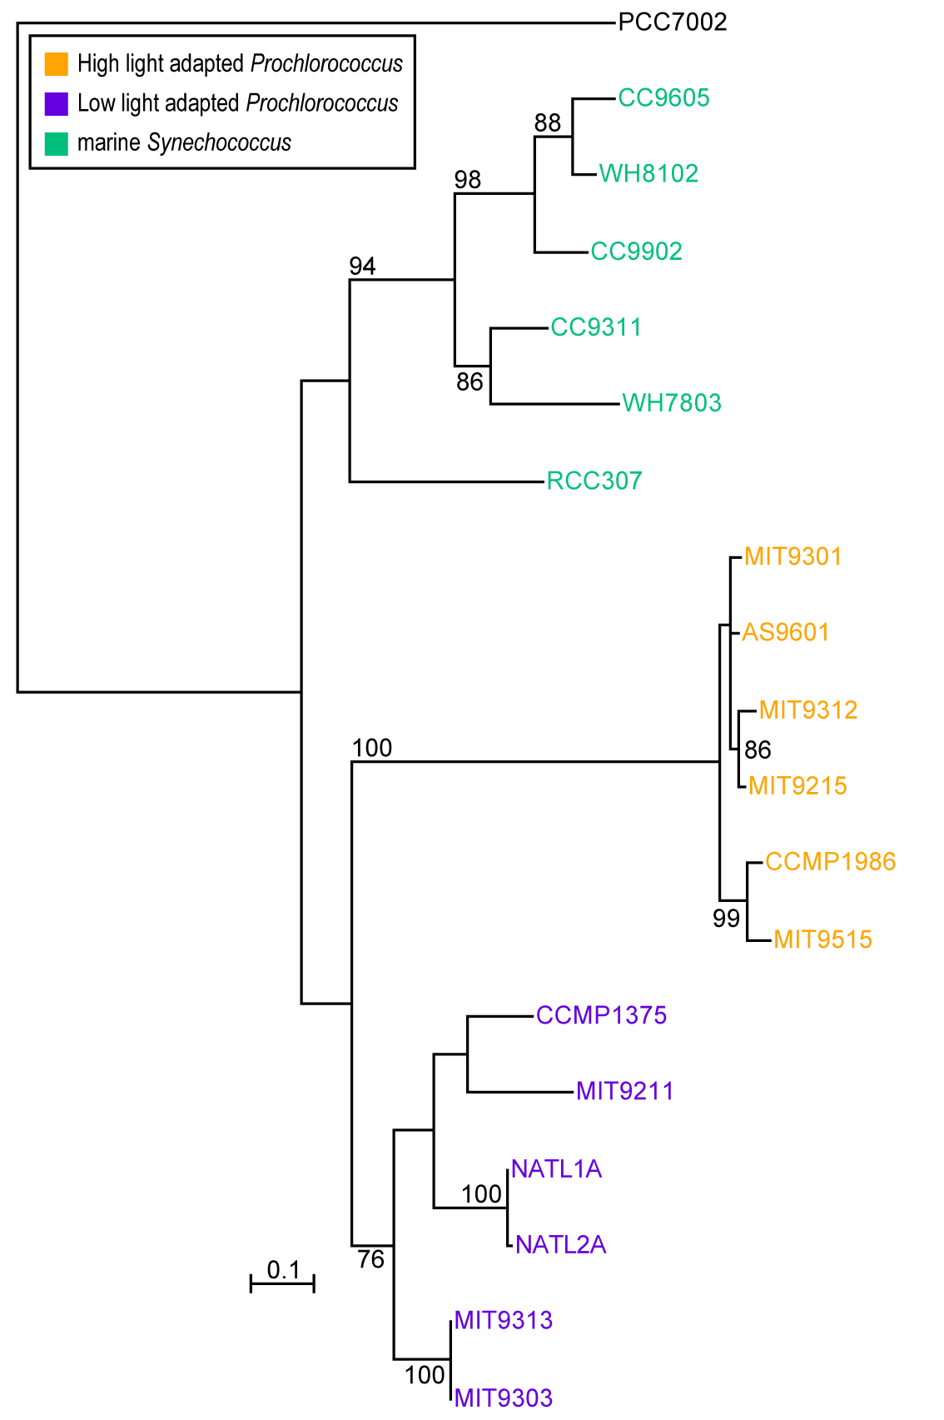
Phylogeny of delta subunit of ATP synthase.

Slide 40

Other approaches to find transferred genes
Gene presence absence data for closely related genomes (for additional genes)
Phylogenetic conflict (for homologous replacement (e.g. quartet decompositon spectra see Figs. 1 and 2)
Composition based analyses (for very recent transfers).

Slide 41
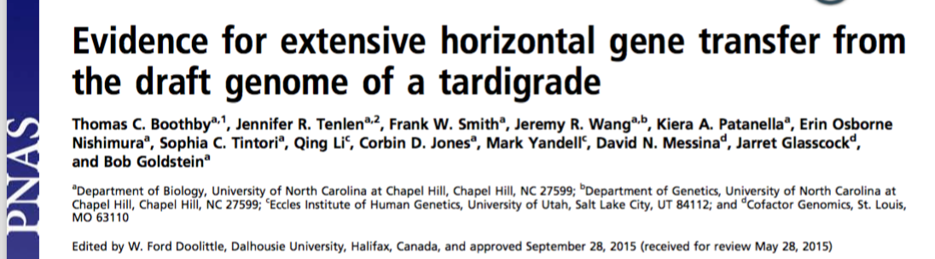
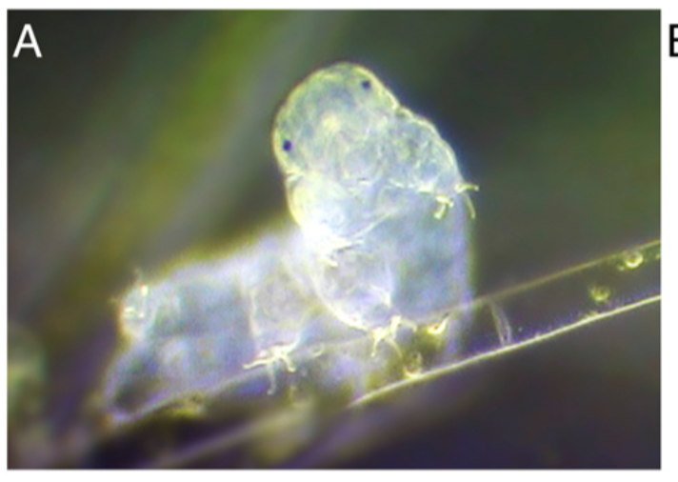
Discussion of
HGT from Bacteria to Tardigrades
We estimate that approximately one-sixth of tardigrade genes entered by HGT, nearly double the fraction found in the most extreme cases of HGT into animals known to date. Foreign genes have supplemented, expanded, and even replaced some metazoan gene families within the tardigrade genome. Our results demonstrate that an unexpectedly large fraction of an animal genome can be derived from foreign sources.

Slide 42
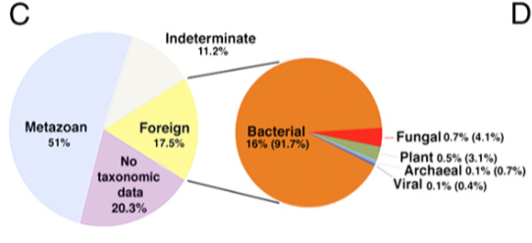
Source of genes in the H. dujardini genome as determined by HGT index calculations

Slide 43
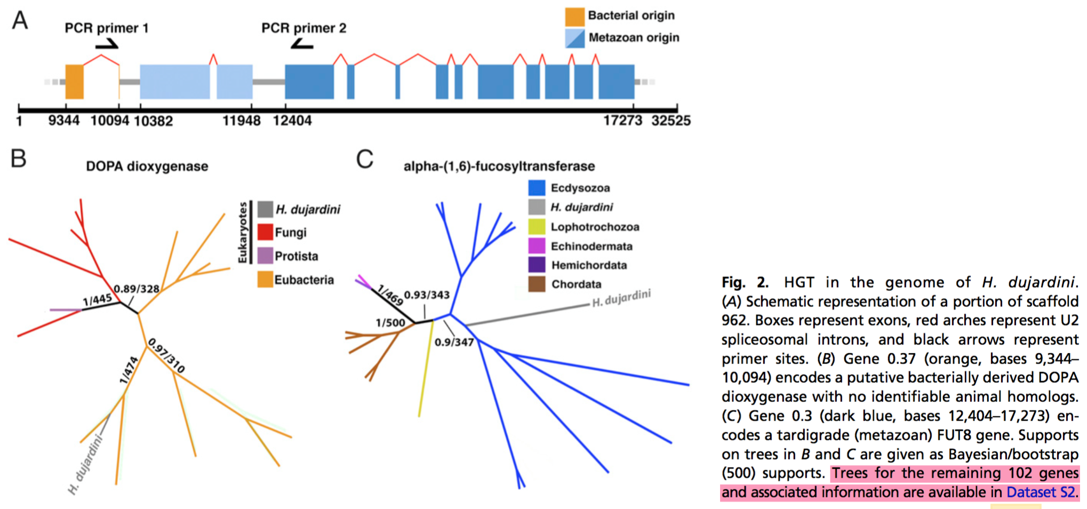
Discussion of
HGT from Bacteria to Tardigrades

Slide 44
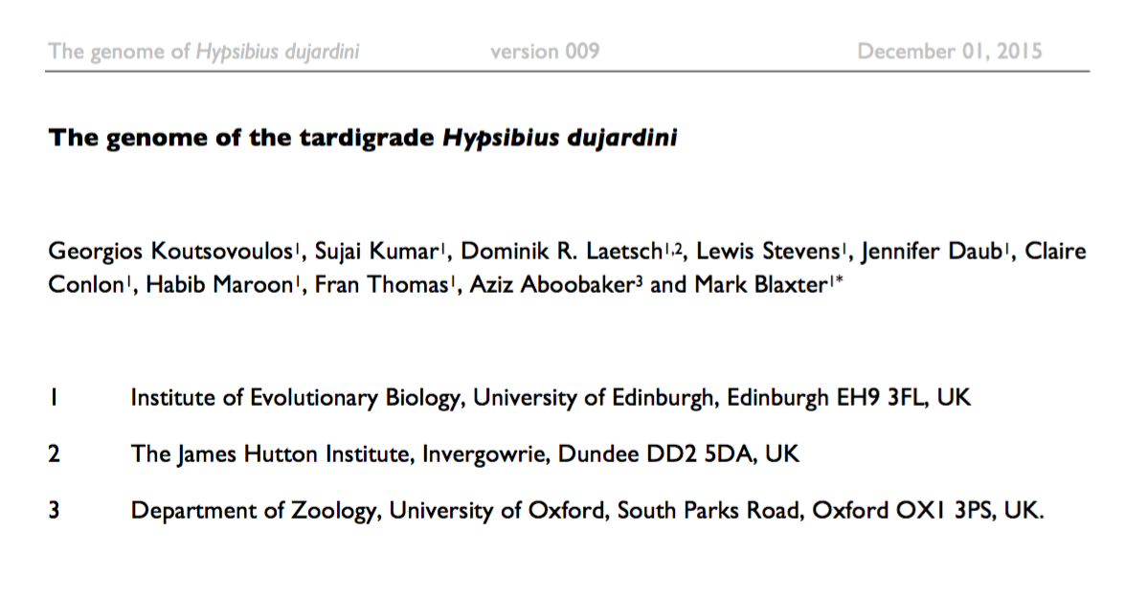
BIOARCHIVES
doi: http://dx.doi.org/10.1101/033464
http://biorxiv.org/content/early/2015/12/01/033464

Slide 45
“While the raw data indicated extensive contamination with bacteria, presumably from the gut or surface of the animals, careful cleaning generated a clean tardigrade dataset for assembly.”

Slide 46
Our assembly, and inferences from it, conflict with a recently published draft genome (UNC) 6 for what is essentially the same strain of H. dujardini. Our assembly, despite having superior assembly statistics, is ~120 Mb shorter than the UNC assembly. Our genome size estimate from sequence assembly is congruent with the values we obtained by direct measurement. We find 15,000 fewer protein-coding genes, and a hugely reduced impact of predicted HGT on gene content in H. dujardini. These HGT candidates await detailed validation. While resolution of the conflict between these assemblies awaits detailed examination based on close scrutiny of the raw UNC data, our analyses suggest that the UNC assembly is compromised by sequences that derive from bacterial contaminants, and that the expanded genome span, additional genes, and HGT candidates are likely to be artefactual.

Slide 47
Figure 4: Mapping of read data to UNC assembly identifies non-shared
contaminants and no expression from bacterial scaffolds
A Blobplot showing the UNC assembly contigs distributed by GC proportion and coverage derived from the UNC raw genomic sequence data (data file TG-300). Scaffold points are scaled by length, and coloured based on taxonomic assignment of the sum of the best BLAST and Diamond matches for all the genes on the scaffold. Taxonomic assignments are summed by phylum.
B Blobplot showing the UNC assembly contigs distributed by GC proportion and coverage derived from the Edinburgh raw genomic sequence data. Scaffold points are scaled by length, and coloured based on taxonomic assignment of the sum of the best BLAST and Diamond matches for all the genes on the scaffold. Taxonomic assignments are summed by phylum.

Slide 48
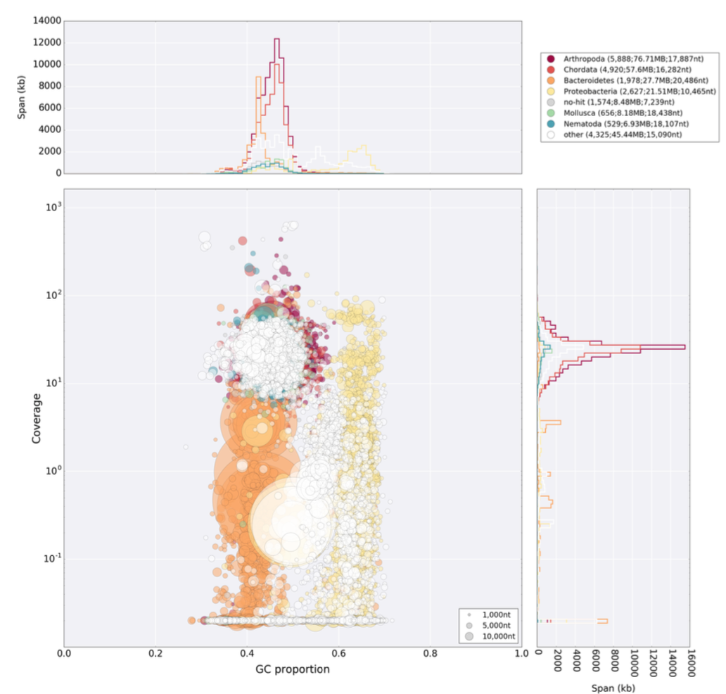
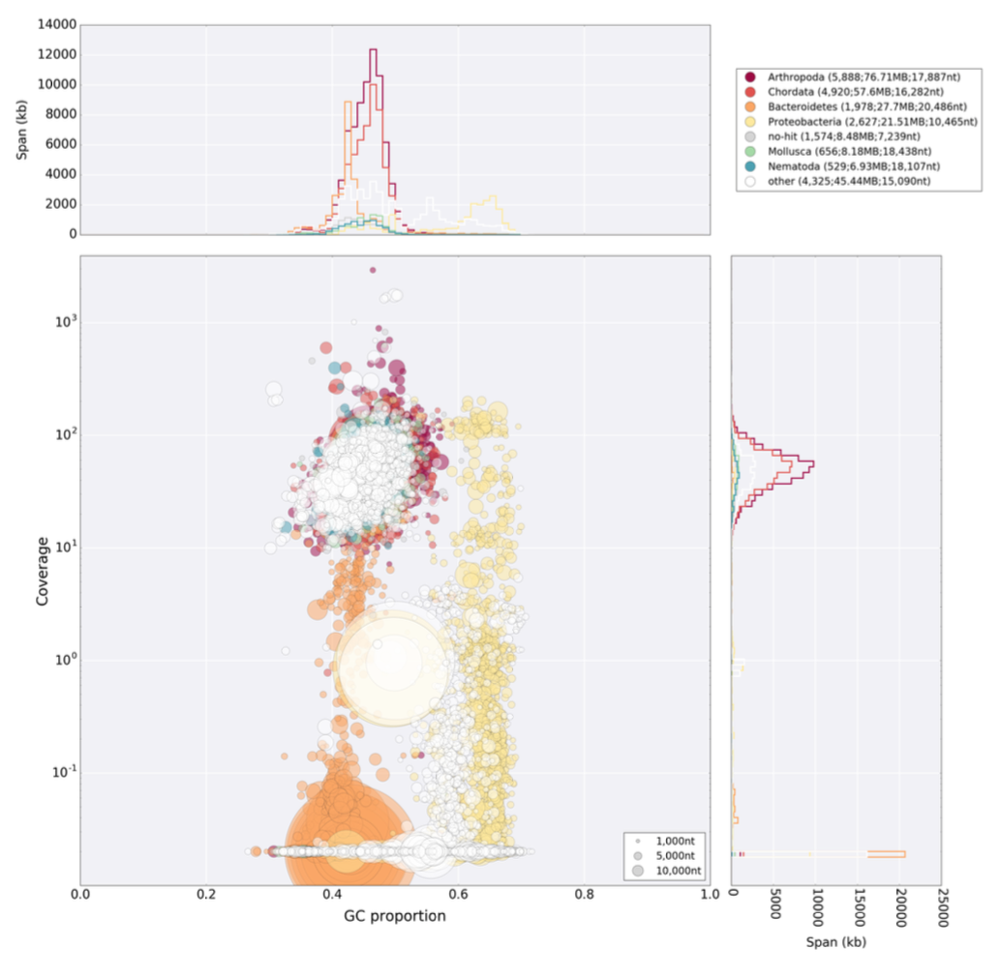
UNC reads
Edinburgh reads
both mapped on the UNC assembly

Slide 49
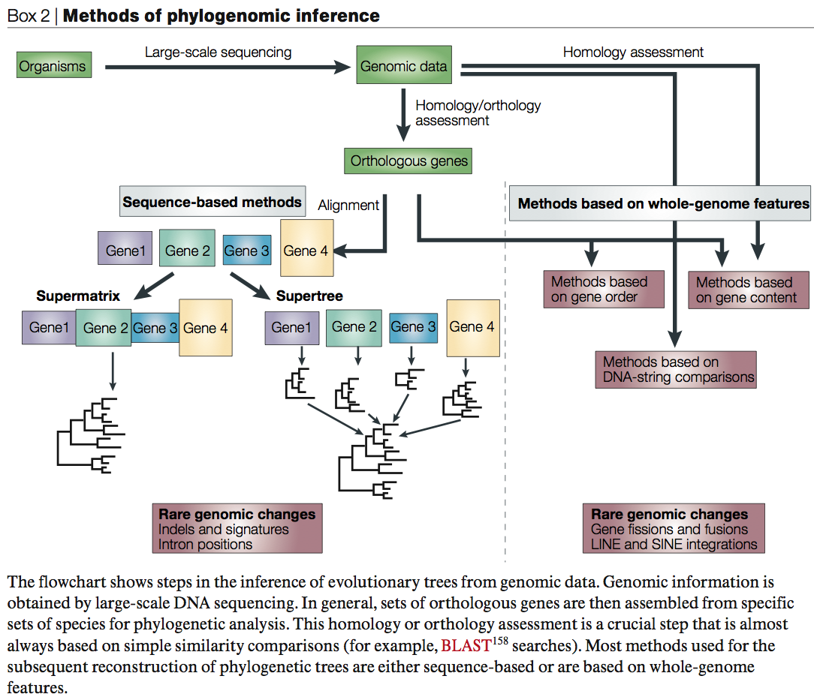
From:
Delsuc F, Brinkmann H, Philippe H.
Phylogenomics and the reconstruction of the tree of life.
Nat Rev Genet. 2005 May;6(5):361-75.

Slide 50
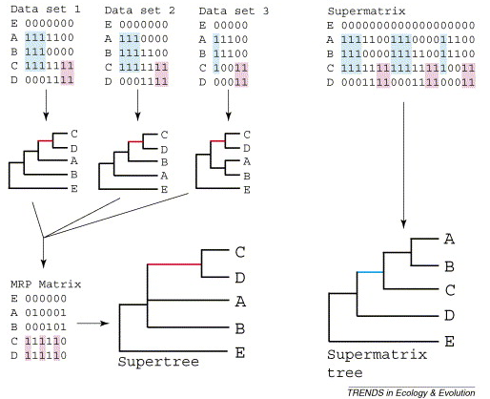
Supertree vs. Supermatrix
From:
Alan de Queiroz John Gatesy:
The supermatrix approach to systematics
Trends Ecol Evol. 2007 Jan;22(1):34-41
Schematic of MRP supertree (left) and parsimony supermatrix (right) approaches to the analysis of three data sets. Clade C+D is supported by all three separate data sets, but not by the supermatrix. Synapomorphies for clade C+D are highlighted in pink. Clade A+B+C is not supported by separate analyses of the three data sets, but is supported by the supermatrix. Synapomorphies for clade A+B+C are highlighted in blue. E is the outgroup used to root the tree.

Slide 51
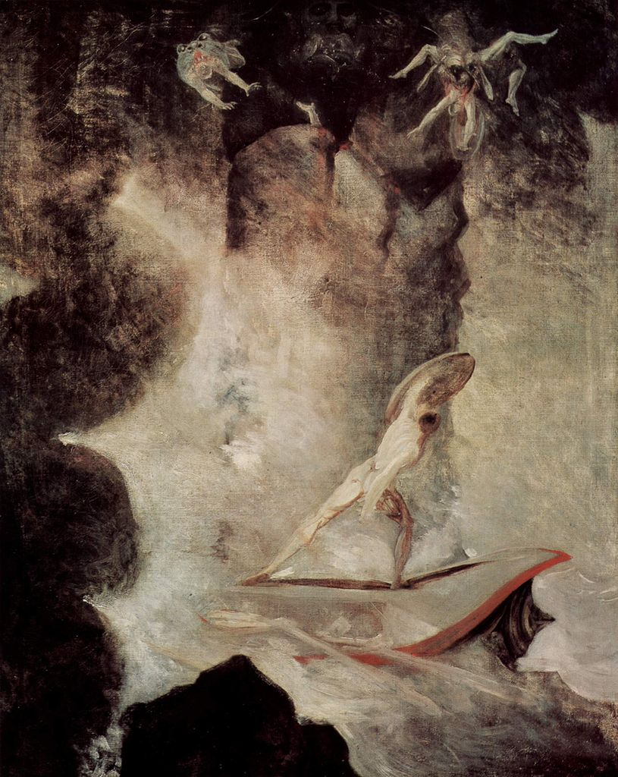
Johann Heinrich Füssli
Odysseus vor Scilla und Charybdis
From: http://en.wikipedia.org/wiki/File:Johann_Heinrich_F%C3%BCssli_054.jpg

Slide 52
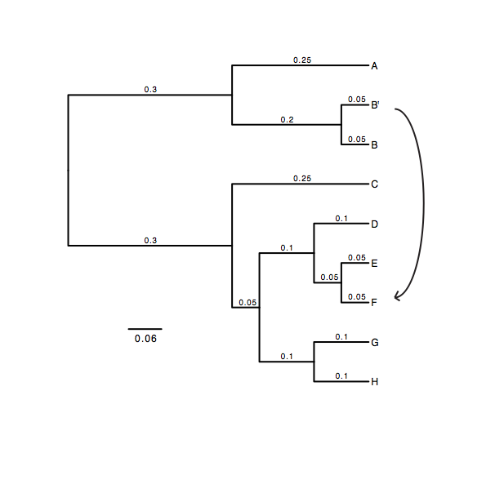
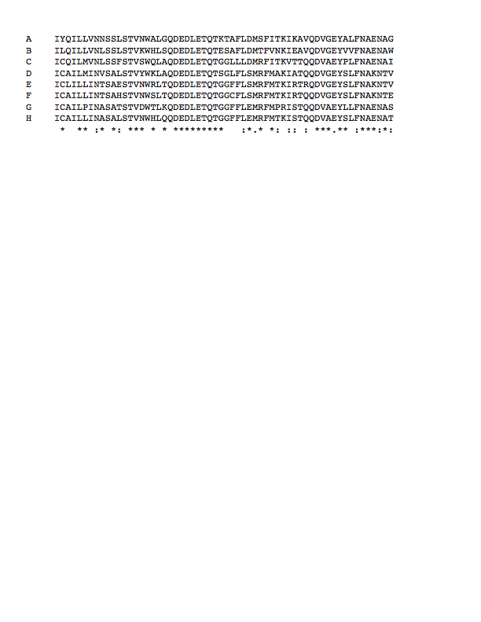
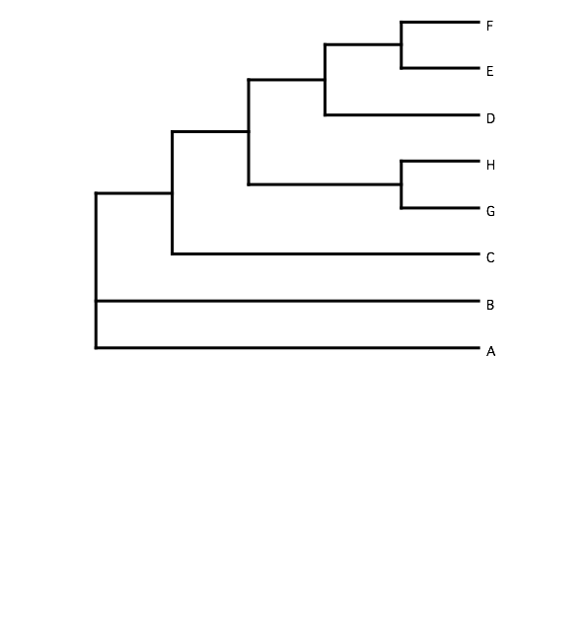
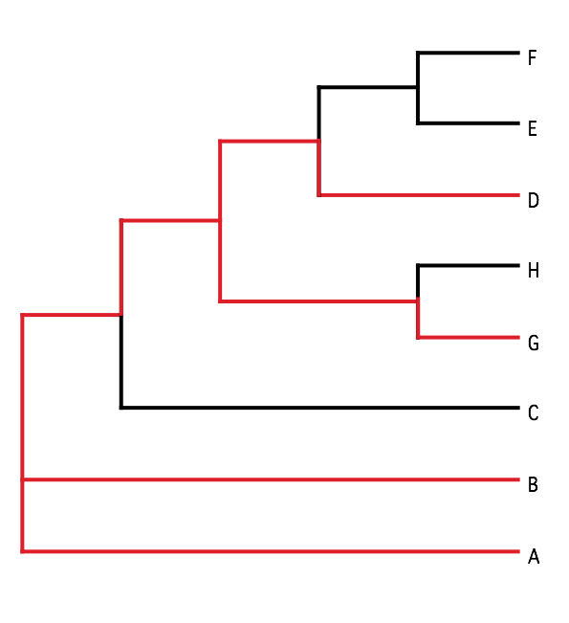
B) Generate 100 datasets using Evolver with certain amount of HGTs
A) Template tree
C) Calculate 1 tree using the concatenated dataset or 100 individual trees
D) Calculate Quartet based tree using Quartet Suite
Repeated 100 times…

Slide 53
Supermatrix versus
Quartet based Supertree
inset: simulated phylogeny

Slide 54
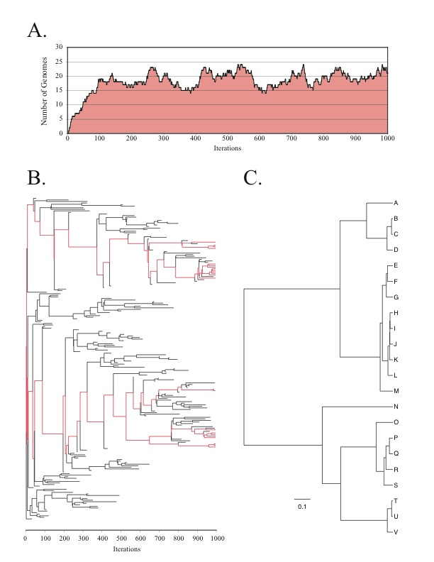
Note : Using same genome seed random number will reproduce same genome history
From: Lapierre P, Lasek-Nesselquist E, and Gogarten JP (2012)
The impact of HGT on phylogenomic reconstruction methods
Brief Bioinform [first published online August 20, 2012] doi:10.1093/bib/bbs050

Slide 55
HGT EvolSimulator Results

Slide 57
See http://bib.oxfordjournals.org/content/15/1/79.full for more information.

