Slide 1
student evaluations
Please go to husky CT and complete student evaluations !

Slide 2
**********************************
* Assignment 4 *
**********************************
Question 1:
The primary kingdoms but most importantly, the phylogenetic structure of the prokaryote domain
85
2009
450
Question 2:
2001 The intein of the Thermoplasma A-ATPase A subunit: Structure, evolution and expression in E. coli
Question 3:
(gogarten[Author] NOT (ATP[All Fields] AND ("nitric oxide synthase"[MeSH Terms] OR ("nitric"[All Fields] AND "oxide"[All Fields] AND "synthase"[All Fields]) OR "nitric oxide synthase"[All Fields] OR "synthase"[All Fields]))) OR ("adenosine triphosphatases"[MeSH Terms] OR ("adenosine"[All Fields] AND "triphosphatases"[All Fields]) OR "adenosine triphosphatases"[All Fields] OR "atpase"[All Fields])
64
Question 4:
13 and it levels the playing field so that heavily cited papers arent seen first compared to those that arent cited as often.
The gene, protein and glycan structures of laccase from Pleurotus ostreatus. 82 times
Published 1996. Last Cited 2013
It was fairly exciting
Yes, most of the abstracts were free online but other parts of the article would need to be purchased or subscribed to see the rest
cited 128 times. It is almost twice as much as the other one.
Question 5:
8
2
14095
Very good chance that all of these are homologs.
2 matches
Differences in the composition of these ATPases even though they are related.
Chromosome: 1 NC_003070.9 29660088..29665078
Question 6:
Central positions are missing (need crucial information)
Question 7:
Archae
Phylum: Euryarchaeota
Family: Thermoplasmataceae
7870 protein sequences and 2 Genomes

Slide 3
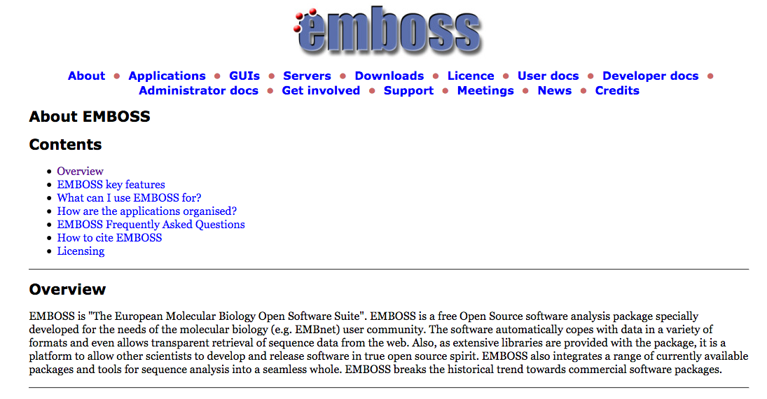

Slide 4
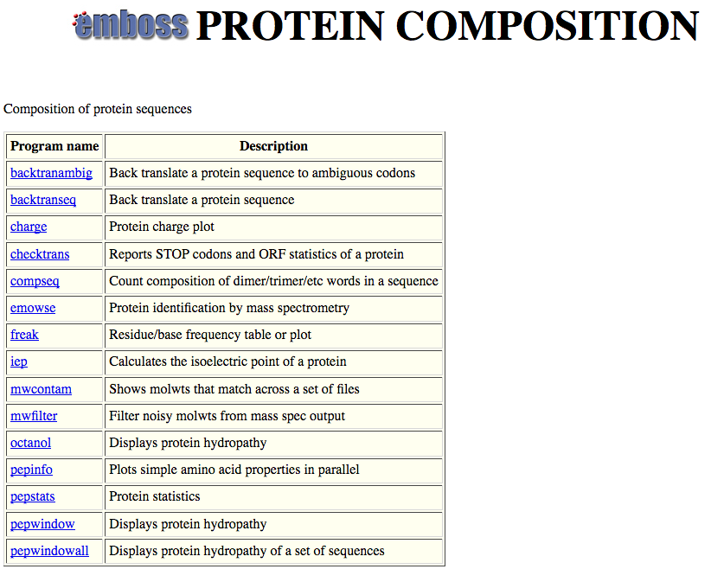

Slide 5
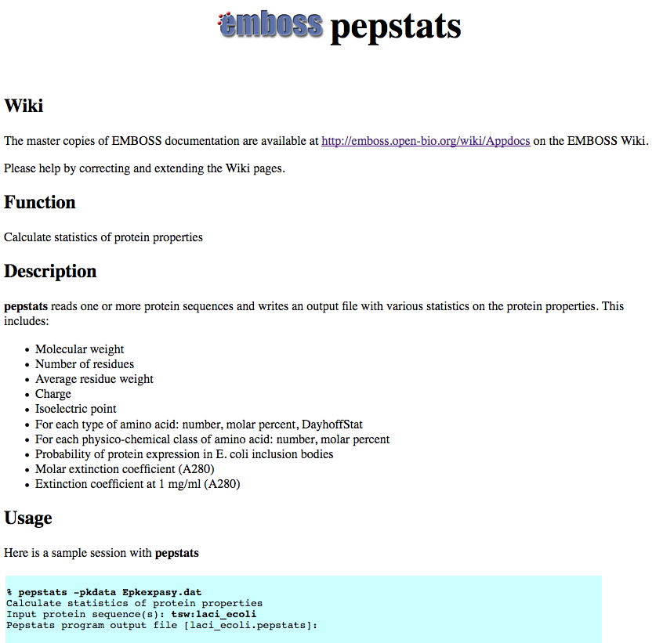

Slide 6
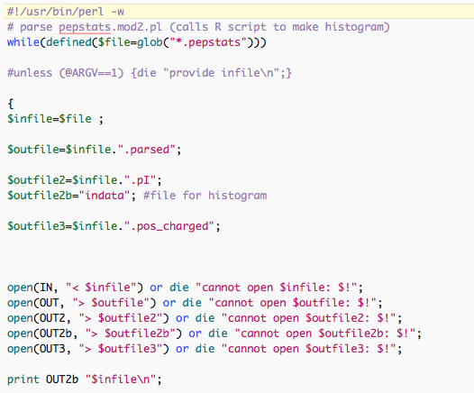

Slide 7

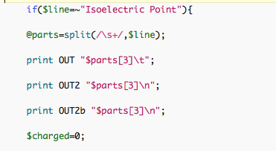
…

Slide 8
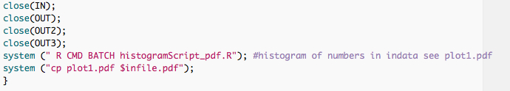

Slide 9
DNA, cell wall & membrane bound proteins
pH at which protein has no charge

Slide 10
Histogram of theoretical isoelectric points of Saccharomyces proteins
DNA, cell wall & membrane bound proteins
pH at which protein has no charge

Slide 11
Histogram of theoretical isoelectric points of Thermplasmatales proteins
pH at which protein has no charge

Slide 12
Histogram of theoretical isoelectric points of Haloferax proteins
Salt in strategy
At neutral pH most proteins with negative charge
pH at which protein has no charge

