Slide 1
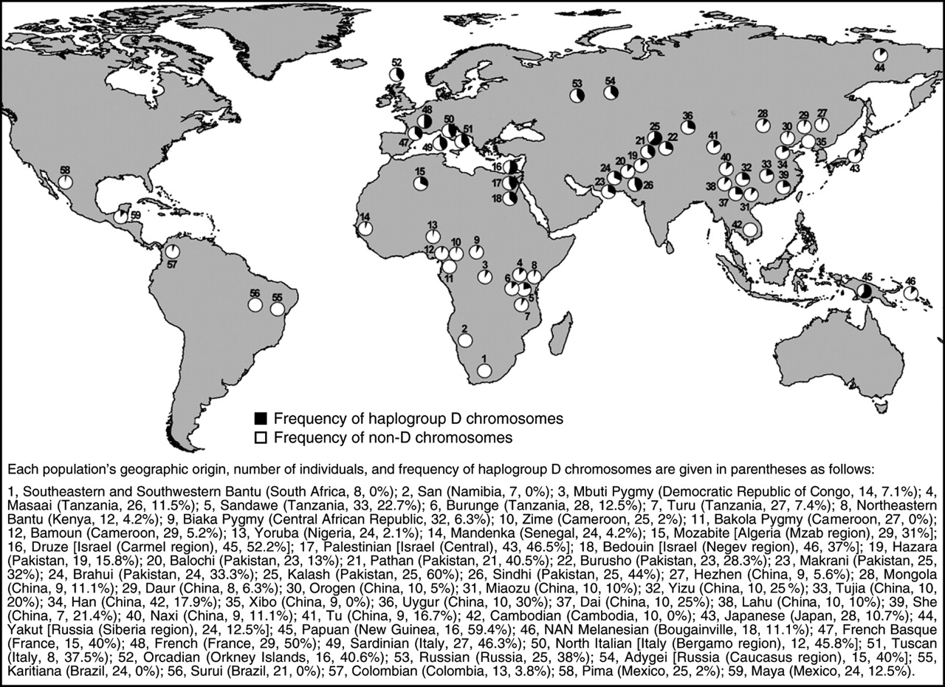
Variant arose about
5800 years ago

Slide 2
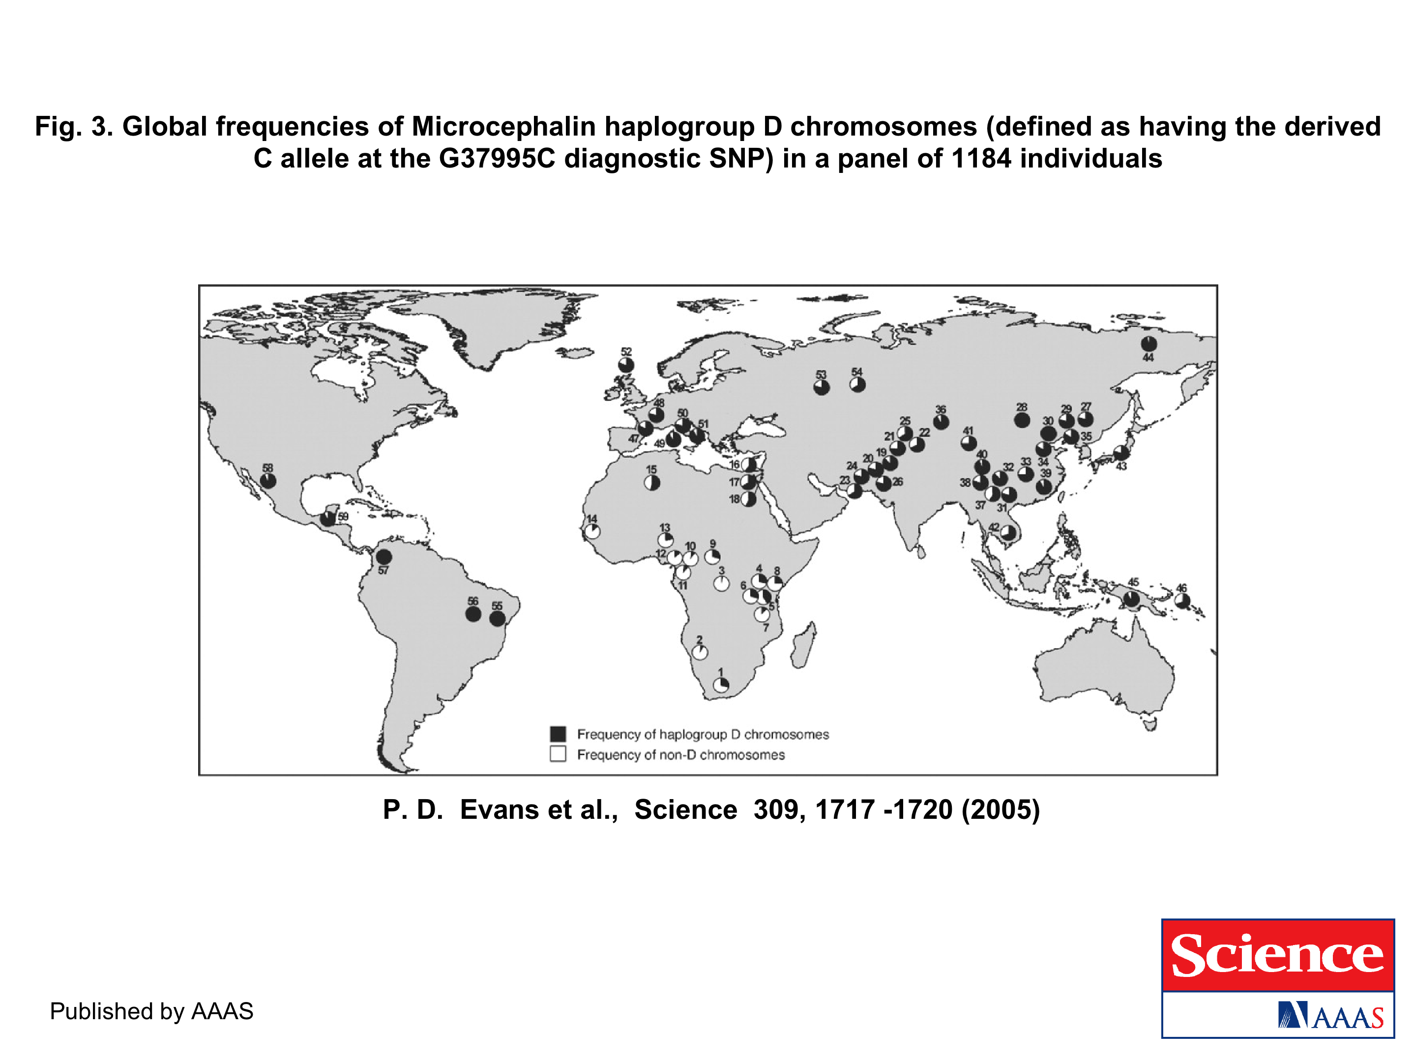
The age of haplogroup D was found to be ~37,000 years

Slide 3
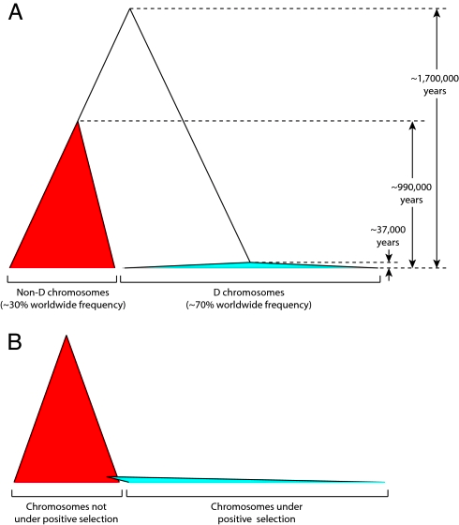
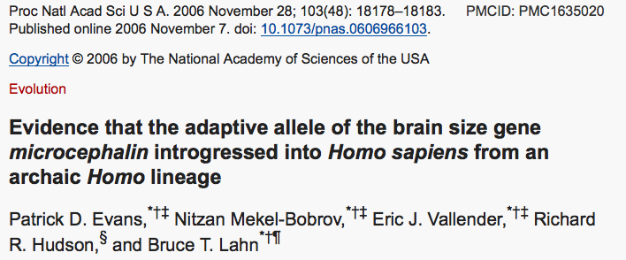

Slide 4
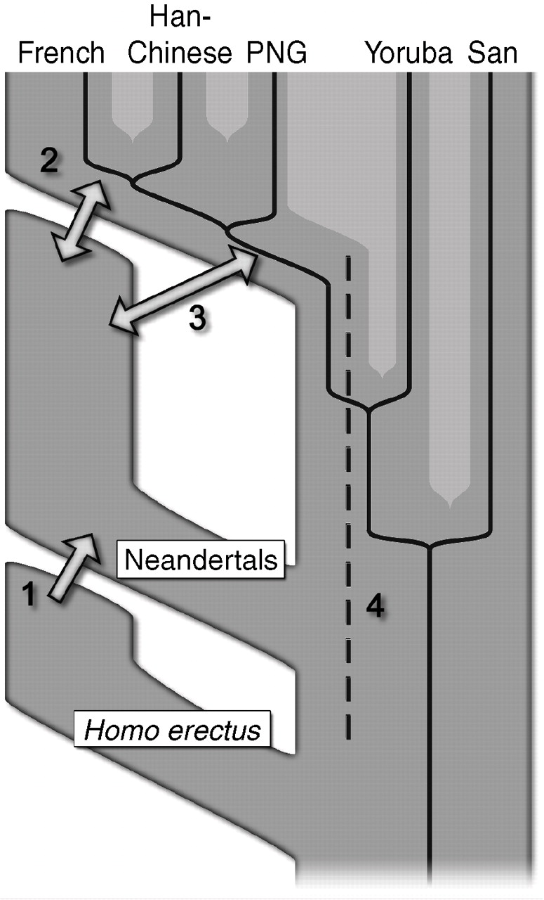

Fig. 6 Four possible scenarios of genetic mixture involving Neandertals.
R E Green et al. Science 2010;328:710-722
Published by AAAS
Notes:
Four possible scenarios of genetic mixture involving Neandertals. Scenario 1 represents gene flow into Neandertal from other archaic hominins, here collectively referred to as Homo erectus. This would manifest itself as segments of the Neandertal genome with unexpectedly high divergence from present-day humans. Scenario 2 represents gene flow between late Neandertals and early modern humans in Europe and/or western Asia. We see no evidence of this because Neandertals are equally distantly related to all non-Africans. However, such gene flow may have taken place without leaving traces in the present-day gene pool. Scenario 3 represents gene flow between Neandertals and the ancestors of all non-Africans. This is the most parsimonious explanation of our observation. Although we detect gene flow only from Neandertals into modern humans, gene flow in the reverse direction may also have occurred. Scenario 4 represents old substructure in Africa that persisted from the origin of Neandertals until the ancestors of non-Africans left Africa. This scenario is also compatible with the current data.

Slide 5
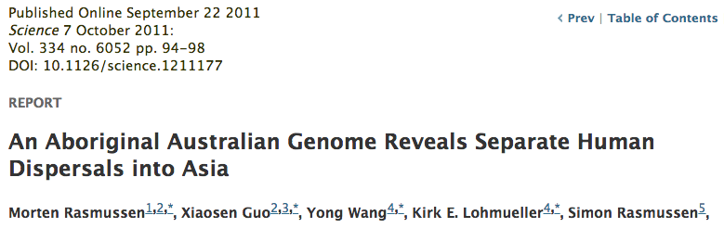
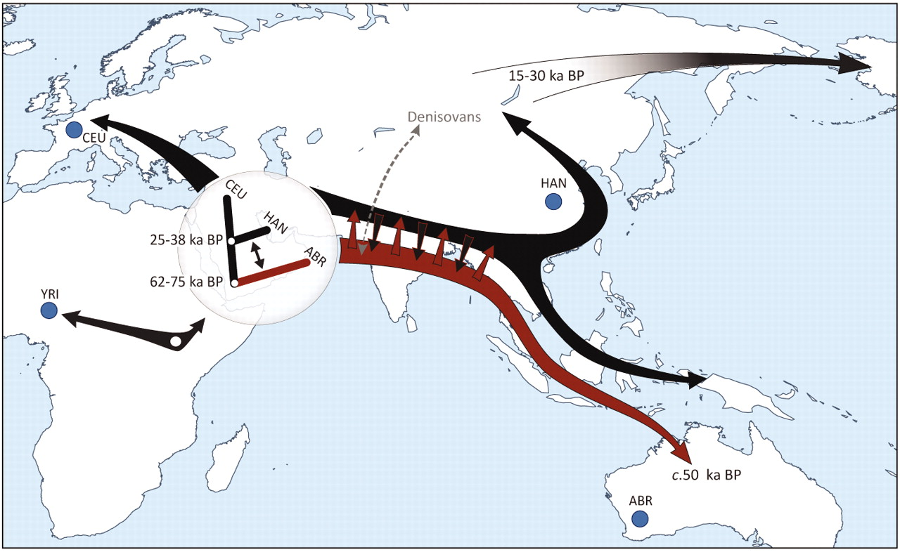

Slide 6
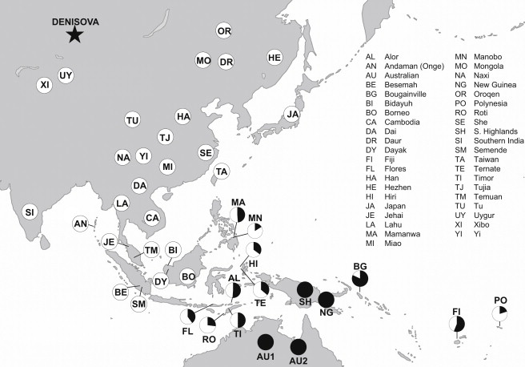
Figure 1 Denisovan Genetic Material as a Fraction of that in New Guineans Populations are only shown as having Denisova ancestry if the estimates are more than two standard errors from zero (we combine estimates for populations in this study wit...
David Reich , Nick Patterson , Martin Kircher , Frederick Delfin , Madhusudan?R. Nandineni , Irina Pugach , Albert...
Denisova Admixture and the First Modern Human Dispersals into Southeast Asia and Oceania
The American Journal of Human Genetics Volume 89, Issue 4 2011 516 - 528
http://dx.doi.org/10.1016/j.ajhg.2011.09.005

Slide 7
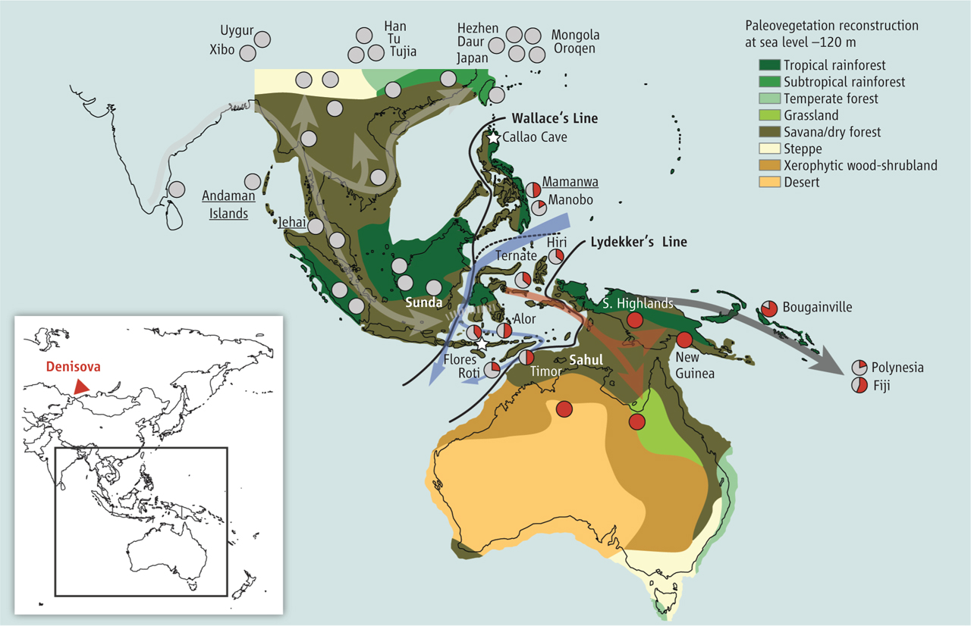
Did the Denisovans Cross Wallace's Line?
Science 18 October 2013:
vol. 342 no. 6156 321-323
Ancient migrations.
The proportions of Denisovan DNA in modern human populations are shown as red in pie charts, relative to New Guinea and Australian Aborigines (3). Wallace's Line (8) is formed by the powerful Indonesian flow-through current (blue arrows) and marks the limit of the Sunda shelf and Eurasian placental mammals.

Slide 8
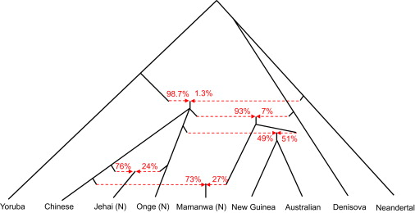
Figure 3 A Model of Population Separation and Admixture that Fits the Data The admixture graph suggests Denisova-related gene flow into a common ancestral population of Mamanwa, New Guineans, and Australians, followed by admixture of New Guinean...
David Reich , Nick Patterson , Martin Kircher , Frederick Delfin , Madhusudan R. Nandineni , Irina Pugach , Albert...
Denisova Admixture and the First Modern Human Dispersals into Southeast Asia and Oceania
The American Journal of Human Genetics Volume 89, Issue 4 2011 516 - 528
http://dx.doi.org/10.1016/j.ajhg.2011.09.005

Slide 9
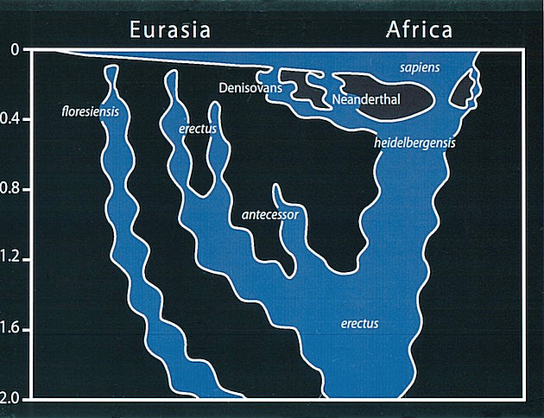
Archaic human admixture with modern Homo sapiens
From: http://en.wikipedia.org/wiki/Archaic_human_admixture_with_modern_Homo_sapiens

Slide 10
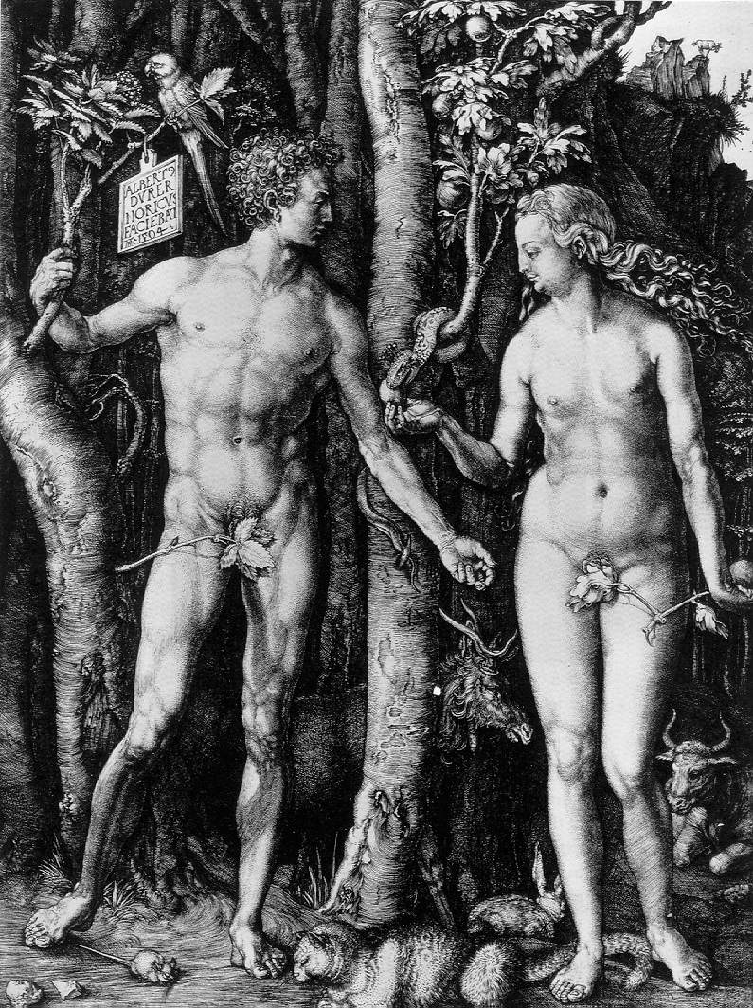
Y chromosome
Adam
Mitochondrial
Eve
Lived
approximately
40,000 years ago
Lived
166,000-249,000
years ago
Thomson, R. et al. (2000) Proc Natl Acad Sci U S A 97, 7360-5
Underhill, P.A. et al. (2000) Nat Genet 26, 358-61
Mendez et al. (2013) American Journal of Human Genetics 92 (3): 454.
Cann, R.L. et al. (1987) Nature 325, 31-6
Vigilant, L. et al. (1991) Science 253, 1503-7
Albrecht Dürer, The Fall of Man, 1504
Adam and Eve never met ☹
The same is true for ancestral rRNAs, EF, ATPases!

Slide 11
“Genotyping of a DNA sample that was submitted to a commercial genetic-testing facility demonstrated that the Y chromosome of this African American individual carried the ancestral state of all known Y chromosome SNPs.”
Mendez , et al. 2013
An African American Paternal Lineage Adds an Extremely Ancient Root to the Human Y Chromosome Phylogenetic Tree
The American Journal of Human Genetics Volume 92, Issue 3 2013 454 - 459
http://dx.doi.org/10.1016/j.ajhg.2013.02.002

Slide 12
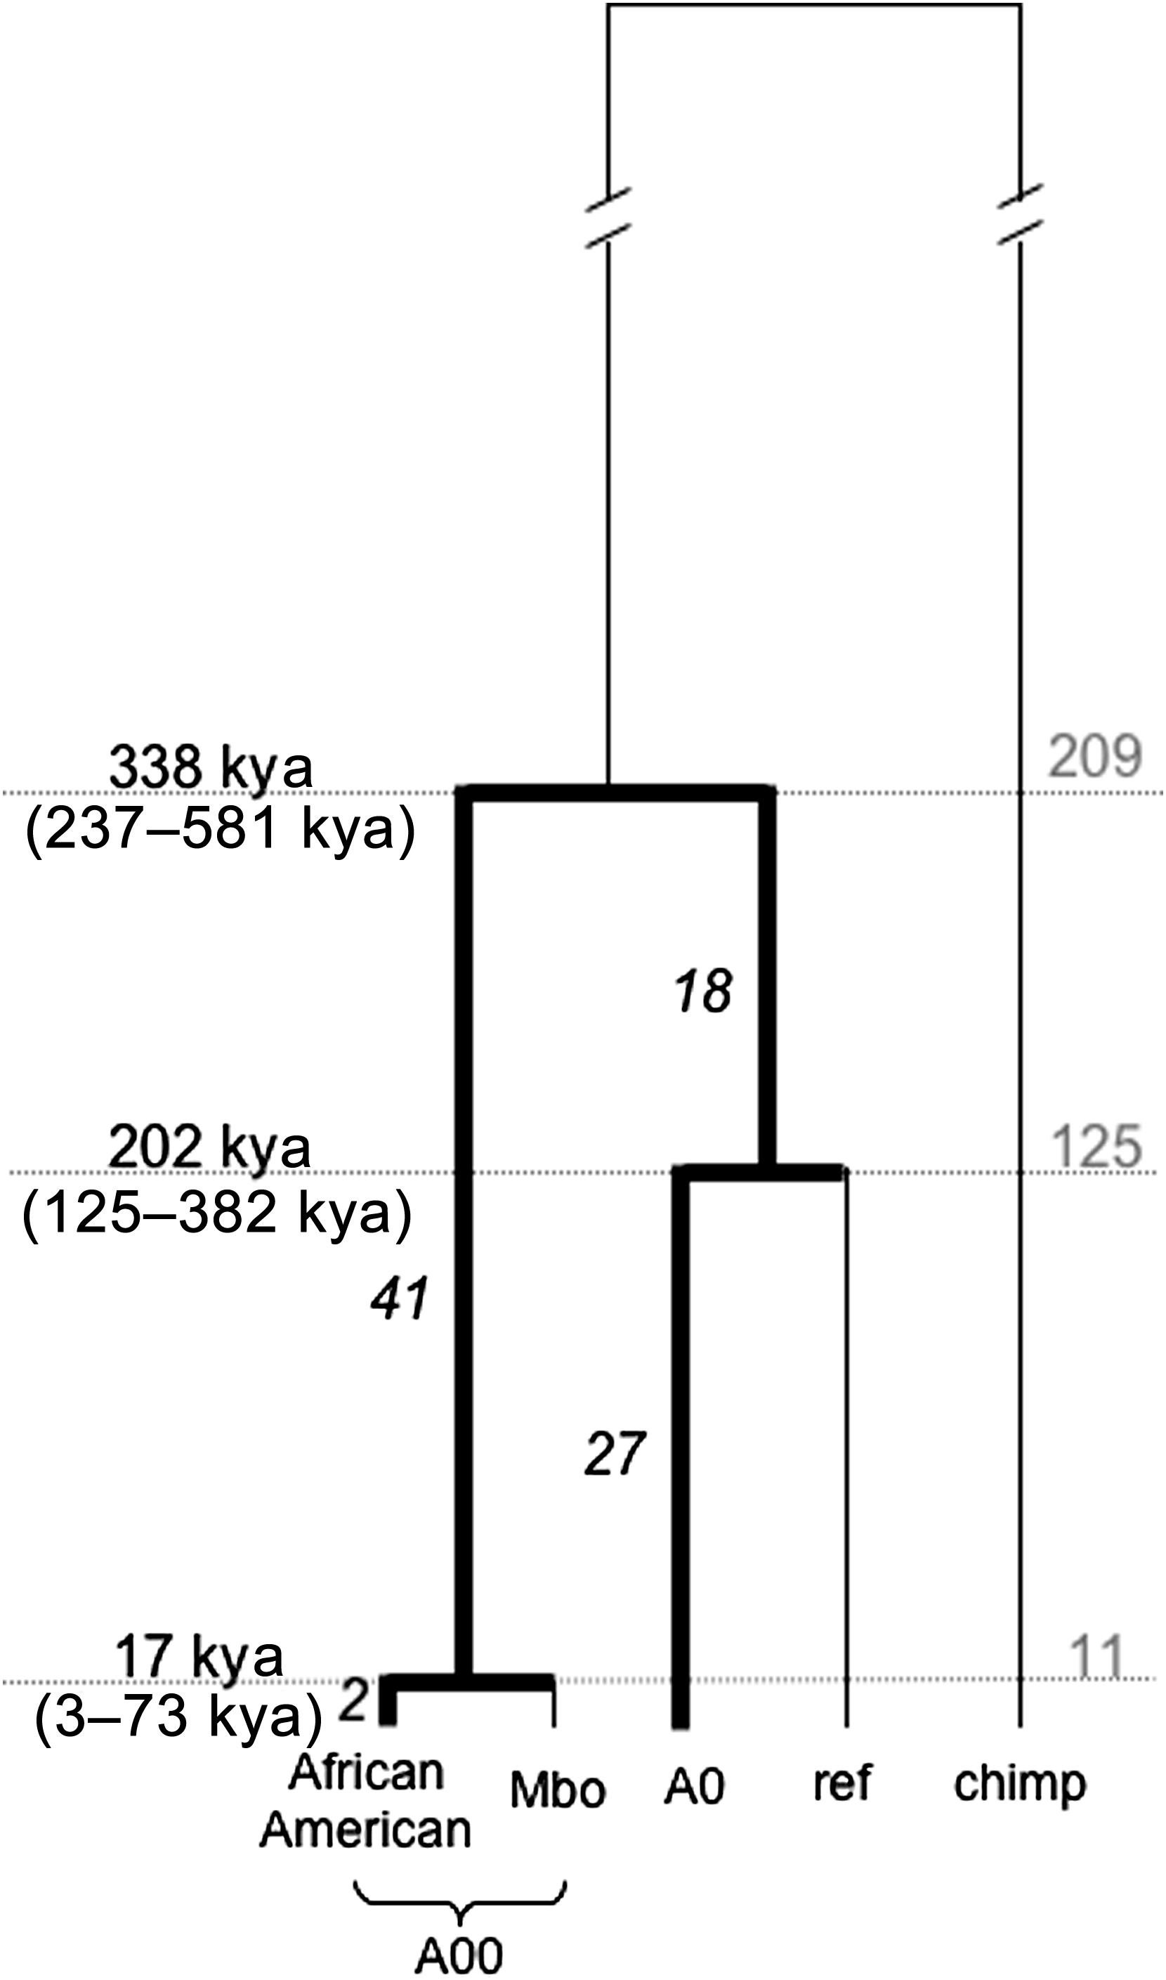
Figure 1 Genealogy of A00, A0, and the Reference Sequence Lineages on which mutations were identified and lineages that were used for placing those mutations on the genealogy are indicated with thick and thin lines, respectively. The numbers of ...
Mendez , et al. 2013
An African American Paternal Lineage Adds an Extremely Ancient Root to the Human Y Chromosome Phylogenetic Tree
The American Journal of Human Genetics Volume 92, Issue 3 2013 454 - 459
http://dx.doi.org/10.1016/j.ajhg.2013.02.002

Slide 13
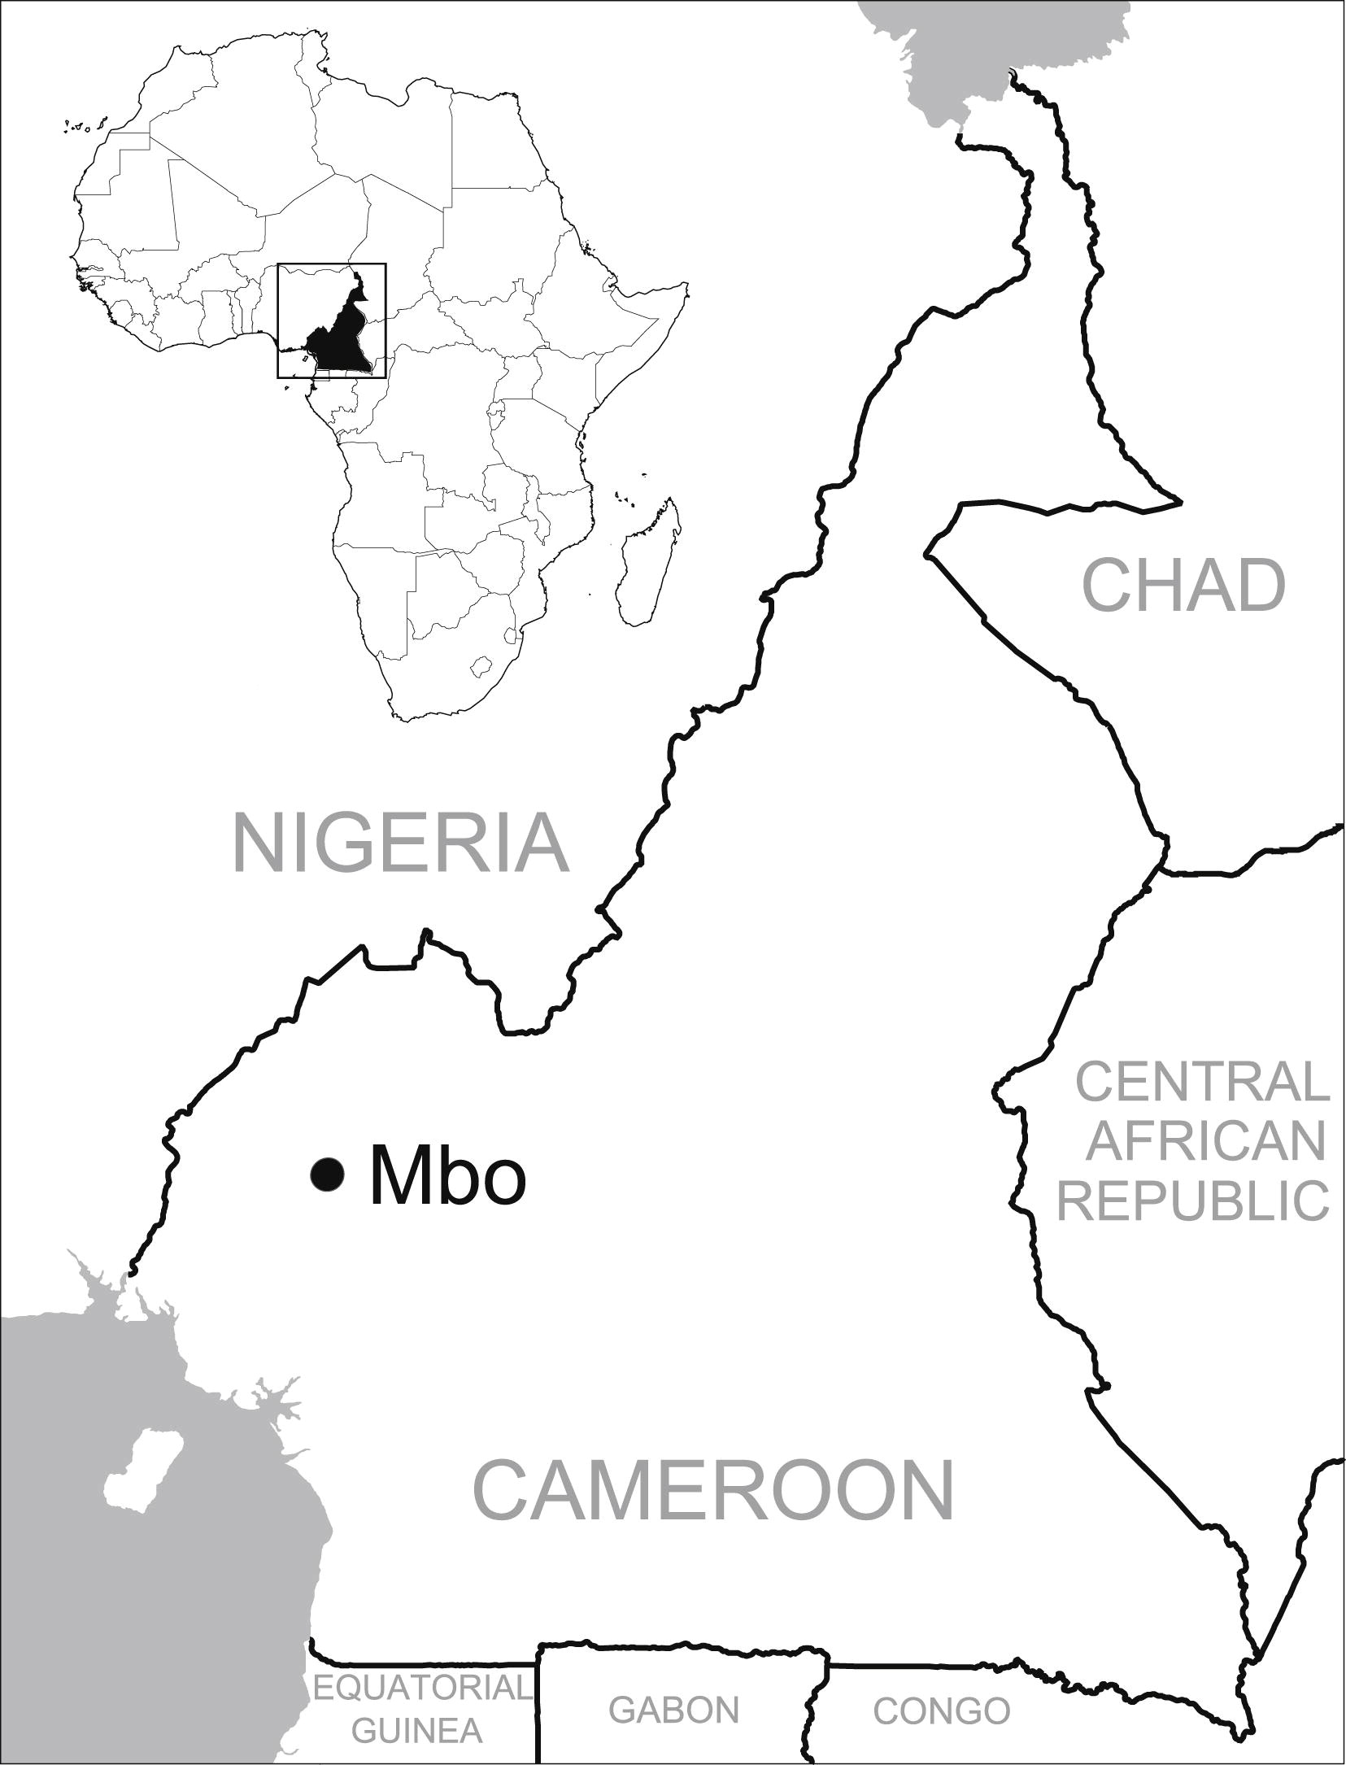
Figure 2 Map Showing Cameroon and the Approximate Location where Mbo Speakers Live
Fernando L. Mendez , Thomas Krahn , Bonnie Schrack , Astrid-Maria Krahn , Krishna R. Veeramah , August E. Woerner ...
An African American Paternal Lineage Adds an Extremely Ancient Root to the Human Y Chromosome Phylogenetic Tree
The American Journal of Human Genetics Volume 92, Issue 3 2013 454 - 459
http://dx.doi.org/10.1016/j.ajhg.2013.02.002

Slide 14
For more discussion on archaic and early humans see:
http://en.wikipedia.org/wiki/Denisova_hominin
http://www.nytimes.com/2012/01/31/science/gains-in-dna-are-speeding-research-into-human-origins.html
http://www.nytimes.com/2014/10/23/science/research-humans-interbred-with-neanderthals.html?
http://www.sciencedirect.com/science/article/pii/S0002929711003958
http://www.abc.net.au/science/articles/2012/08/31/3580500.htm
http://www.sciencemag.org/content/334/6052/94.full
http://www.sciencemag.org/content/334/6052/94/F2.expansion.html
http://haplogroup-a.com/Ancient-Root-AJHG2013.pdf

Slide 15
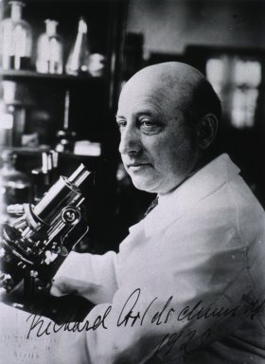
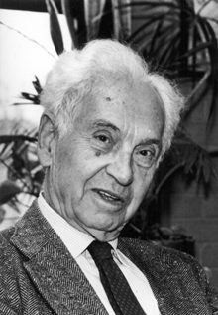
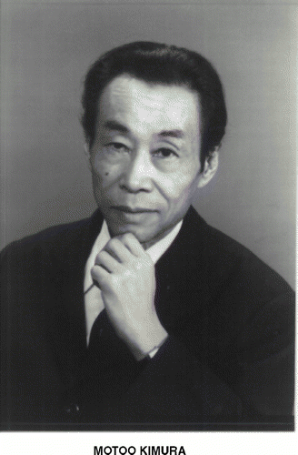
How do you define evolution?
Richard Goldschmidt 1940
hopeful monsters
Mutationism HGT/WGD!
Punctuated Equilibrium
Few genes / large effect
Vilified by Mayr, celebrated 1977 Gould & Evo-devo
Ernst Mayr 1942
NeoDarwinian Synthesis
Natural Selection
Gradualism
Many genes/small effect
Dario – “Fisher right”
Motoo Kimura 1968
Neutral Theory
Genetic Drift is main force for changing allele frequencies
Slide from Chris Pires
Notes:
Goldschmitdt,R. (1940). The Material Basis of Evolution
Mayr, Ernst (1942). Systematics and the origin of species, from the viewpoint of a zoologist

Slide 16
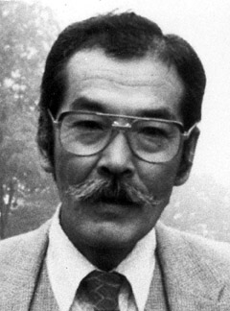
Duplications and Evolution
Ohno postulated that gene duplication plays a major role in evolution
Small scale duplications (SSD)
Whole genome duplications (WGD)
Polyploid: nucleus contains three or more copies of each chromosome
Autopolyploid: formed within a single species
Diploids AA and A’A’ Polyploid AAA’A’
Allopolyploid: formed from more than one species
Diploids AA and BB Polyploid AABB
Susumu Ohno 1970
Evolution by gene duplication
1R and 2R hypothesis
“Junk DNA” 1972
Slide from Chris Pires

Slide 17
Aside: Gene and genome duplication versus
Horizontal Gene Transfer
Gene family expansion through horizontal gene transfer –
the most common process in prokaryotes
Gene duplication through lineage fusion
Very common in plants, but also in animals
Autochtonous gene/genome
duplication are rare
in prokaryotes

