Slide 1

Bayes’ Theorem
Likelihood
describes how well the model predicts the data
P(data|model, I)
P(model|data, I) = P(model, I)
P(data,I)
Posterior
Probability
represents the degree
to which we believe a given model accurately describes the situation
given the available data and all of our prior information I
Prior
Probability
describes the degree to which we believe the model accurately describes reality
based on all of our prior information.
Normalizing
constant
Reverend Thomas Bayes (1702-1761)

Slide 2
Alternative Approaches to Estimate
Posterior Probabilities
Bayesian Posterior Probability Mapping with MrBayes
(Huelsenbeck and Ronquist, 2001)
Problem:
Strimmer’s formula
L_{i}
p_{i}=
only considers 3 trees
(those that maximize the likelihood for
the three topologies)
L₁+L₂+L₃
Solution:
Exploration of the tree space by sampling trees using a biased random walk
(Implemented in MrBayes program)
Trees with higher likelihoods will be sampled more often
N_{i}
p_{i}≈
N_{total}
,where N_{i} - number of sampled trees of topology i, i=1,2,3
N_{total} – total number of sampled trees (has to be large)

Slide 3
Illustration of a biased random walk
Image generated with Paul Lewis's MCRobot
Figures generated using MCRobot program (Paul Lewis, 2001)

Slide 4
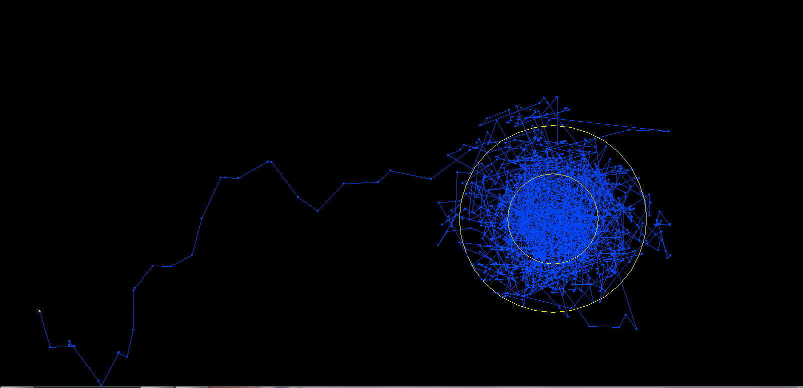
One needs to remove the burnin that is created, when the robot initially runs around in parameter space without seeing the probability landscape.

Slide 5
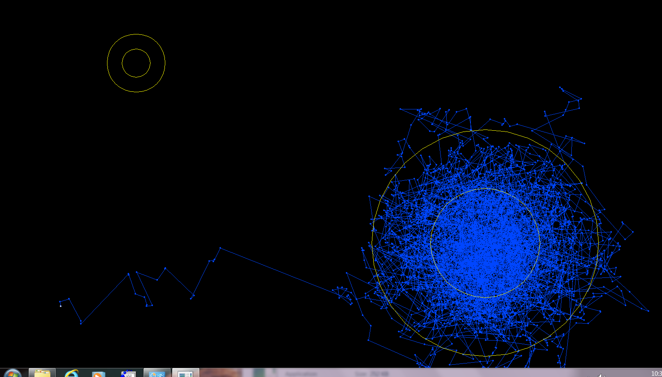
One complication is that the robot might be stuck on a local optimum.

Slide 6
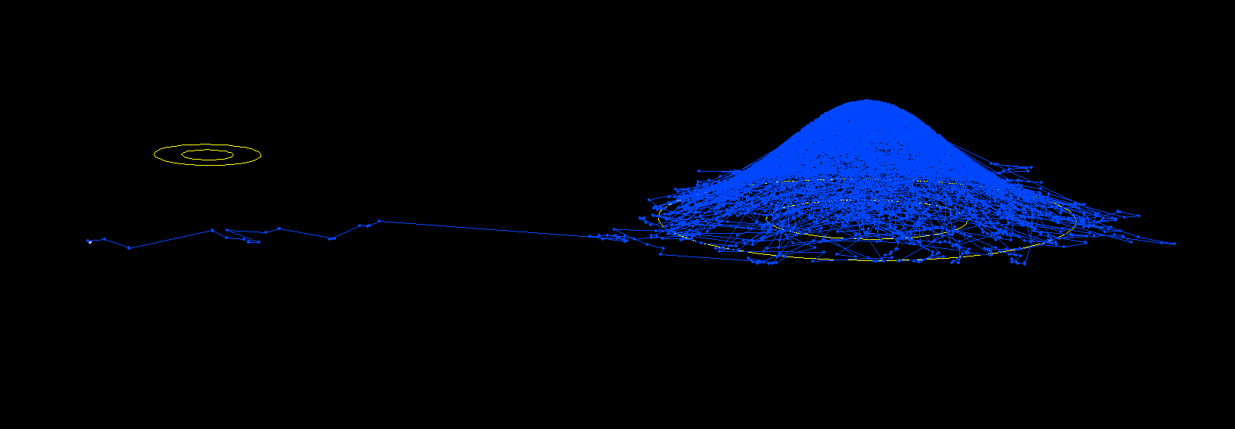
One complication is that the robot might be stuck on a local optimum. (Same as last slide but in sideview).

Slide 7
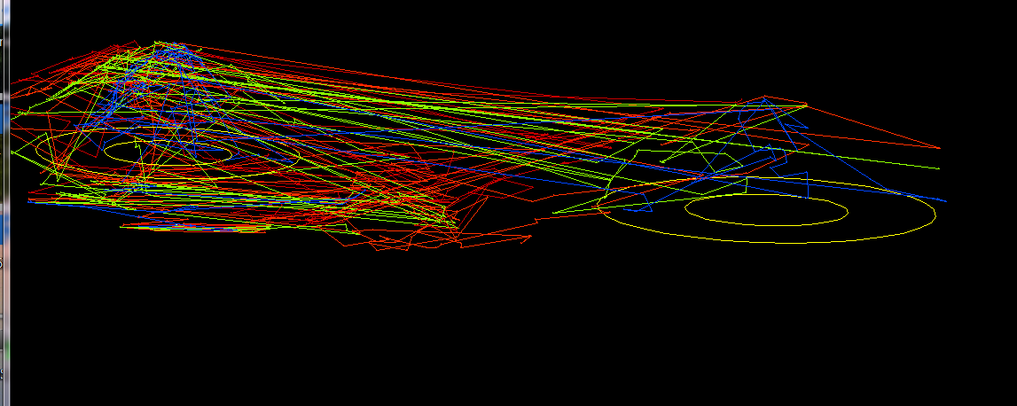
One solution is to run multiple chains, some of which “heated”, so that the probability landscape is melted down, and the robots move away more easily away from the optimum. The different chains compare their sampled probability, and switch in case the heated chain is better

Slide 8
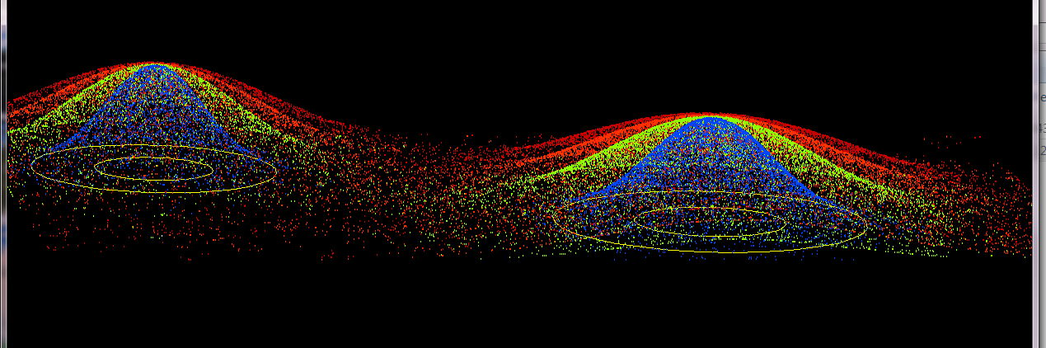
4 chains, same as previous, but many more generations, and the trajectory is not plotted, only the points visited by each of the four chains.

Slide 9
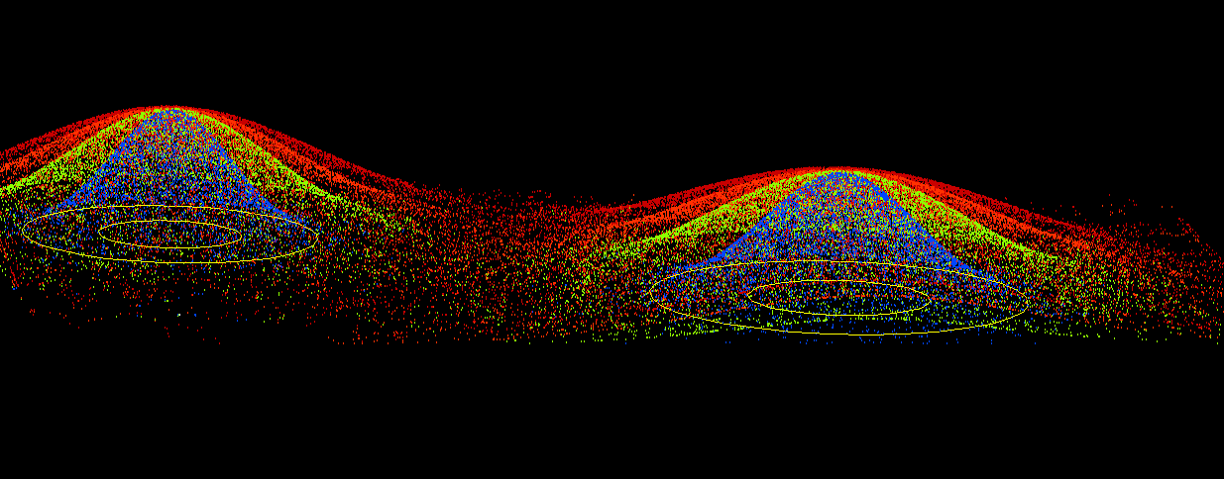
4 chains, same as previous, but even more generations

Slide 10
Why could a gene tree be different from the species tree?
Lack of resolution
Lineage sorting
Gene duplications/gene loss (paralogs/orthologs)
Gene transfer
Systematic artifacts (e.g., compositional bias and long branch attraction)

Slide 11
Trees – what might they mean?
Calculating a tree is comparatively easy, figuring out what it might mean is much more difficult.
If this is the probable organismal tree:
species A
species B
species C
species D
what could be the reason for obtaining this gene tree:
seq. from A
seq. from D
seq. from C
seq. from B

Slide 12
lack of resolution
seq. from A
seq. from D
seq. from C
seq. from B
e.g., 60% bootstrap support for bipartition (AD)(CB)

Slide 13
long branch attraction artifact
the two longest branches join together
seq. from A
seq. from D
seq. from C
seq. from B
e.g., 100% bootstrap support for bipartition (AD)(CB)
What could you do to investigate if this is a possible explanation?
use only slow positions,
use an algorithm that corrects for ASRV

Slide 14
Gene transfer
Organismal tree:
species A
species B
Gene Transfer
species C
species D
molecular tree:
seq. from A
seq. from D
seq. from C
speciation
seq. from B
gene transfer

Slide 15
Lineage Sorting
Organismal tree:
species A
species B
species C
Genes diverge and coexist in the
organismal lineage
species D
molecular tree:
seq. from A
seq. from D
seq. from C
seq. from B

Slide 16
Gene duplication
Organismal tree:
species A
species B
species C
gene duplication
species D
molecular tree:
molecular tree:
molecular tree:
seq. from A
seq. from A
seq. from A
seq. from B
seq. from B
seq. from C
seq. from C
seq. from D
seq. from D
seq. from D
seq.’ from B
seq.’ from B
seq.’ from B
seq.’ from C
seq.’ from C
gene duplication
seq.’ from C
gene duplication
gene duplication
seq.’ from D
seq.’ from D

Slide 17
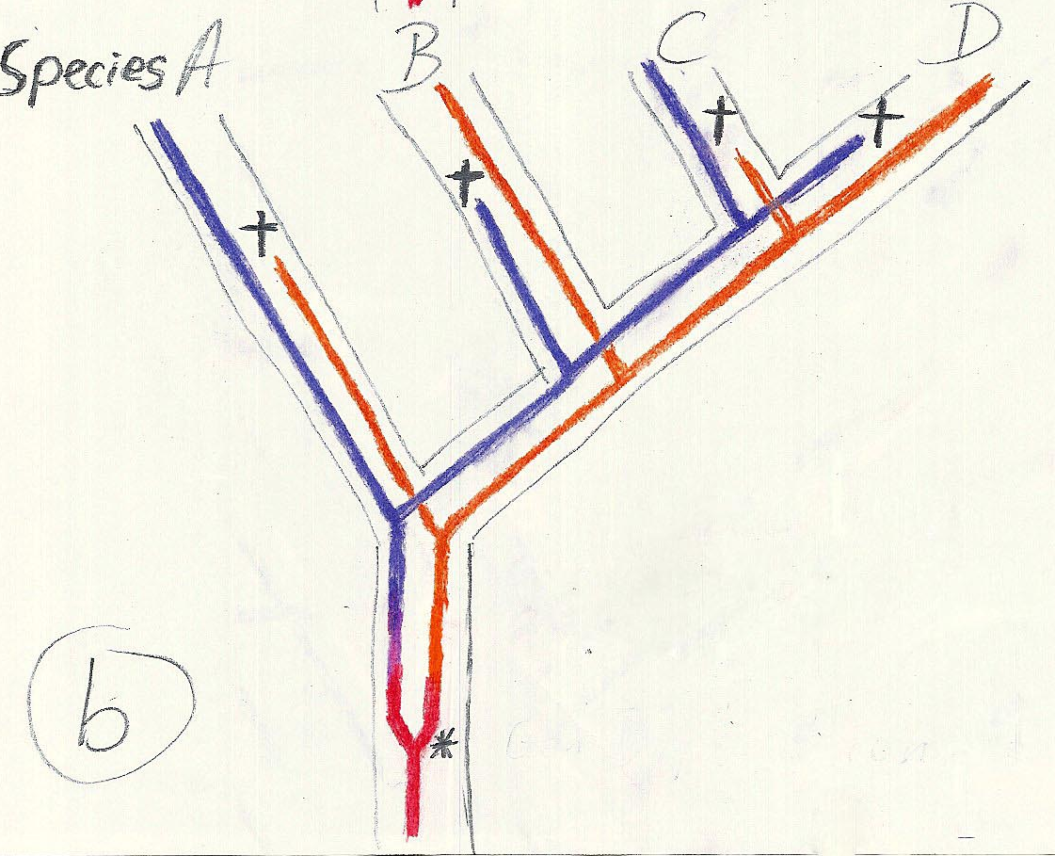
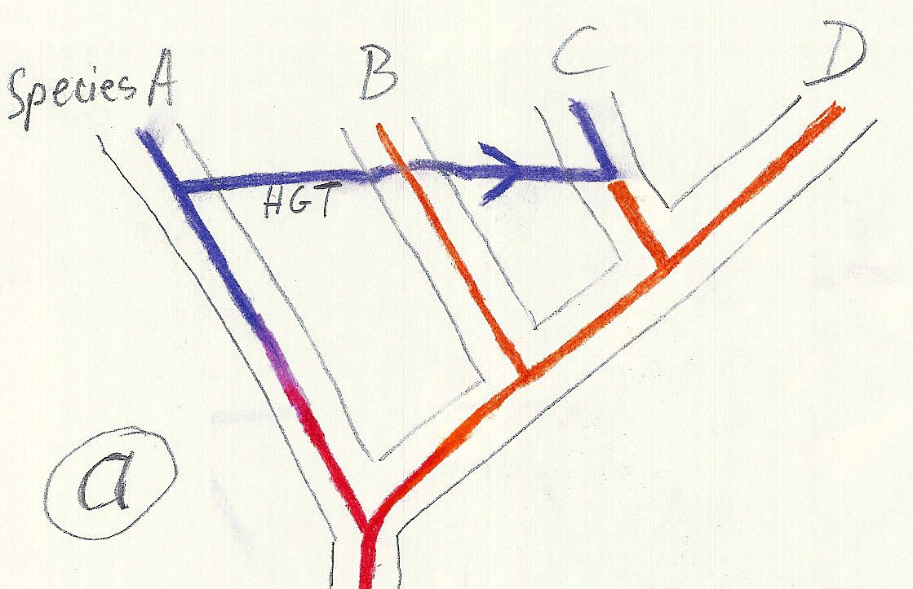
Gene duplication and gene transfer are equivalent explanations.
The more relatives of C are found that do not have the blue type of gene, the less likely is the duplication loss scenario
Ancient duplication followed by gene loss
Horizontal or lateral Gene
Note that scenario B involves many more individual events than A
1 HGT with
orthologous replacement
1 gene duplication followed by 4 independent gene loss events

Slide 18
Function, ortho- and paralogy
molecular tree:
seq. from A
seq.’ from B
seq.’ from C
seq.’ from D
gene duplication
seq. from B
seq. from C
seq. from D
The presence of the duplication is a taxonomic character (shared derived character in species B C D).
The phylogeny suggests that seq’ and seq have similar function, and that this function was important in the evolution of the clade BCD.
seq’ in B and seq’in C and D are orthologs and probably have the same function, whereas seq and seq’ in BCD probably have different function (the difference might be in subfunctionalization of functions that seq had in A. – e.g. organ specific expression)

