Slide 1
Neutral theory:
The vast majority of observed sequence differences between members of a population are neutral (or close to neutral). These differences can be fixed in the population through random genetic drift. Some mutations are strongly counter selected (this is why there are patterns of conserved residues). Only very seldom is a mutation under positive selection.
The neutral theory does not say that all evolution is neutral and everything is only due to to genetic drift.

Slide 2
the gradualist point of view
Evolution occurs within populations where the fittest organisms have a selective advantage. Over time the advantages genes become fixed in a population and the population gradually changes.
Note: this is not in contradiction to the the theory of neutral evolution. (which says what ?)
Processes that MIGHT go beyond inheritance with variation and selection?
  Horizontal gene transfer and recombination
  Polyploidization (botany, vertebrate evolution) see here or here
  Fusion and cooperation of organisms (Kefir, lichen, also the eukaryotic cell)
  Targeted mutations (?), genetic memory (?) (see Foster's and Hall's reviews on directed/adaptive mutations; see here for a counterpoint)
  Random genetic drift
  Gratuitous complexity
  Selfish genes (who/what is the subject of evolution??)
  Parasitism, altruism, Morons
  Evolutionary capacitors
  Hopeless monsters (in analogy to Goldschmidt’s hopeful monsters)

Slide 3
Nearly Neutral theory:
Even synonymous mutations do not lead to random composition but to codon bias. Small negative selection might be sufficient to produce the observed codon usage bias.

Slide 4
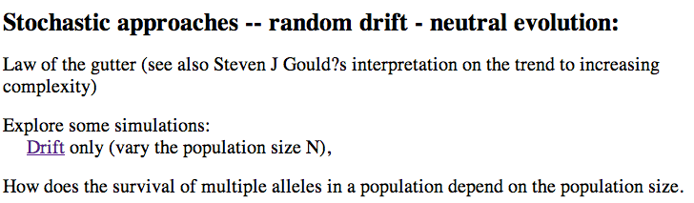
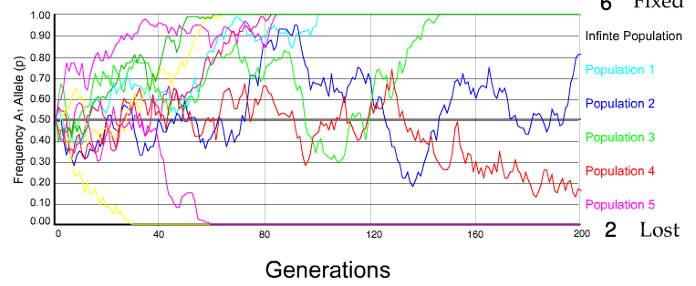
N=50 s=0
10 replicates

Slide 5
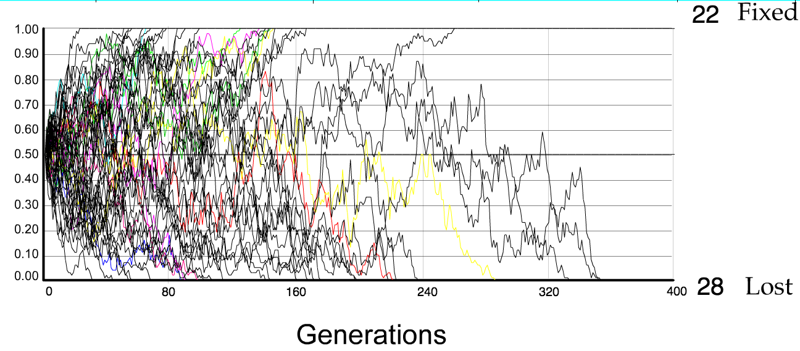
N=50 s=0
50 replicates

Slide 6
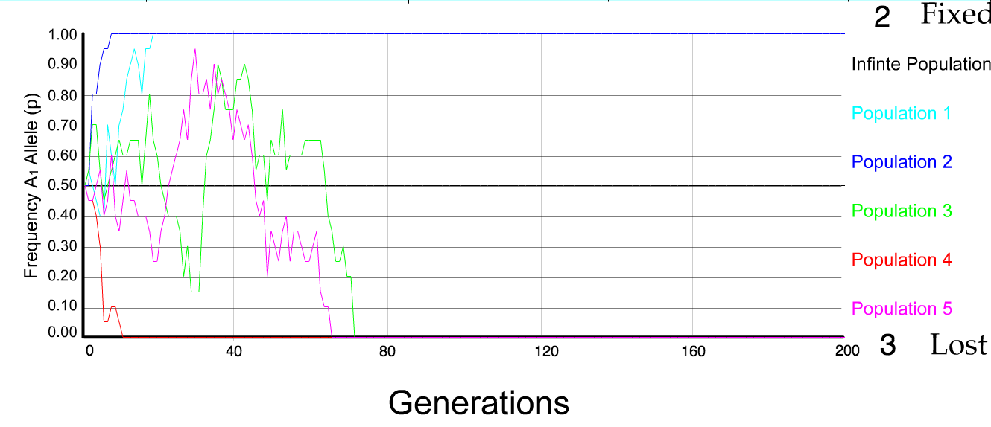
N=10 s=0
5 replicates

Slide 7
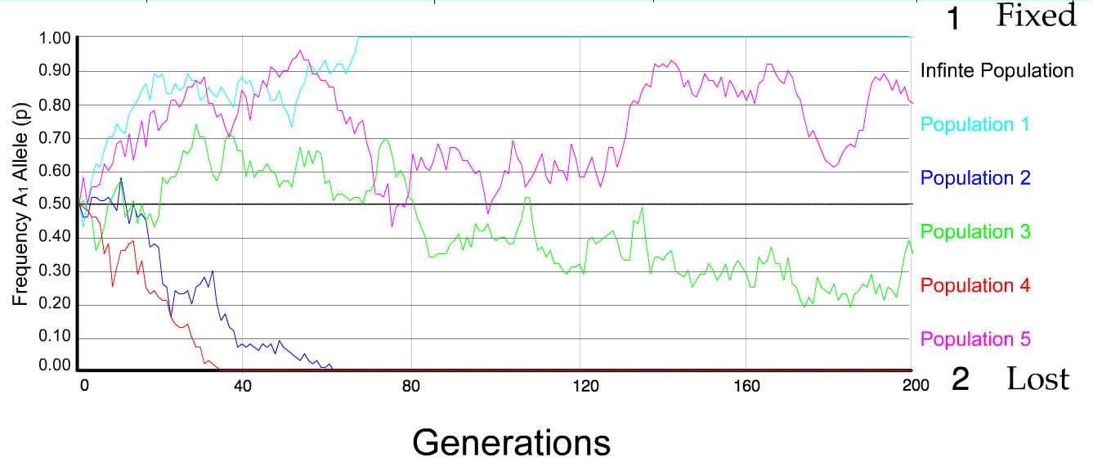
N=50 s=0
5 replicates

Slide 8
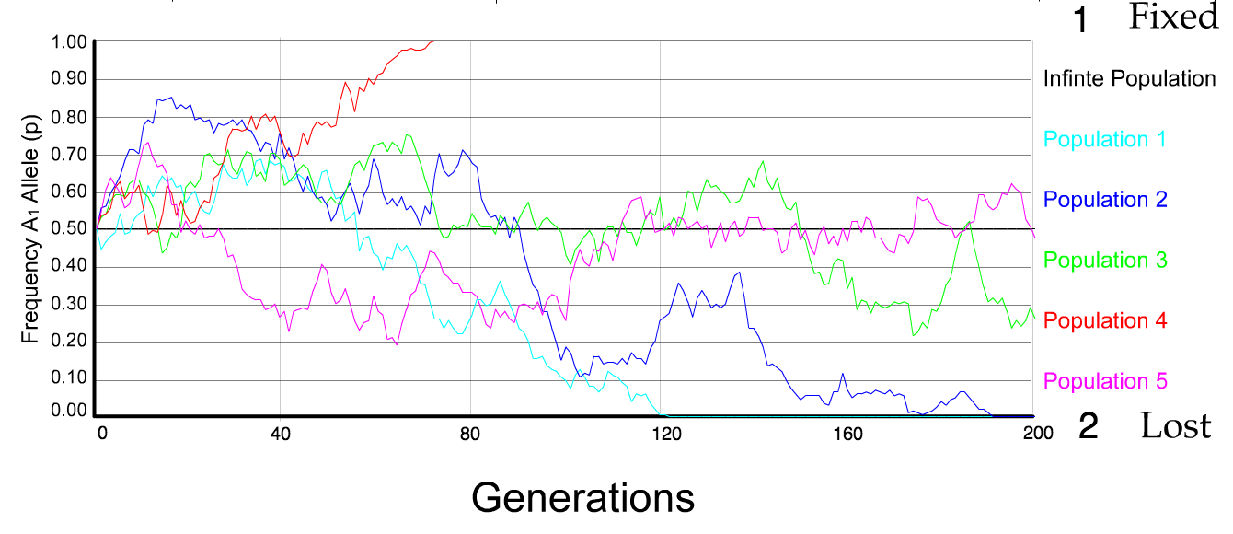
N=100 s=0
5 replicates

Slide 9
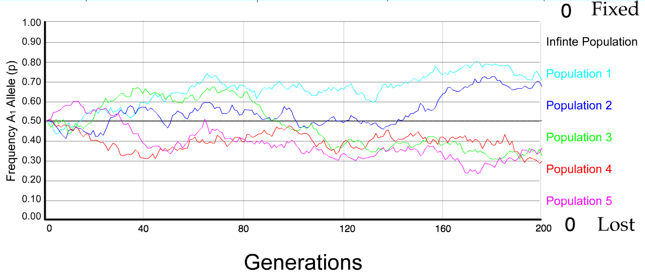
N=500 s=0
5 replicates

Slide 10
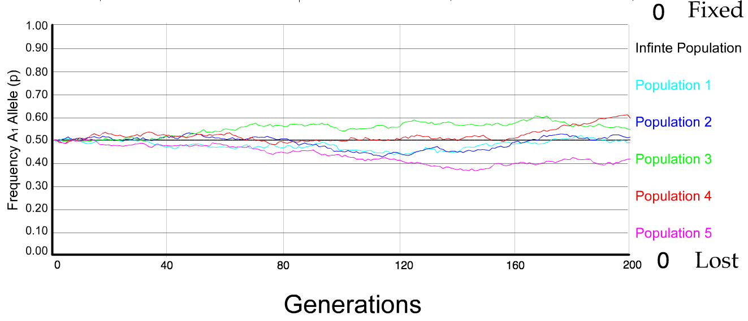
N=5000 s=0
5 replicates

Slide 11
s=0
Probability of fixation, P, is equal to frequency of allele in population. Mutation rate (per gene/per unit of time) = u ;
freq. with which allele is generated in diploid population size N =u*2N
Probability of fixation for each allele = 1/(2N)
Substitution rate =
frequency with which new alleles are generated * Probability of fixation= u*2N *1/(2N) = u = Mutation rate
Therefore:
If f s=0, the substitution rate is independent of population size, and equal to the mutation rate !!!! (NOTE: Mutation unequal Substitution! )
This is the reason that there is hope that the molecular clock might sometimes work.
Fixation time due to drift alone:
t_{av}=4*N_{e} generations
(N_{e}=effective population size; For n discrete generations
N_{e}= n/(1/N₁+1/N₂+…..1/N_{n})

Slide 12
s>0
Time till fixation on average:
t_{av}= (2/s) ln (2N) generations
(also true for mutations with negative “s” ! discuss among yourselves)
E.g.: N=10⁶,
s=0: average time to fixation: 4*10⁶ generations
s=0.01: average time to fixation: 2900 generations
N=10⁴,
s=0: average time to fixation: 40.000 generations
s=0.01: average time to fixation: 1.900 generations
N=10¹¹ (100 billion – size of the Prochlorococcus population),
s=0: average time to fixation: 4*10¹¹ generations (about 1 billion years) s=0.01: average time to fixation: 5200 generations (about 14 years)
Test question: What is the probability of fixation?
=> substitution rate of mutation under positive selection is larger than the rate with which neutral mutations are fixed.

Slide 13
Positive selection (s>0)
A new allele (mutant) confers some increase in the fitness of the organism
Selection acts to favour this allele
Also called adaptive selection or Darwinian selection.
NOTE: Fitness = ability to survive and reproduce
Modified from from www.tcd.ie/Genetics/staff/Aoife/GE3026/GE3026_1+2.ppt

Slide 14
Random Genetic Drift
Selection
100
advantageous
Allele frequency
disadvantageous
0
Modified from from www.tcd.ie/Genetics/staff/Aoife/GE3026/GE3026_1+2.ppt

Slide 15
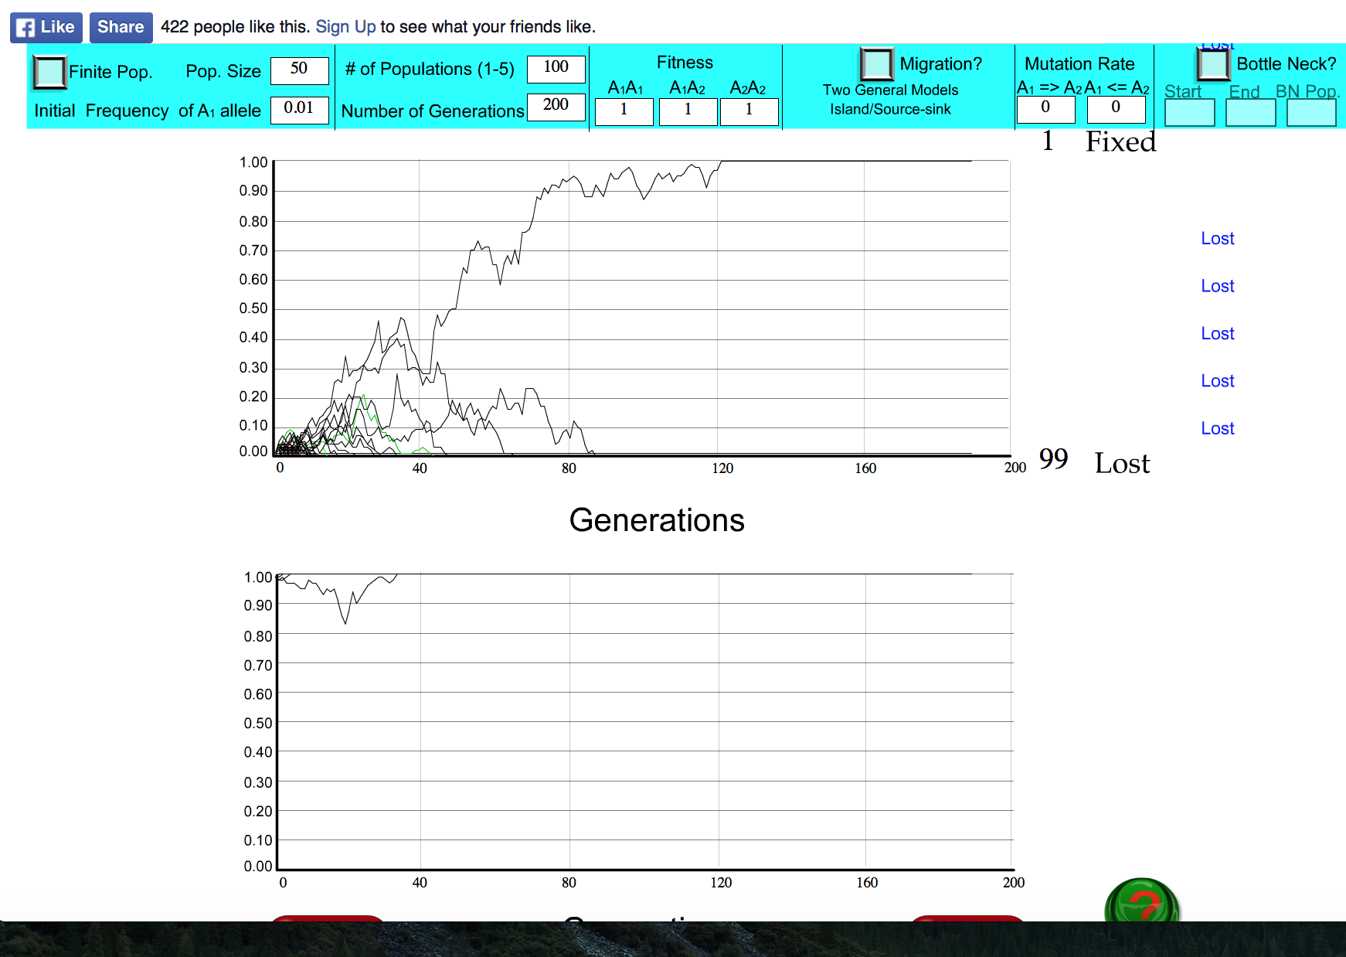
s=0

Slide 16
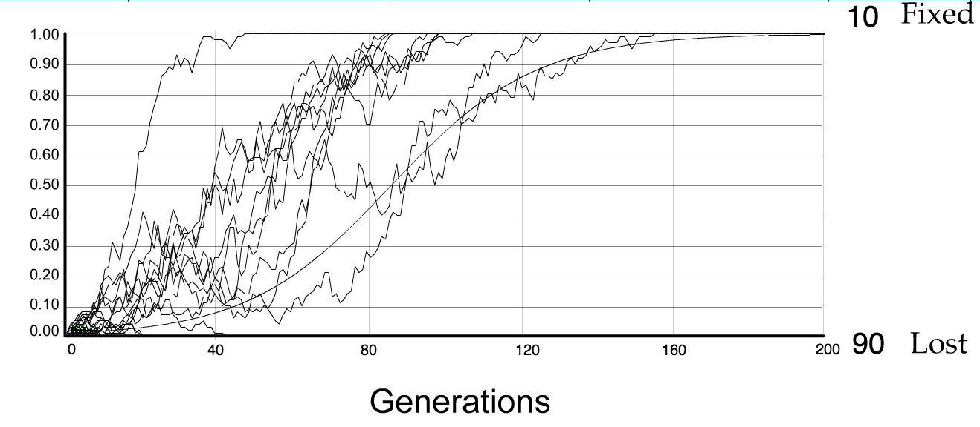
For advantageous mutations:
Probability of fixation, P, is approximately equal to 2s;
e.g., if selective advantage s = 5% then P = 10%
tav=2/s*log2N generations = 40*log100= 80

Slide 17
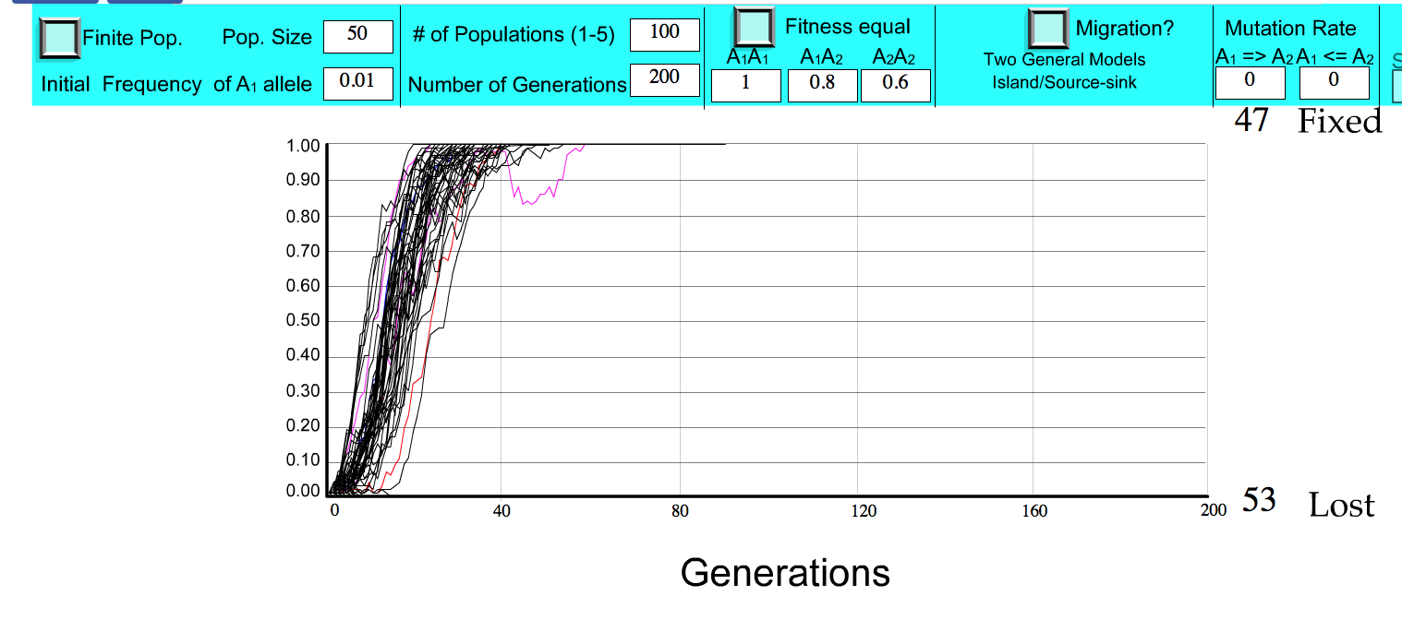
S=.2 => shorter fixation time.

Slide 18
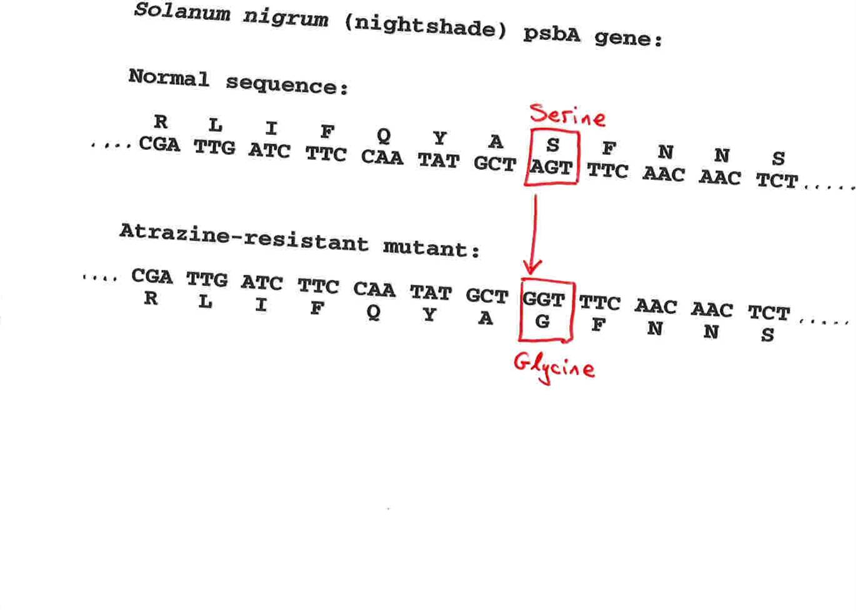
Advantageous allele
Herbicide resistance gene in nightshade plant
Modified from from www.tcd.ie/Genetics/staff/Aoife/GE3026/GE3026_1+2.ppt

Slide 19
selection versus drift
The larger the population the longer it takes for an allele to become fixed.
Note: Even though an allele conveys a strong selective advantage of 10%, the allele has a rather large chance to go extinct.
Note#2: Fixation is faster under selection than under drift.
Question: Can you think of genes that have a high fixation probability? (Hint: HGT)

Slide 20
s=0
Fixation time due to drift alone:
t_{av}=4*N_{e} generations
(N_{e}=effective population size; For n discrete generations
N_{e}= n/(1/N₁+1/N₂+…..1/N_{n})
Correlar:
The number of alleles that differ by neutral mutations that one can observe in a random sample of alleles is a measure of the size of the effective population.
From Lynch and Conery, The Origins of Genome Complexity, Science 302, 1401-1404
Insight into long-term effective population sizes can be acquired from the nucleotide variation at silent sites in protein-coding genes (i.e., sites at which a nucleotide substitution leaves the encoded amino acid unchanged). The rate of introduction of new variation per site in two randomly compared alleles is 2u (twice the mutation rate per nucleotide), whereas the expected rate of loss of variation from neutral sites is 1/(2N_{e}) in a randomly mating diploid population. At equilibrium, the average number of nucleotide substitutions at neutral sites is 4N_{e}u, with slight modifications required for other modes of inheritance
… the total abundance of a species need not reflect the more evolutionarily relevant genetic effective population size (N_{e}), which determines the degree to which gene frequencies are faithfully transmitted across generations. For example, a large population can behave genetically like a small one if a minor fraction of individuals contribute to the reproductive pool or if beneficial chromosomal segments periodically sweep through the population.

Slide 21
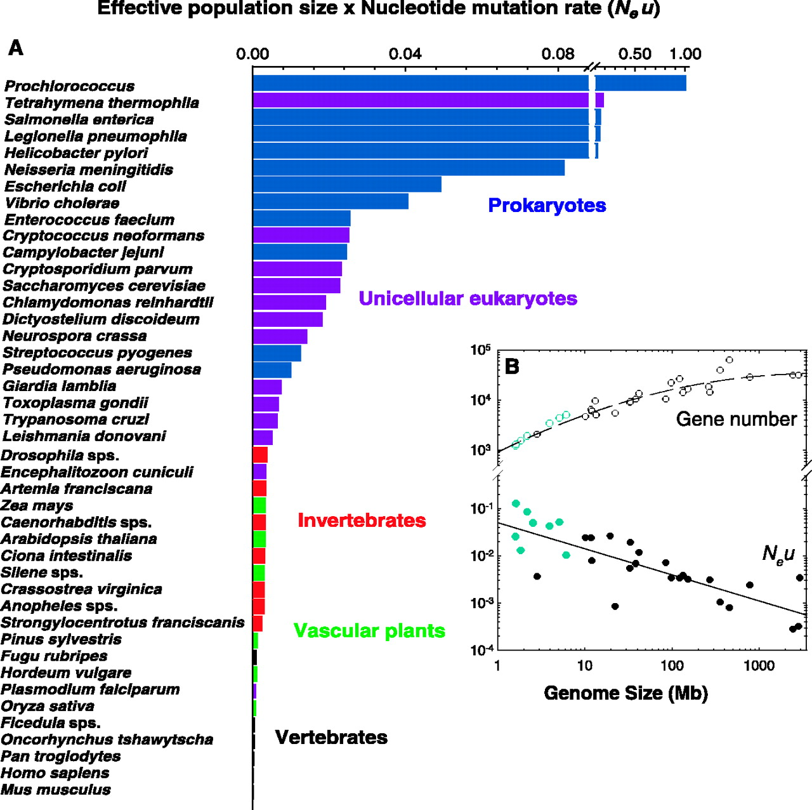

Fig. 1. (A) Estimates of the composite parameter Neu for a phylogenetically diverse assemblage of species.
Michael Lynch, and John S. Conery Science 2003;302:1401-1404
Published by AAAS
Notes:
(A) Estimates of the composite parameter N_{e}u for a phylogenetically diverse assemblage of species. (B) The relationship between estimated N_{e}u, total gene number, and genome size. Data for prokaryotes are plotted in blue. The log-log regression of N_{e}u versus genome size is highly significant, with an intercept of –1.30 ± 0.40, a slope of –0.55 ± 0.07, and r² = 0.659, df = 28 (1). The number of species plotted differs between graphs because genome structure information is not available for all species with N_{e}u estimates.

Slide 22
Negative selection (s<0)
A new allele (mutant) confers some decrease in the fitness of the organism
Selection acts to remove this allele
Also called purifying selection
Modified from from www.tcd.ie/Genetics/staff/Aoife/GE3026/GE3026_1+2.ppt

Slide 23
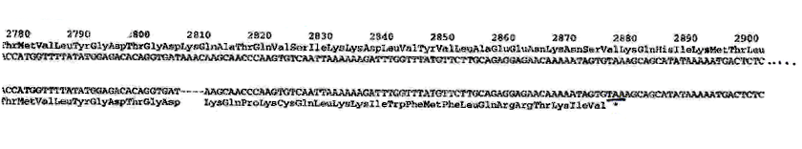
Deleterious allele
Human breast cancer gene, BRCA2
5% of breast cancer cases are familial
Mutations in BRCA2 account for 20% of familial cases
Normal (wild type) allele
Mutant allele
(Montreal 440
Family)
Stop codon
4 base pair deletion
Causes frameshift
Modified from from www.tcd.ie/Genetics/staff/Aoife/GE3026/GE3026_1+2.ppt

Slide 24
Neutral mutations
Neither advantageous nor disadvantageous
Invisible to selection (no selection)
Frequency subject to ‘drift’ in the population
Random drift – random changes in small populations

Slide 25
Types of Mutation-Substitution
Replacement of one nucleotide by another
Synonymous (Doesn’t change amino acid)
  Rate sometimes indicated by Ks
  Rate sometimes indicated by d_{s}
Non-Synonymous (Changes Amino Acid)
  Rate sometimes indicated by Ka
  Rate sometimes indicated by d_{n}
(this and the following 4 slides are from
mentor.lscf.ucsb.edu/course/ spring/eemb102/lecture/Lecture7.ppt)

Slide 26
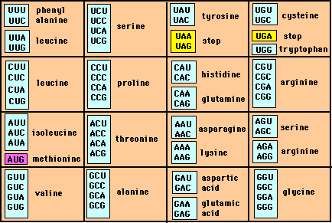
Genetic Code – Note degeneracy of 1st vs 2nd vs 3rd position sites

Slide 27
Genetic Code
Four-fold degenerate site – Any substitution is synonymous
From: mentor.lscf.ucsb.edu/course/spring/eemb102/lecture/Lecture7.ppt

Slide 28
Genetic Code
Two-fold degenerate site – Some substitutions synonymous, some
non-synonymous
From: mentor.lscf.ucsb.edu/course/spring/eemb102/lecture/Lecture7.ppt

Slide 29
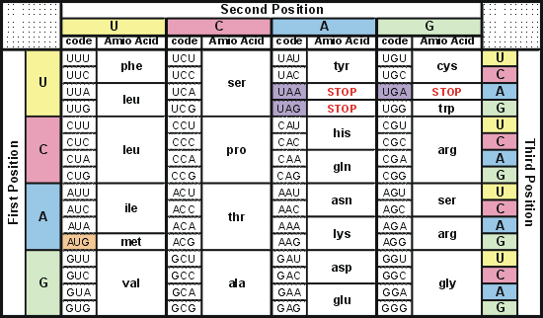
Degeneracy of 1st vs 2nd vs 3rd position sites results in 25.5% synonymous changes and 74.5% non synonymous changes (Yang&Nielsen,1998).
Genetic Code
Notes:
An inspection of the genetic code table suggests most changes at the first position are nonsynonymous, all changes at the second codon position are nonsynonymous and only some changes at the third position are synonymous. As a result we do not expect to see equal proportions of synonymous and nonsynonymous mutations even if there is no selection at protein level. Indeed, if mutations from any one nucleotide to any other occur at the same rate , we expect 25.5% of mutations to be synonymous and 74.5% mutations to be nonsynonymous.

Slide 30
Measuring Selection on Genes
Null hypothesis = neutral evolution
Under neutral evolution, synonymous changes should accumulate at a rate equal to mutation rate
Under neutral evolution, amino acid substitutions should also accumulate at a rate equal to the mutation rate
From: mentor.lscf.ucsb.edu/course/spring/eemb102/lecture/Lecture7.ppt

Slide 31
Counting #s/#a
Ser Ser Ser Ser Ser
Species1 TGA TGC TGT TGT TGT
Ser Ser Ser Ser Ala
Species2 TGT TGT TGT TGT GGT
#s = 2 sites
#a = 1 site
#a/#s=0.5
To assess selection pressures one needs to calculate the rates (Ka, Ks), i.e. the occurring substitutions as a fraction of the possible syn. and nonsyn. substitutions.
Things get more complicated, if one wants to take transition transversion ratios and codon bias into account. See chapter 4 in Nei and Kumar, Molecular Evolution and Phylogenetics.
Modified from: mentor.lscf.ucsb.edu/course/spring/eemb102/lecture/Lecture7.ppt

Slide 32
Testing for selection using dN/dS ratio
dN/dS ratio (aka Ka/Ks or ω (omega) ratio) where
dN = number of non-synonymous substitutions / number of all possible non-synonymous substitutions
dS =number of synonymous substitutions / number of all possible synonymous substitutions
dN/dS >1 positive, Darwinian selection
dN/dS =1 neutral evolution
dN/dS <1 negative, purifying selection
Notes:
The synonymous and non-synonymous rates dN and dS are defined as the numbers of synonymous and nonsynonymous substitutions per site. The ratio of the two rates omega=dN/dS then measures selective pressure at the protein level. If selection level has no effect on fitness, nonsynonymous mutations will be fixed at the same rate as synonymous mutations so that dN=dS and omega=1. If nonsynonymous mutations are deleterious purifying selection will reduce their fixation rate so that dN<dS and omega<1. If nonsynonymous mutations are favored by Darwinian selection, they will be fixed at a higher rate than synonymous mutations resulting in dN>dS and omega>1.

Slide 33
dambe
Two programs worked well for me to align nucleotide sequences based on the amino acid alignment,
One is DAMBE (only for windows). This is a handy program for a lot of things, including reading a lot of different formats, calculating phylogenies, it even runs codeml (from PAML) for you.
The procedure is not straight forward, but is well described on the help pages. After installing DAMBE go to HELP -> general HELP -> sequences -> align nucleotide sequences based on …->
If you follow the instructions to the letter, it works fine.
DAMBE also calculates Ka and Ks distances from codon based aligned sequences.

Slide 34
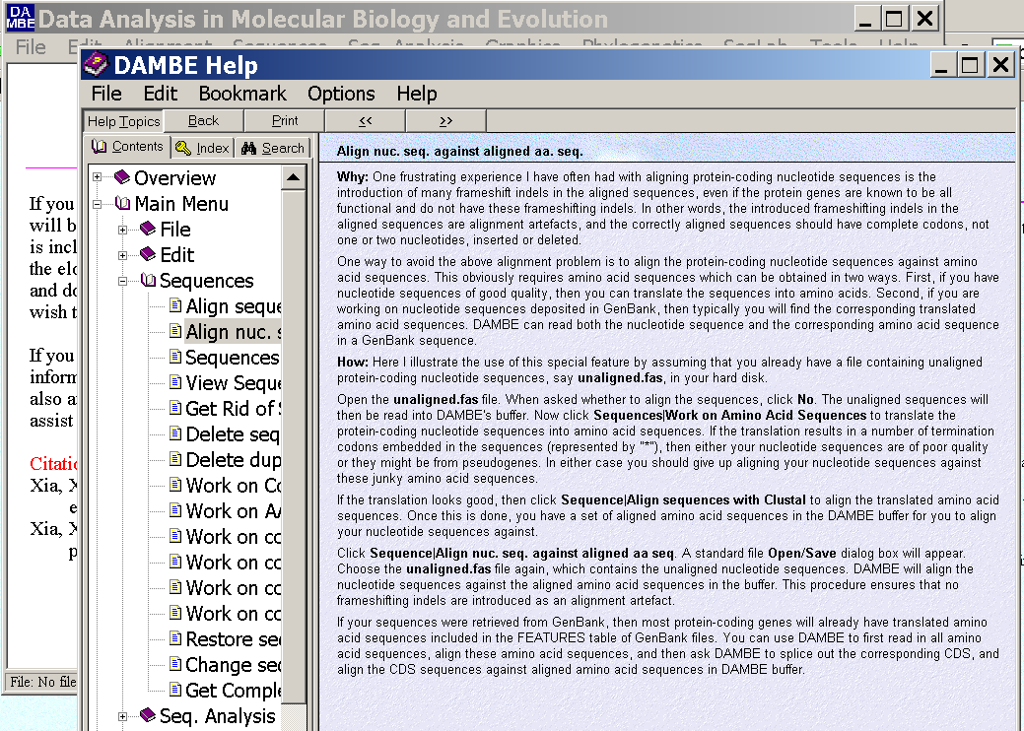
dambe (cont)

Slide 35
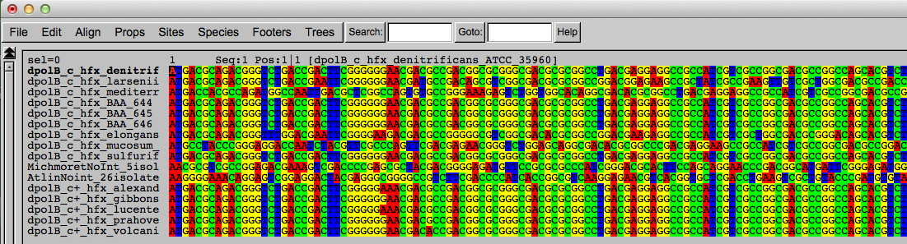
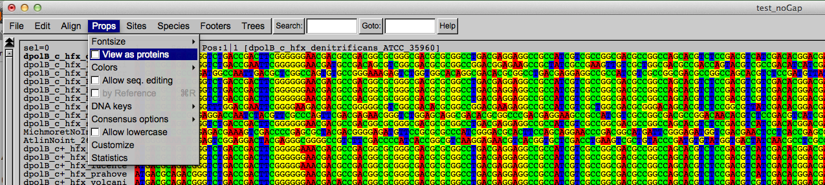
Codon based alignments in Seaview
Load nucleotide sequences (no gaps in sequences, sequence starts with nucleotide corresponding to 1st codon position)
Select view as proteins

Slide 36
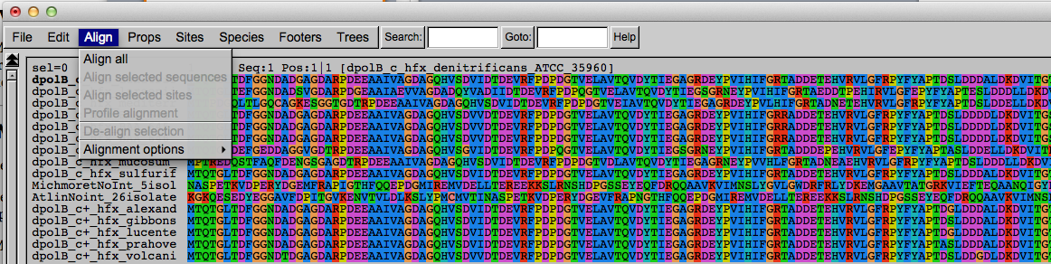
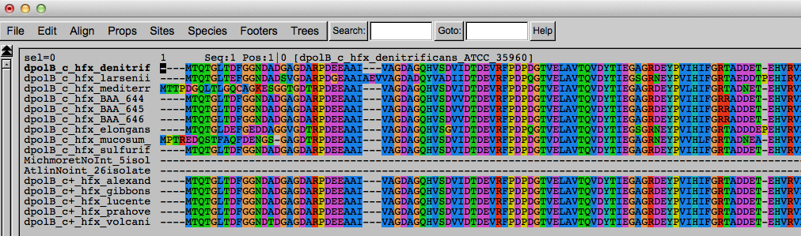
Codon based alignments in Seaview
With the protein sequences displayed, align sequences
Select view as nucleotides

Slide 37
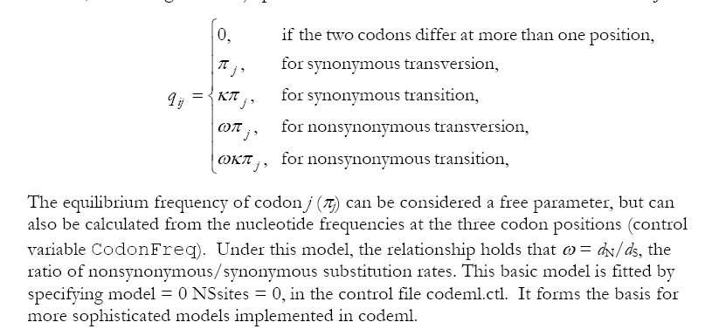
PAML (codeml) the basic model

Slide 38

sites versus branches
You can determine omega for the whole dataset; however, usually not all sites in a sequence are under selection all the time.
PAML (and other programs) allow to either determine omega for each site over the whole tree, ,
or determine omega for each branch for the whole sequence,
.
It would be great to do both, i.e., conclude codon 176 in the vacuolar ATPases was under positive selection during the evolution of modern humans – alas, a single site often does not provide much statistics. PAML does provide a branch site model.

Slide 39
Sites model(s)
have been shown to work great in few instances.
The most celebrated case is the influenza virus HA gene.
A talk by Walter Fitch (slides and sound) on the evolution of
this molecule is here .
This article by Yang et al, 2000 gives more background on ml aproaches to measure omega. The dataset used by Yang et al is here: flu_data.paup .

Slide 40
sites model in MrBayes
The MrBayes block in a nexus file might look something like this:
begin mrbayes;
set autoclose=yes;
lset nst=2 rates=gamma nucmodel=codon omegavar=Ny98;
mcmcp samplefreq=500 printfreq=500;
mcmc ngen=500000;
sump burnin=50;
sumt burnin=50;
end;

Slide 41
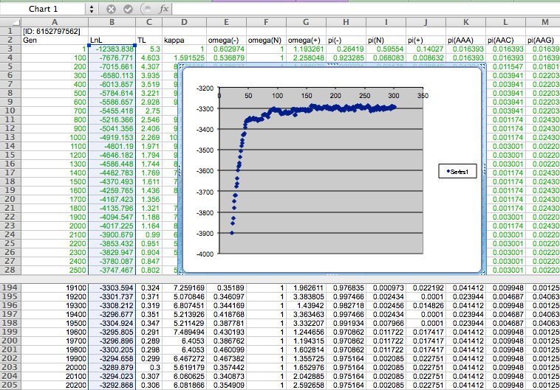

Slide 42
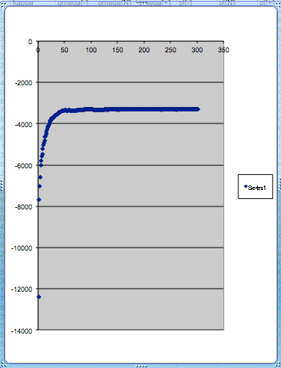
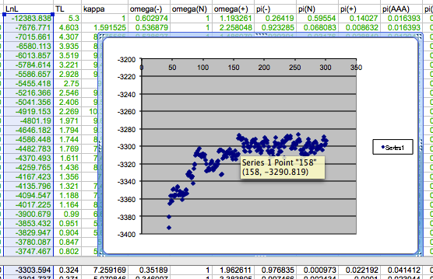
plot LogL to determine which samples to ignore
the same after rescaling the y-axis

Slide 43
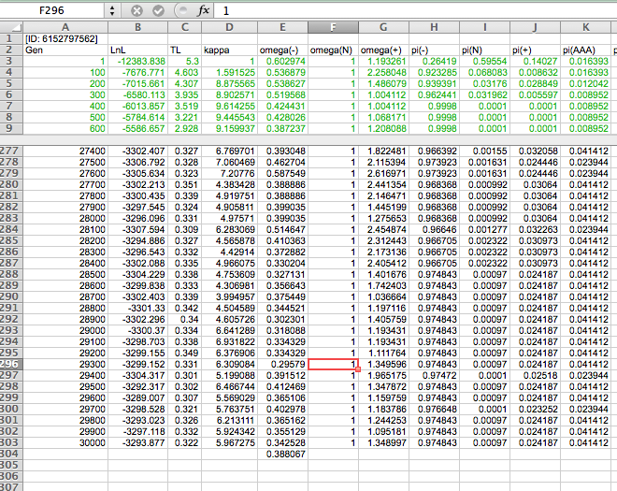

Slide 44
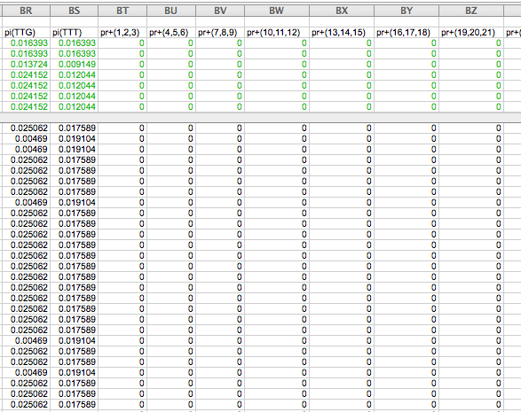

Slide 45
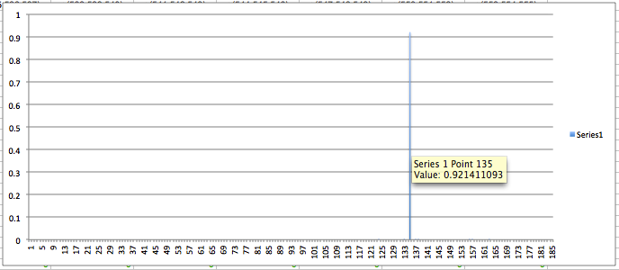
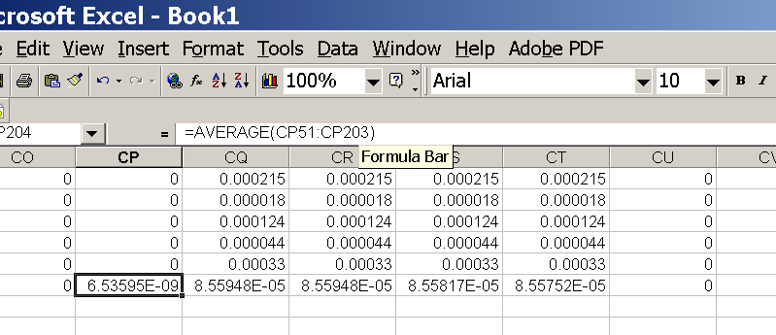
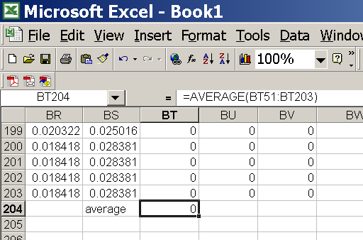
for each codon calculate the the average probability
copy paste formula
plot row
enter formula

Slide 46
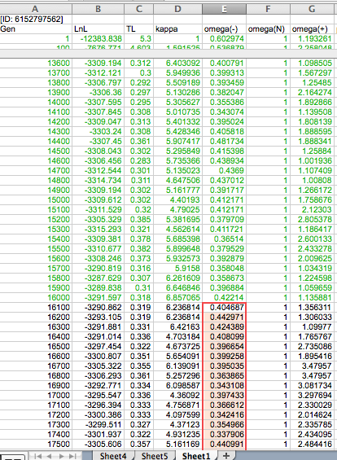
To determine credibility interval for a parameter (here omega<1):
Select values for the parameter, sampled after the burning.
Copy paste to a new spreadsheet,

Slide 47
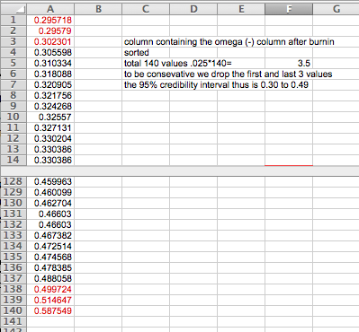
Sort values according to size,
Discard top and bottom 2.5%
Remainder gives 95% credibility interval.

Slide 48
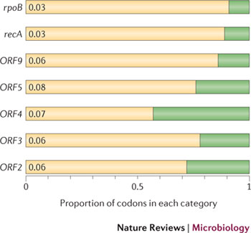
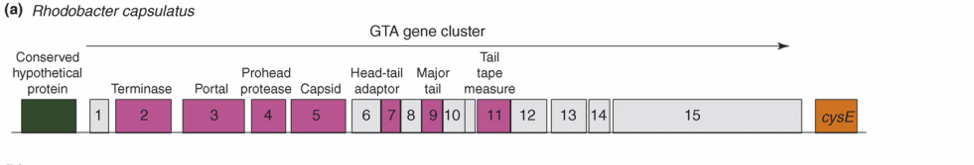
Purifying selection in GTA genes
dN/dS <1 for GTA genes has been used to infer selection for function
GTA genes
Lang AS, Zhaxybayeva O, Beatty JT. Nat Rev Microbiol. 2012 Jun 11;10(7):472-82
Lang, A.S. & Beatty, J.T. Trends in Microbiology , Vol.15, No.2 , 2006
Notes:
The ratio of non-synonymous-to-synonymous (dN/dS, or ω) codon substitution rates can be used as an indication of the selective pressure acting on a protein-coding gene. If a gene (or gene segment) is under purifying selection, non-synonymous mutations (that is, mutations resulting in a change of the encoded amino acid) will be selected against, resulting in ω < 1. In neutrally evolving proteins, synonymous and non-synonymous mutations will be fixed at approximately the same rate, resulting in ω = 1. Because different regions of a protein-coding gene may be under different selective constraints, codons can be divided into two categories: those with ω < 1 (yellow; the estimated ω is indicated on the bar) and those with ω fixed to 1 (green); the estimated proportion of codons in each category is given on the horizontal axis.

Slide 49
Purifying selection in E.coli ORFans
dN-dS < 0 for some ORFan E. coli clusters seems to suggest they are functional genes.
Gene groups | Number | dN-dS>0 | dN-dS<0 | dN-dS=0
E. coli ORFan clusters | 3773 | 944 (25%) | 1953 (52%) | 876 (23%)
Clusters of E.coli sequences found in Salmonella sp., Citrobacter sp. | 610 | 104 (17%) | 423(69%) | 83 (14%)
Clusters of E.coli sequences found in some Enterobacteriaceae only | 373 | 8 (2%) | 365 (98%) | 0 (0%)
Adapted after Yu, G. and Stoltzfus, A. Genome Biol Evol (2012) Vol. 4 1176-1187

Slide 50
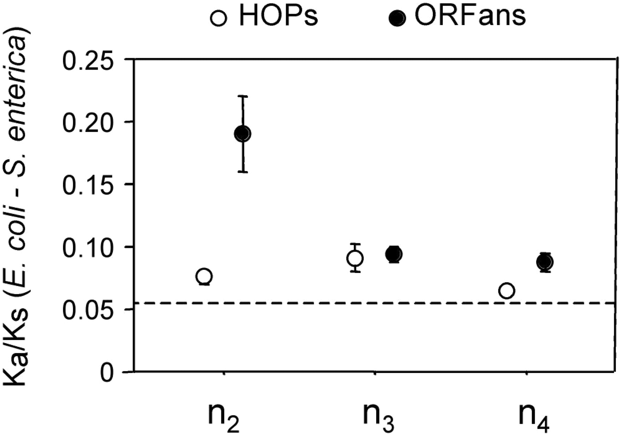
Vincent Daubin and Howard Ochman: Bacterial Genomes as New Gene Homes: The Genealogy of ORFans in E. coli. Genome Research 14:1036-1042, 2004
The ratio of non-synonymous to synonymous substitutions for genes found only in the E.coli - Salmonella clade is lower than 1, but larger than for more widely distributed genes.
Increasing phylogenetic depth
Fig. 3 from Vincent Daubin and Howard Ochman, Genome Research 14:1036-1042, 2004

Slide 51

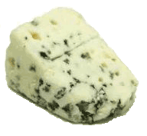
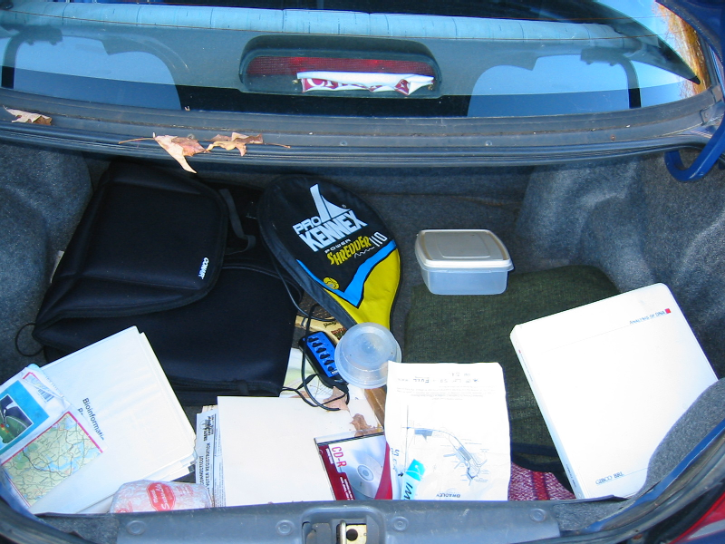
Trunk-of-my-car analogy: Hardly anything in there is the is the result of providing a selective advantage. Some items are removed quickly (purifying selection), some are useful under some conditions, but most things do not alter the fitness. See here for a published version.
Could some of the inferred purifying selection be due to the acquisition of novel detrimental characteristics (e.g., protein toxicity, HOPELESS MONSTERS)?

Slide 52
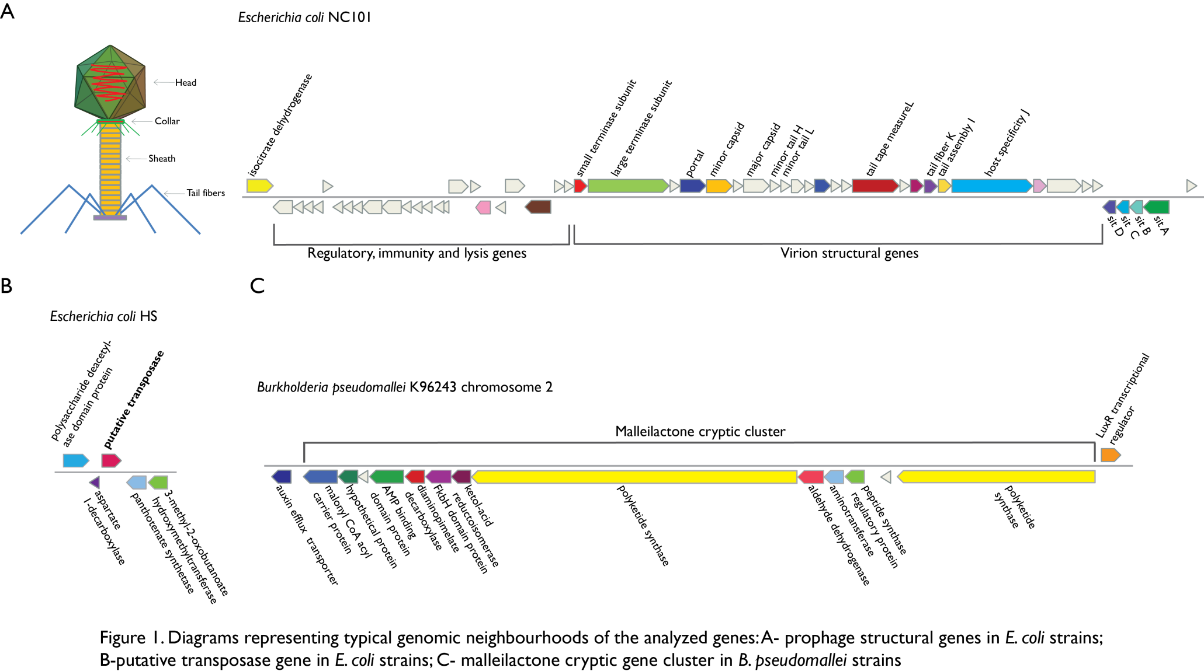
Vertically Inherited Genes Not Expressed for Function

Slide 53
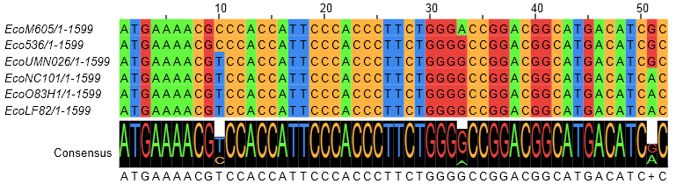
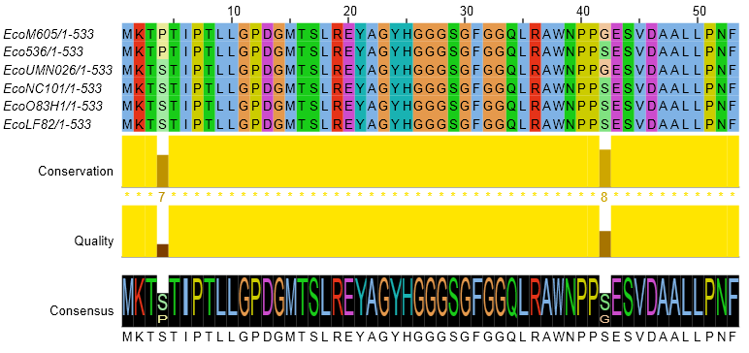
Counting Algorithm
Calculate number of different nucleotides/amino acids per MSA column (X)
Calculate number of nucleotides/amino acids substitutions (X-1)
Calculate number of synonymous changes
S=(N-1)nc-N
assuming N=(N-1)aa
X=2 1 nucleotide substitution
1 non-synonymous change
X=2 1 amino acid substitution

Slide 54
Simulation Algorithm
Calculate MSA nucleotide frequencies (%A,%T,%G,%C)
Introduce a given number of random substitutions ( at any position) based on inferred base frequencies
Compare translated mutated codon with the initial translated codon and count synonymous and non-synonymous substitutions

Slide 55
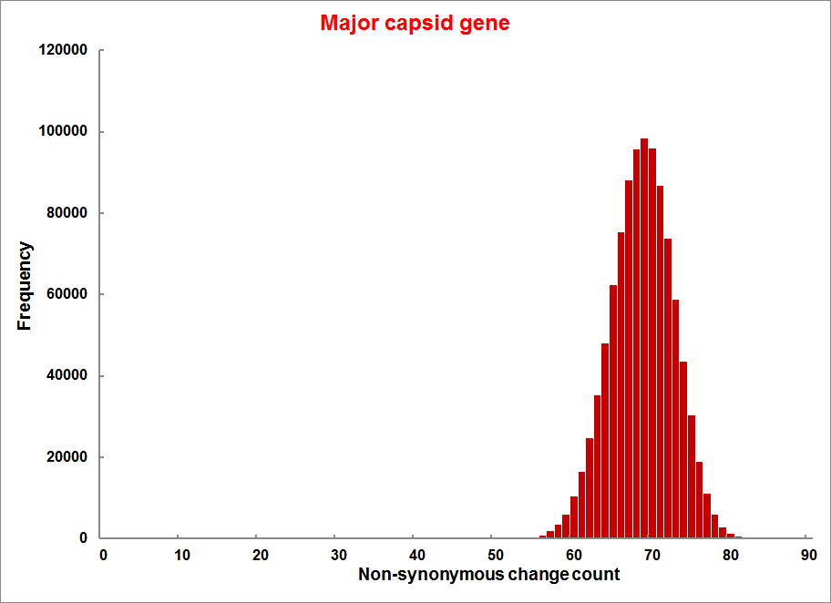
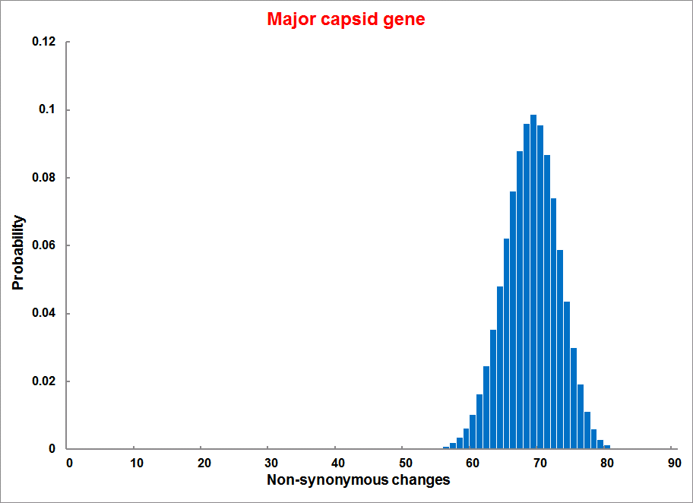
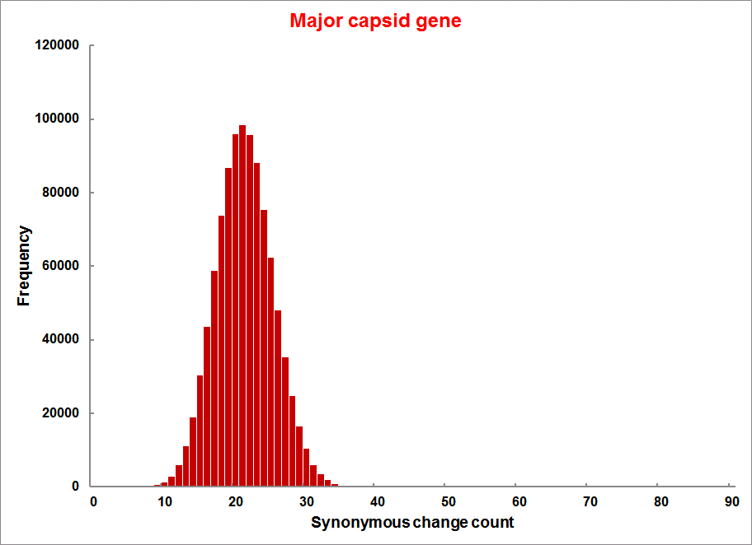
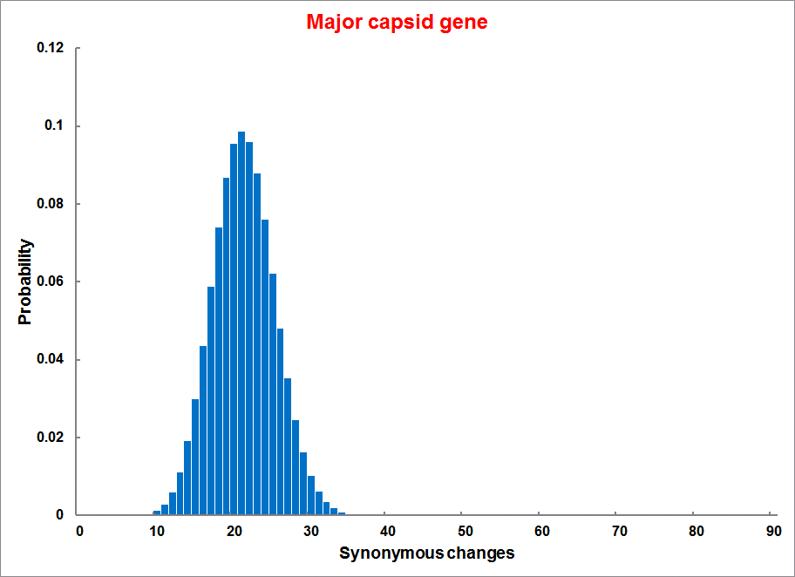
Evolution of Coding DNA Sequences Under a Neutral Model
E. coli Prophage Genes
Count distribution from simulations
Probability distribution
n=90
Non-synonymous
n= 90
k= 24
p=0.763
P(≤24)=3.63E-23
Observed=24
P(≤24) < 10⁻⁶
n=90
Synonymous
n= 90
k= 66
p=0.2365
P(≥66)=3.22E-23
Observed=66
P(≥66) < 10⁻⁶

Slide 56
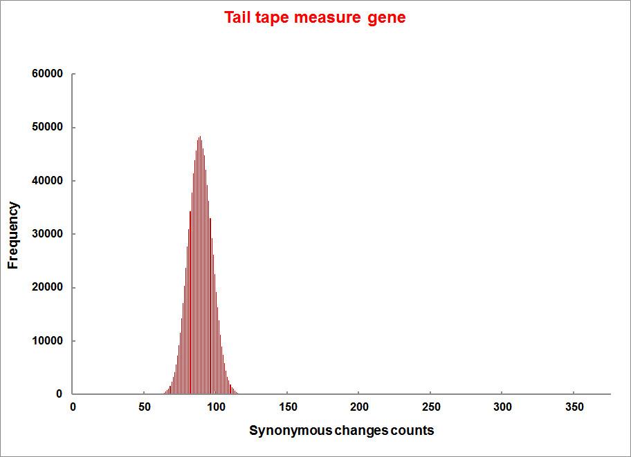
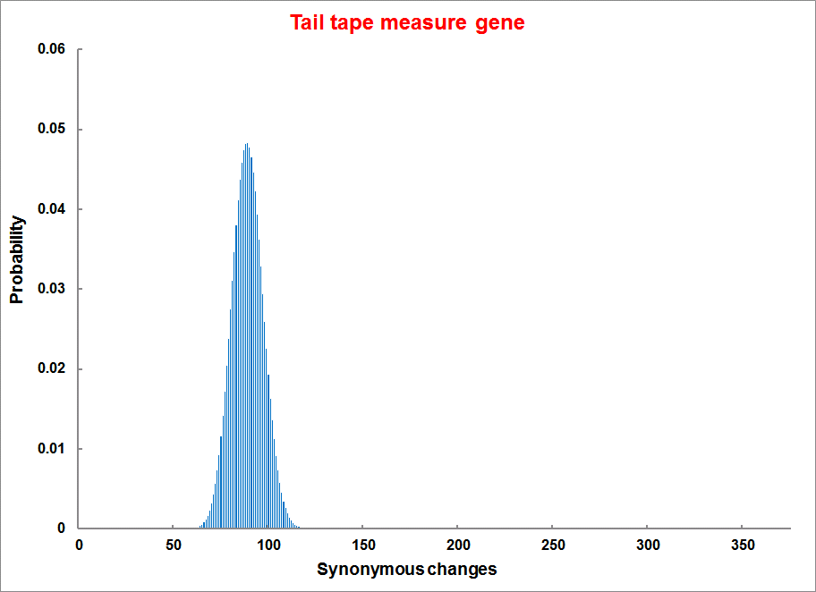
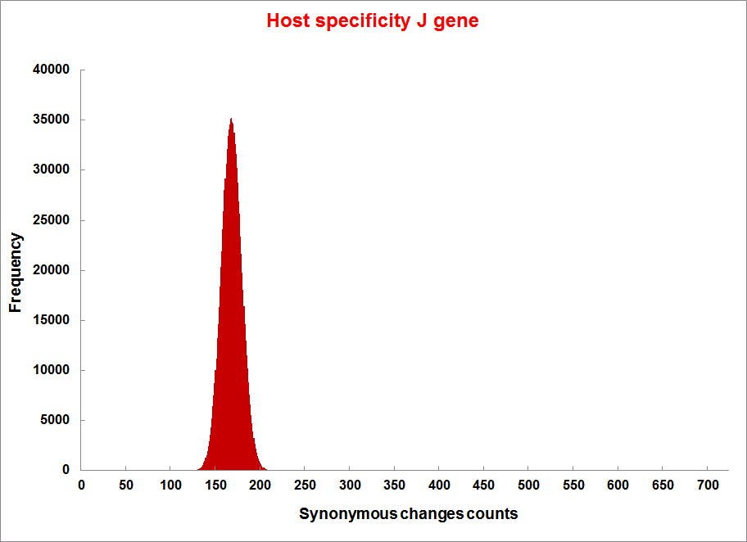
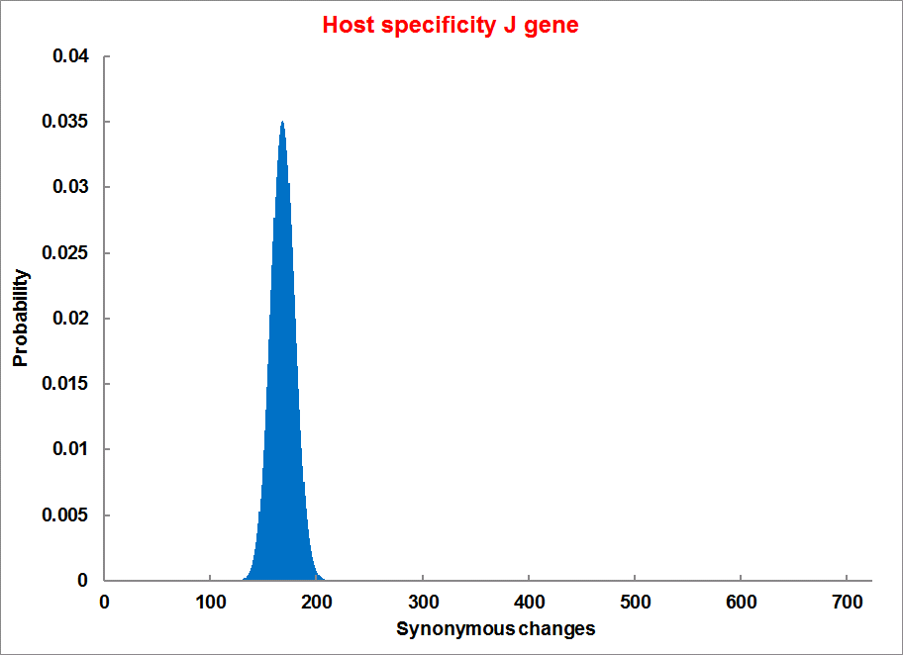
Evolution of Coding DNA Sequences Under a Neutral Model
E. coli Prophage Genes
Count distribution
Probability distribution
n=375
Synonymous
n= 375
k= 243
p=0.237
P(≥243)=7.92E-64
Observed=243
P(≥243) < 10⁻⁶
n=723
Synonymous
n= 723
k= 498
p=0.232
P(≥498)=6.41E-149
Observed=498
P(≥498) < 10⁻⁶

Slide 57
Trunk-of-my-car analogy from:
Does Sequence Conservation Provide Evidence for Biological Function?
SeilaOmer¹Timothy J.Harlow¹Johann PeterGogarten¹² https://doi.org/10.1016/j.tim.2016.09.010
… another reason for the presence of purifying selection is that mutations may lead to a product whose presence is detrimental (e.g., protein toxicity) to the organism. In the trunk of a car analogy, a piece of cheese left in the trunk will rot, producing an obnoxious smell, which will lead to its removal from the trunk. Similarly, a sack of fertilizer might turn into an explosive, prompting fast elimination. In this case, purifying selection occurs because the gene product after the mutation is detrimental, not because the gene before mutation was beneficial.
Could some of the inferred purifying selection be due to the acquisition of novel detrimental characteristics (e.g., protein toxicity, HOPELESS MONSTERS)?

Slide 58
Evolution of Coding DNA Sequences Under a Neutral Model
E. coli Prophage Genes
 |  | OBSERVED |  | SIMULATED |  | Dnapars | Simulated | Codeml
Gene | Alignment Length (bp) | Substitutions | Synonymous changes* | Substitutions | p-value synonymous (given *) | Minimum number of substitutions | dN/dS | dN/dS
Major capsid | 1023 | 90 | 66 | 90 | 3.23E-23 | 94 | 0.113 | 0.13142
Minor capsid C | 1329 | 81 | 59 | 81 | 1.98E-19 | 84 | 0.124 | 0.17704
Large terminase subunit | 1923 | 75 | 67 | 75 | 7.10E-35 | 82 | 0.035 | 0.03773
Small terminase subunit | 543 | 100 | 66 | 100 | 1.07E-19 | 101 | 0.156 | 0.25147
Portal | 1599 | 55 | 46 | 55 | 1.36E-21 | *64 | 0.057 | 0.08081
Protease | 1329 | 55 | 37 | 55 | 4.64E-11 | 55 | 0.162 | 0.24421
Minor tail H | 2565 | 260 | 168 | 260 | 1.81E-44 | 260 | 0.17 | 0.30928
Minor tail L | 696 | 30 | 26 | 30 | 1.30E-13 | 30 | 0.044 | 0.05004
Host specificity J | 3480 | 723 | 498 | 723 | 6.42E-149 | *773 | 0.137 | 0.17103
Tail fiber K | 741 | 41 | 28 | 41 | 1.06E-09 | 44 | 0.14 | 0.18354
Tail assembly I | 669 | 39 | 33 | 39 | 3.82E-15 | 40 | 0.064 | 0.07987
Tail tape measure protein | 2577 | 375 | 243 | 375 | 7.92E-64 | 378 | 0.169 | 0.27957
Values well under the p=0.01 threshold, suggesting rejection of the null hypothesis of neutral evolution of prophage sequences.

Slide 59
Evolution of Coding DNA Sequences Under a Neutral Model
B. pseudomallei Cryptic Malleilactone Operon Genes and
E. coli transposase sequences
 |  | OBSERVED |  | SIMULATED
Gene | Alignment Length (bp) | Substitutions | Synonymous changes* | Substitutions | p-value synonymous (given *)
Aldehyde dehydrogenase | 1544 | 13 | 3 | 13 | 4.67E-04
AMP- binding protein | 1865 | 9 | 6 | 9 | 1.68E-02
Adenosylmethionine-8-amino-7-oxononanoate aminotransferase | 1421 | 20 | 12 | 20 | 6.78E-04
Fatty-acid CoA ligase | 1859 | 13 | 2 | 13 | 8.71E-01
Diaminopimelate decarboxylase | 1388 | 7 | 3 | 7 | 6.63E-01
Malonyl CoA-acyl transacylase | 899 | 2 | 1 | 2 | 4.36E-01
FkbH domain protein | 1481 | 17 | 9 | 17 | 2.05E-02
Hypothethical protein | 431 | 3 | 2 | 3 | 1.47E-01
Ketol-acid reductoisomerase | 1091 | 2 | 0 | 2 | 1.00E+00
Peptide synthase regulatory protein | 1079 | 10 | 5 | 10 | 8.91E-02
Polyketide-peptide synthase | 12479 | 135 | 66 | 135 | 4.35E-27
 |  | OBSERVED |  | SIMULATED
Gene | Alignment Length (bp) | Substitutions | Synonymous changes* | Substitutions | p-value synonymous (given *)
Putative transposase | 903 | 175 | 107 | 175 | 1.15E-29

Slide 60
Other ways to detect positive selection
Selective sweeps -> fewer alleles present in population
(see contributions from archaic Humans for example)
Repeated episodes of positive selection -> high dN
(works well for repeated positive – aka diversifying – selection; e.g. virus interaction with the immunesystem)

Slide 61
Other ways to detect positive selection
Selective sweeps -> fewer alleles present in population
(allele shows little within allele divergence - see contributions from archaic Humans for example),
SNP or neighboring SNPs are at higher frequency within a population.
Repeated episodes of positive selection -> high dN

Slide 62
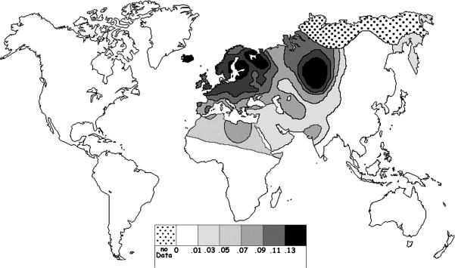
Fig. 1 Current world-wide frequency distribution of CCR5-Δ32 allele frequencies. Only the frequencies of Native populations have been evidenced in Americas, Asia, Africa and Oceania. Map redrawn and modified principally from <ce:cross-ref refid="bib5"> B...
Eric Faure , Manuela Royer-Carenzi
Is the European spatial distribution of the HIV-1-resistant CCR5-Δ32 allele formed by a breakdown of the pathocenosis due to the historical Roman expansion?
Infection, Genetics and Evolution, Volume 8, Issue 6, 2008, 864 - 874
http://dx.doi.org/10.1016/j.meegid.2008.08.007

Slide 63
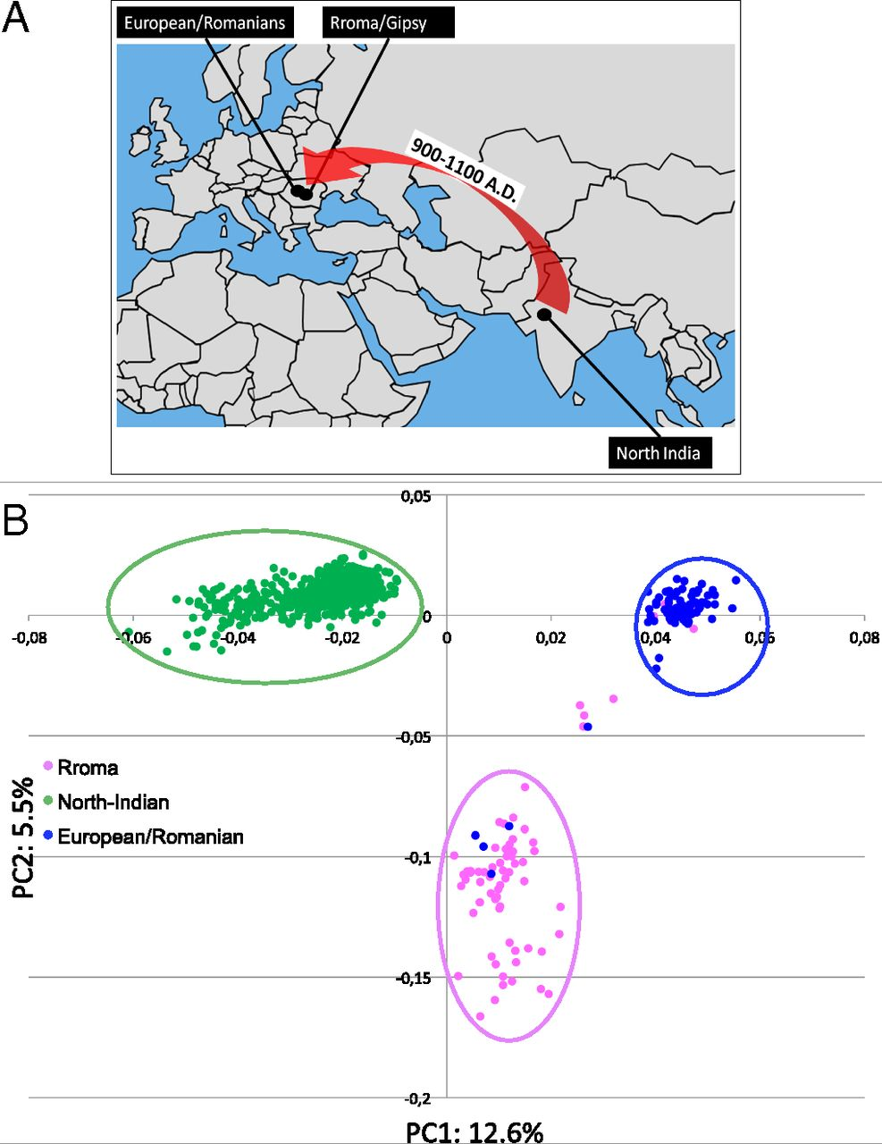
Geographic origin of the three populations studied.
196,524 SNPs
-> PCA
Hafid Laayouni et al. PNAS 2014;111:2668-2673
©2014 by National Academy of Sciences
Notes:
Geographic origin of the three populations studied. (A) European/Romanians and Rroma/Gipsy share the same location, even if the origin of the latter is in North India. (B) Plot of the populations under analysis according to the coordinates to the two main eigenvectors of smartpca (Eigensoft) analysis, in which each dot represents an individual. Individuals within the circles and the same color have been considered for the study; those of different colors represent false population allocation and those intermediate represent admixed individuals. ROM, nongypsy Romanians; INDI, individuals from North India; GYP, Rroma/Gypsies living in Romania.

Slide 64

Manhattan plot of results of selection tests in Rroma, Romanians, and Indians using TreeSelect statistic (A) and XP-CLR statistic (B).
SNP frequencies within and between populations
selective sweeps detected through linkage disequilibrium
Laayouni H et al. PNAS 2014;111:2668-2673
Convergent evolution in European and Rroma populations reveals pressure exerted by plague on Toll-like receptors.
©2014 by National Academy of Sciences
Notes:
Manhattan plot of results of selection tests in Rroma, Romanians, and Indians using TreeSelect statistic (A) and XP-CLR statistic (B). Chromosomes ordered from chromosome 1 to chromosome 22.

Slide 65

Variant arose about
5800 years ago

Slide 66

The age of haplogroup D was found to be ~37,000 years

Slide 67



Slide 68



How do you define evolution?
Richard Goldschmidt 1940
hopeful monsters
Mutationism HGT/WGD!
Punctuated Equilibrium
Few genes / large effect
Vilified by Mayr, celebrated 1977 Gould & Evo-devo
Ernst Mayr 1942
NeoDarwinian Synthesis
Natural Selection
Gradualism
Many genes/small effect
Dario – “Fisher right”
Motoo Kimura 1968
Neutral Theory
Genetic Drift is main force for changing allele frequencies
Slide from Chris Pires
Notes:
Goldschmitdt,R. (1940). The Material Basis of Evolution
Mayr, Ernst (1942). Systematics and the origin of species, from the viewpoint of a zoologist

Slide 69

Duplications and Evolution
Ohno postulated that gene duplication plays a major role in evolution
Small scale duplications (SSD)
Whole genome duplications (WGD)
Polyploid: nucleus contains three or more copies of each chromosome
Autopolyploid: formed within a single species
Diploids AA and A’A’ Polyploid AAA’A’
Allopolyploid: formed from more than one species
Diploids AA and BB Polyploid AABB
Susumu Ohno 1970
Evolution by gene duplication
1R and 2R hypothesis
“Junk DNA” 1972
Slide from Chris Pires

Slide 70


e.g. gene duplications in yeast
from Benner et al., 2002
Figure 1. The number of duplicated gene pairs (vertical axis) in the genome of the yeast Saccharomyces cerevisiae versus f₂, a metric that models divergence of silent positions in twofold redundant codon systems via an approach-to-equilibrium kinetic process and therefore acts as a logarithmic scale of the time since the duplications occurred. Recent duplications are represented by bars at the right. Duplications that diverged so long ago that equilibrium at the silent sites has been reached are represented by bars where f₂ 0.55. Noticeable are episodes of gene duplication between the two extremes, including a duplication at f₂ 0.84. This represents the duplication, at ~80 Ma, whereby yeast gained its ability to ferment sugars found in fruits created by angiosperms. Also noticeable are recent duplications of genes that enable yeast to speed DNA synthesis, protein synthesis, and malt degradation, presumably representing yeast's recent interaction with humans.
The chemical pathway that converts glucose to alcohol in yeast arose ~80 Ma, near the time that fermentable fruits became dominant. Gene families that suffered duplication near this time, captured in the episode of gene duplication represented in the histogram in Fig. 1 by bars at f₂ 0.84, are named in red. According to the hypothesis, this pathway became useful to yeast when angiosperms (flowering, fruiting plants) began to provide abundant sources of fermentable sugar in their fruits.

Slide 71

Gene Transfer, Sex, and Recombination:
Inventions do not need to be made sequentially
Gene transfer, followed by homologous or non-homologous recombination, allows inventions to be shared across the tree of life

Slide 72
Aside: Gene and genome duplication versus
Horizontal Gene Transfer
Autochtonous gene/genome
duplication are rare
in prokaryotes
Gene family expansion through horizontal gene transfer –
the most common process in prokaryotes

Slide 73

Horizontal Gene Transfer (HGT) and the
Acquisition of New Capabilities
Most important process to adapt microorganisms to new environments.
E.g.: Antibiotic and heavy metal resistance,
pathways that allow acquisition and breakdown of new substrates.
Creation of new metabolic pathways.
HGT not autochthonous gene duplication is the main
process of gene family expansion in prokaryotes.
Also important in the recent evolution of multicellular eukaryotes
(HGT between fish species and between grasses).
Selection acts on the Holobiont (= Host + Symbionts)
To adapt to new conditions, new symbionts can be acquired, or existing symbionts can acquire new genes through HGT.

Slide 74





Gene Transfer in Eukaryotes
Bacterial parasites on red algae
HGT
Human gut symbiont

Slide 75

Gene Transfer in Eukaryotes – Example 2
Highlights
Key genes for C₄ photosynthesis were transmitted between distantly related grasses
These genes contributed to the adaptation of the primary metabolism
Their transmission was independent from most of the genome
Curr Biol. 2012 Mar 6;22(5):445-9. Epub 2012 Feb 16.
Adaptive Evolution of C(4) Photosynthesis
through Recurrent Lateral Gene Transfer.
Christin PA, Edwards EJ, Besnard G, Boxall SF, Gregory R, Kellogg EA, Hartwell J, Osborne CP.
Eric H. Roalson Current Biology Vol 22 No 5 R162

Slide 76

Gene Transfer in Eukaryotes – Example 2
From: Christin PA, Edwards EJ, Besnard G, Boxall SF, Gregory R, Kellogg EA, Hartwell J, Osborne CP.
Adaptive Evolution of C(4) Photosynthesis
through Recurrent Lateral Gene Transfer. Curr Biol. 2012 Mar 6;22(5):445-9. Epub 2012 Feb 16.

Slide 77


Gene Transfer in Eukaryotes – Example 3

Slide 78
HGT as a force creating new pathways

Slide 79

HGT as a force creating new pathways – Example I
Acetoclastic Methanogenesis
Unique to subset of Archaea
Energy production via reduction of multiple carbon substrates to CH₄
900 Million metric tons of biogenic methane produced annually.
Over 66% of biogenic methane is produced from acetate, mostly by Methanosarcina genera.
From: Galagan et al., 2002
Fournier and Gogarten (2008) Evolution of Acetoclastic Methanogenesis in Methanosarcina via Horizontal Gene Transfer from Cellulolytic Clostridia. J. Bacteriol. 190(3):1124-7

Slide 80


Clostridia acetigenic pathway
Methanosarcina
acetoclastic pathway
AckA
HGT
PtaA
PtaA
AckA
Figures drawn with Metacyc (www.metacyc.org)

Slide 81

Consensus trees of Pta and AckA homologs within the Clostridia. Branches in which there were postulated horizontal gene transfers to Methanosarcina are indicated by an asterisk. Homologs from the firmicute F. nucleatum were used as outgroups to root the trees. The numbers associated with each clade indicate bootstrap values for maximum likelihood and neighbor joining and the posterior probability from Bayesian inference, respectively. Sequence alignment was ...

Slide 82

Maximum likelihood phylogenetic trees of Pta and AckA homologs. Homologs found in Methanosarcina are red and in both cases are found in a monophyletic group corresponding to the Clostridia (blue) ... .

Slide 83

HGT as a force creating new pathways – Example 2
Oxygen producing photosynthesis

Slide 84

A heterologous fusion model for the evolution of oxygenic photosynthesis based on phylogenetic analysis.
Xiong J et al. PNAS 1998;95:14851-14856
©1998 by National Academy of Sciences
Notes:
A heterologous fusion model for the evolution of oxygenic photosynthesis based on phylogenetic analysis. Details of the model are provided in the text.

Slide 85
HGT as a force creating new pathways – Example 3
Acetyl-CoA Assimilation: Methylaspartate Cycle
Acetate
Alcohols
Polyhydroxybutyrate
Fatty acids
acetyl-CoA
Lysine, leucine
oxaloacetate
citrate
malate
isocitrate
CO
2
fumarate
acetyl-CoA
2-oxoglutarate
Poly-γ -glutamate
succinate
glutamate
Proteins
glyoxylate
γ-Glutamylcystein
succinyl-CoA
methylaspartate
CO
Osmoadaptation
2
propionyl-CoA
mesaconate
3-methylmalyl-CoA
mesaconyl-CoA
Khomyakova, Bükmez, Thomas, Erb, Berg, Science, 2011

Slide 86
Comparison of different anaplerotic pathways
acetyl-CoA
acetyl-CoA
acetyl-CoA
acetyl-CoA
crotonyl-CoA
oxaloacetate
citrate
oxaloacetate
citrate
CO
2
malate
isocitrate
acetyl-CoA
ethylmalonyl-CoA
CO
2
fumarate
acetyl-CoA
2-oxoglutarate
malate
isocitrate
methylsuccinyl-CoA
glyoxylate
succinate
glutamate
CO
2
mesaconyl-CoA
glyoxylate
2-oxoglutarate
3-methylmalyl-CoA
succinyl-CoA
methylaspartate
fumarate
CO
propionyl-CoA
glyoxylate
2
propionyl-CoA
mesaconate
CO
2
CO
2
acetyl-CoA
succinate
succinyl-CoA
3-methylmalyl-CoA
mesaconyl-CoA
succinyl-CoA
malate
Citric acid cycle and
Glyoxylate cycle
Ethylmalonyl-CoA
pathway
Methylaspartate cycle
Bacteria, Eukarya and some Archaea
α-Proteobacteria, streptomycetes
haloarchaea

Slide 87
HGT as a force creating new pathways – Example 3
Acetyl-CoA Assimilation: methylaspartate cycle
Haloarchaea
Haloarcula marismortui,
Natrialba magadii
Glutamate fermentation,
Bacteria
Propionate assimilation
Acetate
assimilation, Bacteria
Khomyakova, Bükmez, Thomas, Erb, Berg, Science, 2011

