Slide 1
STUDENT EVALUATIONS
Please go to husky CT and complete student evaluations !

Slide 2
Testing for selection using dN/dS ratio
dN/dS ratio (aka Ka/Ks or ω (omega) ratio) where
dN = number of non-synonymous substitutions / number of all possible non-synonymous substitutions
dS =number of synonymous substitutions / number of all possible synonymous substitutions
dN/dS >1 positive, Darwinian selection
dN/dS =1 neutral evolution
dN/dS <1 negative, purifying selection
Notes:
The synonymous and non-synonymous rates dN and dS are defined as the numbers of synonymous and nonsynonymous substitutions per site. The ratio of the two rates omega=dN/dS then measures selective pressure at the protein level. If selection level has no effect on fitness, nonsynonymous mutations will be fixed at the same rate as synonymous mutations so that dN=dS and omega=1. If nonsynonymous mutations are deleterious purifying selection will reduce their fixation rate so that dN<dS and omega<1. If nonsynonymous mutations are favored by Darwinian selection, they will be fixed at a higher rate than synonymous mutations resulting in dN>dS and omega>1.

Slide 3
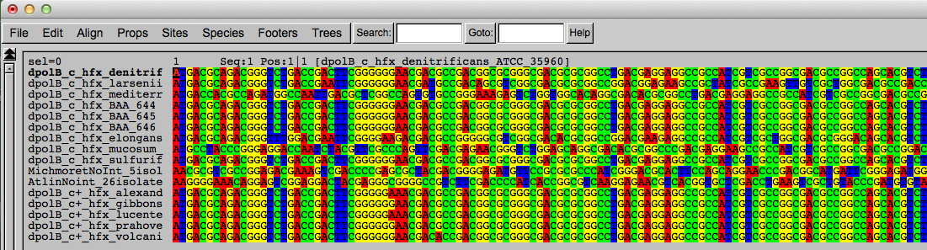
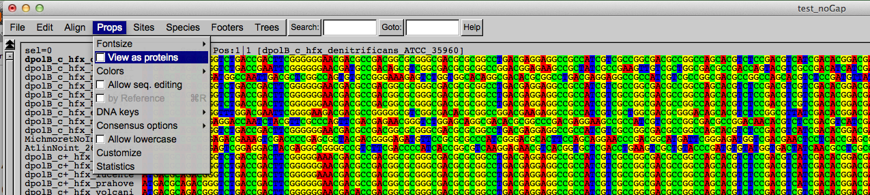
Codon based alignments in Seaview
Load nucleotide sequences (no gaps in sequences, sequence starts with nucleotide corresponding to 1st codon position)
Select view as proteins

Slide 4
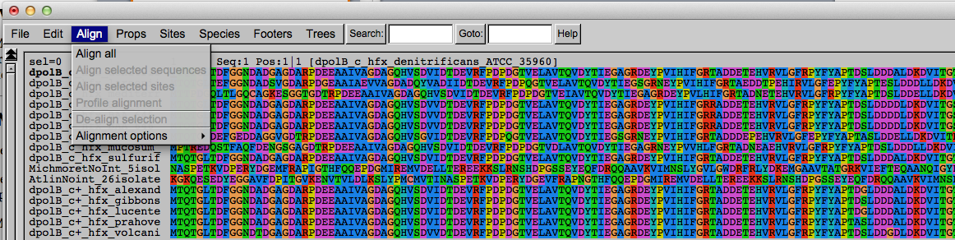
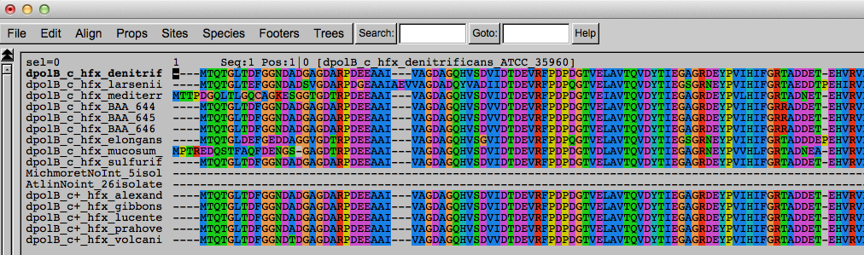
Codon based alignments in Seaview
With the protein sequences displayed, align sequences
Select view as nucleotides

Slide 5
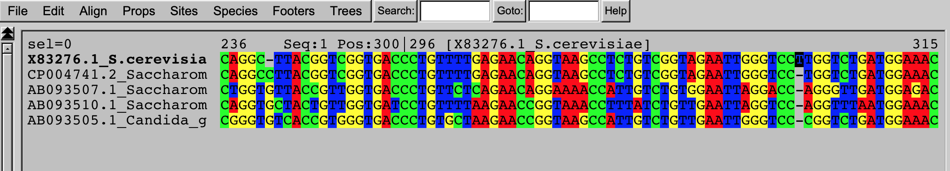
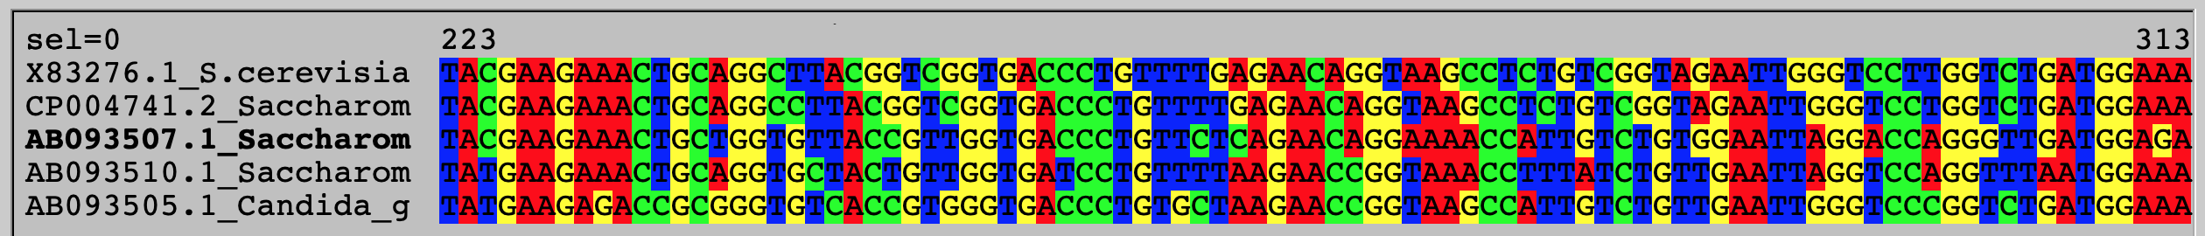
Problem:
Mutation that are not single nucleotide substitutions mess things up. E.g., an deletion of one nucleotide leads to a frame shift that is compensated by an insertion of a single nucleotide 30 nucleotides down the road. In an aa based alignment this will lead to many nonsynonymous substitutions.
Nucleotide alignment:
deletion
insertion
AA – based alignment

Slide 6
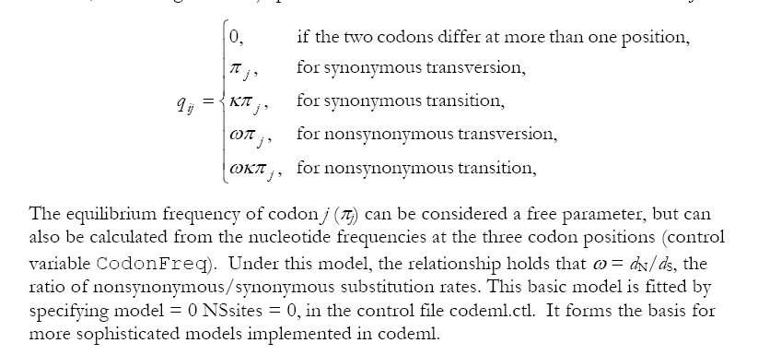
PAML (codeml) the basic model

Slide 7
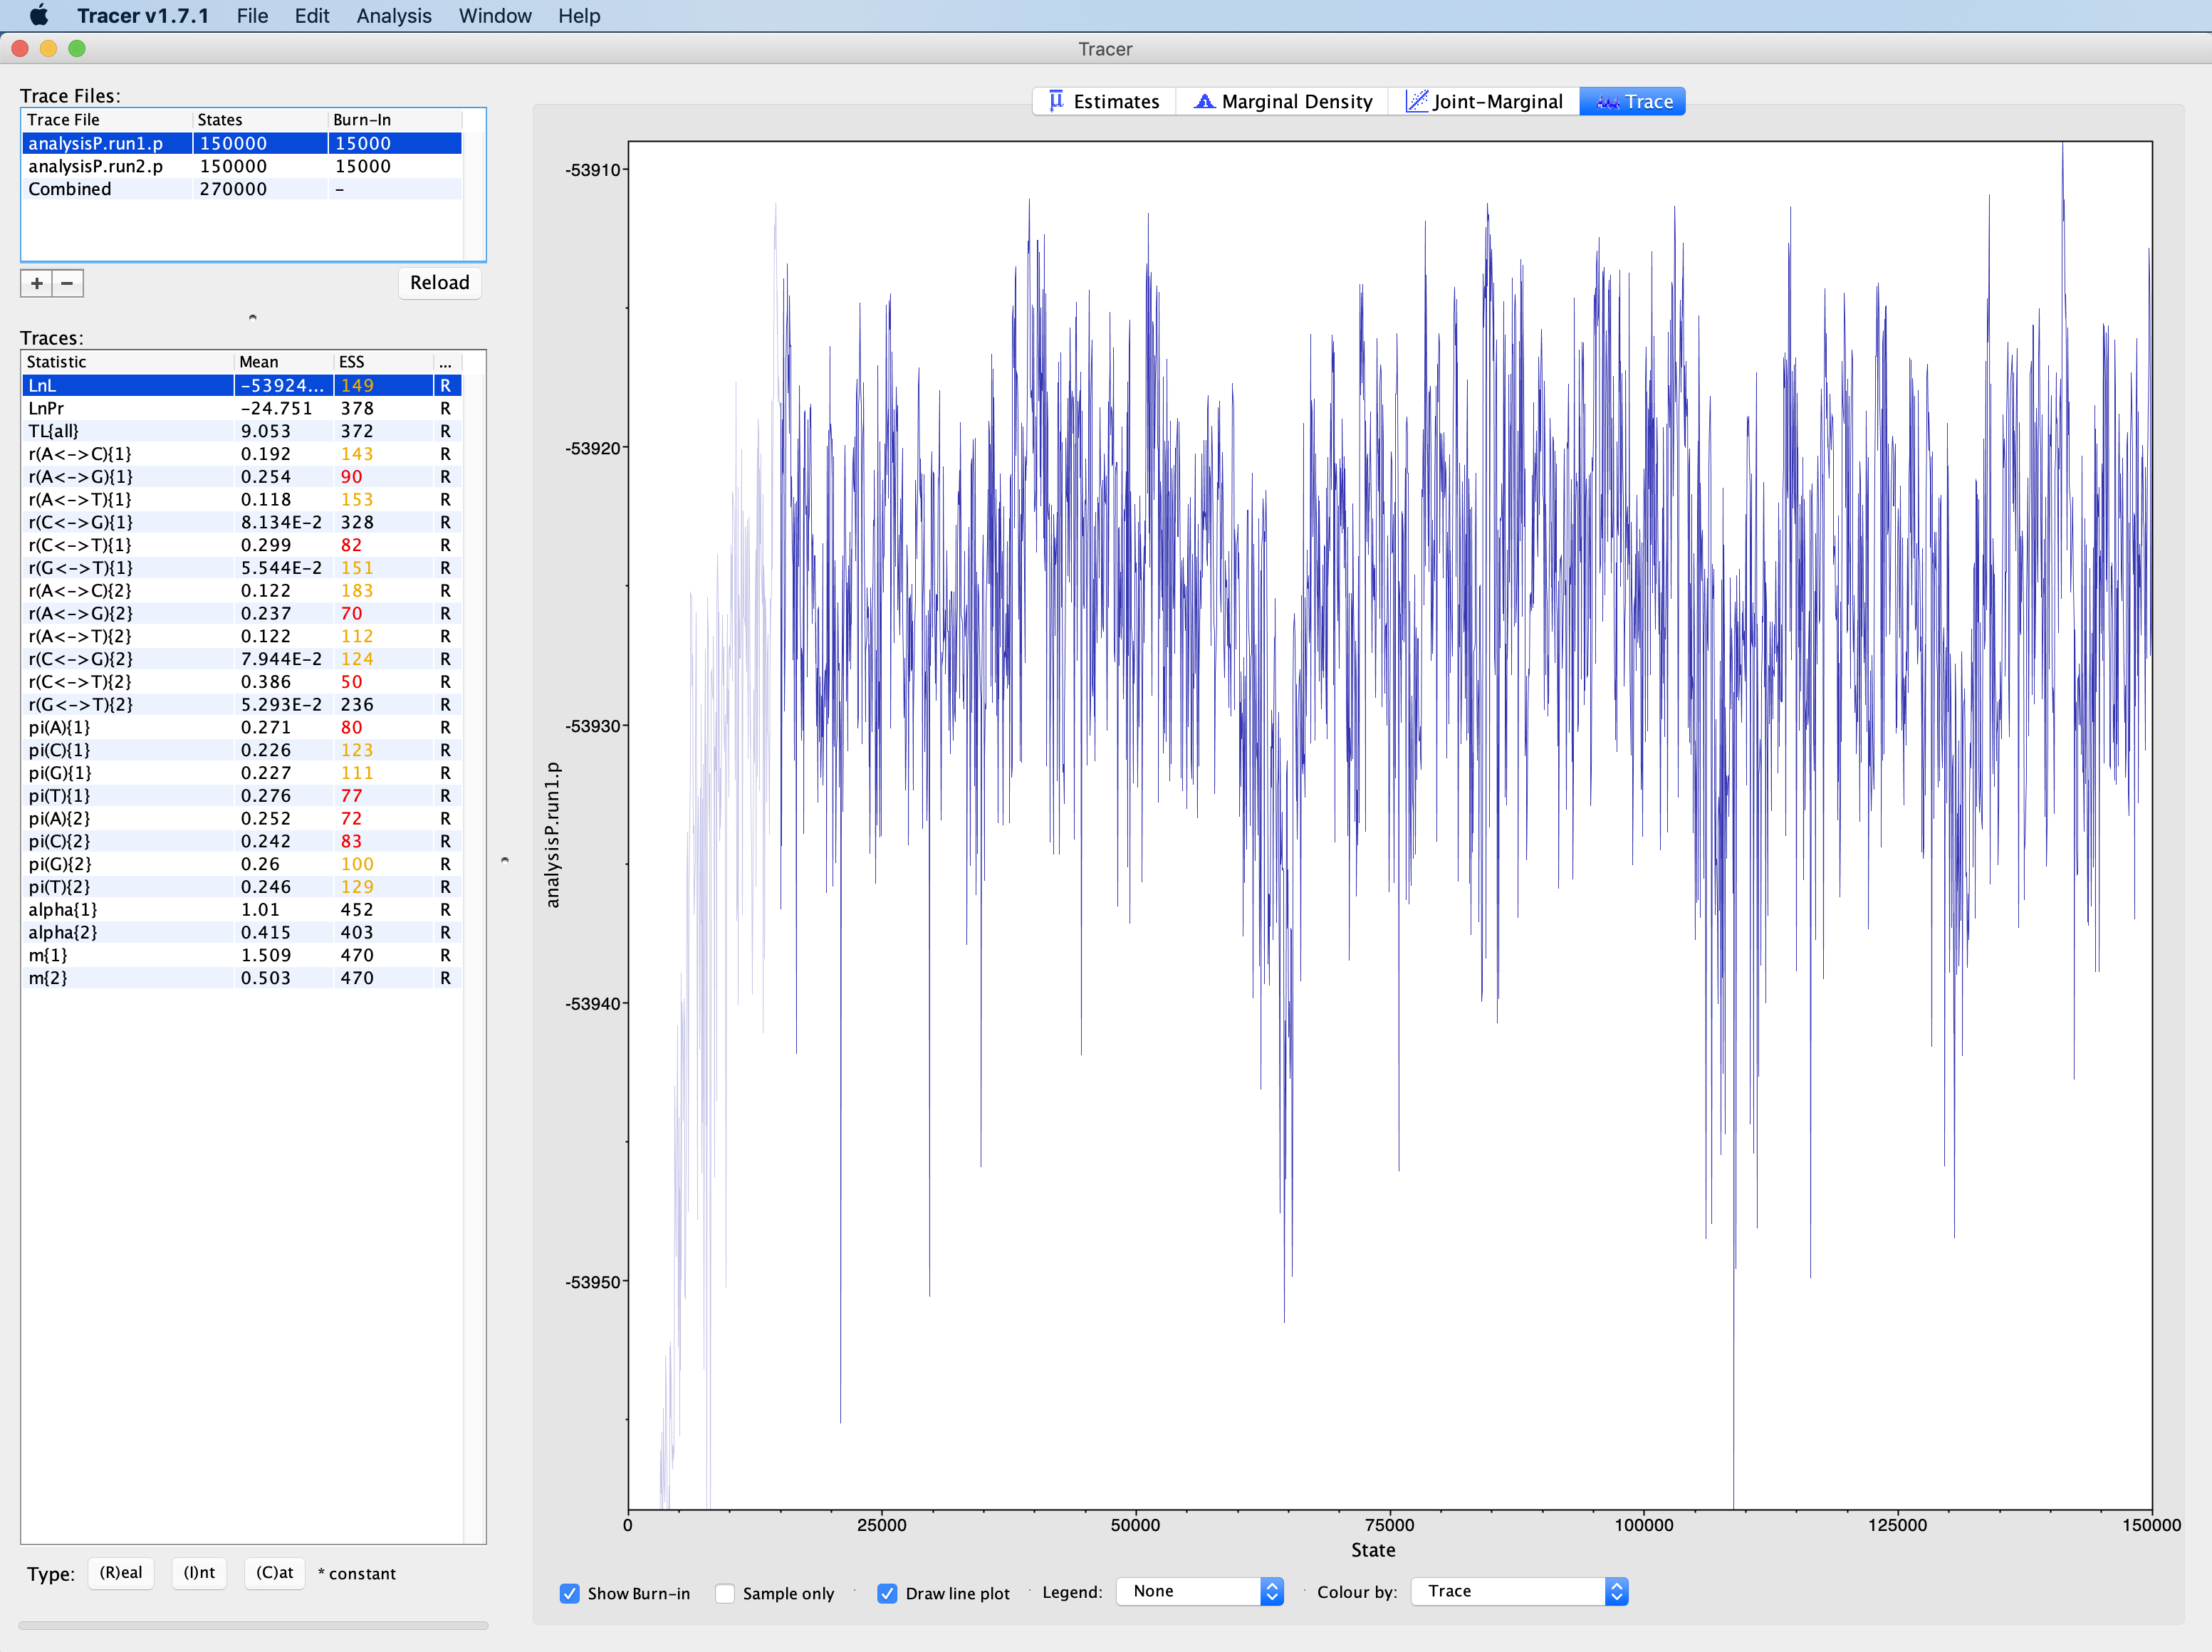
Trace of lnL from Exercise #2

Slide 8
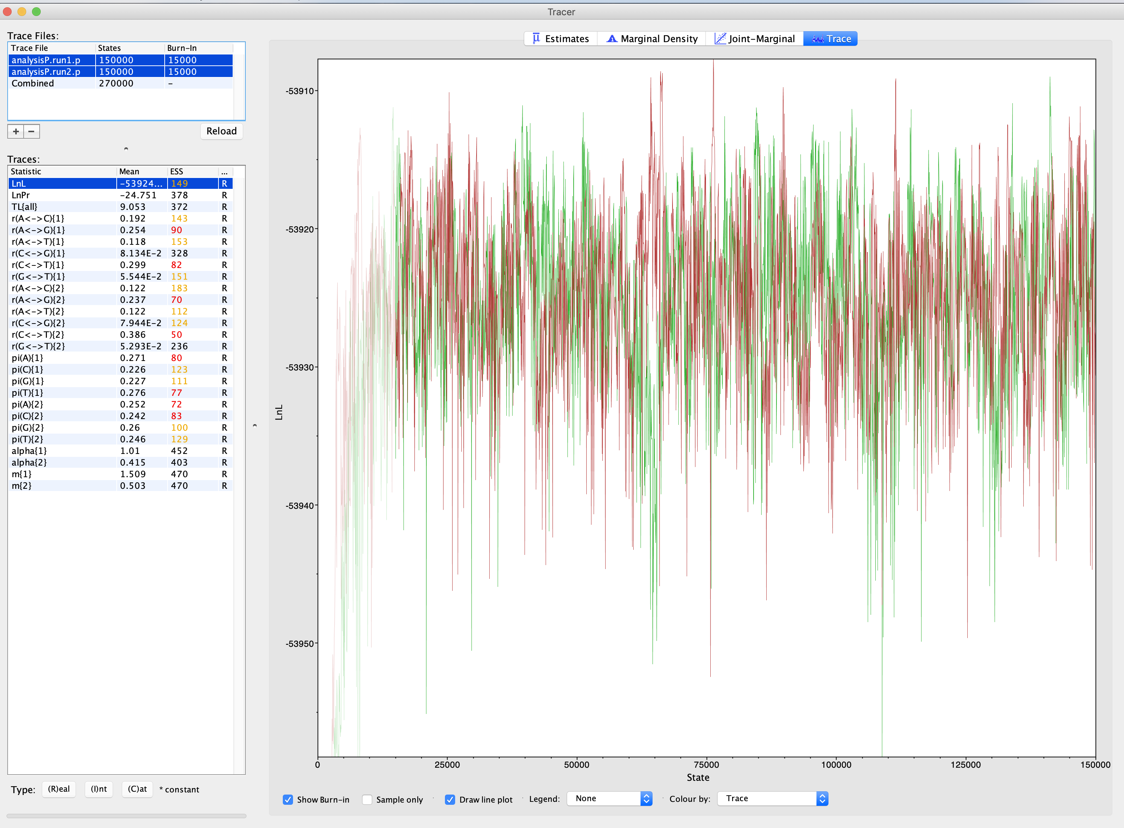
Trace of lnL from Exercise #2

Slide 9
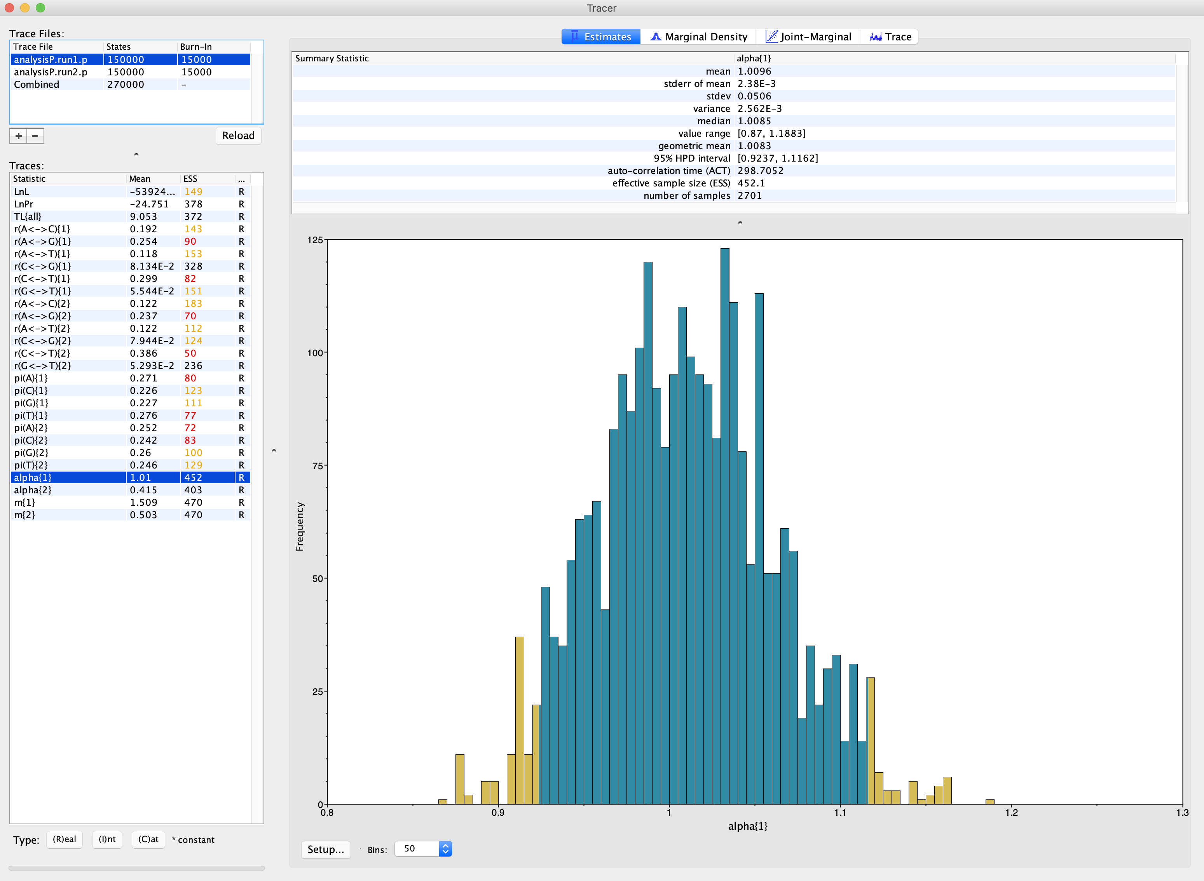
Histogram of shape parameter for intein partition

Slide 10
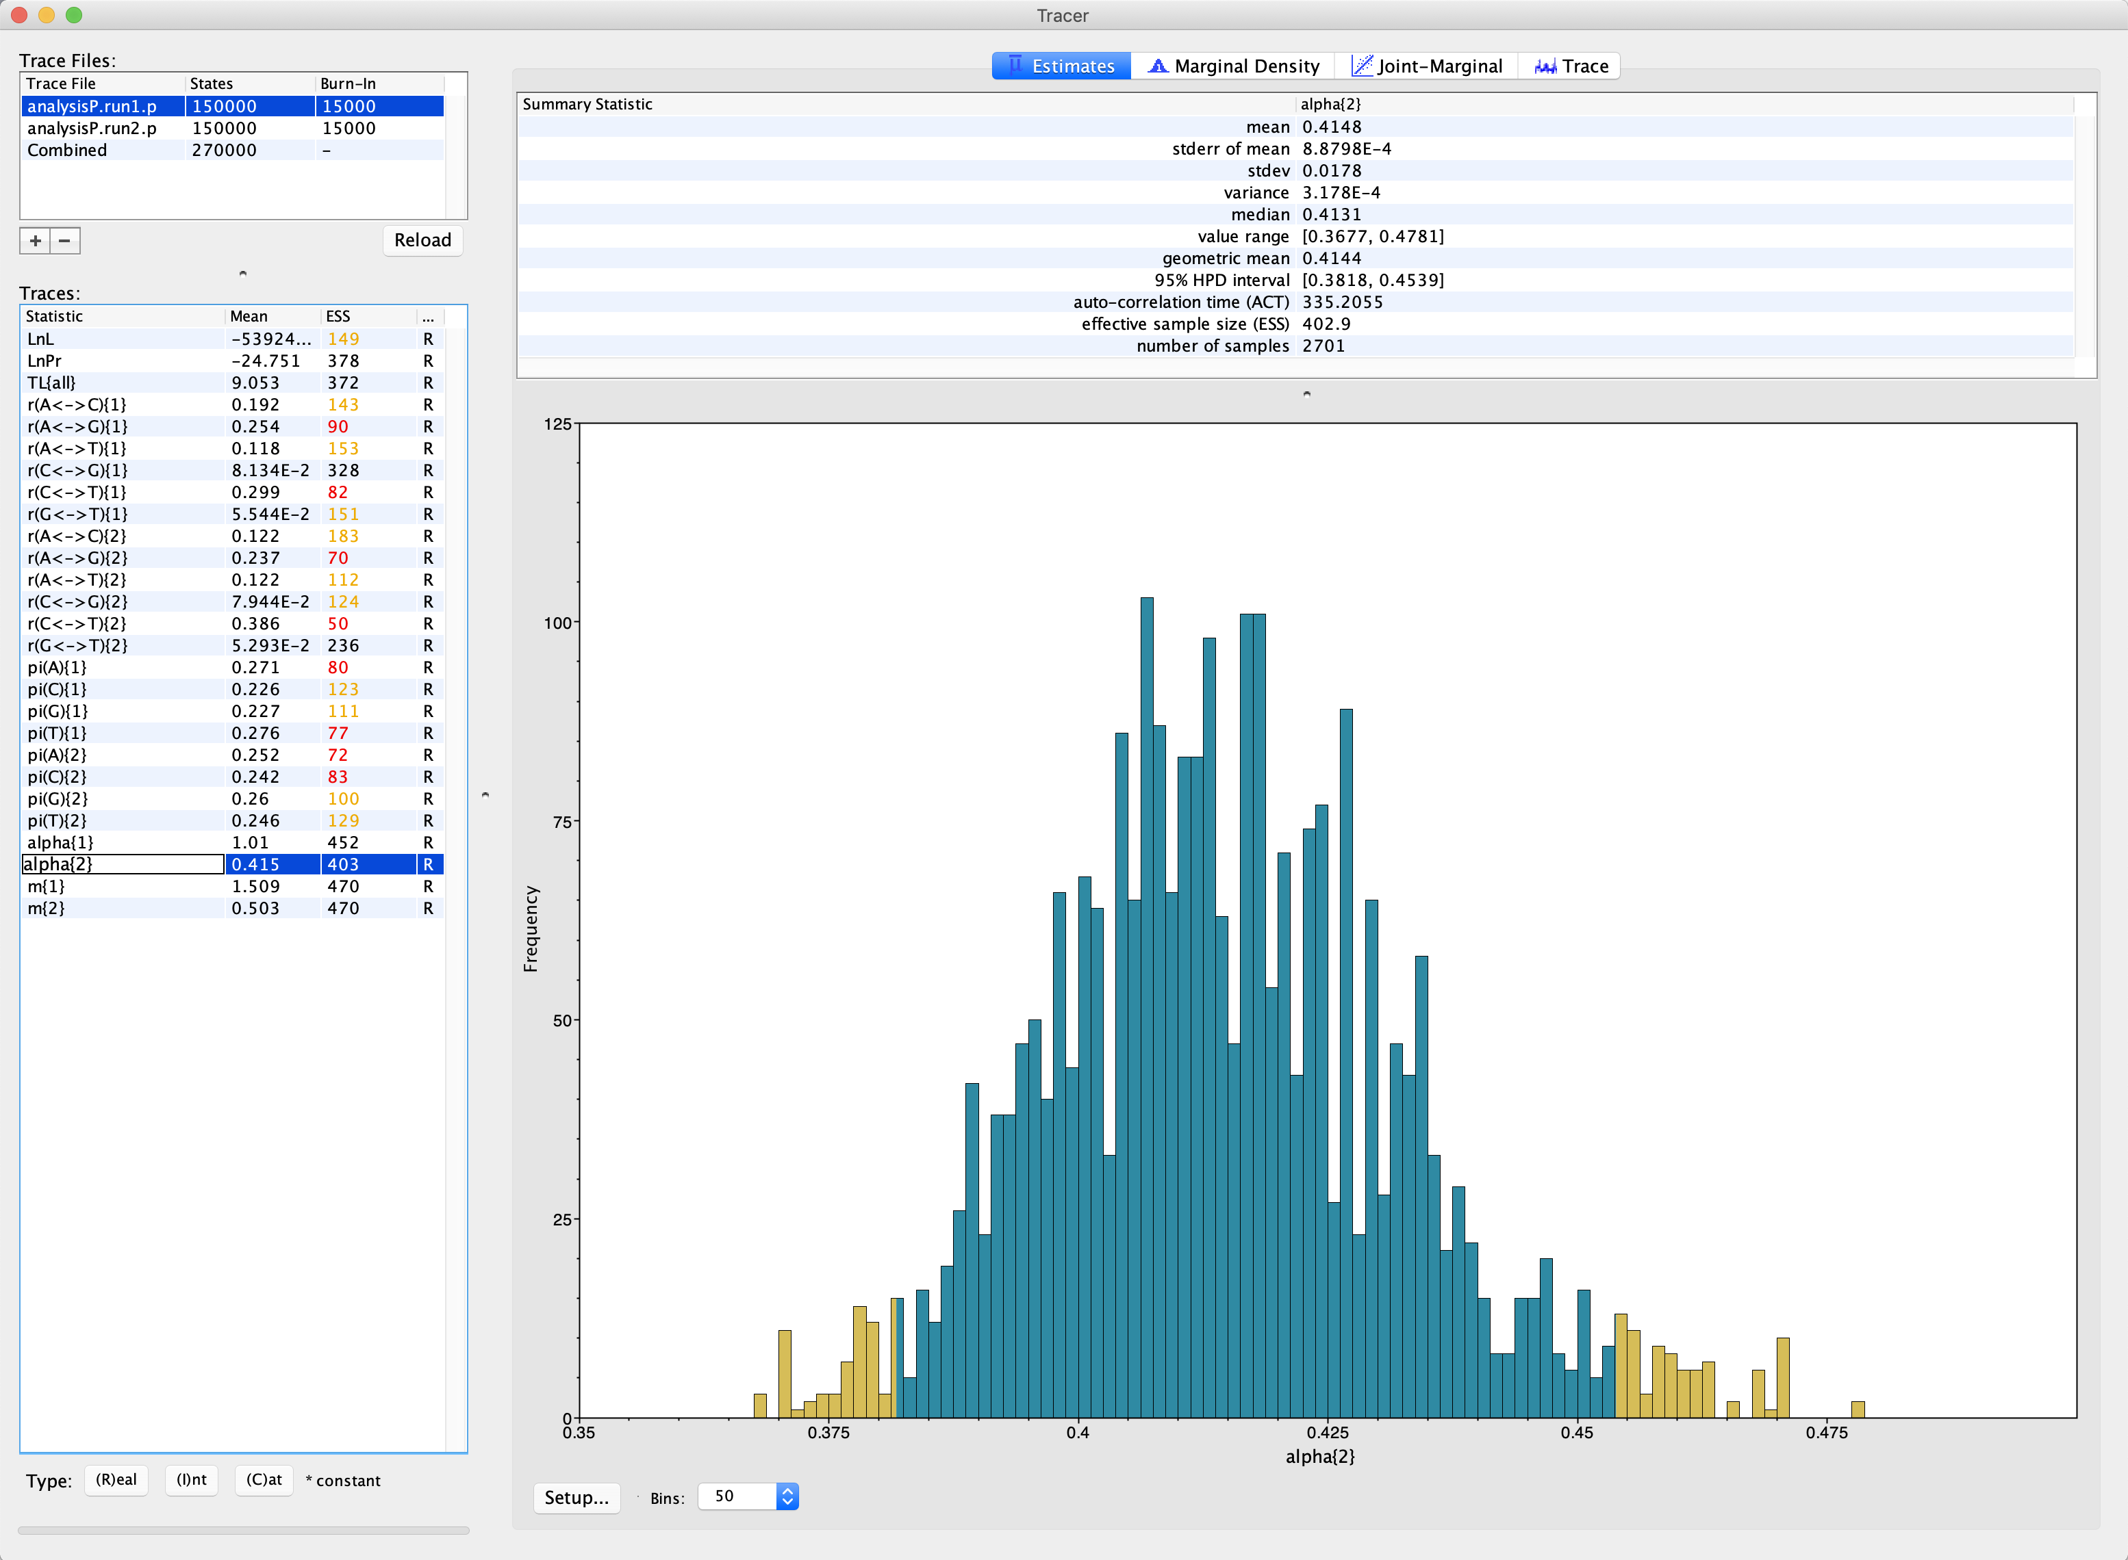
Histogram of shape parameter for extein partition

Slide 11
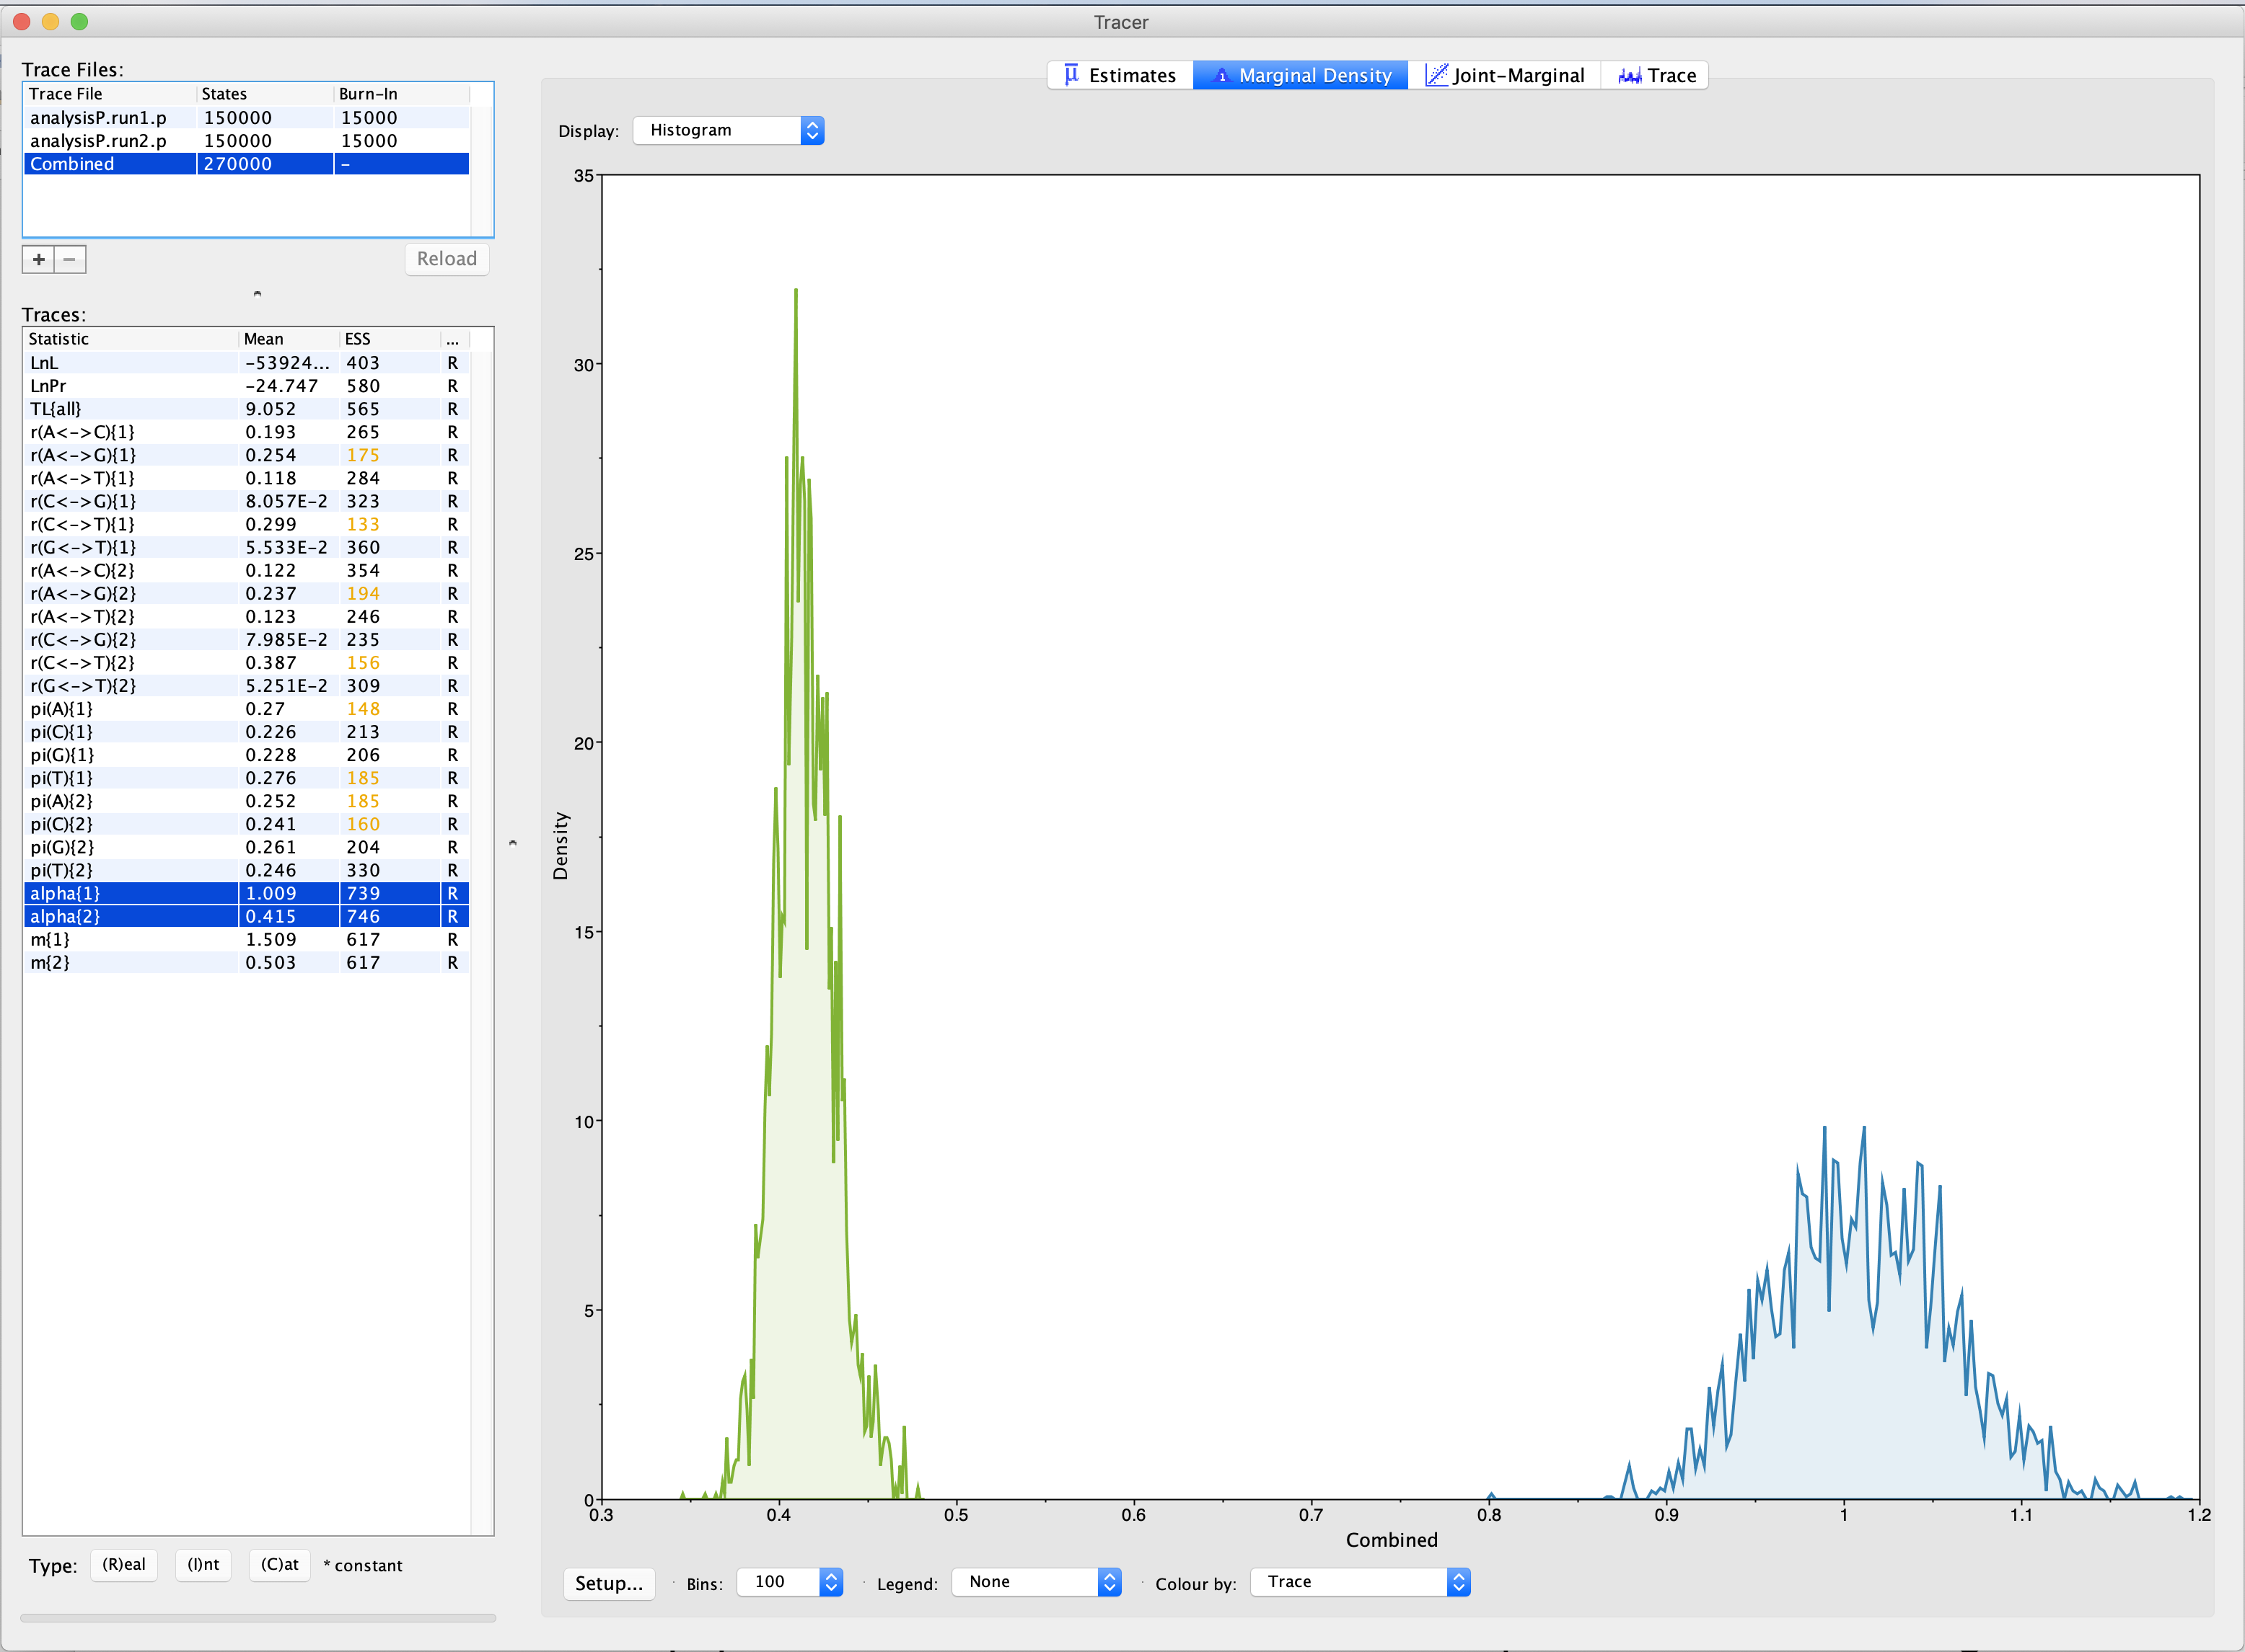
Histogram of shape parameters both partitions

Slide 12
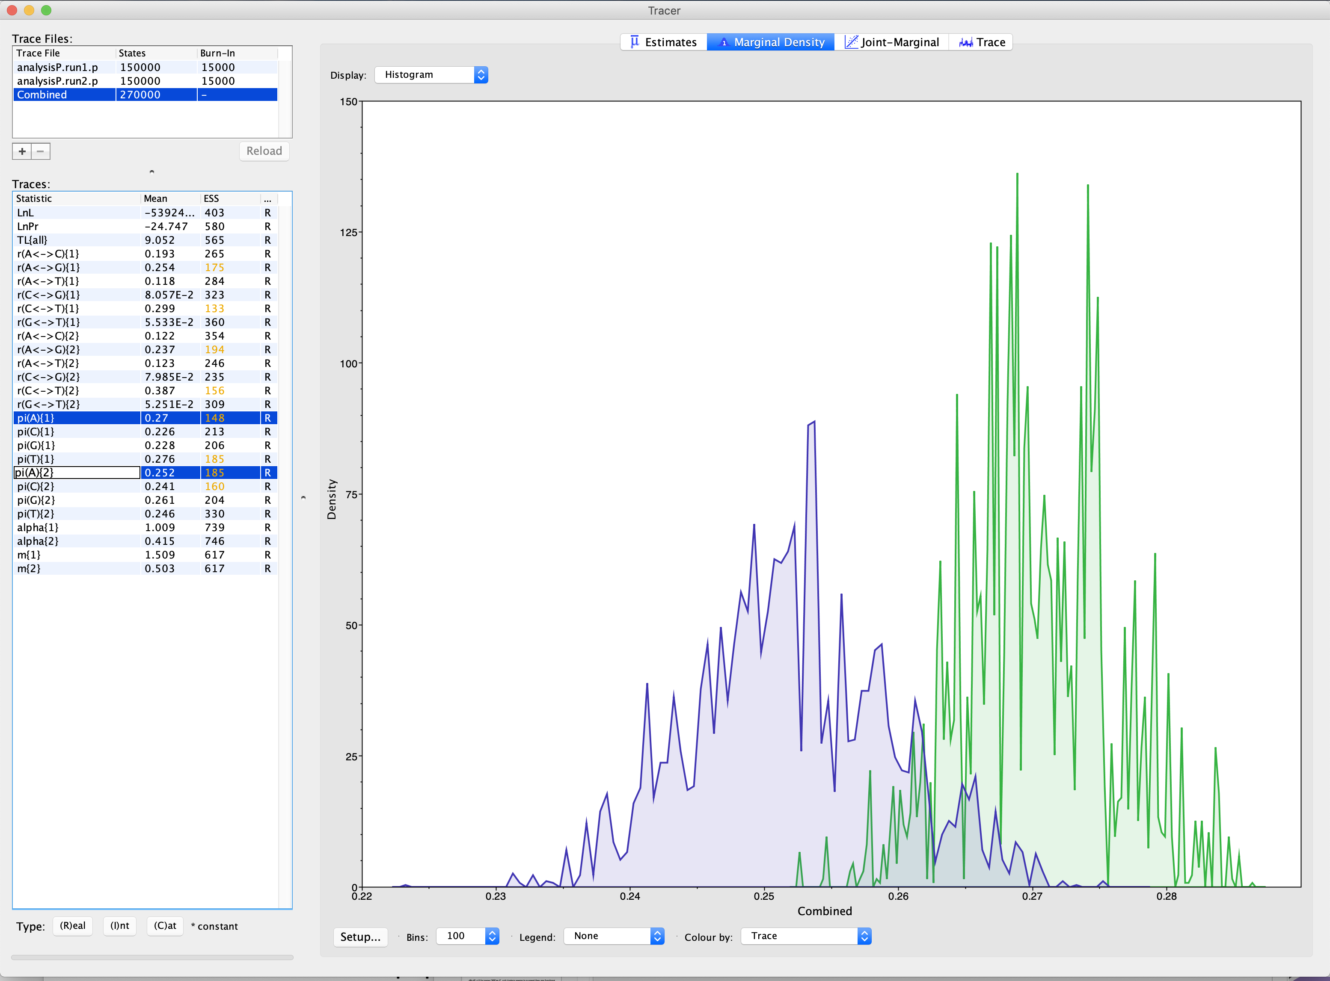
Stationary estimates for A frequency

Slide 13
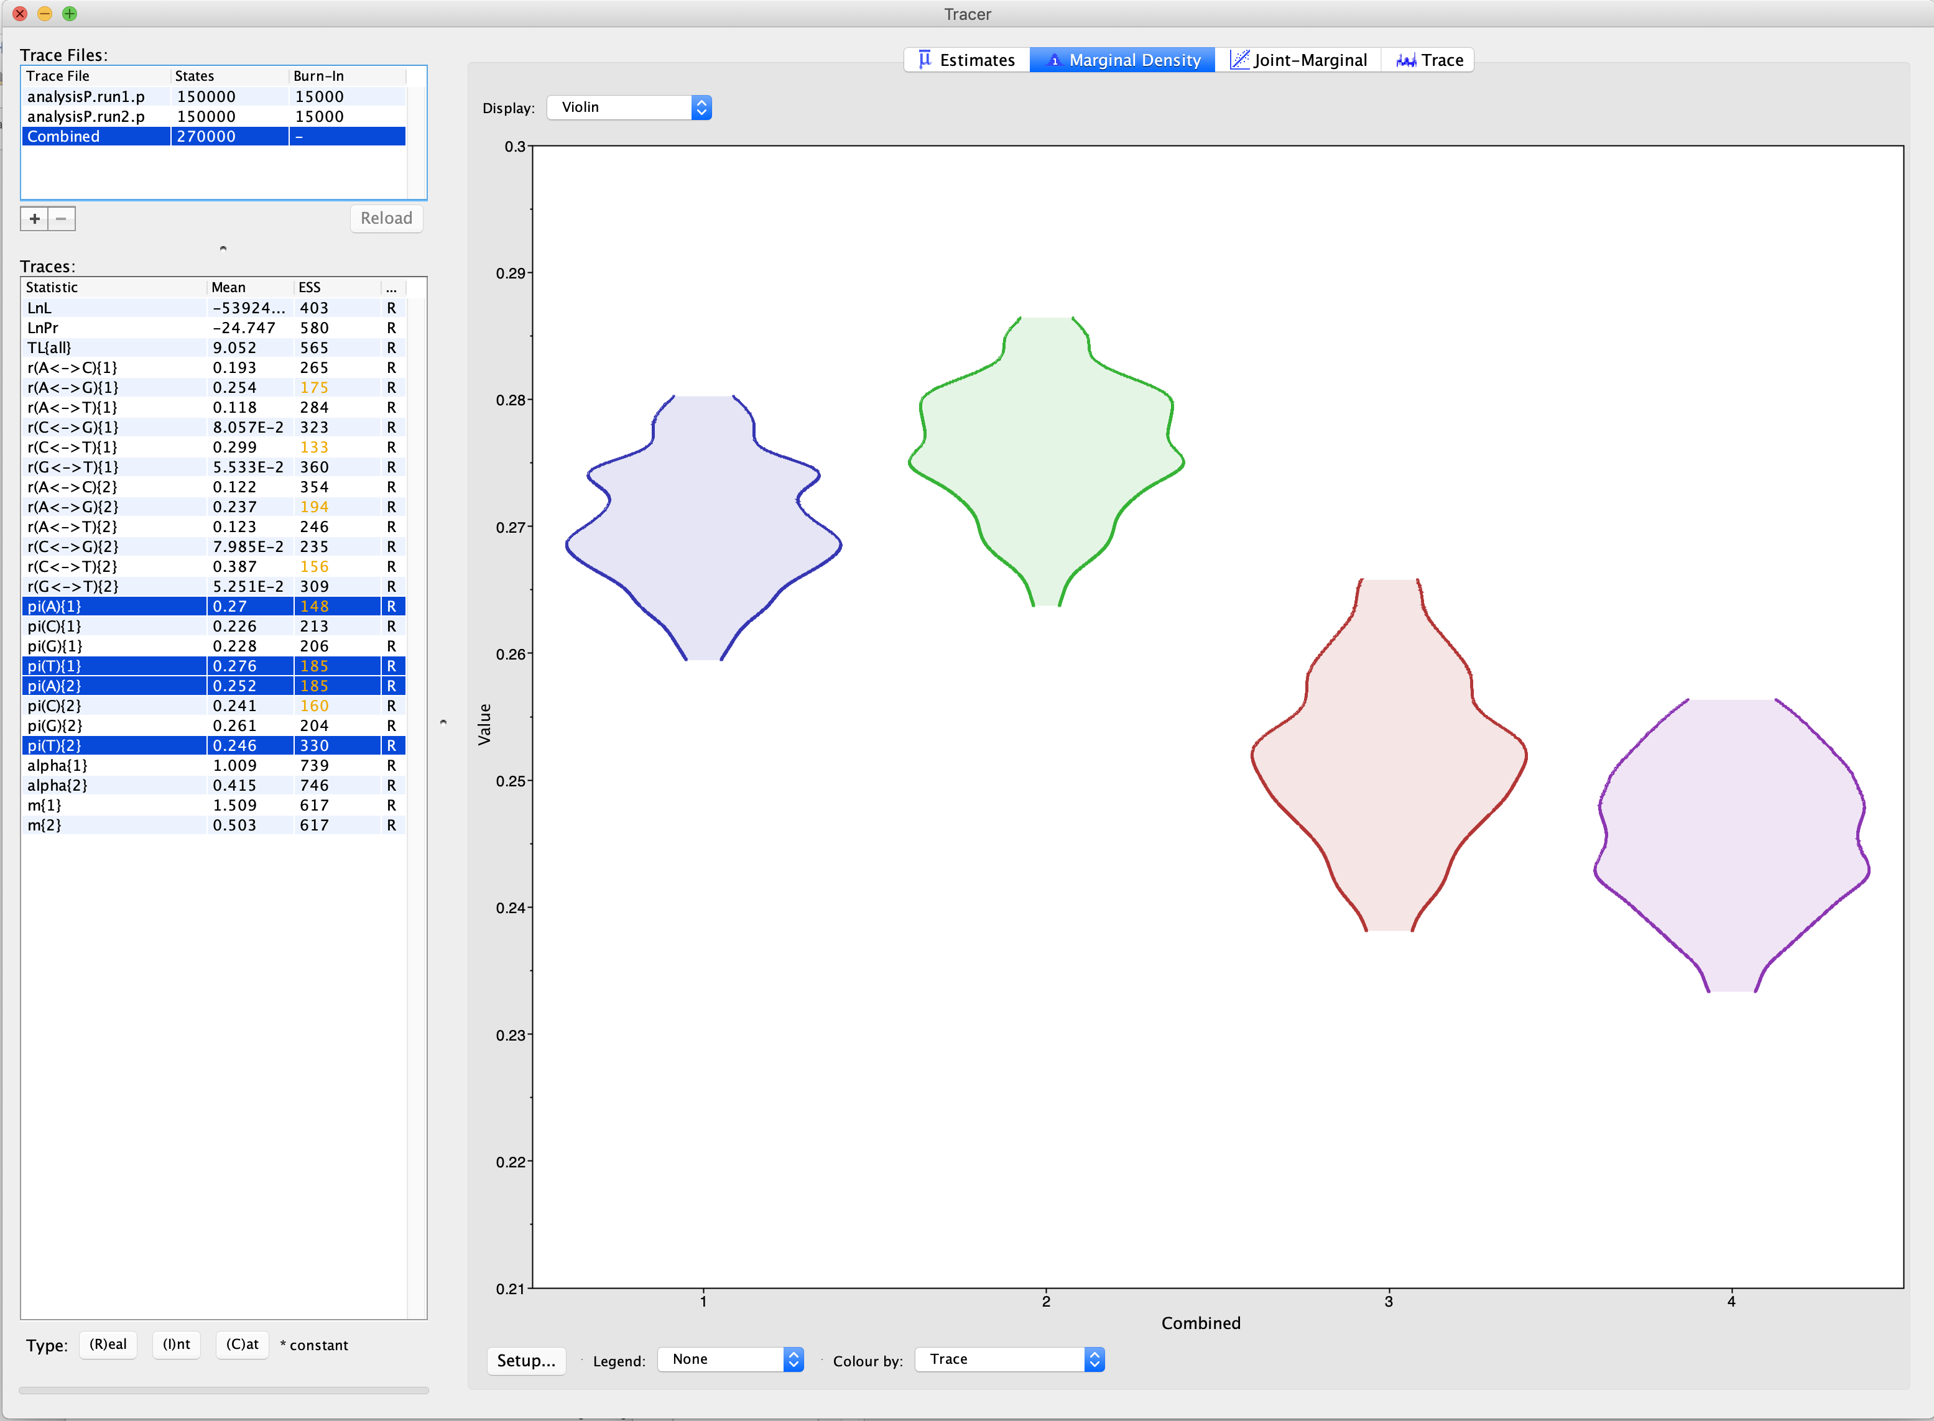
Stationary estimates for A and T frequency

Slide 14
Estimated Omega value per codon along vma-1 gen in yeasts
Extein: start - 285 and 895 - end
Intein: 286 - 895

Slide 15
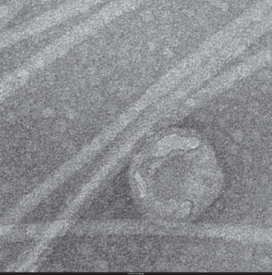
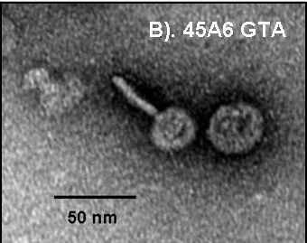
GTA
Genetic transfer Agents

Slide 16
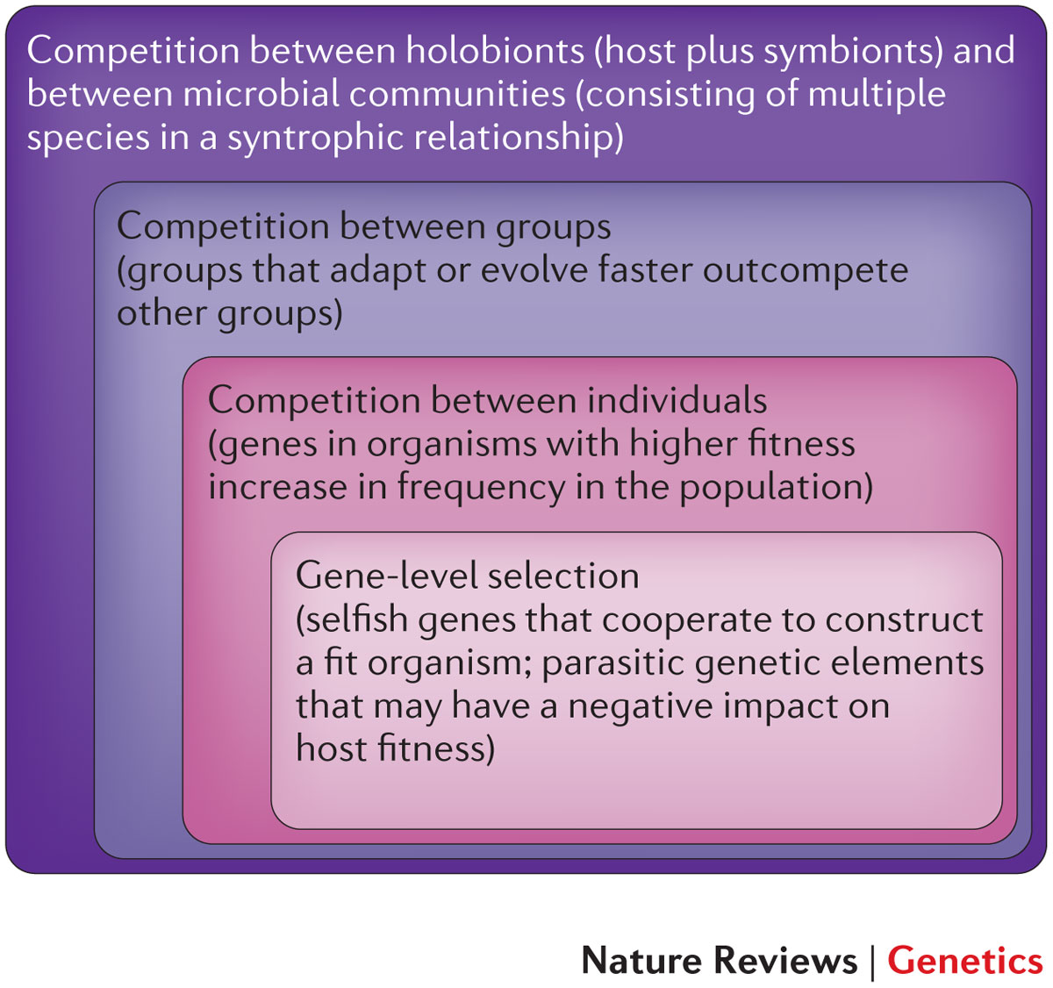
Figure 2: Nested levels of selection on gene content.
From: https://www.nature.com/articles/nrg3962 doi: 10.1038/nrg3962

Slide 17
Rhodobacter capsulatus
GTA discovered in 1974
Resemble prophage (see next slide)
Regulated quorum sensing system
RcGTA like gene clusters shown in many
α-proteobacteria, interpreted to suggest vertical transmission began around the time of the split of the groups of proteobacteria.

Slide 18
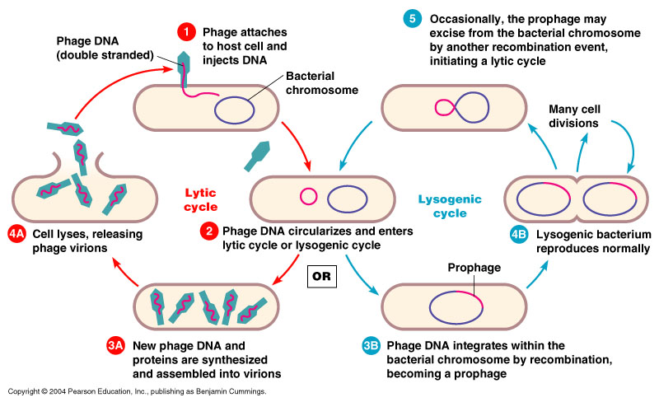
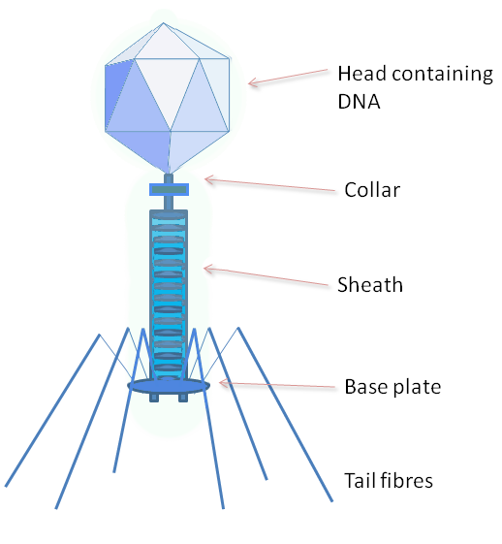
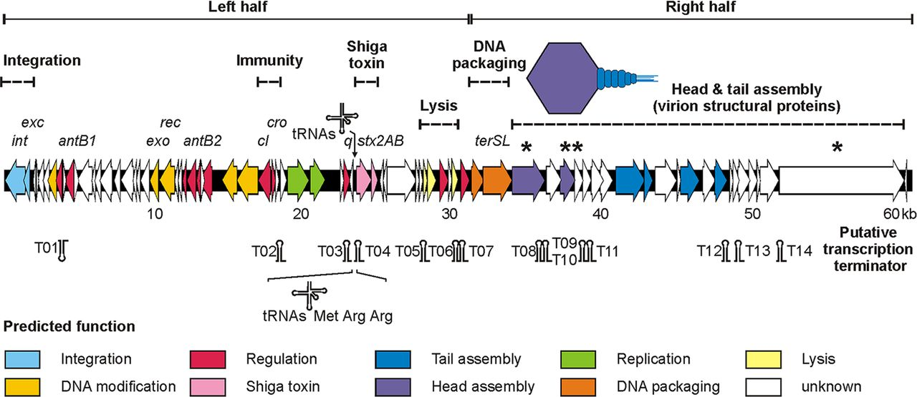
Lysogenic Phages
Lambdoid phage P13374
Beutin L et al. J. Virol. 2012;86:10444-10455
Notes:
A typical lambdoid phage has 2 stages

Slide 19
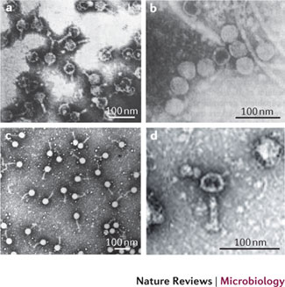
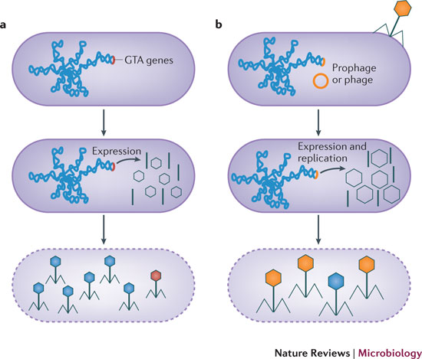
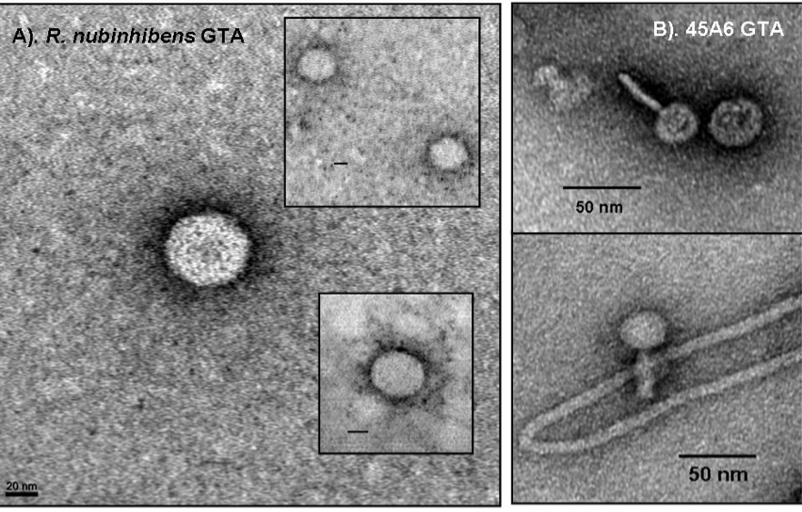
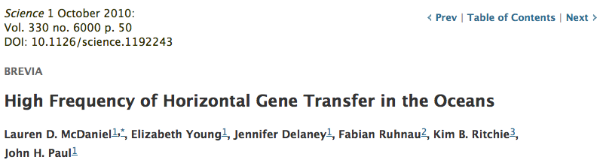
„Promiscuous little bastards...“ J. Paul
GTAs smaller capsids pack more often host DNA than their own genes
GTA
Phage
Lang AS, Zhaxybayeva O, Beatty JT. Nat Rev Microbiol. 2012 Jun 11;10(7):472-82
Lang AS, Zhaxybayeva O, Beatty JT. Nat Rev Microbiol. 2012 Jun 11;10(7):472-82
Notes:
GTA do not pack full complement of genes; it has been suggested GTAs are being produced via a process of productive infection
Phage-like particles that transfer random host genome sequences in a similar process to general transduction
Have been identified in Roseobacter sp., Rhodobacter capsulatus, Bartonella spp., Desulfovibrio desulfuricans, Methanococcus voltae, Brachyspira hyodysenteriae
Thought to be major players in horizontal gene transfers occurring in marine microbial communities
a | The genes encoding the gene transfer agent (GTA) particles are located on the host chromosome, and their expression leads to the production of GTA particles (black). GTA genes have never been found to excise from the genome as part of GTA production. Random DNA segments from the producing cell are packaged in the particles (blue particle heads), and only the occasional particle contains GTA genes (red particle head). For all genetically characterized GTAs, the amount of DNA packaged is insufficient to encode the phage-like structure (as indicated by the small heads). It is presumed that GTAs require lysis (dashed line) for release from cells. b | In the production of transducing phages, phage or prophage genes within the host genome are expressed, resulting in the production of phage particles (black) and replication of the phage genome (not shown). Packaging of the complete phage genome then occurs (orange phage heads), with occasional packaging of non-phage DNA (blue phage head). Note that this is an oversimplification and some transducing phage particles can contain both phage and cellular genomic DNA. Tailed phage structures require lysis to be released from cells.

Slide 20
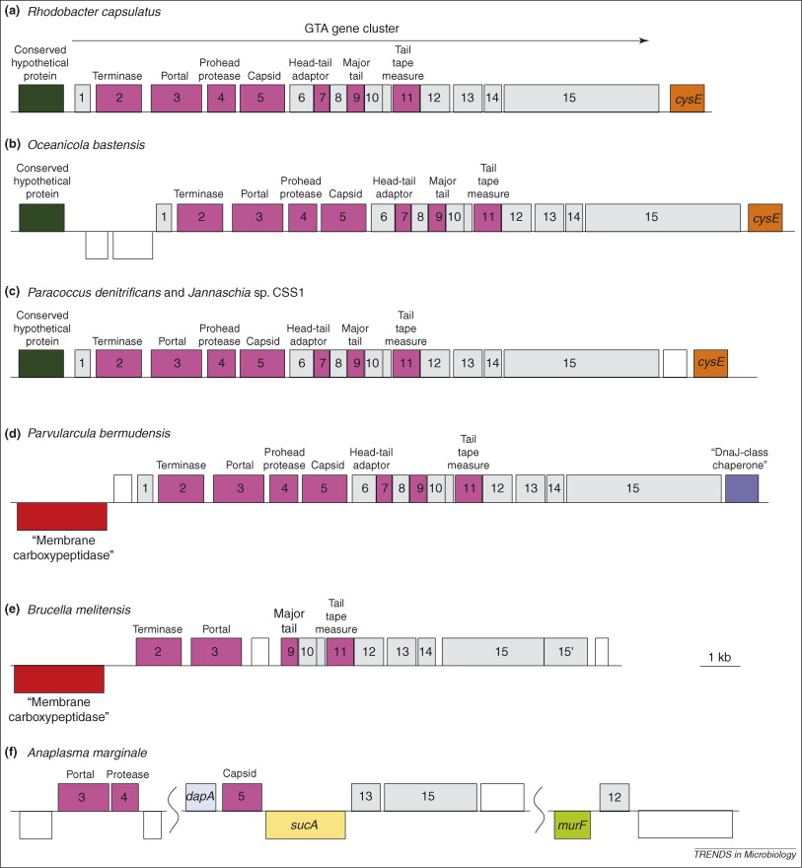
GTA Origin and Evolution
The conserved gene neighborhoods suggests vertical inheritance in α-proteobacterial lineages
Lang, A.S. & Beatty, J.T. Trends in Microbiology , Vol.15, No.2 , 2006
Notes:
Syntenic arrangement is valid only for Rhodobacterales
Widespread presence of RcGTA clusters, pattern of RcGTA-gene like distribution in these species and the results of phylogenetic analyses in these species suggest a prokaryotic ancestor of all alpha-proteobacteria contained RcGTA-like genes.

Slide 21
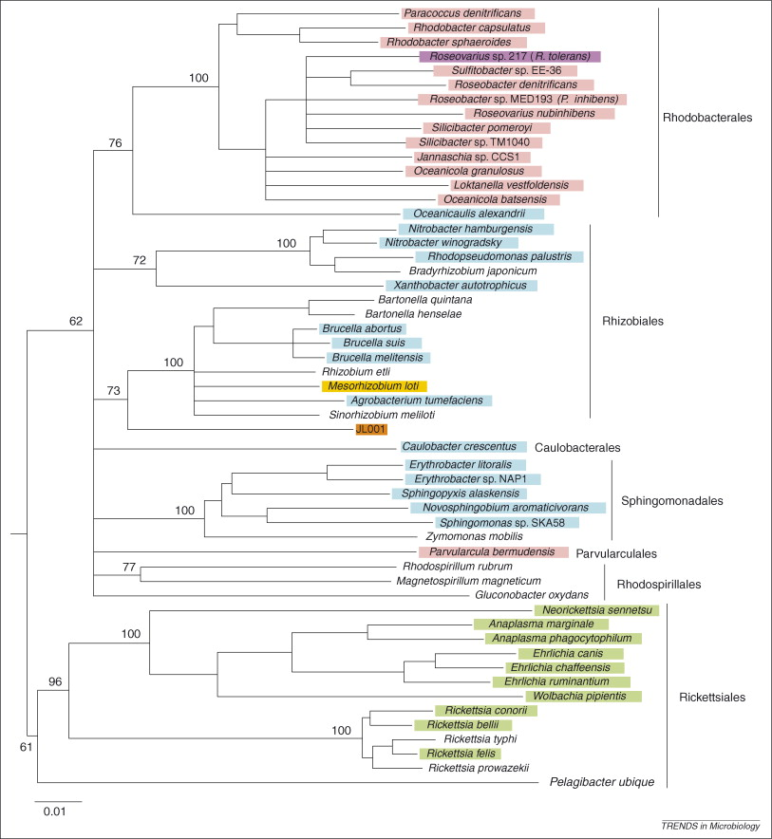
GTA Origin and Evolution
Widespread presence of RcGTA-like gene clusters in many α-proteobacterial species was suggested to argue for the origin from an GTA ancestor
16S rRNA
no GTA-like genes.
GTA-like genes in prophage gene cluster
complete syntenic GTA-like clusters
>1 GTA-like gene
Lang, A.S. & Beatty, J.T. Trends in Microbiology , Vol.15, No.2 , 2006
Notes:
Widespread presence of RcGTA clusters, pattern of RcGTA-gene like distribution in these species and the results of phylogenetic analyses in these species suggest a prokaryotic ancestor of all alpha-proteobacteria contained RcGTA-like genes.

Slide 22
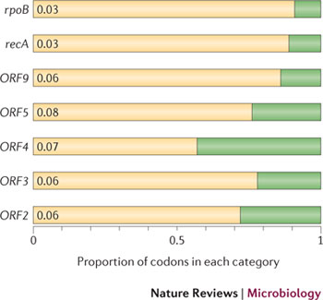
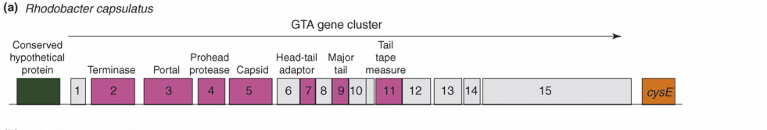
Purifying selection in GTA genes
dN/dS <1 for GTA genes has been used to infer selection for function
GTA genes
Lang AS, Zhaxybayeva O, Beatty JT. Nat Rev Microbiol. 2012 Jun 11;10(7):472-82
Lang, A.S. & Beatty, J.T. Trends in Microbiology , Vol.15, No.2 , 2006
Notes:
The ratio of non-synonymous-to-synonymous (dN/dS, or ω) codon substitution rates can be used as an indication of the selective pressure acting on a protein-coding gene. If a gene (or gene segment) is under purifying selection, non-synonymous mutations (that is, mutations resulting in a change of the encoded amino acid) will be selected against, resulting in ω < 1. In neutrally evolving proteins, synonymous and non-synonymous mutations will be fixed at approximately the same rate, resulting in ω = 1. Because different regions of a protein-coding gene may be under different selective constraints, codons can be divided into two categories: those with ω < 1 (yellow; the estimated ω is indicated on the bar) and those with ω fixed to 1 (green); the estimated proportion of codons in each category is given on the horizontal axis.

Slide 23
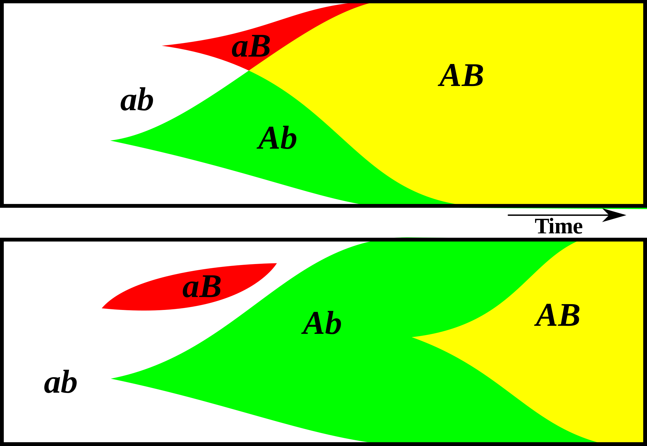
Gene Transfer, Sex, and Recombination:
Inventions do not need to be made sequentially
Gene transfer, followed by homologous or non-homologous recombination, allows inventions to be shared across the tree of life

Slide 24
GTA- cells can invade GTA populations, the reverse is only possible (Panel B), if GTA+ cells can restrict the benefits of recombination to GTA+ cells.
From Soucy and Redfield (2018)
10.3389/fmicb.2018.02527
Notes:
Effects of competition. All runs used α = 1.5 and high-high regulation. Note the exponential scale of the Y-axis. (A,B) eff. = 1.0. (A) a large GTA⁺ population being invaded by control GTA⁺ cells (orange) and by GTA⁻ cells that can (dark green) or cannot (light green) recombine. (B) a large GTA⁻ population being invaded by control GTA⁻ cells (green) and by GTA⁺ cells that can (light orange) or cannot (dark orange) sequester recombination. (C,D) Like (A,B) but with eff. = 0.2.

Slide 25
GTAs cannot survive as selfish genetic elements, because
GTAs are too small to encode all GTA genes
The GTA+ cell dies upon release of the GTAs
At best on GTA- cell (that has a mutation in its GTA can be converted to GTA+.
Recombination is beneficial to a group, because it prevents slightly deleterious mutations to be fixed along site beneficial ones, and it allows beneficial mutations that occurred in different cells to come together in a lineage. However, GTAs do not represent a evolutionary stable strategy.
GTA- cells can invade GTA+ population (the never lyse themselves, and the reap the benefits of recombination).
GTA+ cells can only invade a GTA- population, if the GTA+ cells manage somehow to restrict recombination to other GTA+ cells.
Why are GTAs around?
GTAs just represent decaying phages … But they are under purifying selection (however, see below).
The gene transfer they catalyze has some other benefits, Rosie Redfield (here) discusses the possibility that they might help transfer immunity against phages. (Can this be an evolutionary stable strategy?)

Slide 26
Purifying selection in E.coli ORFans
dN-dS < 0 for some ORFan E. coli clusters seems to suggest they are functional genes.
Gene groups | Number | dN-dS>0 | dN-dS<0 | dN-dS=0
E. coli ORFan clusters | 3773 | 944 (25%) | 1953 (52%) | 876 (23%)
Clusters of E.coli sequences found in Salmonella sp., Citrobacter sp. | 610 | 104 (17%) | 423(69%) | 83 (14%)
Clusters of E.coli sequences found in some Enterobacteriaceae only | 373 | 8 (2%) | 365 (98%) | 0 (0%)
Adapted after Yu, G. and Stoltzfus, A. Genome Biol Evol (2012) Vol. 4 1176-1187

Slide 27
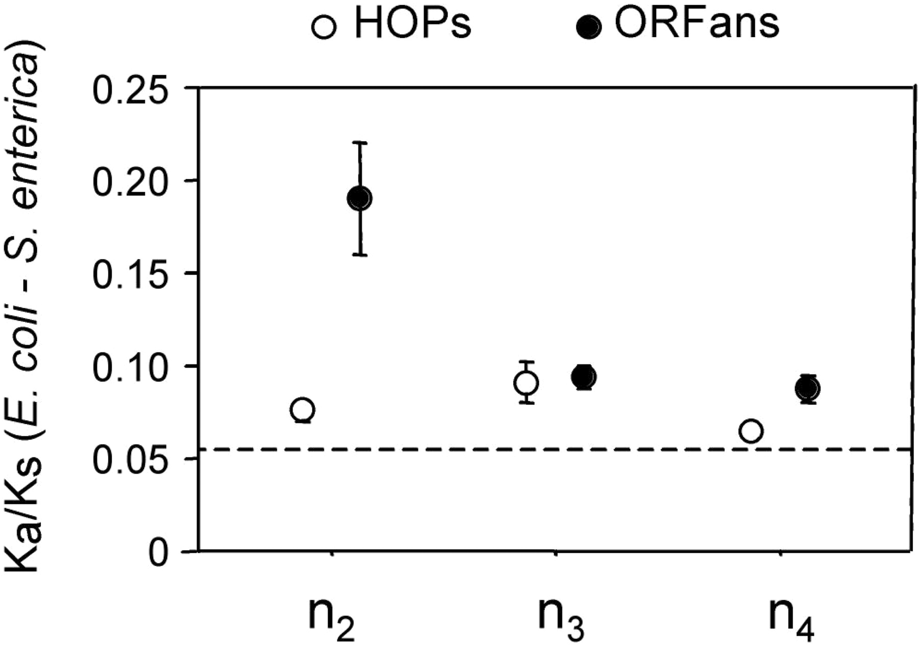
Vincent Daubin and Howard Ochman: Bacterial Genomes as New Gene Homes: The Genealogy of ORFans in E. coli. Genome Research 14:1036-1042, 2004
The ratio of non-synonymous to synonymous substitutions for genes found only in the E.coli - Salmonella clade is lower than 1, but larger than for more widely distributed genes.
Increasing phylogenetic depth
Fig. 3 from Vincent Daubin and Howard Ochman, Genome Research 14:1036-1042, 2004

Slide 28

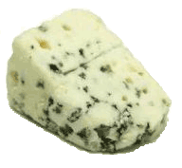
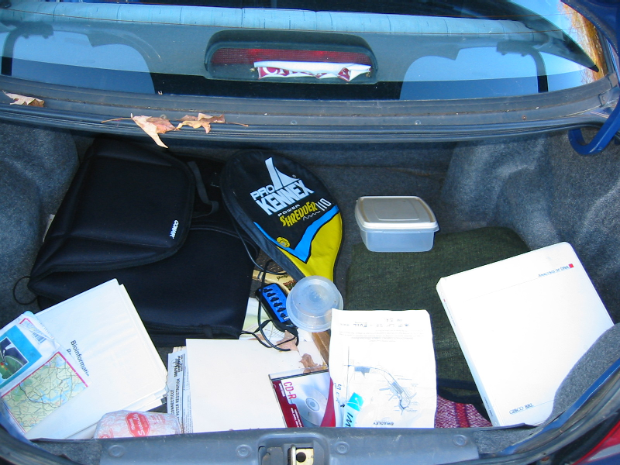
Trunk-of-my-car analogy: Hardly anything in there is the is the result of providing a selective advantage. Some items are removed quickly (purifying selection), some are useful under some conditions, but most things do not alter the fitness. See here for a published version.
Could some of the inferred purifying selection be due to the acquisition of novel detrimental characteristics (e.g., protein toxicity, HOPELESS MONSTERS)?

Slide 29
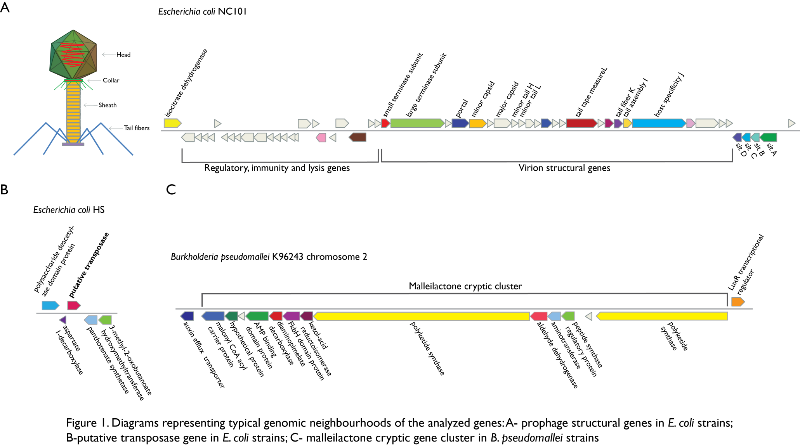
Vertically Inherited Genes Not Expressed for Function

Slide 30
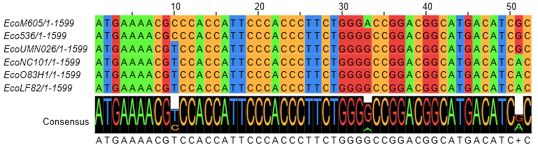
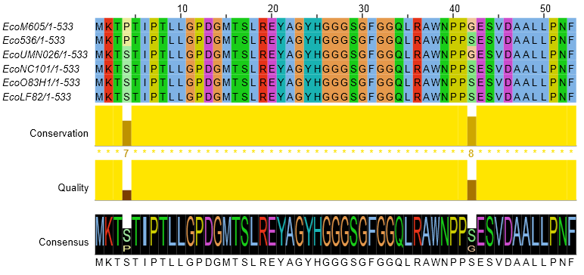
Counting Algorithm
Calculate number of different nucleotides/amino acids per MSA column (X)
Calculate number of nucleotides/amino acids substitutions (X-1)
Calculate number of synonymous changes
S=(N-1)nc-N
assuming N=(N-1)aa
X=2 1 nucleotide substitution
1 non-synonymous change
X=2 1 amino acid substitution

Slide 31
Simulation Algorithm
Calculate MSA nucleotide frequencies (%A,%T,%G,%C)
Introduce a given number of random substitutions ( at any position) based on inferred base frequencies
Compare translated mutated codon with the initial translated codon and count synonymous and non-synonymous substitutions

Slide 32
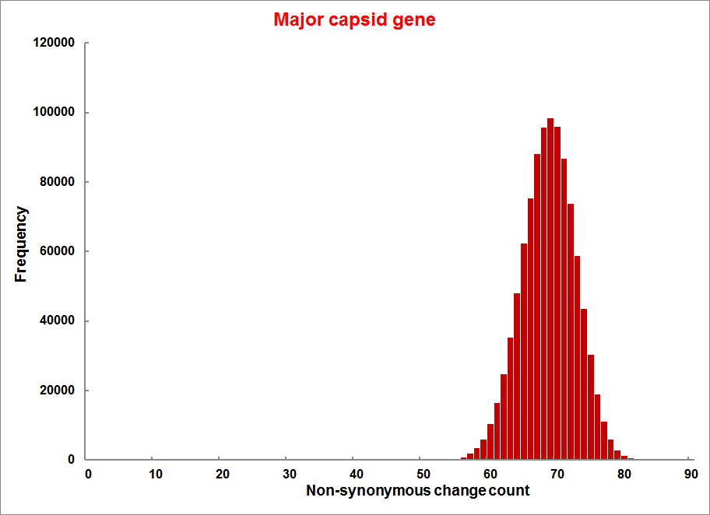
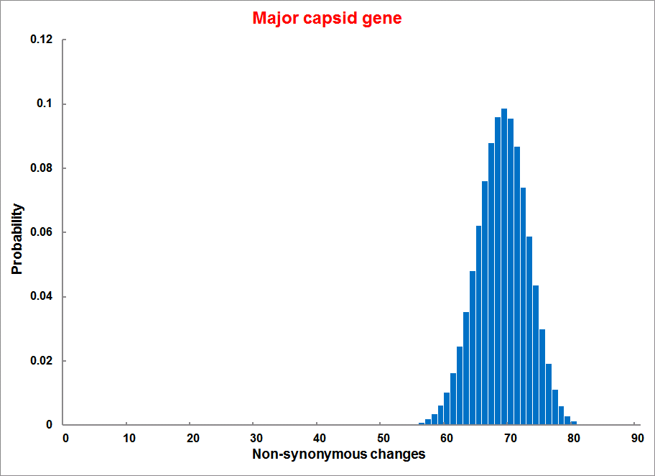
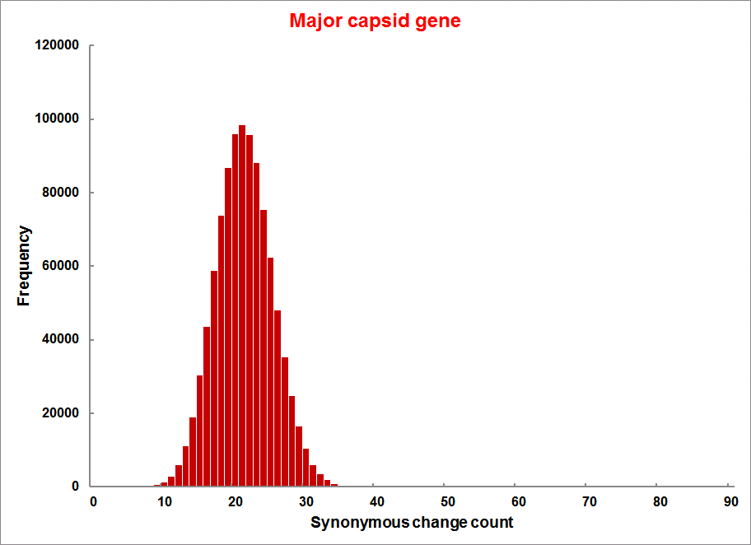
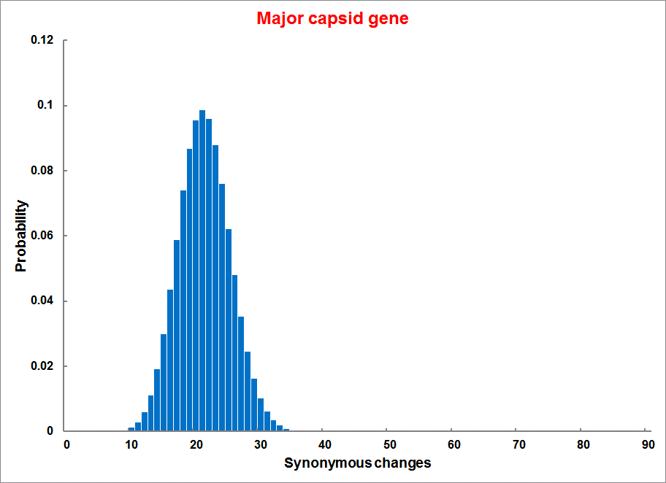
Evolution of Coding DNA Sequences Under a Neutral Model
E. coli Prophage Genes
Count distribution from simulations
Probability distribution
n=90
Non-synonymous
n= 90
k= 24
p=0.763
P(≤24)=3.63E-23
Observed=24
P(≤24) < 10⁻⁶
n=90
Synonymous
n= 90
k= 66
p=0.2365
P(≥66)=3.22E-23
Observed=66
P(≥66) < 10⁻⁶

Slide 33
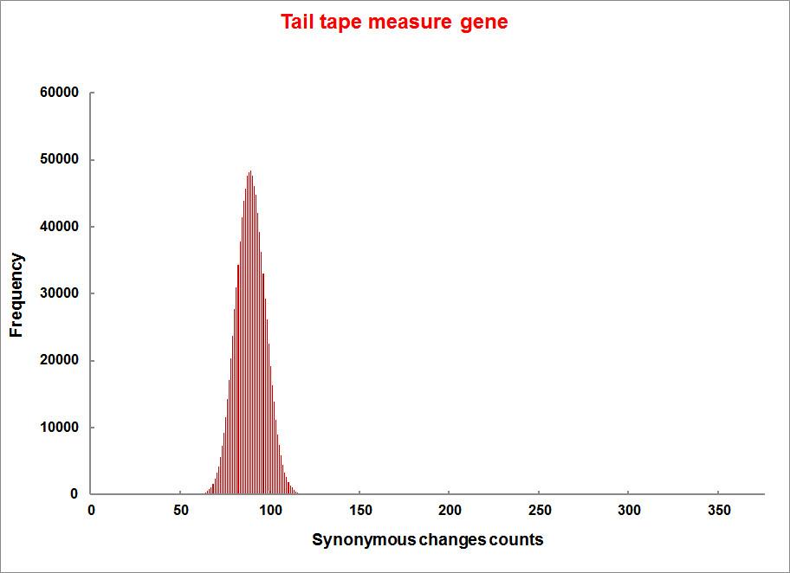
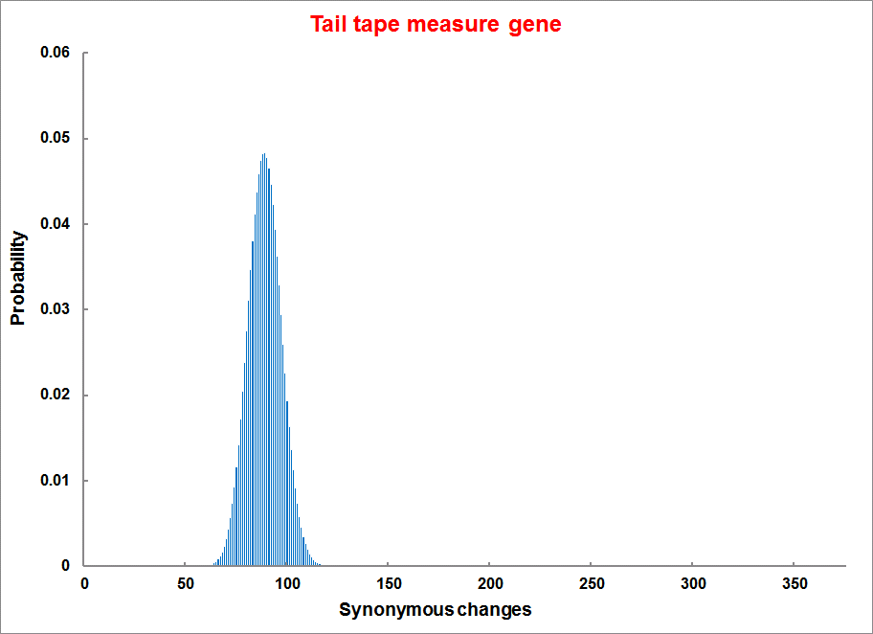
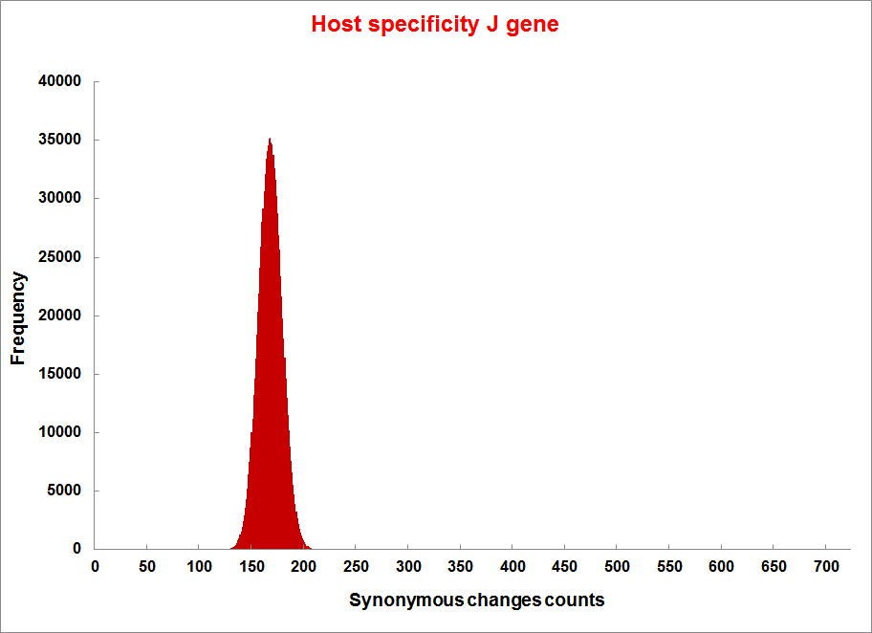
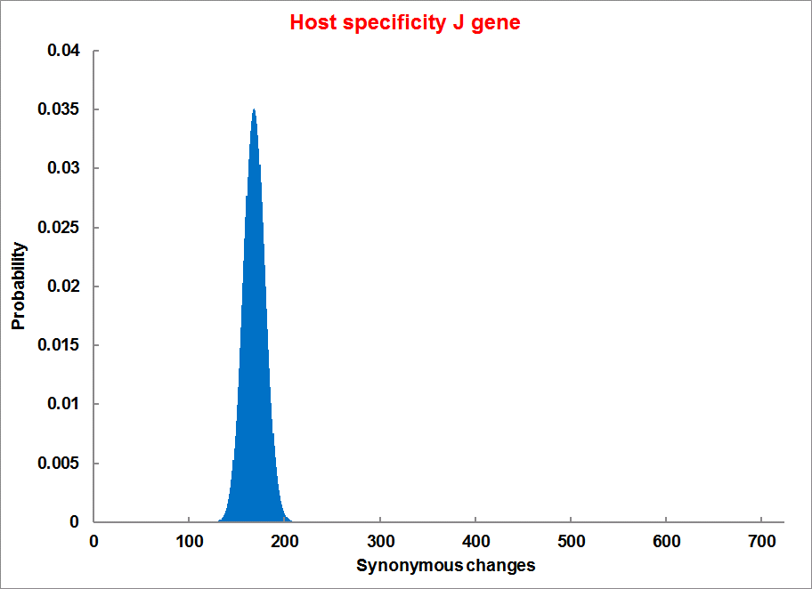
Evolution of Coding DNA Sequences Under a Neutral Model
E. coli Prophage Genes
Count distribution
Probability distribution
n=375
Synonymous
n= 375
k= 243
p=0.237
P(≥243)=7.92E-64
Observed=243
P(≥243) < 10⁻⁶
n=723
Synonymous
n= 723
k= 498
p=0.232
P(≥498)=6.41E-149
Observed=498
P(≥498) < 10⁻⁶

Slide 34
Trunk-of-my-car analogy from:
Does Sequence Conservation Provide Evidence for Biological Function?
SeilaOmer¹Timothy J.Harlow¹Johann PeterGogarten¹² https://doi.org/10.1016/j.tim.2016.09.010
… another reason for the presence of purifying selection is that mutations may lead to a product whose presence is detrimental (e.g., protein toxicity) to the organism. In the trunk of a car analogy, a piece of cheese left in the trunk will rot, producing an obnoxious smell, which will lead to its removal from the trunk. Similarly, a sack of fertilizer might turn into an explosive, prompting fast elimination. In this case, purifying selection occurs because the gene product after the mutation is detrimental, not because the gene before mutation was beneficial.
Could some of the inferred purifying selection be due to the acquisition of novel detrimental characteristics (e.g., protein toxicity, HOPELESS MONSTERS)?

Slide 35
Evolution of Coding DNA Sequences Under a Neutral Model
E. coli Prophage Genes
 |  | OBSERVED |  | SIMULATED |  | Dnapars | Simulated | Codeml
Gene | Alignment Length (bp) | Substitutions | Synonymous changes* | Substitutions | p-value synonymous (given *) | Minimum number of substitutions | dN/dS | dN/dS
Major capsid | 1023 | 90 | 66 | 90 | 3.23E-23 | 94 | 0.113 | 0.13142
Minor capsid C | 1329 | 81 | 59 | 81 | 1.98E-19 | 84 | 0.124 | 0.17704
Large terminase subunit | 1923 | 75 | 67 | 75 | 7.10E-35 | 82 | 0.035 | 0.03773
Small terminase subunit | 543 | 100 | 66 | 100 | 1.07E-19 | 101 | 0.156 | 0.25147
Portal | 1599 | 55 | 46 | 55 | 1.36E-21 | *64 | 0.057 | 0.08081
Protease | 1329 | 55 | 37 | 55 | 4.64E-11 | 55 | 0.162 | 0.24421
Minor tail H | 2565 | 260 | 168 | 260 | 1.81E-44 | 260 | 0.17 | 0.30928
Minor tail L | 696 | 30 | 26 | 30 | 1.30E-13 | 30 | 0.044 | 0.05004
Host specificity J | 3480 | 723 | 498 | 723 | 6.42E-149 | *773 | 0.137 | 0.17103
Tail fiber K | 741 | 41 | 28 | 41 | 1.06E-09 | 44 | 0.14 | 0.18354
Tail assembly I | 669 | 39 | 33 | 39 | 3.82E-15 | 40 | 0.064 | 0.07987
Tail tape measure protein | 2577 | 375 | 243 | 375 | 7.92E-64 | 378 | 0.169 | 0.27957
Values well under the p=0.01 threshold, suggesting rejection of the null hypothesis of neutral evolution of prophage sequences.

Slide 36
Evolution of Coding DNA Sequences Under a Neutral Model
B. pseudomallei Cryptic Malleilactone Operon Genes and
E. coli transposase sequences
 |  | OBSERVED |  | SIMULATED
Gene | Alignment Length (bp) | Substitutions | Synonymous changes* | Substitutions | p-value synonymous (given *)
Aldehyde dehydrogenase | 1544 | 13 | 3 | 13 | 4.67E-04
AMP- binding protein | 1865 | 9 | 6 | 9 | 1.68E-02
Adenosylmethionine-8-amino-7-oxononanoate aminotransferase | 1421 | 20 | 12 | 20 | 6.78E-04
Fatty-acid CoA ligase | 1859 | 13 | 2 | 13 | 8.71E-01
Diaminopimelate decarboxylase | 1388 | 7 | 3 | 7 | 6.63E-01
Malonyl CoA-acyl transacylase | 899 | 2 | 1 | 2 | 4.36E-01
FkbH domain protein | 1481 | 17 | 9 | 17 | 2.05E-02
Hypothethical protein | 431 | 3 | 2 | 3 | 1.47E-01
Ketol-acid reductoisomerase | 1091 | 2 | 0 | 2 | 1.00E+00
Peptide synthase regulatory protein | 1079 | 10 | 5 | 10 | 8.91E-02
Polyketide-peptide synthase | 12479 | 135 | 66 | 135 | 4.35E-27
 |  | OBSERVED |  | SIMULATED
Gene | Alignment Length (bp) | Substitutions | Synonymous changes* | Substitutions | p-value synonymous (given *)
Putative transposase | 903 | 175 | 107 | 175 | 1.15E-29

Slide 37
Other ways to detect positive selection
Selective sweeps -> fewer alleles present in population
(see contributions from archaic Humans for example)
Repeated episodes of positive selection -> high dN
(works well for repeated positive – aka diversifying – selection; e.g. virus interaction with the immunesystem)

Slide 38
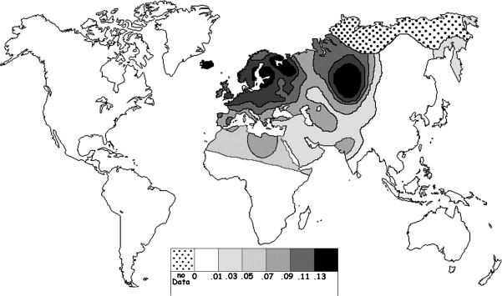
Fig. 1 Current world-wide frequency distribution of CCR5-Δ32 allele frequencies. Only the frequencies of Native populations have been evidenced in Americas, Asia, Africa and Oceania. Map redrawn and modified principally from <ce:cross-ref refid="bib5"> B...
Eric Faure , Manuela Royer-Carenzi
Is the European spatial distribution of the HIV-1-resistant CCR5-Δ32 allele formed by a breakdown of the pathocenosis due to the historical Roman expansion?
Infection, Genetics and Evolution, Volume 8, Issue 6, 2008, 864 - 874
http://dx.doi.org/10.1016/j.meegid.2008.08.007

Slide 39
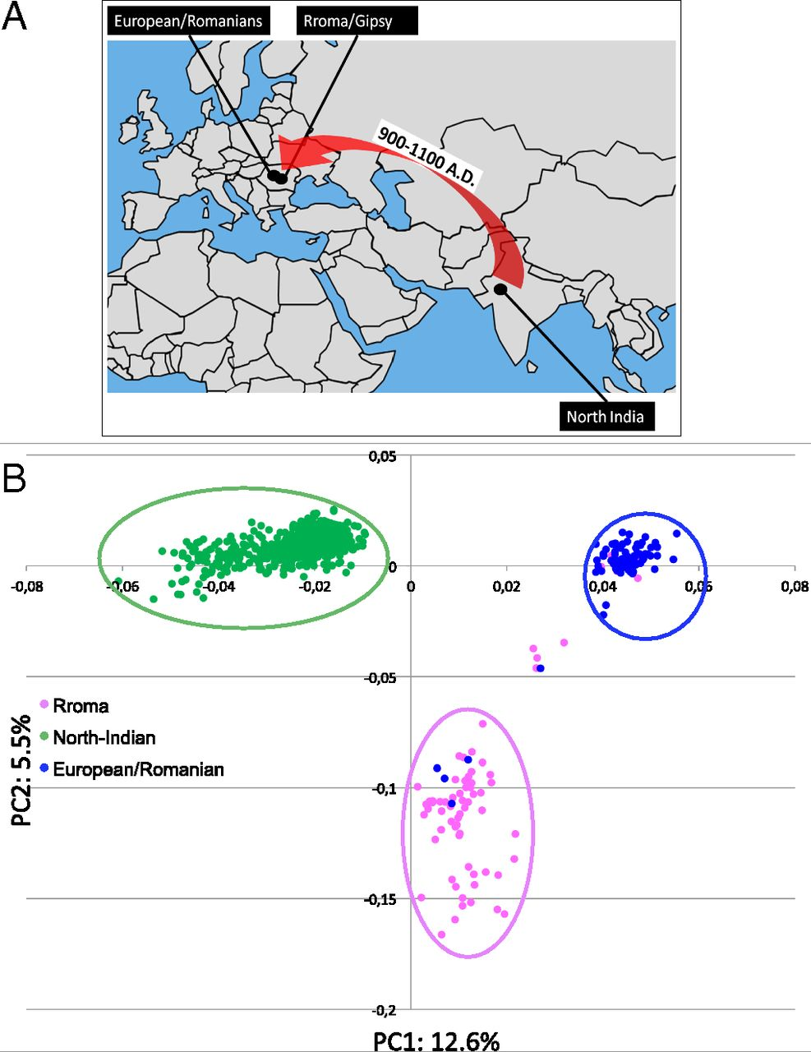
Geographic origin of the three populations studied.
196,524 SNPs
-> PCA
Hafid Laayouni et al. PNAS 2014;111:2668-2673
©2014 by National Academy of Sciences
Notes:
Geographic origin of the three populations studied. (A) European/Romanians and Rroma/Gipsy share the same location, even if the origin of the latter is in North India. (B) Plot of the populations under analysis according to the coordinates to the two main eigenvectors of smartpca (Eigensoft) analysis, in which each dot represents an individual. Individuals within the circles and the same color have been considered for the study; those of different colors represent false population allocation and those intermediate represent admixed individuals. ROM, nongypsy Romanians; INDI, individuals from North India; GYP, Rroma/Gypsies living in Romania.

Slide 40
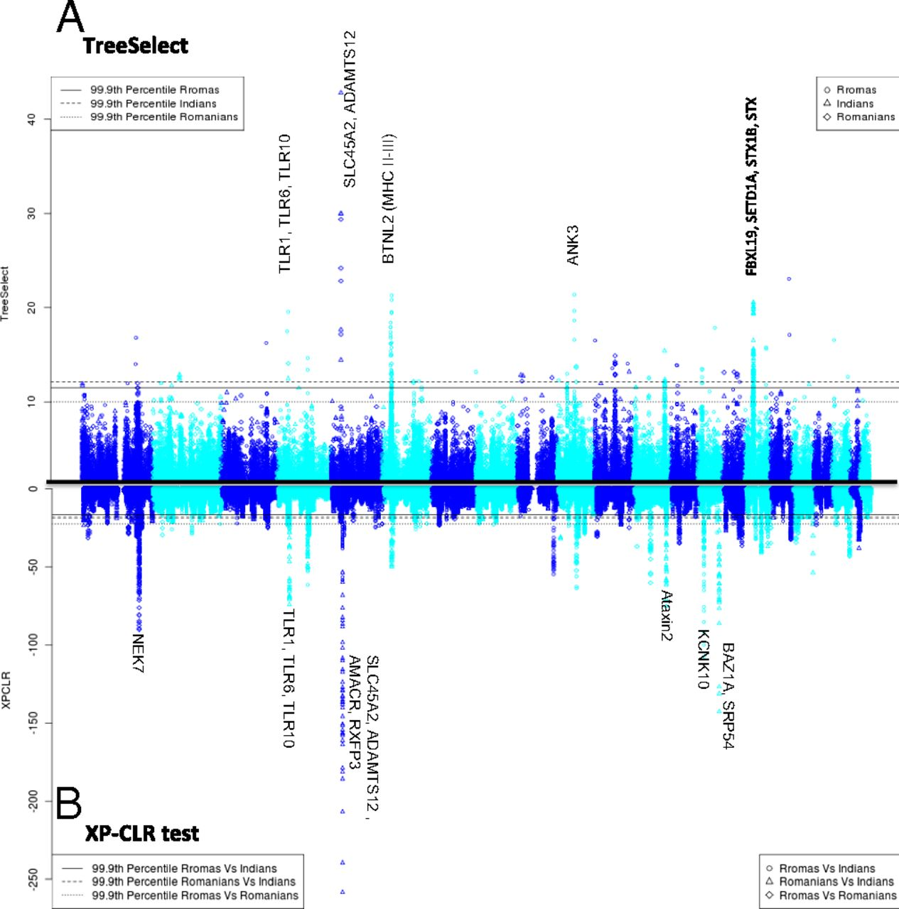
Manhattan plot of results of selection tests in Rroma, Romanians, and Indians using TreeSelect statistic (A) and XP-CLR statistic (B).
SNP frequencies within and between populations
selective sweeps detected through linkage disequilibrium
Laayouni H et al. PNAS 2014;111:2668-2673
Convergent evolution in European and Rroma populations reveals pressure exerted by plague on Toll-like receptors.
©2014 by National Academy of Sciences
Notes:
Manhattan plot of results of selection tests in Rroma, Romanians, and Indians using TreeSelect statistic (A) and XP-CLR statistic (B). Chromosomes ordered from chromosome 1 to chromosome 22.

Slide 41
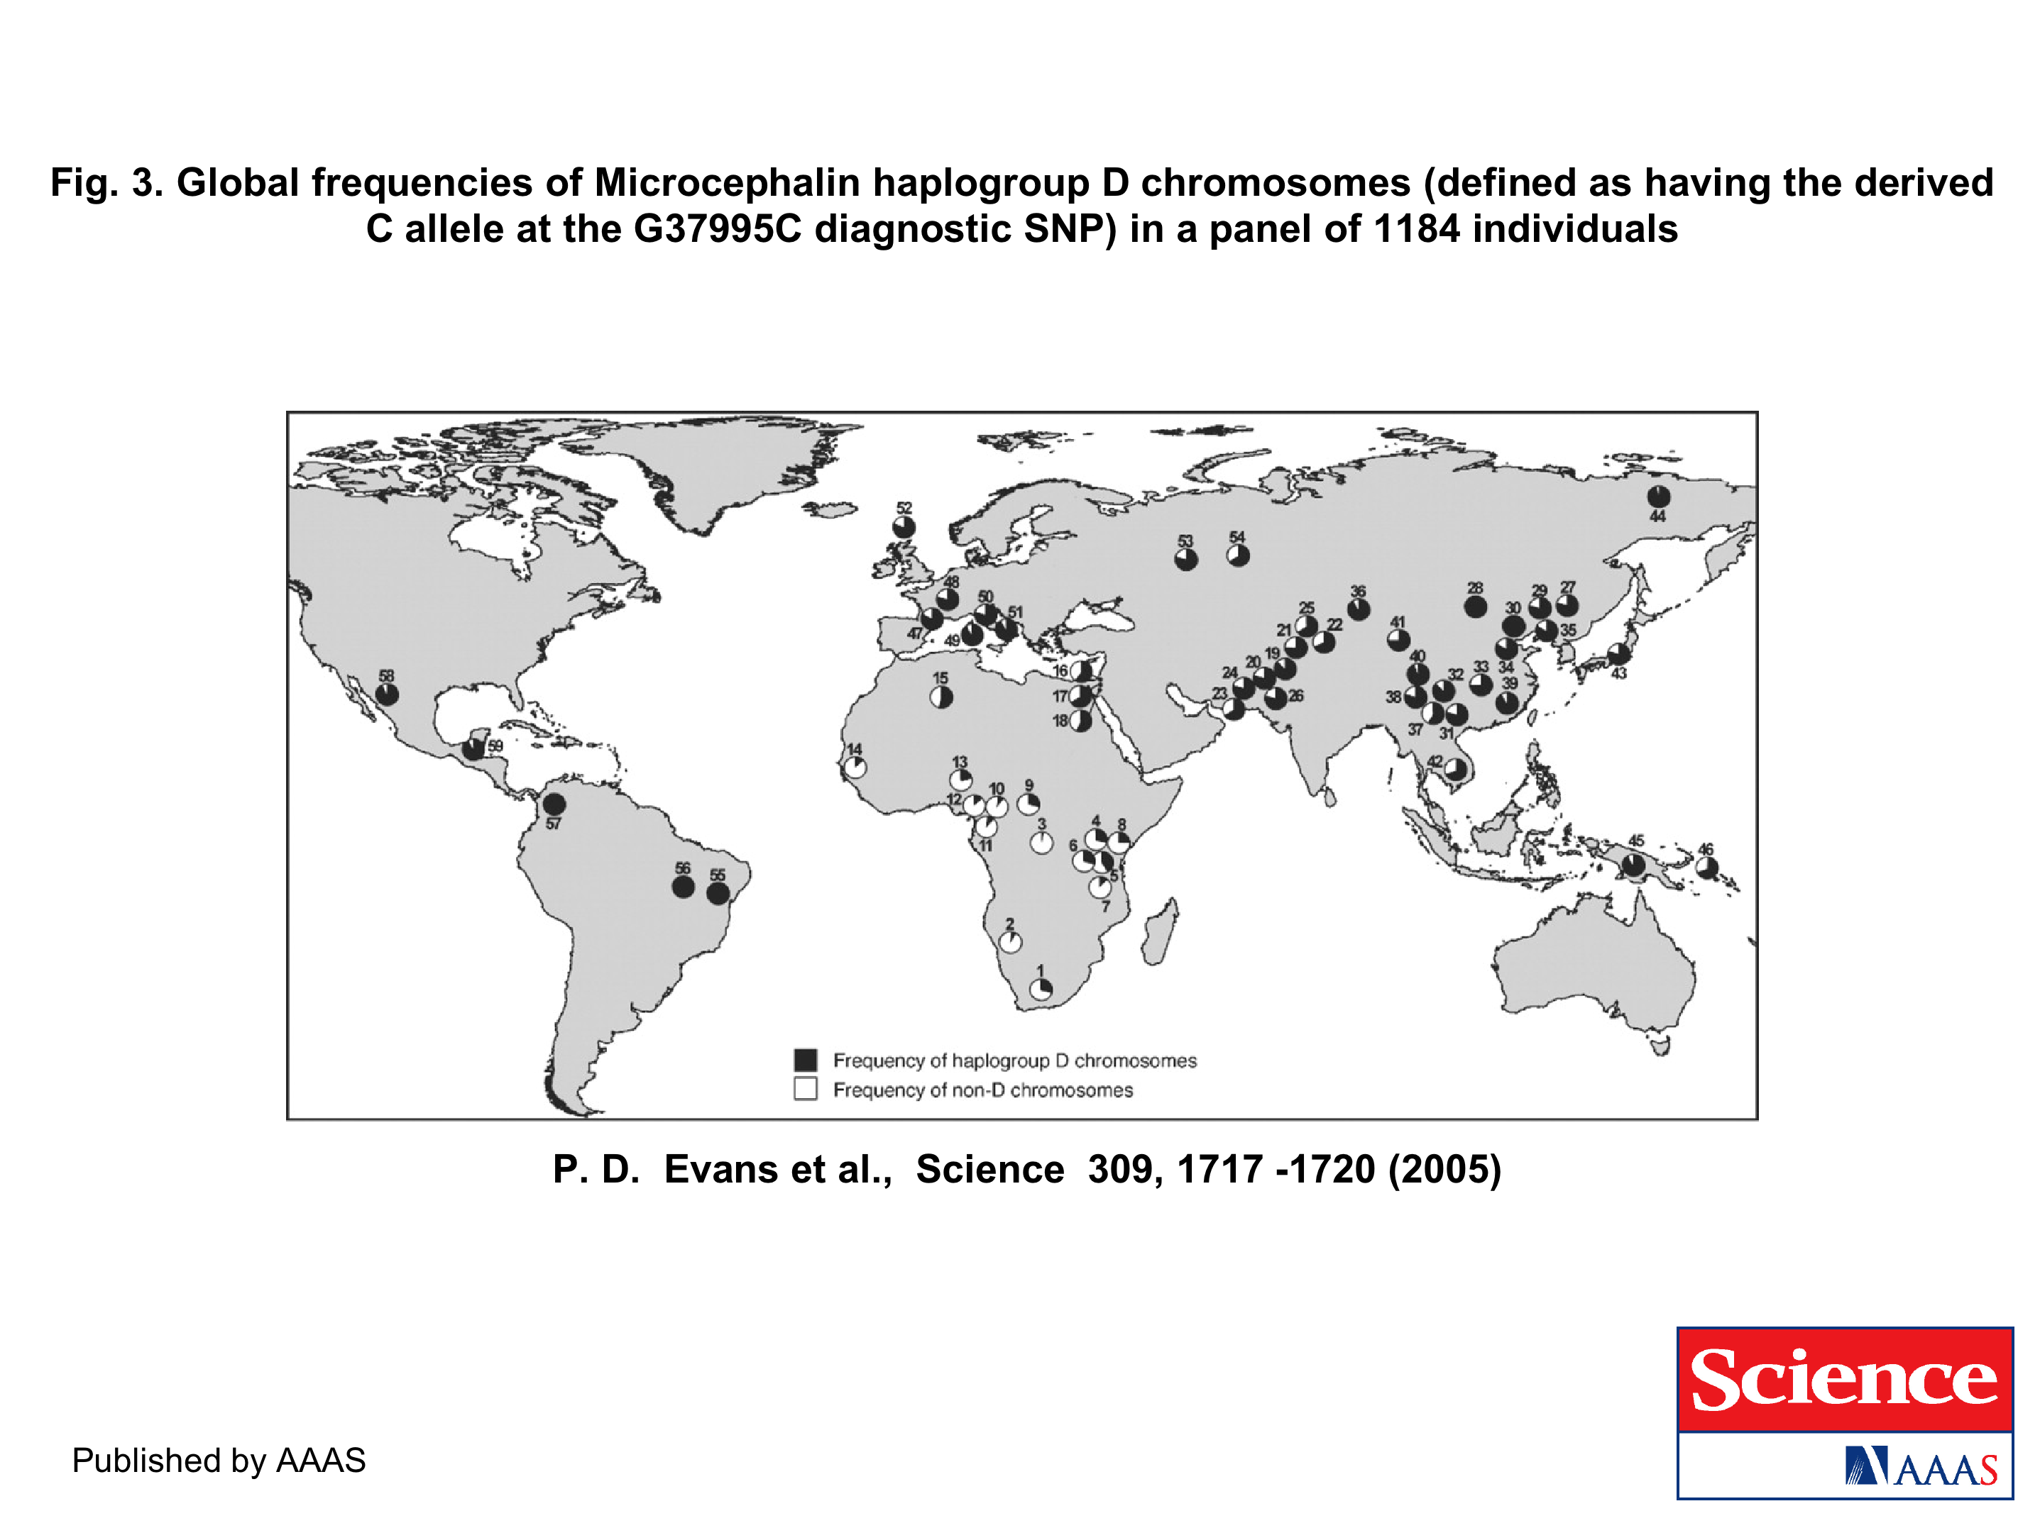
The age of haplogroup D was found to be ~37,000 years

Slide 42
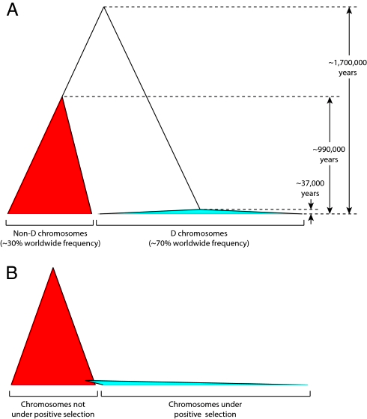
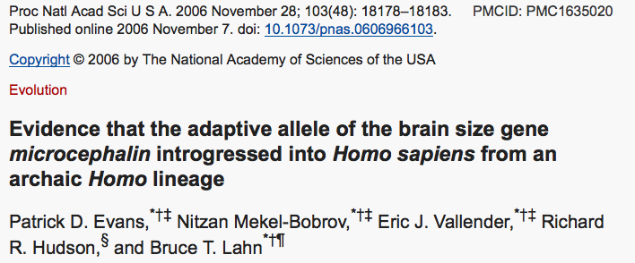

Slide 43
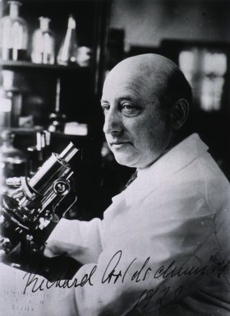


How do you define evolution?
Richard Goldschmidt 1940
hopeful monsters
Mutationism HGT/WGD!
Punctuated Equilibrium
Few genes / large effect
Vilified by Mayr, celebrated 1977 Gould & Evo-devo
Ernst Mayr 1942
NeoDarwinian Synthesis
Natural Selection
Gradualism
Many genes/small effect
Dario – “Fisher right”
Motoo Kimura 1968
Neutral Theory
Genetic Drift is main force for changing allele frequencies
Slide from Chris Pires
Notes:
Goldschmitdt,R. (1940). The Material Basis of Evolution
Mayr, Ernst (1942). Systematics and the origin of species, from the viewpoint of a zoologist

Slide 44

Duplications and Evolution
Ohno postulated that gene duplication plays a major role in evolution
Small scale duplications (SSD)
Whole genome duplications (WGD)
Polyploid: nucleus contains three or more copies of each chromosome
Autopolyploid: formed within a single species
Diploids AA and A’A’ Polyploid AAA’A’
Allopolyploid: formed from more than one species
Diploids AA and BB Polyploid AABB
Susumu Ohno 1970
Evolution by gene duplication
1R and 2R hypothesis
“Junk DNA” 1972
Slide from Chris Pires

Slide 45


e.g. gene duplications in yeast
from Benner et al., 2002
Figure 1. The number of duplicated gene pairs (vertical axis) in the genome of the yeast Saccharomyces cerevisiae versus f₂, a metric that models divergence of silent positions in twofold redundant codon systems via an approach-to-equilibrium kinetic process and therefore acts as a logarithmic scale of the time since the duplications occurred. Recent duplications are represented by bars at the right. Duplications that diverged so long ago that equilibrium at the silent sites has been reached are represented by bars where f₂ 0.55. Noticeable are episodes of gene duplication between the two extremes, including a duplication at f₂ 0.84. This represents the duplication, at ~80 Ma, whereby yeast gained its ability to ferment sugars found in fruits created by angiosperms. Also noticeable are recent duplications of genes that enable yeast to speed DNA synthesis, protein synthesis, and malt degradation, presumably representing yeast's recent interaction with humans.
The chemical pathway that converts glucose to alcohol in yeast arose ~80 Ma, near the time that fermentable fruits became dominant. Gene families that suffered duplication near this time, captured in the episode of gene duplication represented in the histogram in Fig. 1 by bars at f₂ 0.84, are named in red. According to the hypothesis, this pathway became useful to yeast when angiosperms (flowering, fruiting plants) began to provide abundant sources of fermentable sugar in their fruits.

Slide 46
Gene Transfer, Sex, and Recombination:
Inventions do not need to be made sequentially
Gene transfer, followed by homologous or non-homologous recombination, allows inventions to be shared across the tree of life

Slide 47
Aside: Gene and genome duplication versus
Horizontal Gene Transfer
Autochtonous gene/genome
duplication are rare
in prokaryotes
Gene family expansion through horizontal gene transfer –
the most common process in prokaryotes

Slide 48

Horizontal Gene Transfer (HGT) and the
Acquisition of New Capabilities
Most important process to adapt microorganisms to new environments.
E.g.: Antibiotic and heavy metal resistance,
pathways that allow acquisition and breakdown of new substrates.
Creation of new metabolic pathways.
HGT not autochthonous gene duplication is the main
process of gene family expansion in prokaryotes.
Also important in the recent evolution of multicellular eukaryotes
(HGT between fish species and between grasses).
Selection acts on the Holobiont (= Host + Symbionts)
To adapt to new conditions, new symbionts can be acquired, or existing symbionts can acquire new genes through HGT.

Slide 49





Gene Transfer in Eukaryotes
Bacterial parasites on red algae
HGT
Human gut symbiont

Slide 50

Gene Transfer in Eukaryotes – Example 2
Highlights
Key genes for C₄ photosynthesis were transmitted between distantly related grasses
These genes contributed to the adaptation of the primary metabolism
Their transmission was independent from most of the genome
Curr Biol. 2012 Mar 6;22(5):445-9. Epub 2012 Feb 16.
Adaptive Evolution of C(4) Photosynthesis
through Recurrent Lateral Gene Transfer.
Christin PA, Edwards EJ, Besnard G, Boxall SF, Gregory R, Kellogg EA, Hartwell J, Osborne CP.
Eric H. Roalson Current Biology Vol 22 No 5 R162

Slide 51

Gene Transfer in Eukaryotes – Example 2
From: Christin PA, Edwards EJ, Besnard G, Boxall SF, Gregory R, Kellogg EA, Hartwell J, Osborne CP.
Adaptive Evolution of C(4) Photosynthesis
through Recurrent Lateral Gene Transfer. Curr Biol. 2012 Mar 6;22(5):445-9. Epub 2012 Feb 16.

Slide 52


Gene Transfer in Eukaryotes – Example 3

Slide 53
HGT as a force creating new pathways

Slide 54

HGT as a force creating new pathways – Example I
Acetoclastic Methanogenesis
Unique to subset of Archaea
Energy production via reduction of multiple carbon substrates to CH₄
900 Million metric tons of biogenic methane produced annually.
Over 66% of biogenic methane is produced from acetate, mostly by Methanosarcina genera.
From: Galagan et al., 2002
Fournier and Gogarten (2008) Evolution of Acetoclastic Methanogenesis in Methanosarcina via Horizontal Gene Transfer from Cellulolytic Clostridia. J. Bacteriol. 190(3):1124-7

Slide 55


Clostridia acetigenic pathway
Methanosarcina
acetoclastic pathway
AckA
HGT
PtaA
PtaA
AckA
Figures drawn with Metacyc (www.metacyc.org)

Slide 56

Consensus trees of Pta and AckA homologs within the Clostridia. Branches in which there were postulated horizontal gene transfers to Methanosarcina are indicated by an asterisk. Homologs from the firmicute F. nucleatum were used as outgroups to root the trees. The numbers associated with each clade indicate bootstrap values for maximum likelihood and neighbor joining and the posterior probability from Bayesian inference, respectively. Sequence alignment was ...

Slide 57

Maximum likelihood phylogenetic trees of Pta and AckA homologs. Homologs found in Methanosarcina are red and in both cases are found in a monophyletic group corresponding to the Clostridia (blue) ... .

Slide 58

HGT as a force creating new pathways – Example 2
Oxygen producing photosynthesis

Slide 59

A heterologous fusion model for the evolution of oxygenic photosynthesis based on phylogenetic analysis.
Xiong J et al. PNAS 1998;95:14851-14856
©1998 by National Academy of Sciences
Notes:
A heterologous fusion model for the evolution of oxygenic photosynthesis based on phylogenetic analysis. Details of the model are provided in the text.

Slide 60
HGT as a force creating new pathways – Example 3
Acetyl-CoA Assimilation: Methylaspartate Cycle
Acetate
Alcohols
Polyhydroxybutyrate
Fatty acids
acetyl-CoA
Lysine, leucine
oxaloacetate
citrate
malate
isocitrate
CO
2
fumarate
acetyl-CoA
2-oxoglutarate
Poly-γ -glutamate
succinate
glutamate
Proteins
glyoxylate
γ-Glutamylcystein
succinyl-CoA
methylaspartate
CO
Osmoadaptation
2
propionyl-CoA
mesaconate
3-methylmalyl-CoA
mesaconyl-CoA
Khomyakova, Bükmez, Thomas, Erb, Berg, Science, 2011

Slide 61
Comparison of different anaplerotic pathways
acetyl-CoA
acetyl-CoA
acetyl-CoA
acetyl-CoA
crotonyl-CoA
oxaloacetate
citrate
oxaloacetate
citrate
CO
2
malate
isocitrate
acetyl-CoA
ethylmalonyl-CoA
CO
2
fumarate
acetyl-CoA
2-oxoglutarate
malate
isocitrate
methylsuccinyl-CoA
glyoxylate
succinate
glutamate
CO
2
mesaconyl-CoA
glyoxylate
2-oxoglutarate
3-methylmalyl-CoA
succinyl-CoA
methylaspartate
fumarate
CO
propionyl-CoA
glyoxylate
2
propionyl-CoA
mesaconate
CO
2
CO
2
acetyl-CoA
succinate
succinyl-CoA
3-methylmalyl-CoA
mesaconyl-CoA
succinyl-CoA
malate
Citric acid cycle and
Glyoxylate cycle
Ethylmalonyl-CoA
pathway
Methylaspartate cycle
Bacteria, Eukarya and some Archaea
α-Proteobacteria, streptomycetes
haloarchaea

Slide 62
HGT as a force creating new pathways – Example 3
Acetyl-CoA Assimilation: methylaspartate cycle
Haloarchaea
Haloarcula marismortui,
Natrialba magadii
Glutamate fermentation,
Bacteria
Propionate assimilation
Acetate
assimilation, Bacteria
Khomyakova, Bükmez, Thomas, Erb, Berg, Science, 2011

Slide 63
PSI (position-specific iterated) BLAST
The NCBI page described PSI blast as follows:
“Position-Specific Iterated BLAST (PSI-BLAST) provides an automated, easy-to-use version of a "profile" search, which is a sensitive way to look for sequence homologues.
The program first performs a gapped BLAST database search. The PSI-BLAST program uses the information from any significant alignments returned to construct a position-specific score matrix, which replaces the query sequence for the next round of database searching.
PSI-BLAST may be iterated until no new significant alignments are found. At this time PSI-BLAST may be used only for comparing protein queries with protein databases.”

Slide 64
The Psi-Blast Approach
1. Use results of BlastP query to construct a multiple sequence alignment
2. Construct a position-specific scoring matrix from the alignment
3. Search database with alignment instead of query sequence
4. Add matches to alignment and repeat
Psi-Blast can use existing multiple alignment, or
use RPS-Blast to search a database of PSSMs

Slide 65

PSI BLAST scheme

Slide 66

Position-specific Matrix
by Bob Friedman
M Gribskov, A D McLachlan, and D Eisenberg (1987) Profile analysis: detection of distantly related proteins. PNAS 84:4355-8.

Slide 67

Psi-Blast Results
Query: 55670331 (intein)
link to sequence here, check BLink ☺

Slide 68
E-values and significance
Usually E values larger than 0.0001 are not considered as demonstration of homology.
For small values the E value gives the probability to find a match of this quality in a search of a databank of the same size by chance alone.
E-values give the expected number of matches with an alignment score this good or better,
P-values give the probability of to find a match of this quality or better.
P values are [0,1], E-values are [0,infinity).
For small values E=P
Problem: If you do 1000 blast searches, you expect one match due to chance with a P-value of 0.001
“One should” use a correction for multiple tests, like the Bonferroni correction.

Slide 69
PSI BLAST and E-values!
Psi-Blast is for finding matches among divergent sequences (position-specific information)
WARNING: For the nth iteration of a PSI BLAST search, the E-value gives the expected number of matches to the profile NOT to the initial query sequence!
The danger is that the profile was corrupted in an earlier iteration.

Slide 70
PSI Blast from the command line
Often you want to run a PSIBLAST search with two different databanks -
one to create the PSSM, the other to get sequences:
To create the PSSM:
blastpgp -d nr -i subI -j 5 -C subI.ckp -a 2 -o subI.out -h 0.00001 -F f
blastpgp -d swissprot -i gamma -j 5 -C gamma.ckp -a 2 -o gamma.out -h 0.00001 -F f
Runs 4 iterations of a PSIblast
the -h option tells the program to use matches with E <10^-5 for the next iteration,
(the default is 10⁻³ )
-C creates a checkpoint (called subI.ckp),
-o writes the output to subI.out,
-i option specifies input as using subI as input (a fasta formated aa sequence).
The nr databank used is stored in /common/data/
-a 2 use two processors
-h e-value threshold for inclusion in multipass model [Real]
default = 0.002 THIS IS A RATHER HIGH NUMBER!!!
(It might help to use the node with more memory (017)
(command is ssh node017)

Slide 71
To use the PSSM:
blastpgp -d /Users/jpgogarten/genomes/msb8.faa -i subI -a 2 -R subI.ckp -o subI.out3 -F f
blastpgp -d /Users/jpgogarten/genomes/msb8.faa -i gamma -a 2 -R gamma.ckp -o gamma.out3 -F f
Runs another iteration of the same blast search, but uses the databank /Users/jpgogarten/genomes/msb8.faa
-R tells the program where to resume
-d specifies a different databank
-i input file - same sequence as before
-o output_filename
-a 2 use two processors
-h e-value threshold for inclusion in multipass model [Real]
default = 0.002. This is a rather high number, but might be ok for the last iteration.

Slide 72
PSI Blast and finding gene families within genomes
2nd step: use PSSM to search genome:
Use protein sequences encoded in genome as target:
blastpgp -d target_genome.faa -i query.name -a 2 -R query.ckp -o query.out3 -F f
B) Use nucleotide sequence and tblastn. This is an advantage if you are also interested in pseudogenes, and/or if you don’t trust the genome annotation:
blastall -i query.name -d target_genome_nucl.ffn -p psitblastn -R query.ckp

