Slide 1
STUDENT EVALUATIONS of TEACHING
Please go to husky CT and complete student evaluations !
This morning, 5 out of 38 students had filled out the SET ☹

Slide 2
PSI (position-specific iterated) BLAST
The NCBI page described PSI blast as follows:
“Position-Specific Iterated BLAST (PSI-BLAST) provides an automated, easy-to-use version of a "profile" search, which is a sensitive way to look for sequence homologues.
The program first performs a gapped BLAST database search. The PSI-BLAST program uses the information from any significant alignments returned to construct a position-specific score matrix, which replaces the query sequence for the next round of database searching.
PSI-BLAST may be iterated until no new significant alignments are found. At this time PSI-BLAST may be used only for comparing protein queries with protein databases.”

Slide 3
The Psi-Blast Approach
1. Use results of BlastP query to construct a multiple sequence alignment
2. Construct a position-specific scoring matrix from the alignment
3. Search database with alignment instead of query sequence
4. Add matches to alignment and repeat
Psi-Blast can use existing multiple alignment, or
use RPS-Blast to search a database of PSSMs

Slide 4
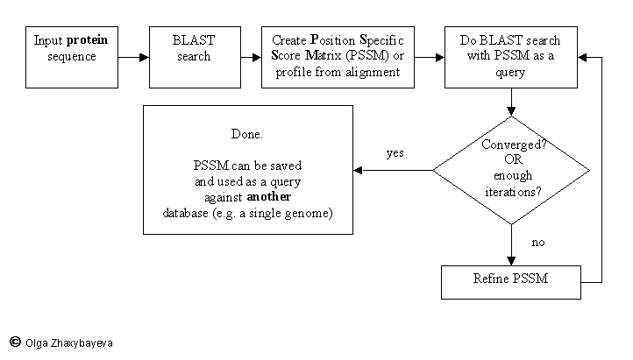
PSI BLAST scheme

Slide 5
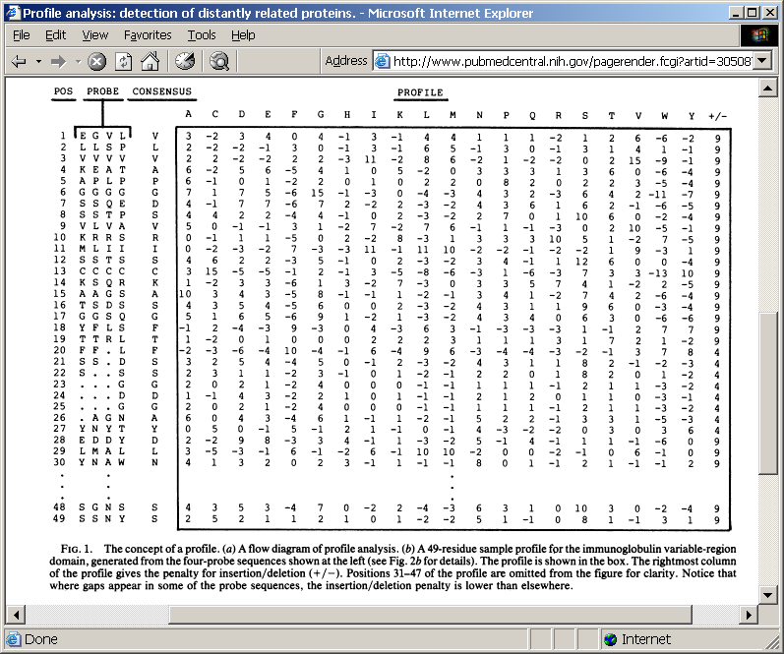
Position-specific Matrix
by Bob Friedman
M Gribskov, A D McLachlan, and D Eisenberg (1987) Profile analysis: detection of distantly related proteins. PNAS 84:4355-8.

Slide 6
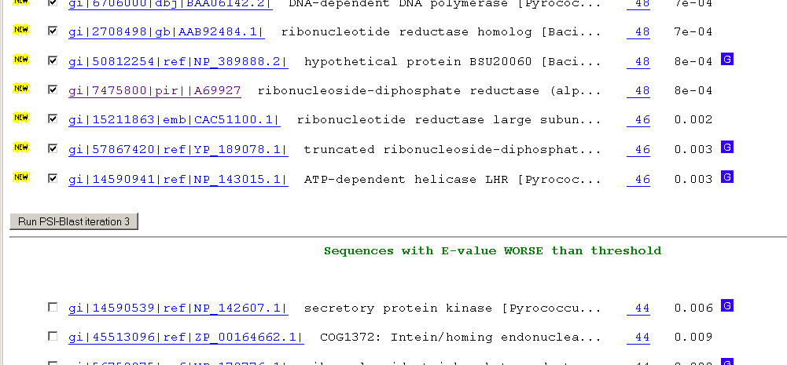
Psi-Blast Results
Query: 55670331 (intein)
link to sequence here, check BLink ☺

Slide 7
E-values and significance
Usually E values larger than 0.0001 are not considered as demonstration of homology.
For small values the E value gives the probability to find a match of this quality in a search of a databank of the same size by chance alone.
E-values give the expected number of matches with an alignment score this good or better,
P-values give the probability of to find a match of this quality or better.
P values are [0,1], E-values are [0,infinity).
For small values E=P
Problem: If you do 1000 blast searches, you expect one match due to chance with a P-value of 0.001
“One should” use a correction for multiple tests, like the Bonferroni correction.

Slide 8
PSI BLAST and E-values!
Psi-Blast is for finding matches among divergent sequences (position-specific information)
WARNING: For the nth iteration of a PSI BLAST search, the E-value gives the expected number of matches to the profile NOT to the initial query sequence!
The danger is that the profile was corrupted in an earlier iteration.

Slide 9
PSI Blast from the command line
Often you want to run a PSIBLAST search with two different databanks -
one to create the PSSM, the other to get sequences:
To create the PSSM:
blastpgp -d nr -i subI -j 5 -C subI.ckp -a 2 -o subI.out -h 0.00001 -F f
blastpgp -d swissprot -i gamma -j 5 -C gamma.ckp -a 2 -o gamma.out -h 0.00001 -F f
Runs 4 iterations of a PSIblast
the -h option tells the program to use matches with E <10^-5 for the next iteration,
(the default is 10⁻³ )
-C creates a checkpoint (called subI.ckp),
-o writes the output to subI.out,
-i option specifies input as using subI as input (a fasta formated aa sequence).
The nr databank used is stored in /common/data/
-a 2 use two processors
-h e-value threshold for inclusion in multipass model [Real]
default = 0.002 THIS IS A RATHER HIGH NUMBER!!!
(It might help to use the node with more memory (017)
(command is ssh node017)

Slide 10
To use the PSSM:
blastpgp -d /Users/jpgogarten/genomes/msb8.faa -i subI -a 2 -R subI.ckp -o subI.out3 -F f
blastpgp -d /Users/jpgogarten/genomes/msb8.faa -i gamma -a 2 -R gamma.ckp -o gamma.out3 -F f
Runs another iteration of the same blast search, but uses the databank /Users/jpgogarten/genomes/msb8.faa
-R tells the program where to resume
-d specifies a different databank
-i input file - same sequence as before
-o output_filename
-a 2 use two processors
-h e-value threshold for inclusion in multipass model [Real]
default = 0.002. This is a rather high number, but might be ok for the last iteration.

Slide 11
PSI Blast and finding gene families within genomes
2nd step: use PSSM to search genome:
Use protein sequences encoded in genome as target:
blastpgp -d target_genome.faa -i query.name -a 2 -R query.ckp -o query.out3 -F f
B) Use nucleotide sequence and tblastn. This is an advantage if you are also interested in pseudogenes, and/or if you don’t trust the genome annotation:
blastall -i query.name -d target_genome_nucl.ffn -p psitblastn -R query.ckp

Slide 12
Estimated Omega value per codon along vma-1 gen in yeasts
Extein: start - 285 and 895 - end
Intein: 286 - 895

Slide 13
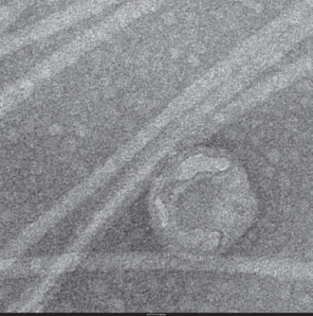
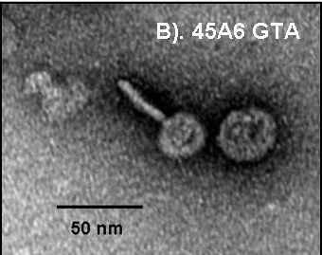
GTA
Genetic transfer Agents

Slide 14
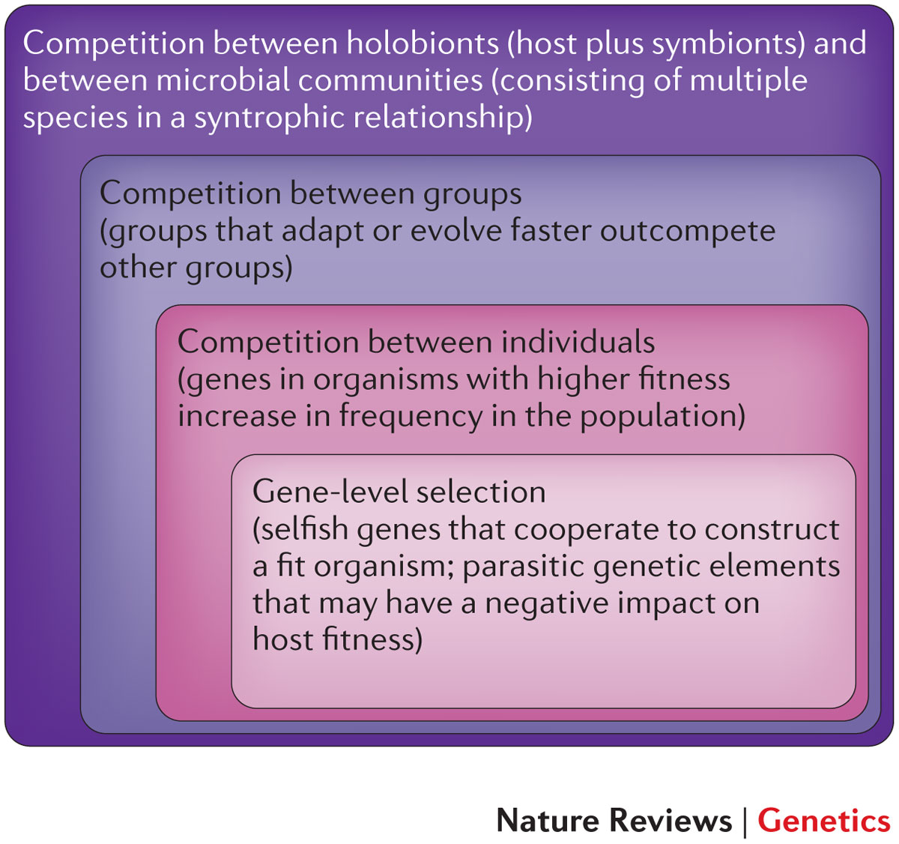
Figure 2: Nested levels of selection on gene content.
From: https://www.nature.com/articles/nrg3962 doi: 10.1038/nrg3962

Slide 15
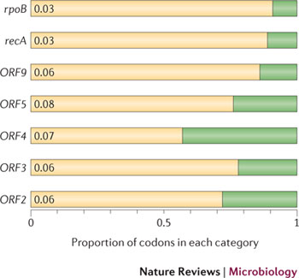
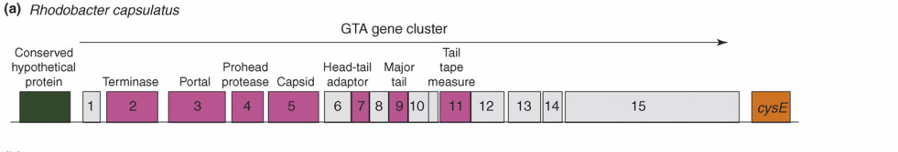
Purifying selection in GTA genes
dN/dS <1 for GTA genes has been used to infer selection for function
GTA genes
Lang AS, Zhaxybayeva O, Beatty JT. Nat Rev Microbiol. 2012 Jun 11;10(7):472-82
Lang, A.S. & Beatty, J.T. Trends in Microbiology , Vol.15, No.2 , 2006
Notes:
The ratio of non-synonymous-to-synonymous (dN/dS, or ω) codon substitution rates can be used as an indication of the selective pressure acting on a protein-coding gene. If a gene (or gene segment) is under purifying selection, non-synonymous mutations (that is, mutations resulting in a change of the encoded amino acid) will be selected against, resulting in ω < 1. In neutrally evolving proteins, synonymous and non-synonymous mutations will be fixed at approximately the same rate, resulting in ω = 1. Because different regions of a protein-coding gene may be under different selective constraints, codons can be divided into two categories: those with ω < 1 (yellow; the estimated ω is indicated on the bar) and those with ω fixed to 1 (green); the estimated proportion of codons in each category is given on the horizontal axis.

Slide 16
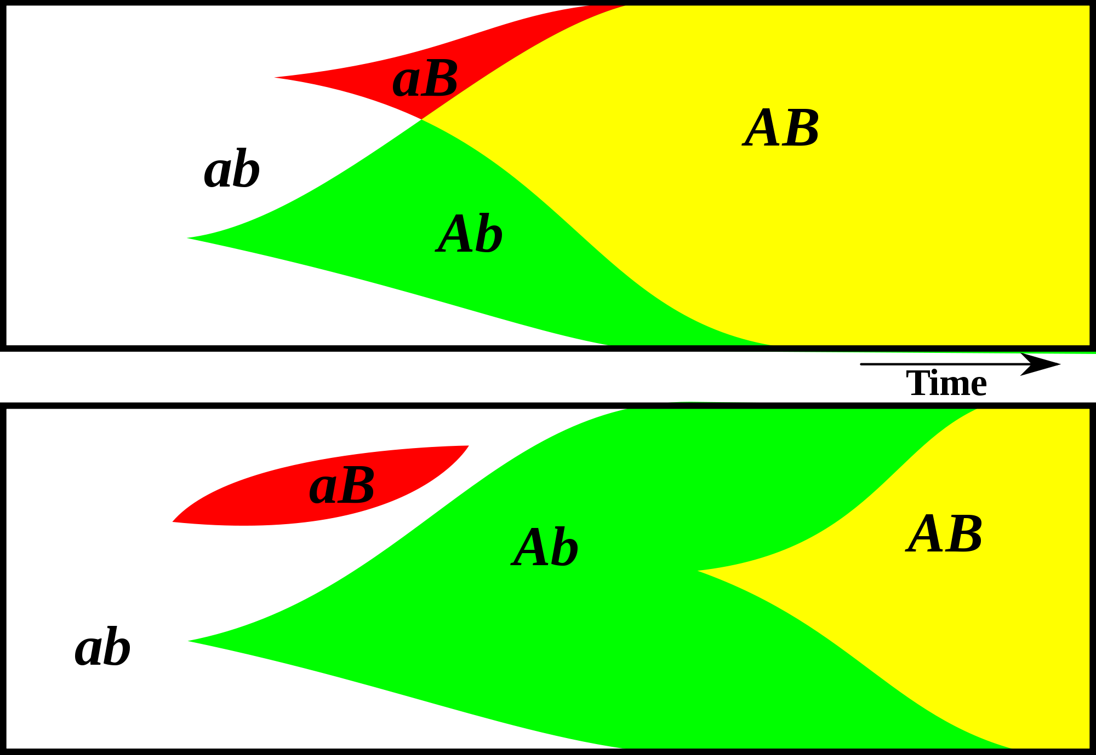
Gene Transfer, Sex, and Recombination:
Inventions do not need to be made sequentially
Gene transfer, followed by homologous or non-homologous recombination, allows inventions to be shared across the tree of life

Slide 17
GTA- cells can invade GTA populations, the reverse is only possible (Panel B), if GTA+ cells can restrict the benefits of recombination to GTA+ cells.
From Soucy and Redfield (2018)
10.3389/fmicb.2018.02527
Notes:
Effects of competition. All runs used α = 1.5 and high-high regulation. Note the exponential scale of the Y-axis. (A,B) eff. = 1.0. (A) a large GTA⁺ population being invaded by control GTA⁺ cells (orange) and by GTA⁻ cells that can (dark green) or cannot (light green) recombine. (B) a large GTA⁻ population being invaded by control GTA⁻ cells (green) and by GTA⁺ cells that can (light orange) or cannot (dark orange) sequester recombination. (C,D) Like (A,B) but with eff. = 0.2.

Slide 18
GTAs cannot survive as selfish genetic elements, because
GTAs are too small to encode all GTA genes
The GTA+ cell dies upon release of the GTAs
At best on GTA- cell (that has a mutation in its GTA can be converted to GTA+.
Recombination is beneficial to a group, because it prevents slightly deleterious mutations to be fixed along site beneficial ones, and it allows beneficial mutations that occurred in different cells to come together in a lineage. However, GTAs do not represent a evolutionary stable strategy.
GTA- cells can invade GTA+ population (the never lyse themselves, and the reap the benefits of recombination).
GTA+ cells can only invade a GTA- population, if the GTA+ cells manage somehow to restrict recombination to other GTA+ cells.
Why are GTAs around?
GTAs just represent decaying phages … But they are under purifying selection (however, see below).
The gene transfer they catalyze has some other benefits, Rosie Redfield (here) discusses the possibility that they might help transfer immunity against phages. (Can this be an evolutionary stable strategy?)

Slide 19
Purifying selection in E.coli ORFans
dN-dS < 0 for some ORFan E. coli clusters seems to suggest they are functional genes.
Gene groups | Number | dN-dS>0 | dN-dS<0 | dN-dS=0
E. coli ORFan clusters | 3773 | 944 (25%) | 1953 (52%) | 876 (23%)
Clusters of E.coli sequences found in Salmonella sp., Citrobacter sp. | 610 | 104 (17%) | 423(69%) | 83 (14%)
Clusters of E.coli sequences found in some Enterobacteriaceae only | 373 | 8 (2%) | 365 (98%) | 0 (0%)
Adapted after Yu, G. and Stoltzfus, A. Genome Biol Evol (2012) Vol. 4 1176-1187

Slide 20
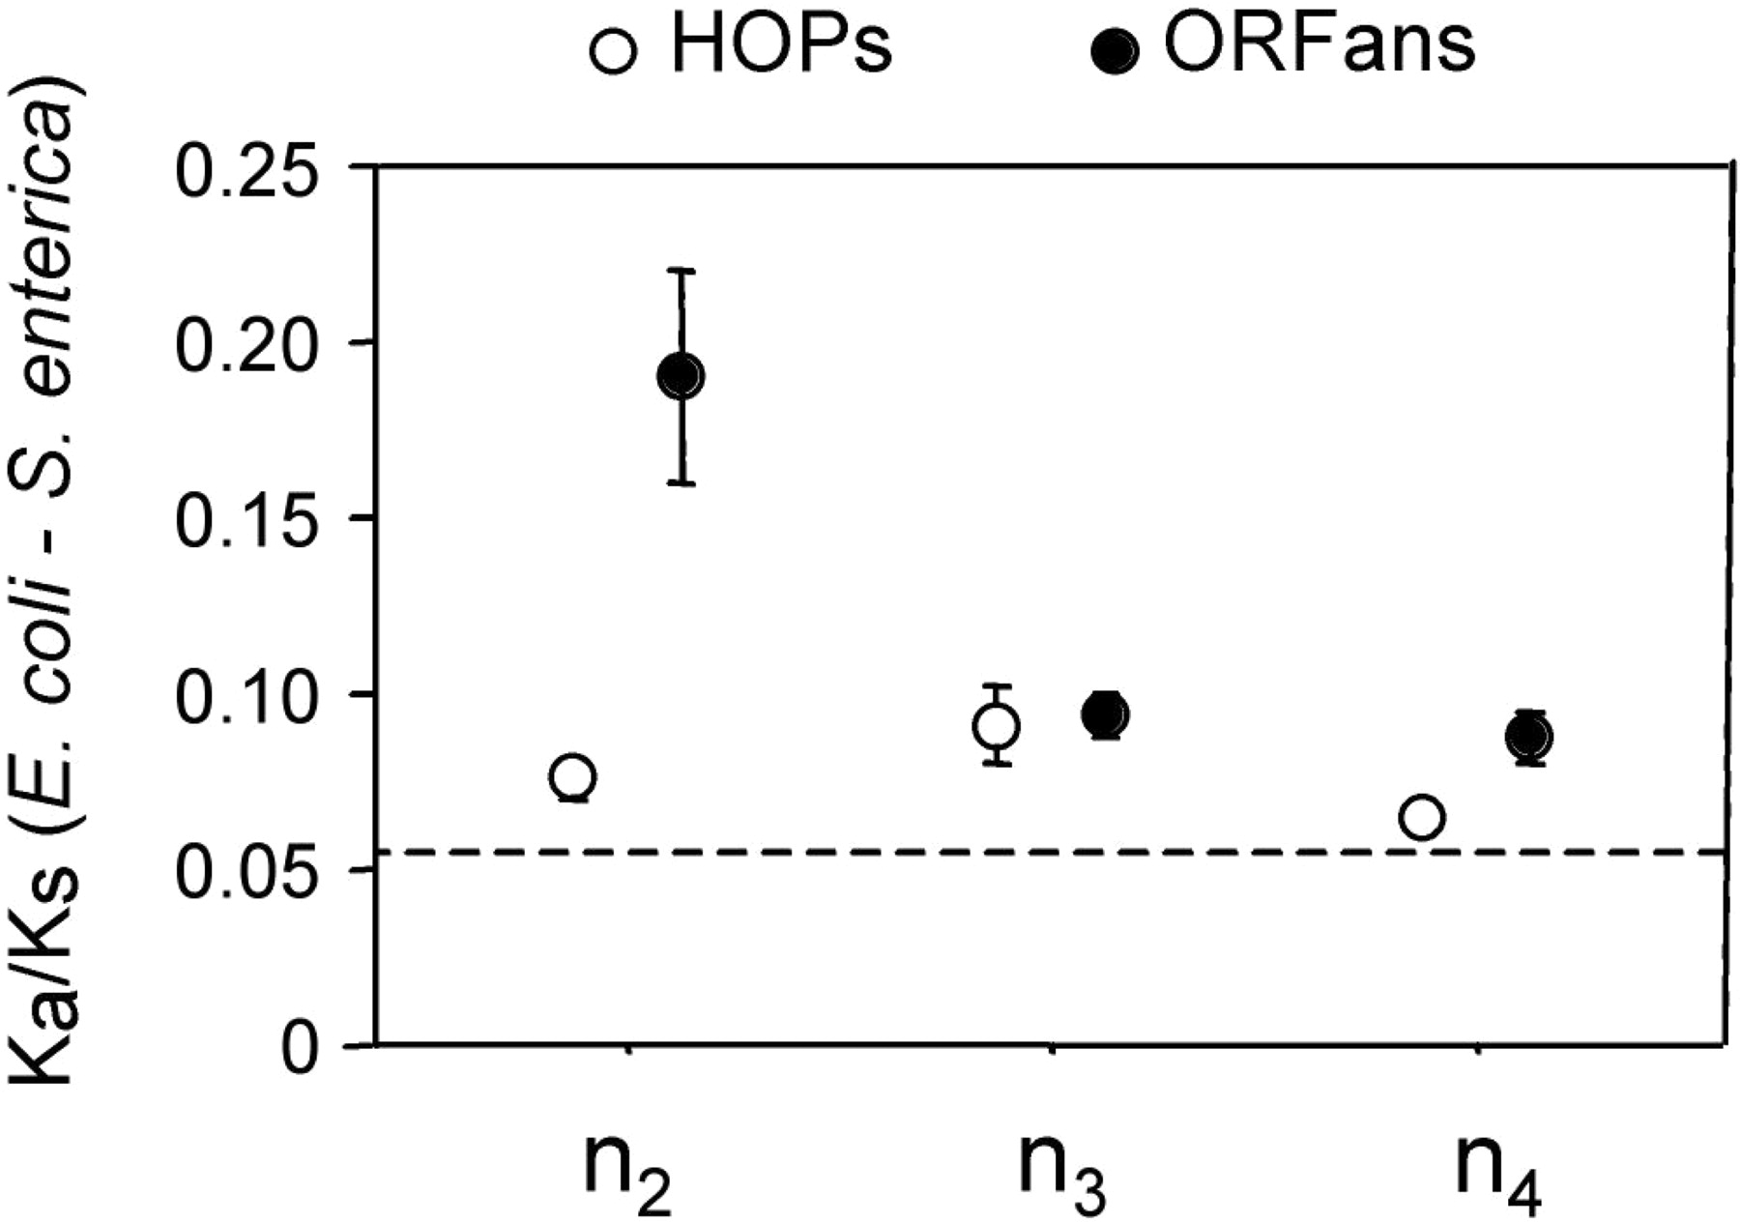
Vincent Daubin and Howard Ochman: Bacterial Genomes as New Gene Homes: The Genealogy of ORFans in E. coli. Genome Research 14:1036-1042, 2004
The ratio of non-synonymous to synonymous substitutions for genes found only in the E.coli - Salmonella clade is lower than 1, but larger than for more widely distributed genes.
Increasing phylogenetic depth
Fig. 3 from Vincent Daubin and Howard Ochman, Genome Research 14:1036-1042, 2004

Slide 21
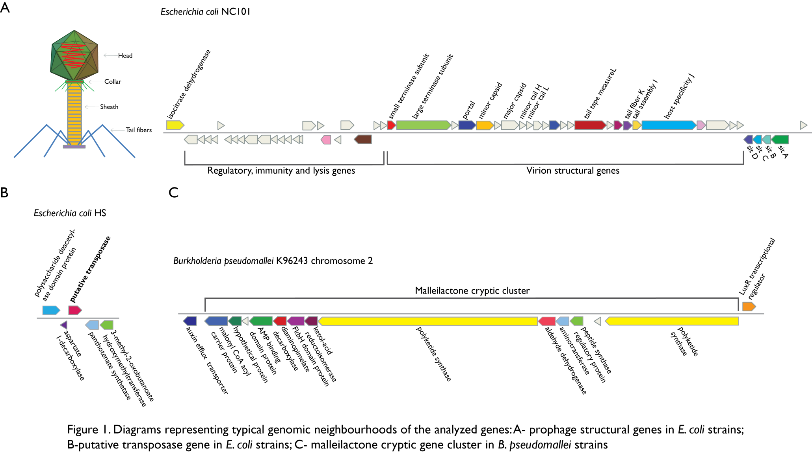
Vertically Inherited Genes Not Expressed for Function

Slide 22
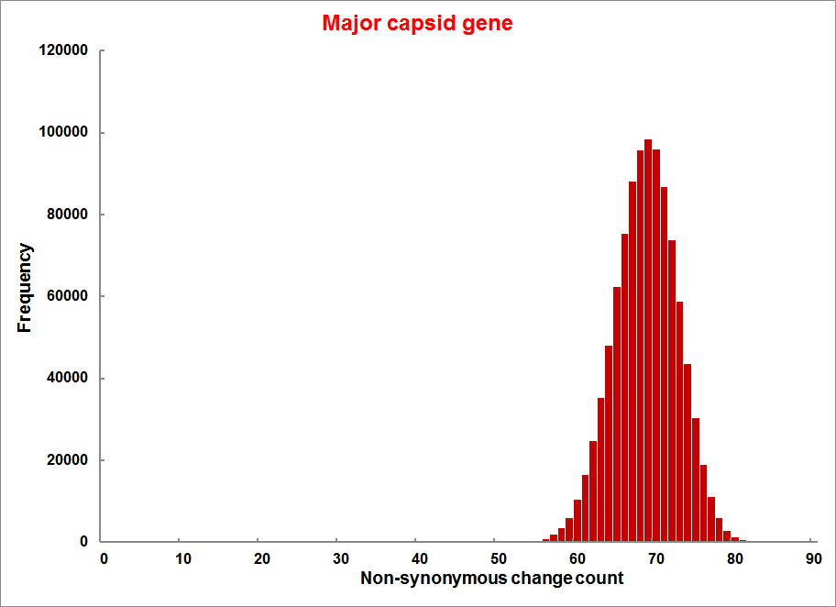
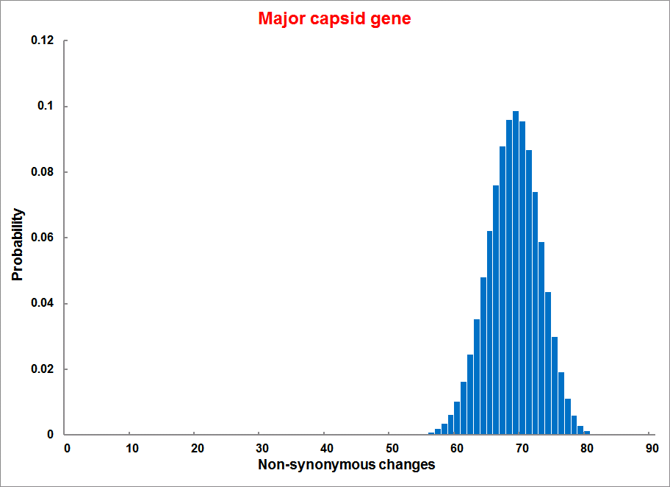
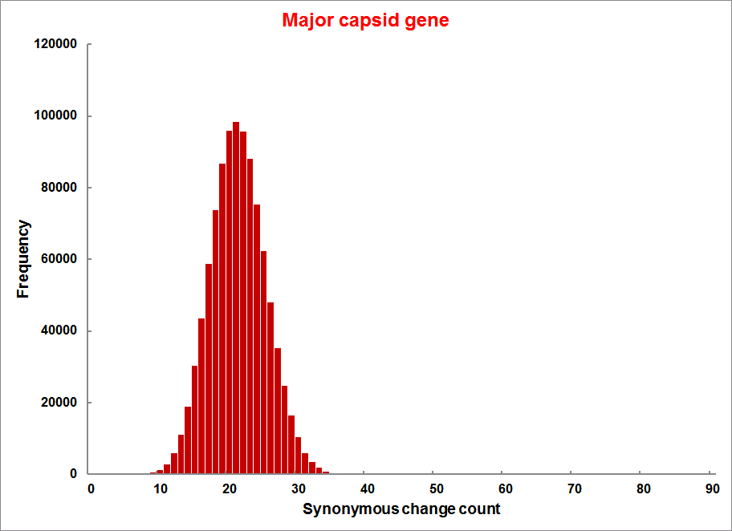
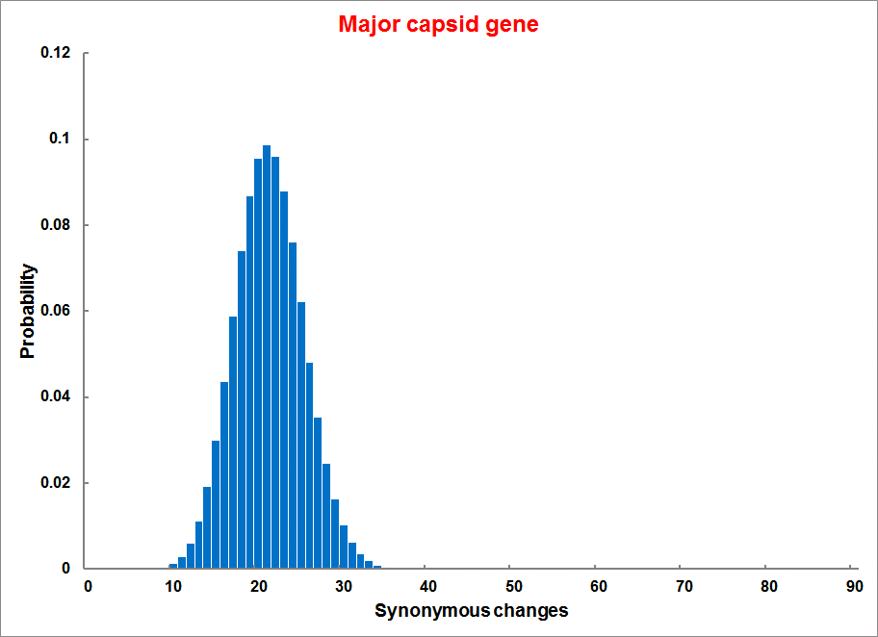
Evolution of Coding DNA Sequences Under a Neutral Model
E. coli Prophage Genes
Count distribution from simulations
Probability distribution
n=90
Non-synonymous
n= 90
k= 24
p=0.763
P(≤24)=3.63E-23
Observed=24
P(≤24) < 10⁻⁶
n=90
Synonymous
n= 90
k= 66
p=0.2365
P(≥66)=3.22E-23
Observed=66
P(≥66) < 10⁻⁶

Slide 23
Evolution of Coding DNA Sequences Under a Neutral Model
E. coli Prophage Genes
 |  | OBSERVED |  | SIMULATED |  | Dnapars | Simulated | Codeml
Gene | Alignment Length (bp) | Substitutions | Synonymous changes* | Substitutions | p-value synonymous (given *) | Minimum number of substitutions | dN/dS | dN/dS
Major capsid | 1023 | 90 | 66 | 90 | 3.23E-23 | 94 | 0.113 | 0.13142
Minor capsid C | 1329 | 81 | 59 | 81 | 1.98E-19 | 84 | 0.124 | 0.17704
Large terminase subunit | 1923 | 75 | 67 | 75 | 7.10E-35 | 82 | 0.035 | 0.03773
Small terminase subunit | 543 | 100 | 66 | 100 | 1.07E-19 | 101 | 0.156 | 0.25147
Portal | 1599 | 55 | 46 | 55 | 1.36E-21 | *64 | 0.057 | 0.08081
Protease | 1329 | 55 | 37 | 55 | 4.64E-11 | 55 | 0.162 | 0.24421
Minor tail H | 2565 | 260 | 168 | 260 | 1.81E-44 | 260 | 0.17 | 0.30928
Minor tail L | 696 | 30 | 26 | 30 | 1.30E-13 | 30 | 0.044 | 0.05004
Host specificity J | 3480 | 723 | 498 | 723 | 6.42E-149 | *773 | 0.137 | 0.17103
Tail fiber K | 741 | 41 | 28 | 41 | 1.06E-09 | 44 | 0.14 | 0.18354
Tail assembly I | 669 | 39 | 33 | 39 | 3.82E-15 | 40 | 0.064 | 0.07987
Tail tape measure protein | 2577 | 375 | 243 | 375 | 7.92E-64 | 378 | 0.169 | 0.27957
Values well under the p=0.01 threshold, suggesting rejection of the null hypothesis of neutral evolution of prophage sequences.

Slide 24

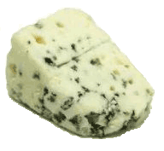
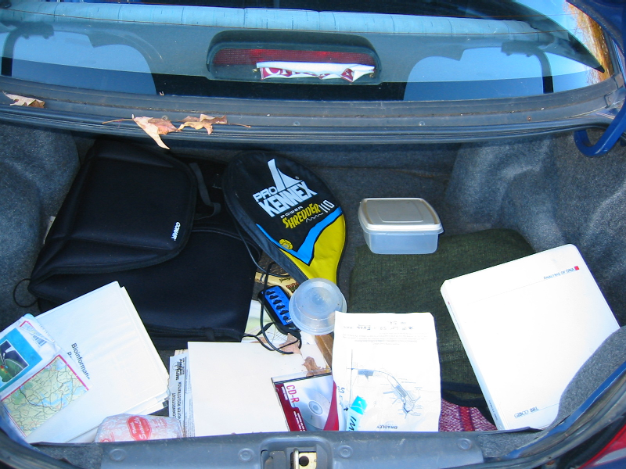
Trunk-of-my-car analogy: Hardly anything in there is the is the result of providing a selective advantage. Some items are removed quickly (purifying selection), some are useful under some conditions, but most things do not alter the fitness. See here for a published version.
Could some of the inferred purifying selection be due to the acquisition of novel detrimental characteristics (e.g., protein toxicity, HOPELESS MONSTERS)?

Slide 25
Other ways to detect positive selection
Selective sweeps -> fewer alleles present in population
(see contributions from archaic Humans for example)
Repeated episodes of positive selection -> high dN
(works well for repeated positive – aka diversifying – selection; e.g. virus interaction with the immunesystem)

Slide 26
Gene Transfer, Sex, and Recombination:
Inventions do not need to be made sequentially
Gene transfer, followed by homologous or non-homologous recombination, allows inventions to be shared across the tree of life

Slide 27
Aside: Gene and genome duplication versus
Horizontal Gene Transfer
Autochtonous gene/genome
duplication are rare
in prokaryotes
Gene family expansion through horizontal gene transfer –
the most common process in prokaryotes

Slide 28
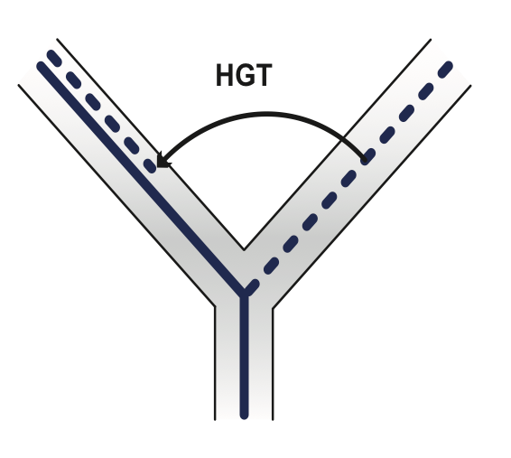
Horizontal Gene Transfer (HGT) and the
Acquisition of New Capabilities
Most important process to adapt microorganisms to new environments.
E.g.: Antibiotic and heavy metal resistance,
pathways that allow acquisition and breakdown of new substrates.
Creation of new metabolic pathways.
HGT not autochthonous gene duplication is the main
process of gene family expansion in prokaryotes.
Also important in the recent evolution of multicellular eukaryotes
(HGT between fish species and between grasses).
Selection acts on the Holobiont (= Host + Symbionts)
To adapt to new conditions, new symbionts can be acquired, or existing symbionts can acquire new genes through HGT.

Slide 29
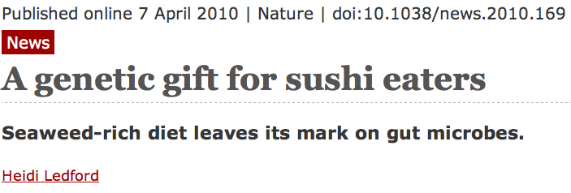
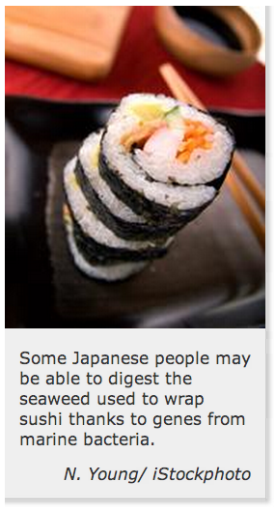
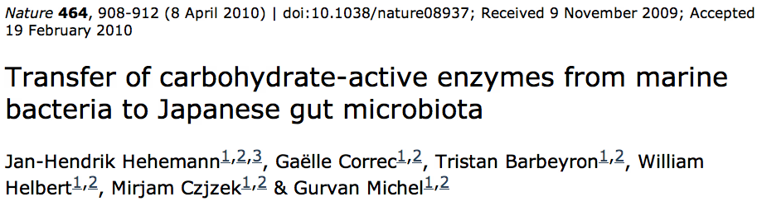
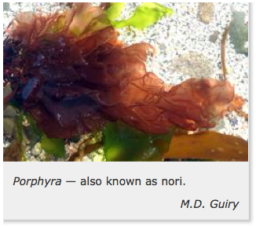

Gene Transfer in Eukaryotes
Bacterial parasites on red algae
HGT
Human gut symbiont

Slide 30
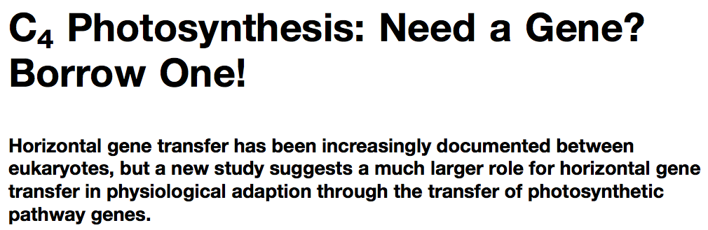
Gene Transfer in Eukaryotes – Example 2
Highlights
Key genes for C₄ photosynthesis were transmitted between distantly related grasses
These genes contributed to the adaptation of the primary metabolism
Their transmission was independent from most of the genome
Curr Biol. 2012 Mar 6;22(5):445-9. Epub 2012 Feb 16.
Adaptive Evolution of C(4) Photosynthesis
through Recurrent Lateral Gene Transfer.
Christin PA, Edwards EJ, Besnard G, Boxall SF, Gregory R, Kellogg EA, Hartwell J, Osborne CP.
Eric H. Roalson Current Biology Vol 22 No 5 R162

Slide 31
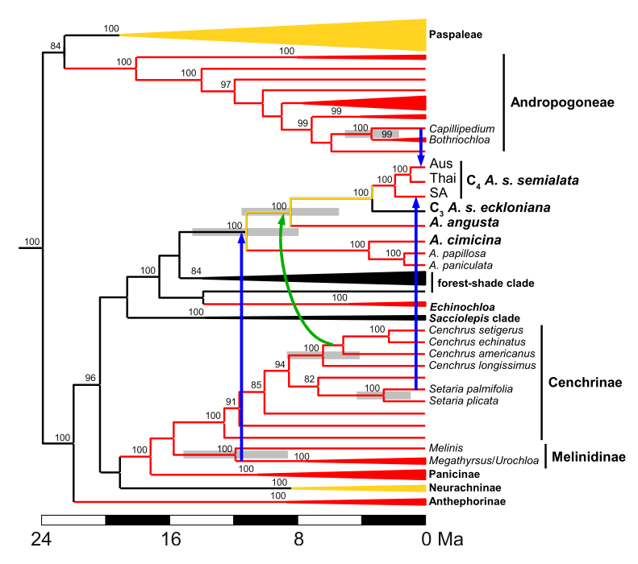
Gene Transfer in Eukaryotes – Example 2
From: Christin PA, Edwards EJ, Besnard G, Boxall SF, Gregory R, Kellogg EA, Hartwell J, Osborne CP.
Adaptive Evolution of C(4) Photosynthesis
through Recurrent Lateral Gene Transfer. Curr Biol. 2012 Mar 6;22(5):445-9. Epub 2012 Feb 16.

Slide 32
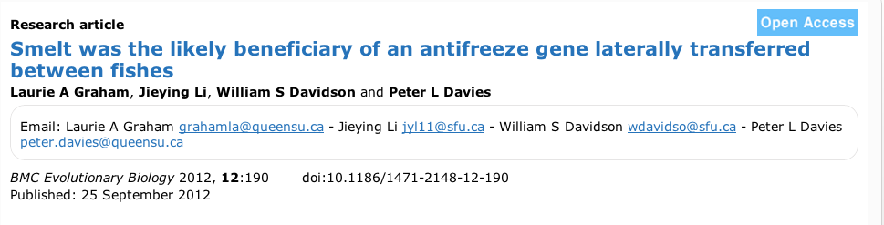
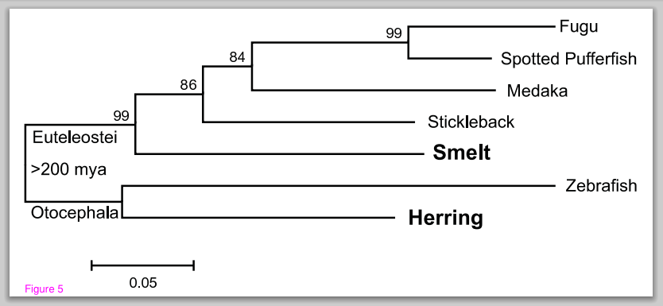
Gene Transfer in Eukaryotes – Example 3

Slide 33
HGT as a force creating new pathways

Slide 34
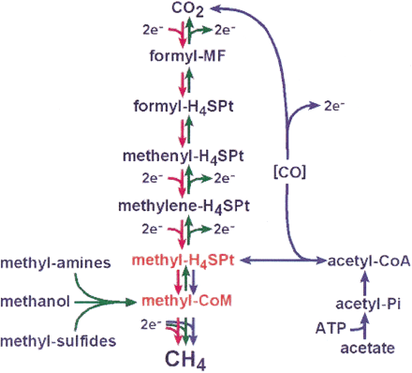
HGT as a force creating new pathways – Example I
Acetoclastic Methanogenesis
Unique to subset of Archaea
Energy production via reduction of multiple carbon substrates to CH₄
900 Million metric tons of biogenic methane produced annually.
Over 66% of biogenic methane is produced from acetate, mostly by Methanosarcina genera.
From: Galagan et al., 2002
Fournier and Gogarten (2008) Evolution of Acetoclastic Methanogenesis in Methanosarcina via Horizontal Gene Transfer from Cellulolytic Clostridia. J. Bacteriol. 190(3):1124-7

Slide 35
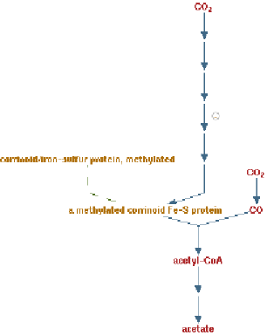
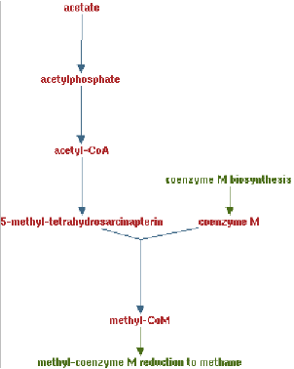
Clostridia acetigenic pathway
Methanosarcina
acetoclastic pathway
AckA
HGT
PtaA
PtaA
AckA
Figures drawn with Metacyc (www.metacyc.org)

Slide 36
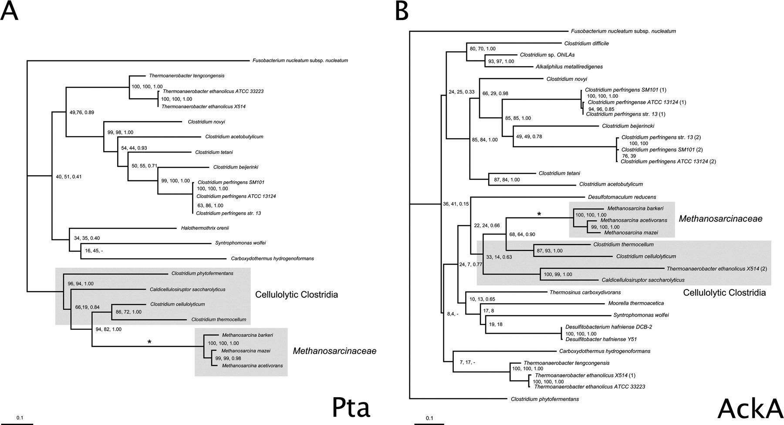
Consensus trees of Pta and AckA homologs within the Clostridia. Branches in which there were postulated horizontal gene transfers to Methanosarcina are indicated by an asterisk. Homologs from the firmicute F. nucleatum were used as outgroups to root the trees. The numbers associated with each clade indicate bootstrap values for maximum likelihood and neighbor joining and the posterior probability from Bayesian inference, respectively. Sequence alignment was ...

Slide 37
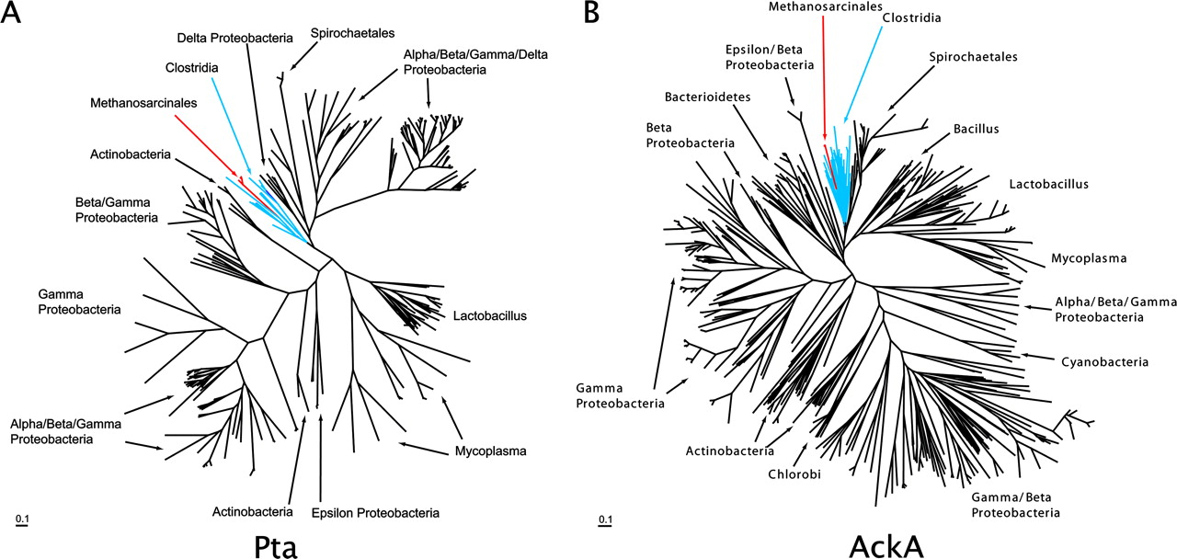
Maximum likelihood phylogenetic trees of Pta and AckA homologs. Homologs found in Methanosarcina are red and in both cases are found in a monophyletic group corresponding to the Clostridia (blue) ... .

Slide 38
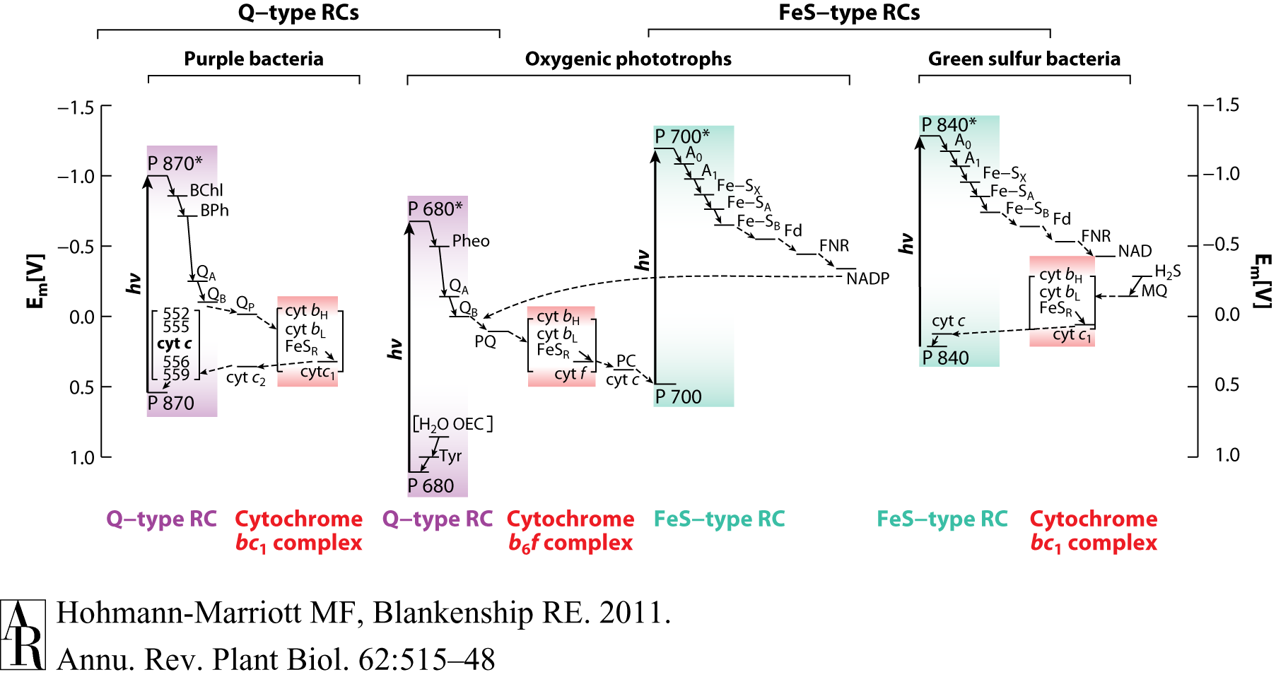
HGT as a force creating new pathways – Example 2
Oxygen producing photosynthesis

Slide 39
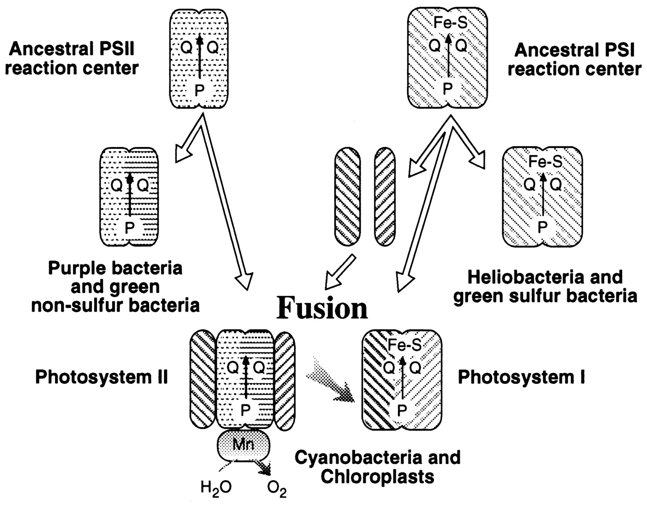
A heterologous fusion model for the evolution of oxygenic photosynthesis based on phylogenetic analysis.
Xiong J et al. PNAS 1998;95:14851-14856
©1998 by National Academy of Sciences
Notes:
A heterologous fusion model for the evolution of oxygenic photosynthesis based on phylogenetic analysis. Details of the model are provided in the text.

Slide 40
HGT as a force creating new pathways – Example 3
Acetyl-CoA Assimilation: Methylaspartate Cycle
Acetate
Alcohols
Polyhydroxybutyrate
Fatty acids
acetyl-CoA
Lysine, leucine
oxaloacetate
citrate
malate
isocitrate
CO
2
fumarate
acetyl-CoA
2-oxoglutarate
Poly-γ -glutamate
succinate
glutamate
Proteins
glyoxylate
γ-Glutamylcystein
succinyl-CoA
methylaspartate
CO
Osmoadaptation
2
propionyl-CoA
mesaconate
3-methylmalyl-CoA
mesaconyl-CoA
Khomyakova, Bükmez, Thomas, Erb, Berg, Science, 2011

Slide 41
Comparison of different anaplerotic pathways
acetyl-CoA
acetyl-CoA
acetyl-CoA
acetyl-CoA
crotonyl-CoA
oxaloacetate
citrate
oxaloacetate
citrate
CO
2
malate
isocitrate
acetyl-CoA
ethylmalonyl-CoA
CO
2
fumarate
acetyl-CoA
2-oxoglutarate
malate
isocitrate
methylsuccinyl-CoA
glyoxylate
succinate
glutamate
CO
2
mesaconyl-CoA
glyoxylate
2-oxoglutarate
3-methylmalyl-CoA
succinyl-CoA
methylaspartate
fumarate
CO
propionyl-CoA
glyoxylate
2
propionyl-CoA
mesaconate
CO
2
CO
2
acetyl-CoA
succinate
succinyl-CoA
3-methylmalyl-CoA
mesaconyl-CoA
succinyl-CoA
malate
Citric acid cycle and
Glyoxylate cycle
Ethylmalonyl-CoA
pathway
Methylaspartate cycle
Bacteria, Eukarya and some Archaea
α-Proteobacteria, streptomycetes
haloarchaea

Slide 42
HGT as a force creating new pathways – Example 3
Acetyl-CoA Assimilation: methylaspartate cycle
Haloarchaea
Haloarcula marismortui,
Natrialba magadii
Glutamate fermentation,
Bacteria
Propionate assimilation
Acetate
assimilation, Bacteria
Khomyakova, Bükmez, Thomas, Erb, Berg, Science, 2011

Slide 43
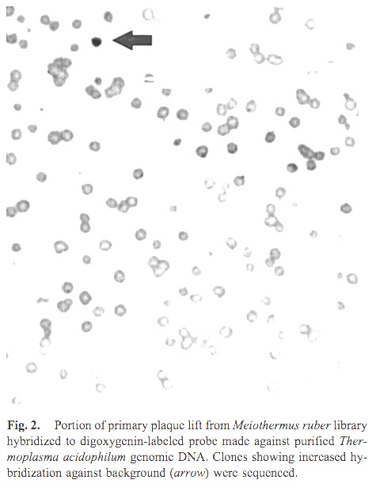
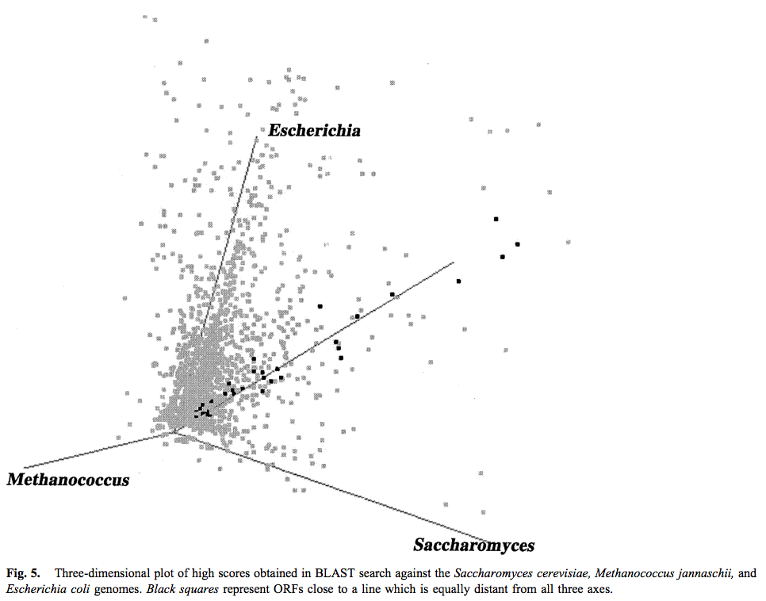
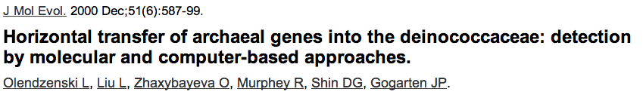
Finding transferred genes
Screening in the wet-lab and in the computer

Slide 44
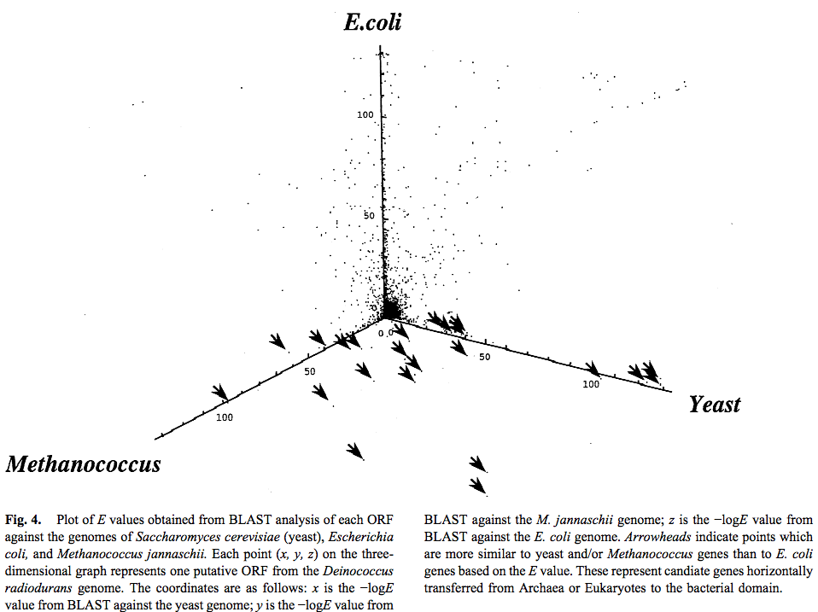
Finding transferred genes

Slide 45
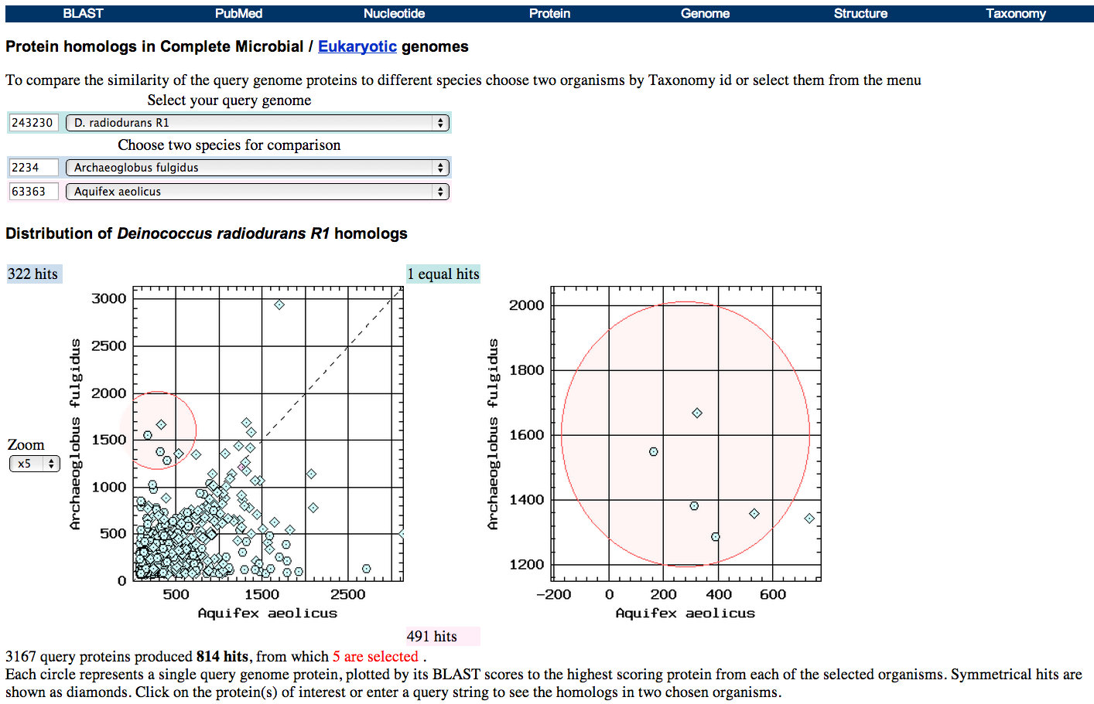
Taxplot at NCBI

Slide 46
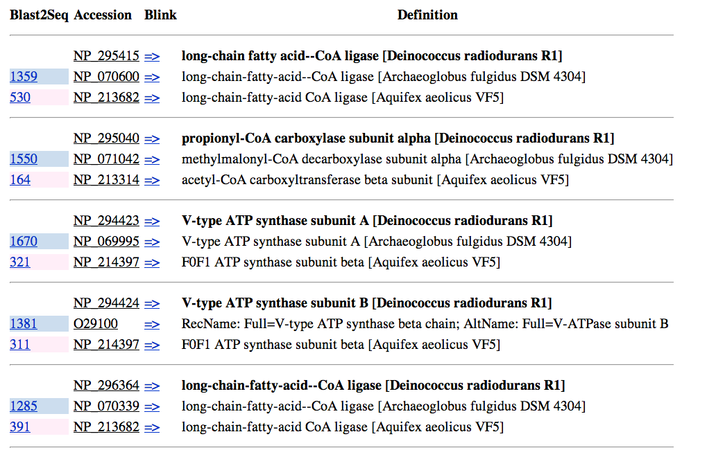
Taxplot at NCBI

Slide 47
Other approaches to find transferred genes
Gene presence absence data for closely related genomes (for additional genes)
Phylogenetic conflict (for homologous replacement (e.g. quartet decompositon spectra see Figs. 1 and 2)
Composition based analyses (for very recent transfers).

Slide 48
Example for a parametric bootstrap analysis

Slide 49
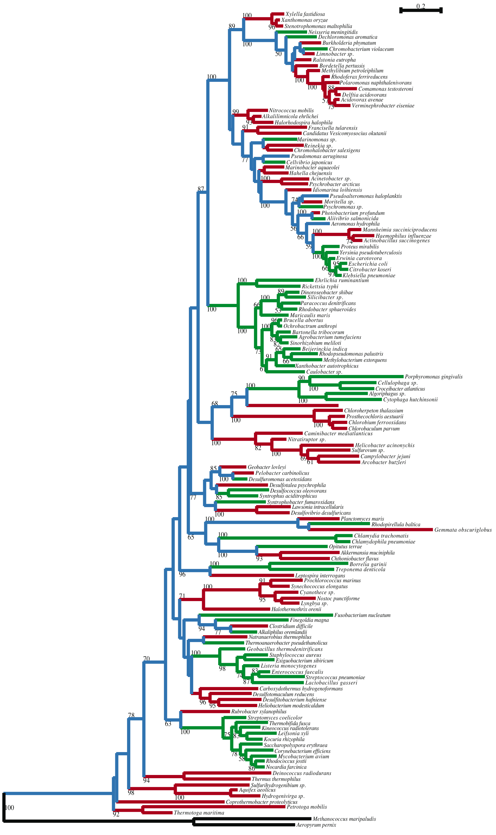
16S rRNA phylogeny colored according to tyrRS type
Under the assumption that both types were present in the bacterial ancestor and explaining the observed distribution only through gene loss:
133 taxa and 58 gene loss events,
34 losses of type A, 23 of type B
Green - Type A tyrRS
Red - Type B tyrRS
Blue - Both types of tyrRS
Andam, Williams, Gogarten 2010 PNAS
Notes:
Gene loss only model is also rejected using the threeState LGT developped in Tal Pupko’s group.

Slide 50
LGT3State Method
Simulated under
"loss-only" model;
likelihood under HGT model
Real data under HGT model
Generated 1000 bootstrap trees under loss-only model
Notes:
LGT3state
The null model states that HGT does not occur in the evolution of the tyrRS genes and that only gene loss events can explain the distribution patterns of types A and B in the bacterial domain. This model implies that the bacterial ancestor carried both types of TyrRS. The second model is that both gene losses and gains of the alternative gene can occur, i. e. , a genome carrying a TyrRS type B can gain a type A, and vice versa, resulting in a genome with both types A and B present, and from which one TyrRS type may eventually be lost. In this model, HGT shapes the taxonomic distribution of bacterial TyrRS.
Using parametric bootstrap as implemented by LGT3State (23), we generated 1000 bootstrap trees to which we applied the null model. Thus, we have 1000 datasets reflecting the outcomes under the null model, which are compared to the real dataset under the HGT model. The distribution of the 1000 likelihood values gives us a measure of what to expect under the null hypothesis.
The log-likelihood values obtained for all 1000 datasets under the null model, ranging from -89.7 to -111.8, were lower than the log-likelihood under the HGT model for the original tree. We therefore can reject the null model (ancient gene duplication followed by gene loss only) with a significance level of p < 0.001.

Slide 51
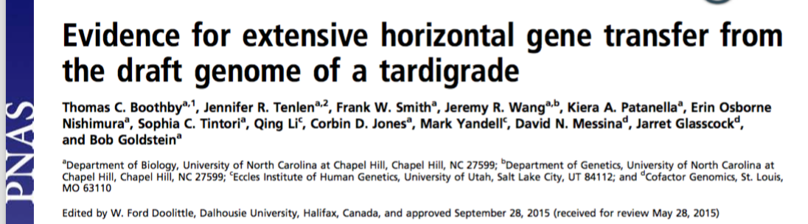
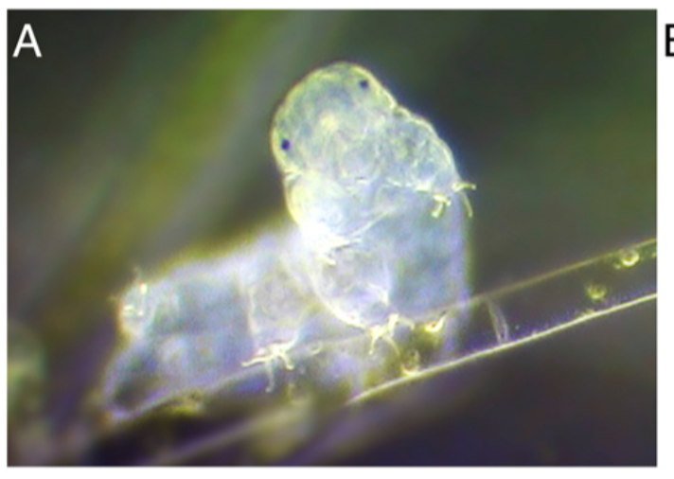
Discussion of
HGT from Bacteria to Tardigrades
We estimate that approximately one-sixth of tardigrade genes entered by HGT, nearly double the fraction found in the most extreme cases of HGT into animals known to date. Foreign genes have supplemented, expanded, and even replaced some metazoan gene families within the tardigrade genome. Our results demonstrate that an unexpectedly large fraction of an animal genome can be derived from foreign sources.

Slide 52
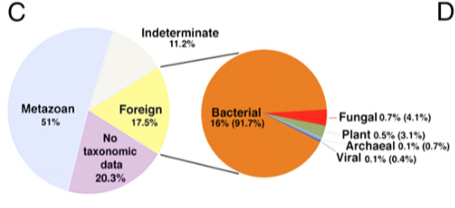
Source of genes in the H. dujardini genome as determined by HGT index calculations

Slide 53
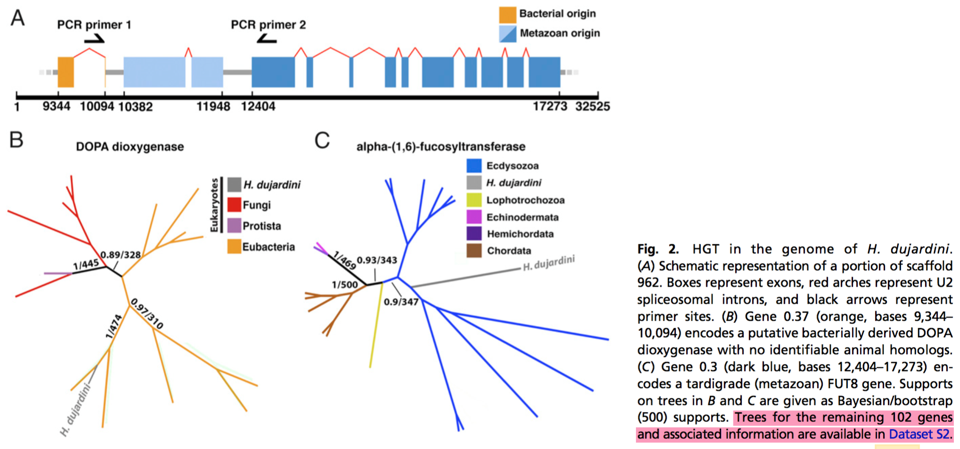
Discussion of
HGT from Bacteria to Tardigrades

Slide 54
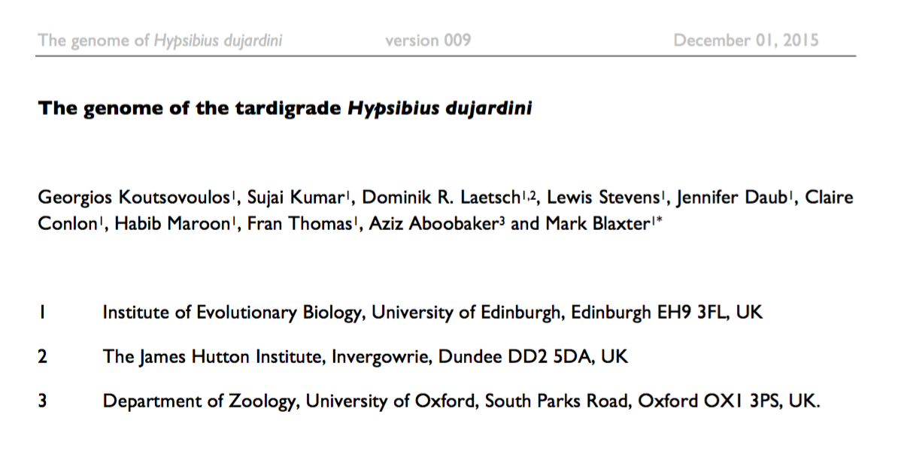
BIOARCHIVES
doi: http://dx.doi.org/10.1101/033464
http://biorxiv.org/content/early/2015/12/01/033464

Slide 55
“While the raw data indicated extensive contamination with bacteria, presumably from the gut or surface of the animals, careful cleaning generated a clean tardigrade dataset for assembly.”

Slide 56
Our assembly, and inferences from it, conflict with a recently published draft genome (UNC) 6 for what is essentially the same strain of H. dujardini. Our assembly, despite having superior assembly statistics, is ~120 Mb shorter than the UNC assembly. Our genome size estimate from sequence assembly is congruent with the values we obtained by direct measurement. We find 15,000 fewer protein-coding genes, and a hugely reduced impact of predicted HGT on gene content in H. dujardini. These HGT candidates await detailed validation. While resolution of the conflict between these assemblies awaits detailed examination based on close scrutiny of the raw UNC data, our analyses suggest that the UNC assembly is compromised by sequences that derive from bacterial contaminants, and that the expanded genome span, additional genes, and HGT candidates are likely to be artefactual.

Slide 57
Figure 4: Mapping of read data to UNC assembly identifies non-shared
contaminants and no expression from bacterial scaffolds
A Blobplot showing the UNC assembly contigs distributed by GC proportion and coverage derived from the UNC raw genomic sequence data (data file TG-300). Scaffold points are scaled by length, and coloured based on taxonomic assignment of the sum of the best BLAST and Diamond matches for all the genes on the scaffold. Taxonomic assignments are summed by phylum.
B Blobplot showing the UNC assembly contigs distributed by GC proportion and coverage derived from the Edinburgh raw genomic sequence data. Scaffold points are scaled by length, and coloured based on taxonomic assignment of the sum of the best BLAST and Diamond matches for all the genes on the scaffold. Taxonomic assignments are summed by phylum.

Slide 58
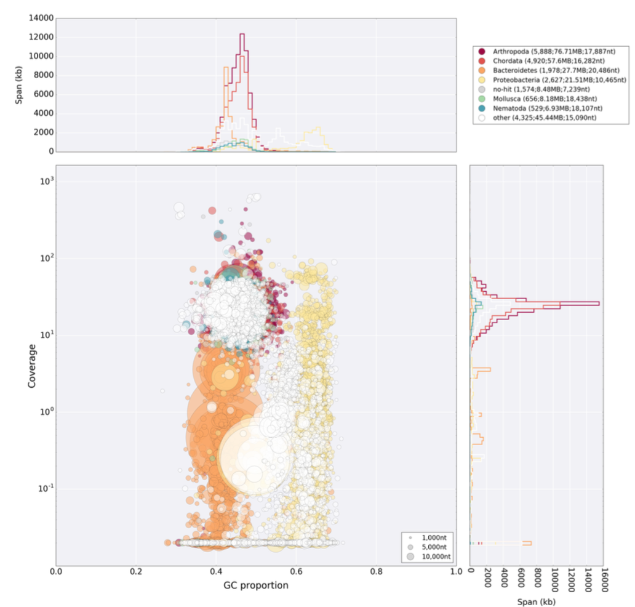
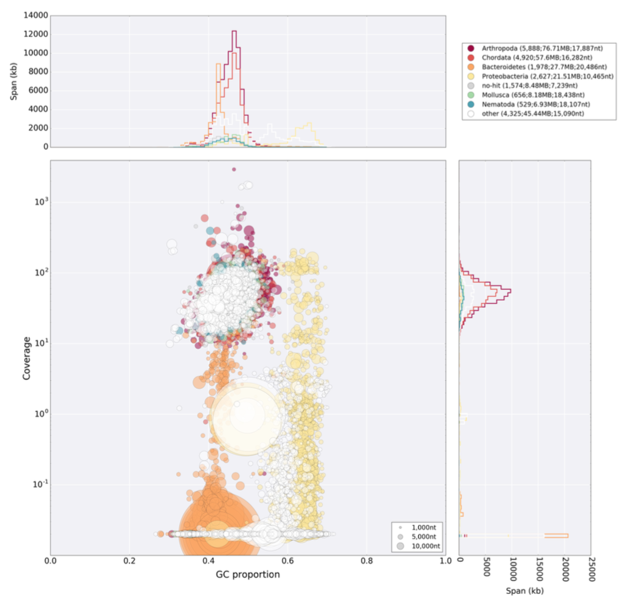
UNC reads
Edinburgh reads
both mapped on the UNC assembly

