Slide 1
STUDENT EVALUATIONS of TEACHING
Please go to husky CT and complete student evaluations !
This morning 9 out of 38 students had filled out the SET ☹

Slide 2
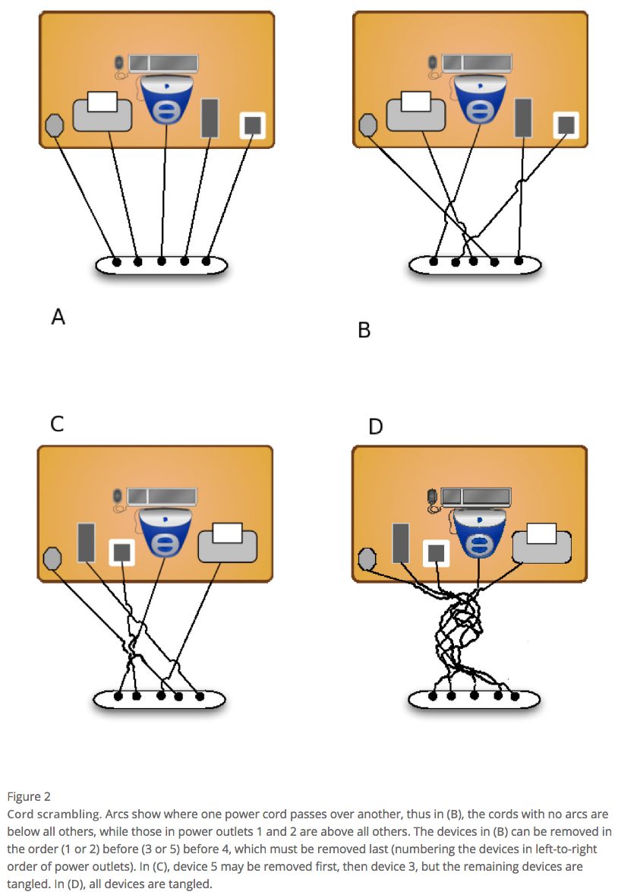
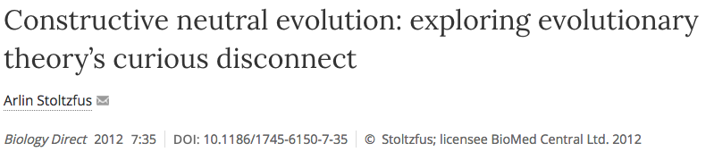
Mutations can have a directing force (A)
Arlin’s example of computer cables
From:

Slide 3
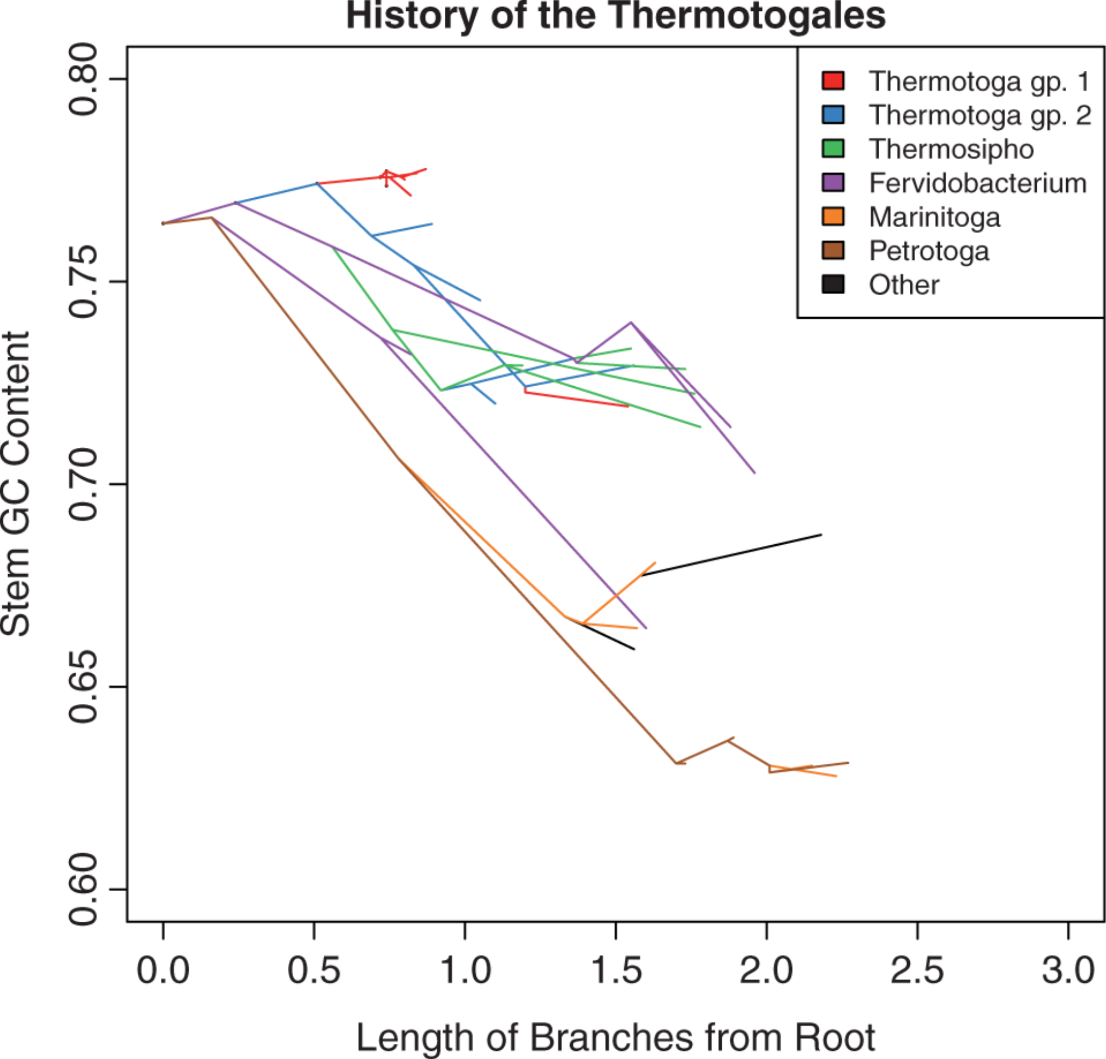
Mutations can have a directing force (B)
Mutations bias temperature adaptation towards lower temperature:
From: Anna G. Green Kristen S. Swithers Jan F. Gogarten Johann Peter Gogarten
Reconstruction of Ancestral 16S rRNA Reveals Mutation Bias in the Evolution of Optimal Growth Temperature in the Thermotogae Phylum
Mol Biol Evol. 2013;30(11):2463-2474. doi:10.1093/molbev/mst145

Slide 4
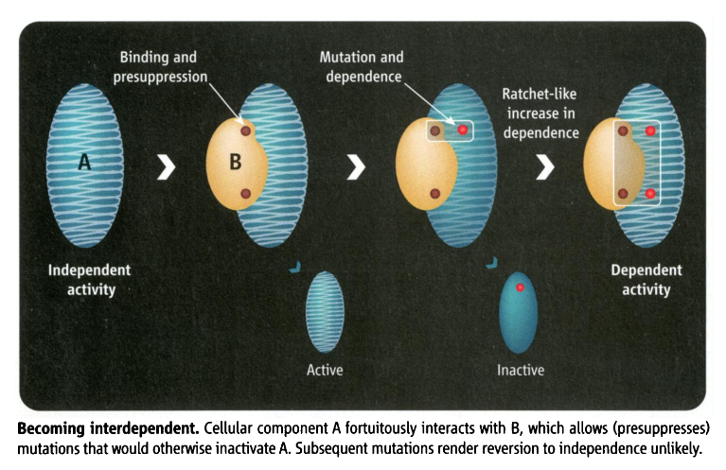
Mutations can have a directing force (C)
Constructive neutral evolution:
Random interactions between macromolecules lower the overall free energy, leading to more stability, allowing for destabilizing mutations to occur. The mutated macromolecule remains stable and active, as long as the binding partner is present.
From: Irremediable Complexity?
Author(s): Michael W. Gray, Julius Lukeš, John M. Archibald, Patrick J. Keeling and W.
Ford Doolittle
Source: Science, New Series, Vol. 330, No. 6006 (12 November 2010), pp. 920-921

Slide 5
From: Inteins: nature's gift to protein chemists
Neel H. Shah and Tom W. Muir
DOI: 10.1039/C3SC52951G

Slide 6
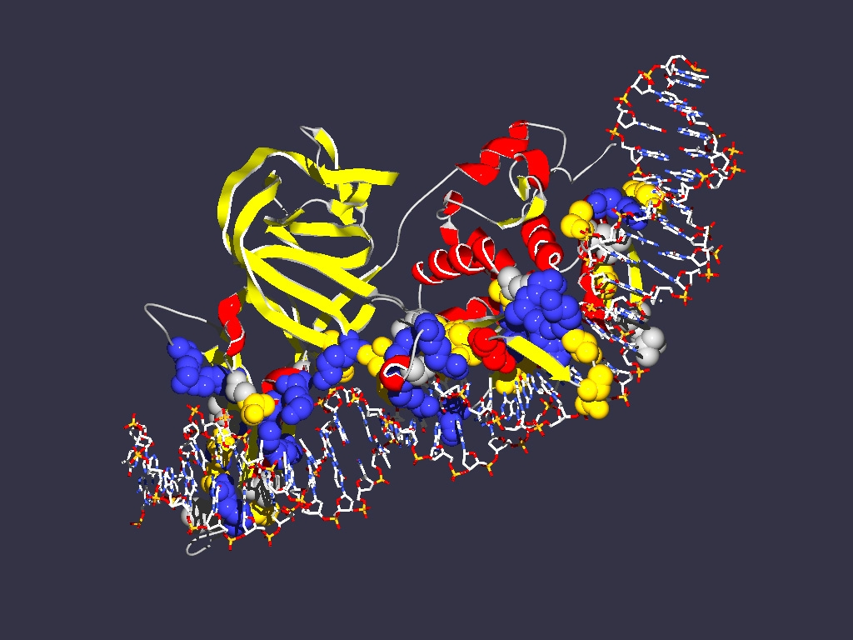
In case of inteins the co-evolution of genes results in
Mutualism between splicing and homing endonuclease domain
Commensalism between host protein and intein without HE domain
Parasitism between host protein and intein with HE
Encoding
1LWS
Extein = Host Protein
Intein Splicing Domain
Structure from Moure et al. (2002)
Nat.Struct.Biol. 9: 764-770
Homing Endonuclease (HE)
domain

Slide 7
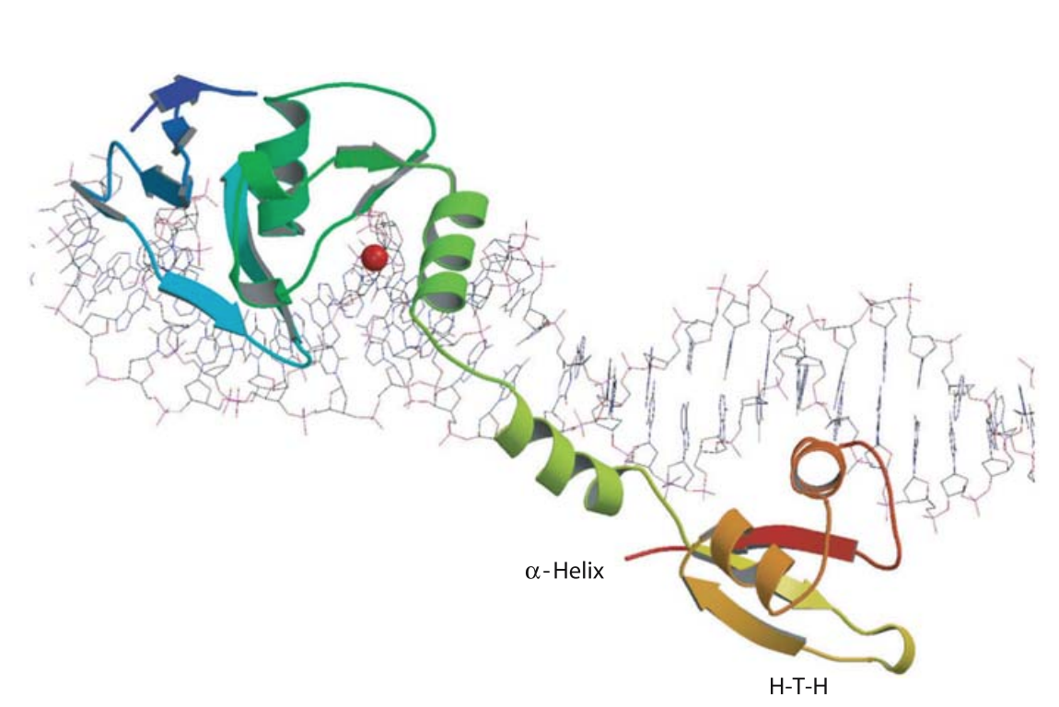
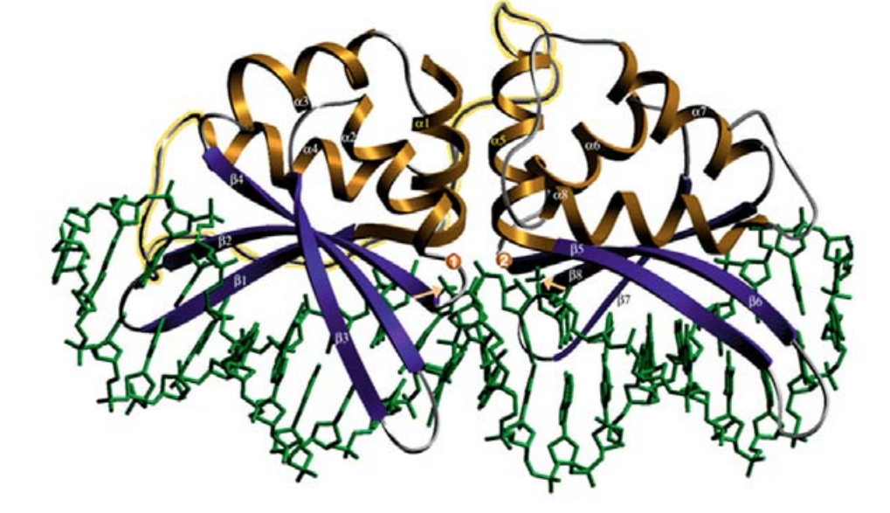
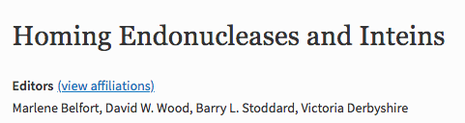
Inteins and Homing Endonucleases HEs
Inteins can occur with and without HEs -- the latter are also called Mini Inteins
Inteins have been found associated with different types of HEs
LAGLIDADG HEs
GIY-YIG HEs
HNH endonuclease and relatives
HEs can occur without self-splicing elements (intron and inteins). In this case the HE often disrupts an ORF, and the two parts of the “host proteins” unite into a functional protein without a covalent bond.
From

Slide 8
Free Standing HEs
http://www.pnas.org/content/104/15/6176#ref-22

Slide 9

From

Slide 10
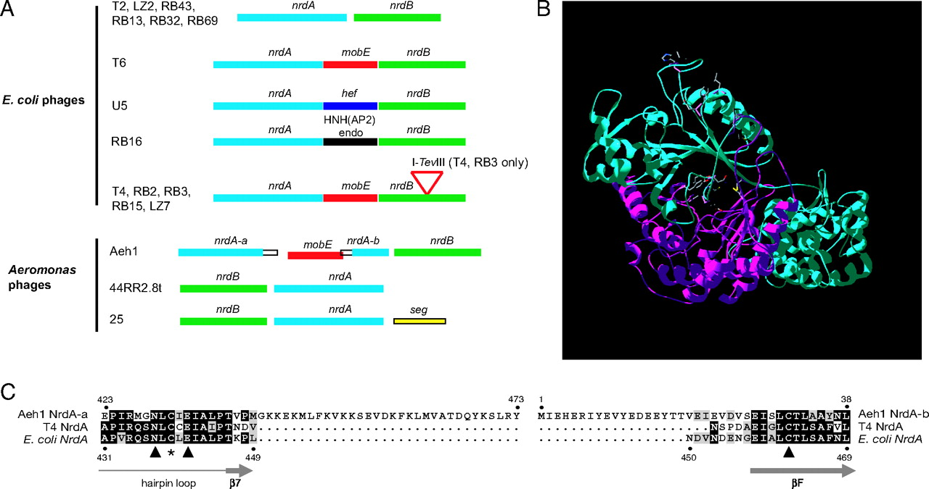

The nrdA-nrdB genomic region of T-even phage is a hotspot of homing endonuclease insertion.
Nancy C. Friedrich et al. PNAS 2007;104:15:6176-6181
©2007 by National Academy of Sciences
Notes:
The nrdA-nrdB genomic region of T-even phage is a hotspot of homing endonuclease insertion. (A) Gene composition of the nrdA-nrdB region of E. coli and Aeromonas phages (not to scale). Self-splicing group I introns are indicated by a triangle. Open boxes indicate the unique DNA sequences accompanying the mobE insertion. HNH(AP2), HNH family endonuclease (47); hef, homing endonuclease-like function (22); seg, similarity to endonuclease encoded within group I introns (5). (B) Homology model of Aeh1 NrdA-a and NrdA-b proteins based on the known structure of E. coli NrdA (24) by using the program Swiss-Model at ExPASy Home Page (http://swissmodel.expasy.org/). The RNR-specific β/α-barrel domain with the active site is a composite of the NrdA-a (blue) and NrdA-b (magenta). Active-site residues Cys-219, Asn-429, Cys-431, and Glu-433 in NrdA-a and Cys-31, Tyr-300, and Tyr-301 in NrdA-b (model center) are highlighted as well as conserved specificity-site residues Asps226, Leu-228, Ile-262, His-269, and Phe-275 in NrdA-a (model top). (C) Amino acid alignment of the split Aeh1 NrdA-a and NrdA-b proteins with the contiguous E. coli and phage T4 NrdA homologs. Numbers above the alignment indicate amino acid positions in the Aeh1 NrdA-a and NrdA-b proteins, whereas numbers below the alignment refer to the E. coli NrdA protein. The star indicates a conserved active-site cysteine residue (Cys-439 of E. coli NrdA), and triangles indicate conserved active-site residues (from left Asn-437, Glu-441, and Cys-462 of E. coli NrdA). Secondary-structure elements of E. coli NrdA are indicated below the alignment (β, β-strand). Black and gray shading indicate identical and similar amino acids, respectively, between the sequences.
HNH family endonuclease, mobE,
seg, similarity to endonuclease encoded within group I introns

Slide 11
Split inteins as an example for CNE
From: Inteins: nature's gift to protein chemists
Neel H. Shah and Tom W. Muir
DOI: 10.1039/C3SC52951G

Slide 12
Split inteins as an example for CNE
Transcribed
and translated
Functional replicative
DNA polymerase III
dnaE
dnaE
cis splicing
dnaE1
Non covalent inter-actions between N and C intein
trans splicing
dnaE1
Gene encoding extein
extein
Gene encoding splicing domains
Intein splicing domains
Gene encoding homing endonuclease domain
Intein homing endonuclease domains

Slide 13
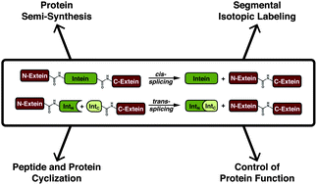
From: Inteins: nature's gift to protein chemists
Neel H. Shah and Tom W. Muir
DOI: 10.1039/C3SC52951G

Slide 14
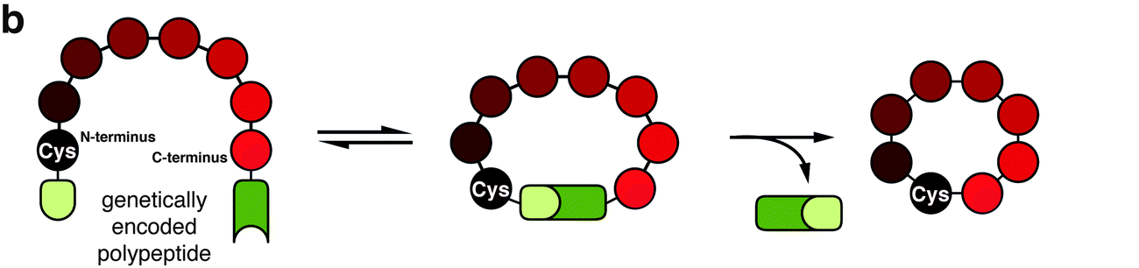
From: Inteins: nature's gift to protein chemists
Neel H. Shah and Tom W. Muir
DOI: 10.1039/C3SC52951G

Slide 15
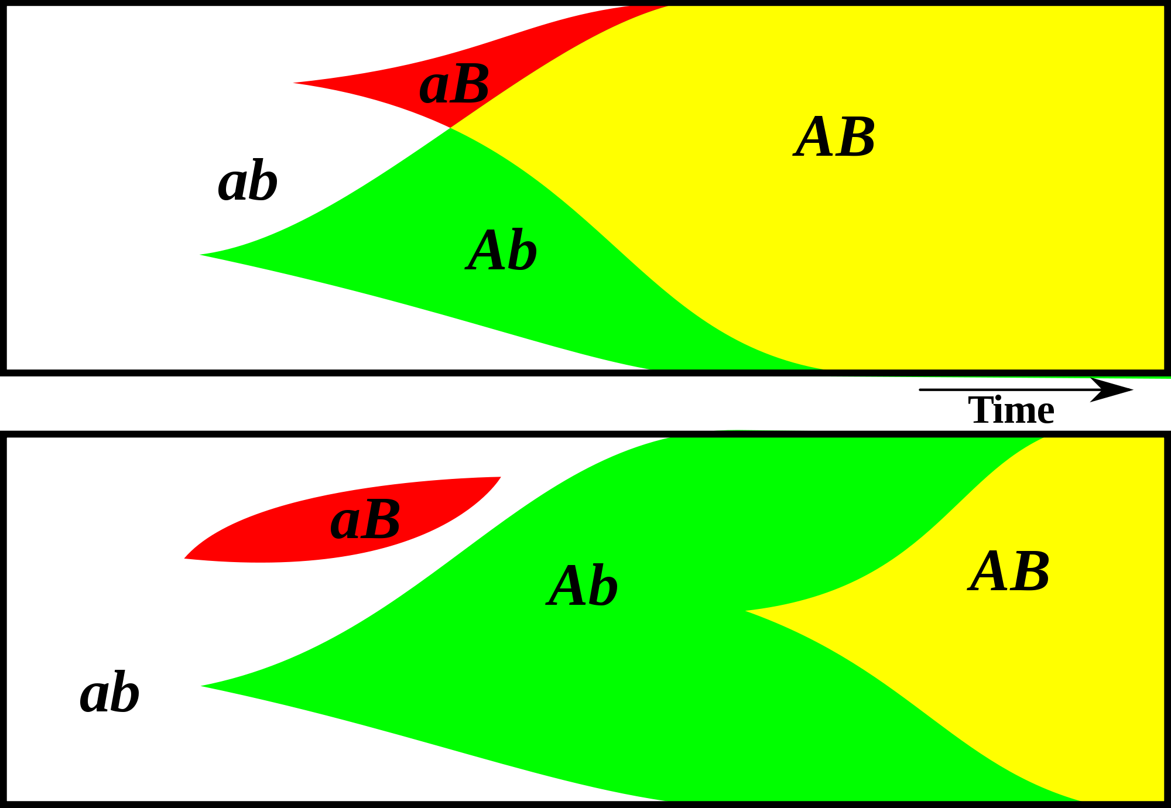
Gene Transfer, Sex, and Recombination:
Inventions do not need to be made sequentially
Gene transfer, followed by homologous or non-homologous recombination, allows inventions to be shared across the tree of life

Slide 16
Aside: Gene and genome duplication versus
Horizontal Gene Transfer
Autochtonous gene/genome
duplication are rare
in prokaryotes
Gene family expansion through horizontal gene transfer –
the most common process in prokaryotes

Slide 17
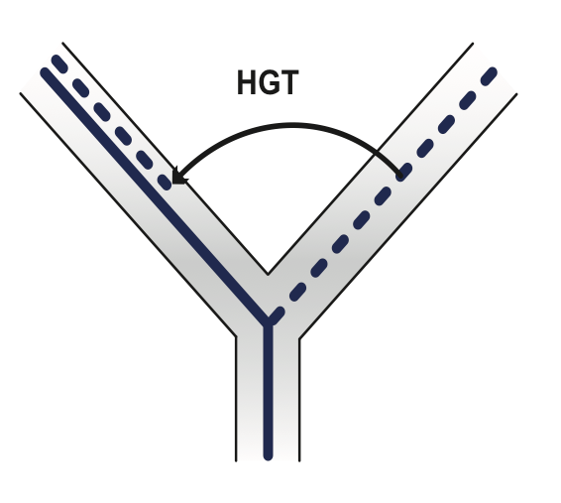
Horizontal Gene Transfer (HGT) and the
Acquisition of New Capabilities
Most important process to adapt microorganisms to new environments.
E.g.: Antibiotic and heavy metal resistance,
pathways that allow acquisition and breakdown of new substrates.
Creation of new metabolic pathways.
HGT not autochthonous gene duplication is the main
process of gene family expansion in prokaryotes.
Also important in the recent evolution of multicellular eukaryotes
(HGT between fish species and between grasses).
Selection acts on the Holobiont (= Host + Symbionts)
To adapt to new conditions, new symbionts can be acquired, or existing symbionts can acquire new genes through HGT.

Slide 18
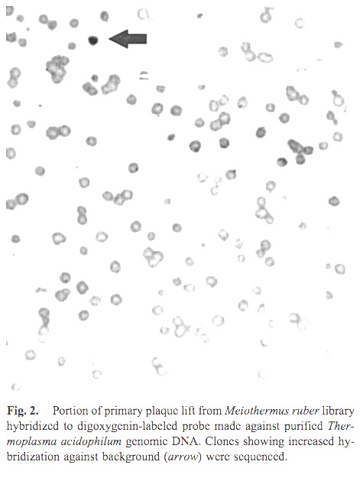
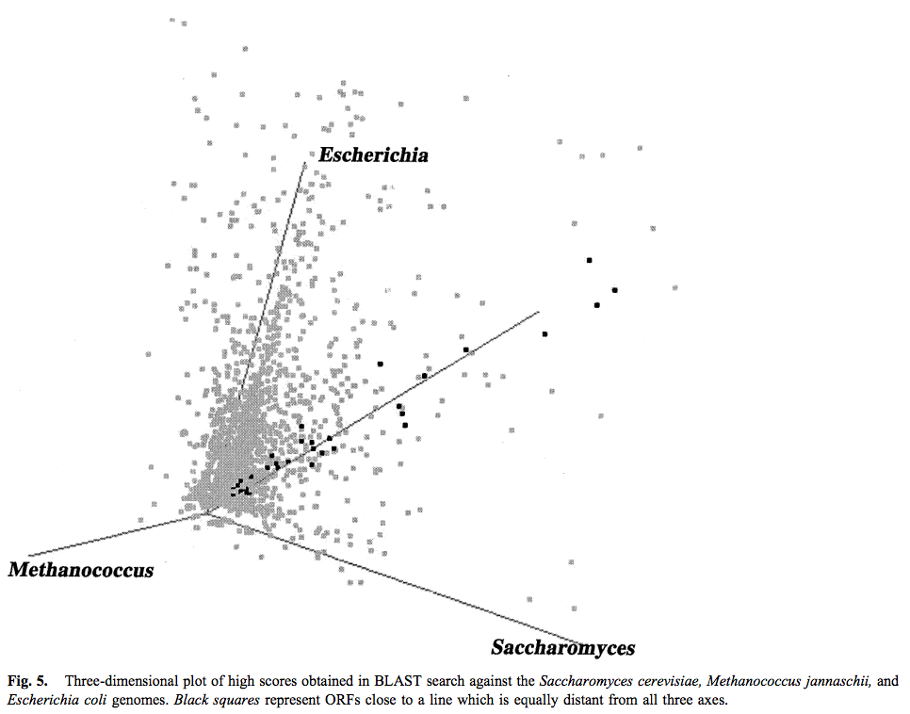
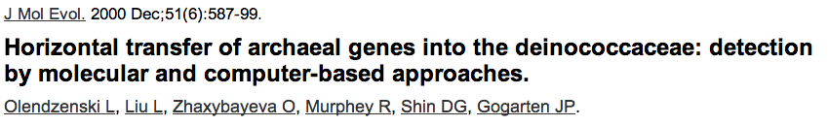
Finding transferred genes
Screening in the wet-lab and in the computer

Slide 19
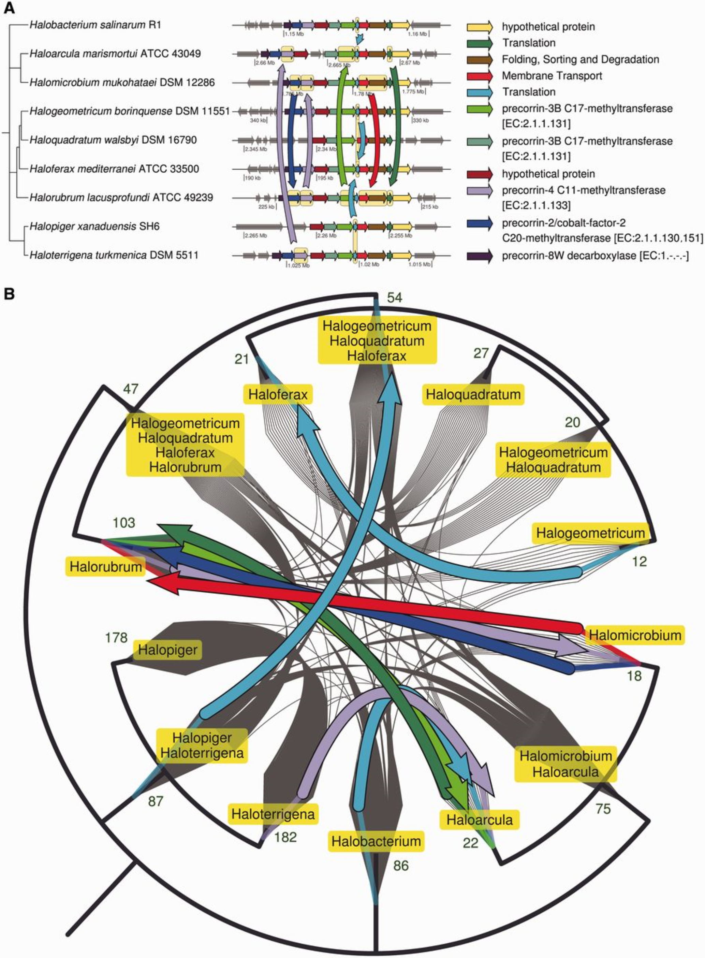
From: Quantifying Homologous Replacement of Loci between Haloarchaeal Species
Genome Biol Evol. 2012;4(12):1223-1244. doi:10.1093/gbe/evs098
.
Notes:
Fig. 3.— (A) Directed hierarchical network of extant and ancestral genomes showing HGTs of cobalamin (vitamin B<sub>12</sub>) biosynthesis genes. The nodes in the network are defined by the ribosomal protein phylogeny of nine haloarchaea, a subset of the full analysis of 21 genomes. The edges of the network are the vertical arrows indicating inferred HGTs by HR and are colored by homology. The network is arranged to also show the chromosomal regions coding for the proteins involved in cobalamin (vitamin B<sub>12</sub>) biosynthesis. The phylogeny edge length units are arbitrary time units; the chromosome map scale units are megabases (Mb). Horizontal arrows depict ORFs in 3′–5′ strand direction and are scaled to base pairs. Shared colors indicate most recent homology except for gray, which indicates no local homology. (B) Directed hierarchical network depicting the same HGTs as in figure 1(A) with arrows also colored by most recent homology. Gray lines indicate all other inferred HGTs, the directions of which are not indicated to maintain clarity. The green numbers indicate the total HGT events to or from that ancestral population.
19

Slide 20
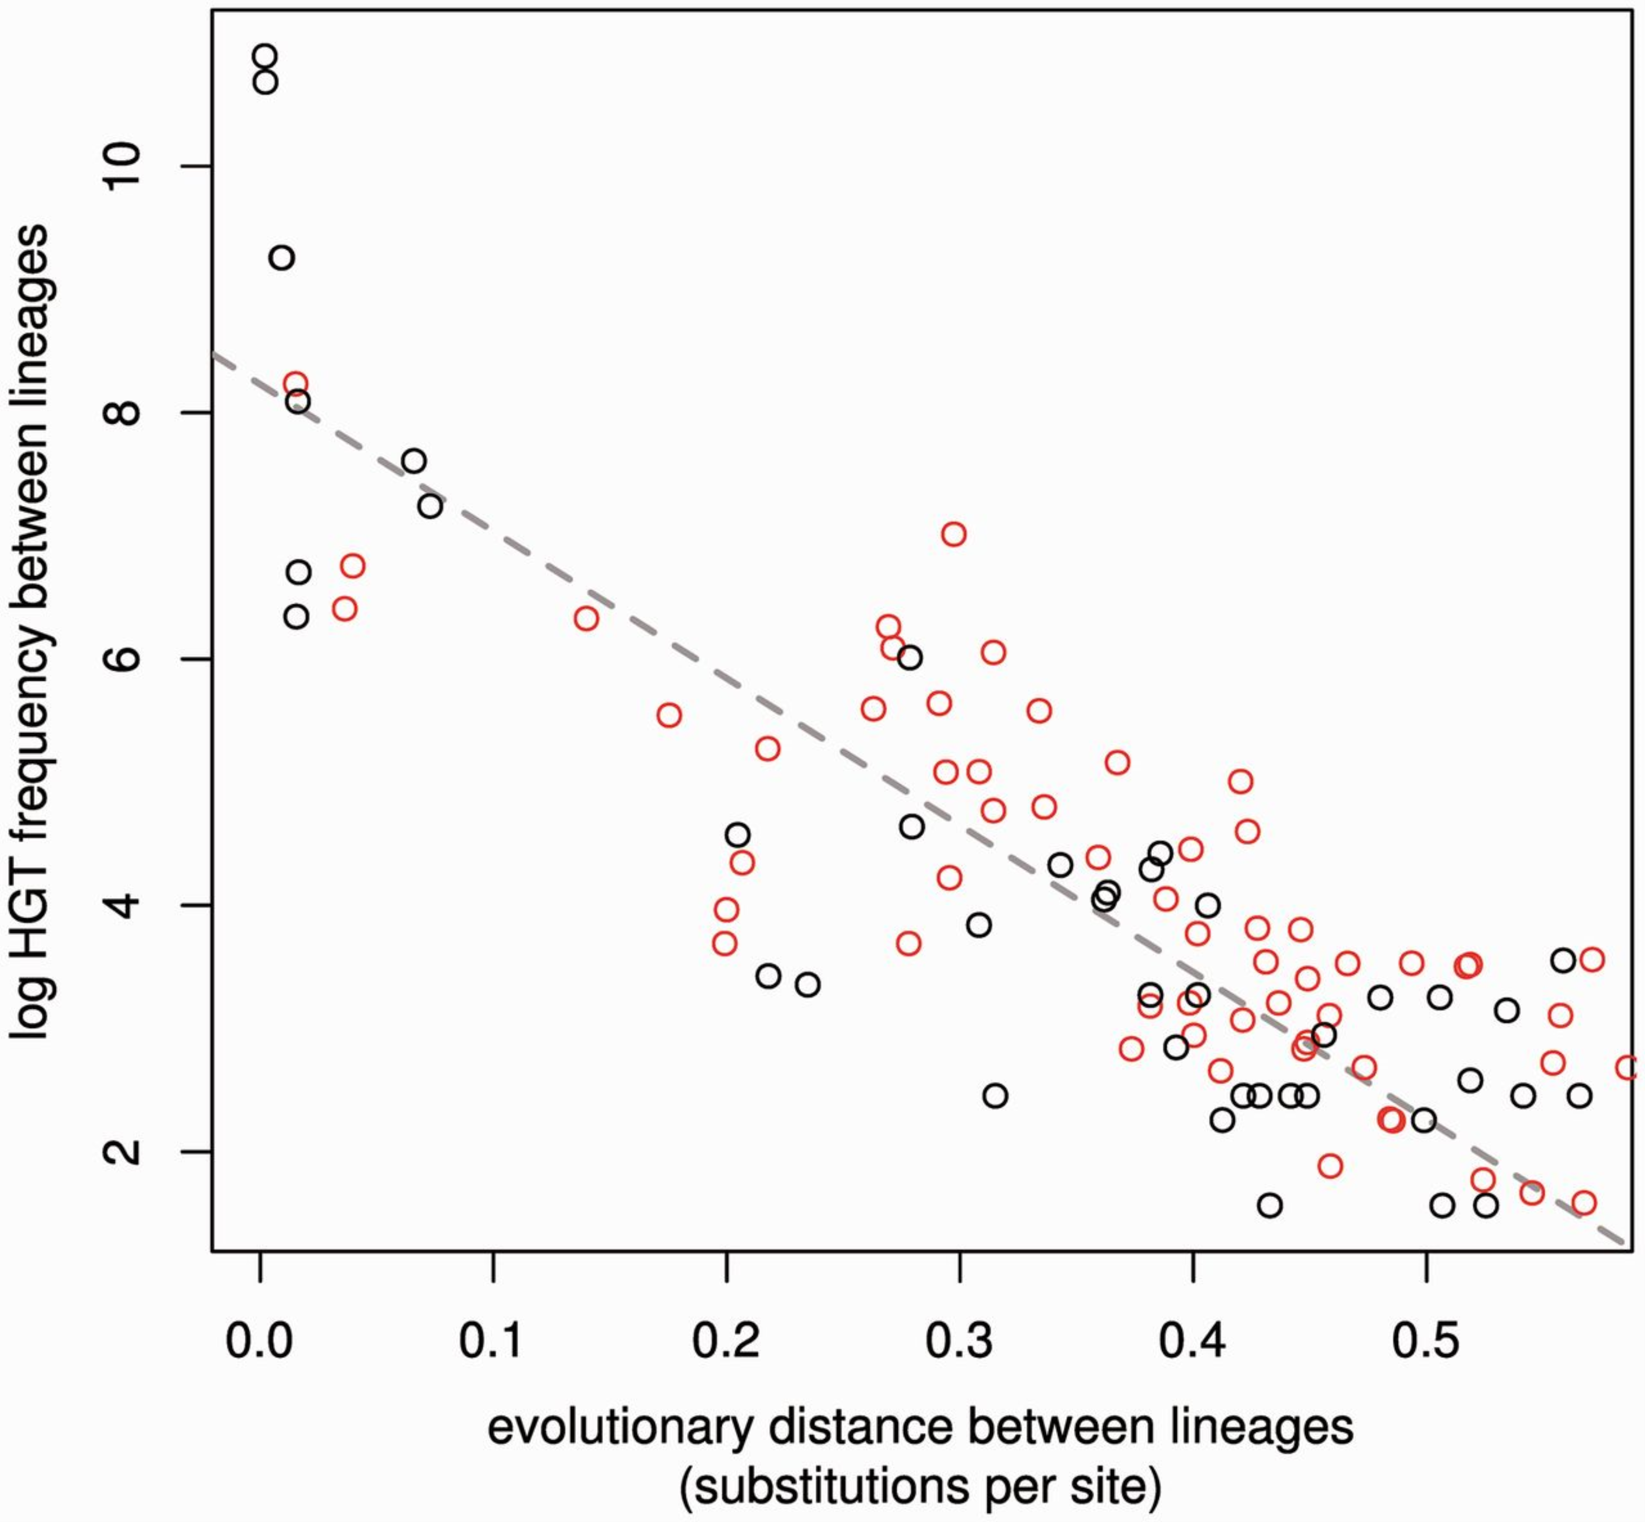
From: Quantifying Homologous Replacement of Loci between Haloarchaeal Species
Genome Biol Evol. 2012;4(12):1223-1244. doi:10.1093/gbe/evs098
Notes:
Fig. 4.— Scatter plot of frequency of HGT events between two lineages versus the distance across the ribosome phylogeny in substitutions per site. Black: HGT between terminal edges and red: HGT between internal edges. Frequency was calculated as the total inferred HGT events between two edges on the ribosome phylogeny per overlapping edge length when scaled to a relaxed molecular clock. The dashed line is a linear model fitted after natural log transformation of the frequencies between terminal edges, R<sup>2 </sup>= 0.78, P < 6 × 10<sup>−15</sup>. Terminal edges are considered more reliable than internal edges because tips are at present day. Fitted HGT frequencies between all edges, R<sup>2 </sup>= 0.72, P < 1 × 10<sup>−16</sup>. An inverse log-linear relationship for recombination rates versus genome similarity has also been observed in experimental studies and inferred from sequence data of closely related bacterial genera.
20

Slide 21
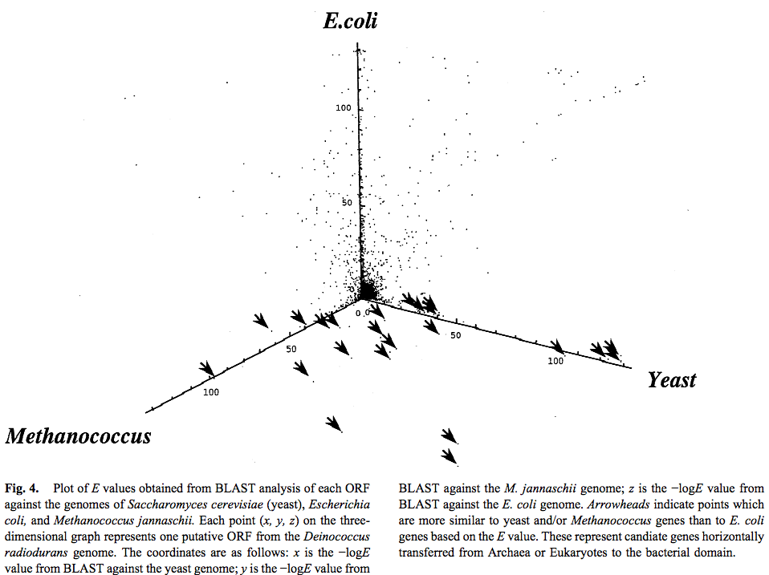
Finding transferred genes

Slide 22
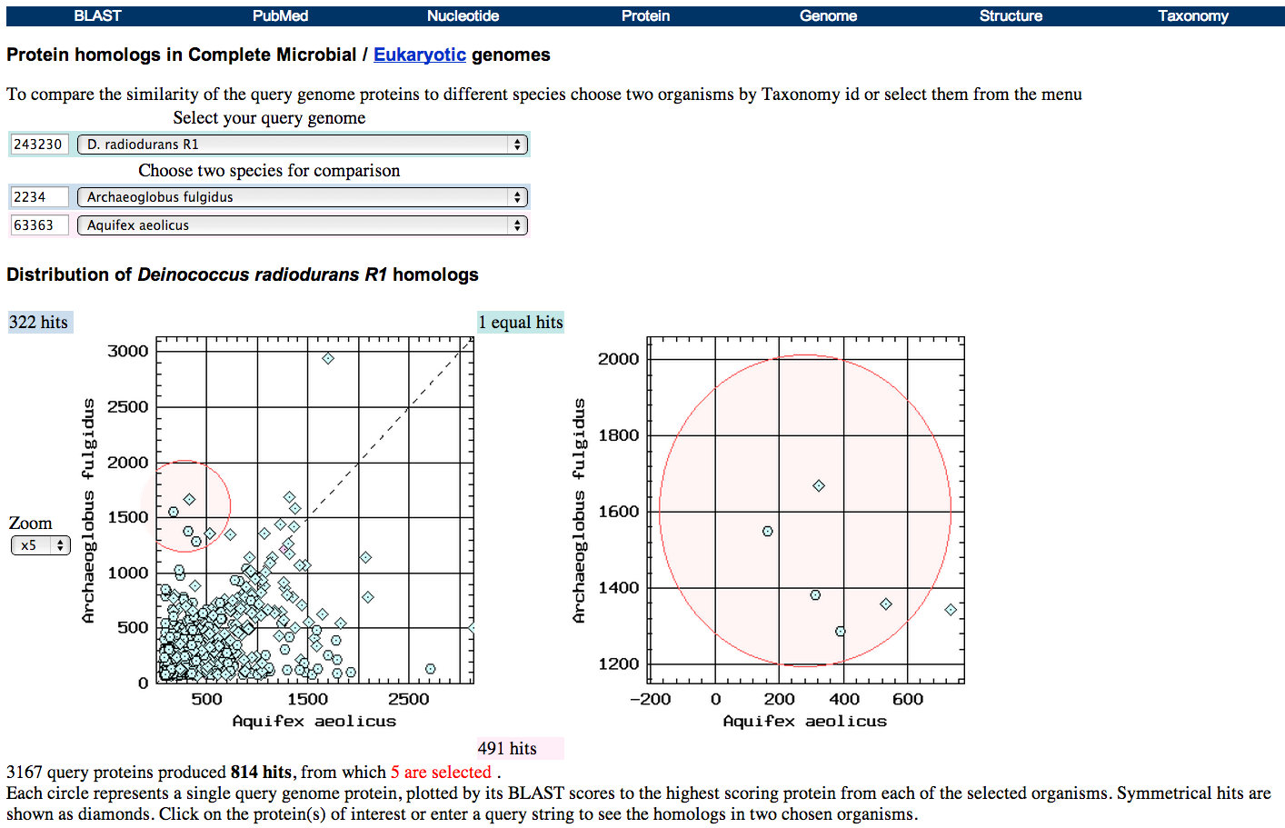
Taxplot at NCBI

Slide 23
Other approaches to find transferred genes
Gene presence absence data for closely related genomes (for additional genes)
Phylogenetic conflict (for homologous replacement (e.g. quartet decompositon spectra see Figs. 1 and 2))
Composition based analyses (for very recent transfers).

Slide 24
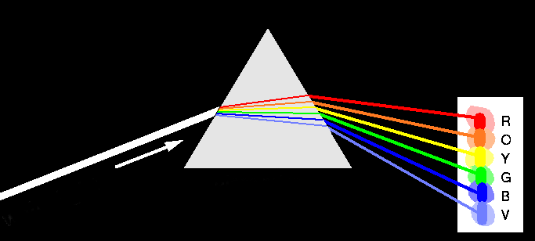
Decomposition of Phylogenetic Data
Phylogenetic information
present in genomes
Break information
into small quanta
of information
Analyze spectra to detect transferred genes and plurality consensus.

Slide 25

TOOLS TO ANALYZE PHYLOGENETIC INFORMATION FROM MULTIPLE GENES IN GENOMES:
Bipartition Spectra (Lento Plots)

Slide 26
BIPARTITION OF A PHYLOGENETIC TREE
Bipartition (or split) – a division of a phylogenetic tree into two parts that are connected by a single branch.
It divides a dataset into two groups, but it does not consider the relationships within each of the two groups.
Yellow vs Rest
* * * . . . * *
95
compatible to illustrated
bipartition
Orange vs Rest
. . * . . . . *
* * * . . . . .
incompatible to illustrated
bipartition

Slide 27
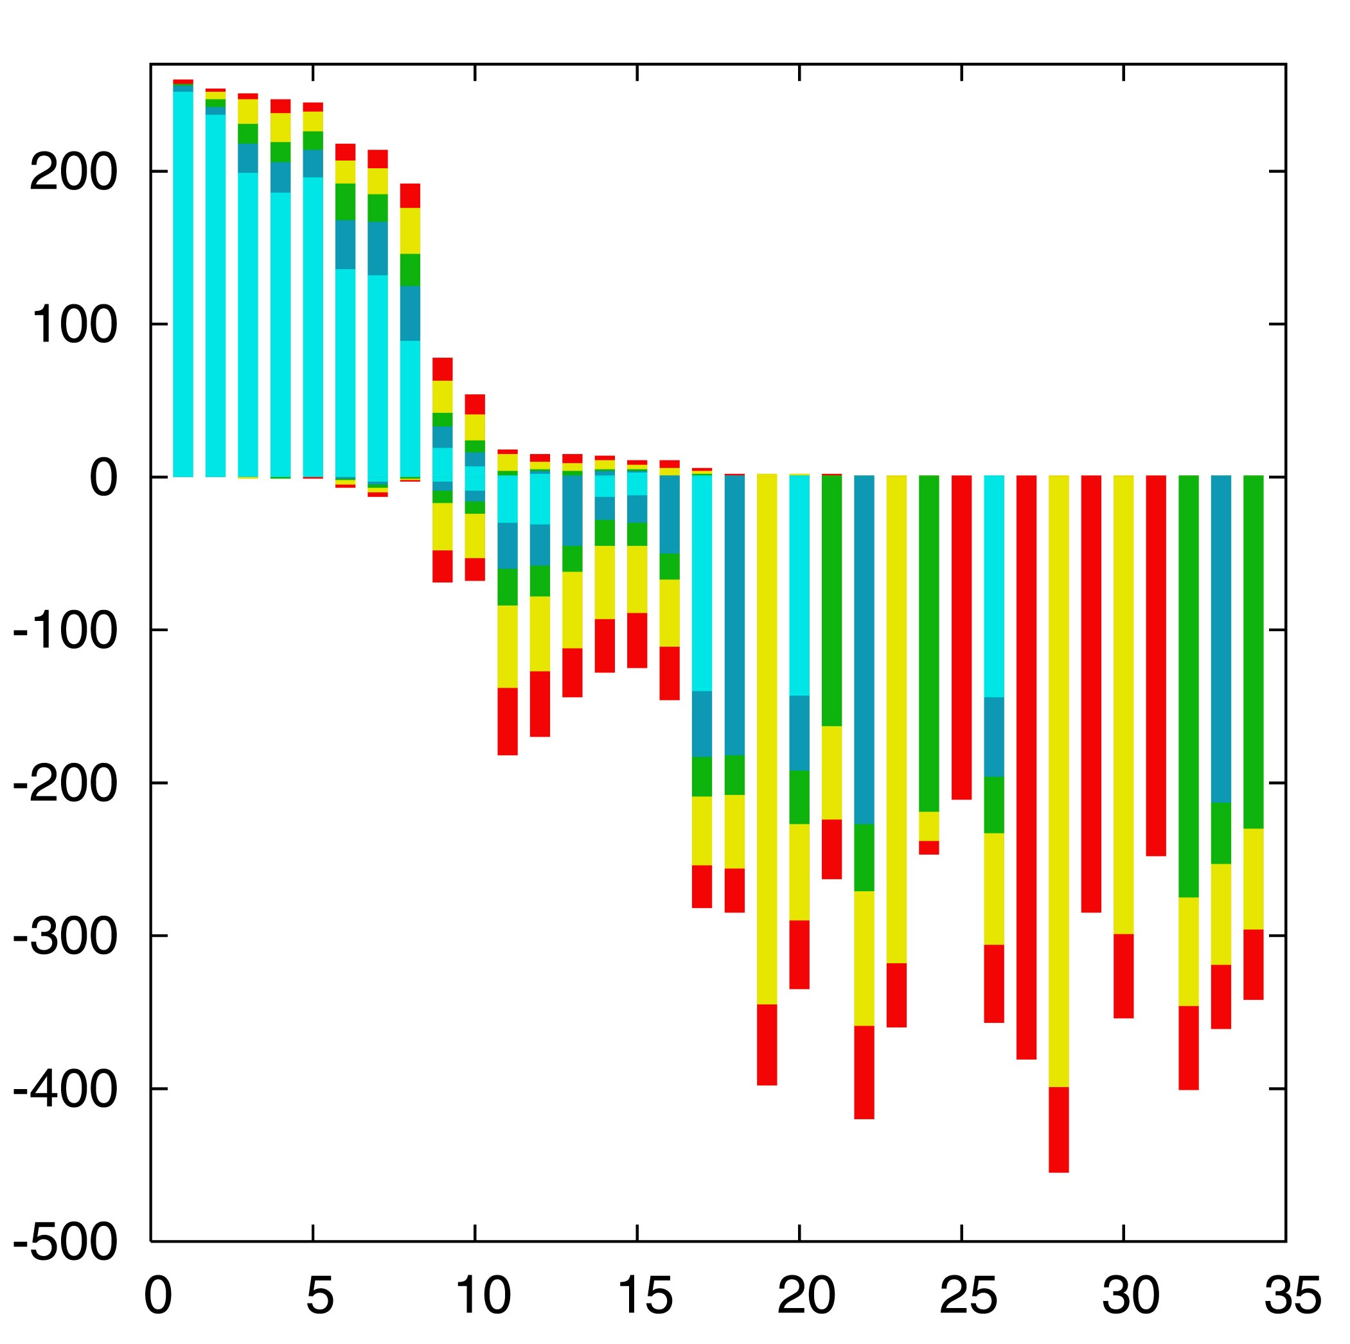

“Lento”-plot of 34 supported bipartitions (out of 4082 possible)
13 gamma-
proteobacterial
genomes
(258 putative
orthologs):
E.coli
Buchnera
Haemophilus
Pasteurella
Salmonella
Yersinia pestis
(2 strains)
Vibrio
Xanthomonas
(2 sp.)
Pseudomonas
Wigglesworthia
There are 13,749,310,575 possible unrooted tree topologies for 13 genomes

Slide 28
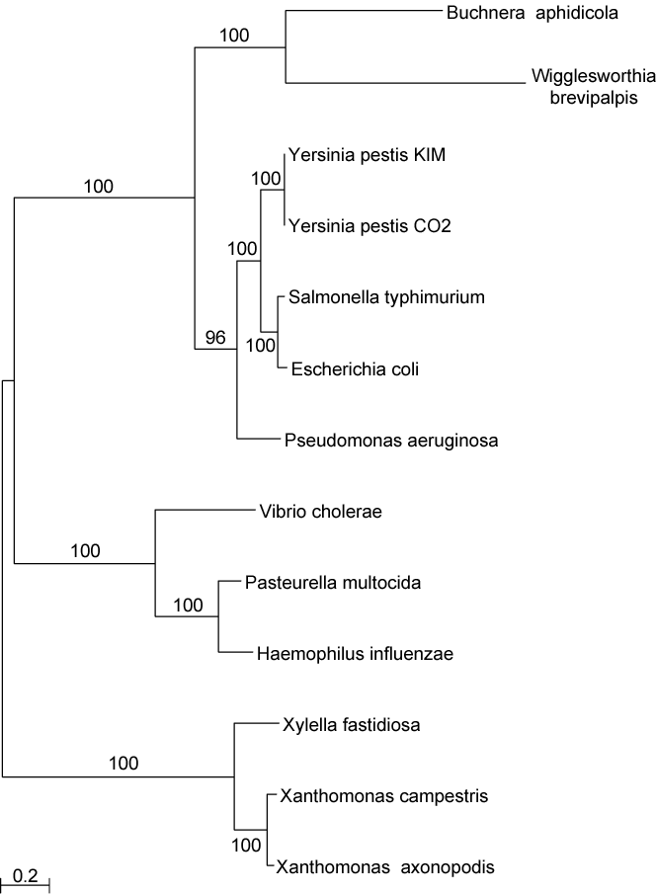
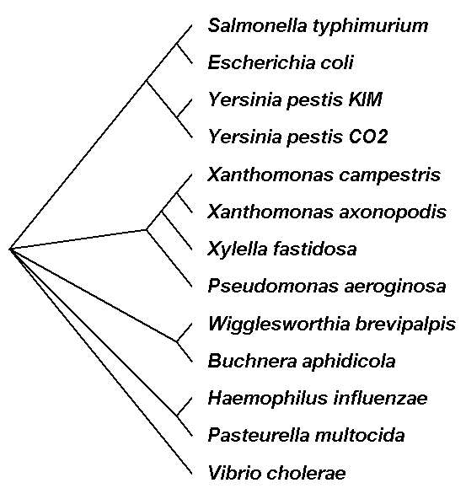
Consensus clusters of eight significantly supported bipartitions
Phylogeny of putatively transferred gene
(virulence factor homologs (mviN))
only 258 genes analyzed

Slide 29

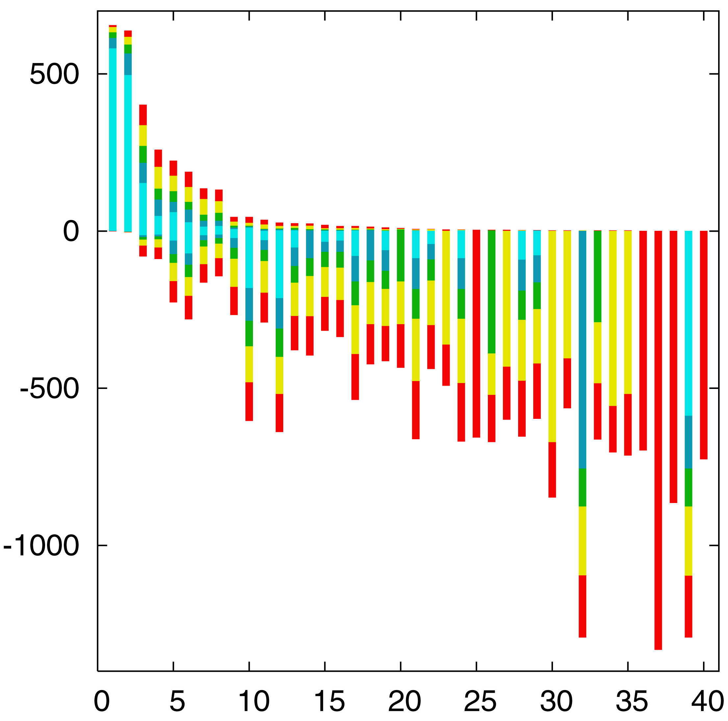
“Lento”-plot of supported bipartitions (out of 501 possible)
10 cyanobacteria:
Anabaena
Trichodesmium
Synechocystis sp.
Prochlorococcus
marinus
(3 strains)
Marine
Synechococcus
Thermo-
synechococcus
elongatus
Gloeobacter
Nostoc
punctioforme
Number of datasets
Based on 678 sets of orthologous genes
Zhaxybayeva, Lapierre and Gogarten, Trends in Genetics, 2004, 20(5): 254-260.

Slide 30
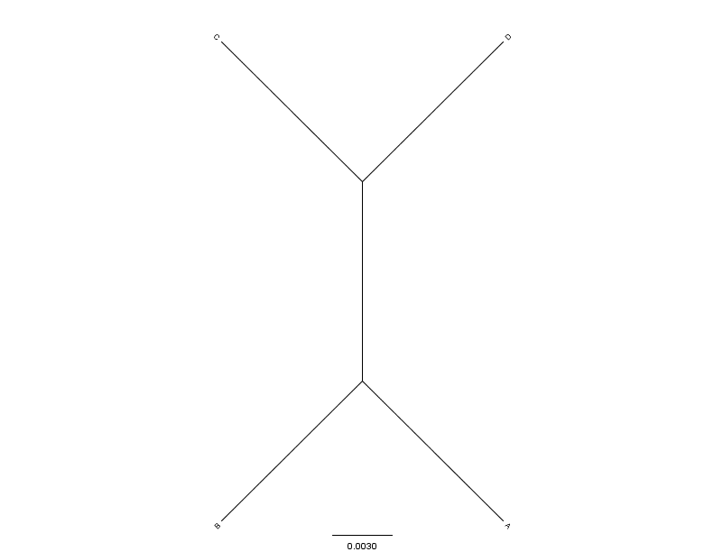
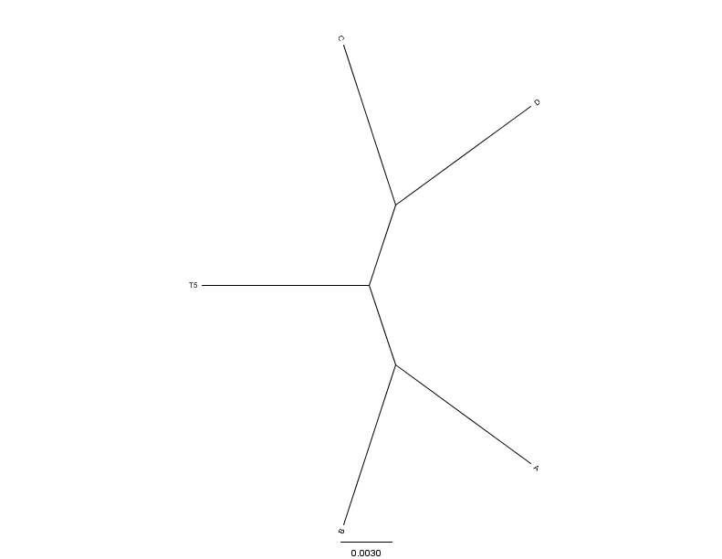
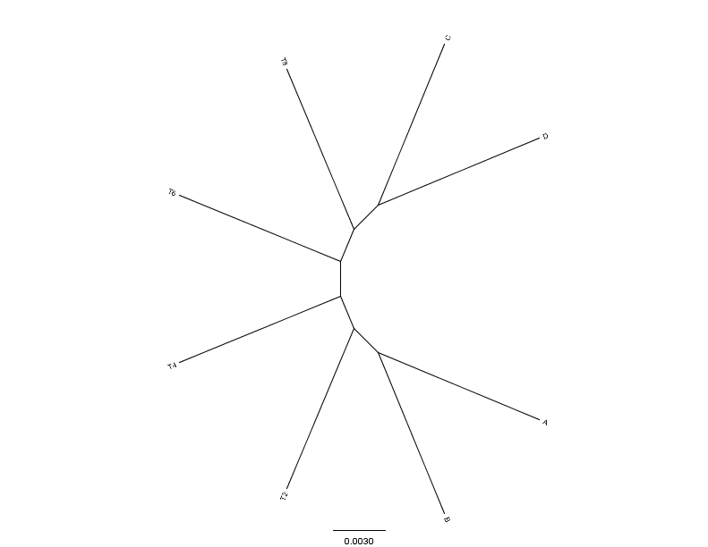
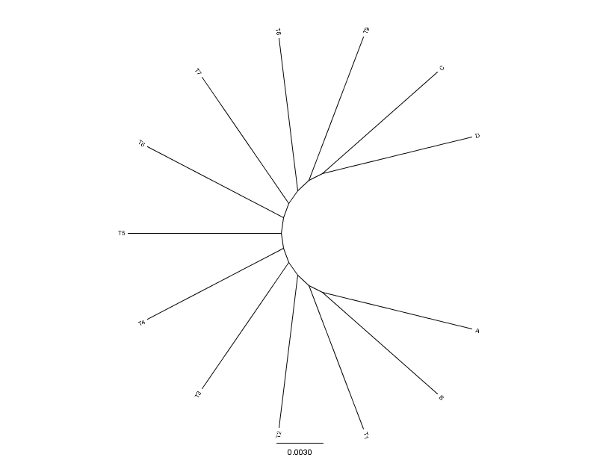
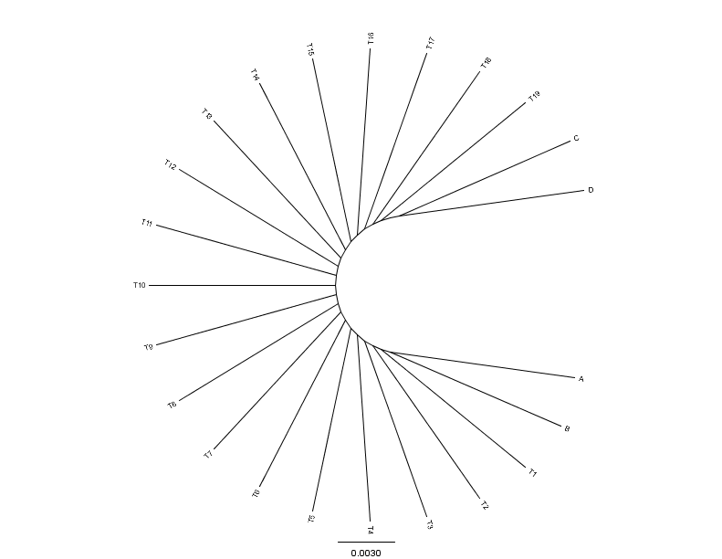
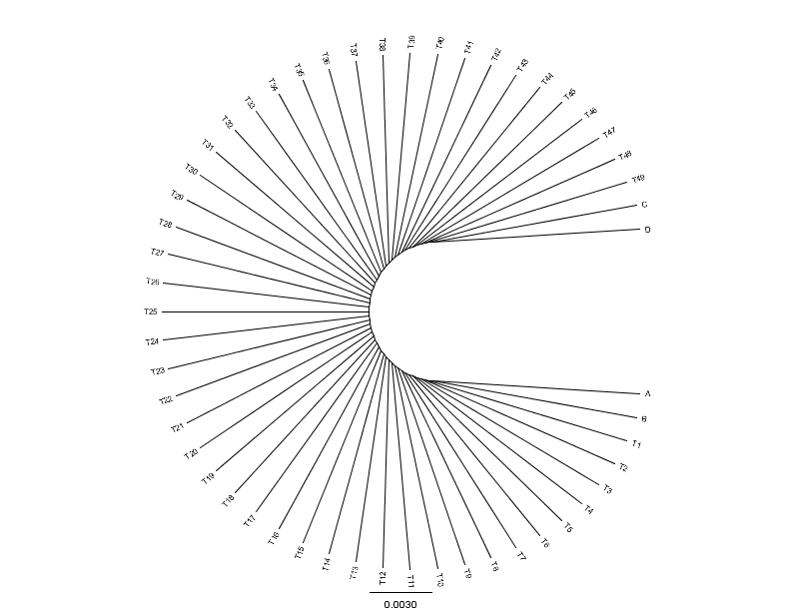
C
D
C
C
D
0.01
0.01
D
N=4(0)
N=5(1)
N=8(4)
0.01
A
0.01
0.01
B
B
B
A
A
B
C
C
D
D
C
D
A
A
A
B
B
B
N=13(9)
N=23(19)
N=53(49)
From: Mao F, Williams D, Zhaxybayeva O, Poptsova M, Lapierre P, Gogarten JP, Xu Y (2012)
BMC Bioinformatics 13:123, doi:10.1186/1471-2105-13-123

Slide 31


Results :
Maximum Bootstrap Support value for Bipartition separating (AB) and (CD)
Maximum Bootstrap Support value
for embedded Quartet (AB),(CD)

Slide 32
Bipartition Paradox:
The more sequences are added, the lower the support for bipartitions that include all sequences. The more data one uses, the lower the bootstrap support values become.
This paradox disappears when only embedded splits for 4 sequences are considered.

Slide 33
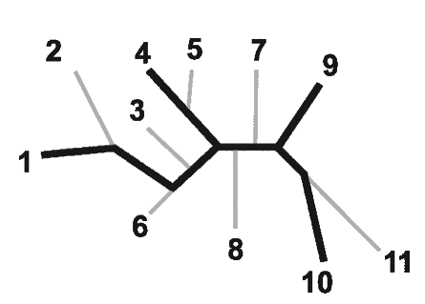
Bootstrap support values for embedded quartets
+
: tree calculated from one pseudo-sample generated by bootstraping from an alignment of one gene family present in 11 genomes
: embedded quartet for genomes
1, 4, 9, and 10 .
This bootstrap sample supports the topology ((1,4),9,10).
1
9
1
9
1
10
4
√
10
10
4
9
4
Zhaxybayeva et al. 2006, Genome Research, 16(9):1099-108
Quartet spectral analyses of genomes iterates over three loops:
Repeat for all bootstrap samples.
Repeat for all possible embedded quartets.
Repeat for all gene families.

Slide 34
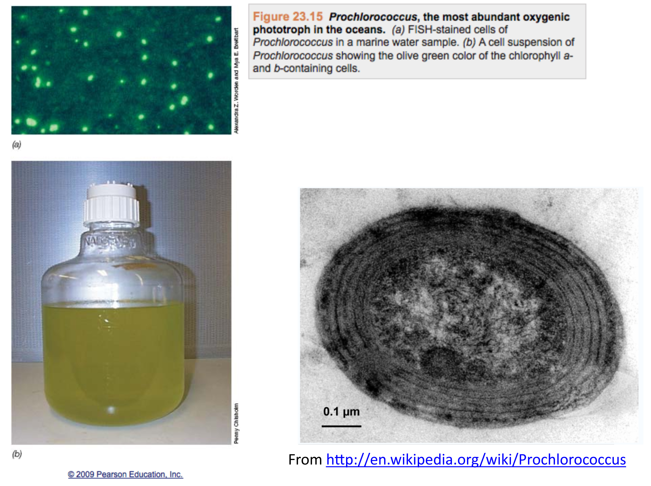

Slide 35
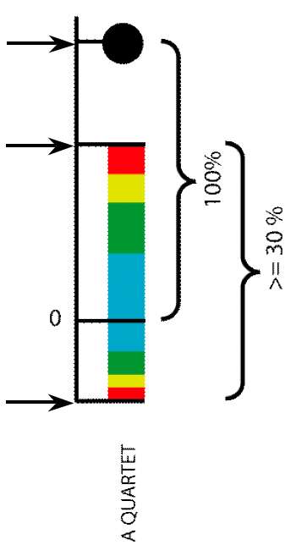
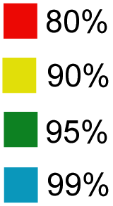
Illustration of one component of a quartet spectral analyses Summary of phylogenetic information for one genome quartet for all gene families
Total number of gene families containing the species quartet
Number of gene families supporting the same topology as the plurality
(colored according to bootstrap support level)
Number of gene families supporting one of the two alternative quartet topologies

Slide 36
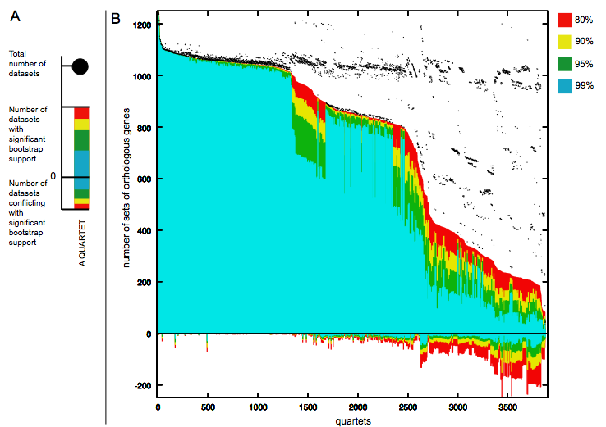
Quartet decomposition analysis of 19 Prochlorococcus and marine Synechococcus genomes. Quartets with a very short internal branch or very long external branches as well those resolved by less than 30% of gene families were excluded from the analyses to minimize artifacts of phylogenetic reconstruction.

Slide 37
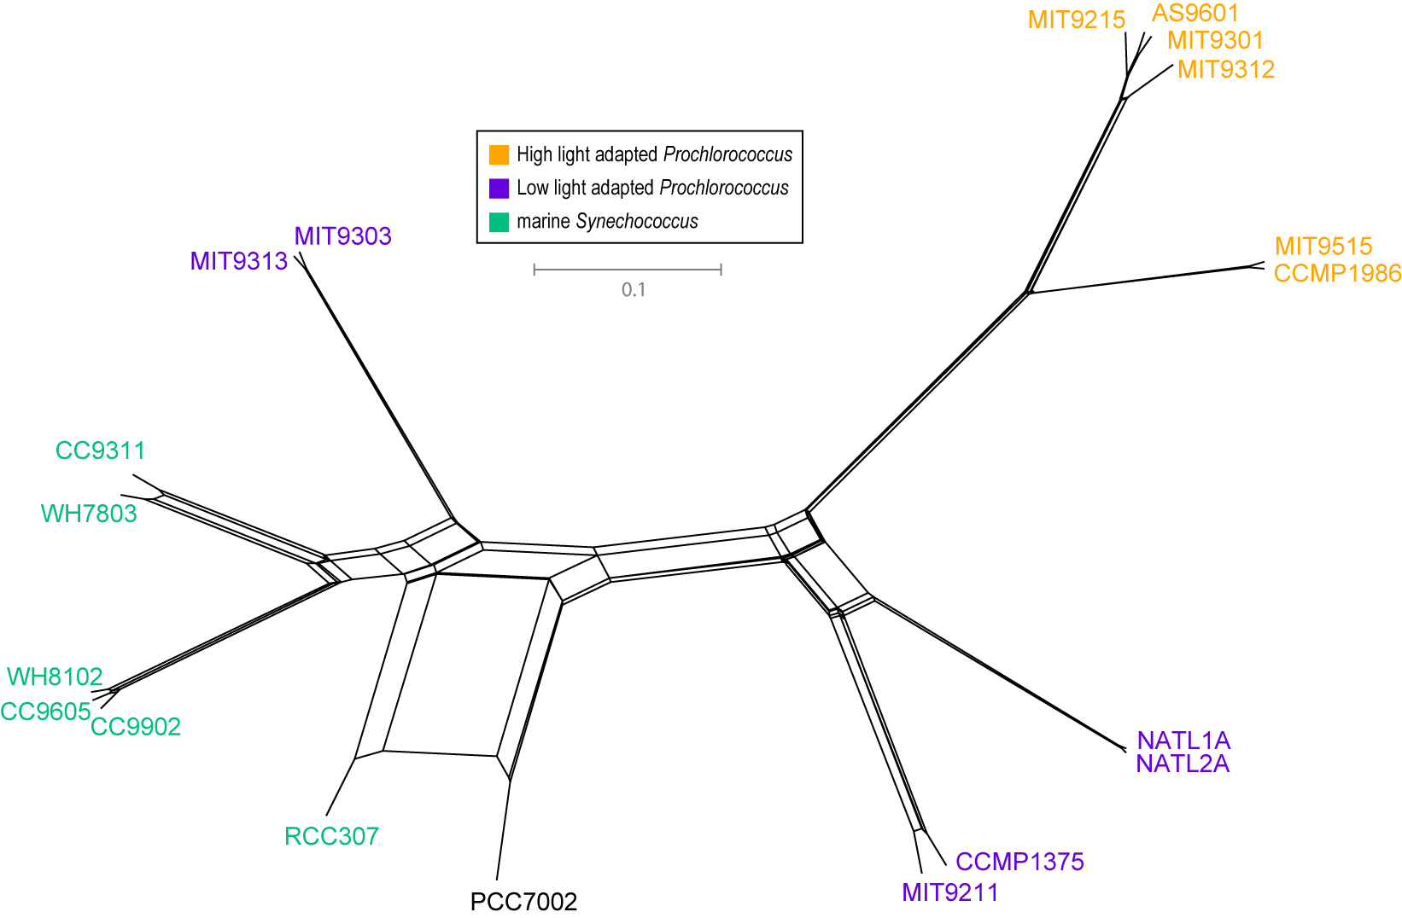
NeighborNet (calculated with SplitsTree 4.0)
Plurality neighbor-net calculated as supertree (from the MRP matrix using SplitsTree 4.0) from all quartets significantly supported by all individual gene families (1812) without in-paralogs.

Slide 38
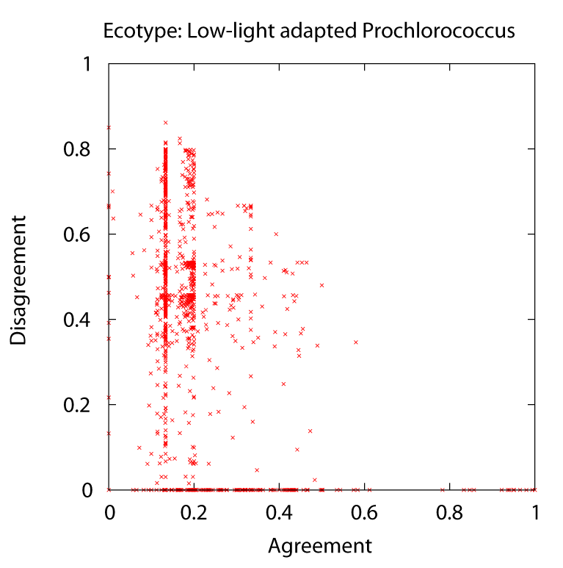
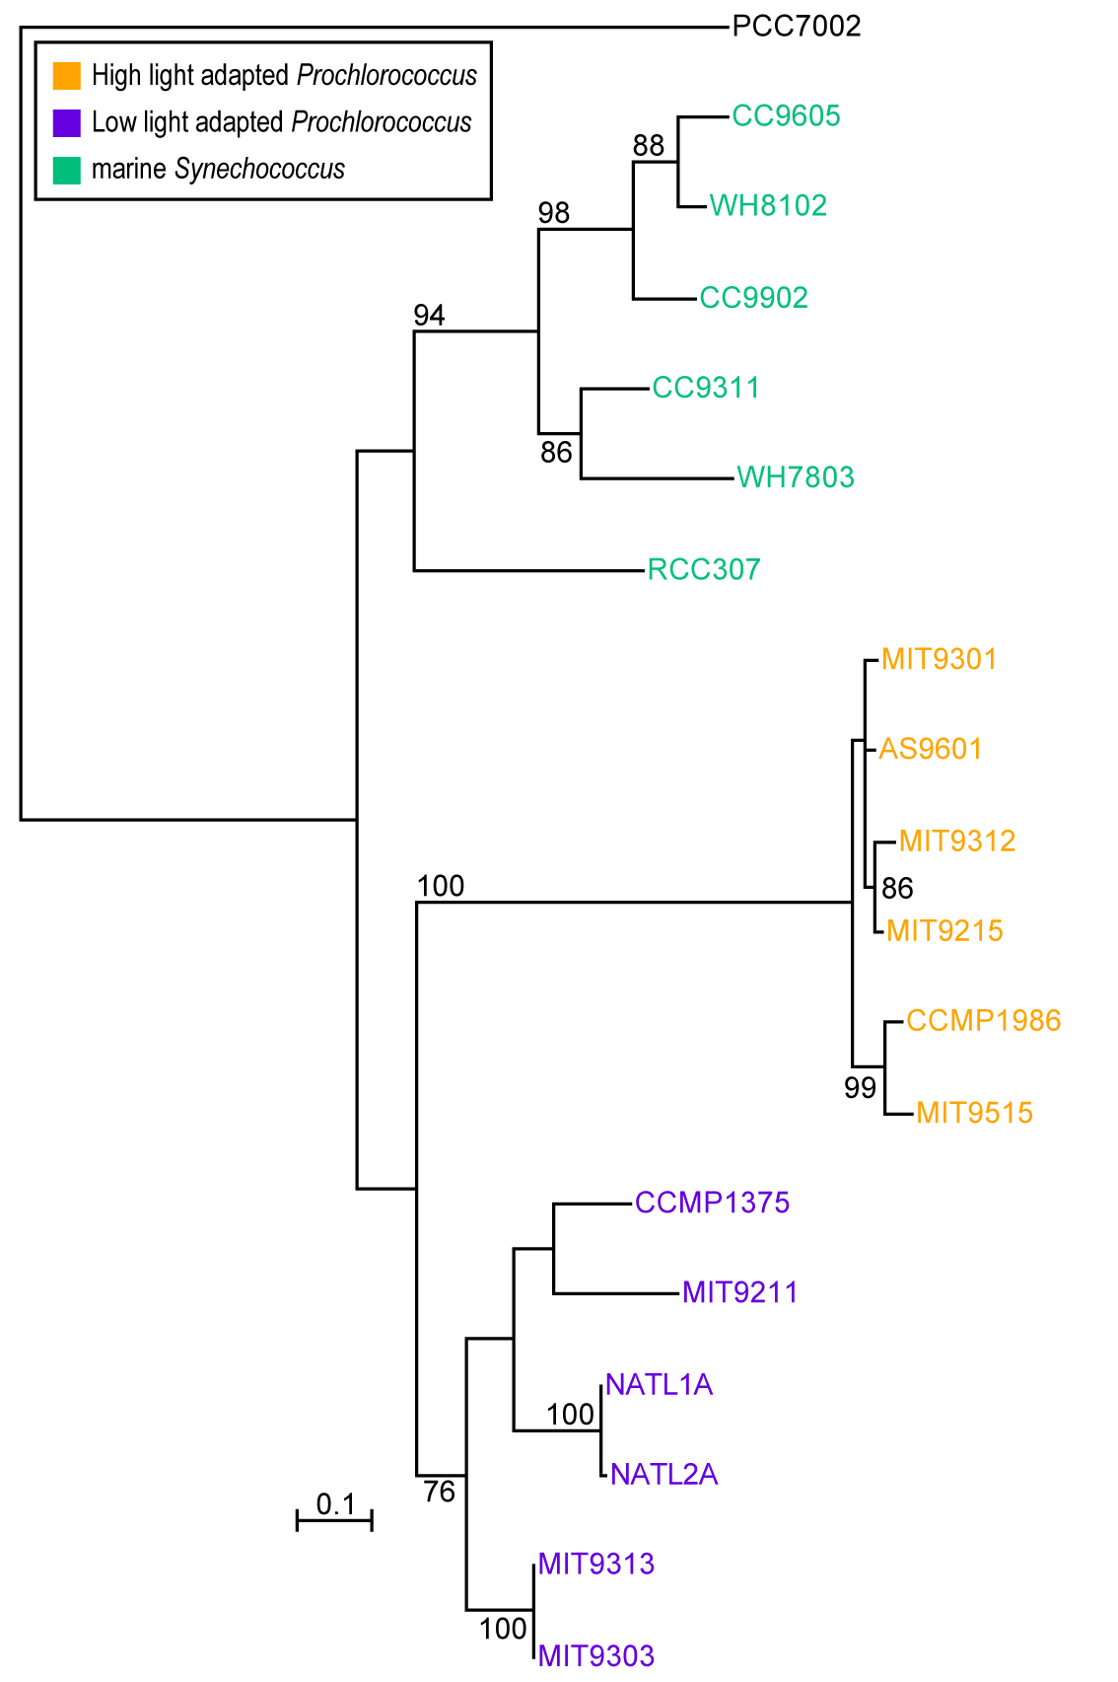
Phylogeny of delta subunit of ATP synthase.

Slide 39
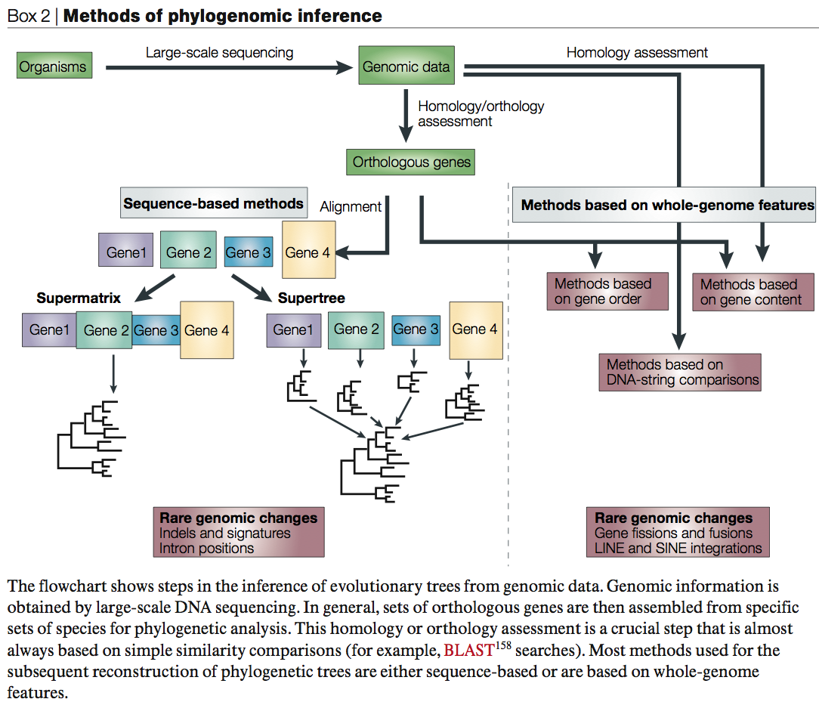
From:
Delsuc F, Brinkmann H, Philippe H.
Phylogenomics and the reconstruction of the tree of life.
Nat Rev Genet. 2005 May;6(5):361-75.

Slide 40
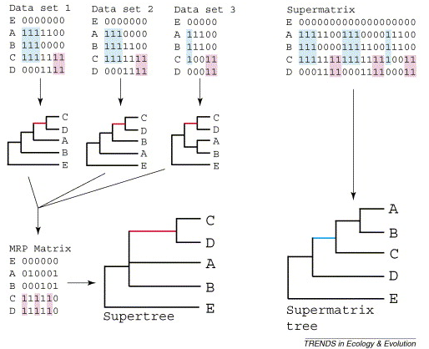
Supertree vs. Supermatrix
From:
Alan de Queiroz John Gatesy:
The supermatrix approach to systematics
Trends Ecol Evol. 2007 Jan;22(1):34-41
Schematic of MRP supertree (left) and parsimony supermatrix (right) approaches to the analysis of three data sets. Clade C+D is supported by all three separate data sets, but not by the supermatrix. Synapomorphies for clade C+D are highlighted in pink. Clade A+B+C is not supported by separate analyses of the three data sets, but is supported by the supermatrix. Synapomorphies for clade A+B+C are highlighted in blue. E is the outgroup used to root the tree.

Slide 41
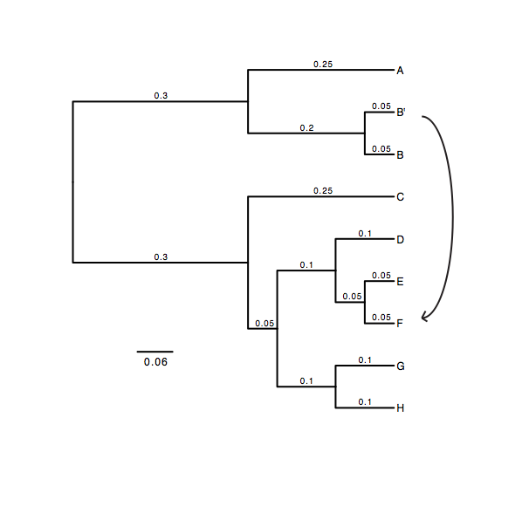
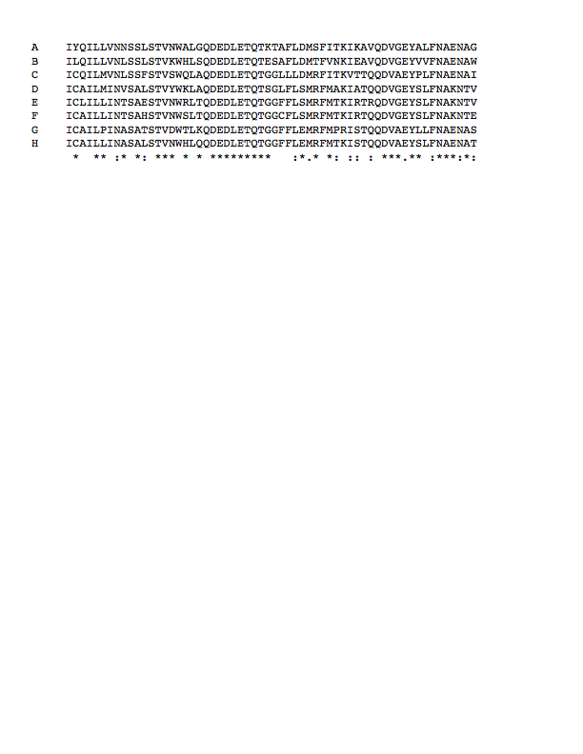
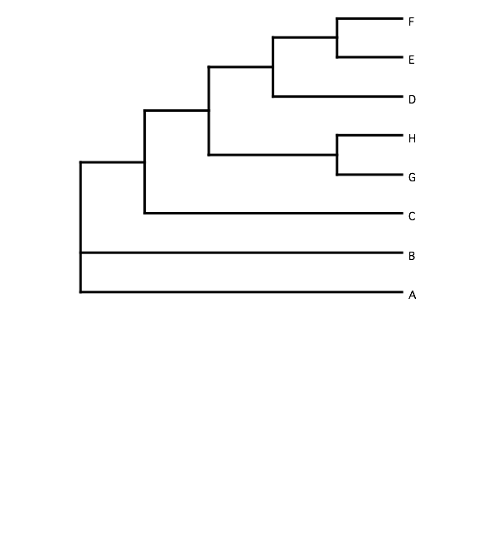
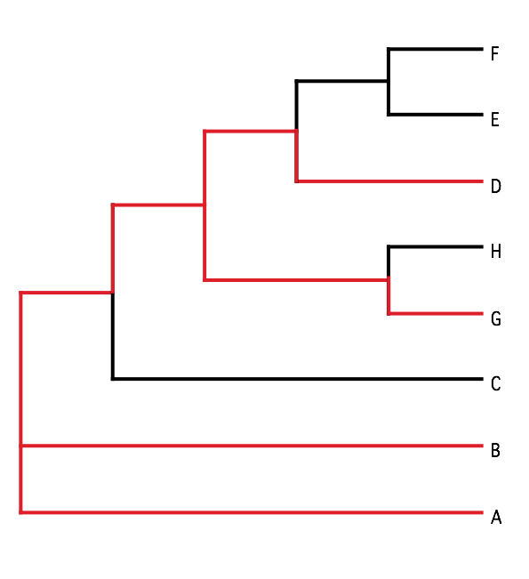
B) Generate 100 datasets using Evolver with certain amount of HGTs
A) Template tree
C) Calculate 1 tree using the concatenated dataset or 100 individual trees
D) Calculate Quartet based tree using Quartet Suite
Repeated 100 times…

Slide 42
Supermatrix versus
Quartet based Supertree
inset: simulated phylogeny

Slide 43
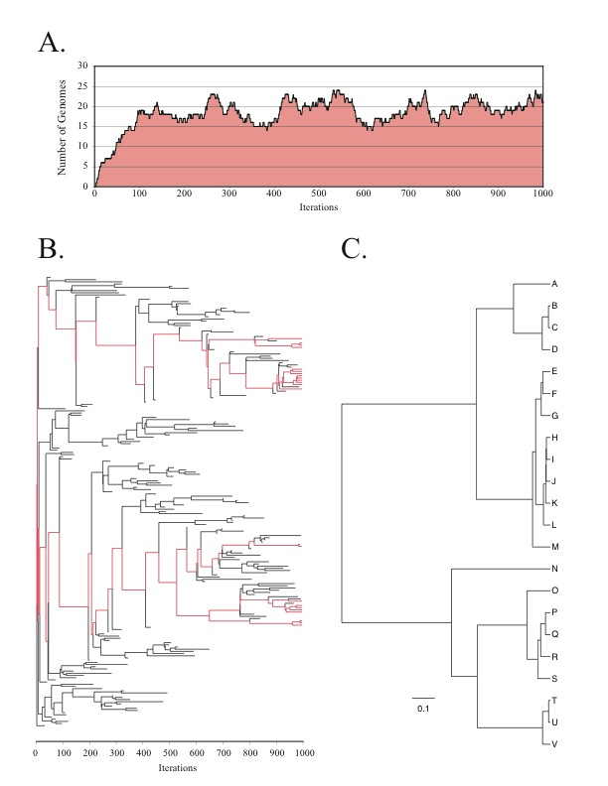
Note : Using same genome seed random number will reproduce same genome history
From: Lapierre P, Lasek-Nesselquist E, and Gogarten JP (2012)
The impact of HGT on phylogenomic reconstruction methods
Brief Bioinform [first published online August 20, 2012] doi:10.1093/bib/bbs050

Slide 44
HGT EvolSimulator Results

Slide 46
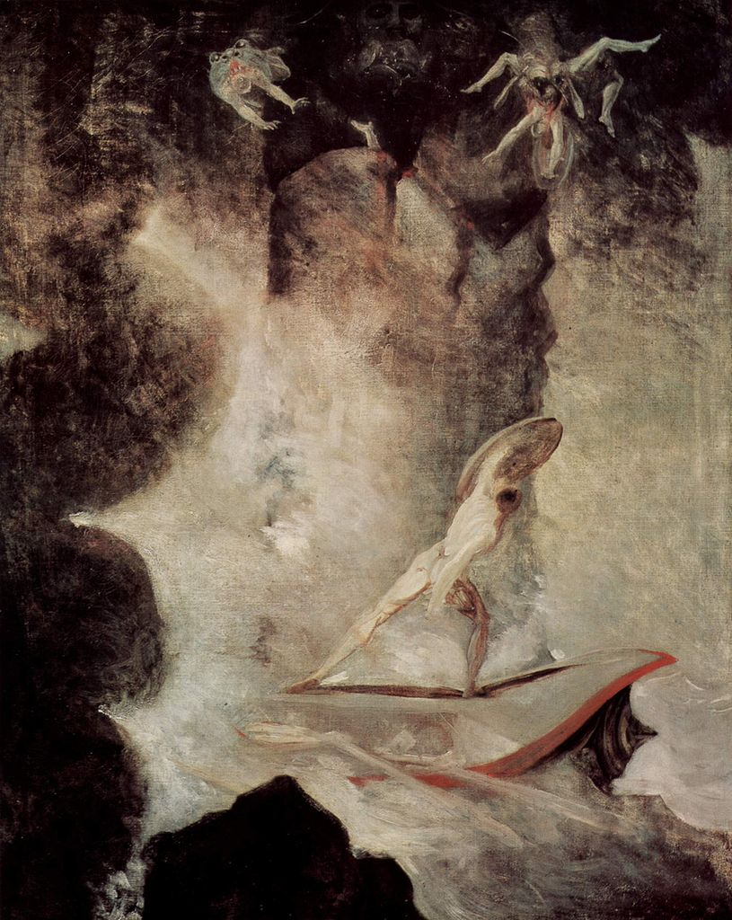
Johann Heinrich Füssli
Odysseus vor Scilla und Charybdis
From: http://en.wikipedia.org/wiki/File:Johann_Heinrich_F%C3%BCssli_054.jpg

