Slide 1
Genbank
Founded in 1982 at the Los Alamos National Laboratory
Initially managed at Stanford in conjunction with the BIOSCI/Bionet news groups
1989-92 transition to the NCBI on the east coast
One precursor was Margaret Dayhoff’s Atlas of Protein Sequence and Structure
In 1987 genbank fit onto a few 360 KB floppy disks.
Genbank uses a flat file database format (see http://en.wikipedia.org/wiki/Flat_file_database)
NCBI does not use a relational databank (as in Oracle, peoplesoft)
NCBI stores data in ASN.1 format (http://en.wikipedia.org/wiki/Abstract_Syntax_Notation_One),
which allows to hardwire crosslinks to other data bases, and makes retrieval of related information fast.
NCBI’s sample record (http://www.ncbi.nlm.nih.gov/Sitemap/samplerecord.html) contains links
to most the fields used in the gbk flatfile.
In the genbank records at NCBI the links connect to the features (i.e. the pubmed record, or the encoded protein sequence) --- not easy to work with.

Slide 2
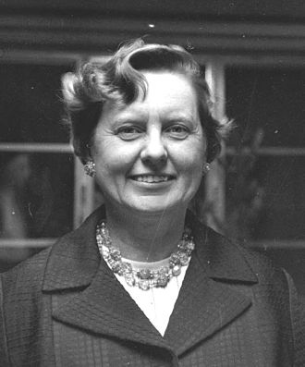
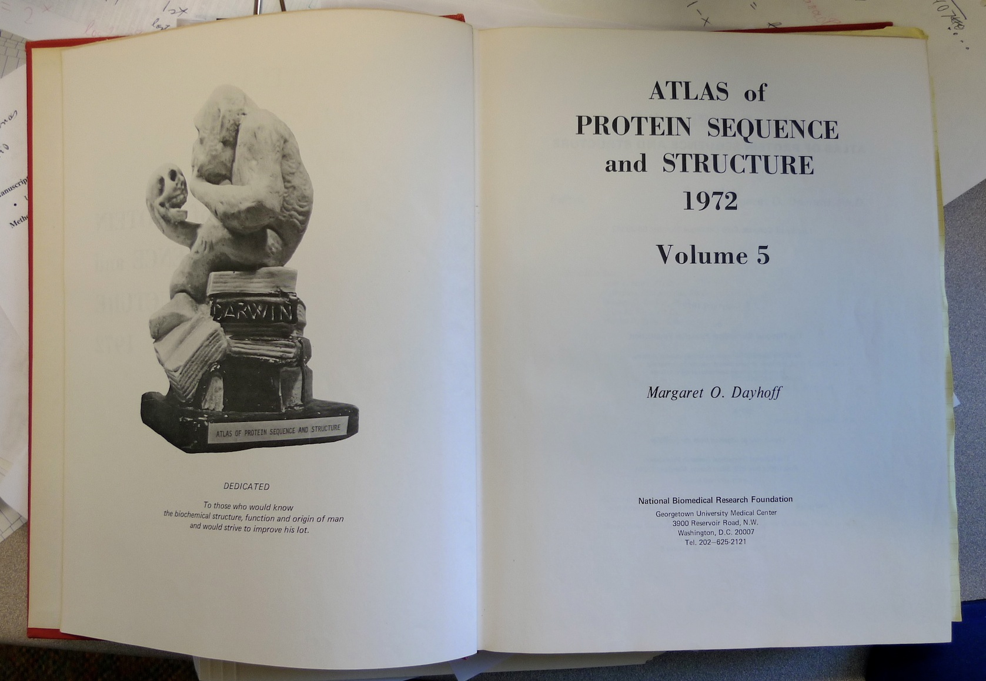
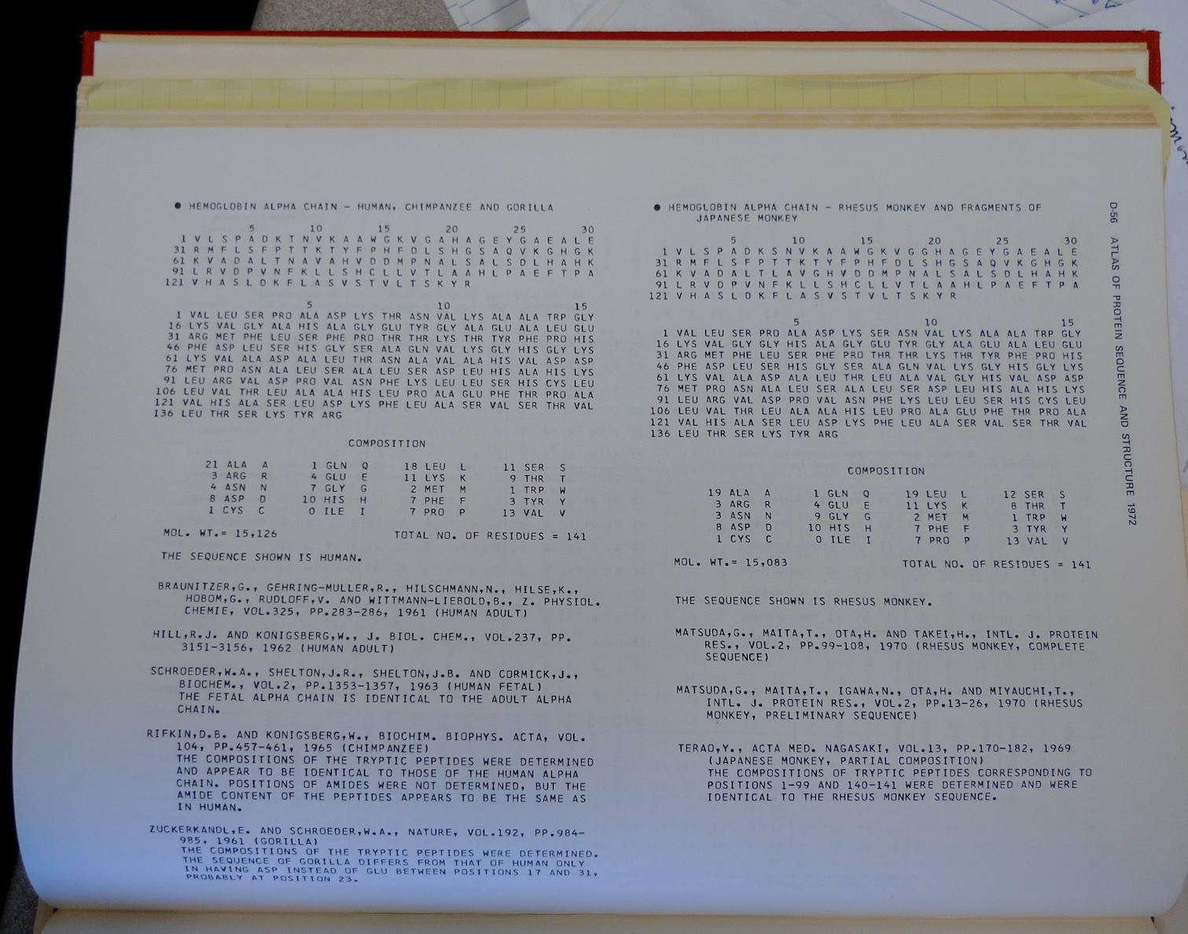
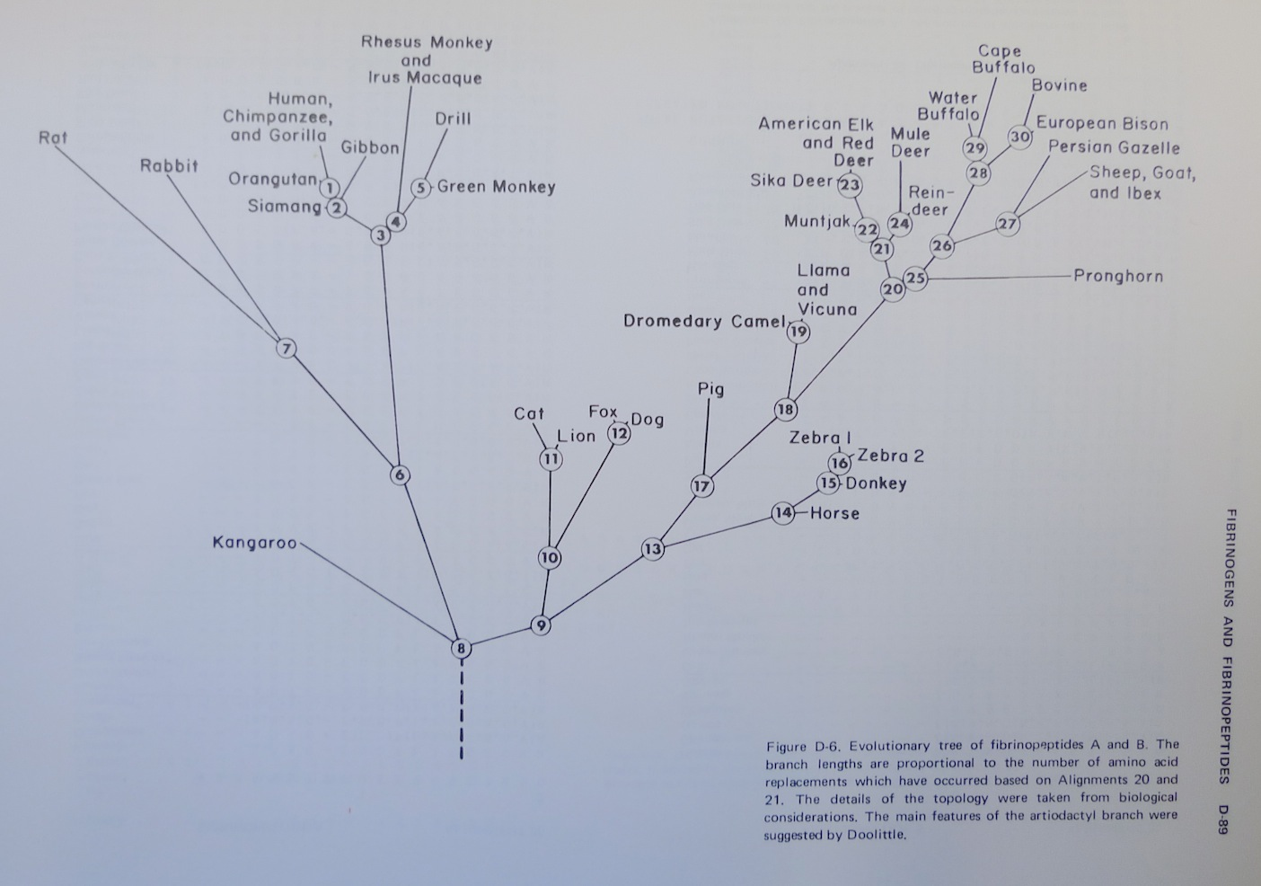
Dr. Margaret Belle (Oakley) Dayhoff
March 11, 1925 – February 5, 1983
Among other things, we owe her the first nucleotide and protein data bank, the PAM substitution matrix, and the single letter amino acid code. (Image from wikipedia)

Slide 3
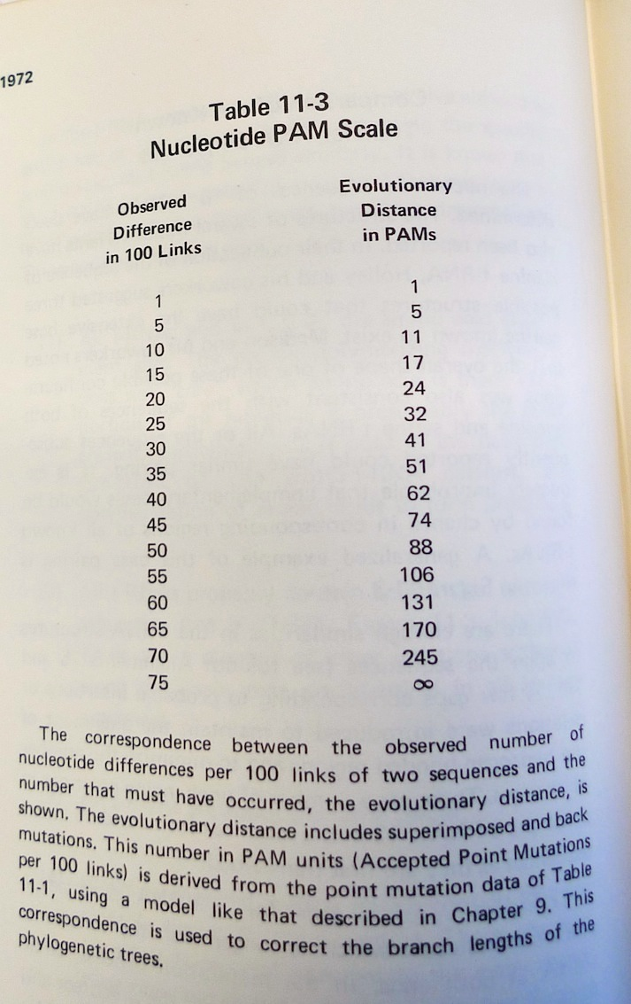
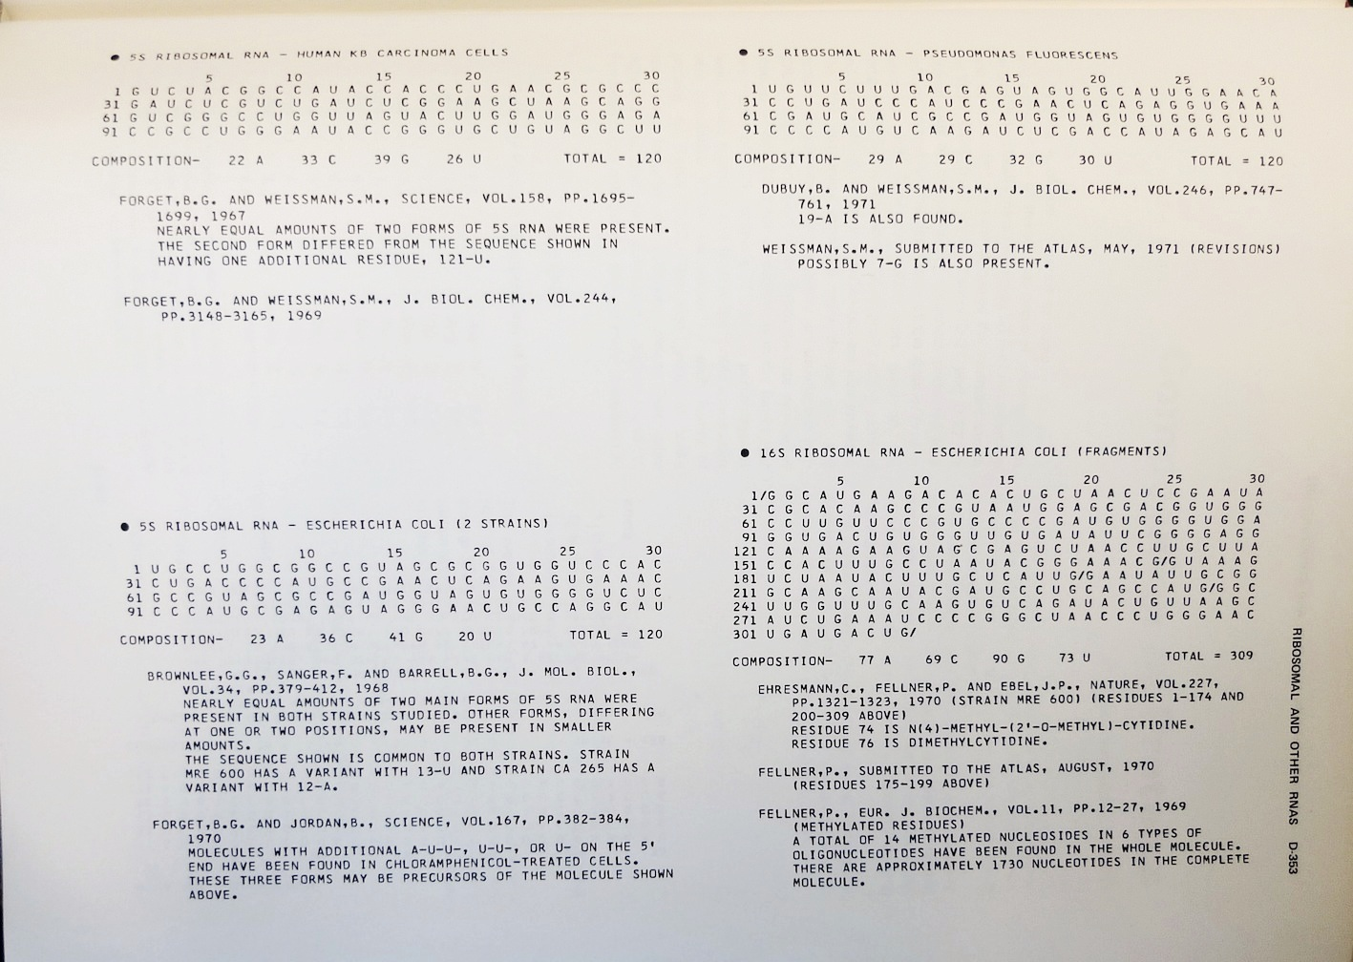
Atlas of Protein Sequences 1972 (cont)
The Atlas also contained RNA sequences, and PAM matrix for nucleotides

Slide 4
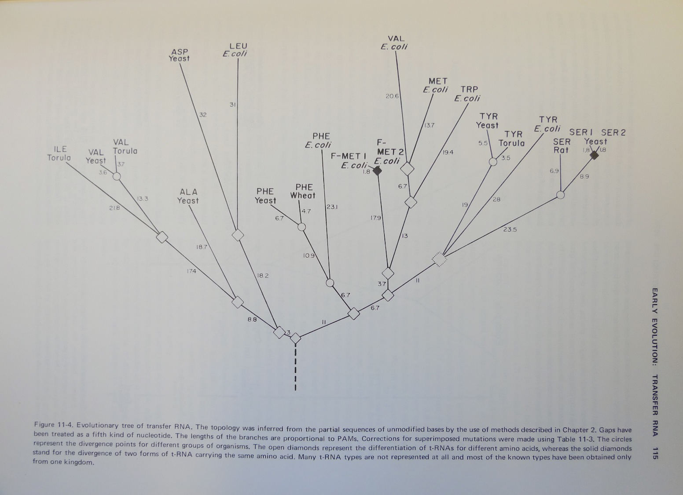
Atlas of Protein Sequences 1972 (cont)
Contained phylogenetic reconstructions that went back in time to far before the Last Unversal Common Ancestor (LUCA) aka the cenancestor of all living cellular organisms alive today.
tRNA phylogeny

Slide 5
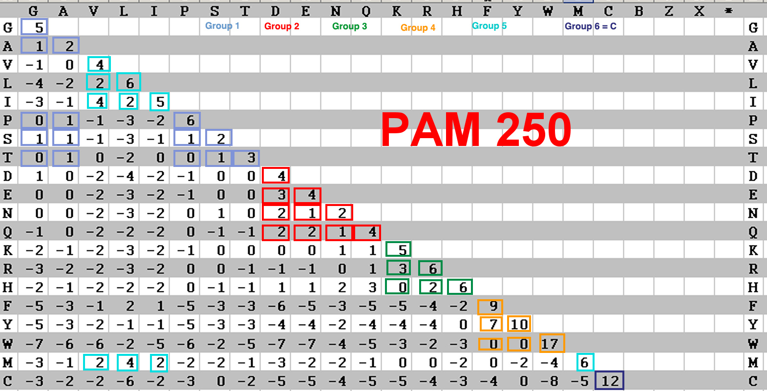
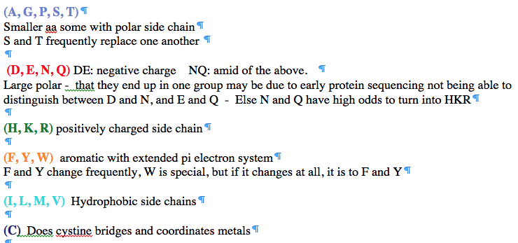
PAM 250 log (odds) matrix
Notes:
Dayhoff recoding

Slide 6
Selecting Scoring Matrices
Choose a matrix appropriate to the suspected degree of sequence identity between the query and its target sequences
PAM: empirically derived for close relatives
BLOSUM: empirically derived for distant relatives
6

