Slide 1
What is in a tree?
Trees form molecular data are usually calculated as unrooted trees (at least they should be - if they are not this is usually a mistake).
To root a tree you either can assume a molecular clock (substitutions occur at a constant rate, again this assumption is usually not warranted and needs to be tested),
or you can use an outgroup (i.e. something that you know forms the deepest branch).
  For example, to root a phylogeny of birds, you could use the homologous characters from a reptile as outgroup; to find the root in a tree depicting the relations between different human mitochondria, you could use the mitochondria from chimpanzees or from Neanderthals as an outgroup; to root a phylogeny of alpha hemoglobins you could use a beta hemoglobin sequence, or a myoglobin sequence as outgroup. What could be the outgroup for the Tree-of-Life?
Trees have a branching pattern (also called the topology), and branch lengths.
Often the branch lengths are ignored in depicting trees (these trees often are referred to as cladograms - note that cladograms should be considered rooted).
You can swap branches attached to a node, and in an unrooted you can depict the tree as rooted in any branch you like without changing the tree.

Slide 2
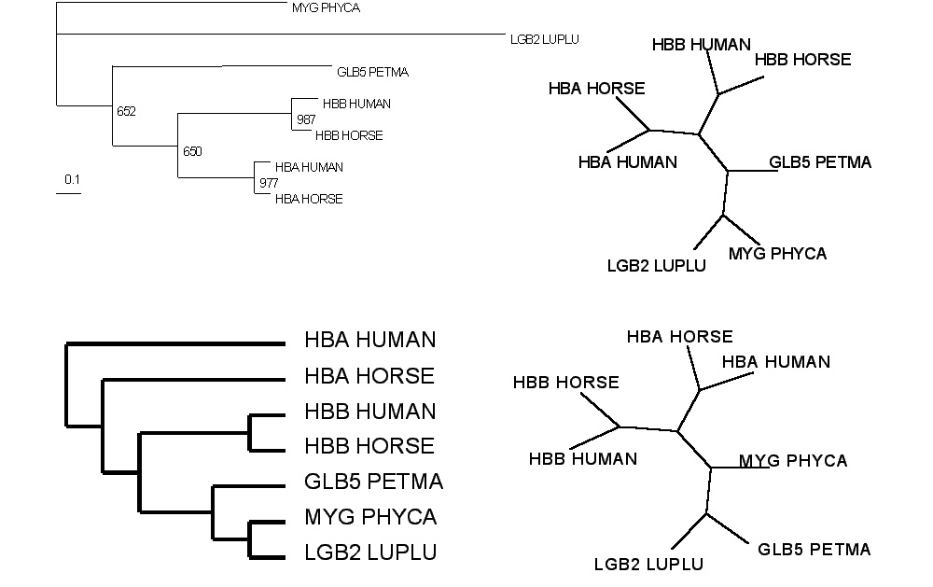
Test:Which of these trees is different?
More tests here

Slide 3
Trees in Newick or parenthesis format
Trees rooted on a node are usually considered as unrooted
Trees rooted on a branch are usually considered as rooted
((A, B), (C, D), E)
(((A, B), (C, D)), E)
Arbitrarily rooted in a node –
While displayed as rooted in a node, the tree should be considered as unrooted
Strictly bifurcating –
The root is located on the branch leading to E
More links here and here and here

Slide 4
Phylogenetic Reconstruction – Why?
A) Systematic classification of organisms
e.g.: Who were the first angiosperms? (i.e. where are the first angiosperms located relative to present day angiosperms?) Where in the tree of life is the last common ancestor located?
B) Evolution of molecules
e.g.: domain shuffling, reassignment of function, gene duplications, horizontal gene transfer, drug targets,
detection of genes that drive evolution of a species/population
(e.g. influenca virus)
C) Identification of organisms
e.g., phylotyping in microbiome samples,
origin of genes and viruses (e.g., HIV virus, recent ebola outbreak)

Slide 5
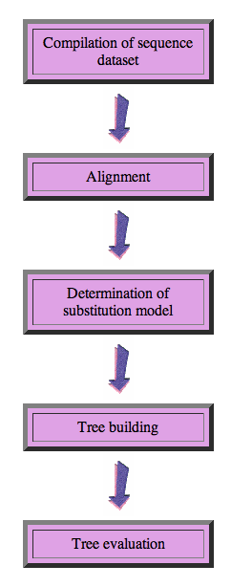
Steps of the phylogenetic analysis
Phylogenetic analysis is an inference of evolutionary relationships between organisms.
Phylogenetics tries to answer the question
“How did groups of organisms come into existence?”
Those relationships are usually represented by tree-like diagrams.
Note: the equation of biological evolution with a tree like process has limited validity at best.

Slide 6
Phylogenetic reconstruction - How
Distance analyses
  calculate pairwise distances
  (different distance measures, correction for multiple hits, correction for codon bias)
  make distance matrix (table of pairwise corrected distances)
  calculate tree from distance matrix
    i) using optimality criterion
    (e.g.: smallest error between distance matrix
    and distances in tree, or use
    ii) algorithmic approaches (UPGMA or neighbor joining)

Slide 7
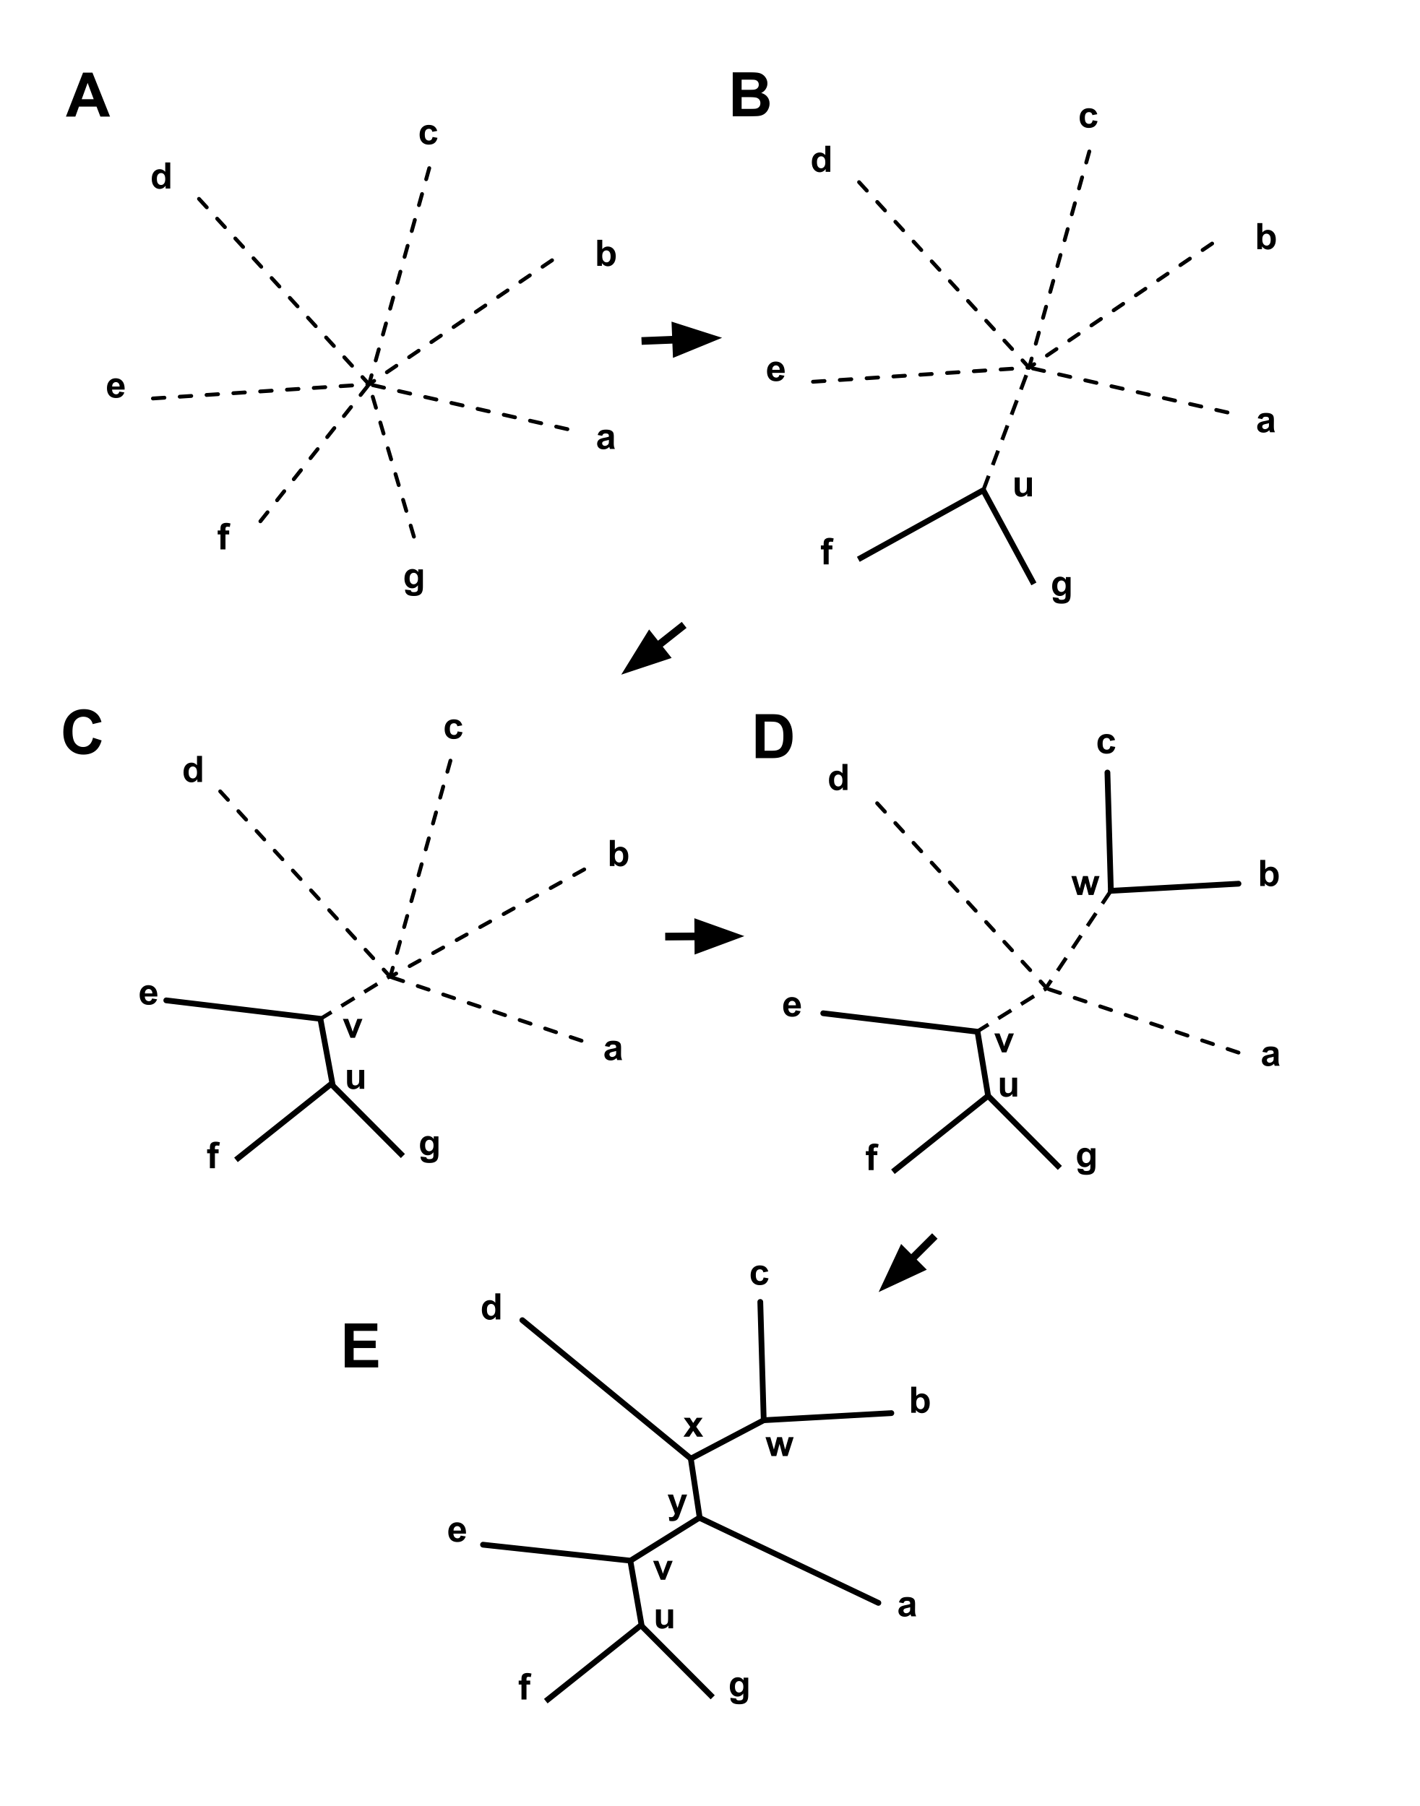
Algorithmic approaches (no global optimality criterion)
Principle of Neighbor Joining
From Wikipedia
UPGMA from Richard Edwards (here)
Wikipedia also has a good work through.

Slide 8
Phylogenetic reconstruction - How
Parsimony analyses
  find that tree that explains sequence data with minimum number of substitutions
  (tree includes hypothesis of sequence at each of the nodes)
Maximum Likelihood analyses
  given a model for sequence evolution, find the tree that has the highest probability under this model.
  This approach can also be used to successively refine the model using the maximum likelihood ratio test.
Bayesian statistics use ML analyses to calculate posterior probabilities for trees, clades and evolutionary parameters. Especially MCMC approaches have become very popular in the last year, because they allow to estimate evolutionary parameters (e.g., which site in a virus protein is under positive selection), without assuming that one actually knows the "true" phylogeny.

Slide 9
Else:
spectral analyses, like evolutionary parsimony, look only at patterns of substitutions,
Another way to categorize methods of phylogenetic reconstruction is to ask if they are using
an optimality criterion (e.g.: smallest error between distance matrix and distances in tree, least number of steps, highest probability), or
algorithmic approaches (UPGMA or neighbor joining)
Packages and programs available: PHYLIP, phyml, MrBayes, Tree-Puzzle, PAUP*, clustalw, raxml, PhyloGenie, HyPhy

Slide 10
Maximum Likelihood

Slide 11
Estimating Models and Model Parameters.
Likelihood: Probability of a dataset given a model and a set of parameter.
Maximum likelihood: maximum probability of drawing the sample actually obtained using the model parameters as variable. (This usually is a tiny number, thus usually one uses the negative logarithm).
This works great for finding the best fitting parameters,
AND
Maximum Likelihood Estimation (MLE) can be used to test if assuming a more complicated model is justified by the data

Slide 12
Example Regression Regression Polynomials
When has one added too many parameters?
The fit undoubted increases with each parameter, but does this increase justify the additional parameter?
Notes:
The fit undoubted increases with each parameter, but does this increase justify the additional parameter?

Slide 13
One could use the maximum likelihood ratio test
Let L1 be the maximum value of the likelihood of the data without the additional assumption. In other words, L1 is the likelihood of the data with all the parameters unrestricted and maximum likelihood estimates substituted for these parameters.
Let L0 be the maximum value of the likelihood when the parameters are restricted (and reduced in number) based on the assumption. Assume k parameters were lost (i.e., L0 has k less parameters than L1).
Form the ratio λ=L0/L1. This ratio is always between 0 and 1 and the less likely the assumption is, the smaller λ will be. This can be quantified at a given confidence level as follows:
Calculate χ2=−2 ln λ. The smaller λ is, the larger χ2 will be.
We can tell when χ2 is significantly large by comparing it to the 100(1−α) percentile point of a Chi-Square distribution with degrees of freedom. χ2has an approximate Chi-Square distribution with kdegrees of freedom and the approximation is usually good, even for small sample sizes.
The likelihood ratio test computes χ2 and rejects the assumption if χ2 is larger than a Chi-Square percentile with k degrees of freedom, where the percentile corresponds to the confidence level chosen by the analyst.
From: https://www.itl.nist.gov/div898/handbook/apr/section2/apr233.htm
Alternatives to the MLRT are the use of the Akaike information criterion or the Bayesian information criterion

Slide 14
Aside:
MLE is a sophisticated version of Ockham razor.
Ockham razor favors the explanation that can
explain an observation with the fewest
assumptions (the parsimony principle).
MLE favors the explanation under which the observation is most probable. (MLE becomes equivalent to parsimony, if all events are equally probable. Note: you can also apply different weights to the events that are counted in parsimony, or ignore some altogether, e.g., transversion parsimony.)

Slide 15
Non-Parametric Bootstrap:
Creating pseudo-samples (sampling with replacement, sample size n)
Jacknife:
Creating pseudo-samples (sampling without replacement, sample size n/2)
Parametric Bootstrap:
Creating pseudo-samples through simulations using a model and parameters estimated from the data
Doing the impossible:
Statistics on a single sample
Evaluation of pseudo-samples measures how much information in the original data support a conclusion.

Slide 16
Creating bootstrap or pseudo-samples through sampling alignment columns with replacement
From “Bootstrap and Rogue Identification Tests for Phylogenetic Analyses”
Molecular Biology and Evolution 35(1) DOI: 10.1093/molbev/msy118

Slide 17
Bootstrap Take Home Messages
If all pseudo-samples lead to the same conclusion (which then is said to have 100% bootstrap support), the original data set contained strong support for the conclusion
If only few pseudo-samples support a conclusion the original data do not strongly support the conclusion
Some consider 100-%bootstrap-support as analogous to a P-value.
Bootstrap support values are conservative
If a parameter value is estimated from the data, the bootstrap samples can be used to create confidence intervals (this is based on the finding that in cases where one can obtain many real samples, the real samples and the pseudo-samples show the same variance)

Slide 18
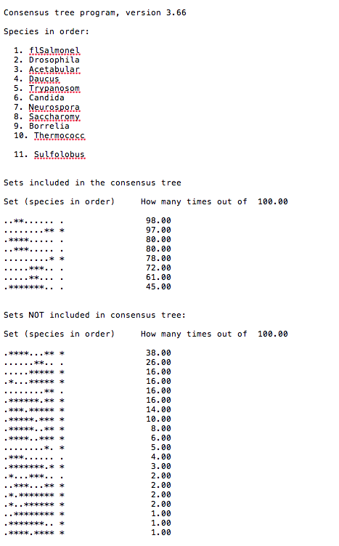
Output from consense

Slide 19
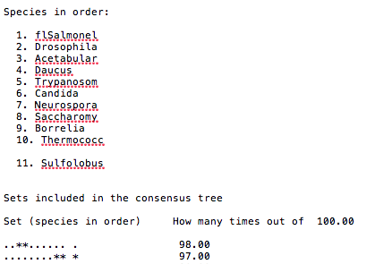
Output from consense

Slide 20
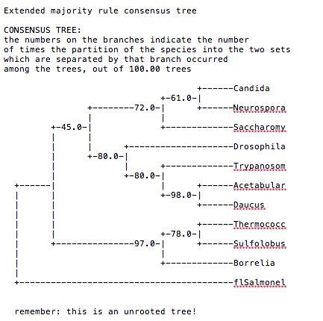
Output from consense

Slide 21
Phylip
written and distributed by Joe Felsenstein and collaborators (some of the following is copied from the PHYLIP homepage)
PHYLIP (the PHYLogeny Inference Package) is a package of programs for inferring phylogenies (evolutionary trees).
PHYLIP is the most widely-distributed phylogeny package, and competes with PAUP* to be the one responsible for the largest number of published trees. PHYLIP has been in distribution since 1980, and has over 15,000 registered users.
Output is written onto special files with names like "outfile" and "outtree". Trees written onto "outtree" are in the Newick format, an informal standard agreed to in 1986 by authors of a number of major phylogeny packages.
Input is either provided via a file called “infile” or in response to a prompt.

Slide 22
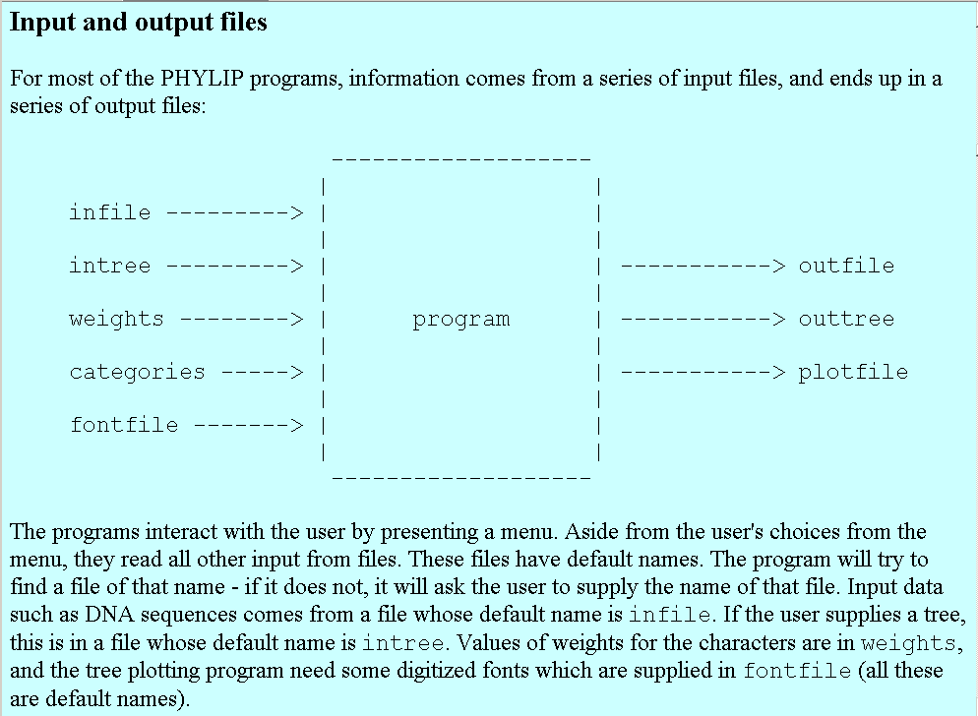
input and output

Slide 23
What’s in PHYLIP
Programs in PHYLIP allow to do parsimony, distance matrix, and likelihood methods, including bootstrapping and consensus trees. Data types that can be handled include molecular sequences, gene frequencies, restriction sites and fragments, distance matrices, and discrete characters.
Phylip works well with protein and nucleotide sequences
Many other programs mimic the style of PHYLIP programs.
(e.g. TREEPUZZLE, phyml, protml)
Many other packages use PHYIP programs in their inner workings (e.g., PHYLO_WIN)
PHYLIP runs under all operating systems
Web interfaces are available

Slide 24
Programs in PHYLIP are Modular
For example:
SEQBOOT take one set of aligned sequences and writes out a file containing bootstrap samples.
PROTDIST takes a aligned sequences (one or many sets) and calculates distance matices (one or many)
FITCH (or NEIGHBOR) calculate best fitting or neighbor joining trees from one or many distance matrices
CONSENSE takes many trees and returns a consensus tree
…. modules are available to draw trees as well, but often people use treeview, figtree, or njplot

Slide 25
The Phylip Manual
is an excellent source of information.
Brief one line descriptions of the programs are here
The easiest way to run PHYLIP programs is via a command
line menu (similar to clustalw). The program is invoked through clicking on an icon, or by typing the program name at the command line.
> seqboot
> protpars
> fitch
If there is no file called infile the program responds with:
[gogarten@carrot gogarten]$ seqboot
seqboot: can't find input file "infile"
Please enter a new file name>

Slide 26
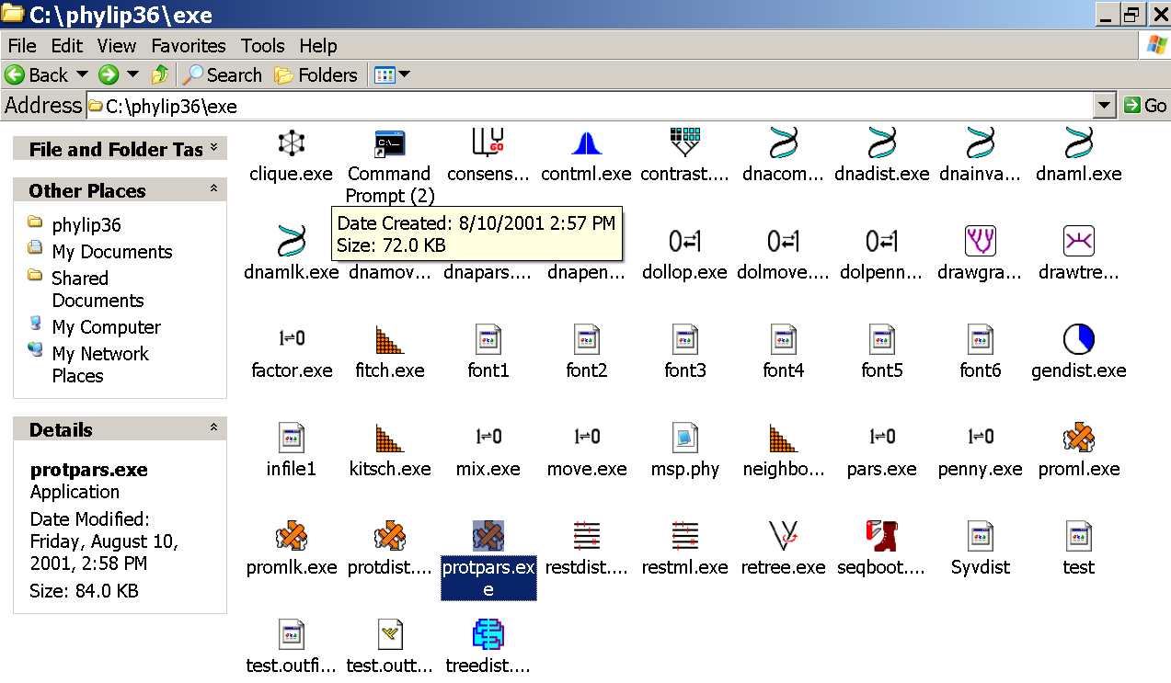
program folder

Slide 27
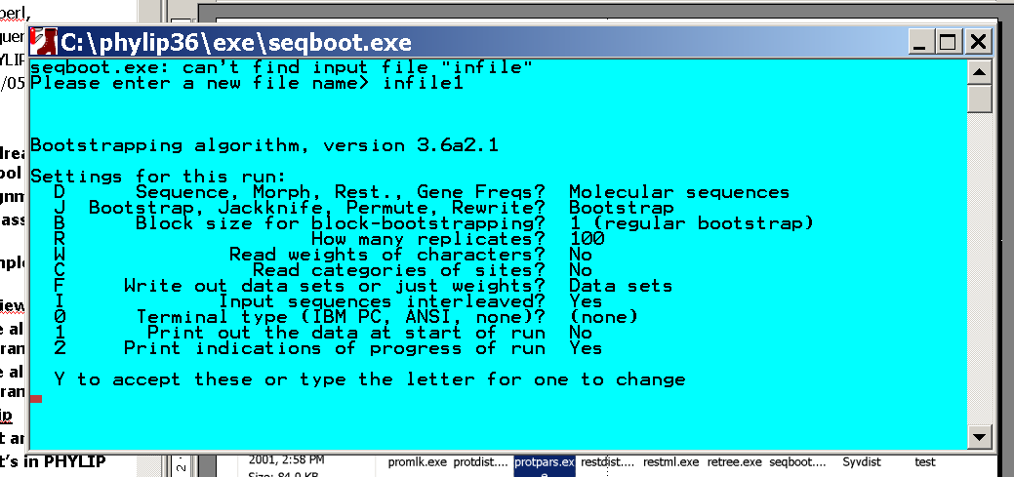
menu interface
example: seqboot and protpars on infile1

Slide 28
Sequence alignment:
CLUSTALW
MUSCLE
Removing ambiguous positions:
T-COFFEE
FORBACK
Generation of pseudosamples:
SEQBOOT
PROTDIST
TREE-PUZZLE
Calculating and evaluating phylogenies:
PROTPARS
PHYML
NEIGHBOR
FITCH
Comparing phylogenies:
CONSENSE
SH-TEST in TREE-PUZZLE
Comparing models:
Maximum Likelihood Ratio Test
Visualizing trees:
ATV, njplot, or treeview
Phylip programs can be combined in many different ways with one another and with programs that use the same file formats.

Slide 29
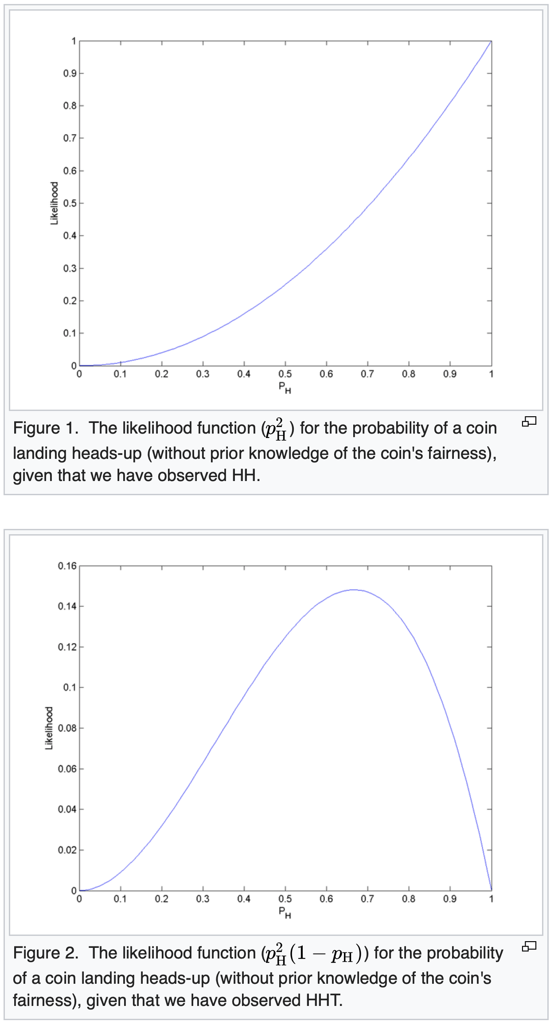
A problem with MLE
Does not take priors into account.
For an example see the likelihood for coin toss on the right. If on obtains two heads after tossing a coin twice, the MLE estimate for the probability to obtain head is 1.

Slide 30
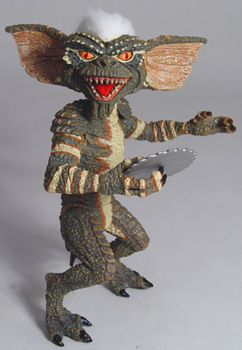
Elliot Sober’s Gremlins
?
Observation: It is Halloween, you sit in you rocking chair. Suddenly you hear a loud noise in the attic
Hypothesis: gremlins in the attic playing bowling
Likelihood =
P(noise|gremlins in the attic) = 1
P(gremlins in the attic|noise)
?
?

Slide 31
Likelihood estimates do not take prior information into consideration:
e.g., if the result of three coin tosses is 3 times head, then the likelihood estimate for the frequency of having a head is 1 (3 out of 3 events) and the estimate for the frequency of having a head is zero.
The probability that both events (A and B) occur
Both sides expressed as conditional probability
If A is the model and B is the data, then
P(B|A) is the likelihood of model A
P(A|B) is the posterior probability of the model given the data.
P(A) is the considered the prior probability of the model.
P(B) often is treated as a normalizing constant.

Slide 32
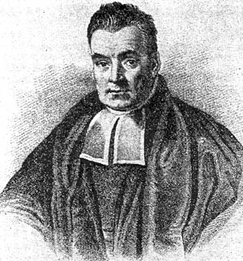
Bayes’ Theorem
Likelihood
describes how well the model predicts the data
P(data|model, I)
P(model|data, I) = P(model, I)
P(data,I)
Posterior
Probability
represents the degree
to which we believe a given model accurately describes the situation
given the available data and all of our prior information I
Prior
Probability
describes the degree to which we believe the model accurately describes reality
based on all of our prior information.
Normalizing
constant
Reverend Thomas Bayes (1702-1761)

Slide 33
Odds ratios, Bayes’ factors, and decision making
A rare genetic disease is discovered. Although only one in a million people carry it, you consider getting screened. You are told that the genetic test is extremely good; it is 100% sensitive (it is always correct if you have the disease) and 99.99% specific (it gives a false positive result only 0.01% of the time). Having recently learned Bayes' theorem, you decide not to take the test. Why?
(From Durbin et.al. "Biological Sequence Analysis", Cambridge University Press, 1998; )

Slide 34
We want to know the probability of being healthy(X) given the positive test(PT) results(Y).
According to the Bayes' Theorem,
P(healthy|PT)=P(PT|healthy)*P(healthy)/P(PT)
From the problem we know that
P(healthy)=1-0.000001=0.999999
and getting a false positive
P(PT|healthy)=0.0001. (Specificity)
The only unknown in the formula above is the probability of having a positive test P(PT). It can be calculated using the definition of marginal probability. There are only two possible events:
"being healthy" and "being sick". Therefore
P(PT)=P(PT|healthy)*P(healthy)+P(PT|sick)*P(sick)
From the problem we know that the test is always correct in presence of the disease
P(PT|sick)=1.0
and
P(sick)=0.000001.
Substituting the numbers into the formula we get
P(PT)=0.0001*0.999999+1.0*0.000001=0.000101
And
P(healthy|PT)=0.0001*0.999999/0.000101=0.990098
Sensitivity = 100%
Specificity = 99.99%

Slide 35
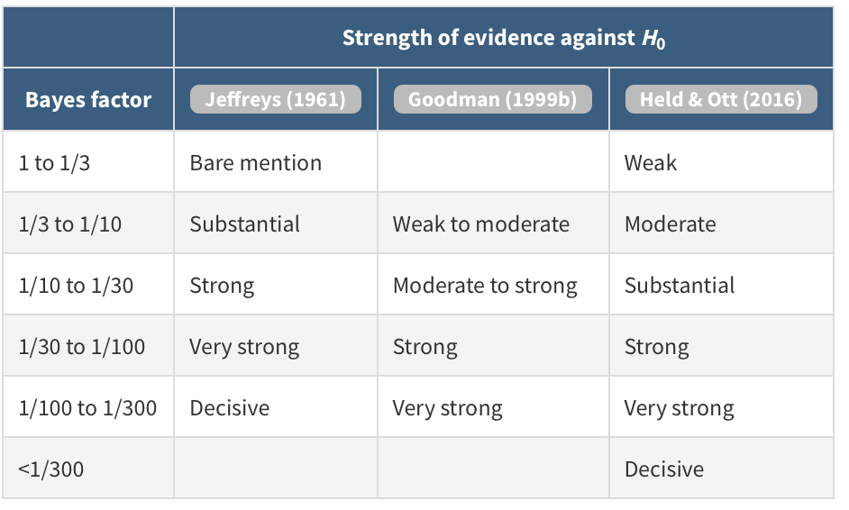
Bayes factors
Given 2 hypothesis (H₀ and H₁). The ratio in posterior probability is
P(H₀/data)
P(H₁/data)
P(data/H₀)
P(data/H₁)
=
*
Prior H₀
(Because we consider the ratio, P(data) cancels out)
Prior H₁
Ratio of posterior probabilities
Ratio of
prior probabilities of the two hypotheses
This ratio is known as Bayes factor. It
measures how your confidence in H₀ decreases by considering the data.
Bayesian thinking and the use of odds ratios were popularized by
Harold Jeffereys and Alan Turing.
From:https://doi.org/10.1146/annurev-statistics-031017-100307

Slide 36
Estimating Bayesian Posterior Probabilities through biased sampling
Exploration of parameter space by sampling posterior probabilities (likelihoods) using a biased random walk through parameter space (Metropolis Hastings Coupled Monte Carlo Markov Chain or MC³)
Pick a set of parameters at random
Calculate the likelihood of the data / posterior probability for this set of parameters
Change one of the parameter by a little bit, recalculate the likelihood
If the posterior probability increased, use these parameter values as a starting point for the next parameter change (back to 3), if it gets worse calculate the ratio of the posterior probabilities and take these odds to accept or reject the new parameter as a starting point for the next step.
N_{i}
P_{i} ≈
,where N_{i} - number of sampled parameter states that you are interested in
N_{total} – total number of samples (has to be large)
N_{total}

Slide 37
Alternative Approaches to Estimate
Posterior Probabilities
Bayesian Posterior Probability Mapping with MrBayes
(Huelsenbeck and Ronquist, 2001)
Problem:
Strimmer’s formula
L_{i}
p_{i}=
only considers 3 trees
(those that maximize the likelihood for
the three topologies)
L₁+L₂+L₃
Solution:
Exploration of the tree space by sampling trees using a biased random walk
(Implemented in MrBayes program)
Trees with higher likelihoods will be sampled more often
N_{i}
p_{i}≈
N_{total}
,where N_{i} - number of sampled trees of topology i, i=1,2,3
N_{total} – total number of sampled trees (has to be large)

Slide 38
Illustration of a biased random walk
Image generated with Paul Lewis's MCRobot
Figure generated using MCRobot program (Paul Lewis, 2001)

Slide 39
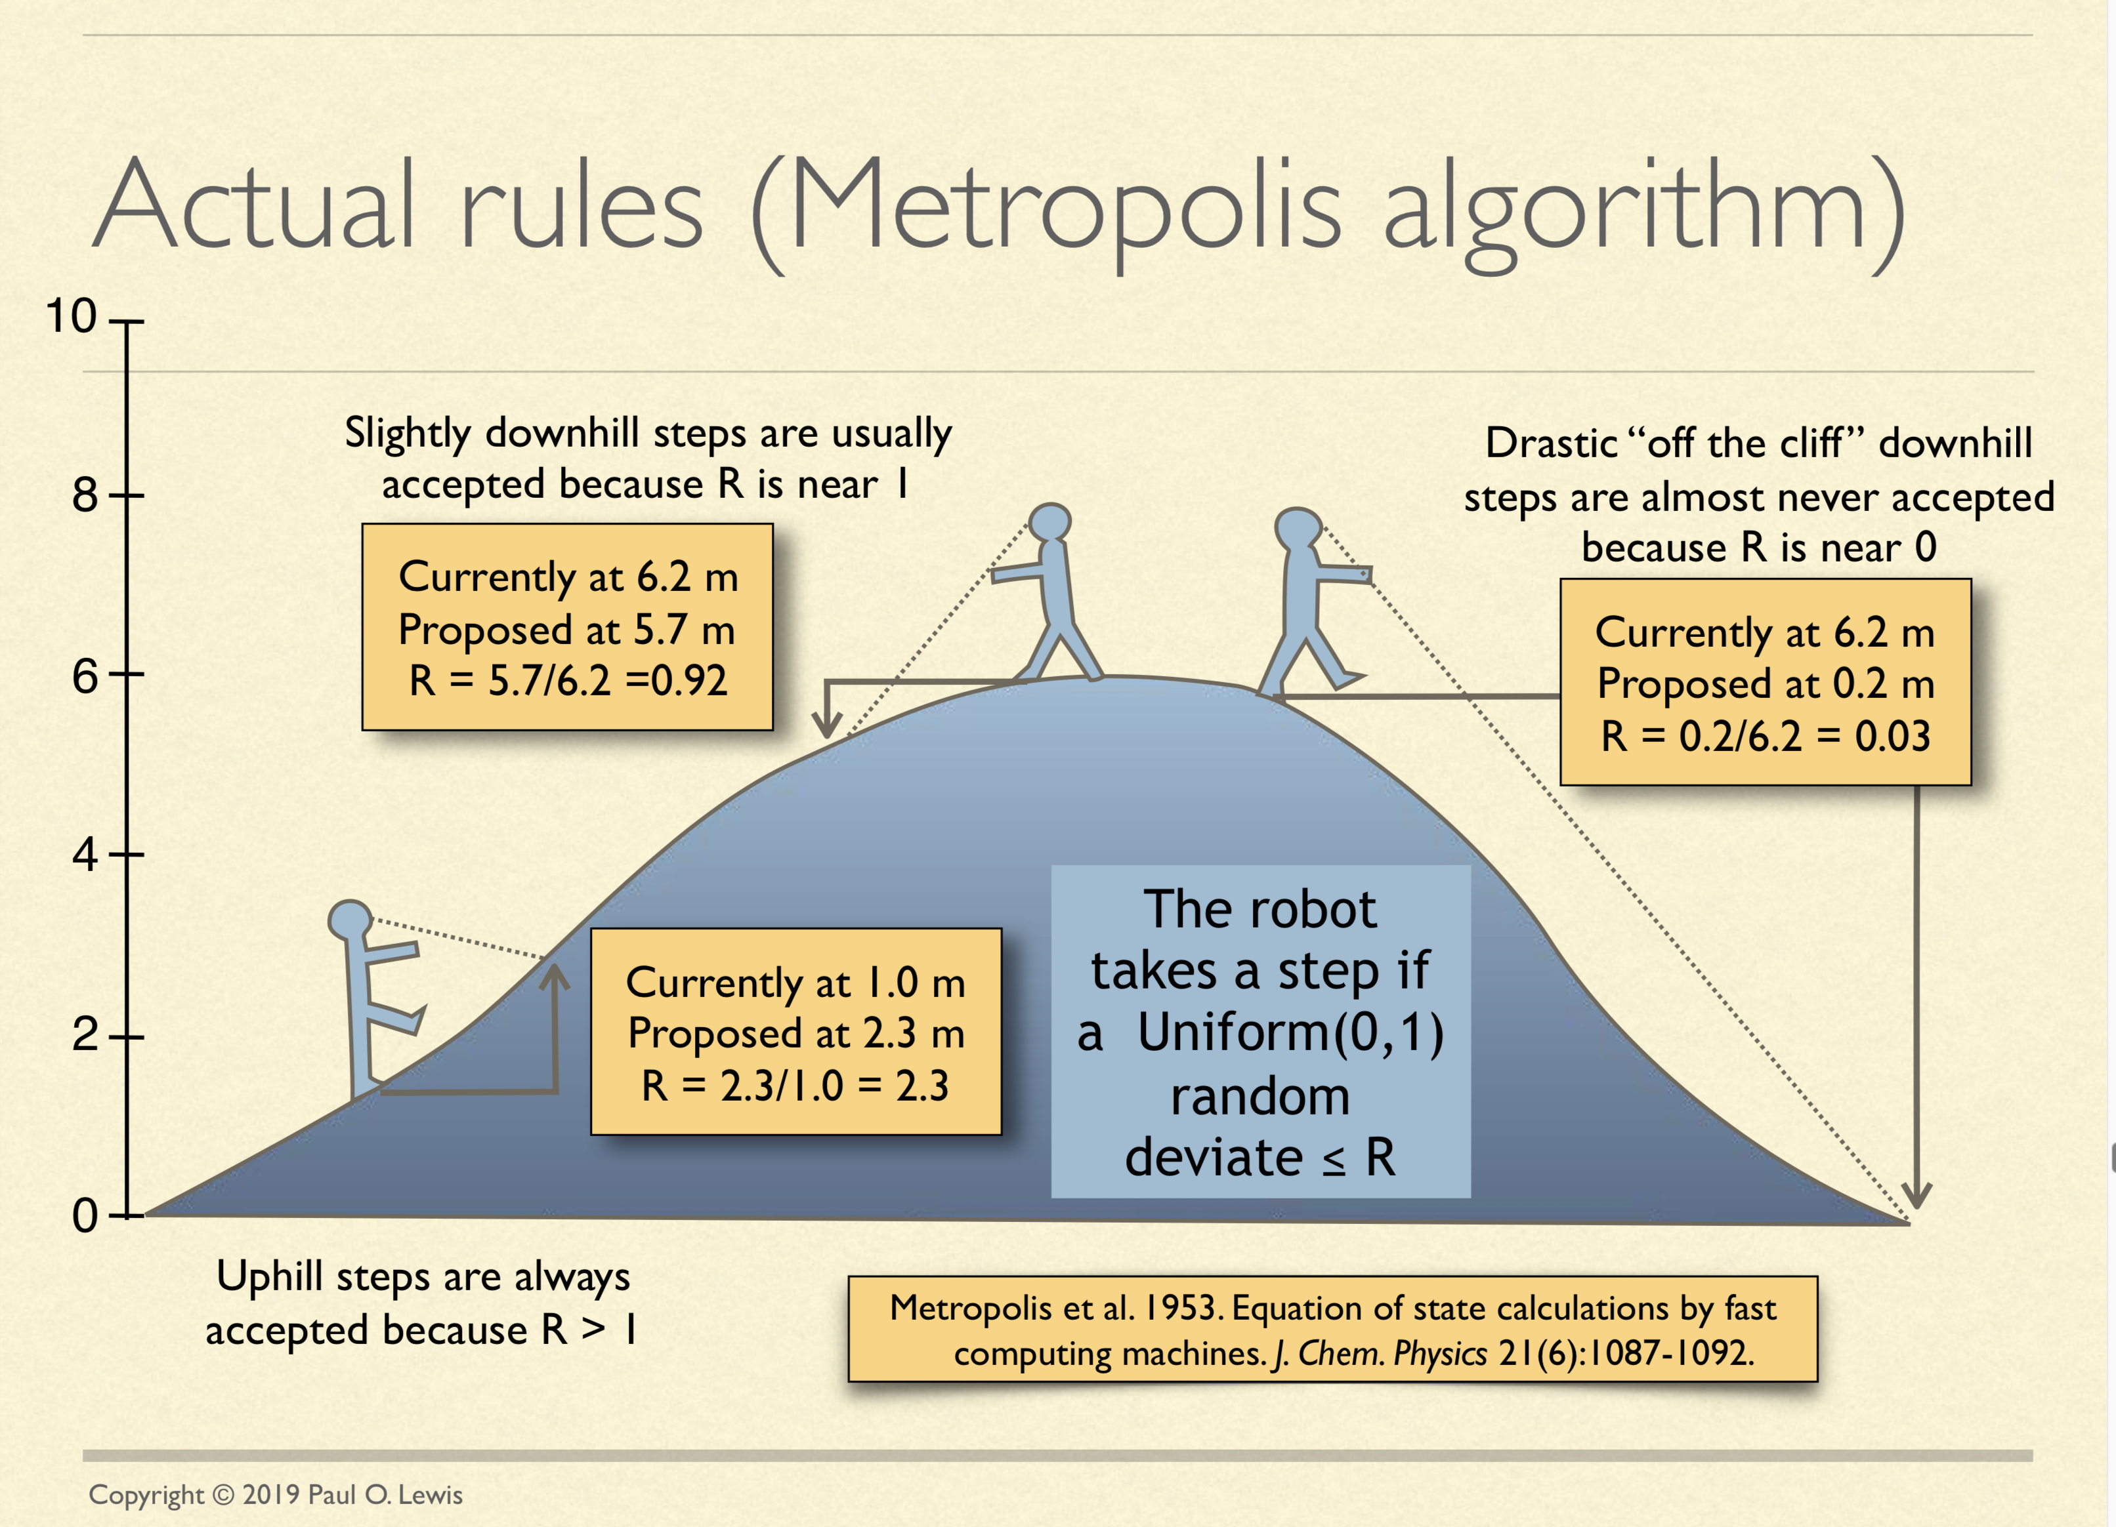
See: http://hydrodictyon.eeb.uconn.edu/people/plewis/downloads/wh2019/lewis-bayesian-part1.pdf

Slide 40
Why could a gene tree be different from the species tree?
Lack of resolution
Lineage sorting
Gene duplications/gene loss (paralogs/orthologs)
Gene transfer
Systematic artifacts (e.g., compositional bias and long branch attraction)

Slide 41
Trees – what might they mean?
Calculating a tree is comparatively easy, figuring out what it might mean is much more difficult.
If this is the probable organismal tree:
species A
species B
species C
species D
what could be the reason for obtaining this gene tree:
seq. from A
seq. from D
seq. from C
seq. from B

Slide 42
lack of resolution
seq. from A
seq. from D
seq. from C
seq. from B
e.g., 60% bootstrap support for bipartition (AD)(CB)

Slide 43
long branch attraction artifact
the two longest branches join together
seq. from A
seq. from D
seq. from C
seq. from B
e.g., 100% bootstrap support for bipartition (AD)(CB)
What could you do to investigate if this is a possible explanation?
use only slow positions,
use an algorithm that corrects for ASRV

Slide 44
Gene transfer
Organismal tree:
species A
species B
Gene Transfer
species C
species D
molecular tree:
seq. from A
seq. from D
seq. from C
speciation
seq. from B
gene transfer

Slide 45
Lineage Sorting
Organismal tree:
species A
species B
species C
Genes diverge and coexist in the
organismal lineage
species D
molecular tree:
seq. from A
seq. from D
seq. from C
seq. from B

Slide 46
Gene duplication
Organismal tree:
species A
species B
species C
gene duplication
species D
molecular tree:
molecular tree:
molecular tree:
seq. from A
seq. from A
seq. from A
seq. from B
seq. from B
seq. from C
seq. from C
seq. from D
seq. from D
seq. from D
seq.’ from B
seq.’ from B
seq.’ from B
seq.’ from C
seq.’ from C
gene duplication
seq.’ from C
gene duplication
gene duplication
seq.’ from D
seq.’ from D

Slide 47
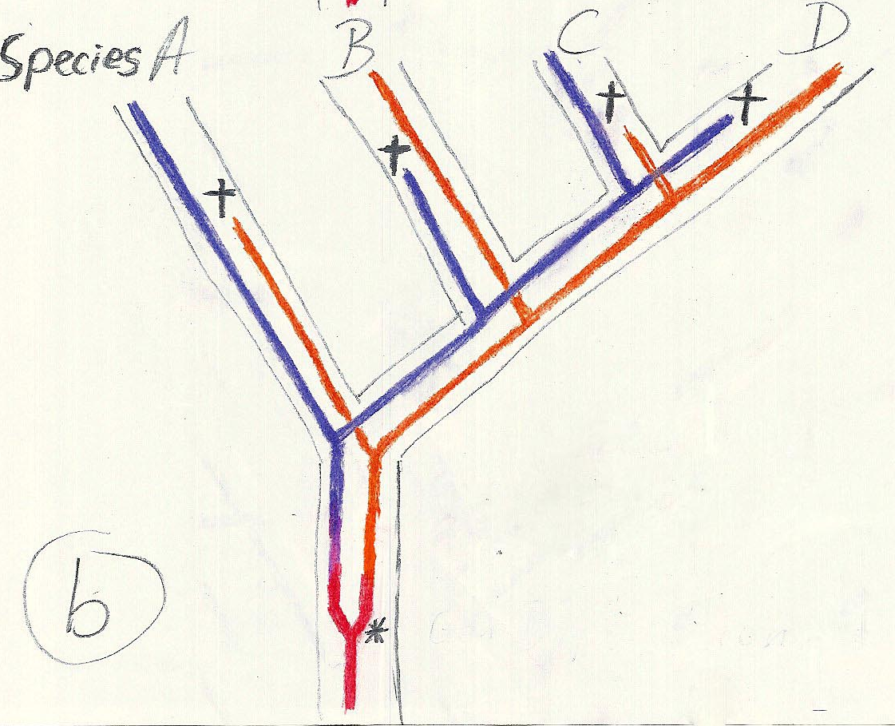
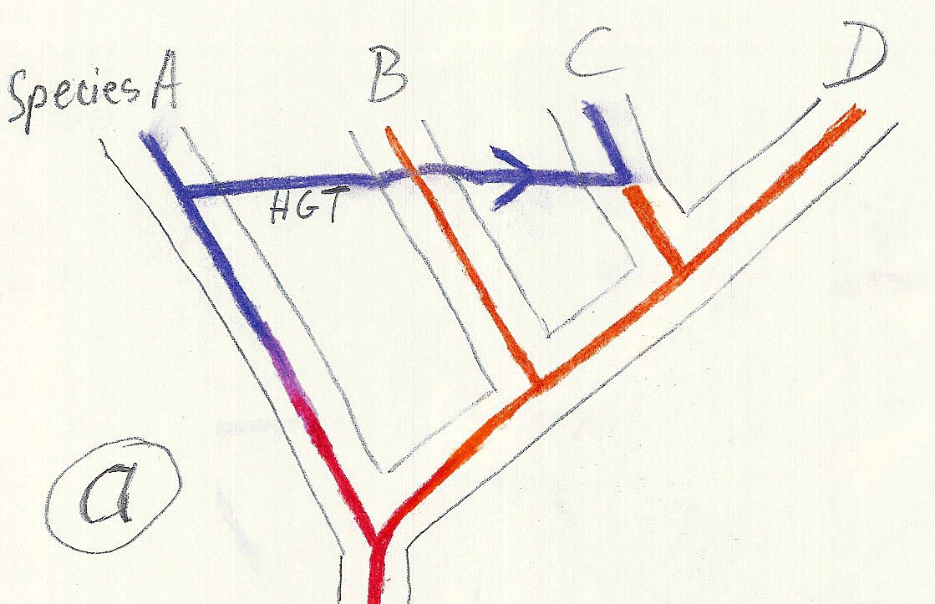
Gene duplication and gene transfer are equivalent explanations.
The more relatives of C are found that do not have the blue type of gene, the less likely is the duplication loss scenario
Ancient duplication followed by gene loss
Horizontal or lateral Gene
Note that scenario B involves many more individual events than A
1 HGT with
orthologous replacement
1 gene duplication followed by 4 independent gene loss events

Slide 48
Function, ortho- and paralogy
molecular tree:
seq. from A
seq.’ from B
seq.’ from C
seq.’ from D
gene duplication
seq. from B
seq. from C
seq. from D
The presence of the duplication is a taxonomic character (shared derived character in species B C D).
The phylogeny suggests that seq’ and seq have similar function, and that this function possibly was important in the evolution of the clade BCD.
seq’ in B and seq’ in C and D are orthologs and probably have the same function, whereas seq and seq’ in BCD probably have different function (the difference might be in subfunctionalization of functions that seq had in A. – e.g. organ specific expression)

