Slide 4
Review
Drift versus selection

Slide 5
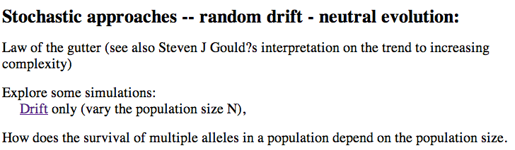
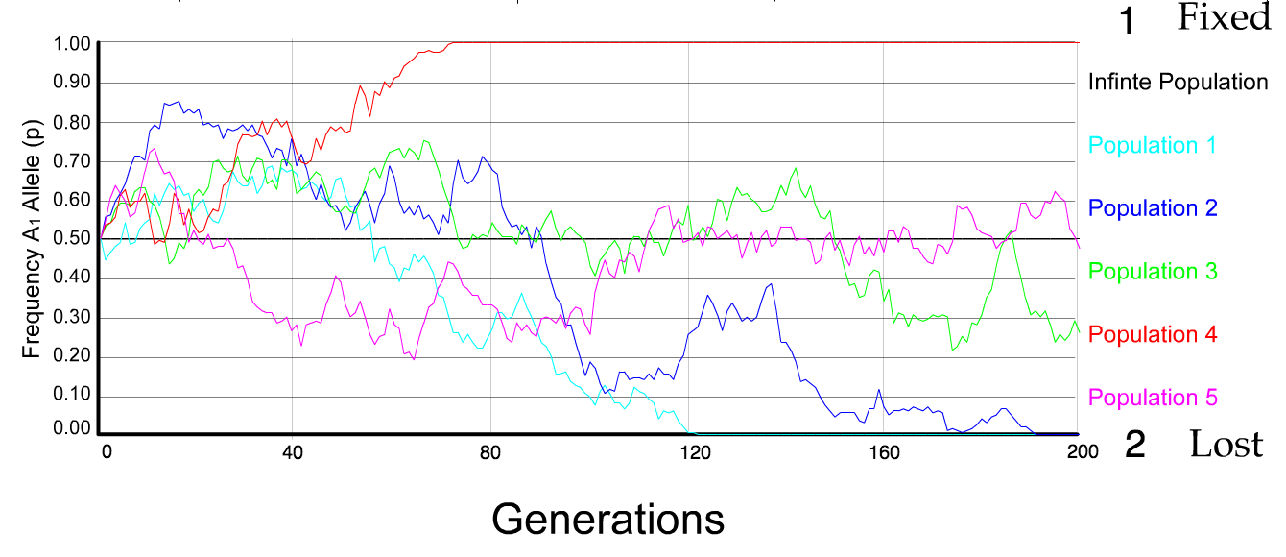
N=100 s=0
5 replicates

Slide 6
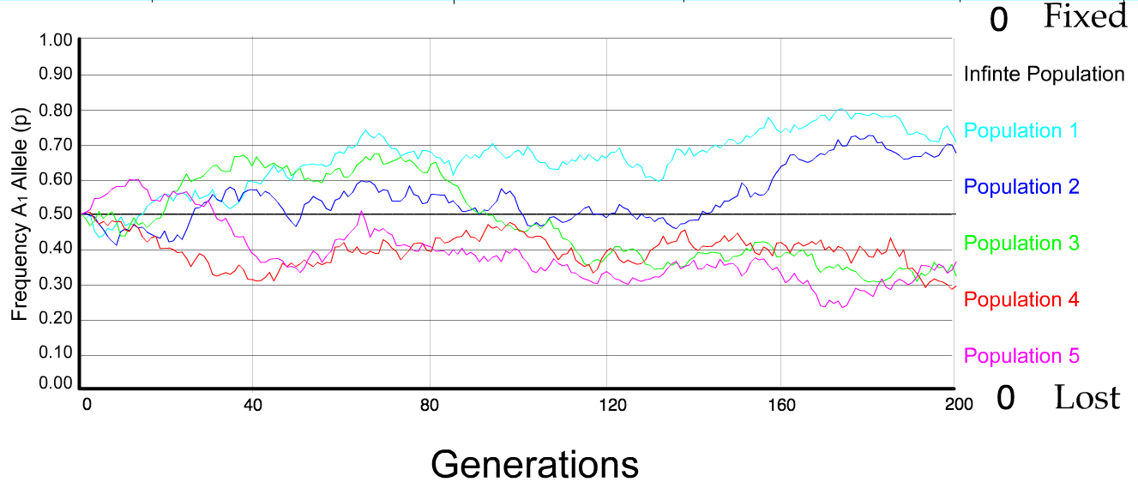
N=500 s=0
5 replicates

Slide 7
s=0
Probability of fixation, P, is equal to frequency of allele in population. Mutation rate (per gene/per unit of time) = u ;
freq. with which allele is generated in diploid population size N =u*2N
Probability of fixation for each allele = 1/(2N)
Substitution rate =
frequency with which new alleles are generated * Probability of fixation= u*2N *1/(2N) = u = Mutation rate
Therefore:
If f s=0, the substitution rate is independent of population size, and equal to the mutation rate !!!! (NOTE: Mutation unequal Substitution! )
This is the reason that there is hope that the molecular clock might sometimes work.
Fixation time due to drift alone:
t_{av}=4*N_{e} generations
(N_{e}=effective population size; For n discrete generations
N_{e}= n/(1/N₁+1/N₂+…..1/N_{n})

Slide 8
Positive selection (s>0)
A new allele (mutant) confers some increase in the fitness of the organism
Selection acts to favour this allele
Also called adaptive selection or Darwinian selection.
NOTE: Fitness = ability to survive and reproduce
Modified from from www.tcd.ie/Genetics/staff/Aoife/GE3026/GE3026_1+2.ppt

Slide 9
s>0
Time till fixation on average:
t_{av}= (2/s) ln (2N) generations
(also true for mutations with negative “s” ! discuss among yourselves)
E.g.: N=10⁶,
s=0: average time to fixation: 4*10⁶ generations
s=0.01: average time to fixation: 2900 generations
N=10⁴,
s=0: average time to fixation: 40.000 generations
s=0.01: average time to fixation: 1.900 generations
N=10¹¹ (100 billion – size of the Prochlorococcus population),
s=0: average time to fixation: 4*10¹¹ generations (about 1 billion years) s=0.01: average time to fixation: 5200 generations (about 14 years)
Test question: What is the probability of fixation?
=> substitution rate of mutation under positive selection is larger than the rate with which neutral mutations are fixed.

Slide 10
Random Genetic Drift
Selection
100
advantageous
Allele frequency
disadvantageous
0
Modified from from www.tcd.ie/Genetics/staff/Aoife/GE3026/GE3026_1+2.ppt

Slide 11
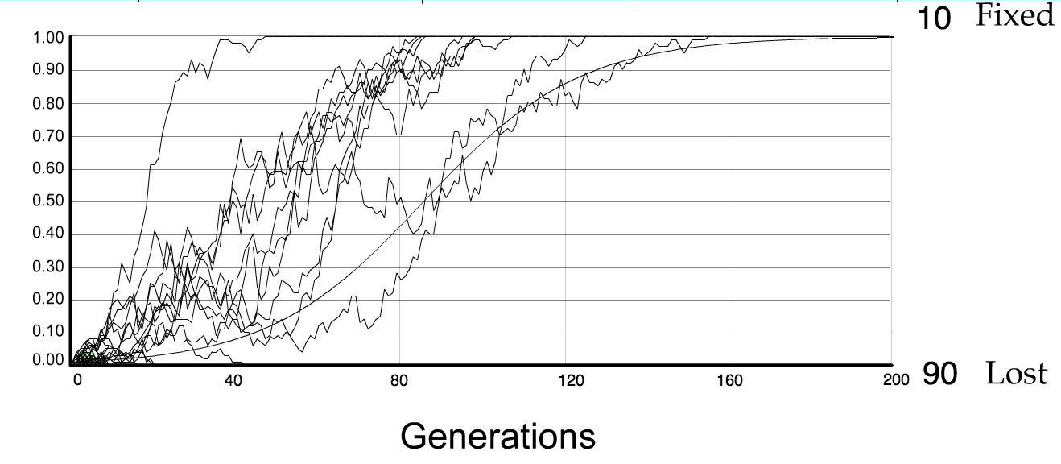
For advantageous mutations:
Probability of fixation, P, is approximately equal to 2s;
e.g., if selective advantage s = 5% then P = 10%
tav=2/s*log2N generations = 40*log100= 80

Slide 12
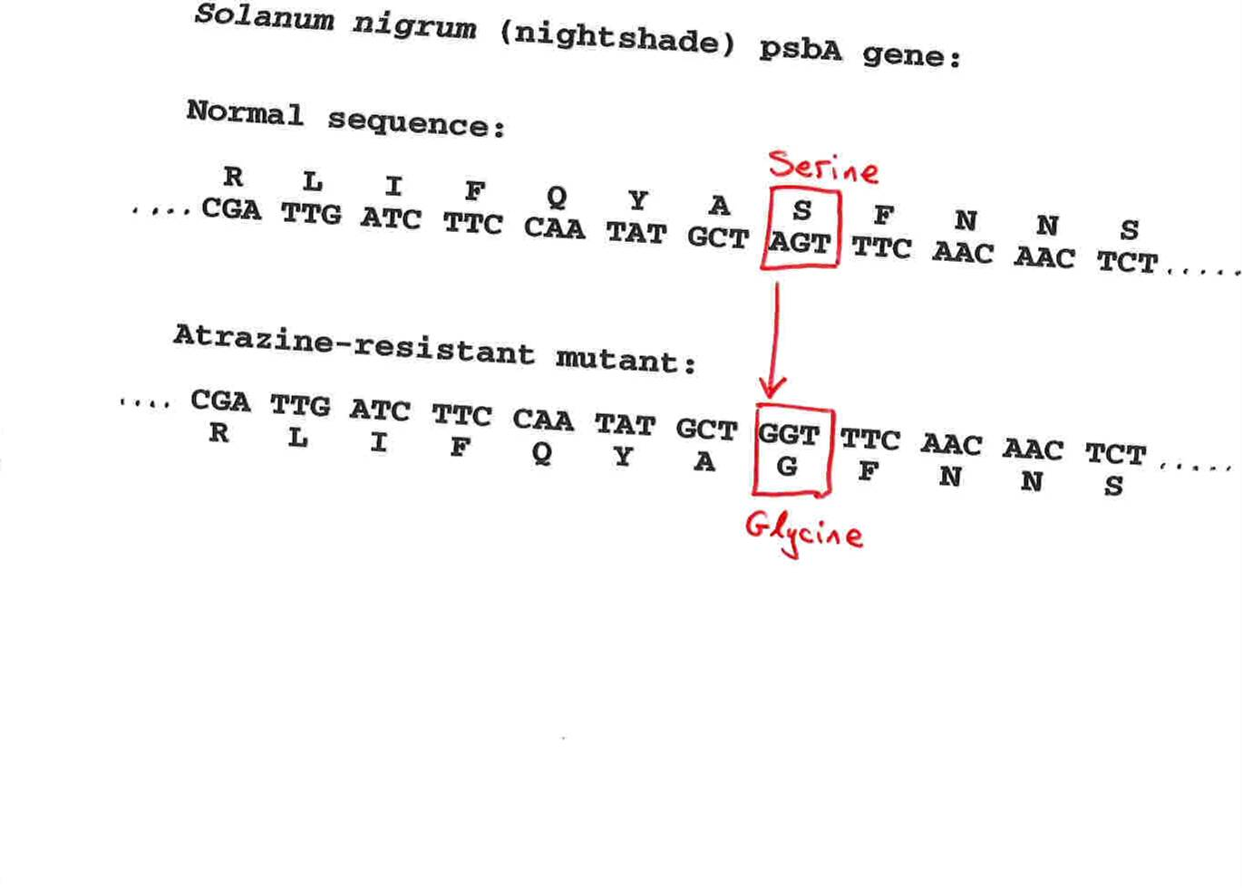
Advantageous allele
Herbicide resistance gene in nightshade plant
Modified from from www.tcd.ie/Genetics/staff/Aoife/GE3026/GE3026_1+2.ppt

Slide 13
selection versus drift
The larger the population the longer it takes for an allele to become fixed.
Note: Even though an allele conveys a strong selective advantage of 10%, the allele has a rather large chance to go extinct.
Note#2: Fixation is faster under selection than under drift.
Question: Can you think of genes that have a higher fixation probability? (Hint: HGT)

Slide 14
Negative selection (s<0)
A new allele (mutant) confers some decrease in the fitness of the organism
Selection acts to remove this allele
Also called purifying selection
Modified from from www.tcd.ie/Genetics/staff/Aoife/GE3026/GE3026_1+2.ppt

Slide 15
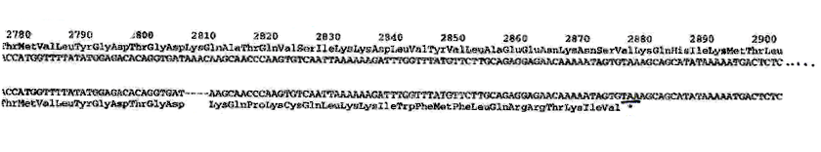
Deleterious allele
Human breast cancer gene, BRCA2
5% of breast cancer cases are familial
Mutations in BRCA2 account for 20% of familial cases
Normal (wild type) allele
Mutant allele
(Montreal 440
Family)
Stop codon
4 base pair deletion
Causes frameshift
Modified from from www.tcd.ie/Genetics/staff/Aoife/GE3026/GE3026_1+2.ppt

Slide 16
Neutral mutations
Neither advantageous nor disadvantageous
Invisible to selection (no selection)
Frequency subject to ‘drift’ in the population
Random drift – random changes in small populations

Slide 17
Types of Mutation-Substitution
Replacement of one nucleotide by another
Synonymous (Doesn’t change amino acid)
  Rate sometimes indicated by Ks
  Rate sometimes indicated by d_{s}
Non-Synonymous (Changes Amino Acid)
  Rate sometimes indicated by Ka
  Rate sometimes indicated by d_{n}
(this and the following 4 slides are from
mentor.lscf.ucsb.edu/course/ spring/eemb102/lecture/Lecture7.ppt)

Slide 18
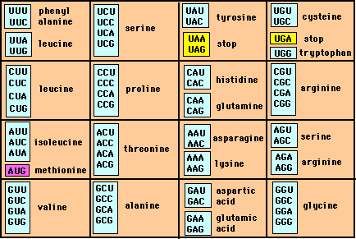
Genetic Code – Note degeneracy of 1st vs 2nd vs 3rd position sites

Slide 19
Genetic Code
Four-fold degenerate site – Any substitution is synonymous
From: mentor.lscf.ucsb.edu/course/spring/eemb102/lecture/Lecture7.ppt

Slide 20
Genetic Code
Two-fold degenerate site – Some substitutions synonymous, some
non-synonymous
From: mentor.lscf.ucsb.edu/course/spring/eemb102/lecture/Lecture7.ppt

Slide 21
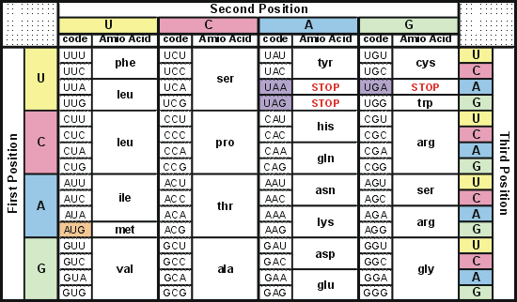
Degeneracy of 1st vs 2nd vs 3rd position sites results in 25.5% synonymous changes and 74.5% non synonymous changes (Yang&Nielsen,1998).
Genetic Code
Notes:
An inspection of the genetic code table suggests most changes at the first position are nonsynonymous, all changes at the second codon position are nonsynonymous and only some changes at the third position are synonymous. As a result we do not expect to see equal proportions of synonymous and nonsynonymous mutations even if there is no selection at protein level. Indeed, if mutations from any one nucleotide to any other occur at the same rate , we expect 25.5% of mutations to be synonymous and 74.5% mutations to be nonsynonymous.

Slide 22
Measuring Selection on Genes
Null hypothesis = neutral evolution
Under neutral evolution, synonymous changes should accumulate at a rate equal to mutation rate
Under neutral evolution, amino acid substitutions should also accumulate at a rate equal to the mutation rate
From: mentor.lscf.ucsb.edu/course/spring/eemb102/lecture/Lecture7.ppt

Slide 23
Counting #s/#a
Ser Ser Ser Ser Ser
Species1 TGA TGC TGT TGT TGT
Ser Ser Ser Ser Ala
Species2 TGT TGT TGT TGT GGT
#s = 2 sites
#a = 1 site
#a/#s=0.5
To assess selection pressures one needs to calculate the rates (Ka, Ks), i.e. the occurring substitutions as a fraction of the possible syn. and nonsyn. substitutions.
Things get more complicated, if one wants to take transition transversion ratios and codon bias into account. See chapter 4 in Nei and Kumar, Molecular Evolution and Phylogenetics.
Modified from: mentor.lscf.ucsb.edu/course/spring/eemb102/lecture/Lecture7.ppt

Slide 24
Testing for selection using dN/dS ratio
dN/dS ratio (aka Ka/Ks or ω (omega) ratio) where
dN = number of non-synonymous substitutions / number of all possible non-synonymous substitutions
dS =number of synonymous substitutions / number of all possible synonymous substitutions
dN/dS >1 positive, Darwinian selection
dN/dS =1 neutral evolution
dN/dS <1 negative, purifying selection
Notes:
The synonymous and non-synonymous rates dN and dS are defined as the numbers of synonymous and nonsynonymous substitutions per site. The ratio of the two rates omega=dN/dS then measures selective pressure at the protein level. If selection level has no effect on fitness, nonsynonymous mutations will be fixed at the same rate as synonymous mutations so that dN=dS and omega=1. If nonsynonymous mutations are deleterious purifying selection will reduce their fixation rate so that dN<dS and omega<1. If nonsynonymous mutations are favored by Darwinian selection, they will be fixed at a higher rate than synonymous mutations resulting in dN>dS and omega>1.

Slide 25
dambe
Two programs worked well for me to align nucleotide sequences based on the amino acid alignment,
One is DAMBE (only for windows). This is a handy program for a lot of things, including reading a lot of different formats, calculating phylogenies, it even runs codeml (from PAML) for you.
The procedure is not straight forward, but is well described on the help pages. After installing DAMBE go to HELP -> general HELP -> sequences -> align nucleotide sequences based on …->
If you follow the instructions to the letter, it works fine.
DAMBE also calculates Ka and Ks distances from codon based aligned sequences.

Slide 26
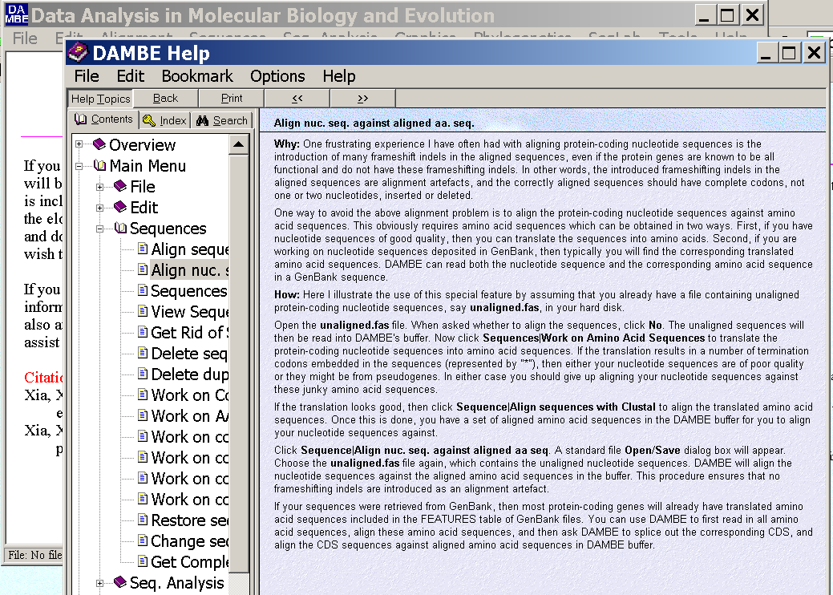
dambe (cont)

Slide 27
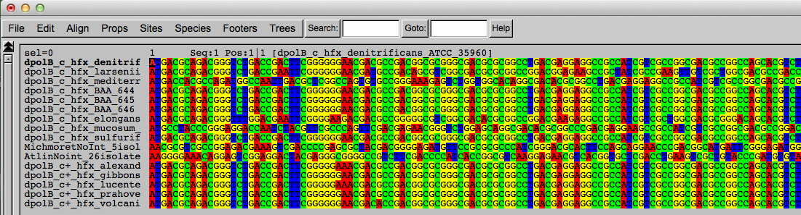
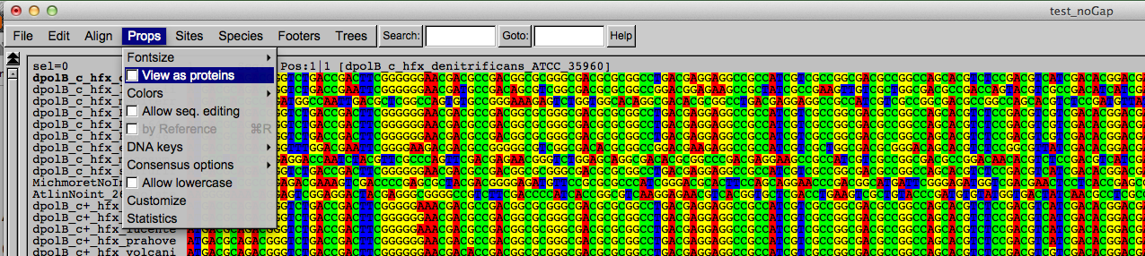
Codon based alignments in Seaview
Load nucleotide sequences (no gaps in sequences, sequence starts with nucleotide corresponding to 1st codon position)
Select view as proteins

Slide 28
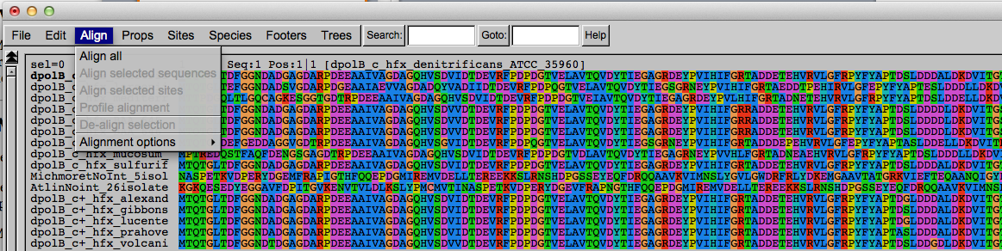
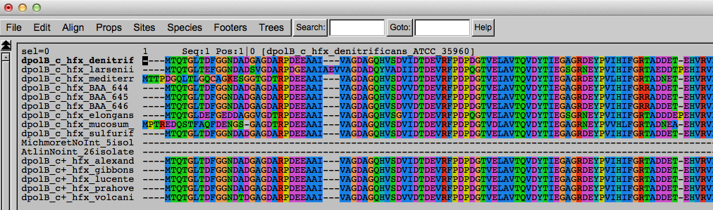
Codon based alignments in Seaview
With the protein sequences displayed, align sequences
Select view as nucleotides

Slide 29
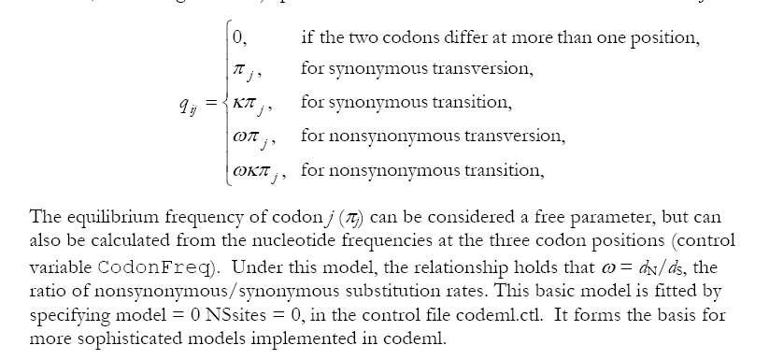
PAML (codeml) the basic model

Slide 30

sites versus branches
You can determine omega for the whole dataset; however, usually not all sites in a sequence are under selection all the time.
PAML (and other programs) allow to either determine omega for each site over the whole tree, ,
or determine omega for each branch for the whole sequence,
.
It would be great to do both, i.e., conclude codon 176 in the vacuolar ATPases was under positive selection during the evolution of modern humans – alas, a single site often does not provide much statistics.
PAML does provide a branch site model.

Slide 31
Sites model(s)
have been shown to work great in few instances.
The most celebrated case is the influenza virus HA gene.
A talk by Walter Fitch (slides and sound) on the evolution of
this molecule is here .
This article by Yang et al, 2000 gives more background on ml aproaches to measure omega. The dataset used by Yang et al is here: flu_data.paup .

Slide 32
sites model in MrBayes
The MrBayes block in a nexus file might look something like this:
begin mrbayes;
set autoclose=yes;
lset nst=2 rates=gamma nucmodel=codon omegavar=Ny98;
mcmcp samplefreq=500 printfreq=500;
mcmc ngen=500000;
sump burnin=50;
sumt burnin=50;
end;

Slide 33
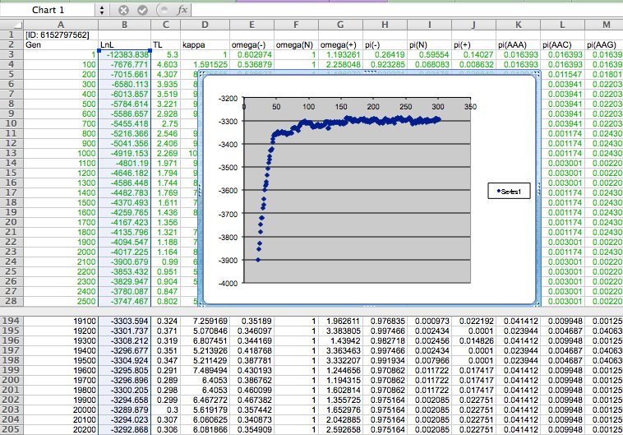

Slide 34
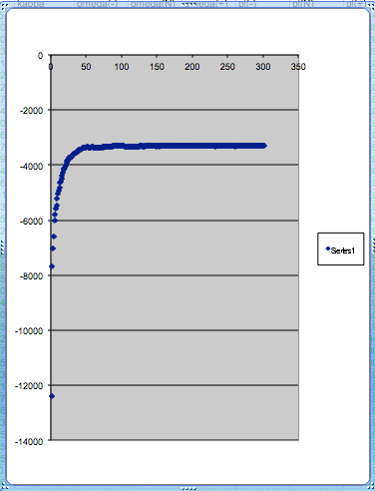
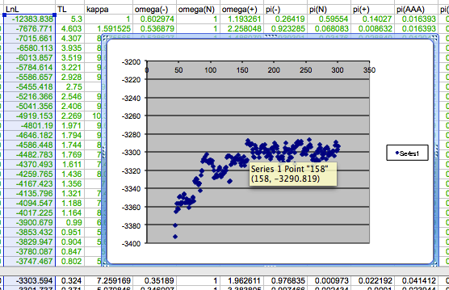
plot LogL to determine which samples to ignore
the same after rescaling the y-axis

Slide 35
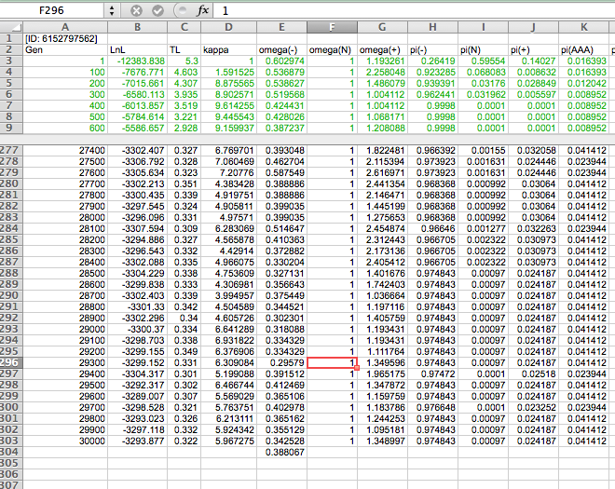

Slide 36
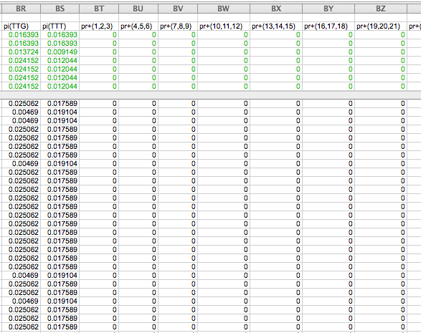

Slide 37
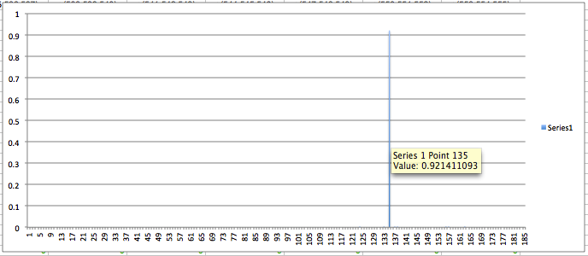
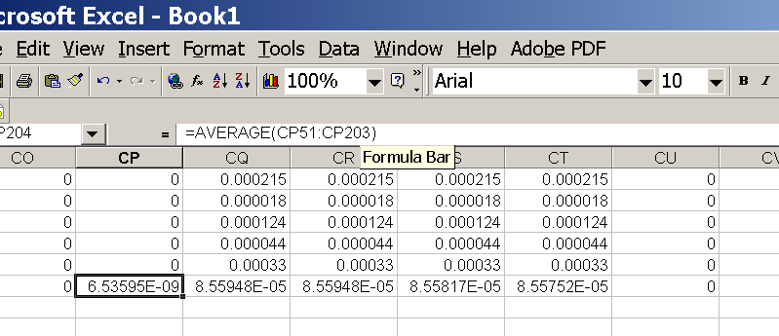
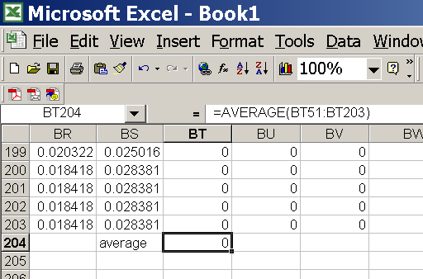
for each codon calculate the the average probability
copy paste formula
plot row
enter formula

Slide 38
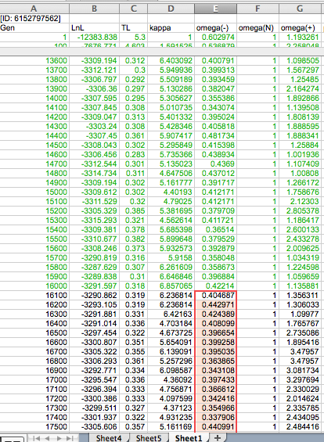
To determine credibility interval for a parameter (here omega<1):
Select values for the parameter, sampled after the burning.
Copy paste to a new spreadsheet,

Slide 39
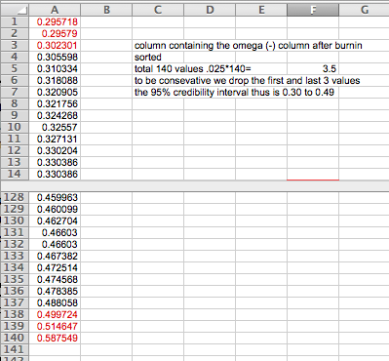
Sort values according to size,
Discard top and bottom 2.5%
Remainder gives 95% credibility interval.

Slide 40
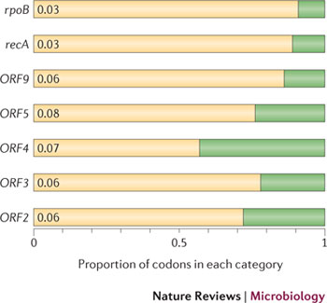
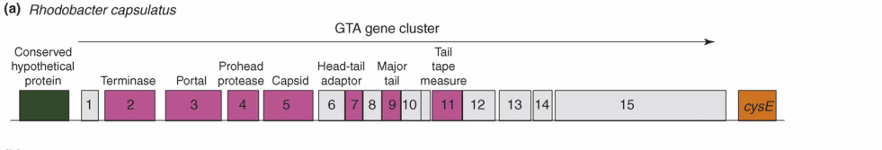
Purifying selection in GTA genes
dN/dS <1 for GTA genes has been used to infer selection for function
GTA genes
Lang AS, Zhaxybayeva O, Beatty JT. Nat Rev Microbiol. 2012 Jun 11;10(7):472-82
Lang, A.S. & Beatty, J.T. Trends in Microbiology , Vol.15, No.2 , 2006
Notes:
The ratio of non-synonymous-to-synonymous (dN/dS, or ω) codon substitution rates can be used as an indication of the selective pressure acting on a protein-coding gene. If a gene (or gene segment) is under purifying selection, non-synonymous mutations (that is, mutations resulting in a change of the encoded amino acid) will be selected against, resulting in ω < 1. In neutrally evolving proteins, synonymous and non-synonymous mutations will be fixed at approximately the same rate, resulting in ω = 1. Because different regions of a protein-coding gene may be under different selective constraints, codons can be divided into two categories: those with ω < 1 (yellow; the estimated ω is indicated on the bar) and those with ω fixed to 1 (green); the estimated proportion of codons in each category is given on the horizontal axis.

Slide 41
Purifying selection in E.coli ORFans
dN-dS < 0 for some ORFan E. coli clusters seems to suggest they are functional genes.
Gene groups | Number | dN-dS>0 | dN-dS<0 | dN-dS=0
E. coli ORFan clusters | 3773 | 944 (25%) | 1953 (52%) | 876 (23%)
Clusters of E.coli sequences found in Salmonella sp., Citrobacter sp. | 610 | 104 (17%) | 423(69%) | 83 (14%)
Clusters of E.coli sequences found in some Enterobacteriaceae only | 373 | 8 (2%) | 365 (98%) | 0 (0%)
Adapted after Yu, G. and Stoltzfus, A. Genome Biol Evol (2012) Vol. 4 1176-1187

Slide 42
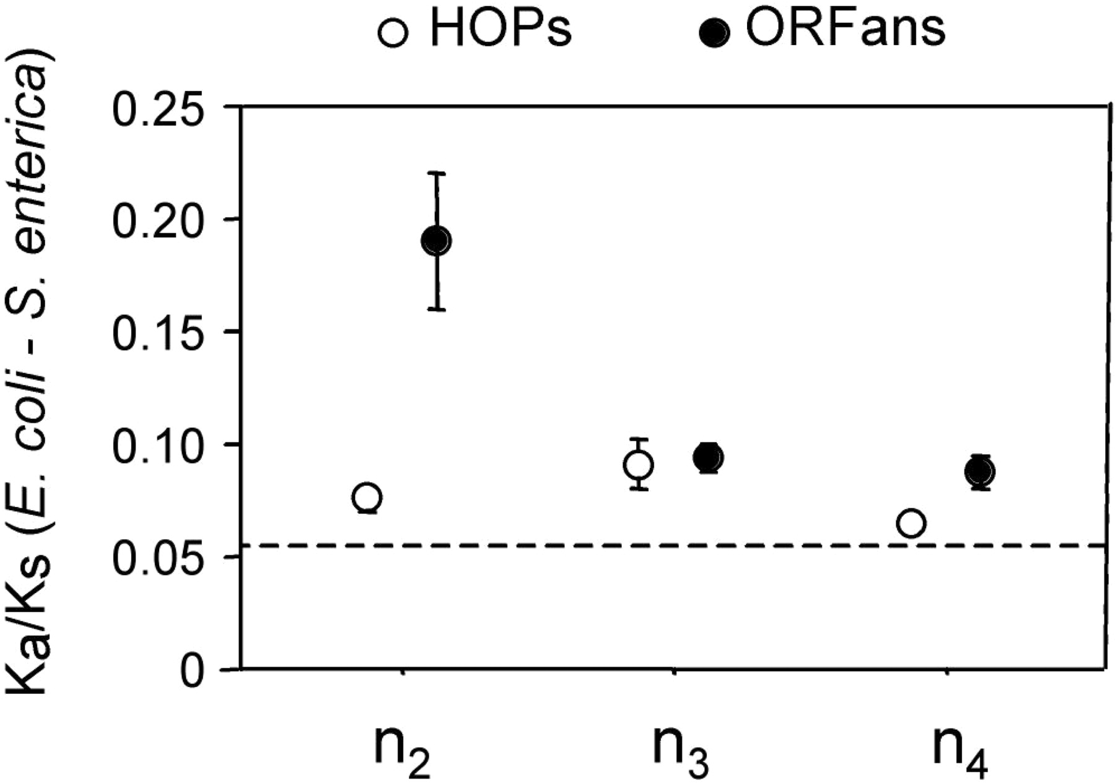
Vincent Daubin and Howard Ochman: Bacterial Genomes as New Gene Homes: The Genealogy of ORFans in E. coli. Genome Research 14:1036-1042, 2004
The ratio of non-synonymous to synonymous substitutions for genes found only in the E.coli - Salmonella clade is lower than 1, but larger than for more widely distributed genes.
Increasing phylogenetic depth
Fig. 3 from Vincent Daubin and Howard Ochman, Genome Research 14:1036-1042, 2004

Slide 43

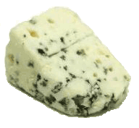
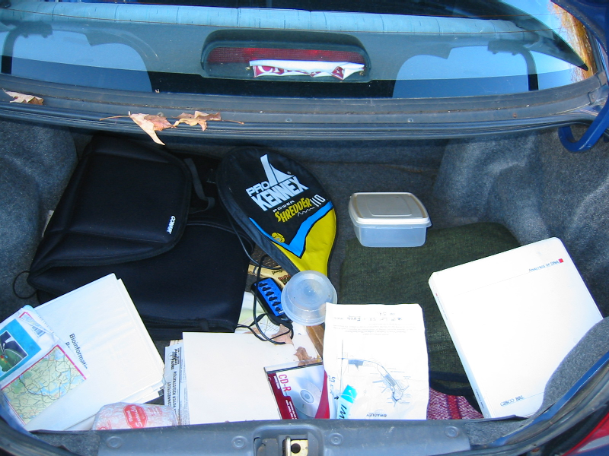
Trunk-of-my-car analogy: Hardly anything in there is the is the result of providing a selective advantage. Some items are removed quickly (purifying selection), some are useful under some conditions, but most things do not alter the fitness. See here for a published version.
Could some of the inferred purifying selection be due to the acquisition of novel detrimental characteristics (e.g., protein toxicity, HOPELESS MONSTERS)?

Slide 44
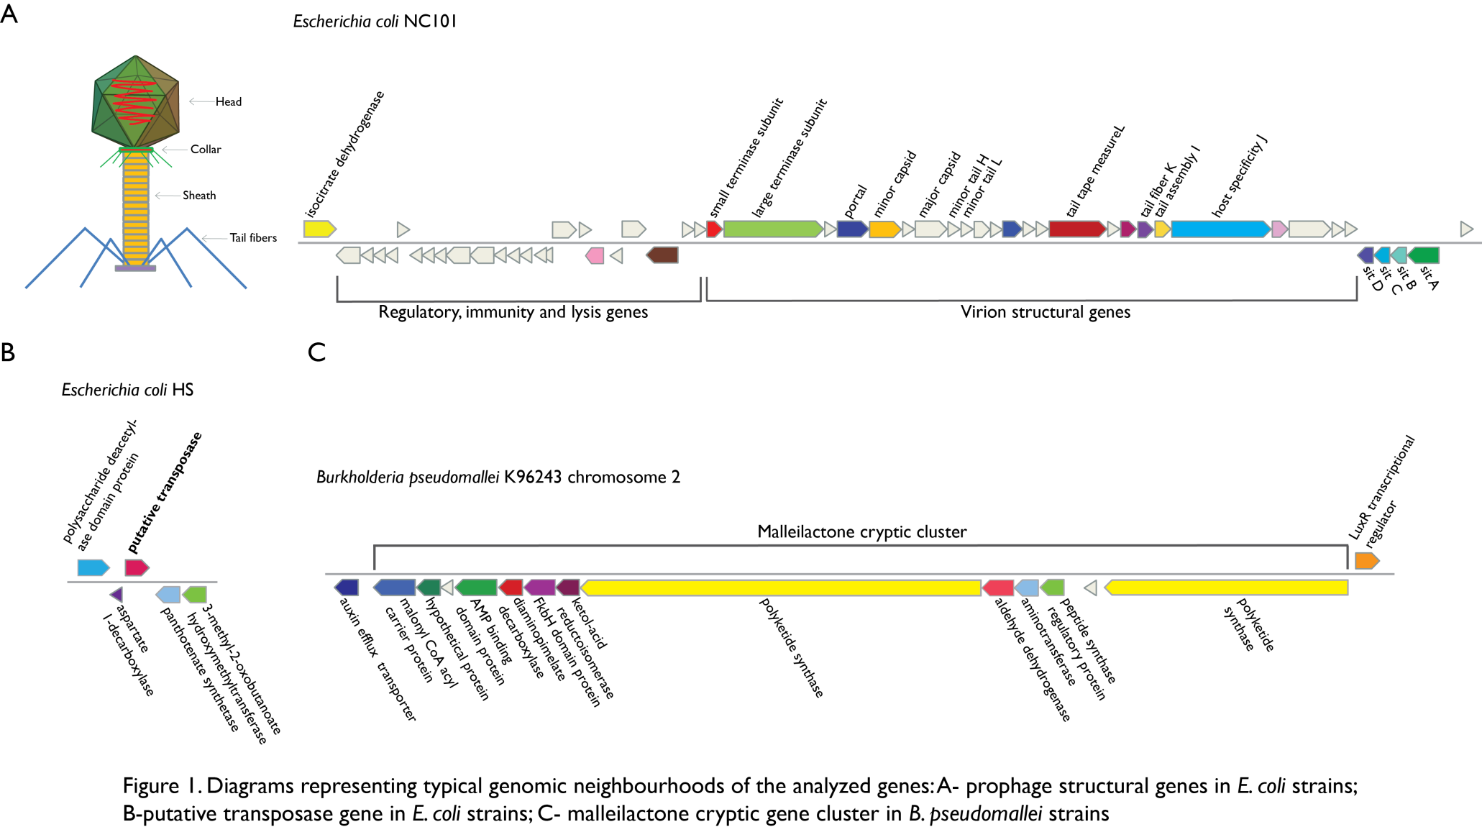
Vertically Inherited Genes Not Expressed for Function

Slide 45
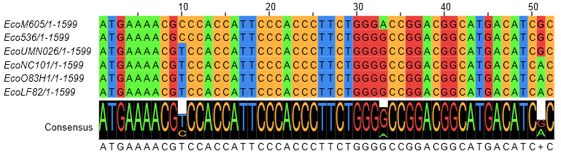
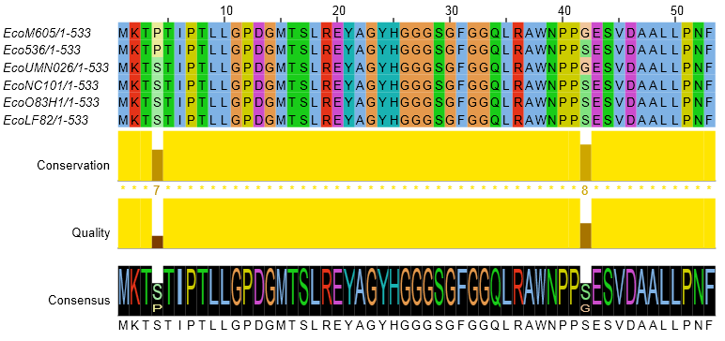
Counting Algorithm
Calculate number of different nucleotides/amino acids per MSA column (X)
Calculate number of nucleotides/amino acids substitutions (X-1)
Calculate number of synonymous changes
S=(N-1)nc-N
assuming N=(N-1)aa
X=2 1 nucleotide substitution
1 non-synonymous change
X=2 1 amino acid substitution

Slide 46
Simulation Algorithm
Calculate MSA nucleotide frequencies (%A,%T,%G,%C)
Introduce a given number of random substitutions ( at any position) based on inferred base frequencies
Compare translated mutated codon with the initial translated codon and count synonymous and non-synonymous substitutions

Slide 47
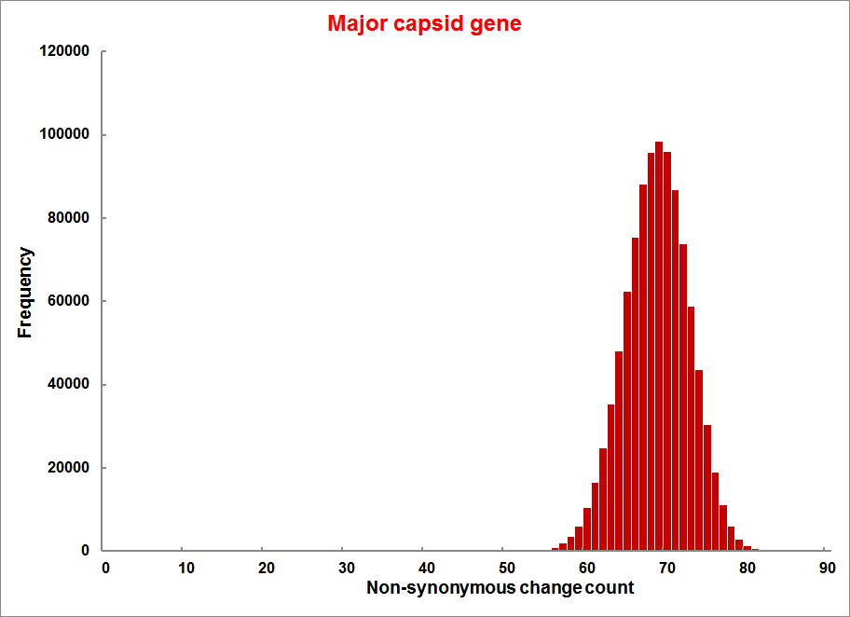
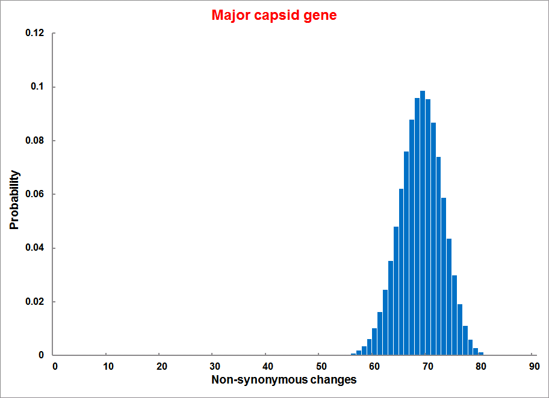
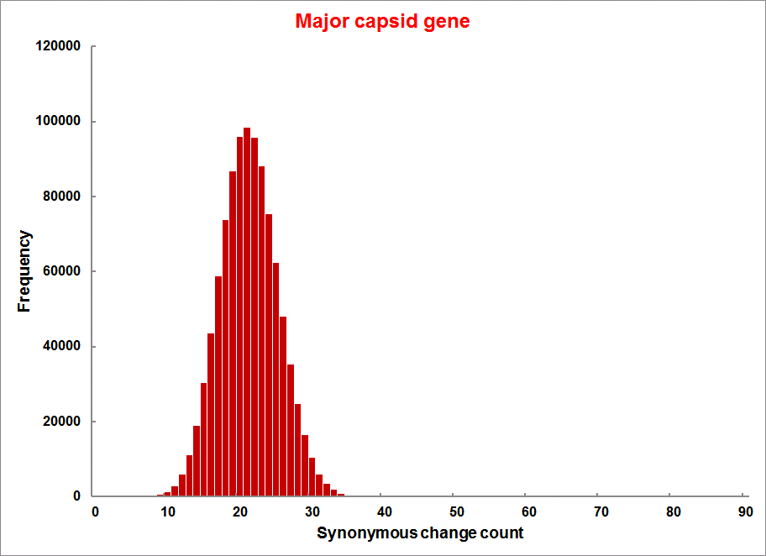
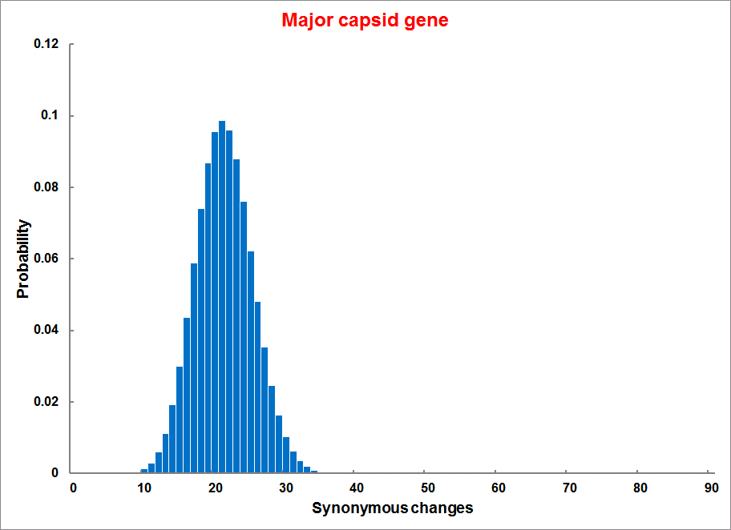
Evolution of Coding DNA Sequences Under a Neutral Model
E. coli Prophage Genes
Count distribution from simulations
Probability distribution
n=90
Non-synonymous
n= 90
k= 24
p=0.763
P(≤24)=3.63E-23
Observed=24
P(≤24) < 10⁻⁶
n=90
Synonymous
n= 90
k= 66
p=0.2365
P(≥66)=3.22E-23
Observed=66
P(≥66) < 10⁻⁶

Slide 48
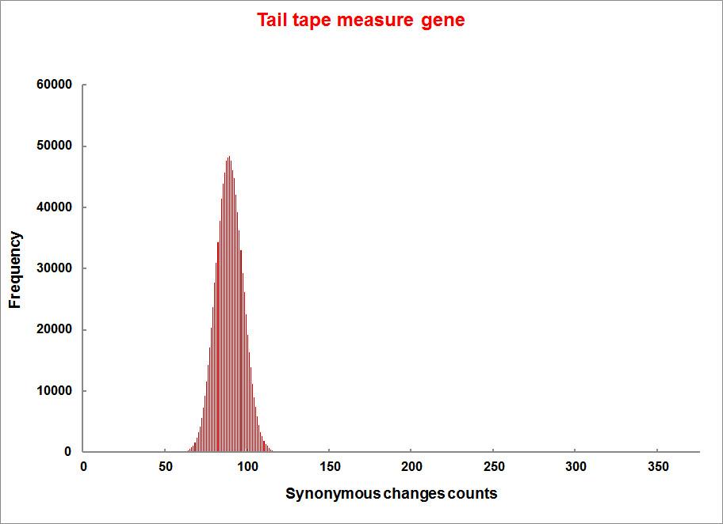
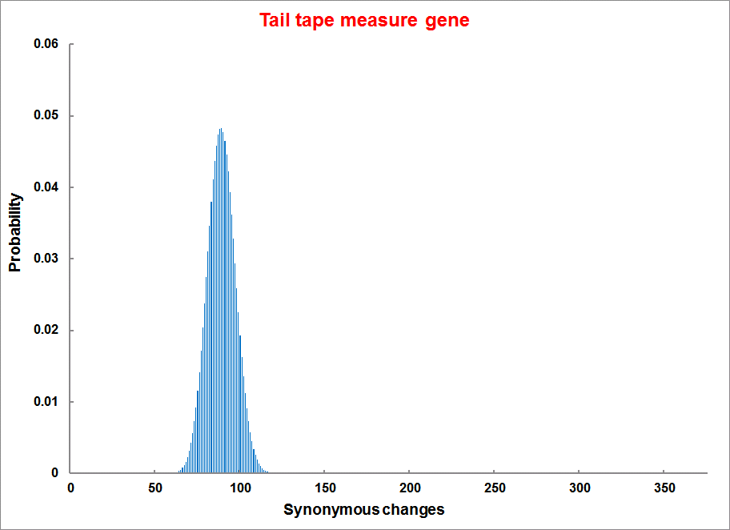
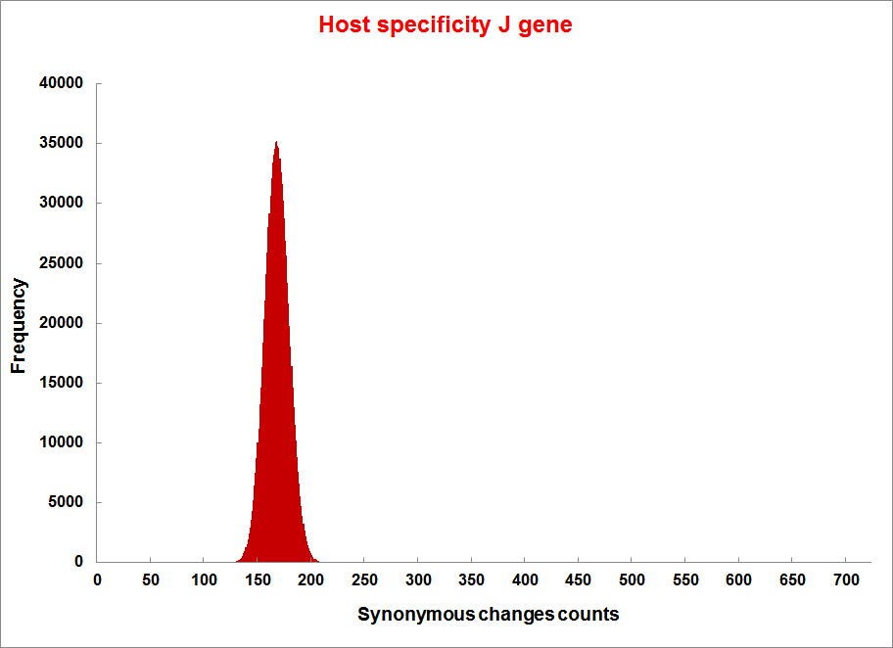
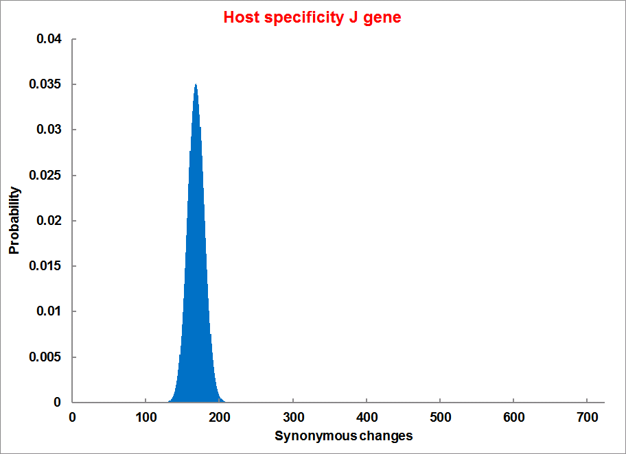
Evolution of Coding DNA Sequences Under a Neutral Model
E. coli Prophage Genes
Count distribution
Probability distribution
n=375
Synonymous
n= 375
k= 243
p=0.237
P(≥243)=7.92E-64
Observed=243
P(≥243) < 10⁻⁶
n=723
Synonymous
n= 723
k= 498
p=0.232
P(≥498)=6.41E-149
Observed=498
P(≥498) < 10⁻⁶

Slide 49
Evolution of Coding DNA Sequences Under a Neutral Model
E. coli Prophage Genes
 |  | OBSERVED |  | SIMULATED |  | Dnapars | Simulated | Codeml
Gene | Alignment Length (bp) | Substitutions | Synonymous changes* | Substitutions | p-value synonymous (given *) | Minimum number of substitutions | dN/dS | dN/dS
Major capsid | 1023 | 90 | 66 | 90 | 3.23E-23 | 94 | 0.113 | 0.13142
Minor capsid C | 1329 | 81 | 59 | 81 | 1.98E-19 | 84 | 0.124 | 0.17704
Large terminase subunit | 1923 | 75 | 67 | 75 | 7.10E-35 | 82 | 0.035 | 0.03773
Small terminase subunit | 543 | 100 | 66 | 100 | 1.07E-19 | 101 | 0.156 | 0.25147
Portal | 1599 | 55 | 46 | 55 | 1.36E-21 | *64 | 0.057 | 0.08081
Protease | 1329 | 55 | 37 | 55 | 4.64E-11 | 55 | 0.162 | 0.24421
Minor tail H | 2565 | 260 | 168 | 260 | 1.81E-44 | 260 | 0.17 | 0.30928
Minor tail L | 696 | 30 | 26 | 30 | 1.30E-13 | 30 | 0.044 | 0.05004
Host specificity J | 3480 | 723 | 498 | 723 | 6.42E-149 | *773 | 0.137 | 0.17103
Tail fiber K | 741 | 41 | 28 | 41 | 1.06E-09 | 44 | 0.14 | 0.18354
Tail assembly I | 669 | 39 | 33 | 39 | 3.82E-15 | 40 | 0.064 | 0.07987
Tail tape measure protein | 2577 | 375 | 243 | 375 | 7.92E-64 | 378 | 0.169 | 0.27957
Values well under the p=0.01 threshold, suggesting rejection of the null hypothesis of neutral evolution of prophage sequences.

Slide 50
Evolution of Coding DNA Sequences Under a Neutral Model
B. pseudomallei Cryptic Malleilactone Operon Genes and
E. coli transposase sequences
 |  | OBSERVED |  | SIMULATED
Gene | Alignment Length (bp) | Substitutions | Synonymous changes* | Substitutions | p-value synonymous (given *)
Aldehyde dehydrogenase | 1544 | 13 | 3 | 13 | 4.67E-04
AMP- binding protein | 1865 | 9 | 6 | 9 | 1.68E-02
Adenosylmethionine-8-amino-7-oxononanoate aminotransferase | 1421 | 20 | 12 | 20 | 6.78E-04
Fatty-acid CoA ligase | 1859 | 13 | 2 | 13 | 8.71E-01
Diaminopimelate decarboxylase | 1388 | 7 | 3 | 7 | 6.63E-01
Malonyl CoA-acyl transacylase | 899 | 2 | 1 | 2 | 4.36E-01
FkbH domain protein | 1481 | 17 | 9 | 17 | 2.05E-02
Hypothethical protein | 431 | 3 | 2 | 3 | 1.47E-01
Ketol-acid reductoisomerase | 1091 | 2 | 0 | 2 | 1.00E+00
Peptide synthase regulatory protein | 1079 | 10 | 5 | 10 | 8.91E-02
Polyketide-peptide synthase | 12479 | 135 | 66 | 135 | 4.35E-27
 |  | OBSERVED |  | SIMULATED
Gene | Alignment Length (bp) | Substitutions | Synonymous changes* | Substitutions | p-value synonymous (given *)
Putative transposase | 903 | 175 | 107 | 175 | 1.15E-29

Slide 51
Other ways to detect positive selection
Selective sweeps -> fewer alleles present in population
(silent site diversity is erased by gene driven to fixation;
allele shows little within allele divergence - see contributions from archaic Humans for example),
SNP or neighboring SNPs are at higher frequency within a population.
Repeated episodes of positive selection -> high dN
(works well for repeated positive – aka diversifying – selection; e.g. virus interaction with the immunesystem)

Slide 52
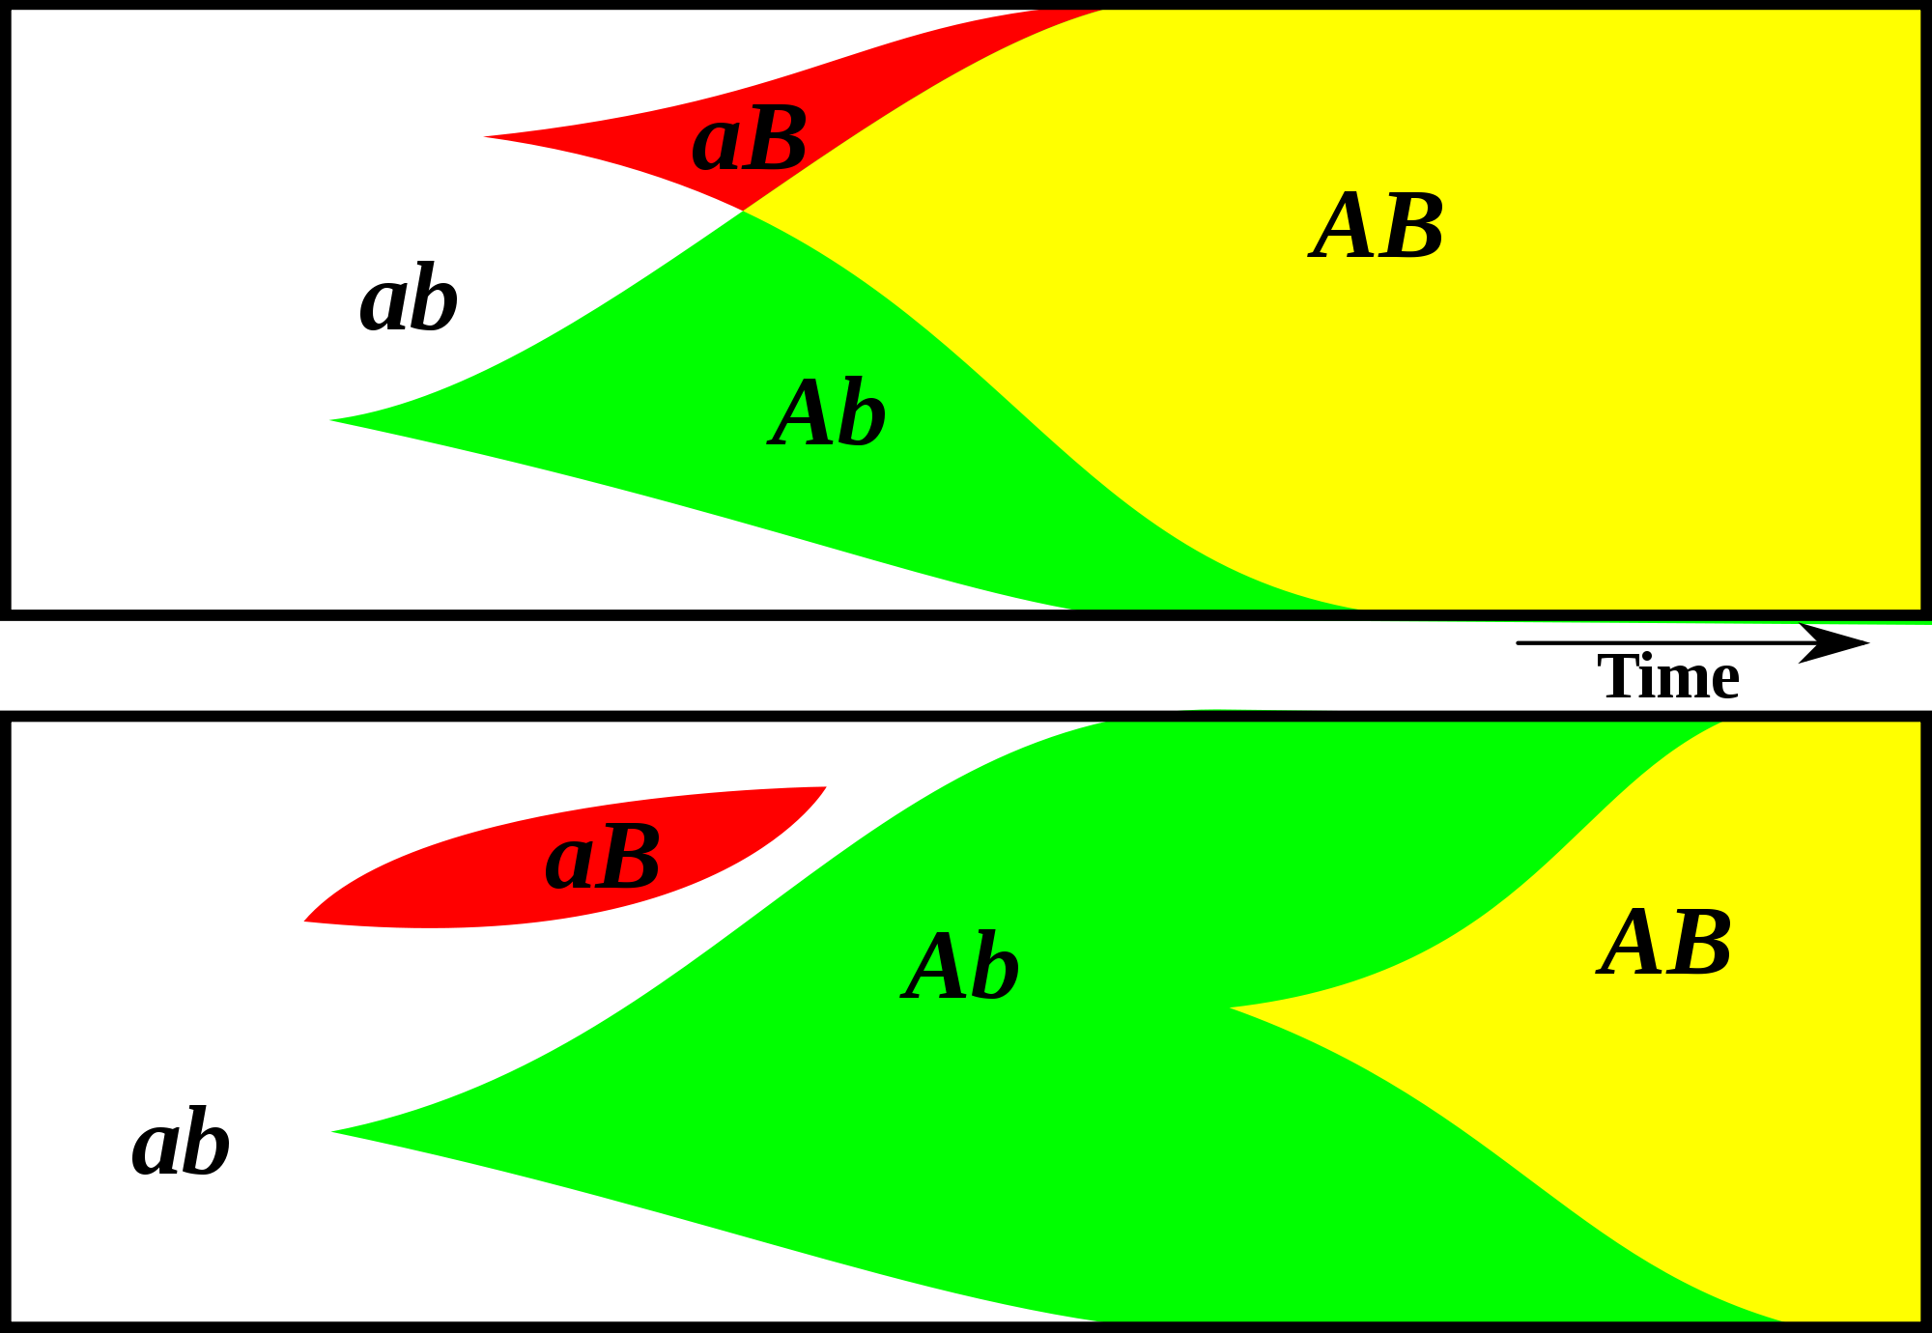
Gene Transfer, Sex, and Recombination:
Inventions do not need to be made sequentially
Gene transfer, followed by homologous or non-homologous recombination, allows inventions to be shared across the tree of life

Slide 53
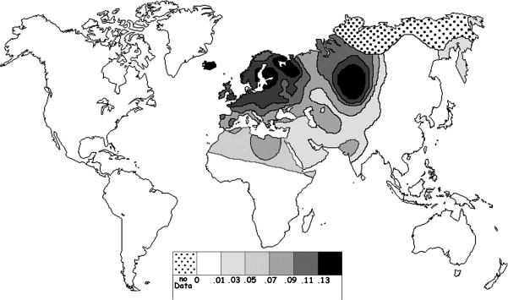
Fig. 1 Current world-wide frequency distribution of CCR5-Δ32 allele frequencies. Only the frequencies of Native populations have been evidenced in Americas, Asia, Africa and Oceania. Map redrawn and modified principally from <ce:cross-ref refid="bib5"> B...
Eric Faure , Manuela Royer-Carenzi
Is the European spatial distribution of the HIV-1-resistant CCR5-Δ32 allele formed by a breakdown of the pathocenosis due to the historical Roman expansion?
Infection, Genetics and Evolution, Volume 8, Issue 6, 2008, 864 - 874
http://dx.doi.org/10.1016/j.meegid.2008.08.007

Slide 54
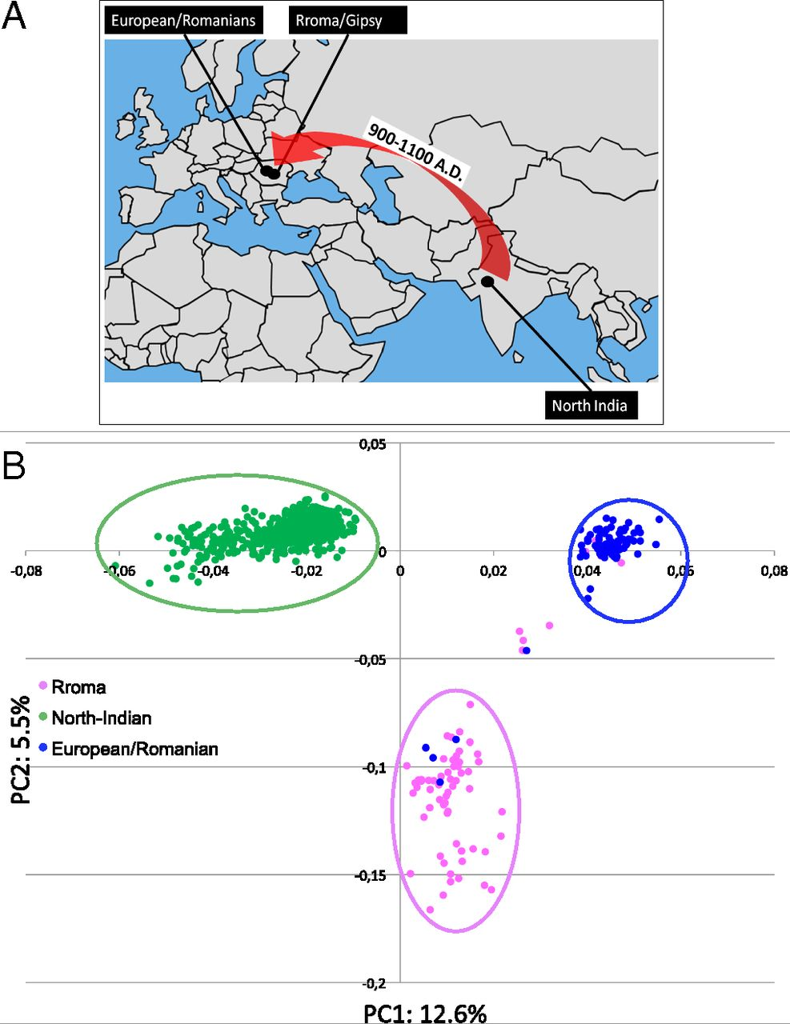
Geographic origin of the three populations studied.
196,524 SNPs
-> PCA
Hafid Laayouni et al. PNAS 2014;111:2668-2673
©2014 by National Academy of Sciences
Notes:
Geographic origin of the three populations studied. (A) European/Romanians and Rroma/Gipsy share the same location, even if the origin of the latter is in North India. (B) Plot of the populations under analysis according to the coordinates to the two main eigenvectors of smartpca (Eigensoft) analysis, in which each dot represents an individual. Individuals within the circles and the same color have been considered for the study; those of different colors represent false population allocation and those intermediate represent admixed individuals. ROM, nongypsy Romanians; INDI, individuals from North India; GYP, Rroma/Gypsies living in Romania.

Slide 55
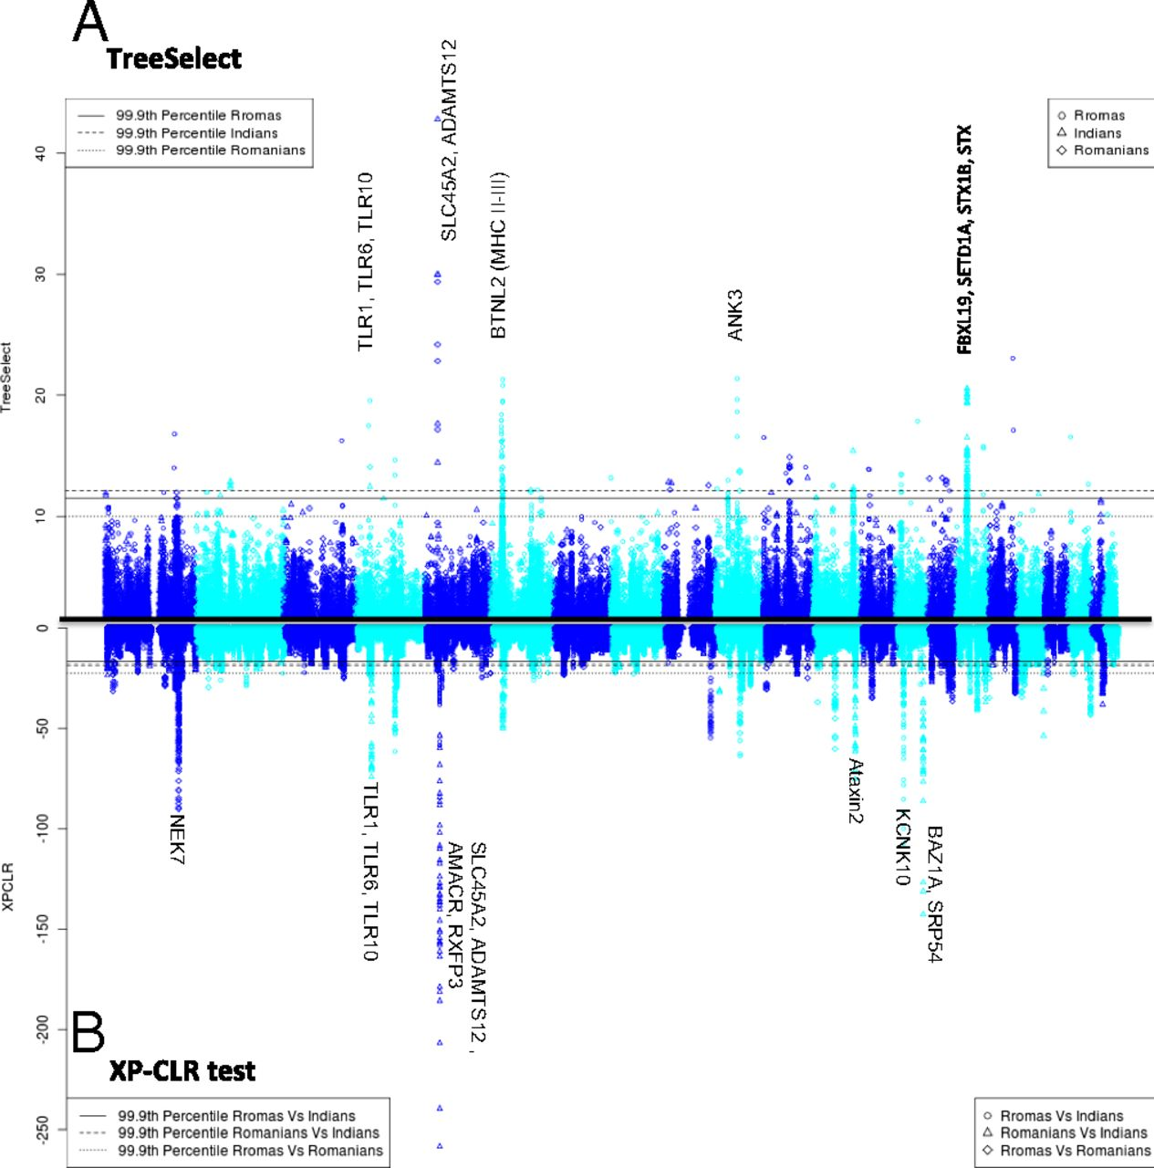
Manhattan plot of results of selection tests in Rroma, Romanians, and Indians using TreeSelect statistic (A) and XP-CLR statistic (B).
SNP frequencies within and between populations
selective sweeps detected through linkage disequilibrium
Laayouni H et al. PNAS 2014;111:2668-2673
Convergent evolution in European and Rroma populations reveals pressure exerted by plague on Toll-like receptors.
©2014 by National Academy of Sciences
Notes:
Manhattan plot of results of selection tests in Rroma, Romanians, and Indians using TreeSelect statistic (A) and XP-CLR statistic (B). Chromosomes ordered from chromosome 1 to chromosome 22.

Slide 56
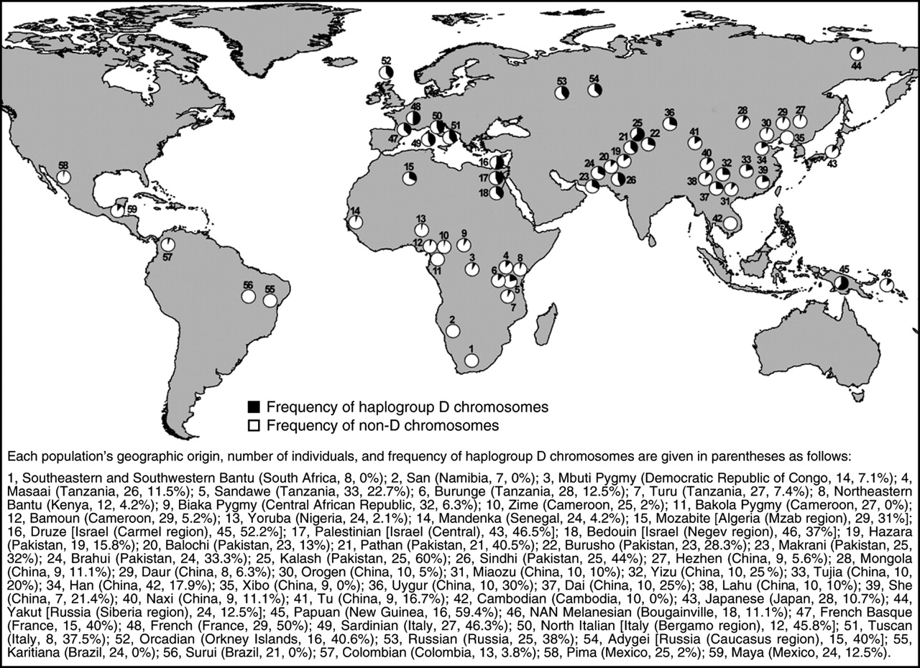
Variant arose about
5800 years ago

Slide 57
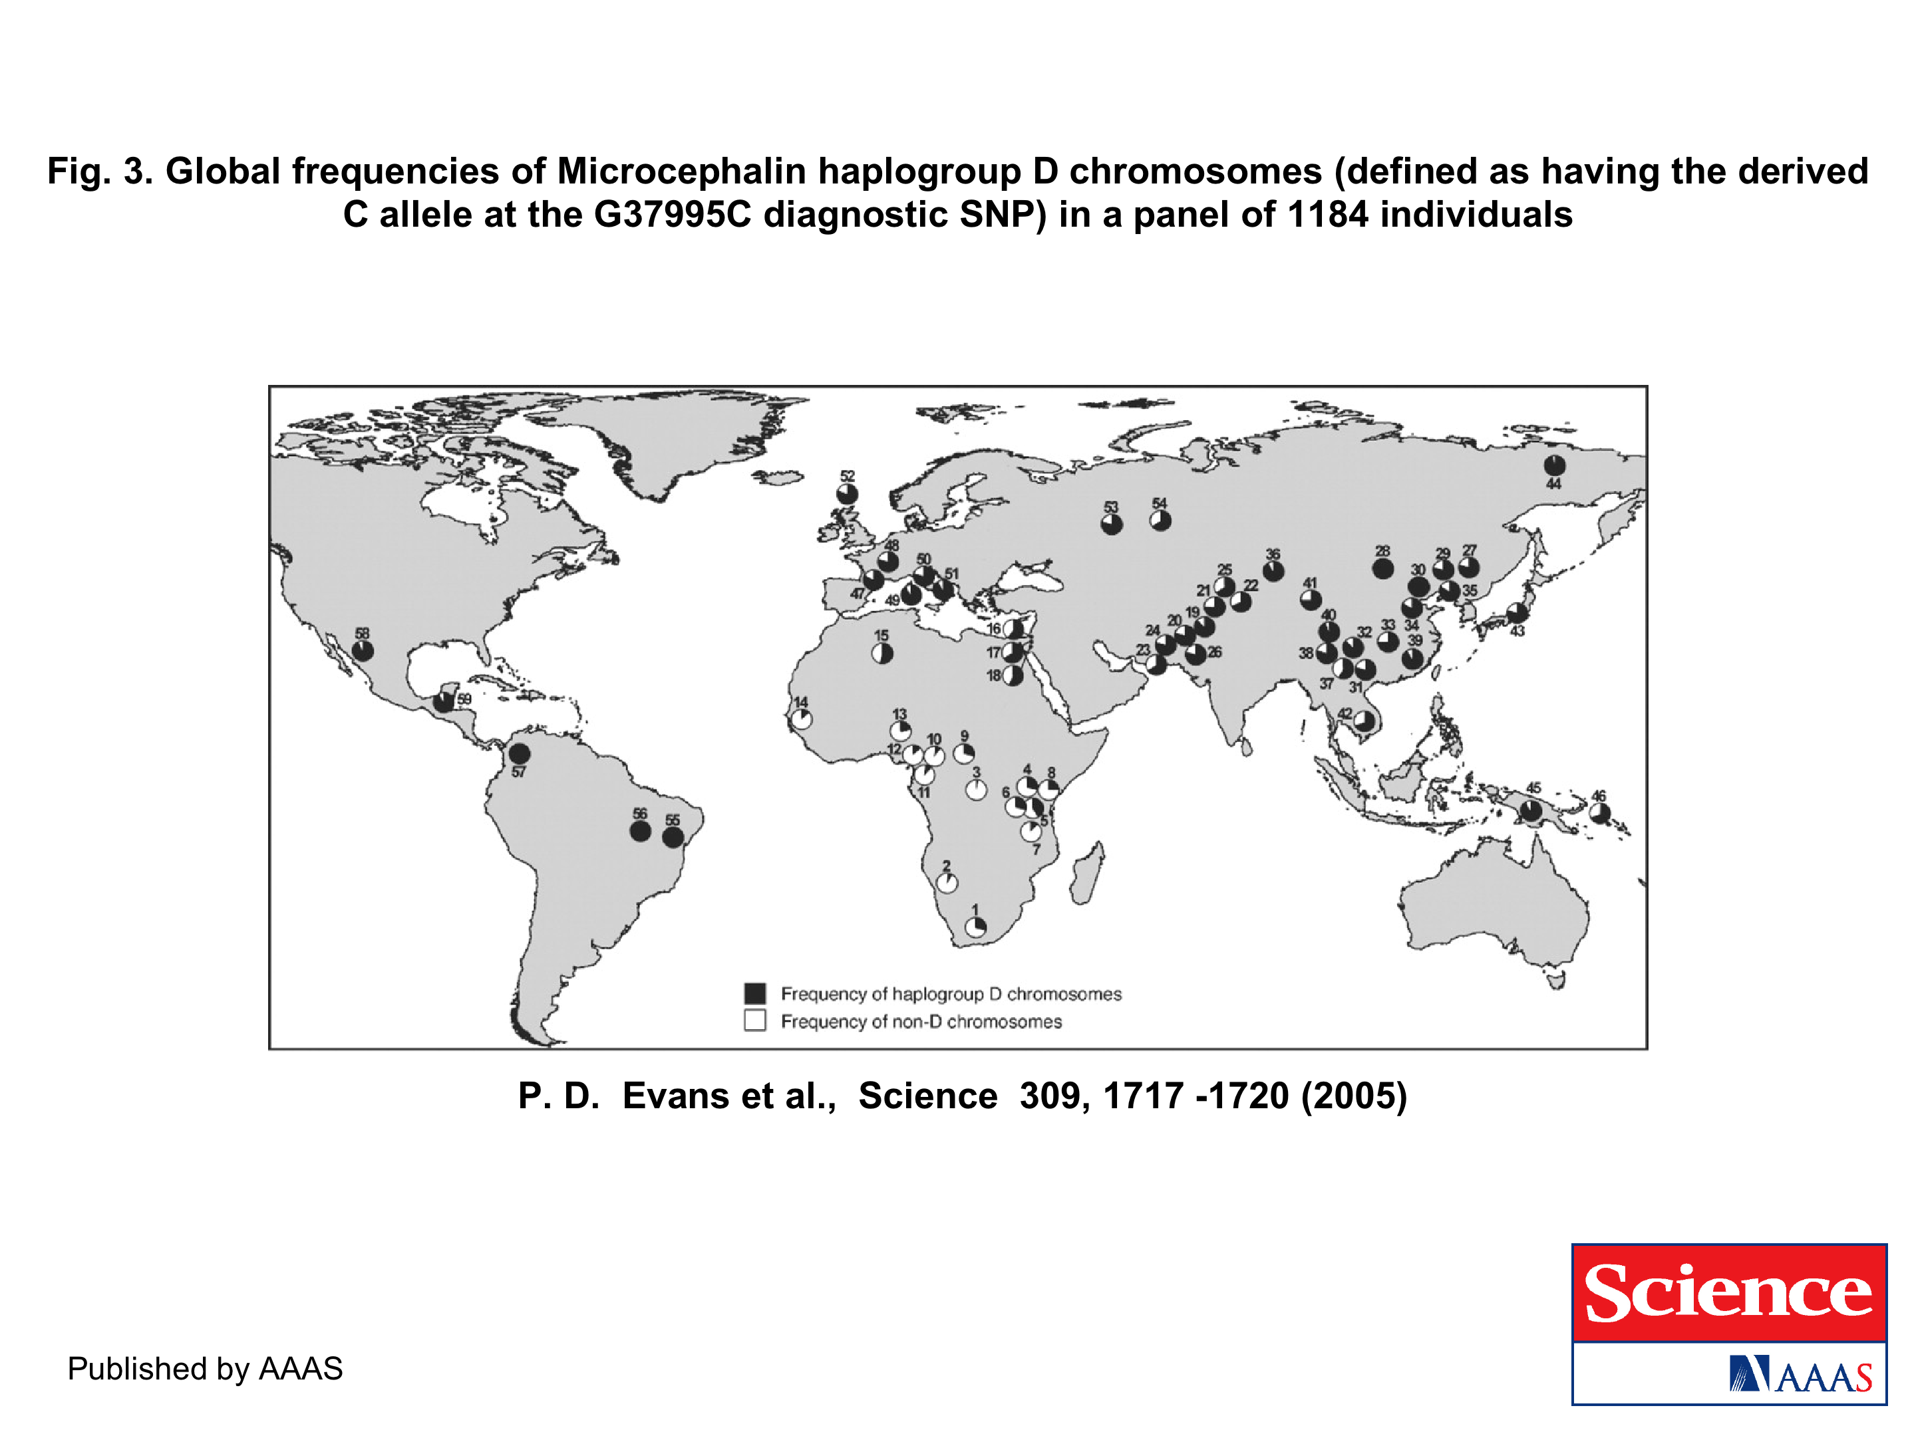
The age of haplogroup D was found to be ~37,000 years

Slide 58
