Slide 1
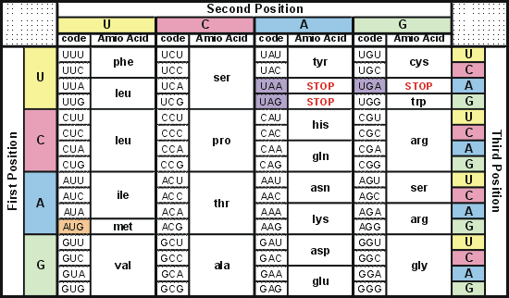
Degeneracy of 1st vs 2nd vs 3rd position sites results in 25.5% synonymous changes and 74.5% non synonymous changes (Yang&Nielsen,1998).
Genetic Code
Notes:
An inspection of the genetic code table suggests most changes at the first position are nonsynonymous, all changes at the second codon position are nonsynonymous and only some changes at the third position are synonymous. As a result we do not expect to see equal proportions of synonymous and nonsynonymous mutations even if there is no selection at protein level. Indeed, if mutations from any one nucleotide to any other occur at the same rate , we expect 25.5% of mutations to be synonymous and 74.5% mutations to be nonsynonymous.

Slide 2
Measuring Selection on Genes
Null hypothesis = neutral evolution
Under neutral evolution, synonymous changes should accumulate at a rate equal to mutation rate
Under neutral evolution, amino acid substitutions should also accumulate at a rate equal to the mutation rate
From: mentor.lscf.ucsb.edu/course/spring/eemb102/lecture/Lecture7.ppt

Slide 3
Testing for selection using dN/dS ratio
dN/dS ratio (aka Ka/Ks or ω (omega) ratio) where
dN = number of non-synonymous substitutions / number of all possible non-synonymous substitutions
dS =number of synonymous substitutions / number of all possible synonymous substitutions
dN/dS >1 positive, Darwinian selection
dN/dS =1 neutral evolution
dN/dS <1 negative, purifying selection
Notes:
The synonymous and non-synonymous rates dN and dS are defined as the numbers of synonymous and nonsynonymous substitutions per site. The ratio of the two rates omega=dN/dS then measures selective pressure at the protein level. If selection level has no effect on fitness, nonsynonymous mutations will be fixed at the same rate as synonymous mutations so that dN=dS and omega=1. If nonsynonymous mutations are deleterious purifying selection will reduce their fixation rate so that dN<dS and omega<1. If nonsynonymous mutations are favored by Darwinian selection, they will be fixed at a higher rate than synonymous mutations resulting in dN>dS and omega>1.

Slide 4
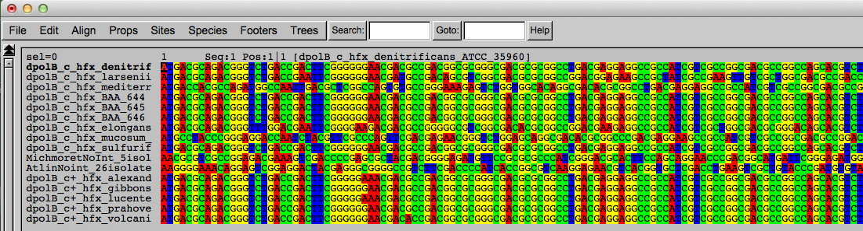
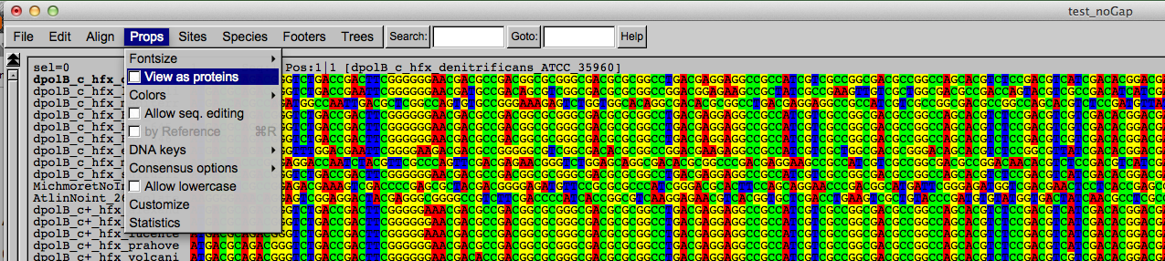
Codon based alignments in Seaview
Load nucleotide sequences (no gaps in sequences, sequence starts with nucleotide corresponding to 1st codon position)
Select view as proteins

Slide 5
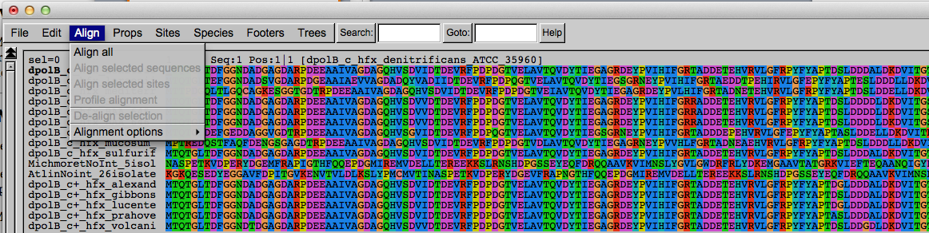
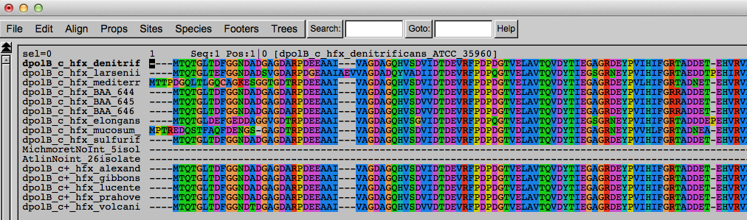
Codon based alignments in Seaview
With the protein sequences displayed, align sequences
Select view as nucleotides

Slide 6
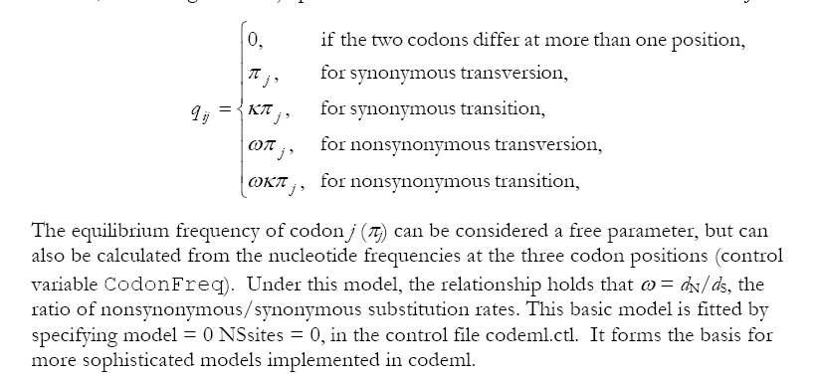
PAML (codeml) the basic model

Slide 7

sites versus branches
You can determine omega for the whole dataset; however, usually not all sites in a sequence are under selection all the time.
PAML (and other programs) allow to either determine omega for each site over the whole tree, ,
or determine omega for each branch for the whole sequence,
.
It would be great to do both, i.e., conclude codon 176 in the vacuolar ATPases was under positive selection during the evolution of modern humans – alas, a single site often does not provide much statistics.
PAML does provide a branch site model.

Slide 8
Sites model(s)
have been shown to work great in few instances.
The most celebrated case is the influenza virus HA gene.
A talk by Walter Fitch (slides and sound) on the evolution of
this molecule is here .
This article by Yang et al, 2000 gives more background on ml aproaches to measure omega. The dataset used by Yang et al is here: flu_data.paup .

Slide 9
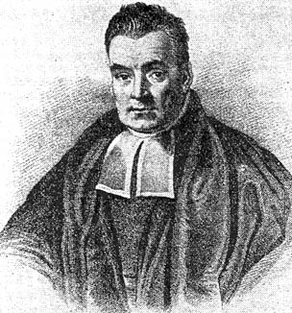
Bayes’ Theorem
Likelihood
describes how well the model predicts the data
P(data|model, I)
P(model|data, I) = P(model, I)
P(data,I)
Posterior
Probability
represents the degree
to which we believe a given model accurately describes the situation
given the available data and all of our prior information I
Prior
Probability
describes the degree to which we believe the model accurately describes reality
based on all of our prior information.
Normalizing
constant
Reverend Thomas Bayes (1702-1761)

Slide 10
Estimating Bayesian Posterior Probabilities through biased sampling
Exploration of parameter space by sampling posterior probabilities (likelihoods) using a biased random walk through parameter space (Metropolis Hastings Coupled Monte Carlo Markov Chain or MC³)
Pick a set of parameters at random
Calculate the likelihood of the data / posterior probability for this set of parameters
Change one of the parameter by a little bit, recalculate the likelihood
If the posterior probability increased, use these parameter values as a starting point for the next parameter change (back to 3), if it gets worse calculate the ratio of the posterior probabilities and take these odds to accept or reject the new parameter value as a starting point for the next step.
N_{i}
P_{i} ≈
,where N_{i} - number of sampled parameter values that you are interested in
N_{total} – total number of samples (has to be large)
N_{total}

Slide 11
Illustration of a biased random walk
Image generated with Paul Lewis's MCRobot
Figure generated using MCRobot program (Paul Lewis, 2001)

Slide 12
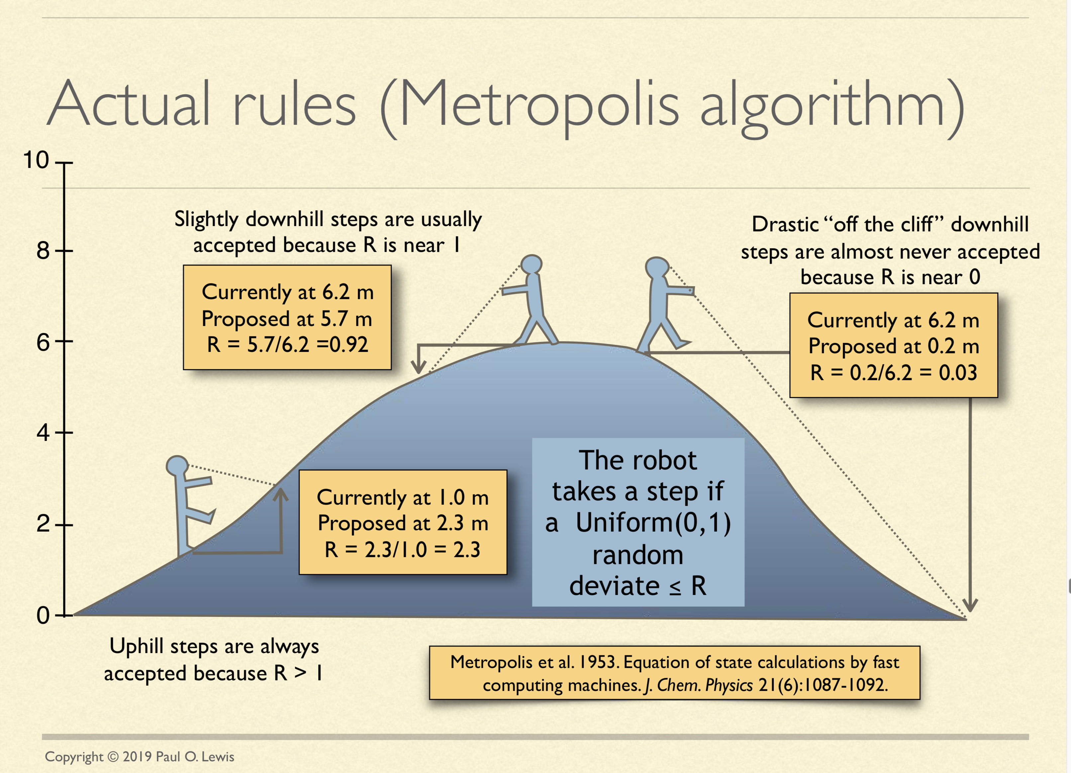
See: http://hydrodictyon.eeb.uconn.edu/people/plewis/downloads/wh2019/lewis-bayesian-part1.pdf

Slide 13
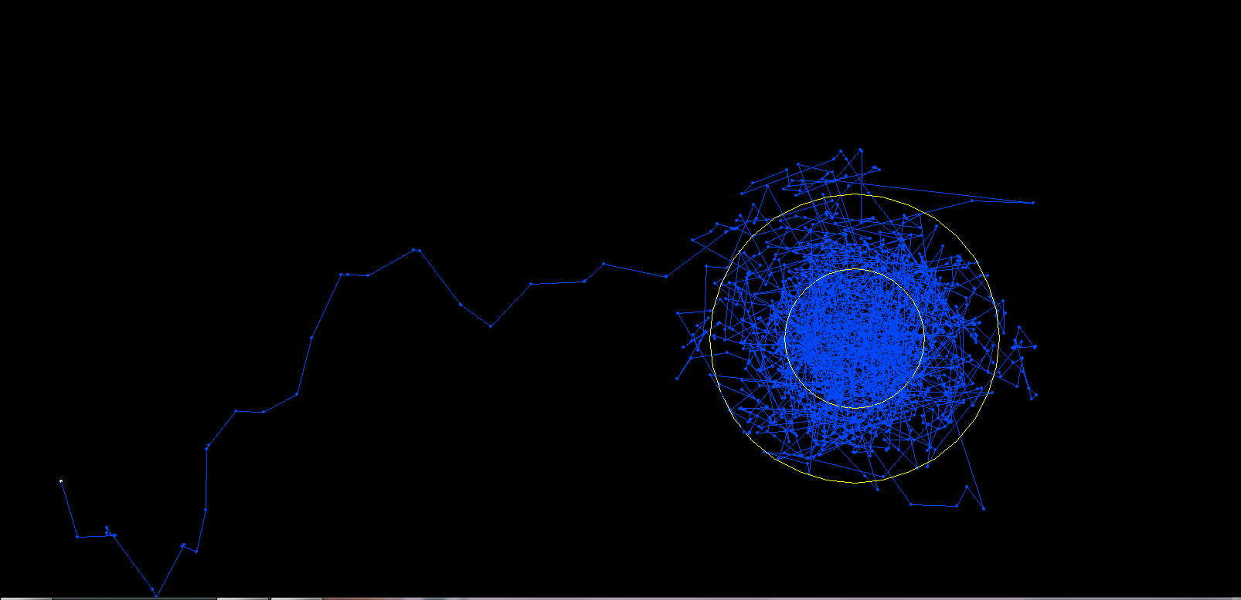
One needs to remove the burnin that is created, when the robot initially runs around in parameter space without seeing the probability landscape.

Slide 14
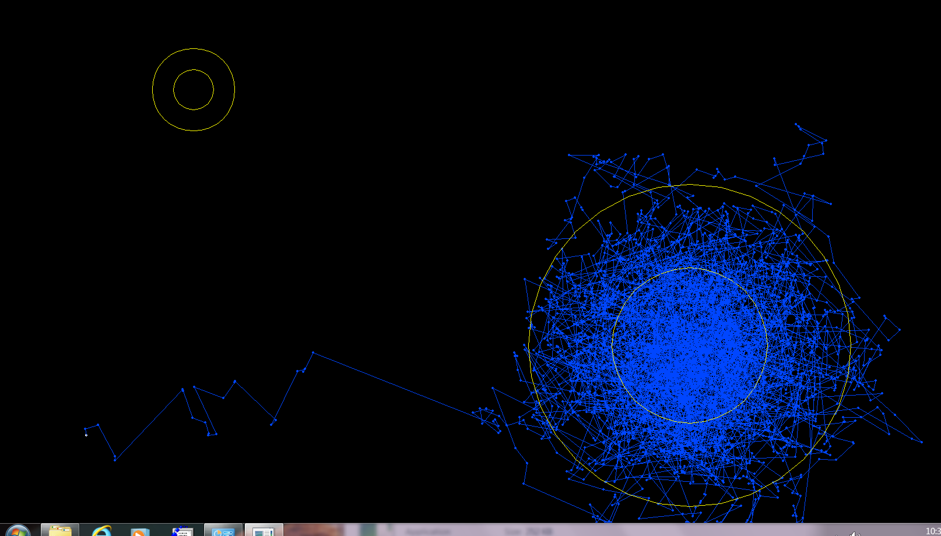
One complication is that the robot might be stuck on a local optimum.

Slide 15
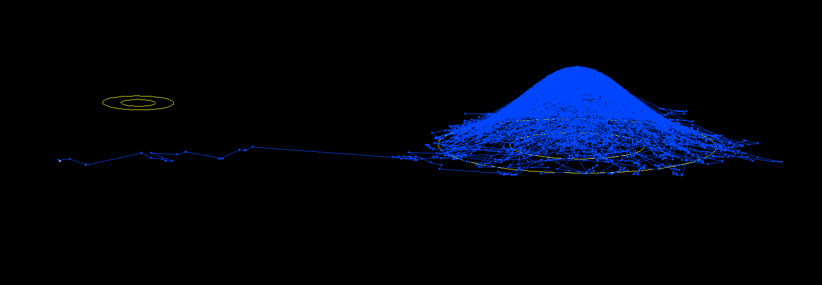
One complication is that the robot might be stuck on a local optimum. (Same as last slide but in sideview).

Slide 16
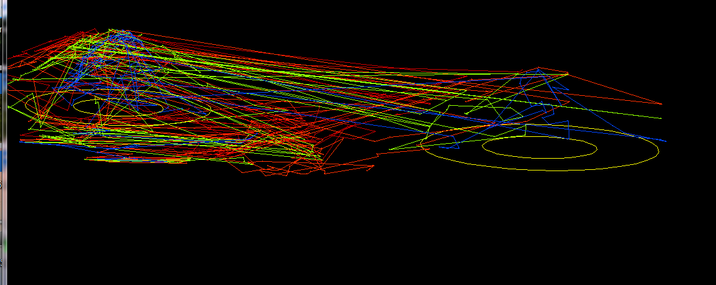
One solution is to run multiple chains, some of which “heated”, so that the probability landscape is melted down, and the robots move away more easily away from the optimum. The different chains compare their sampled probability, and switch in case the heated chain is better

Slide 17
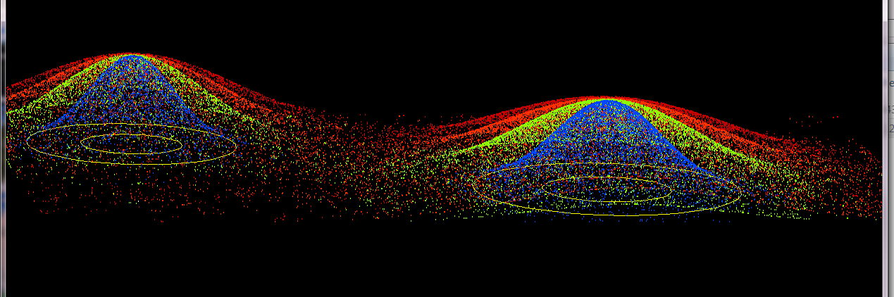
4 chains, same as previous, but many more generations, and the trajectory is not plotted, only the points visited by each of the four chains.

Slide 18
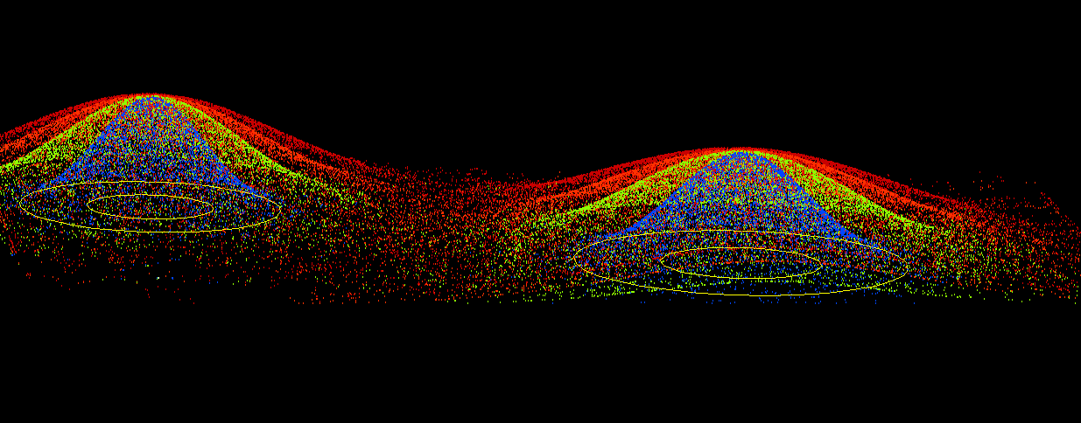
4 chains, same as previous, but even more generations

Slide 19
sites model in MrBayes
The MrBayes block in a nexus file might look something like this:
begin mrbayes;
set autoclose=yes;
lset nst=2 rates=gamma nucmodel=codon omegavar=Ny98;
mcmcp samplefreq=500 printfreq=500;
mcmc ngen=500000;
sump burnin=50;
sumt burnin=50;
end;
nst sets the number of different substitution rates. Nst =2 allows for different rates for transitions and transversions (the kappa in the Yang model).

Slide 20
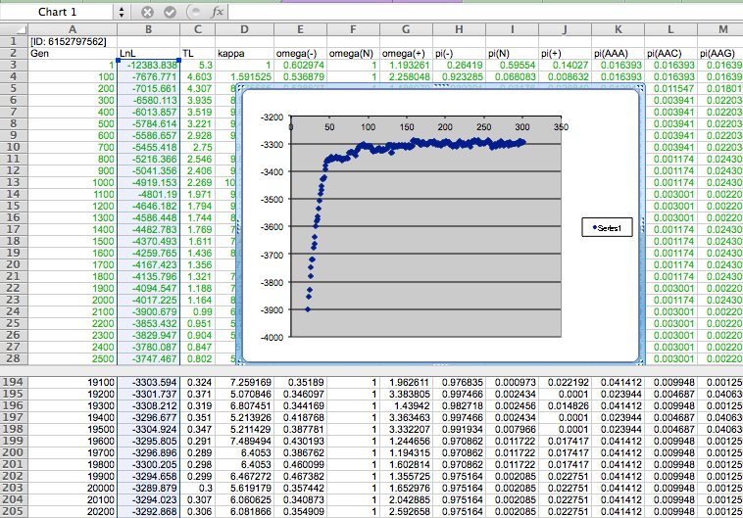

Slide 21
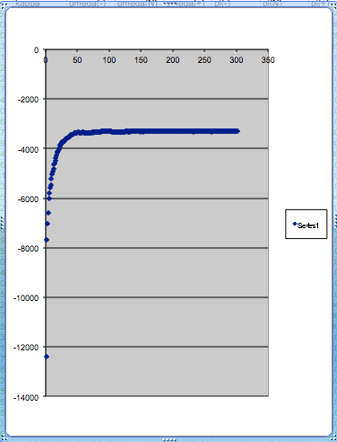
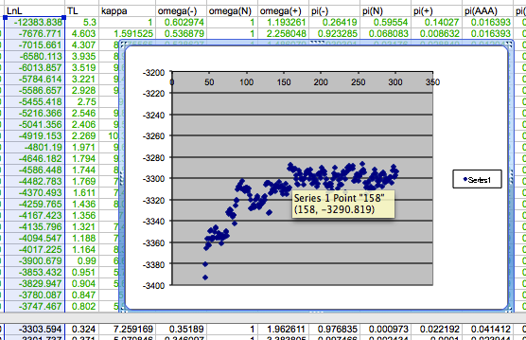
plot LogL to determine which samples to ignore
the same after rescaling the y-axis

Slide 22
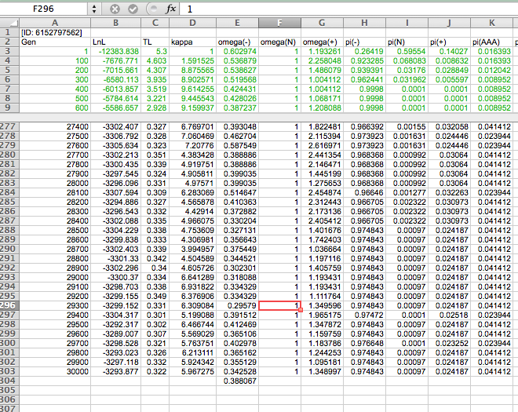

Slide 23
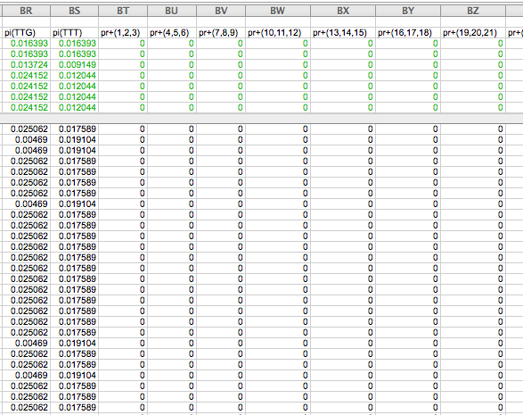

Slide 24
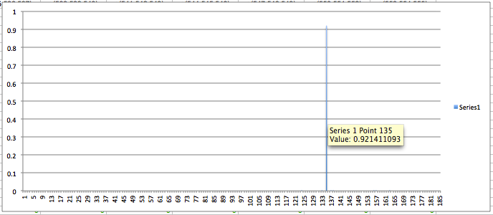
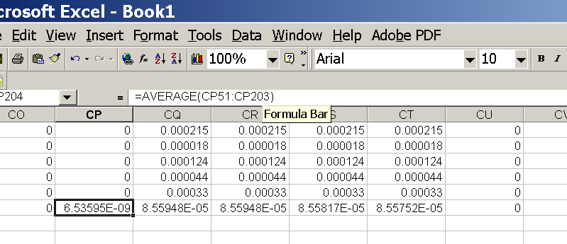
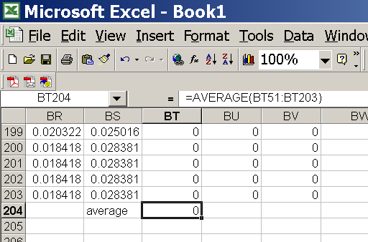
for each codon calculate the the average probability
copy paste formula
plot row
enter formula

Slide 25
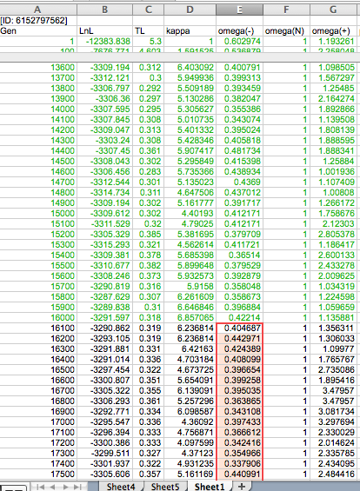
To determine credibility interval for a parameter (here omega<1):
Select values for the parameter, sampled after the burning.
Copy paste to a new spreadsheet,

Slide 26
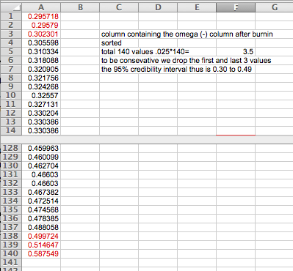
Sort values according to size,
Discard top and bottom 2.5%
Remainder gives 95% credibility interval.

Slide 27
Programs that can be used to determine dN/dS:
PAML (phylogenetic analysis using maximum likelihood).
Runs from the command line, using a control file.
Not easy to use, but, once one gets the hang of it, it is very powerful.
Hyphy (hypothesis testing using phylogeny). A webserver is available: https://www.datamonkey.org . Easier to use for novices, good graphics.

Slide 28

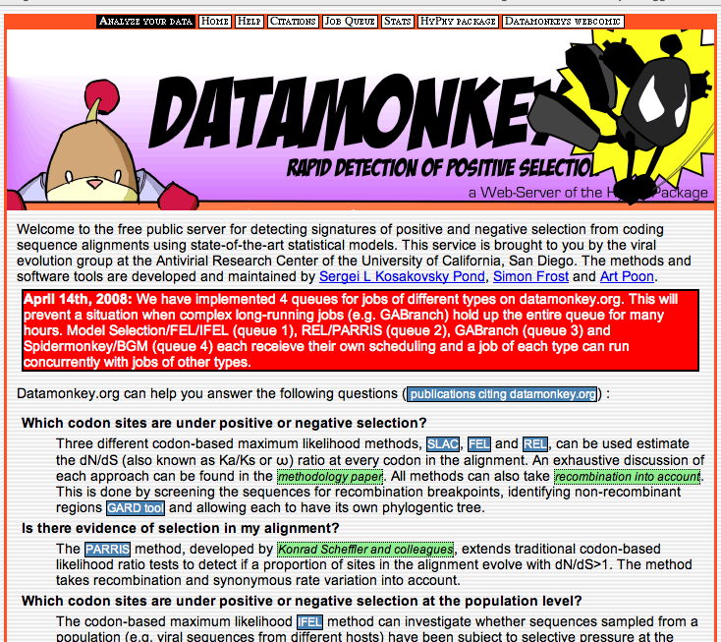
Hy-Phy -
Hypothesis Testing using Phylogenies.
Using Batchfiles or GUI
Information at http://www.hyphy.org/
Selected analyses also can be
performed online at
http://www.datamonkey.org/

Slide 29
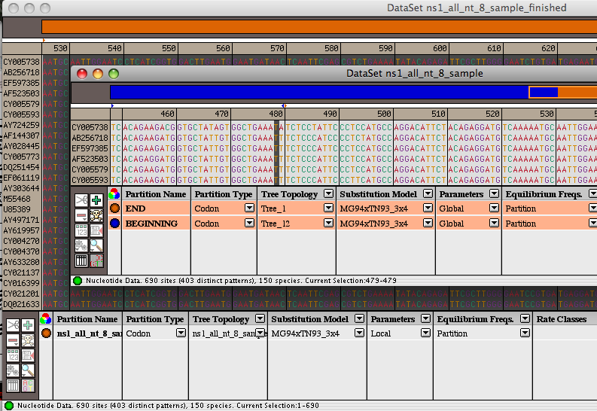
Example testing for dN/dS in two partitions of the data --
John’s dataset
Alternatively, especially if the the two models are not nested, one can set up two different windows with the same dataset:
Model 1
Model 2

Slide 30
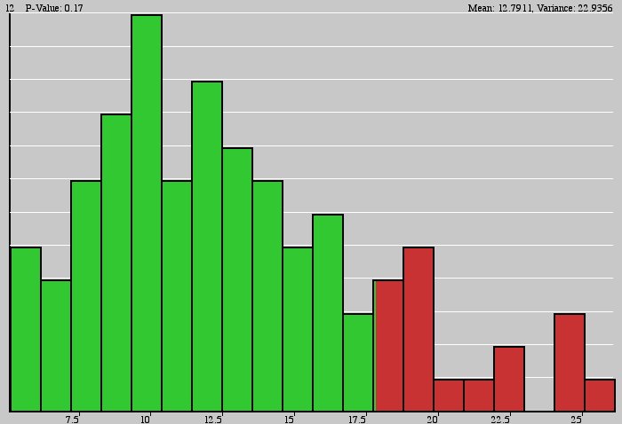
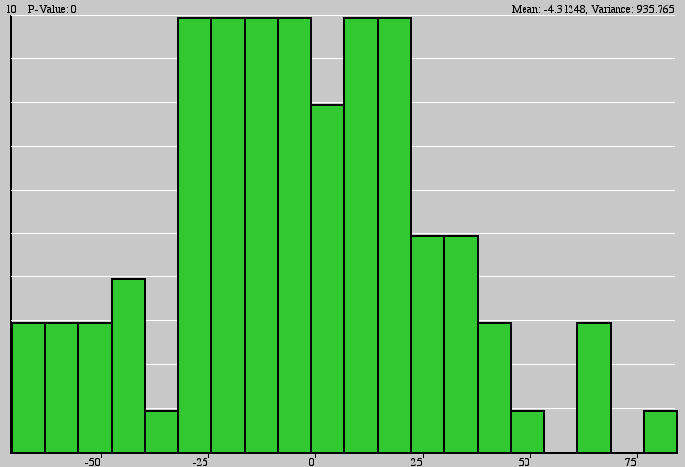
Example testing for dN/dS in two partitions of the data --
John’s dataset
Simulation under model 2, evaluation under model 1, calculate LR
Compare real LR to distribution from simulated LR values. The result might look something like this or this

Slide 31
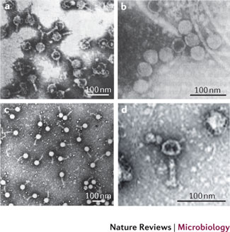
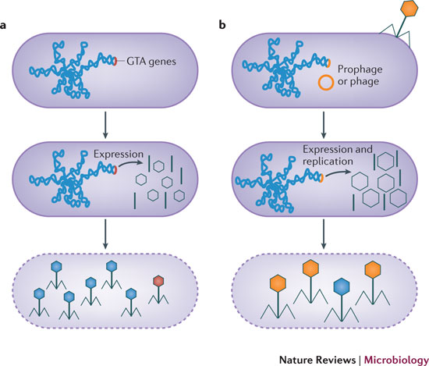
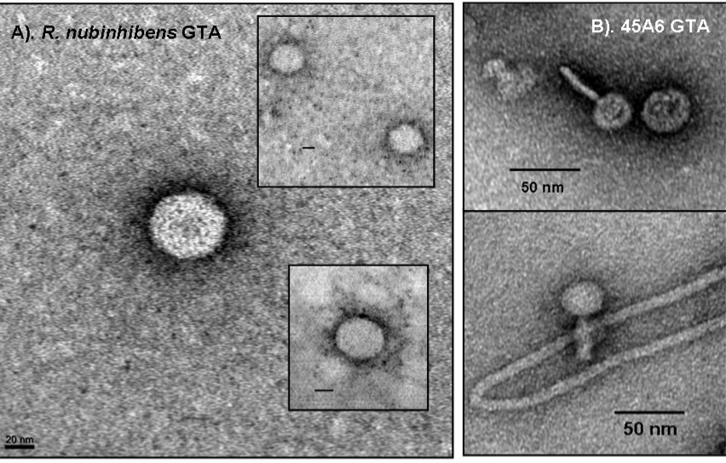
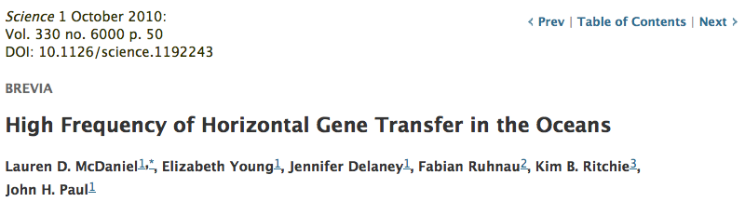
„Promiscuous little bastards...“ J. Paul
GTAs smaller capsids pack more often host DNA than their own genes
GTA
Phage
Lang AS, Zhaxybayeva O, Beatty JT. Nat Rev Microbiol. 2012 Jun 11;10(7):472-82
Lang AS, Zhaxybayeva O, Beatty JT. Nat Rev Microbiol. 2012 Jun 11;10(7):472-82
Notes:
GTA do not pack full complement of genes; it has been suggested GTAs are being produced via a process of productive infection
Phage-like particles that transfer random host genome sequences in a similar process to general transduction
Have been identified in Roseobacter sp., Rhodobacter capsulatus, Bartonella spp., Desulfovibrio desulfuricans, Methanococcus voltae, Brachyspira hyodysenteriae
Thought to be major players in horizontal gene transfers occurring in marine microbial communities
a | The genes encoding the gene transfer agent (GTA) particles are located on the host chromosome, and their expression leads to the production of GTA particles (black). GTA genes have never been found to excise from the genome as part of GTA production. Random DNA segments from the producing cell are packaged in the particles (blue particle heads), and only the occasional particle contains GTA genes (red particle head). For all genetically characterized GTAs, the amount of DNA packaged is insufficient to encode the phage-like structure (as indicated by the small heads). It is presumed that GTAs require lysis (dashed line) for release from cells. b | In the production of transducing phages, phage or prophage genes within the host genome are expressed, resulting in the production of phage particles (black) and replication of the phage genome (not shown). Packaging of the complete phage genome then occurs (orange phage heads), with occasional packaging of non-phage DNA (blue phage head). Note that this is an oversimplification and some transducing phage particles can contain both phage and cellular genomic DNA. Tailed phage structures require lysis to be released from cells.

Slide 32
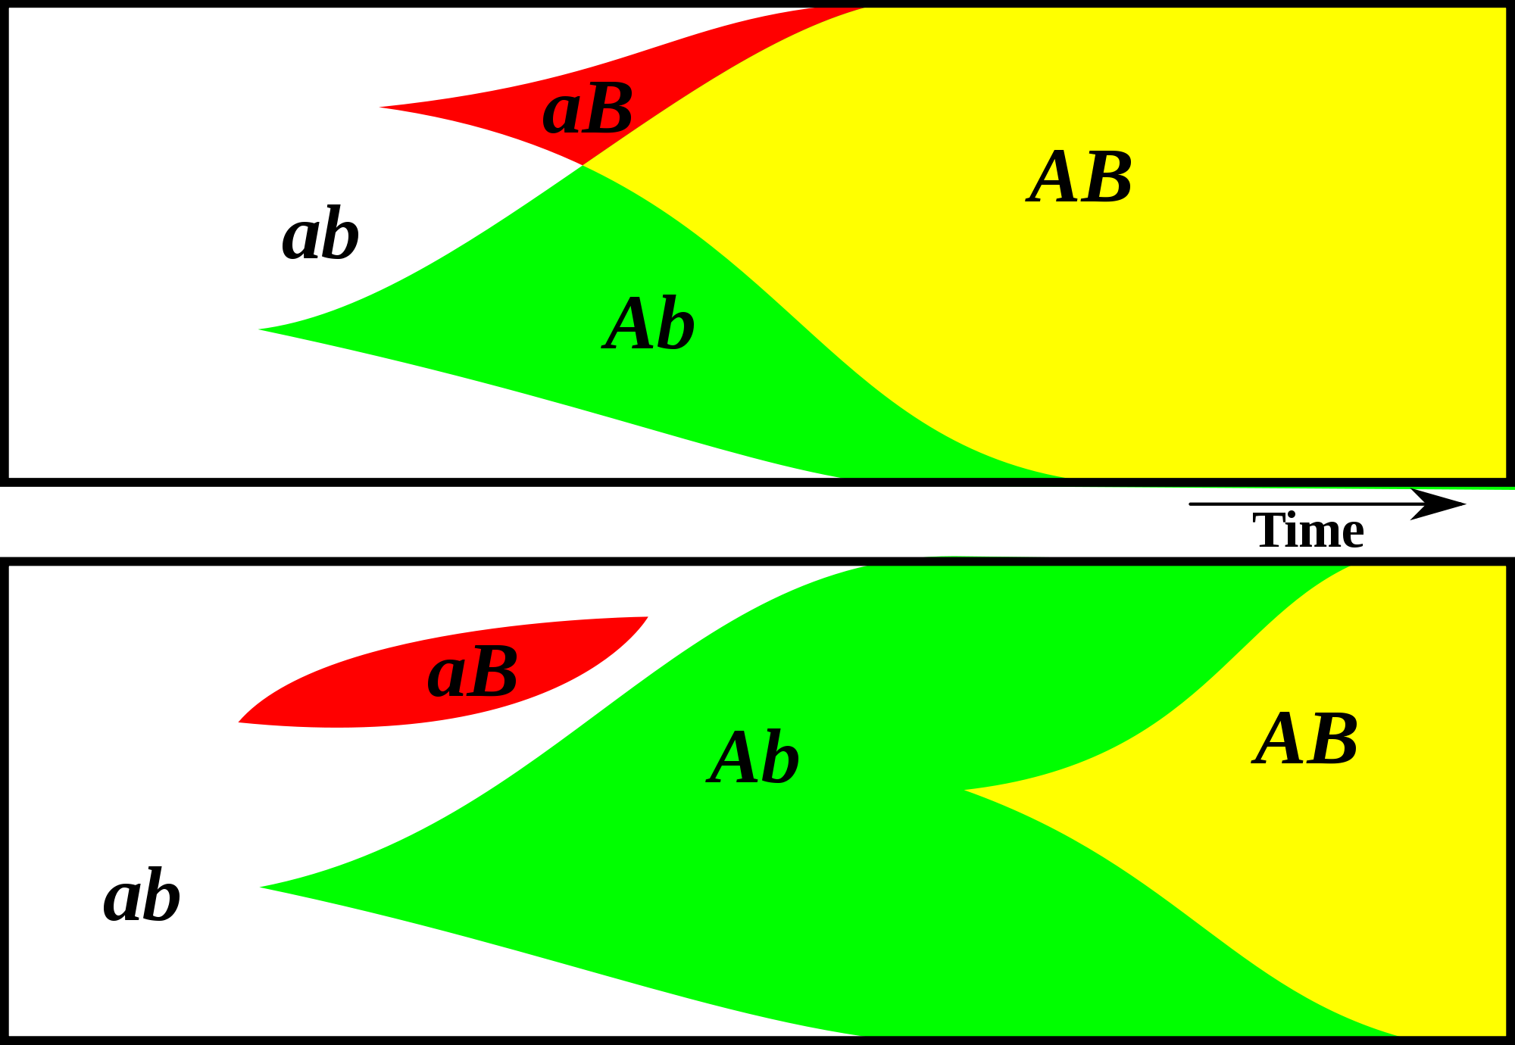
Gene Transfer, Sex, and Recombination:
Inventions do not need to be made sequentially
Gene transfer, followed by homologous or non-homologous recombination, allows inventions to be shared across the tree of life

Slide 33
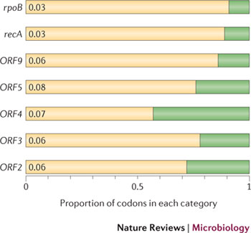
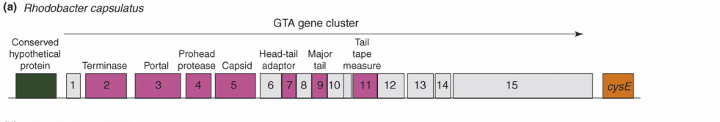
Purifying selection in GTA genes
dN/dS <1 for GTA genes has been used to infer selection for function
GTA genes
Lang AS, Zhaxybayeva O, Beatty JT. Nat Rev Microbiol. 2012 Jun 11;10(7):472-82
Lang, A.S. & Beatty, J.T. Trends in Microbiology , Vol.15, No.2 , 2006
Notes:
The ratio of non-synonymous-to-synonymous (dN/dS, or ω) codon substitution rates can be used as an indication of the selective pressure acting on a protein-coding gene. If a gene (or gene segment) is under purifying selection, non-synonymous mutations (that is, mutations resulting in a change of the encoded amino acid) will be selected against, resulting in ω < 1. In neutrally evolving proteins, synonymous and non-synonymous mutations will be fixed at approximately the same rate, resulting in ω = 1. Because different regions of a protein-coding gene may be under different selective constraints, codons can be divided into two categories: those with ω < 1 (yellow; the estimated ω is indicated on the bar) and those with ω fixed to 1 (green); the estimated proportion of codons in each category is given on the horizontal axis.

Slide 34
GTA- cells can invade GTA populations, the reverse is only possible (Panel B), if GTA+ cells can restrict the benefits of recombination to GTA+ cells.
From Soucy and Redfield (2018)
10.3389/fmicb.2018.02527
Notes:
Effects of competition. All runs used α = 1.5 and high-high regulation. Note the exponential scale of the Y-axis. (A,B) eff. = 1.0. (A) a large GTA⁺ population being invaded by control GTA⁺ cells (orange) and by GTA⁻ cells that can (dark green) or cannot (light green) recombine. (B) a large GTA⁻ population being invaded by control GTA⁻ cells (green) and by GTA⁺ cells that can (light orange) or cannot (dark orange) sequester recombination. (C,D) Like (A,B) but with eff. = 0.2.

Slide 35
GTAs cannot survive as selfish genetic elements, because
GTAs are too small to encode all GTA genes
The GTA+ cell dies upon release of the GTAs
At best on GTA- cell (that has a mutation in its GTA can be converted to GTA+.
Recombination is beneficial to a group, because it prevents slightly deleterious mutations to be fixed along site beneficial ones, and it allows beneficial mutations that occurred in different cells to come together in a lineage. However, GTAs do not represent a evolutionary stable strategy.
GTA- cells can invade GTA+ population (the never lyse themselves, and the reap the benefits of recombination).
GTA+ cells can only invade a GTA- population, if the GTA+ cells manage somehow to restrict recombination to other GTA+ cells.
Why are GTAs around?
GTAs just represent decaying phages … But they are under purifying selection (however, see below).
The gene transfer the GTAs catalyze has some other benefits, Rosie Redfield (here) discusses the possibility that they might help transfer immunity against phages. (Could this be an evolutionary stable strategy?)

Slide 36

A) GTAs as vehicles to share gene fragments of invading phage with uninfected phage.
B) The microbial way to recycle remains.
In aquatic systems, death by lysis keeps nutrients available.
Death by “old age” that keeps the cells envelope intact, removes nutrients into the sediments.

Slide 37
Purifying selection in E.coli ORFans
dN-dS < 0 for some ORFan E. coli clusters seems to suggest they are functional genes.
Gene groups | Number | dN-dS>0 | dN-dS<0 | dN-dS=0
E. coli ORFan clusters | 3773 | 944 (25%) | 1953 (52%) | 876 (23%)
Clusters of E.coli sequences found in Salmonella sp., Citrobacter sp. | 610 | 104 (17%) | 423(69%) | 83 (14%)
Clusters of E.coli sequences found in some Enterobacteriaceae only | 373 | 8 (2%) | 365 (98%) | 0 (0%)
Adapted after Yu, G. and Stoltzfus, A. Genome Biol Evol (2012) Vol. 4 1176-1187

Slide 38
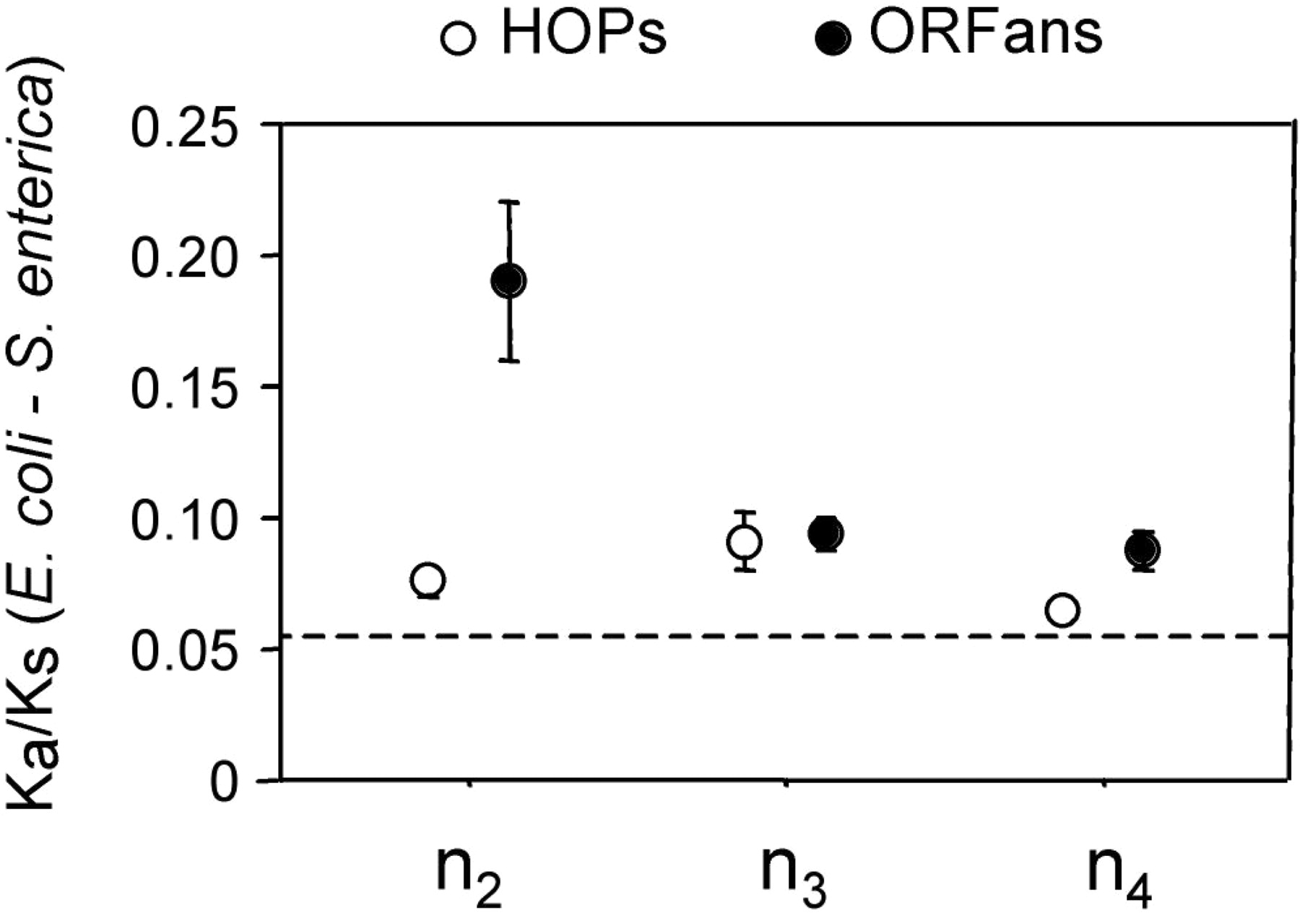
Vincent Daubin and Howard Ochman: Bacterial Genomes as New Gene Homes: The Genealogy of ORFans in E. coli. Genome Research 14:1036-1042, 2004
The ratio of non-synonymous to synonymous substitutions for genes found only in the E.coli - Salmonella clade is lower than 1, but larger than for more widely distributed genes.
Increasing phylogenetic depth
Fig. 3 from Vincent Daubin and Howard Ochman, Genome Research 14:1036-1042, 2004

Slide 39

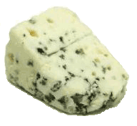
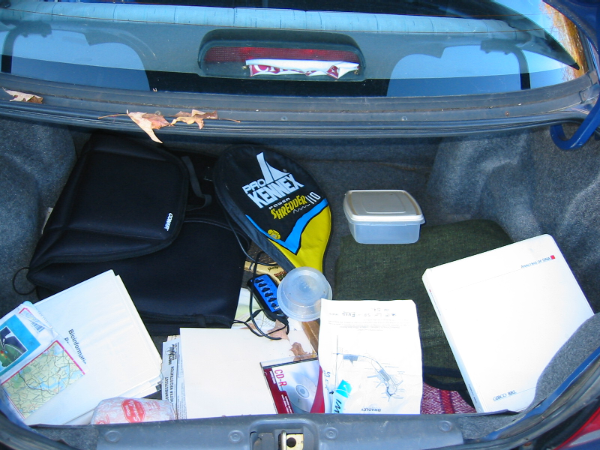
Trunk-of-my-car analogy: Hardly anything in there is the is the result of providing a selective advantage. Some items are removed quickly (purifying selection), some are useful under some conditions, but most things do not alter the fitness. See here for a published version.
Could some of the inferred purifying selection be due to the acquisition of novel detrimental characteristics (e.g., protein toxicity, HOPELESS MONSTERS)?

Slide 40
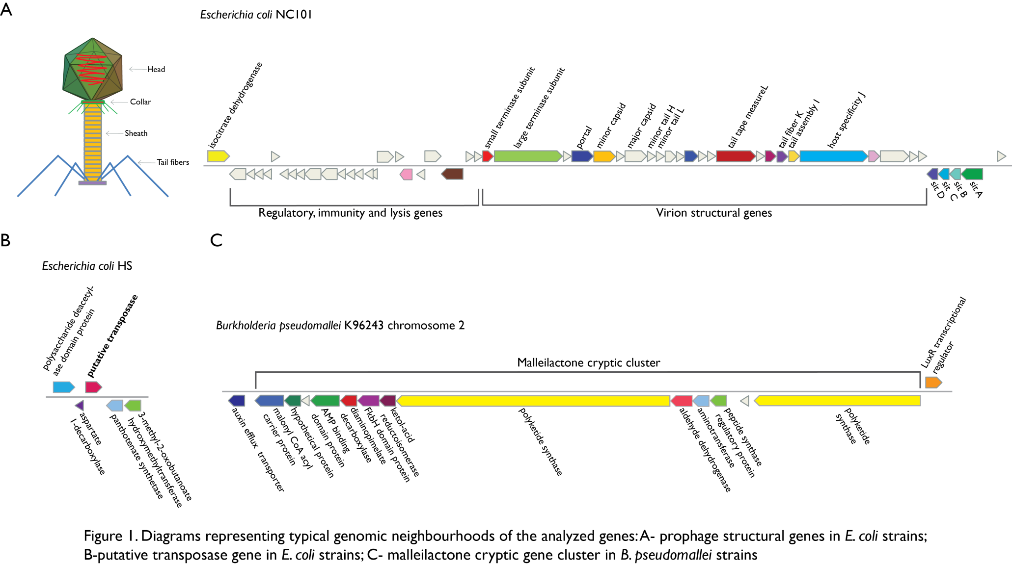
Vertically Inherited Genes Not Expressed for Function

Slide 41
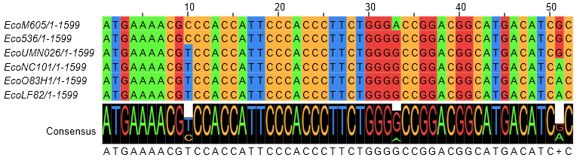
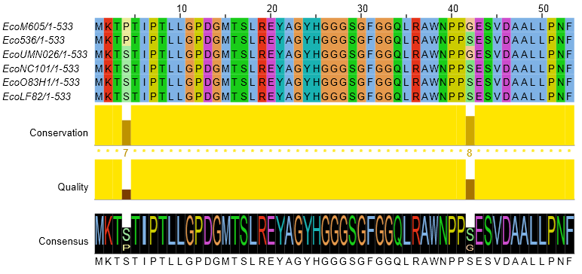
Counting Algorithm
Calculate number of different nucleotides/amino acids per MSA column (X)
Calculate number of nucleotides/amino acids substitutions (X-1)
Calculate number of synonymous changes
S=(N-1)nc-N
assuming N=(N-1)aa
X=2 1 nucleotide substitution
1 non-synonymous change
X=2 1 amino acid substitution

Slide 42
Simulation Algorithm
Calculate MSA nucleotide frequencies (%A,%T,%G,%C)
Introduce a given number of random substitutions ( at any position) based on inferred base frequencies
Compare translated mutated codon with the initial translated codon and count synonymous and non-synonymous substitutions

Slide 43
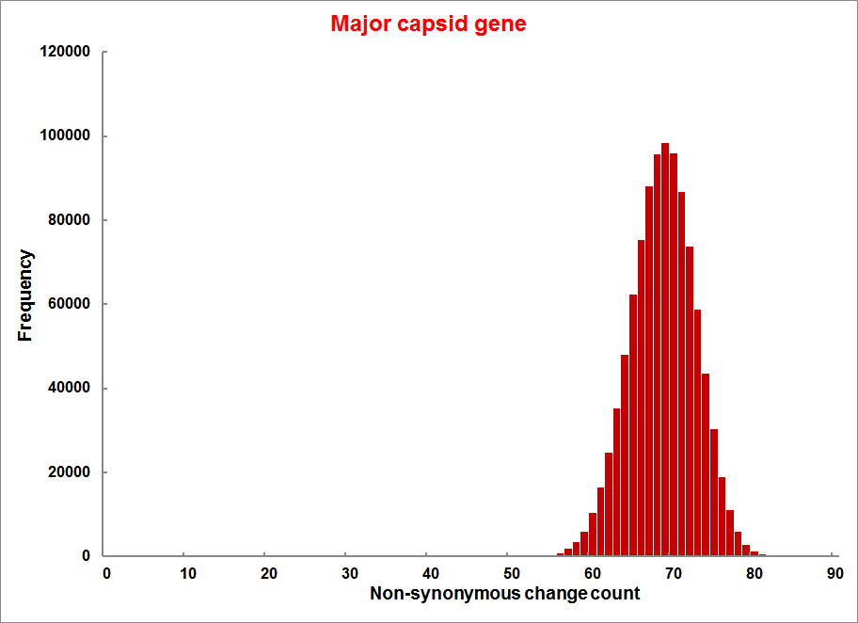
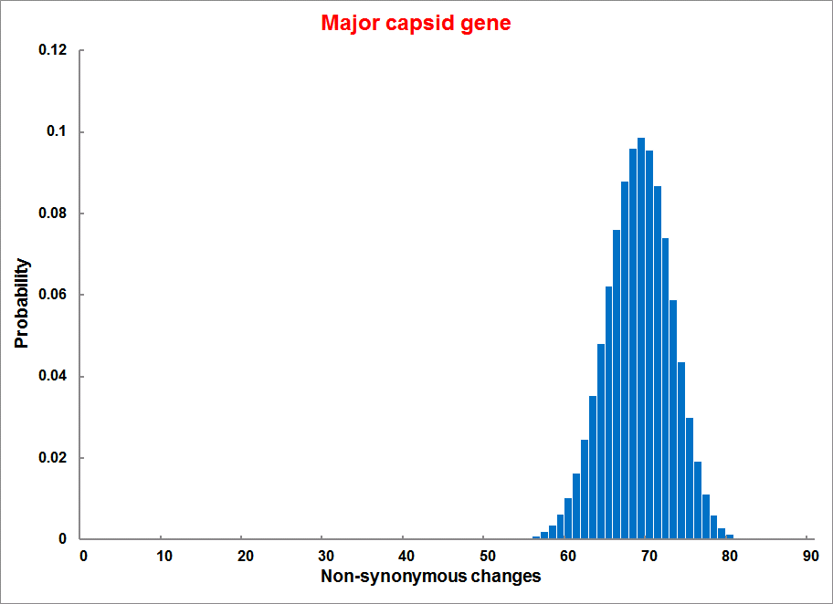
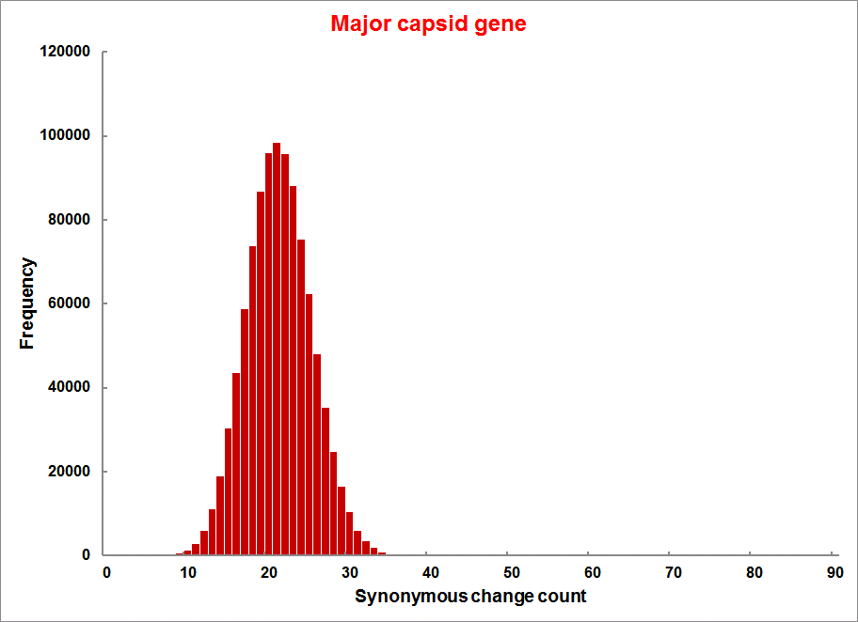
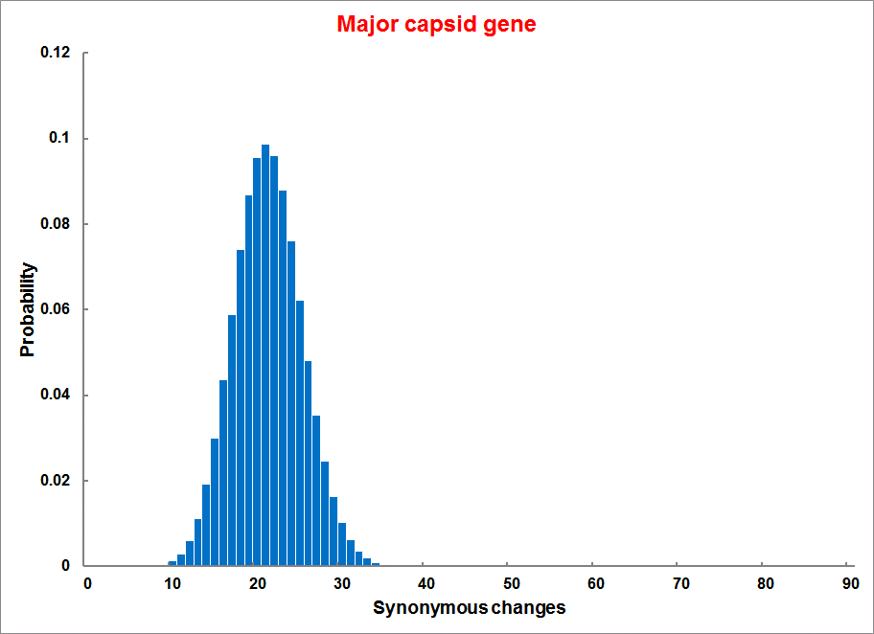
Evolution of Coding DNA Sequences Under a Neutral Model
E. coli Prophage Genes
Count distribution from simulations
Probability distribution
n=90
Non-synonymous
n= 90
k= 24
p=0.763
P(≤24)=3.63E-23
Observed=24
P(≤24) < 10⁻⁶
n=90
Synonymous
n= 90
k= 66
p=0.2365
P(≥66)=3.22E-23
Observed=66
P(≥66) < 10⁻⁶

Slide 44
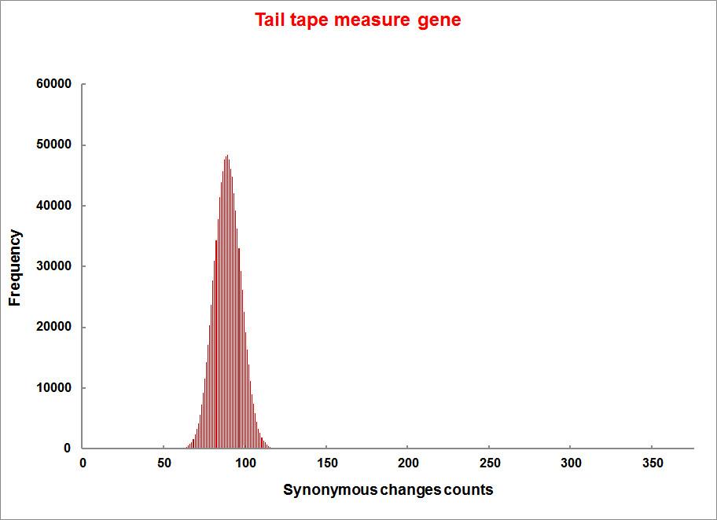
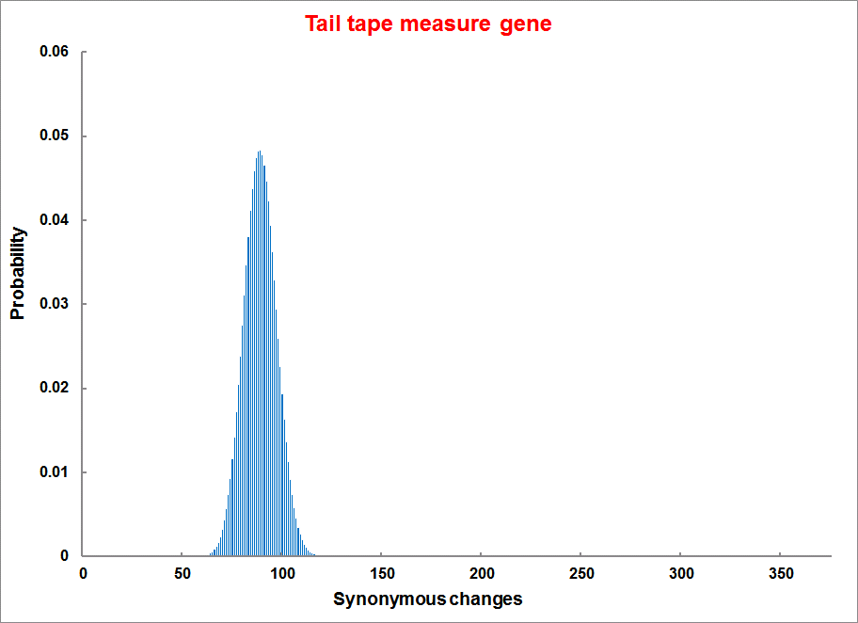
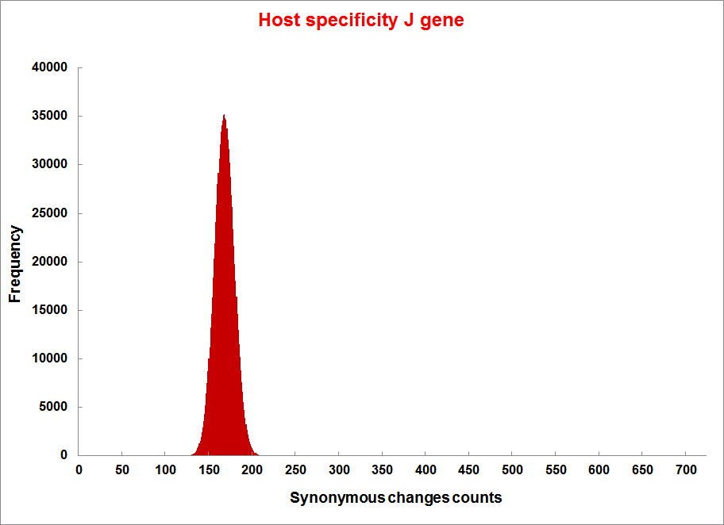
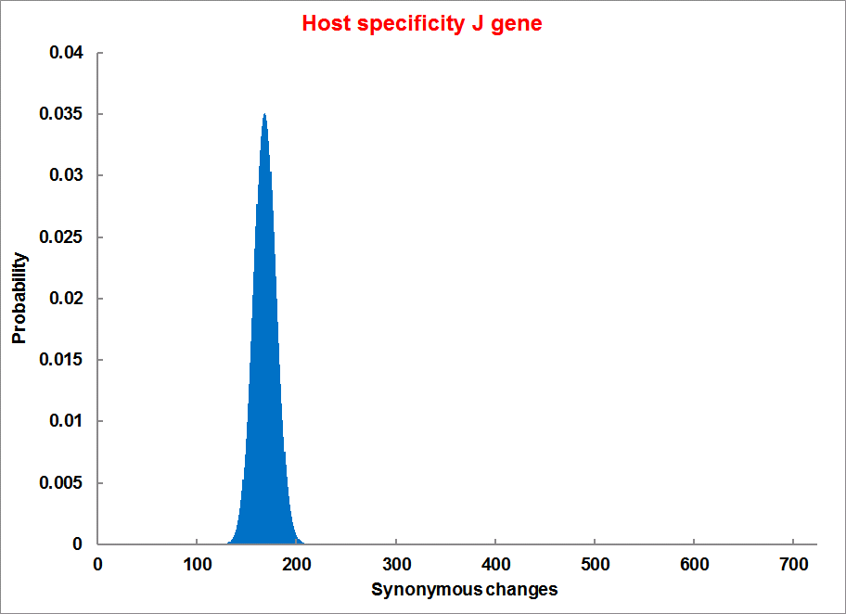
Evolution of Coding DNA Sequences Under a Neutral Model
E. coli Prophage Genes
Count distribution
Probability distribution
n=375
Synonymous
n= 375
k= 243
p=0.237
P(≥243)=7.92E-64
Observed=243
P(≥243) < 10⁻⁶
n=723
Synonymous
n= 723
k= 498
p=0.232
P(≥498)=6.41E-149
Observed=498
P(≥498) < 10⁻⁶

Slide 45
Evolution of Coding DNA Sequences Under a Neutral Model
E. coli Prophage Genes
 |  | OBSERVED |  | SIMULATED |  | Dnapars | Simulated | Codeml
Gene | Alignment Length (bp) | Substitutions | Synonymous changes* | Substitutions | p-value synonymous (given *) | Minimum number of substitutions | dN/dS | dN/dS
Major capsid | 1023 | 90 | 66 | 90 | 3.23E-23 | 94 | 0.113 | 0.13142
Minor capsid C | 1329 | 81 | 59 | 81 | 1.98E-19 | 84 | 0.124 | 0.17704
Large terminase subunit | 1923 | 75 | 67 | 75 | 7.10E-35 | 82 | 0.035 | 0.03773
Small terminase subunit | 543 | 100 | 66 | 100 | 1.07E-19 | 101 | 0.156 | 0.25147
Portal | 1599 | 55 | 46 | 55 | 1.36E-21 | *64 | 0.057 | 0.08081
Protease | 1329 | 55 | 37 | 55 | 4.64E-11 | 55 | 0.162 | 0.24421
Minor tail H | 2565 | 260 | 168 | 260 | 1.81E-44 | 260 | 0.17 | 0.30928
Minor tail L | 696 | 30 | 26 | 30 | 1.30E-13 | 30 | 0.044 | 0.05004
Host specificity J | 3480 | 723 | 498 | 723 | 6.42E-149 | *773 | 0.137 | 0.17103
Tail fiber K | 741 | 41 | 28 | 41 | 1.06E-09 | 44 | 0.14 | 0.18354
Tail assembly I | 669 | 39 | 33 | 39 | 3.82E-15 | 40 | 0.064 | 0.07987
Tail tape measure protein | 2577 | 375 | 243 | 375 | 7.92E-64 | 378 | 0.169 | 0.27957
Values well under the p=0.01 threshold, suggesting rejection of the null hypothesis of neutral evolution of prophage sequences.

Slide 46
Evolution of Coding DNA Sequences Under a Neutral Model
B. pseudomallei Cryptic Malleilactone Operon Genes and
E. coli transposase sequences
 |  | OBSERVED |  | SIMULATED
Gene | Alignment Length (bp) | Substitutions | Synonymous changes* | Substitutions | p-value synonymous (given *)
Aldehyde dehydrogenase | 1544 | 13 | 3 | 13 | 4.67E-04
AMP- binding protein | 1865 | 9 | 6 | 9 | 1.68E-02
Adenosylmethionine-8-amino-7-oxononanoate aminotransferase | 1421 | 20 | 12 | 20 | 6.78E-04
Fatty-acid CoA ligase | 1859 | 13 | 2 | 13 | 8.71E-01
Diaminopimelate decarboxylase | 1388 | 7 | 3 | 7 | 6.63E-01
Malonyl CoA-acyl transacylase | 899 | 2 | 1 | 2 | 4.36E-01
FkbH domain protein | 1481 | 17 | 9 | 17 | 2.05E-02
Hypothethical protein | 431 | 3 | 2 | 3 | 1.47E-01
Ketol-acid reductoisomerase | 1091 | 2 | 0 | 2 | 1.00E+00
Peptide synthase regulatory protein | 1079 | 10 | 5 | 10 | 8.91E-02
Polyketide-peptide synthase | 12479 | 135 | 66 | 135 | 4.35E-27
 |  | OBSERVED |  | SIMULATED
Gene | Alignment Length (bp) | Substitutions | Synonymous changes* | Substitutions | p-value synonymous (given *)
Putative transposase | 903 | 175 | 107 | 175 | 1.15E-29

Slide 47
Problems faced by dN/dS analyses
Regions around gaps often are problematic. An alignment of non-homologous positions will increase the number of apparent non-synonymous substitutions.
This may be the a reason for the inference of positive selection in human olfactory receptors.

Slide 48
Other ways to detect positive selection
Selective sweeps -> fewer alleles present in population
(silent site diversity is erased by gene driven to fixation;
allele shows little within allele divergence - see contributions from archaic Humans for example),
SNP or neighboring SNPs are at higher frequency within a population.
Repeated episodes of positive selection -> high dN
(works well for repeated positive – aka diversifying – selection; e.g. virus interaction with the immune system)

Slide 49
Gene Transfer, Sex, and Recombination:
Inventions do not need to be made sequentially
Gene transfer, followed by homologous or non-homologous recombination, allows inventions to be shared across the tree of life

Slide 50
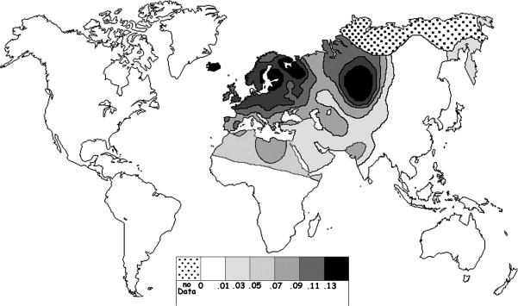
Fig. 1 Current world-wide frequency distribution of CCR5-Δ32 allele frequencies. Only the frequencies of Native populations have been evidenced in Americas, Asia, Africa and Oceania. Map redrawn and modified principally from <ce:cross-ref refid="bib5"> B...
Eric Faure , Manuela Royer-Carenzi
Is the European spatial distribution of the HIV-1-resistant CCR5-Δ32 allele formed by a breakdown of the pathocenosis due to the historical Roman expansion?
Infection, Genetics and Evolution, Volume 8, Issue 6, 2008, 864 - 874
http://dx.doi.org/10.1016/j.meegid.2008.08.007

Slide 51

Geographic origin of the three populations studied.
196,524 SNPs
-> PCA
Hafid Laayouni et al. PNAS 2014;111:2668-2673
©2014 by National Academy of Sciences
Notes:
Geographic origin of the three populations studied. (A) European/Romanians and Rroma/Gipsy share the same location, even if the origin of the latter is in North India. (B) Plot of the populations under analysis according to the coordinates to the two main eigenvectors of smartpca (Eigensoft) analysis, in which each dot represents an individual. Individuals within the circles and the same color have been considered for the study; those of different colors represent false population allocation and those intermediate represent admixed individuals. ROM, nongypsy Romanians; INDI, individuals from North India; GYP, Rroma/Gypsies living in Romania.

Slide 52

Manhattan plot of results of selection tests in Rroma, Romanians, and Indians using TreeSelect statistic (A) and XP-CLR statistic (B).
SNP frequencies within and between populations
selective sweeps detected through linkage disequilibrium
Laayouni H et al. PNAS 2014;111:2668-2673
Convergent evolution in European and Rroma populations reveals pressure exerted by plague on Toll-like receptors.
©2014 by National Academy of Sciences
Notes:
Manhattan plot of results of selection tests in Rroma, Romanians, and Indians using TreeSelect statistic (A) and XP-CLR statistic (B). Chromosomes ordered from chromosome 1 to chromosome 22.

Slide 53

Variant arose about
5800 years ago

Slide 54

The age of haplogroup D was found to be ~37,000 years

Slide 55



