Slide 1
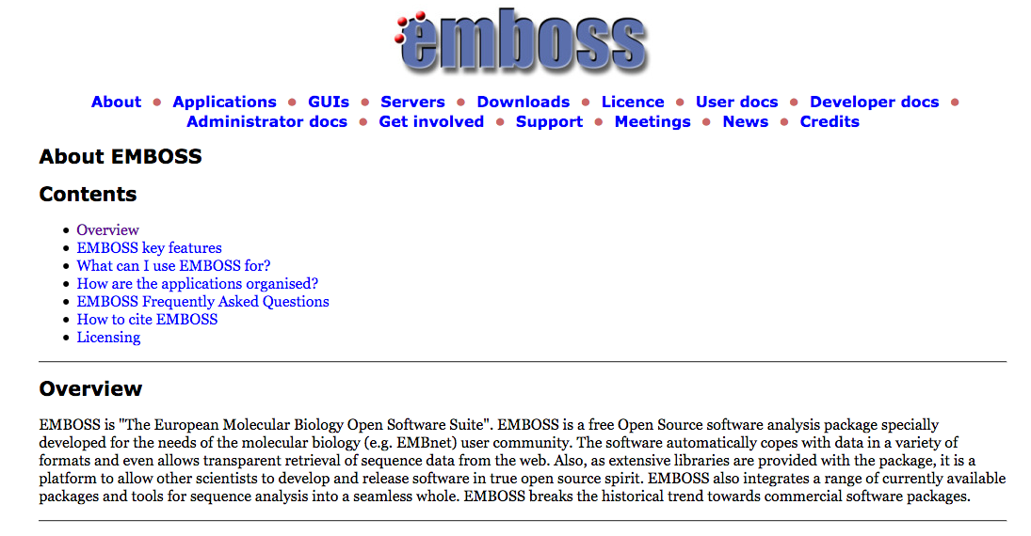

Slide 2
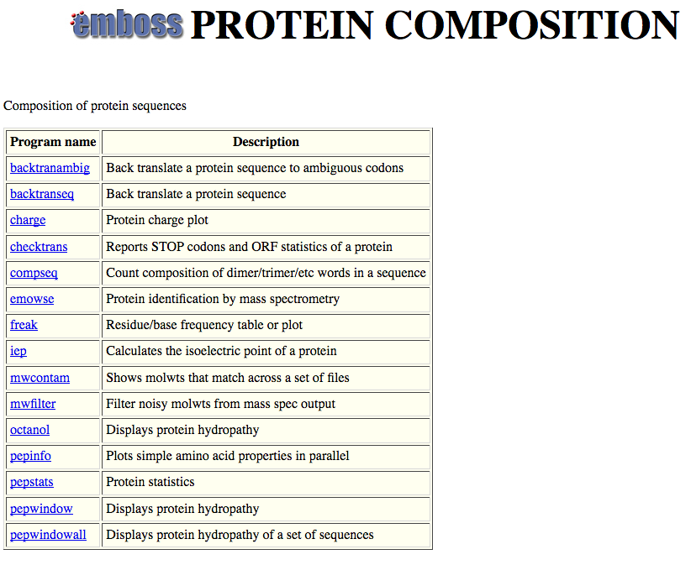

Slide 3
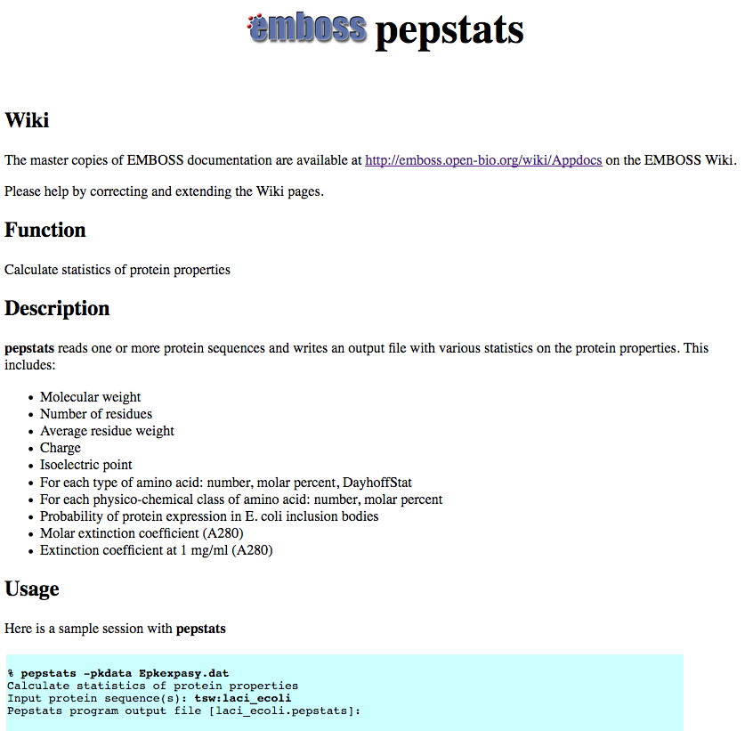

Slide 4
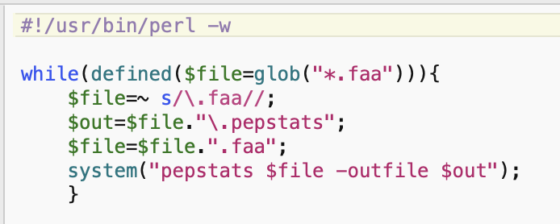
run_pepstats.pl

Slide 5
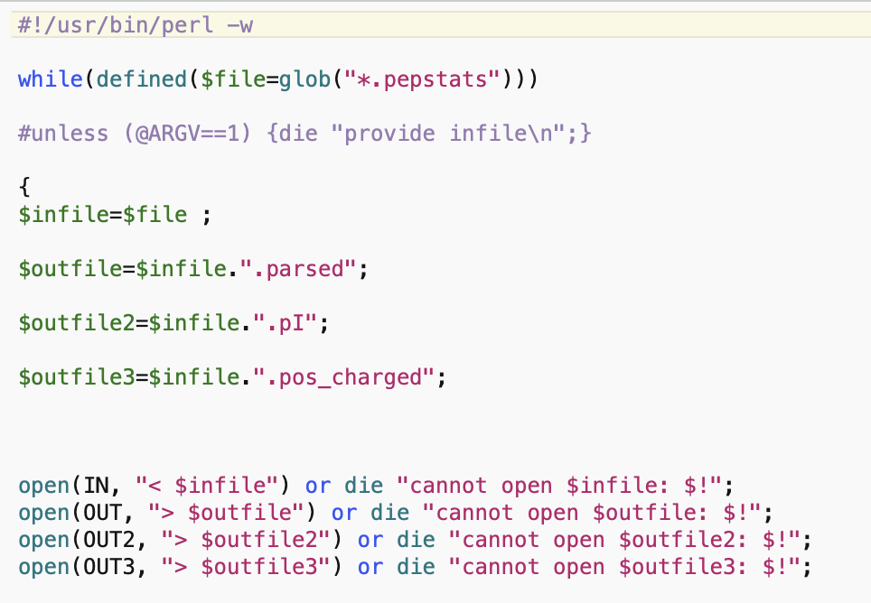
parse_pepstats.pl

Slide 6
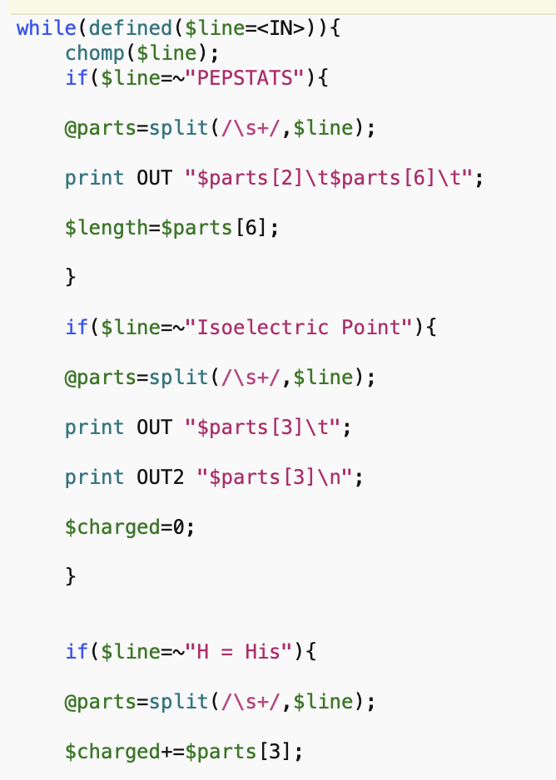
parse_pepstats.pl

Slide 7
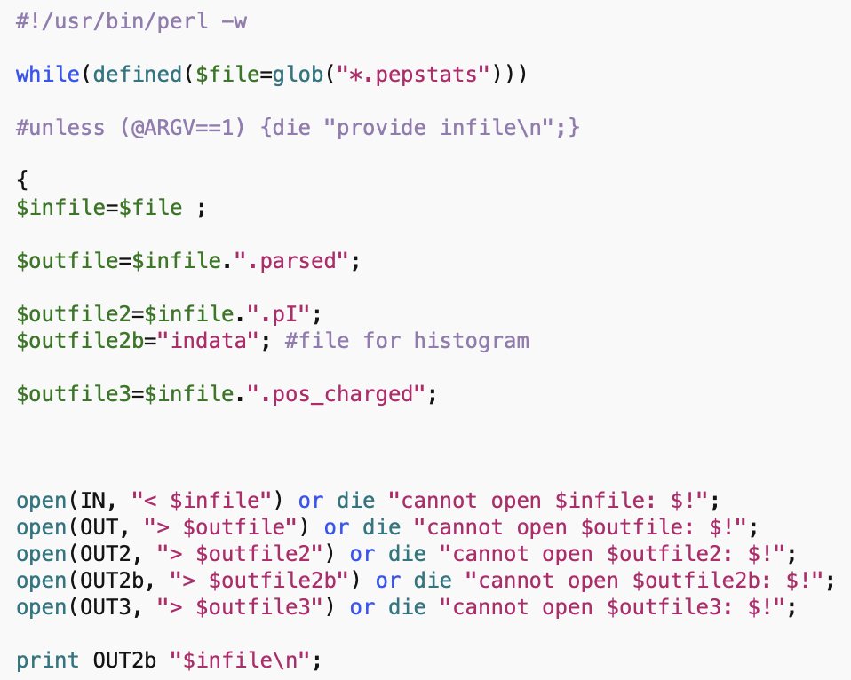
parse_pepstats_mod.pl

Slide 8
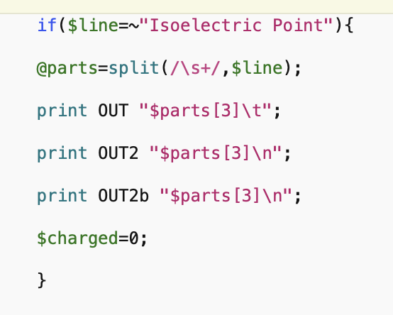
parse_pepstats_mod.pl

Slide 9
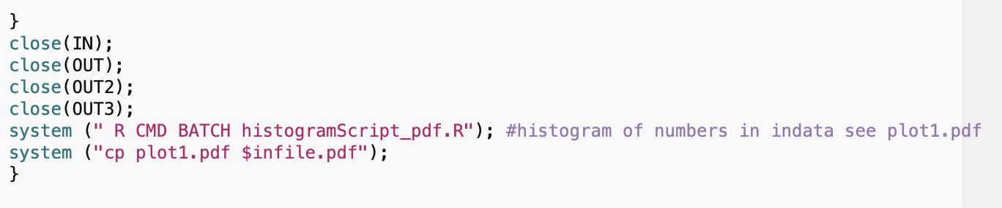
parse_pepstats_mod.pl

Slide 10
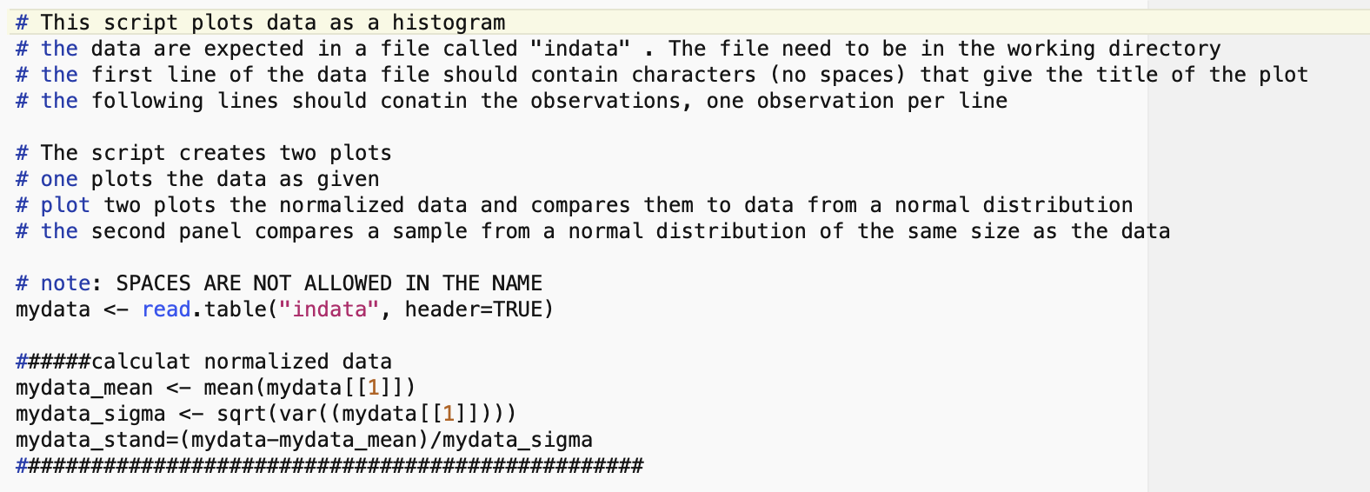
histogramScript_pdf.R

Slide 11
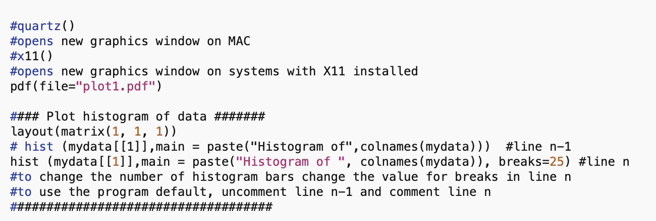
histogramScript_pdf.R

Slide 12
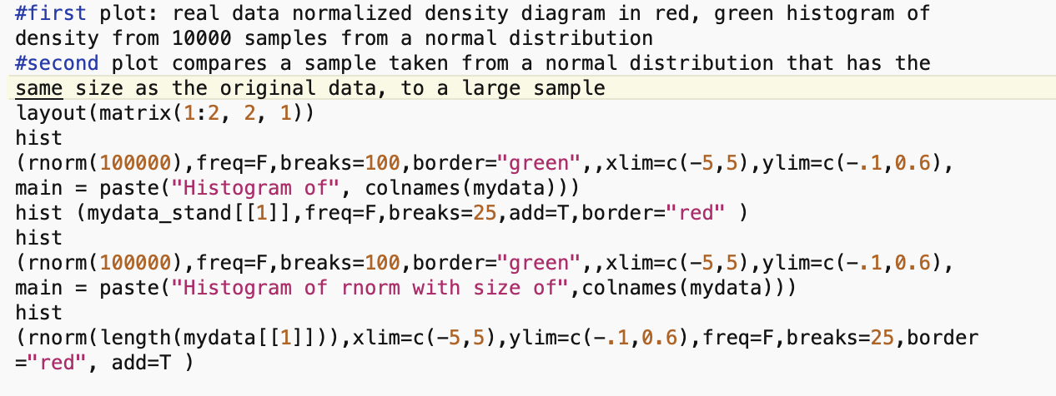
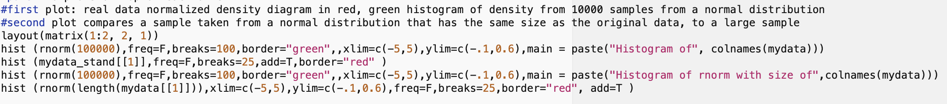
histogramScript_pdf.R

Slide 13
pH at which protein has no charge

Slide 14
DNA, cell wall & membrane bound proteins
pH at which protein has no charge

Slide 16
pH at which protein has no charge

Slide 17
Histogram of theoretical isoelectric points of Thermplasmatales proteins
pH at which protein has no charge

Slide 18
pH at which protein has no charge

Slide 19
Histogram of theoretical isoelectric points of Saccharomyces proteins
DNA, cell wall & membrane bound proteins
pH at which protein has no charge

Slide 20
Histogram of theoretical isoelectric points of Haloferax proteins
Salt in strategy
At neutral pH most proteins with negative charge
pH at which protein has no charge

