Slide 1
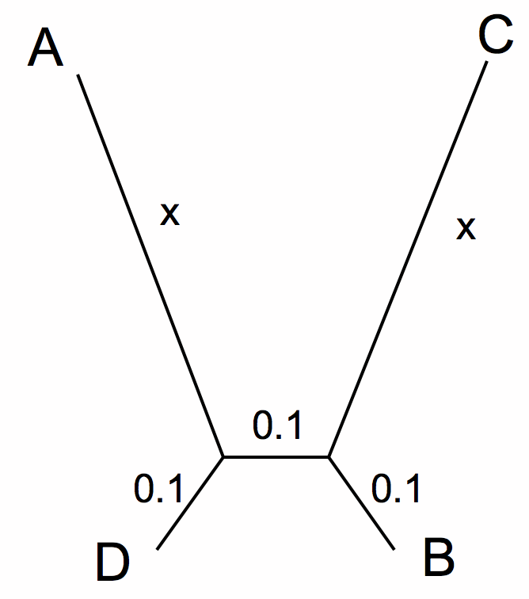
LBA
A
C
D
B
True Tree
LBA Tree
ProtPars
X

Slide 2
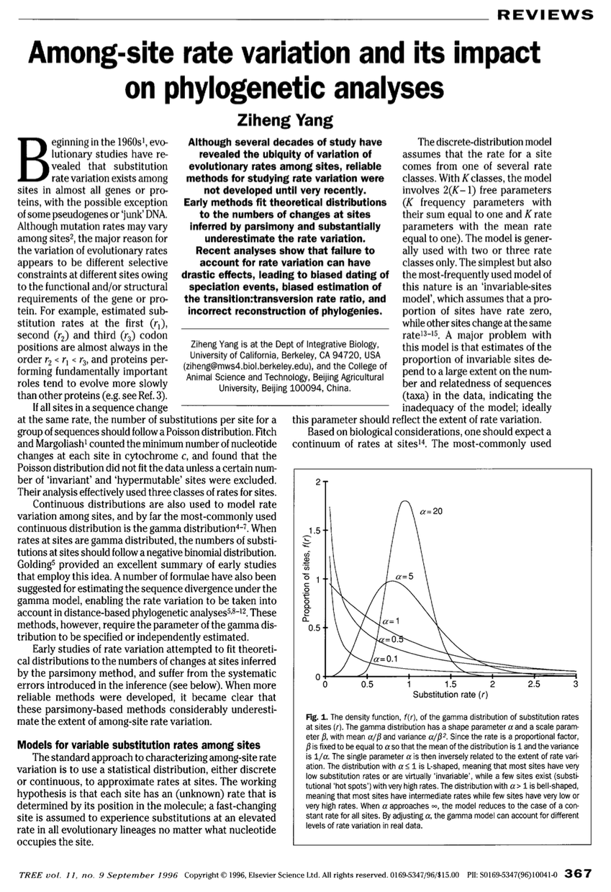

Slide 3
