Slide 1
MCB3421
class 23
Introns, Emboss, Compositional Bias

Slide 2
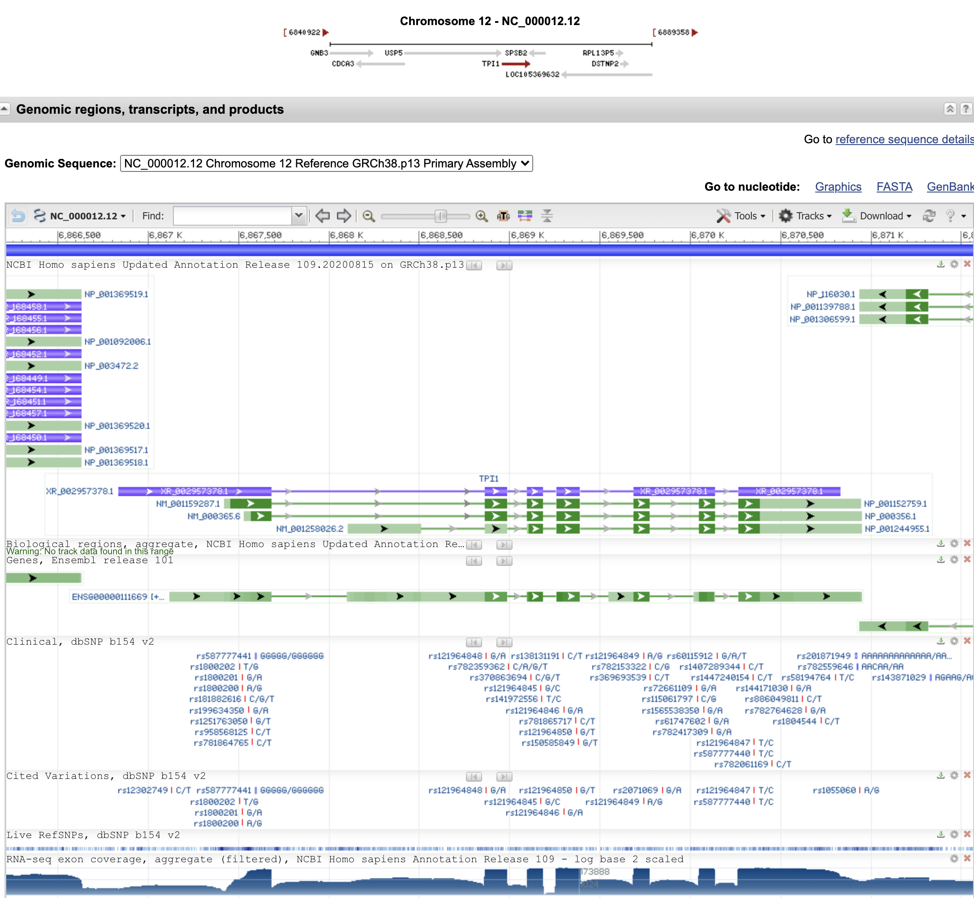
The human tpi1 gene in NCBI

Slide 3
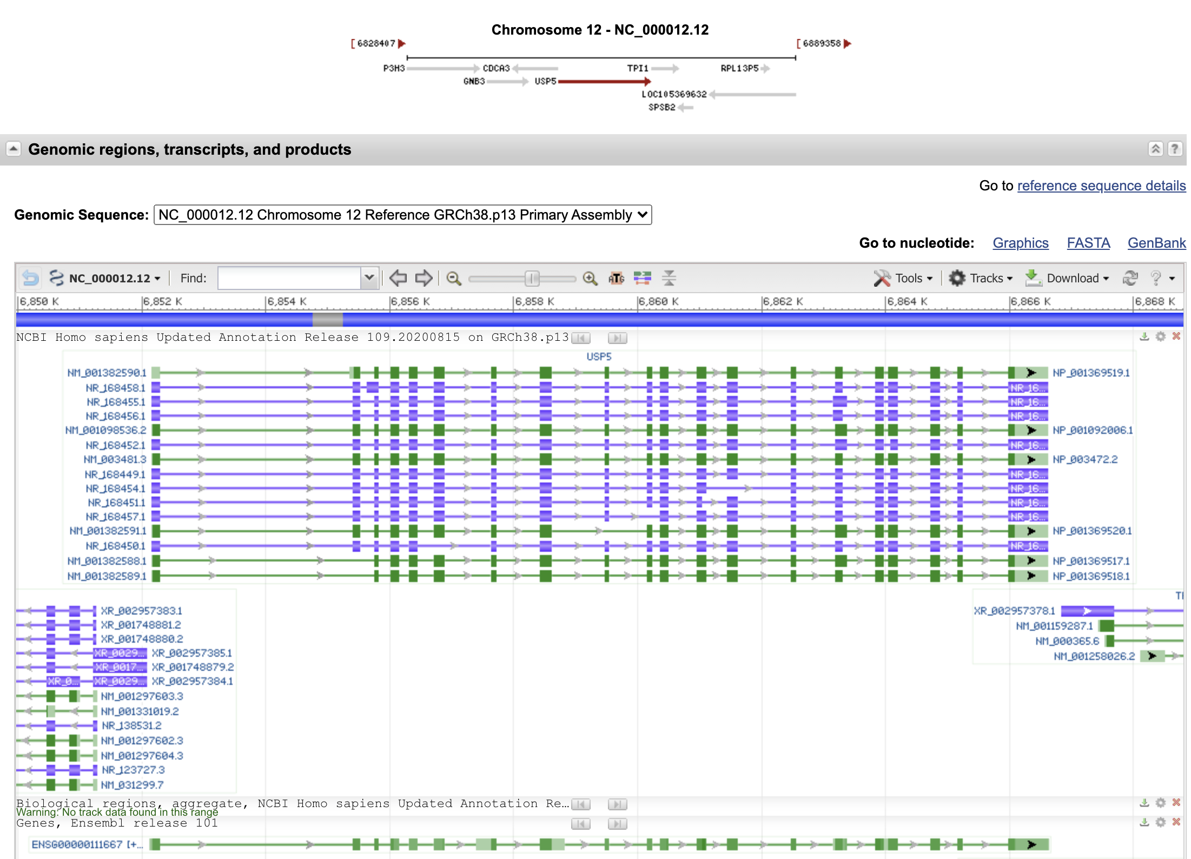
The neighboring gene,
ubiquitin specific peptidase 5,
is perhaps more typical:

Slide 4
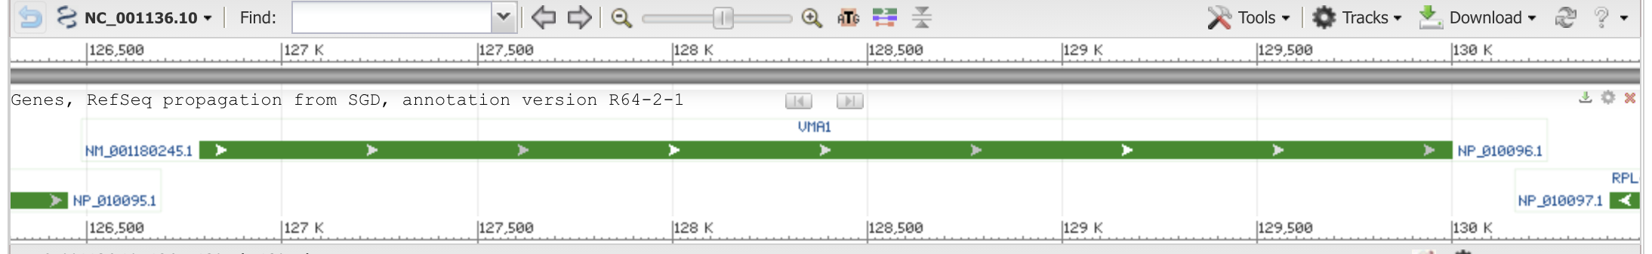
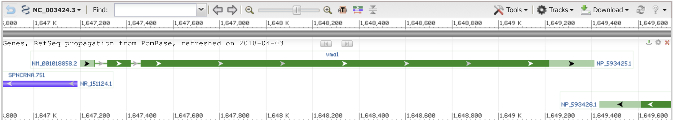
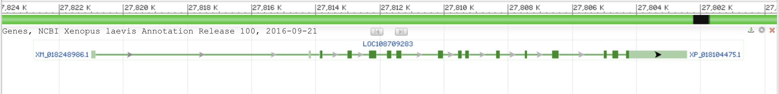
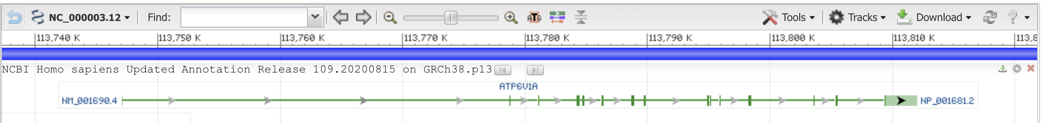
vma1 genes
Saccharomyces cerevisiae S288C
Schizosaccharomyces pombe
Xenopus laevis (African clawed frog)
(one of two paralogs)
Homo sapiens (human)

Slide 5
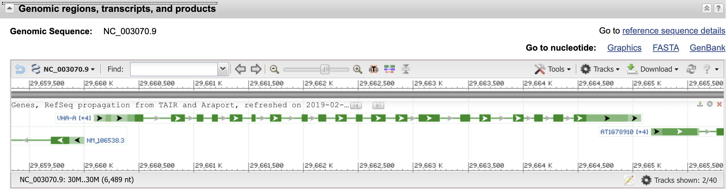
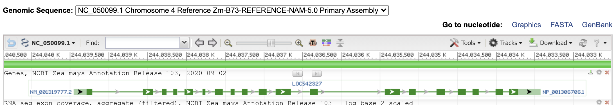
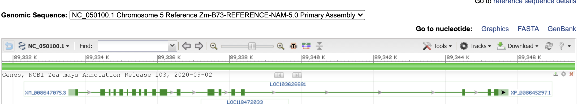
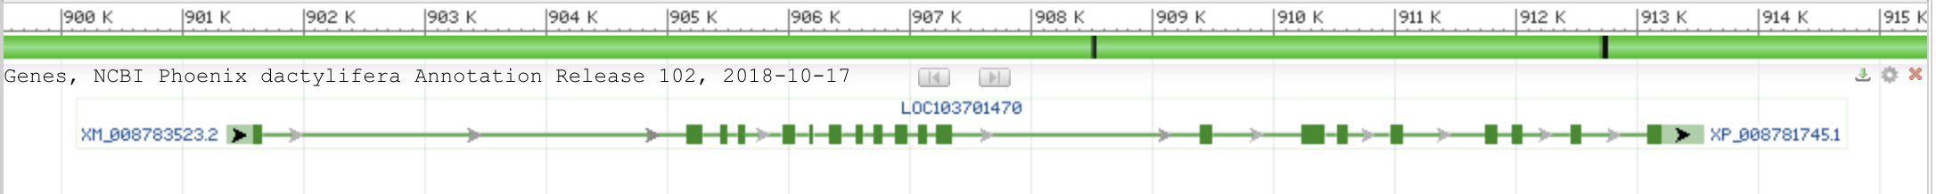
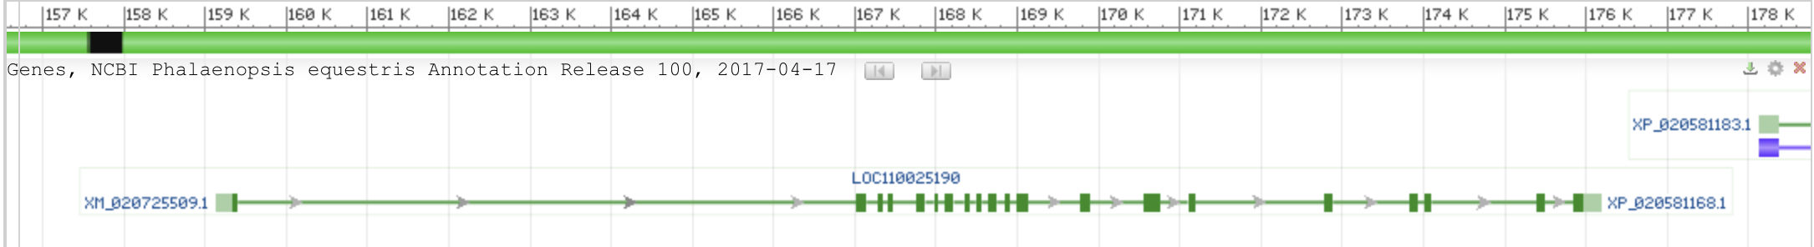
vma1 genes
Arabidopsis thaliana (thale cress)
Zea mays chromosome 4
Zea mays chromosome 5
Phoenix dactylifera (date palm)
Phalaenopsis equestris (orchid)

Slide 6
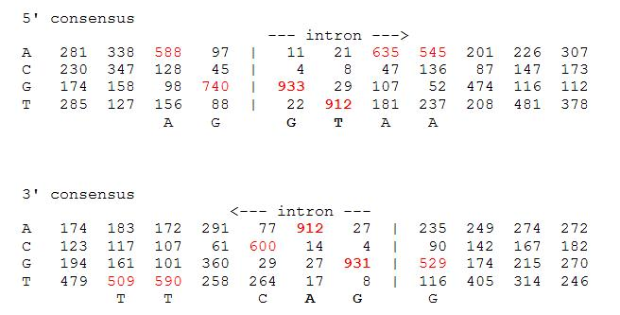
Splice site consensus in Arabidopsis thaliana

Slide 7
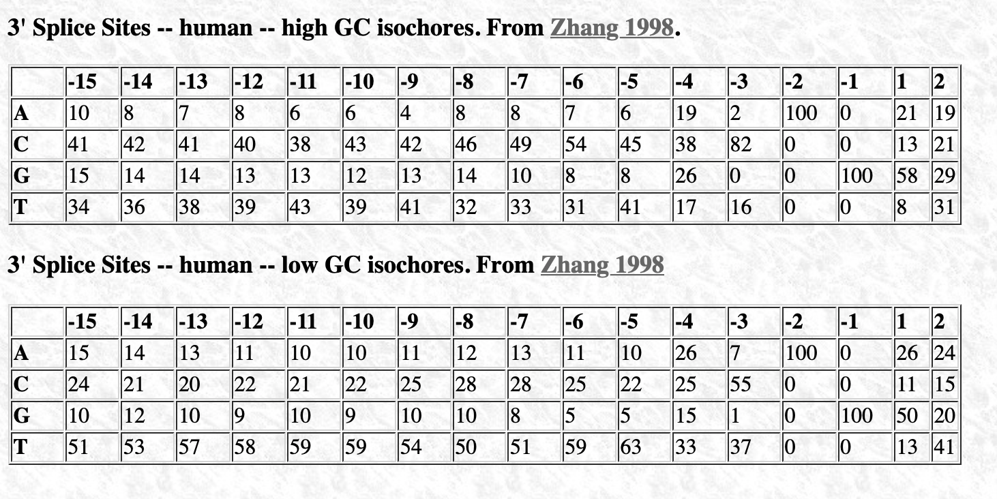
Splice site consensus humans
C A G || G T
From: http://science.umd.edu/labs/mount/RNAinfo/matrices.html https://pubmed.ncbi.nlm.nih.gov/9536098/

Slide 8
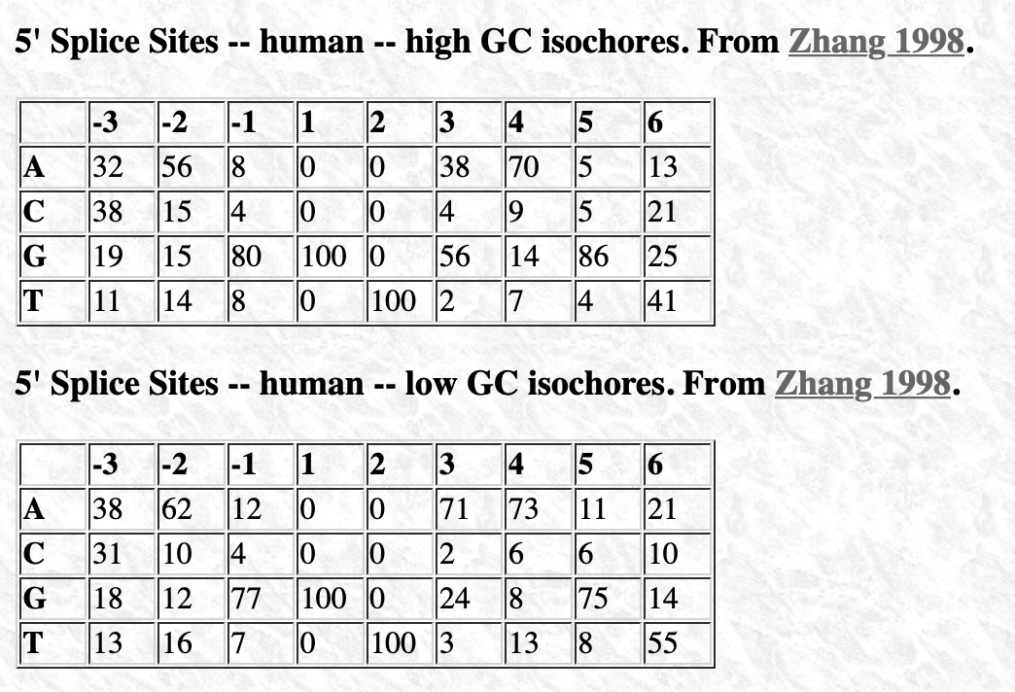
Splice site consensus humans
A G || G T
From: http://science.umd.edu/labs/mount/RNAinfo/matrices.html https://pubmed.ncbi.nlm.nih.gov/9536098/

Slide 9
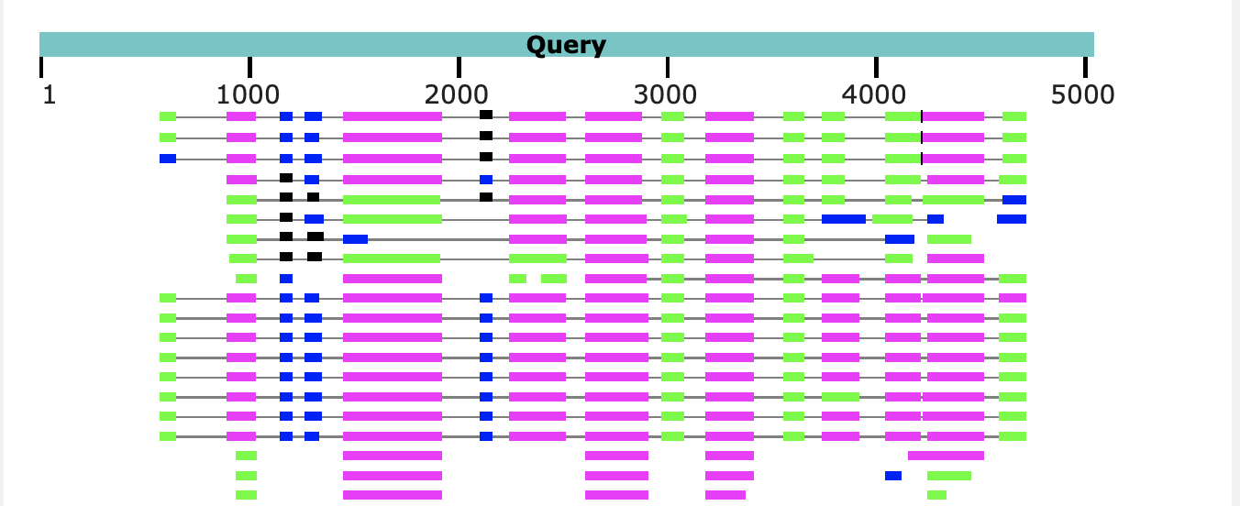
Predicting Intron and Exon sequences using computational approaches remains problematic.
The best way approach is to compare a cDNA or EST to the genome.
The second best is to compare the genome sequence to a protein databank.
The parts of the query that does not have matches corresponds to introns.
Note the large number of introns present in Arabidopsis, which is a plant with a very small genome. In other organisms the introns are even larger.

Slide 10
Predicting Open Reading Frames
GeneMark uses hidden Markov models and can be trained using training sets
-- works for pro- and eukaryotes and metagenomes
-- GenemarkS is the “standard to gene calling in viruses and prokaryotes
Glimmer was developed for prokaryotes,
-- a related software (GlimmerHMM) was developed for eukaryotes
Keep in mind that ab initio approaches work less well than those based on homology.
Popular are
PROKKA (described here)
RAST
Both rely on homology and already annotated similar genomes.
The cycle of identifying essential genes (aatRNAsynthases, DNA and RNA polymerases, ATPsynthases), and using these to train gene prediction software seems to work well.

Slide 11
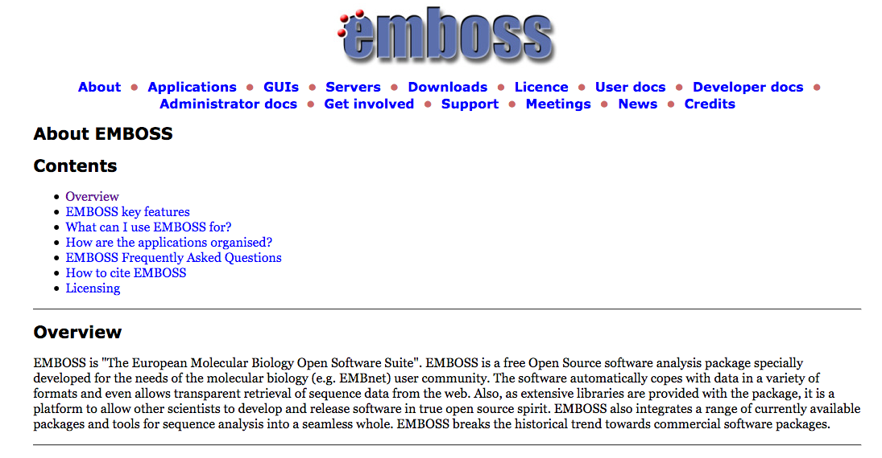

Slide 12
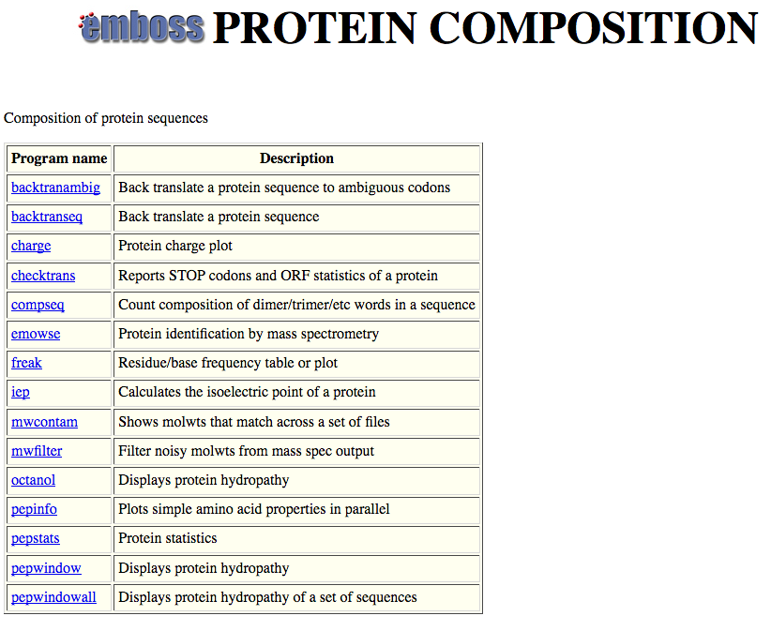

Slide 13
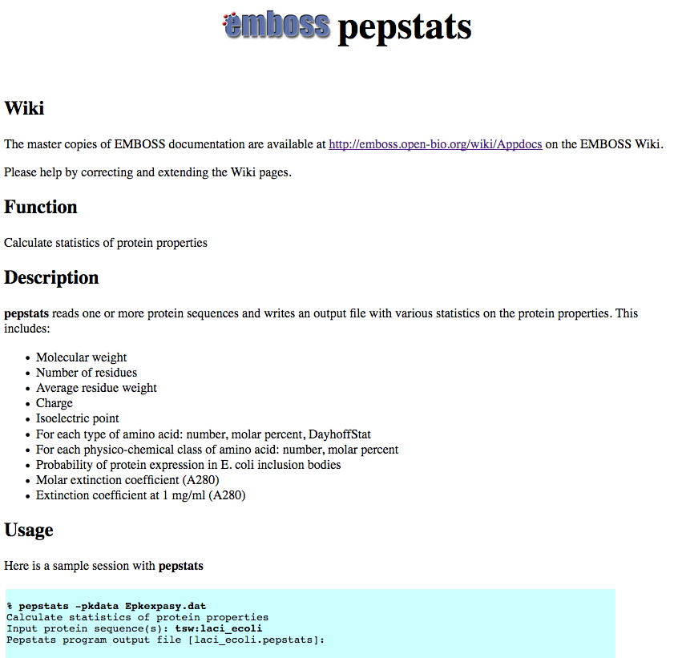

Slide 14
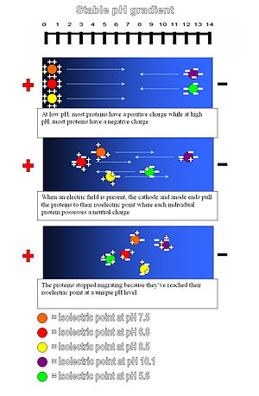
Isoelectric point (pI) of a protein: The pH at which the net charge of the protein is zero.
This can be experimentally determined using isoelectric focusing gels.
Theoretical pI is calculated from the pKs of the individual amino acids.

Slide 15
PEPSTATS of QAY18538.1 from 1 to 580
Molecular weight = 64213.14 Residues = 580
Average Residue Weight = 110.712 Charge = -74.0
Isoelectric Point = 3.9355
A280 Molar Extinction Coefficients = 21890 (reduced) 22140 (cystine bridges)
A280 Extinction Coefficients 1mg/ml = 0.341 (reduced) 0.345 (cystine bridges)
Probability of expression in inclusion bodies = 0.979
Residue Number Mole% DayhoffStat
A = Ala 46 7.931 0.922
B = Asx 0 0.000 0.000
C = Cys 4 0.690 0.238
D = Asp 81 13.966 2.539
/.../
Property Residues Number Mole%
Tiny (A+C+G+S+T) 157 27.069
Small (A+B+C+D+G+N+P+S+T+V) 328 56.552
Aliphatic (A+I+L+V) 169 29.138
Aromatic (F+H+W+Y) 38 6.552
Non-polar (A+C+F+G+I+L+M+P+V+W+Y) 267 46.034
Polar (D+E+H+K+N+Q+R+S+T+Z) 313 53.966
Charged (B+D+E+H+K+R+Z) 196 33.793
Basic (H+K+R) 63 10.862
Acidic (B+D+E+Z) 133 22.931

Slide 16
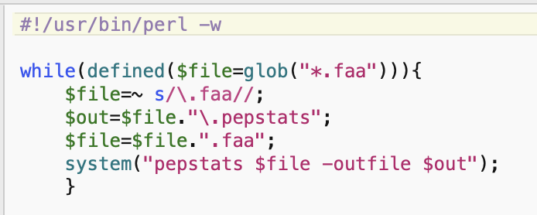
run_pepstats.pl

Slide 17
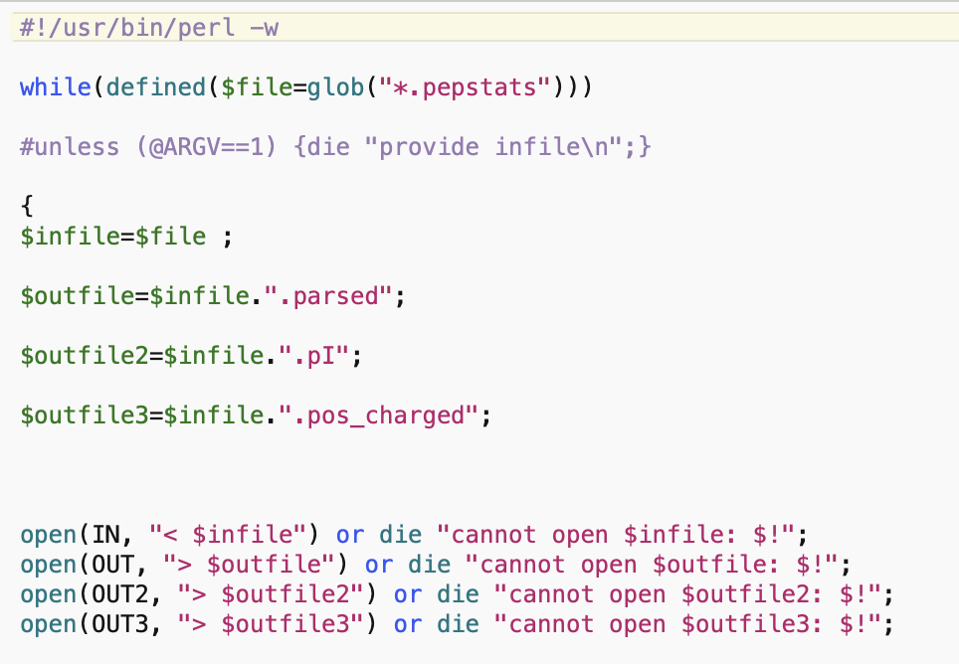
parse_pepstats.pl

Slide 18
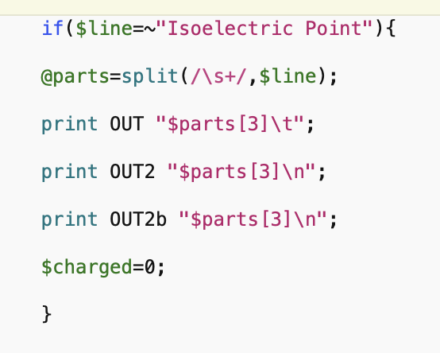
parse_pepstats_mod.pl

Slide 19
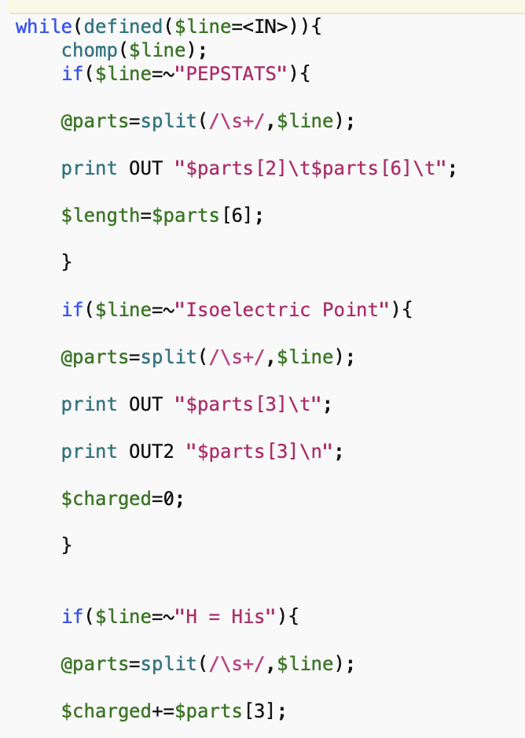
parse_pepstats.pl

Slide 20
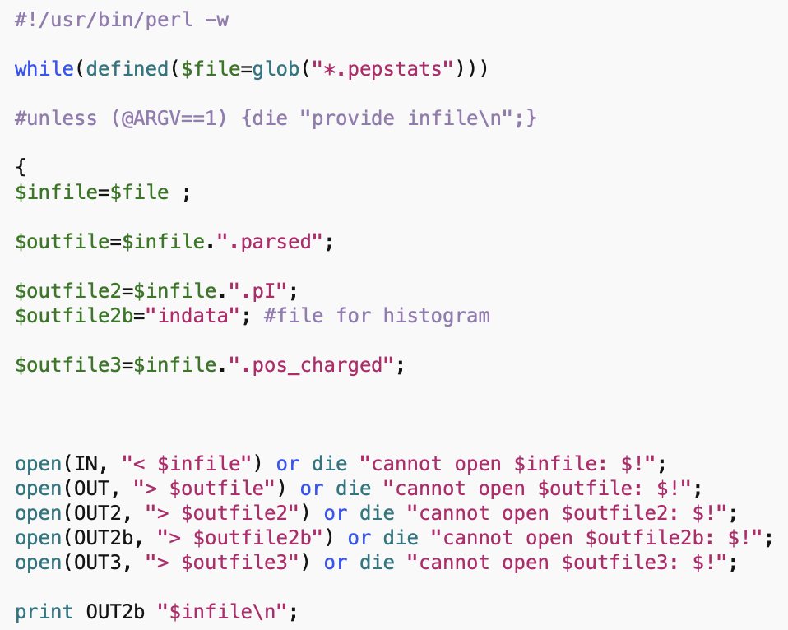
parse_pepstats_mod.pl

Slide 21
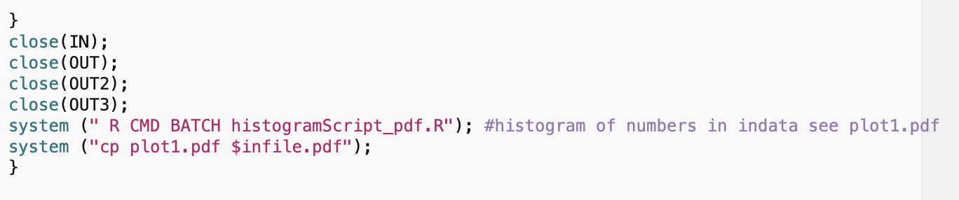
parse_pepstats_mod.pl

Slide 22
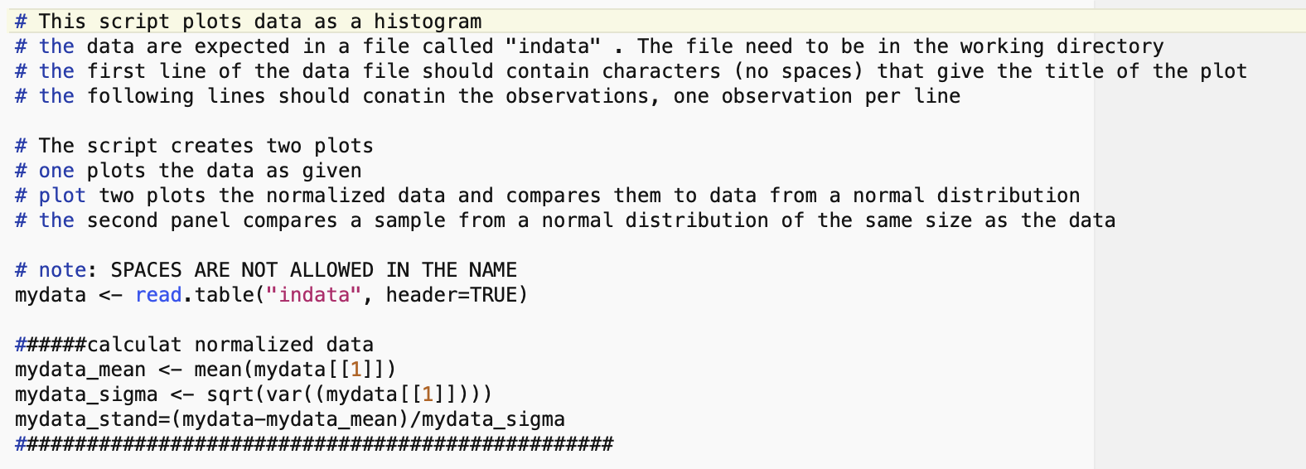
histogramScript_pdf.R

Slide 23
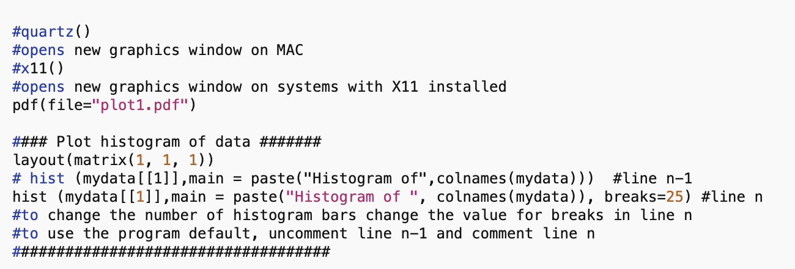
histogramScript_pdf.R

Slide 24
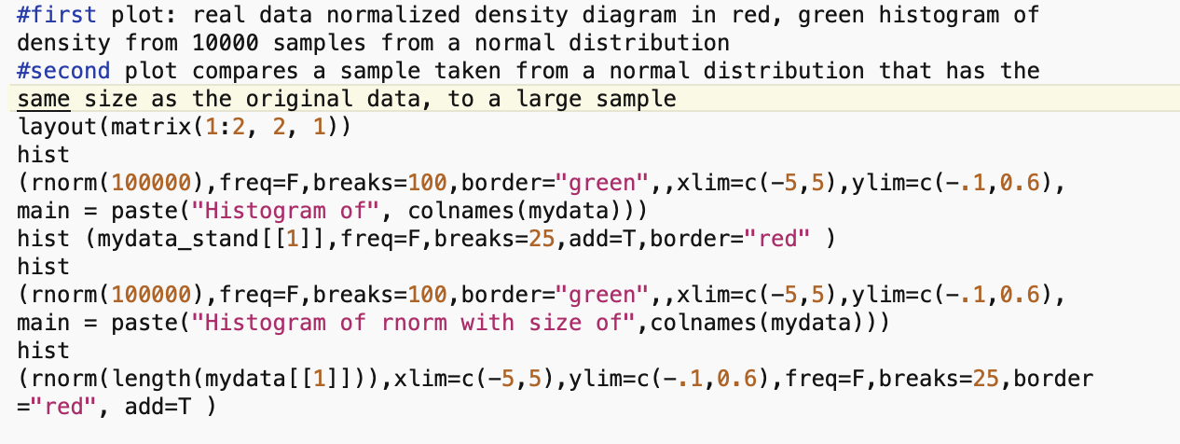
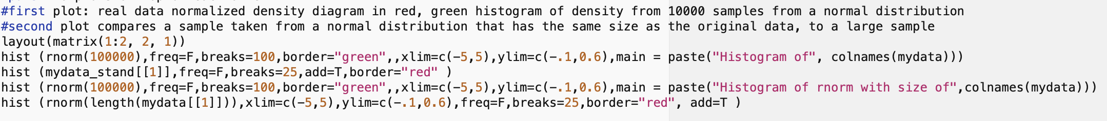
histogramScript_pdf.R

Slide 25
pH at which protein has no charge

Slide 26
DNA, cell wall & membrane bound proteins
pH at which protein has no charge

Slide 27
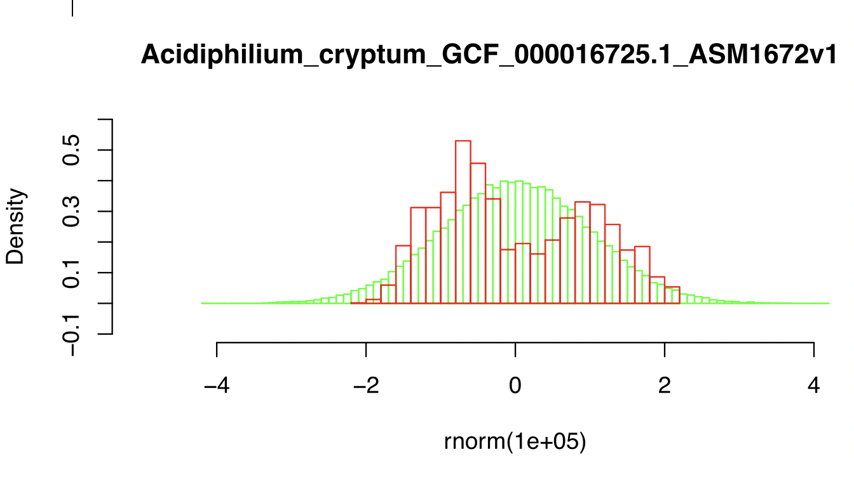

Slide 28
DNA, cell wall & membrane bound proteins
pH at which protein has no charge

Slide 29
Histogram of theoretical isoelectric points of Thermplasmatales proteins
pH at which protein has no charge

Slide 30
pH at which protein has no charge

Slide 31
Histogram of theoretical isoelectric points of Saccharomyces proteins
DNA, cell wall & membrane bound proteins
pH at which protein has no charge

Slide 32
Strategies for extreme halophily
Exclude salts, balance with other osmotically active substances.
Balance external Na⁺ Cl⁻ with internal K⁺ Cl⁻
This leads to very high internal K⁺ concentration (> 5M)
At this ionic strength, the reach of a charge on a protein does not reach very far.
To compensate, proteins in organisms following the salt in strategy have many negative charges.
Consequently, most proteins have an acidic isoelectric point.

Slide 33
Histogram of theoretical isoelectric points of Haloferax proteins
Salt in strategy
At neutral pH most proteins with negative charge
pH at which protein has no charge

