Slide 1
Addons on tracer and omega estimates & on publication quality trees

Slide 2
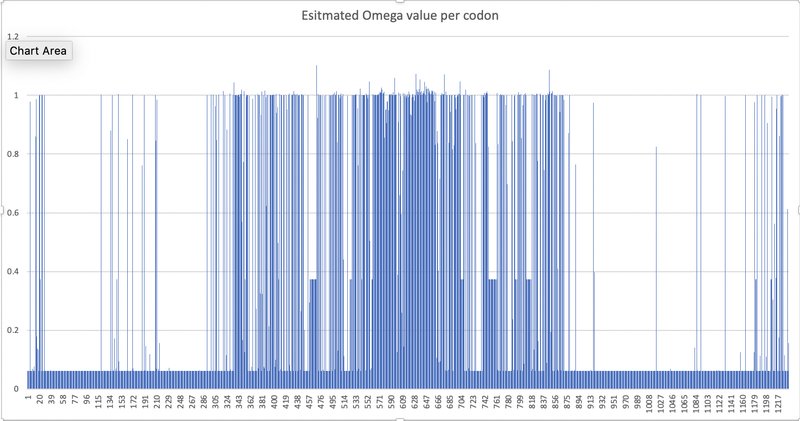
We had done a dN/dS analysis along the Yeast vma1 gene (with intein).
One way to analyze this is in Excel:
Intein start
Intein end
The height of each bar gives the estimated omega value. One can do the same in tracer ->

Slide 3
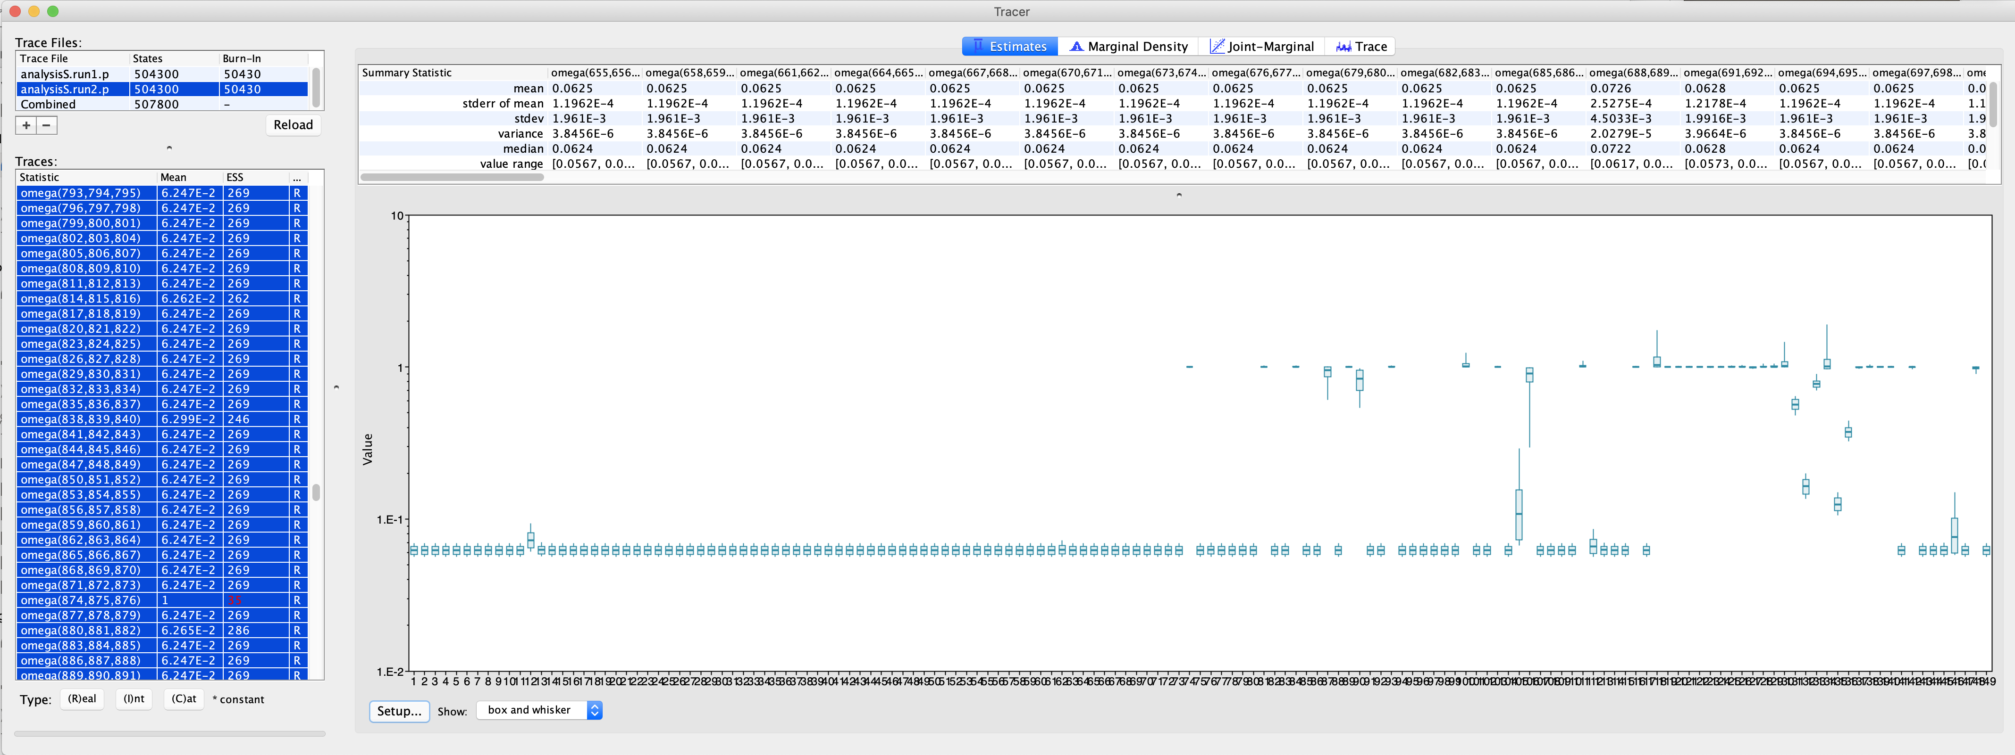
The same in tracer (which had difficulties to display all of the codons at the same time):
Start of intein
Note: I chose a logarithmic scale on the Y - axis

Slide 4
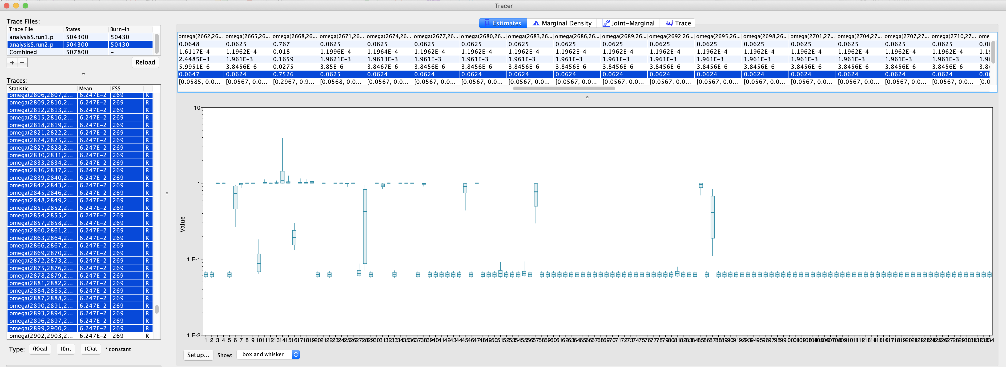
The same in tracer (which had difficulties to display all of the codons at the same time):
End of intein
An advantage of tracer is that it plots the credibility interval. (The disadvantage is that it tends to choke on too much data)

Slide 5
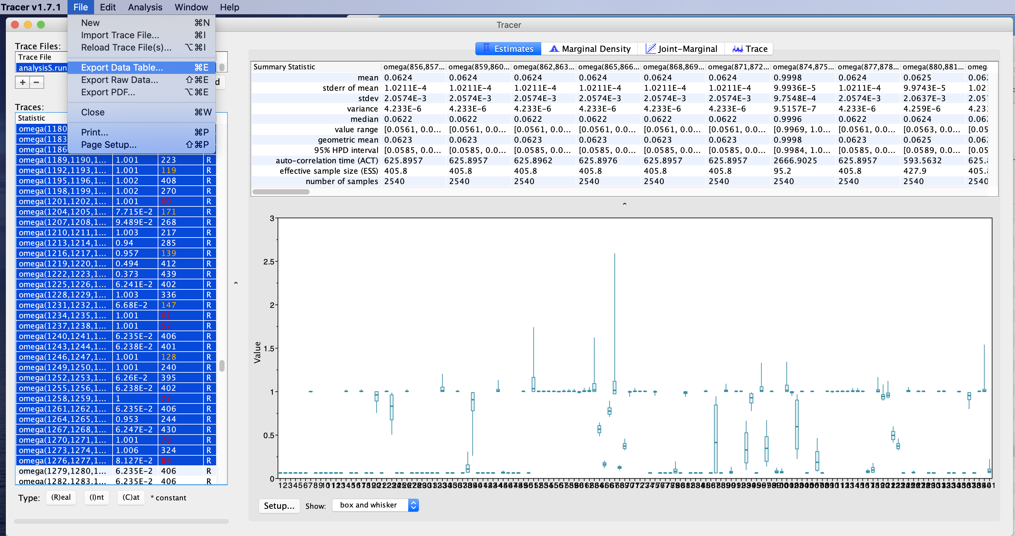
Omega values for the beginning of the intein.
Note: All 95%HPD intervals either are <1 or include 1 (non logarithmic scale)
Note 2: If you want to analyze the intervals in more detail, you can save them as a table that can be imported into excel ....

Slide 6
Figtree --- incidentally, developed by the same group that developed tracer
Reads trees in a variety of different formats (including Newick)
Re-root, flip branches, subtree
color, branch and node labels
Draws trees as trees, stars, and circular diagrams

Slide 7
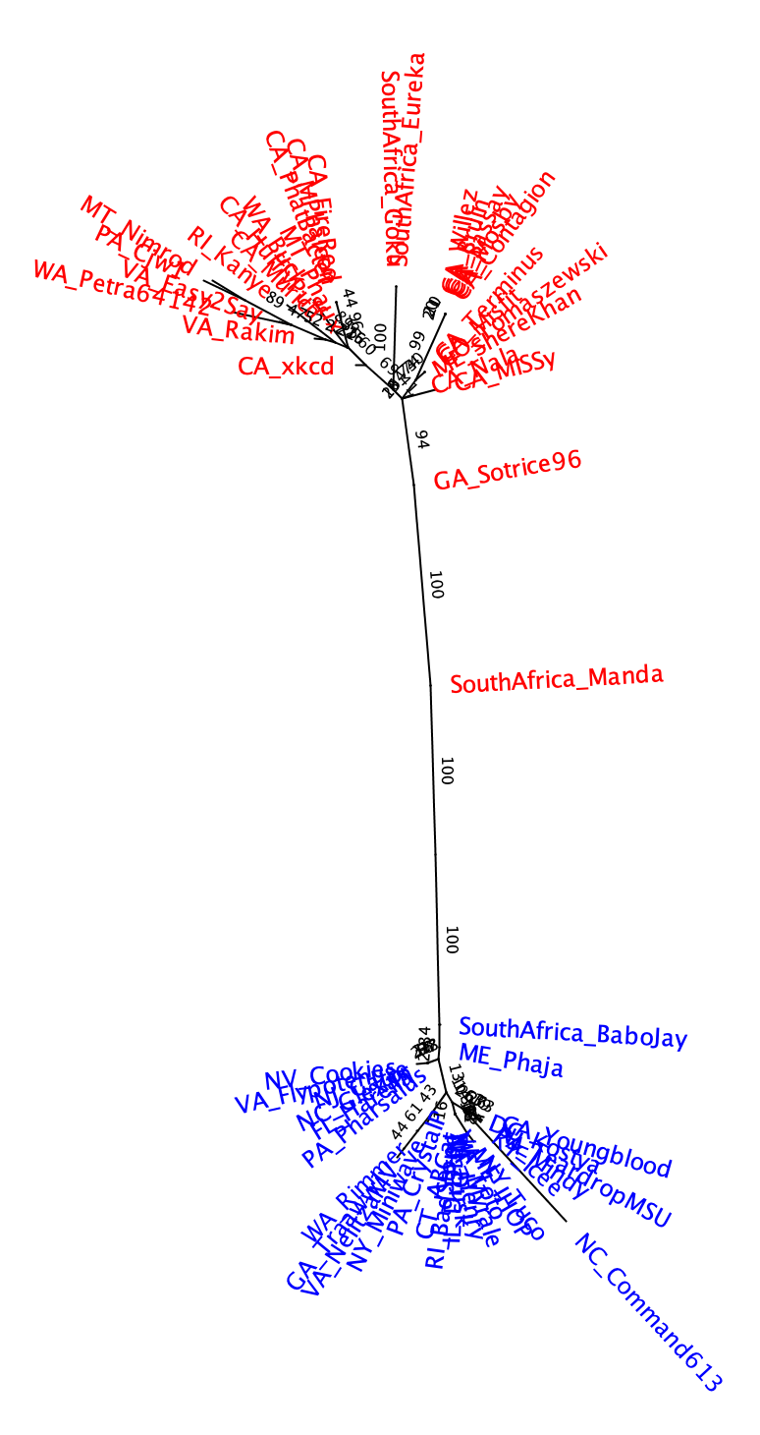
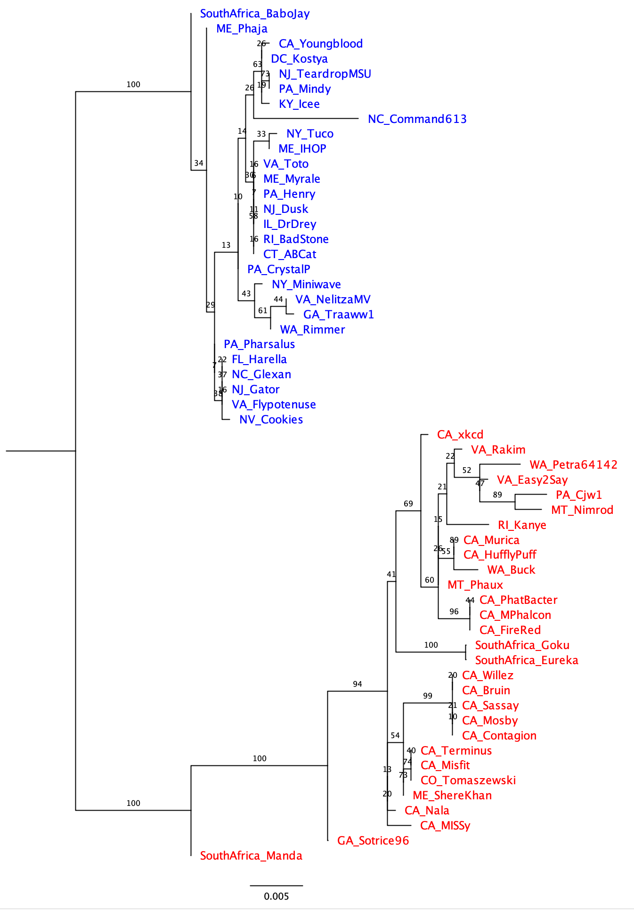
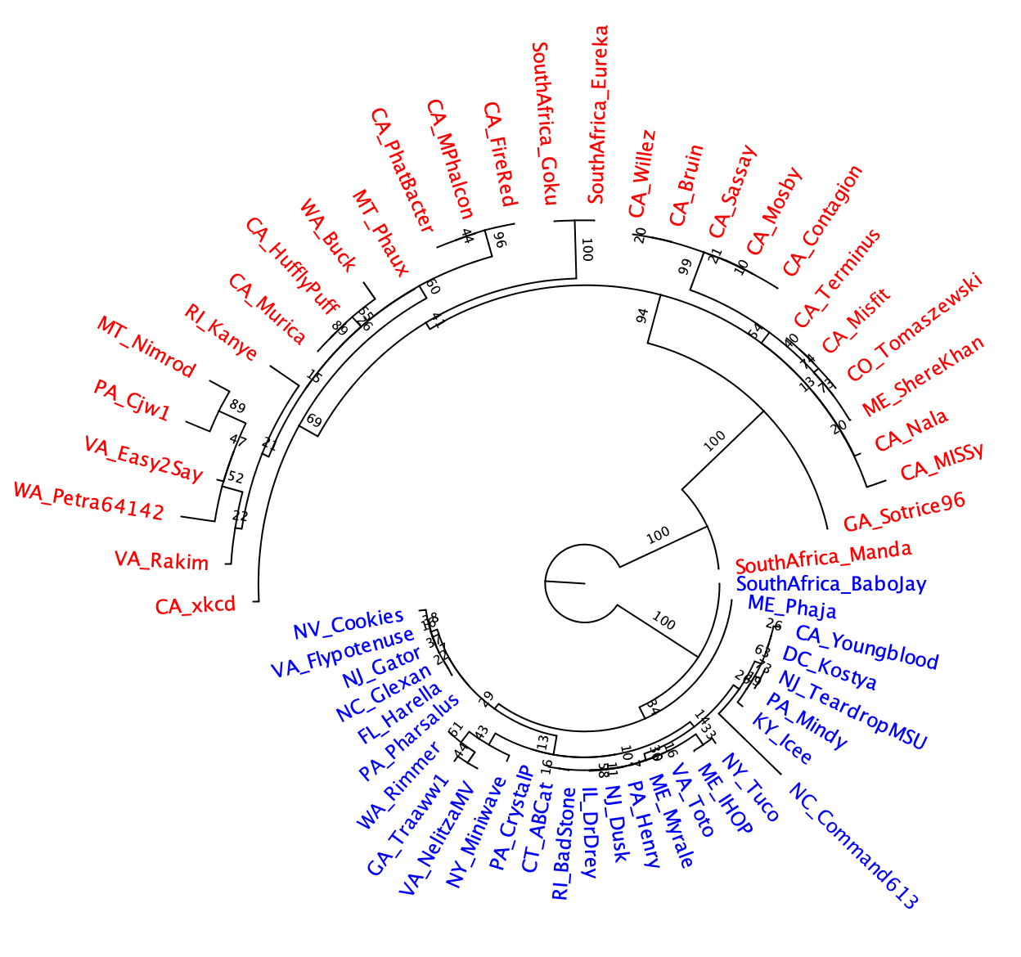
Different ways to draw the tree
Given that the tree does not have an outgroup, the branch at the root is strange!

Slide 8
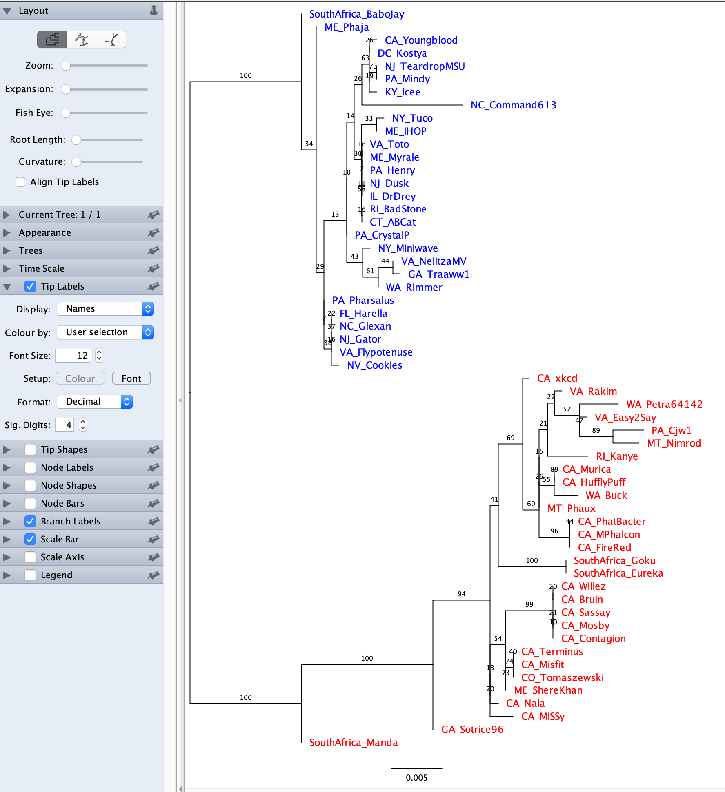
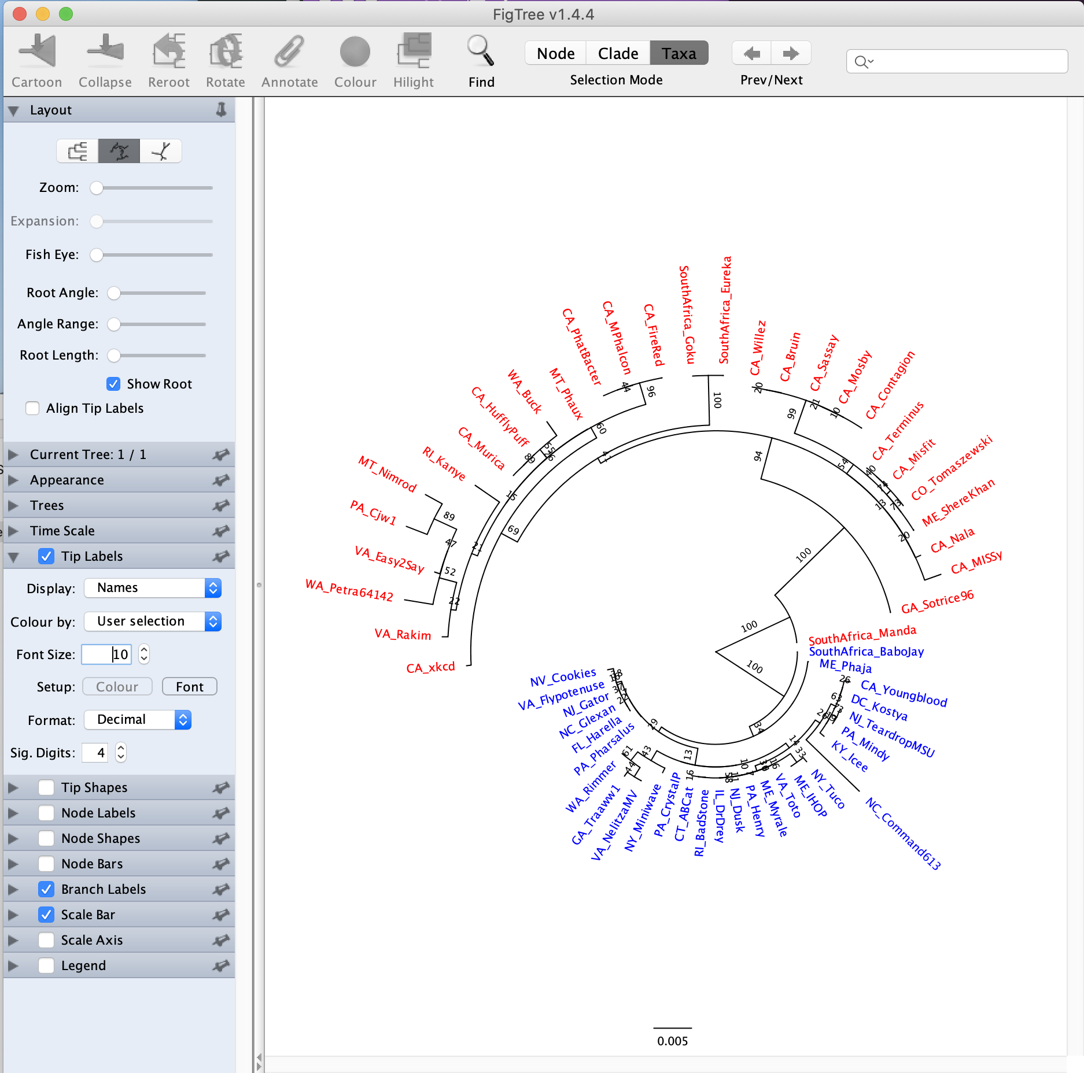
moving the toot length lever to the left helps

Slide 9
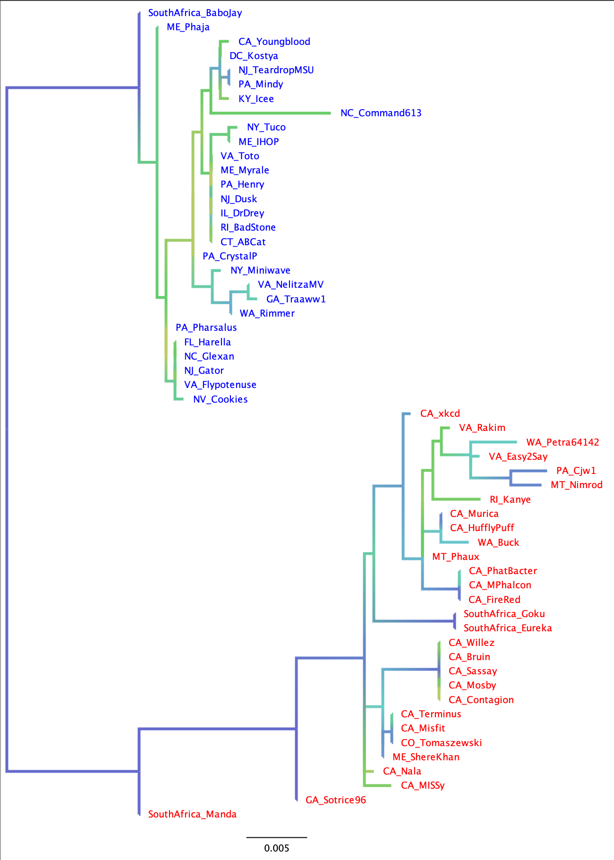
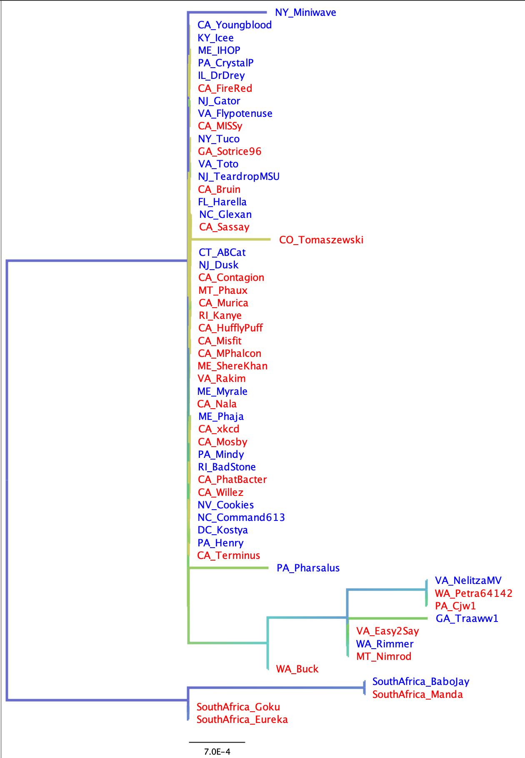
If you have multiple gene trees from the same set (or subset) of species, and the leaves have the same names, the colors carry over to the new tree you open
Branches gradient colored according to support value
Extein
-> the clans defined by the extein tree are not reflected in the intein phylogeny. The intein was transferred several times between the red and green clans. Note the nearly identical intein between red and green leaves.
Intein

