Slide 1
MCB 3421 – class 14
Phylogenetic reconstruction
Part I

Slide 2
Phylogenetic Reconstruction – Why?
A) Systematic classification of organisms
e.g.: Who were the first angiosperms? (i.e. where are the first angiosperms located relative to present day angiosperms?) Where in the tree of life is the last common ancestor located?
B) Evolution of molecules
e.g.: domain shuffling, reassignment of function, gene duplications, horizontal gene transfer, drug targets, detection of genes that drive evolution of a species/population (e.g. influenca virus)
C) Identification of organisms
e.g., phylotyping in microbiome samples, origin of genes and viruses (e.g., HIV virus, recent ebola outbreak)

Slide 3
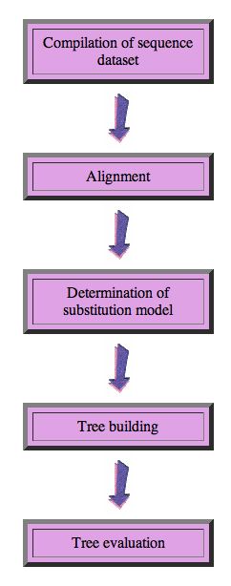
Steps of the phylogenetic analysis
Phylogenetic analysis is an inference of evolutionary relationships between organisms.
Phylogenetics tries to answer the question “How did groups of organisms come into existence?”
Those relationships are usually represented by tree-like diagrams.
Note: the equation of biological evolution with a tree like process has limited validity at best.

Slide 4
Phylogenetic reconstruction - How
Distance analyses
calculate pairwise distances
(different distance measures, correction for multiple hits, correction for codon bias)
make distance matrix (table of pairwise corrected distances)
calculate tree from distance matrix
i) using optimality criterion
(e.g.: smallest error between distance matrix and distances in tree, or use
ii) algorithmic approaches (UPGMA or neighbor joining)

Slide 5
Algorithmic approaches (no global optimality criterion)
Principle of Neighbor Joining
From Wikipedia
UPGMA from Richard Edwards (here)
Wikipedia also has a good work through.

Slide 6
Phylogenetic reconstruction - How
Distance matrix based analyses
Parsimony analyses
find that tree that explains sequence data with minimum number of substitutions
(tree includes hypothesis of sequence at each of the nodes)
Maximum Likelihood analyses
given a model for sequence evolution, find the tree that has the highest probability under this model.
This approach can also be used to successively refine the model using the maximum likelihood ratio test.
Bayesian statistics use ML analyses to calculate posterior probabilities for trees, clades and evolutionary parameters. These approaches have become very popular in the last years, because they allow to estimate evolutionary parameters (e.g., which site in a virus protein is under positive selection), without assuming that one actually knows the "true" phylogeny.

Slide 7
Else:
spectral analyses, like evolutionary parsimony, look only at patterns of substitutions,
Another way to categorize methods of phylogenetic reconstruction is to ask if they are using
an optimality criterion (e.g.: smallest error between distance matrix and distances in tree, least number of steps, highest probability), or
algorithmic approaches (UPGMA or neighbor joining)
Packages and programs available: iqtree, MrBayes, PAUP*, phyml, raxml, PHYLIP, PAML, Tree-Puzzle, clustalw, PhyloGenie, HyPhy, seaview (GUI for PHYLIP and phyml)

Slide 8
Maximum Likelihood

Slide 9
Estimating Models and Model Parameters.
Likelihood: Probability of a dataset given a model and a set of parameter.
Maximum likelihood: maximum probability of drawing the sample actually obtained using the model parameters as variable. (This usually is a tiny number, thus usually one uses the negative logarithm).
This works great for finding the best fitting parameters, AND Maximum Likelihood Estimation (MLE) can be used to test if assuming a more complicated model is justified by the data

Slide 10
Example Regression Regression Polynomials
When has one added too many parameters?
The fit undoubted increases with each parameter, but does this increase justify the additional parameter?
Notes:
The fit undoubted increases with each parameter, but does this increase justify the additional parameter?

Slide 11
One could use the maximum likelihood ratio test
Let L1 be the maximum value of the likelihood of the data without the additional assumption. In other words, L1 is the likelihood of the data with all the parameters unrestricted and maximum likelihood estimates substituted for these parameters.
Let L0 be the maximum value of the likelihood when the parameters are restricted (and reduced in number) based on the assumption. Assume k parameters were lost (i.e., L0 has k less parameters than L1).
Form the ratio λ=L0/L1. This ratio is always between 0 and 1 and the less likely the assumption is, the smaller λ will be. This can be quantified at a given confidence level as follows:
Calculate χ2=−2 ln λ. The smaller λ is, the larger χ2 will be.
We can tell when χ2 is significantly large by comparing it to the 100(1−α) percentile point of a Chi-Square distribution with degrees of freedom. χ2has an approximate Chi-Square distribution with kdegrees of freedom and the approximation is usually good, even for small sample sizes.
The likelihood ratio test computes χ2 and rejects the assumption if χ2 is larger than a Chi-Square percentile with k degrees of freedom, where the percentile corresponds to the confidence level chosen by the analyst.
From: https://www.itl.nist.gov/div898/handbook/apr/section2/apr233.htm
Alternatives to the MLRT are the use of the Akaike information criterion or the Bayesian information criterion

Slide 12
Aside:
MLE is a sophisticated version of Ockham razor.
Ockham razor favors the explanation that can explain an observation with the fewest assumptions (the parsimony principle).
MLE favors the explanation under which the observation is most probable. (MLE becomes equivalent to parsimony, if all events are equally probable. Note: you can also apply different weights to the events that are counted in parsimony, or ignore some altogether, e.g., transversion parsimony.)

Slide 13
Non-Parametric Bootstrap: Creating pseudo-samples (sampling with replacement, sample size n)
Jacknife:
Creating pseudo-samples (sampling without replacement, sample size n/2)
Parametric Bootstrap: Creating pseudo-samples through simulations using a model and parameters estimated from the data
Doing the impossible:
Statistics on a single sample
Evaluation of pseudo-samples measures how much information in the original data support a conclusion.

Slide 14
Creating bootstrap or pseudo-samples through sampling alignment columns with replacement
From “Bootstrap and Rogue Identification Tests for Phylogenetic Analyses”
Molecular Biology and Evolution 35(1) DOI: 10.1093/molbev/msy118

Slide 15
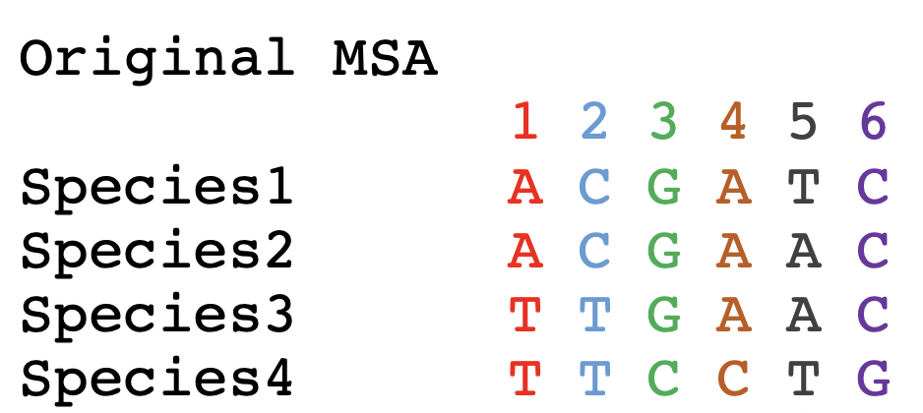
Bootstrapping example:

Slide 16
Parsimony informative sites

Slide 17
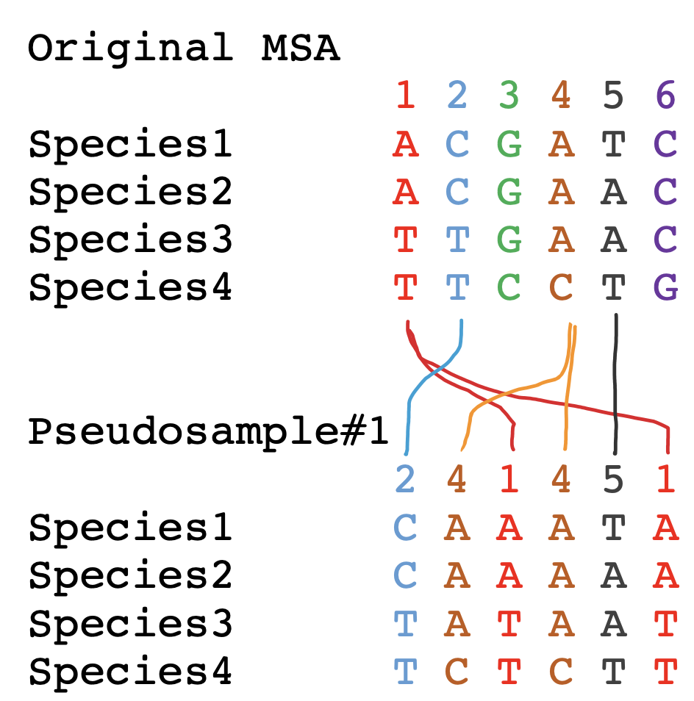
To sample with replacement for the alignment columns, we role six-sided dice six times. Assume you got the following numbers: (2 4 1 4 5 1)
In this case column 3 and 6 did not make it into the pseudosample, and columns 1 and 4 made it twice.

Slide 18
Bootstrap Take Home Messages
If all pseudo-samples lead to the same conclusion (which then is said to have 100% bootstrap support), the original data set contained strong support for the conclusion
If only few pseudo-samples support a conclusion the original data do not strongly support the conclusion
Some consider 100-%bootstrap-support as analogous to a P-value.
Bootstrap support values are conservative
If a parameter value is estimated from the data, the bootstrap samples can be used to create confidence intervals (this is based on the finding that in cases where one can obtain many real samples, the real samples and the pseudo-samples show the same variance)

Slide 19
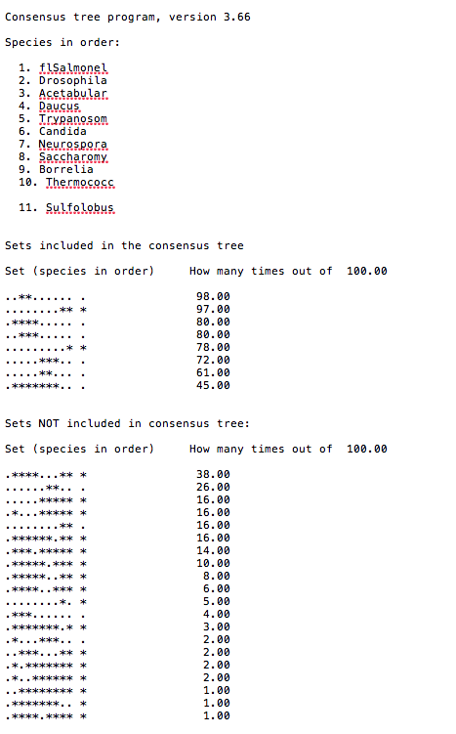
Output from consense

Slide 20
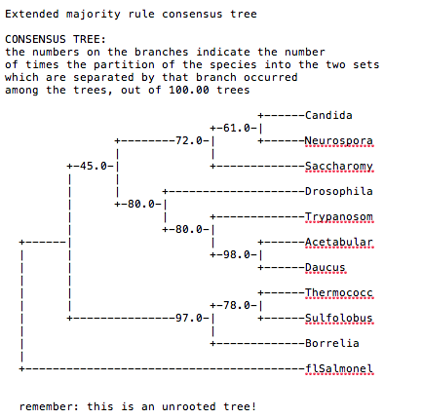
Output from consense

