Slide 1
MCB 3421 – class 16
Phylogenetic reconstruction
Part I

Slide 2
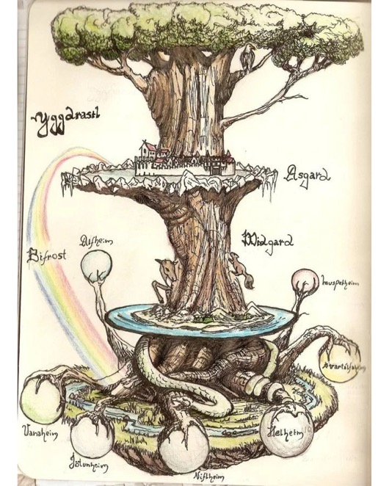
Trees have a long history in depicting evolutionary history, but also for depicting the diversity of life. (Note many Trees of Life depict the latter, and do not imply an evolutionary history)
The biblical tree of life
Yggdrasil
(North Mythology)
Mexican tree of life

Slide 3
What is in a tree?
Trees form molecular data are usually calculated as unrooted trees (at least they should be - if they are not, this is usually a mistake).
To root a tree you either can assume a molecular clock (substitutions occur at a constant rate, again this assumption is usually not warranted and needs to be tested),
or you can use an outgroup (i.e. something that you know forms the deepest branch).
  For example, to root a phylogeny of birds, you could use the homologous characters from a reptile as outgroup; to find the root in a tree depicting the relations between different human mitochondria, you could use the mitochondria from chimpanzees or from Neanderthals as an outgroup; to root a phylogeny of alpha hemoglobins you could use a beta hemoglobin sequence, or a myoglobin sequence as outgroup. What could be the outgroup for the Tree-of-Life?
Trees have a branching pattern (also called the topology), and branch lengths.
Often the branch lengths are ignored in depicting trees (these trees often are referred to as cladograms - note that cladograms should be considered rooted).
You can swap branches attached to a node, and in an unrooted you can depict the tree as rooted in any branch you like without changing the tree.

Slide 4
Trees often are rearranged and can become misleading to the non-expert:
The two trees are identical, the fact that one depicts humans on top does not reflect us being more advanced, it just is one of many possible ways to draw a tree.

Slide 5
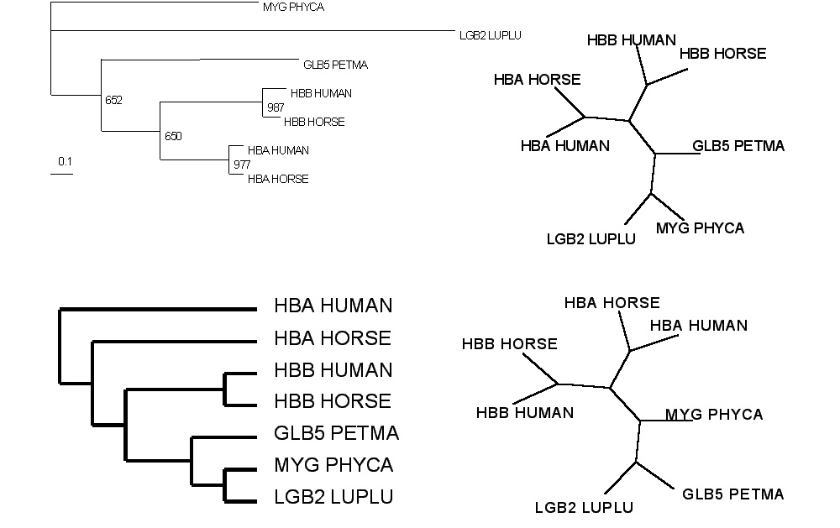
Test:Which of these trees is different?
More tests here

Slide 6
If you like tests on trees:
Science had an article on a
“The Tree-Thinking Challenge”, with a supplement that contained two quizzes on trees (with answers)
E.g.:
On the basis of the tree on the left, is the frog more closely related to the fish or the human?
Does the tree on the right change your mind?

Slide 7
Trees in Newick or parenthesis format
Trees rooted on a node are usually considered as unrooted
Trees rooted on a branch are usually considered as rooted
((A, B), (C, D), E)
(((A, B), (C, D)), E)
Arbitrarily rooted in a node –
While displayed as rooted in a node, the tree should be considered as unrooted
Strictly bifurcating –
The root is located on the branch leading to E
More links here and here and here

Slide 8
Phylogenetic Reconstruction – Why?
A) Systematic classification of organisms
e.g.: Who were the first angiosperms? (i.e. where are the first angiosperms located relative to present day angiosperms?) Where in the tree of life is the last common ancestor located?
B) Evolution of molecules
e.g.: domain shuffling, reassignment of function, gene duplications, horizontal gene transfer, drug targets,
detection of genes that drive evolution of a species/population
(e.g. influenca virus)
C) Identification of organisms
e.g., phylotyping in microbiome samples,
origin of genes and viruses (e.g., HIV virus, recent ebola outbreak)

Slide 9
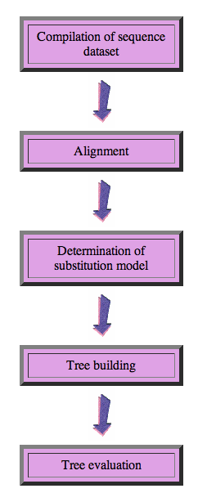
Steps of the phylogenetic analysis
Phylogenetic analysis is an inference of evolutionary relationships between organisms.
Phylogenetics tries to answer the question
“How did groups of organisms come into existence?”
Those relationships are usually represented by tree-like diagrams.
Note: the equation of biological evolution with a tree like process has limited validity at best.

Slide 10
Phylogenetic reconstruction - How
Distance analyses
  calculate pairwise distances
  (different distance measures, correction for multiple hits, correction for codon bias)
  make distance matrix (table of pairwise corrected distances)
  calculate tree from distance matrix
    i) using optimality criterion
    (e.g.: smallest error between distance matrix and distances in tree,
    or use
    ii) algorithmic approaches (UPGMA or neighbor joining)

Slide 11
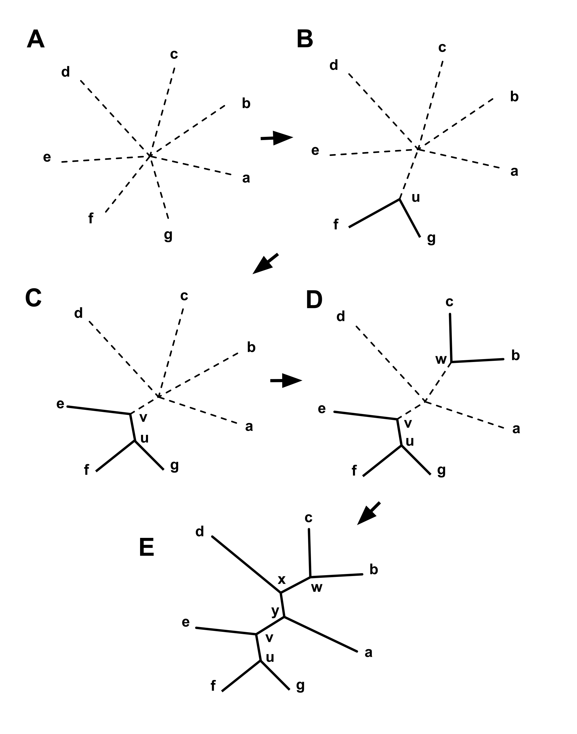
Algorithmic approaches (no global optimality criterion)
Principle of Neighbor Joining
From Wikipedia
UPGMA from Richard Edwards (here)
Wikipedia also has a good work through.

Slide 12
Phylogenetic reconstruction - How
Distance matrix based analyses
Parsimony analyses
  find that tree that explains sequence data with minimum number of substitutions
  (tree includes hypothesis of sequence at each of the nodes)
Maximum Likelihood analyses
  given a model for sequence evolution, find the tree that has the highest probability under this model.
  This approach can also be used to successively refine the model using the maximum likelihood ratio test.
Bayesian statistics use ML analyses to calculate posterior probabilities for trees, clades and evolutionary parameters. These approaches have become very popular in the last years, because they allow to estimate evolutionary parameters (e.g., which site in a virus protein is under positive selection), without assuming that one actually knows the "true" phylogeny.

Slide 13
Else:
spectral analyses, like evolutionary parsimony, look only at patterns of substitutions,
Another way to categorize methods of phylogenetic reconstruction is to ask if they are using
an optimality criterion (e.g.: smallest error between distance matrix and distances in tree, least number of steps, highest probability), or
algorithmic approaches (UPGMA or neighbor joining)
Packages and programs available:
iqtree, MrBayes, PAUP*, phyml, raxml, PHYLIP, PAML, Tree-Puzzle, clustalw, PhyloGenie, HyPhy, seaview (GUI for PHYLIP and phyml)

Slide 14
Maximum Likelihood

Slide 15
Estimating Models and Model Parameters.
Likelihood: Probability of a dataset given a model and a set of parameter.
Maximum likelihood: maximum probability of drawing the sample actually obtained using the model parameters as variable. (This usually is a tiny number, thus usually one uses the negative logarithm).
This works great for finding the best fitting parameters,
AND
Maximum Likelihood Estimation (MLE) can be used to test if assuming a more complicated model is justified by the data

Slide 16
Example Regression Regression Polynomials
When has one added too many parameters?
The fit undoubted increases with each parameter, but does this increase justify the additional parameter?
Notes:
The fit undoubted increases with each parameter, but does this increase justify the additional parameter?

Slide 17
One could use the maximum likelihood ratio test
Let L1 be the maximum value of the likelihood of the data without the additional assumption. In other words, L1 is the likelihood of the data with all the parameters unrestricted and maximum likelihood estimates substituted for these parameters.
Let L0 be the maximum value of the likelihood when the parameters are restricted (and reduced in number) based on the assumption. Assume k parameters were lost (i.e., L0 has k less parameters than L1).
Form the ratio λ=L0/L1. This ratio is always between 0 and 1 and the less likely the assumption is, the smaller λ will be. This can be quantified at a given confidence level as follows:
Calculate χ2=−2 ln λ. The smaller λ is, the larger χ2 will be.
We can tell when χ2 is significantly large by comparing it to the 100(1−α) percentile point of a Chi-Square distribution with degrees of freedom. χ2has an approximate Chi-Square distribution with kdegrees of freedom and the approximation is usually good, even for small sample sizes.
The likelihood ratio test computes χ2 and rejects the assumption if χ2 is larger than a Chi-Square percentile with k degrees of freedom, where the percentile corresponds to the confidence level chosen by the analyst.
From: https://www.itl.nist.gov/div898/handbook/apr/section2/apr233.htm
Alternatives to the MLRT are the use of the Akaike information criterion or the Bayesian information criterion

Slide 18
Aside:
MLE is a sophisticated version of Ockham razor.
Ockham razor favors the explanation that can
explain an observation with the fewest
assumptions (the parsimony principle).
MLE favors the explanation under which the observation is most probable. (MLE becomes equivalent to parsimony, if all events are equally probable. Note: you can also apply different weights to the events that are counted in parsimony, or ignore some altogether, e.g., transversion parsimony.)

Slide 19
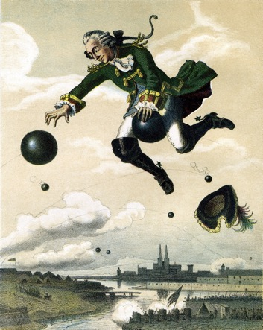
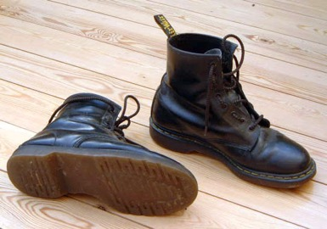
Non-Parametric Bootstrap:
Creating pseudo-samples (sampling with replacement, sample size n)
Jacknife:
Creating pseudo-samples (sampling without replacement, sample size n/2)
Parametric Bootstrap:
Creating pseudo-samples through simulations using a model and parameters estimated from the data
Doing the impossible:
Statistics on a single sample
Evaluation of pseudo-samples measures how much information in the original data support a conclusion.

Slide 20
Creating bootstrap or pseudo-samples through sampling alignment columns with replacement
From “Bootstrap and Rogue Identification Tests for Phylogenetic Analyses”
Molecular Biology and Evolution 35(1) DOI: 10.1093/molbev/msy118

Slide 21
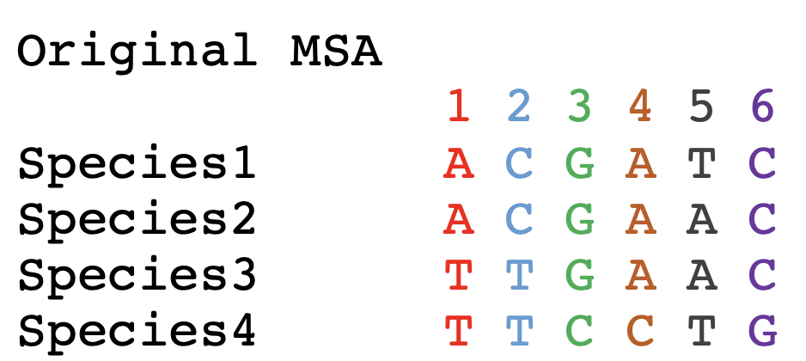
Bootstrapping example:

Slide 22
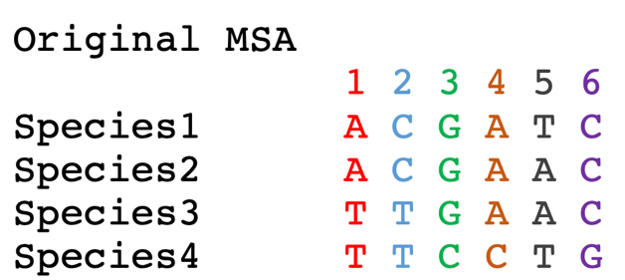
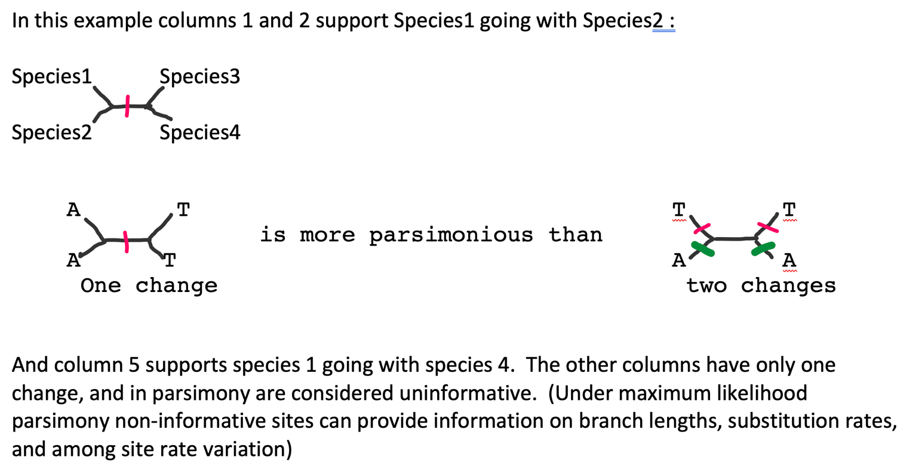
Parsimony informative sites

Slide 23
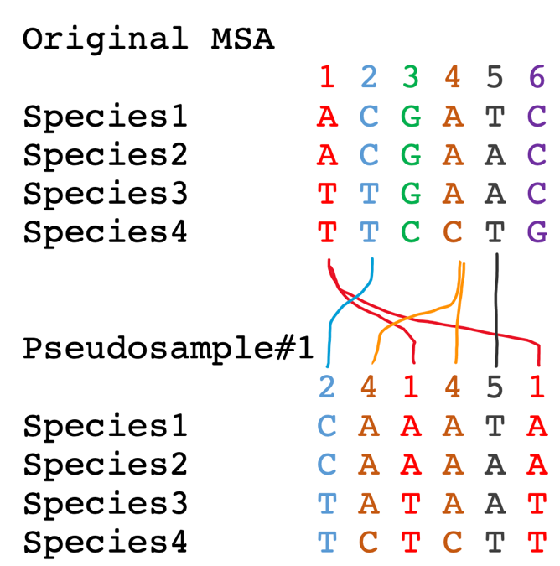
To sample with replacement for the alignment columns, we role six-sided dice six times. Assume you got the following numbers:
(2 4 1 4 5 1)
In this case column 3 and 6 did not make it into the pseudosample, and columns 1 and 4 made it twice.

Slide 24
Bootstrap Take Home Messages
If all pseudo-samples lead to the same conclusion (which then is said to have 100% bootstrap support), the original data set contained strong support for the conclusion
If only few pseudo-samples support a conclusion the original data do not strongly support the conclusion
Some consider 100-%bootstrap-support as analogous to a P-value.
Bootstrap support values are conservative
If a parameter value is estimated from the data, the bootstrap samples can be used to create confidence intervals (this is based on the finding that in cases where one can obtain many real samples, the real samples and the pseudo-samples show the same variance)

Slide 25
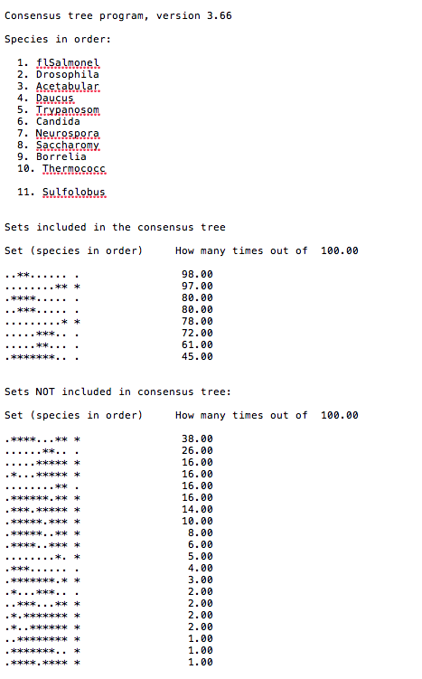
Output from consense

Slide 26
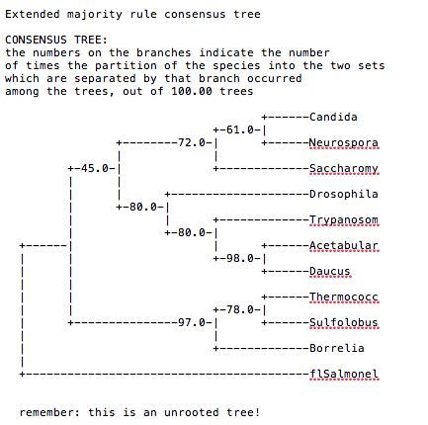
Output from consense

Slide 27
Why could a gene tree be different from the species tree?
Lack of resolution
Lineage sorting
Gene duplications/gene loss (paralogs/orthologs)
Gene transfer
Systematic artifacts (e.g., compositional bias and long branch attraction)

Slide 28
Trees – what might they mean?
Calculating a tree is comparatively easy, figuring out what it might mean is much more difficult.
If this is the probable organismal tree:
species A
species B
species C
species D
what could be the reason for obtaining this gene tree:
seq. from A
seq. from D
seq. from C
seq. from B

Slide 29
lack of resolution
seq. from A
seq. from D
seq. from C
seq. from B
e.g., 60% bootstrap support for bipartition (AD)(CB)

Slide 30
long branch attraction artifact
the two longest branches join together
seq. from A
seq. from D
seq. from C
seq. from B
e.g., 100% bootstrap support for bipartition (AD)(CB)
What could you do to investigate if this is a possible explanation?
use only slow positions,
use an algorithm that corrects for ASRV

Slide 31
Gene transfer
Organismal tree:
species A
species B
Gene Transfer
species C
species D
molecular tree:
seq. from A
seq. from D
seq. from C
speciation
seq. from B
gene transfer

Slide 32
Lineage Sorting
Organismal tree:
species A
species B
species C
Genes diverge and coexist in the
organismal lineage
species D
molecular tree:
seq. from A
seq. from D
seq. from C
seq. from B

Slide 33
Gene duplication
Organismal tree:
species A
species B
species C
gene duplication
species D
molecular tree:
seq. from A
seq. from B
seq. from C
seq. from D
seq.’ from B
seq.’ from C
gene duplication
seq.’ from D

Slide 34
Gene duplication
Organismal tree:
species A
species B
species C
gene duplication
species D
molecular tree:
seq. from A
with gene loss
seq. from D
seq.’ from B
seq.’ from C
gene duplication

Slide 35
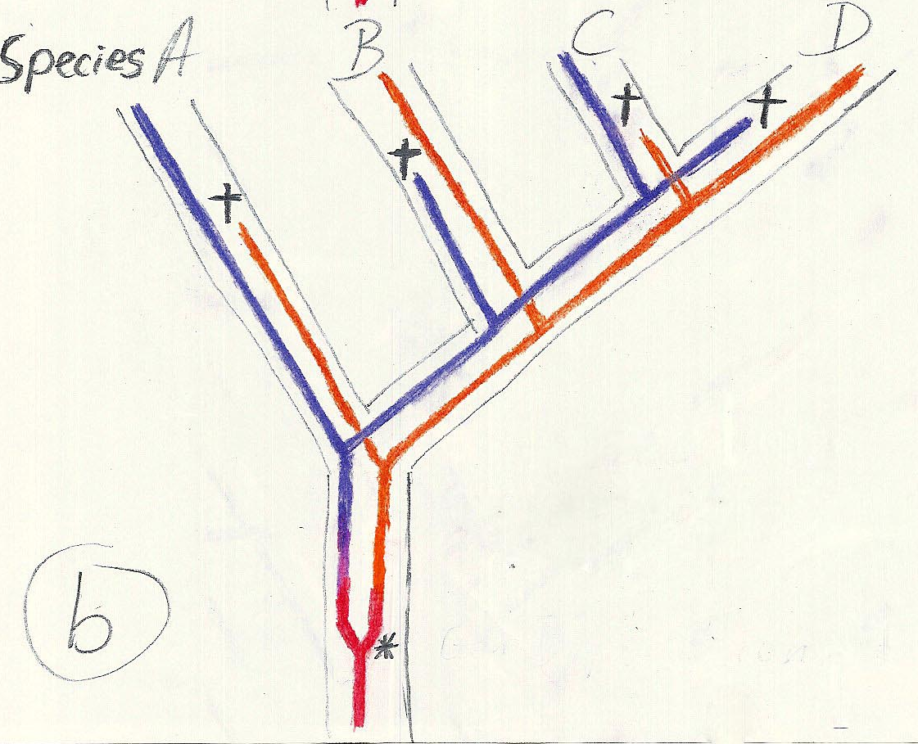
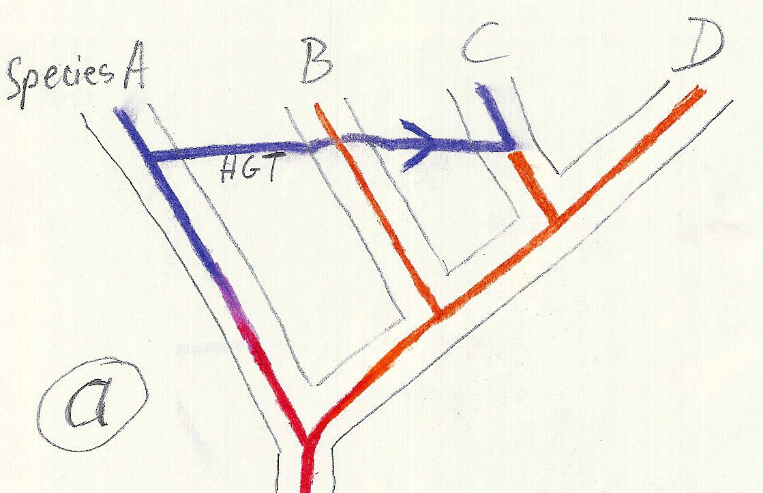
Gene duplication and gene transfer are equivalent explanations.
The more relatives of C are found that do not have the blue type of gene, the less likely is the duplication loss scenario
Ancient duplication followed by gene loss
Horizontal or lateral Gene
Note that scenario B involves many more individual events than A
1 HGT with
orthologous replacement
1 gene duplication followed by 4 independent gene loss events

