Slide 1
MCB 3421 – class 18
Bayesian Approaches
to
Phylogenetic Reconstruction

Slide 2
Parsimony: Find the tree (or trees) that explains data with the smallest number of substitutions (aka as Occam’s razor).
Note: parsimony does poorly in the presence of short and long branches
Maximum Likelihood: Find the tree and model that make the dataset most probable.
Note: the probability of an individual data set is tiny. Usually a 0, followed by several 10000 zeros. -LogL values of 90000 are common.
Bayesian Approach: Find the tree and model that are most probable given the data and prior information.
Note: The Bayesian analysis and the biased random walk in parameter space use the likelihood (but not the maximum likelihood) associated with the points in in parameter space.

Slide 3

Elliot Sober’s Gremlins
Observation: Loud noise in the attic
?
Hypothesis: gremlins in the attic playing bowling
Likelihood =
P(noise|gremlins in the attic)
What you would want to know (posterior probability):
P(gremlins in the attic|noise)
?
?

Slide 4
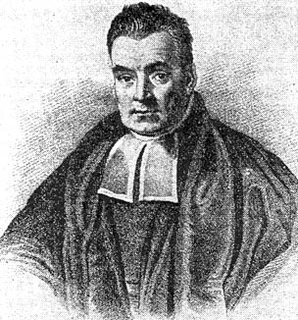
Bayes’ Theorem
Likelihood
describes how well the model predicts the data
P(data|model, I)
P(model|data, I) = P(model, I)
P(data,I)
Posterior
Probability
represents the degree
to which we believe a given model accurately describes the situation
given the available data and all of our prior information I
Prior
Probability
describes the degree to which we believe the model accurately describes reality
based on all of our prior information.
Normalizing
constant
Reverend Thomas Bayes (1702-1761)

Slide 5
Likelihood estimates do not take prior information into consideration:
e.g., if the result of three coin tosses is 3 times head, then the likelihood estimate for the frequency of having a head is 1 (3 out of 3 events) and the estimate for the frequency of having a head is zero.
The probability that both events (A and B) occur
Both sides expressed as conditional probability
If A is the model and B is the data, then
P(B|A) is the likelihood of model A
P(A|B) is the posterior probability of the model given the data.
P(A) is the considered the prior probability of the model.
P(B) often is treated as a normalizing constant.

Slide 6
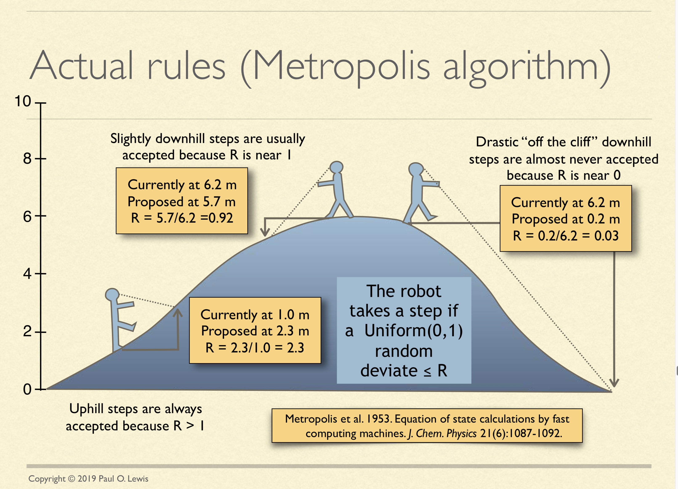
See: http://hydrodictyon.eeb.uconn.edu/people/plewis/downloads/wh2019/lewis-bayesian-part1.pdf

Slide 7
Estimating Bayesian Posterior Probabilities through biased sampling
Exploration of parameter space by sampling posterior probabilities (likelihoods) using a biased random walk through parameter space (Metropolis Hastings Coupled Monte Carlo Markov Chain or MC³)
Pick a set of parameters at random
Calculate the likelihood of the data / posterior probability for this set of parameters
Change one of the parameter by a little bit, recalculate the likelihood
If the posterior probability increased, use these parameter values as a starting point for the next parameter change (back to 3), if it gets worse calculate the ratio of the posterior probabilities and take these odds to accept or reject the new parameter as a starting point for the next step.
N_{i}
P_{i} ≈
,where N_{i} - number of sampled parameter states that you are interested in
N_{total} – total number of samples (has to be large)
N_{total}

Slide 8
Alternative Approaches to Estimate
Posterior Probabilities
Bayesian Posterior Probability Mapping with MrBayes
(Huelsenbeck and Ronquist, 2001)
Problem:
Strimmer’s formula
L_{i}
p_{i}=
only considers 3 trees
(those that maximize the likelihood for
the three topologies)
L₁+L₂+L₃
Solution:
Exploration of the tree space by sampling trees using a biased random walk
(Implemented in MrBayes program)
Trees with higher likelihoods will be sampled more often
N_{i}
p_{i}≈
N_{total}
,where N_{i} - number of sampled trees of topology i, i=1,2,3
N_{total} – total number of sampled trees (has to be large)

Slide 9
Illustration of a biased random walk
Figures generated using MCRobot program (Paul Lewis, 2001)

Slide 10
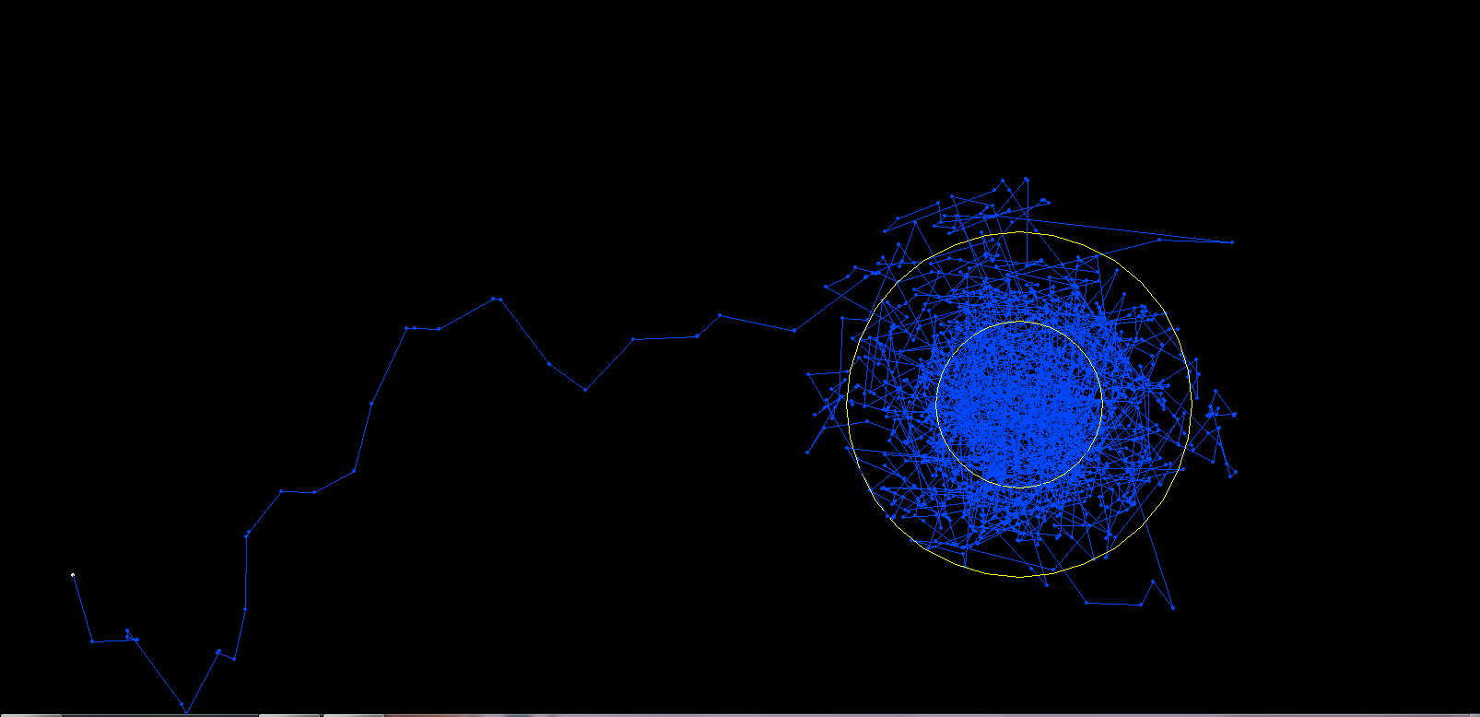
One needs to remove the burnin that is created, when the robot initially runs around in parameter space without seeing the probability landscape.

Slide 11
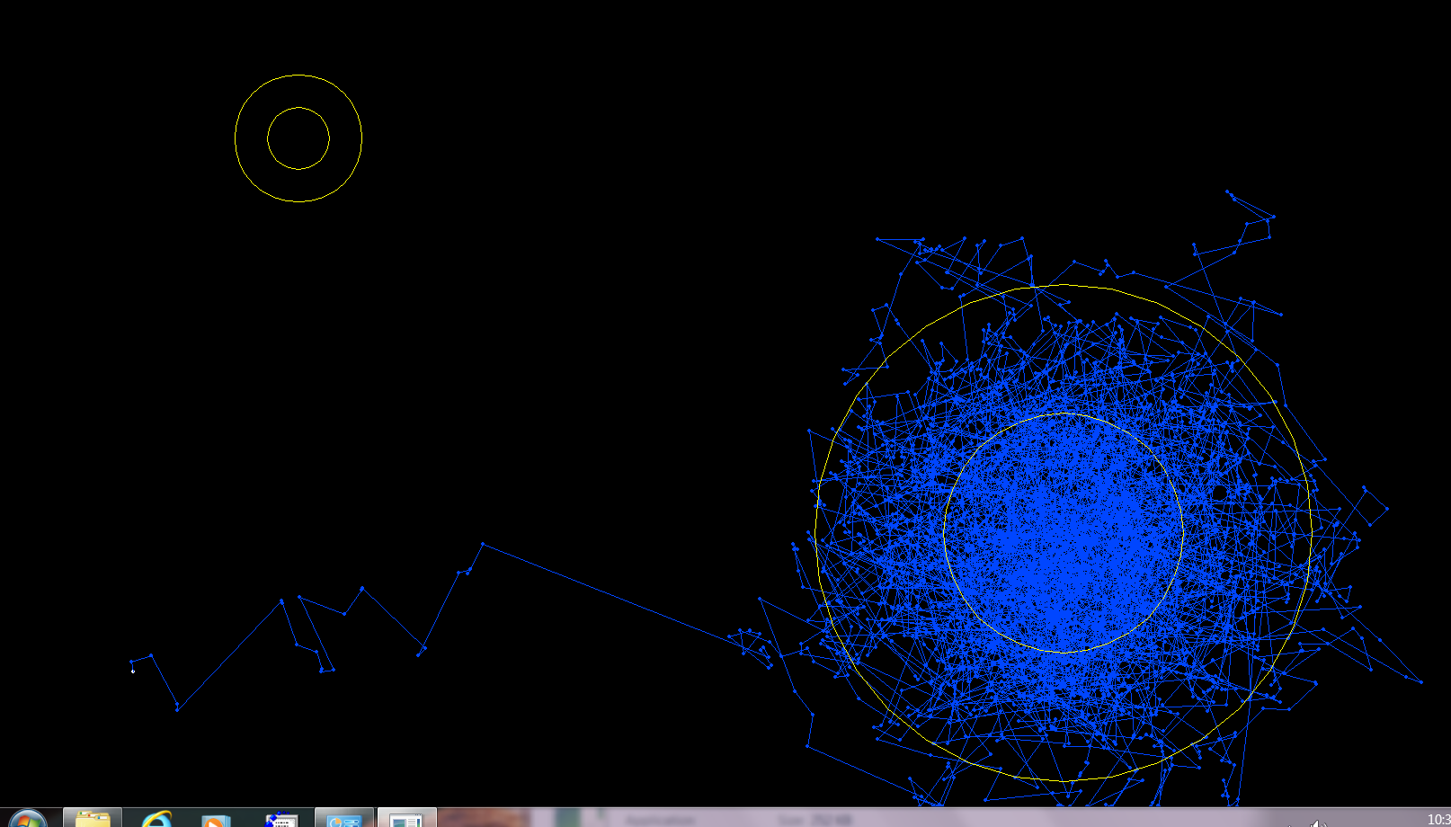
One complication is that the robot might be stuck on a local optimum.

Slide 12
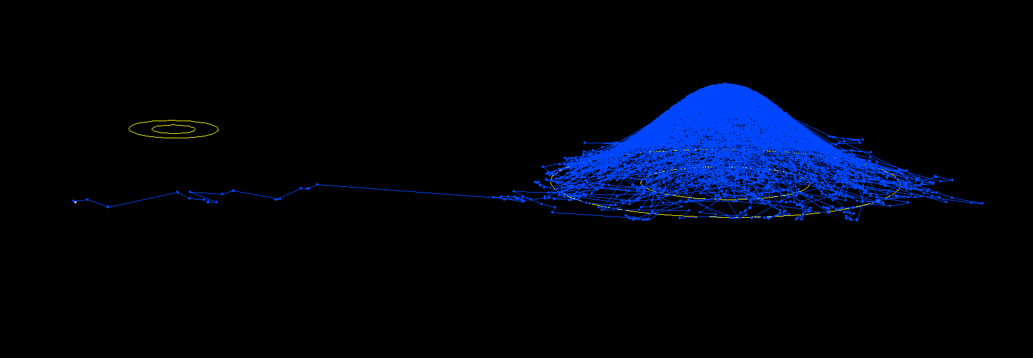
One complication is that the robot might be stuck on a local optimum. (Same as last slide but in sideview).

Slide 13
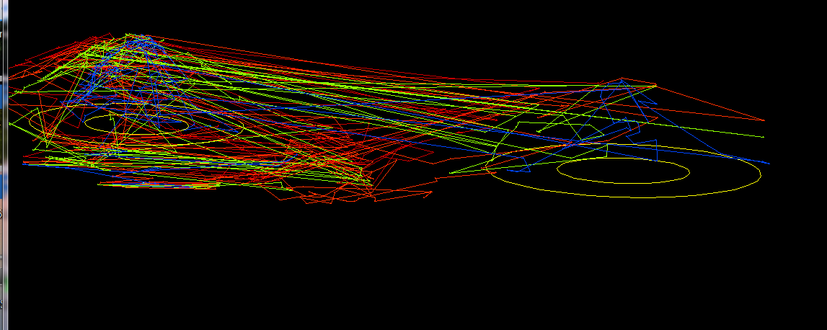
One solution is to run multiple chains, some of which “heated”, so that the probability landscape is melted down, and the robots move more easily away from the optimum. The different chains compare their sampled probability, and switch in case the heated chain is better.

Slide 14
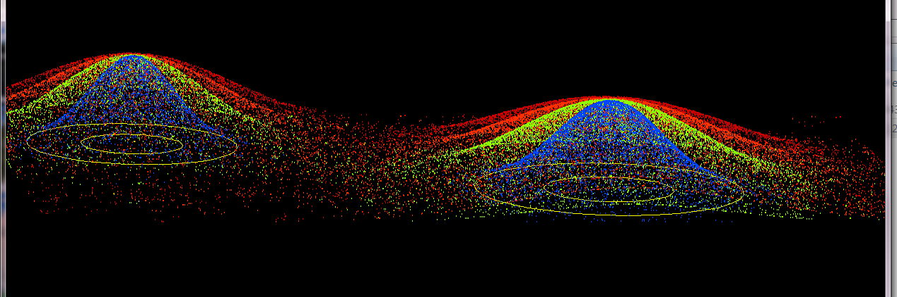
4 chains, same as previous, but many more generations, and the trajectory is not plotted, only the points visited by each of the four chains.

Slide 15
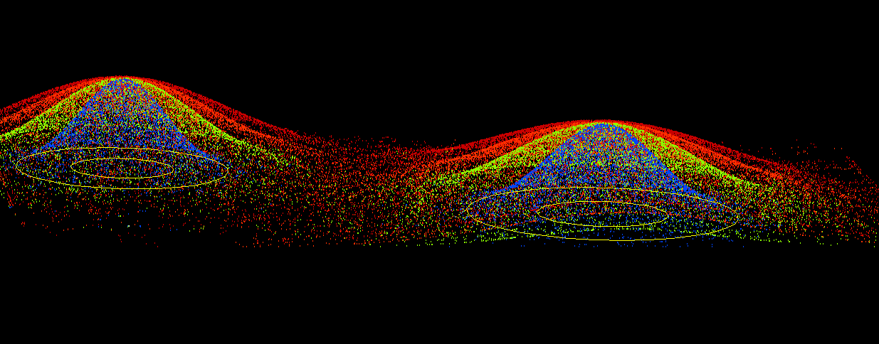
4 chains, same as previous, but even more generations

Slide 16
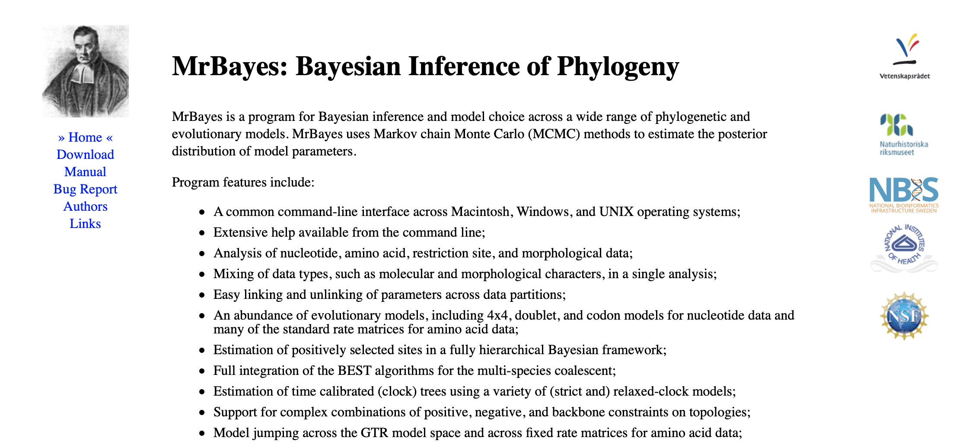

Slide 17
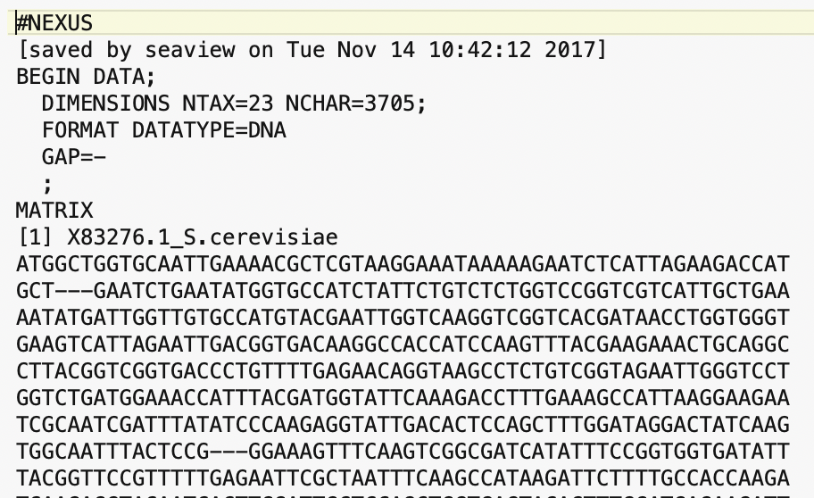
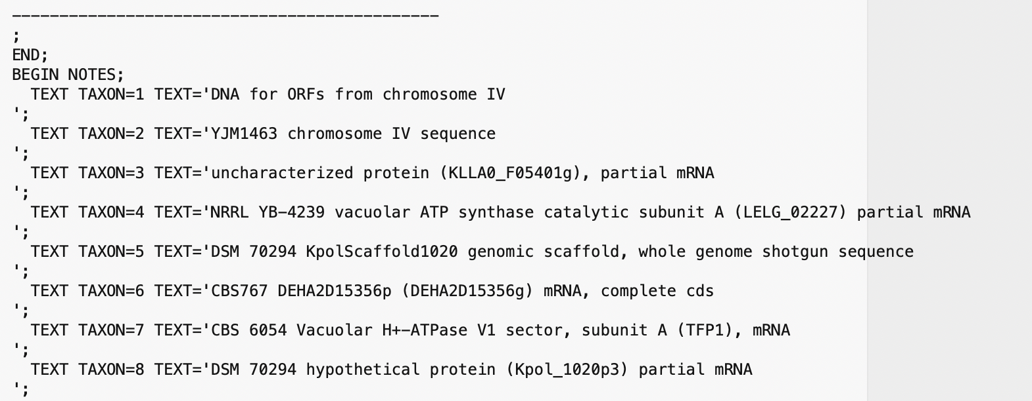
MrBayes reads Nexus files (can be generated from Seaview).
This retains partitioning data (e.g., into sites from exteins and inteins)
Nexus files can have command blocks at the end for different programs (PAUP or MrBayes)
Beginning of the file:
End of Data matrix, beginning of notes

Slide 18
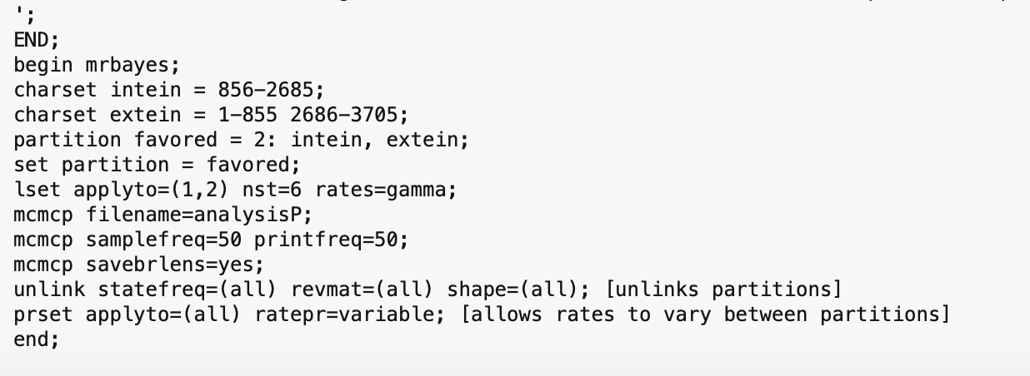
MrBayes block:
You need to consult the MrBayes manual at http://mrbayes.sourceforge.net/mb3.2_manual.pdf
to figure out the commands
Start mb -> execute Filename -> mcmc (starts the ”robot”)

Slide 19
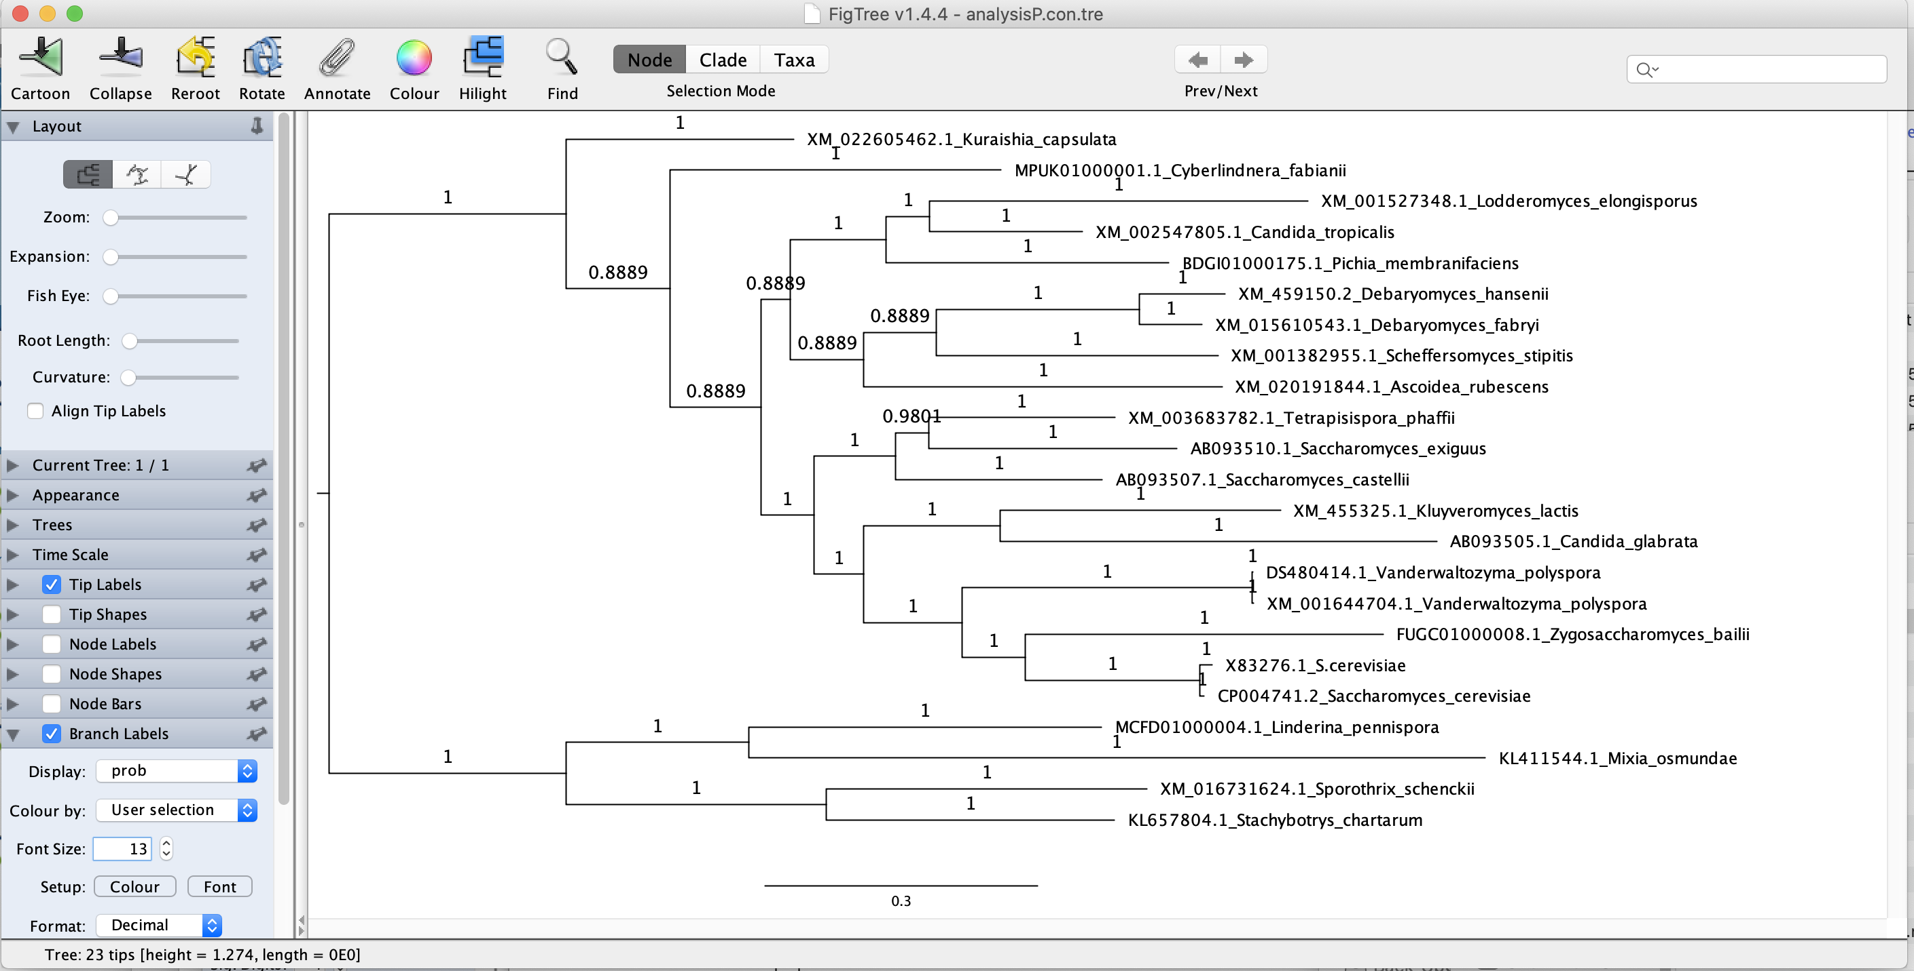
MrBayes creates a tree file (.t) that contains the trees sampled during the run.
This can be summarized into a consensus tree: (shown here in Figtree).

Slide 20
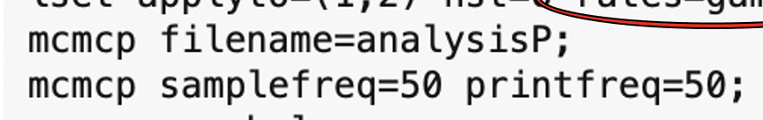
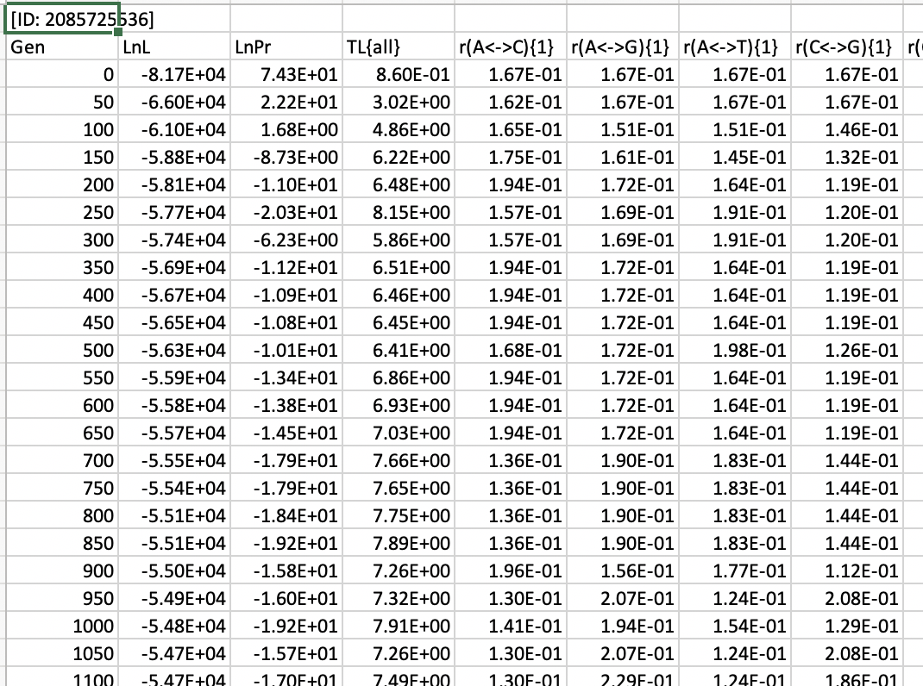
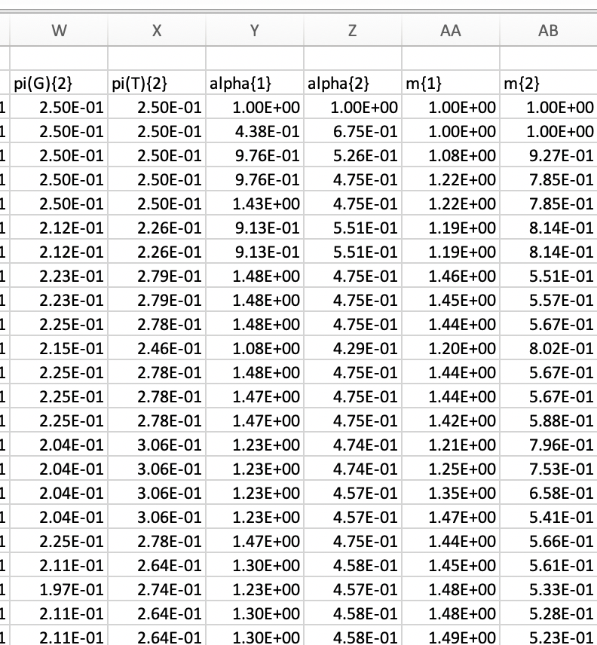
MrBayes also creates a parameter file (.p) that contains the parameters for the specified samples

Slide 21
Log Likelihood over generations
End Burnin

Slide 22
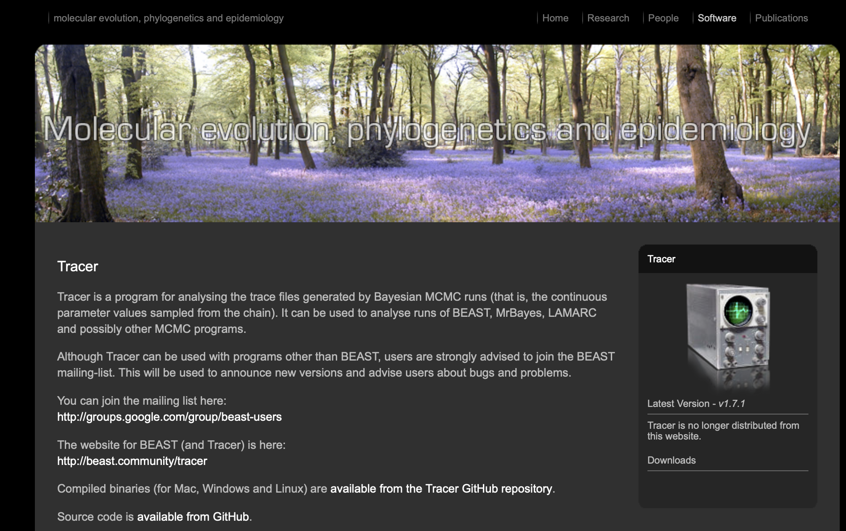
By default MrBayes is doing two parallel runs (with 4 chains each).
This allows to test convergence.
Tracer is a beautiful program that helps to analyze and visualize MCMCMC runs:
(much easier than in Excel)

Slide 23
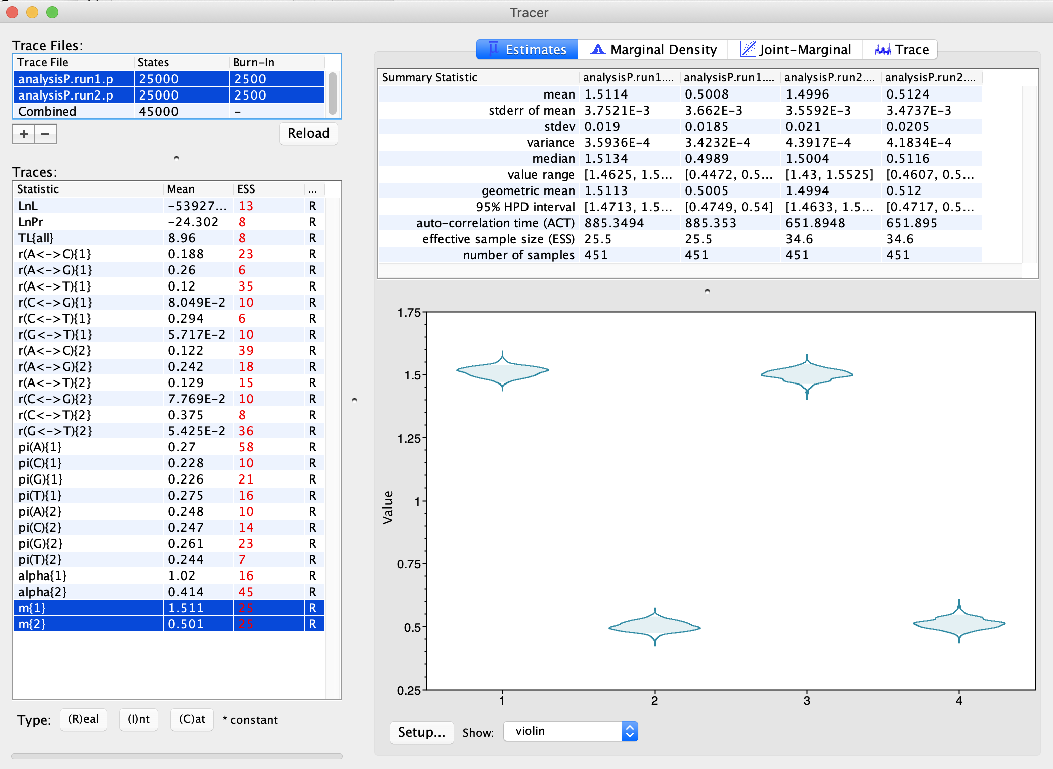
The relative substitution rates for the two partitions and the two runs.
As Violin plot:

Slide 24
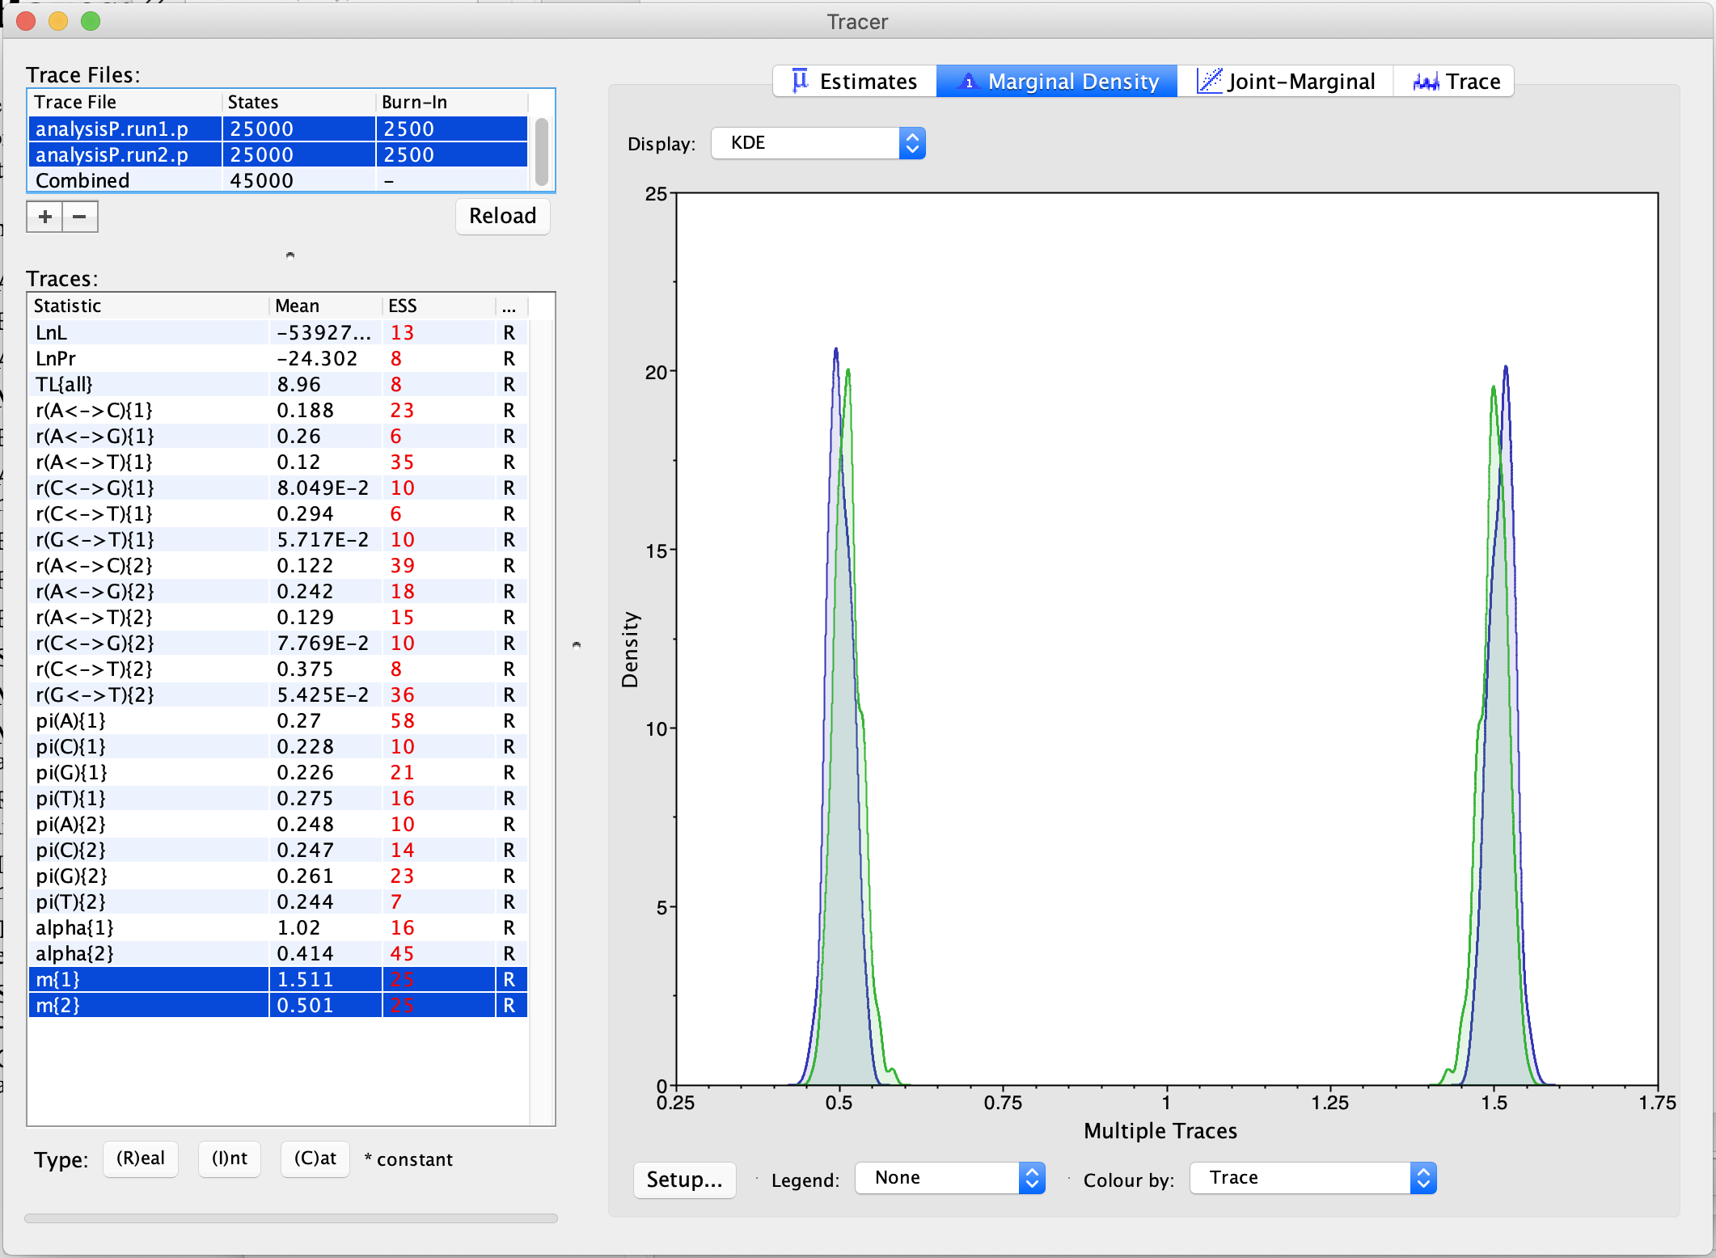
The relative substitution rates for the two partitions and the two runs.
As smoothed histogram:

Slide 25
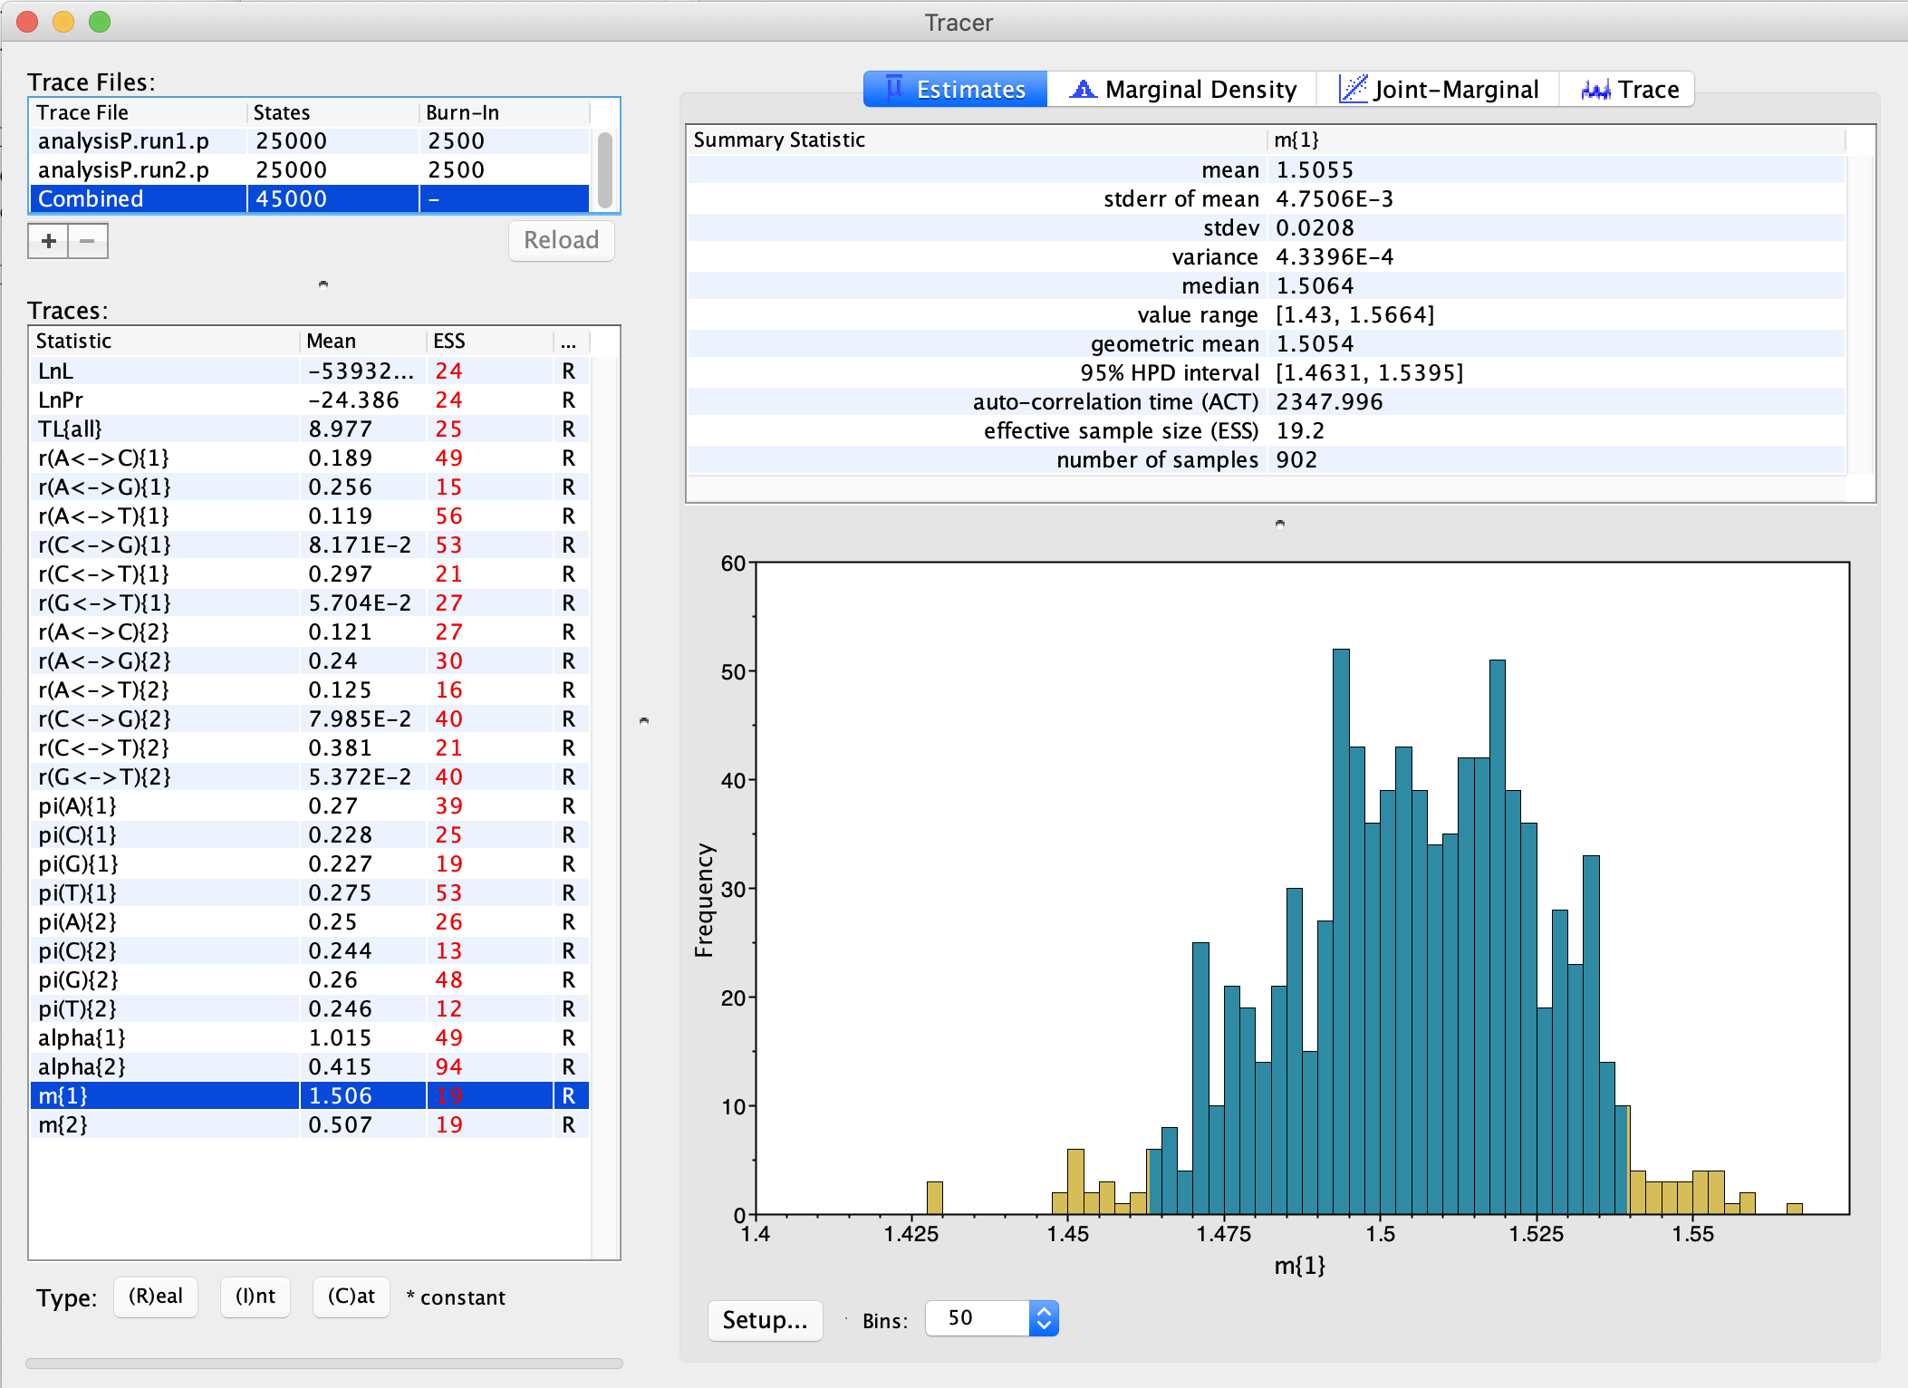
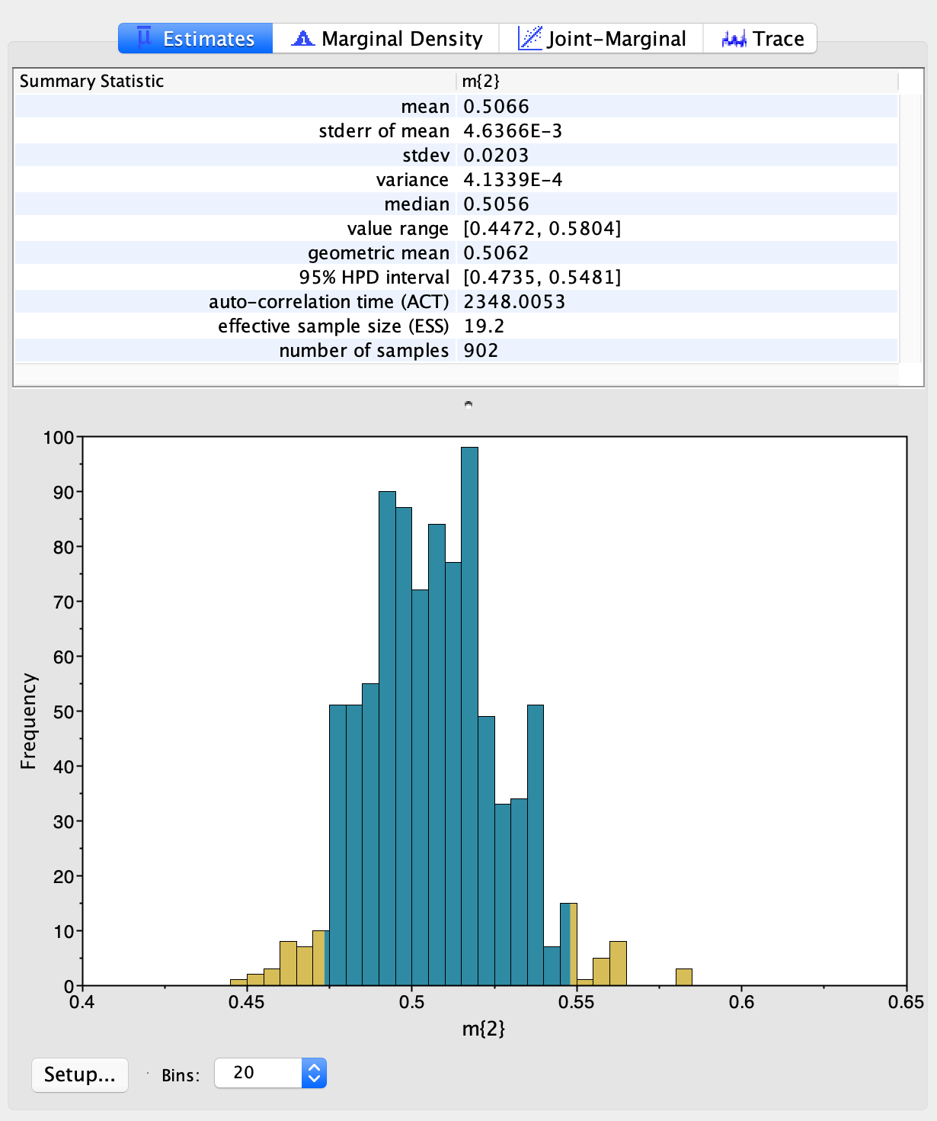
Distribution of relative substitution rate for the intein, versus the extein
=>

Slide 26
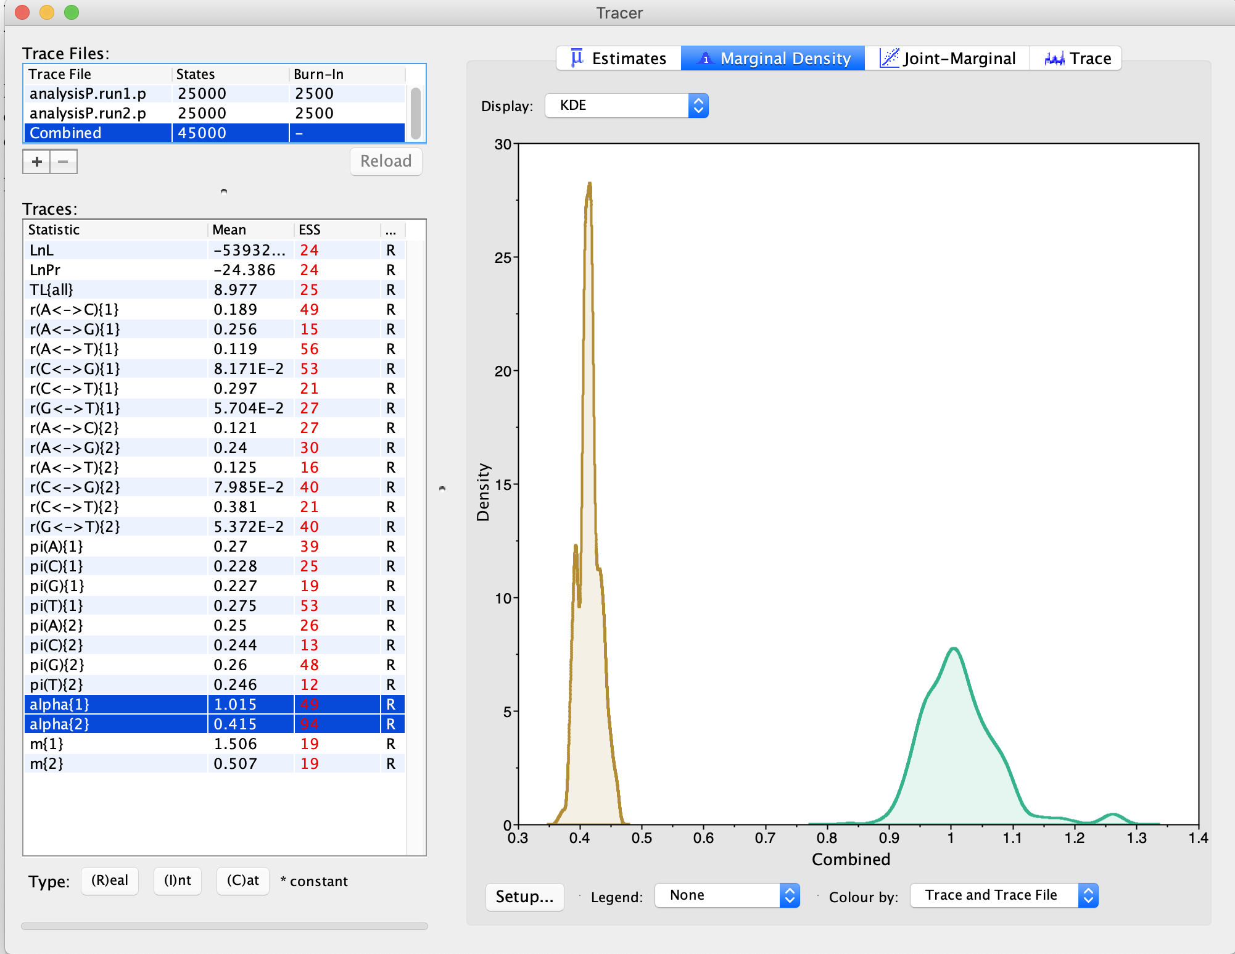
The shape parameter describing the Among Site Rate Variation (ASRV) for the two partitions:
Extein
Intein

Slide 27
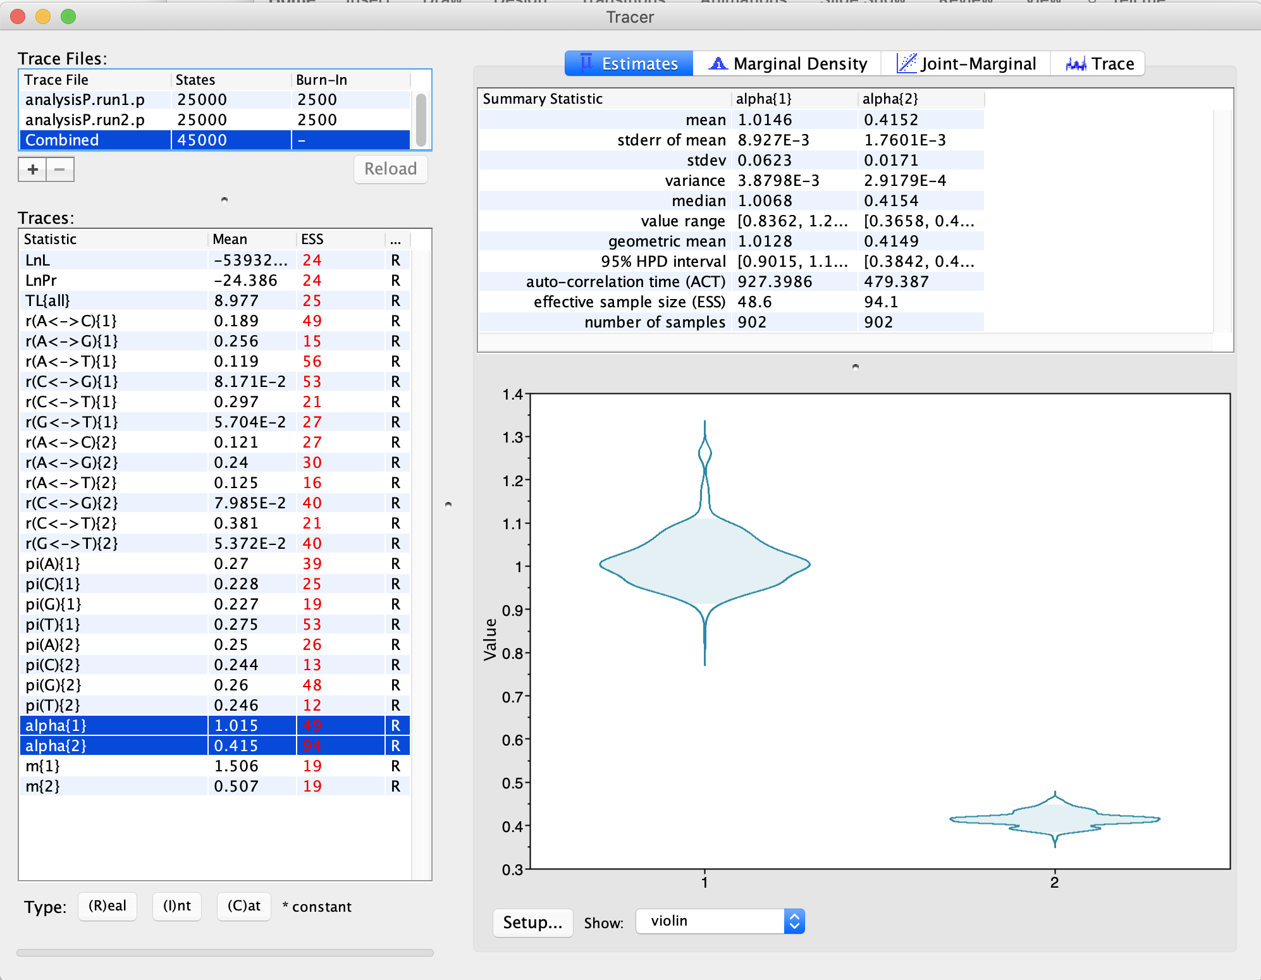
The shape parameter describing the Among Site Rate Variation (ASRV) for the two partitions:
Intein
Extein

Slide 28
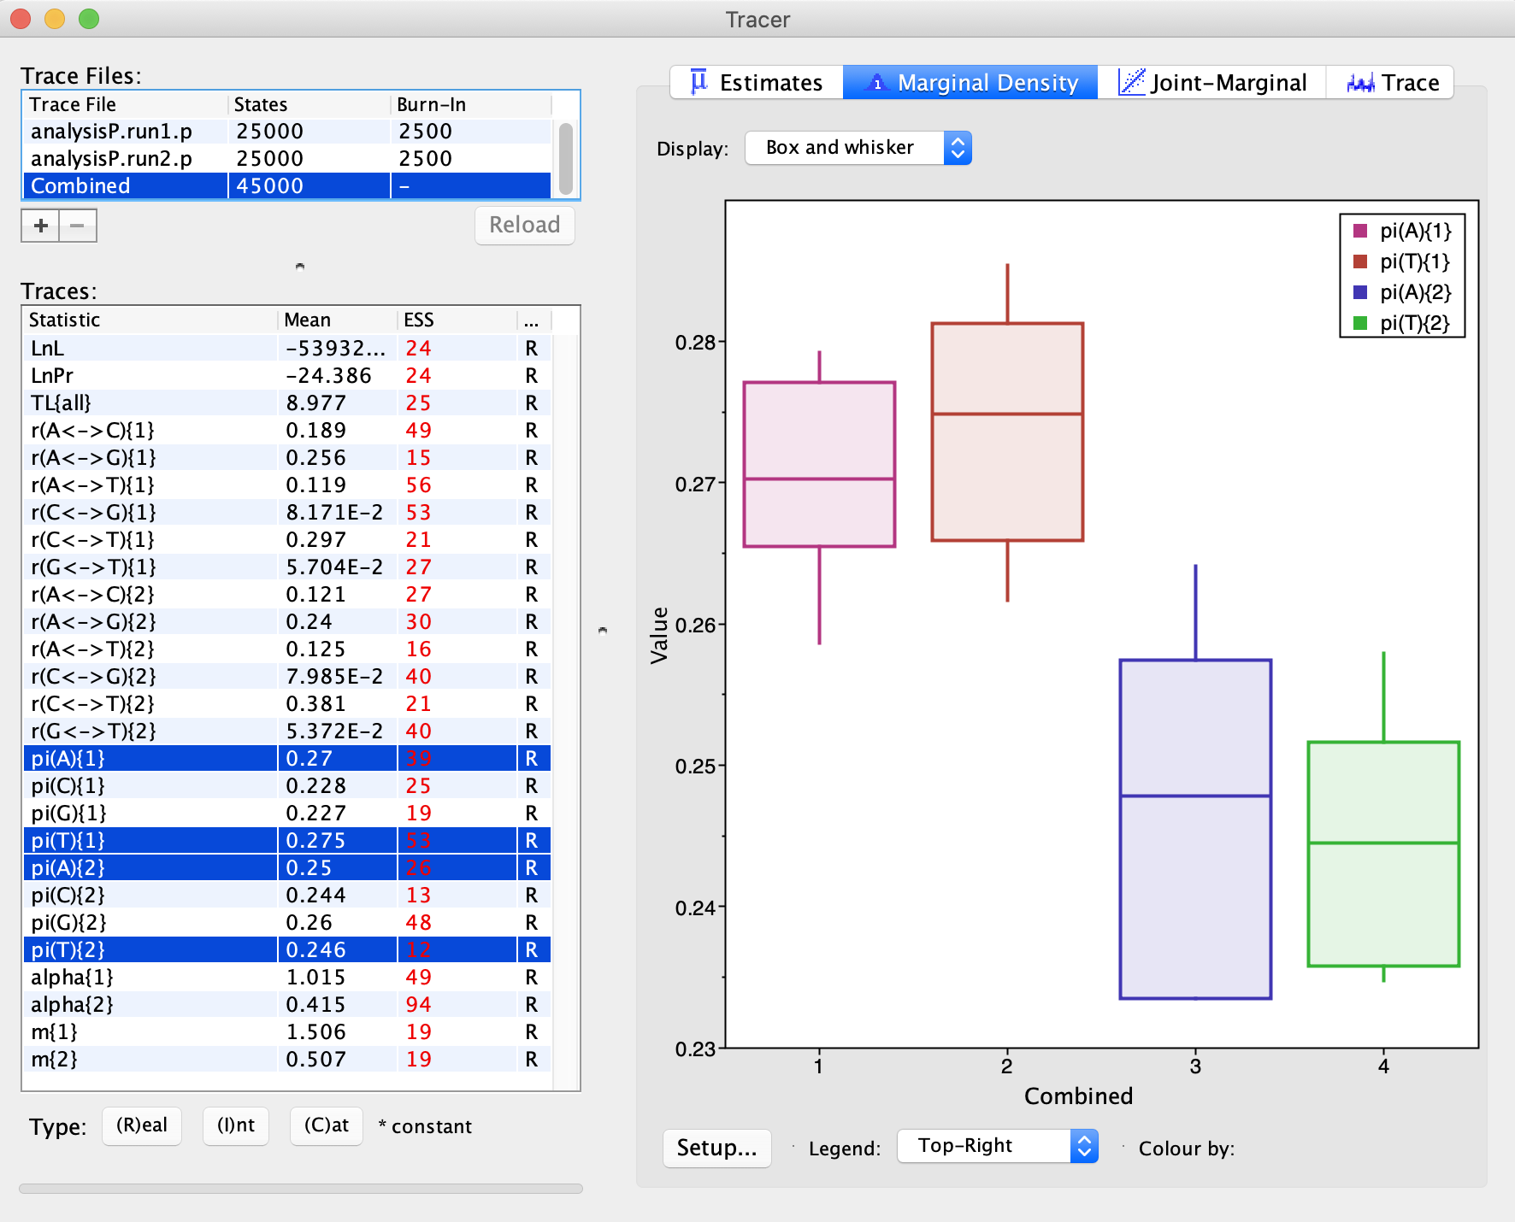
AT content is higher for the intein.
This also may reflect less selection, because mutations from GC pairs to AT pairs occur more frequently (mutational bias)
Intein
Extein

Slide 29
Bottomline:
Bayesian analyses make it easy to describe parameters governing the evolution of molecules
Intein have a less extreme ASRV compared to exteins
Inteins have a higher (three times) substitution rate
Tracer (or Excel) makes it easy to obtain 95% high probability intervals for parameter values.
Concerns with the analysis used as an example:
The example should have run much longer ...
If we suspect HGT of the intein, the datasets have been analyzed separately (and not linked to the same tree explored in the same

Slide 30
From the discussion board:
Question: In what kind of situation would you most likely use the Bayesian method? Not only does the computing time take longer than MLE, but it seems as if sometimes using priors can cause a biased model if they are not well defined enough or reliable. How would you know that this is the best option to use?
A) Priors also can prevent stupid conclusions (as in the coin example, or the gremlins in the attic).
B) If you are only interested in the best tree, recently developed ml approaches are probably as good as any. I some instances, especially if you do not know if the maximum likelihood tree is the true tree, and you want to estimate parameters for the gene’s evolution (e.g., how much selection is acting on a gene?) the Bayesian approach is better, because in the random MCMCMC run one samples at all trees according to ther posterior probability (Or in scientific terms one marginalizes of the different possible trees in estimating parameters and their credibility interval). We might get to this on Friday.

Slide 31
From the discussion board:
Question: Which are the most common reasons for a gene tree to be different than the species tree? and why?
Among prokaryotes most certainly gene transfer. And gene transfer is not restricted to genes at the periphery of metabolism, even (and possibly especially) genes involved in translation and transcription are readily transferred. See https://academic.oup.com/mbe/article/19/12/2226/997576 for a discussion of HGT in prokaryotes.
HGT plays the role of sex in prokaryotes, but it is not limited to facilitating recombination with a species. Especially the occasional transfer between more divergent organism makes inferring species trees difficult. (What even is prokaryotic species? Organisms that frequently exchange genes via HGT?)
Among Eukaryotes, most would probably say lineage sorting. But introgression (sex with organism from a related species appears to occur rather frequently). Often molecular data suggest a more recent divergence than the fossil record, and a possible explanation is that organisms from related species had sex, thus the genomes stayed similar, even though adaptations to different environments had already taken place. (possible examples from our family tree here , here, and here.
However, even among eukaryotes HGT is much more frequent than most are aware of. Thus I think HGT and introgression a serious contender of creating conflicts between gene histories.

Slide 32
From the discussion board:
Question: Which phylogenetic tree is more preferable when analyzing more accurate evolutionary relationships in eukaryotes, gene trees versus species trees, and why? Is one better than the other?
Obtaining a species tree is rather difficult. In some cases, morphological characters (as in Hennig's insect phylogeny) may be sufficient; however, in most instances today the species tree is inferred from many genes or many gene trees. Either concatenating many genes into a single dataset (aka supermatrix), or using a supertree approach - calculating trees for individual genes and then combining the trees into a single consensus tree.
Both of these approaches, concatenating genes versus combining gene trees, has advantages and disadvantages -- we will talk about this in the future, but if you are curious, you could check out https://academic.oup.com/bib/article/15/1/79/186338

Slide 33
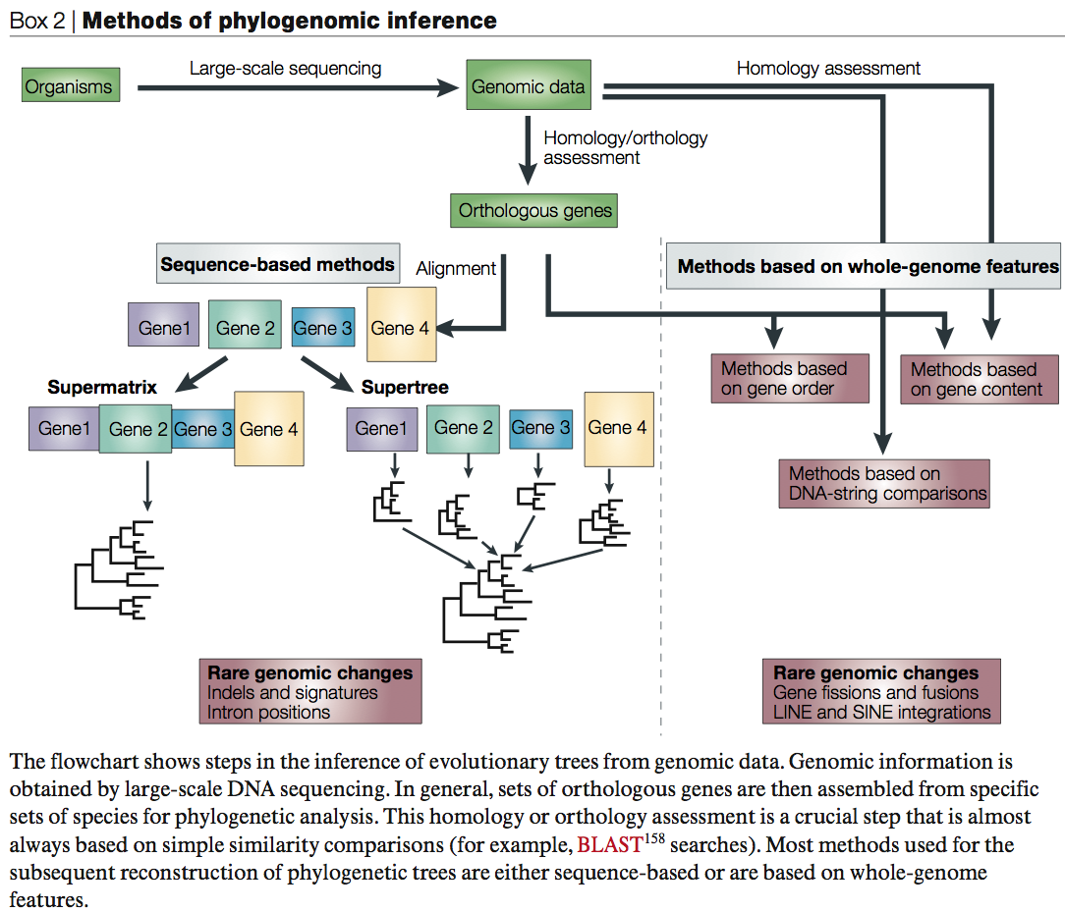
From:
Delsuc F, Brinkmann H, Philippe H.
Phylogenomics and the reconstruction of the tree of life.
Nat Rev Genet. 2005 May;6(5):361-75.

Slide 34
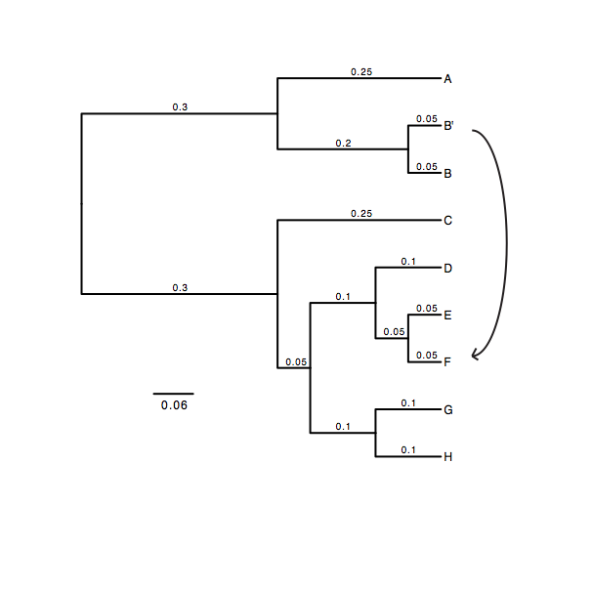
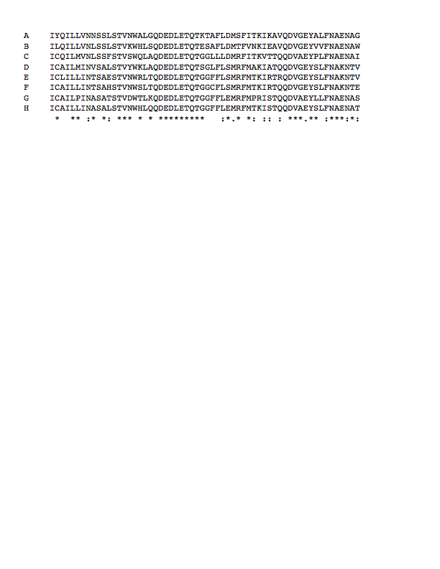
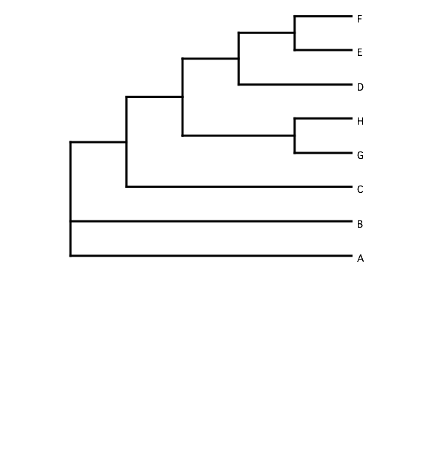
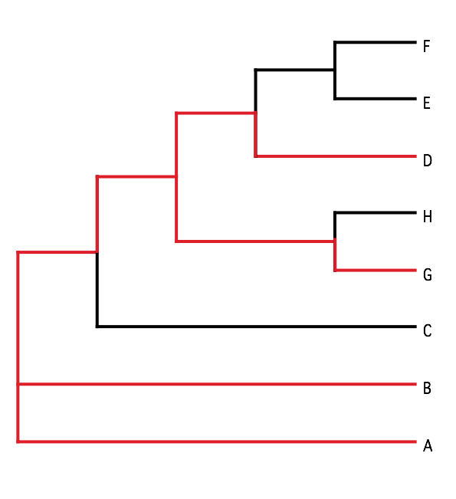
B) Generate 100 datasets using Evolver with certain amount of HGTs
A) Template tree
C) Calculate 1 tree using the concatenated dataset or 100 individual trees
D) Calculate Quartet based tree using Quartet Suite
Repeated 100 times…

Slide 35
Supermatrix versus
Quartet based Supertree
inset: simulated phylogeny

Slide 36
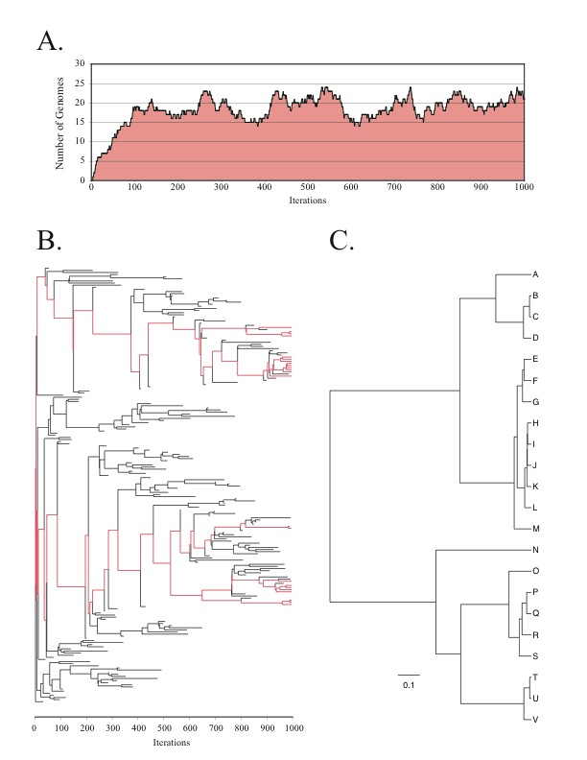
Note : Using same genome seed random number will reproduce same genome history
From: Lapierre P, Lasek-Nesselquist E, and Gogarten JP (2012)
The impact of HGT on phylogenomic reconstruction methods
Brief Bioinform [first published online August 20, 2012] doi:10.1093/bib/bbs050

Slide 37
HGT EvolSimulator Results

Slide 39
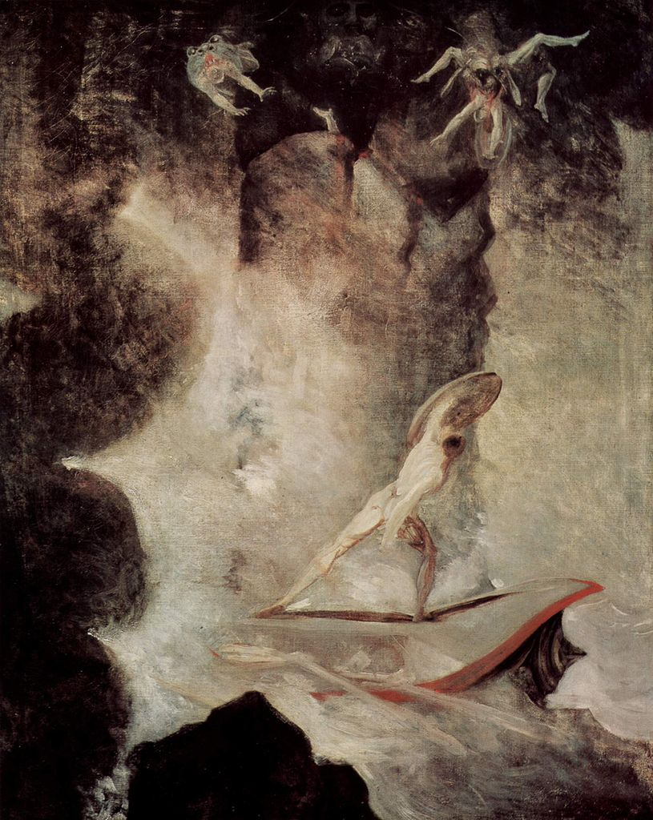
With little phylogenetic information (very divergent sequences, or very similar ones), one needs to concatenate sequences to make use of the information present in very dilute form in the individual datasets.
The problem is that the analysis becomes sensitive to HGT. A gene acquired from outside the group under analysis will pull the recipient towards the base of the phylogeny.
In case individual gene trees are well resolved, supertree approaches are much more robust towards HGT.
Odysseus vor Scilla und Charybdis
Johann Heinrich Füssli

