Slide 1
MCB 3421 – class 20
Drift
versus/and
Selection

Slide 2
s=0 -- neutral mutation
Probability of fixation, P, is equal to frequency of allele in population. Mutation rate (per gene/per unit of time) = u ;
freq. with which allele is generated in diploid population size N =u*2N
Probability of fixation for each allele = 1/(2N)
Substitution rate =
frequency with which new alleles are generated * Probability of fixation= u*2N *1/(2N) = u = Mutation rate
Therefore:
If f s=0, the substitution rate is independent of population size, and equal to the mutation rate !!!! (NOTE: Mutation unequal Substitution! )
This is the reason that there is hope that the molecular clock might sometimes work.
Fixation time due to drift alone:
t_{av}=4*N_{e} generations
(N_{e}=effective population size; For n discrete generations
N_{e}= n/(1/N₁+1/N₂+…..1/N_{n})

Slide 3
Positive selection (s>0)
A new allele (mutant) confers some increase in the fitness of the organism
Selection acts to favour this allele
Also called adaptive selection or Darwinian selection.
In case successive substitutions are under positive selection, this is also called diversifying selection.
NOTE: Fitness = ability to survive and reproduce
Modified from from www.tcd.ie/Genetics/staff/Aoife/GE3026/GE3026_1+2.ppt

Slide 4
s>0
Time till fixation on average:
t_{av}= (2/s) ln (2N) generations
(how come that this is also true for mutations with negative “s” ! discuss among yourselves)
N=10⁴,
s=0: average time to fixation: 40.000 generations
s=0.01: average time to fixation: 1.900 generations
N=10⁶,
s=0: average time to fixation: 4*10⁶ generations
s=0.01: average time to fixation: 2900 generations
N=10¹¹ (100 billion – size of the Prochlorococcus population),
s=0: average time to fixation: 2*10¹¹ generations (about .5 billion years)
s=0.01: average time to fixation: 5200 generations (about 14 years)
Probability of fixation, P, is approximately equal to 2s;
e.g., if selective advantage s = 1% then P = 2%

Slide 5
Random Genetic Drift
Selection
100
advantageous
Allele frequency
disadvantageous
0
Modified from from www.tcd.ie/Genetics/staff/Aoife/GE3026/GE3026_1+2.ppt

Slide 6
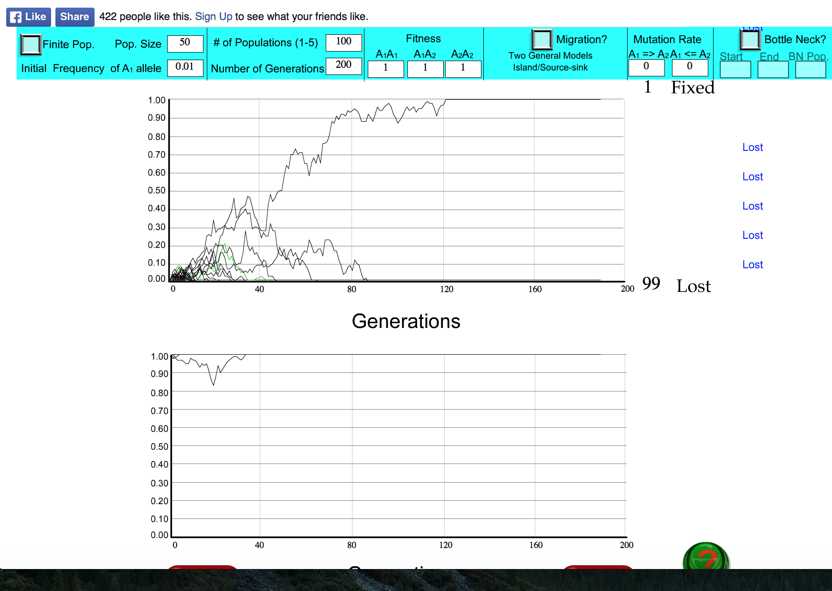
s=0

Slide 7
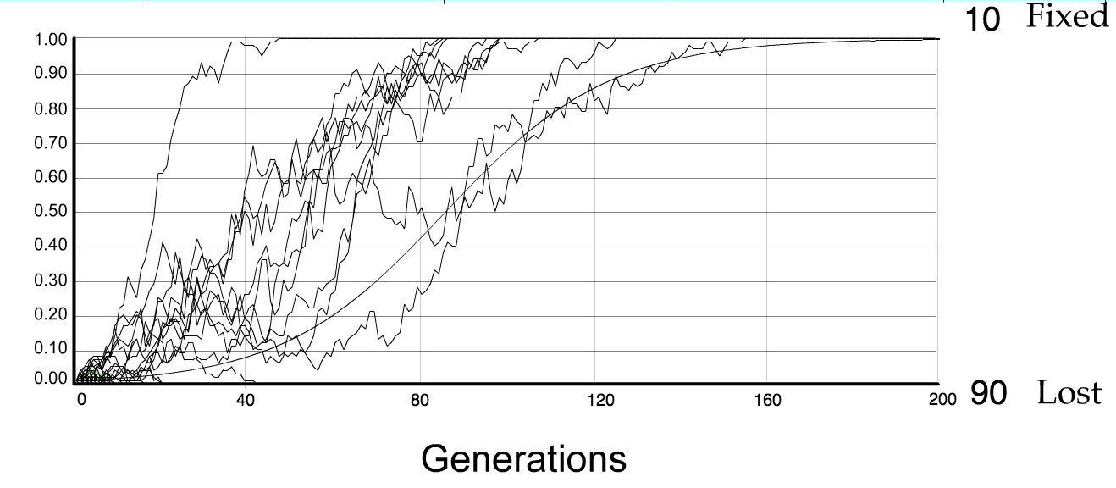
For advantageous mutations:
Probability of fixation, P, is approximately equal to 2s;
e.g., if selective advantage s = 5% then P = 10%
tav=2/s*log2N generations = 40*log100= 80

Slide 8
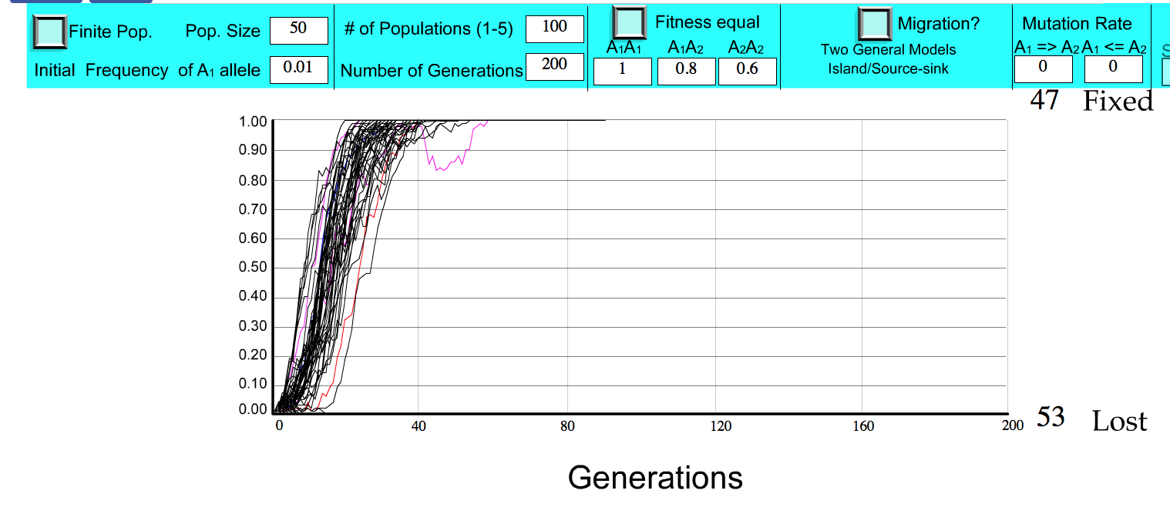
S=.2 => shorter fixation time.

Slide 9
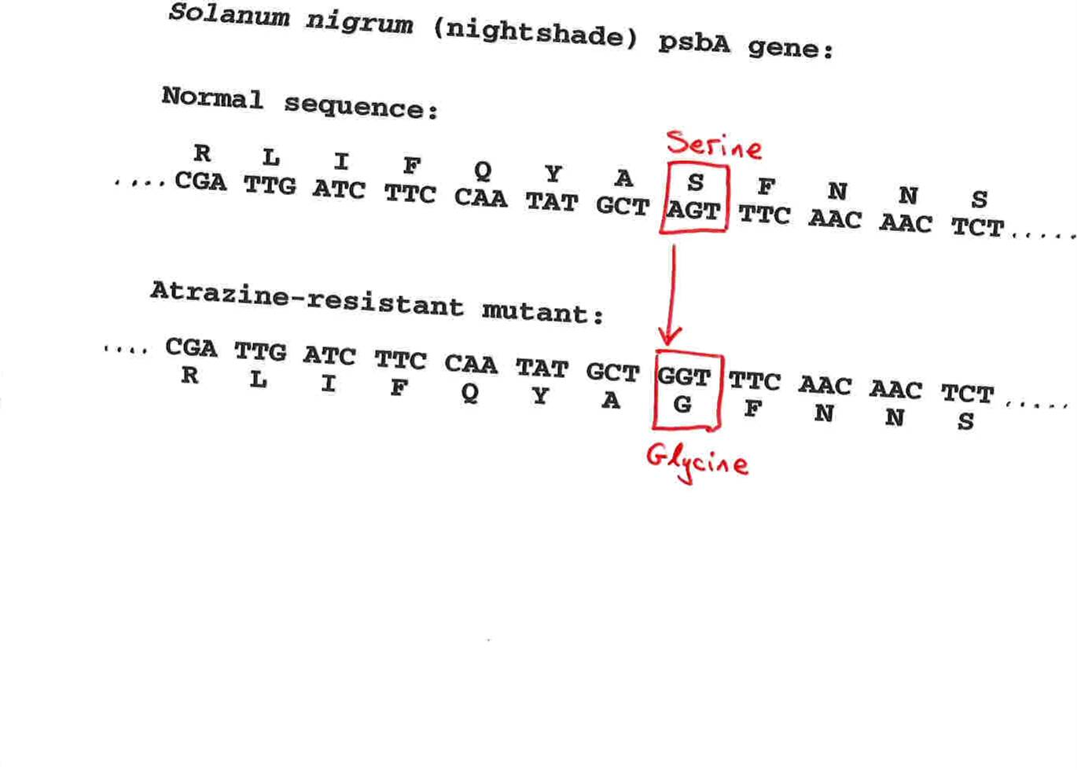
Advantageous allele
Herbicide resistance gene in nightshade plant
Modified from from www.tcd.ie/Genetics/staff/Aoife/GE3026/GE3026_1+2.ppt

Slide 10
selection versus drift
The larger the population the longer it takes for an allele to become fixed.
Note: Even though an allele conveys a strong selective advantage of 10%, the allele has a rather large chance to go extinct.
Note#2: Fixation is faster under selection than under drift.
Question: Can you think of genes that have a higher fixation probability? (Hint: HGT)

Slide 11
Negative selection (s<0)
A new allele (mutant) confers some decrease in the fitness of the organism
Selection acts to remove this allele
Also called purifying selection
Modified from from www.tcd.ie/Genetics/staff/Aoife/GE3026/GE3026_1+2.ppt

Slide 12
Neutral mutations
Neither advantageous nor disadvantageous
Invisible to selection (no selection)
Frequency subject to ‘drift’ in the population
Random drift – random changes of allele frequency in small populations

Slide 13
Types of Mutation-Substitution
Replacement of one nucleotide by another
Synonymous (Doesn’t change amino acid)
  Rate sometimes indicated by Ks
  Rate sometimes indicated by d_{s}
Non-Synonymous (Changes Amino Acid)
  Rate sometimes indicated by Ka
  Rate sometimes indicated by d_{n}
(this and the following 4 slides are from
mentor.lscf.ucsb.edu/course/ spring/eemb102/lecture/Lecture7.ppt)

Slide 14
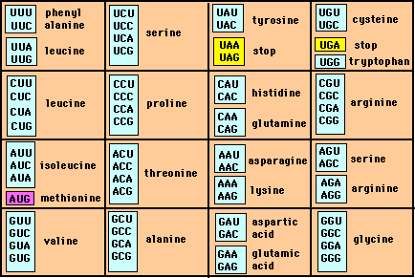
Genetic Code – Note degeneracy of 1st vs 2nd vs 3rd position sites

Slide 15
Genetic Code
Four-fold degenerate site – Any substitution is synonymous
From: mentor.lscf.ucsb.edu/course/spring/eemb102/lecture/Lecture7.ppt

Slide 16
Genetic Code
Two-fold degenerate site – Some substitutions synonymous, some
non-synonymous
From: mentor.lscf.ucsb.edu/course/spring/eemb102/lecture/Lecture7.ppt

Slide 17
Measuring Selection on Genes
Null hypothesis = neutral evolution
Under neutral evolution, synonymous changes should accumulate at a rate equal to mutation rate
Under neutral evolution, amino acid substitutions should also accumulate at a rate equal to the mutation rate

Slide 18
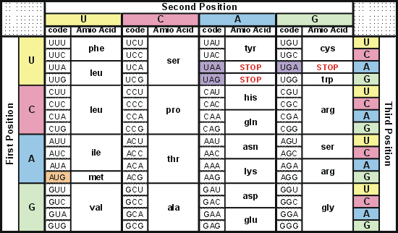
Degeneracy of 1st vs 2nd vs 3rd position sites results in 25.5% synonymous changes and 74.5% non synonymous changes (Yang&Nielsen,1998).
Genetic Code
Notes:
An inspection of the genetic code table suggests most changes at the first position are nonsynonymous, all changes at the second codon position are nonsynonymous and only some changes at the third position are synonymous. As a result we do not expect to see equal proportions of synonymous and nonsynonymous mutations even if there is no selection at protein level. Indeed, if mutations from any one nucleotide to any other occur at the same rate , we expect 25.5% of mutations to be synonymous and 74.5% mutations to be nonsynonymous.

Slide 19
Counting #s/#a
Ser Ser Ser Ser Ser
Species1 TGA TGC TGT TGT TGT
Ser Ser Ser Ser Ala
Species2 TGT TGT TGT TGT GGT
#s = 2 sites
#a = 1 site
#a/#s=0.5
To assess selection pressures one needs to calculate the rates (Ka, Ks), i.e. the occurring substitutions as a fraction of the possible syn. and nonsyn. substitutions.
Things get more complicated, if one wants to take transition transversion ratios and codon bias into account. See
chapter 4 in Nei and Kumar, Molecular Evolution and Phylogenetics.
Modified from: mentor.lscf.ucsb.edu/course/spring/eemb102/lecture/Lecture7.ppt

Slide 20
Testing for selection using dN/dS ratio
dN/dS ratio (aka Ka/Ks or ω (omega) ratio) where
dN = number of non-synonymous substitutions / number of all possible non-synonymous substitutions
dS =number of synonymous substitutions / number of all possible synonymous substitutions
dN/dS >1 positive, Darwinian selection
dN/dS =1 neutral evolution This usually is the null hypothesis!
dN/dS <1 negative, purifying selection
Notes:
The synonymous and non-synonymous rates dN and dS are defined as the numbers of synonymous and nonsynonymous substitutions per site. The ratio of the two rates omega=dN/dS then measures selective pressure at the protein level. If selection level has no effect on fitness, nonsynonymous mutations will be fixed at the same rate as synonymous mutations so that dN=dS and omega=1. If nonsynonymous mutations are deleterious purifying selection will reduce their fixation rate so that dN<dS and omega<1. If nonsynonymous mutations are favored by Darwinian selection, they will be fixed at a higher rate than synonymous mutations resulting in dN>dS and omega>1.

Slide 21
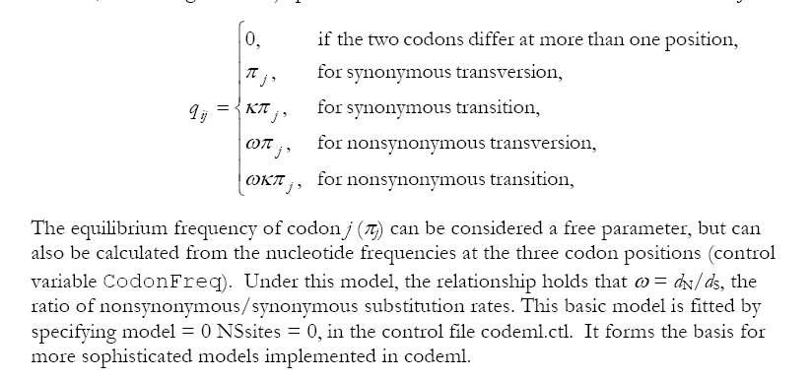
PAML (codeml) the basic model

Slide 22
dambe
Two programs worked well for me to align nucleotide sequences based on the amino acid alignment,
One is DAMBE (only for windows). This is a handy program for a lot of things, including reading a lot of different formats, calculating phylogenies, it even runs codeml (from PAML) for you.
The procedure is not straight forward, but is well described on the help pages. After installing DAMBE go to HELP -> general HELP -> sequences -> align nucleotide sequences based on …->
If you follow the instructions to the letter, it works fine.
DAMBE also calculates Ka and Ks distances from codon based aligned sequences.

Slide 23
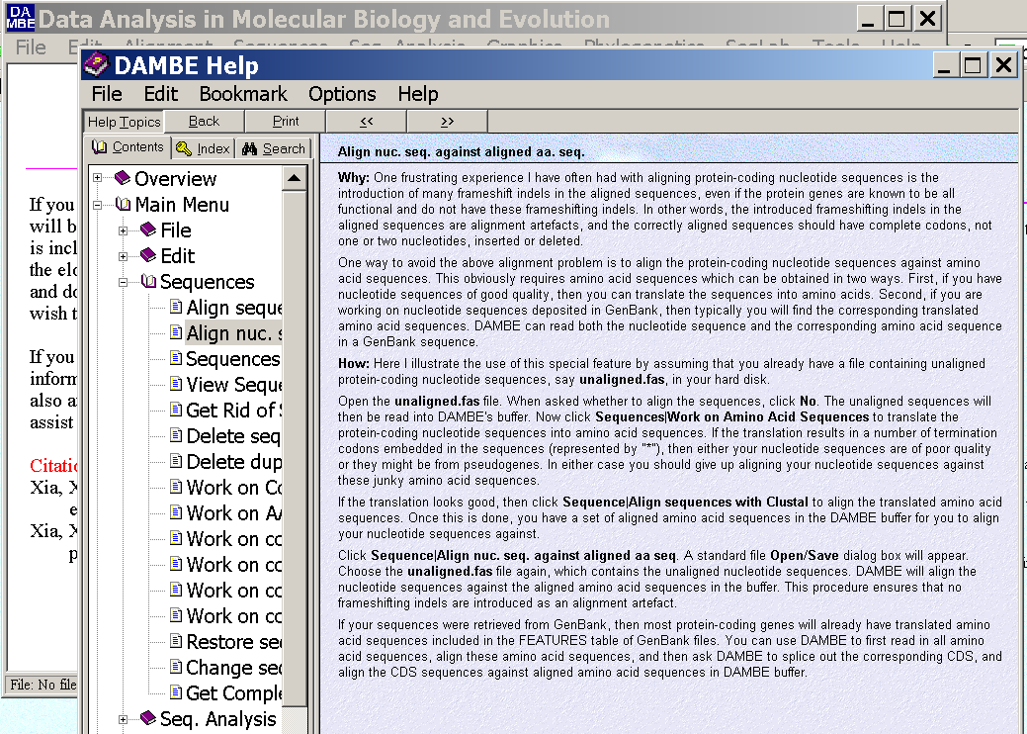
dambe (cont)

Slide 24
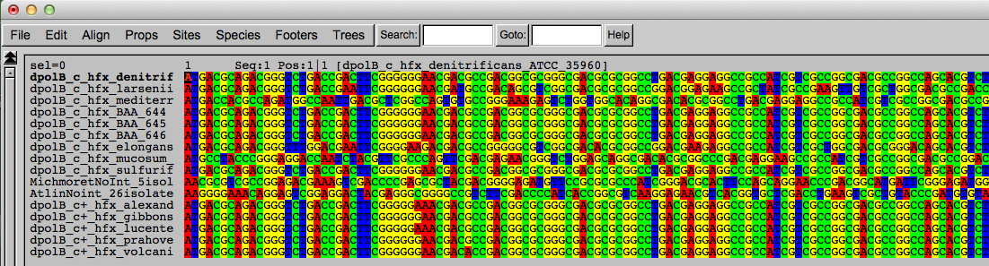
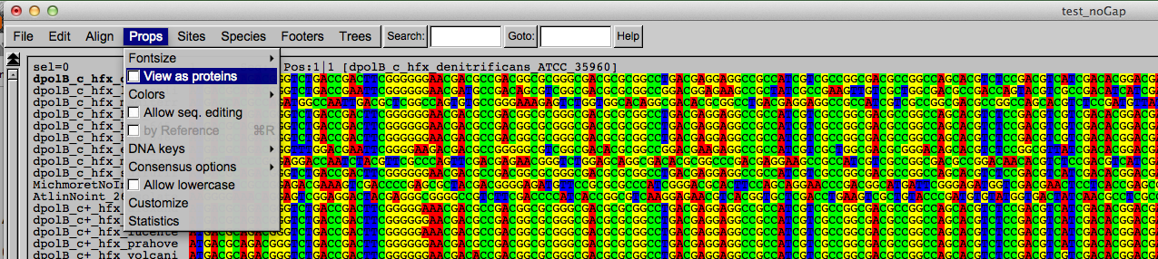
Codon based alignments in Seaview
Load nucleotide sequences (no gaps in sequences, sequence starts with nucleotide corresponding to 1st codon position)
Select view as proteins

Slide 25
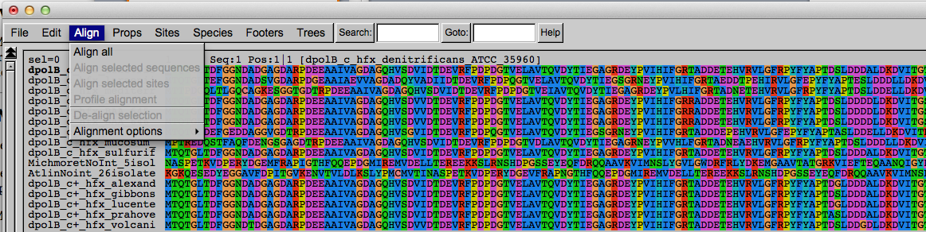
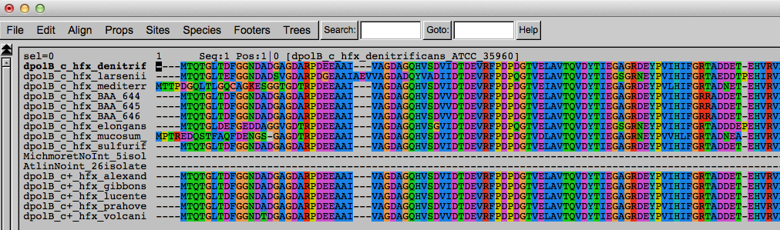
Codon based alignments in Seaview
With the protein sequences displayed, align sequences
Select view as nucleotides

Slide 26
PAML (codeml) the basic model

Slide 27

sites versus branches
You can determine omega for the whole dataset; however, usually not all sites in a sequence are under selection all the time.
PAML (and other programs) allow to either determine omega for each site over the whole tree, ,
or determine omega for each branch for the whole sequence,
.
It would be great to do both, i.e., conclude codon 176 in the vacuolar ATPases was under positive selection during the evolution of modern humans – alas, a single site often does not provide much statistics. PAML does provide a branch site model.

Slide 28
Sites model(s)
have been shown to work great in few instances.
The most celebrated case is the influenza virus HA gene.
A talk by Walter Fitch (slides and sound) on the evolution of
this molecule is here .
This article by Yang et al, 2000 gives more background on ml aproaches to measure omega.
The dataset used by Yang et al is here: flu_data.paup .

Slide 29
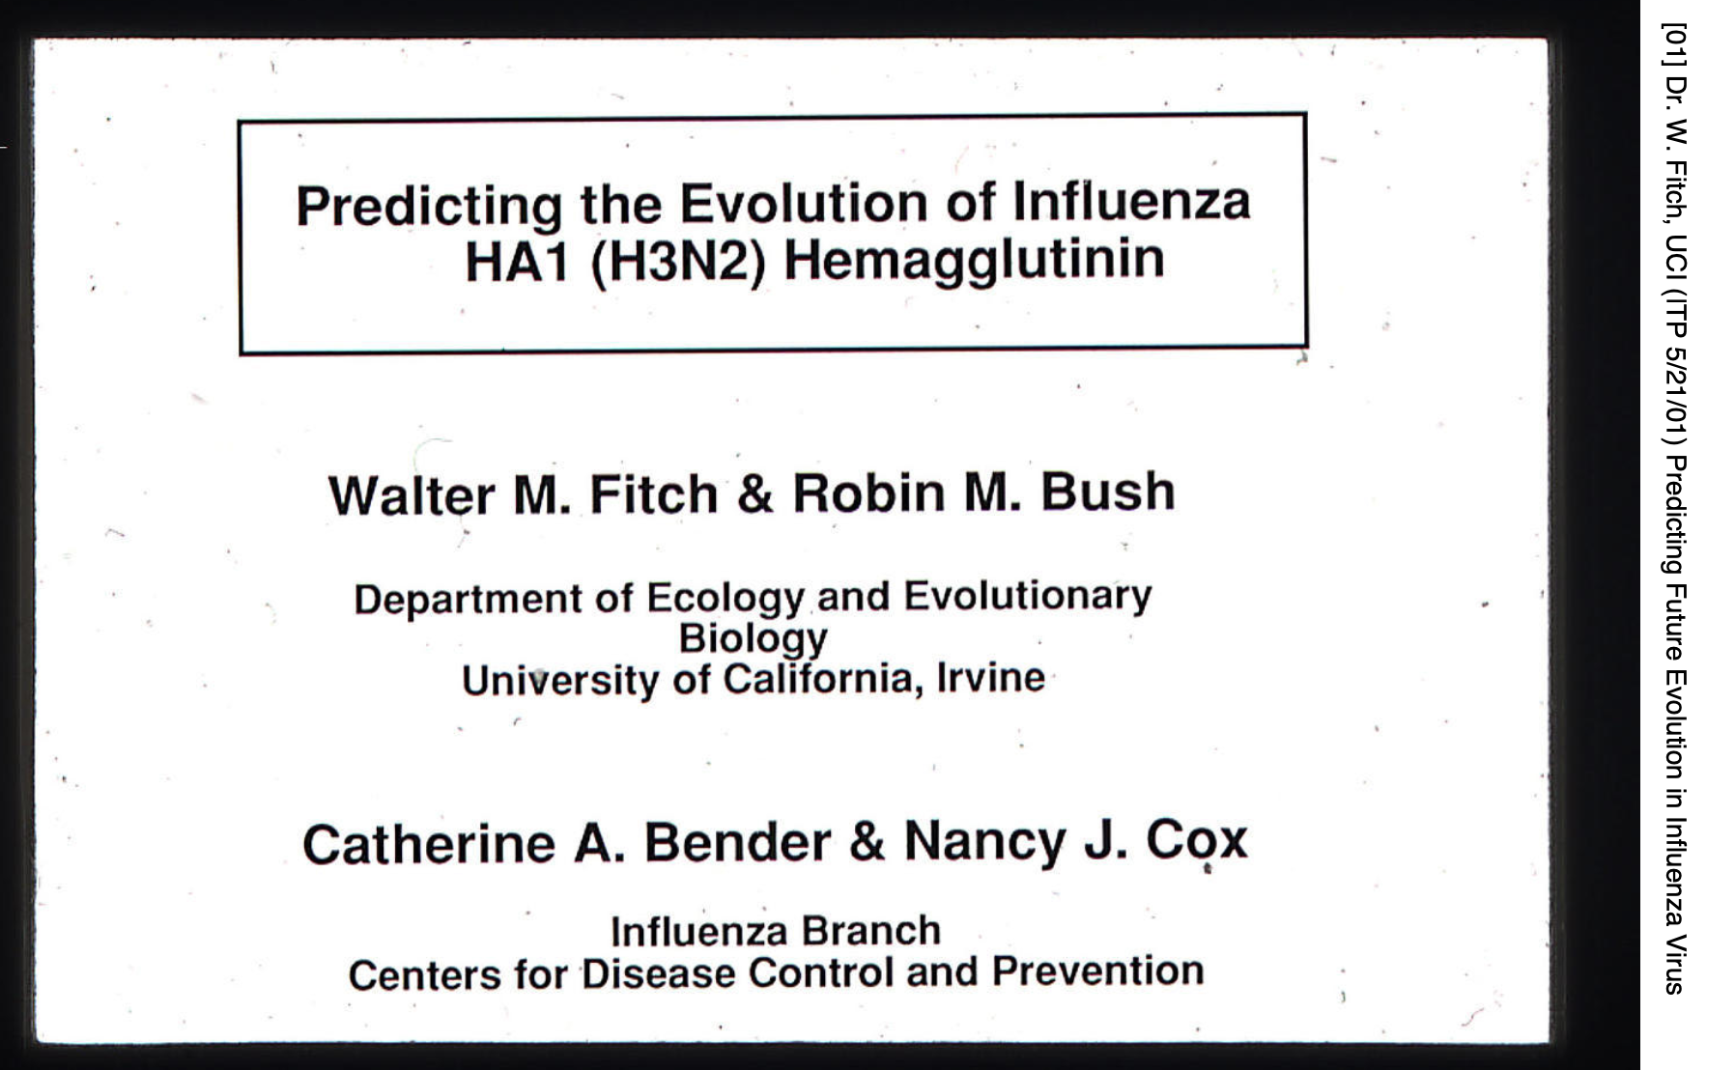
Slides from Walter Fitch’s talk

Slide 30
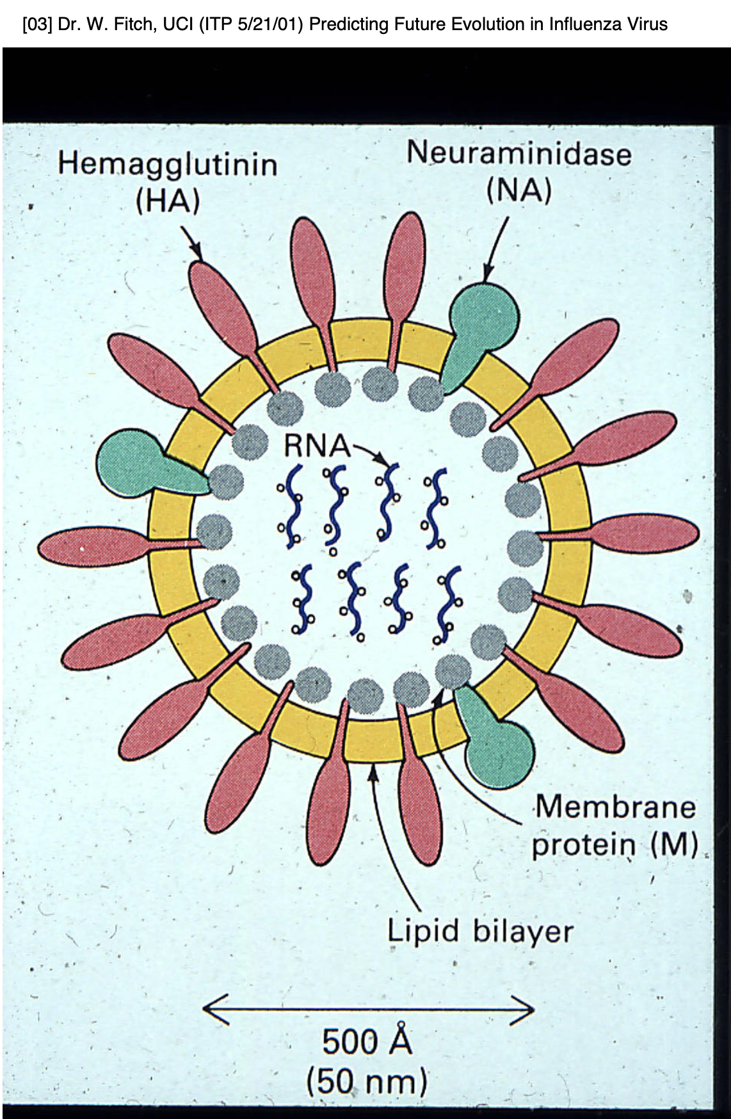
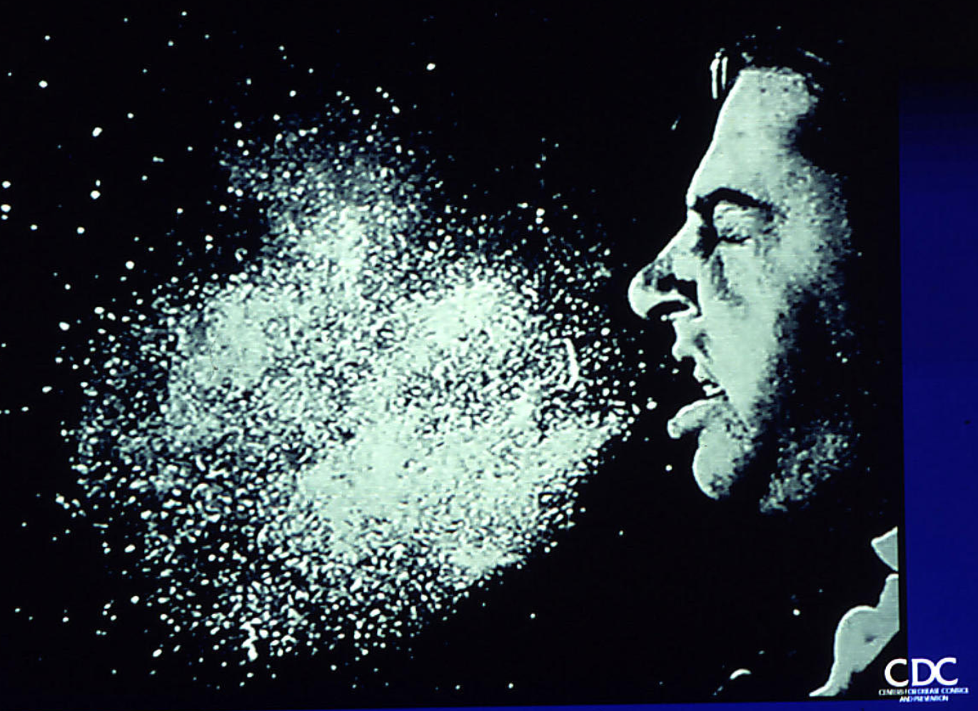

Slide 31
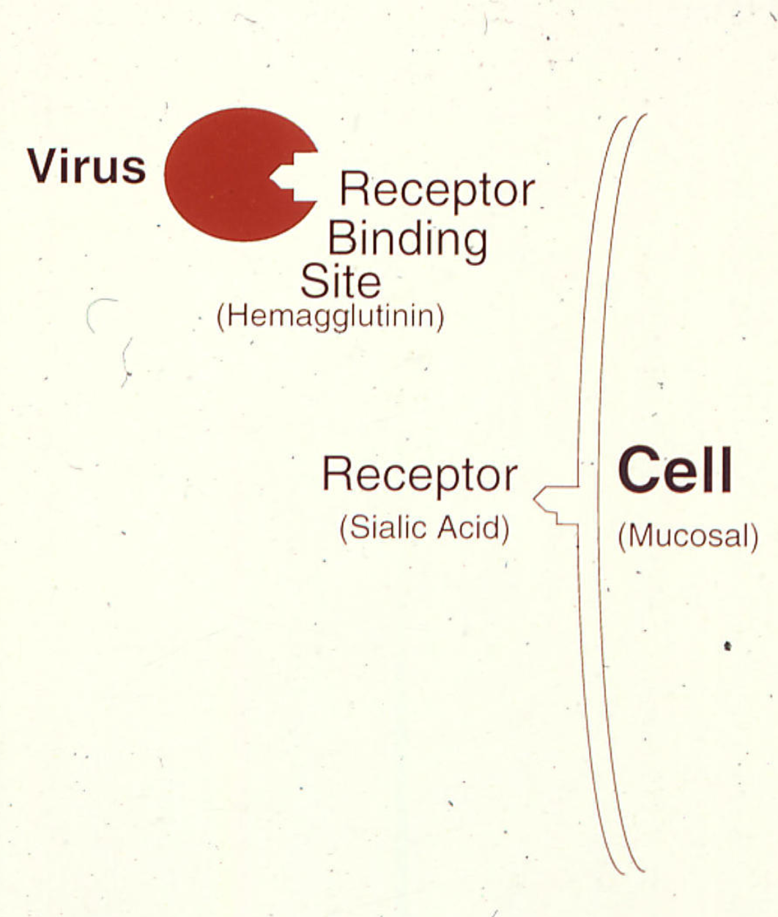
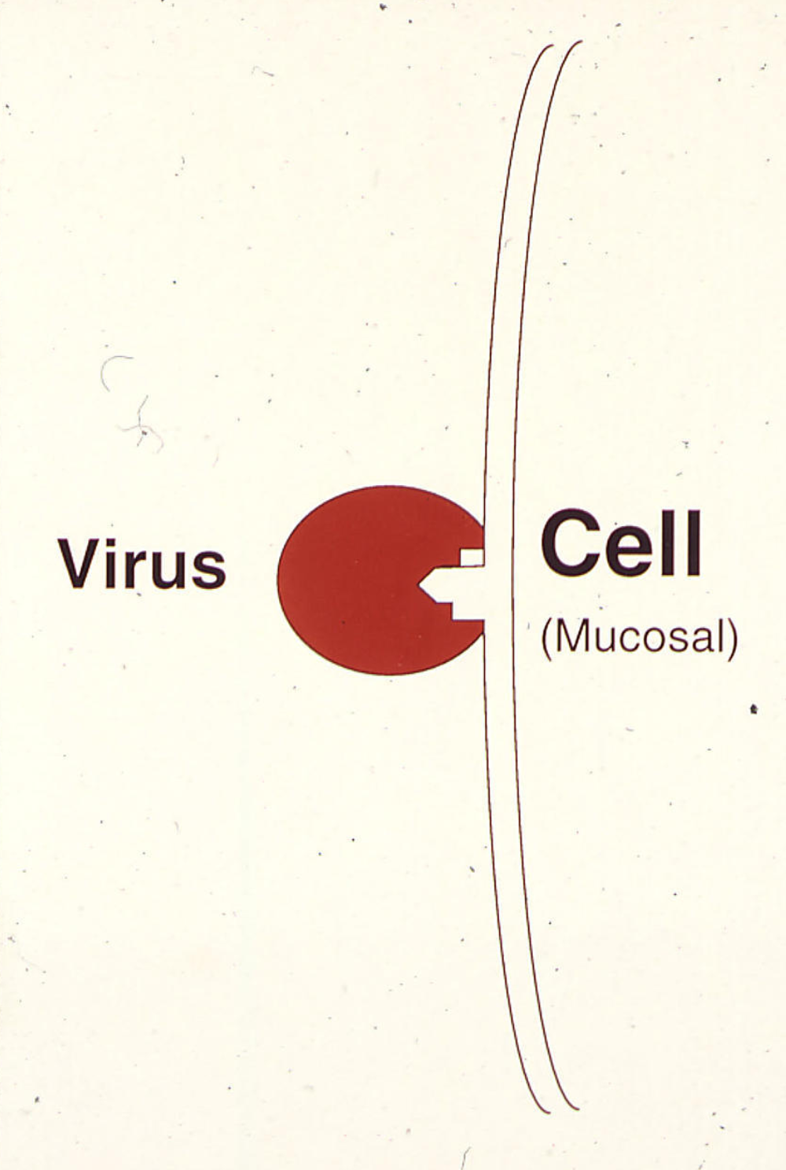

Slide 33
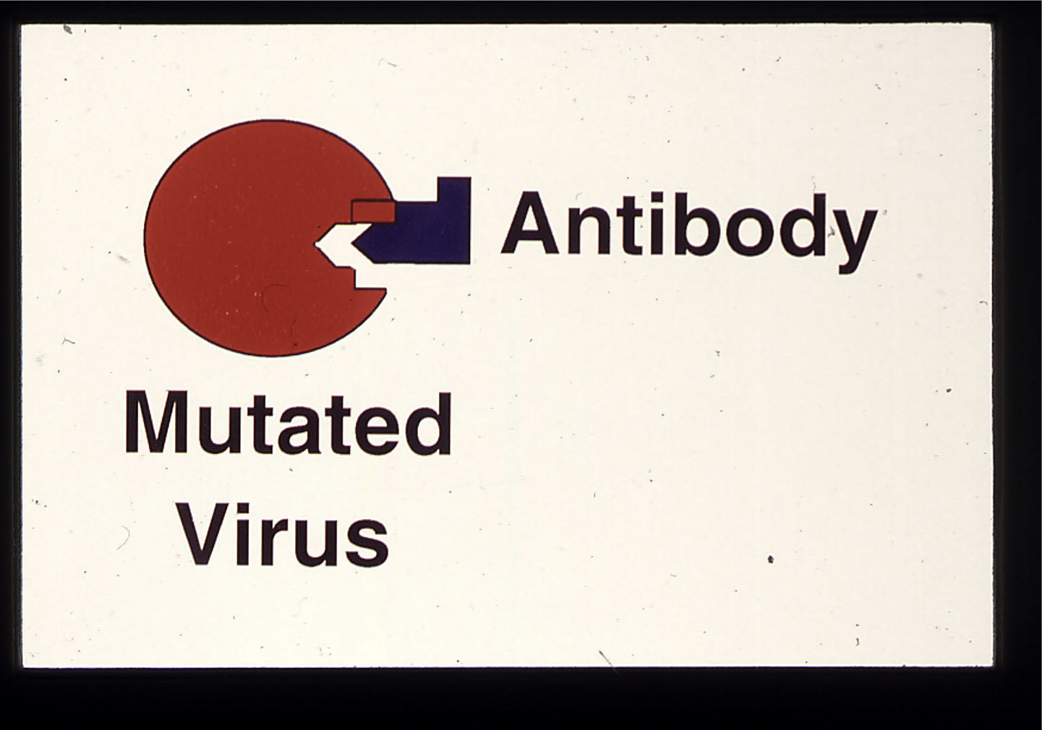

Slide 34
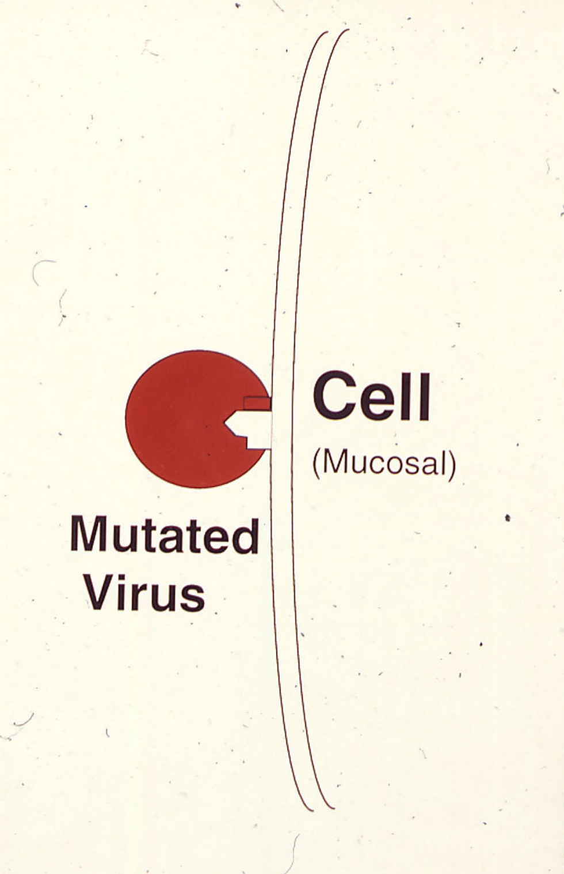
Positive or
Darwinian or
diversifying selection
of the mutated virus

Slide 35
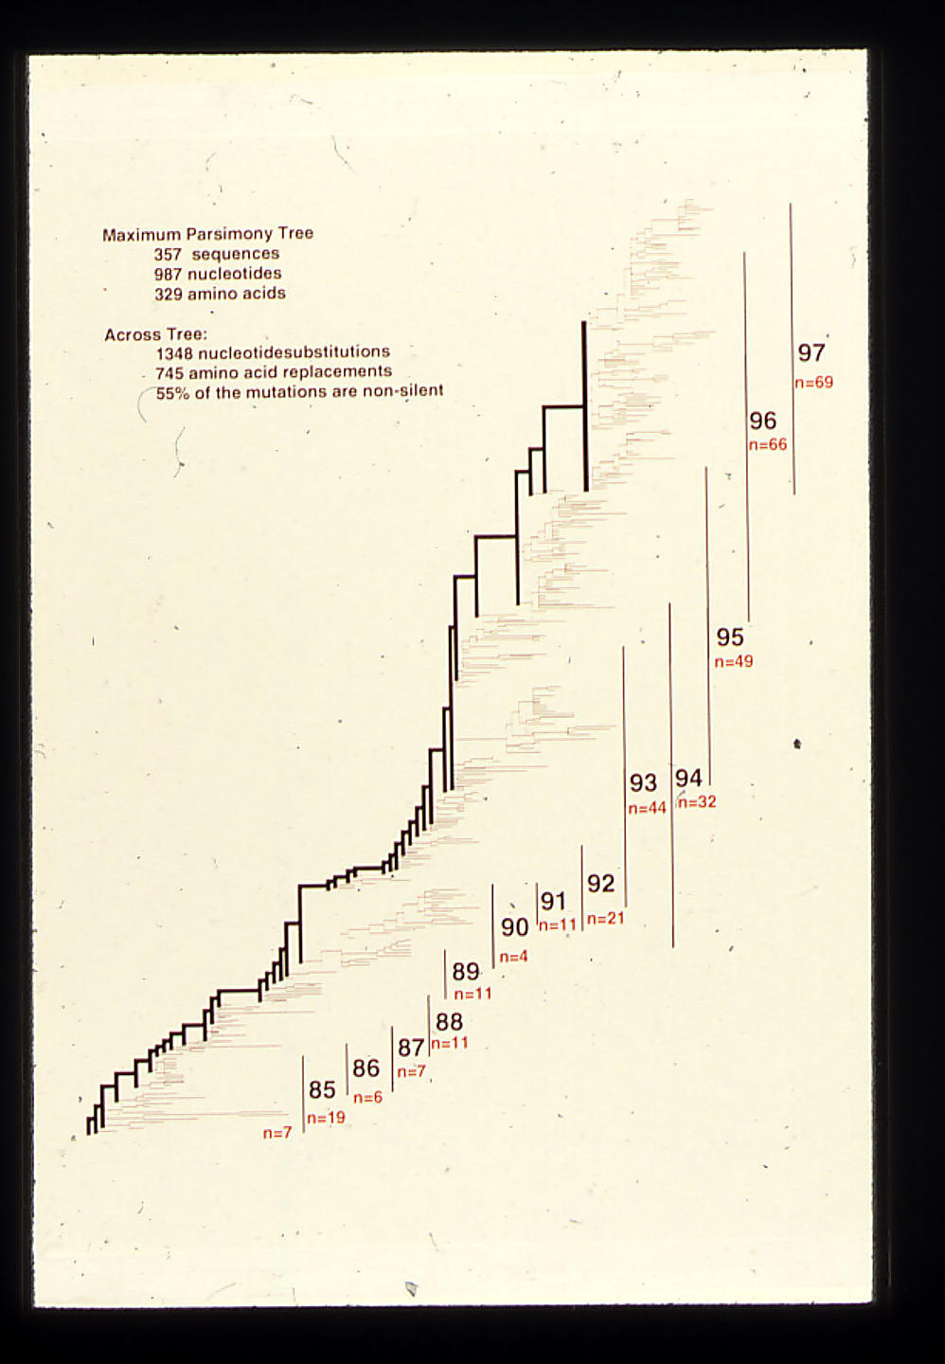
Parsimony phylogeny of influenza HA gene

Slide 36
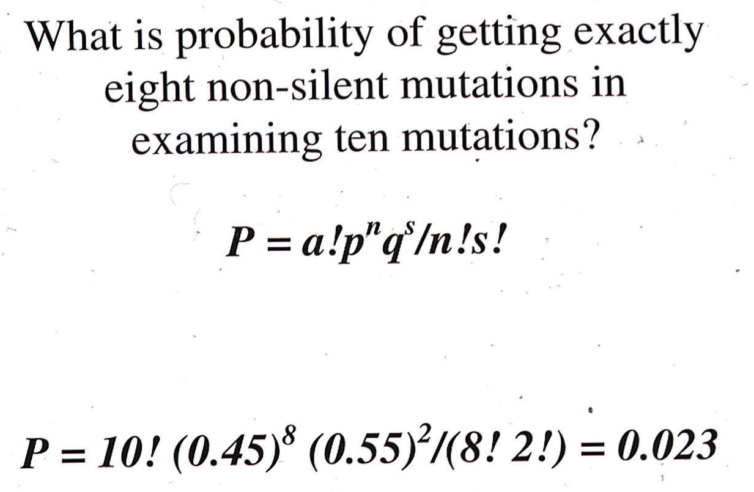
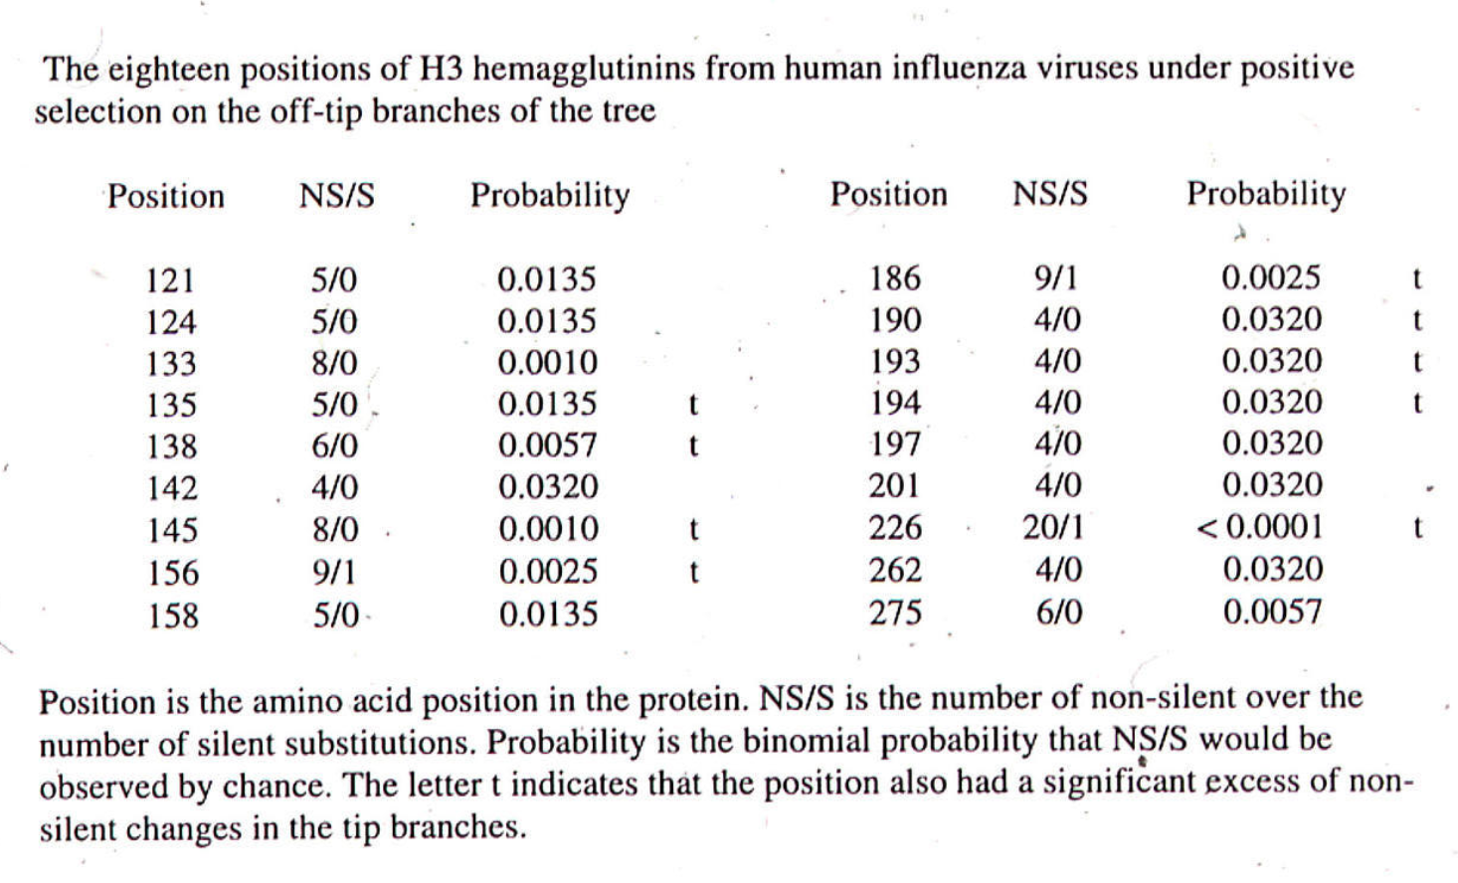

Slide 37
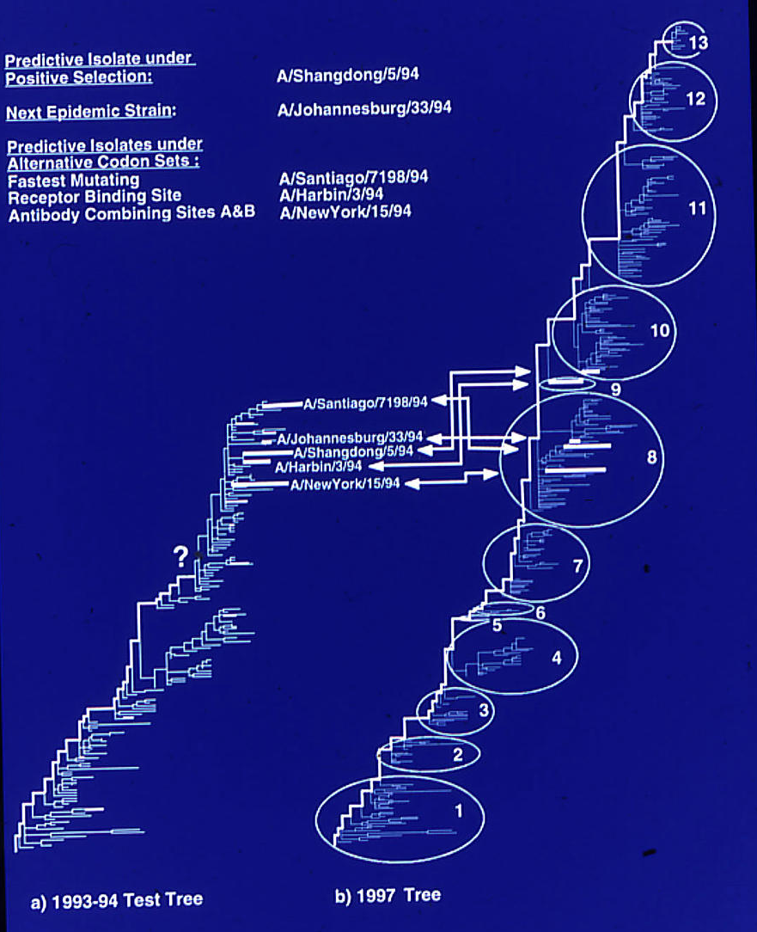

Slide 38
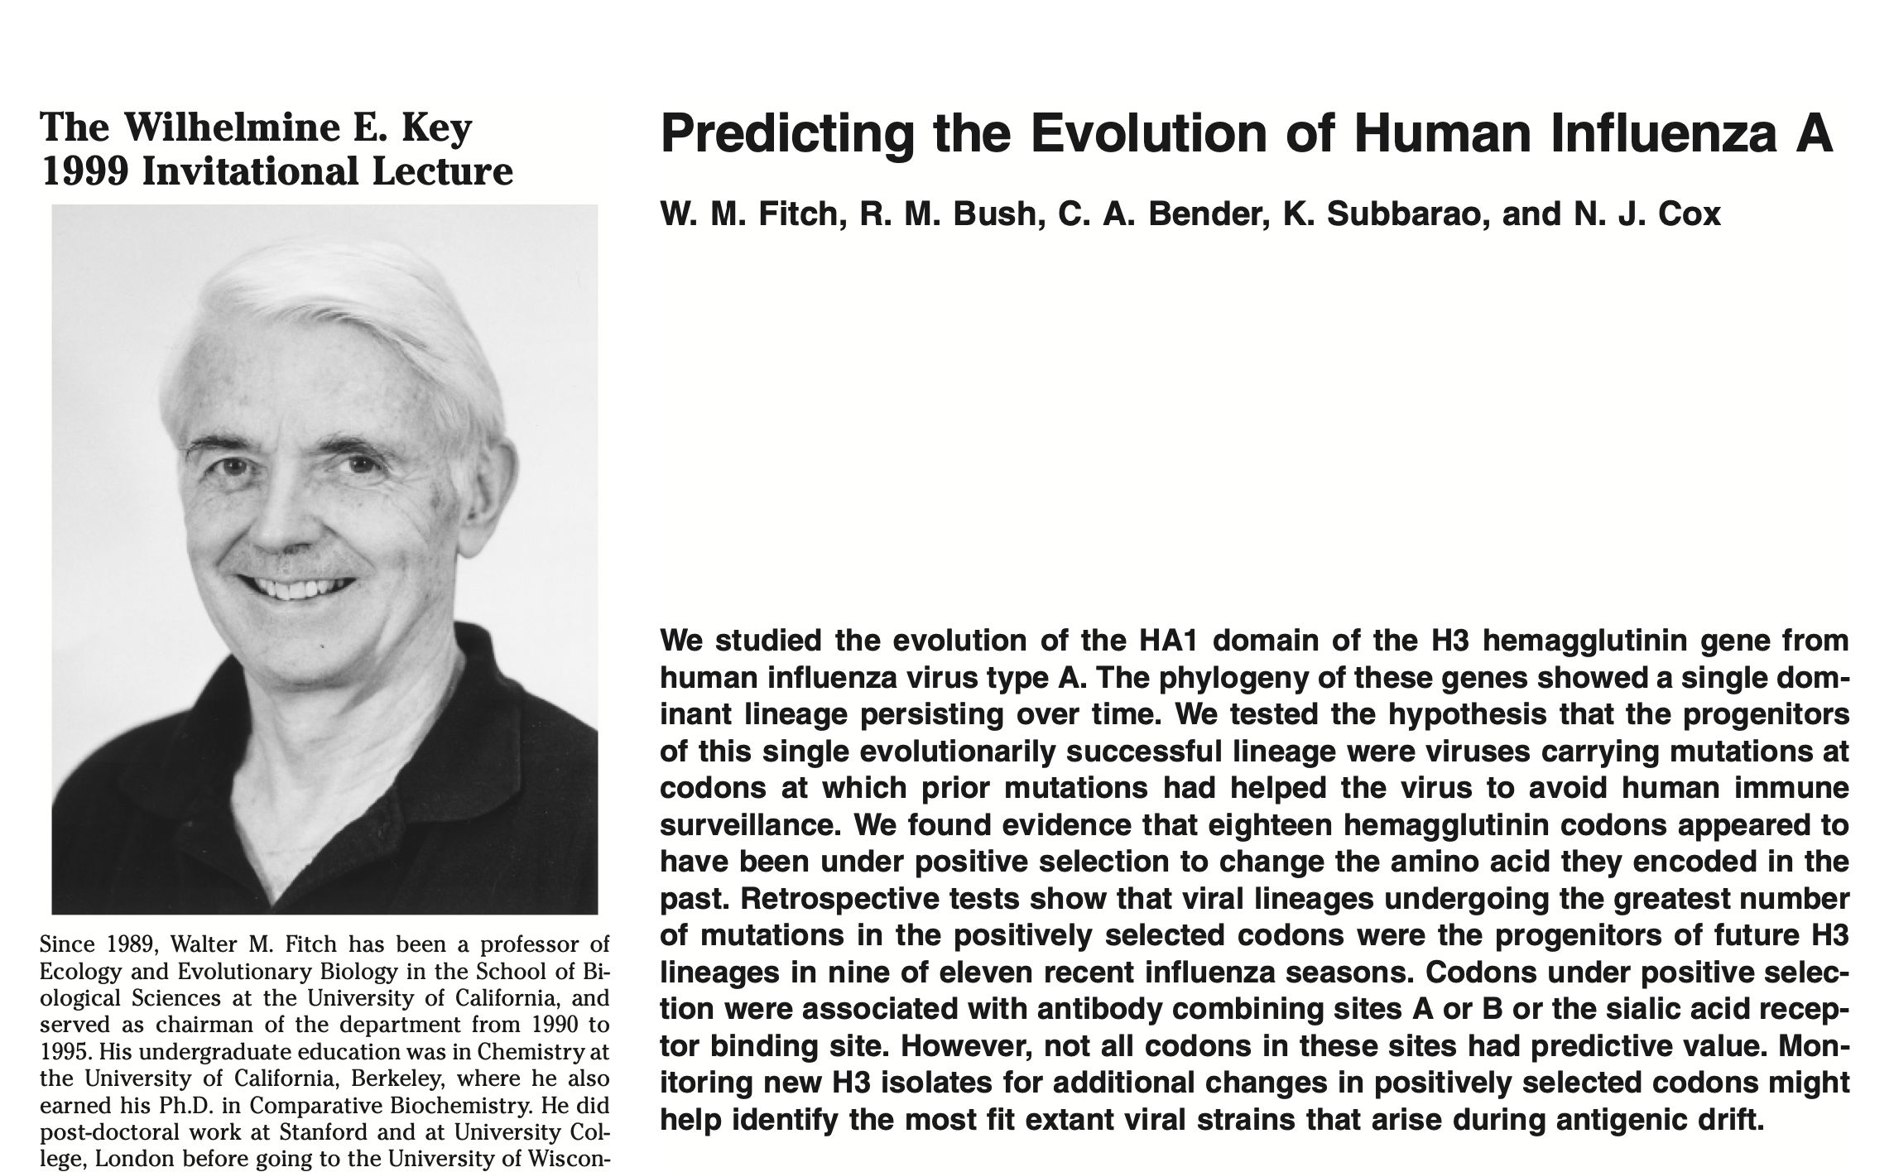
More here:

Slide 39
sites model in MrBayes
The MrBayes block in a nexus file might look something like this:
begin mrbayes;
set autoclose=yes;
lset nst=2 rates=gamma nucmodel=codon omegavar=Ny98;
mcmcp samplefreq=500 printfreq=500;
mcmc ngen=500000;
sump burnin=500;
sumt burnin=500;
end;
This article by Yang et al, 2000 gives more background on ml aproaches to measure omega.
The dataset used by Yang et al is here: flu_data.paup .

Slide 40
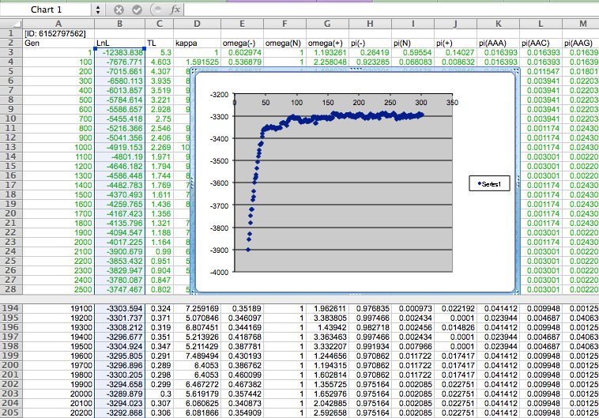

Slide 41
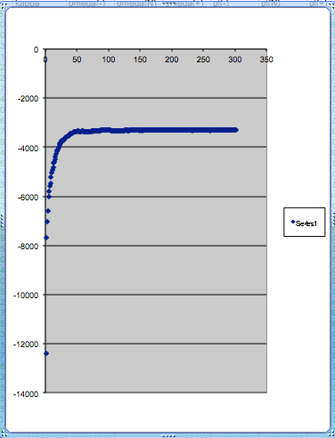
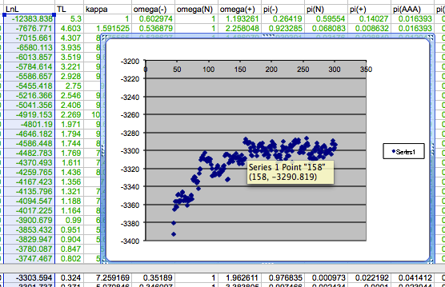
plot LogL to determine which samples to ignore
the same after rescaling the y-axis

Slide 42
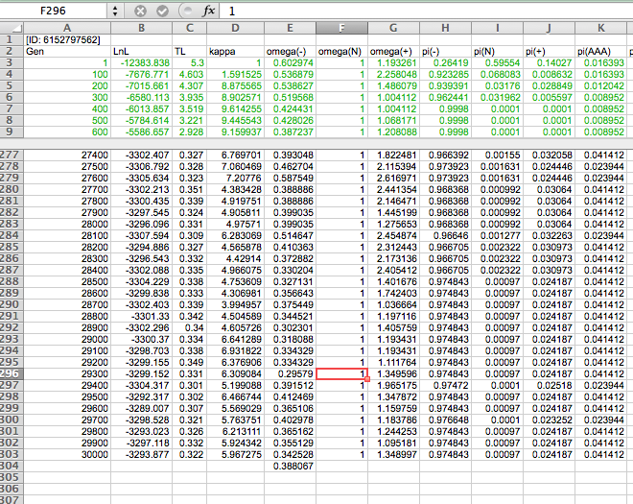

Slide 43
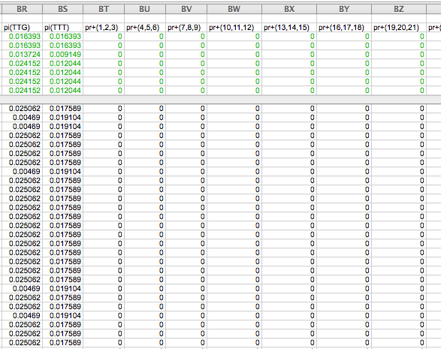

Slide 44
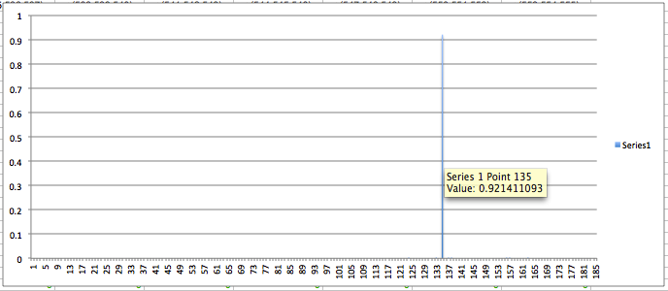
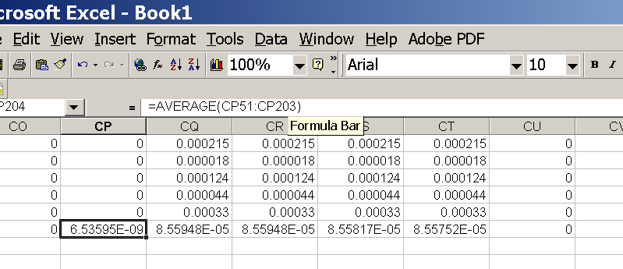
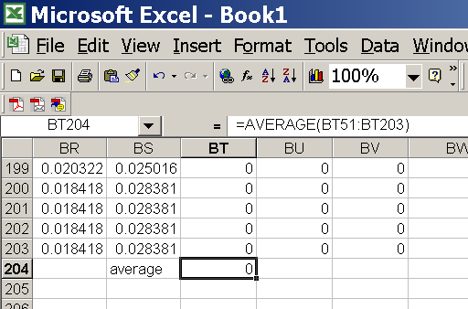
for each codon calculate the the average probability
copy paste formula
plot row
enter formula

Slide 45
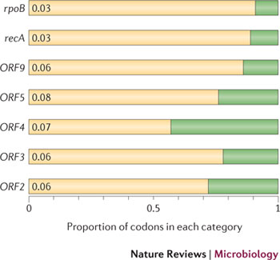
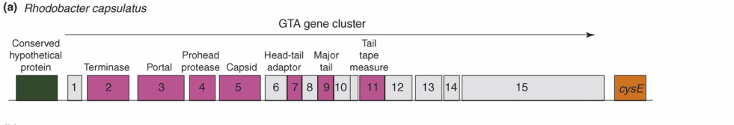
Purifying selection in GTA genes
dN/dS <1 for GTA genes has been used to infer selection for function
GTA genes
Lang AS, Zhaxybayeva O, Beatty JT. Nat Rev Microbiol. 2012 Jun 11;10(7):472-82
Lang, A.S. & Beatty, J.T. Trends in Microbiology , Vol.15, No.2 , 2006
Notes:
The ratio of non-synonymous-to-synonymous (dN/dS, or ω) codon substitution rates can be used as an indication of the selective pressure acting on a protein-coding gene. If a gene (or gene segment) is under purifying selection, non-synonymous mutations (that is, mutations resulting in a change of the encoded amino acid) will be selected against, resulting in ω < 1. In neutrally evolving proteins, synonymous and non-synonymous mutations will be fixed at approximately the same rate, resulting in ω = 1. Because different regions of a protein-coding gene may be under different selective constraints, codons can be divided into two categories: those with ω < 1 (yellow; the estimated ω is indicated on the bar) and those with ω fixed to 1 (green); the estimated proportion of codons in each category is given on the horizontal axis.

Slide 46
Other ways to detect positive selection
Selective sweeps -> fewer alleles present in population (lower heterogeneity between alleles)
-> neighboring genes sweeped along (linkage disequilibrium)
(see below for possible contributions from archaic Humans for example)
Repeated episodes of positive selection -> high dN
(works well for repeated positive – aka diversifying – selection; e.g. virus interaction with the immune system)
A COMMON PROBLEM IS DUE TO UNRELIABLY ALIGNED SEQUENCES, which result in high dN.
Genes that are decaying, or that are pseudogenes already, have a dN/dS close to 1. Adding questionable alignments to this, one can easily arrive at dN/dS > 1.

Slide 47
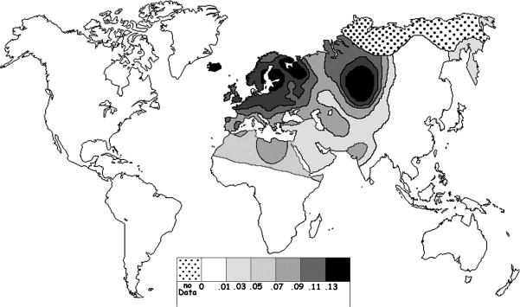
Fig. 1 Current world-wide frequency distribution of CCR5-Δ32 allele frequencies. Only the frequencies of Native populations have been evidenced in Americas, Asia, Africa and Oceania. Map redrawn and modified principally from <ce:cross-ref refid="bib5"> B...
Eric Faure , Manuela Royer-Carenzi
Is the European spatial distribution of the HIV-1-resistant CCR5-Δ32 allele formed by a breakdown of the pathocenosis due to the historical Roman expansion?
Infection, Genetics and Evolution, Volume 8, Issue 6, 2008, 864 - 874
http://dx.doi.org/10.1016/j.meegid.2008.08.007

Slide 48
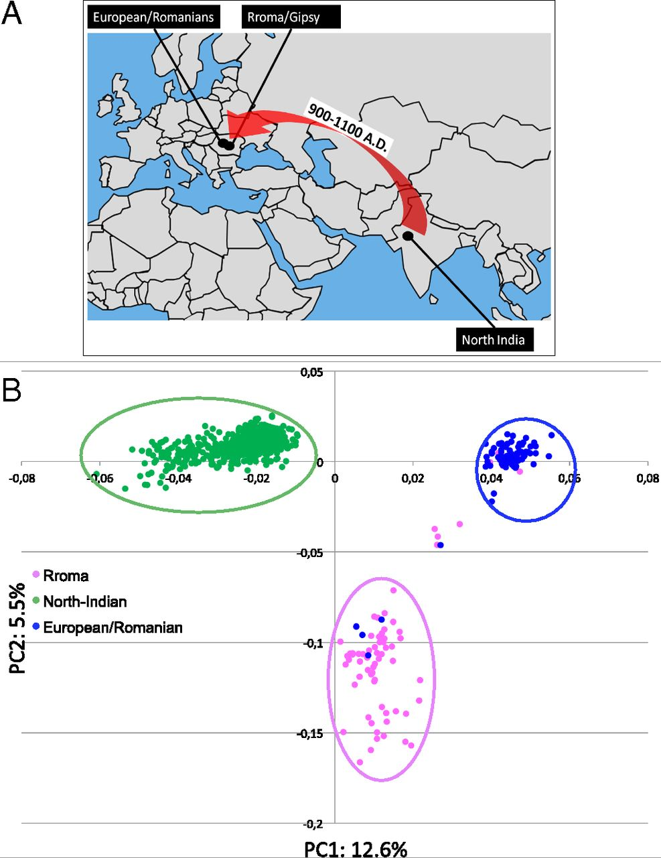
Geographic origin of the three populations studied.
196,524 SNPs
-> PCA
Hafid Laayouni et al. PNAS 2014;111:2668-2673
©2014 by National Academy of Sciences
Notes:
Geographic origin of the three populations studied. (A) European/Romanians and Rroma/Gipsy share the same location, even if the origin of the latter is in North India. (B) Plot of the populations under analysis according to the coordinates to the two main eigenvectors of smartpca (Eigensoft) analysis, in which each dot represents an individual. Individuals within the circles and the same color have been considered for the study; those of different colors represent false population allocation and those intermediate represent admixed individuals. ROM, nongypsy Romanians; INDI, individuals from North India; GYP, Rroma/Gypsies living in Romania.

Slide 49
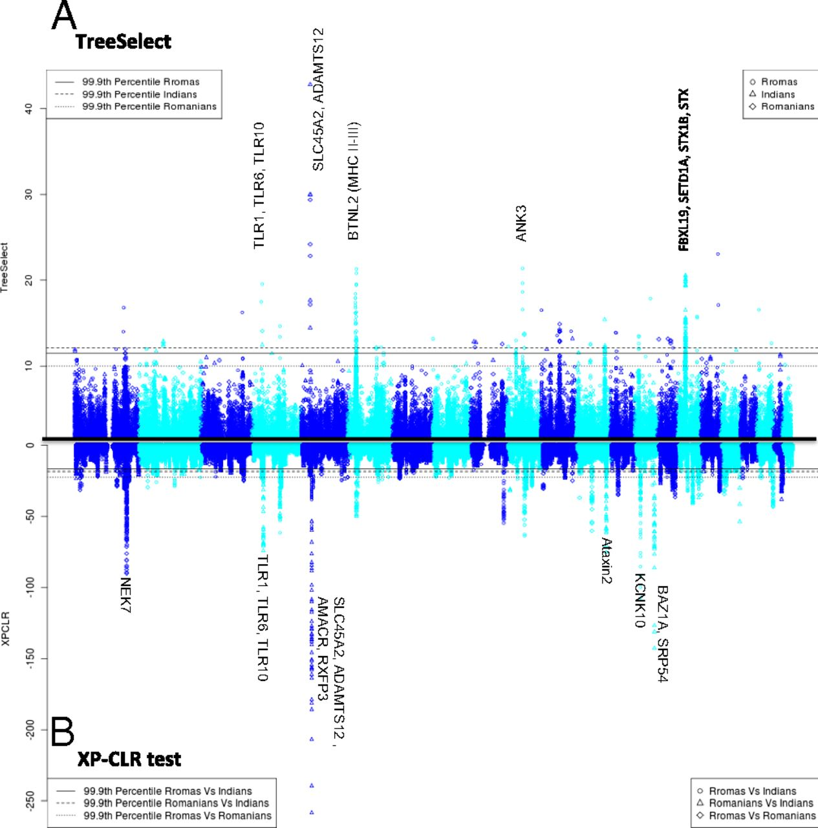
Manhattan plot of results of selection tests in Rroma, Romanians, and Indians using TreeSelect statistic (A) and XP-CLR statistic (B).
SNP frequencies within and between populations
selective sweeps detected through linkage disequilibrium
Laayouni H et al. PNAS 2014;111:2668-2673
Convergent evolution in European and Rroma populations reveals pressure exerted by plague on Toll-like receptors.
©2014 by National Academy of Sciences
Notes:
Manhattan plot of results of selection tests in Rroma, Romanians, and Indians using TreeSelect statistic (A) and XP-CLR statistic (B). Chromosomes ordered from chromosome 1 to chromosome 22.

Slide 50
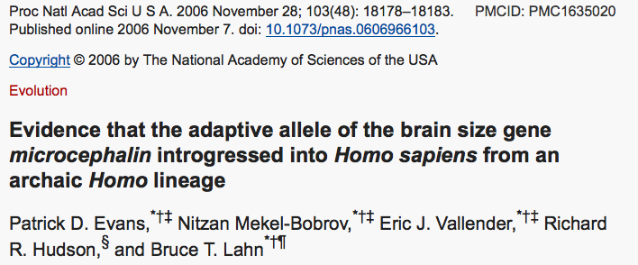
Genes involved in brain development (mutations lead to microencephaly).
Divergent version (alleles) of the wildtype allele exist, with rather uneven frequencies in different human populations.

Slide 51
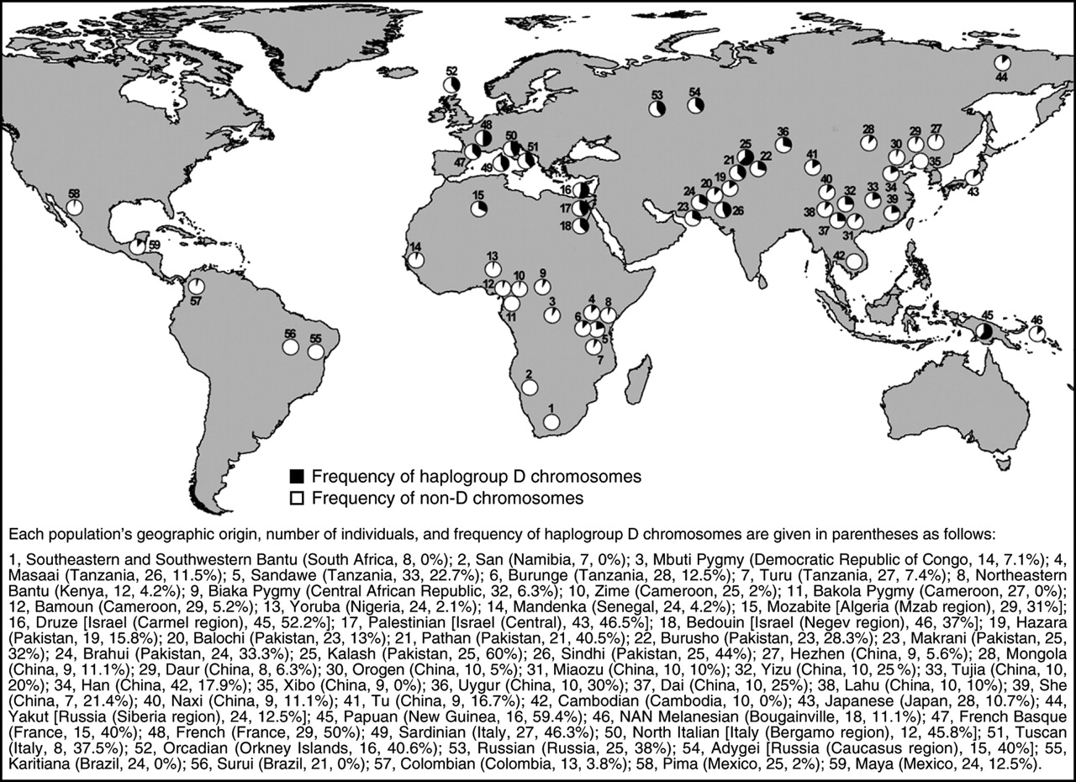
https://science.sciencemag.org/content/309/5741/1720.long
Variant arose about
5800 years ago

Slide 52
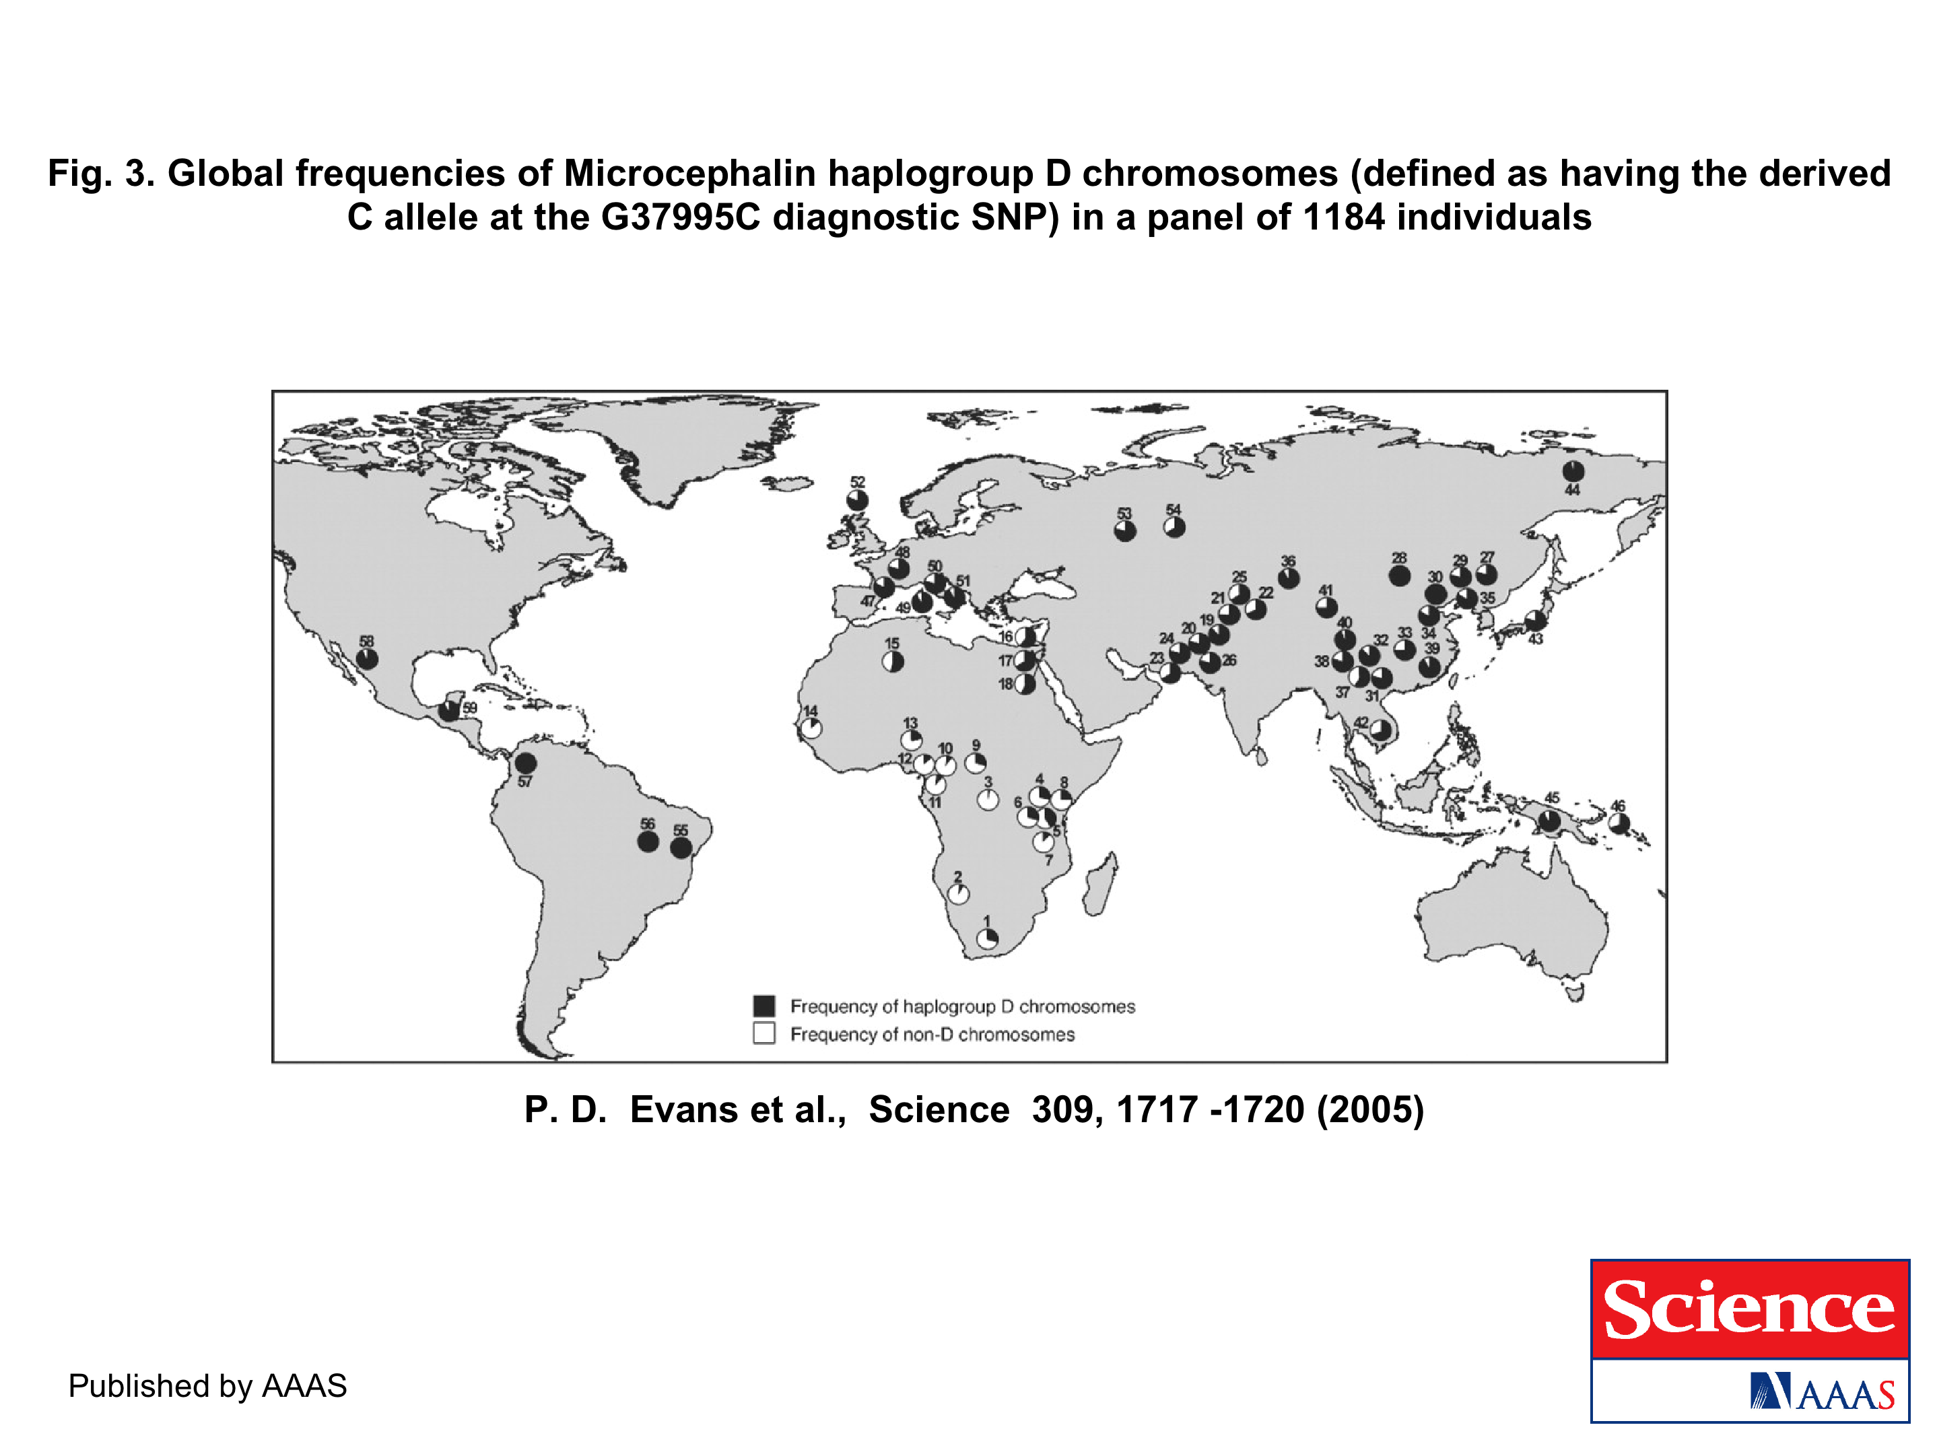
https://science.sciencemag.org/content/309/5741/1717.long
The age of haplogroup D was found to be ~37,000 years

Slide 53
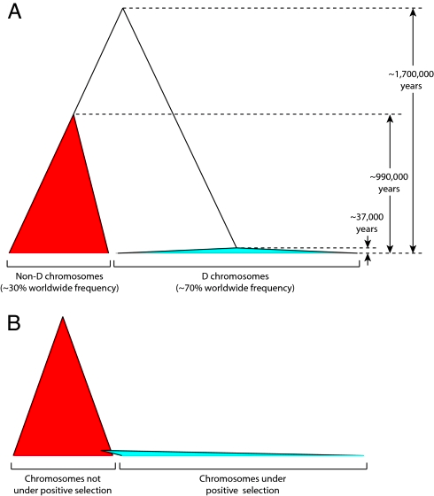

Slide 54
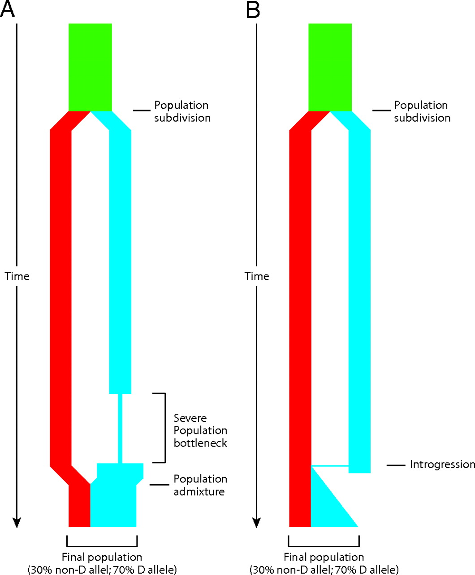

Schematic depiction of two demographic scenarios compatible with the observed genealogy of the microcephalin locus.
Patrick D. Evans et al. PNAS 2006;103:48:18178-18183
©2006 by National Academy of Sciences
Notes:
Schematic depiction of two demographic scenarios compatible with the observed genealogy of the microcephalin locus. In both scenarios, an ancestral population, depicted in green, was subdivided into two reproductively isolated populations. One population, depicted in red, fixes the non-D allele, whereas the other population, depicted in blue, fixes the D allele. (A) In the first scenario, the blue population went through a severe bottleneck that dramatically reduced genetic diversity. It then expanded and merged with the other population. (B) In the second scenario, a rare interbreeding event occurred between the two populations, bringing a copy of the D allele from the blue into the red population. This copy subsequently amplified to high frequency under positive selective pressure. The first scenario depends on demography only and does not require selection. This scenario should therefore affect all sites in the genome. The second scenario requires the action of positive selection on the introgressed allele and is therefore not expected to have a genome-wide effect. The observation that the genealogy of microcephalin is not representative of the genome is consistent with the second scenario.

Slide 55
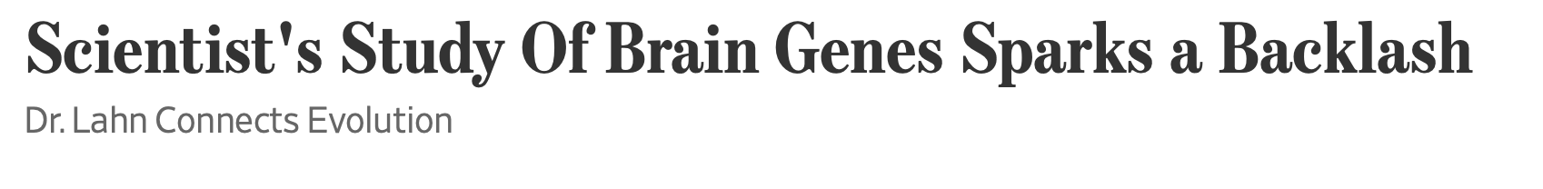
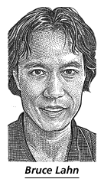
From the WSJ
... told his audience was that genetic changes over the past several thousand years might be linked to brain size and intelligence. He flashed maps that showed the changes had taken hold and spread widely in Europe, Asia and the Americas, but weren't common in sub-Saharan Africa.
Web sites and magazines promoting white "racialism" quickly seized on Dr. Lahn's suggestive scientific snapshot.
The university's patent office is also having second thoughts. Its director, Alan Thomas, says his office is dropping a patent application filed last year that would cover using Dr. Lahn's work as a DNA-based intelligence test. "We really don't want to end up on the front page...for doing eugenics," Mr. Thomas says.
More recently, Dr. Lahn says he was moved when a student asked him whether some knowledge might not be worth having. It is a notion to which he has been warming.
https://www.wsj.com/articles/SB115040765329081636

Slide 56
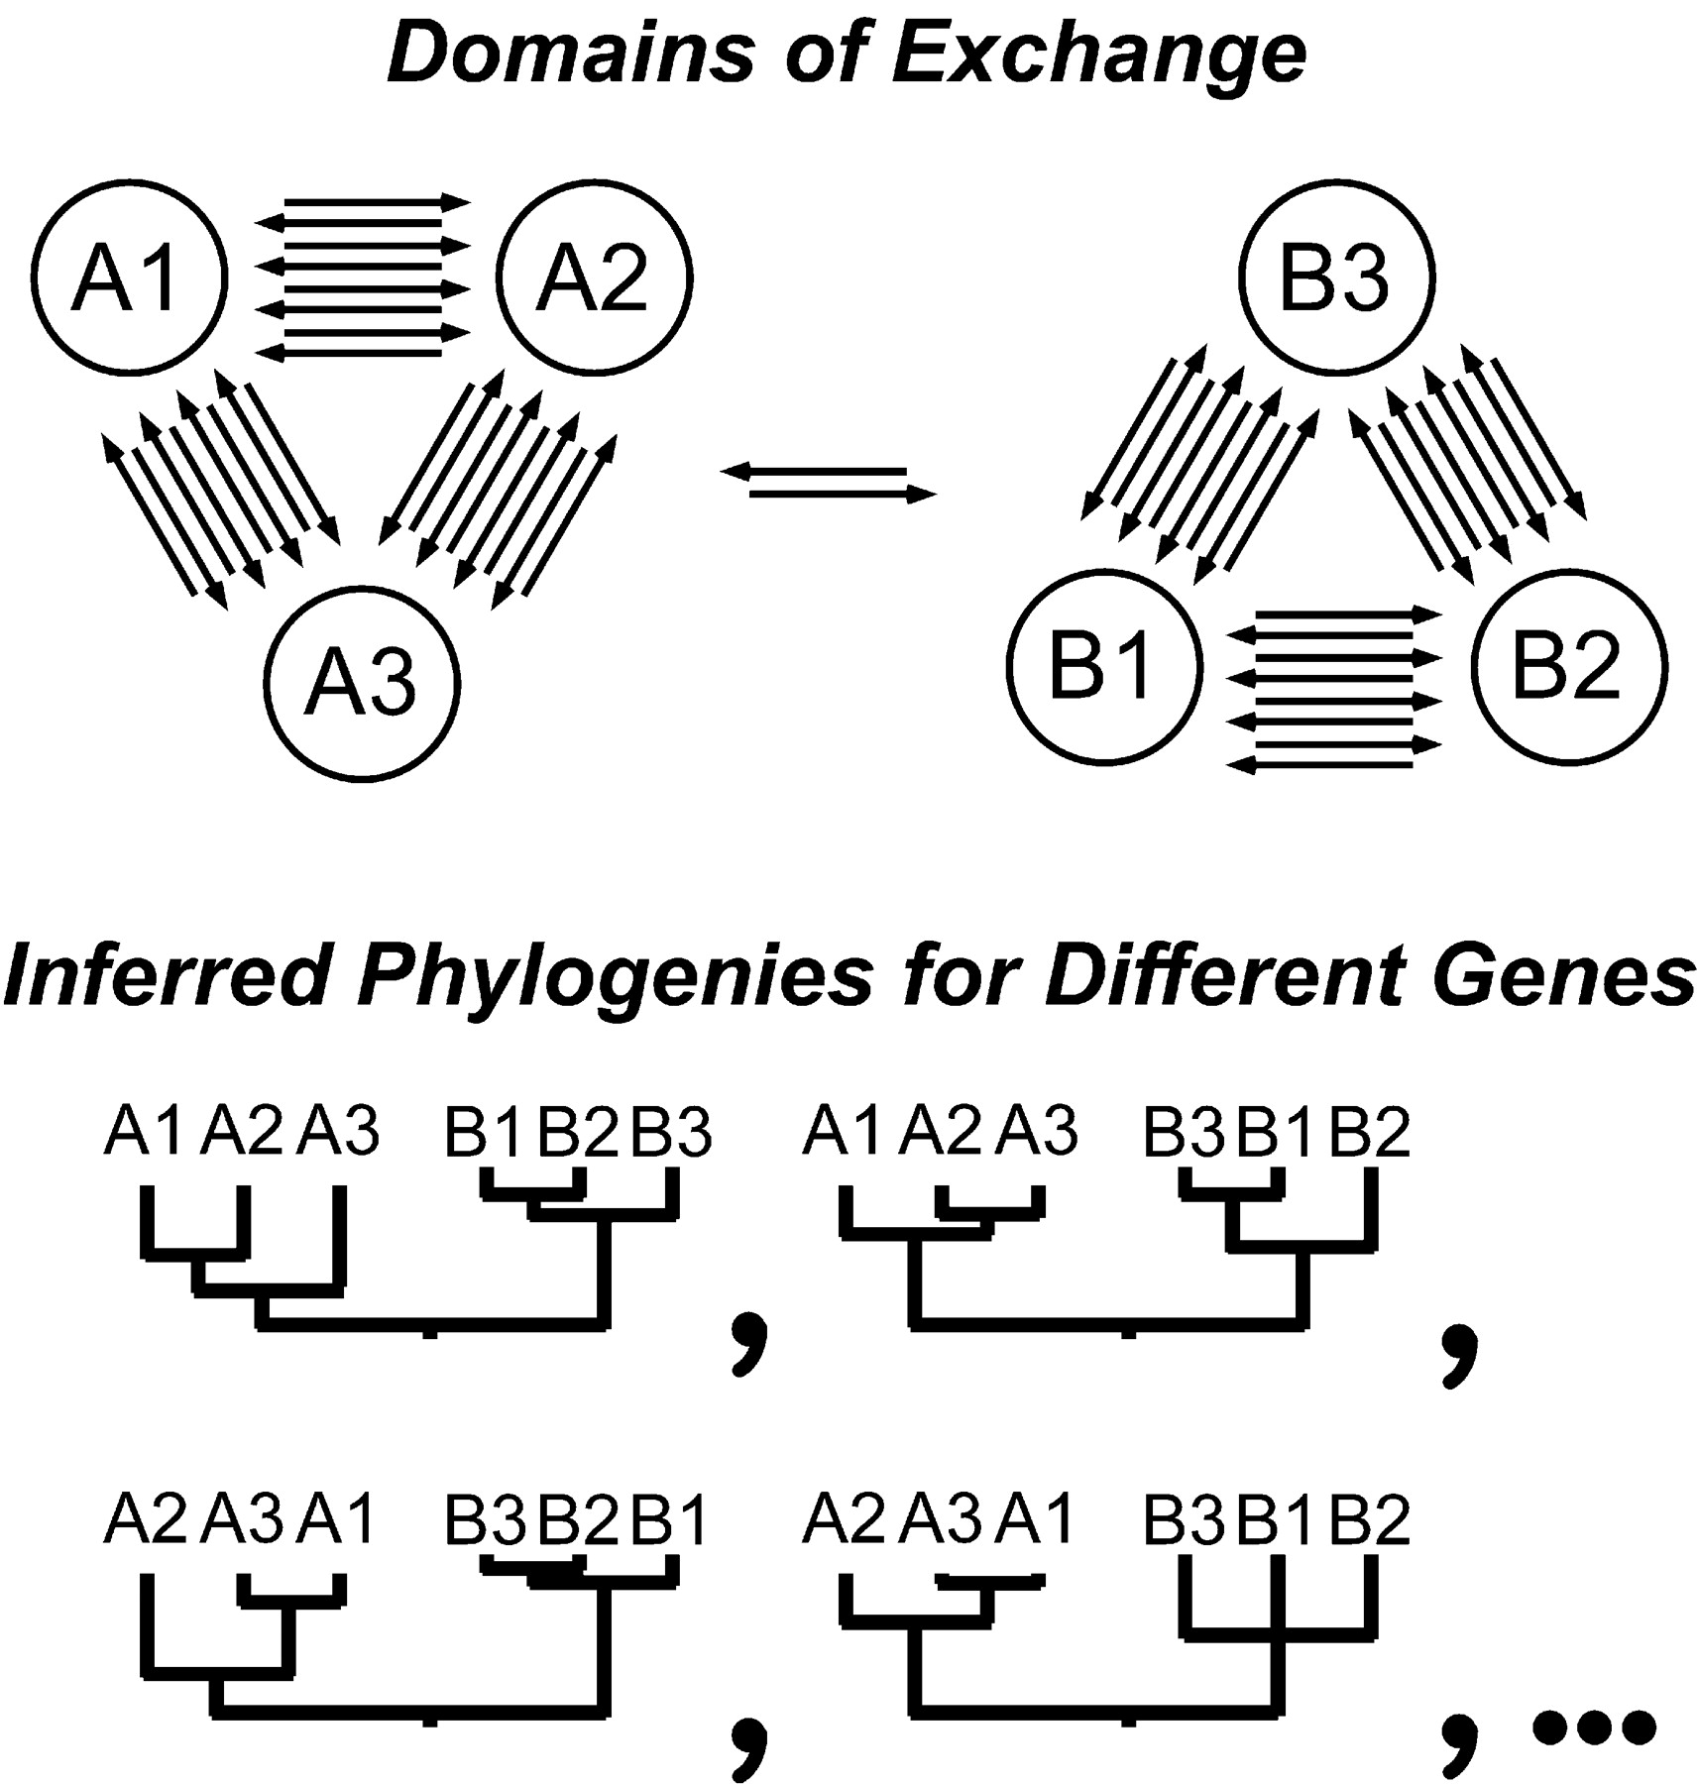

HGT can generate reproducible patterns in molecular phylogenies.
Gogarten, J.P., Doolittle, W.F., Lawrence, J.G., Mol. Biol. Evol. 2002 19:2226-2238.

Slide 57
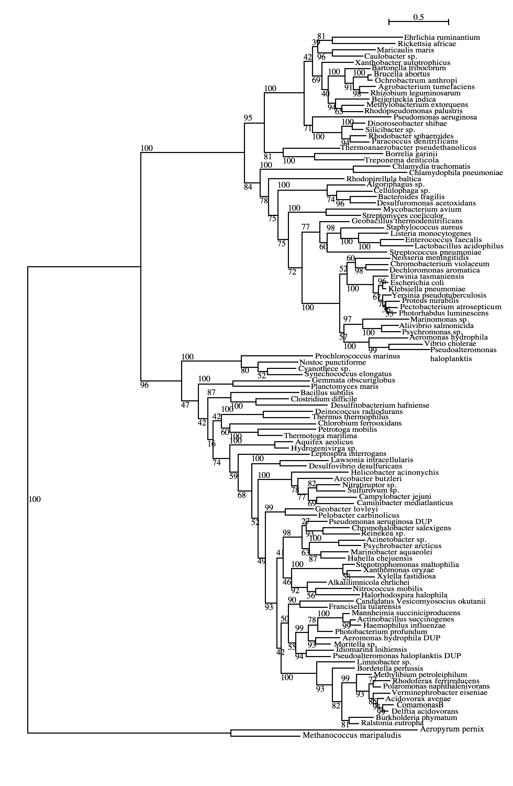
Tyrosyl-tRNA synthetase
Planctomycetes
Firmicutes
Spirochetes
δ-Proteobacteria
γ-Proteobacteria
β-Proteobacteria
Andam, Williams, Gogarten 2010 PNAS
Notes:
There are 3 species (same strain) here that have duplicates found in both subtrees – Pseudomonas aeruginosa PA01, Aeromonas hydrophila ATCC7966 and Pseudoalteromonas haloplanktis TAC125. All three are from complete genome sequences and I checked the papers that published the description of each genome. For Pseudomonas PA01 genome, the authors stated that its large genome size (6.3M bp) was a result of gene duplication, with 50% more paralogous groups than predicted (Stover et al. 2000). However, they didn’t say anything about which genes might have been duplicated. Aeromonas ATCC7966 has more tRNAs (128) than other sequenced genomes and many of these were a result of tandem duplication (Seshadri et al 2006). So does this suggest that their synthetases might have been duplicated as well? They have also found many protein-coding genes that are paralogous. Lastly, the Pseudoaltermonas TAC125 has two chromosomes but all tRNAs are found in only one of them (Medigue et al. 2005). They also found a high number of tRNA genes (106), similar to other vibrios. What I found interesting in their paper is that when they compared its genes with homologs with other related bacteria, the authors found high similarity with Shewanella and Vibrio (which are found in the top part of our tree) and also with Idiomarina and Photobacterium (found in bottom part of our tree). I wonder if some other genes of Pseudoalteromonas also show the same pattern like this? That is, if its other genes that were duplicated also split into two groups?

Slide 58
Homeoalleles
Variants that have the same general function, but can have distinct characteristics.
Gene pool contains different homeoalleles, but individual strains and species usually contain only one of the alleles.
Can be brought together temporarily in a lineage through HGT
Andam, Williams, Gogarten 2010 PNAS
Notes:
The two TyrRS enzymes can be seen as variants similar to alleles in a population. Individual lines of descent possess one or the other of these variants, and in rare instances, they can possess both. We propose to call these variants homeoalleles. Like alleles, they have the same general function, but can have distinct characteristics. As is the case for homeologs in polypoids, homeoalleles cannot be considered orthologs, even though they are homologs with the same function. The line of descent has access to a gene pool that contains both TyrRS homeoalleles, whereas individual strains and species usually contain only one of the alleles. Genes in the accessible gene pool have different propensity to be swapped into an individual line of decent. Genes present in members of the same strain in the same environment likely have the highest propensity of being acquired, genes from organisms with similar regulatory promoter sequences and similar composition will be more frequently acquired than genes with less similar composition and promoters. Genes from divergent organisms will frequently fall in the latter category, and may contain sequence motifs incompatible with the genome organization of the recipient (36).
The two TyrRS types are so divergent (approximately 28 % identity between the two Pseudomonas TyrRS types) that the possibility of homologous recombination between the TyrRS homeoalleles is unlikely. Consequently, in case of TyrRS homeoalleles we expect that the unit of successful horizontal gene transfer includes at least the complete tyrRS gene. Homeoalelles can then be brought together temporarily in a lineage following horizontal transfer, but due to largely overlapping function, only one of the alleles is likely to survive in a lineage on the long run. The surviving allele may be selected due to an adaptive advantage under prevailing conditions.

Slide 59
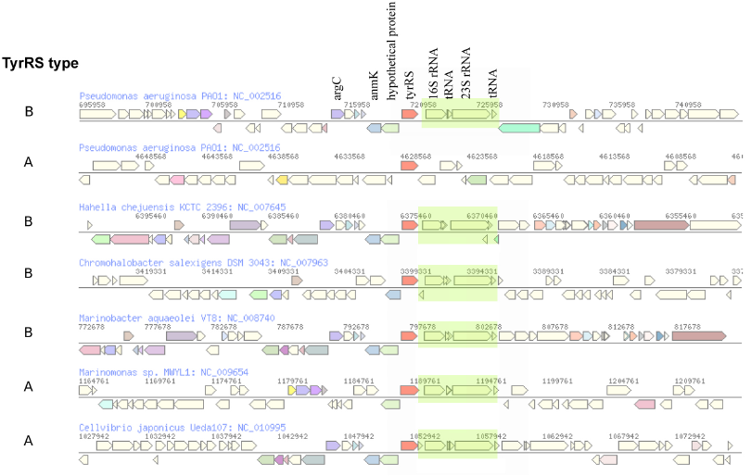
The genomic neighborhood of tyrRS in γ-proteobacteria
Andam, Williams, Gogarten 2010 PNAS
Notes:
similar neighboring gene identity and order for both tyrRS types A and B
The similarities in tyrRS region but differences in tyrRS type imply that transfer of tyrRS types among these genomes followed by homologous recombination. Although the two tyrRS types have low identity, homologous replacement with breakpoints in the neighboring genes may have facilitated the switching between TyrRS types. P. aeruginosa also carries tyrRS type A, but the genomic neighborhood of this gene does not show synteny with that of the tyrRS type A of other closely related taxa.
The finding of similar tyrRS gene neighborhoods in close relatives carrying either type A or type B provides evidence for the replacement of one form of tyrRS with another. Significantly, this rejects the differential loss hypothesis for these organisms. If the last common ancestor possessed both types of enzymes, we would expect the genes coding for each type of tyrRS to possess dissimilar genes flanking them.
The two TyrRS types are so divergent (approximately 28 % identity between the two Pseudomonas TyrRS types) that the possibility of homologous recombination within the TyrRS homeoalleles is unlikely. Consequently, in case of TyrRS homeoalleles, we expect that the unit of successful horizontal gene transfer includes at least the complete tyrRS gene.

Slide 60
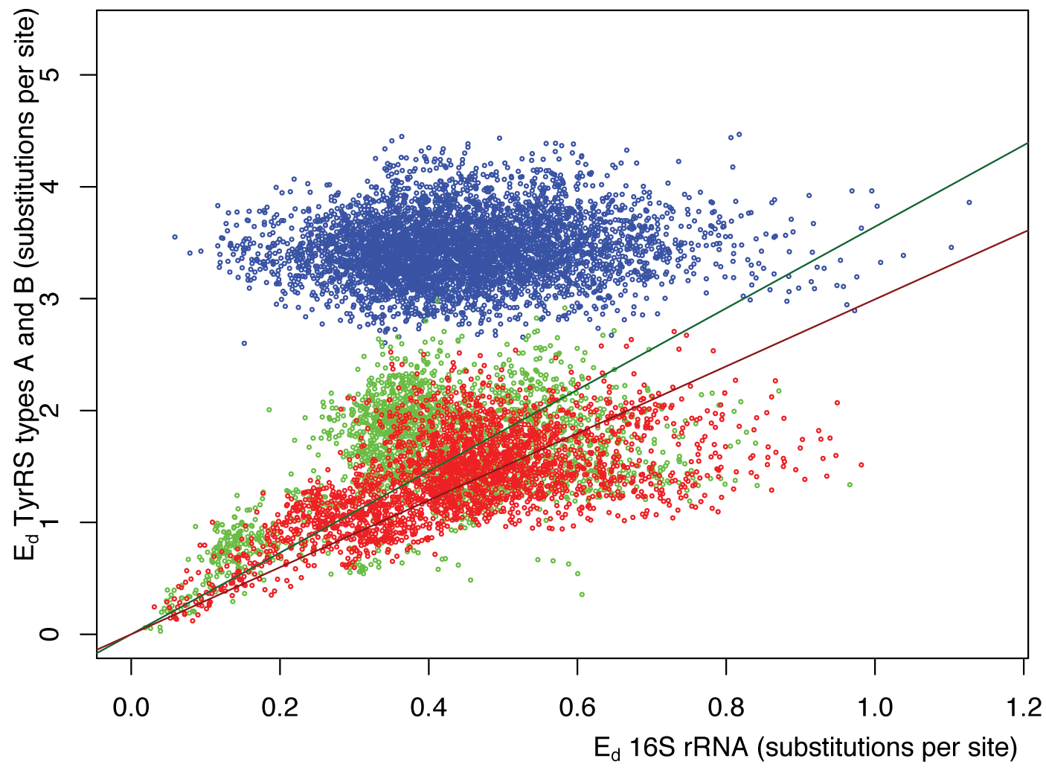
Pairwise distance between tyrRSs versus
pairwise distance of 16S rRNAs from the same genomes
Green -Type A tyrRS
Red - Type B tyrRS
Blue - Between the two types of tyrRS
Andam, Williams, Gogarten 2010 PNAS

Slide 61
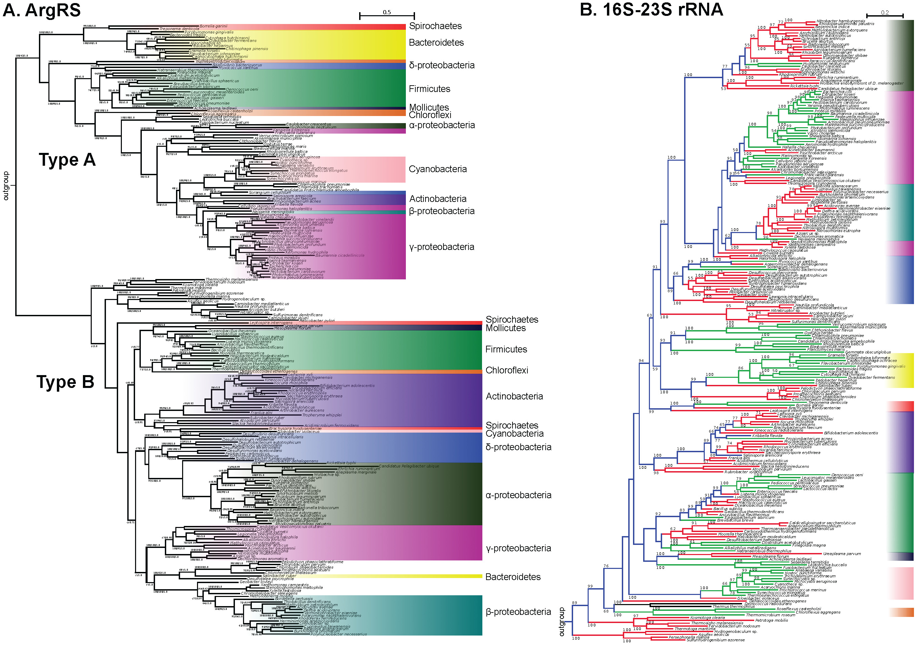

Slide 62
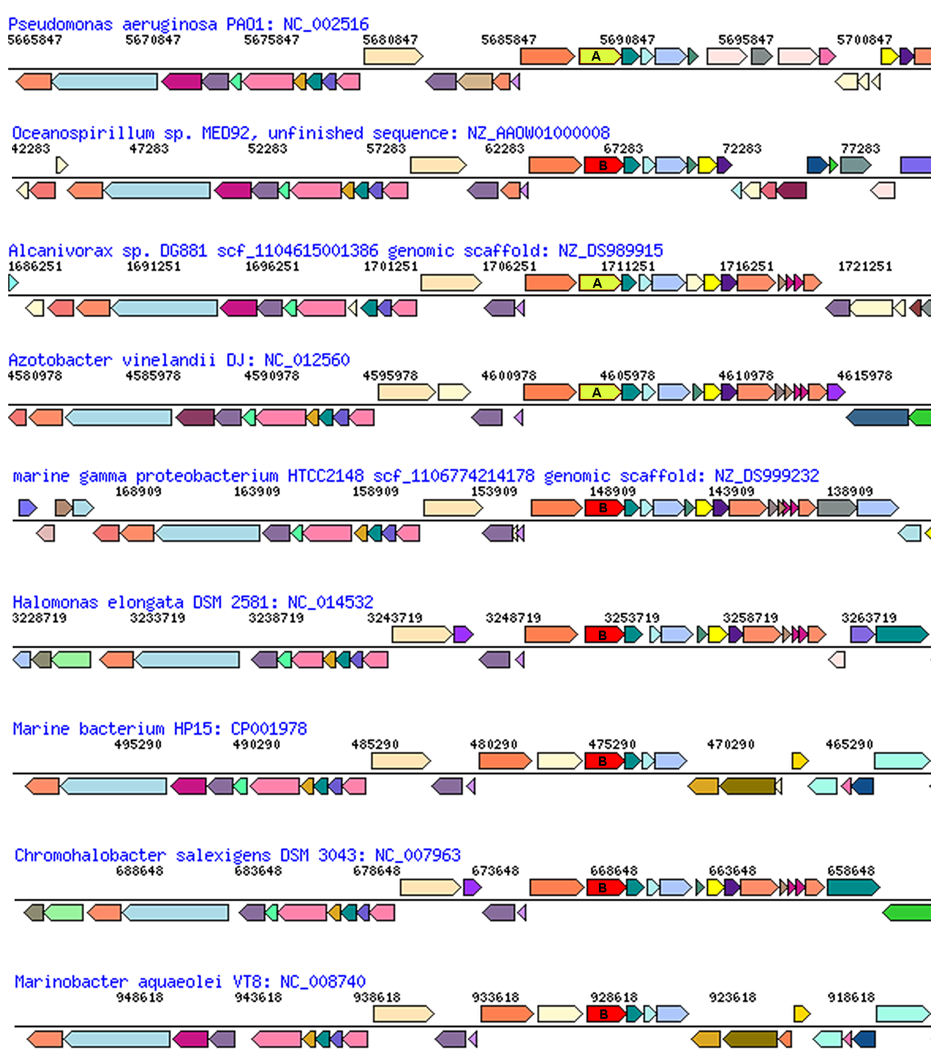
glutamate
synthase
penicillin-bp
ArgRS synteny
between types in Pseudomonadales and Oceanospirillales
aroB
malic enz
ArgRS A&B
PilQ
PriA
HsIU
Pseudomonadales

Slide 63
What is the pan-genome?
The combined genomes of a group of organisms is their pan-genome.
Usually, this refers to a related group of organisms. Either in the abstract:
- i.e., the pan-genome of E. coli
Or a specific subset:
- The pan-genome of the STEC infection in a gut. Or the Bacillus strains colonizing a niche.
Edwards-Venn cogwheel
A.W.F. Edwards 1998

Slide 64
Pangenome
Accessory genes
  Define strains
  Environmental adaptation
  Transitory genes “passing through” the host
  Parasites that have not swept.
  Etc. (see below)
Edwards-Venn cogwheel
A.W.F. Edwards 1998

Slide 65
More terminology
Typically, the term psngenome is used to describe the gene content of a related taxonomic group, like a species or genus, family or phylum.
Sometimes it refers to a broader set like the entire contents of a gut,
but this is usually referred to (and should be referred to) as a meta-genome and considered a separate phenomenon.
Edwards-Venn cogwheel
A.W.F. Edwards 1998

Slide 66
Aside on disputes in terminology:
Two definition for the term microbiome:
Micro-biome: a biome occupied by microorganisms (the skin can be considered a biome, for large organisms, the tundra is an example for a biome)
Microb-i-ome: the summary of -omics information obtained for a microbial community.
It seems #1 has won, see Jonathan Eisen’s discussion here.
Bottomline: The characterization of a micro-biome goes beyond a catalog of species (the microbiota), and certainly beyond the enumerations of 16S rRNA OTUs present in an environment; it includes the interactions between organisms, defining guilds (groups of organisms with similar roles in a biome), placing organisms into guilds, and characterizing the ecological parameters that define the niche. In addition, the microbiome is also populated by phages, other viruses, and eukaryotes. Catalogs of 16S rRNA OTUs and metagenome sequencing are an important first step, but alone they are insufficient to define of fully describe a microbiome.

Slide 67
The pangenome as a shared genetic resource
The homeoalleles provide an example for the pangenome providing a shared genetic recourse. (The different aaRS types provide resistance to antibiotics produced by competitors – switching to another type can provide a selective advantage.)
Another example are weakly selected functions (wsf) – genes or gene clusters that are only used under some conditions, e.g. a complex sugar in the environment. In the absence of the sugar, the genes will decay and may be lost from most genomes, only to be shared between members if the sugar becomes available again.
Jeffrey Lawrence and John Roth suggested that this sharing can drive operon formation (here and here)!
Edwards-Venn cogwheel
A.W.F. Edwards 1998

Slide 68

The pangenome as a shared genetic resource
Another important group of genes among the accessory pool are genes that are involved in cheating (an individual relies on its neighbors to provide the function), or the division of labor (aka mutual cheating). This is the subject of the Strong Black Queen Hypothesis.
A.W.F. Edwards 1998
Edwards-Venn cogwheel

Slide 69

Accessory genes reflecting the Red Queen hypothesis
Genes altering the interactions with viruses and other parasites (Red Queen Hypothesis *)
Modified surface receptors,
Antibiotics to kill competitors
Restriction enzymes (degrading foreign DNA)
* In analogy to to the Red Queen from Lewis Carroll’s Through the Looking-Glass, who states that "it takes all the running you can do, to keep in the same place"
A.W.F. Edwards 1998
Edwards-Venn cogwheel

