Slide 1
MCB 3421 – class 21
HGT and Introgression

Slide 2
Other ways to detect positive selection
Selective sweeps -> fewer alleles present in population (lower heterogeneity between alleles) -> neighboring genes sweeped along (linkage disequilibrium)
(see below for possible contributions from archaic Humans for example) Repeated episodes of positive selection -> high dN
(works well for repeated positive – aka diversifying – selection; e.g. virus interaction with the immune system)
A COMMON PROBLEM IS DUE TO UNRELIABLY ALIGNED SEQUENCES, which result in high dN. Genes that are decaying, or that are pseudogenes already, have a dN/dS close to 1. Adding questionable alignments to this, one can easily arrive at dN/dS > 1.

Slide 3
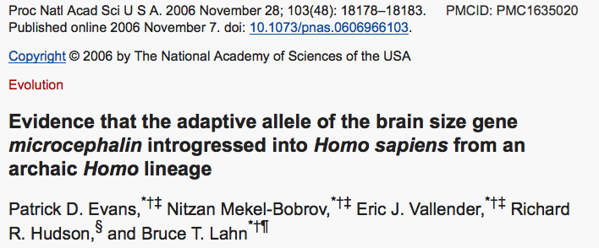
Genes involved in brain development (mutations lead to microencephaly).
Divergent version (alleles) of the wildtype allele exist, with rather uneven frequencies in different human populations.

Slide 4
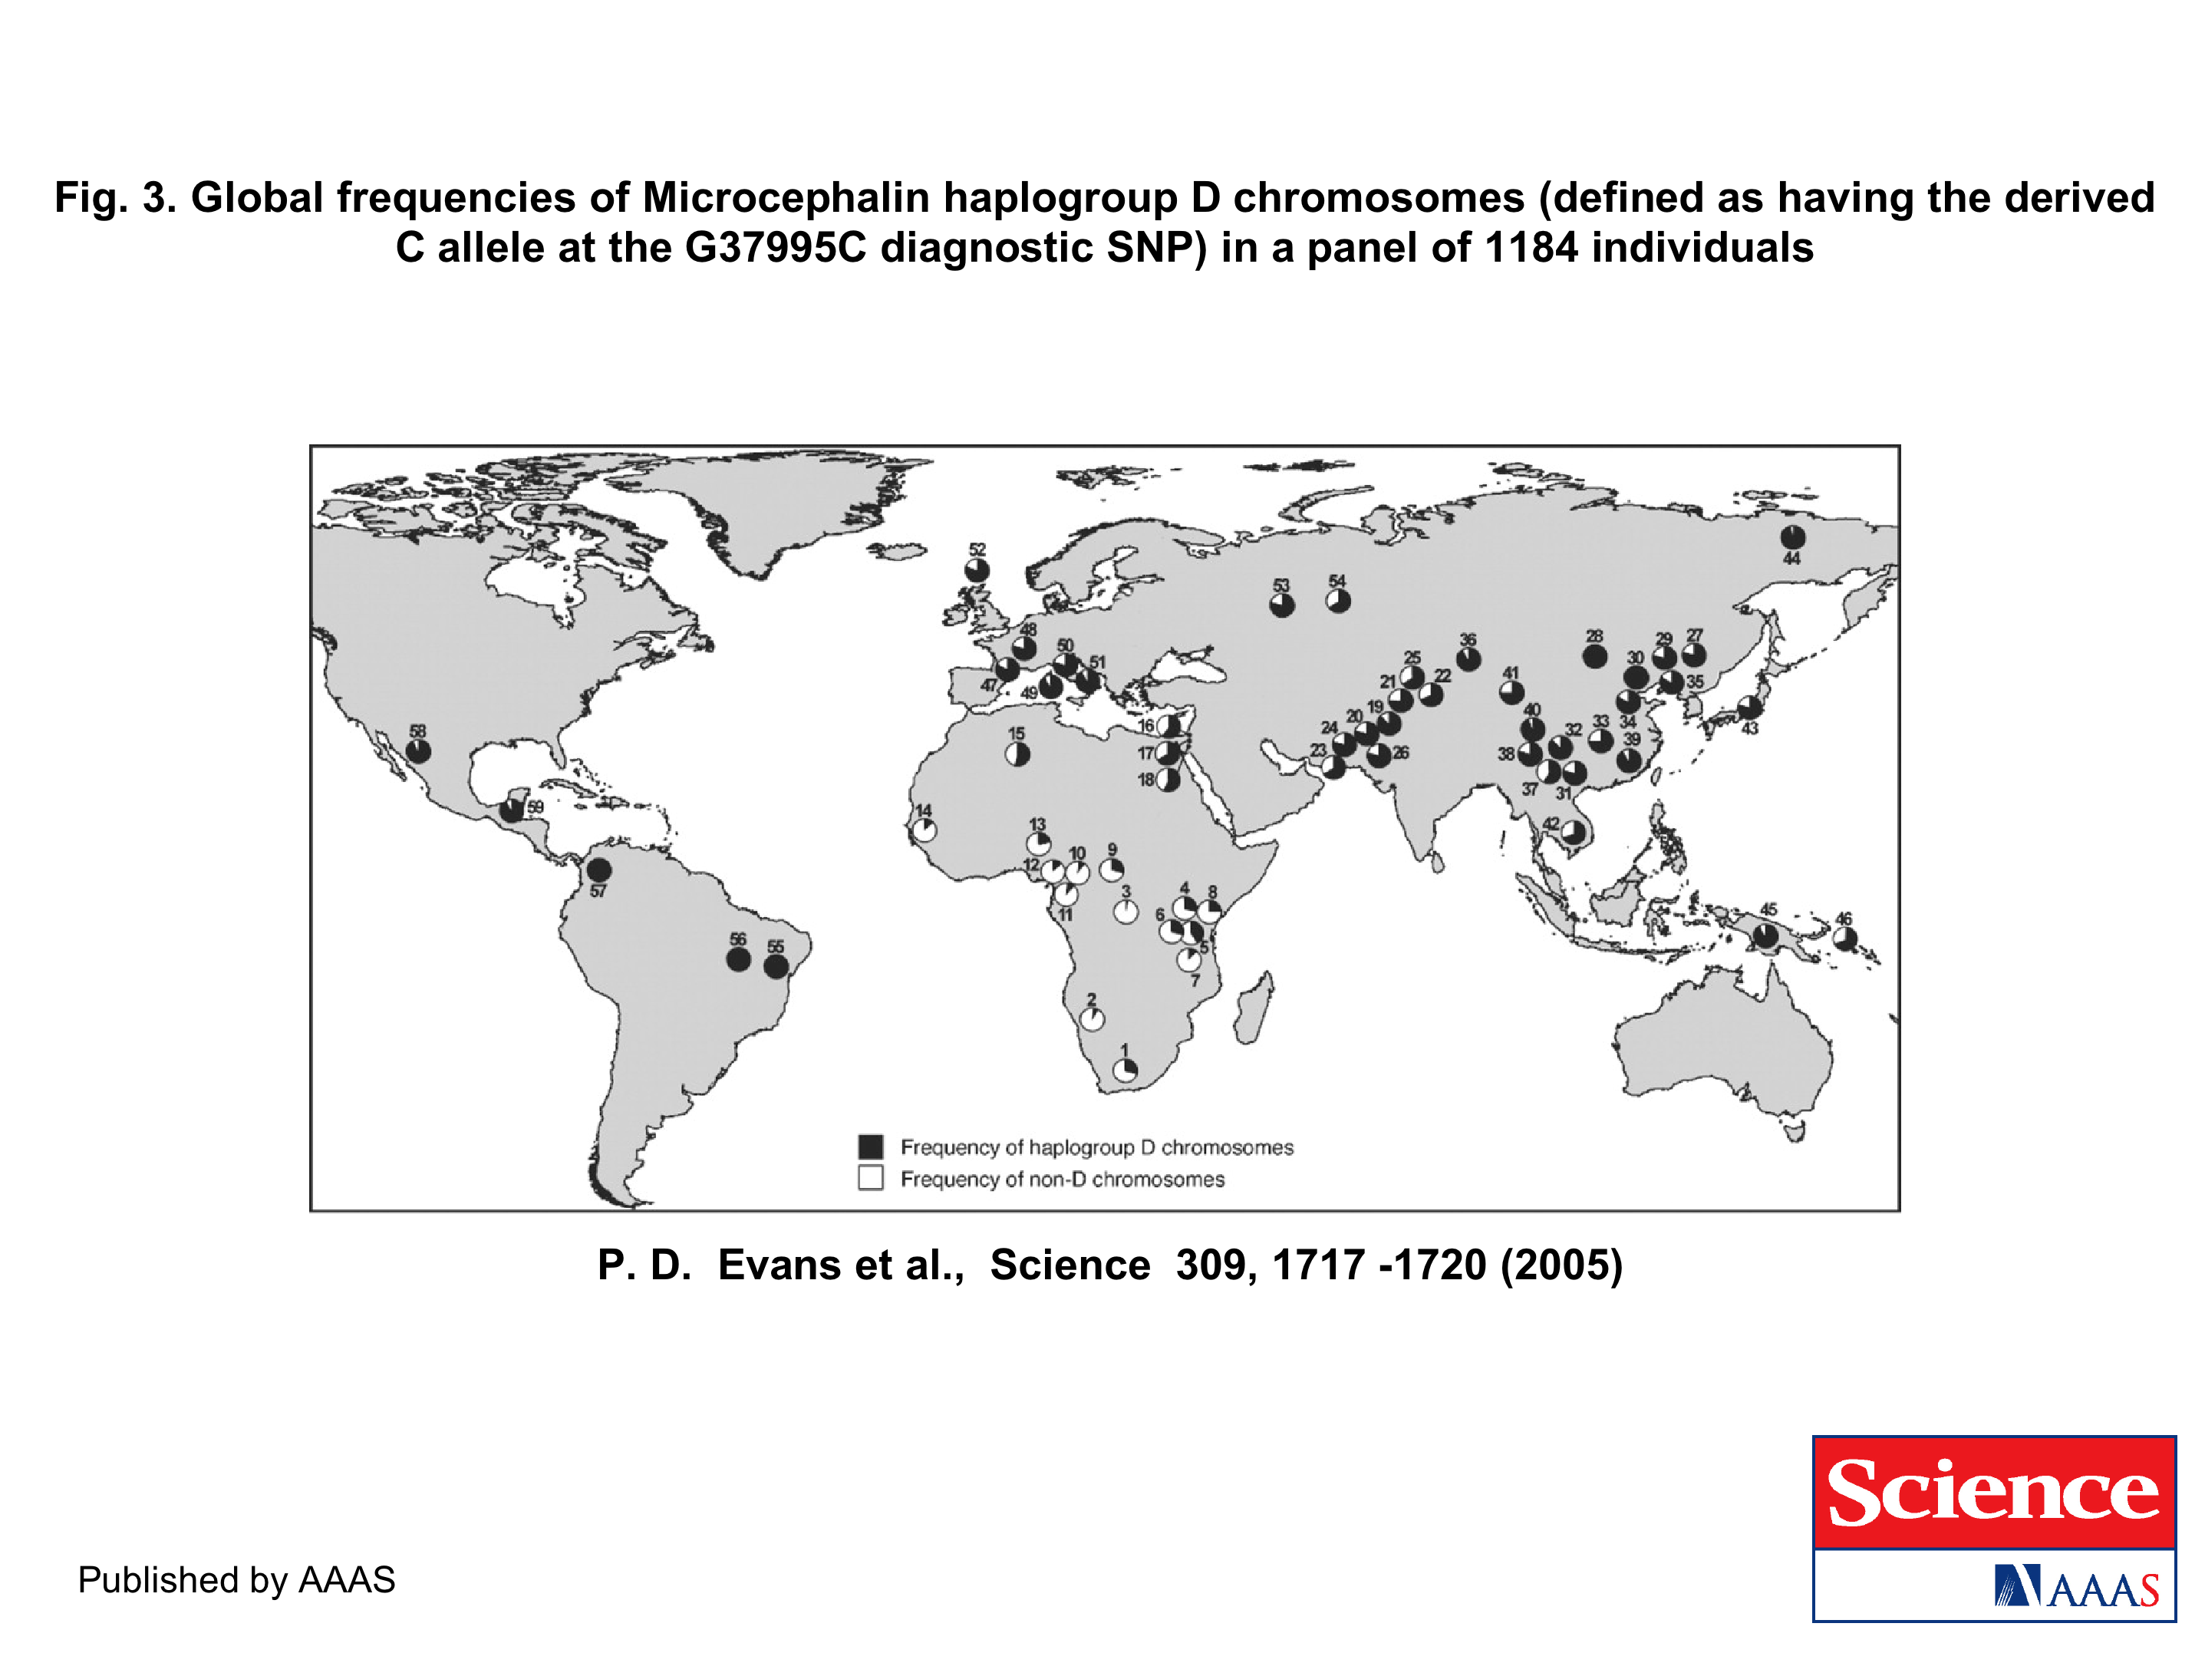
https://science.sciencemag.org/content/309/5741/1717.long
The age of haplogroup D was found to be ~37,000 years

Slide 5
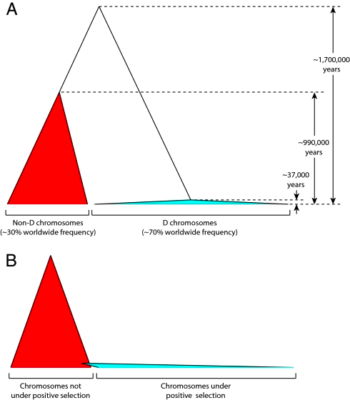

Slide 6
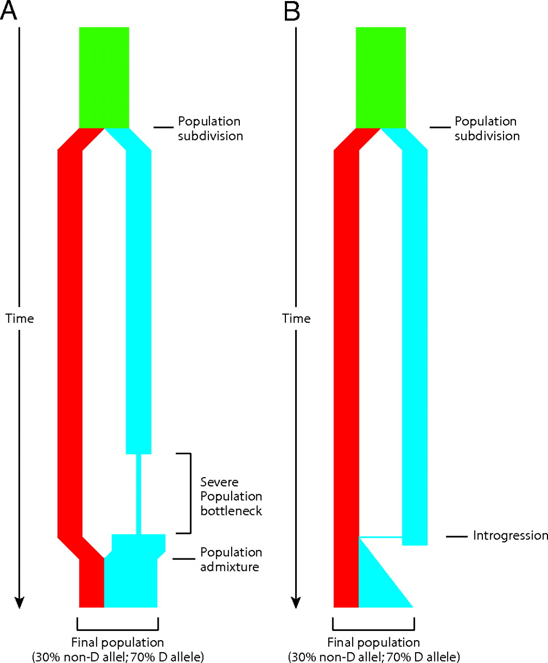
Schematic depiction of two demographic scenarios compatible with the observed genealogy of the microcephalin locus.
Patrick D. Evans et al. PNAS 2006;103:48:18178-18183
©2006 by National Academy of Sciences
Notes:
Schematic depiction of two demographic scenarios compatible with the observed genealogy of the microcephalin locus. In both scenarios, an ancestral population, depicted in green, was subdivided into two reproductively isolated populations. One population, depicted in red, fixes the non-D allele, whereas the other population, depicted in blue, fixes the D allele. (A) In the first scenario, the blue population went through a severe bottleneck that dramatically reduced genetic diversity. It then expanded and merged with the other population. (B) In the second scenario, a rare interbreeding event occurred between the two populations, bringing a copy of the D allele from the blue into the red population. This copy subsequently amplified to high frequency under positive selective pressure. The first scenario depends on demography only and does not require selection. This scenario should therefore affect all sites in the genome. The second scenario requires the action of positive selection on the introgressed allele and is therefore not expected to have a genome-wide effect. The observation that the genealogy of microcephalin is not representative of the genome is consistent with the second scenario.

Slide 7
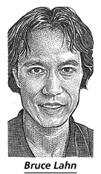
From the WSJ
... told his audience was that genetic changes over the past several thousand years might be linked to brain size and intelligence. He flashed maps that showed the changes had taken hold and spread widely in Europe, Asia and the Americas, but weren't common in sub-Saharan Africa.
Web sites and magazines promoting white "racialism" quickly seized on Dr. Lahn's suggestive scientific snapshot.
The university's patent office is also having second thoughts. Its director, Alan Thomas, says his office is dropping a patent application filed last year that would cover using Dr. Lahn's work as a DNA-based intelligence test. "We really don't want to end up on the front page...for doing eugenics," Mr. Thomas says.
More recently, Dr. Lahn says he was moved when a student asked him whether some knowledge might not be worth having. It is a notion to which he has been warming.
https://www.wsj.com/articles/SB115040765329081636

Slide 8
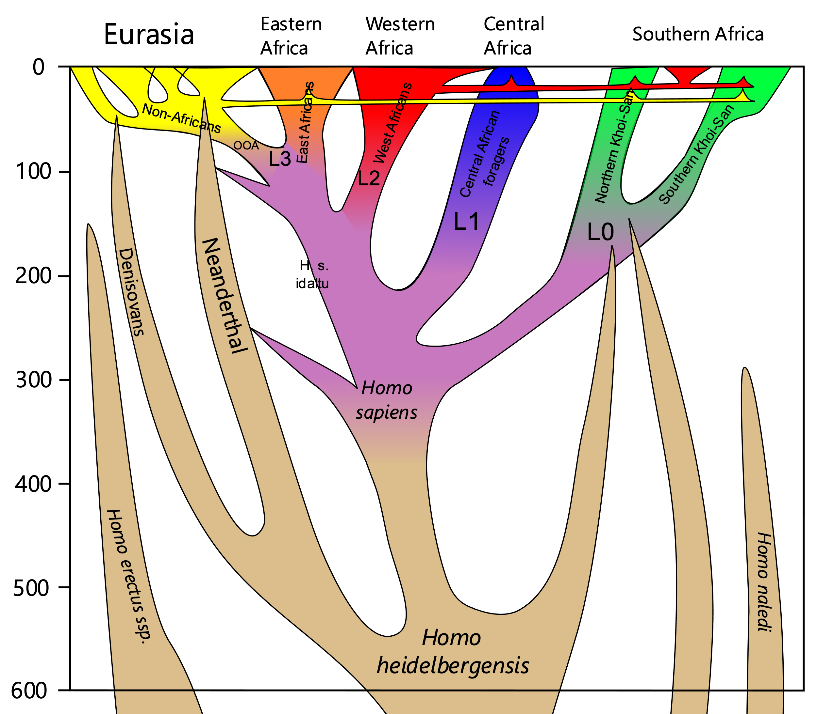
Other archaic introgressions into modern humans:
Many immune system genes in Asian and European modern humans were acquired form Neanderthal and Denisovian humans (here)
The Tibetan people received genes that adapt their red blood cell count and viscosity to high altitude from Denisovians (here).
From Wikipedia:
https://en.wikipedia.org/wiki/Interbreeding_between_archaic_and_modern_humans
https://en.wikipedia.org/wiki/Denisovan

Slide 9
Species tree or branching meandering river?

Slide 10
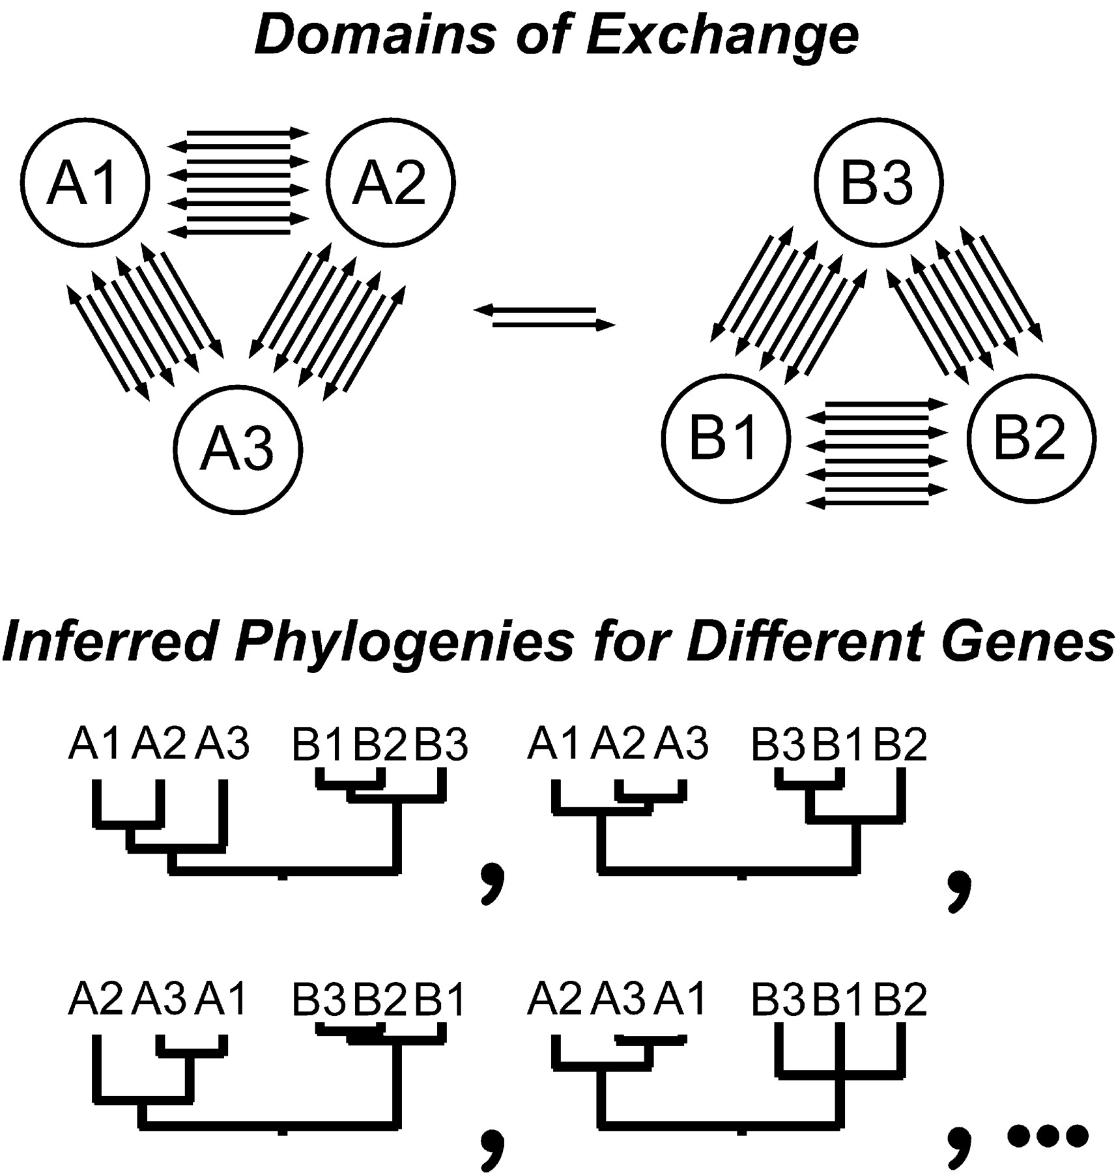
HGT can generate reproducible patterns in molecular phylogenies.
Gogarten, J.P., Doolittle, W.F., Lawrence, J.G., Mol. Biol. Evol. 2002 19:2226-2238.

Slide 11
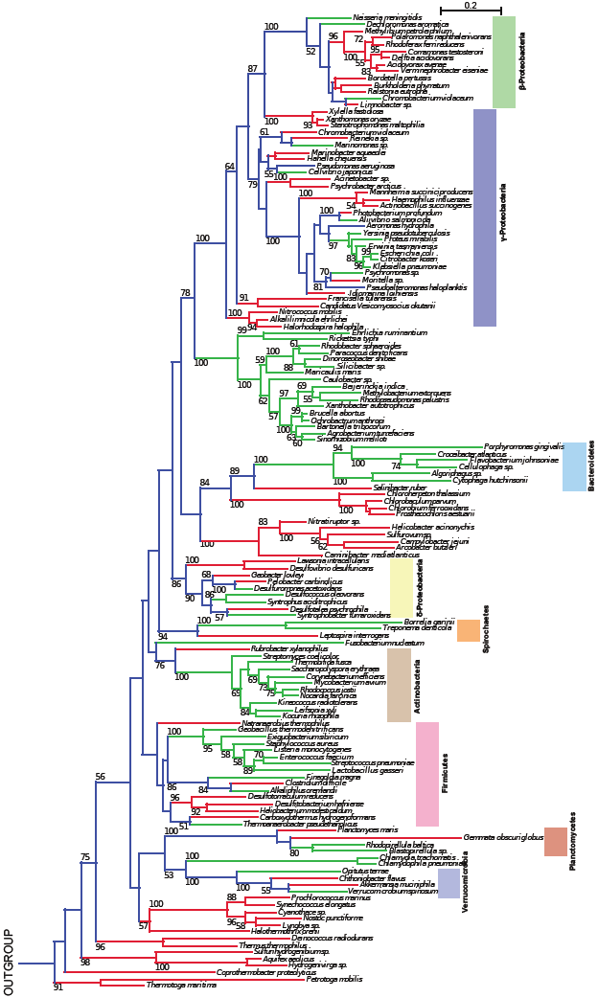
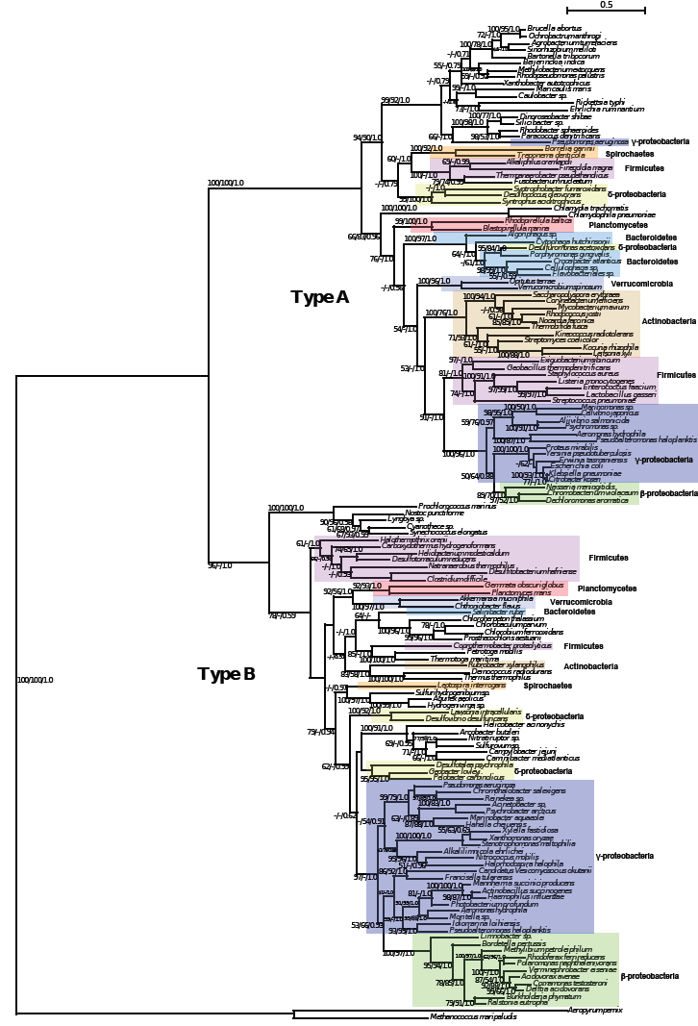
TyrRS
16S rRNA
Green -Type A
Red - Type B
Blue -Types A,B
Andam, Williams, Gogarten 2010 PNAS
Notes:
… a strong conflict with the organismal phylogeny as inferred from the 16S rRNA sequences is apparent.
The 16S rRNA tree shows the distribution of Types A and B.
For each of the two TyrRS groups, phylogenetic reconstruction resulted in trees similar to the ribosomal tree
Although the affiliation of members of a particular phylum does not exactly match that of the ribosomal tree, the overall phylogenetic structure for each bacterial TyrRS type is similar at the class and phylum levels (represented by the colored boxes).
The rRNA tree shows the distribution of Types A and B and the branches are color-coded, green branches – species with A, red branches with B. The internal branches are colored blue, indicating that the bacterial ancestor possessed both A and B. If this is indeed the case, then we have to infer a tremendous number of independent gene loss events that have occurred late in evolution (or the shallow nodes).

Slide 12
Homeoalleles
Variants that have the same general function, but can have distinct characteristics.
Gene pool contains different homeoalleles, but individual strains and species usually contain only one of the alleles.
Can be brought together temporarily in a lineage through HGT
Andam, Williams, Gogarten 2010 PNAS
Notes:
The two TyrRS enzymes can be seen as variants similar to alleles in a population. Individual lines of descent possess one or the other of these variants, and in rare instances, they can possess both. We propose to call these variants homeoalleles. Like alleles, they have the same general function, but can have distinct characteristics. As is the case for homeologs in polypoids, homeoalleles cannot be considered orthologs, even though they are homologs with the same function. The line of descent has access to a gene pool that contains both TyrRS homeoalleles, whereas individual strains and species usually contain only one of the alleles. Genes in the accessible gene pool have different propensity to be swapped into an individual line of decent. Genes present in members of the same strain in the same environment likely have the highest propensity of being acquired, genes from organisms with similar regulatory promoter sequences and similar composition will be more frequently acquired than genes with less similar composition and promoters. Genes from divergent organisms will frequently fall in the latter category, and may contain sequence motifs incompatible with the genome organization of the recipient (36).
The two TyrRS types are so divergent (approximately 28 % identity between the two Pseudomonas TyrRS types) that the possibility of homologous recombination between the TyrRS homeoalleles is unlikely. Consequently, in case of TyrRS homeoalleles we expect that the unit of successful horizontal gene transfer includes at least the complete tyrRS gene. Homeoalelles can then be brought together temporarily in a lineage following horizontal transfer, but due to largely overlapping function, only one of the alleles is likely to survive in a lineage on the long run. The surviving allele may be selected due to an adaptive advantage under prevailing conditions.

Slide 13
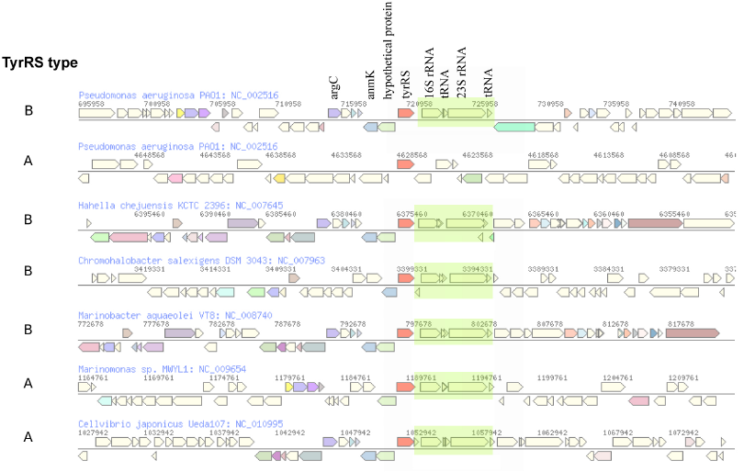
The genomic neighborhood of tyrRS in γ-proteobacteria
Andam, Williams, Gogarten 2010 PNAS
Notes:
similar neighboring gene identity and order for both tyrRS types A and B
The similarities in tyrRS region but differences in tyrRS type imply that transfer of tyrRS types among these genomes followed by homologous recombination. Although the two tyrRS types have low identity, homologous replacement with breakpoints in the neighboring genes may have facilitated the switching between TyrRS types. P. aeruginosa also carries tyrRS type A, but the genomic neighborhood of this gene does not show synteny with that of the tyrRS type A of other closely related taxa.
The finding of similar tyrRS gene neighborhoods in close relatives carrying either type A or type B provides evidence for the replacement of one form of tyrRS with another. Significantly, this rejects the differential loss hypothesis for these organisms. If the last common ancestor possessed both types of enzymes, we would expect the genes coding for each type of tyrRS to possess dissimilar genes flanking them.
The two TyrRS types are so divergent (approximately 28 % identity between the two Pseudomonas TyrRS types) that the possibility of homologous recombination within the TyrRS homeoalleles is unlikely. Consequently, in case of TyrRS homeoalleles, we expect that the unit of successful horizontal gene transfer includes at least the complete tyrRS gene.

Slide 14
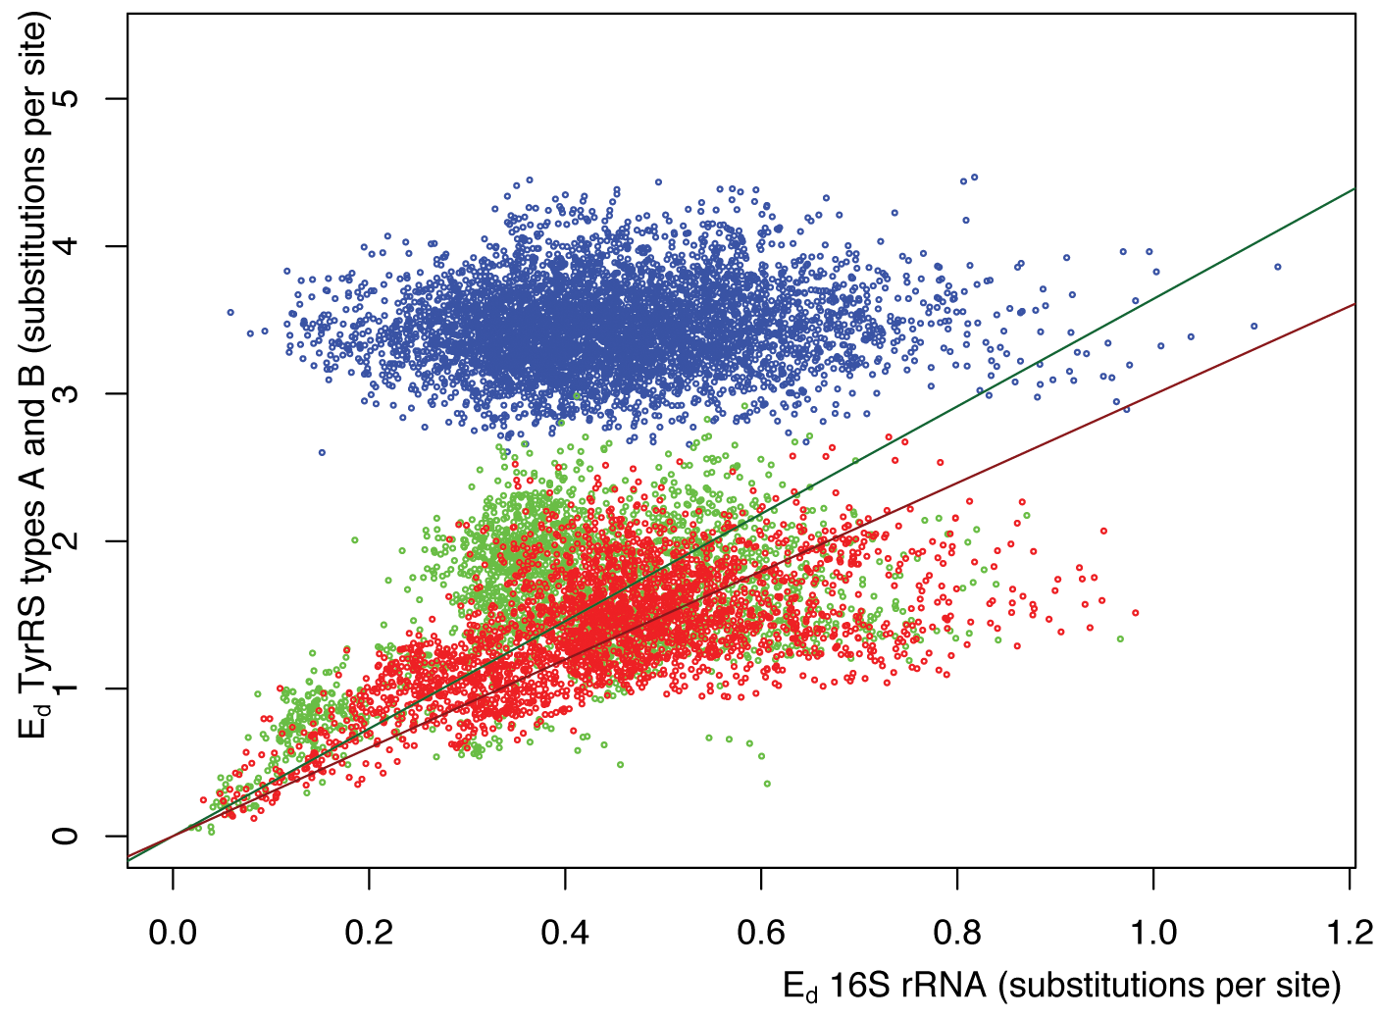
Pairwise distance between tyrRSs versus
pairwise distance of 16S rRNAs from the same genomes
Green -Type A tyrRS
Red - Type B tyrRS
Blue - Between the two types of tyrRS
Andam, Williams, Gogarten 2010 PNAS

Slide 15
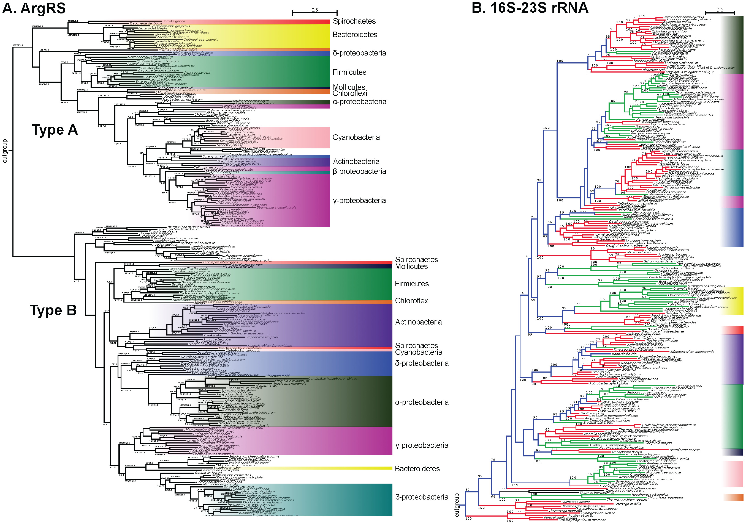

Slide 16
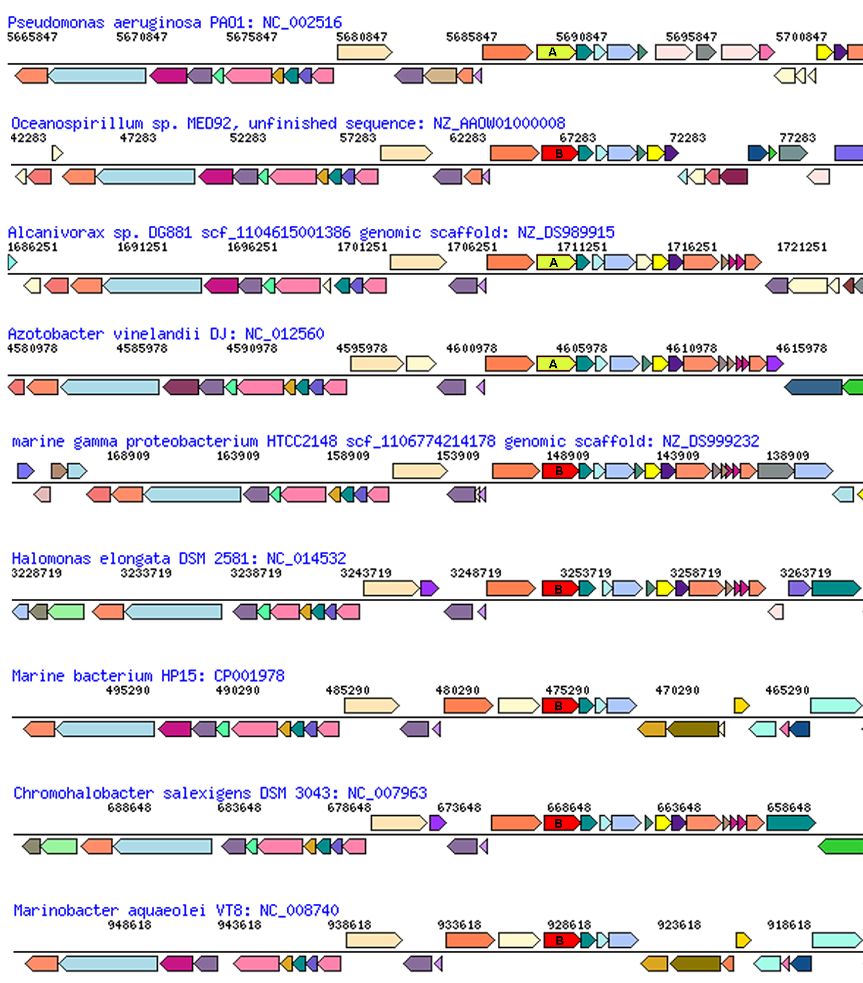
glutamate synthase
penicillin-bp
ArgRS synteny
between types in Pseudomonadales and Oceanospirillales
aroB
malic enz
ArgRS A&B
PilQ
PriA
HsIU
Pseudomonadales

Slide 17
What is the pan-genome?
The combined genomes of a group of organisms is their pan-genome.
Usually, this refers to a related group of organisms. Either in the abstract:
- i.e., the pan-genome of E. coli
Or a specific subset:
- The pan-genome of the STEC infection in a gut. Or the Bacillus strains colonizing a niche.
Edwards-Venn cogwheel
A.W.F. Edwards 1998

Slide 18
Pangenome
Accessory genes
Define strains
Environmental adaptation
Transitory genes “passing through” the host
Parasites that have not swept.
Etc. (see below)
Edwards-Venn cogwheel
A.W.F. Edwards 1998

Slide 19
More terminology
Typically, the term pangenome is used to describe the gene content of a related taxonomic group, like a species or genus, family or phylum.
Sometimes it refers to a broader set like the entire contents of a gut,
but this is usually referred to (and should be referred to) as a meta-genome and considered a separate phenomenon.
Edwards-Venn cogwheel
A.W.F. Edwards 1998

Slide 20
Aside on disputes in terminology:
Two definition for the term microbiome:
Micro-biome: a biome occupied by microorganisms (the skin can be considered a biome, for large organisms, the tundra is an example for a biome)
Microb-i-ome: the summary of -omics information obtained for a microbial community.
It seems #1 has won, see Jonathan Eisen’s discussion here.
Bottomline: The characterization of a micro-biome goes beyond a catalog of species (the microbiota), and certainly beyond the enumerations of 16S rRNA OTUs present in an environment; it includes the interactions between organisms, defining guilds (groups of organisms with similar roles in a biome), placing organisms into guilds, and characterizing the ecological parameters that define the niche. In addition, the microbiome is also populated by phages, other viruses, and eukaryotes. Catalogs of 16S rRNA OTUs and metagenome sequencing are an important first step, but alone they are insufficient to define of fully describe a microbiome.

Slide 21
The pangenome as a shared genetic resource
The homeoalleles provide an example for the pangenome providing a shared genetic recourse. (The different aaRS types provide resistance to antibiotics produced by competitors – switching to another type can provide a selective advantage.)
Another example are weakly selected functions (wsf) – genes or gene clusters that are only used under some conditions, e.g. a complex sugar in the environment. In the absence of the sugar, the genes will decay and may be lost from most genomes, only to be shared between members if the sugar becomes available again.
Jeffrey Lawrence and John Roth suggested that this sharing can drive operon formation (here and here)!
Edwards-Venn cogwheel
A.W.F. Edwards 1998

Slide 22
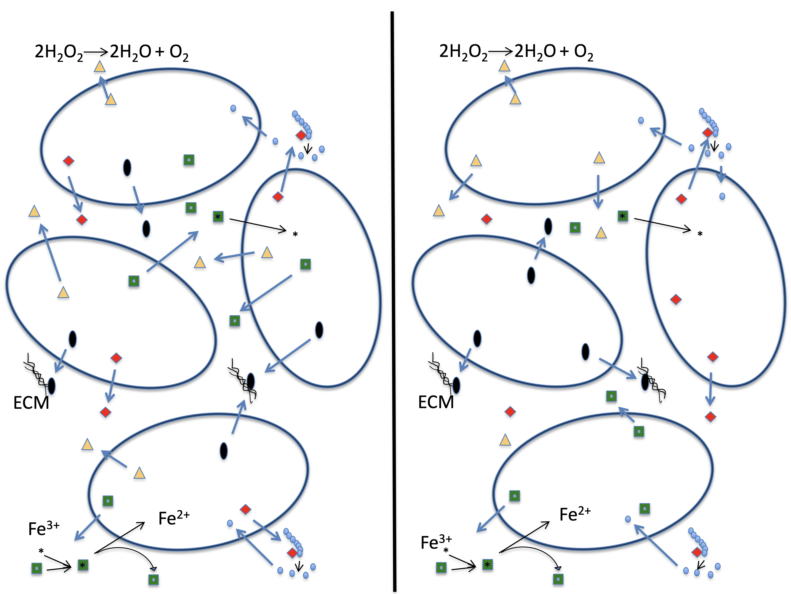
The pangenome as a shared genetic resource
Another important group of genes among the accessory pool are genes that are involved in cheating (an individual relies on its neighbors to provide the function), or the division of labor (aka mutual cheating). This is the subject of the Strong Black Queen Hypothesis.
A.W.F. Edwards 1998
Edwards-Venn cogwheel

Slide 23
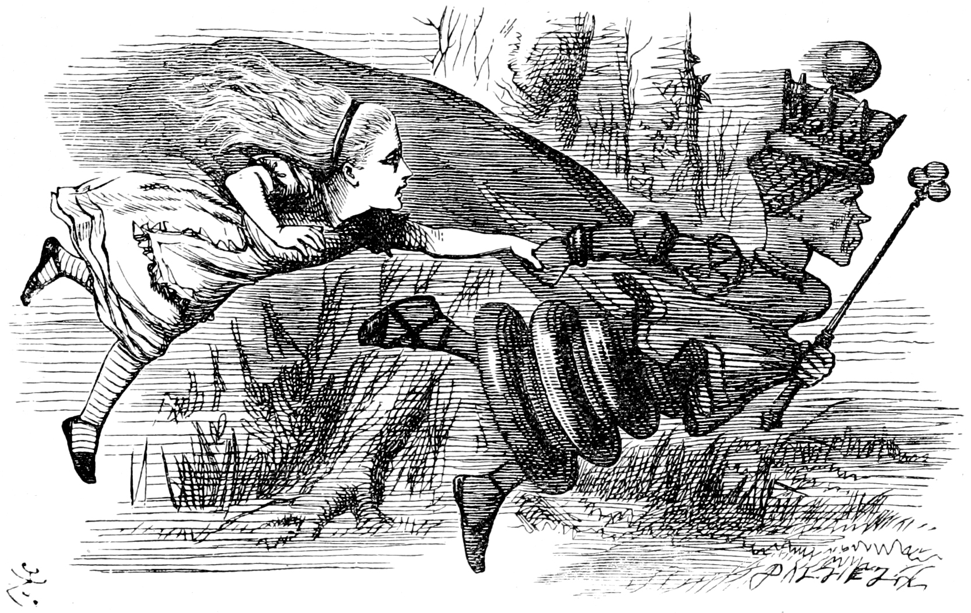
Accessory genes reflecting the Red Queen hypothesis
Genes altering the interactions with viruses and other parasites (Red Queen Hypothesis *)
Modified surface receptors,
Antibiotics to kill competitors
Restriction enzymes (degrading foreign DNA)
* In analogy to to the Red Queen from Lewis Carroll’s Through the Looking-Glass, who states that "it takes all the running you can do, to keep in the same place"
A.W.F. Edwards 1998
Edwards-Venn cogwheel

Slide 24
Roles of Horizontal Gene Transfer
Gene duplications
Creation of new metabolic pathways
Adaptation to new ecological niches
Recombination within and between species prevents linkage (selective sweeps) maintains diversity
accelerates evolution

Slide 25
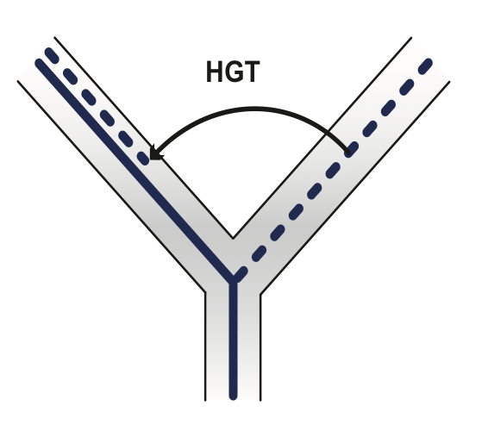
Horizontal Gene Transfer (HGT) and the
Acquisition of New Capabilities
Most important process to adapt microorganisms to new environments. E.g.: Antibiotic and heavy metal resistance, pathways that allow acquisition and breakdown of new substrates.
Creation of new metabolic pathways. (see class 12 on the evolution O₂ producing photosynthesis) Also, methanogenesis from acetate – slides at the end)
HGT, not autochthonous gene duplication, is the main process of gene family expansion in prokaryotes.
Also important in the recent evolution of multicellular eukaryotes (HGT between fish species and between grasses).
Selection acts on the Holobiont (= Host + Symbionts)
To adapt to new conditions, new symbionts can be acquired, or existing symbionts can acquire new genes through HGT.

Slide 26
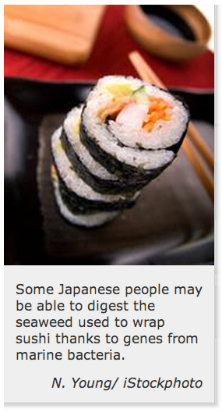
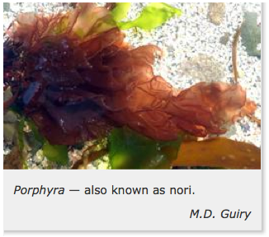
Gene Transfer in Eukaryotes
Bacterial parasites on seaweed
HGT
Human gut symbiont

Slide 27
Niche adapting genes
Observations support a gene centered view of ecology
Genes and operons are adapted to ecological niches, not species

Slide 28
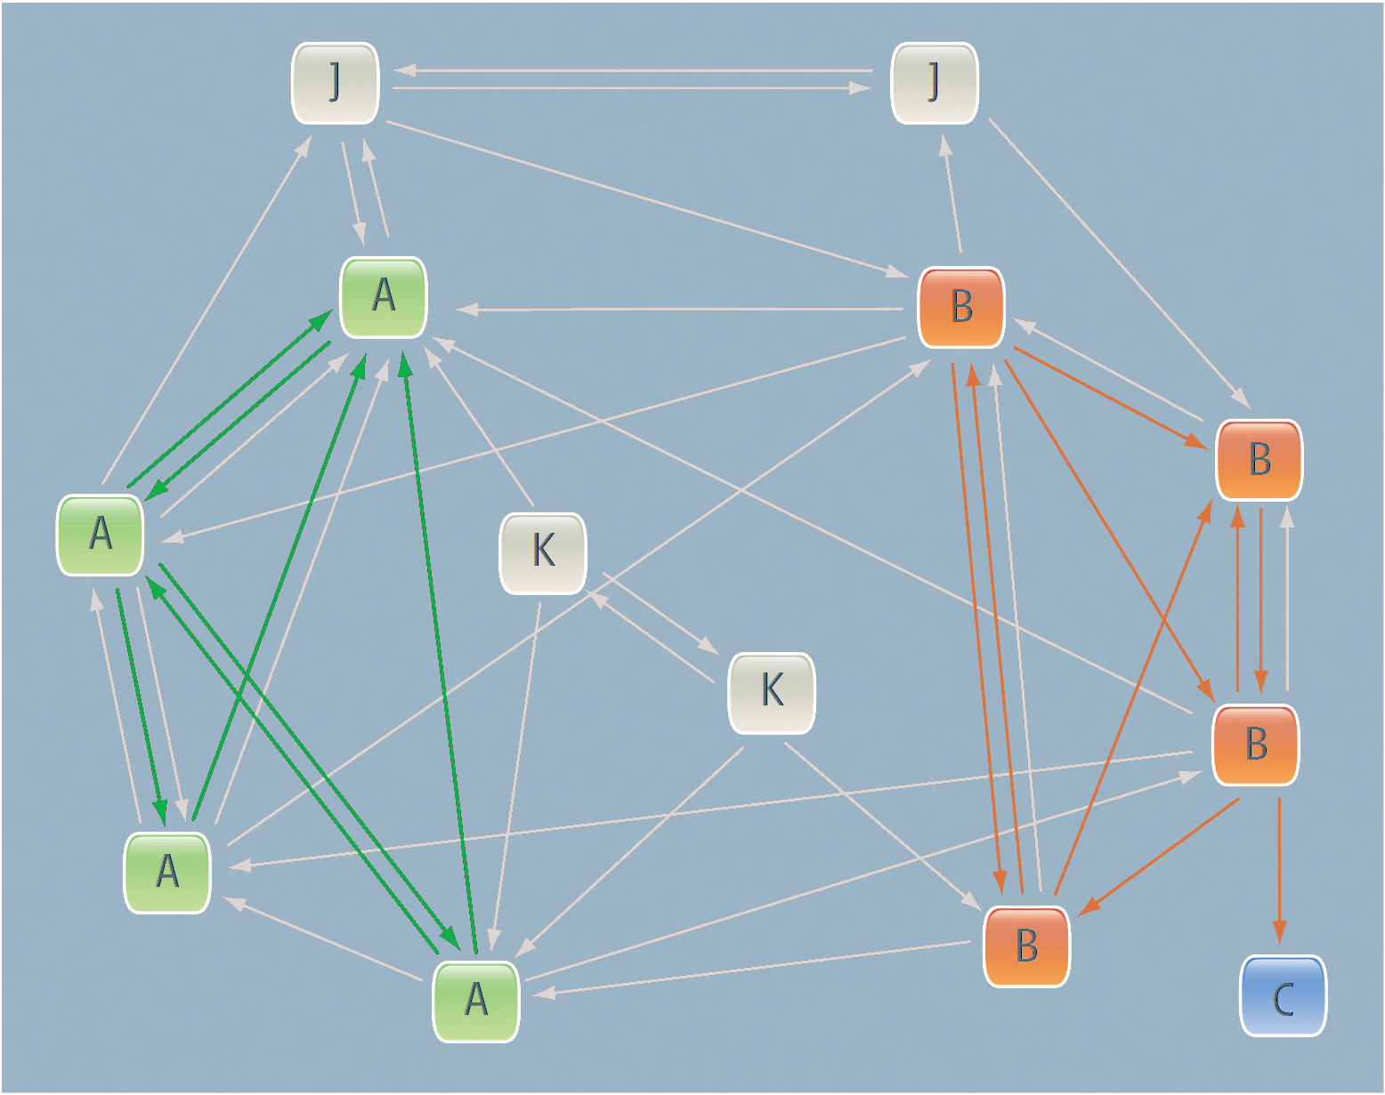
A structured exchange community. Niche defining genes.
Modified from Papke RT, Gogarten JP (2012) How Bacterial Lineages Emerge. Science 336: 45-46
Members of two distinct niches are shown as green and orange squares; gray squares are relatives occupying different niches. Genes that adapt their hosts to these niches are mostly exchanged or recombined between members of the same niche (green and orange arrows), but they might also be shared with recent niche invaders (blue square), accelerating their adaptation to a new habitat.

Slide 29
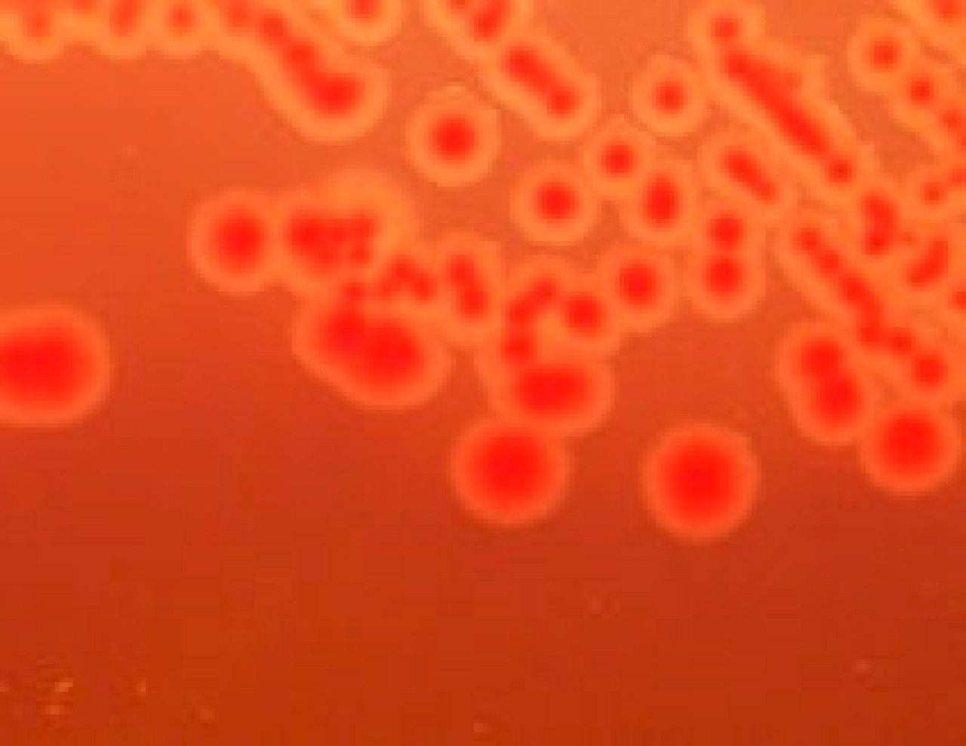
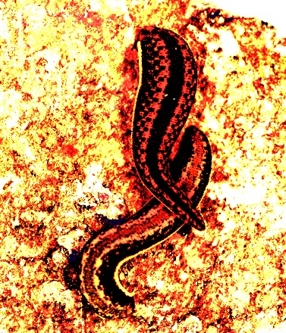
Aeromonas
Genus of γ-proteobacteria.
(Divergence between Escherichia and Aeromonas about 700 million years BP)
Common in freshwater environments.
Forms symbioses with many animals.
(parasitic, commensal, mutualistic)
Some strains can cause disease in humans
wound infection,
Bacteremia,
diarrhea (Traveler’s Diarrhea)
.
Janda J M , and Abbott S L Clin. Microbiol. Rev. 2010;23:35-73 Clinical Microbiology Reviews
http://jb.asm.org/content/189/19.cover-expansion

Slide 30
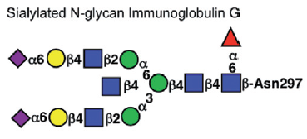
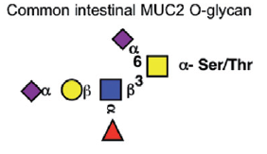
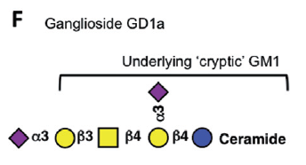
Sialic Acid
α-keto sugar
Neuraminic acid
Cell-to-cell signaling
Bacteria can utilize sialic acid in:
Nutrition
Structural incorporation
Adhesion factor
Unmasking
David Knowles
Lewis and Kewis, 2012

Slide 31
Sialic acid catabolism pathway
Sialoglyconjugate
Sialidase, (NanH)
N-acetylneuraminic acid
Extracellular
Uptake into cell via general porins/specific transporters (NanT)
Intracellular
N-acetylneuraminic acid
N-acetylneuraminic acid lyase (NanA)
N-acetylmannosamine
N-acetylmannosamine kinase (NanK)
N-acetylmannosamine-6P
N-acetylmannosamine- 6P epimerase (NanE)
N-acetylglucosamine-6P

Slide 32
Aeromonas MLSA supermatrix colored according to presence of sialic acid utilization enzymes
Red: N-acetylneuraminate lyase
transcriptional regulator
N -acetylmannosamine-6-phosphate 2-epimerase
N-acetylmannosamine kinase
sodium-glucose/galactose cotransporter (hypothetical protein)
Sialidase absent

Slide 33
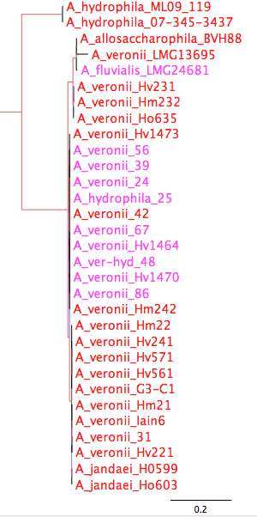
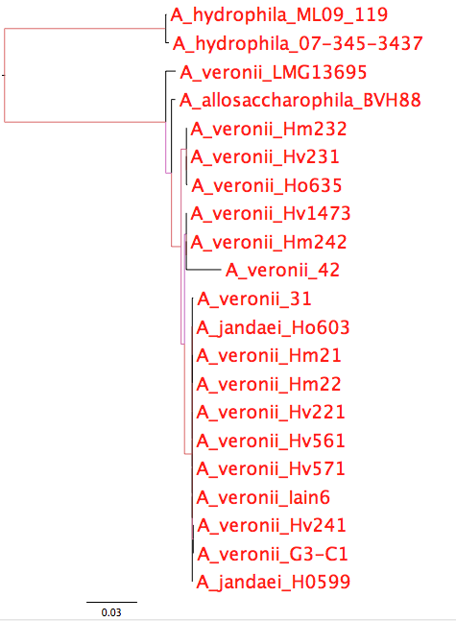
Phylogeny of sialic acid catabolism enzymes
Sialidase
ORFs 1,2,3,4,5
red: contains sialidase, branches colored by aLRT

Slide 34
A structured exchange community. Niche defining genes.
Modified from Papke RT, Gogarten JP (2012) How Bacterial Lineages Emerge. Science 336: 45-46
Members of two distinct niches are shown as green and orange squares; gray squares are relatives occupying different niches. Genes that adapt their hosts to these niches are mostly exchanged or recombined between members of the same niche (green and orange arrows), but they might also be shared with recent niche invaders (blue square), accelerating their adaptation to a new habitat.

Slide 35
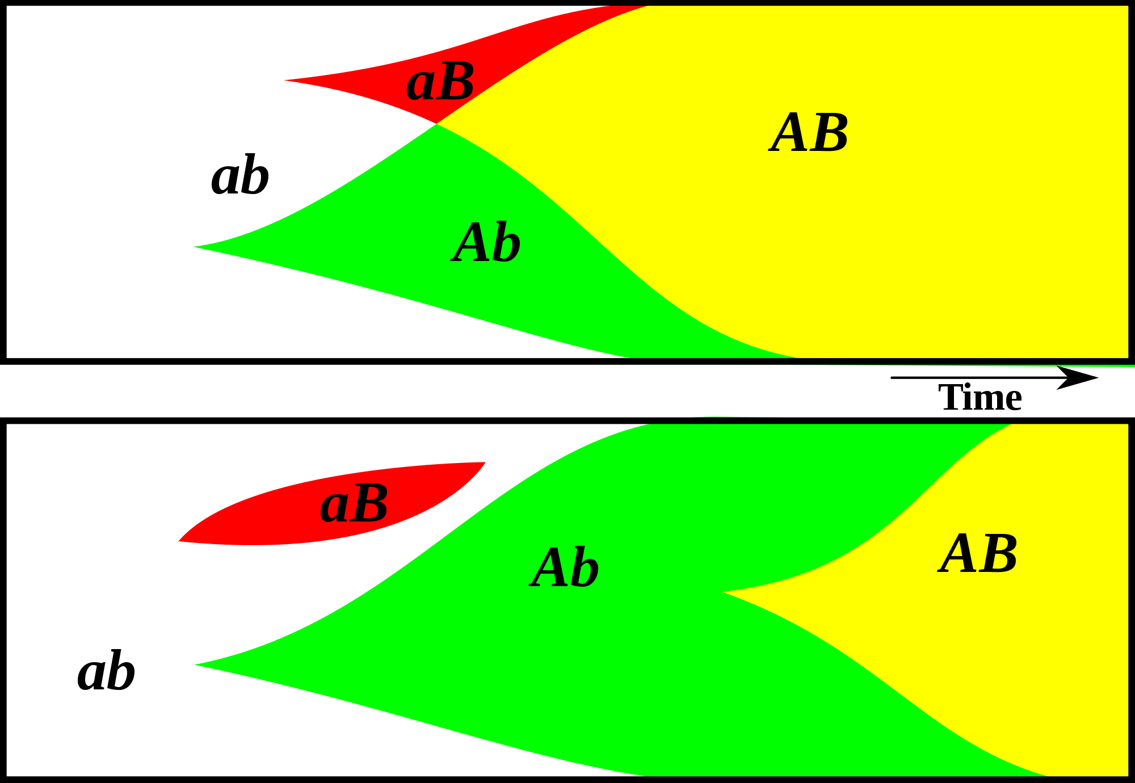
Gene Transfer, Sex, and Recombination:
Inventions do not need to be made sequentially
Gene transfer, followed by homologous or non-homologous recombination, allows inventions to be shared across the tree of life

Slide 36
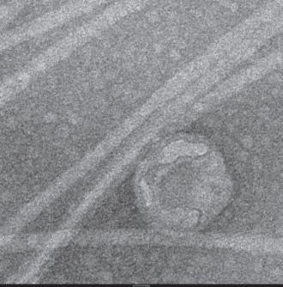
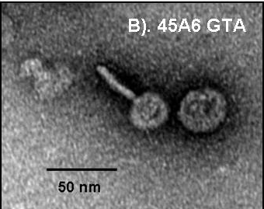
GTA
Genetic transfer Agents
Are they under purifying selection?
Does this reveal function?

Slide 37
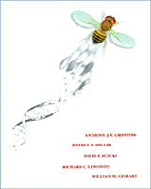
Phage and Horizontal gene Transfer
From:
An Introduction to Genetic Analysis. 7th edition.
Griffiths AJF, Miller JH, Suzuki DT, et al.
New York: W. H. Freeman; 2000.
The mechanism of generalized transduction. In reality, only a very small minority of phage progeny (1 in 10,000) carries donor genes.

Slide 38
Phage and Horizontal gene Transfer
From:
An Introduction to Genetic Analysis. 7th edition.
Griffiths AJF, Miller JH, Suzuki DT, et al.
New York: W. H. Freeman; 2000.
Specialized transduction mechanism in phage λ. (a) A lysogenic bacterial culture can produce normal λ or, rarely, an abnormal particle, λdgal, which is the transducing particle. (b) Transducing by the mixed lysate can produce gal⁺ transductants by the coincorporation of λdgal and a λ wild type.

Slide 39
Gene Transfer Agents: Defective phage, no longer recognize their own DNA
From:
Andrew S. Lang, Olga Zhaxybayeva, and J. Thomas Beatty: Gene transfer agents: phage-like elements of genetic exchange. Nat Rev Microbiol. 2012 Jun 11; 10(7): 472–482.
https://www.ncbi.nlm.nih.gov/pmc/articles/PMC3626599/
GTA
Lysogenic phage
Notes:
a | The genes encoding the gene transfer agent (GTA) particles are located on the host chromosome, and their expression leads to the production of GTA particles (black). GTA genes have never been found to excise from the genome as part of GTA production. Random DNA segments from the producing cell are packaged in the particles (blue particle heads), and only the occasional particle contains GTA genes (red particle head). For all genetically characterized GTAs, the amount of DNA packaged is insufficient to encode the phage-like structure (as indicated by the small heads). It is presumed that GTAs require lysis (dashed line) for release from cells. b | In the production of transducing phages, phage or prophage genes within the host genome are expressed, resulting in the production of phage particles (black) and replication of the phage genome (not shown). Packaging of the complete phage genome then occurs (orange phage heads), with occasional packaging of non-phage DNA (blue phage head). Note that this is an over simplification and some transducing phage particles can contain both phage and cellular genomic DNA. Tailed phage structures require lysis to be released from cells.

Slide 40
GTA in Rhodobacter capsulatus
GTA discovered in 1974
Resemble prophage (see next slide)
Regulated quorum sensing system
RcGTA like gene clusters were found in many α-proteobacteria, interpreted to suggest vertical transmission began around the time of the split of the groups of proteobacteria.

Slide 41
Gene Transfer Agents: Defective phage, no longer recognize their own DNA
From:
Andrew S. Lang, Olga Zhaxybayeva, and J. Thomas Beatty: Gene transfer agents: phage-like elements of genetic exchange. Nat Rev Microbiol. 2012 Jun 11; 10(7): 472–482.
https://www.ncbi.nlm.nih.gov/pmc/articles/PMC3626599/
The heads of GTAs are smaller than is necessary to pack all of the genes encoding the GTA
Notes:
a | Rhodobacter capsulatus gene transfer agents (RcGTAs)³⁰. b | Dd1 particles from Desulfovibrio desulfuricans⁴⁸. c | Virus of Serpulina hyodysenteriae (VSH 1) particles in Brachyspira hyodysenteriae⁵⁰. d | A voltae transfer agent (VTA) particle in Methanococcus voltae⁶⁷. Parts a,c and d are reproduced, with permission, from (respectively) REF. 30 © (1979) Elsevier; REF. 50 © (1997) American Society for Microbiology; and REF. 67© (1999) Society for General Microbiology. Part b is modified, with permission, from REF. 48 © (1987) US National Academy of Sciences.

Slide 42
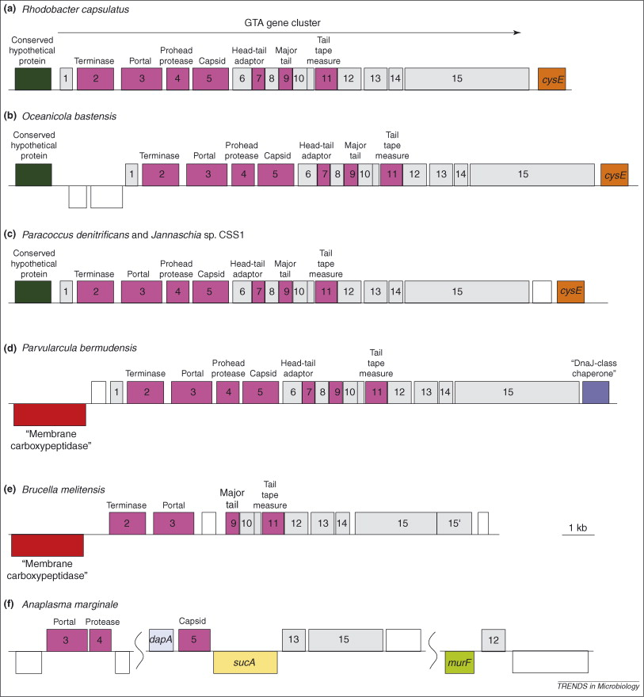
GTA Origin and Evolution
The conserved gene neighborhoods suggests vertical inheritance in α-proteobacterial lineages
Lang, A.S. & Beatty, J.T. Trends in Microbiology , Vol.15, No.2 , 2006
Notes:
Syntenic arrangement is valid only for Rhodobacterales
Widespread presence of RcGTA clusters, pattern of RcGTA-gene like distribution in these species and the results of phylogenetic analyses in these species suggest a prokaryotic ancestor of all alpha-proteobacteria contained RcGTA-like genes.

Slide 43
Purifying selection in GTA genes
dN/dS <1 for GTA genes has been used to infer selection for function
GTA genes
Lang AS, Zhaxybayeva O, Beatty JT. Nat Rev Microbiol. 2012 Jun 11;10(7):472-82
Lang, A.S. & Beatty, J.T. Trends in Microbiology , Vol.15, No.2 , 2006
Notes:
The ratio of non-synonymous-to-synonymous (dN/dS, or ω) codon substitution rates can be used as an indication of the selective pressure acting on a protein-coding gene. If a gene (or gene segment) is under purifying selection, non-synonymous mutations (that is, mutations resulting in a change of the encoded amino acid) will be selected against, resulting in ω < 1. In neutrally evolving proteins, synonymous and non-synonymous mutations will be fixed at approximately the same rate, resulting in ω = 1. Because different regions of a protein-coding gene may be under different selective constraints, codons can be divided into two categories: those with ω < 1 (yellow; the estimated ω is indicated on the bar) and those with ω fixed to 1 (green); the estimated proportion of codons in each category is given on the horizontal axis.

Slide 44
Figure 2: Nested levels of selection on gene content.
From: https://www.nature.com/articles/nrg3962 doi: 10.1038/nrg3962

Slide 45
Gene Transfer, Sex, and Recombination:
Inventions do not need to be made sequentially
Gene transfer, followed by homologous or non-homologous recombination, allows inventions to be shared across the tree of life

Slide 46
GTAs cannot survive as selfish genetic elements, because
GTAs are too small to encode all GTA genes
The GTA+ cell dies upon release of the GTAs
At best one GTA- cell (that has a mutation in its GTA can be converted to GTA+.
Recombination is beneficial to a group, because it prevents slightly deleterious mutations to be fixed along site beneficial ones, and it allows beneficial mutations that occurred in different cells to come together in a lineage. However, GTAs do not represent an evolutionary stable strategy.
GTA- cells can invade GTA+ population (the never lyse themselves, and the reap the benefits of recombination).
GTA+ cells can only invade a GTA- population, if the GTA+ cells manage somehow to restrict recombination to other GTA+ cells.
Why are GTAs around?
GTAs just represent decaying phages … But they are under purifying selection (however, see below).
The gene transfer they catalyze has some other benefits; Rosie Redfield (here) discusses the possibility that they might help transfer immunity against phages. (Can this be an evolutionary stable strategy?)

Slide 47
GTA- cells can invade GTA populations, the reverse is only possible (Panel B), if GTA+ cells can restrict the benefits of recombination to GTA+ cells.
From Soucy and Redfield (2018)
10.3389/fmicb.2018.02527
Notes:
Effects of competition. All runs used α = 1.5 and high-high regulation. Note the exponential scale of the Y-axis. (A,B) eff. = 1.0. (A) a large GTA⁺ population being invaded by control GTA⁺ cells (orange) and by GTA⁻ cells that can (dark green) or cannot (light green) recombine. (B) a large GTA⁻ population being invaded by control GTA⁻ cells (green) and by GTA⁺ cells that can (light orange) or cannot (dark orange) sequester recombination. (C,D) Like (A,B) but with eff. = 0.2.

Slide 48
Purifying selection in GTA genes
dN/dS <1 for GTA genes has been used to infer selection for function
GTA genes
Lang AS, Zhaxybayeva O, Beatty JT. Nat Rev Microbiol. 2012 Jun 11;10(7):472-82
Lang, A.S. & Beatty, J.T. Trends in Microbiology , Vol.15, No.2 , 2006
Notes:
The ratio of non-synonymous-to-synonymous (dN/dS, or ω) codon substitution rates can be used as an indication of the selective pressure acting on a protein-coding gene. If a gene (or gene segment) is under purifying selection, non-synonymous mutations (that is, mutations resulting in a change of the encoded amino acid) will be selected against, resulting in ω < 1. In neutrally evolving proteins, synonymous and non-synonymous mutations will be fixed at approximately the same rate, resulting in ω = 1. Because different regions of a protein-coding gene may be under different selective constraints, codons can be divided into two categories: those with ω < 1 (yellow; the estimated ω is indicated on the bar) and those with ω fixed to 1 (green); the estimated proportion of codons in each category is given on the horizontal axis.

Slide 49
Purifying selection in E.coli ORFans
dN-dS < 0 for some ORFan E. coli clusters seems to suggest they are functional genes.
Gene groups | Number | dN-dS>0 | dN-dS<0 | dN-dS=0
E. coli ORFan clusters | 3773 | 944 (25%) | 1953 (52%) | 876 (23%)
Clusters of E.coli sequences found in Salmonella sp., Citrobacter sp. | 610 | 104 (17%) | 423(69%) | 83 (14%)
Clusters of E.coli sequences found in some Enterobacteriaceae only | 373 | 8 (2%) | 365 (98%) | 0 (0%)
Adapted after Yu, G. and Stoltzfus, A. Genome Biol Evol (2012) Vol. 4 1176-1187

Slide 50
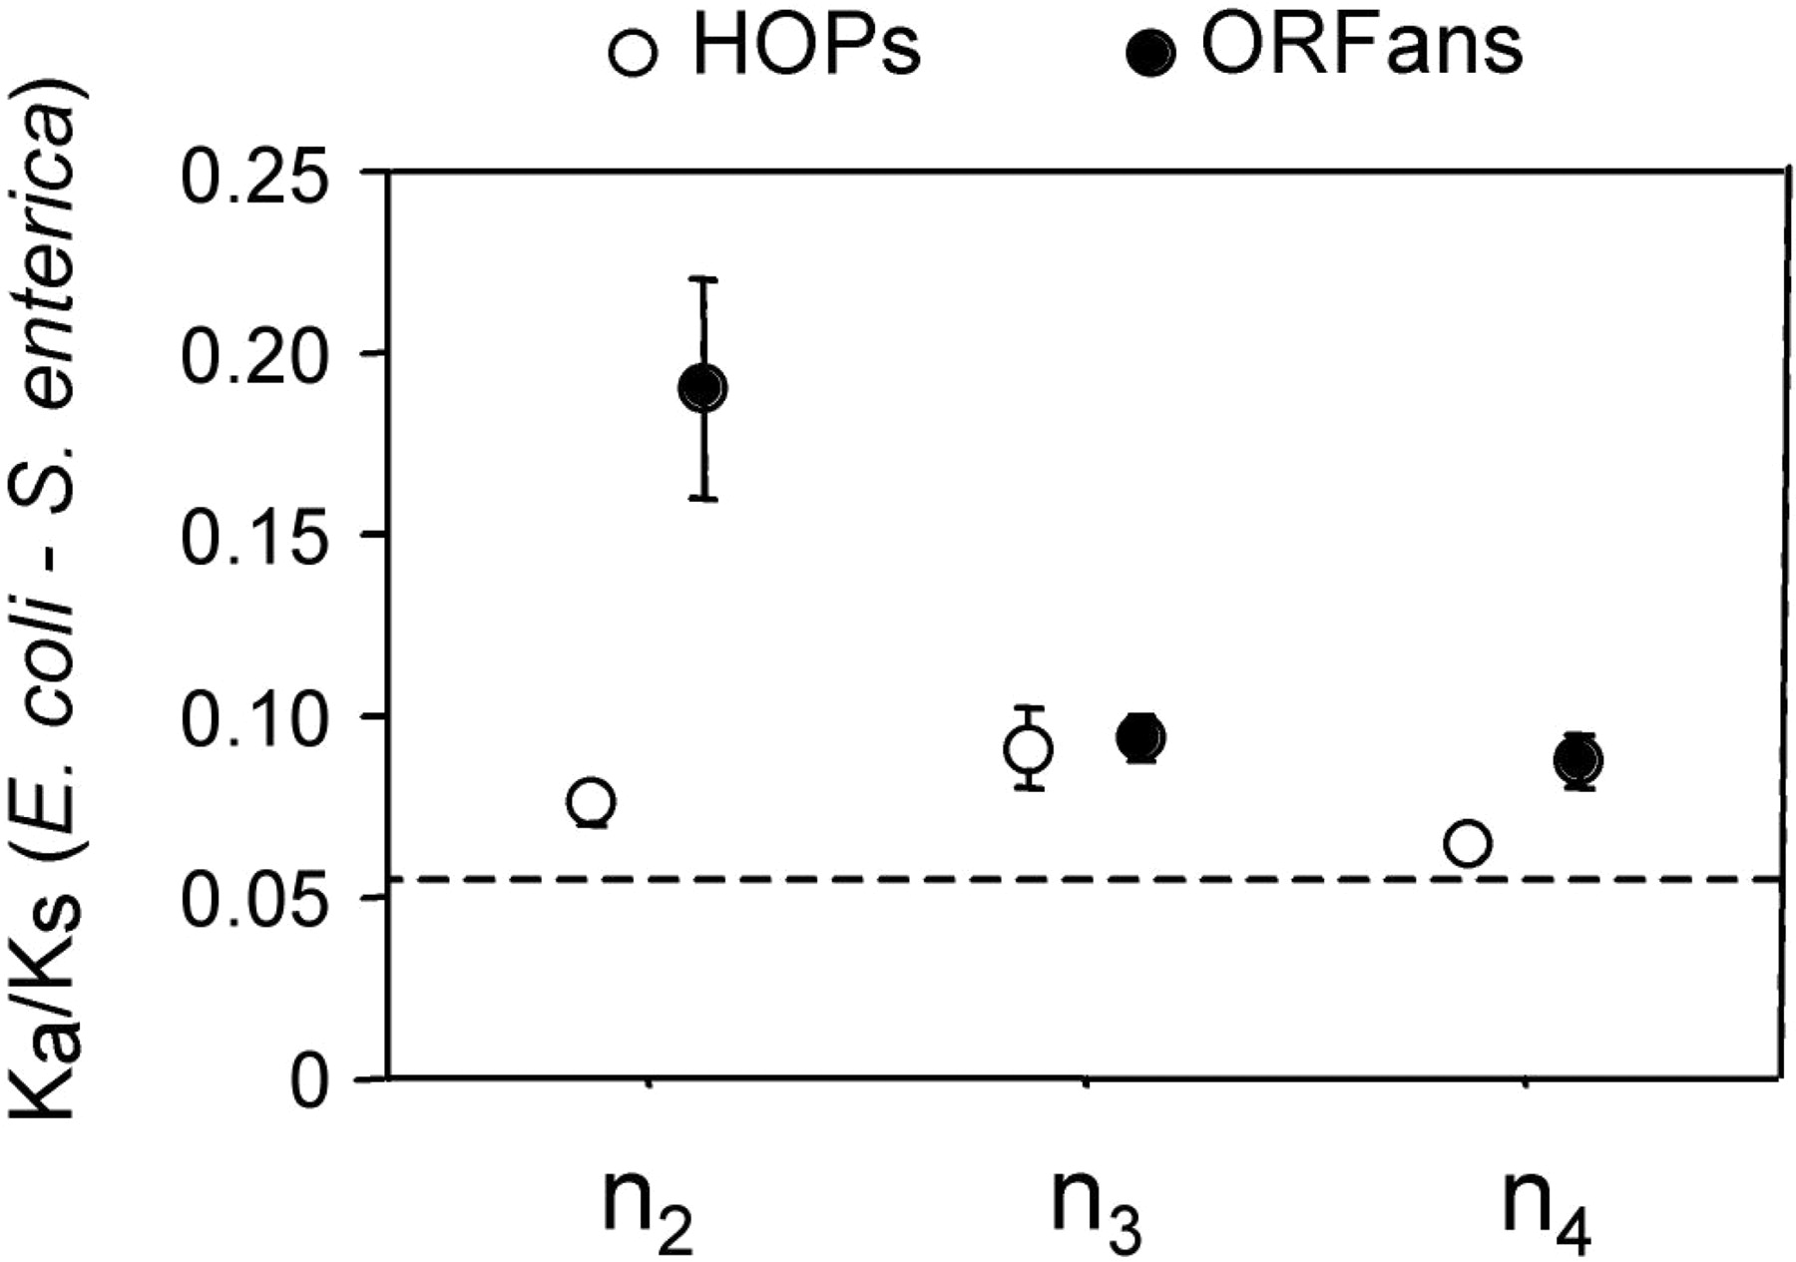
Vincent Daubin and Howard Ochman: Bacterial Genomes as New Gene Homes: The Genealogy of ORFans in E. coli. Genome Research 14:1036-1042, 2004
The ratio of non-synonymous to synonymous substitutions for genes found only in the E.coli - Salmonella clade is lower than 1, but larger than for more widely distributed genes.
Increasing phylogenetic depth
Fig. 3 from Vincent Daubin and Howard Ochman, Genome Research 14:1036-1042, 2004

Slide 51
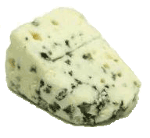
Trunk-of-my-car analogy: Hardly anything in there is the is the result of providing a selective advantage. Some items are removed quickly (purifying selection), some are useful under some conditions, but most things do not alter the fitness. See here for a published version.
Could some of the inferred purifying selection be due to the acquisition of novel detrimental characteristics (e.g., protein toxicity, HOPELESS MONSTERS)?

Slide 52
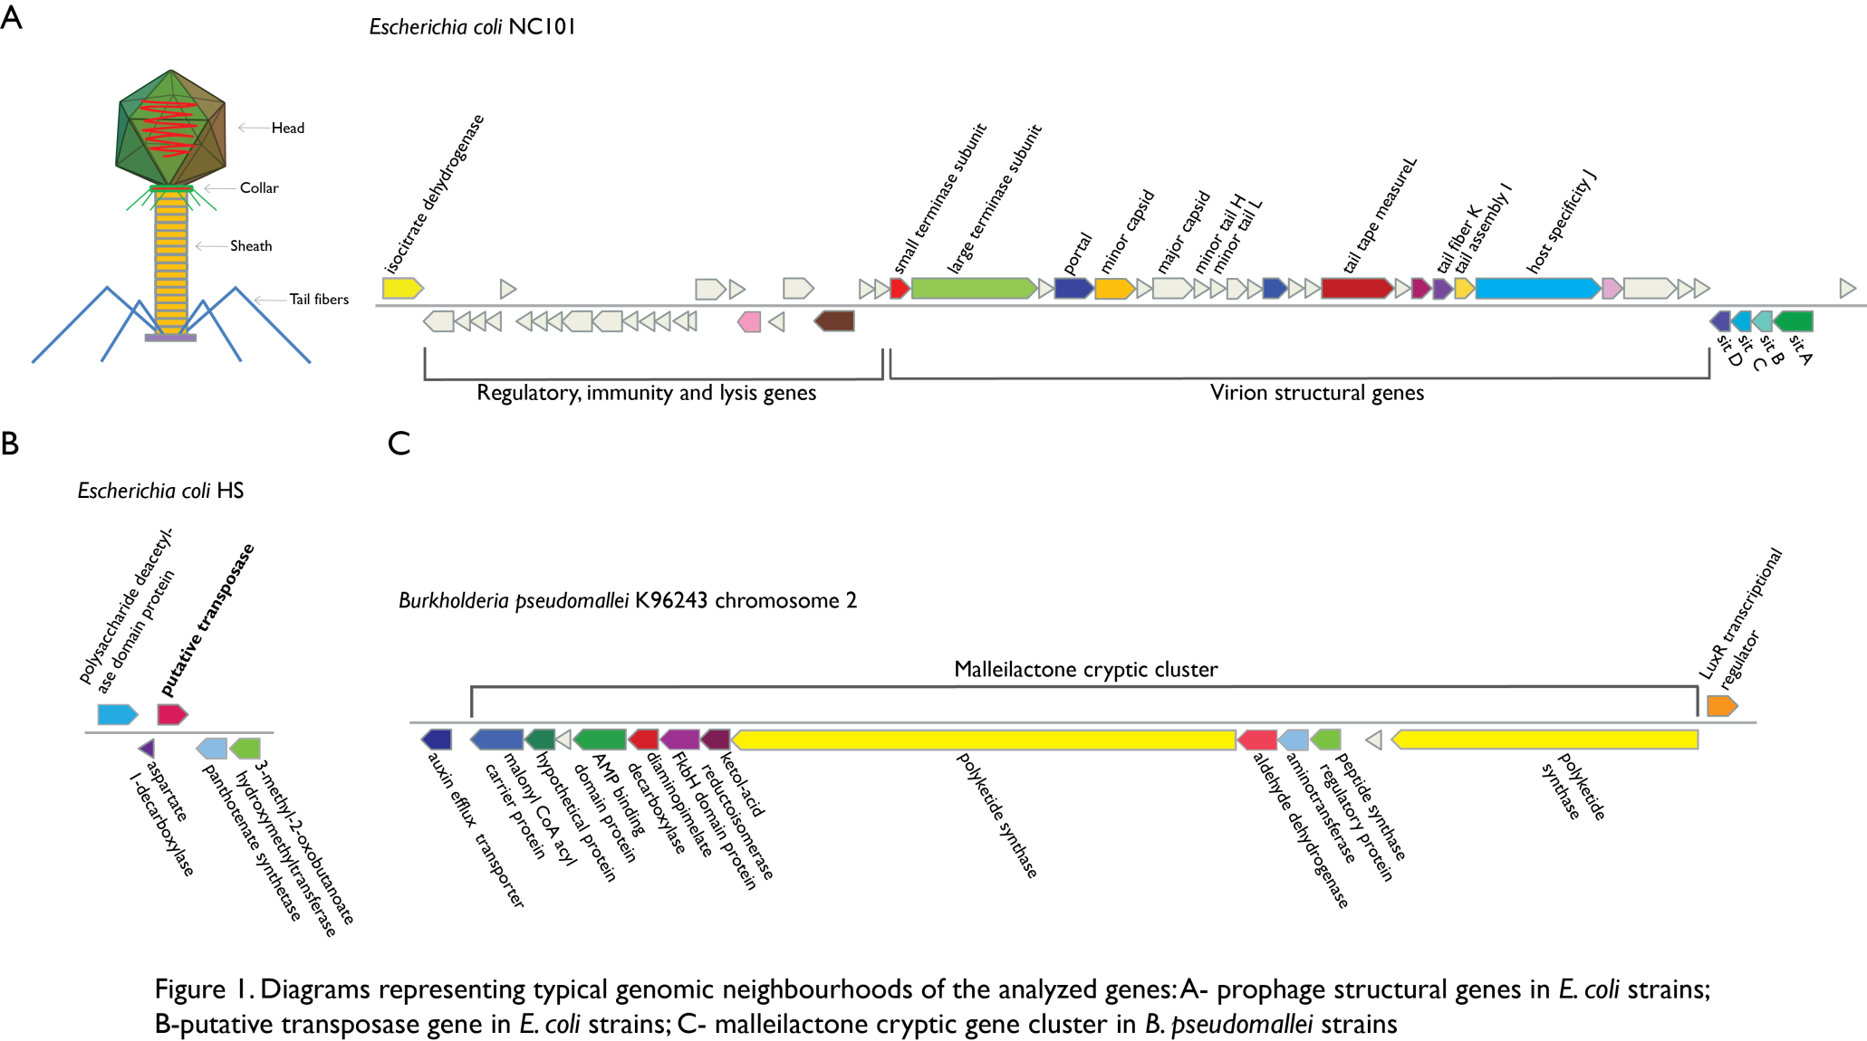
Vertically Inherited Genes Not Expressed for Function

Slide 53
Counting Algorithm
Calculate number of different nucleotides/amino acids per MSA column (X)
Calculate number of nucleotides/amino acids substitutions (X-1)
Calculate number of synonymous changes
S=(N-1)nc-N
assuming N=(N-1)aa
X=2 1 nucleotide substitution
1 non-synonymous change
X=2 1 amino acid substitution

Slide 54
Simulation Algorithm
Calculate MSA nucleotide frequencies (%A,%T,%G,%C)
Introduce a given number of random substitutions ( at any position) based on inferred base frequencies
Compare translated mutated codon with the initial translated codon and count synonymous and non-synonymous substitutions

Slide 55
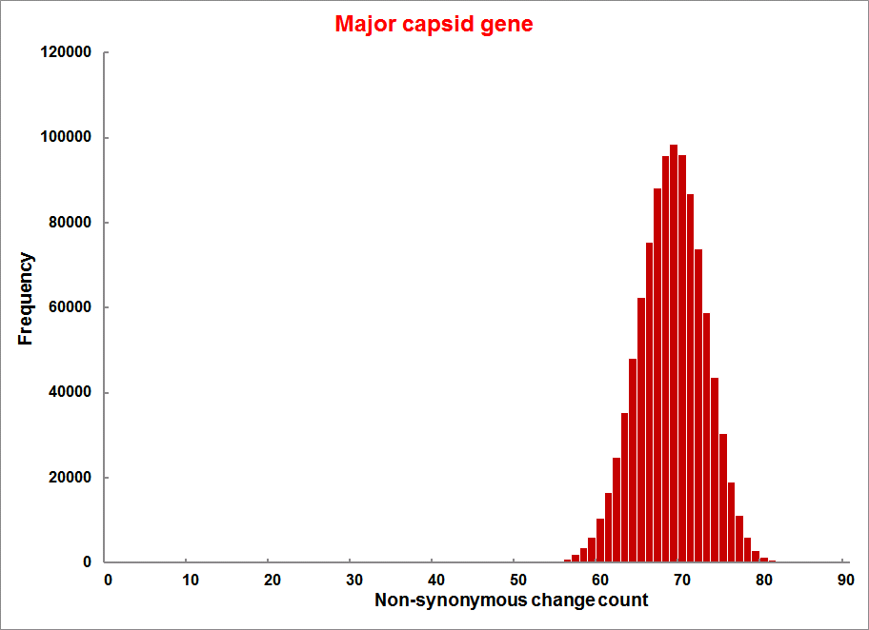
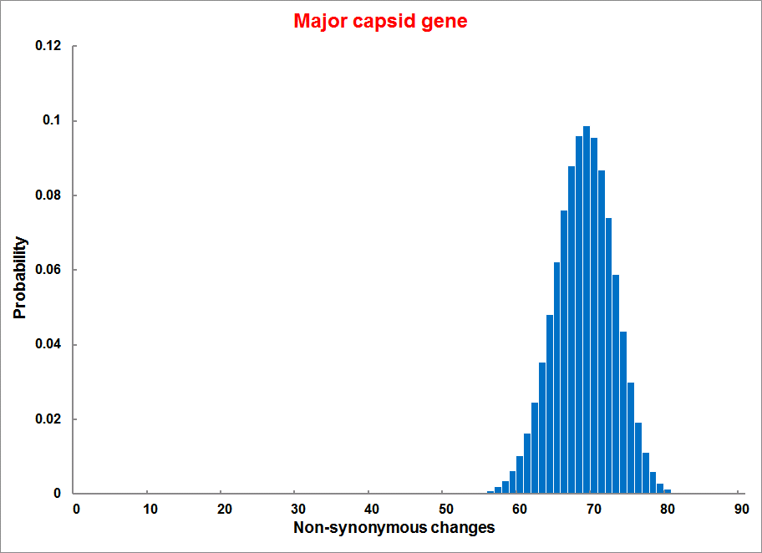
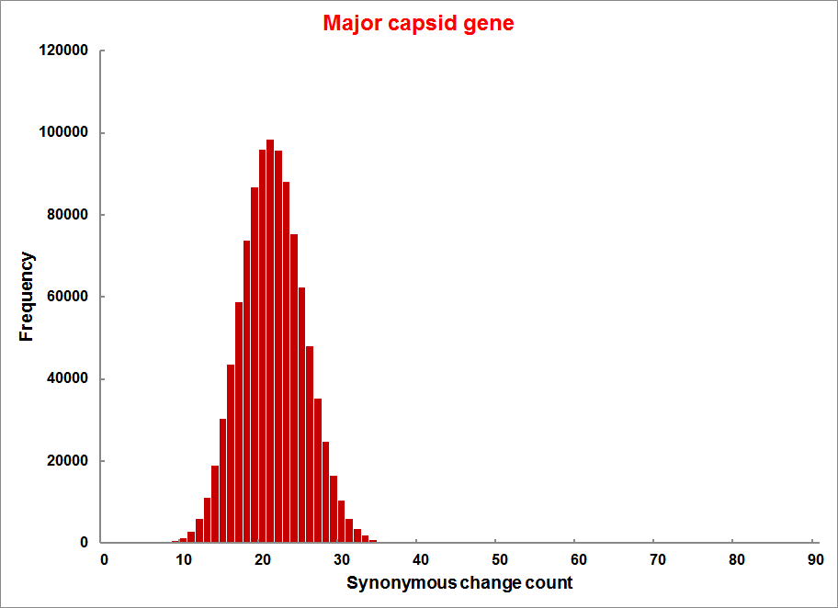
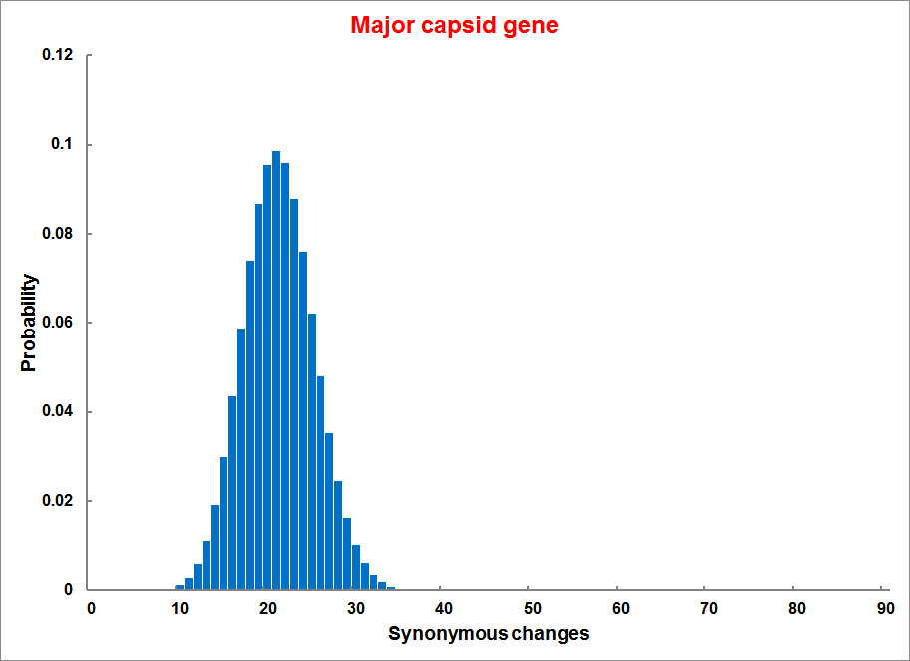
Evolution of Coding DNA Sequences Under a Neutral Model E. coli Prophage Genes
Count distribution from simulations
Probability distribution
n=90
Non-synonymous
n= 90
k= 24
p=0.763
P(≤24)=3.63E-23
Observed=24
P(≤24) < 10⁻⁶
n=90
Synonymous
n= 90
k= 66
p=0.2365
P(≥66)=3.22E-23
Observed=66
P(≥66) < 10⁻⁶

Slide 56
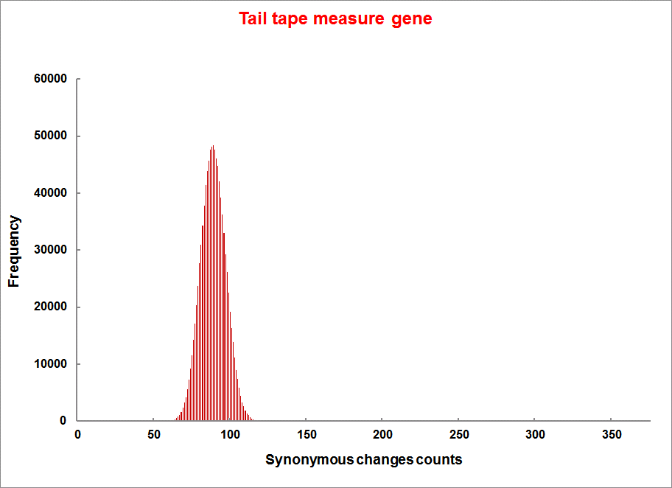
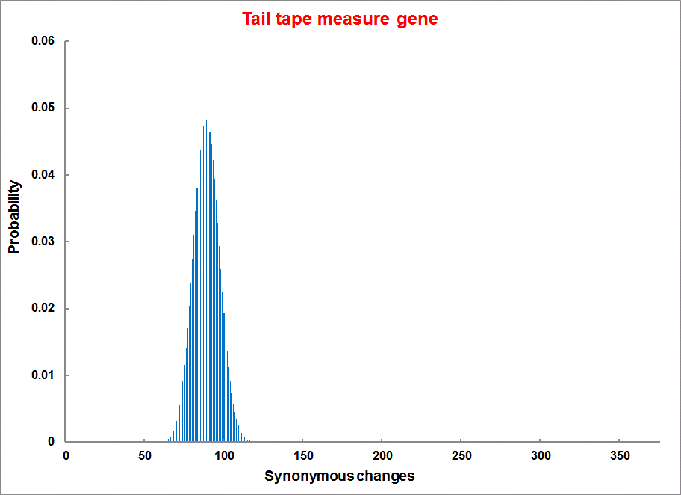
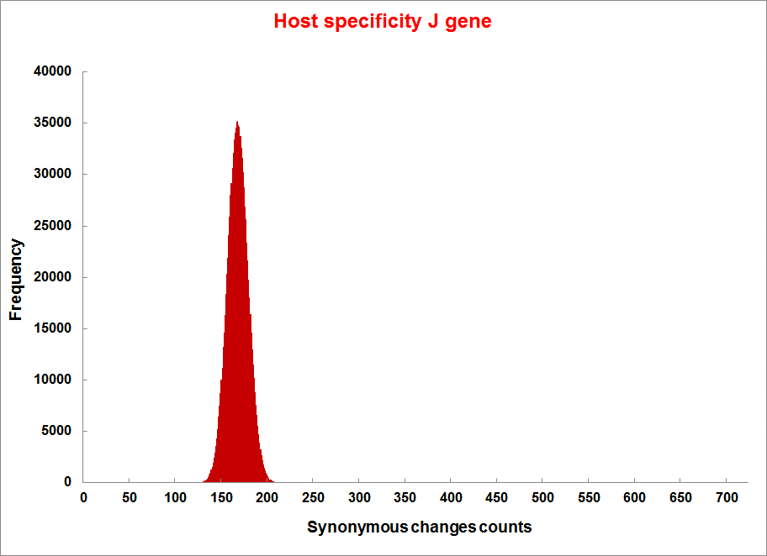
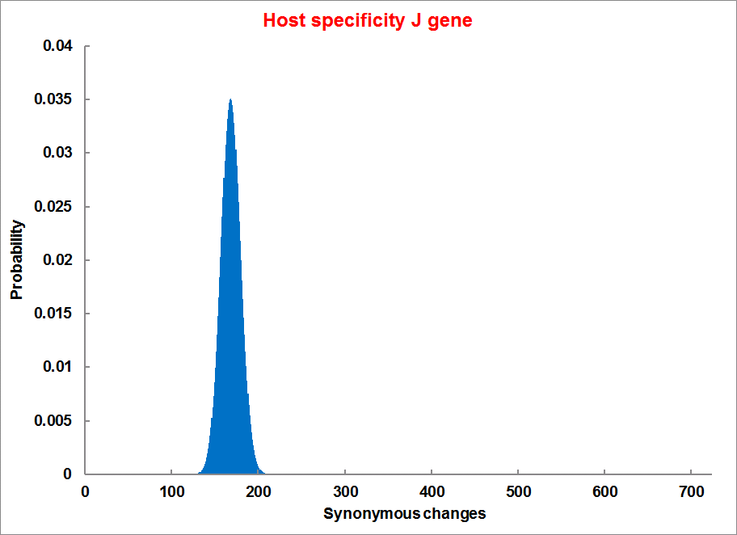
Evolution of Coding DNA Sequences Under a Neutral Model E. coli Prophage Genes
Count distribution
Probability distribution
n=375
Synonymous
n= 375
k= 243
p=0.237
P(≥243)=7.92E-64
Observed=243
P(≥243) < 10⁻⁶
n=723
Synonymous
n= 723
k= 498
p=0.232
P(≥498)=6.41E-149
Observed=498
P(≥498) < 10⁻⁶

Slide 57
Evolution of Coding DNA Sequences Under a Neutral Model E. coli Prophage Genes
 |  | OBSERVED |  | SIMULATED |  | Dnapars | Simulated | Codeml
Gene | Alignment Length (bp) | Substitutions | Synonymous changes* | Substitutions | p-value synonymous (given *) | Minimum number of substitutions | dN/dS | dN/dS
Major capsid | 1023 | 90 | 66 | 90 | 3.23E-23 | 94 | 0.113 | 0.13142
Minor capsid C | 1329 | 81 | 59 | 81 | 1.98E-19 | 84 | 0.124 | 0.17704
Large terminase subunit | 1923 | 75 | 67 | 75 | 7.10E-35 | 82 | 0.035 | 0.03773
Small terminase subunit | 543 | 100 | 66 | 100 | 1.07E-19 | 101 | 0.156 | 0.25147
Portal | 1599 | 55 | 46 | 55 | 1.36E-21 | *64 | 0.057 | 0.08081
Protease | 1329 | 55 | 37 | 55 | 4.64E-11 | 55 | 0.162 | 0.24421
Minor tail H | 2565 | 260 | 168 | 260 | 1.81E-44 | 260 | 0.17 | 0.30928
Minor tail L | 696 | 30 | 26 | 30 | 1.30E-13 | 30 | 0.044 | 0.05004
Host specificity J | 3480 | 723 | 498 | 723 | 6.42E-149 | *773 | 0.137 | 0.17103
Tail fiber K | 741 | 41 | 28 | 41 | 1.06E-09 | 44 | 0.14 | 0.18354
Tail assembly I | 669 | 39 | 33 | 39 | 3.82E-15 | 40 | 0.064 | 0.07987
Tail tape measure protein | 2577 | 375 | 243 | 375 | 7.92E-64 | 378 | 0.169 | 0.27957
Values well under the p=0.01 threshold, suggesting rejection of the null hypothesis of neutral evolution of prophage sequences.

Slide 58
dN/dS < 1 is not sufficient evidence for the beneficial function of the encoded protein.
Prophages that have not been active as phages and are inherited vertically have a dN/dS below 1.
A dN/dS of this size may be due to the encoded protein turning bad after some mutations.

Slide 59
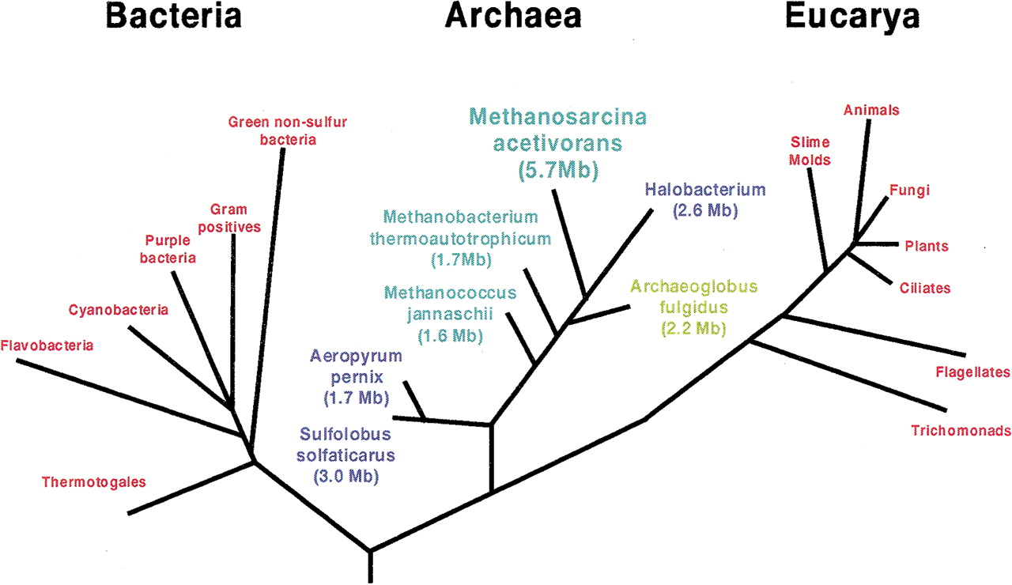
Thermo- plasmatales
Pyrococci
Modified from: Galagan et al., 2002

Slide 60
Methanogenesis
Unique to subset of Archaea
Energy production via reduction of multiple carbon substrates to CH₄
900 Million metric tons of biogenic methane produced annually.
Over 66% of biogenic methane is produced from acetate, mostly by Methanosarcina genera.
From: Galagan et al., 2002

Slide 61
Methanogenesis
CODH complex: reversible Acetyl-CoA synthesis
Acetoclastic methanogenesis- specific pathway:
acetate kinase (AckA) and phosphotransacetylase (Pta)
From: Galagan et al., 2002

Slide 62
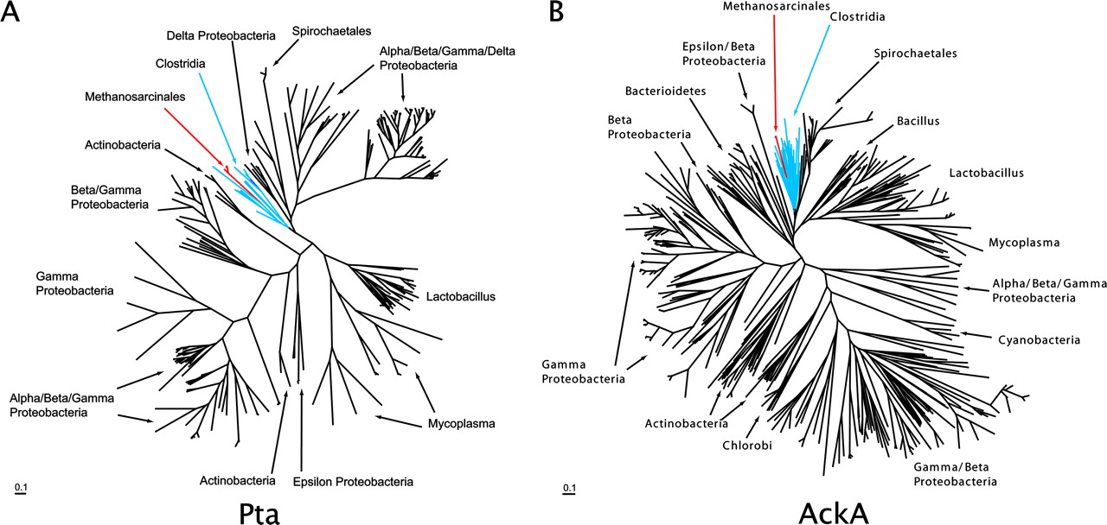
Modified form Fournier and Gogarten (2008) Evolution of Acetoclastic Methanogenesis in Methanosarcina via Horizontal Gene Transfer from Cellulolytic Clostridia. J. Bacteriol. 190(3):1124-7
The sequences from Methanosarcina (red) branch within the Clostridia (blue)

Slide 63
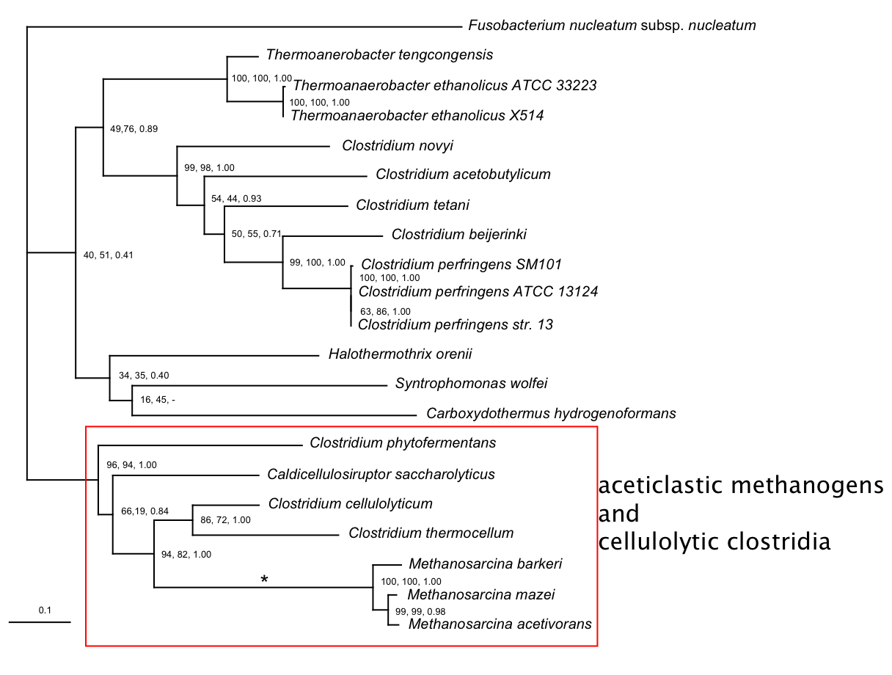
Phosphotransacetylase (Pta)
Modified form Fournier and Gogarten (2008) Evolution of Acetoclastic Methanogenesis in Methanosarcina via Horizontal Gene Transfer from Cellulolytic Clostridia. J. Bacteriol. 190(3):1124-7
acetoclastic Methanosarcina and cellulolytic clostridia

Slide 64
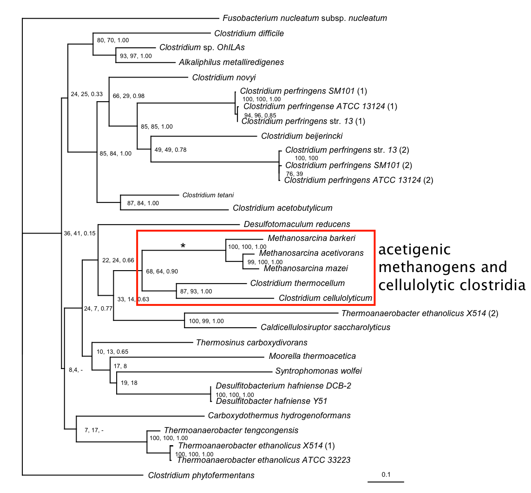
acetate kinase (AckA)
acetoclastic methonogens and cellulolytic clostridia
Modified form Fournier and Gogarten (2008) Evolution of Acetoclastic Methanogenesis in Methanosarcina via Horizontal Gene Transfer from Cellulolytic Clostridia. J. Bacteriol. 190(3):1124-7

Slide 65
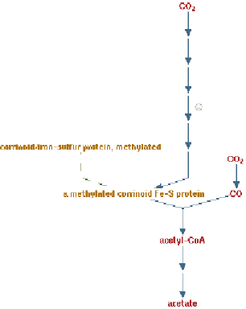
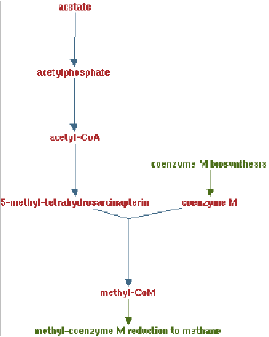
Clostridia acetigenic pathway
Methanosarcina
aceticlastic pathway
AckA
HGT
PtaA
PtaA
AckA
Figures drawn with Metacyc (www.metacyc.org)
Notes:
This transfer probably occurred after landplants had already evolved and produced the substrate for the diversification of the cellulolytic clostridia in diverse, cellulose-rich, freshwater environment, which presumably required the availability of significant terrestrial plant biomass for fermentation, probably no earlier than the Mid-Ordovician or about 475 million years ago

