Slide 1
MCB 3421 – computer-lab 14
discussion

Slide 2
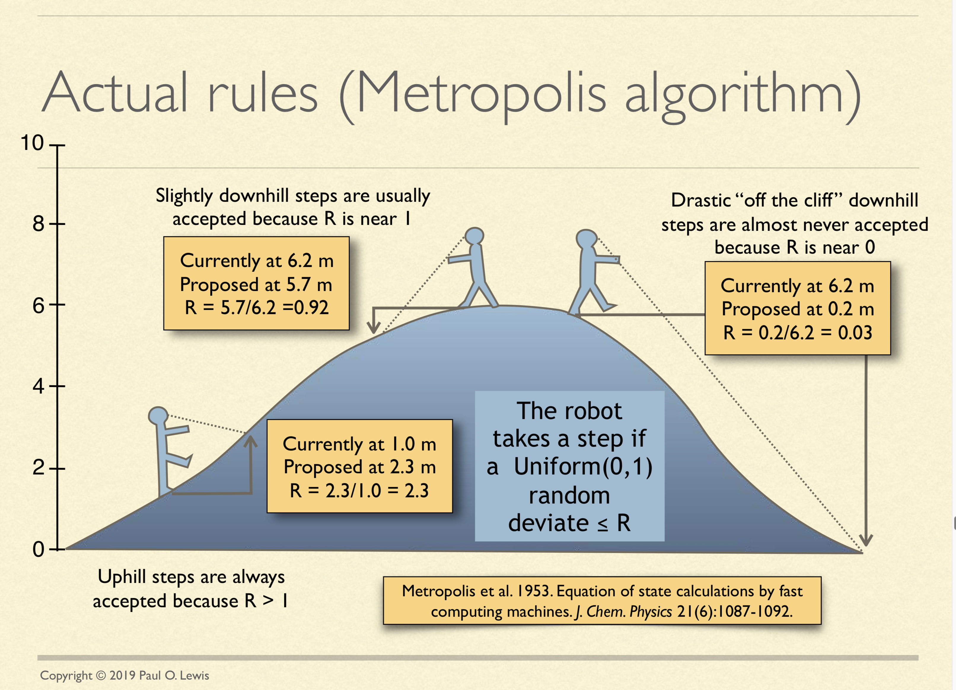
See: http://hydrodictyon.eeb.uconn.edu/people/plewis/downloads/wh2019/lewis-bayesian-part1.pdf

Slide 3
HGT EvolSimulator Results
Supertree approaches
are more robust in
the presence of HGT
HGT:
Super-tree wins

Slide 4
Sequence Similarity
(too similar, or
too divergent)
Supermatrix wins

Slide 5
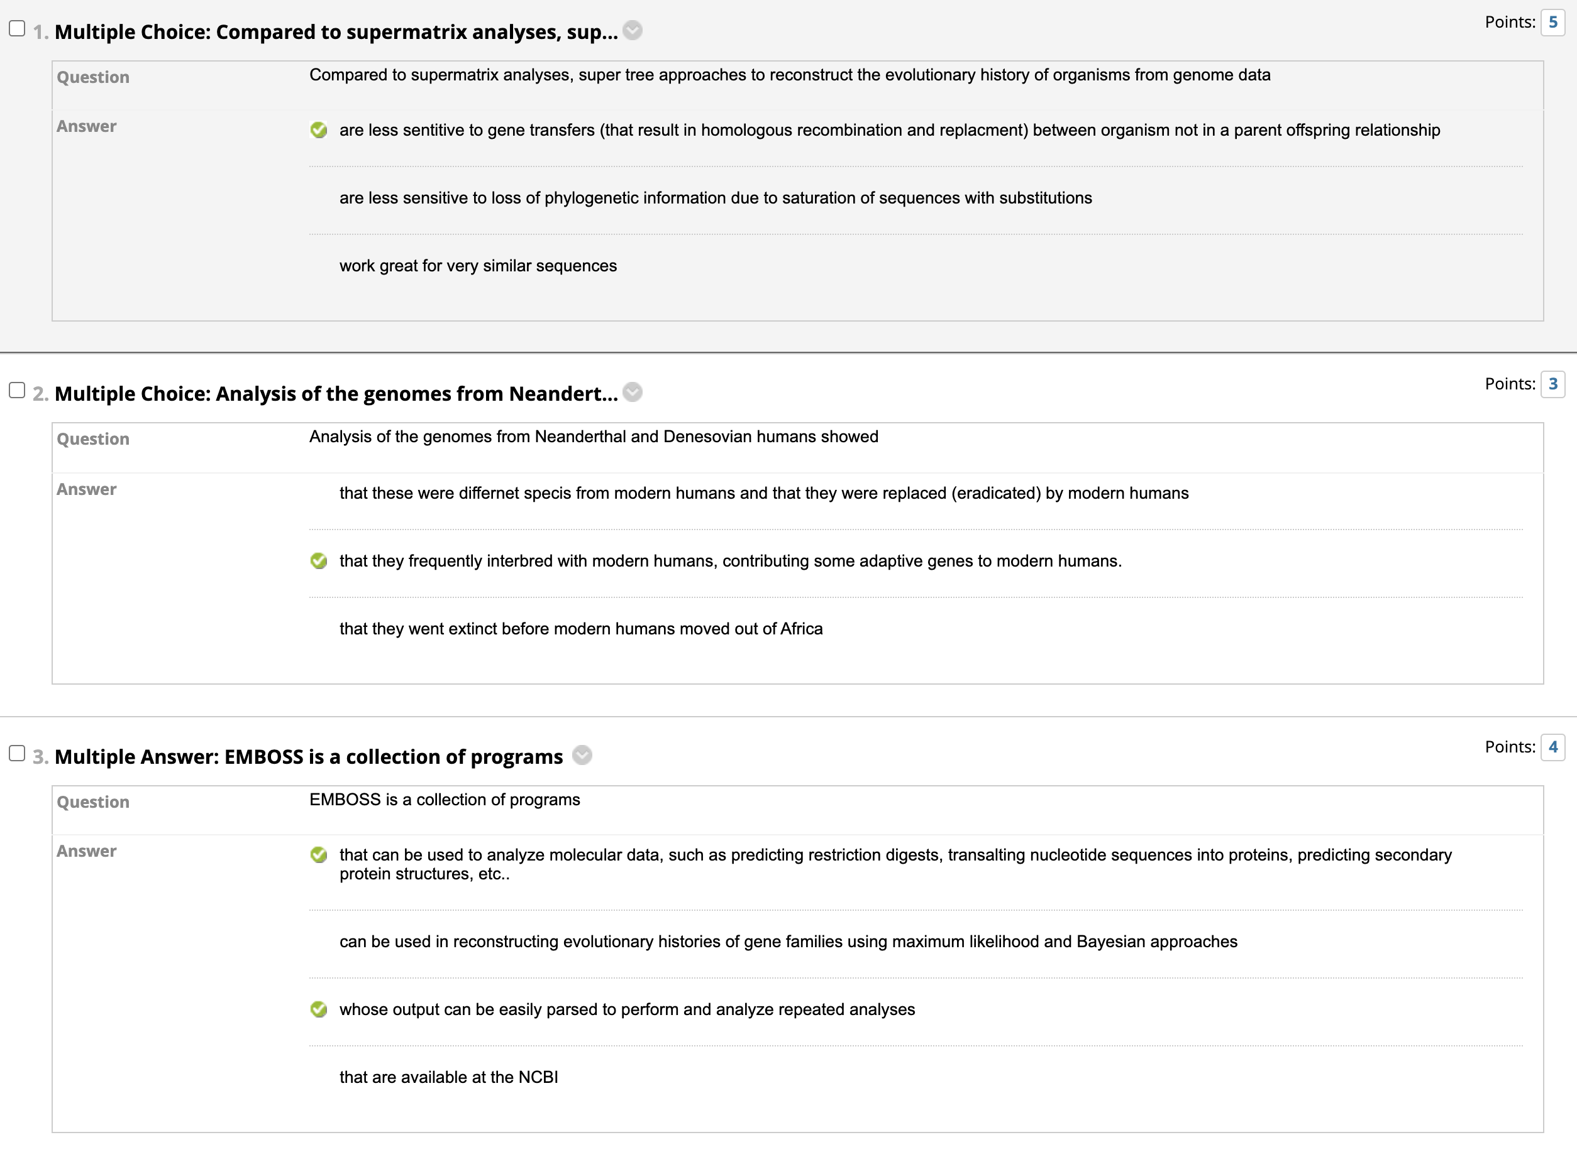

Slide 6
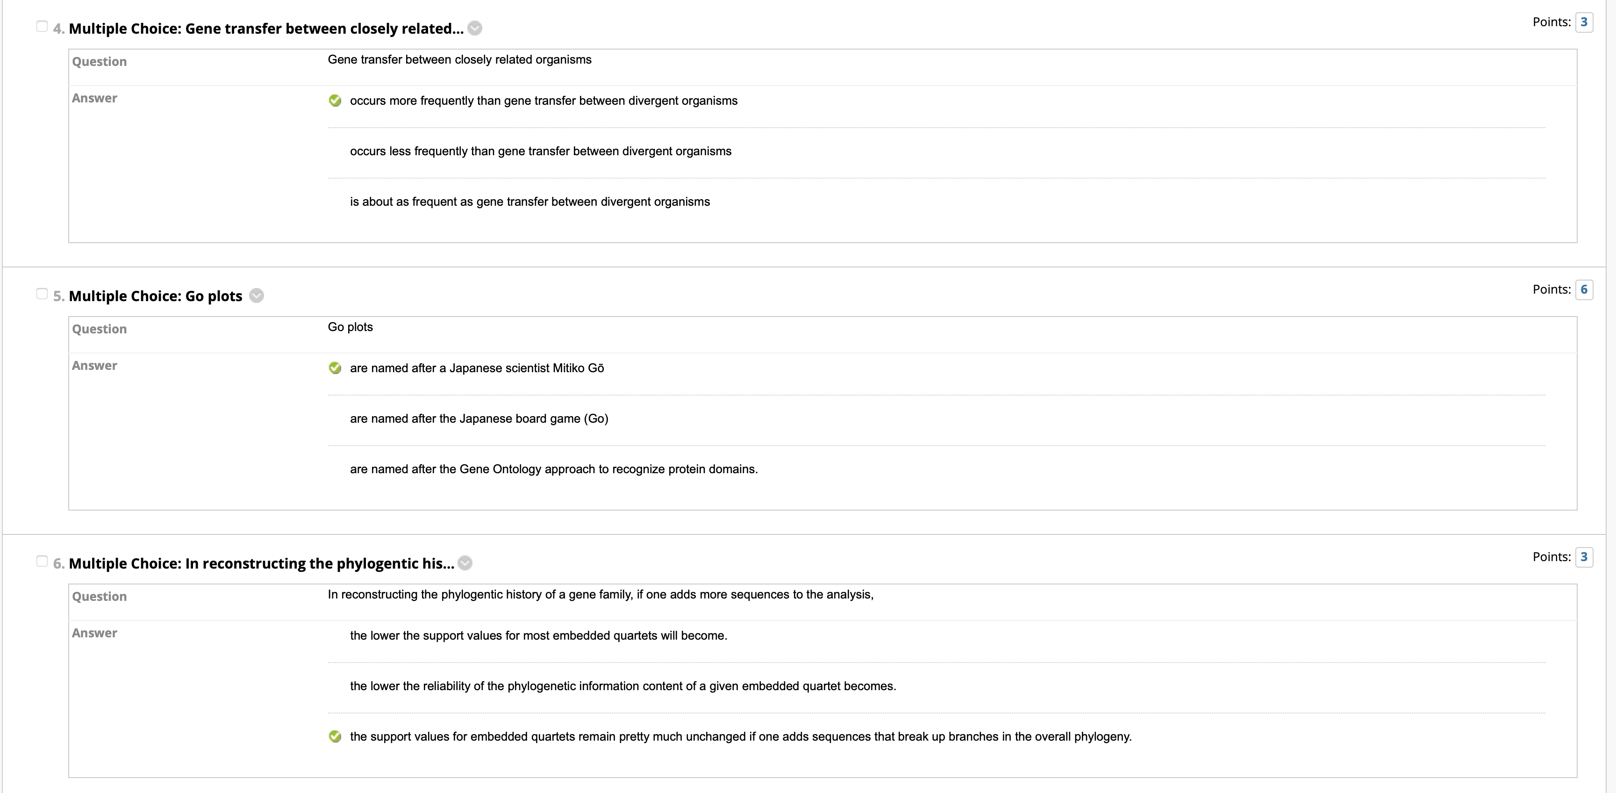

Slide 7
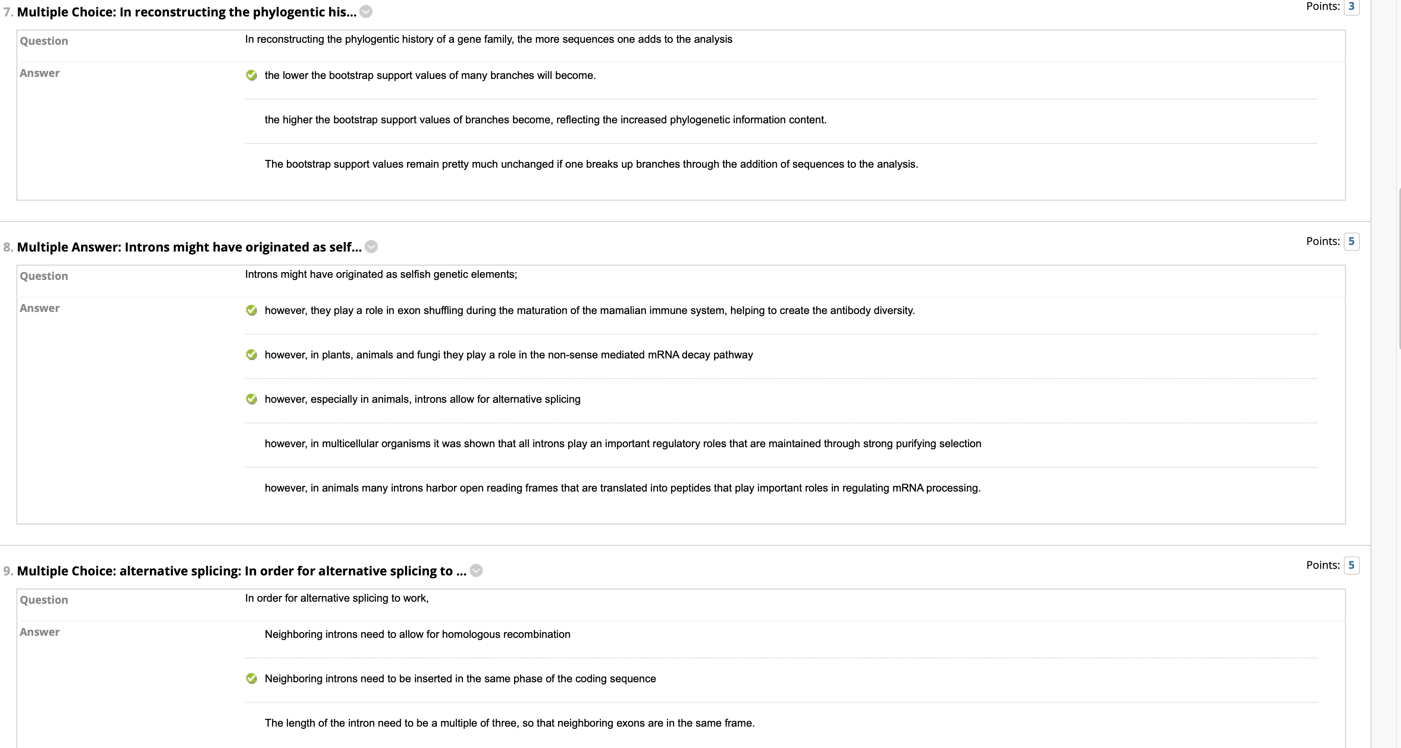

Slide 8
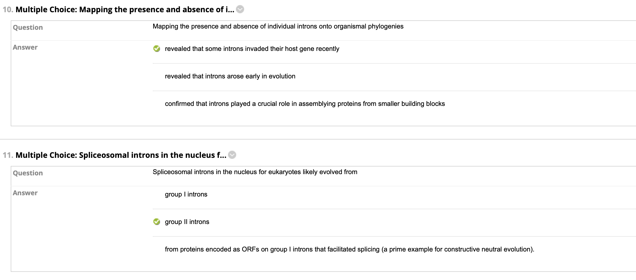

Slide 9
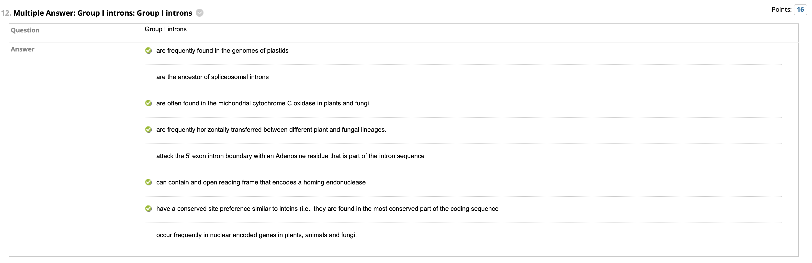

Slide 10
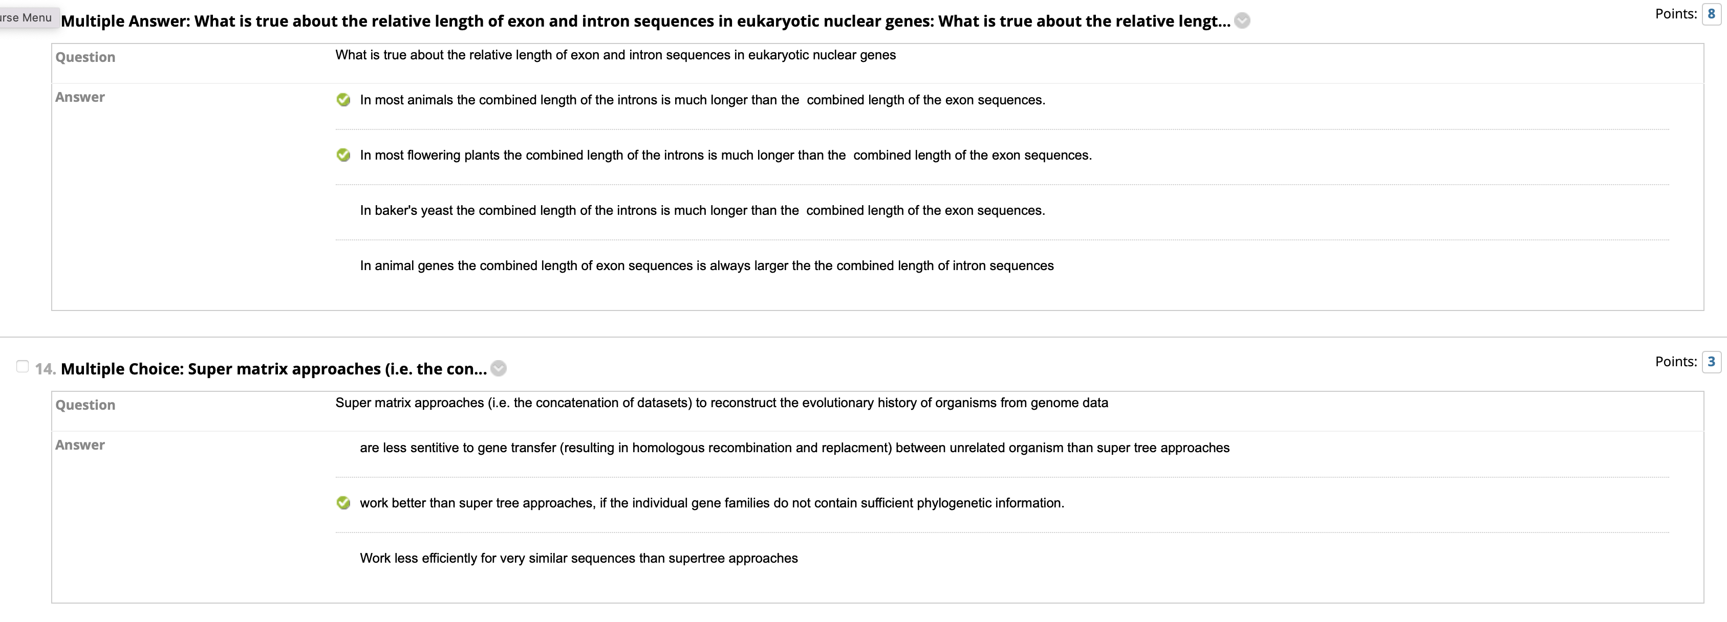

Slide 11
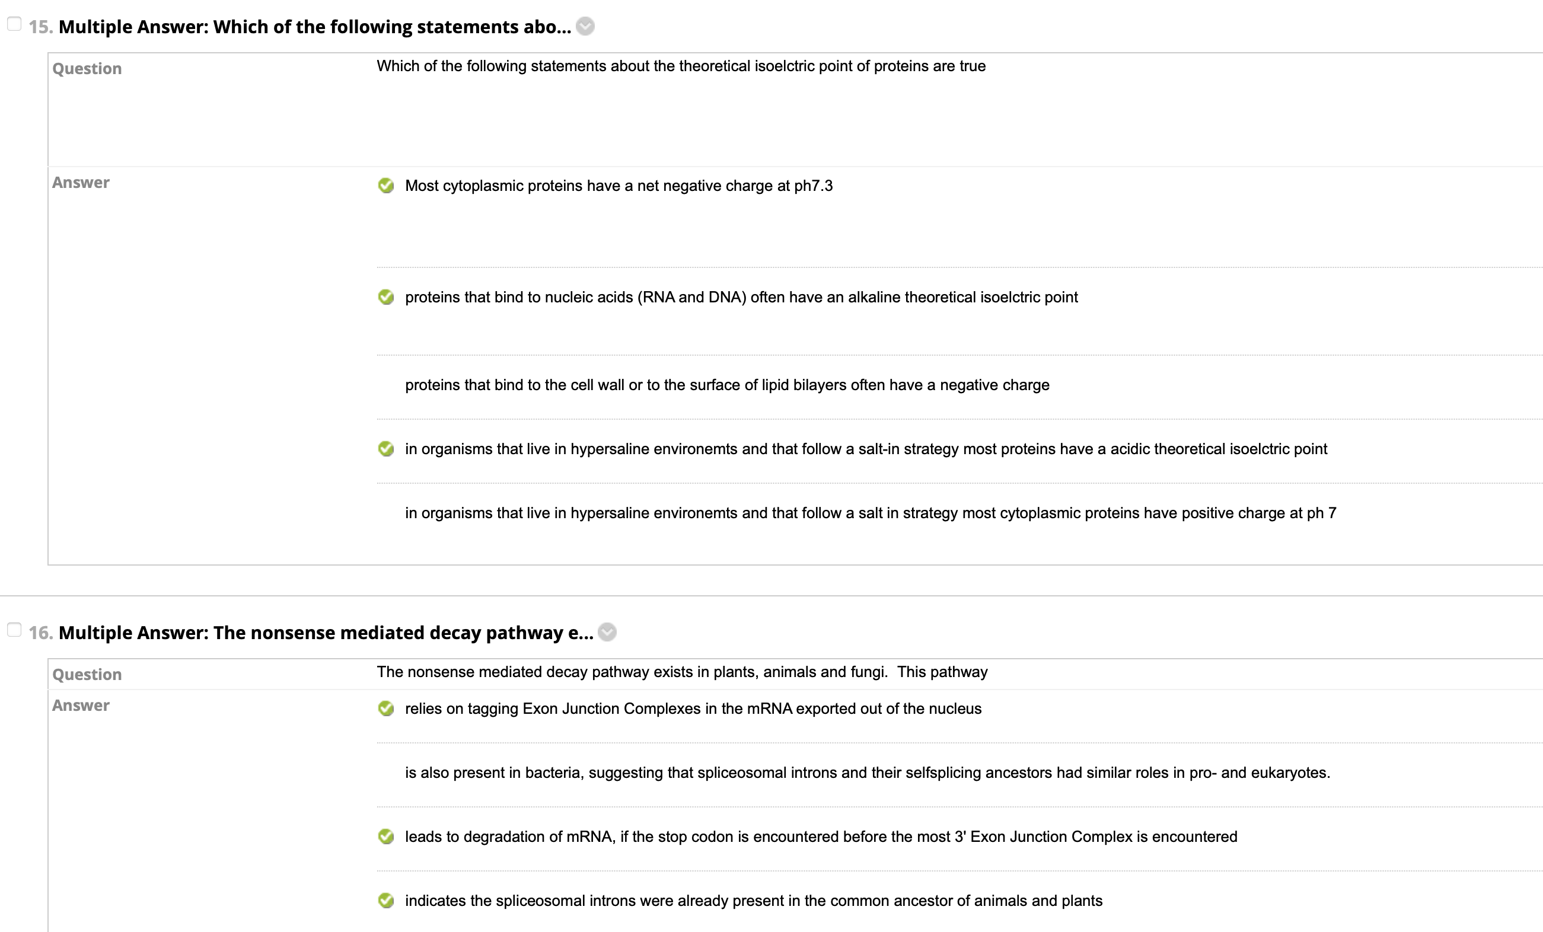

Slide 12
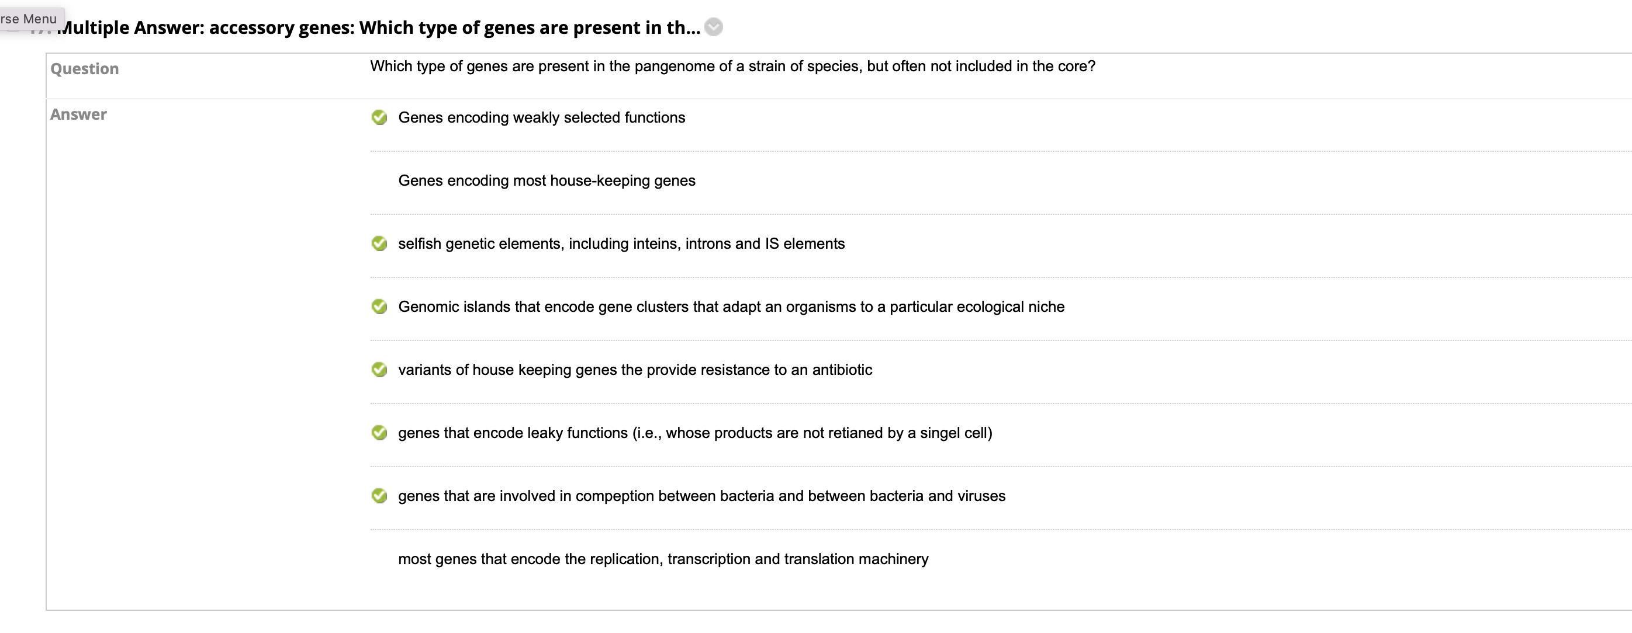

Slide 13
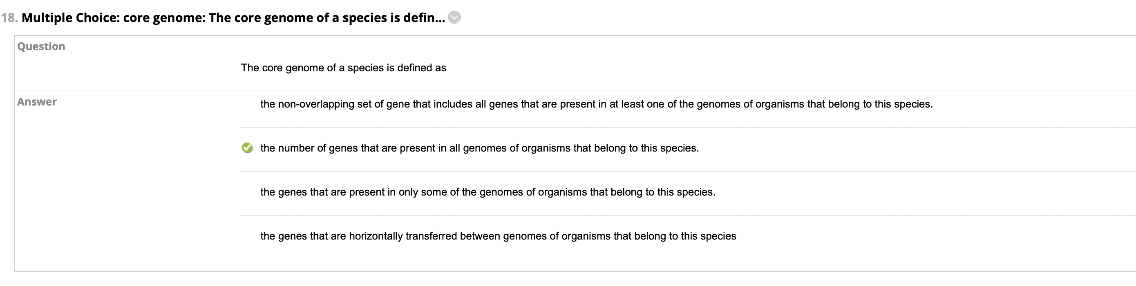

Slide 14
Assume you are running MrBayes and stop the program to look at your robot’s current position. You see that it is sitting at a point where P=0.9. If the next step would put it at P=0.89, is the robot likely to make the step even though the probability is decreasing? (see class 18 slide 6)
the probability for the robot to go downhill is .89/.9 = .99

Slide 15
Given the standard genetic code, and assuming that all codons occur with the same frequency, and assuming a random placement of mutations, what ratio for non-synonymous to synonymous mutations would you expect.
3 Non-synonymous substitution to 1 synonymous substitution
The same number
3-synonymous substitution to 1 non synonymous substitution

Slide 16
What are two common reasons for long branch attraction artifacts to occur in phylogenetic reconstructions?
Long branches due to high substitution rates
Long branches due to the absence of site branches

Slide 17
Give at least 2 (less than 4) examples for complexity that (probably) was created though Constructive neutral evolution.
Split inteins
Additional proteins added to ribosomes and spliceosomes
The invasion nuclear encoded genes by introns

Slide 18
Describe some advantages that the command-line interface has over a typical graphics user interface.
Easy to incorporate commands into scripts to develop analytical pipelines, and to execute repetitive tasks.
Copy commands into an electronic notebook is an easy way to keep track of things.

