Slide 1
MCB 3421
Class 7
Databanks, Entrez and the history of Genbank

Slide 2
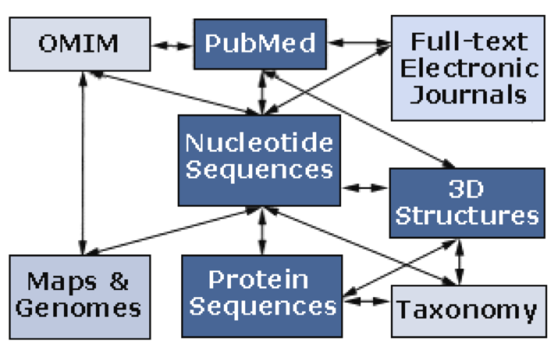
Databanks at the NCBI
NCBI (National Center for Biotechnology Information) is a home for many public biological databases (see diagram below). All of the databases are interlinked, and they all have common search and retrieval system - Entrez.
Very old connection diagram:
A list of the different databases in ENTREZ is here

Slide 3
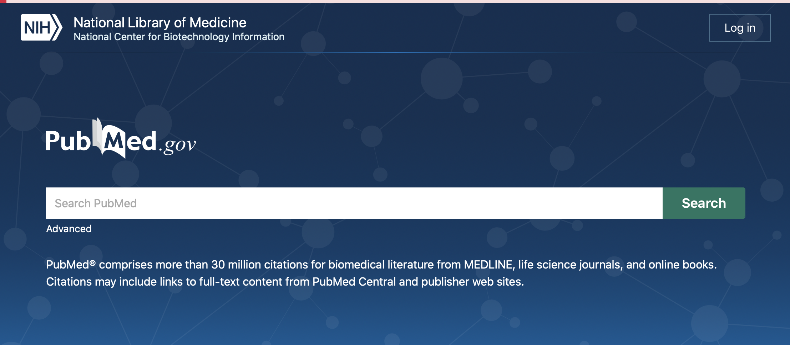
To get from the new pubmed interface to an interface that includes all databanks click on the NIH link

Slide 4
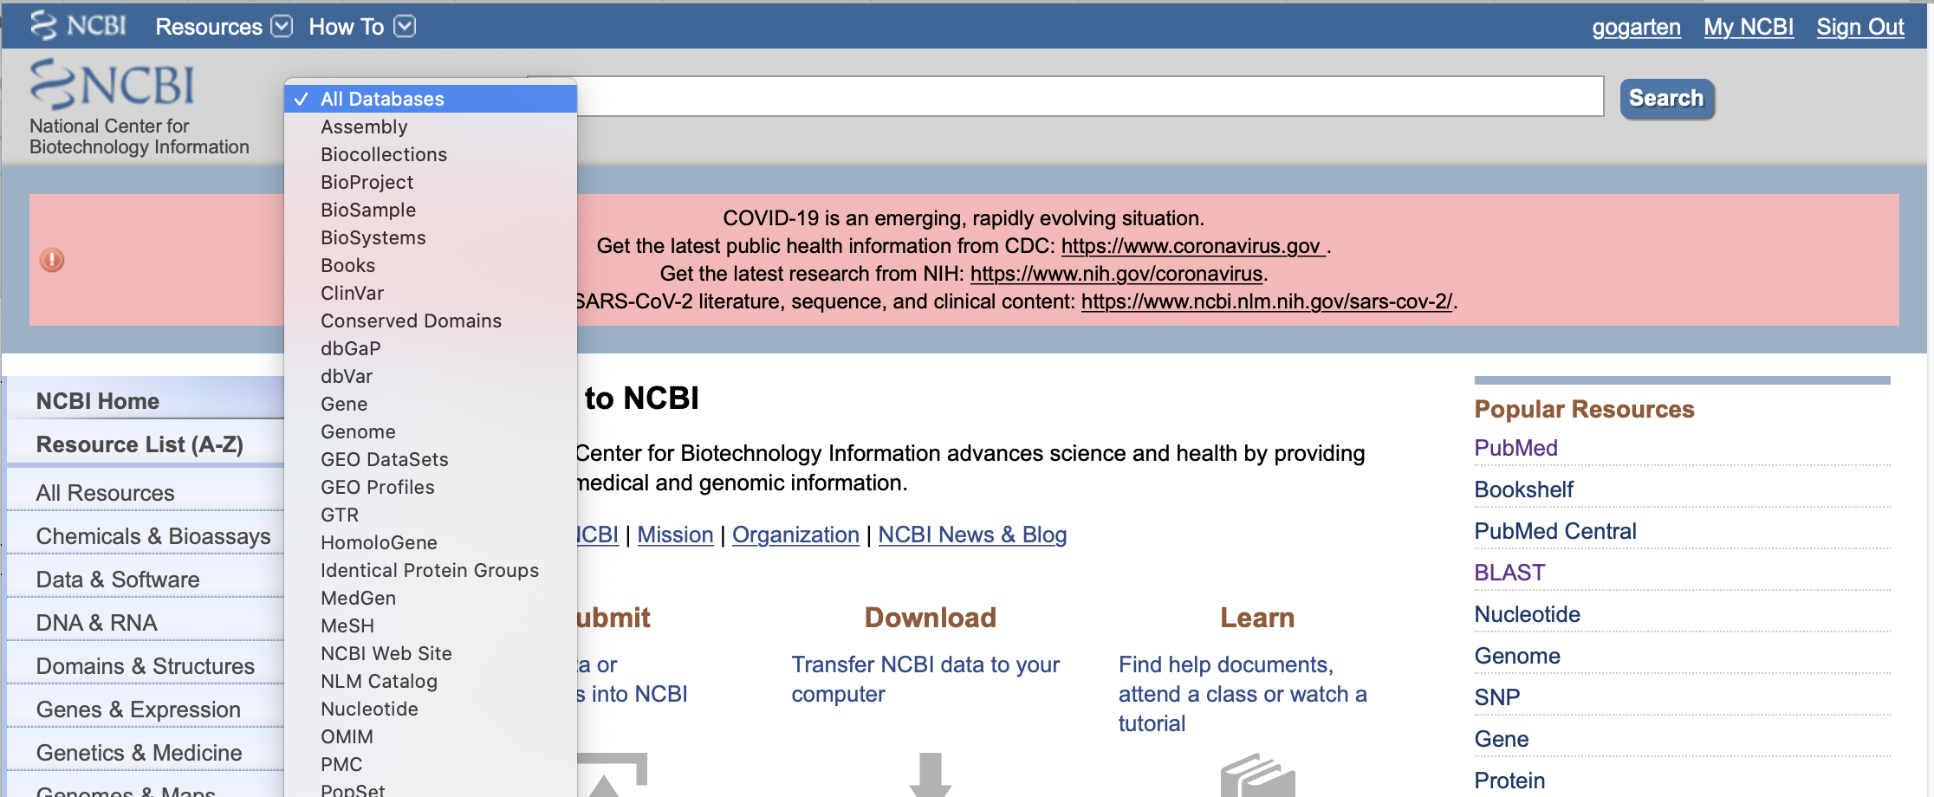
This allows to search either individual or all databases simultaneously.
For example, if you search for a particular protein that is listed with the “accession” A3C58_00620

Slide 5
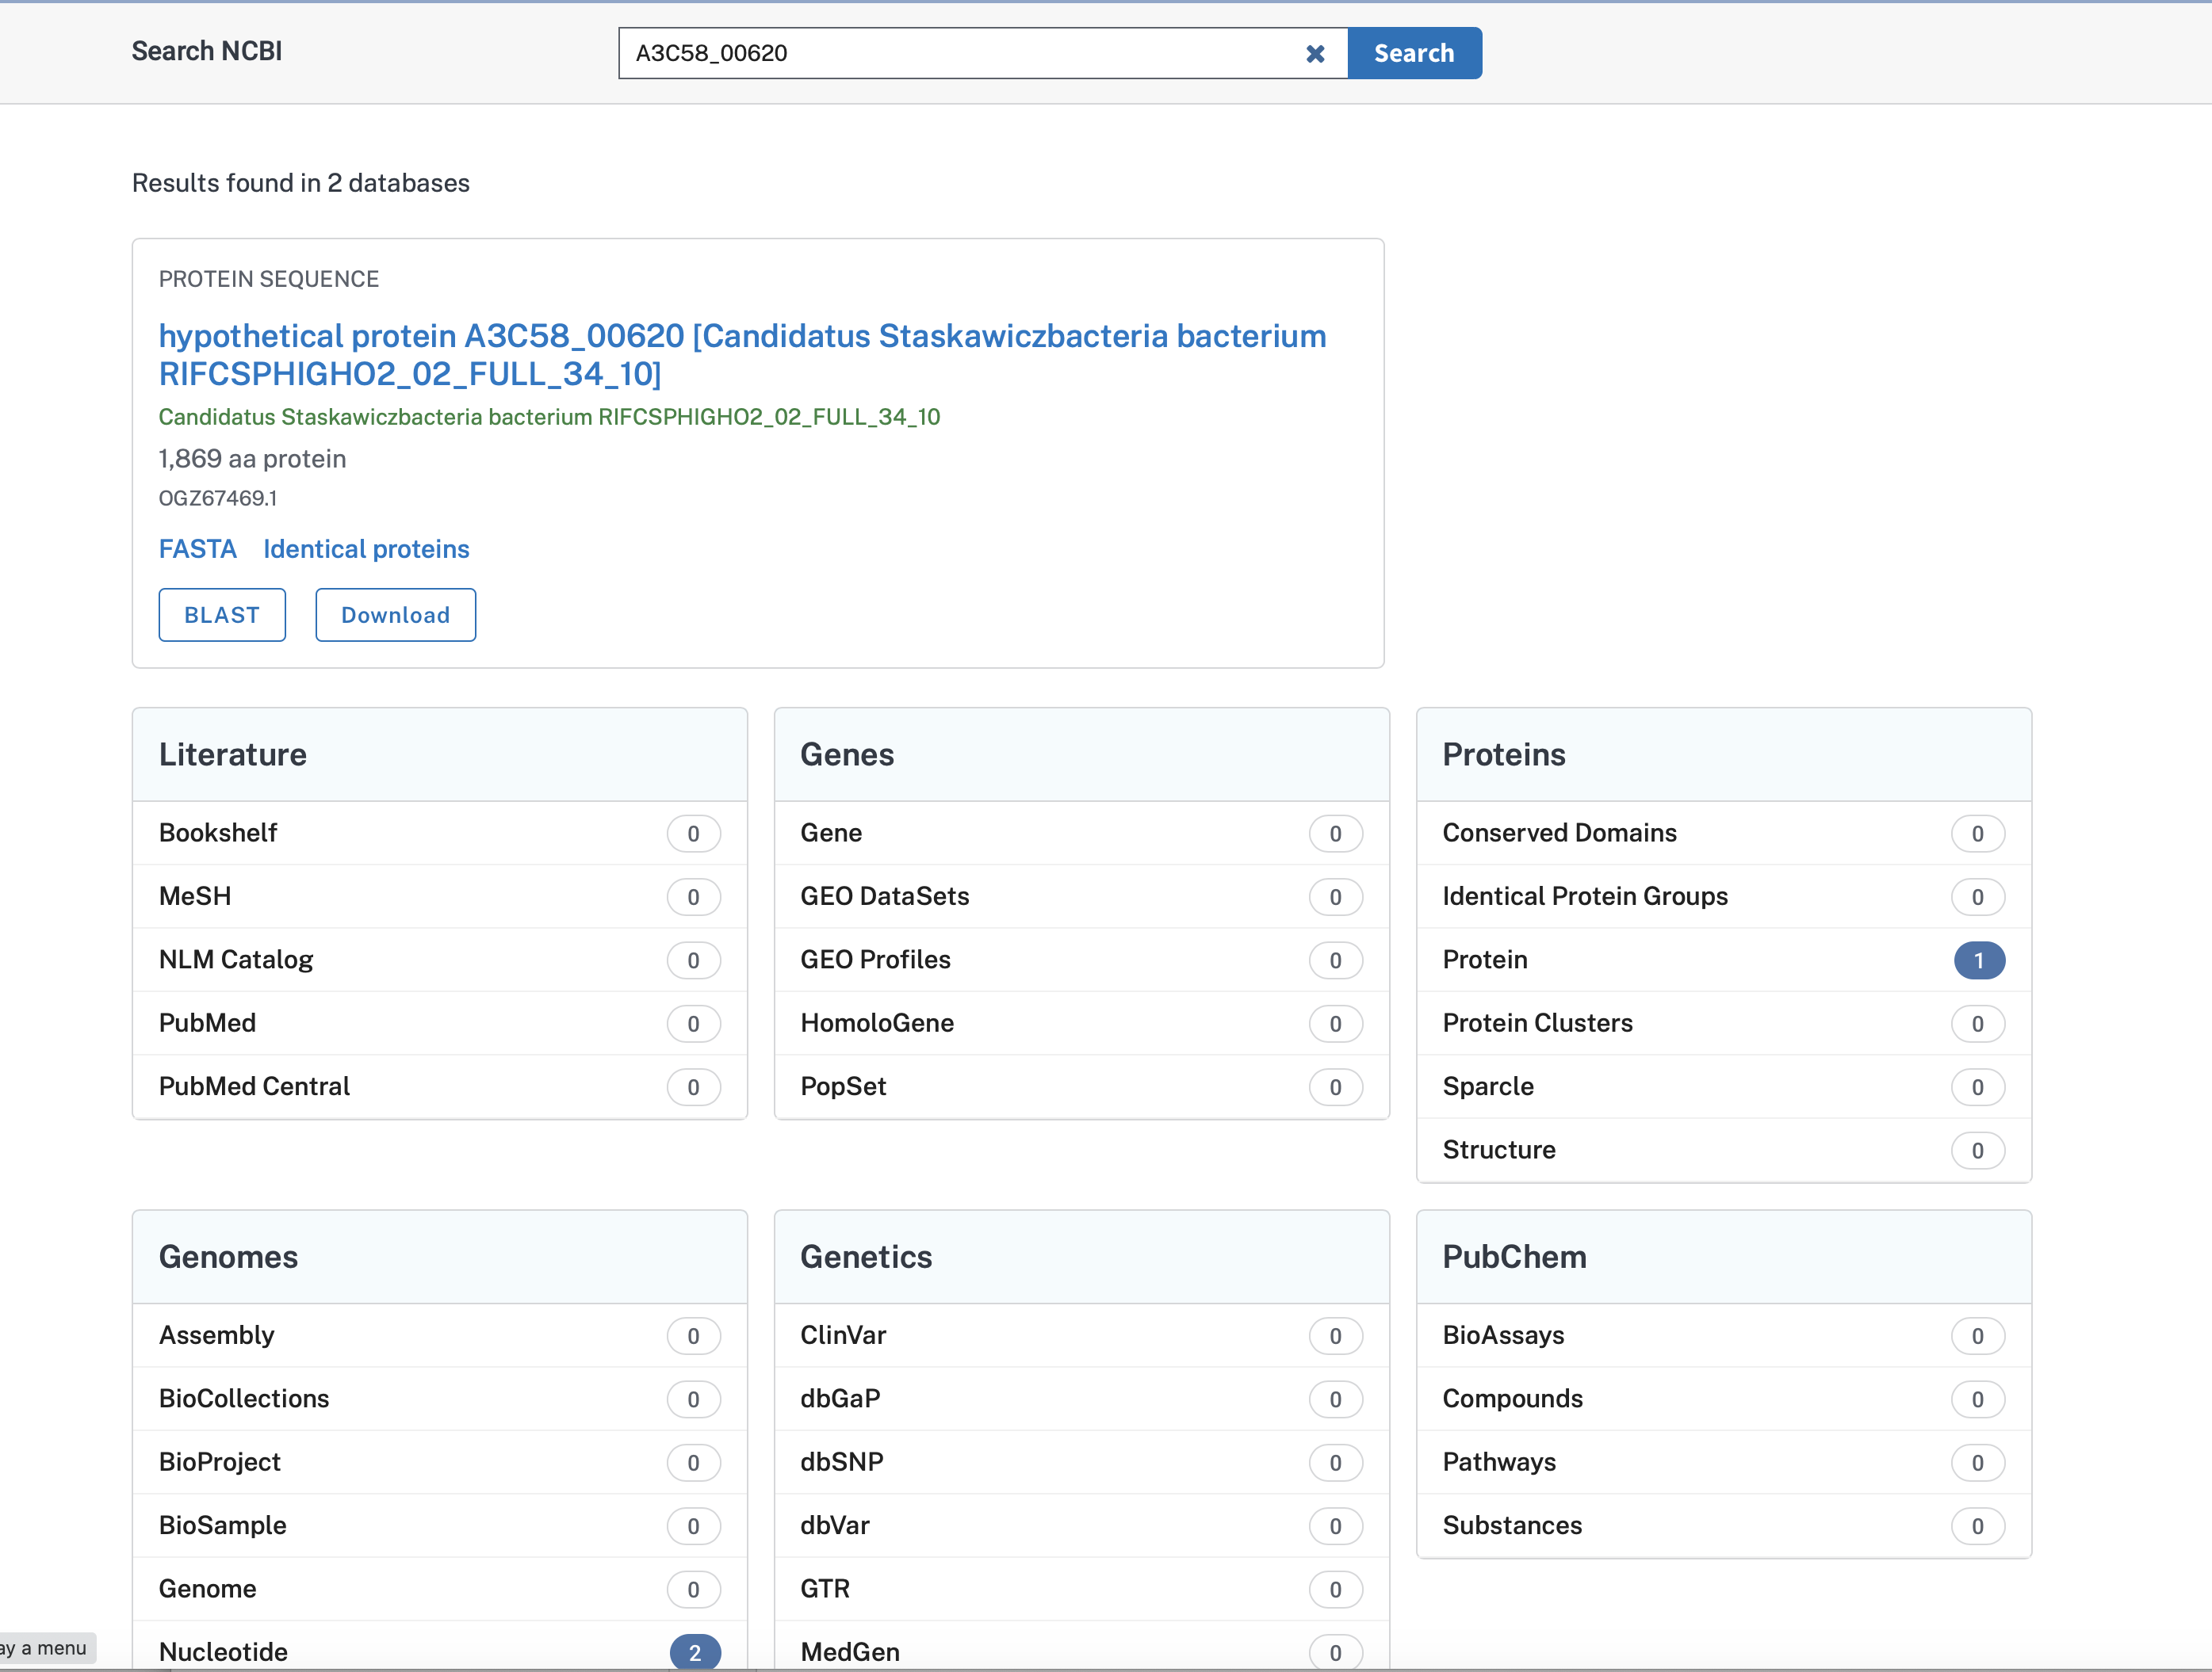
One match in protein databank, and two in genomes (which have the number in the annotation)
Clicking the link gets you to a listing of the entries, and another click gets you to the sequence.

Slide 6
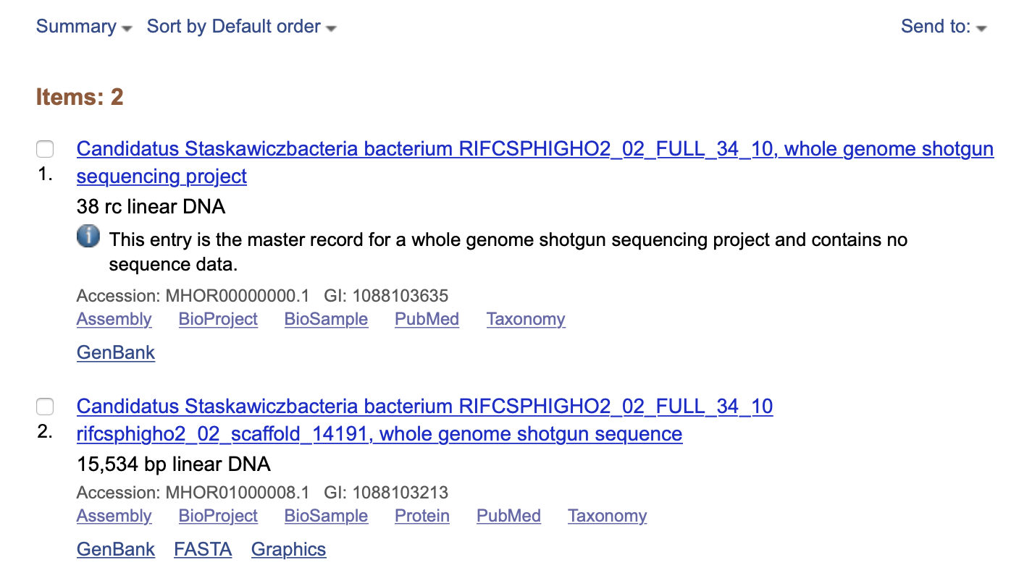
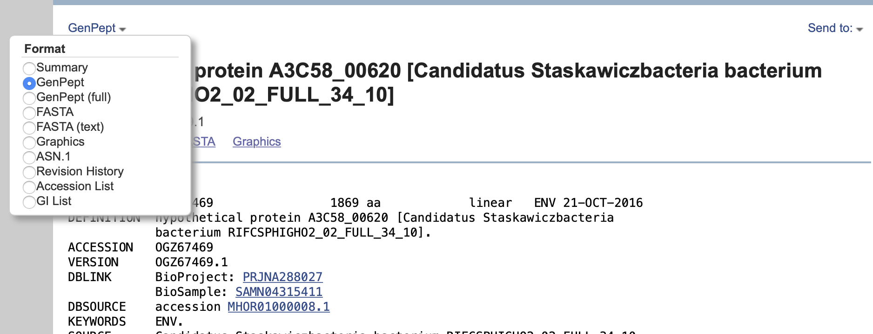
You also can send item to file or a clipboard for later use

Slide 7
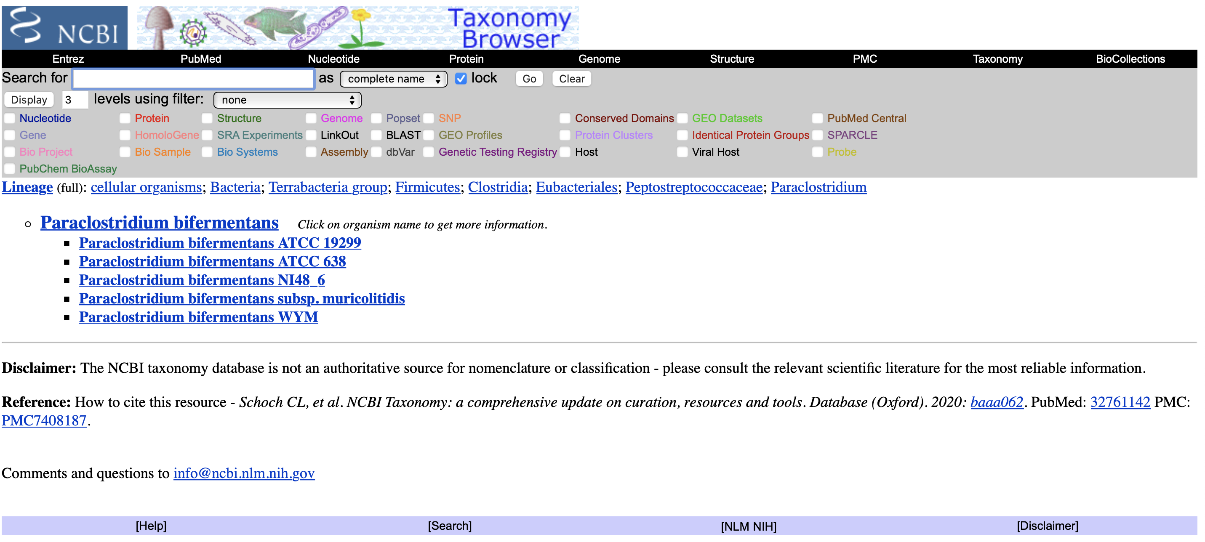
If you want to know more about the organism, you could use the taxonomy databank

Slide 8
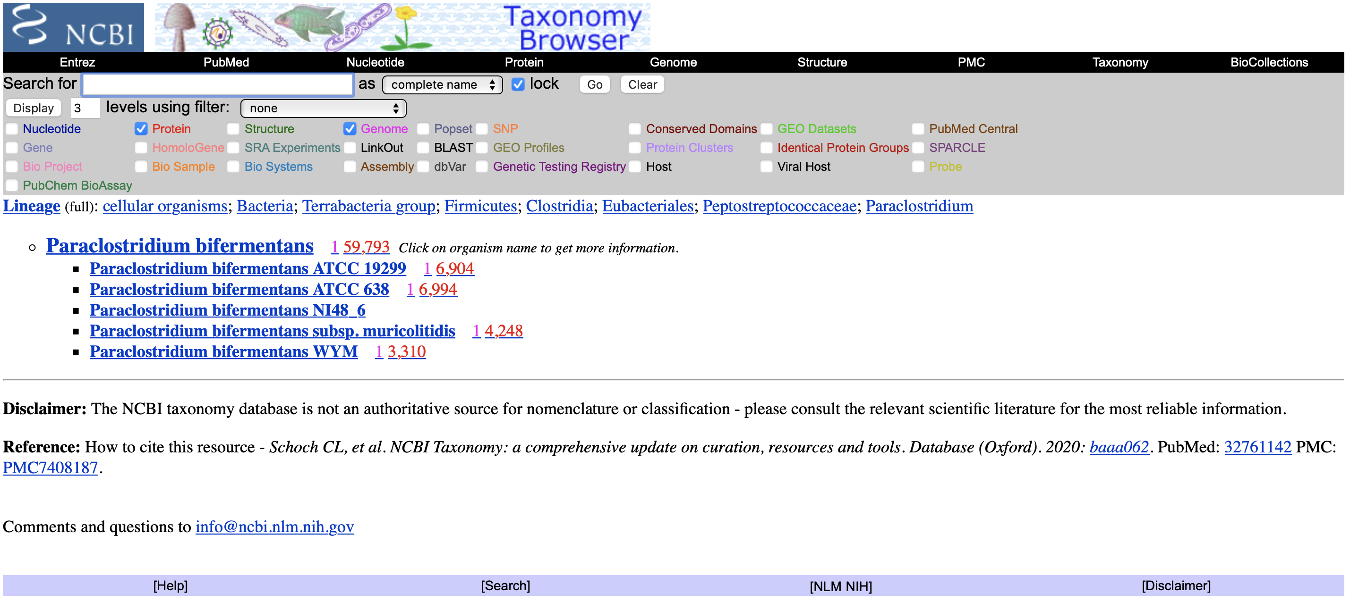
If you want to download all genomes or all proteins from the respective databanks, select items in the header

Slide 9
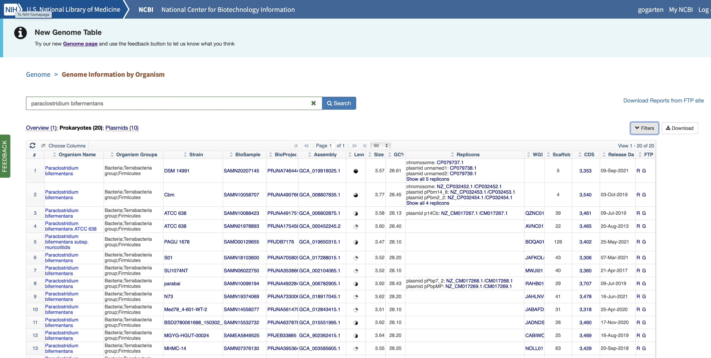
For genomes, the NCBI’s genome browser is a more straight-forward resource:

Slide 10
Distinctions between Databanks
Supervised databanks with gatekeeper. Examples: Swissprot Refseq (at NCBI) Entries are checked for accuracy. + more reliable annotations -- frequently out of date | Repositories without gatekeeper. Examples: GenBank EMBL TrEMBL Everything is accepted. + everything is available -- many duplicates -- poor reliability of annotations

Slide 11
Problem with Ownership
One problem in maintaining databanks (supervised and unsupervised) is "ownership" of sequences, which in many data banks prevents a continuous update of sequences. Even if errors are detected, they are not easily removed form the databank.
Example 1: Jordan Konisky’s K⁺ pump (putative P-type ATPase) in Methanococcus voltae.
Example 2: ATP synthase operons in E.coli see Fig.1 in http://mic.microbiologyresearch.org/content/journal/micro/10.1099/mic.0.033811-0#tab2
Example 3: Even species names are often wrongly assigned (see slides and/or manuscript)

Slide 12
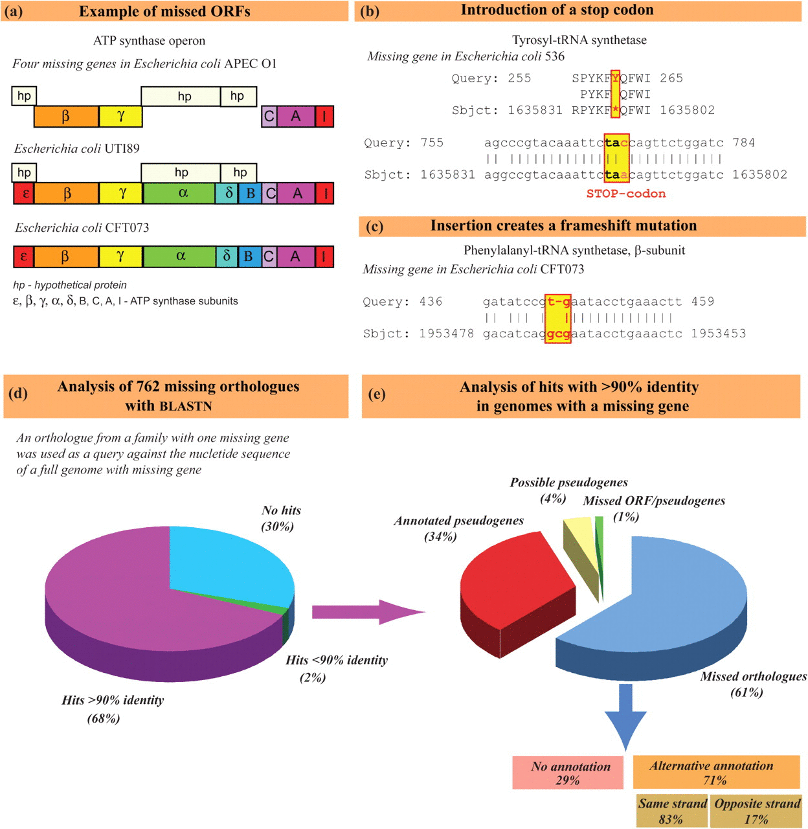
The hypothetical proteins in APEC01 have now become part of a conserved hypothetical protein family – they are found in many other E. coli.

Slide 13
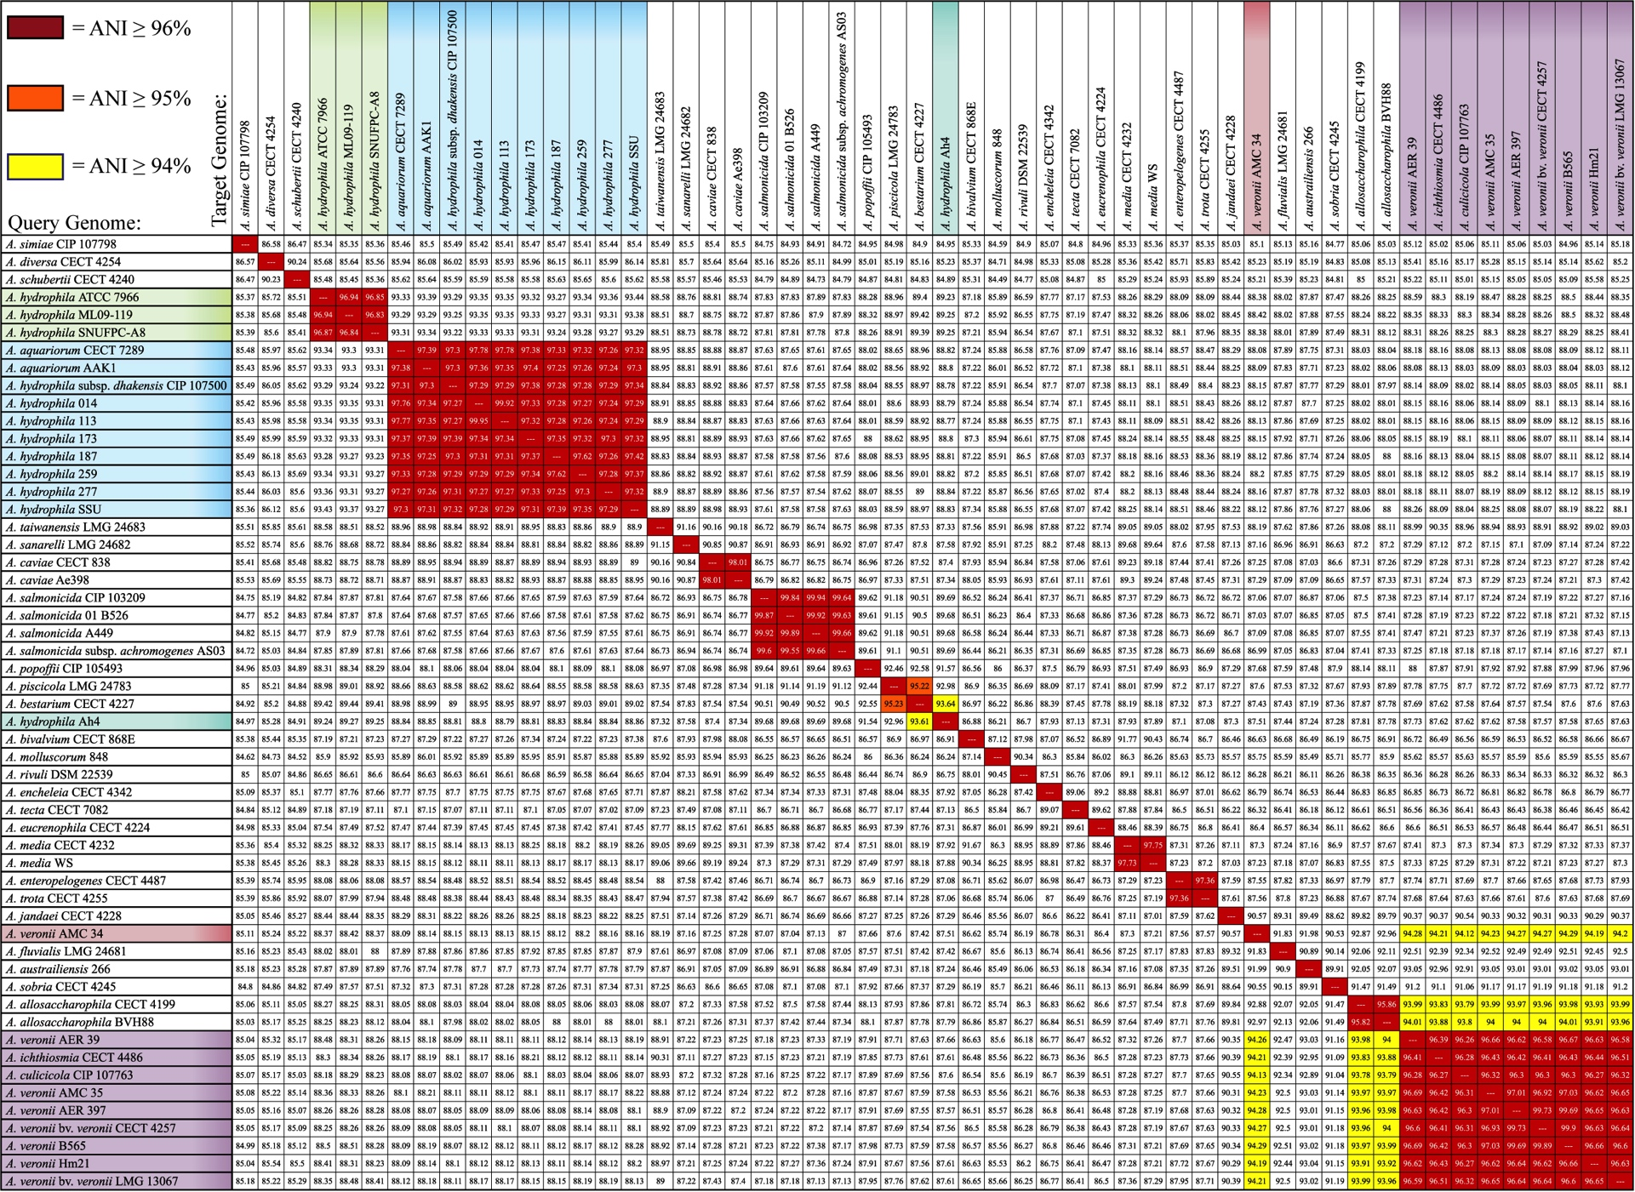
Average Nucleotide Identity (mANI)
A. hydrophila
A. aquariorum/
dhakensis
A. caviae
A. salmonicida
A. piscicola / bestarium /hydrophila AH4
A. media
A. enteropelogenes / trota
A. allosaccharophila
A. veronii
Using JSpecies (Richter and Rosselló-Móra, 2009, PNAS 106: 19126–19131)

Slide 14
Genbank
Founded in 1982 at the Los Alamos National Laboratory
Initially managed at Stanford in conjunction with the BIOSCI/Bionet news groups
1989-92 transition to the NCBI on the east coast
One precursor was Margaret Dayhoff’s Atlas of Protein Sequence and Structure
In 1987 genbank fit onto a few 360 KB floppy disks.
Genbank uses a flat file database format (see http://en.wikipedia.org/wiki/Flat_file_database)
NCBI does not use a relational databank (as in Oracle, peoplesoft)
NCBI stores data in ASN.1 format (http://en.wikipedia.org/wiki/Abstract_Syntax_Notation_One),
which allows to hardwire crosslinks to other data banks, and makes retrieval of related information fast.
NCBI’s sample record (http://www.ncbi.nlm.nih.gov/Sitemap/samplerecord.html) contains links
to most the fields used in the gbk flatfile.
In the genbank records at NCBI the links connect to the features (i.e. the pubmed record, or the encoded protein sequence) --- not easy to work with.

Slide 15
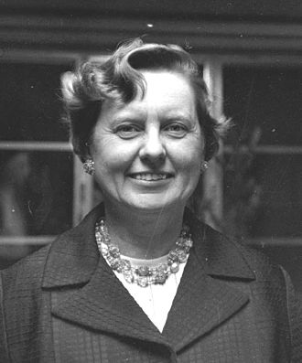
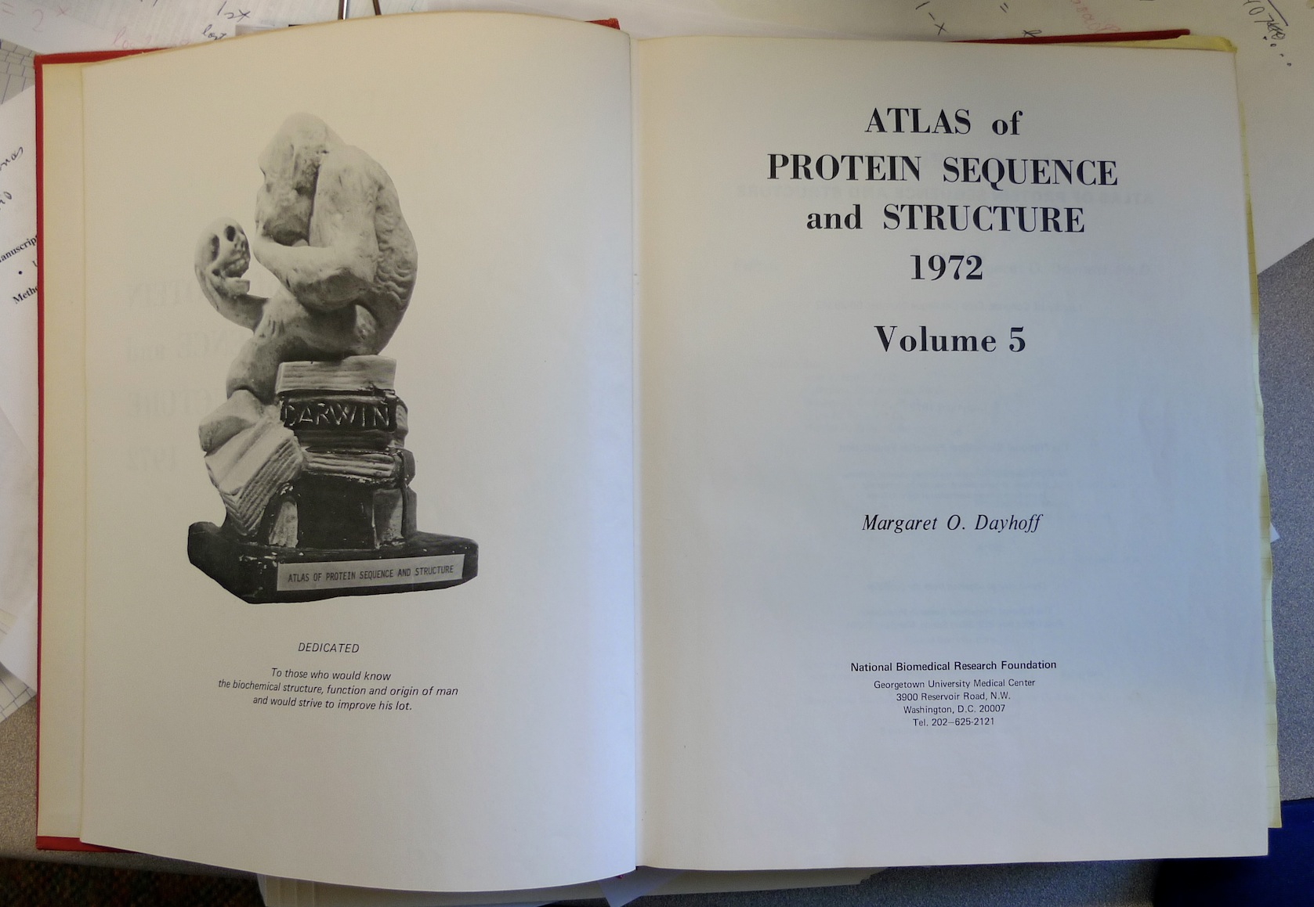
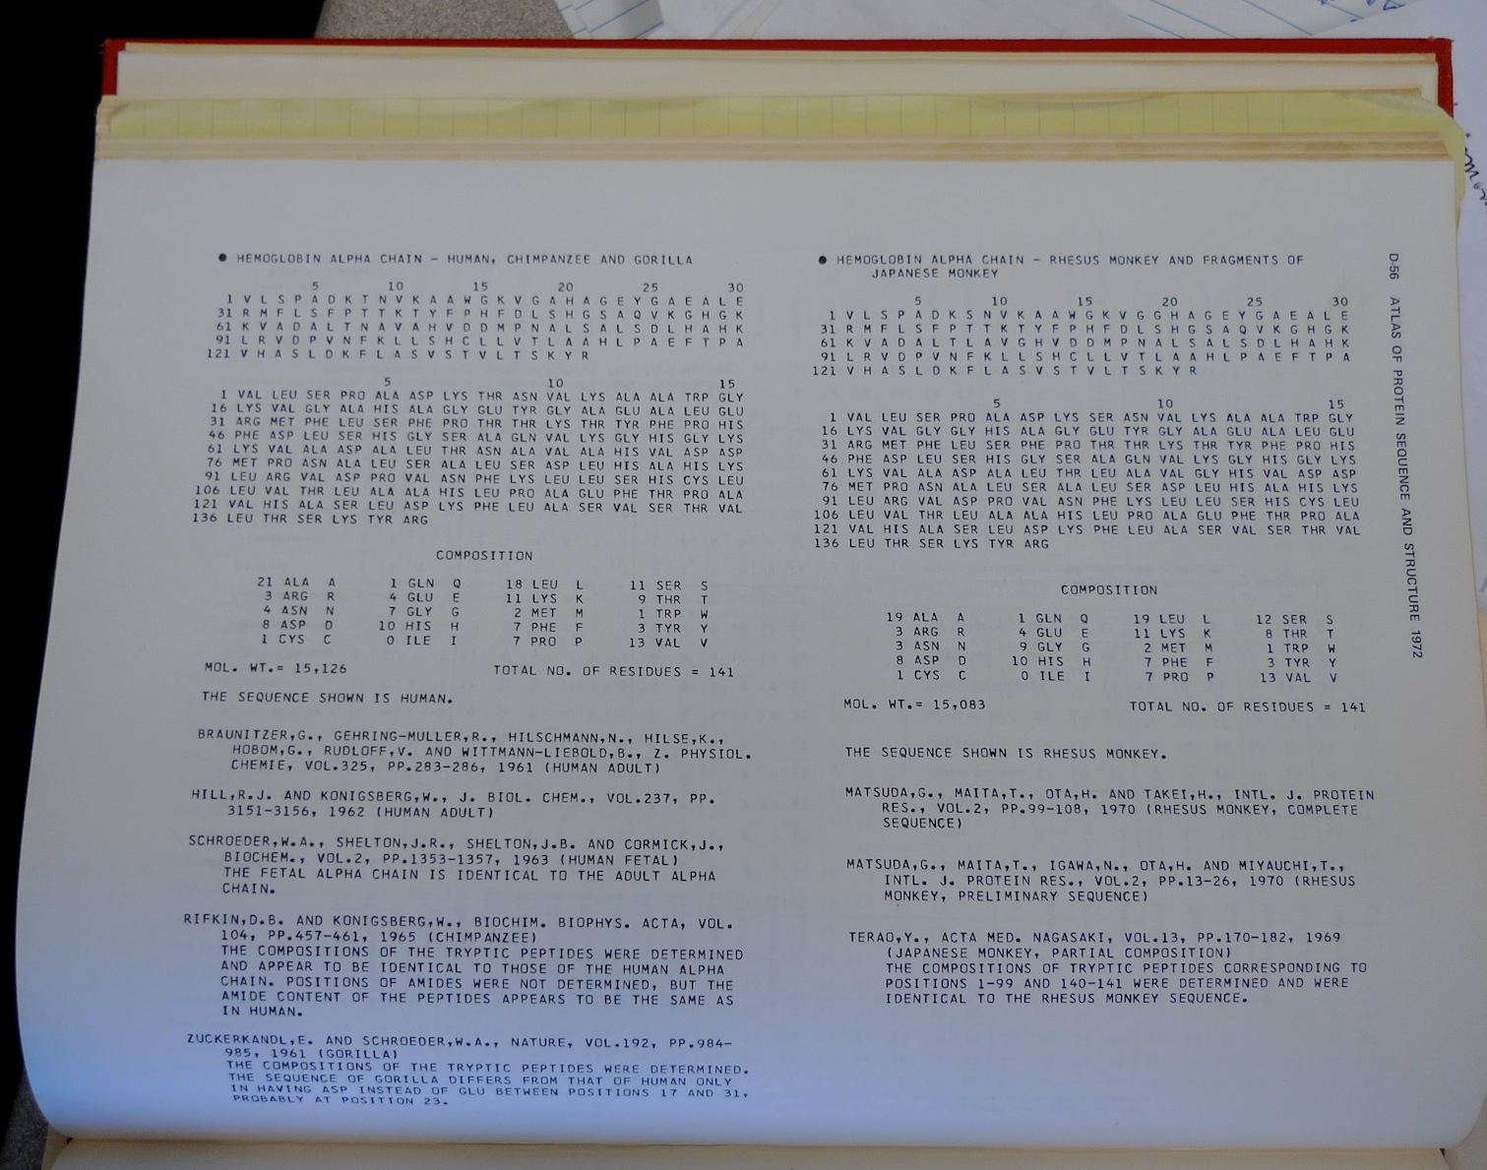
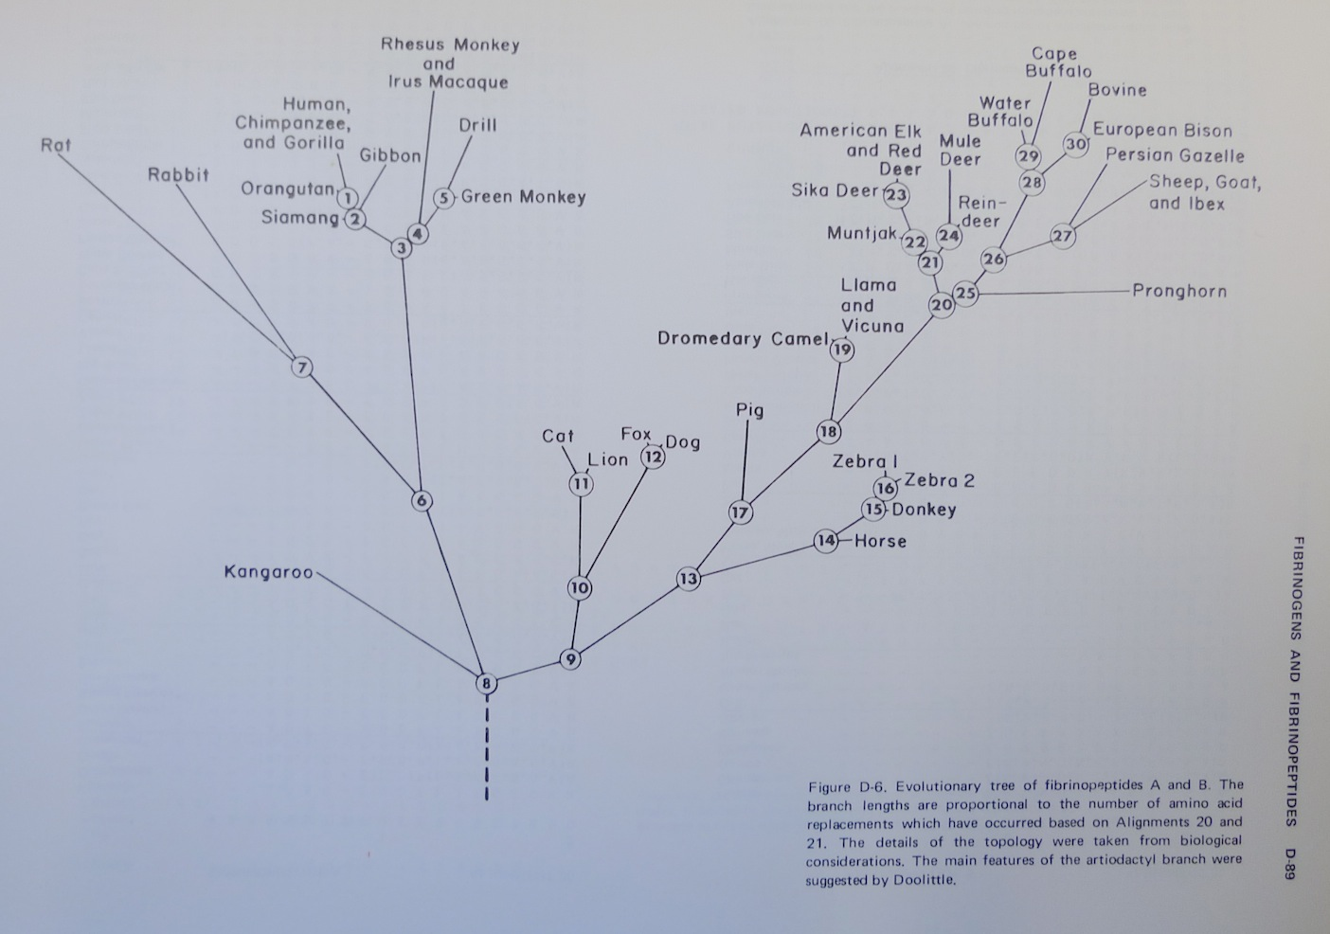
Dr. Margaret Belle (Oakley) Dayhoff
March 11, 1925 – February 5, 1983
Among other things, we owe her the first nucleotide and protein data bank, the PAM substitution matrix, and the single letter amino acid code. (Image from wikipedia)

Slide 16
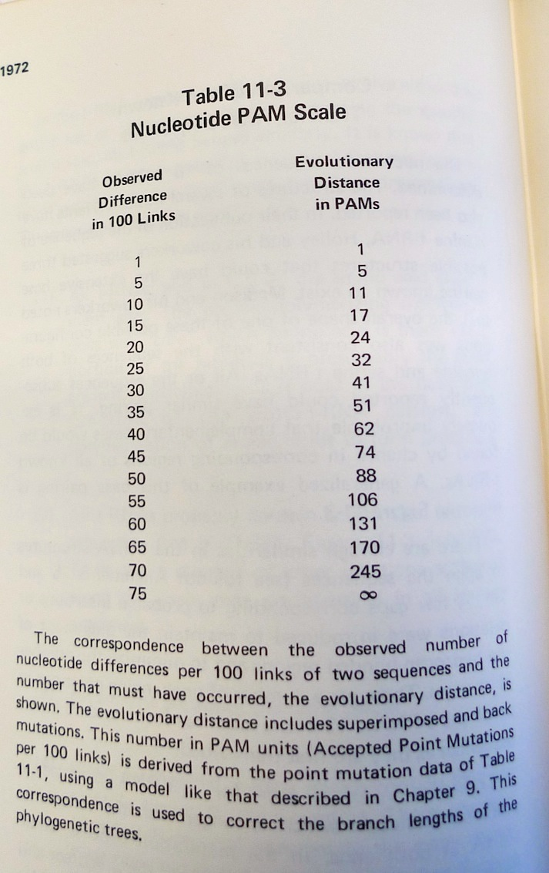
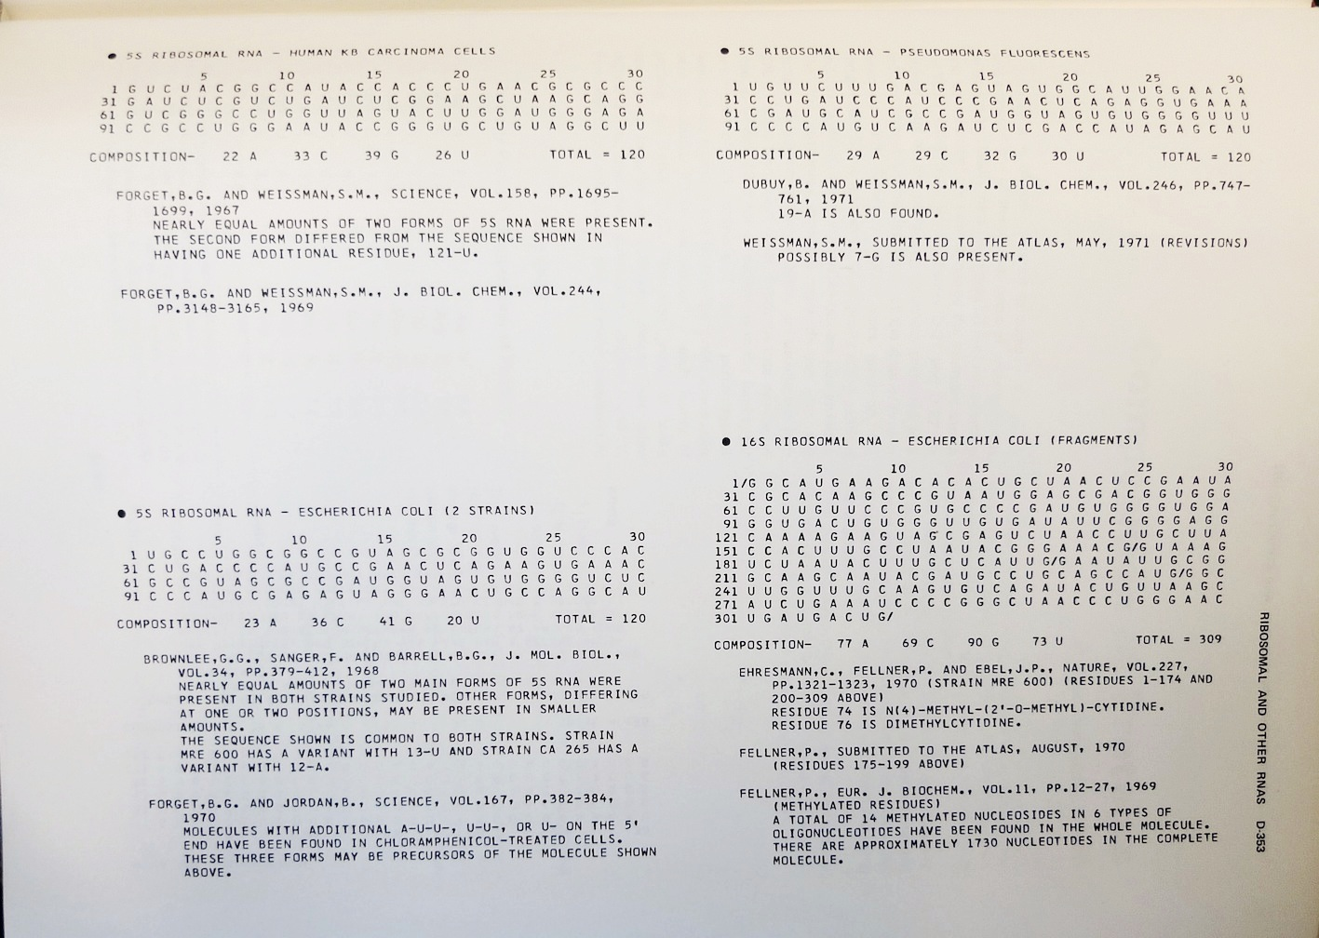
Atlas of Protein Sequences 1972 (cont)
The Atlas also contained RNA sequences, and PAM matrix for nucleotides

Slide 17
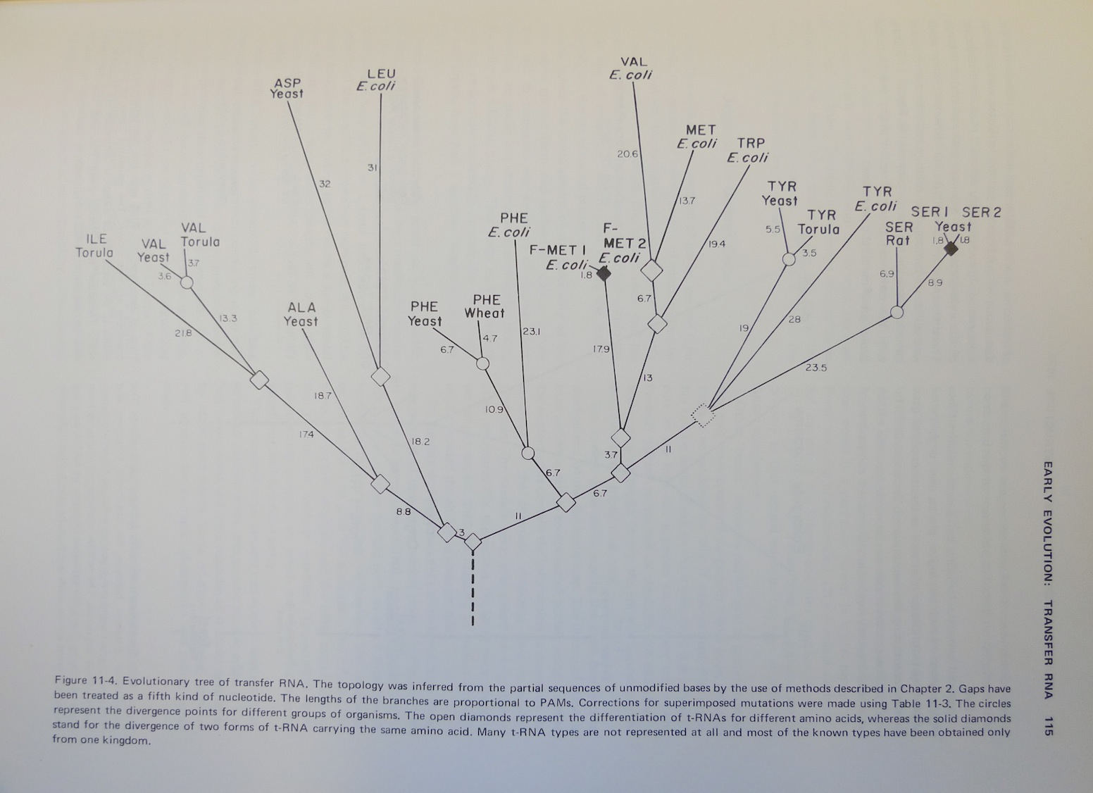
Atlas of Protein Sequences 1972 (cont)
Contained phylogenetic reconstructions that went back in time to far before the Last Universal Common Ancestor (LUCA) aka the cenancestor of all living cellular organisms alive today.
tRNA phylogeny

Slide 18
Selecting Scoring Matrices
Choose a matrix appropriate to the suspected degree of sequence identity between the query and its target sequences
PAM: empirically derived for close relatives
BLOSUM: empirically derived for distant relatives
18

Slide 19
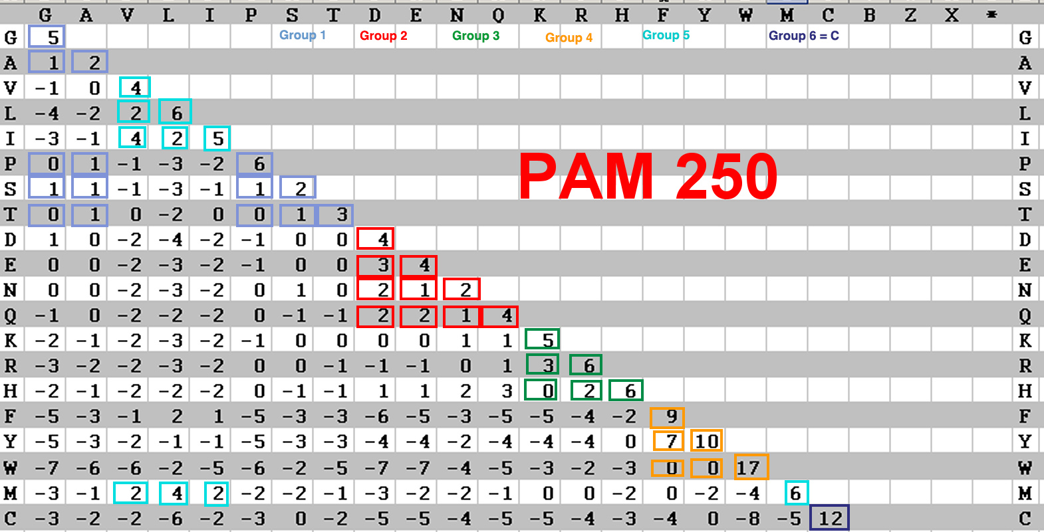
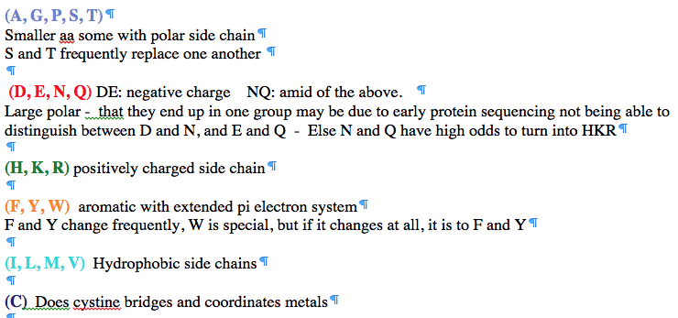
PAM 250 log (odds) matrix
Notes:
Dayhoff recoding

