Slide 1
MCB3421
class 23
Introns, Figtree, Emboss, Compositional Bias

Slide 2
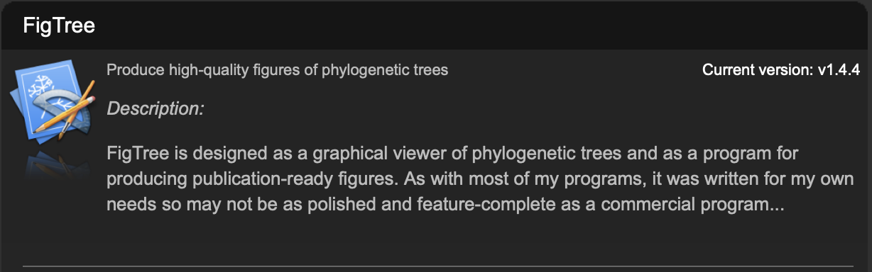
Figtree developed by the same group that developed tracer
Reads trees in a variety of different formats (including Newick)
Re-root, flip branches, subtree
color, branch and node labels
Draws trees as trees, stars, and circular diagrams

Slide 3
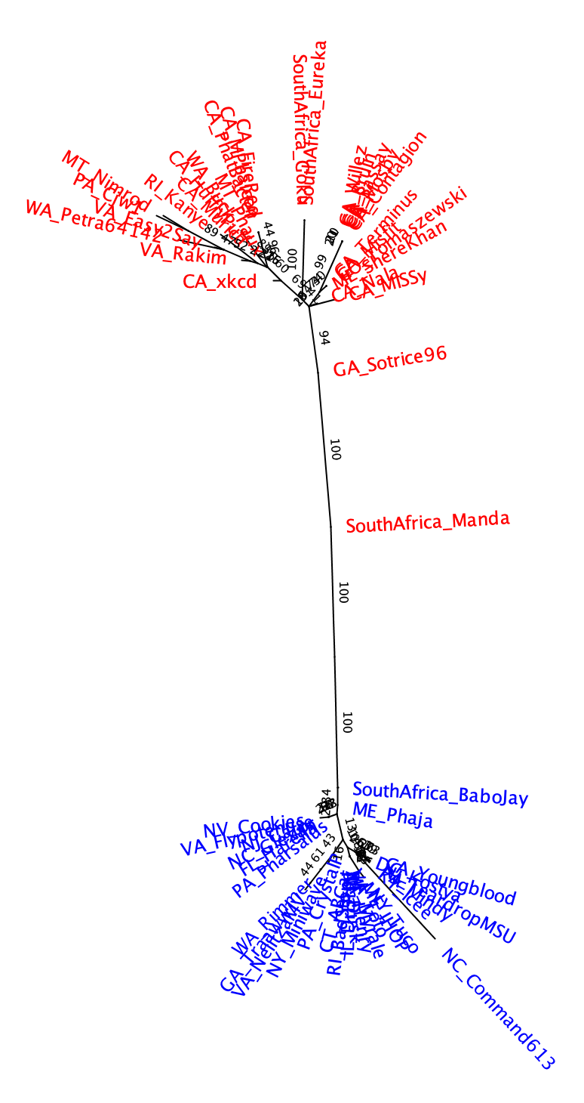
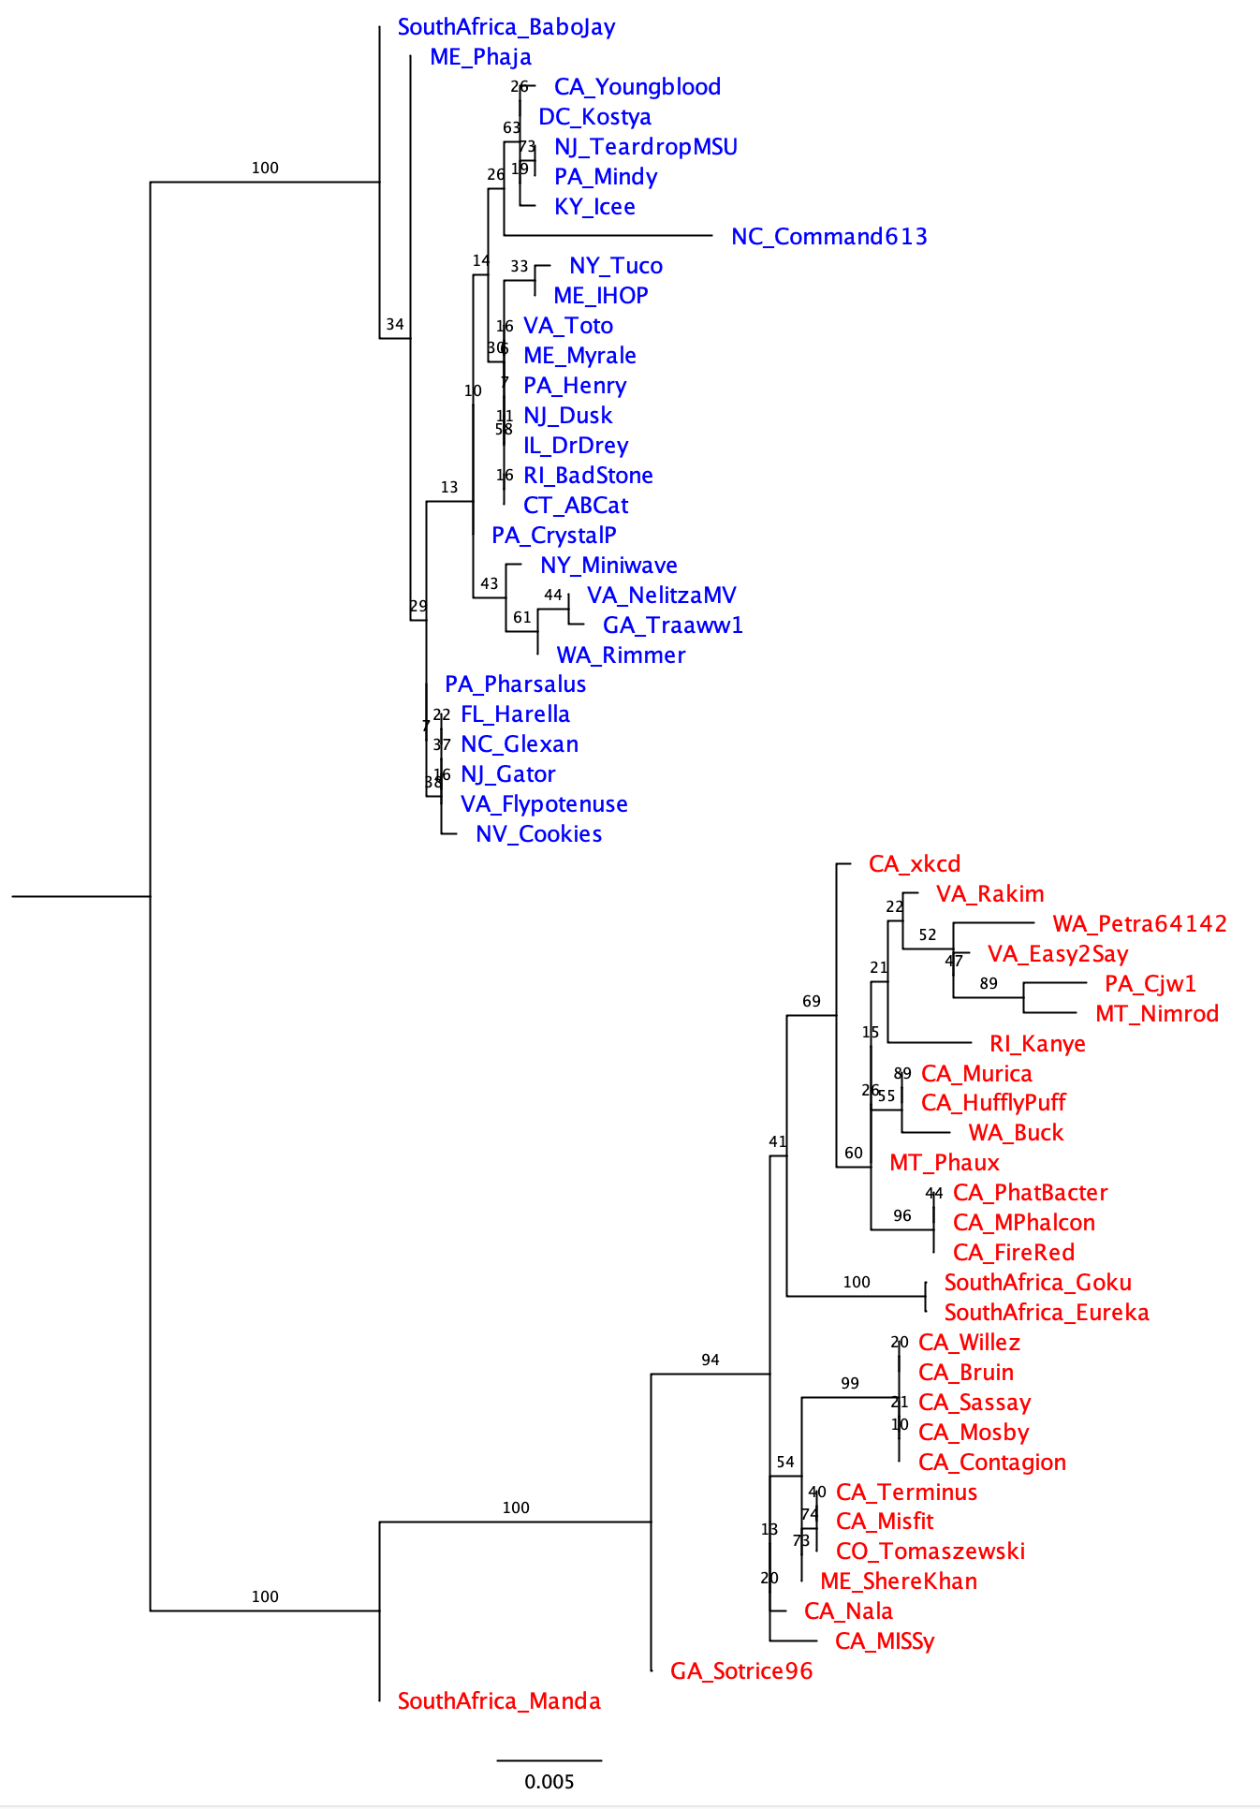
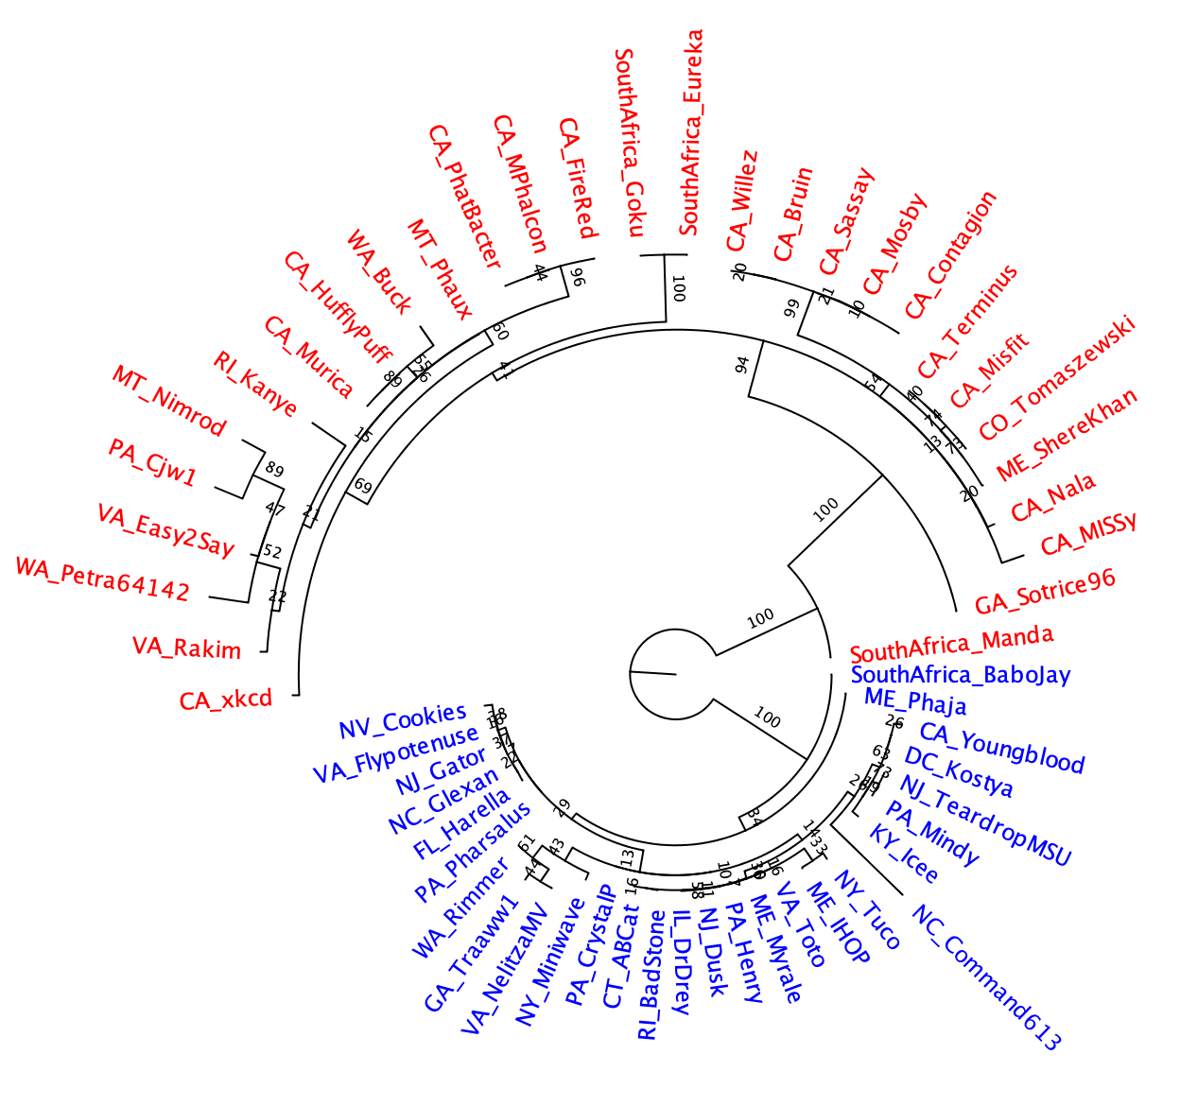
Different ways to draw the tree
Given that the tree does not have an outgroup, the branch at the root is strange!

Slide 4
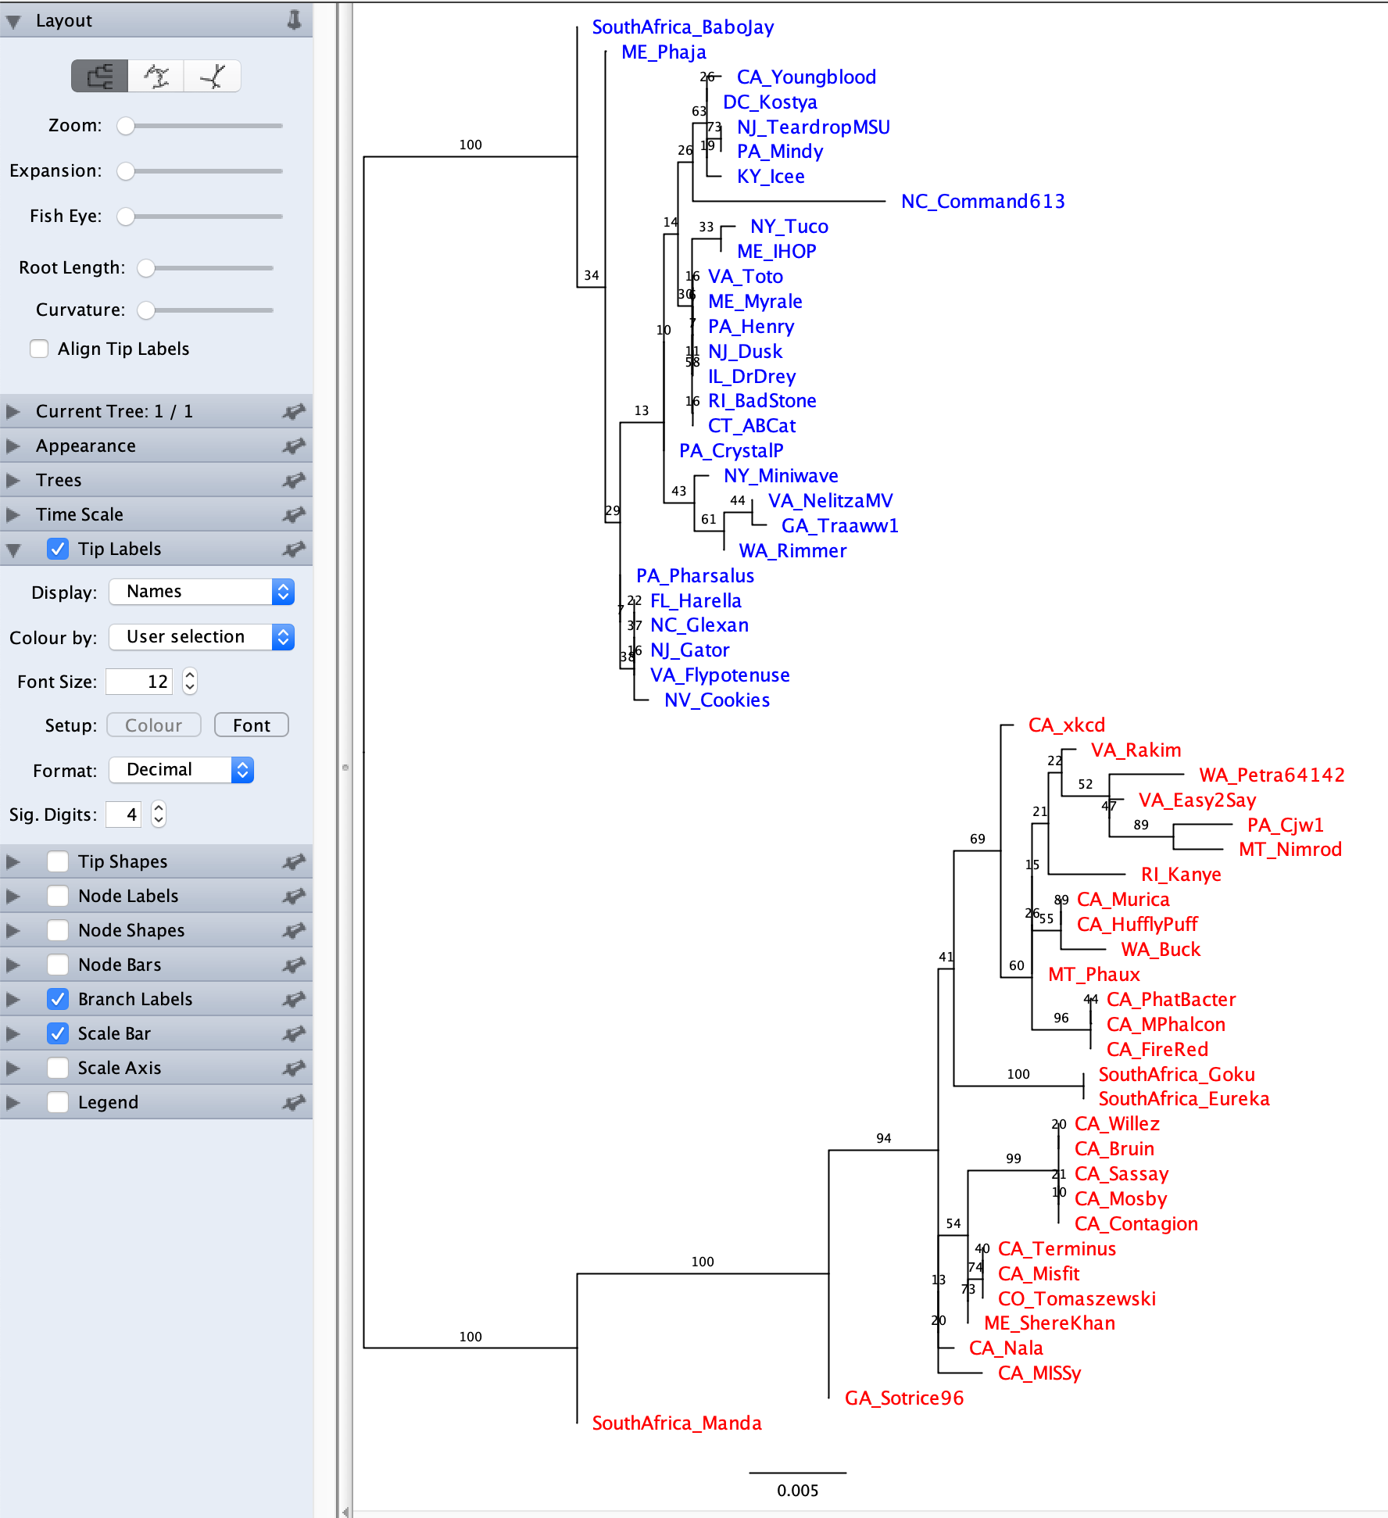
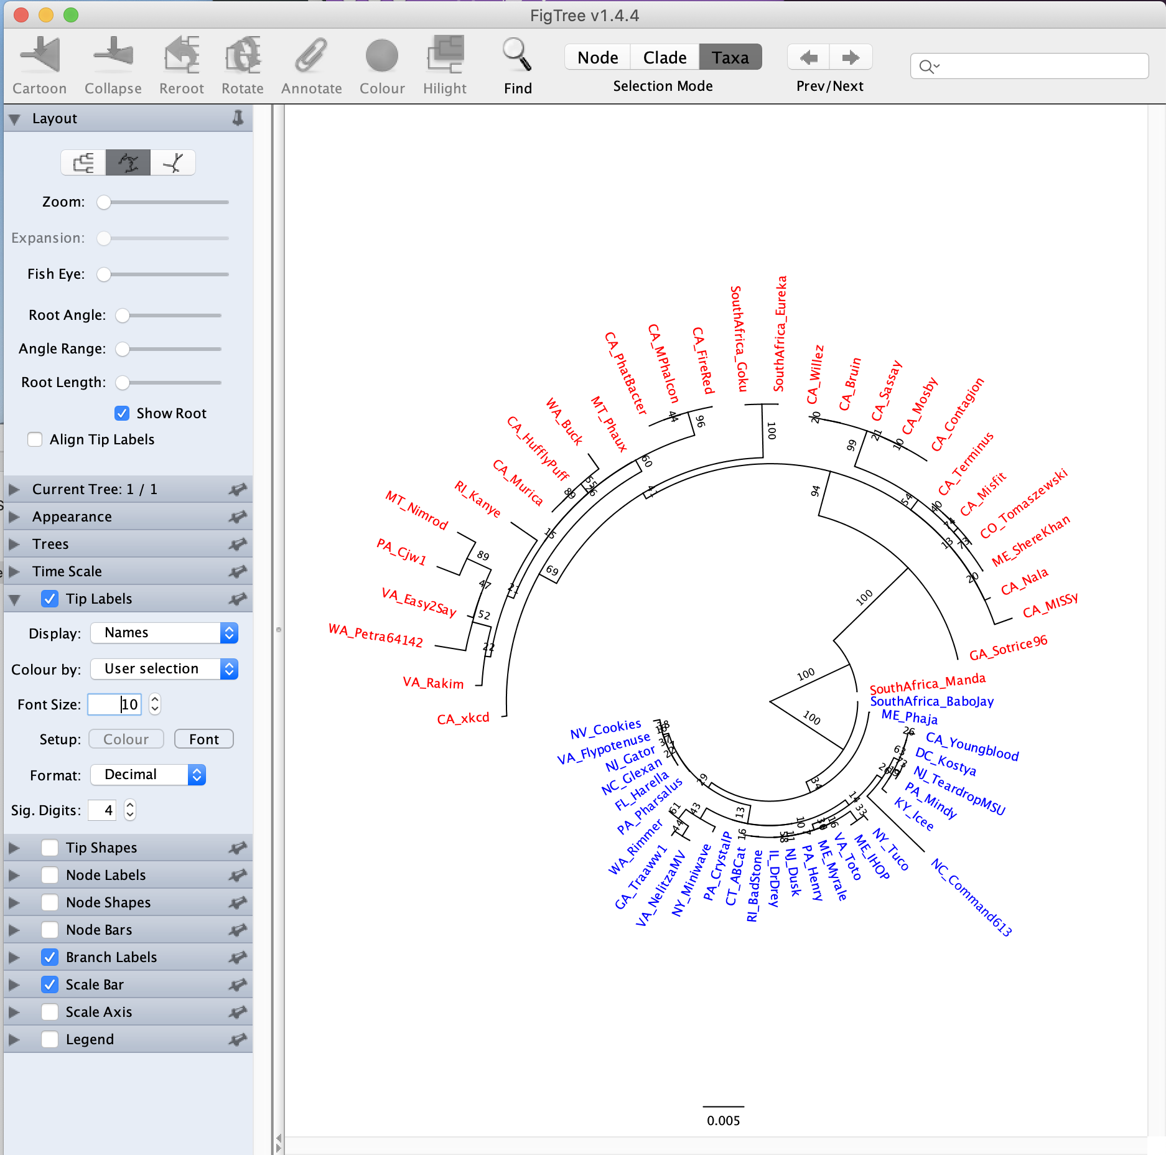
moving the toot length lever to the left helps

Slide 5
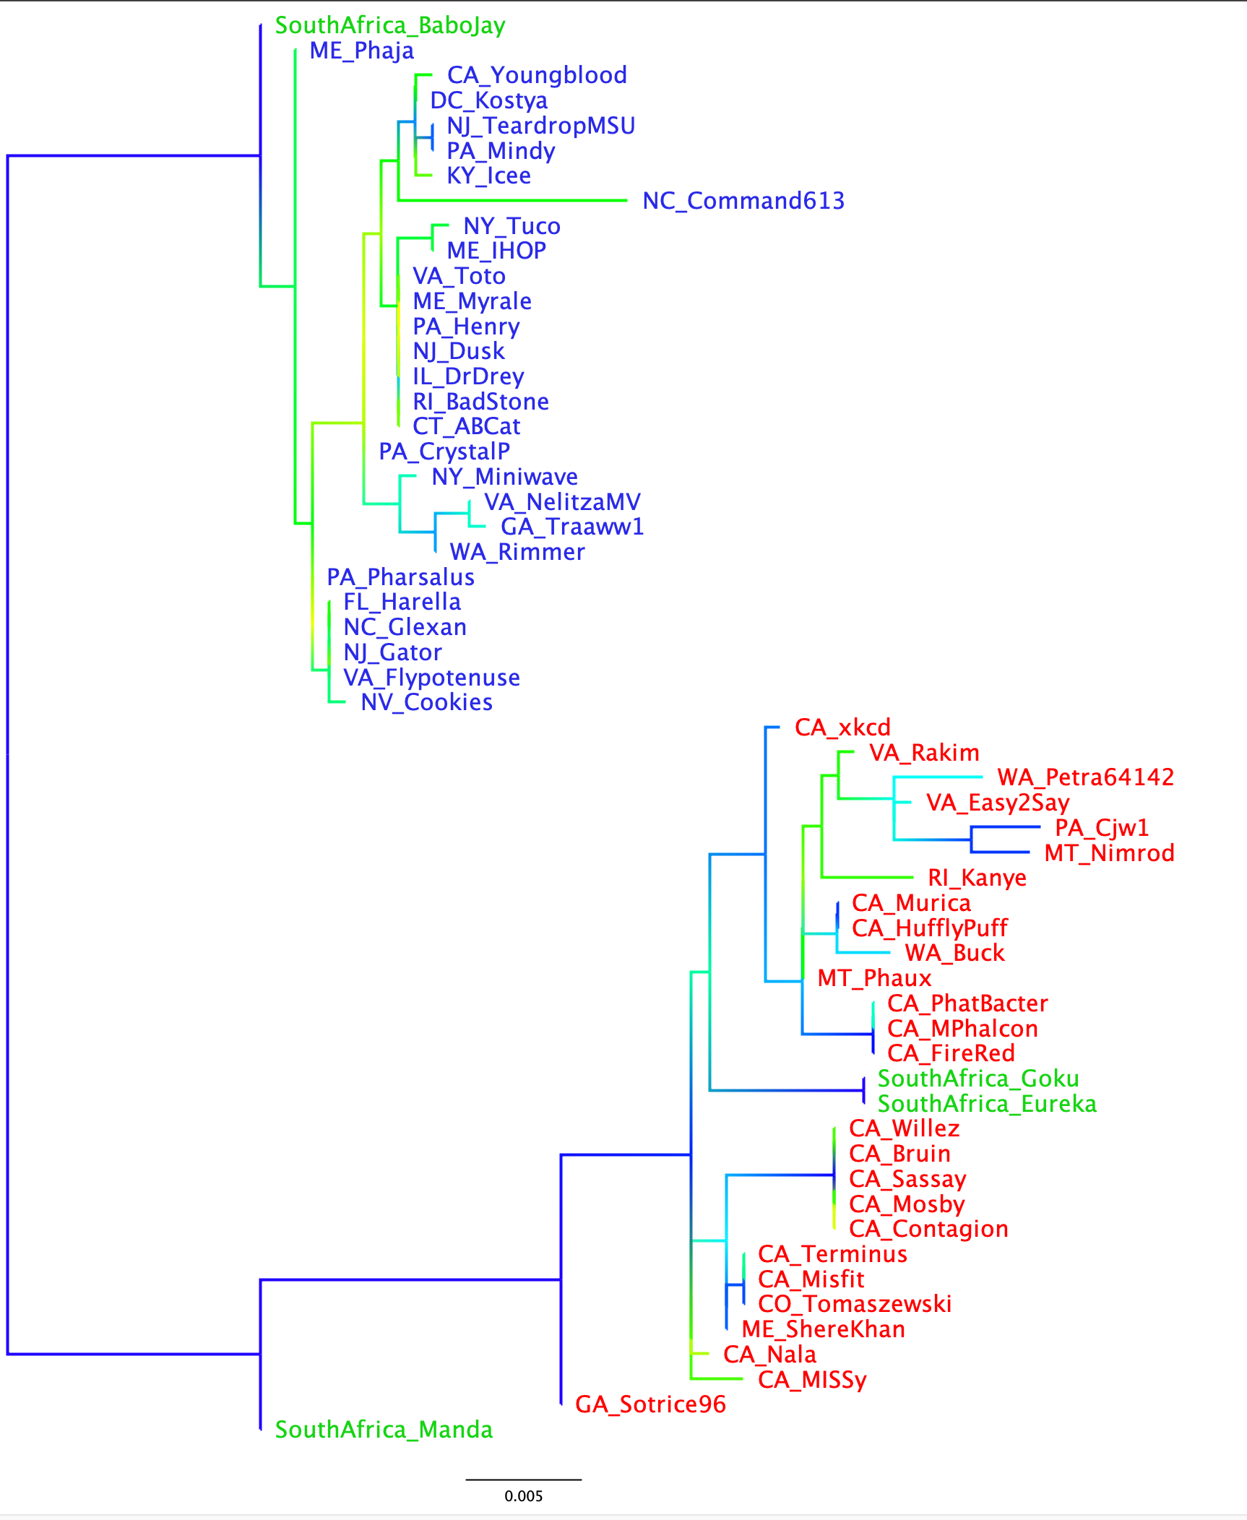
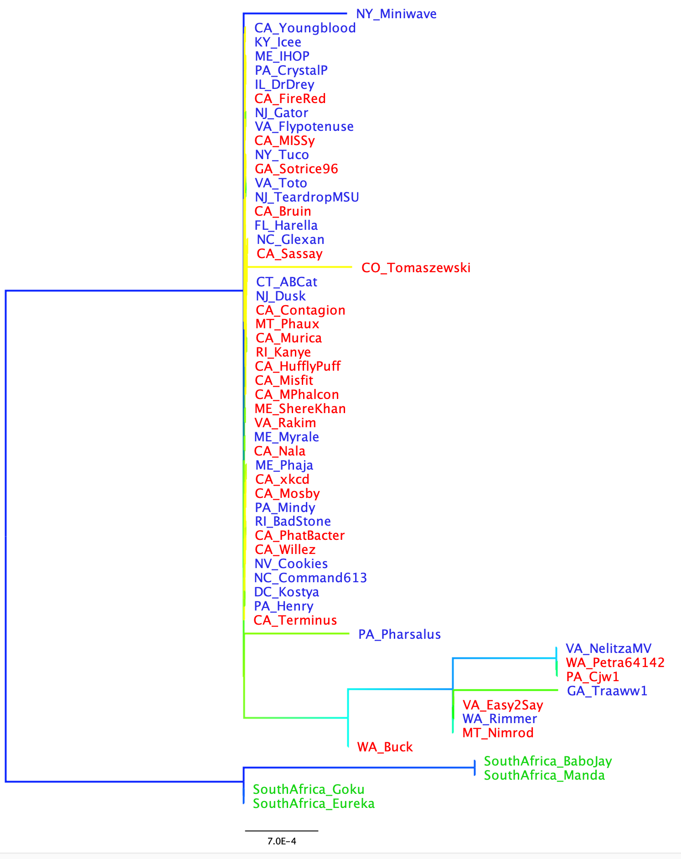
If you have multiple gene trees from the same set (or subset) of species, and the leaves have the same names, the colors carry over to the new tree you open
Branches gradient colored according to support value
Extein
-> the clans defined by the extein tree are not reflected in the intein phylogeny. The intein was transferred several times between the red and green clans. Note the nearly identical intein between red and green leaves.
Intein

Slide 6
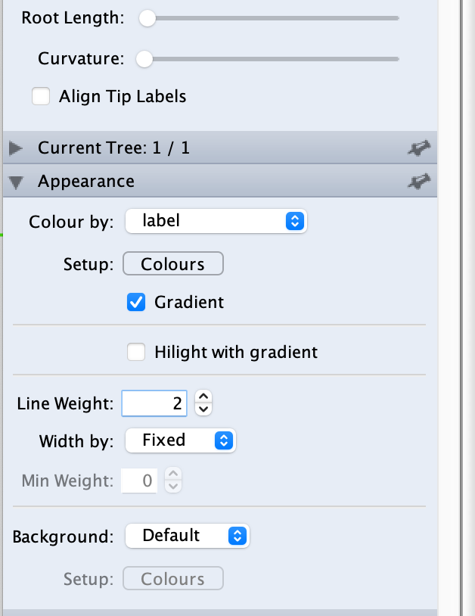
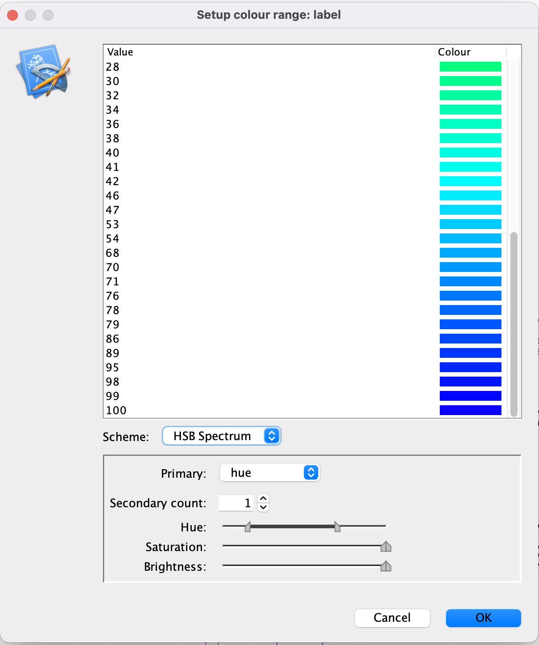

Slide 7
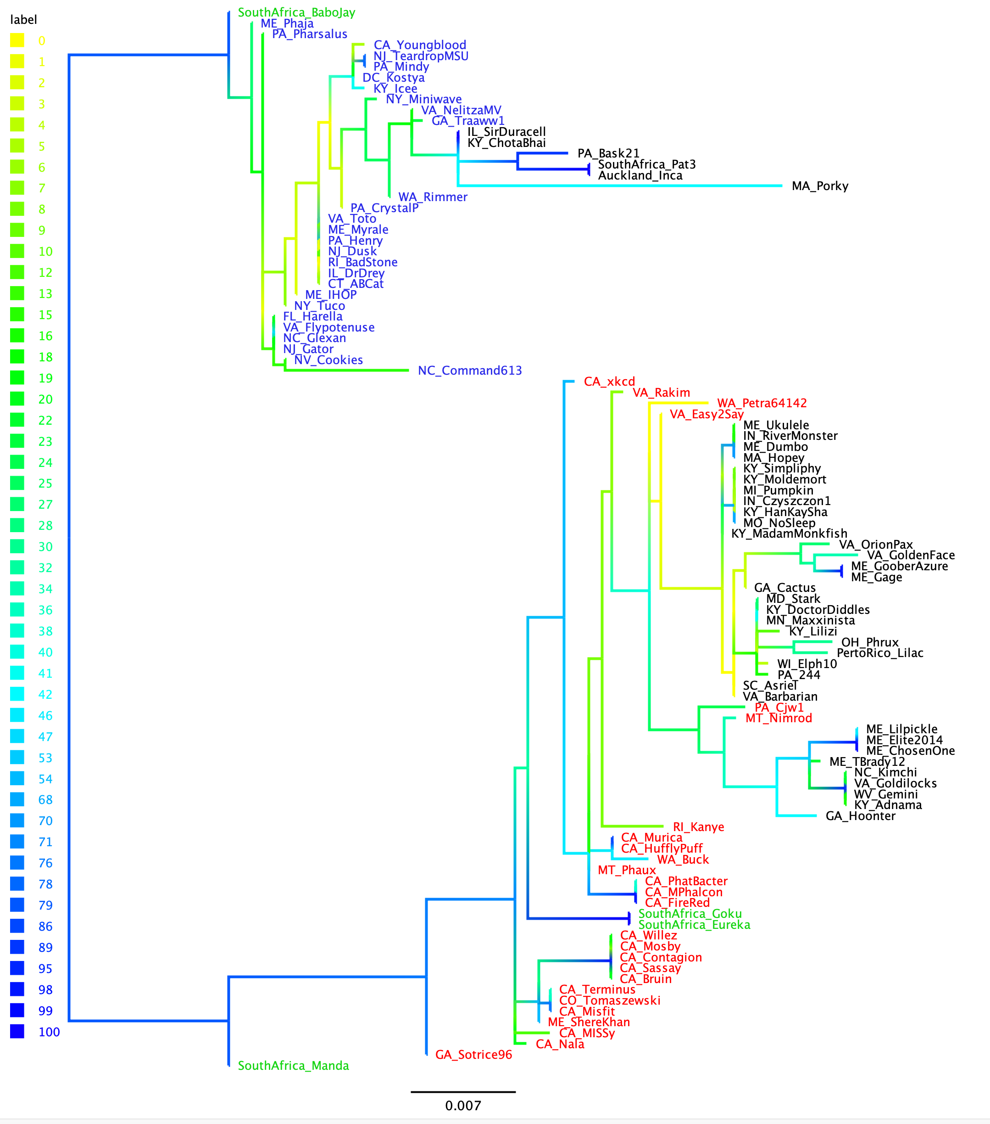
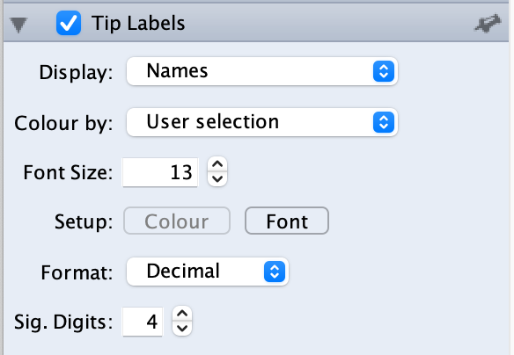
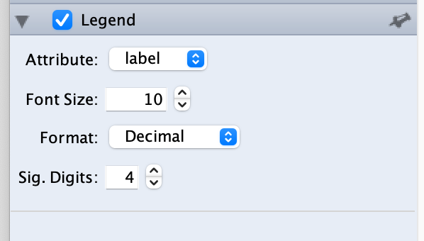
Phylogeny of Exteins in terminases
of Actinophage cluster E
no Intein
clade 1
clade 2

Slide 8
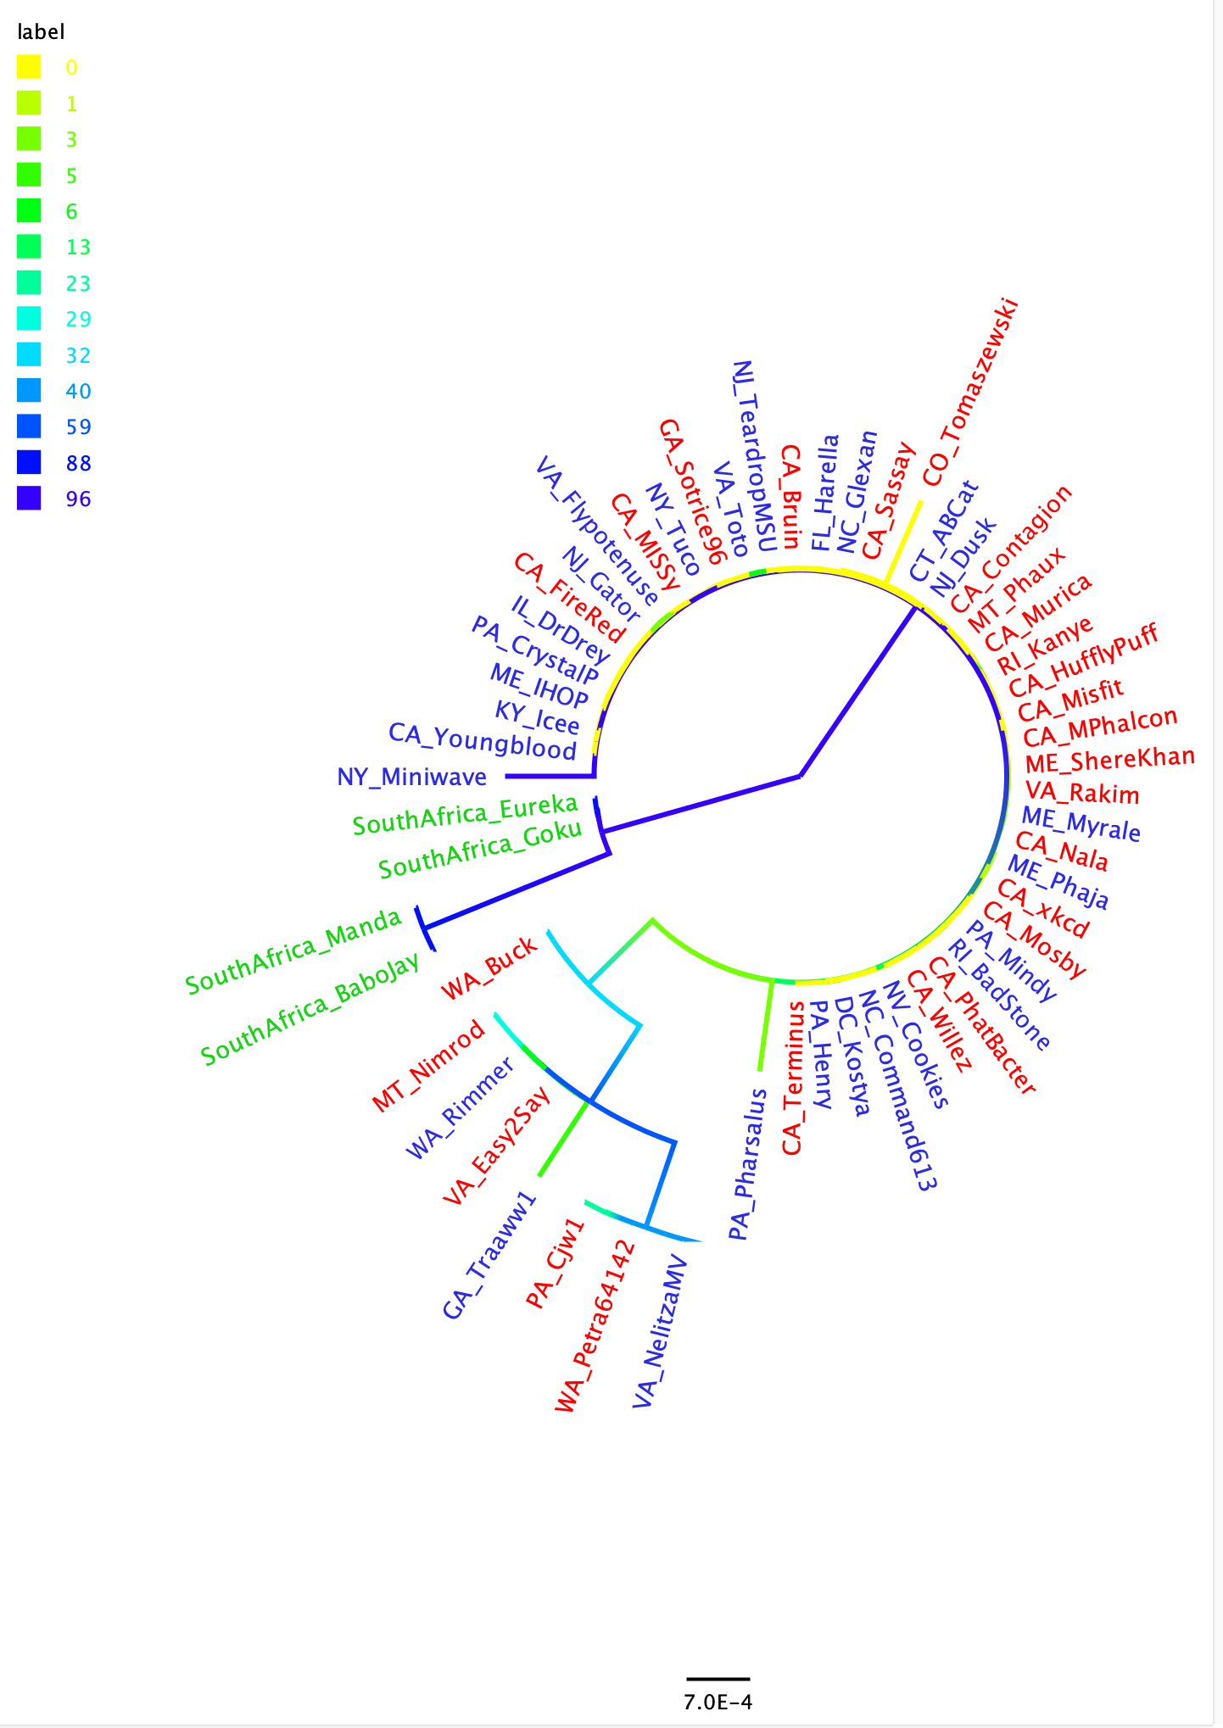
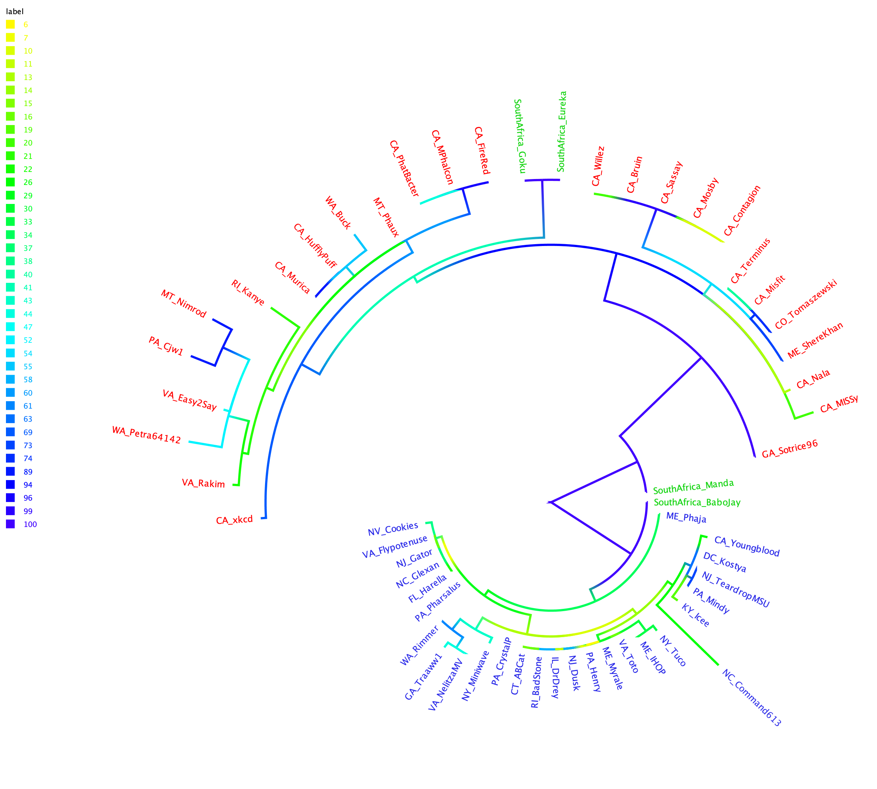

Slide 9
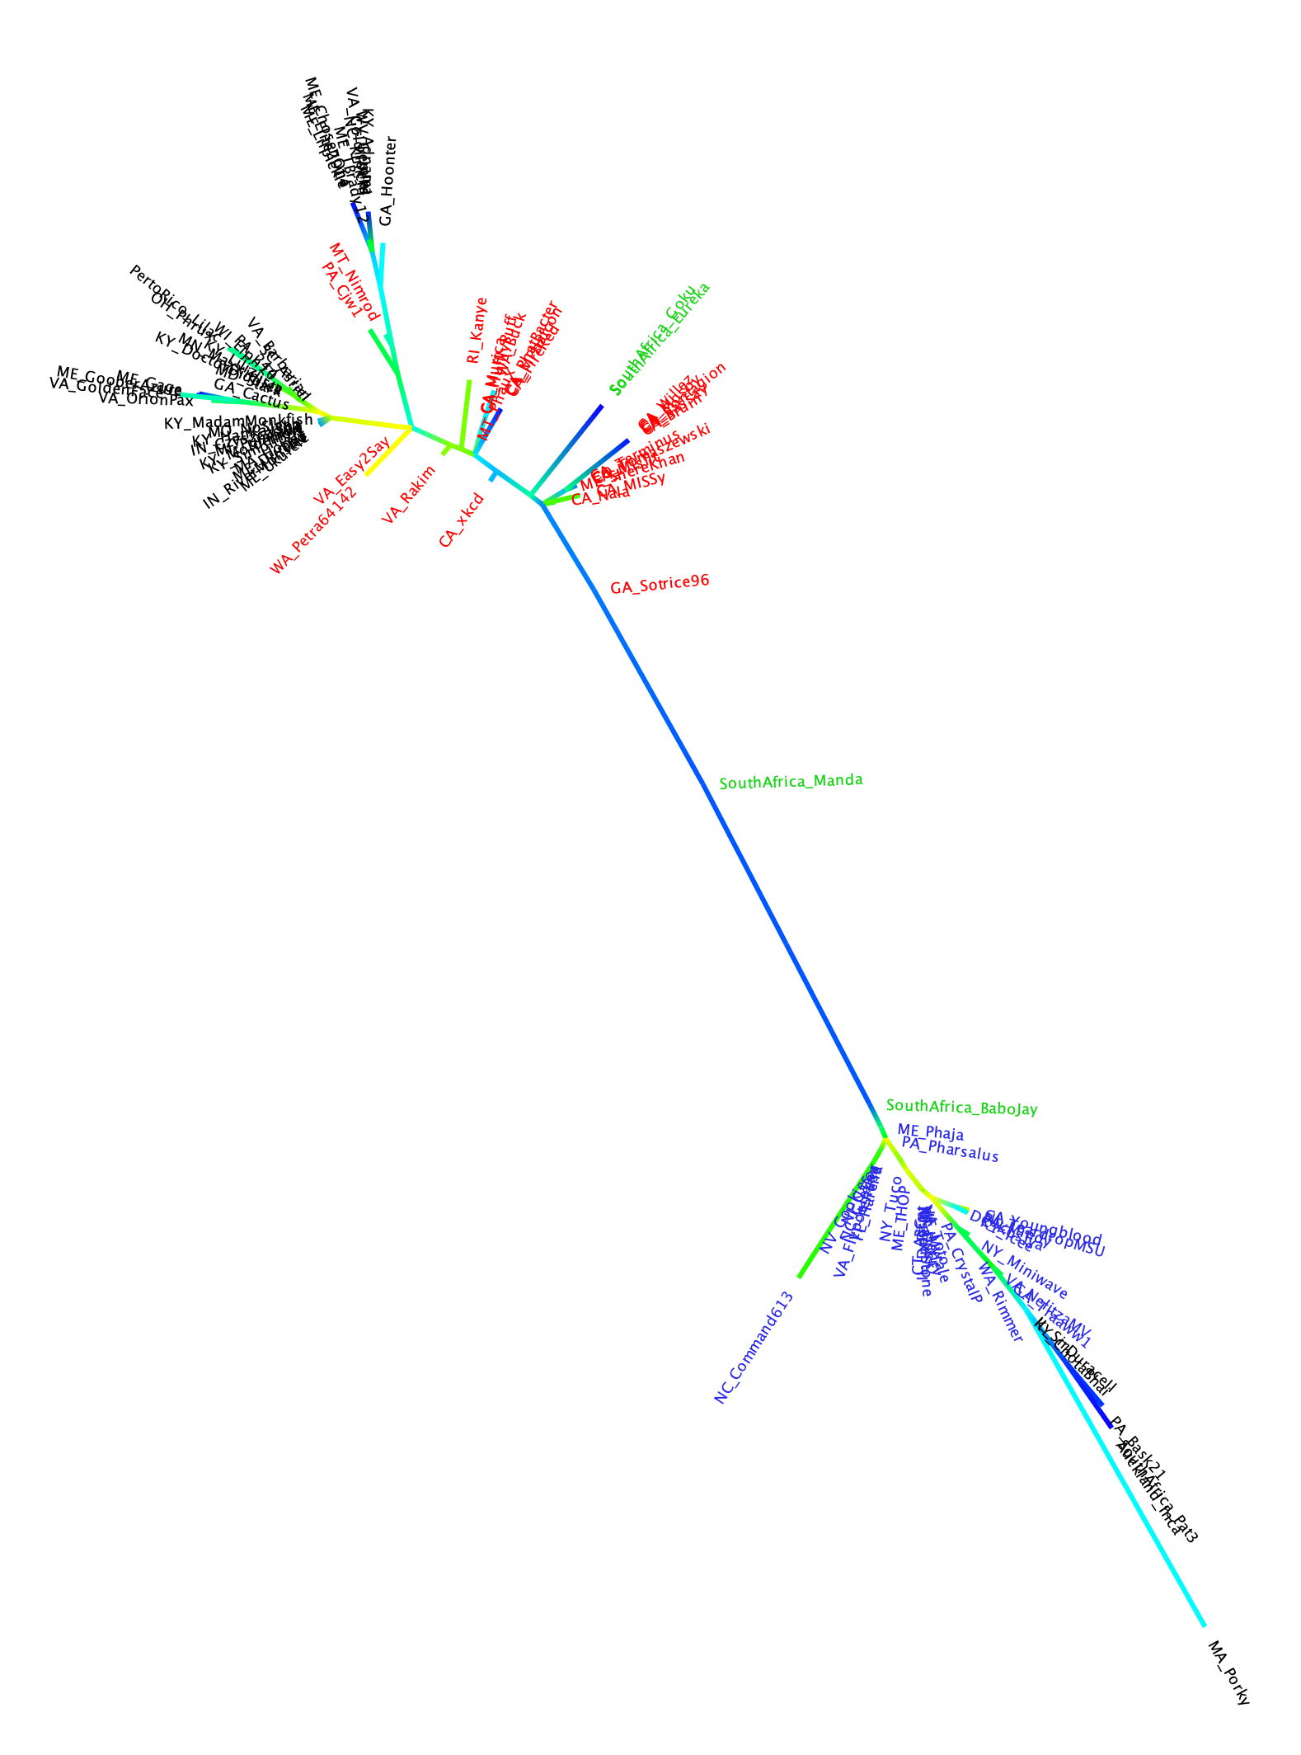
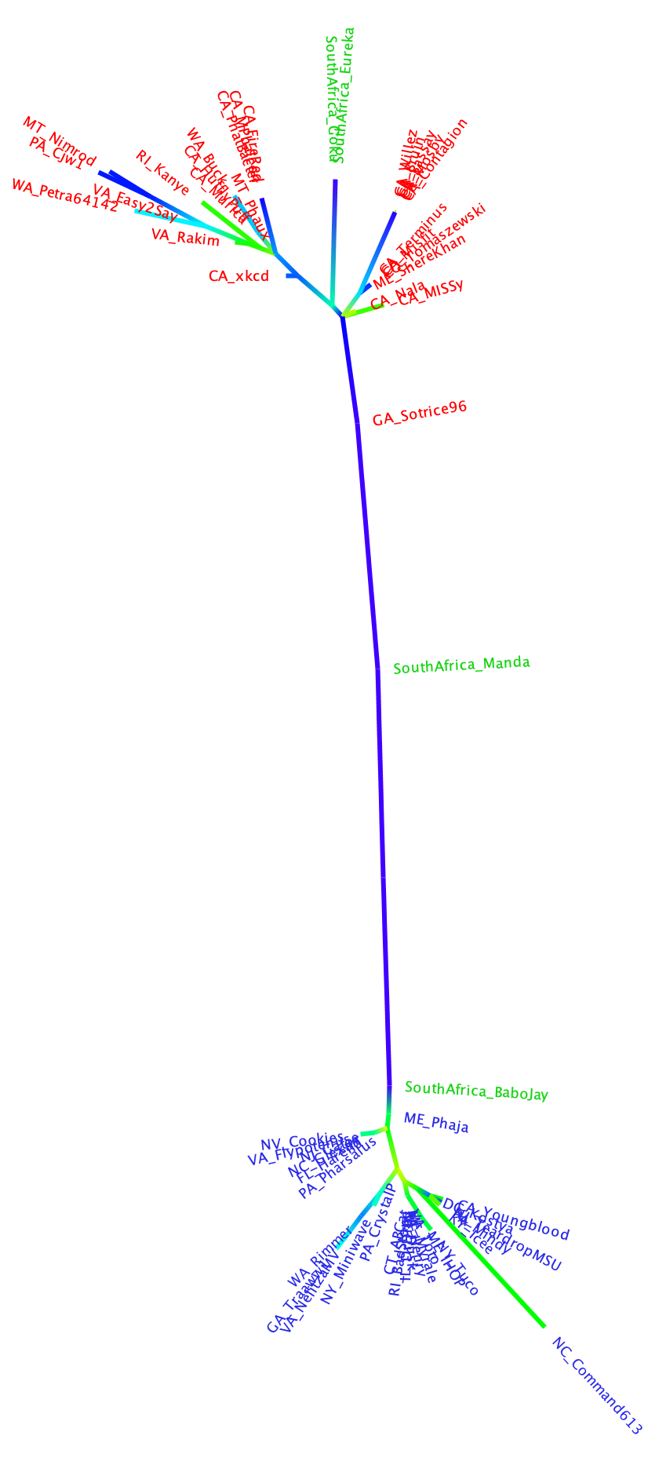
exteins
intein
containing exteins

Slide 10
Introns

Slide 11
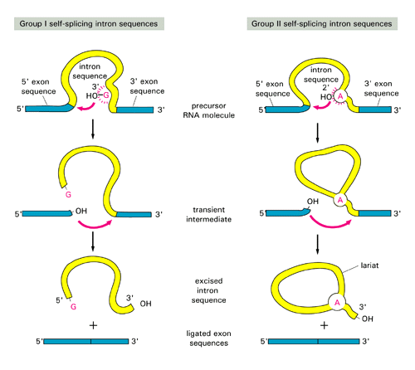

Slide 12
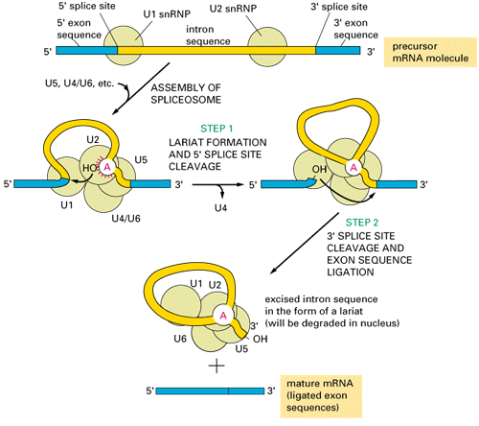

Slide 13
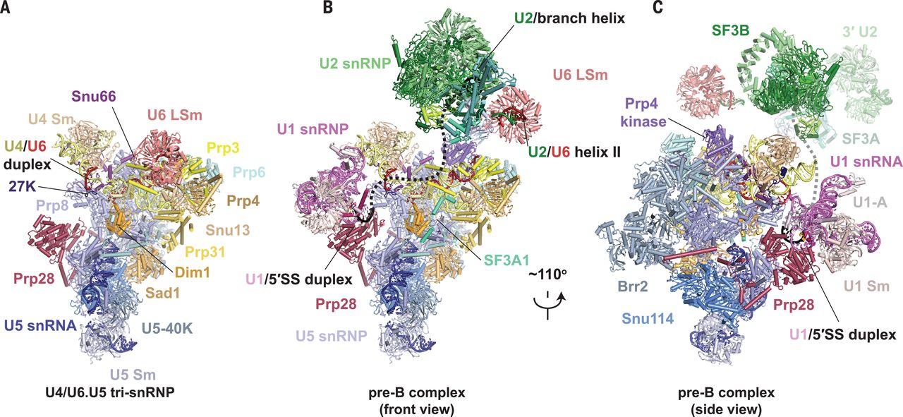

Fig. 1 Structures of human tri-snRNP and pre–B complex.
Clément Charenton et al. Science 2019;364:362-367
Copyright © 2019 The Authors, some rights reserved; exclusive licensee American Association for the Advancement of Science. No claim to original U.S. Government Works
Notes:
Structures of human tri-snRNP and pre–B complex. (A) Overview of human U4/U6.U5 tri-snRNP. (B and C) Overview of the human U1.U2.U4/U6.U5 pre–B complex in two orientations. The black dashed line represents the theoretical path of the pre-mRNA intron.

Slide 14
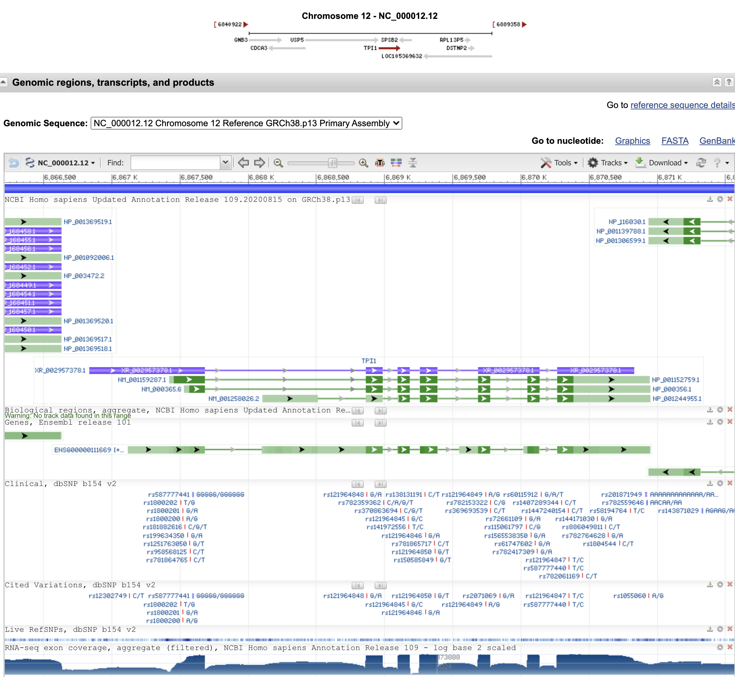
The human tpi1 gene in NCBI

Slide 15
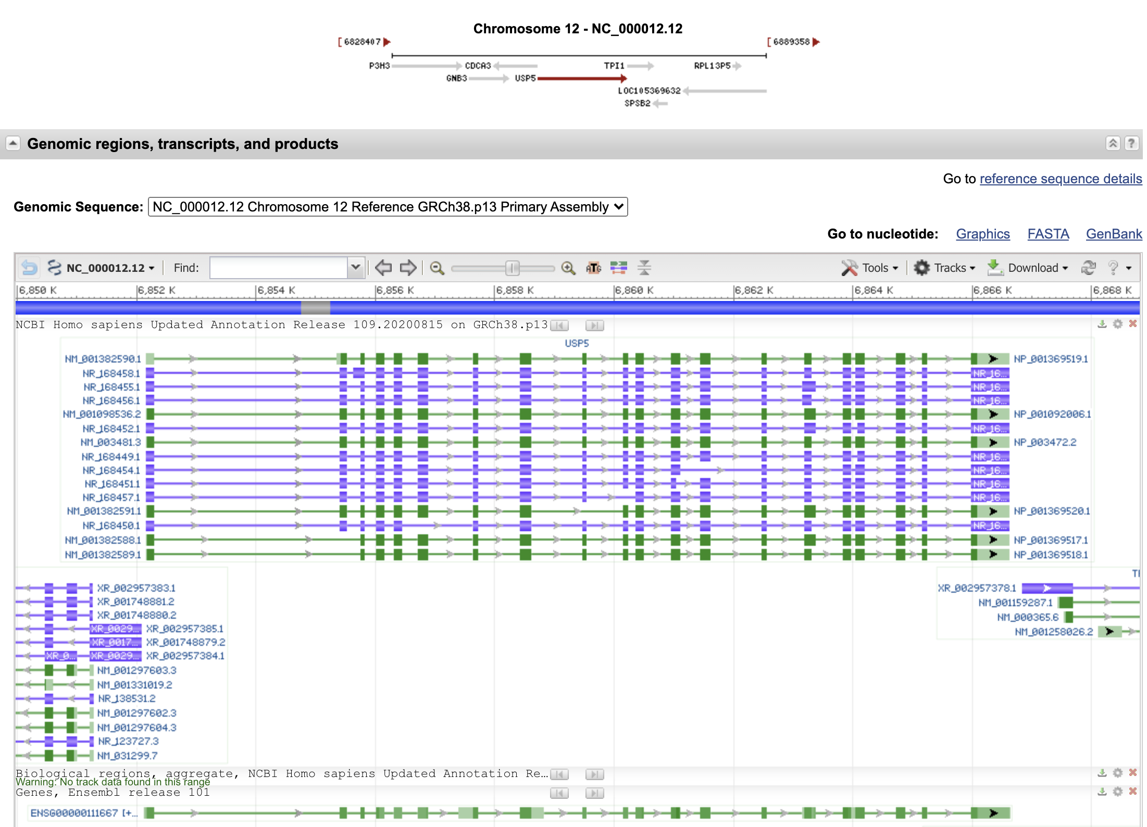
The neighboring gene,
ubiquitin specific peptidase 5,
is perhaps more typical:

Slide 16
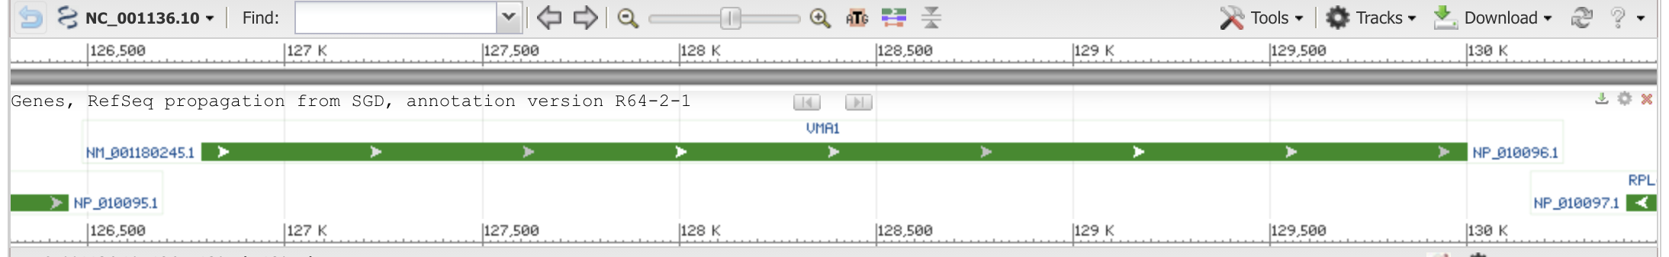
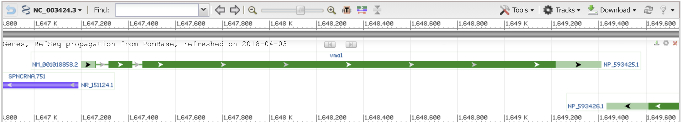
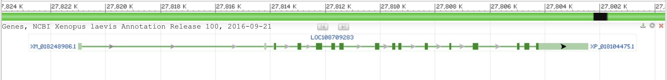
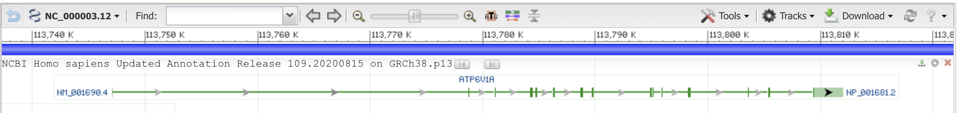
vma1 genes
Saccharomyces cerevisiae S288C
Schizosaccharomyces pombe
Xenopus laevis (African clawed frog)
(one of two paralogs)
Homo sapiens (human)

Slide 17
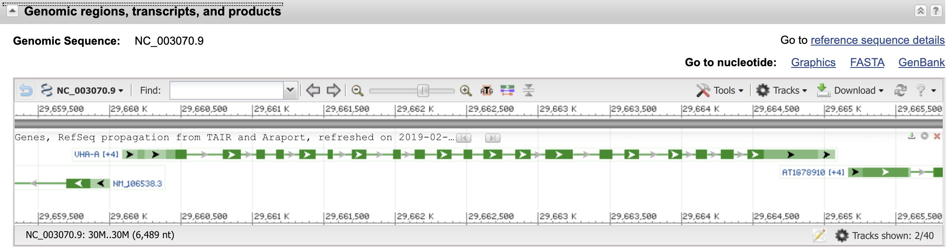
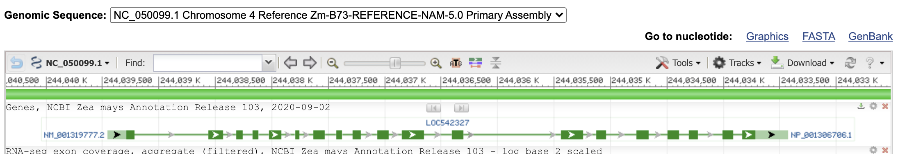
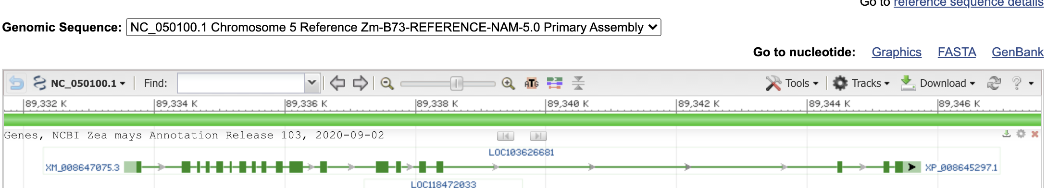
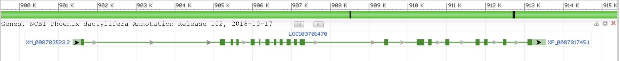
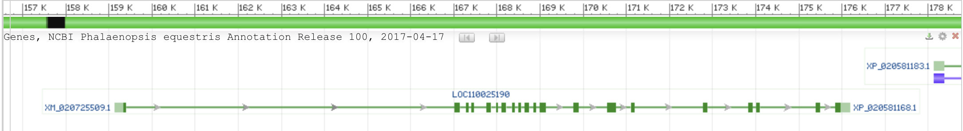
vma1 genes
Arabidopsis thaliana (thale cress)
Zea mays chromosome 4
Zea mays chromosome 5
Phoenix dactylifera (date palm)
Phalaenopsis equestris (orchid)

Slide 18
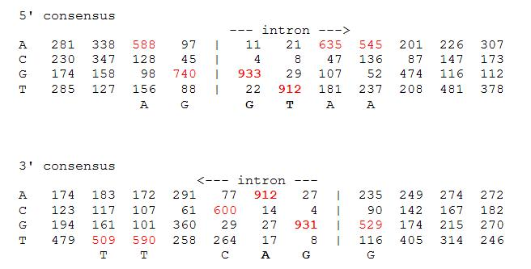
Splice site consensus in Arabidopsis thaliana

Slide 19
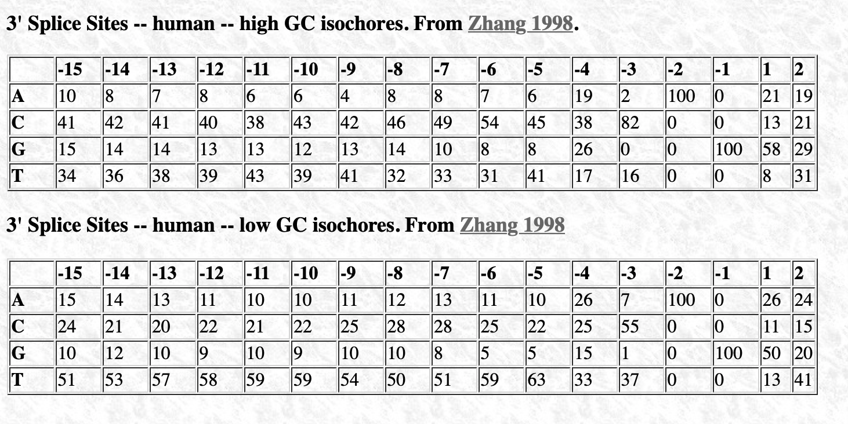
Splice site consensus humans
C A G || G T
From: http://science.umd.edu/labs/mount/RNAinfo/matrices.html https://pubmed.ncbi.nlm.nih.gov/9536098/

Slide 20
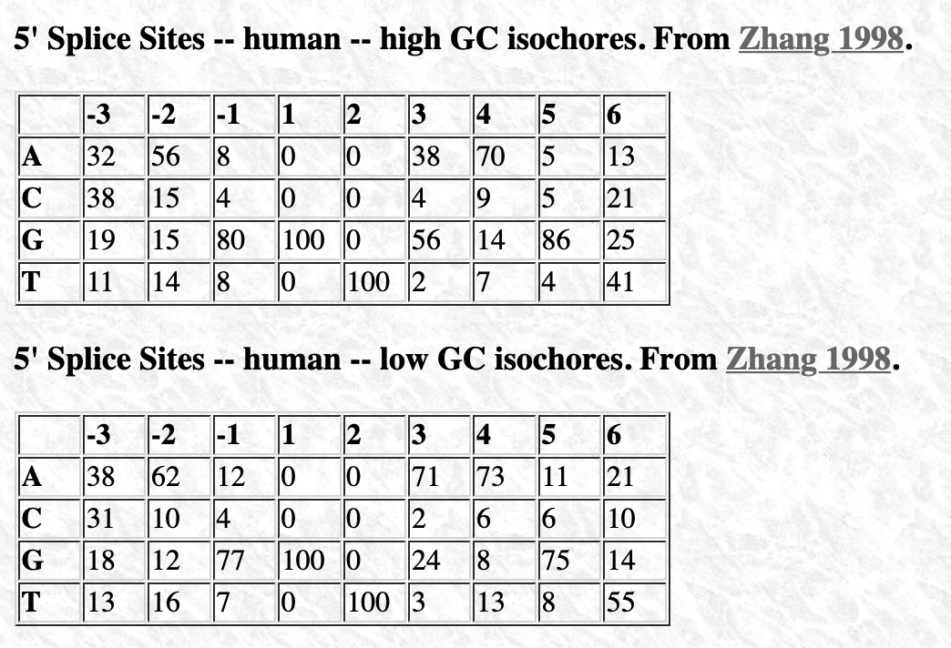
Splice site consensus humans
A G || G T
From: http://science.umd.edu/labs/mount/RNAinfo/matrices.html https://pubmed.ncbi.nlm.nih.gov/9536098/

Slide 21
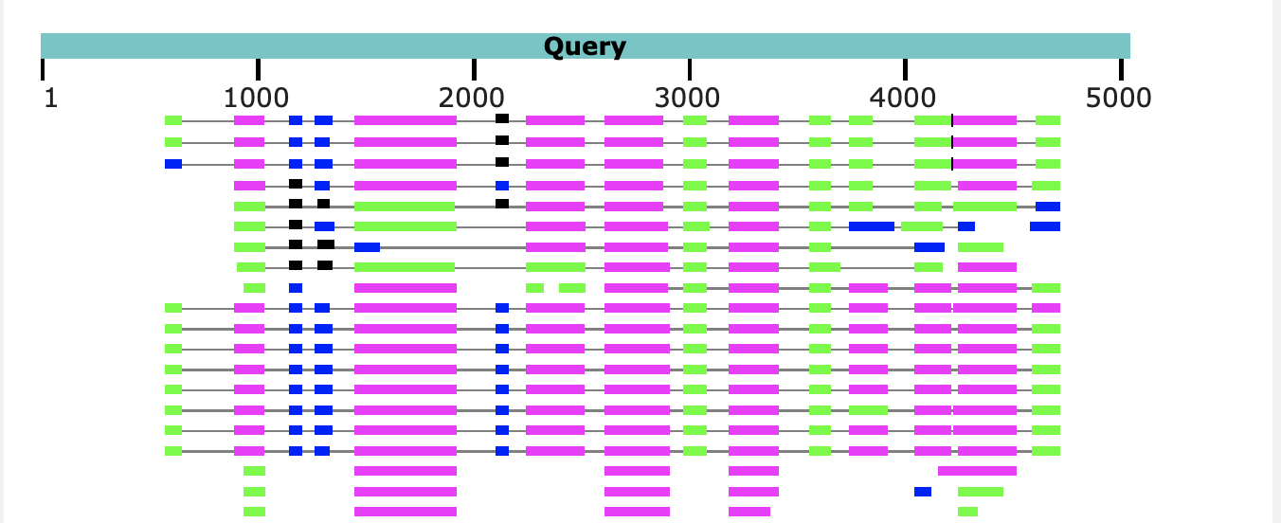
Predicting Intron and Exon sequences using computational approaches remains problematic.
The best way approach is to compare a cDNA or EST to the genome.
The second best is to compare the genome sequence to a protein databank.
The parts of the query that does not have matches corresponds to introns.
Note the large number of introns present in Arabidopsis, which is a plant with a very small genome. In other organisms the introns are even larger.

Slide 22
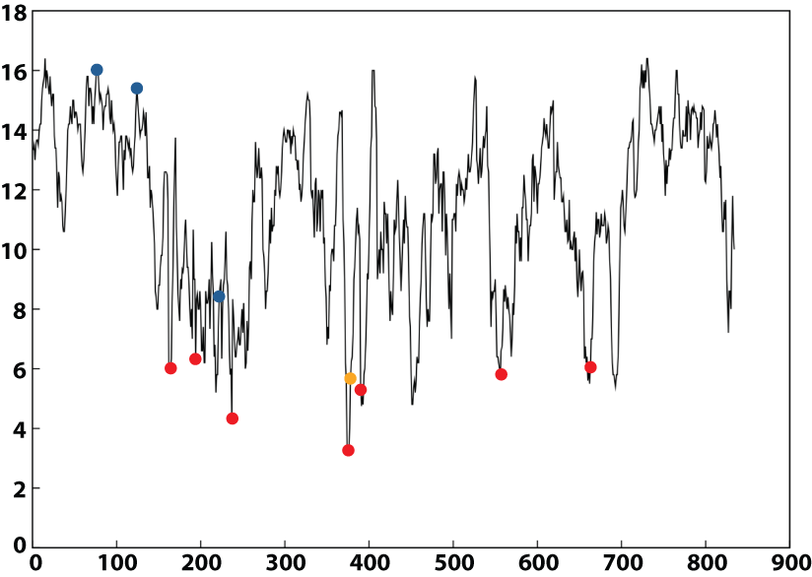

Ribonucleotide Reductase
Intein
Group I Introns
Group II Introns

Slide 23
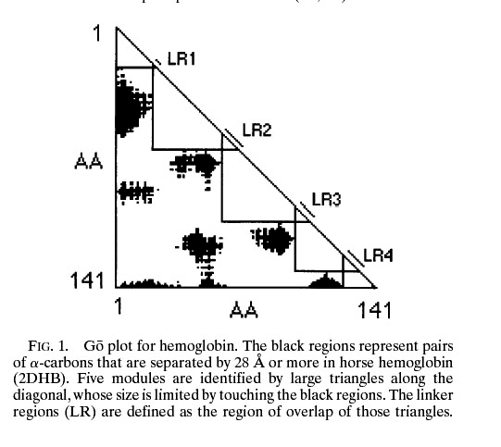
From:
Intron positions correlate with module boundaries in ancient proteins
Sandro Jose de Souza, Manyuan Long, Lloyd Schoenbach, Scott William Roy, and Walter Gilbert
https://www.pnas.org/content/93/25/14632
Named after Mitiko Gō

Slide 24
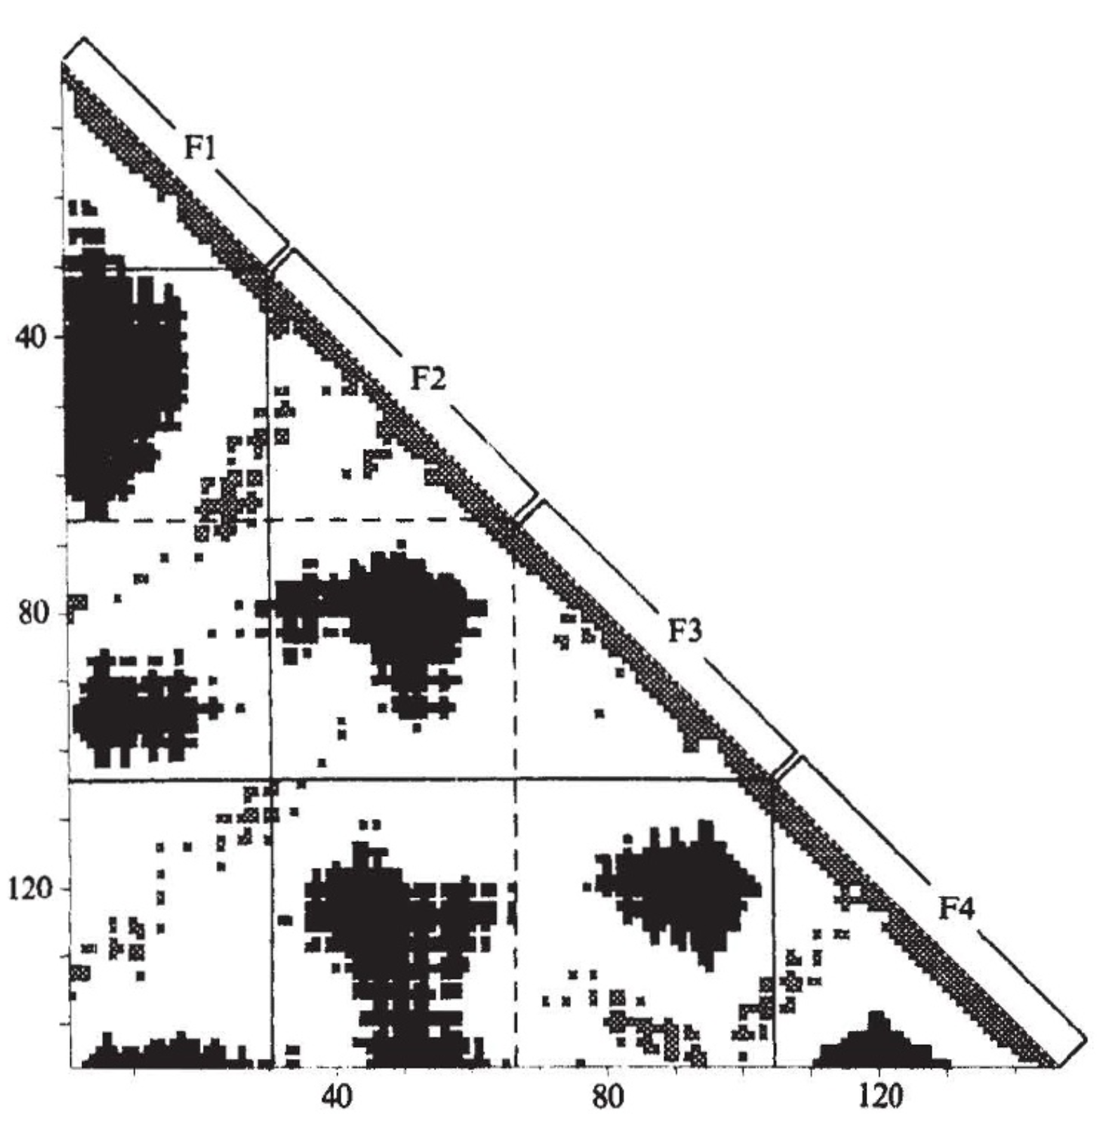
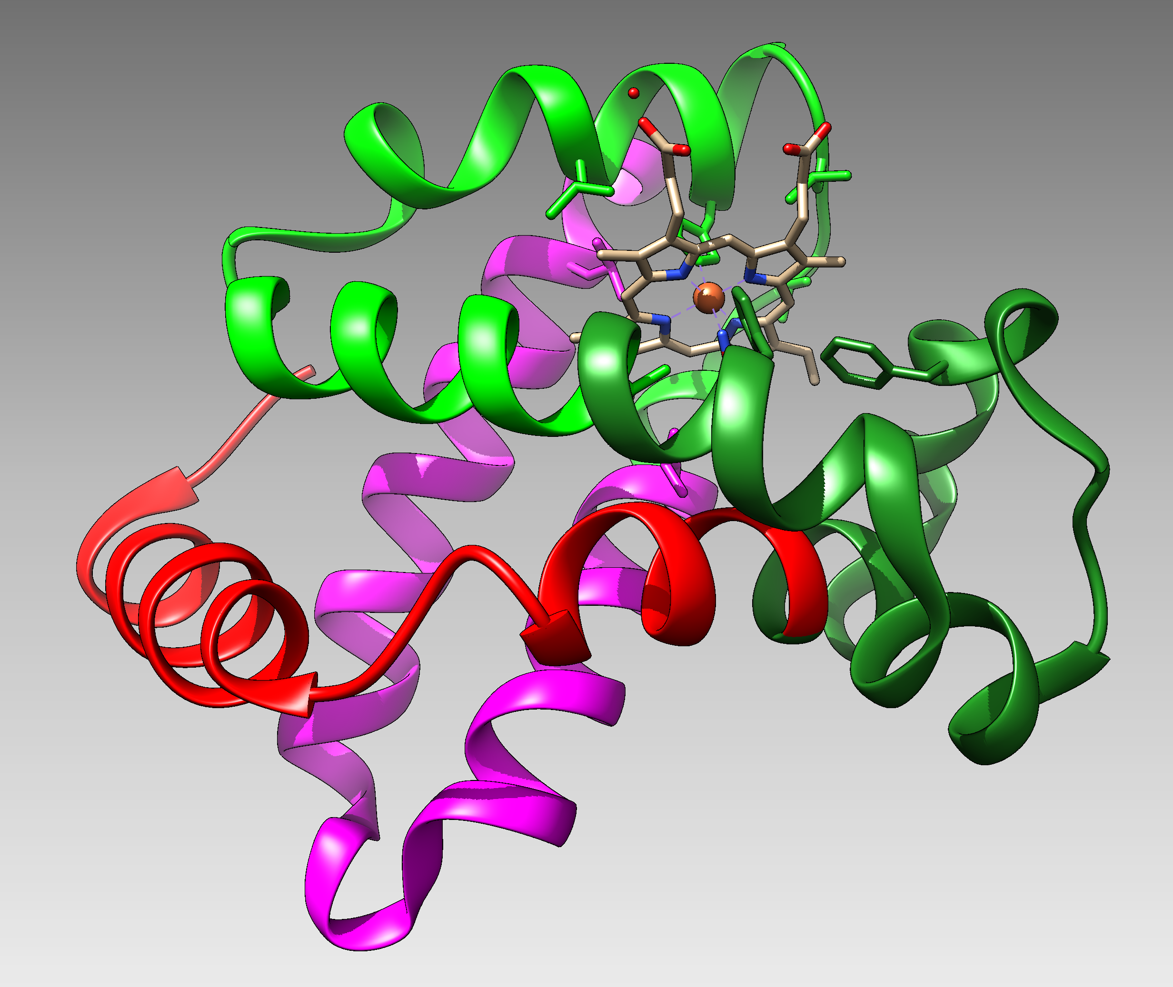
From:
Correlation of DNA exonic regions with protein structural units in haemoglobin
Mitiko Gō
Nature volume 291, pages90–92(1981)
beta SU from 4N8T Go domains colored
F1
F2
F3
F4

Slide 25
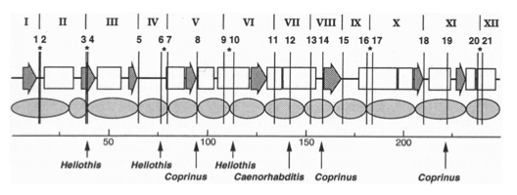

Slide 26
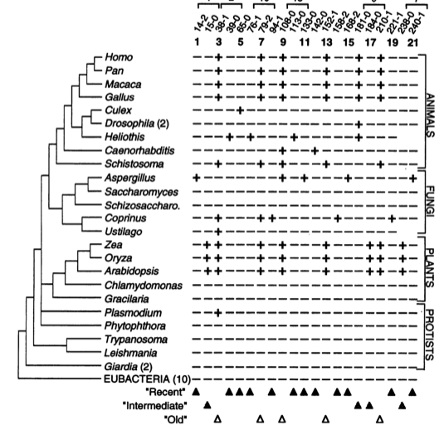

Slide 27
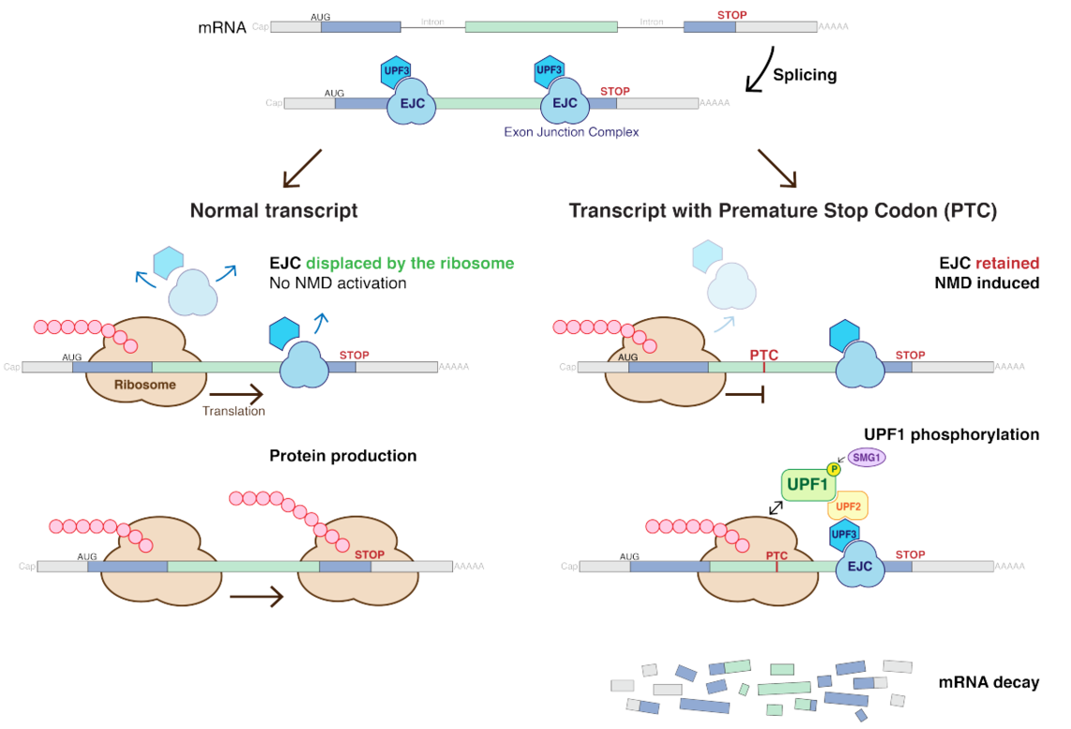
Nonsense-mediated mRNA decay (NMD) pathway
/
/
From:
https://en.wikipedia.org/wiki/Nonsense-mediated_decay
More details at https://en.wikipedia.org/wiki/MRNA_surveillance

Slide 28
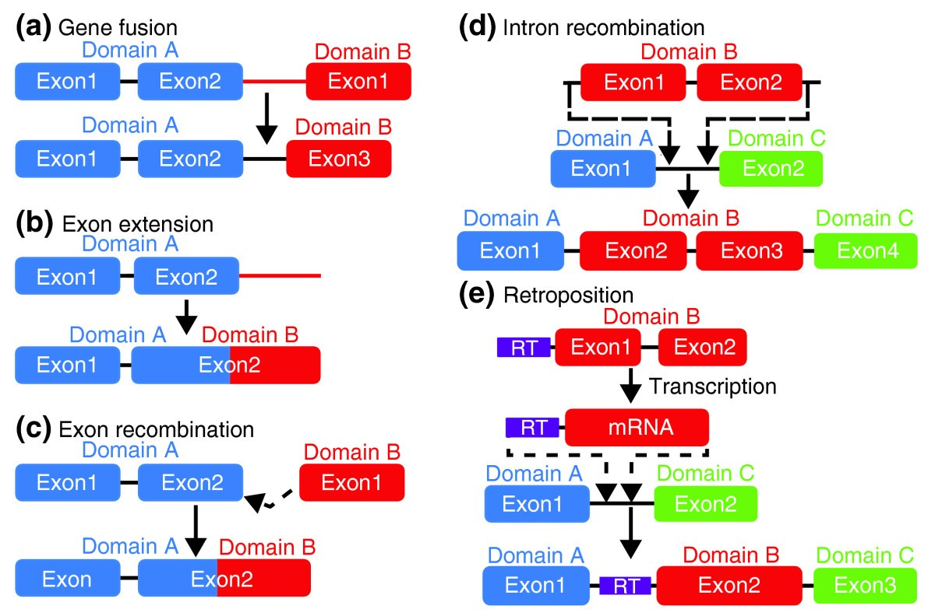
From: How do proteins gain new domains?
(a) Gene fusion. The noncoding region between two genes is modified so that the exons of the first gene become spliced with the second. (most common in animals)
(b) Exon extension. The noncoding region following an exon becomes part of the exon and codes for a new domain.
(c) Exon recombination. The exons of two genes become directly joined.
(d) Intron recombination. An exon from one gene is inserted into the intron of another. (rare Less than 10%)
(e) Retroposition. A retrotransposon sequence (RT, purple) mediates the copying of itself and a neighboring gene region via an mRNA intermediate, followed by insertion into another gene. (Rare (?) Gained domain encoded by a single exon).
/
Data from https://www.ncbi.nlm.nih.gov/pmc/articles/PMC2926785/

Slide 29
Introns early
Introns late
Self splicing RNAs are an example for catalytic RNA that could have been present in RNA world.
There is little reason to assume that the RNA world was not plagued by self-splicing parasites.
Neighboring Introns are more frequently in same phase than expected by chance (but not by much ☺)
Spliceosomal introns are present in deep branching eukaryotes
Introns frequently are found in linker regions (see Go plots)
Exon shuffling can create a large number of different catalytic sites (see the maturation of the immune system)
The nonsense mediated decay pathway exists in plants, animals and fungi. This pathway relies on tagging Exon Junction Complexes, i.e. the widespread presence of spliceosomal introns.
Mapping individual introns onto organismal evolutionary history shows that many introns inserted into the sites where they are found presently more recently.
Intron preference for linker region could be the result of selection (they do less harm here than in tightly packed domains.
Exon shuffling in the maturation of the adaptive immune system is a modern trait of vertebrates.
Even if some introns are ancient, this does not prove that they played a role in assembling the now existing protein families.
In the recent evolution (in the presence of many large introns), recombination in introns (exon shuffling appears to be rare – gene fusions are more common)

Slide 30
Predicting Open Reading Frames
GeneMark uses hidden Markov models and can be trained using training sets
-- works for pro- and eukaryotes and metagenomes
-- GenemarkS is the “standard to gene calling in viruses and prokaryotes
Glimmer was developed for prokaryotes,
-- a related software (GlimmerHMM) was developed for eukaryotes
Keep in mind that ab initio approaches work less well than those based on homology.
Popular are
PROKKA (described here)
RAST
Both rely on homology and already annotated similar genomes.
The cycle of identifying essential genes (aatRNAsynthases, DNA and RNA polymerases, ATPsynthases), and using these to train gene prediction software seems to work well.

Slide 31
Interlude from class 23

Slide 32
Purifying selection in E.coli ORFans
dN-dS < 0 for some ORFan E. coli clusters seems to suggest they are functional genes.
Gene groups | Number | dN-dS>0 | dN-dS<0 | dN-dS=0
E. coli ORFan clusters | 3773 | 944 (25%) | 1953 (52%) | 876 (23%)
Clusters of E.coli sequences found in Salmonella sp., Citrobacter sp. | 610 | 104 (17%) | 423(69%) | 83 (14%)
Clusters of E.coli sequences found in some Enterobacteriaceae only | 373 | 8 (2%) | 365 (98%) | 0 (0%)
Adapted after Yu, G. and Stoltzfus, A. Genome Biol Evol (2012) Vol. 4 1176-1187

Slide 33
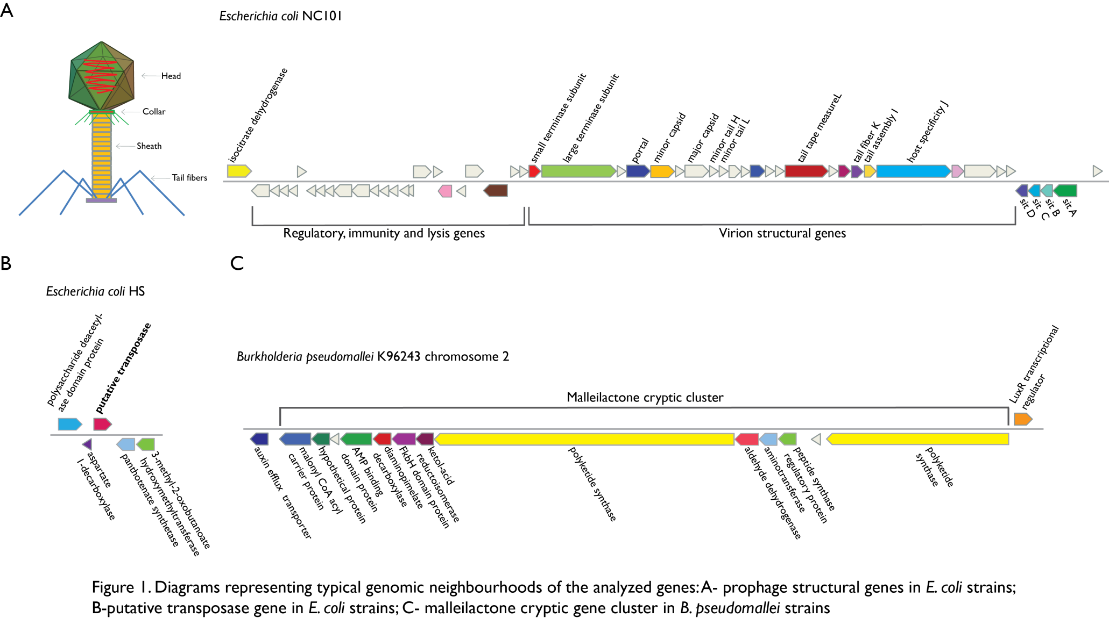
Vertically Inherited Genes Not Expressed for Function

Slide 34

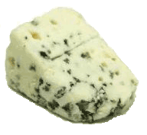
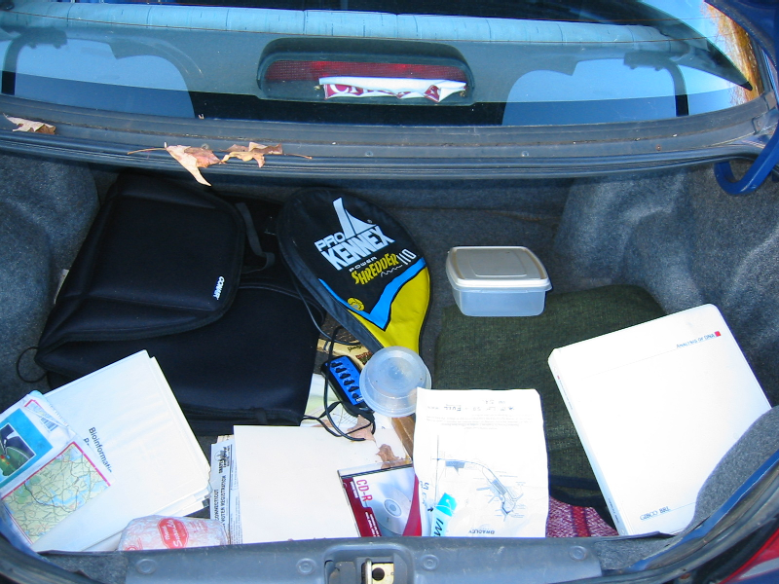
Trunk-of-my-car analogy: Hardly anything in there is the is the result of providing a selective advantage. Some items are removed quickly (purifying selection), some are useful under some conditions, but most things do not alter the fitness. See here for a published version.
Could some of the inferred purifying selection be due to the acquisition of novel detrimental characteristics (e.g., protein toxicity, HOPELESS MONSTERS)?

Slide 35
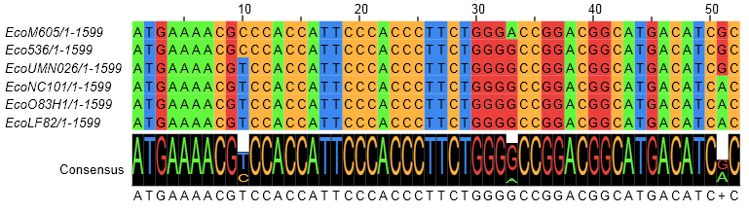
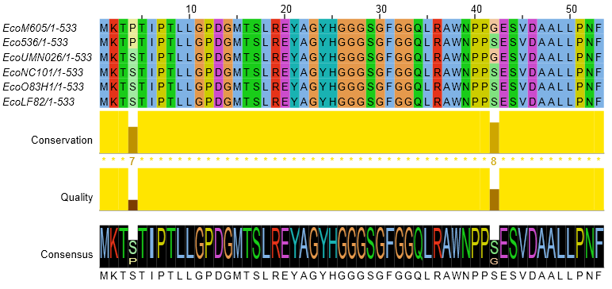
Counting Algorithm
Calculate number of different nucleotides/amino acids per MSA column (X)
Calculate number of nucleotides/amino acids substitutions (X-1)
Calculate number of synonymous changes
S=(N-1)nc-N
assuming N=(N-1)aa
X=2 1 nucleotide substitution
1 non-synonymous change
X=2 1 amino acid substitution

Slide 36
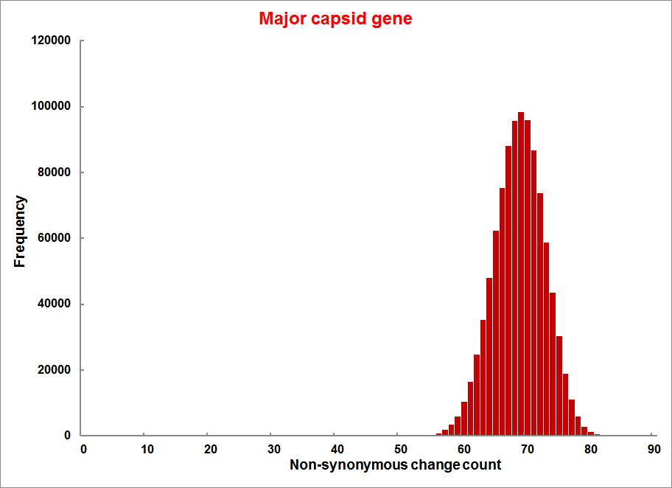
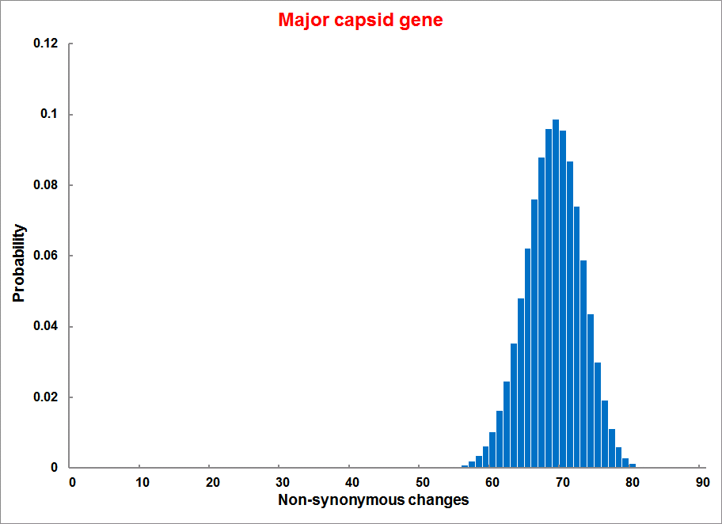


Evolution of Coding DNA Sequences Under a Neutral Model
E. coli Prophage Genes
Count distribution from simulations
Probability distribution
n=90
Non-synonymous
n= 90
k= 24
p=0.763
P(≤24)=3.63E-23
Observed=24
P(≤24) < 10⁻⁶
n=90
Synonymous
n= 90
k= 66
p=0.2365
P(≥66)=3.22E-23
Observed=66
P(≥66) < 10⁻⁶

Slide 37
Evolution of Coding DNA Sequences Under a Neutral Model
E. coli Prophage Genes
 |  | OBSERVED |  | SIMULATED |  | Dnapars | Simulated | Codeml
Gene | Alignment Length (bp) | Substitutions | Synonymous changes* | Substitutions | p-value synonymous (given *) | Minimum number of substitutions | dN/dS | dN/dS
Major capsid | 1023 | 90 | 66 | 90 | 3.23E-23 | 94 | 0.113 | 0.13142
Minor capsid C | 1329 | 81 | 59 | 81 | 1.98E-19 | 84 | 0.124 | 0.17704
Large terminase subunit | 1923 | 75 | 67 | 75 | 7.10E-35 | 82 | 0.035 | 0.03773
Small terminase subunit | 543 | 100 | 66 | 100 | 1.07E-19 | 101 | 0.156 | 0.25147
Portal | 1599 | 55 | 46 | 55 | 1.36E-21 | *64 | 0.057 | 0.08081
Protease | 1329 | 55 | 37 | 55 | 4.64E-11 | 55 | 0.162 | 0.24421
Minor tail H | 2565 | 260 | 168 | 260 | 1.81E-44 | 260 | 0.17 | 0.30928
Minor tail L | 696 | 30 | 26 | 30 | 1.30E-13 | 30 | 0.044 | 0.05004
Host specificity J | 3480 | 723 | 498 | 723 | 6.42E-149 | *773 | 0.137 | 0.17103
Tail fiber K | 741 | 41 | 28 | 41 | 1.06E-09 | 44 | 0.14 | 0.18354
Tail assembly I | 669 | 39 | 33 | 39 | 3.82E-15 | 40 | 0.064 | 0.07987
Tail tape measure protein | 2577 | 375 | 243 | 375 | 7.92E-64 | 378 | 0.169 | 0.27957
Values well under the p=0.01 threshold, suggesting rejection of the null hypothesis of neutral evolution of prophage sequences.

Slide 38
dN/dS < 1 is not sufficient evidence for the beneficial function of the encoded protein.
Prophages that have not been active as phages and are inherited vertically have a dN/dS below 1.
Purifying selection (dN/dS < 1) may occur because the gene product after the mutation is detrimental, not because the gene before mutation was beneficial.

Slide 39


Slide 40


Slide 41


Slide 42

Isoelectric point (pI) of a protein: The pH at which the net charge of the protein is zero.
This can be experimentally determined using isoelectric focusing gels.
Theoretical pI is calculated from the pKs of the individual amino acids.

Slide 43
PEPSTATS of QAY18538.1 from 1 to 580
Molecular weight = 64213.14 Residues = 580
Average Residue Weight = 110.712 Charge = -74.0
Isoelectric Point = 3.9355
A280 Molar Extinction Coefficients = 21890 (reduced) 22140 (cystine bridges)
A280 Extinction Coefficients 1mg/ml = 0.341 (reduced) 0.345 (cystine bridges)
Probability of expression in inclusion bodies = 0.979
Residue Number Mole% DayhoffStat
A = Ala 46 7.931 0.922
B = Asx 0 0.000 0.000
C = Cys 4 0.690 0.238
D = Asp 81 13.966 2.539
/.../
Property Residues Number Mole%
Tiny (A+C+G+S+T) 157 27.069
Small (A+B+C+D+G+N+P+S+T+V) 328 56.552
Aliphatic (A+I+L+V) 169 29.138
Aromatic (F+H+W+Y) 38 6.552
Non-polar (A+C+F+G+I+L+M+P+V+W+Y) 267 46.034
Polar (D+E+H+K+N+Q+R+S+T+Z) 313 53.966
Charged (B+D+E+H+K+R+Z) 196 33.793
Basic (H+K+R) 63 10.862
Acidic (B+D+E+Z) 133 22.931

Slide 44

run_pepstats.pl

Slide 45

parse_pepstats.pl

Slide 46

parse_pepstats_mod.pl

Slide 47

parse_pepstats.pl

Slide 48

parse_pepstats_mod.pl

Slide 49

parse_pepstats_mod.pl

Slide 50

histogramScript_pdf.R

Slide 51

histogramScript_pdf.R

Slide 52


histogramScript_pdf.R

Slide 53
pH at which protein has no charge

Slide 54
DNA, cell wall & membrane bound proteins
pH at which protein has no charge

Slide 55


Slide 56
DNA, cell wall & membrane bound proteins
pH at which protein has no charge

Slide 57
Histogram of theoretical isoelectric points of Thermplasmatales proteins
pH at which protein has no charge

Slide 58
pH at which protein has no charge

Slide 59
Histogram of theoretical isoelectric points of Saccharomyces proteins
DNA, cell wall & membrane bound proteins
pH at which protein has no charge

Slide 60
Strategies for extreme halophily
Exclude salts, balance with other osmotically active substances.
Balance external Na⁺ Cl⁻ with internal K⁺ Cl⁻
This leads to very high internal K⁺ concentration (> 5M)
At this ionic strength, the reach of a charge on a protein does not reach very far.
To compensate, proteins in organisms following the salt in strategy have many negative charges.
Consequently, most proteins have an acidic isoelectric point.

Slide 61
Histogram of theoretical isoelectric points of Haloferax proteins
Salt in strategy
At neutral pH most proteins with negative charge
pH at which protein has no charge

