Slide 1
MCB 3421 – class 10
The transitive property of homology
The fossil record for early life
LUCA and the early heavy bombardment of Earth

Slide 2
If A is a homolog of B & B is a homolog of C
A
B
B
C
then
A
B
C
B
C
A
A
C
B
or
or

Slide 3
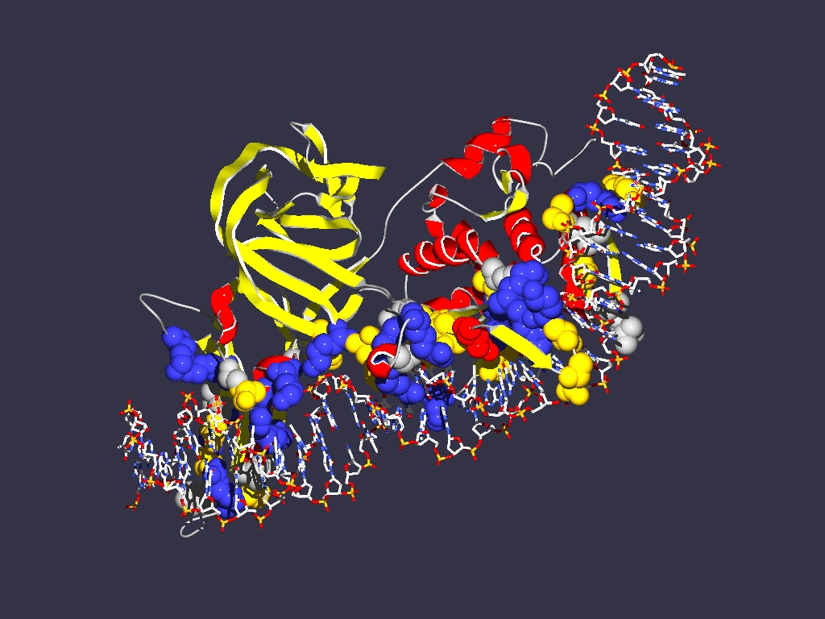
The transitive property of homology ”Exception”
A or B or C are not one, but several entities lumped together
Example:
Encoding
1LWS
Extein = Host Protein
Intein Splicing Domain
Homing Endonuclease (HE)
domain
Each component can have its own homologs

Slide 4
Exception to the transitive property of homology
In a pairwise blast search multiple components in the query might be revealed as follows:
Query: GI 6320016 (V-ATPase a-SU from Yeast)
6320016 (V‐ATPase A‐SU from Yeast)
GI 1303679 (V‐ATPase A‐SU from Acetabularia)
GI 1303679 (V‐ATPase A‐SU from Acetabularia)
Homolog 1:
GI 1303679 (V‐ATPase A‐SU from Acetabularia)
V-ATPase a-SU from Acetabularia
Homolog 2:
HO-endonuclease from Yeast

Slide 5
While homology is a transitive property, the parts of a protein (or DNA) that are homologous need to be the same. E.g. 6320016 (V‐ATPase A‐SU from Yeast) is homologous to 1303679 (V‐ATPase A‐SU from Acetabularia) and to 2507047 (mating type switching endonuclease from yeast), but different parts of 6320016 give rise to this homology.

Slide 6
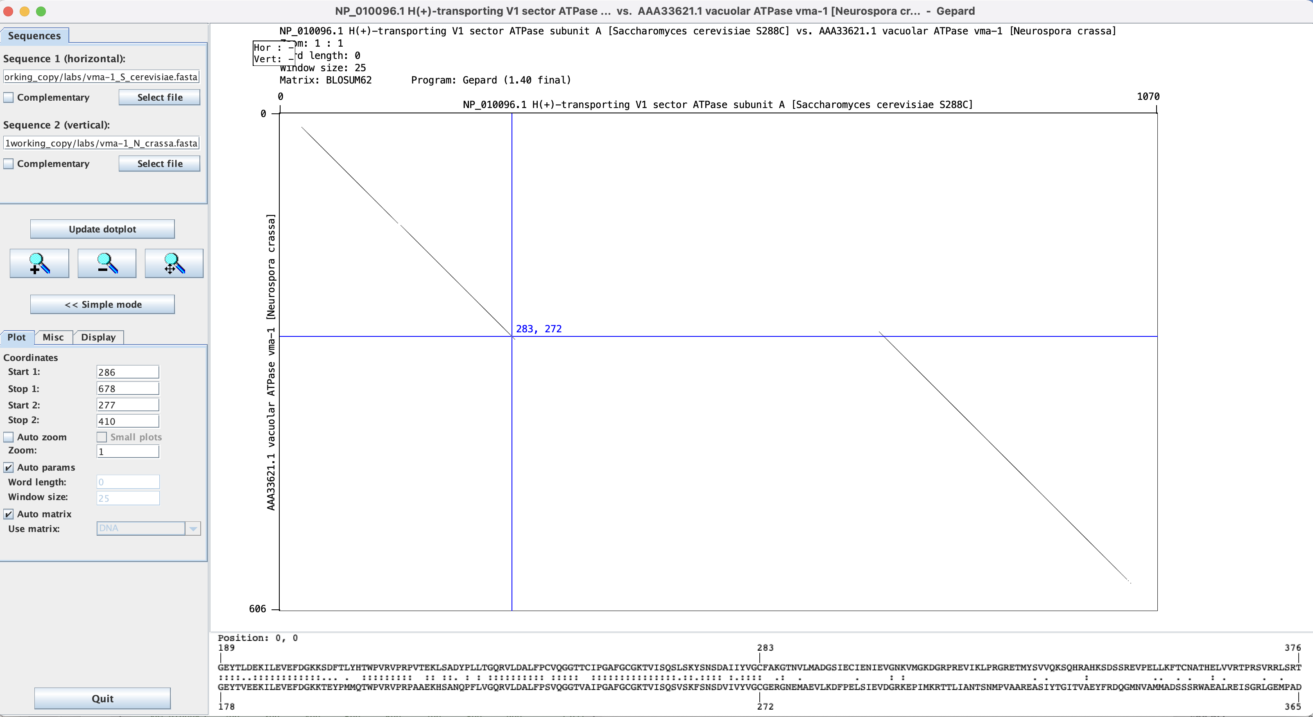
Dotplot in Gephard: Yeast vs Neurosora V-ATPase A-subunit.
Note: while the match ends at position 283, the diagonal extends a little beyond this. The first aa of the intein is the C

Slide 7
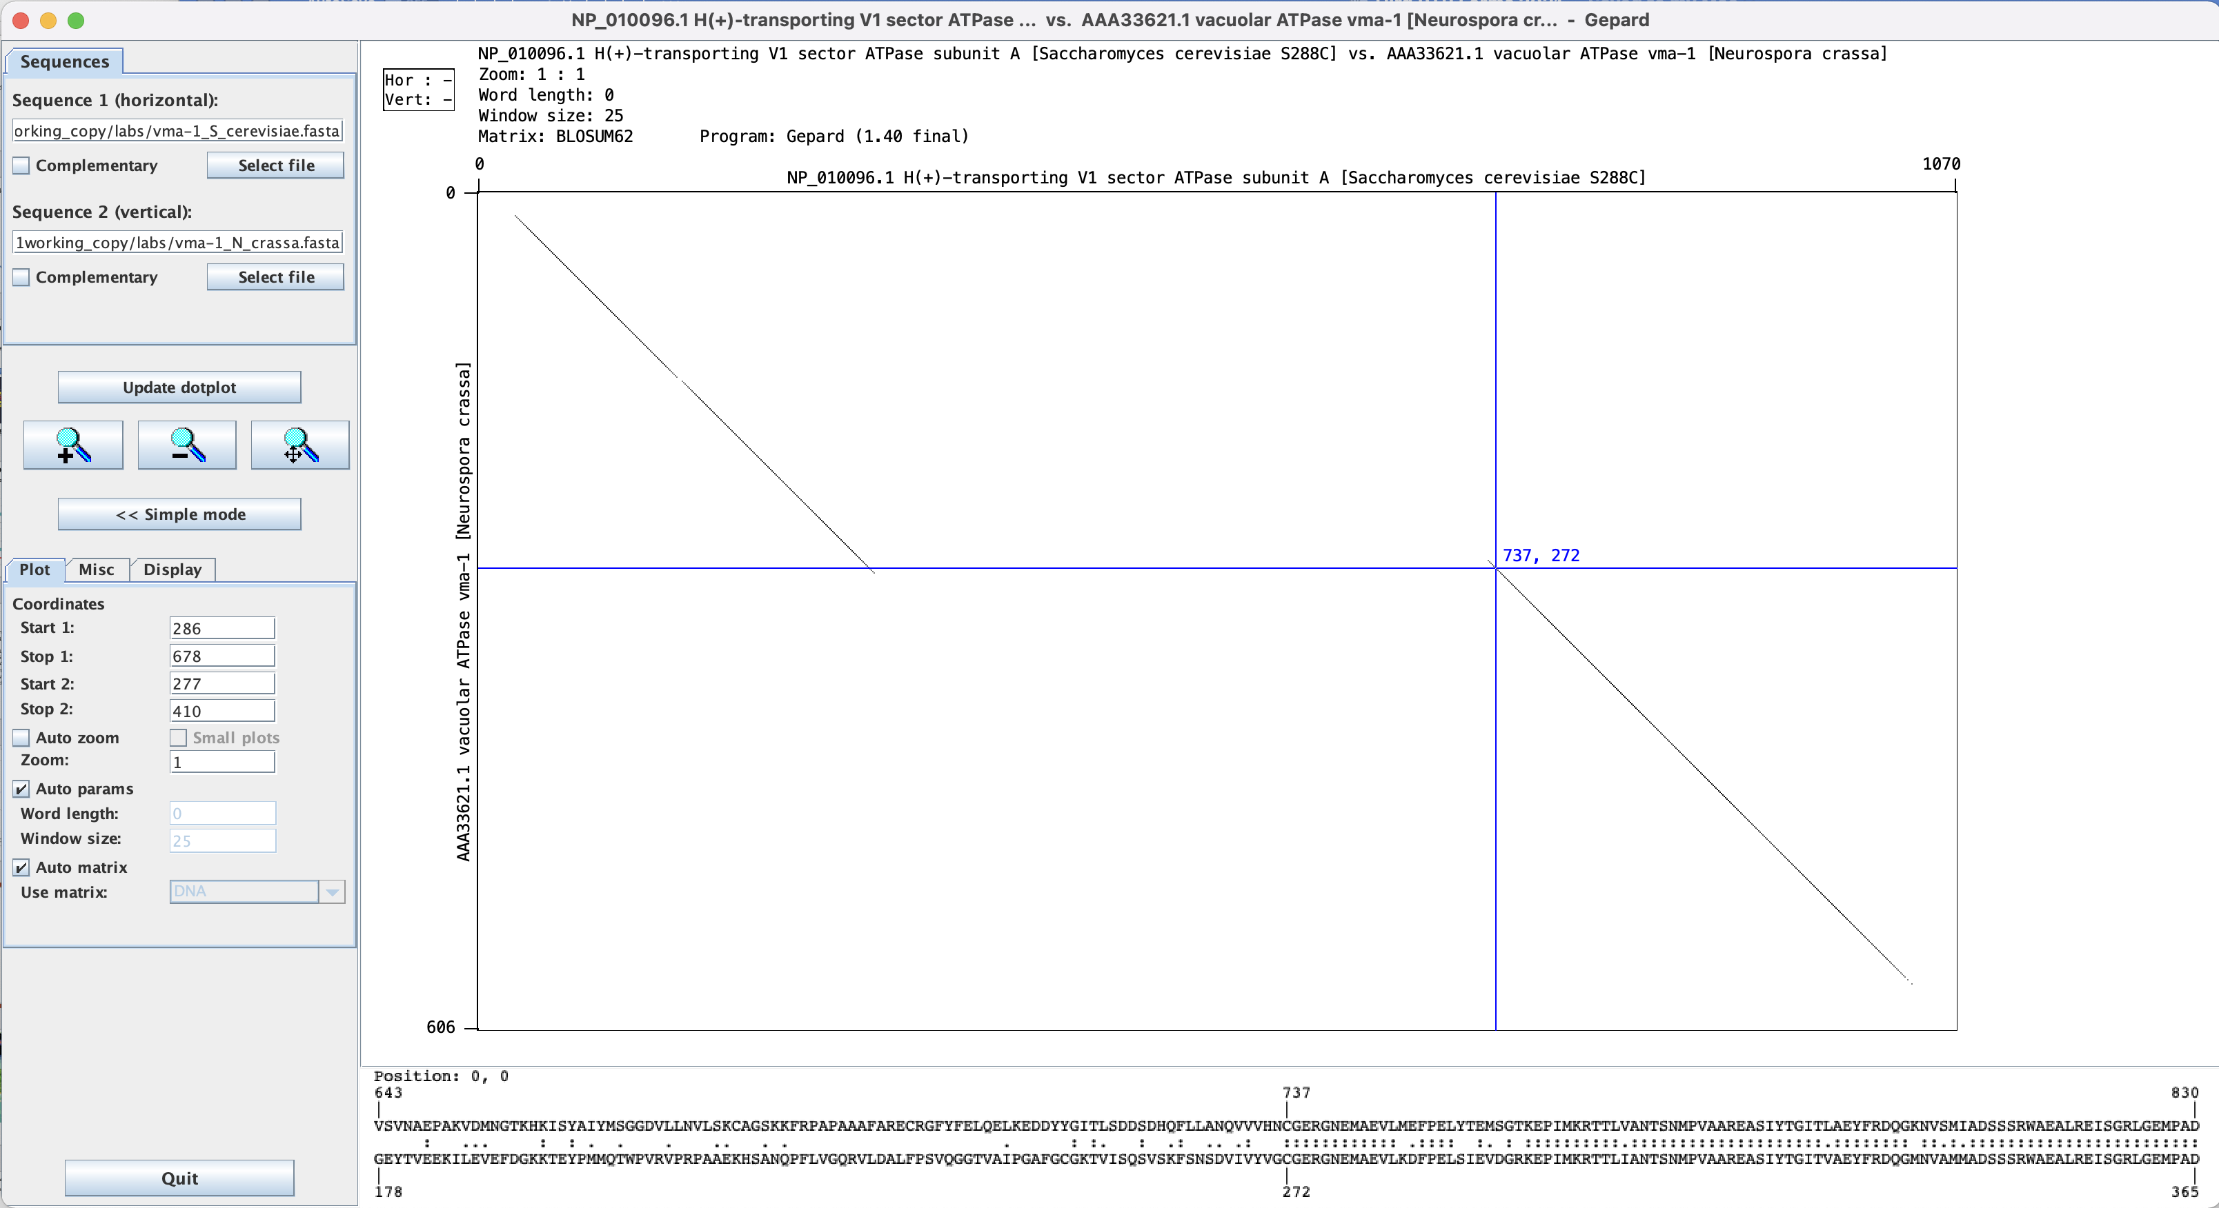
The last aa of the inteins are HN

Slide 8
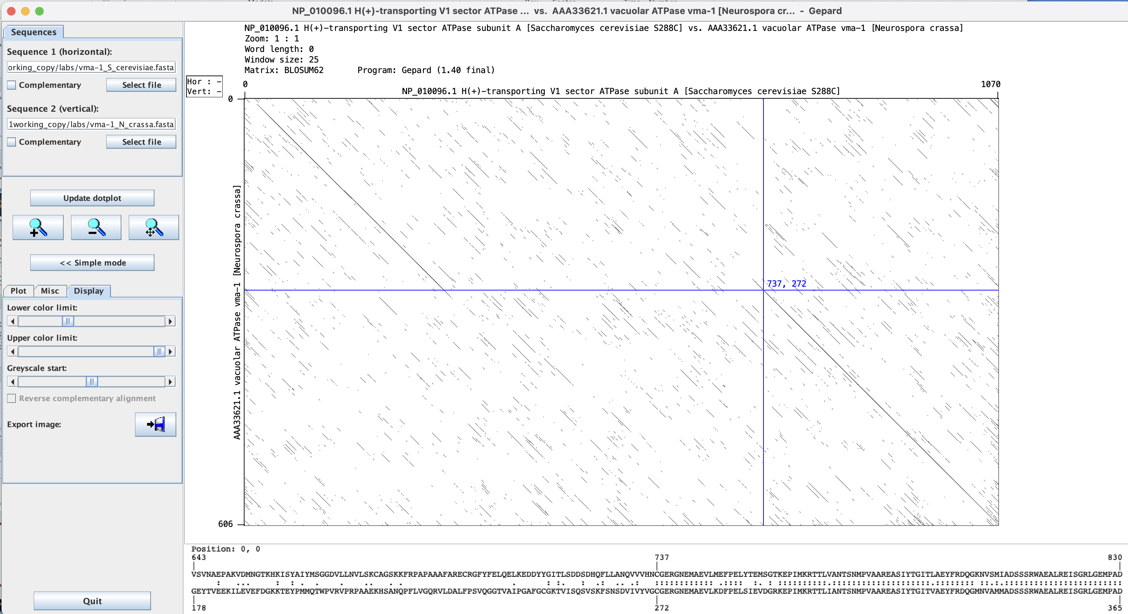
Adjusting which windows to display.

Slide 9
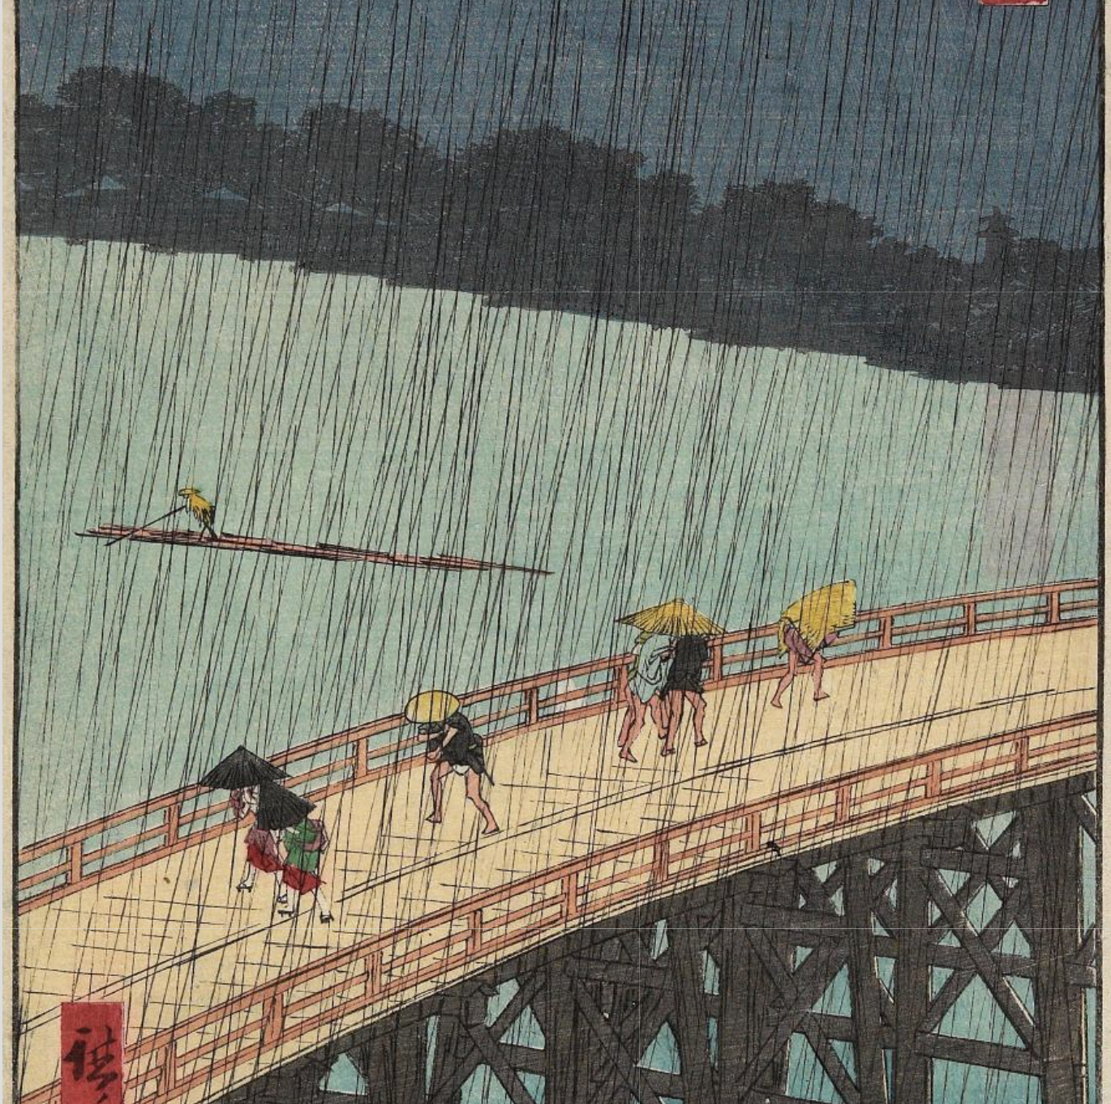
Distant View of Atake in Evening Shower
from: http://archive.artsmia.org/art-of-asia/explore/explore-collection-ukiyo-e-rain.cfm.html

Slide 10
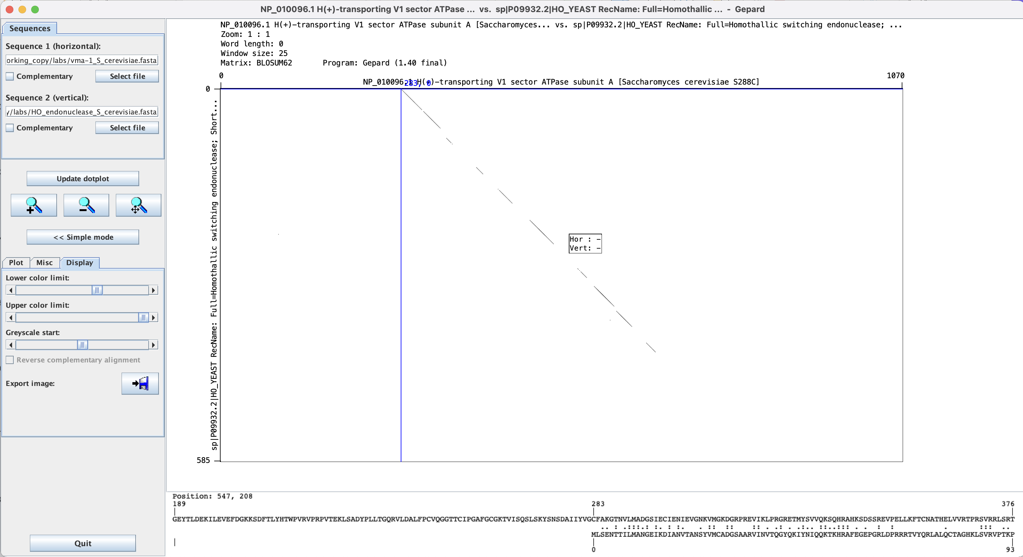
This works moderately well for divergent sequences – one could increase the window size and decrease the lower color limit

Slide 11
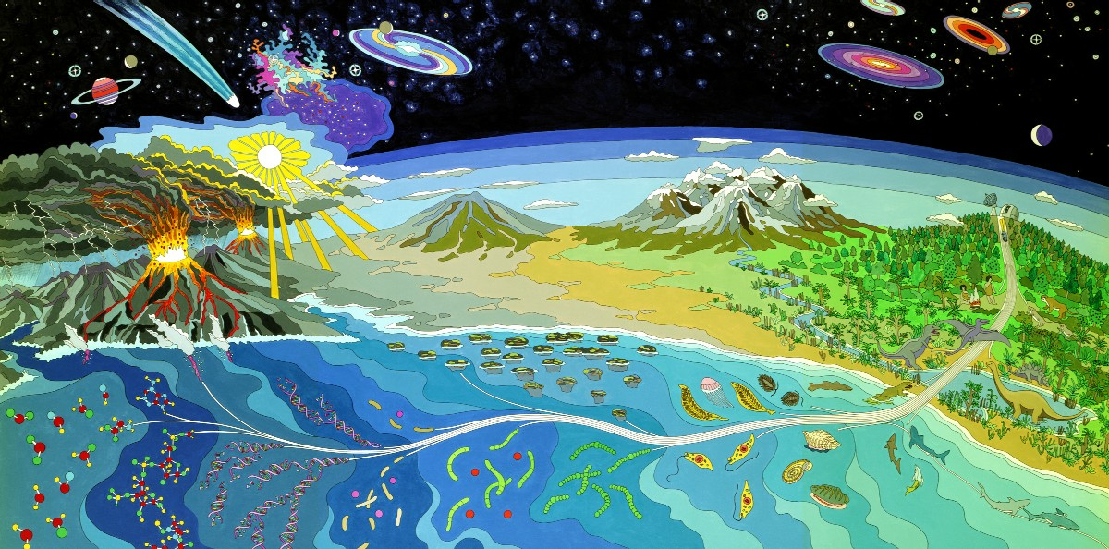
Mural at NASA Ames Research Center
The record for early life

Slide 12
With the insistence of NSF and NIH that articles reporting on funded research are accessible by the public with a year after publication, many recent articles are available to everyone. Exceptions are review articles and commentaries and particularly annoying, older articles in Science (e.g., Bill Schopf’s article on 3.5 billion-year-old* cyanobacterial fossils.
Aside on scientific articles behind paywalls:
If UConn has a subscription, use vpn (e.g. Pulse) or a computer on campus
Use Scihub (see next slides)
* Names and abbreviations for large numbers are a problem. Most European countries denote 10⁹ as a milliard and 10¹² as billion. This is known as a the short (UK and US) and long scale respectively. From Wikipedia:
For example, Bulgarian, Catalan, Croatian, Czech, Danish, Dutch, Finnish, French, Georgian, German, Hebrew (Asia), Hungarian, Italian, Norwegian, Polish, Portuguese, Romanian, Russian, Serbian, Slovak, Slovenian, Spanish, Swedish, Turkish and Ukrainian — use milliard (or a related word) for the short scale billion, and billion (or a related word) for the long scale billion.
I try to use the term Giga Year Before Present as less ambiguous.

Slide 13
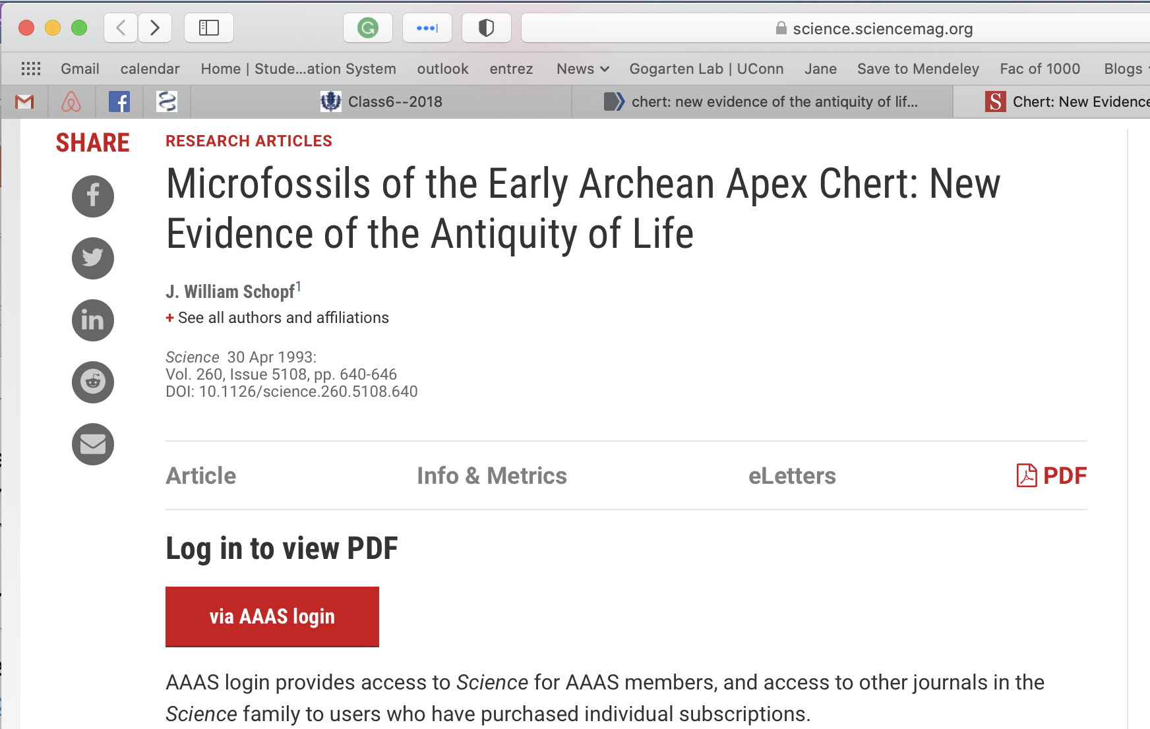

Slide 14
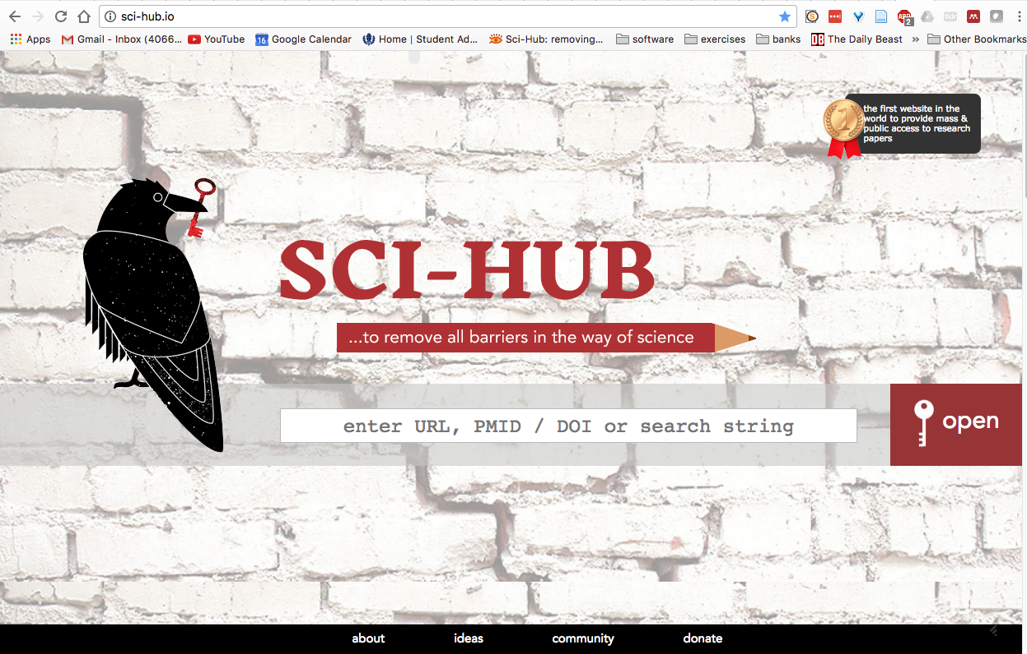
The web’s solution to open access:
Paste DOI here

Slide 15
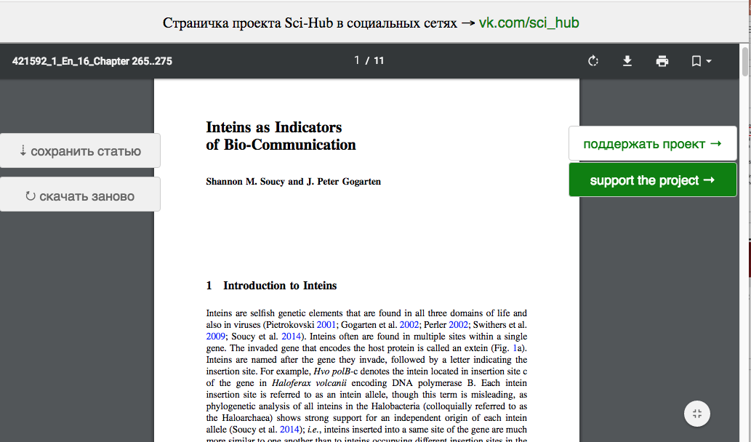
SCI-HUB
Even obscure and very recent Book Chapters are retrieved. This was posted before the authors had received their pdf!

Slide 16
Companion site to SCI-HUB

Slide 17
Jemmy Button was a native American “abducted” by Captain FitzRoy (bought for a button, hence the name) to England to be civilized. He, together with a missionary and other Fuegians were returned to Tierra del Fuego on the same trip that also brought Charles Darwin to the Galapagos.

Slide 18
to download click here

Slide 19
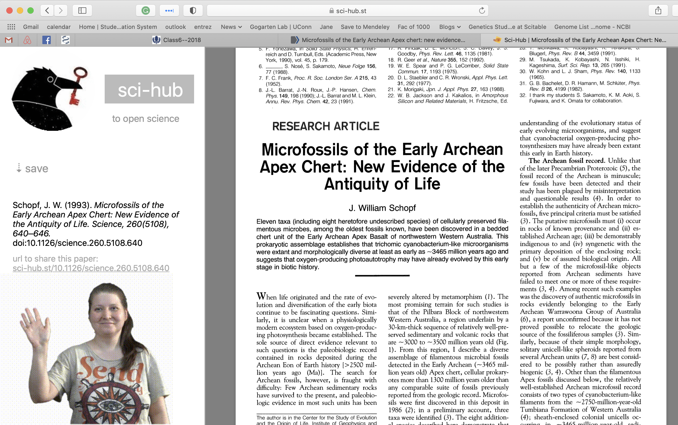

Slide 20
How old is life on Earth?
The Earth is about 4.6 Ga old, but no crustal rocks has survived from that time. The oldest rocks are no older than 4.0 Ga. But zircon crystals dated to 4.4 billion years BP are found in rocks. They are considered evidence for Earth's crust having had formed and being in contact with water already 4.4 billion years GaBP (here and here)
Biological Signature Evidence (examples): Oldest geological evidence for life - 3.8 Ga ago - is based on ¹³C discrimination (carbon derived from living systems often have lower delta ¹³C values than inorganic carbonates) [here]. The rocks are from Akilia island off the coast of Greenland, and severely altered by metamorphism. However, recently the evidence for that was reassessed.
3.7 billion year of rocks from the Isua formation in Greenland contain structures described as stromatholites. here in NYT, report in Nature
The amount of carbon in the Issua formation (and its discrimination against agains 13C) is interpreted by Minik Rosing to indicate a highly productive biosphere.
3.7GA old fossils from marine hydrothermal vent systems (Dodd et al 2017)
Morphological Fossil Evidence: For about a decade the oldest microfossils were considered to be about 3.5 Ga old (see here). The fossils (as interpreted by Bill Schopf) look like "modern" Cyanobacteria. Compare the time to to molecular trees of life: Is this a problem? However, the evidence for these fossils was questioned. 3.2Ga old filamentous fossils, probably of thermophilic chemotrophic prokaryotes (Rasmussen, 2000) 1.8Ga old fossils from Gunflint formation: iron-loving bacteria and cyanobacteria

Slide 21
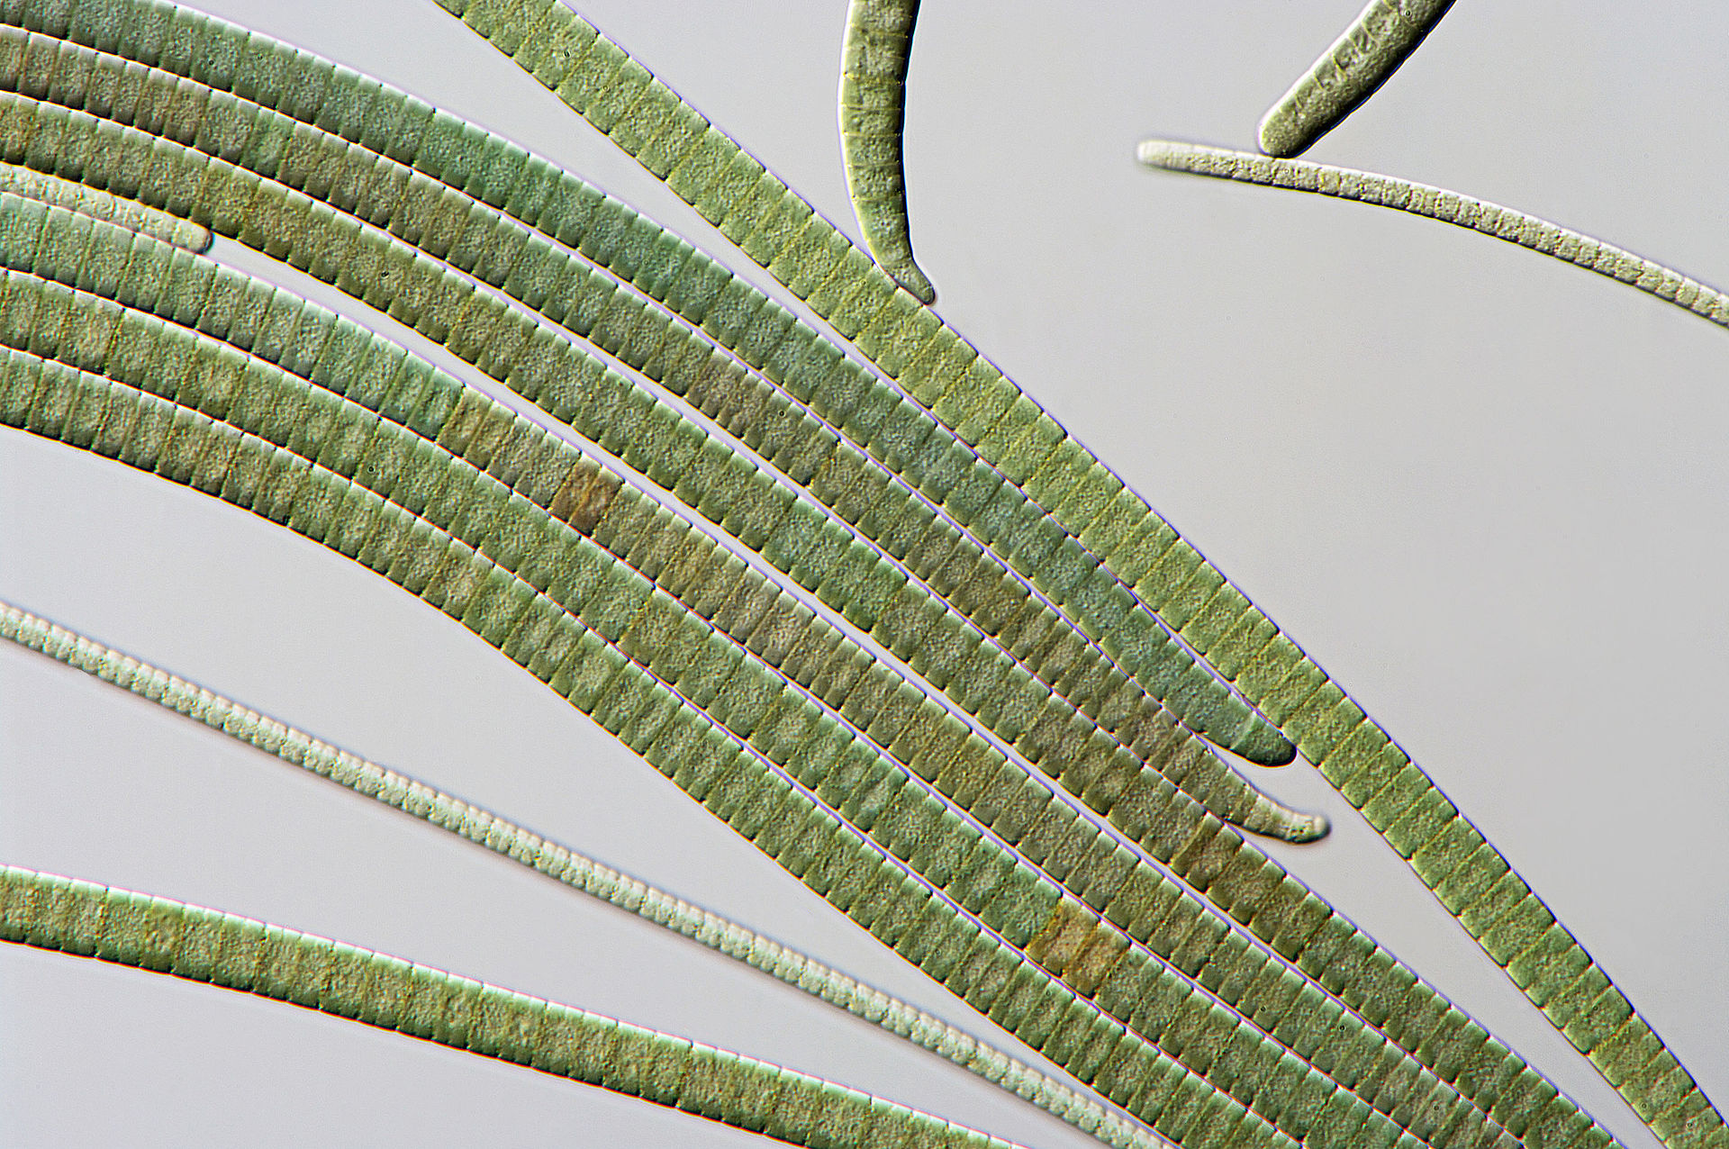
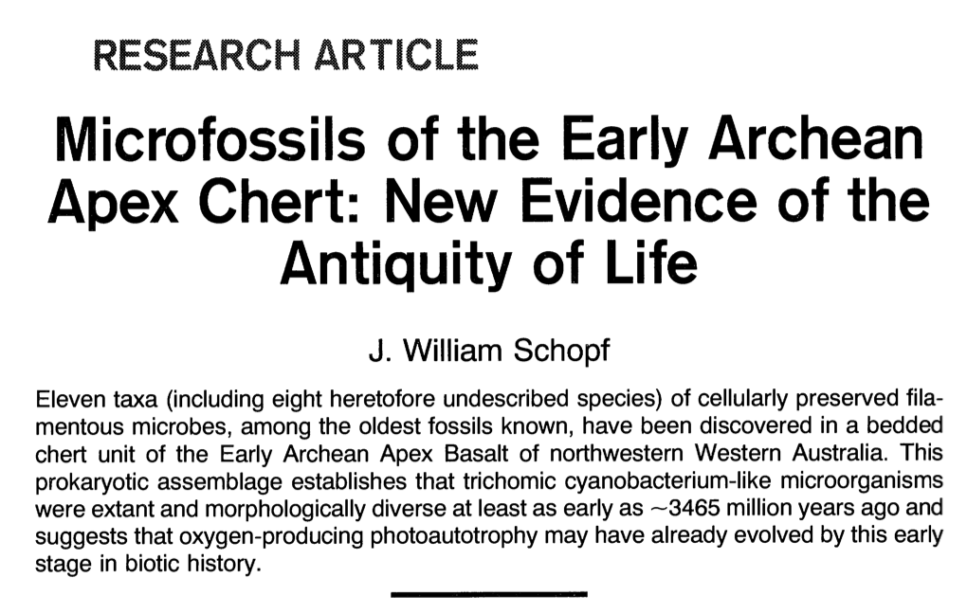
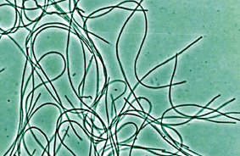
Oscillatoria (a cyanobacterium)
Chloroflexus (green non-sulfur bacteria)
Cyanobacteria-like: while Bill Schopf and others most of the time considered them cyanobacteria, there are non-oxygen producing filamentous photosynthetic bacteria with a very similar morphology

Slide 22
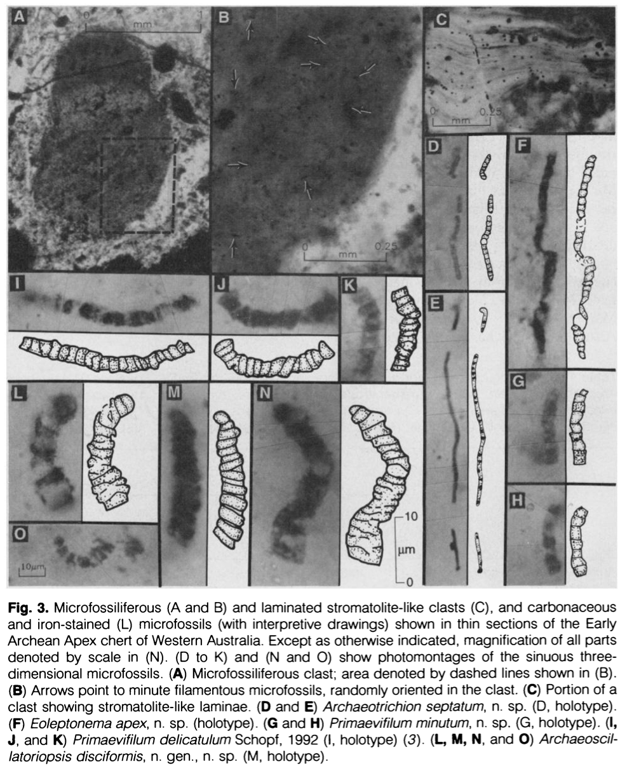
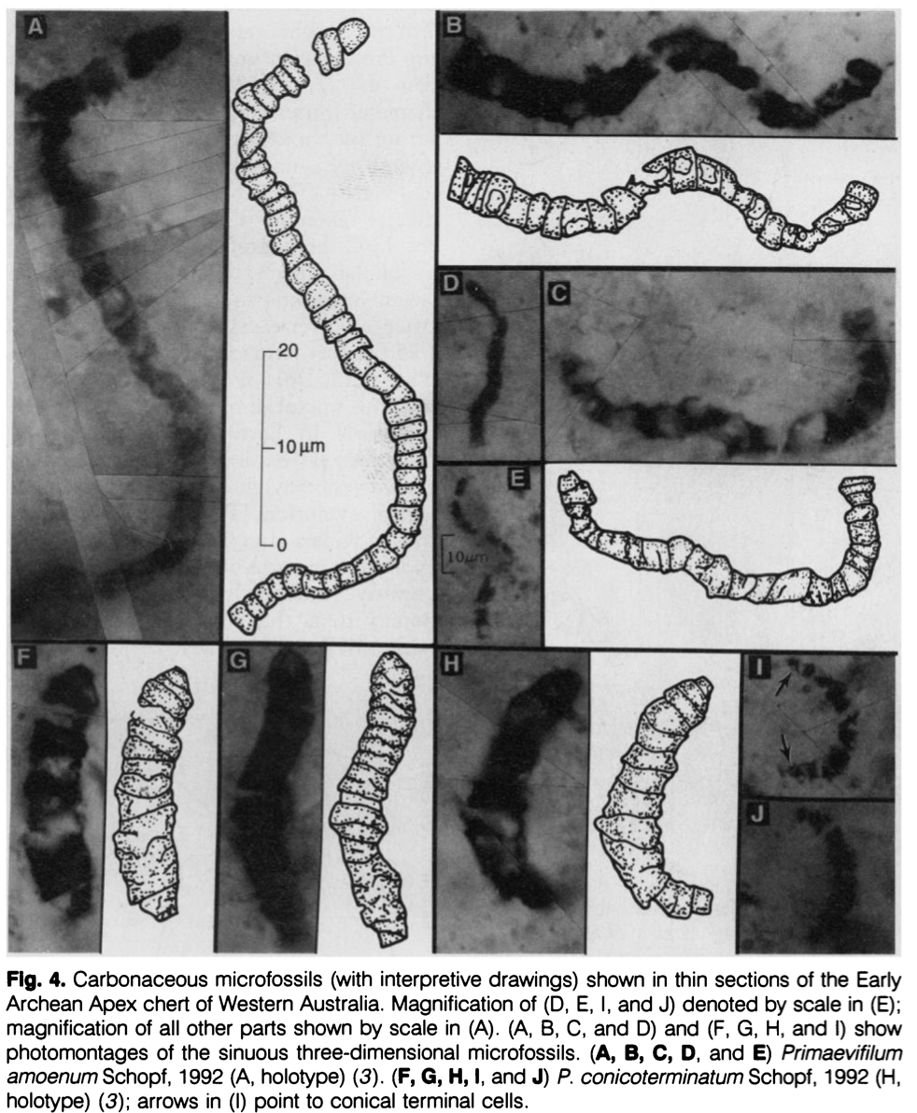

Slide 24
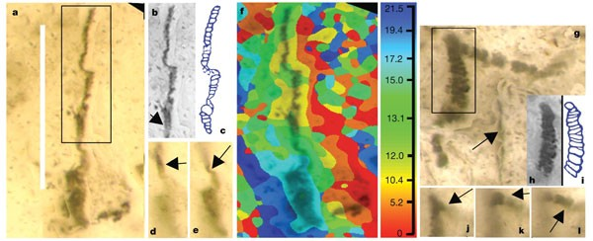
a, New image of putative beggiatoan Eoleptonema apex Holotype (ref. 3), combining the most sharply focused images from successive focal planes; b, c, digital image and interpretative sketch in the style of ref. 3 that omits the lower structure; d, e, new single image frames showing continuity of original and newly imaged structures. f, Topographic map showing computer-selected focal planes (plus scale in µm) of a; g, new image of putative cyanobacterium Archaeoscillatoriopsis disciformis Holotype (ref. 3) showing rhombic ghost (arrow); h, i, digital image and interpretative sketch in the style of ref. 3 that omits the lower structure and side branch; j, k, l, new single image frames showing continuity of original and newly imaged structure. Scale bar, 40 µm.

Slide 25
Mural at NASA Ames Research Center
Darwin’s Coral of Life, tree shape, and indications for early extinctions due to increased environmental temperature.

Slide 26
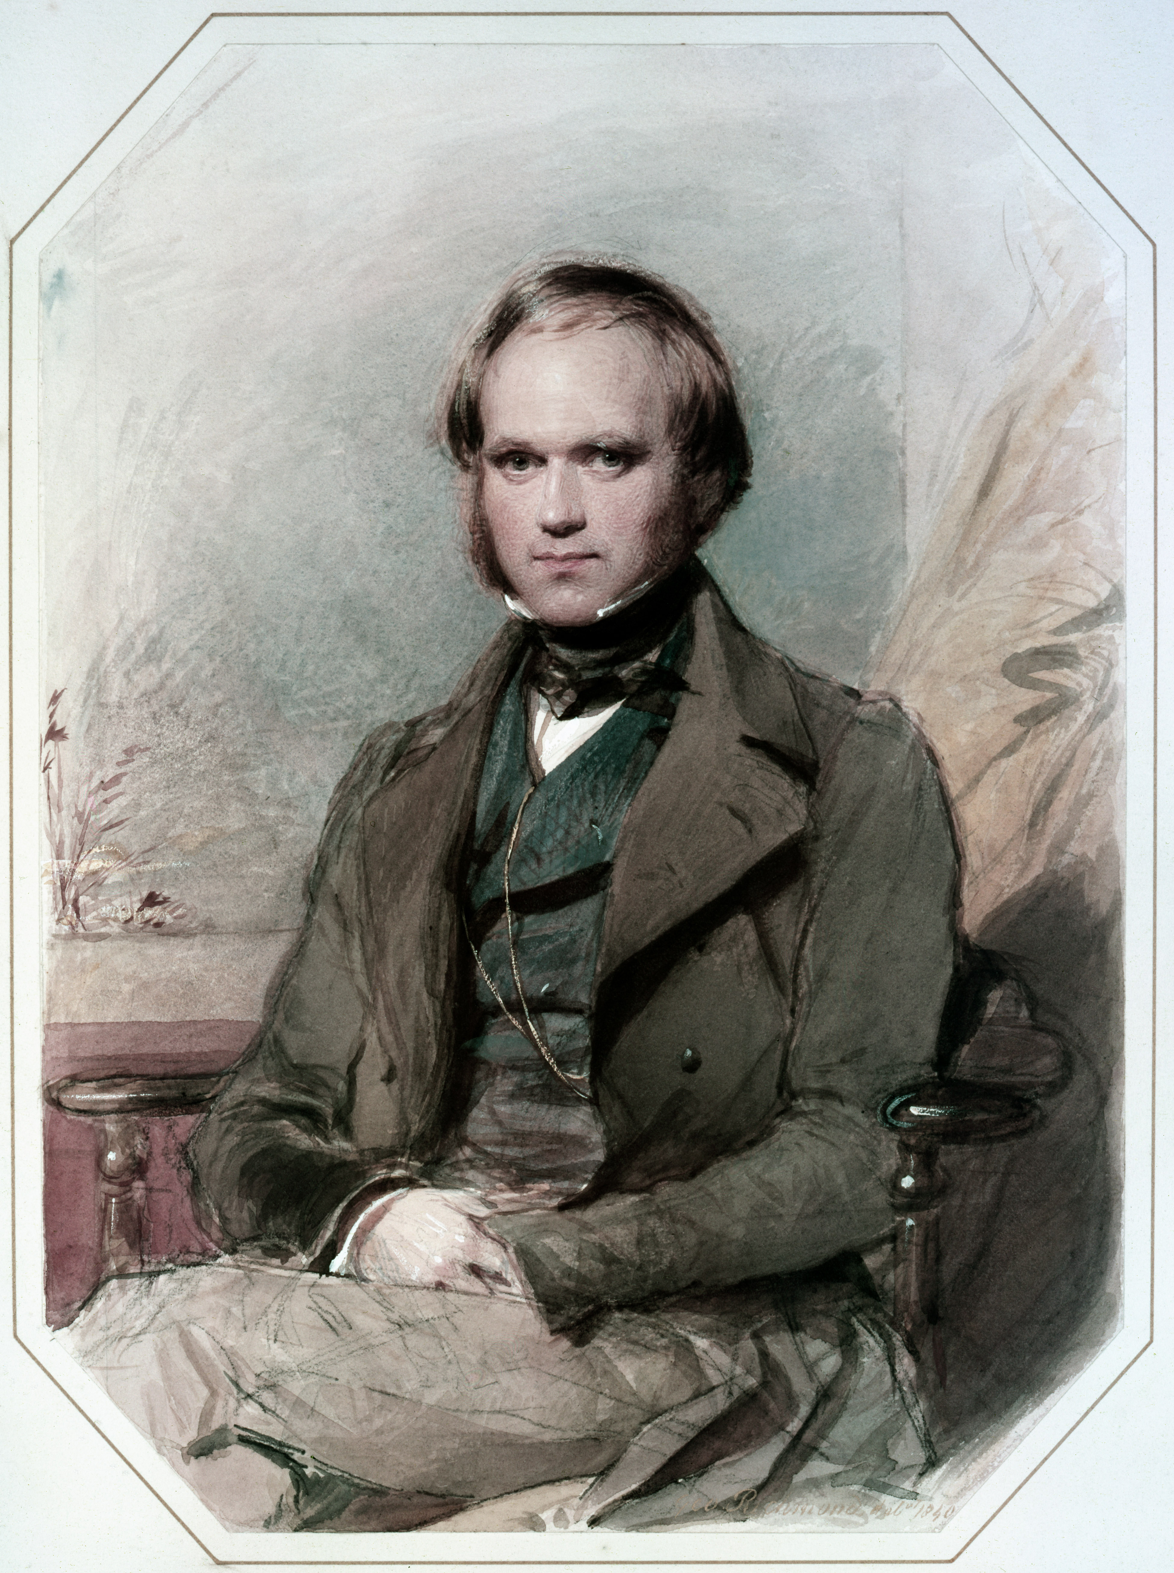
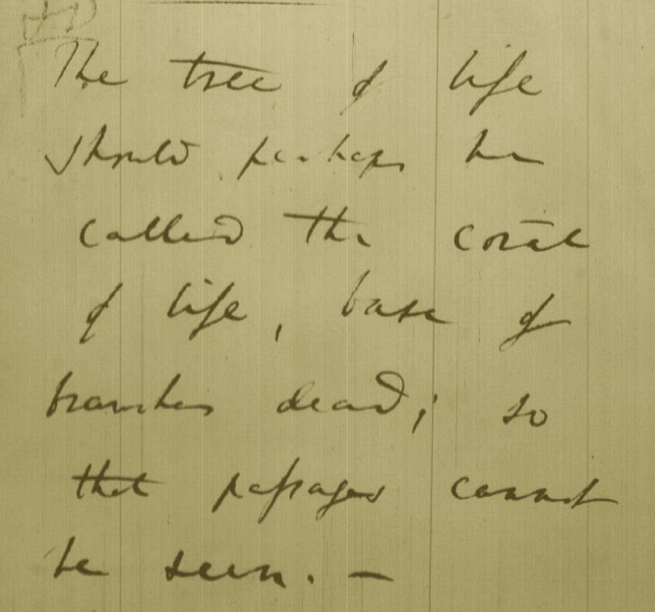
Tree, Web, or Coral of Life?
“The tree of life should perhaps be called the coral of life, base of branches dead”
Charles Darwin
painted by George Richmond in the late 1830
Page B26 from Charles Darwin’s (1809-1882) notebook (1837/38)

Slide 27
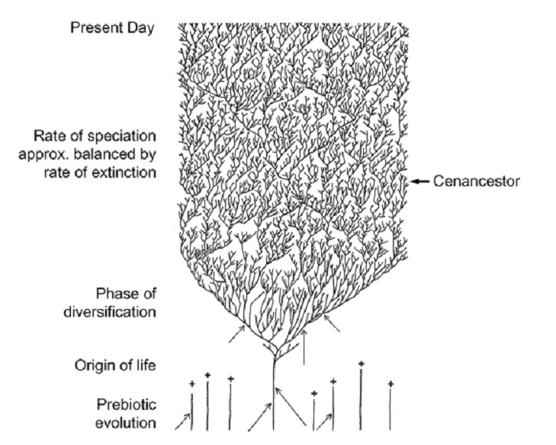
The Coral of Life (Darwin)
ZHAXYBAYEVA and GOGARTEN (2004):
Cladogenesis, Coalescence and the Evolution of the Three Domains of Life.
Trends in Genetics 20 (4): 182- 187
Notes:
The “Coral of Life” and the transfer of characters from now extinct into surviving lineages

Slide 28
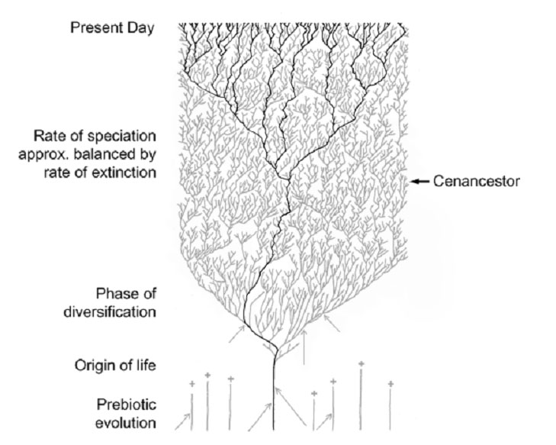
The Coral of Life (Darwin)
ZHAXYBAYEVA and GOGARTEN (2004):
Cladogenesis, Coalescence and the Evolution of the Three Domains of Life.
Trends in Genetics 20 (4): 182- 187
Notes:
The “Coral of Life” and the transfer of characters from now extinct into surviving lineages

Slide 29
The Coral of Life (Darwin)
ZHAXYBAYEVA and GOGARTEN (2004):
Cladogenesis, Coalescence and the Evolution of the Three Domains of Life.
Trends in Genetics 20 (4): 182- 187
Notes:
The “Coral of Life” and the transfer of characters from now extinct into surviving lineages

Slide 30
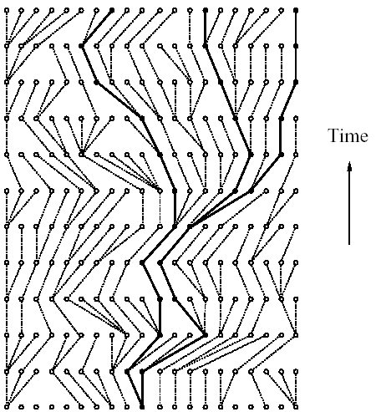
Coalescence – the process of tracing lineages backwards in time to their common ancestors. Every two extant lineages coalesce to their most recent common ancestor. Eventually, all lineages coalesce to the cenancestor.
t/2
(Kingman,
1982)
Illustration is from J. Felsenstein, “Inferring Phylogenies”, Sinauer, 2003

Slide 31
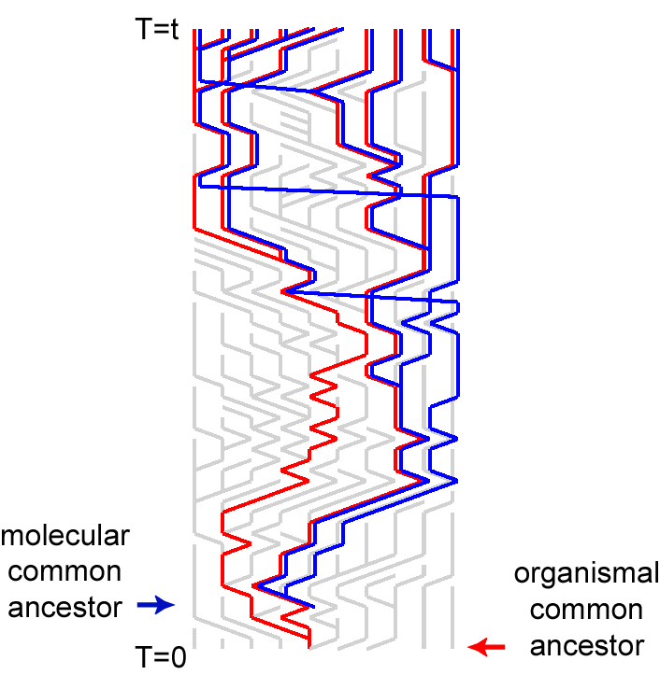
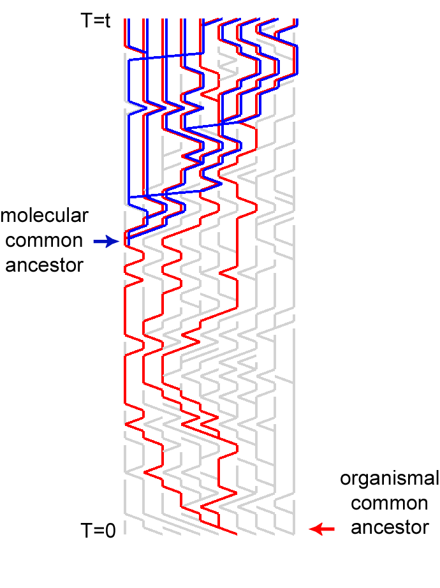
Simulations of organismal evolution by coalescence
One extinction and one speciation event per generation
Horizontal transfer event once in 10 generations
RED: organismal lineages (no HGT)
BLUE: molecular lineages (with HGT)
GRAY: extinct lineages
RESULTS:
Most recent common ancestors are different for organismal and molecular phylogenies
Different coalescence times
Long coalescence of the last two lineages

Slide 32
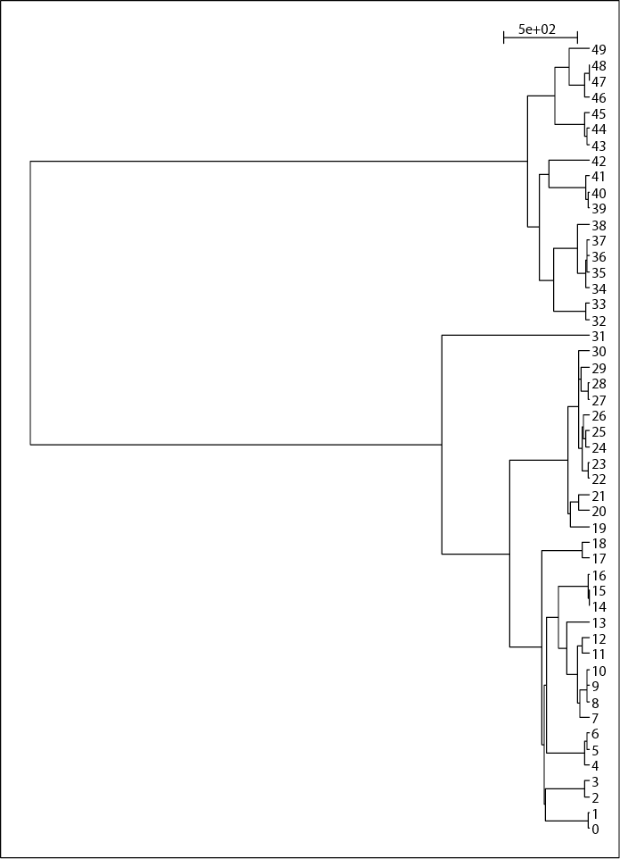
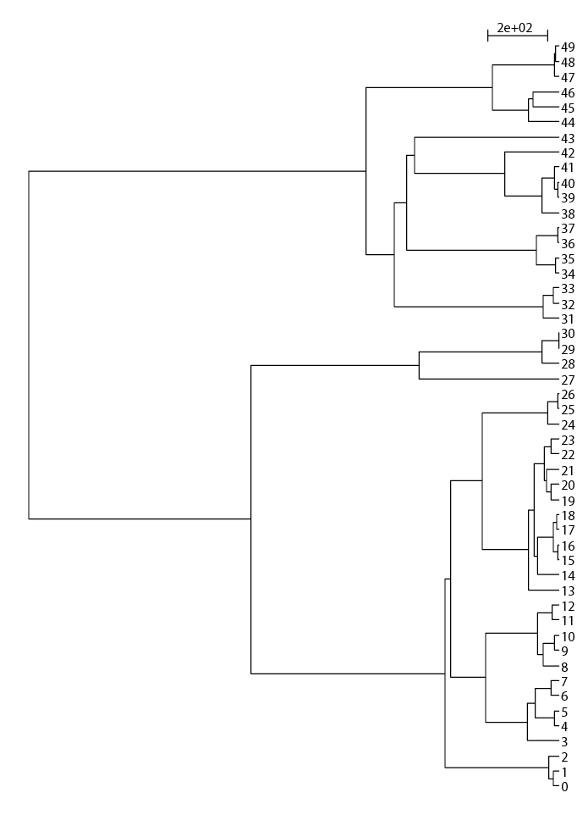
EXTANT LINEAGES FOR THE SIMULATIONS OF 50 LINEAGES

Slide 33
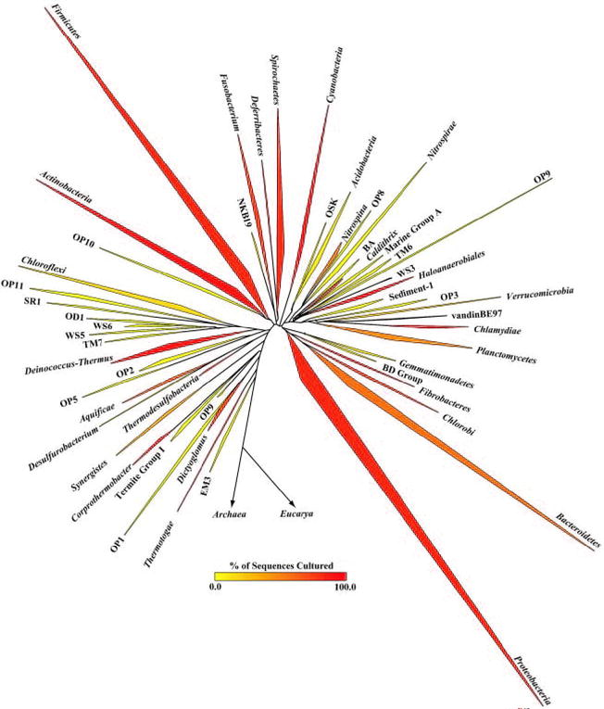
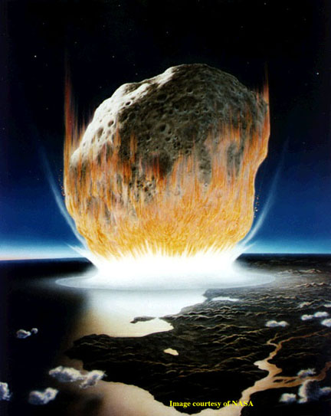
The deviation from the “long branches at the base” pattern could be due to
under sampling
an actual radiation
due to an invention that was not transferred
following a mass extinction
Bacterial 16SrRNA based phylogeny (from P. D. Schloss and J. Handelsman, Microbiology and Molecular Biology Reviews, December 2004.)

Slide 34
The Coral of Life (Darwin)
ZHAXYBAYEVA and GOGARTEN (2004):
Cladogenesis, Coalescence and the Evolution of the Three Domains of Life.
Trends in Genetics 20 (4): 182- 187
Notes:
The “Coral of Life” and the transfer of characters from now extinct into surviving lineages

Slide 35
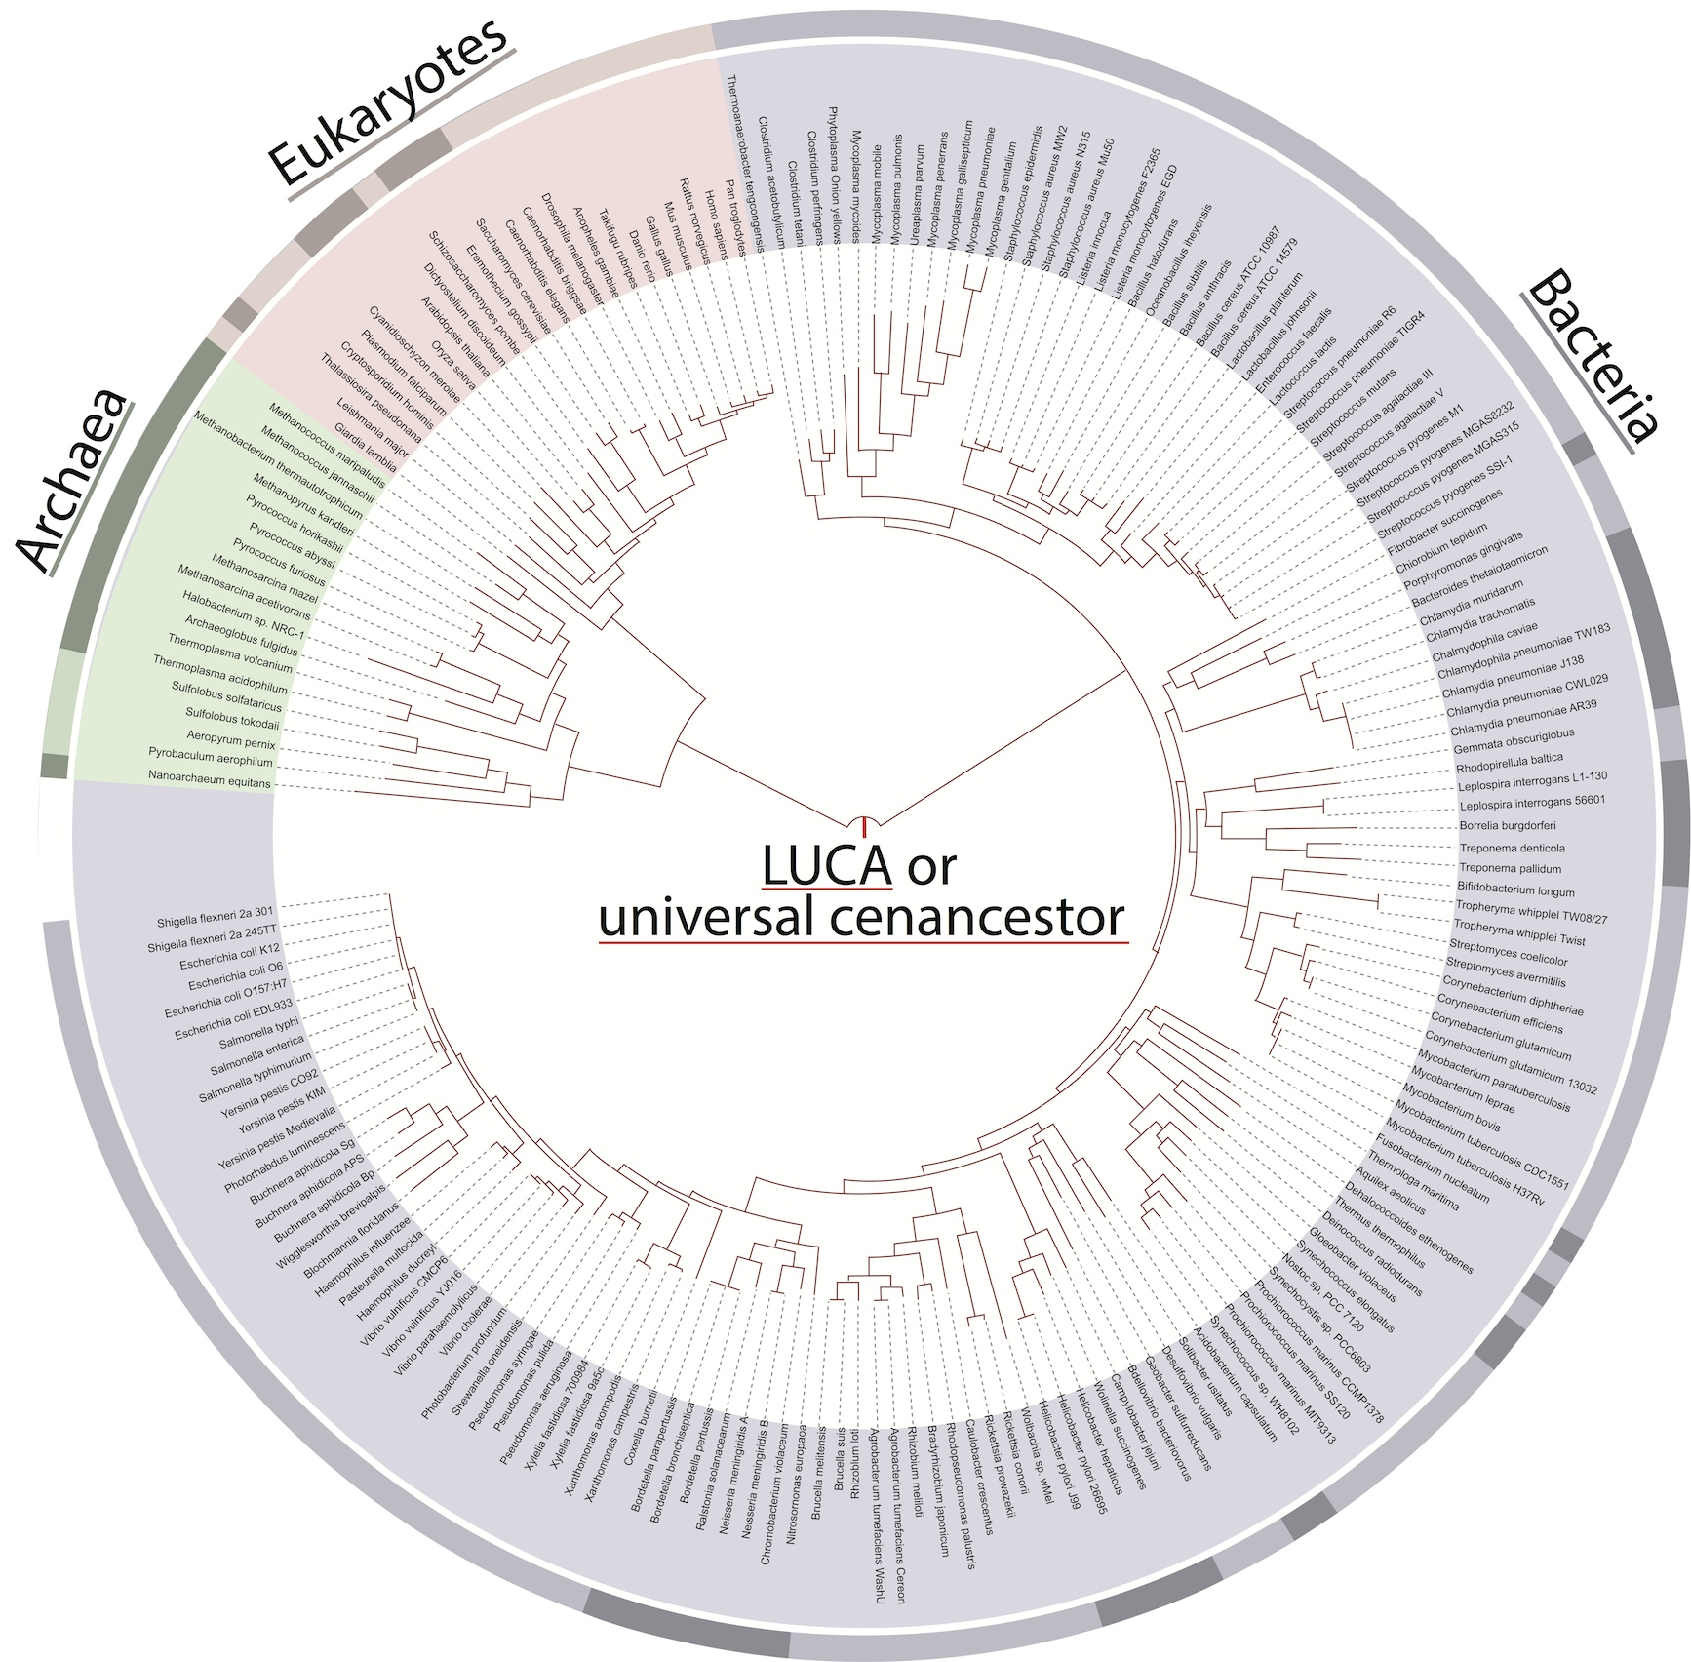
Molecular Phylogenies ➔ Lonely Ancestors
Noteworthy:
Tree topology averaged over many genes (mainly ribosomal proteins).
No reticulations.
Branches do not reflect time.
Only extant organisms and their lucky ancestors are includes
From: http://itol.embl.de/ iTol The interactive Tree of Life
Ciccarelli et al, Science. 2006 311 :1283-7
Notes:
Tree of 1 % as example.

Slide 36
EXTANT LINEAGES FOR THE SIMULATIONS OF 50 LINEAGES

Slide 37
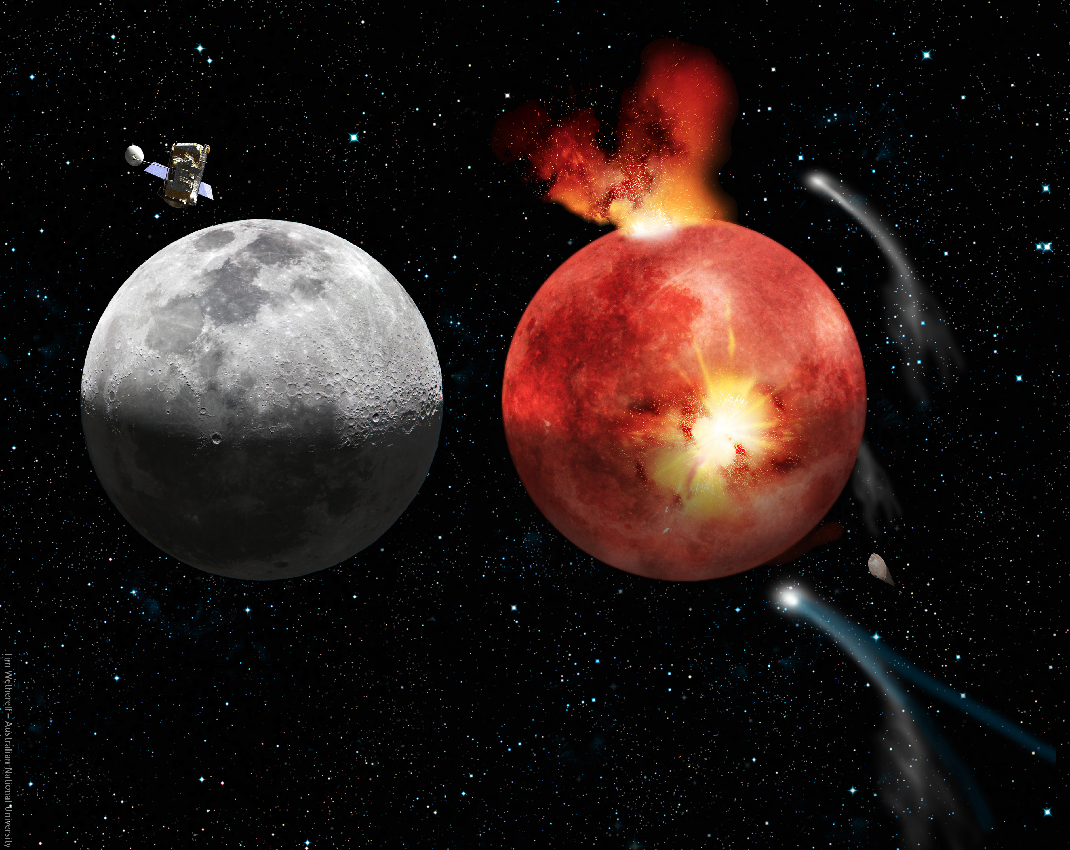
Lunar Cataclysm and Today
The cratering record of the moon
From: http://en.wikipedia.org/wiki/Late_Heavy_Bombardment

Slide 38
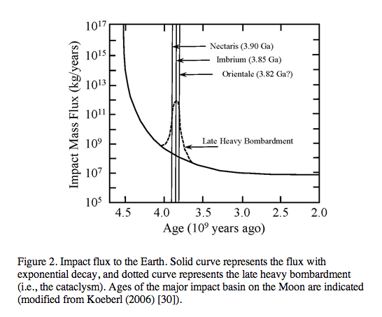
From: http://www.origin-life.gr.jp/3603/3603055/3603055.html
Alternative: tail of early heavy bombardment; however, see Marchi et al. Nature 511:578-82 2014 for an update on the early impact history.

Slide 39
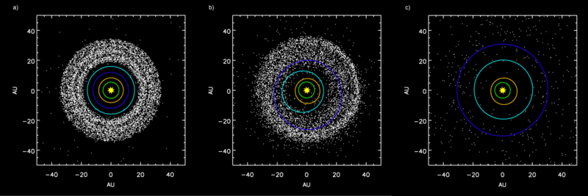
Simulation showing the outer planets and the Kuiper belt:
a) Before Jupiter–Saturn 2:1 resonance.
b) Scattering of Kuiper belt objects into the Solar System after the orbital shift of Neptune.
c) After ejection of Kuiper belt bodies by Jupiter.
From: http://en.wikipedia.org/wiki/Late_Heavy_Bombardment

Slide 40
Early Earth
Early Earth was spinning at a much faster rate: according to computer models, Earth had a six-hour day 4.5 billion years ago! Since then, with the help of our Moon, Earth has been slowing down and our days have been getting longer.
... the Moon was even closer to Earth. Billions of years ago, the Moon was 10 times closer and tides were 1000 times higher. Scientists believe that these extreme tides occurred once every three hours because the Earth was spinning more rapidly. The tides eroded the coastal areas, adding minerals to the oceans.
From: the Lunar Planetary Institute https://www.lpi.usra.edu/education/explore/marvelMoon/background/moon-influence/

Slide 41
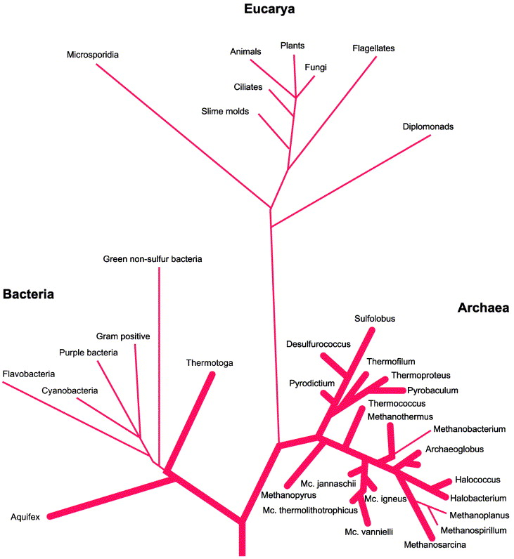
Fig. 3. The classical SSUrRNA distance tree, presented as rooted in the bacterial branch. Bold lines indicate extreme hyperthermophiles. From Stetter (1996).

Slide 42
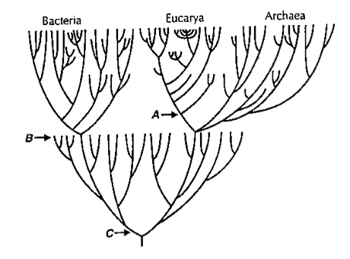
Near frustration of early life
From: Gogarten-Boekels M, Hilario E, Gogarten JP. Orig Life Evol Biosph. 1995 Jun;25(1-3):251-64. The effects of heavy meteorite bombardment on the early evolution —the emergence of the three domains of life.

Slide 43
LUCA (located on the “bacterial branch”) was less thermophilic than the ancestor of the bacterial and archaeal domains
Boussau, B, Blanquart, S, Necsulea, A, Lartillot, N and Gouy, M (2008). Parallel adaptations to high temperatures in the Archaean eon. Nature 456(7224): 942-945 Reconstruction of ancestral protein and rRNA sequences Based on IVYWREL and rRNA stem G+C content LUCA was less thermophilic than the domain ancestors.
Galtier, N, Tourasse, N and Gouy, M (1999). A nonhyperthermophilic common ancestor to extant life forms. Science 283(5399): 220-221.8
rRNA 60°C80°C IVYWREL (corrected for GC content) 20°C70°C

Slide 44
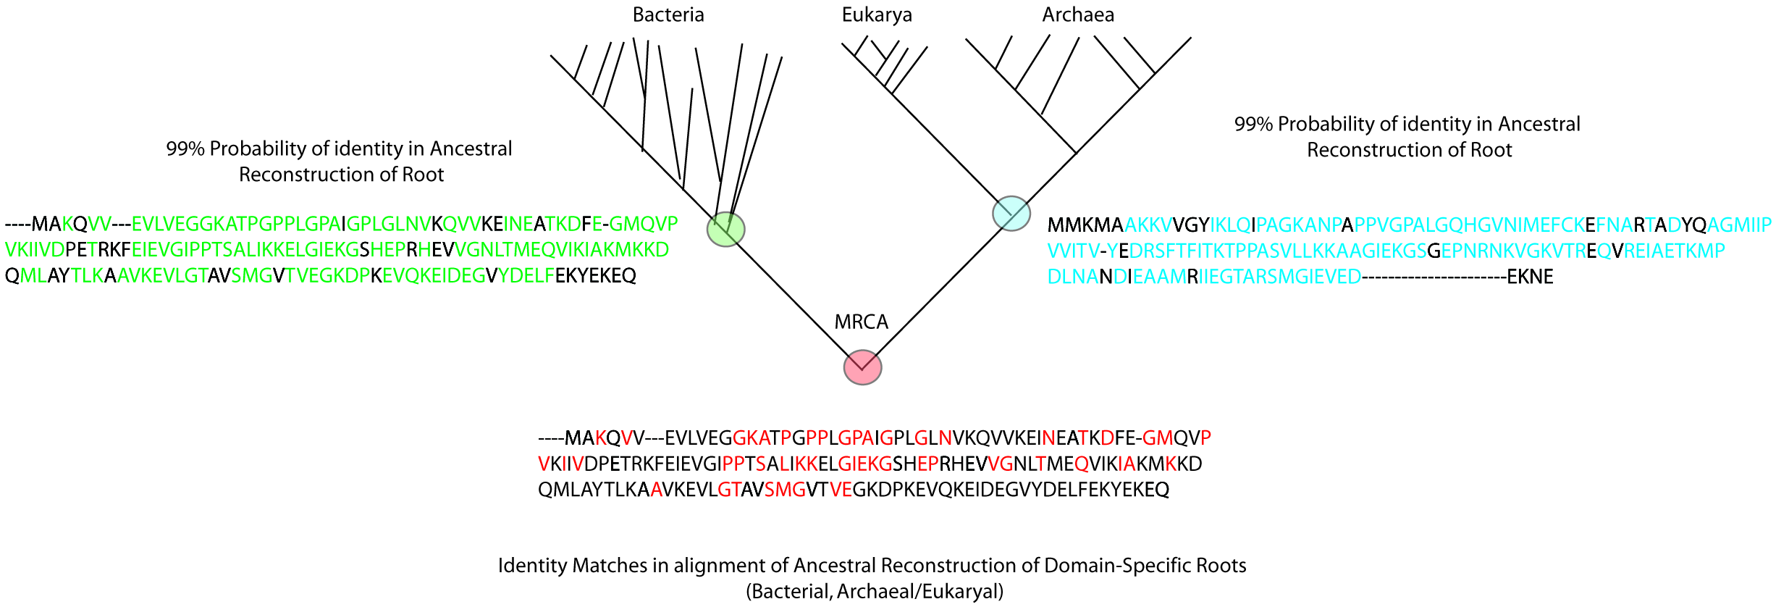
Compositional Stratigraphy
Fournier GP, Gogarten JP. 2007. Signature of a primitive genetic code in ancient protein lineages. J Mol Evol. 65(4):425-436
“We perform a compositional analysis of ribosomal proteins and ATPase subunits in bacterial and archaeal lineages, using conserved positions that came and remained under purifying selection before and up to the most recent common ancestor. An observable shift in amino acid usage at these conserved positions likely provides an untapped window into the history of protein sequence space, allowing events of genetic code expansion to be identified.”

Slide 45
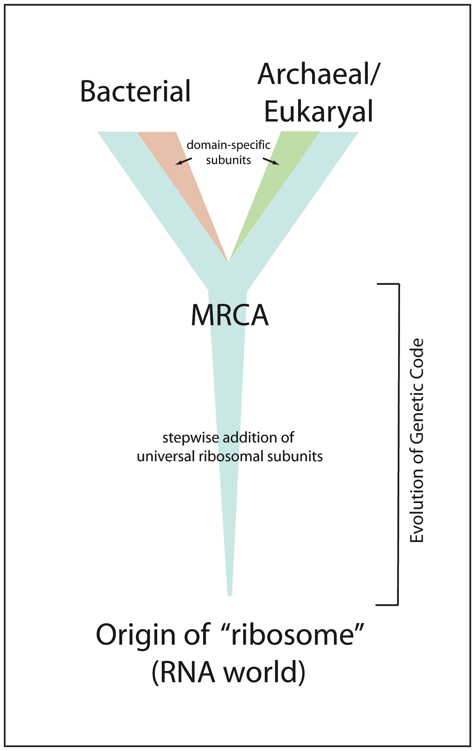
Evolution of the Ribosome
“Core” of ribosome consists of RNA + subset of ribosomal proteins universally conserved in all life (~29 proteins) (Harris et al., 2003)
Likely coevolved with genetic code within an RNA world (Wolf & Koonin, 2007)

Slide 46
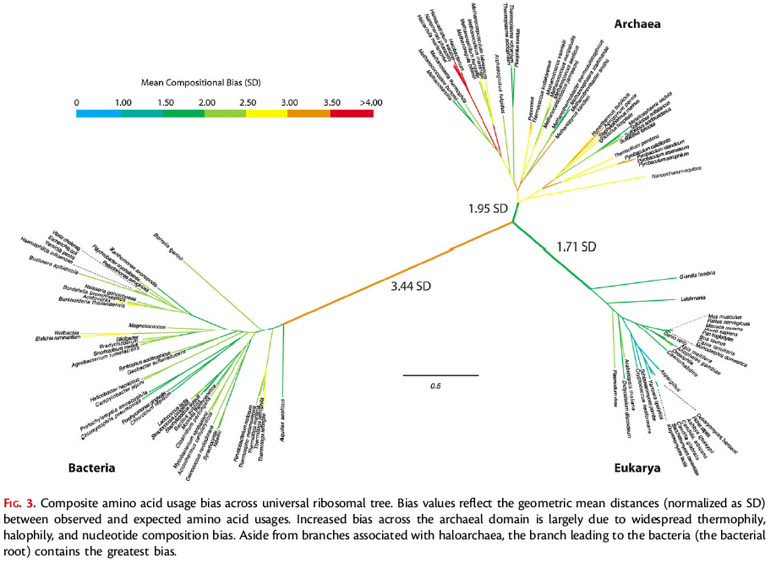
Rooting the Ribosomal Tree of Life using an Echo from the Early Expansion of the Genetic Code (Fournier and Gogarten, MBE 2010)
Notes:
Central branch not IVYWREL biased

Slide 48
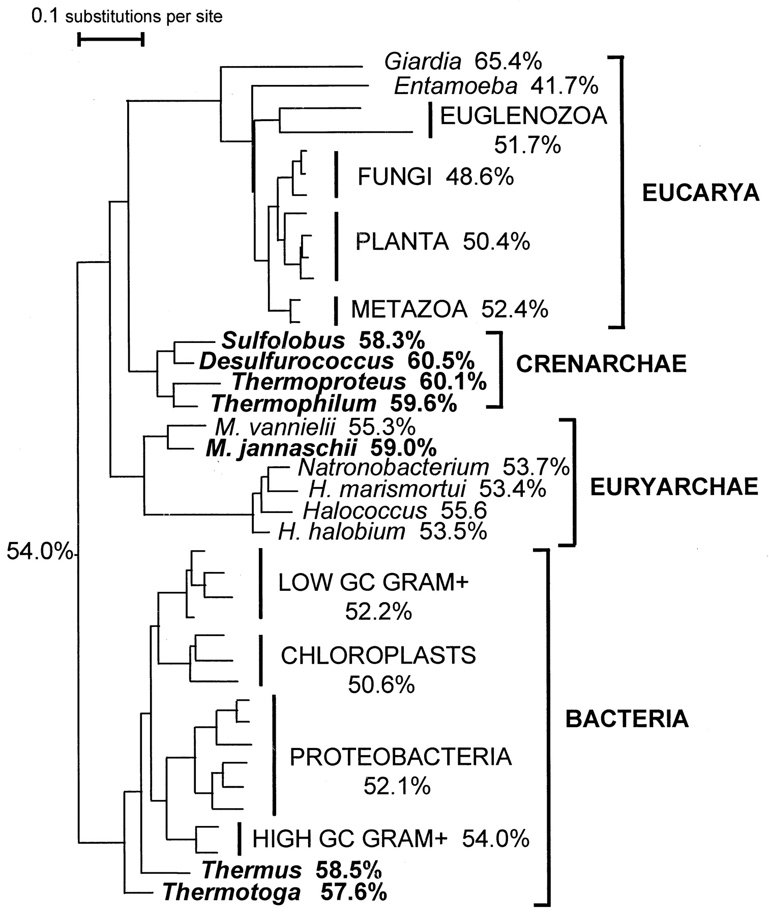
Maximum likelihood tree reconstructed from 40 LSU rRNA sequences (17). G+C contents of (groups of) sequences are given next to taxon names. The inferred ancestral G+C content appears next to the root. Two hundred topologies obtained by rearranging an initial neighbor-joining tree were evaluated. The monophyly of Bacteria, Eucarya, Crenarchaea, Euryarchaea, Euglenozoa, animals, green plants, fungi, high-GC Gram-positive bacteria, low-GC Gram-positive bacteria, proteobacteria, and chloroplasts was kept in all trees, but the remaining branching orders were randomly shuffled; 1409 complete, unambiguously aligned sites were used. The names of thermophilic species are in boldface.M, Methanococcus; H,Halobacterium.

Slide 49
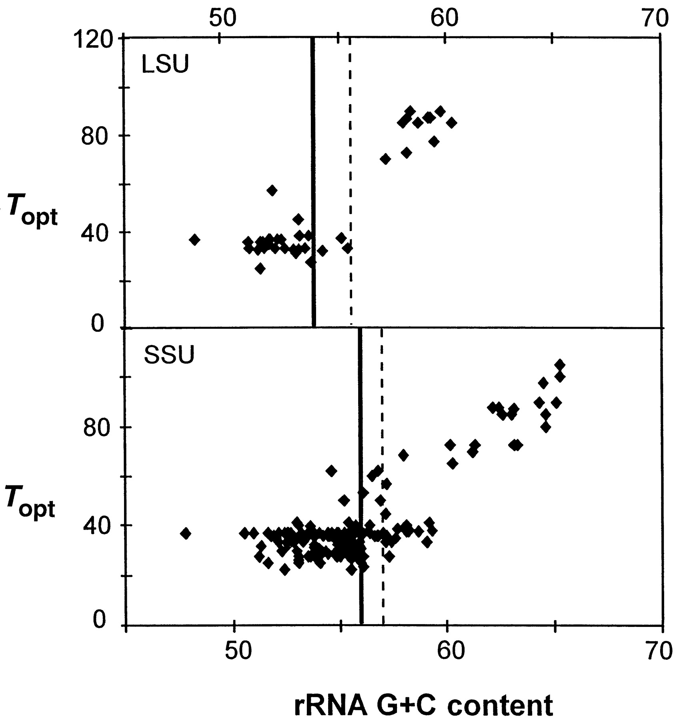
Figure 2 Correlation between optimal growth temperature and rRNA G+C content in prokaryotes.

Slide 50
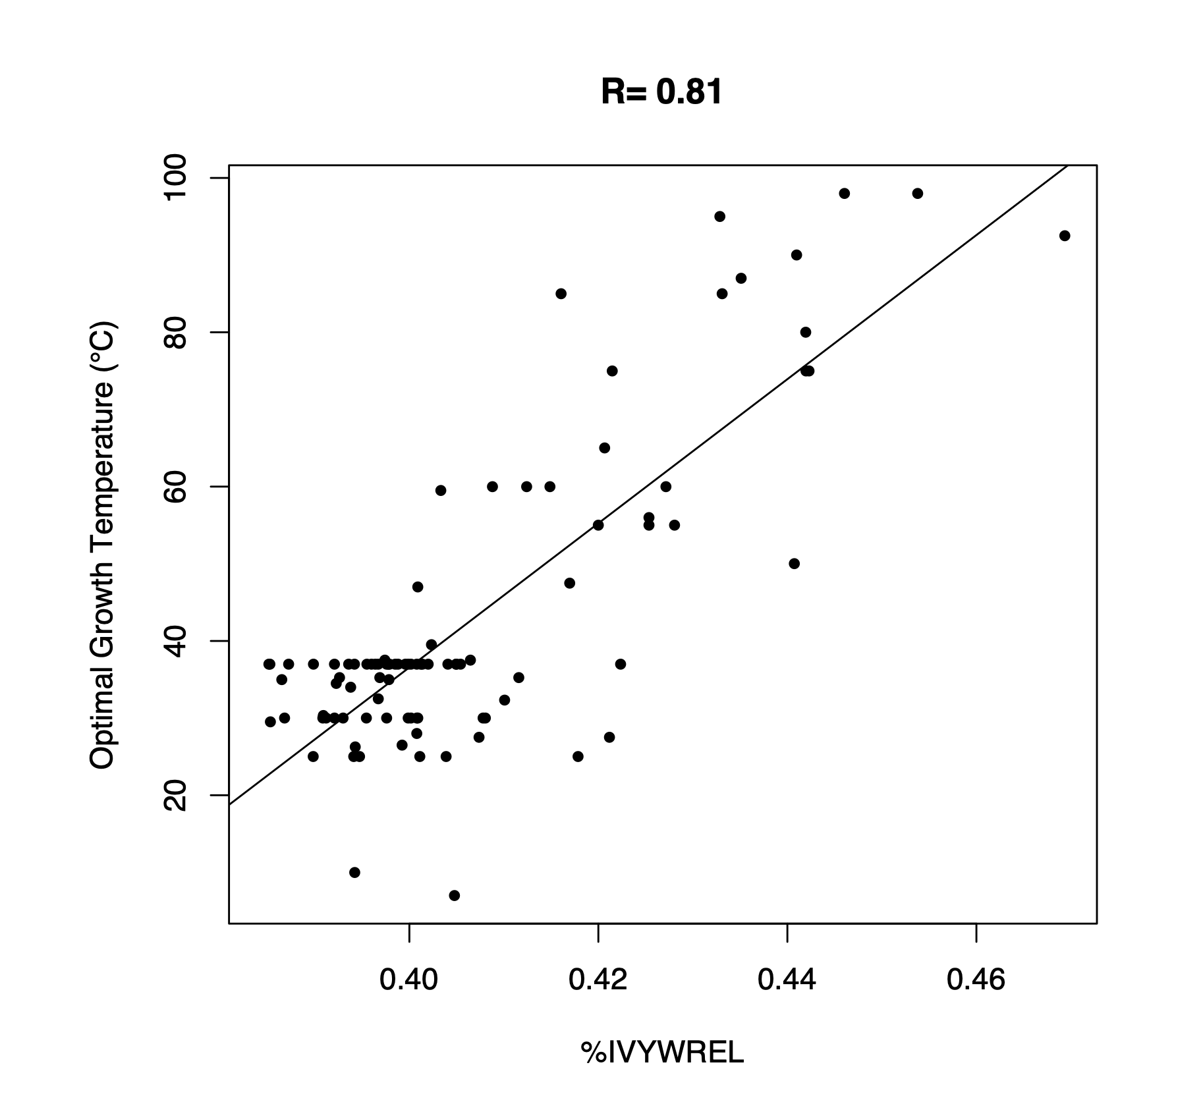
Optimal Growth Temperature
versus
amino acid composition
From: B. Boussau et al. Nature 000, 1-4 (2008) doi:10.1038/nature07393

Slide 51
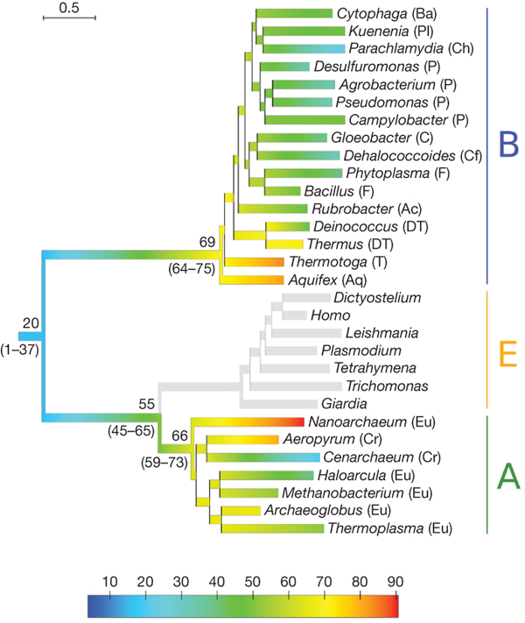
Evolution of thermophily over the tree of life.
B Boussau et al. Nature 000, 1-4 (2008) doi:10.1038/nature07393

Slide 52
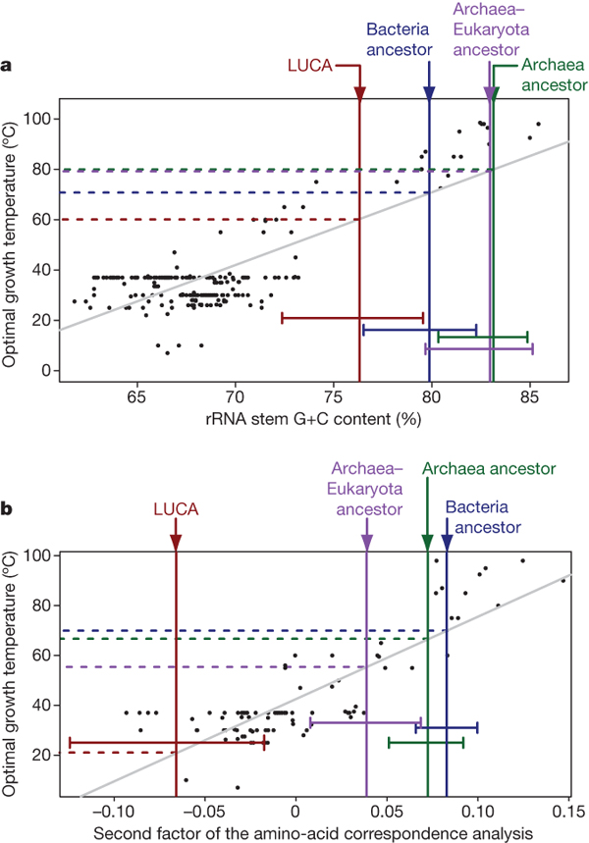
Correlations between sequence compositions and OGT,
and estimates of key ancestral compositions.
B Boussau et al. Nature 000, 1-4 (2008) doi:10.1038/nature07393

Slide 53
Conclusion
Tree shape and amino acid composition of ancestral sequences suggest a bottleneck due to increased environmental temperature at the base of the bacterial and archaeal domains.
Studies of horizontal gene transfers of aaRSs (e.g., rare form of SerRS) suggest that more than two lineages passed through this bottleneck.
See https://link.springer.com/article/10.1007%2Fs11084-011-9261-2 and https://www.ncbi.nlm.nih.gov/pmc/articles/PMC2873001/

Slide 54
The Coral of Life (Darwin)
ZHAXYBAYEVA and GOGARTEN (2004):
Cladogenesis, Coalescence and the Evolution of the Three Domains of Life.
Trends in Genetics 20 (4): 182- 187

Slide 55
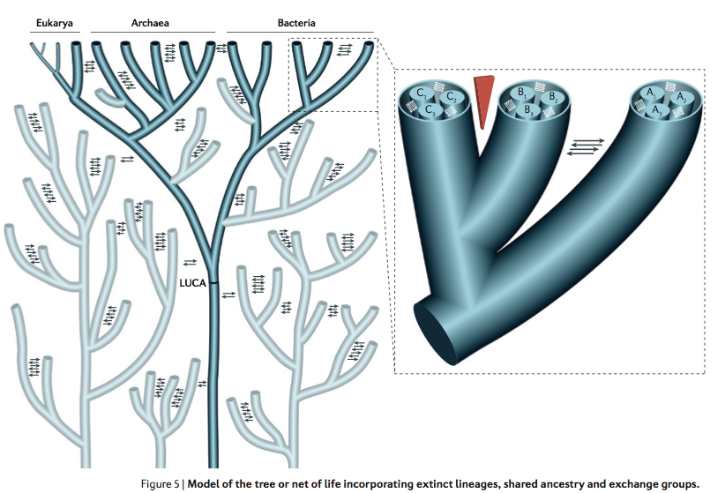
Many Thanks for your Attention!

