Slide 1
Intro to Statistics
MCB 3421 2021
Class 8

Slide 2
False Positives (probability of)
The probability of have the observed outcome under the null hypothesis (the drug doesn’t make a difference, the sequences aren’t related, the target sites are not particularly conserved …)
Example: Sequence similarity between two sequences.
How to measure what is expected under the null hypothesis?
Possibility 1: Randomize one or both of the sequences.
Possibility 2: Compare one of the sequences against a databank. (Assuming the databank has mainly unrelated sequences)
Possibility 3: Use a formula for the distribution that is based on a model or that fit observations.

Slide 3
Distribution under null hypothesis from randomized sequences
Calculate alignment score for actual sequences
Calculate expectation under null hypothesis
randomize (scramble) one (or both) of the sequences and calculate the alignment score for the randomized sequences.
repeat the last step at least 100 times (usually 1000)
describe distribution of randomized alignment scores
Calculate the probability of the score for actual sequences under the null hypothesis, i.e., Is the score obtained for the real sequences significantly better than the score for the randomized sequences?
Lipman and Pearson (1984) Rapid and Sensitive Protein Similarity Searches, Science 227(4693):1435-41, DOI: 10.1126/science.2983426

Slide 4
z -score
MEAN
Alignment Score
Actual Sequences
z Score = 4.1
STDDEV

Slide 5
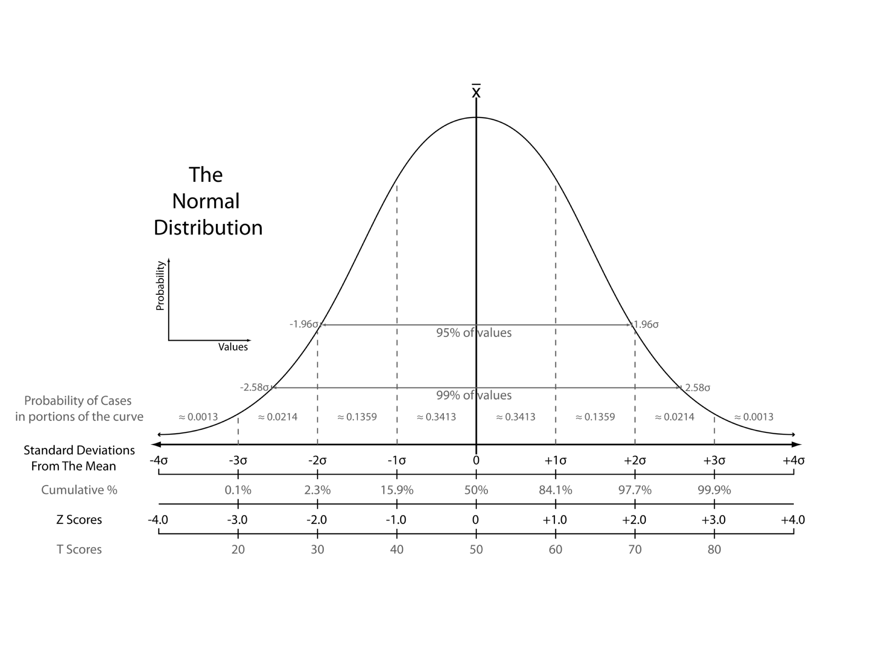
z -score
From: https://en.wikipedia.org/wiki/Standard_score
Notes:
Distinction between probability and probability density

Slide 6
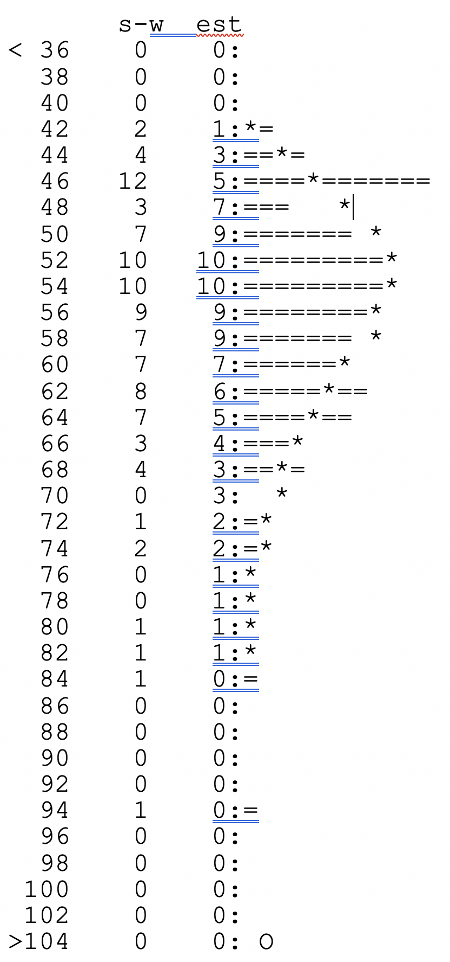
Using a probability distribution
Modern PRSS
43400 residues in 100 sequences,
BLOSUM50 matrix, gap penalties: -12,-2
unshuffled s-w score: 269;
shuffled score range: 43 - 96
Lambda: 0.13635 K: 0.0055017;
P(269)= 1.9668e-13
For 100 sequences, a score >=269 is expected 1.97e-11 times
Notes:
e stabds for engineering format not Eulers number!

Slide 7
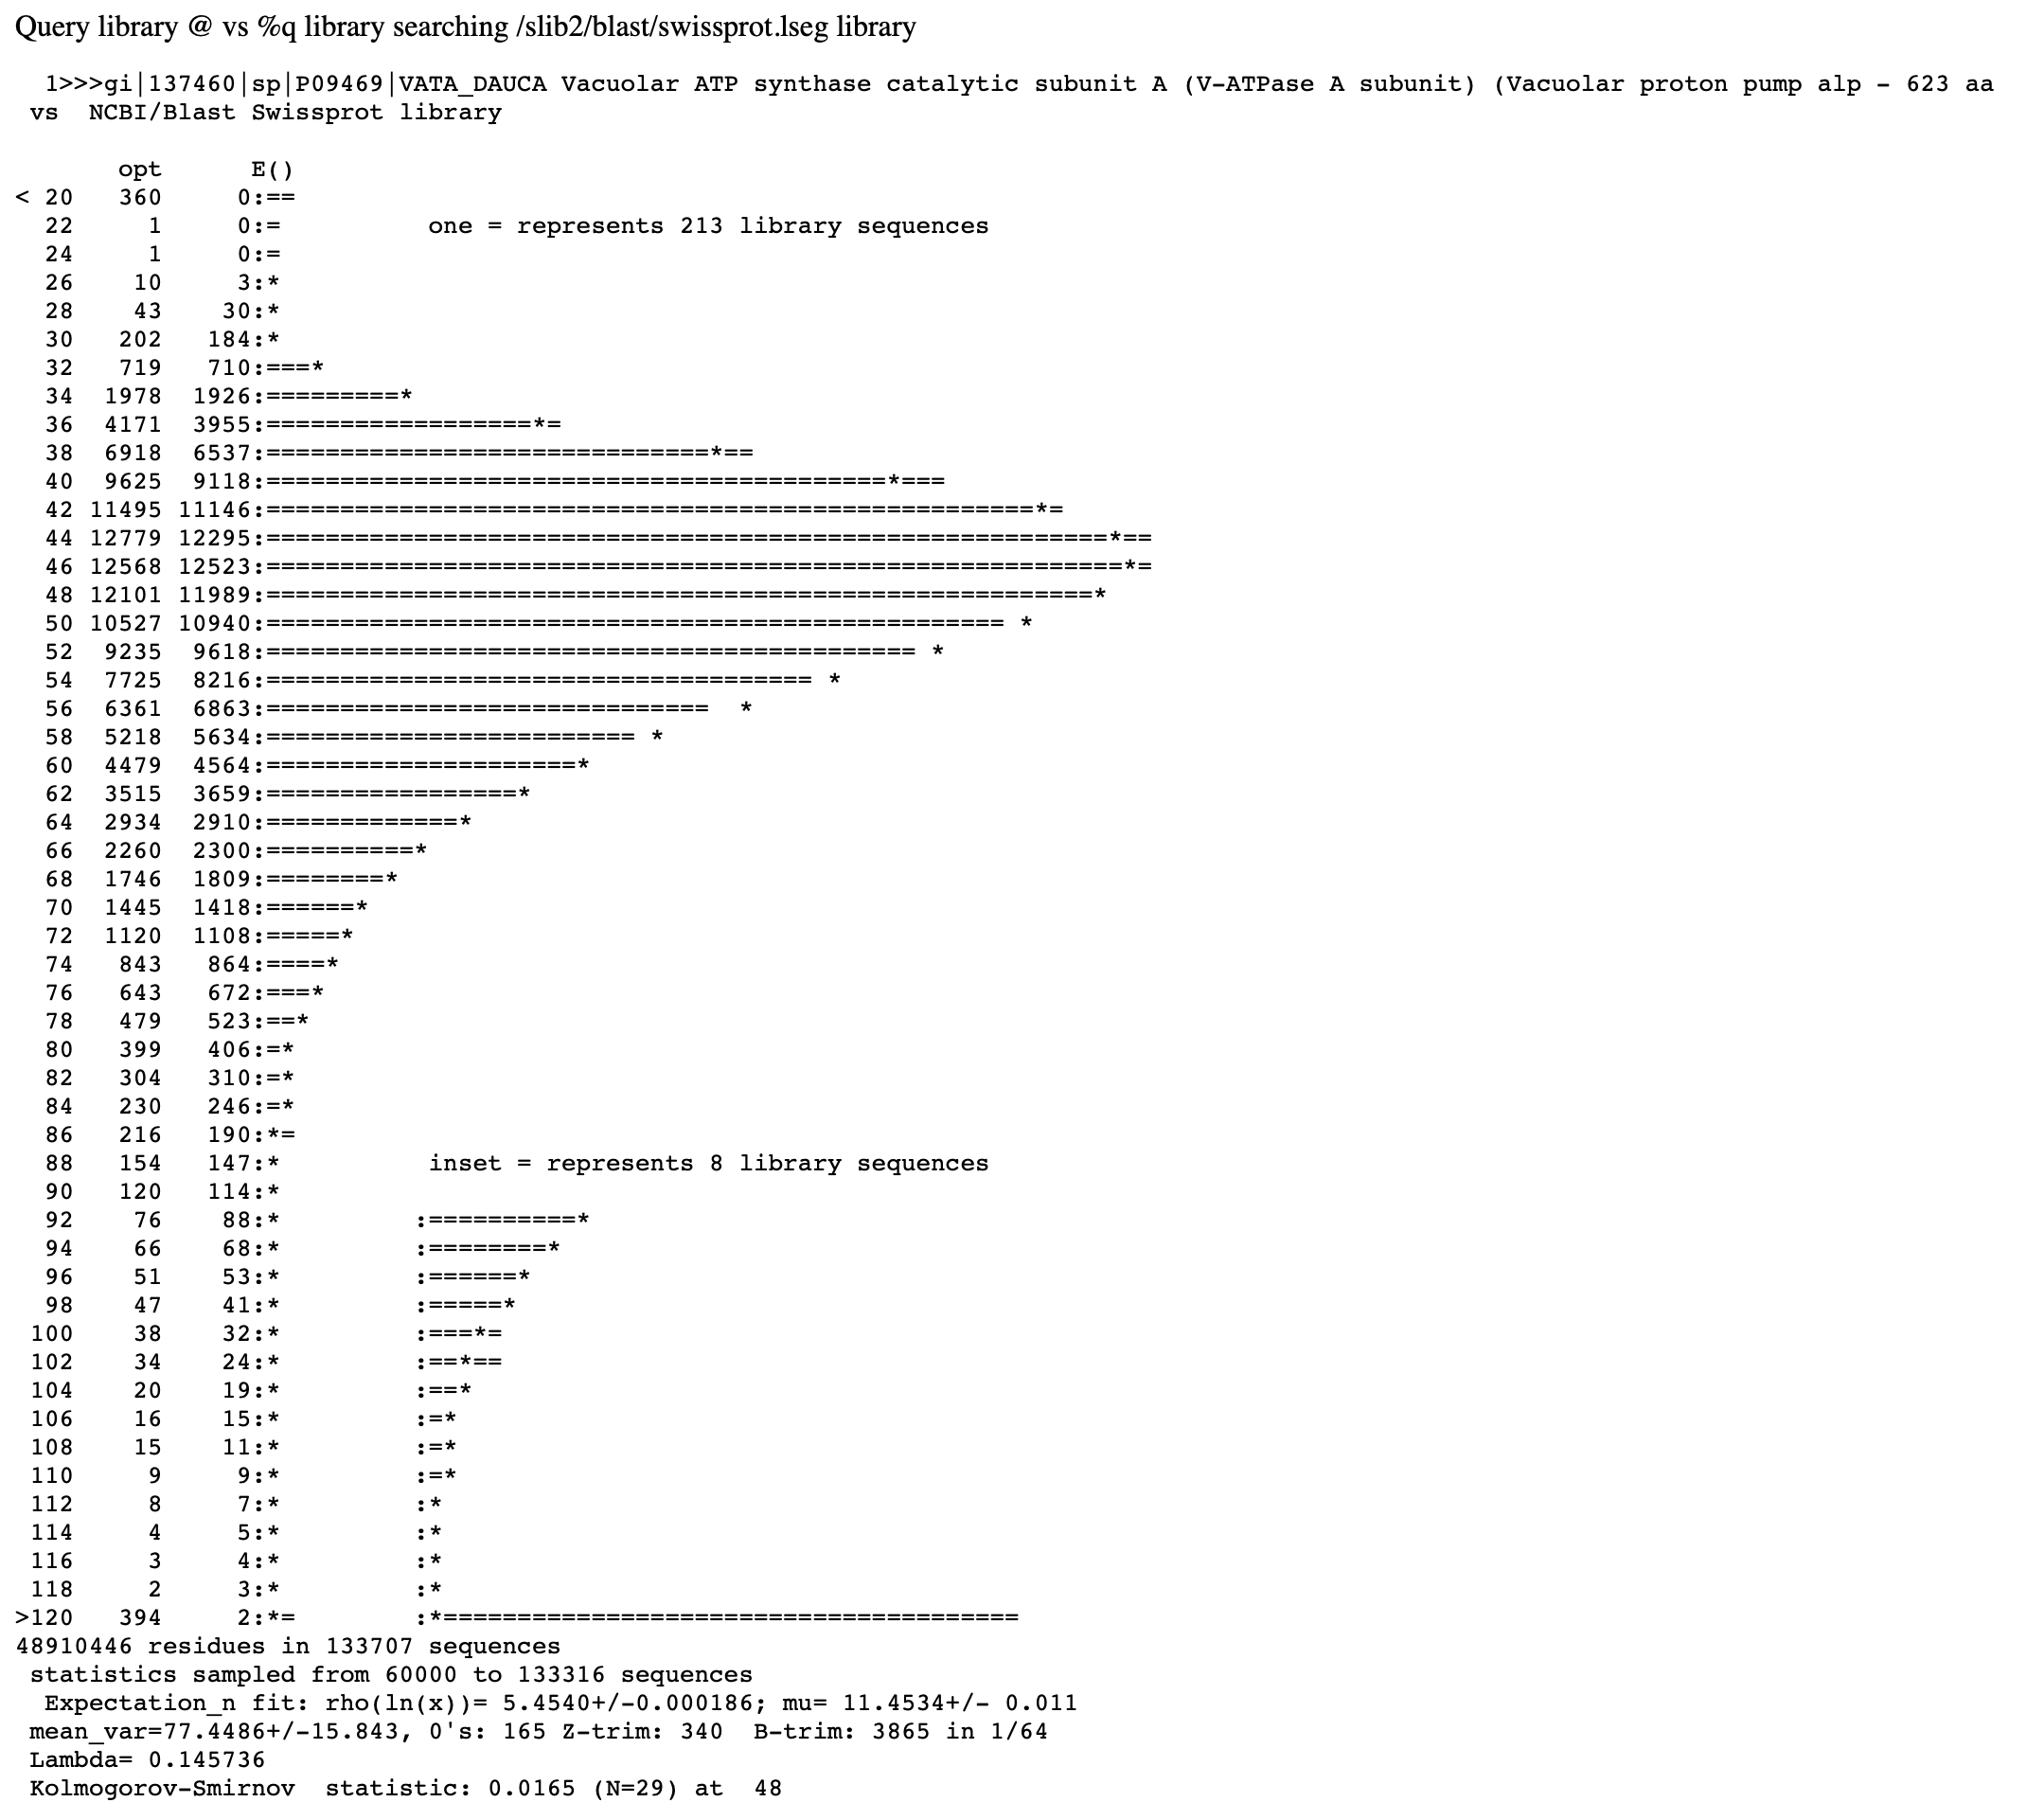
FASTA databank search
(Distribution under H₀ is estimated from the data, i.e. all scores against the databank sequences)

Slide 8
False Positives versus False Negatives
If a databank search with a sequence is considered a search a ”homology search” (significant similar complex sequence are homologs), then
False Positives: non-homologous sequences that are reported as similar (these are very well estimated by E-values)
False Negatives: homologous sequences that are not reported as similar (there are many, but the number is unknown)
Aside: E-values give the expected number of matches with an alignment score this good or better due to chance alone (no shared ancestry, no convergent evolution)
P-values give the probability of to find a match of this quality or better due to chance alone (no shared ancestry, no convergent evolution). The P value is equal to the probability that the null hypothesis (similarity is due to chance alone) is true. This probability is also known as the significance level at which the null hypothesis can be rejected.
P values are [0,1], E-values are [0,infinity).

Slide 9
P-Hacking
You should define a testable hypothesis before you select the data to analyze.
The interactive selection of which data to include or exclude is known as P-hacking – you try out different things until you det the expected result. For example, the question if a government formed by democrats (or republicans) is significantly beneficial to the economy. This depends on which level of government you include, and which measures for the economy you use.
An interactive P-hacking scheme on this question is at
https://projects.fivethirtyeight.com/p-hacking/
Also see https://fivethirtyeight.com/features/science-isnt-broken/#part1

Slide 10
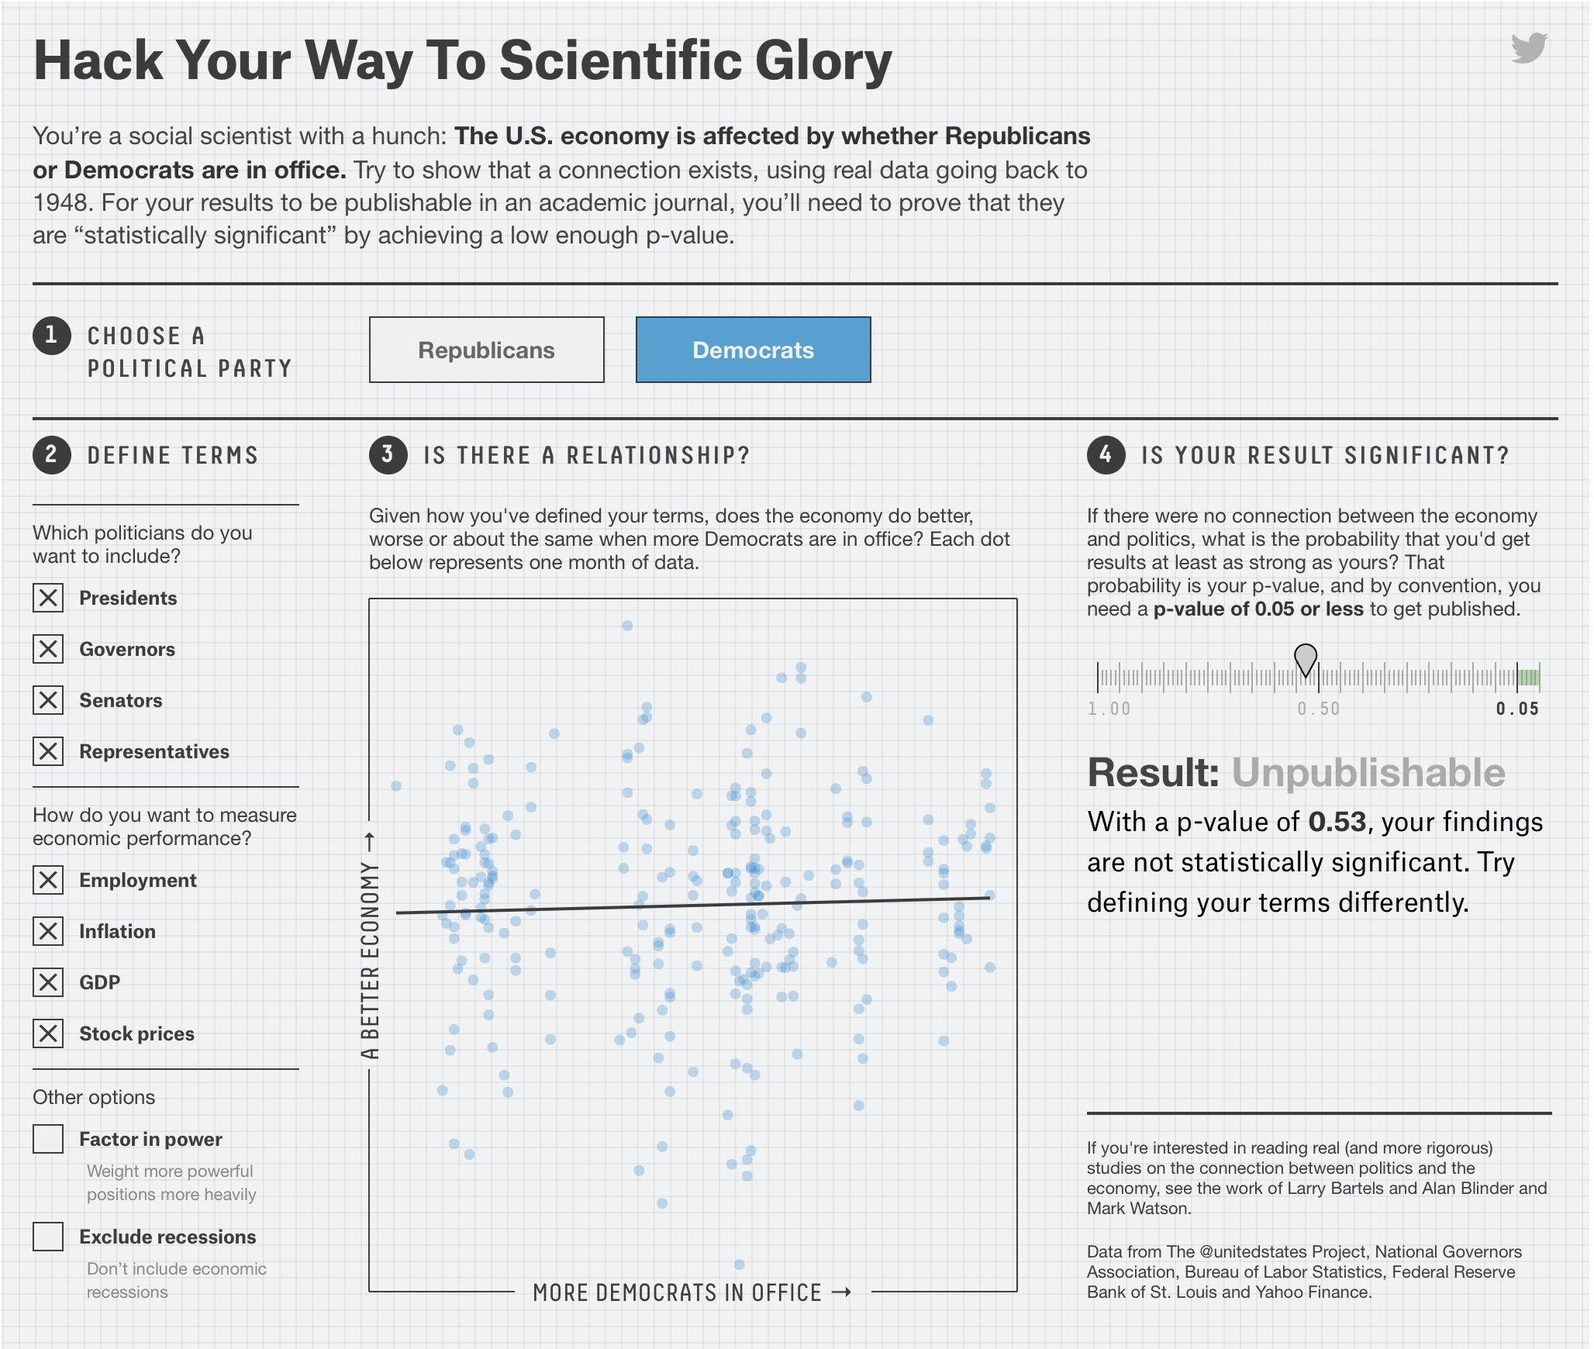
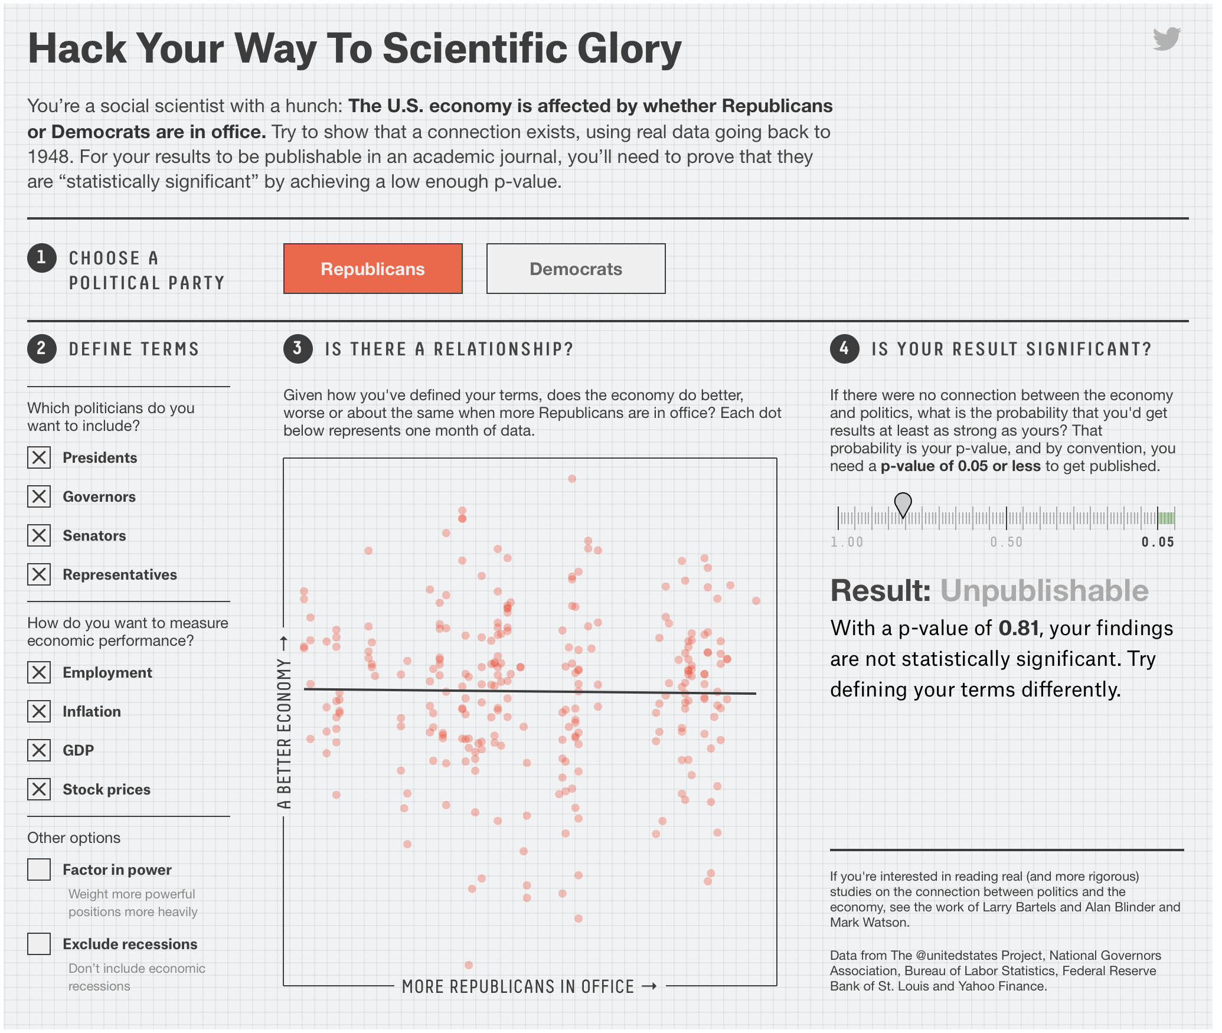
Using all the data does not give significant results

Slide 11
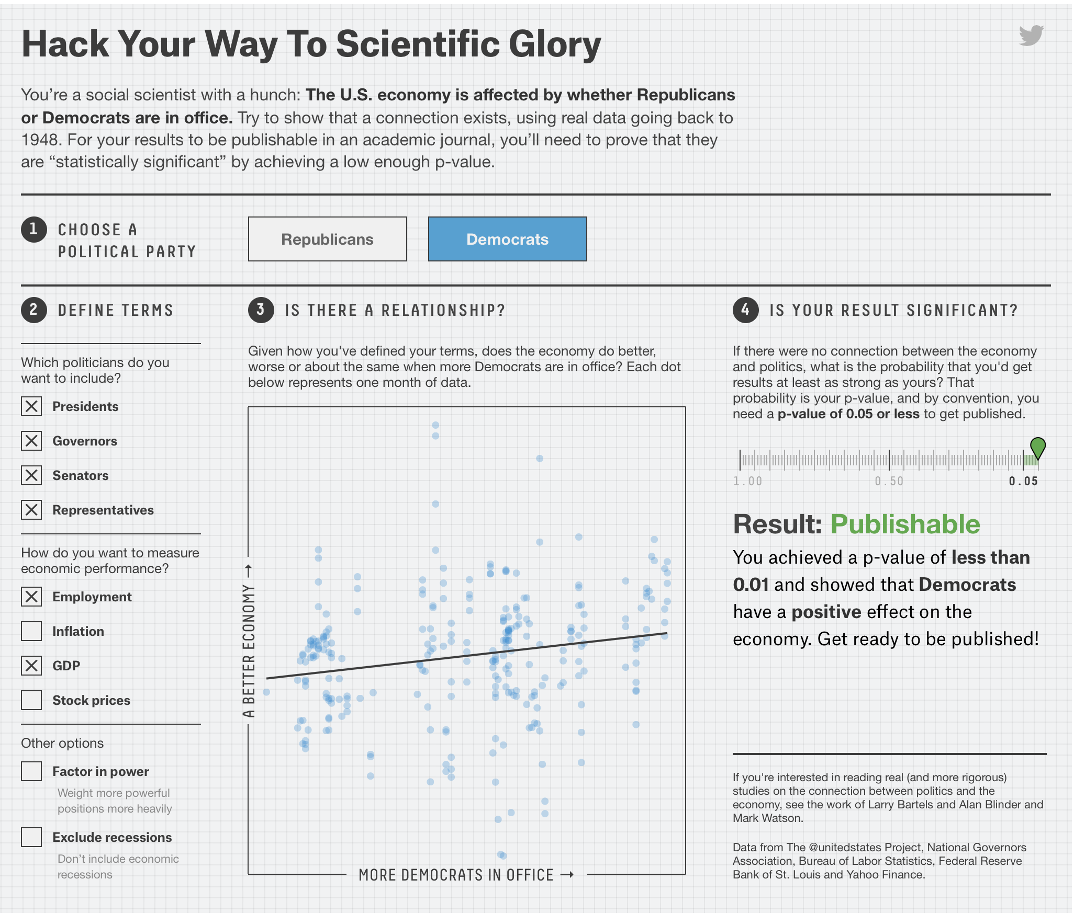
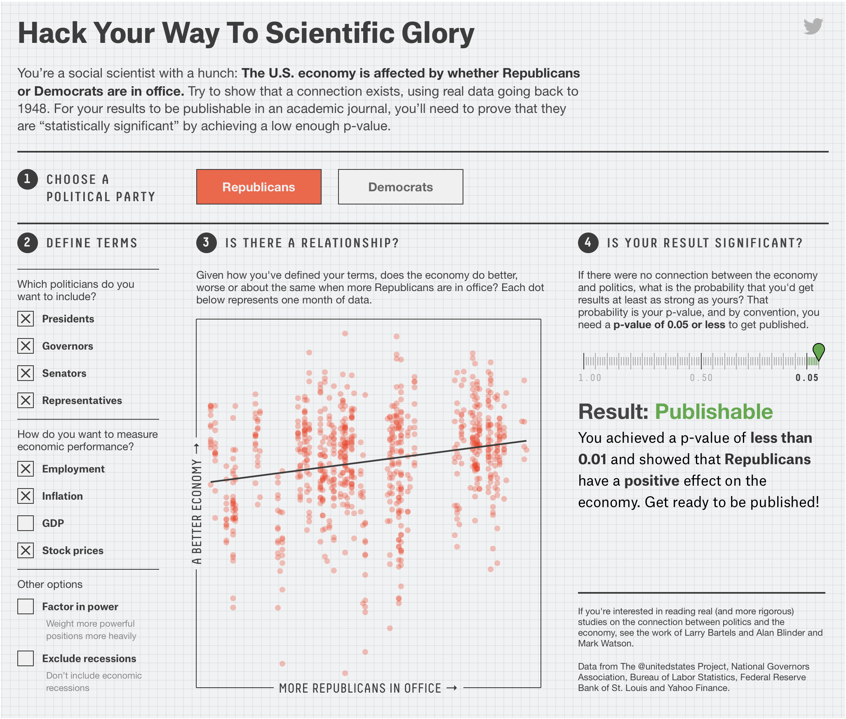
But with minor modification:

Slide 12
Data Dredging aka Fishing Expeditions
If you do 100 experiments, you expect to find one experiment that is significant at the 1% level due to chance alone. (P-value = The probability to find something under the null hypothesis or due to chance alone.)
If in 100 experiments you do not want to have a false positive with a probability of 1%, then you need to correct the P-value for the individual test.
The Bonferroni correction (often considered unreasonably harsh) divides the overall acceptable probability for a false positive by the number of parallel experiments:
Overall P<0.01, n=100, significance level for the individual test:
P=0.01/100=0.0001=10⁻⁴

Slide 13
When do you need a correction for multiple tests?
Expression studies, where you test all possible transcripts simultaneously
Test all genes in a genome against a database of pathogenicity genes

Slide 14
One Person
One Person
doing
doing
one test
N=1000 tests
Without correction
Probability for a false positive
in single test
P<0.01
Probability for a false positive
in single test
P<0.01
Overall probability for a false positive
P<10
Overall probability for a false positive
P<0.01
With Bonferroni correction
Probability for a false positive
in single test
P<0.01/N=0.00001
Overall probability for a false positive
P<0.01

Slide 15
One Person
1000 People
doing
doing
one test
N=1 test each
Without correction
Probability for a false positive
in single test
P<0.01
Overall probability for a false positive
P<10
Probability for a false positive
in single test
P<0.01
Result:
990 people have an insignificant finding and conclude this was a good idea, while it lasted.
10 people have a significant result with P < 0.01
1 person has a a significant result with P < 0.001
They conclude that this is an important and exciting result providing significant support to an important hypothesis.
=> News Headline!
Overall probability for a false positive
P<0.01

Slide 16
Verbal overshadowing is the phenomenon where giving a verbal description of a face (or other complex stimuli) impairs recognition of that face or stimuli first reported by Schooler and Englster-Schooler (1990). The effects are observed across multiple domains of cognition that are known to rely on non-verbal knowledge and perceptual expertise, such as memory. Memory has been known to be influenced by language. Seminal work by Carmichael and collaborators (1932) demonstrated that labels attached to, or associated with, non-verbal forms during memory encoding can affect the way the forms were subsequently reproduced. Because of this, memory performance that relies on reportable aspects of memory that encode visual forms should be vulnerable to the effects of verbalization.
From Wikipedia https://en.wikipedia.org/wiki/Verbal_overshadowing
See: Article in New Yorker at https://www.newyorker.com/magazine/2010/12/13/the-truth-wears-off

Slide 17
The Decline Effect
Other examples
second generation anti-psychotic drugs
connection between symmetry and sexual preference of female birds in nature
The “truth wears off” because:
regression toward the mean
publication bias
novel drugs might have a stronger placebo effect

Slide 18
What can one do to prevent the scientific enterprise to report false results on a regular basis?

