Slide 1
MCB 3421
Class 9
Blast searches via GUI and the command line

Slide 2
blastn and blastp searches using the same gene as query
 | Nucleotide Query | Protein Query
Flowering plants | 1417 | 2055
Other green plants (minus flowering plants) | 36 | 708
Red algae | 7 | 42
Opisthokonts (animals and fungi) | 2479 | >5000
Primates | 5 | 152
Thermoplasmatales | 9 | 117
Cyanobacteria | 0 | 326
The first 6 searches target organisms that posses the vacuolar/archaeal type ATPase, the cyanobacteria only have the more divergent F-ATPase

Slide 3
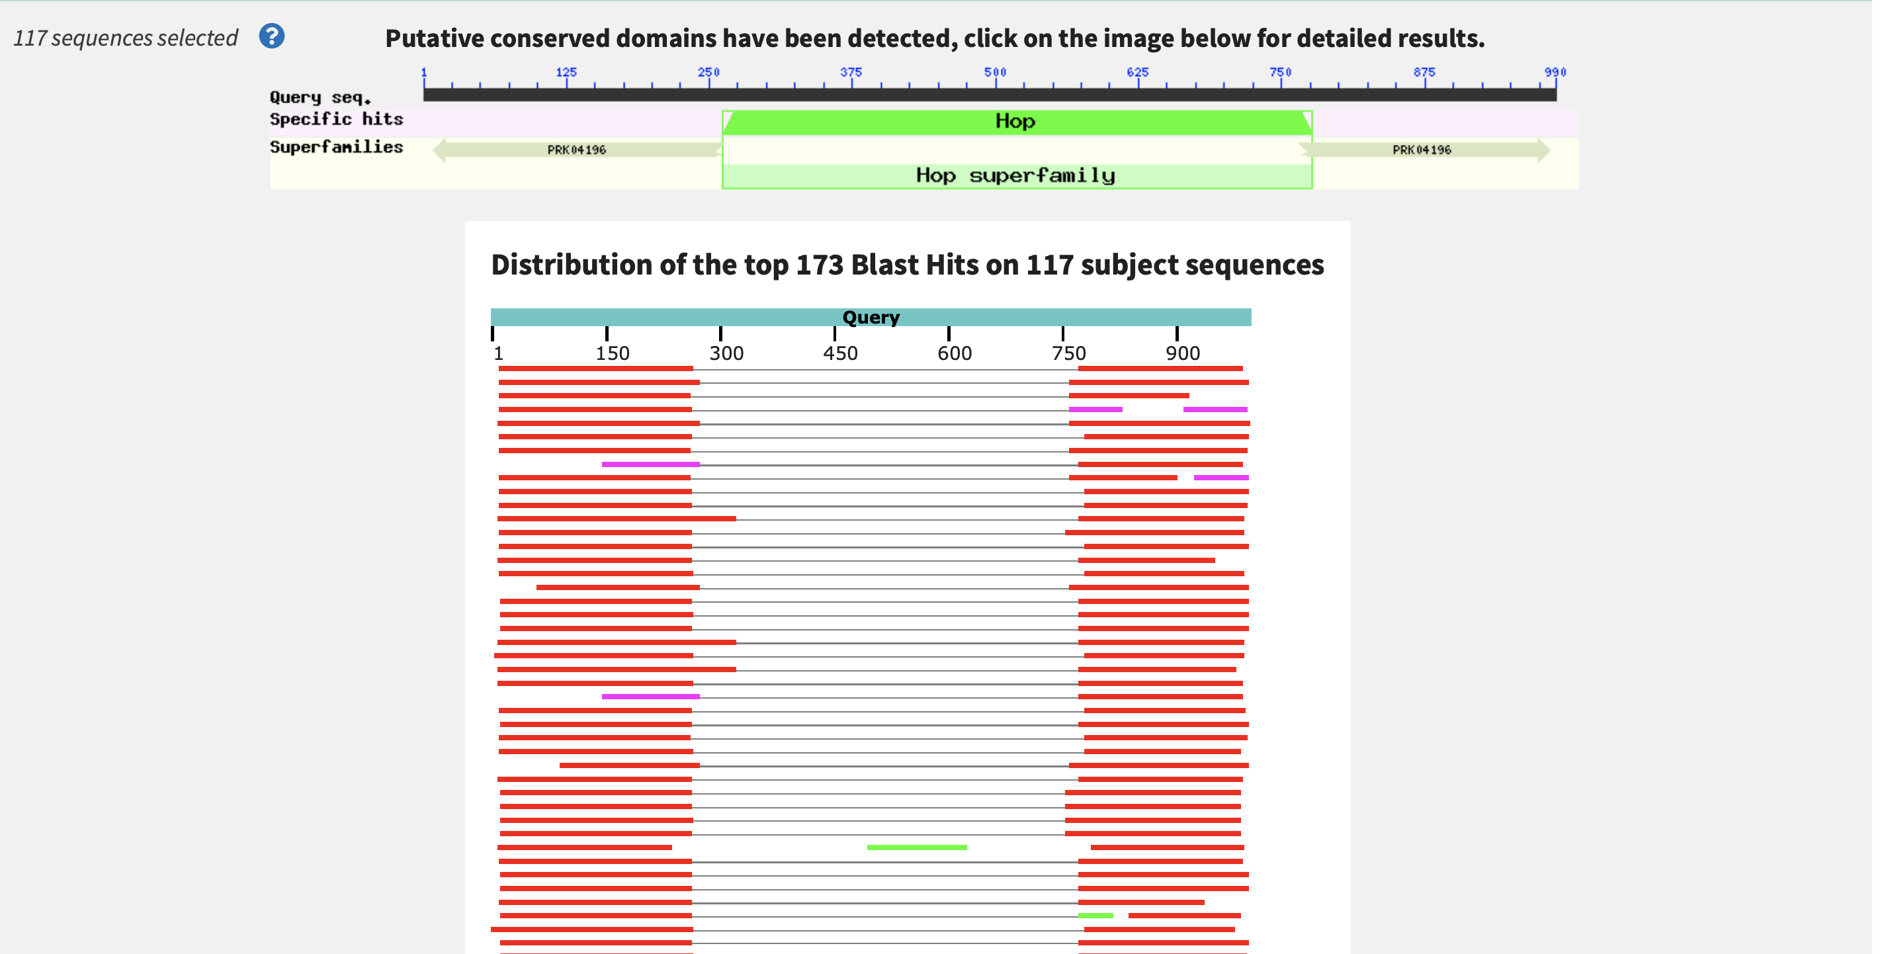
Blast search with an intein containing protein query
Extein
Intein
Extein

Slide 4
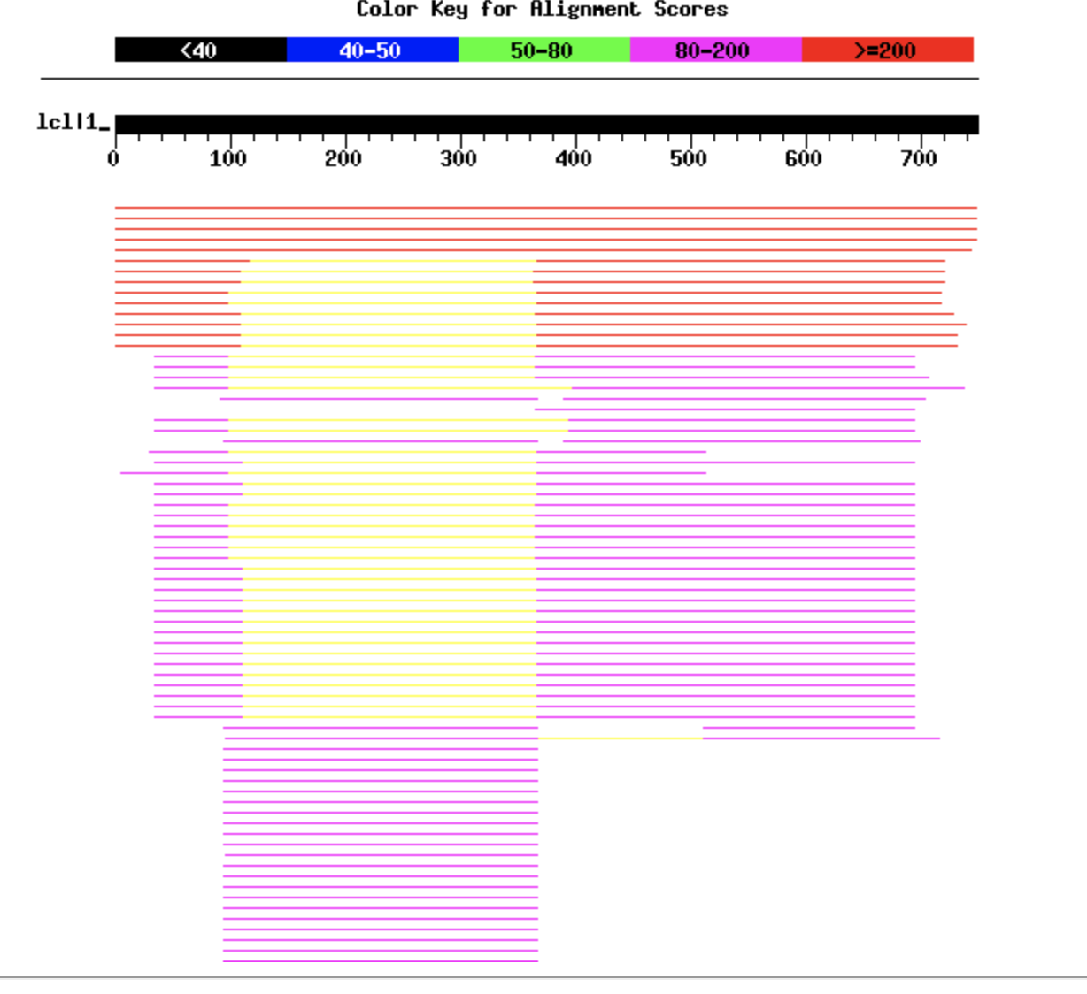
PauloDiaboli Terminase Blastp Search on PhagesDB
Extein and Intein
Extein only
Extein
Extein
Intein
More divergent Extein only
Intein only
Note: blast tries to extend the alignment. Consequently, the boundaries are not always reliable.
Notes:
Started with a blast search on the PauloDiaboli protein sequence
Each line represents a match to a phage that had significant alignment to the query phage (PauloDiaboli)
We can see from this that there are intein only matches, extein only matches, and some that are extein and intein

Slide 5
Review: Types of Error in a Databank Search
False positives: The number of false positives are estimated in the E-value. The P-value or significance value gives the probability that a positive identification is made in error (same as with drug tests). Danger: avoid fishing expeditions. If you do 100 tests on random data, you expect one to be positive at the 1% significance level. You could apply the Bonferroni correction:
The significance level for the individual test is calculated through dividing the overall desired significance level by the number of parallel tests. The null-hypothesis of the overall test is that None of the individual tests is significantly different from chance. (The opposite of none being "at least one")
False negatives: Homologous sequences in the databank that are not recognized as such. If there are only 12000 different protein families, on average a sequence should have (size of the databank)/12000 matches. In other words, the number of false negatives is probably very large.

Slide 6
Uses of Blast in bioinformatics
The Blast web tool at NCBI is limited:
custom and multiple databases are not available
“time-out” before long searches are completed
What if researcher wants to use tBlastn to find all olfactory receptors in the mosquito? Or, if you want to check the presence of a (pseudo)gene in a preliminary genome assembly?
Answer: Use Blast from command-line
Also: The command-line allows the user to run commands repeatedly
by Bob Friedman

Slide 7
Types of Blast searching
blastp compares an amino acid query sequence against a protein sequence database
blastn compares a nucleotide query sequence against a nucleotide sequence database
blastx compares the six-frame conceptual protein translation products of a nucleotide query sequence against a protein sequence database
tblastn compares a protein query sequence against a nucleotide sequence database translated in six reading frames
tblastx compares the six-frame translations of a nucleotide query sequence against the six-frame translations of a nucleotide sequence database.
by Bob Friedman

Slide 8
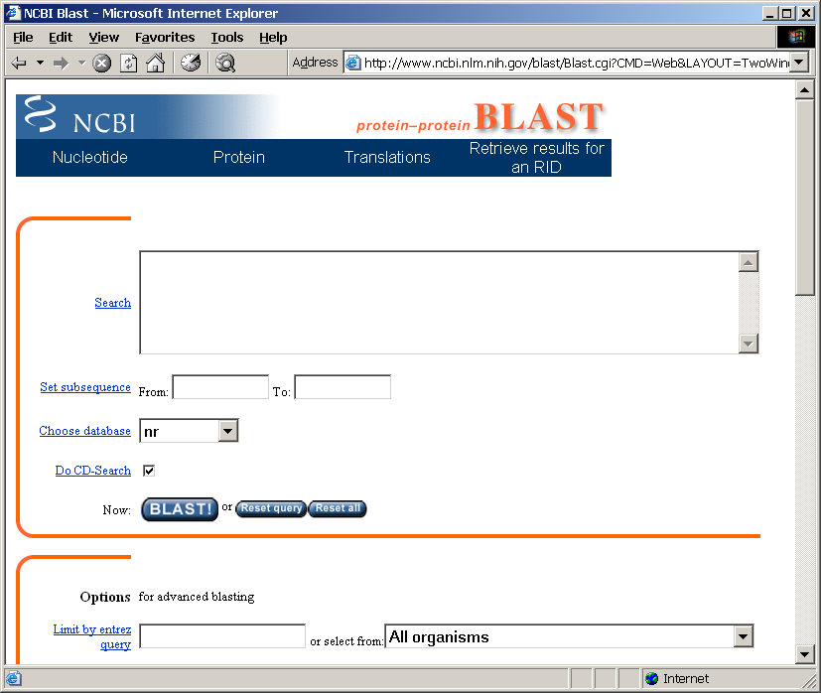
Routine BlastP search
FASTA formatted text
or Genbank ID#
Protein database
Run
by Bob Friedman

Slide 9
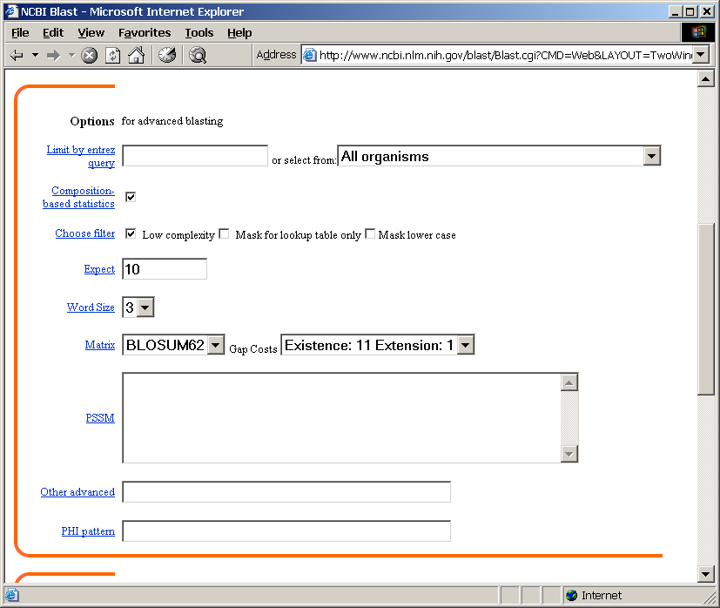
BlastP parameters
Restrict by taxonomic
group
Filter repetitive regions
Statistical cut-off
Size of words in look-up table
Similarity matrix (cost of gaps)
by Bob Friedman

Slide 10
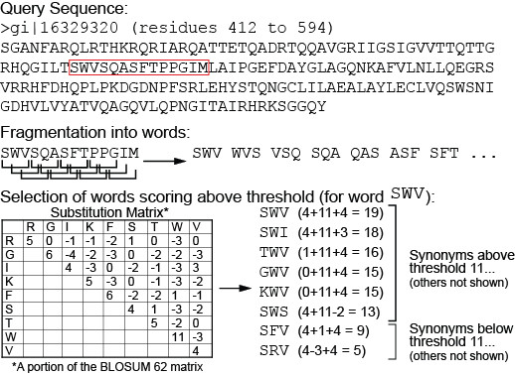
BLAST Phase 1: Segmenting the query sequence; scoring potential word matches--compile
BLAST:
Segments the query sequence into pieces (“words”)
Default word length: 3 amino acids or 11 nucleic acids
Creates a list of synonyms and their scores for comparing query words to target words
Uses scoring matrix to calculate scores for synonyms that might be found in the database
Saves the scores (and synonyms) exceeding a given threshold T
10

Slide 11
BLAST Phase 2: Scanning the database
BLAST
Scans the database for matches to the word list with acceptable T values
Requires two matches (“hits”) within the target sequence
Sets aside sequences with matches above T for further analysis
Words
SWI
PGI
…………..SWITEASFSPPGIM…..
Possible match from the database
11

Slide 12
BLAST Phase 3: Extending the hits
BLAST
Searches 5’ and 3’ of the word hit on both the query and target sequence
Adds up the score for sequence identity or similarity until value exceeds S
Alignment is dropped from subsequent analyses if value never exceeds S
12

Slide 13
Establishing a significant “hit”
Blast’s E-value indicates statistical significance of a sequence match
E-value is the Expected number of sequence matches in database of n number of sequences
database size is arbitrary
multiple testing problem
E-value calculated from many assumptions
E-value depends on size of data bank.
Examples:
E-value = 1 = expect the match to occur in the database by chance 1x
E-value = .01 = expect 1% chance of match occurring
E-value = 1x10⁻²⁰ = strict match between protein domains
by Bob Friedman

Slide 14
Blast databases
EST - Expression Sequence Tags; cDNA
wgs – whole genome shotgun reads
Reference genome sequences
NR - non-redundant DNA or amino acid sequence database
NT - NR database excluding EST, STS, GSS, HTGS
PDB - DNA or amino acid sequences accompanied by 3d structures
STS - Sequence Tagged Sites; short genomic markers for mapping
Swissprot - well-annotated amino-acid sequences
Refseq_select – proteins/mRNAs encoded by well characterized transcripts
env_nr - Metagenomic proteins
SRA – sequence read archive
wgs – whole genome shotgun sequences
At the EBI:
Uniref90 / Uniref50 – data base that clusters sequences more than 90 or 50 % identical and represents each cluster by a single representative sequence Great to assemble sequences to calculate profiles.
by Bob Friedman

Slide 15
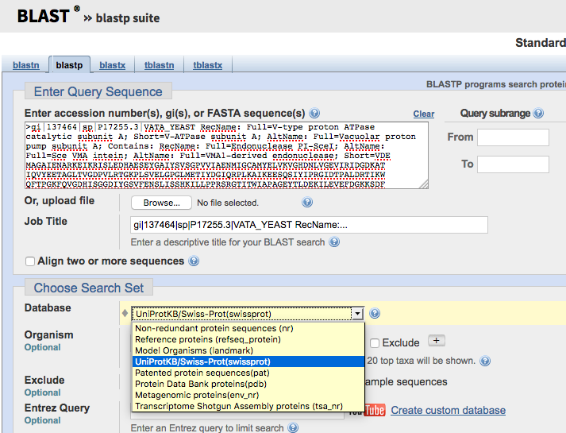

Slide 16
Example of web based BLAST
program: BLASTP sequence: vma1 gi:137464

Slide 17
Effect of low complexity filter
!!! the most common sequences in databases are simple repeats !!!

Slide 18
fasta: an alternative to blast
slower
better alignments between query and database sequences.
An example output is here

Slide 19
Custom databases
Custom databases can include private sequence data, non-redundant gene sets based on genomic locations, merging of genetic data from specific organisms
It’s also faster to search only the sequence data that is necessary
Can search against sequences with custom names
by Bob Friedman

Slide 20
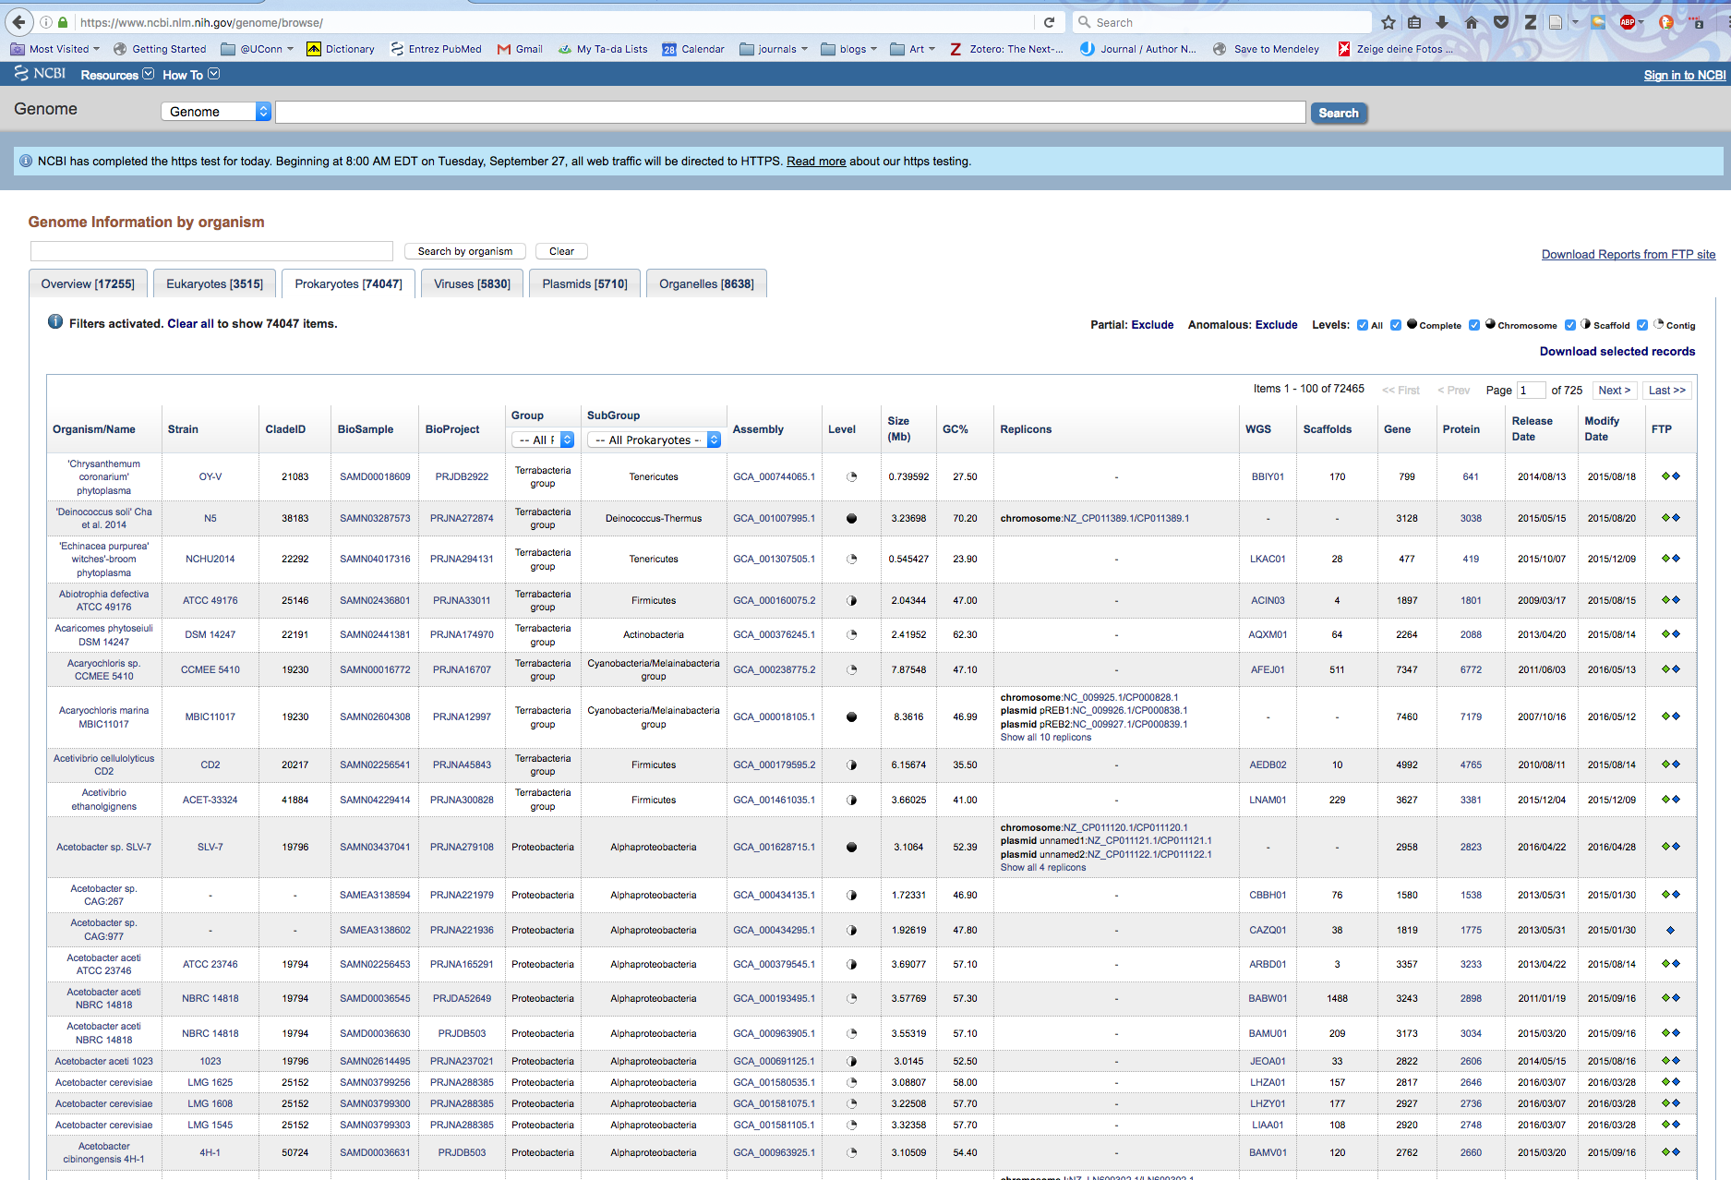
Browsing and retrieving genomes from the NCBI

Slide 21
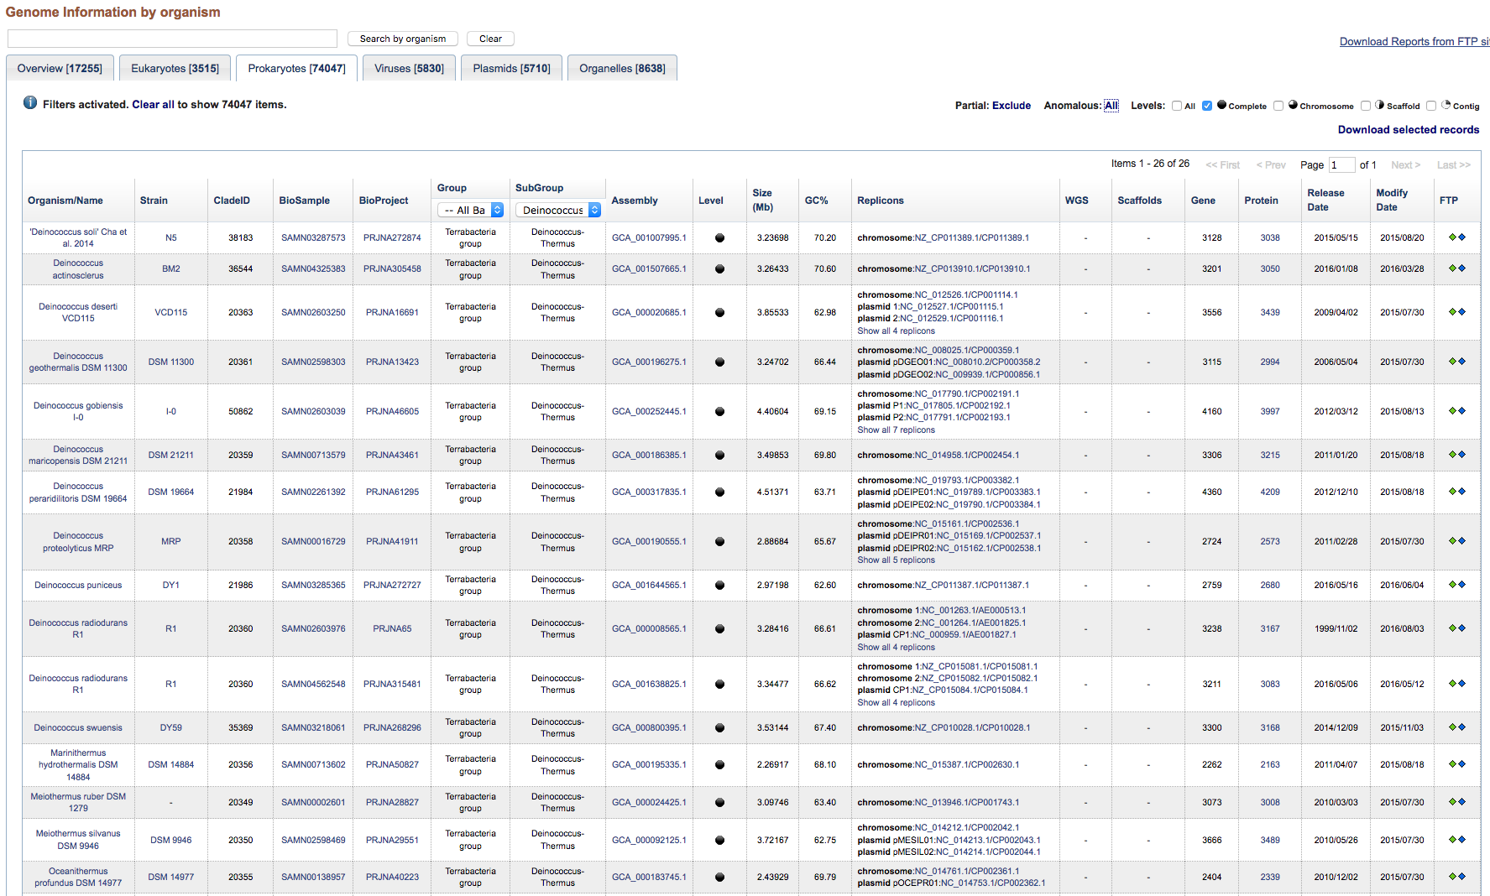
Genome browser at NCBI https://www.ncbi.nlm.nih.gov/genome/browse/

Slide 22
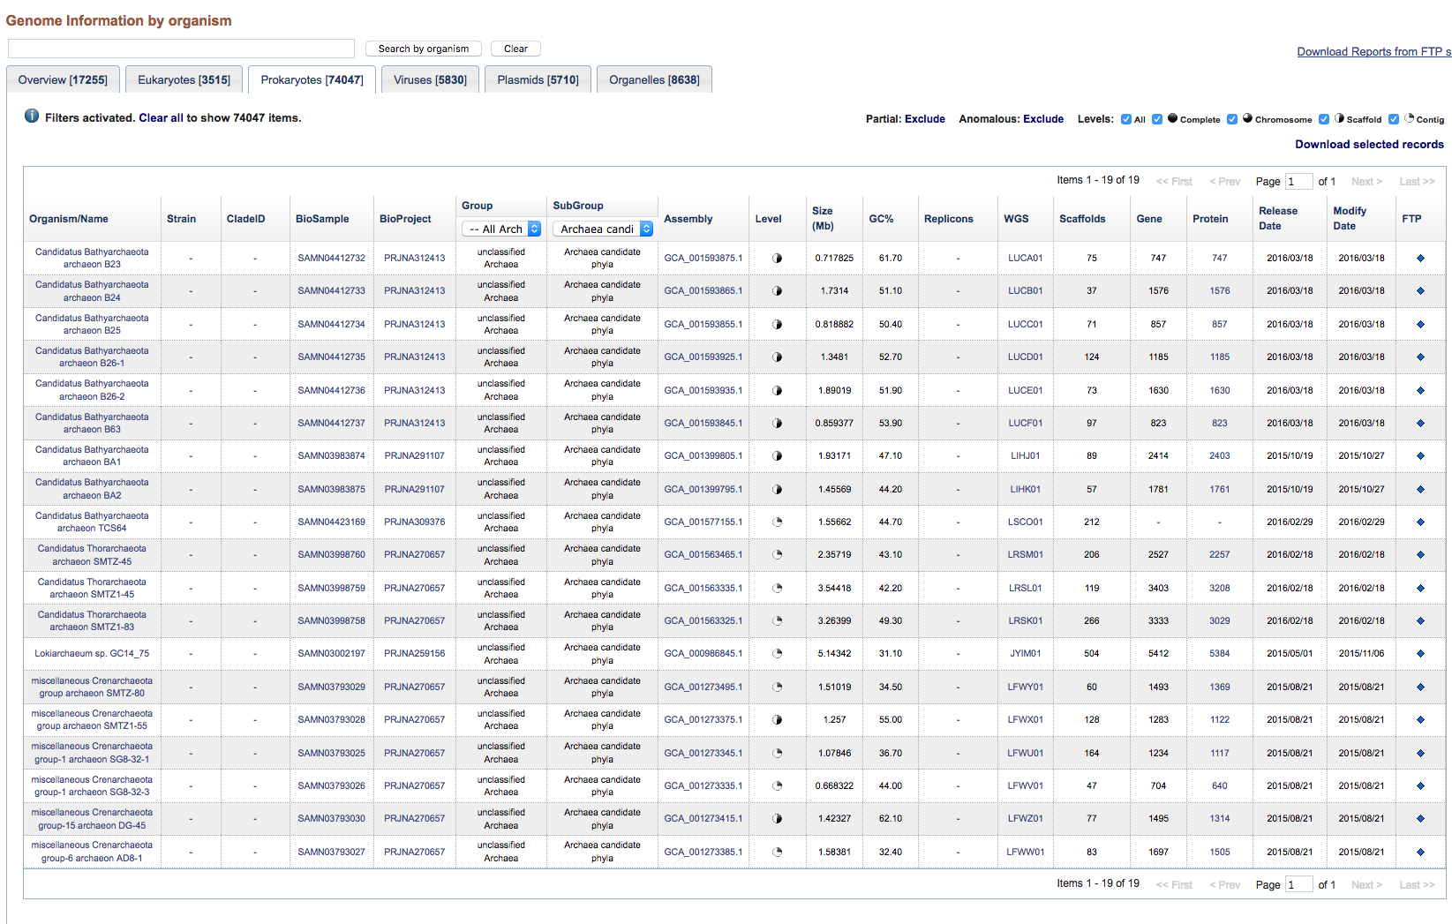

Slide 23
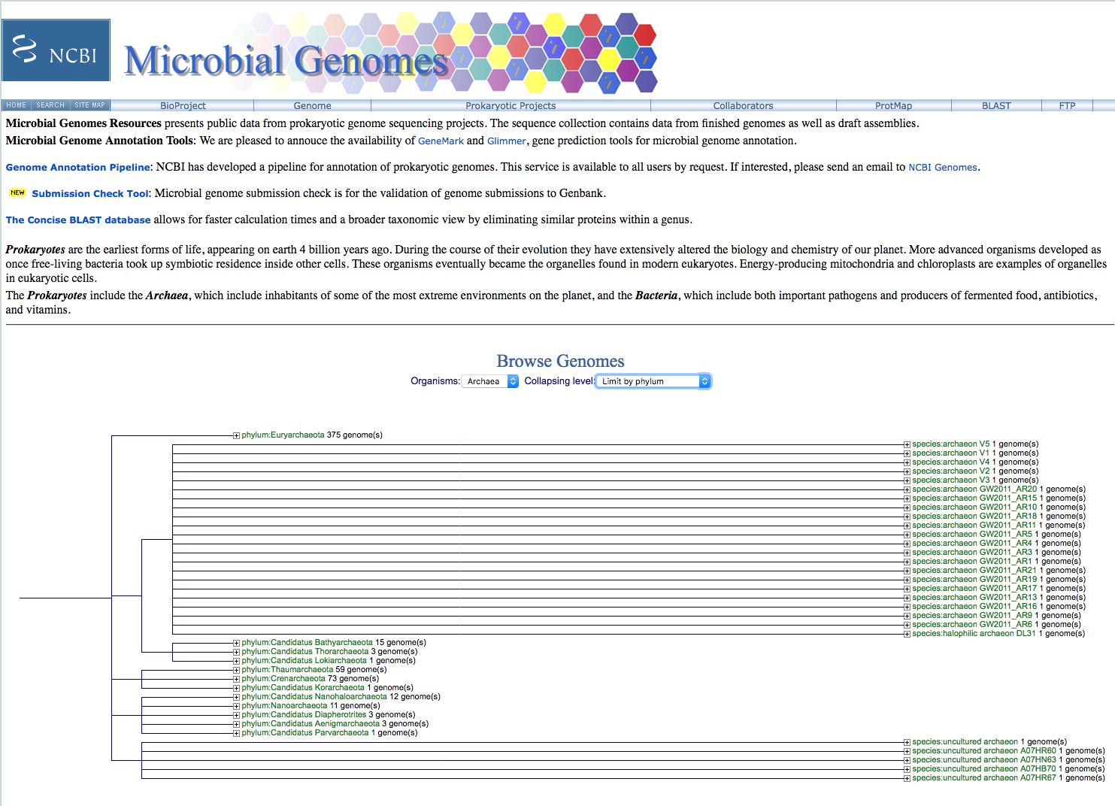

Slide 24
Formatting a custom database
Format sequence data into Fasta format
Example of Fasta format:
>sequence 1
AAATGCTTAAAAA
>sequence 2
AAATTGCTAAAAGA
Convert Fasta to Blast format by using makeblastdb program from command-line:
makeblastdb -in proteins.faa -dbtype prot -parse_seqids
(formatdb.log is a file where the results are logged from the formatting operation)
by Bob Friedman

Slide 25
Searching a custom database:
blastp -query query_protein.faa -db proteins.faa -out blast.txt -outfmt 6
-outfmt 6 specifies a tabular output format.
The default e-value cut-off is 10 (i.e. at the bottom of the list you expect about 10 false positives). To reduce the size of the output file you can set the e value cut-off to 0.0001 (you would probably not have any false positives).
You would add -evalue 0.0001 to the above command.
The output will be written to a text file called blast.txt.
The file query_protein.faa can contain one or many sequences in fasta format. If the file has more than one sequences a blast search will be done for every sequence. However, all the output goes into the same file.

Slide 26
How to get help: command -h
bash-4.2$ blastp -h
USAGE
blastp [-h] [-help] [-import_search_strategy filename]
[-export_search_strategy filename] [-task task_name] [-db database_name]
[-dbsize num_letters] [-gilist filename] [-seqidlist filename]
[-negative_gilist filename] [-negative_seqidlist filename]
[-entrez_query entrez_query] [-db_soft_mask filtering_algorithm]
[-db_hard_mask filtering_algorithm] [-subject subject_input_file]
[-subject_loc range] [-query input_file] [-out output_file]
[-evalue evalue] [-word_size int_value] [-gapopen open_penalty]
[-gapextend extend_penalty] [-qcov_hsp_perc float_value]
[-max_hsps int_value] [-xdrop_ungap float_value] [-xdrop_gap float_value]
[-xdrop_gap_final float_value] [-searchsp int_value]
[-sum_stats bool_value] [-seg SEG_options] [-soft_masking soft_masking]
[-matrix matrix_name] [-threshold float_value] [-culling_limit int_value]
[-best_hit_overhang float_value] [-best_hit_score_edge float_value]
[-window_size int_value] [-lcase_masking] [-query_loc range]
[-parse_deflines] [-outfmt format] [-show_gis]
[-num_descriptions int_value] [-num_alignments int_value]
[-line_length line_length] [-html] [-max_target_seqs num_sequences]
[-num_threads int_value] [-ungapped] [-remote] [-comp_based_stats compo]
[-use_sw_tback] [-version]
DESCRIPTION
Protein-Protein BLAST 2.7.1+
Use '-help' to print detailed descriptions of command line arguments

Slide 27
From blast –help: (goes over several pages)
*** Formatting options
-outfmt <String>
alignment view options:
0 = Pairwise,
1 = Query-anchored showing identities,
2 = Query-anchored no identities,
3 = Flat query-anchored showing identities,
4 = Flat query-anchored no identities,
5 = BLAST XML,
6 = Tabular,
7 = Tabular with comment lines,
8 = Seqalign (Text ASN.1),
9 = Seqalign (Binary ASN.1),
10 = Comma-separated values,
11 = BLAST archive (ASN.1),
12 = Seqalign (JSON),
13 = Multiple-file BLAST JSON,
14 = Multiple-file BLAST XML2,
15 = Single-file BLAST JSON,
16 = Single-file BLAST XML2,
18 = Organism Report

Slide 28
From blast –help: (continued)
Options 6, 7 and 10 can be additionally configured to produce
a custom format specified by space delimited format specifiers.
The supported format specifiers are:
qseqid means Query Seq-id
qgi means Query GI
qacc means Query accesion
qaccver means Query accesion.version
qlen means Query sequence length
sseqid means Subject Seq-id
sallseqid means All subject Seq-id(s), separated by a ';'
sgi means Subject GI
sallgi means All subject GIs
sacc means Subject accession
saccver means Subject accession.version
sallacc means All subject accessions
slen means Subject sequence length
qstart means Start of alignment in query
qend means End of alignment in query
sstart means Start of alignment in subject
send means End of alignment in subject
qseq means Aligned part of query sequence
sseq means Aligned part of subject sequence
evalue means Expect value
bitscore means Bit score
score means Raw score
length means Alignment length
pident means Percentage of identical matches
nident means Number of identical matches
mismatch means Number of mismatches
positive means Number of positive-scoring matches
gapopen means Number of gap openings
gaps means Total number of gaps
ppos means Percentage of positive-scoring matches
frames means Query and subject frames separated by a '/'
qframe means Query frame
sframe means Subject frame
btop means Blast traceback operations (BTOP)
staxid means Subject Taxonomy ID
ssciname means Subject Scientific Name
scomname means Subject Common Name
sblastname means Subject Blast Name
sskingdom means Subject Super Kingdom
staxids means unique Subject Taxonomy ID(s), separated by a ';'
(in numerical order)
sscinames means unique Subject Scientific Name(s), separated by a ';'
scomnames means unique Subject Common Name(s), separated by a ';'
sblastnames means unique Subject Blast Name(s), separated by a ';'
(in alphabetical order)
sskingdoms means unique Subject Super Kingdom(s), separated by a ';'
(in alphabetical order)
stitle means Subject Title
salltitles means All Subject Title(s), separated by a '<>'
sstrand means Subject Strand
qcovs means Query Coverage Per Subject
qcovhsp means Query Coverage Per HSP
qcovus means Query Coverage Per Unique Subject (blastn only)

Slide 29
When not provided, the default value is:
'qaccver saccver pident length mismatch gapopen qstart qend sstart send
evalue bitscore', which is equivalent to the keyword 'std'
Default = `0'
Query accession_number.version
Subject accession_number.version
% identity
Alignment length
Number of mismatches
Number of gap openings
Start of alignment in query
End of alignment in query
Start of alignment in subject
End of alignment in subject
Expect value
Bit score

Slide 30
How to get help: command -h
bash-4.2$ makeblastdb -h
USAGE
makeblastdb [-h] [-help] [-in input_file] [-input_type type]
-dbtype molecule_type [-title database_title] [-parse_seqids]
[-hash_index] [-mask_data mask_data_files] [-mask_id mask_algo_ids]
[-mask_desc mask_algo_descriptions] [-gi_mask]
[-gi_mask_name gi_based_mask_names] [-out database_name]
[-max_file_sz number_of_bytes] [-logfile File_Name] [-taxid TaxID]
[-taxid_map TaxIDMapFile] [-version]
DESCRIPTION
Application to create BLAST databases, version 2.7.1+
Use '-help' to print detailed descriptions of command line arguments

Slide 31
Default tabular output (–outfmt 6): (gene 10 from bacteriophage Zhengyi against actinophagedb)
Zhengyi 94287_EugeneKrabs_Draft_10 99.463 745 4 0 1 745 1 745 0.0 1544
Zhengyi 311157_Unphazed_10 85.542 747 106 1 1 745 1 747 0.0 1338
Zhengyi 325083_Xitlalli_Draft_10 85.906 745 103 1 3 745 4 748 0.0 1337
Zhengyi 15244_ArMaWen_10 85.542 747 106 1 1 745 1 747 0.0 1337
Zhengyi 169244_LilyLou_11 85.408 747 107 1 1 745 1 747 0.0 1335
Zhengyi 288178_Stormbreaker_Draft_10 85.638 745 105 1 3 745 4 748 0.0 1332
Zhengyi 35842_BlueRugrat_Draft_10 85.599 743 105 1 5 745 3 745 0.0 1330
Zhengyi 301381_TinyTimothy_10 84.688 738 105 2 8 745 4 733 0.0 1288
Zhengyi 319351_Wesak_10 84.553 738 106 2 8 745 4 733 0.0 1285
Zhengyi 233484_Phogo_10 81.392 747 129 4 1 745 1 739 0.0 1245
Zhengyi 5978_Alex44_10 81.258 747 130 4 1 745 1 739 0.0 1243
Zhengyi 219502_Pabst_Draft_11 75.963 753 165 7 3 745 4 750 0.0 1155
Zhengyi 5386_Akoni_10 60.881 772 242 11 5 745 7 749 0.0 889
Zhengyi 16330_Ashton_10 60.881 772 242 11 5 745 7 749 0.0 889
Zhengyi 6996_AloeVera_Draft_10 61.061 773 239 12 5 745 4 746 0.0 889
Zhengyi 307288_Truong_10 60.931 773 240 12 5 745 7 749 0.0 887
Zhengyi 97649_Fede_Draft_10 61.282 749 269 13 5 745 4 739 0.0 879
Zhengyi 17656_Atraxi_Draft_10 60.610 754 261 12 5 745 4 734 0.0 874
Zhengyi 184880_Mazun_Draft_10 60.898 757 248 15 7 745 6 732 0.0 870
Zhengyi 234940_PhriedRice_10 60.956 753 254 13 7 745 6 732 0.0 867
Zhengyi 234112_Phractured_10 60.956 753 254 13 7 745 6 732 0.0 867
Zhengyi 229391_Phedro_10 60.956 753 254 13 7 745 6 732 0.0 867
Zhengyi 228522_Pharky_10 60.956 753 254 13 7 745 6 732 0.0 867
Zhengyi 14465_Arete_11 37.517 757 416 19 3 745 13 726 1.30e-133 414
Zhengyi 45652_Burro_10 37.813 759 403 21 7 745 15 724 3.58e-130 405
Zhengyi 13154_Araxxi_10 36.842 760 413 21 5 745 14 725 2.12e-124 390
Zhengyi 307086_Troy_42 26.267 750 406 35 6 721 2 638 1.45e-33 139
Zhengyi 265199_SamW_42 26.267 750 406 35 6 721 2 638 1.45e-33 139
Zhengyi 164472_Lederberg_42 26.267 750 406 35 6 721 2 638 1.45e-33 139
Often looks strange, because some entries run into the next tab – making the font smaller, or loading it into excel helps.

Slide 32
Default tabular output (–outfmt 7): gene all proteins in Hfx. volcanii genome against a nanohaloarchaeal genome (strain SG9)
# Query: WP_004040797.1 hypothetical protein [Haloferax volcanii]
# Database: SG9.faa
# Fields: query acc.ver, subject acc.ver, % identity, alignment length, mismatches, gap opens, q. start, q. end, s. start, s. end, evalue, bit score
# 11 hits found
WP_004040797.1 AOV94602.1 45.000 20 11 0 66 85 1240 1259 0.14 26.6
WP_004040797.1 AOV95267.1 27.273 66 38 3 25 84 354 415 0.37 25.4
WP_004040797.1 AOV94348.1 50.000 14 7 0 104 117 44 57 2.8 22.7
WP_004040797.1 AOV94453.1 25.000 60 43 1 57 116 352 409 3.2 22.7
WP_004040797.1 AOV94962.1 27.869 61 42 2 15 73 547 607 3.2 22.3
WP_004040797.1 AOV94961.1 20.909 110 75 3 10 117 8 107 4.0 21.9
WP_004040797.1 AOV94654.1 66.667 15 5 0 82 96 314 328 6.7 21.6
WP_004040797.1 AOV94708.1 37.500 24 15 0 62 85 8 31 6.9 21.6
WP_004040797.1 AOV94738.1 41.935 31 18 0 30 60 487 517 7.9 21.2
WP_004040797.1 AOV94984.1 37.143 35 20 1 27 59 722 756 8.7 21.2
WP_004040797.1 AOV94472.1 28.235 85 57 1 6 86 142 226 9.4 21.2
# BLASTP 2.7.1+
# Query: WP_004040798.1 hypothetical protein [Haloferax volcanii]
# Database: SG9.faa
# Fields: query acc.ver, subject acc.ver, % identity, alignment length, mismatches, gap opens, q. start, q. end, s. start, s. end, evalue, bit score
# 2 hits found
WP_004040798.1 AOV95137.1 28.889 45 32 0 7 51 15 59 0.23 25.8
WP_004040798.1 AOV95296.1 50.000 14 7 0 125 138 243 256 6.7 22.3
# BLASTP 2.7.1+
# Query: WP_004040800.1 hypothetical protein [Haloferax volcanii]
# Database: SG9.faa
# Fields: query acc.ver, subject acc.ver, % identity, alignment length, mismatches, gap opens, q. start, q. end, s. start, s. end, evalue, bit score
# 13 hits found
WP_004040800.1 AOV94411.1 30.645 62 42 1 247 307 18 79 0.83 26.2
...
Continues for all ~4000 genes in the Haloferax volcanii genome.

Slide 33
Command Line
The favored operating system flavor in computational biology is UNIX/LINUX.
The command line is similar to DOS.
Some of the frequently used commands are here
pwd
ls
ls –l
chmod
chmod a+x blastall.sh
chmod 755 *.sh
cd
cd ..
cd $HOME
passwd
ps ps aux rm more cat vi (text editor) ps ps aux ssh sftp
For windows an “ok” ssh program is putty.
UConn also has a site license for the ssh program from ssh.com

Slide 34
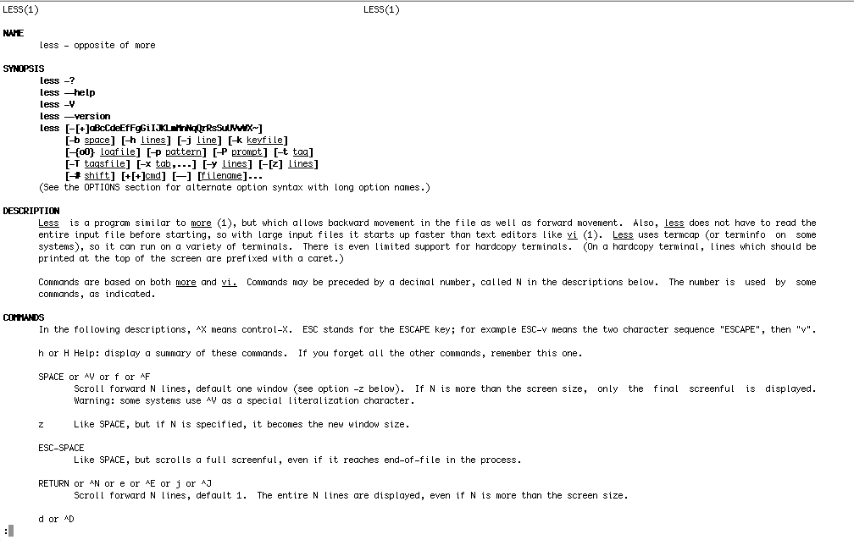
How to get help on unix commands: man command

Slide 35
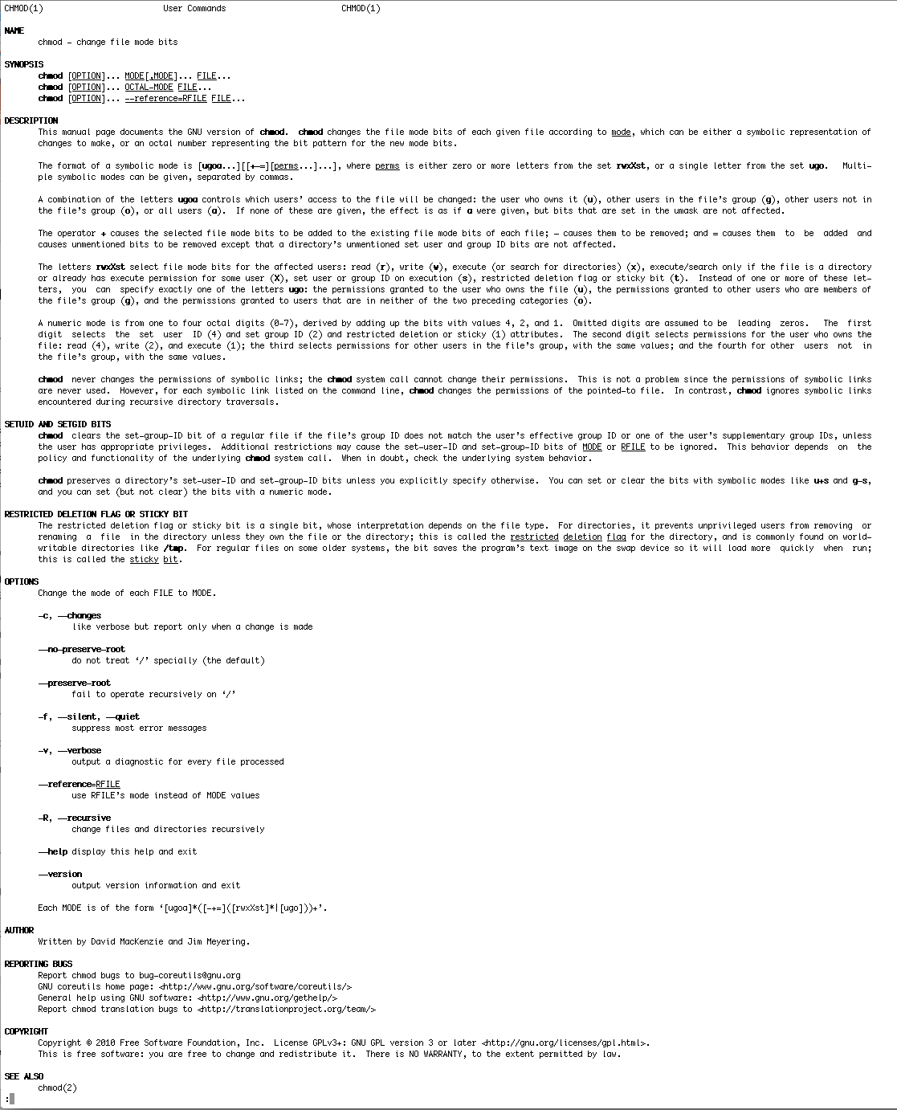
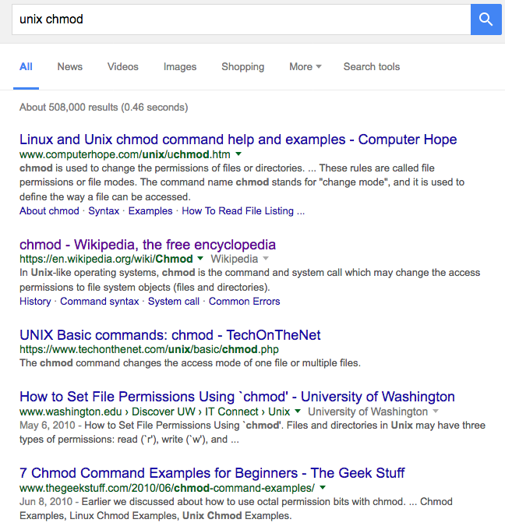
How to get help: man command
man often gives too much information, google is a great alternative.

Slide 36
UNIX
Basic UNIX commands ls, cd, chmod, cp, rm, mkdir, more (or) less, vi, ps, kill -9, man
A brief listing is here
chmod is a particular pain in the ... . Under unix every file has an owner and the owner, his group and everyone else have permissions to read, write and/or execute the file (or they don’t). If you want to see which permissions are currently assigned to your files, type ls -l at the command prompt. chmod a+x *.pl gives everyone execute permission for all files that end with .pl the * is a wildcard. (warning don't ever use rm in conjunction with *)
For more on chmod type ”man chmod” or see here. (In the OSX GUI you can control click at a file, and change permissions in the info box). Most ssh clients (FUGU and SSH) allow you to use a GUI to change file permissions (in FUGU ctrl click).

Slide 37
Unix - command line interface
If you tried to execute a command, and you made a mistake, for example, you mistyped a file name, you can recall the last command using the up arrow (down arrow for more recent).
If you are tired typing long filenames, you can use the tab key to complete the line, provided there is only one way to complete the line. E.g: cd /Desktop could be replaced by cd /D<tab>
If there are two or more choices you hear a boing, if you hit <tab> again, you get a list of choices.
If you want to become more familiar with the unix command line, the code-academy has a good introduction at
https://www.codecademy.com/courses/learn-the-command-line

Slide 38
characters at the end of lines
File tranfers from Windows to UNIX and return:
End of Line characters are a problem. Under Windows DO NOT use notepad, it does not understand UNIX newline symbols ‘\n’.
Best write your programs under UNIX using vi or vim (or any other editor you are comfortable with)
2nd best is to use a text editor like bbedit (very nice and free program for UNIX). Like vi and vim it provides context dependent coloring.
3rd best is to remove end of line symbols in a UNIX editor or use sed (Stream EDitor) after you transferred the file:
sed s/.$// name_of_WINDOWS_infile > name_of_UNIX_outfile (This replaces the last non letter character before the eol ($) with nothing)
Some versions of office allow to save files as UNIX textfiles, but ...
A related problem is encountered by Mac users. Many older text editors will use MAC carriage returns at the end of the line. Most unix programs will not be able to handle these. In a terminal window you could use the following command to convert your file: tr ’\r' ’\n' < name_of_the_Mac_file > name_of_the_unix_file
The EoL confusion is very inconvenient, but there really is no easy solution, tough luck; and you better know about this in case something goes wrong.

Slide 39
Special characters:
\n #newline
\t #tab

Slide 40
To move files between local PC and server:
For windows machines: install Filezilla client for transfer and putty as terminal.
For Macintosh computers: install Filezilla (client!) from https://filezilla-project.org/
To establish a command line connection via ssh (secure shell):
For windows machines: Use PuTTY to establish an ssh connection There are more user-friendly programs (e.g., Bitvise SSH Client); however, UConn’s bioinformatics cluster Xanadu uses different nodes for file transfer and ssh connections, thus the program with more bells and whistles that assume the same address for both doesn’t help much, and mainly creates confusion.
For Macintosh computers: Use the terminal program that is part of the operating system (in the Applications/Utilities folder

