Slide 1


Slide 2
Notebooks are due today!

Slide 3
MCB 3421 – class 11
Gene plots
Origin of replication
Strand bias
cumulative GC skew
Architecture imparting sequences

Slide 4
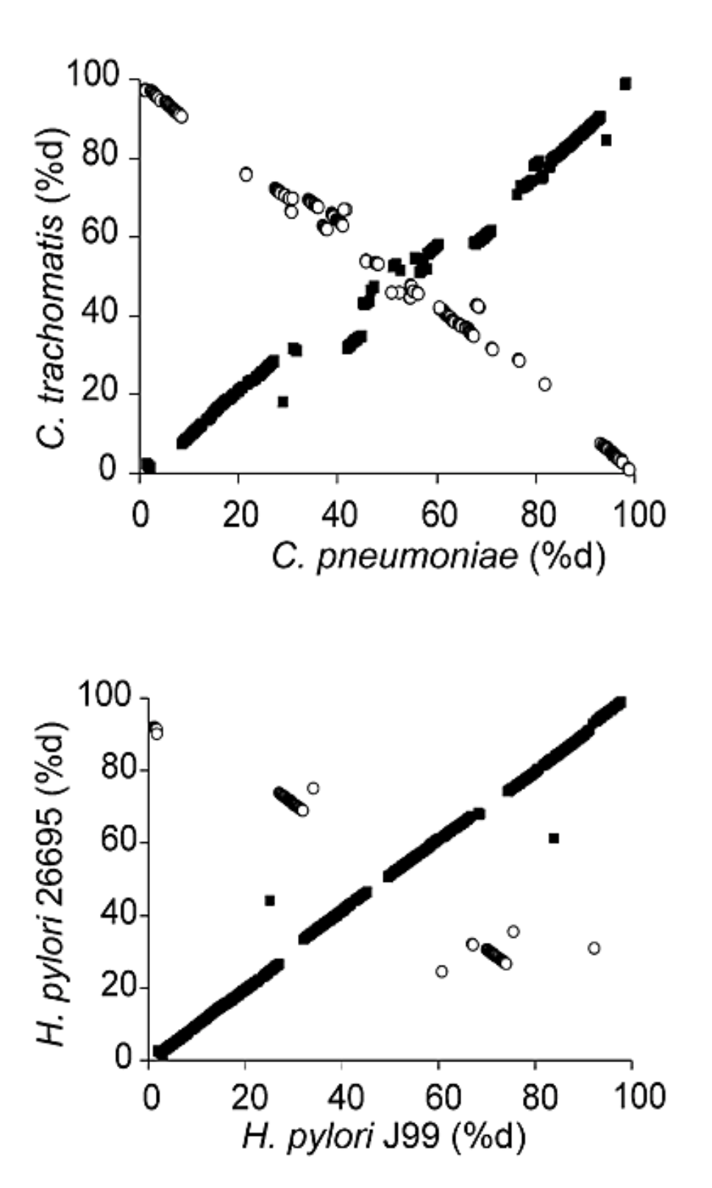
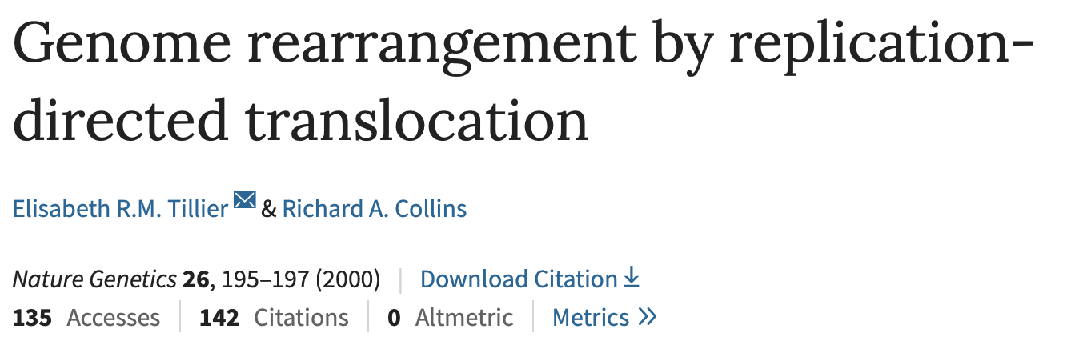
From:

Slide 5
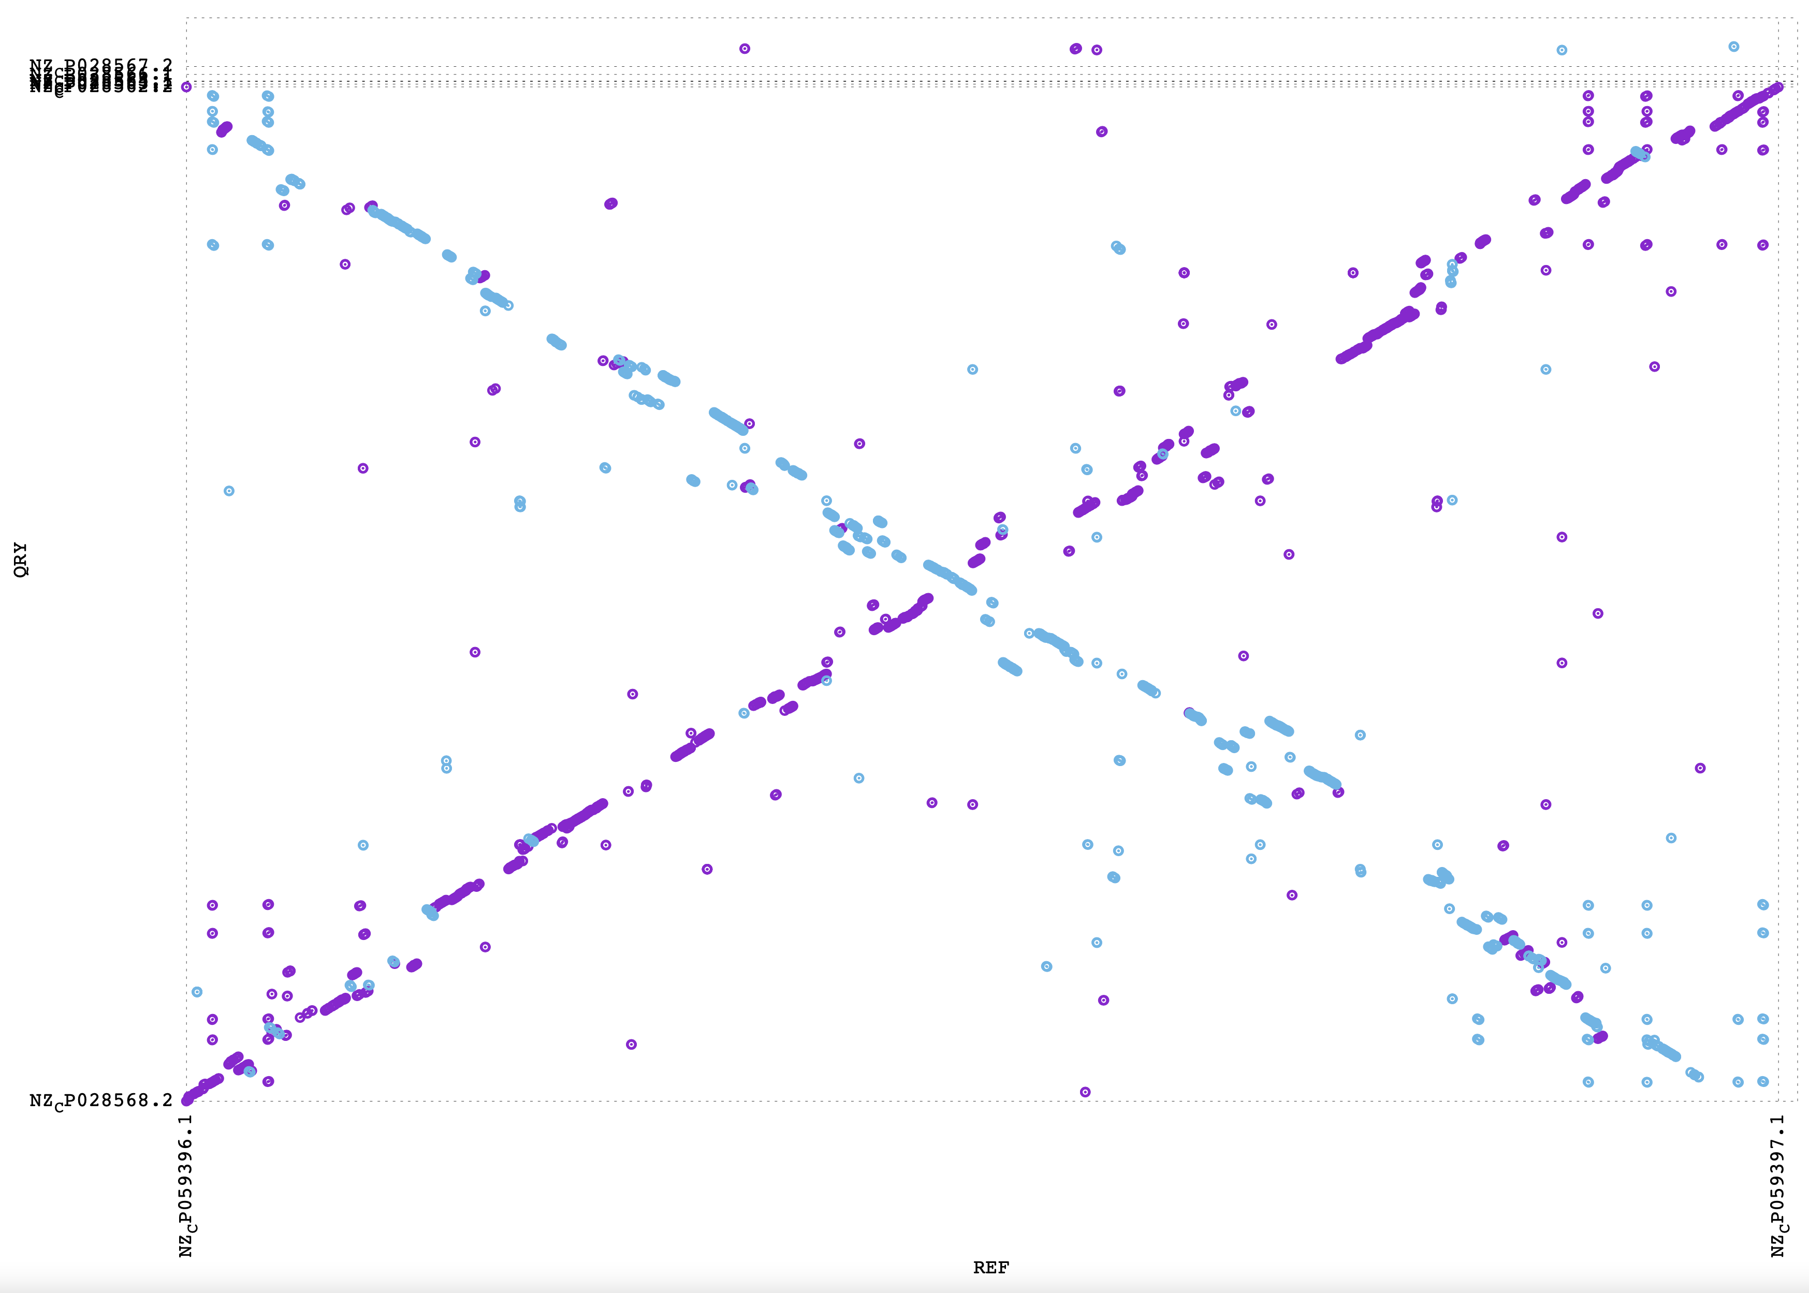
A. hydophila WCHAH045096
Aeromonas veronii HM21

Slide 6
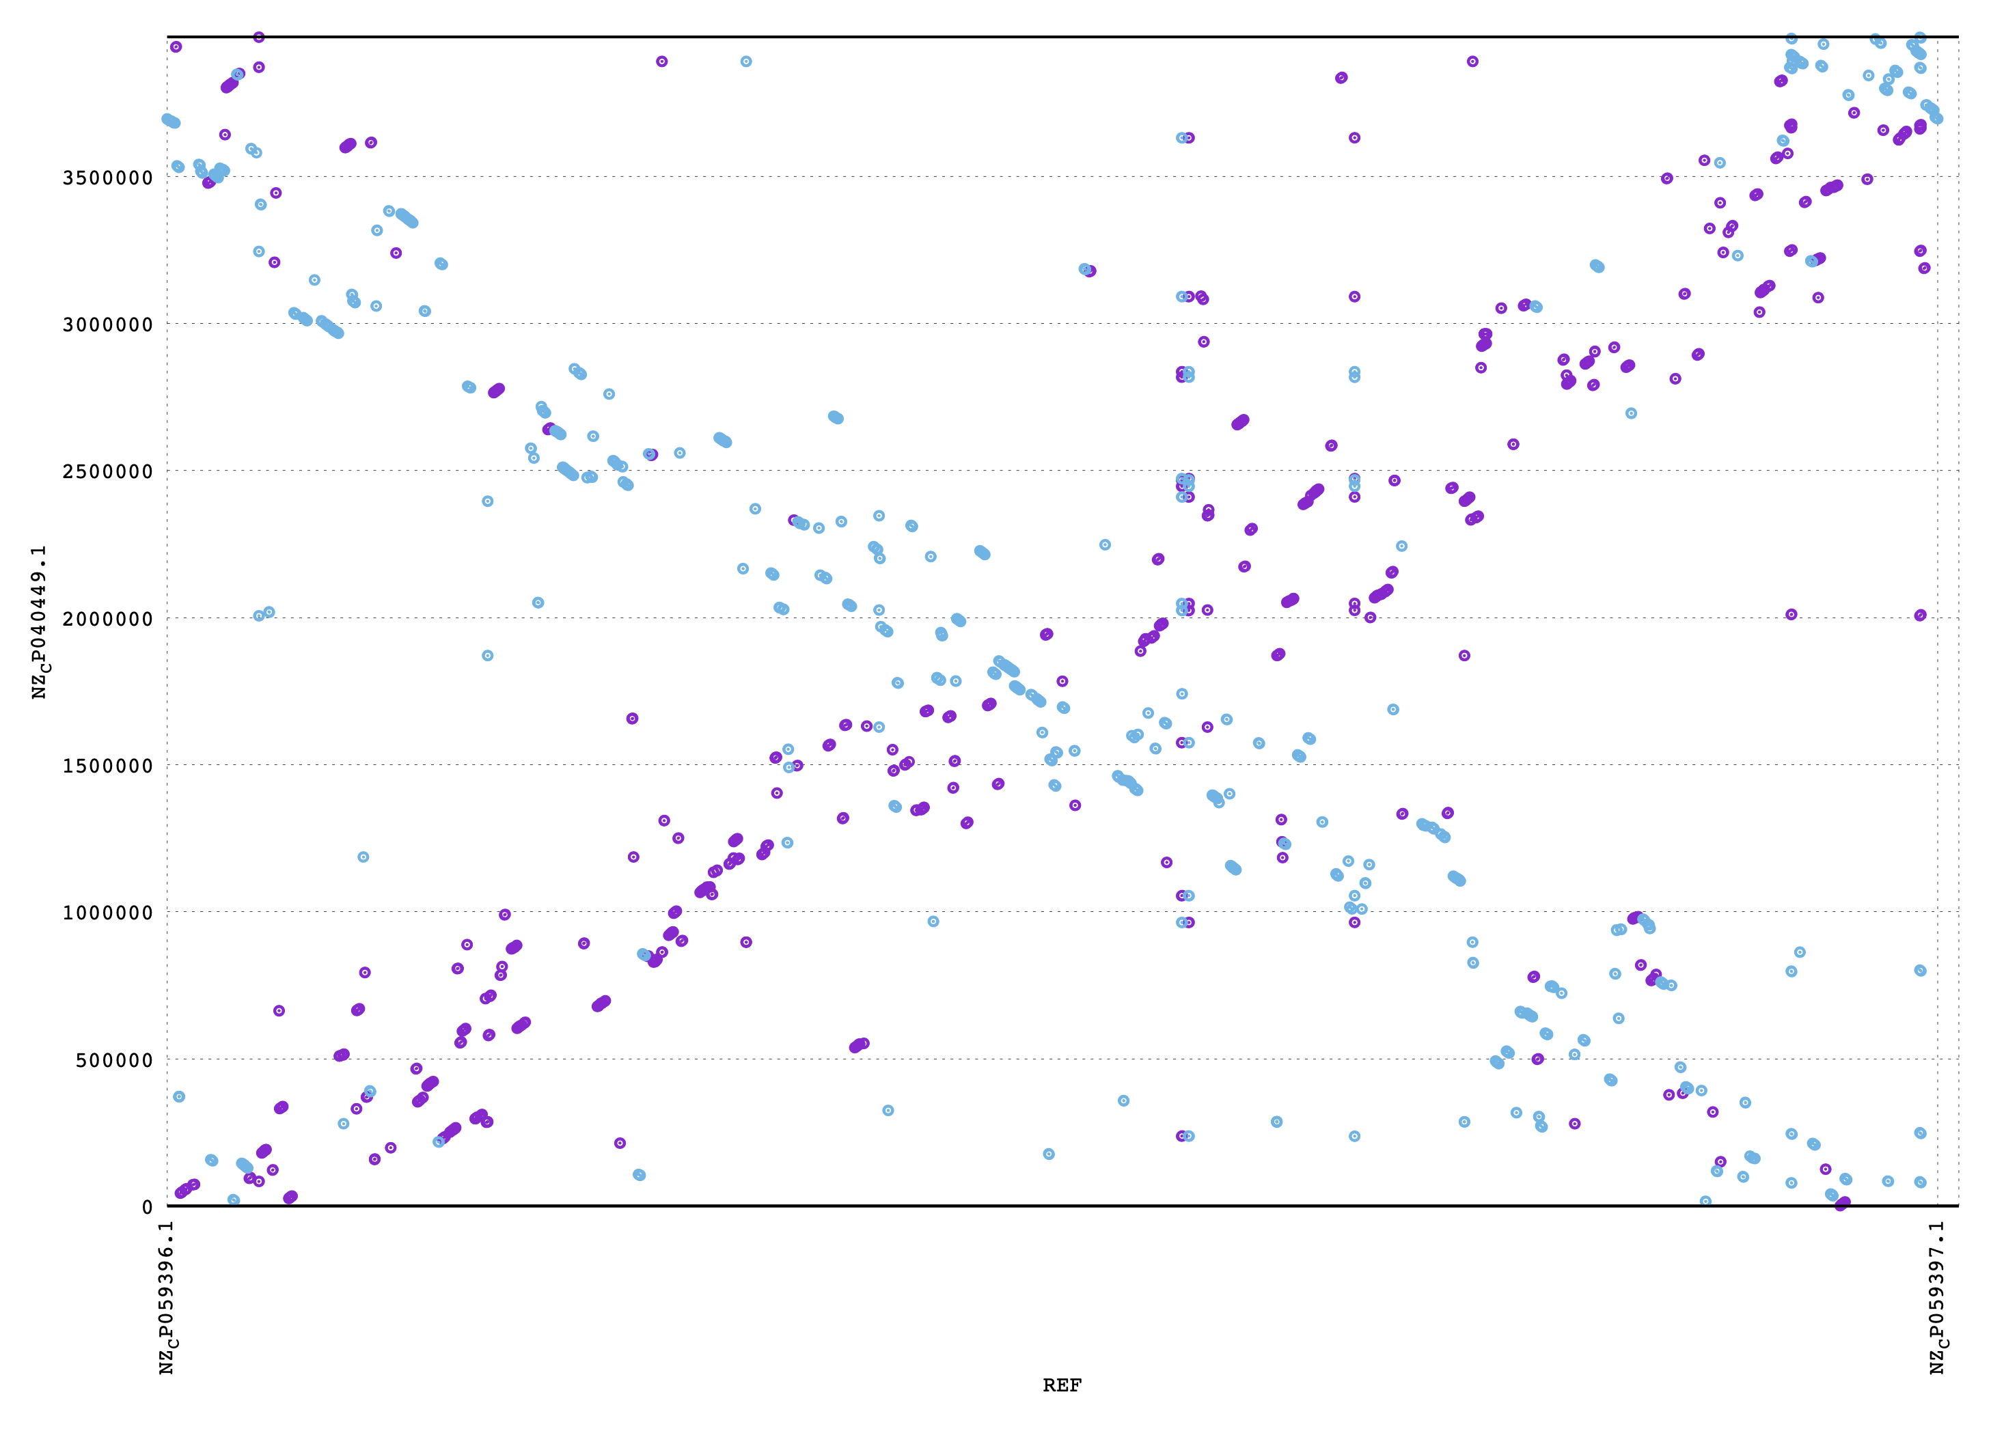
Aeromonas simiae A6
Aeromonas veronii HM21

Slide 7
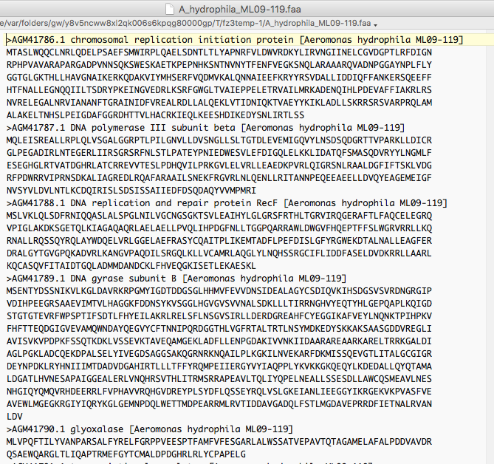
Typical multiple sequence fasta file

Slide 8
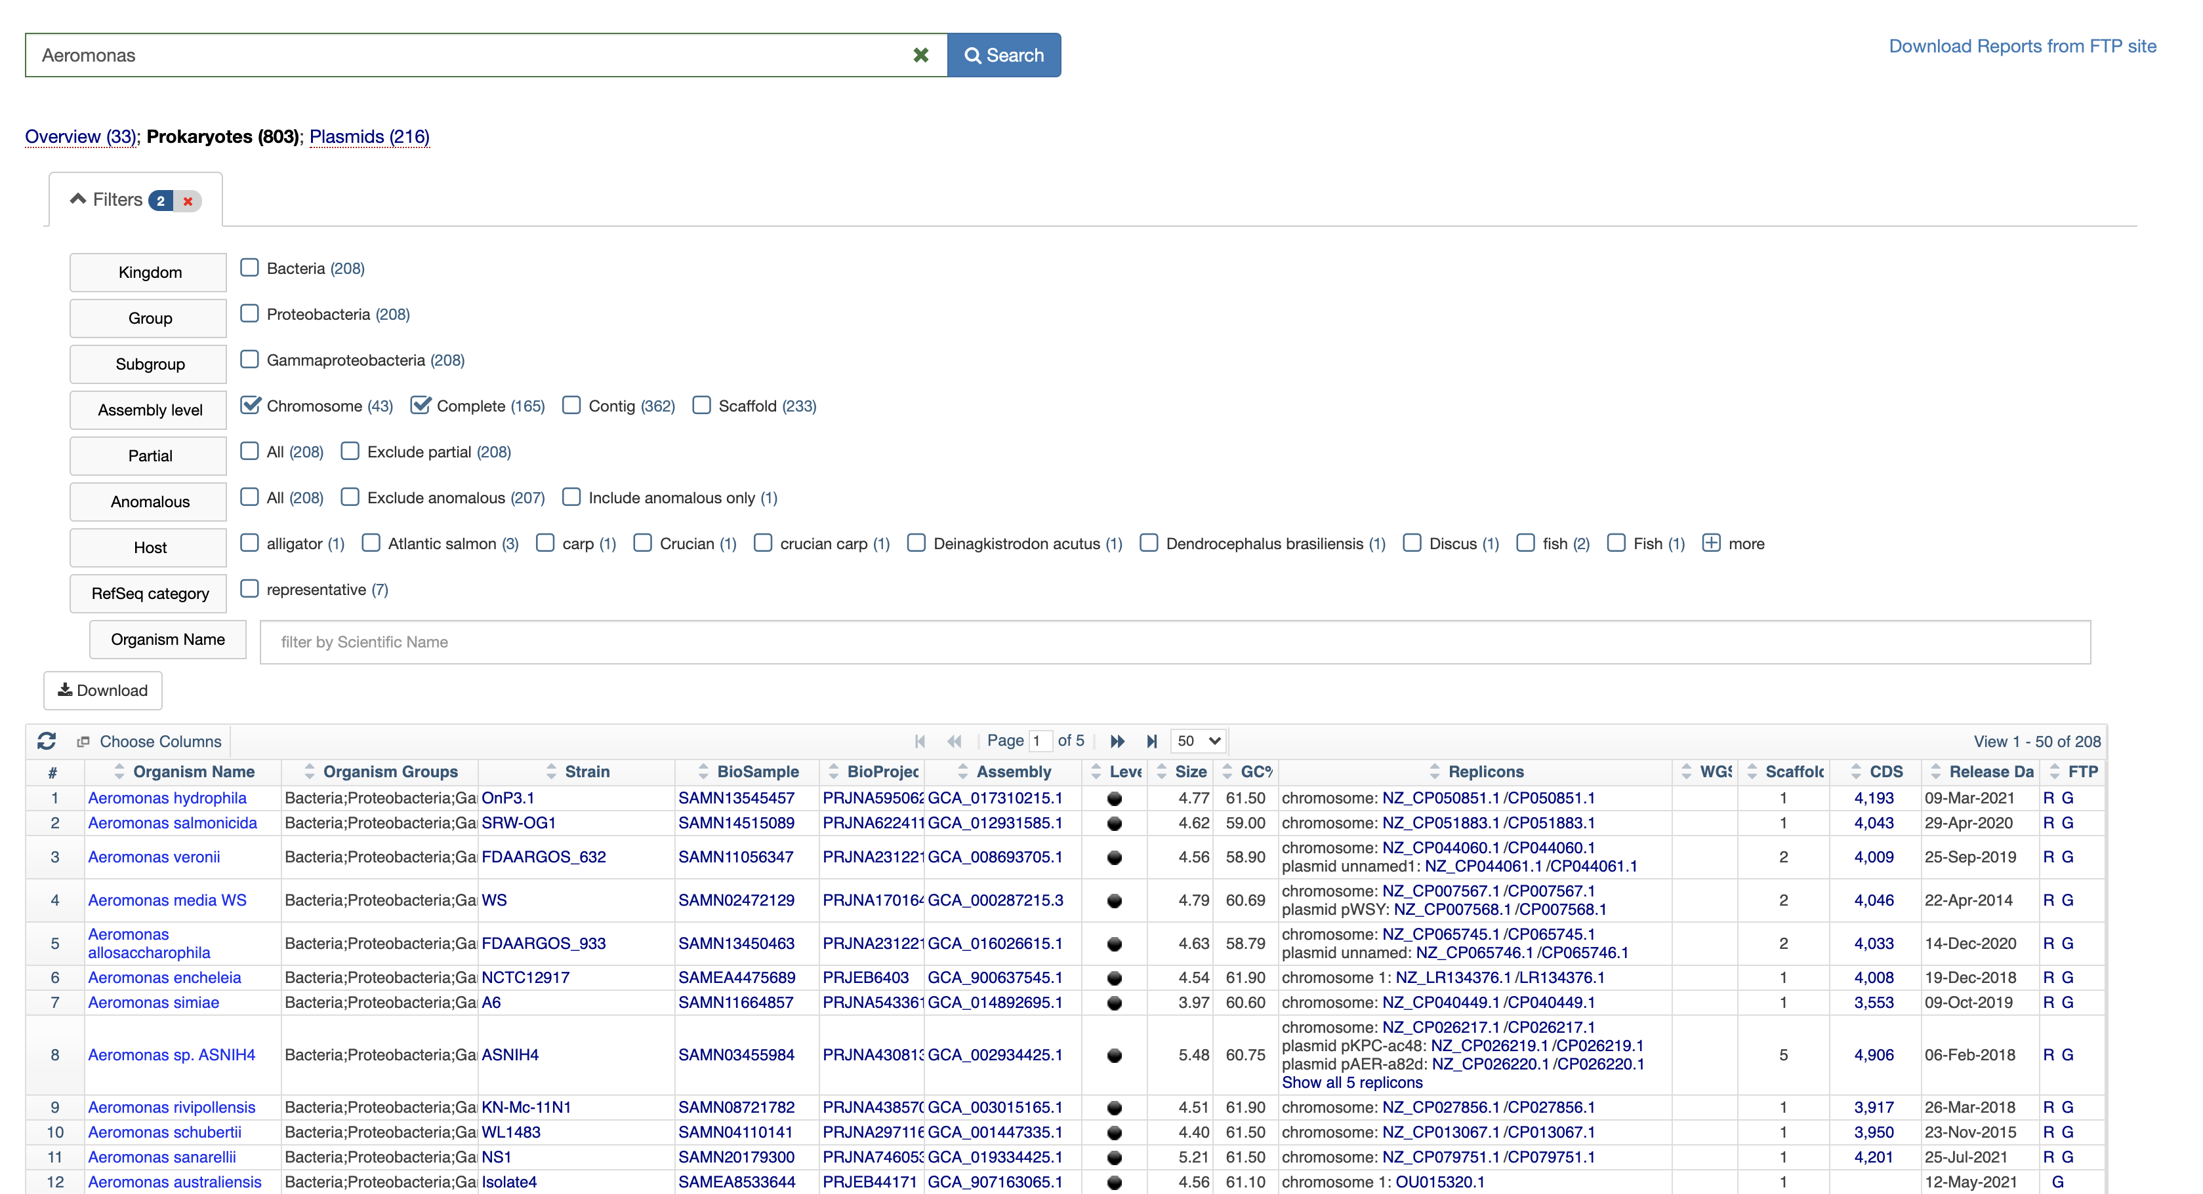
Many genomes are available at the NCBI https://www.ncbi.nlm.nih.gov/genome/browse#!/overview/

Slide 9
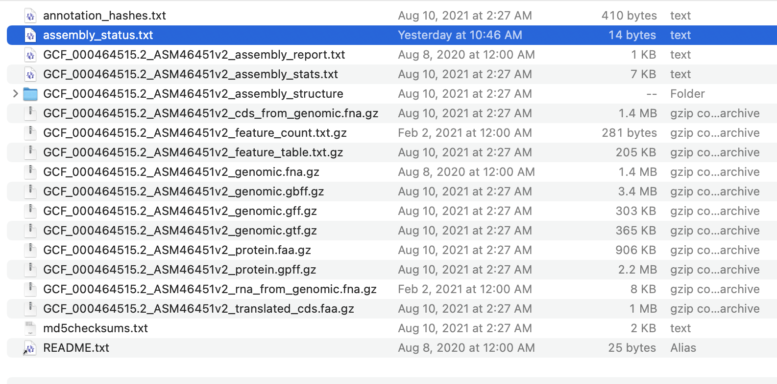
You can open the link in finder, or an FTP program (use guest)
All coding sequences
Genome feature table
The nucleotide sequence
All encoded proteins

Slide 10
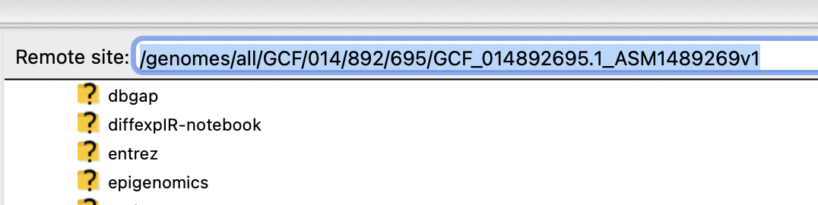
There are different ways to down load the files:
via the finder (under OS X)
Using Filezilla: Connect to ftp.ncbi.nlm.nih.gov login type anonymous. Then copy the R link (right click) from the microbial
browser and paste it into the address field – delete everything before genome:
C) ssh to Xanadu, go to a compute node, and the use the copy url command.
To get the address, copy the R link (right click) to the clipboard, paste it behind curl -O
E.g., curl -O ftp://ftp.ncbi.nlm.nih.gov/genomes/all/GCF/002/850/695/GCF_002850695.3_ASM285069v3/
Then complete the line with
GCF_002850695.3_ASM285069v3_protein.faa.gz (for all the encoded proteins in a multiple fasta file
GCF_002850695.3_ASM285069v3_genomic.fna.gz (for the nucleotide sequence of genome +plasmids
GCF_002850695.3_ASM285069v3_feature_table.txt.gz (for the feature table)
The commands to execute would be
curl -O ftp://ftp.ncbi.nlm.nih.gov/genomes/all/GCF/002/850/695/GCF_002850695.3_ASM285069v3/GCF_002850695.3_ASM285069v3_protein.faa.gz
curl -O ftp://ftp.ncbi.nlm.nih.gov/genomes/all/GCF/002/850/695/GCF_002850695.3_ASM285069v3/GCF_002850695.3_ASM285069v3_genomic.fna.gz
curl -O ftp://ftp.ncbi.nlm.nih.gov/genomes/all/GCF/002/850/695/GCF_002850695.3_ASM285069v3/GCF_002850695.3_ASM285069v3_feature_table.txt.gz
Once you have the files you need to uncompress them using
gunzip GCF_002850695.3_ASM285069v3_protein.faa.gz or using a wild card gunzip *.gz

Slide 11
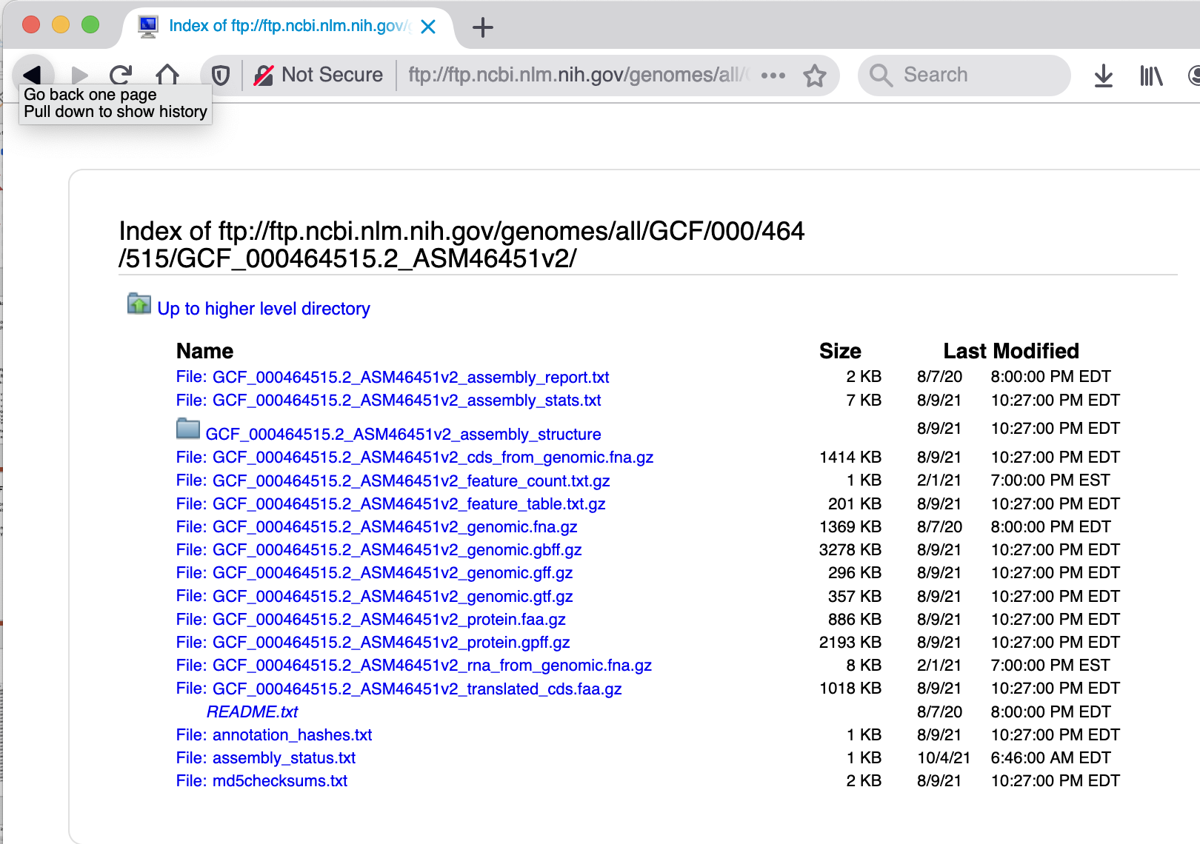
Comment on FTP and browsers:
If you use Firefox, Safari or Chrome, the ftp:// in the address directs you to open the link in finder (and I have not found a way to disable this “feature”). This is totally annoying, if you want to copy the url of a particular file to use curl to download it.
At present waterfox (a slimmed down version of firefox) is working fine.
If you click (left click) on the R-link, you get the following:
You can right click on a file, copy the link and
use it (via paste) in curl :
curl –O ftp://ftp.ncbi.nlm.nih.gov/genomes/all/GCF/000/464/515/GCF_000464515.2_ASM46451v2/GCF_000464515.2_ASM46451v2_genomic.fna.gz
(this is all on one line)

Slide 12
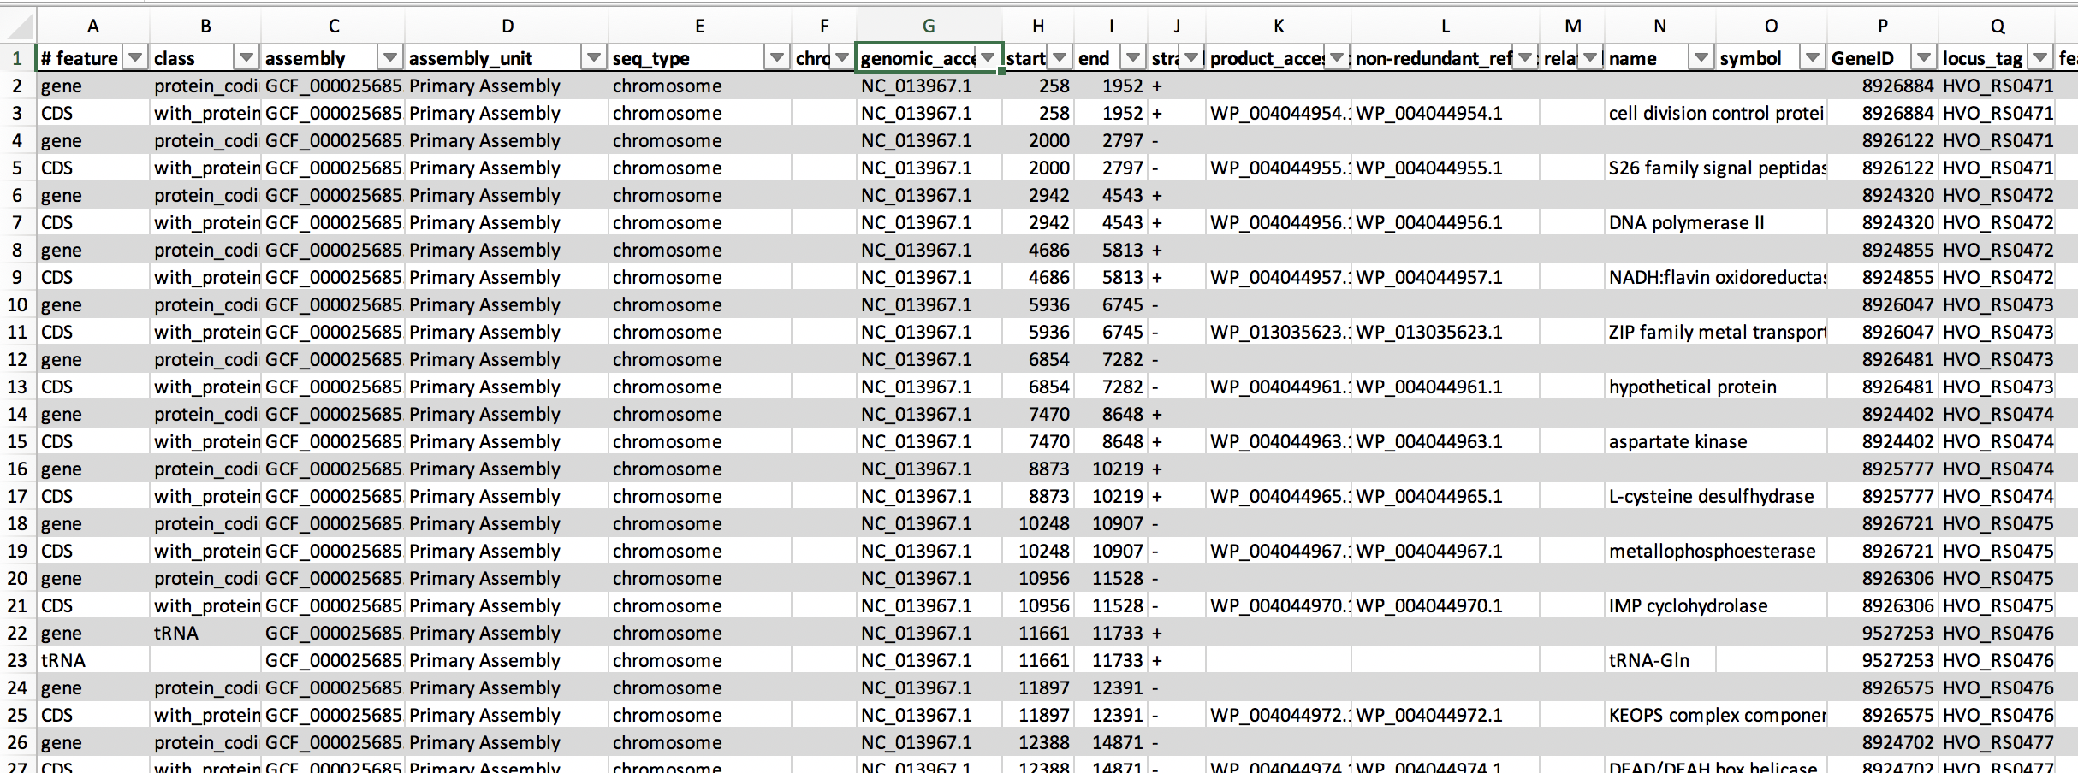
Feature table

Slide 13
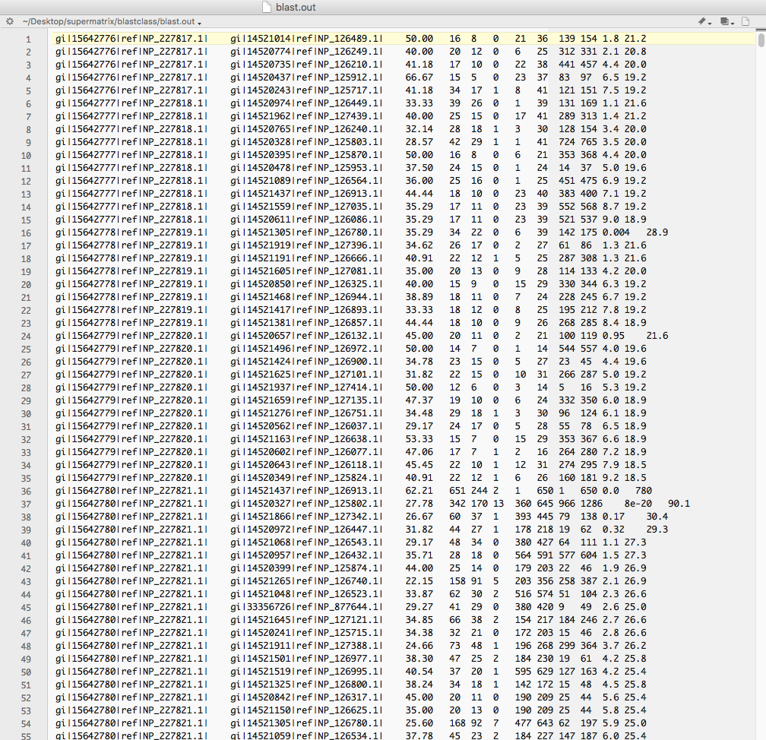
Blast output in tabular form looks like this

Slide 14
There are several different approaches to map a best scoring blast hits to a location in the genome.
One approach is to link databank tables.
A simple alternative is to reannotate the annotation lines so that they start with the location in the genome.

Slide 15
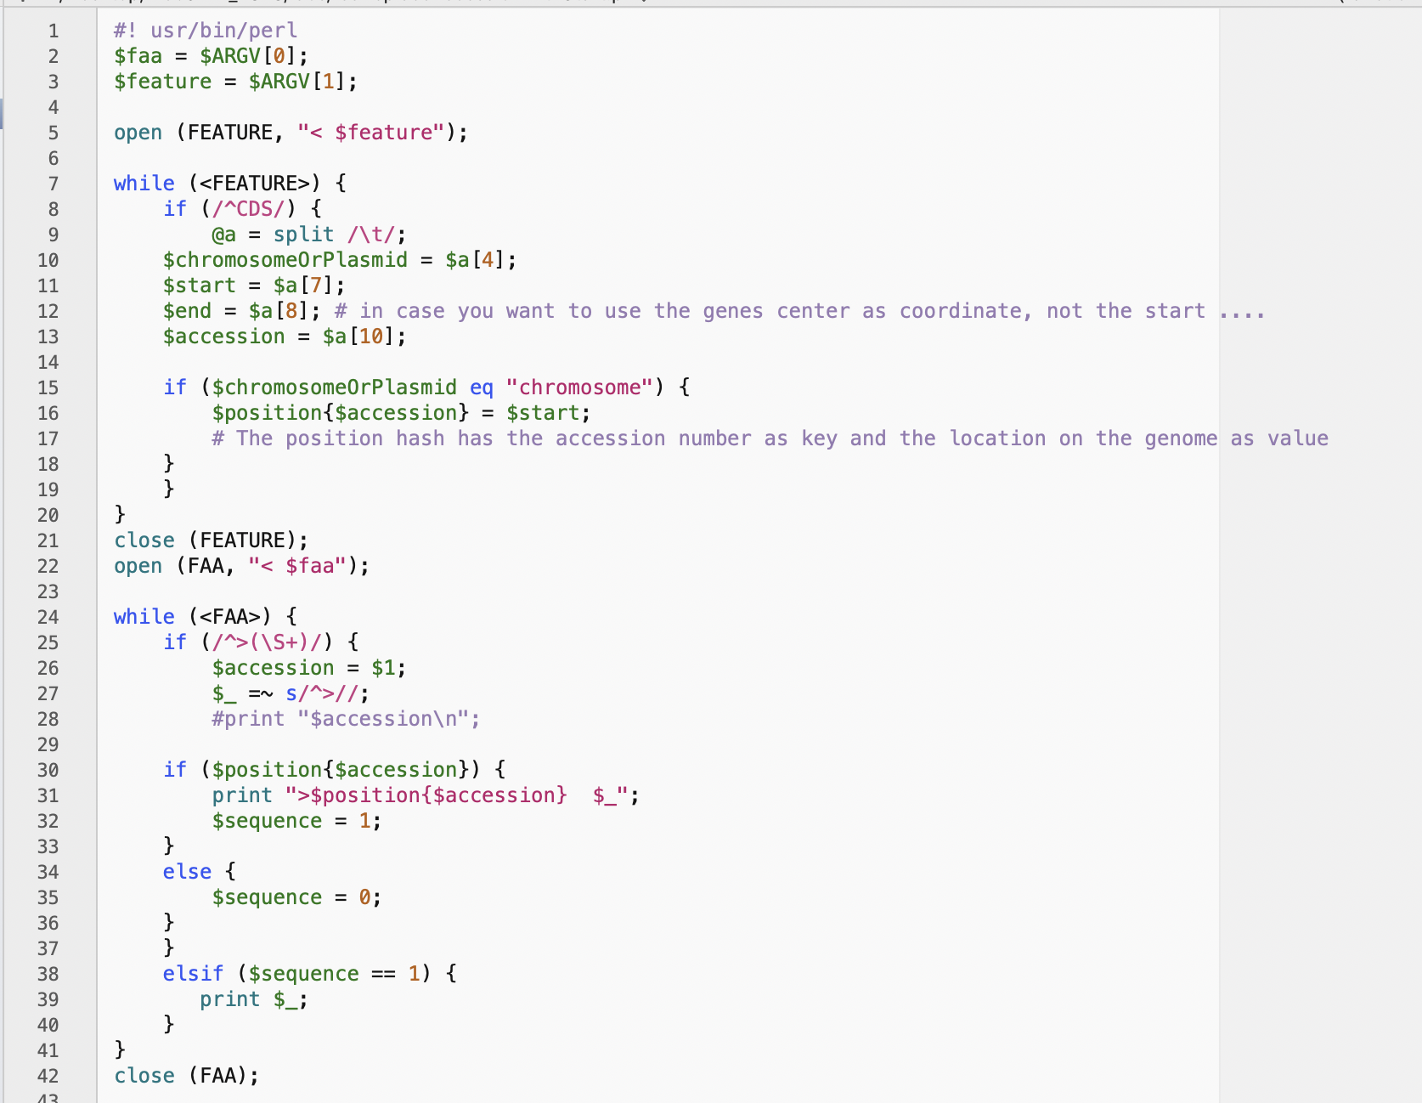
faaReplace AccessionWithStart.pl

Slide 16
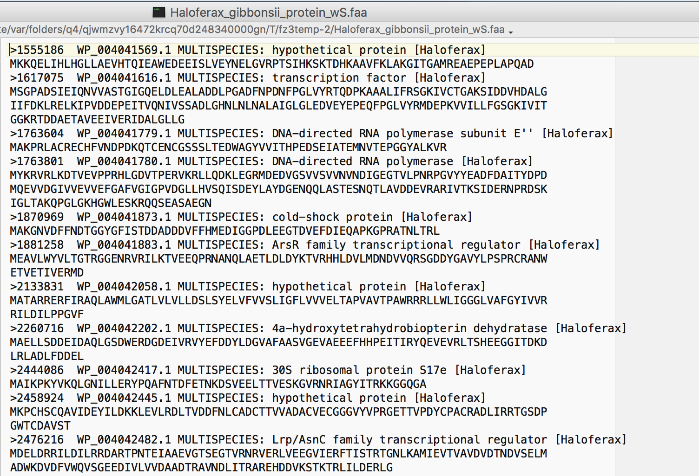
Genome fasta file with location in genome

Slide 17
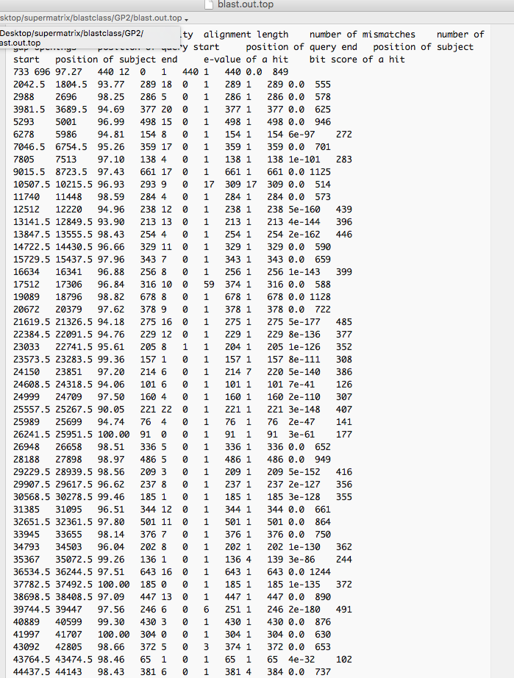
Top scoring hits only
GI replaced with number

Slide 18
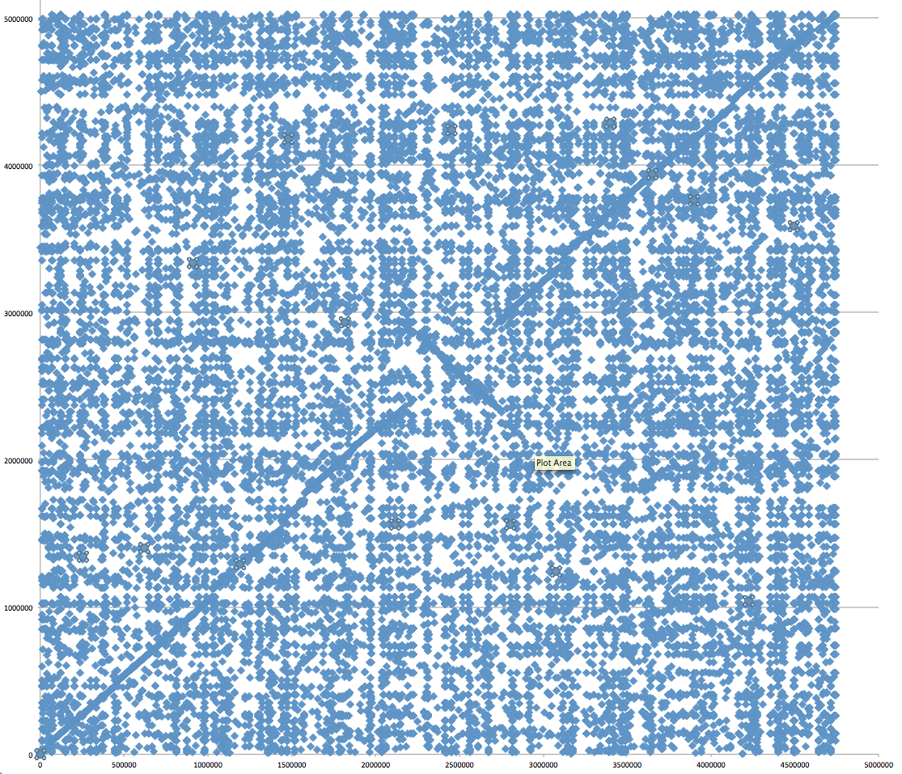
Aeromonas_hydrophila_ATCC_7966_uid58617 versus Aeromonas_hydrophila_ML09_119_uid205540/
Evalue cut off: 10^-4
To only plot the top scoring hits use extract_lines.pl -->

Slide 19
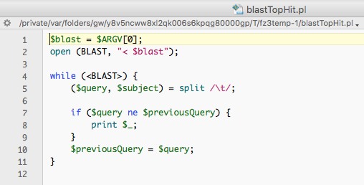

Slide 20
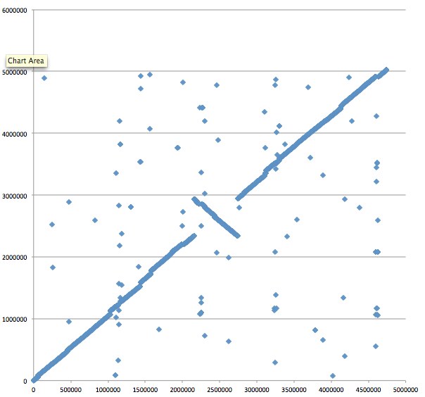
Aeromonas_hydrophila_ATCC_7966_uid58617 versus Aeromonas_hydrophila_ML09_119_uid205540/
E-value cut off: 10^-4
Top-scoring hits only

Slide 21
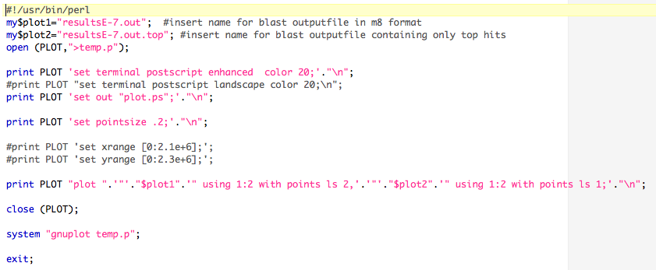
Plot blast.out and blast.out.top

Slide 22
Aeromonas_hydrophila_ATCC_7966_uid58617 versus Aeromonas_hydrophila_ML09_119_uid205540/
Same with Gnuplot

Slide 23
Aeromonas_hydrophila_ML09_119_uid205540 versus Aeromonas_salmonicida A449
Notes:
About 26 recombination events equidistant to the ORI

Slide 24
Aeromonas_veronii B565 versus Aeromonas_hydrophila_ML09_119_uid205540

Slide 25
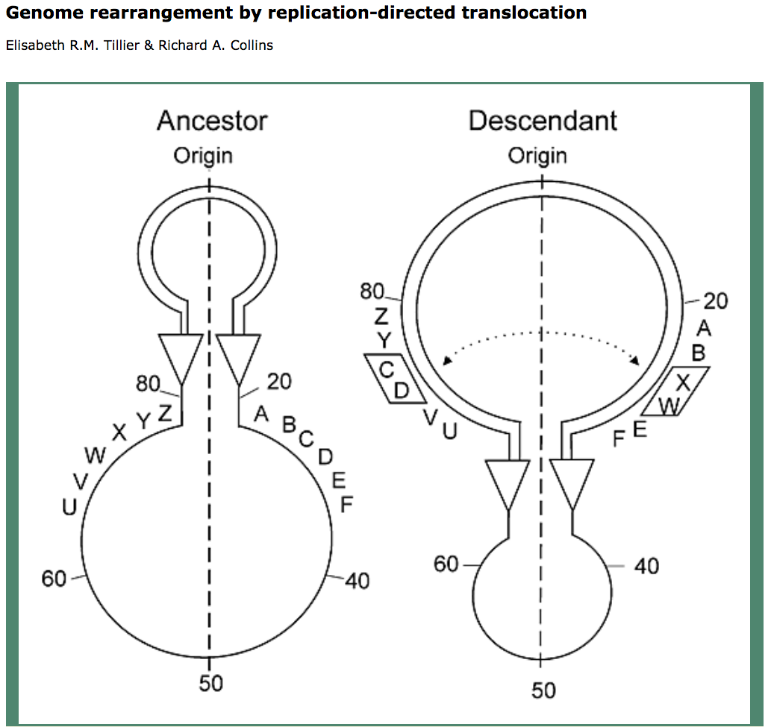
Two Reasons for Recombination Patterns in Microbial genomes:
A) Recombination events occur at the time of replication
Figure 2. Rearrangement of gene order by translocation of genes across the replication axis.
A hypothetical ancestral gene order is indicated (left). After passage of the replication forks (triangles), genes C and D have exchanged positions with W and X by translocation across the replication axis (vertical dashed line) in the descendant genome. For simplicity, the diagram shows a reciprocal translocation that might occur in a single round of replication through two reciprocal recombination events. The diagram does not specify a mechanism for the translocation of genes, which may also occur in several steps as a series of recombination events in separate rounds of replication through intermediate genome organizations. The two replication forks are proposed to be across the replication axis and physically close together, promoting translocation of sequences at the forks. Numbers indicate the percentage of distance from the origin.

Slide 26
GCBias in a window (G-C/(G+C))

Slide 27
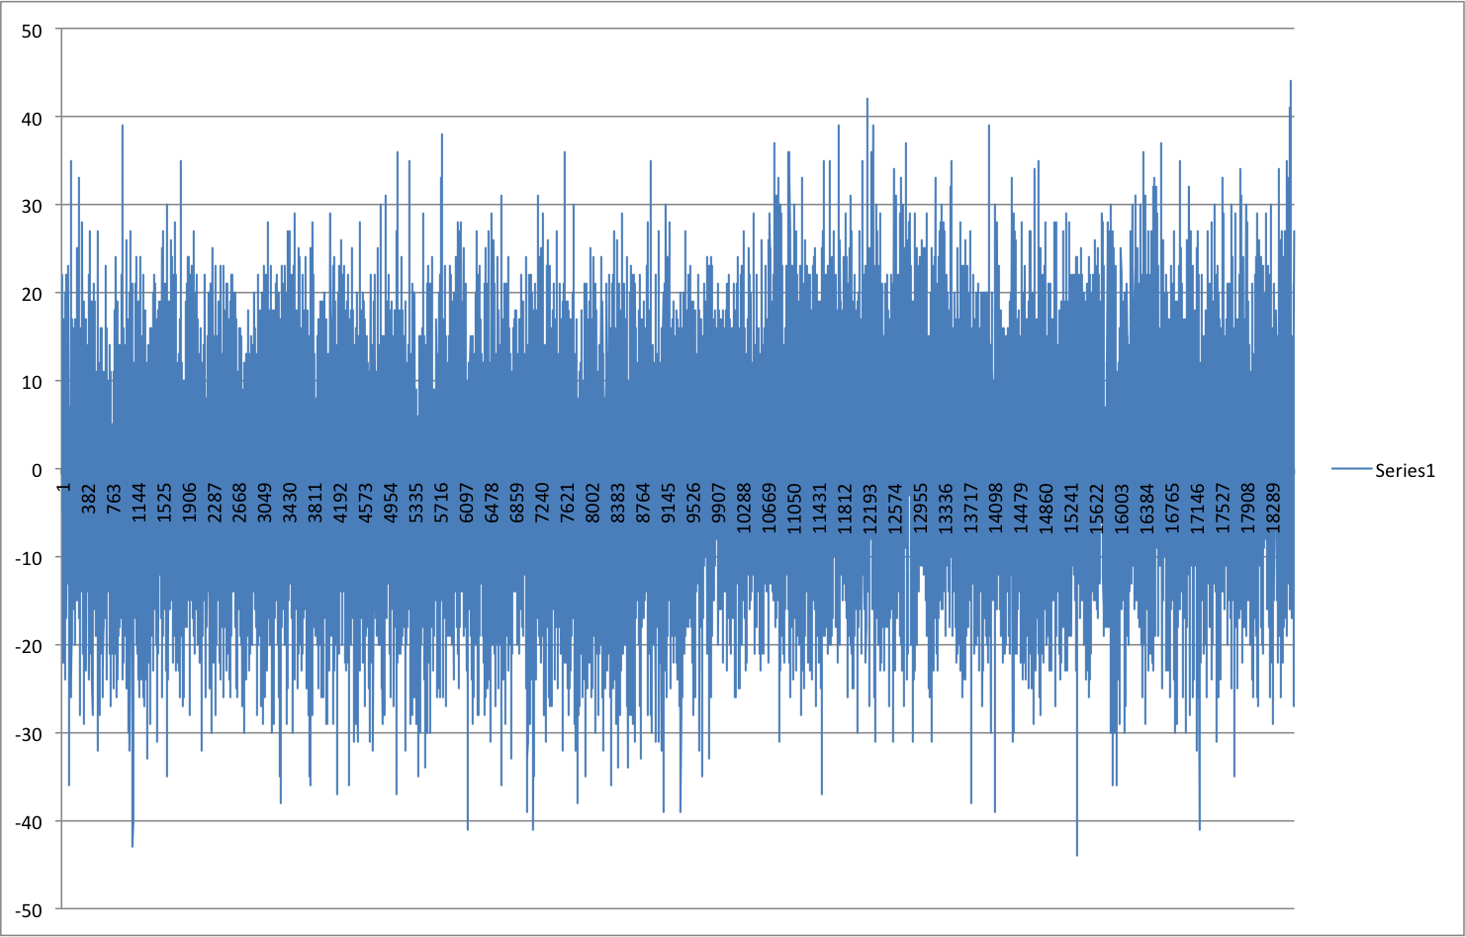
Window=100 , printed every 100

Slide 28
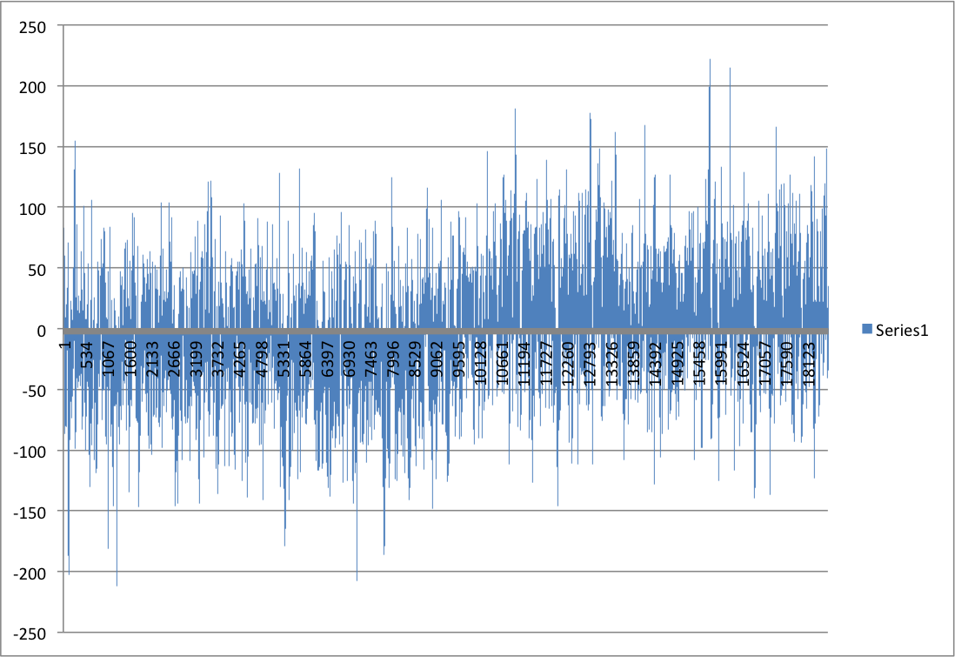
Window=1000 , printed every 100

Slide 29
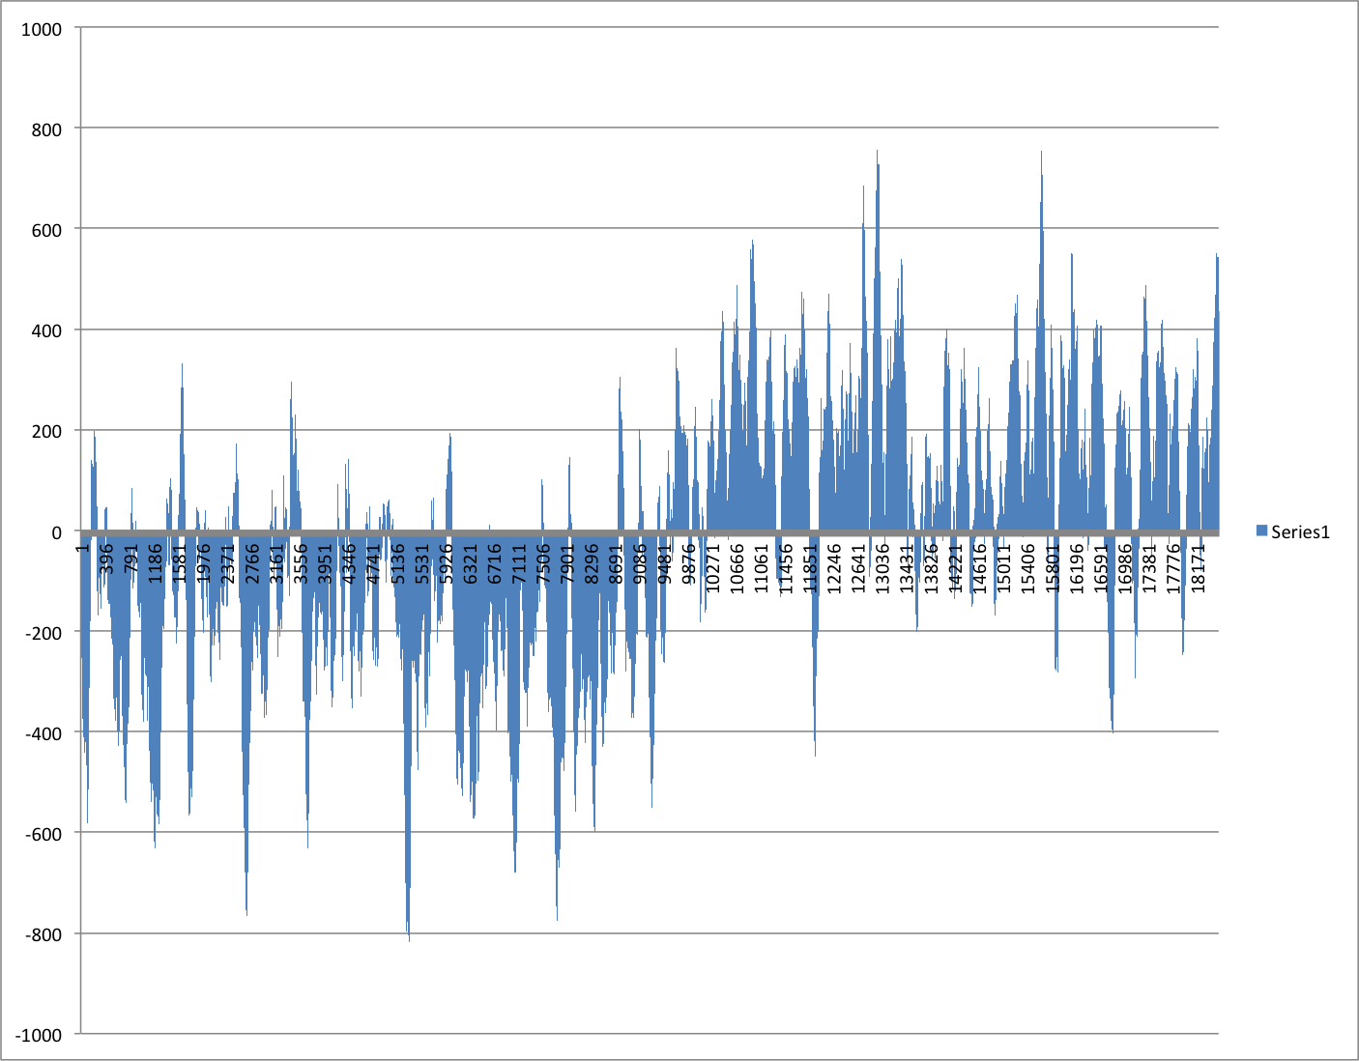
Window=10000 , printed every 100

Slide 30
Cumulative GCSkew
SUM(C-G) measured along the genome from the ORI

Slide 31
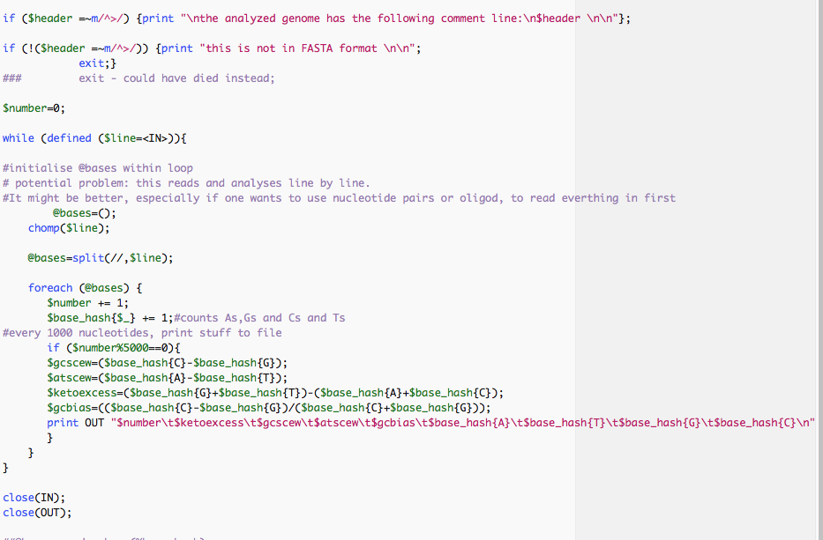
Part of script to calculate cumulative GC bias

Slide 32
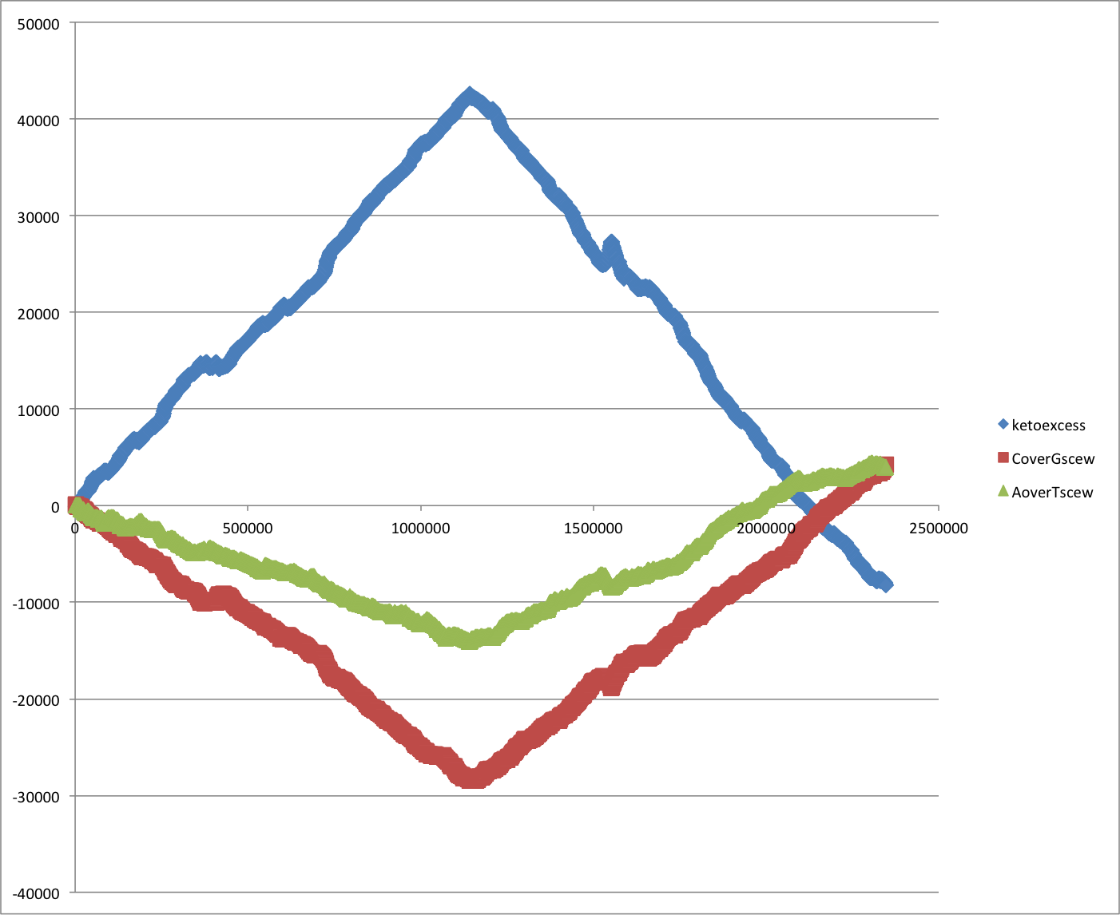
Cumulative Strand Bias SG0

Slide 33
Cumulative Tetramer bias for Thermus thermophilus SG0
The same can be done with oligonucleotide bias (how often does an oligonucleotide occur on one strand minus occurrence on the other strand)

Slide 34
Two Reasons for Recombination Patterns in Microbial genomes:
A) Recombination events occur at the time of replication
Figure 2. Rearrangement of gene order by translocation of genes across the replication axis.
A hypothetical ancestral gene order is indicated (left). After passage of the replication forks (triangles), genes C and D have exchanged positions with W and X by translocation across the replication axis (vertical dashed line) in the descendant genome. For simplicity, the diagram shows a reciprocal translocation that might occur in a single round of replication through two reciprocal recombination events. The diagram does not specify a mechanism for the translocation of genes, which may also occur in several steps as a series of recombination events in separate rounds of replication through intermediate genome organizations. The two replication forks are proposed to be across the replication axis and physically close together, promoting translocation of sequences at the forks. Numbers indicate the percentage of distance from the origin.

Slide 35
Two Reasons for Recombination Patterns in Microbial genomes:
B) Recombination events that do not occur in a symmetric fashion between the two arms result in misplaced Genome Architecture IMparting Sequences (AIMS)
dnaA boxes
one way signals for the replication fork, ter sites , tus binding

Slide 36
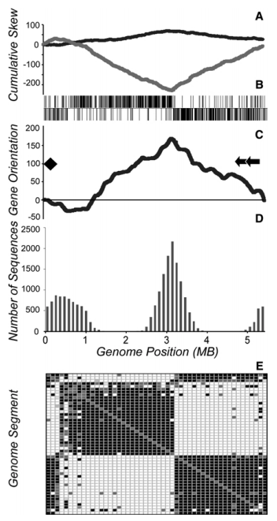
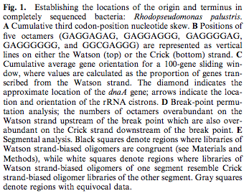
Selection for Chromosome Architecture in Bacteria

Slide 37
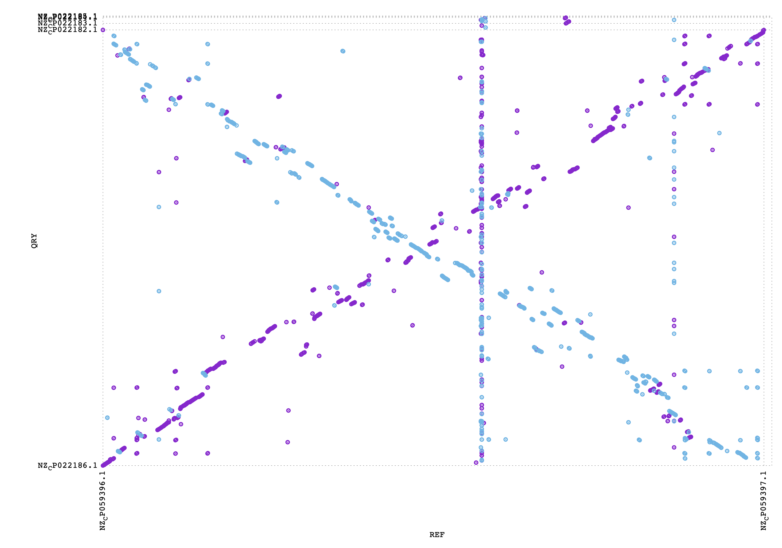
Food for thought- What might have happened here?
Aeromonas salmonicida S68
Aeromonas veronii HM21

Slide 38
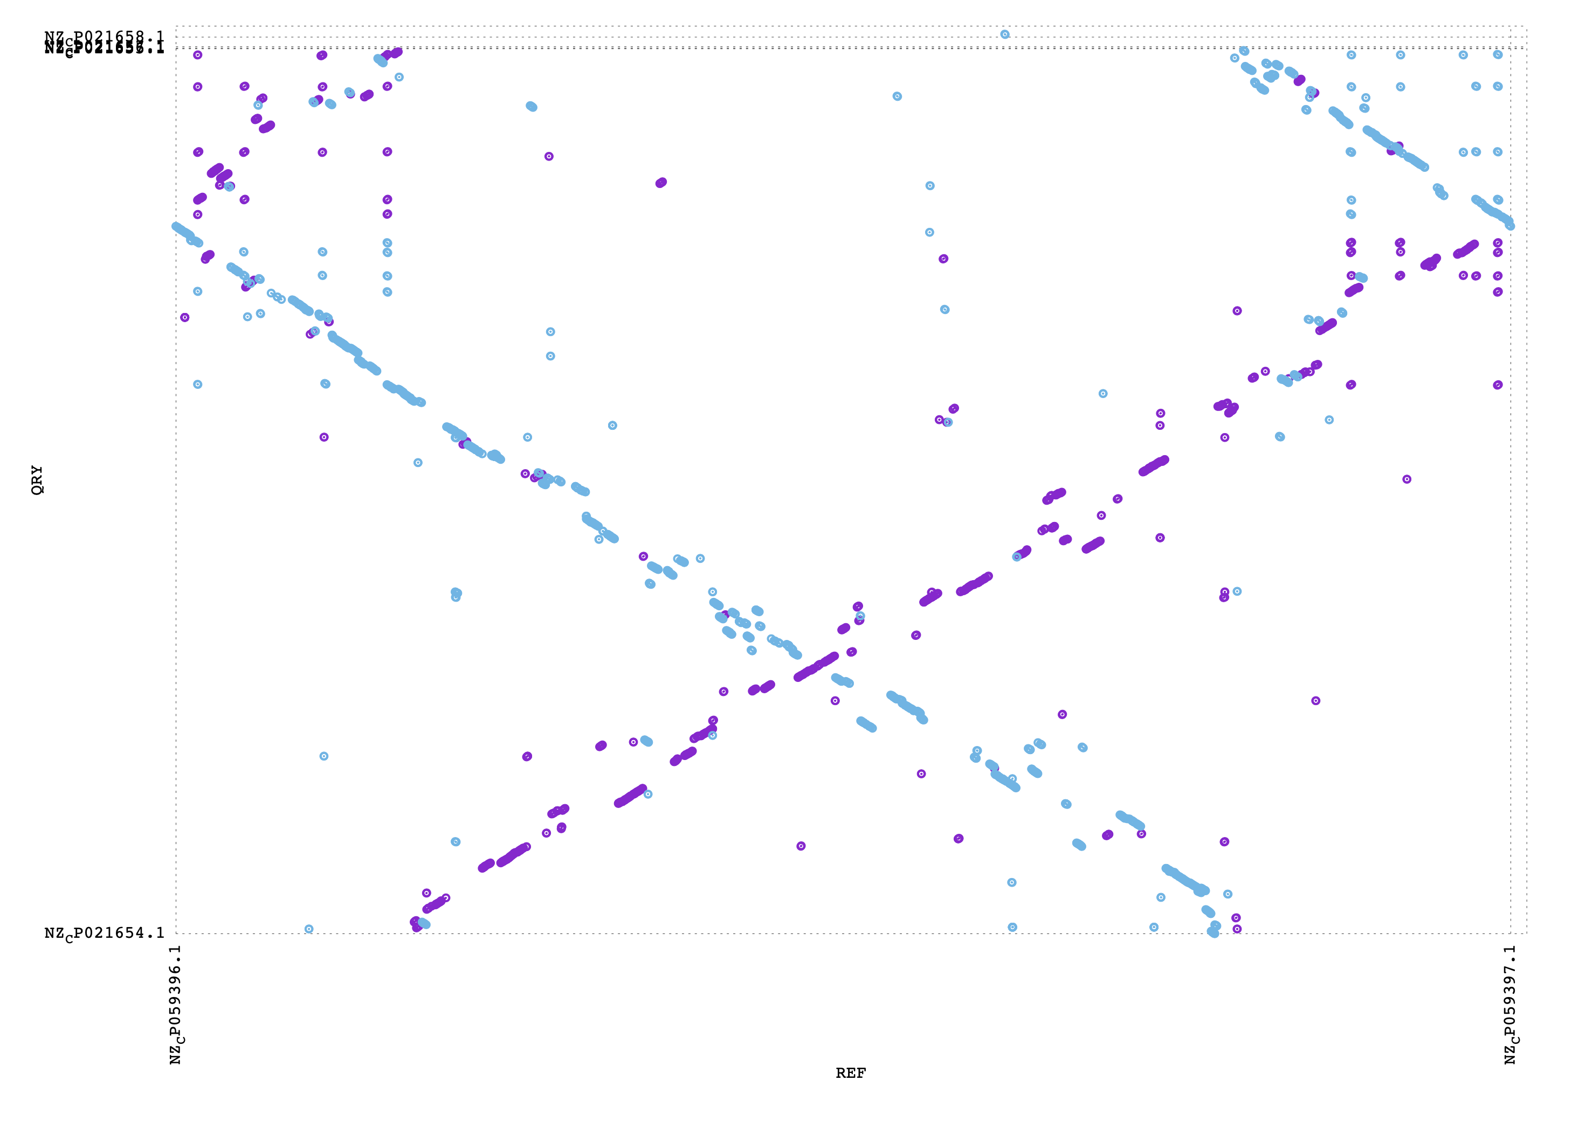
Food for thought- What might have happened here?
Aeromonas salmonicida O23A
Aeromonas veronii HM21

