Slide 1
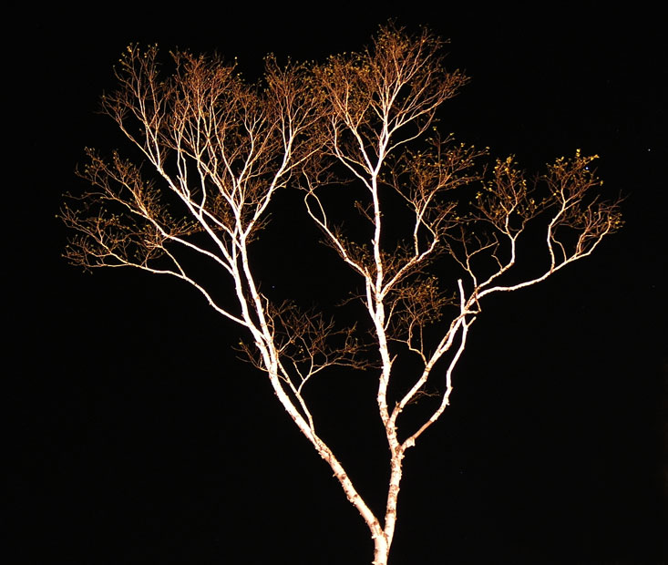
Cladistics A Natural Taxonomy
Eukaryotes
Bacteria
Archaea
MCB 3421 class 12
Cenancestor (aka LUCA or MRCA)

Slide 2
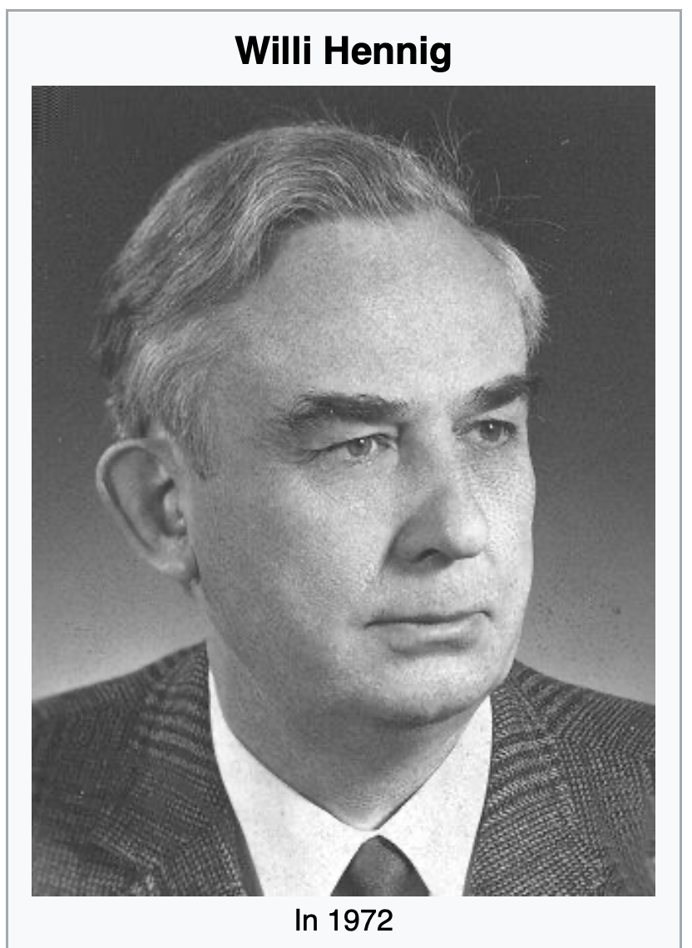
Willi Hennig was the founder of a systematic system based on shared ancestry (aka cladistics).
His area of expertise were insect.
Wings, halteres, hardened fore-wings, the ability to fold wing back, no wings, mouth parts, development includes a pupae ... are excellent characters to classify organisms.
From Wikipedia: https://en.wikipedia.org/wiki/Willi_Hennig

Slide 3
C C C c c
B B b b b
A a a a a
I
II
III
IV
V
D -> d
C -> c
B -> b
A -> a

Slide 4
C C C c c
B B b b b
A a a a a
I
II
III
IV
V
D -> d
Shared derived characters (aka synapomorphies) define monophyletic groups
C -> c
B -> b
A -> a

Slide 5
D D D D d
C C C c c
B B b b b
I
II
III
IV
V
D -> d
Shared primitive characters (aka symplesiomorphies) define paraphyletic groups
C -> c
B -> b
A -> a

Slide 6
D D D D d
C C C c c
B B b b b
A a a a a
I
II
III
IV
V
D -> d
Derived characters that are not shared (as the autapomorphy d) do not provide phylogenetic information.
C -> c
(question: If one would know that A is primitive, would this provide useful phylogenetic information?
B -> b
A -> a

Slide 7
Terminology (1)
According to Hennig:
Shared derived characters define monophyletic groups
Shared primitive characters define paraphyletic groups – they have a common ancestor, but the ancestor is also ancestor to organisms that have the derived character
homoplasies – characters that evolved independently define polyphyletic groups – one could argue that if all of life goes back to a common ancestor, all groups are paraphyletic; however, the point here is to like character to the type of group it defines.

Slide 8
Terminology (2)
Branches, splits, bipartitions
Leaves, or OTUs (operational taxonomic units)
In a rooted tree: clades (else clans)
Mono-, Para-, polyphyletic groups, cladists and a natural taxonomy
The term cladogram refers to a strictly bifurcating diagram, where each clade is defined by a common ancestor that only gives rise to members of this clade. I.e., a clade is monophyletic (derived from one ancestor) as opposed to a polyphyletic group (derived from many ancestors). (Note: you need to know where the root is! If one does not know the root, but one wants to denote a group that groups together, one can use the term clan)
A clade is recognized and defined by shared derived characters (= synapomorphies). Shared primitive characters (= sympleisiomorphies , alternativie spelling is symplesiomorphies) do not define a clade. (See in example drawing ala Hennig).
To use these terms you need to have polarized characters; for most molecular characters you don't know which state is primitive and which is derived (exceptions:....).

Slide 9
What is in a tree?
Trees form molecular data are usually calculated as unrooted trees (at least they should be - if they are not this is usually a mistake).
To root a tree you either can assume a molecular clock (substitutions occur at a constant rate, again this assumption is usually not warranted and needs to be tested),
or you can use an outgroup (i.e. something that you know forms the deepest branch), or you need to be able to decide, which state of a character is primitive – this might work for wings, but usually not for A, G, T, and Cs. For example, to root a phylogeny of birds, you could use the homologous characters from a reptile as outgroup; to find the root in a tree depicting the relations between different human mitochondria, you could use the mitochondria from chimpanzees or from Neanderthals as an outgroup; to root a phylogeny of alpha hemoglobins you could use a beta hemoglobin sequence, or a myoglobin sequence as outgroup. What could be the outgroup for the Tree-of-Life?
Trees have a branching pattern (also called the topology), and branch lengths.
Often the branch lengths are ignored in depicting trees (these trees often are referred to as cladograms - note that cladograms should be considered rooted).
You can swap branches attached to a node, and in an unrooted you can depict the tree as rooted in any branch you like without changing the tree.

Slide 10
More Terminology (3)
Related terms: autapomorphy = a derived character that is only present in one group; an autapomorphic character does not tell us anything about the relationship of the group that has this character ot other groups.
homoplasy = a derived character that was derived twice independently (convergent evolution). Note that the characters in question might still be homologous (e.g. a position in a sequence alignment, frontlimbs turned into wings in birds and bats).
paraphyletic = a taxonomic group that is defined by a common ancestor, however, the common ancestor of this group also has decendants that do not belong to this taxonomic group. Many systematists despise paraphyletic groups (and consider them to be polyphyletic). Examples for paraphyletic groups are reptiles and protists. Many consider the archaea to be paraphyletic as well.
holophyletic = same as above, but the common ancestor gave rise only to members of the group.

Slide 11
Complications and Controversies
According to Hennig:
Shared derived characters define monophyletic groups
Shared primitive characters define paraphyletic groups
homoplasies – characters that evolved independently define polyphyletic groups
According to Ernst Ashlock (and Ernst Mayr and others)
Both, shared derived characters and shared primitive characters define monophyletic groups – they go back to a common ancestor, and they deserve a name (e.g., prokaryotes, reptiles)
Shared derived characters define holophyletic groups
Homoplasies - define polyphyletic groups

Slide 12
Which characters define which groups:
Shared primitive Characters
Shared Derived Characters
Homoplasies
According to Hennig
Polyphyletic
Paraphyletic
Monophyletic
According to Ashlock
Polyphyletic
Holophyletic
Monophyletic

Slide 13
Why Fish don’t exist
According to Willi Hennig (a view accepted by most taxonomist that do not need to teach undergraduate students)
reptiles,
fish,
protists,
algae,
green algae,
prokaryotes,
and many others
are not proper taxonomic groups, because the ancestor of these groups was also ancestor to organisms that are not part of this group.

Slide 14
Why Fish don’t exist
Link to an npr interview
David Starr Jordan on Wikipedia Taxonomist, eugenicist,
first president of Stanford,
and possible murdered of Jane Stanford
You tube video of virtual event with Lulu Miller
Link to book

Slide 15
Trees in Newick or parenthesis format
Trees rooted on a node (basal trifurcation) are usually considered as unrooted
Trees rooted on a branch are usually considered as rooted
((A, B), (C, D), E)
(((A, B), (C, D)), E)
Arbitrarily rooted in a node –
While displayed as rooted in a node, the tree should be considered as unrooted
Strictly bifurcating – The root is located on the branch leading to E
More links here and here and here

