Slide 1
Class 12
Photosynthesis in the Tree/Net of Life
Notes on computer lab
Gene and genome duplications

Slide 2
Take-home exam #4 will be posted today.
It will be due on Friday morning 1.10 am .

Slide 3
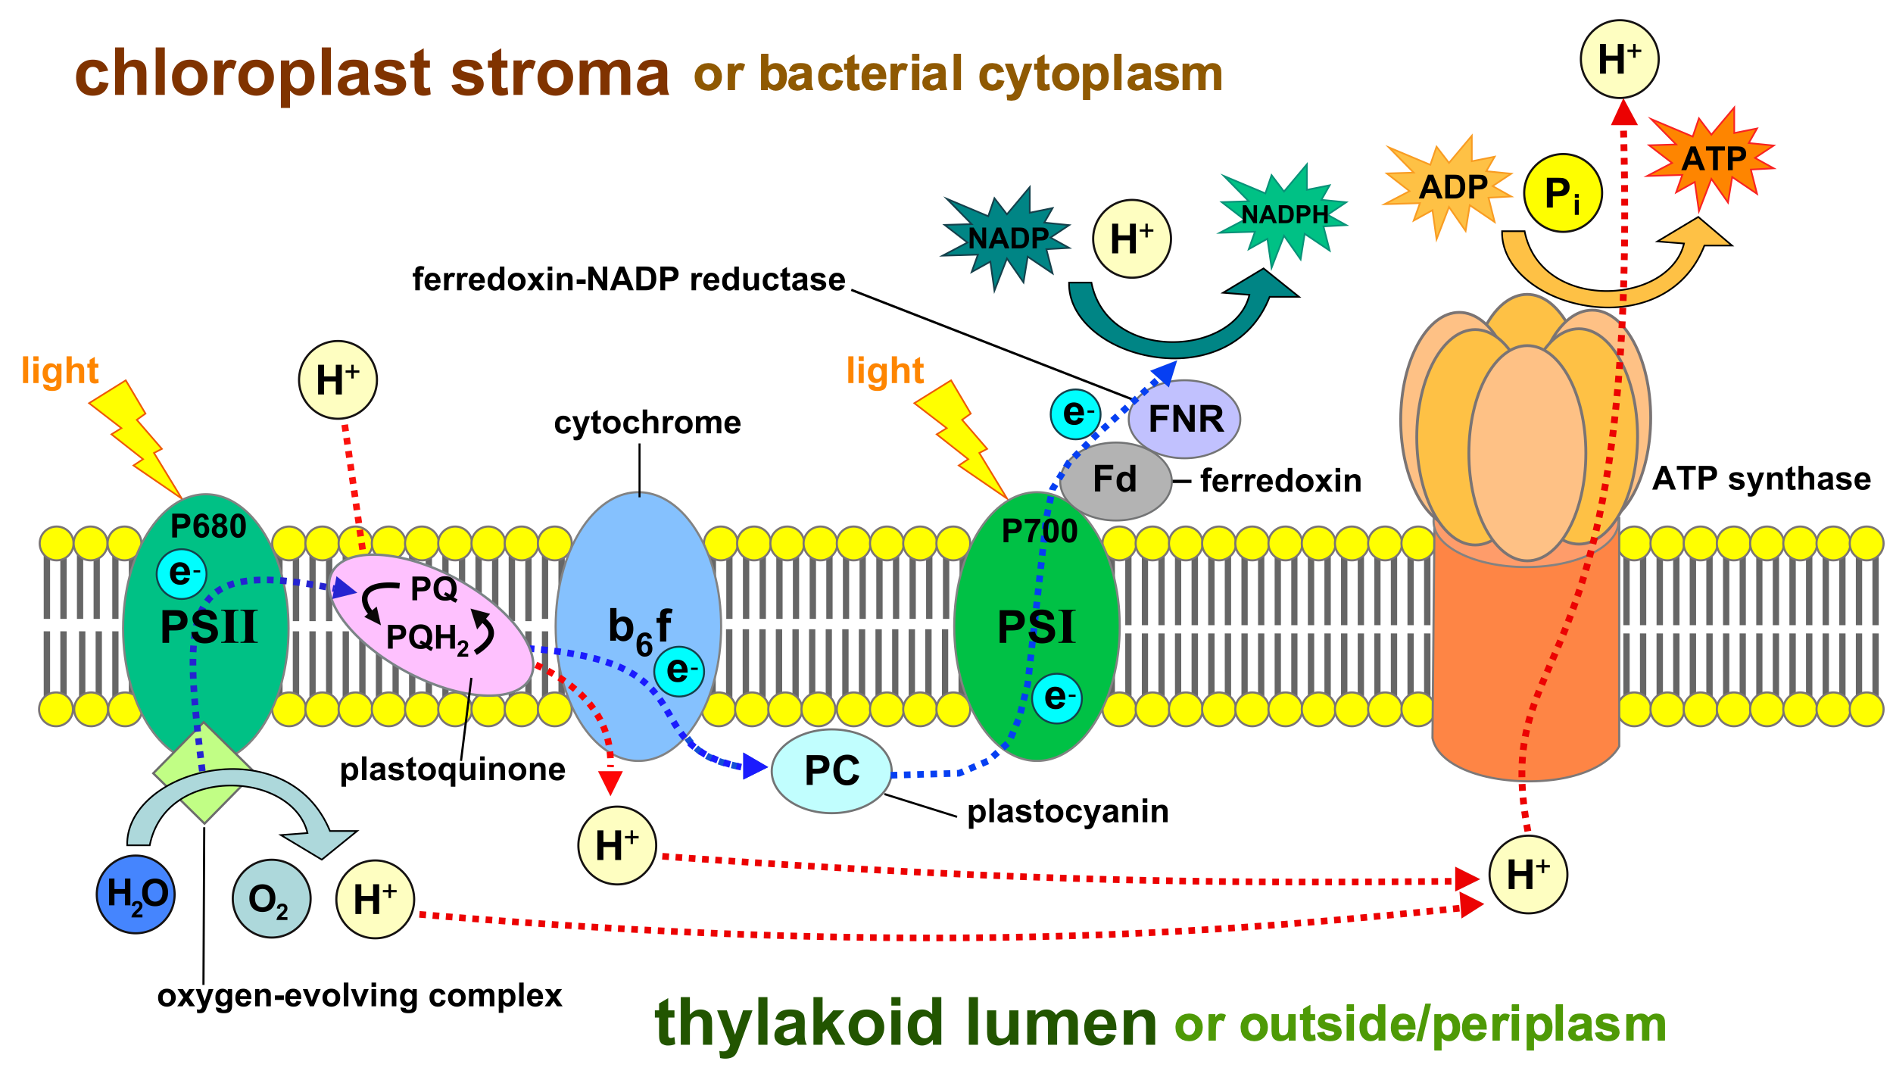

Slide 4
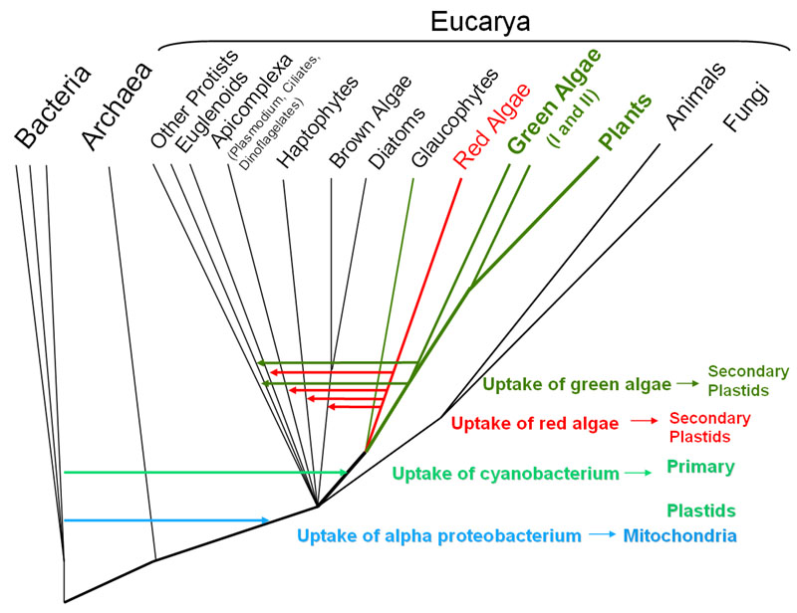
From: http://6e.plantphys.net/topic01.02.html

Slide 5
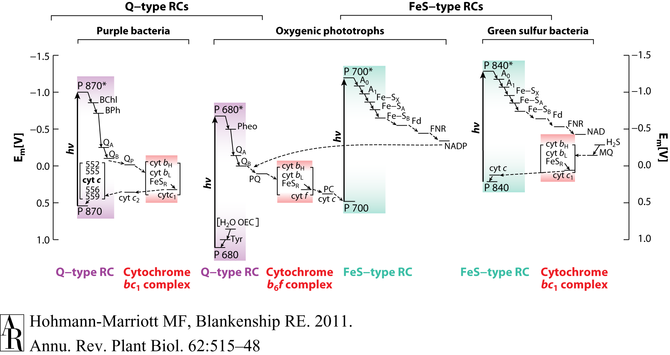
HGT as a force creating new pathways – Example 1
Oxygen producing photosynthesis

Slide 6
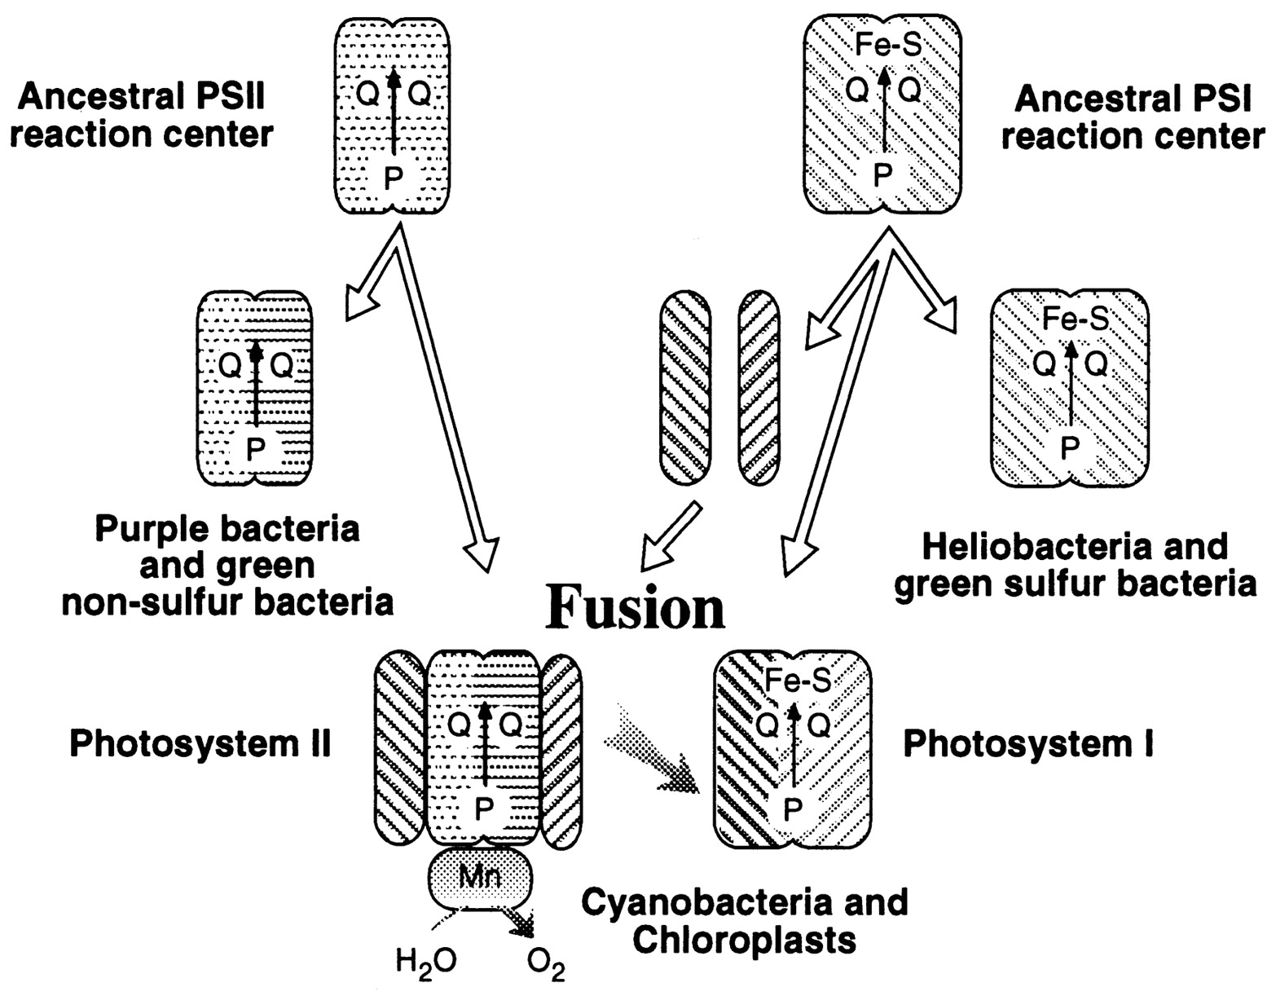
A heterologous fusion model for the evolution of oxygenic photosynthesis based on phylogenetic analysis.
Xiong J et al. PNAS 1998;95:14851-14856
©1998 by National Academy of Sciences
Notes:
A heterologous fusion model for the evolution of oxygenic photosynthesis based on phylogenetic analysis. Details of the model are provided in the text.

Slide 7
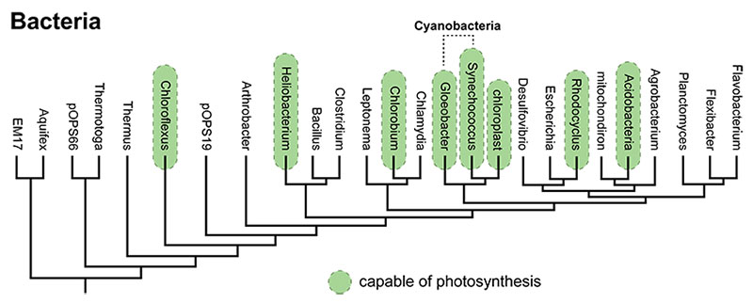
All photosynthetic pathways, including those of the Cyanobacteria, are quite similar. This suggests that they all evolved from a common ancestral pathway — in other words, that they are homologous. However, all the different bacteria that photosynthesize are rather distantly related to one another. The genes coding for photosynthetic pathways seem homologous, but the lineages bearing them are not closely related enough for a common ancestor to have passed the pathways on to all of them. What's the explanation for this apparent paradox? Horizontal transfer.
From: https://evolution.berkeley.edu/evolibrary/news/170503_cyanobacteria

Slide 8
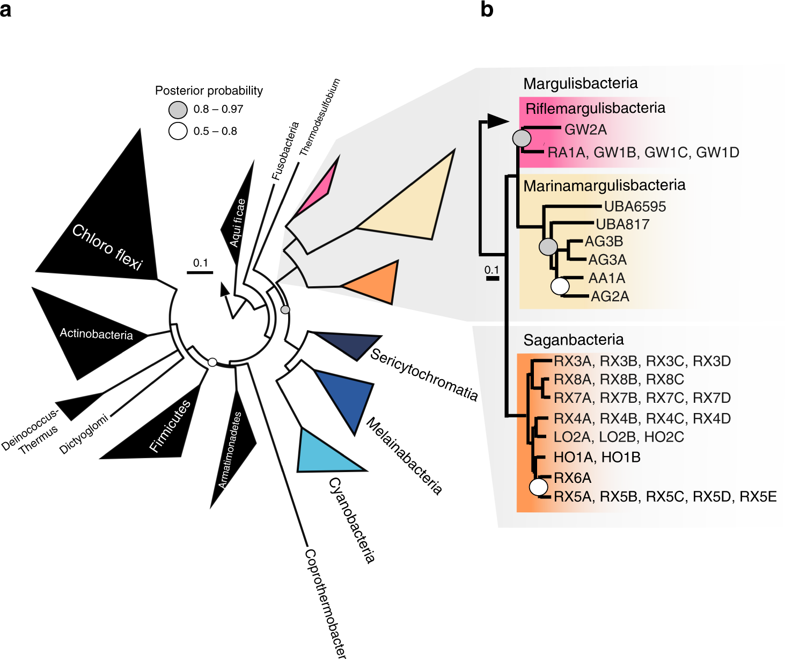
The ancestor of all these groups may have been an anaerobe in which fermentation and H₂metabolism were central metabolic features. The ability to use O₂ as a terminal electron acceptor must have been subsequently acquired by these lineages.
From: https://www.nature.com/articles/s41467-018-08246-y

Slide 9
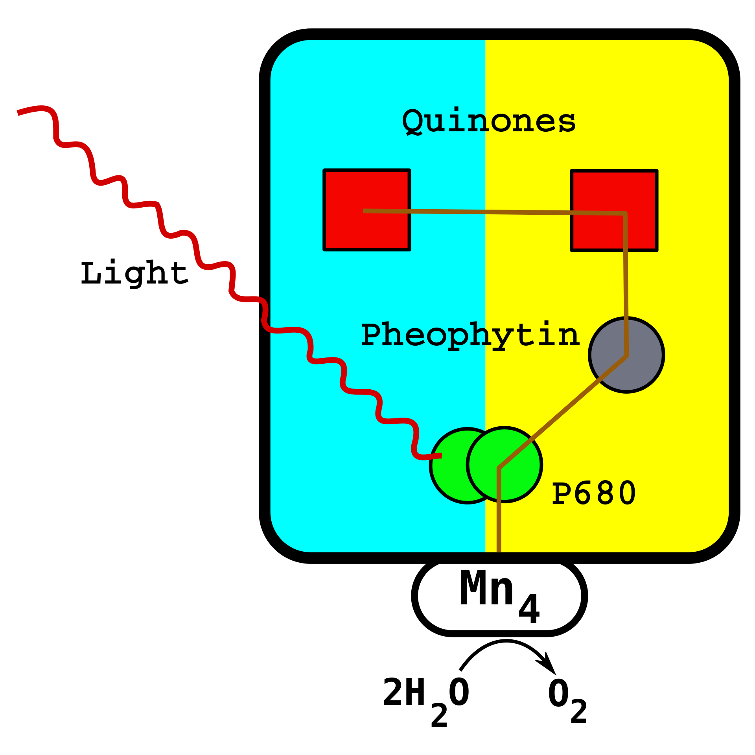
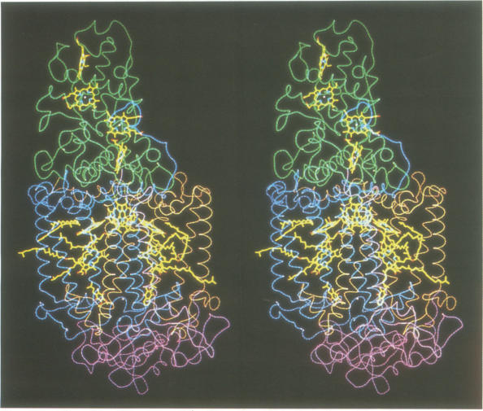
From Wikipedia (left) and J Deisenhofer and H Michel’s Nobel lecture

Slide 10
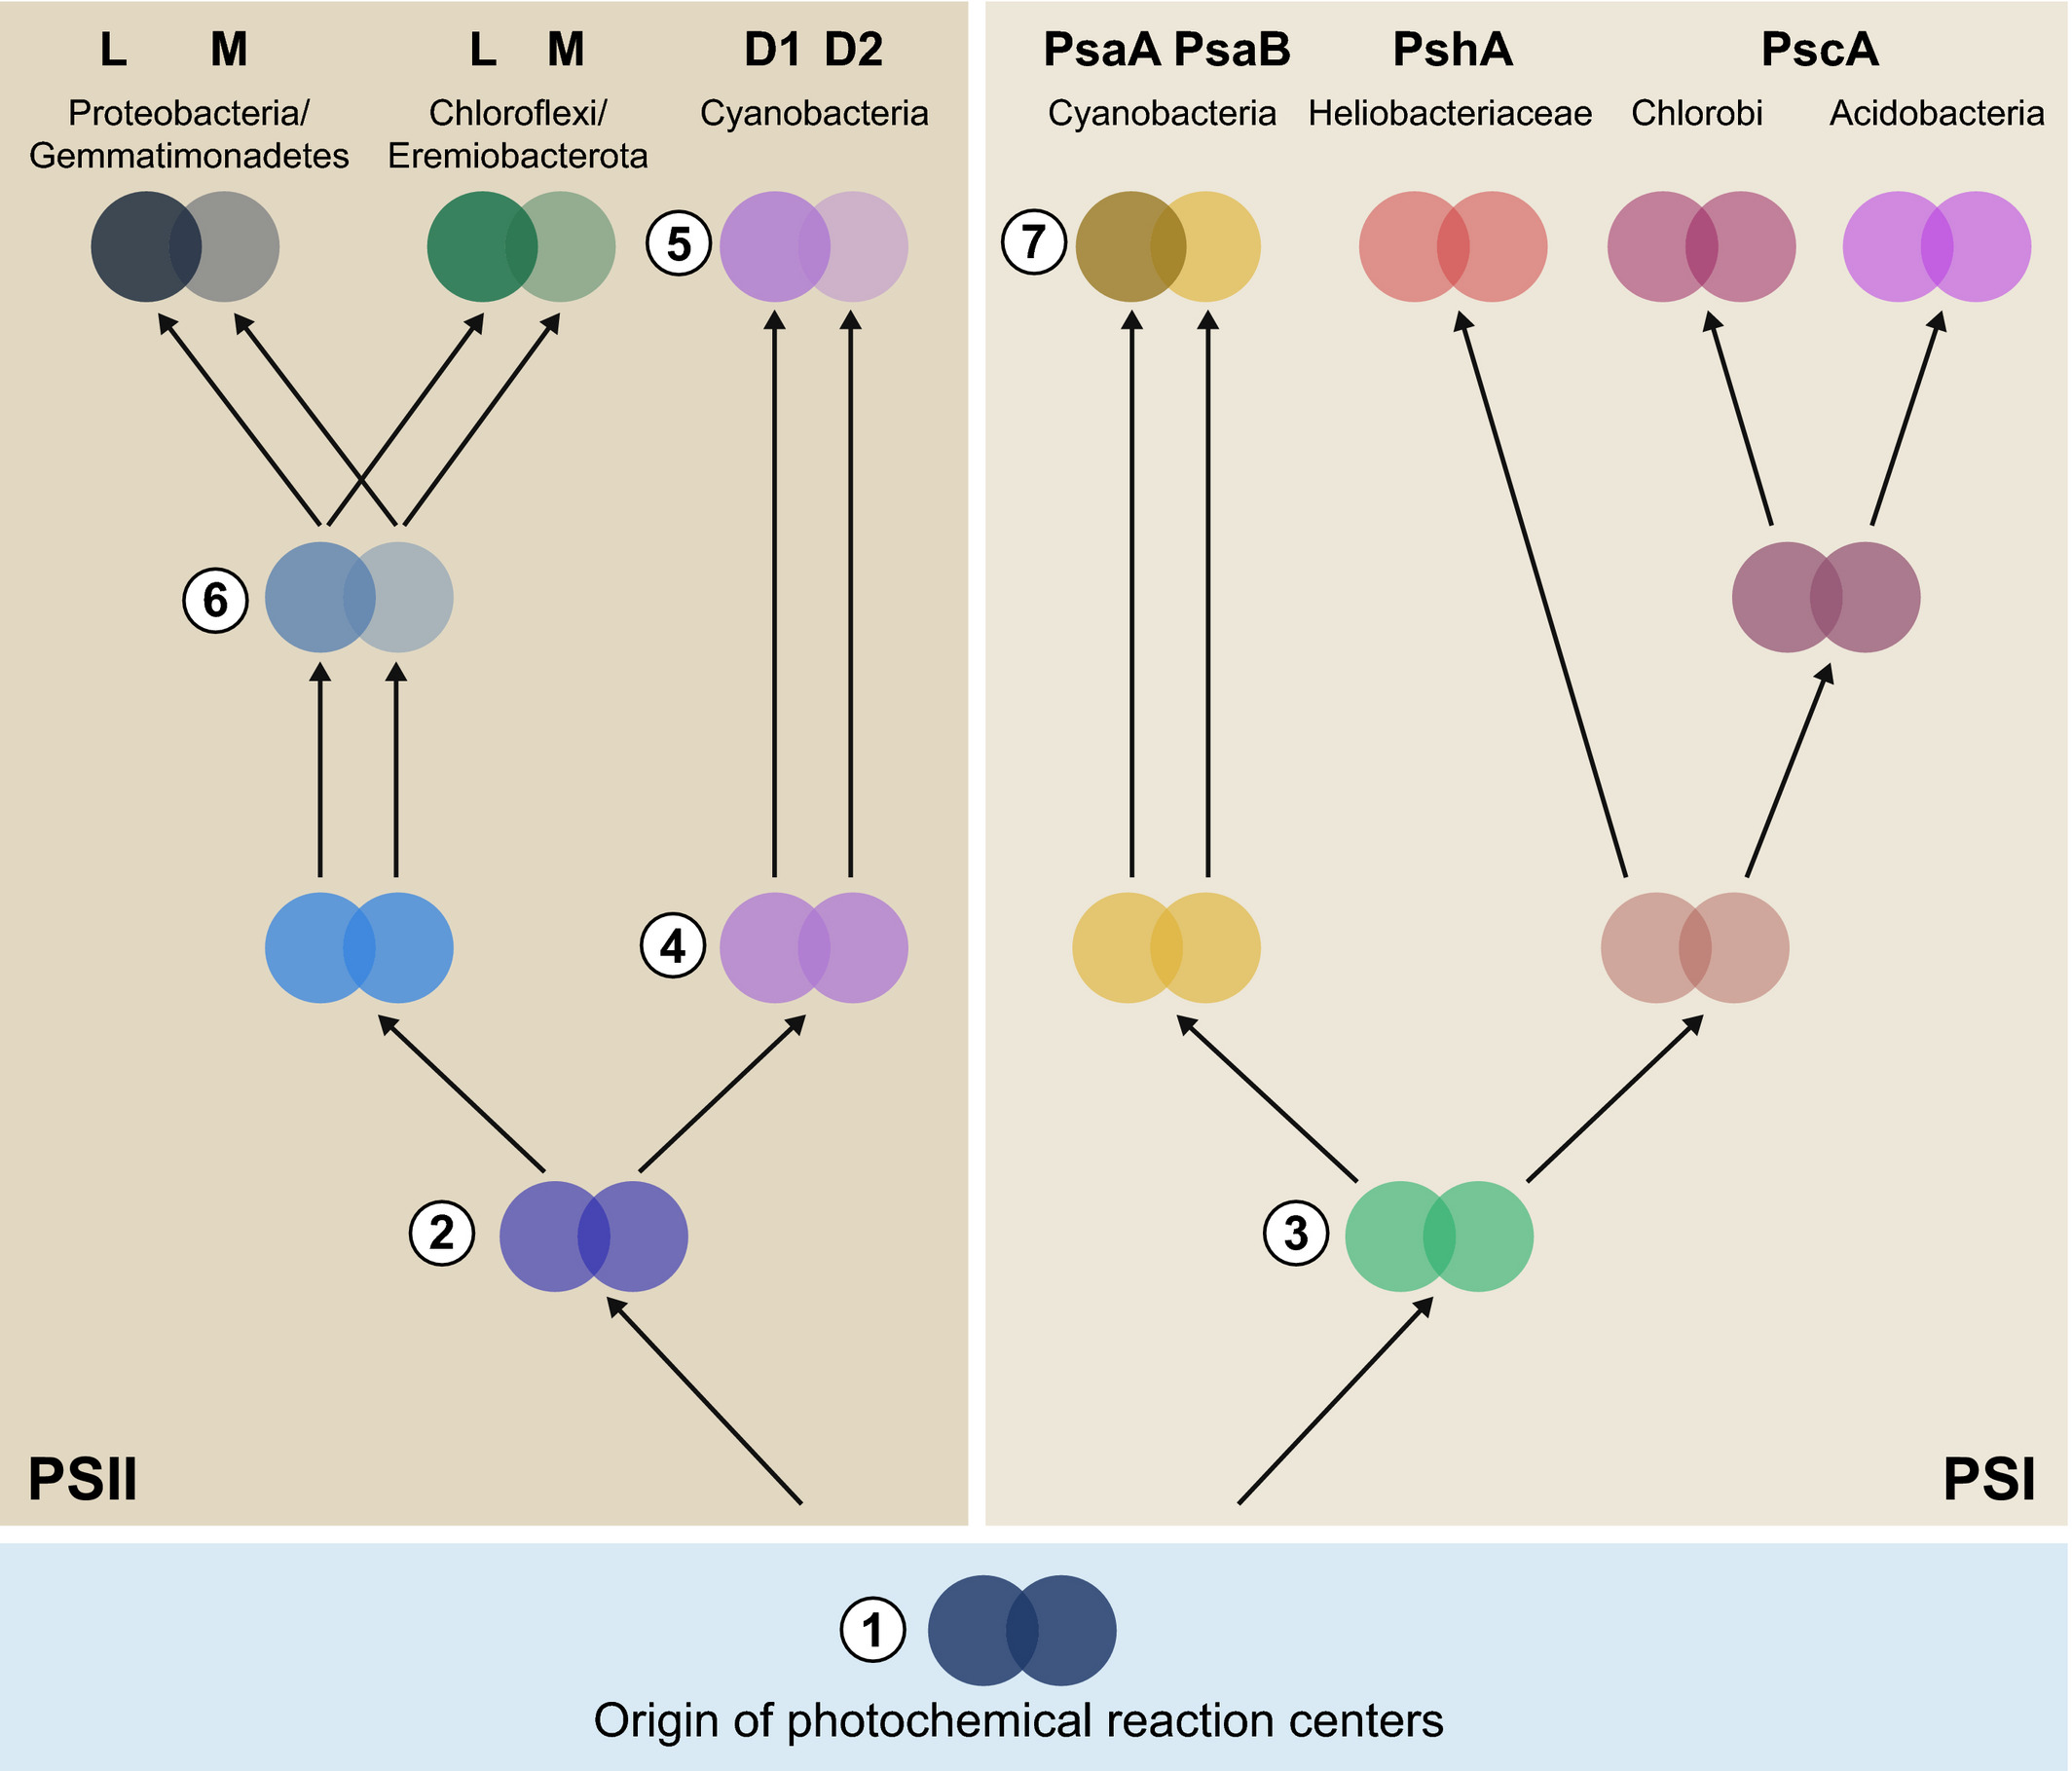
Schematic representation of the evolutionary relationships of reaction center proteins based on molecular phylogenies.
Comment: It is curious that the duplication and divergence between the two reaction center proteins is inferred to have happened three times independently. A more ancient duplication followed by gene conversion seems a more parsimonious explanation.

Slide 11
Notes on Computer Lab 6

Slide 12
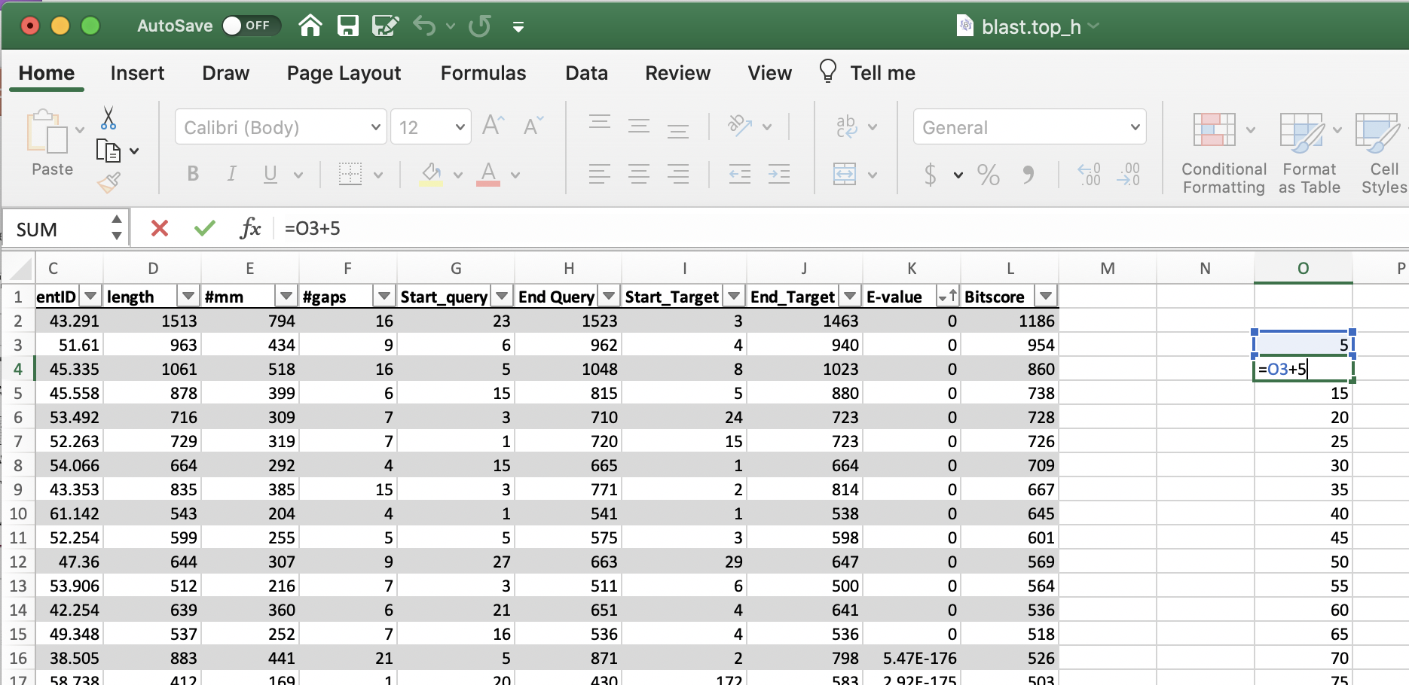
To get a nice-looking histogram, that also is easy to compare to other histograms, it is a good idea to add a column to the right that lists the bins in the histogram. As we want to get a histogram of % identity values (i.e. a depiction of how often did the %id values occur in the selected data) bins of 5% are ok.

Slide 13
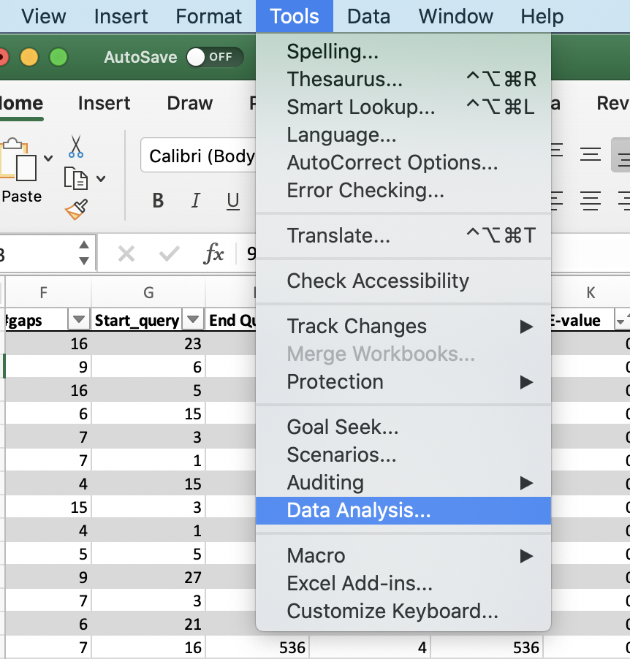
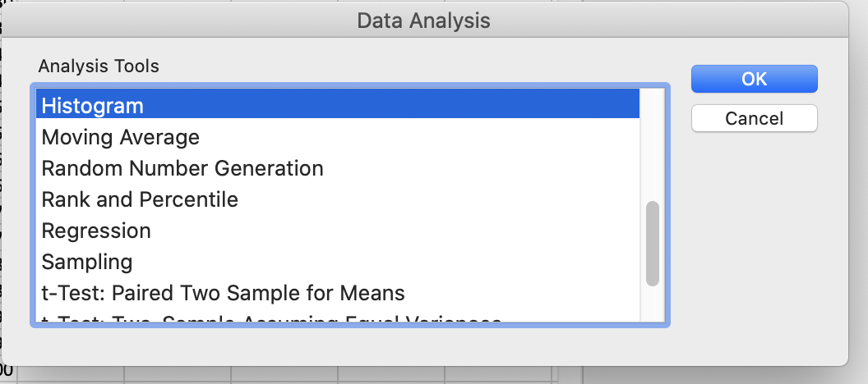
To get a nice histogram use the Data Analysis tool pak. It is part of the standard Excel distribution, but you might have to install it first. Select tools, data analysis, histogram -- the default insert histogram is “ok” but you are stuch with the default bin sizes.

Slide 14
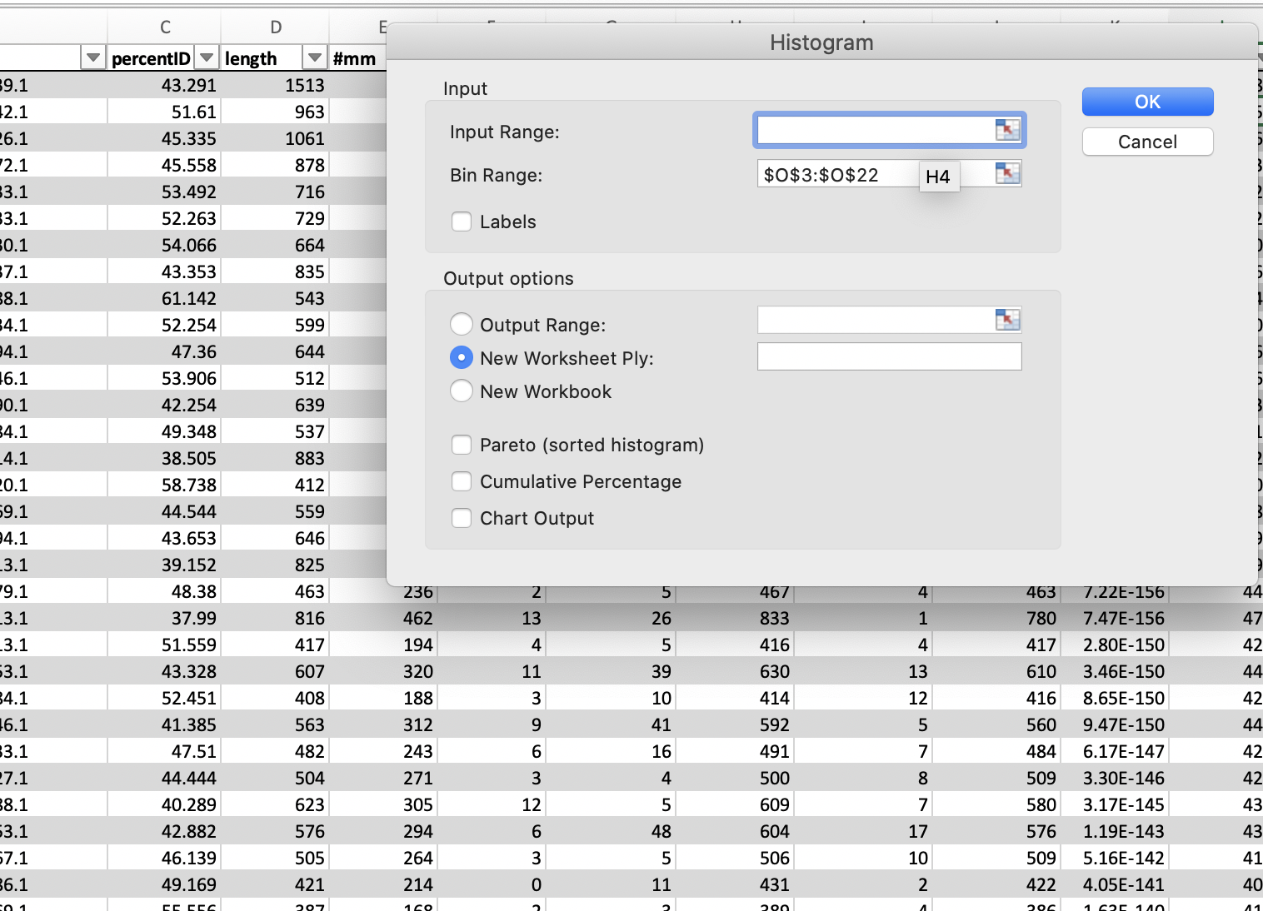
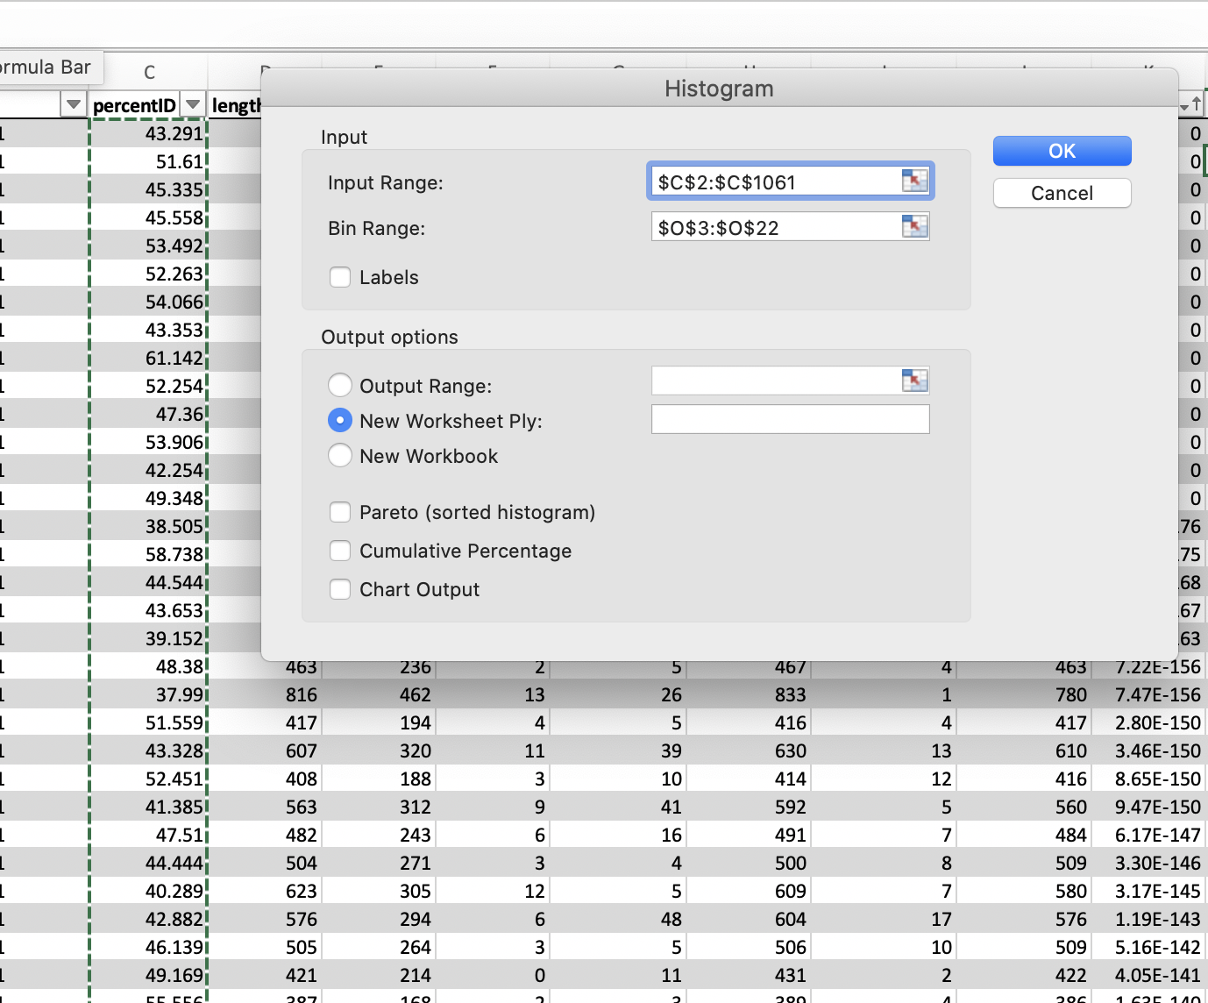
Click in the input range and select the data you want to analyze in a histogram, do the same for the bin range. (In my version, you cannot select a whole column.
select either everything, upto E-values of 1 e-7 or E-values > .5 or 1
click ok

Slide 15
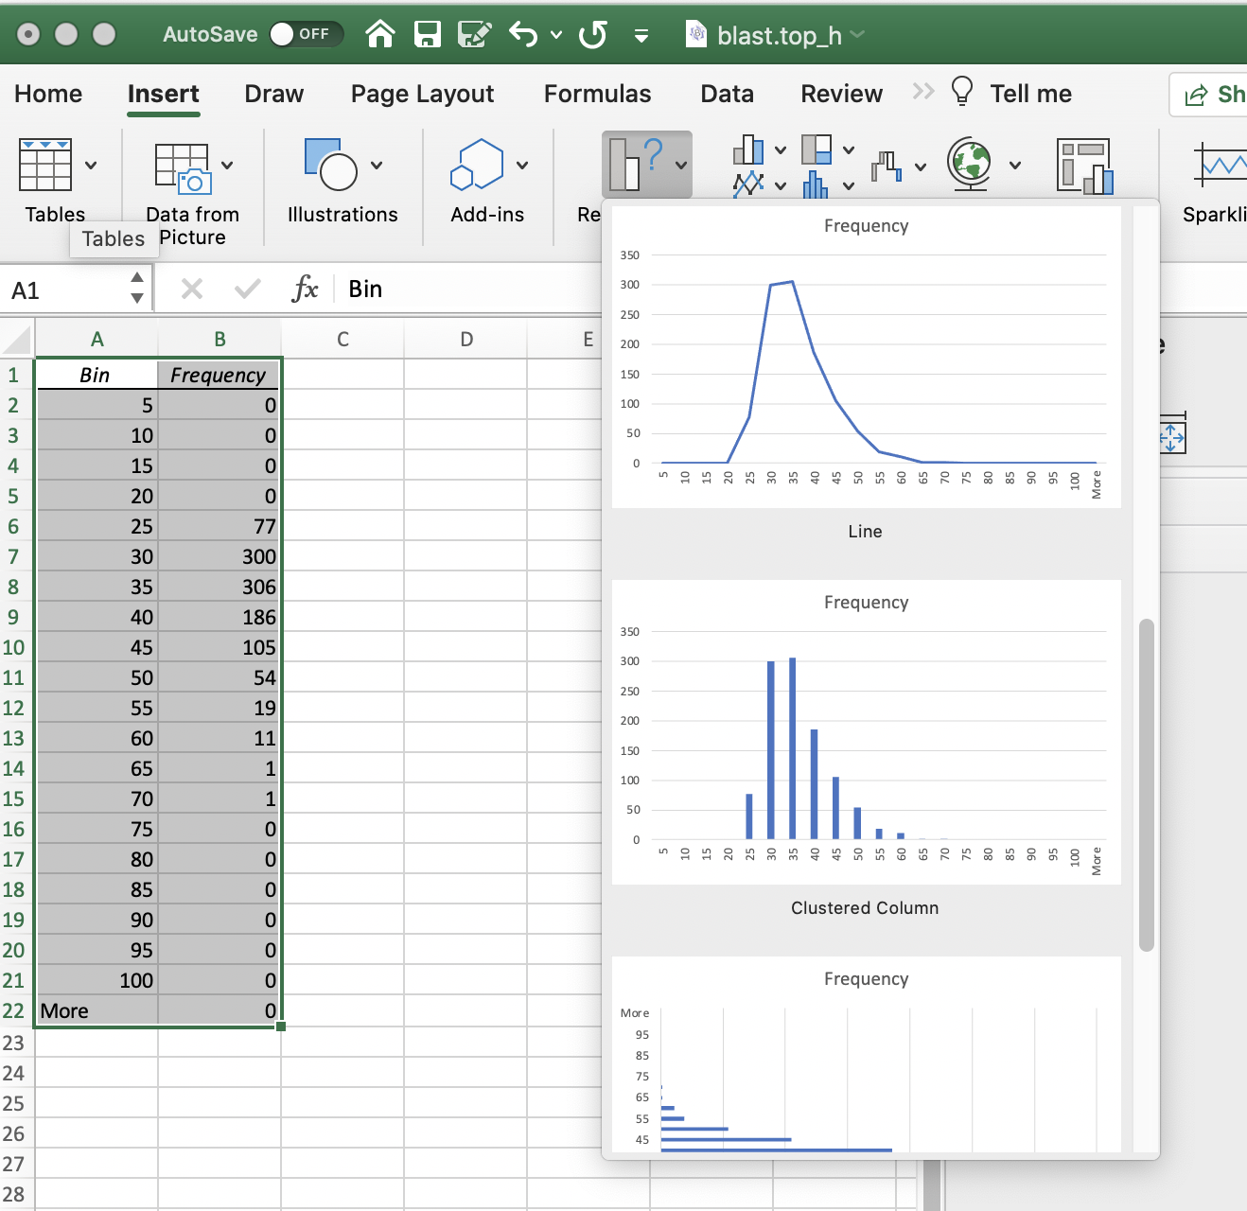
If you selected to place the result into a new worksheet, a table will be inserted in a new sheet.
The easiest is to select the table, and them insert a new graphic from recommended charts:

Slide 16
Percent ID is not an appropriate measure for the quality of a blast hit. The reason is that blast is doing only local alignments and the percent ID is expressed as a fraction of the length of the match.
If the match is 8aa long, a match 4 aa corresponds to 50% identity, but is hardly significant.

Slide 17
Histograms of the number of matches illustrate the problem:
Add a new column to the spread sheet that gives the Number of identical aa per database match = %ID/100 * Length [@percentID]/100*[@length]

