Slide 1
MCB 3421 Class 13
Multiple sequence alignment

Slide 2
the role of gene duplication followed by loss of function in speciation
For Friday, go through the slides from class 11

Slide 3
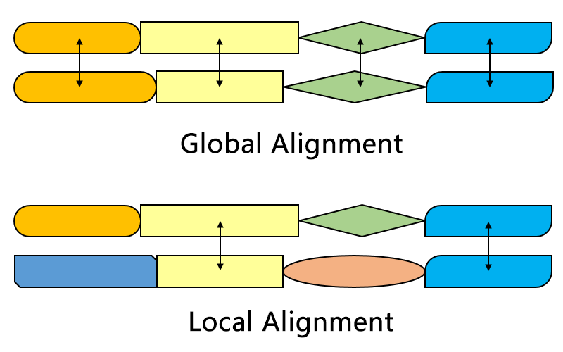
Aligning sequences is part of many analytical pipelines
Alignments can be local or global
local: e.g. blast finds stretches of similar sequences
global: two (or more) sequences are aligned from beginning to end (e.g. in fasta databank searches)
From https://en.wikipedia.org/wiki/Smith–Waterman_algorithm#/media/File:Alignment-Comparison-En.png

Slide 4
dotplot
The easiest way (provided the program runs on your computer) to align two sequences is to use a dotplot or gepard.
In realistic implementations a window of 5 to 20 nucleotides or amino acids is slid along one of the axes (i.e., sequences) and compared to every possible window on the other axis (sequence). The dot intensity can adjusted to reflect the percent identity (or similarity) in the two windows.
Example of a dotplot comparison of a protein with 13 repeated domians compared against itself

Slide 5
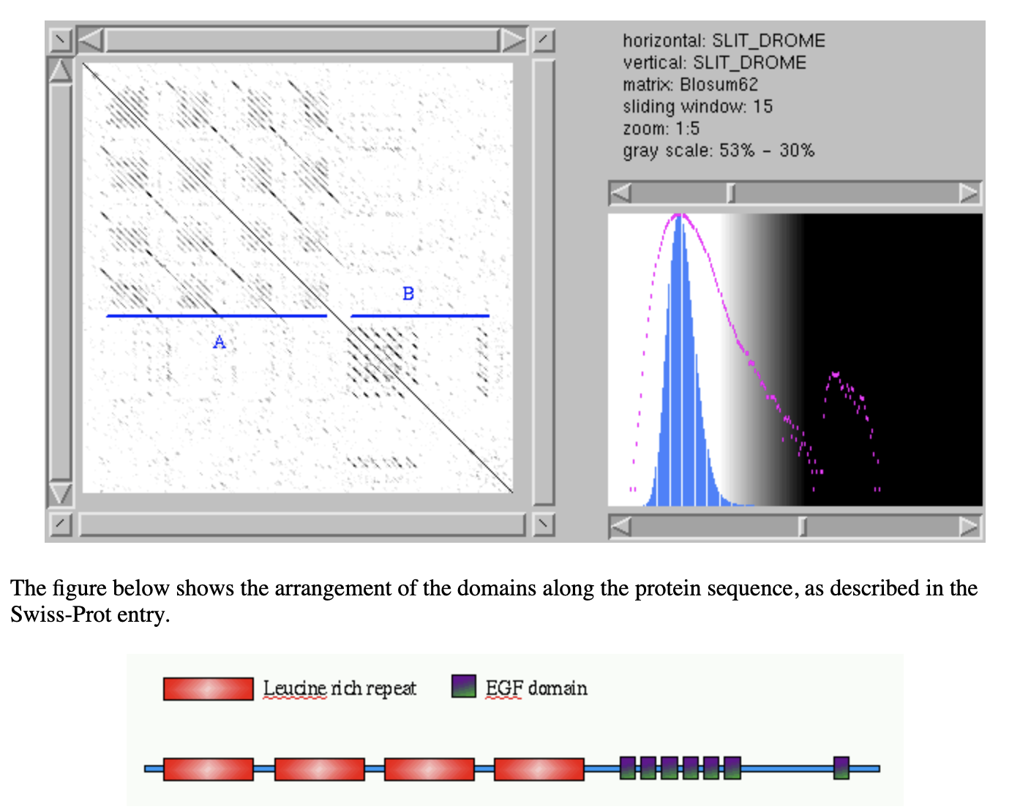
Alignment of a protein against itself consisting of multiple repeted domains
from: https://myhits.sib.swiss/util/dotlet/doc/repeats.html

Slide 6
dotplots can also be used to compare a DNA sequence (in the three forward reading frames) against a protein:
gene encoding the V-ATPases A SU in Arabidopsis
protein sequence of the V-ATPases A SU in Arabidopsis

Slide 7
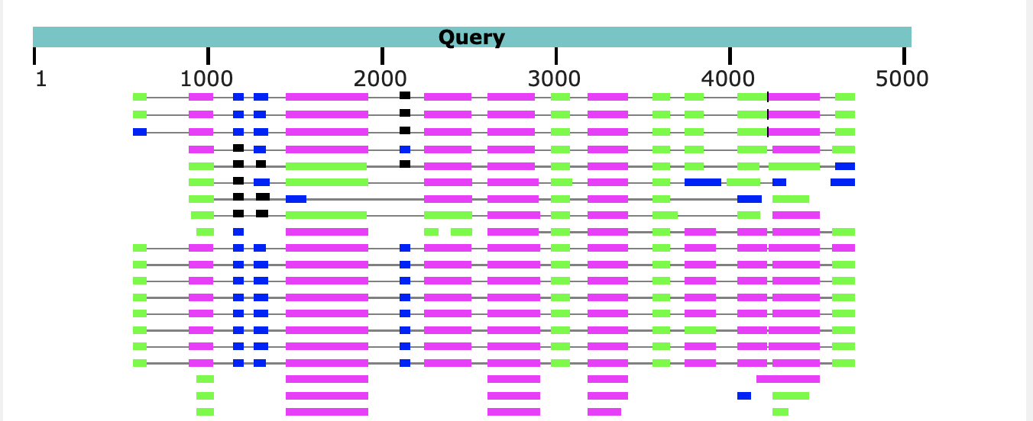
A similar result is obtained using blastx, with the gene sequence as query:
The parts of the query that does not have matches corresponds to introns.
Note the large number of introns present in Arabidopsis, which is a plant with a very small genome. In other organisms the introns are even larger.

Slide 8
The same for the homologous gene (V-ATPase A-SU in humans)
ATP6V1A on chromosome:GRCh38:3:113746433:113812656:1
More and larger introns in humans than in Arabidopsis.

Slide 9
For the homologous gene (V-ATPase A-SU in Schizosaccharomyces)
NC_003424.3:1647199-1649410 Schizosaccharomyces pombe chromosome I
Only two introns in Schizosaccharomyces pombe (baker’s yeast has none). In this case the search was done with blastn against the expressed sequence tags database.

Slide 10
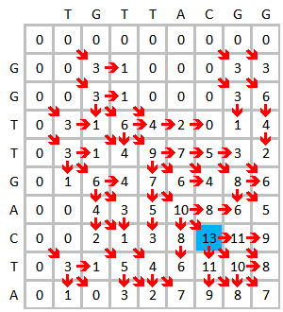
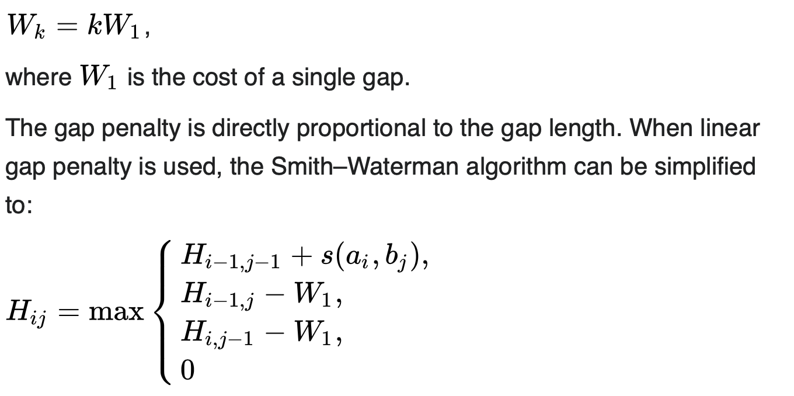
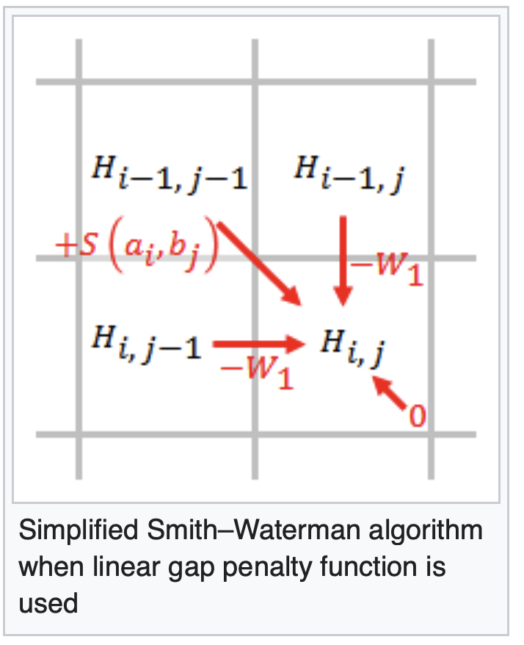
Optimal alignments
For pairwise (this has been extended to three sequences) dynamic programming algorithms have been developed that guarantee to find an optimal alignment (given a scoring matrix and gap penalties) (and you can use shuffling to assess significance of the score)
The most famous of these are the Needleman Wunsch and the Smith Waterman algorithms.
Wikipedia has a good description of the Smith–Waterman algorithm
You write down the sequences on the two axes, and starting at the upper left fill in the maximum score for each field
Assuming a linear gap penalty:

Slide 11
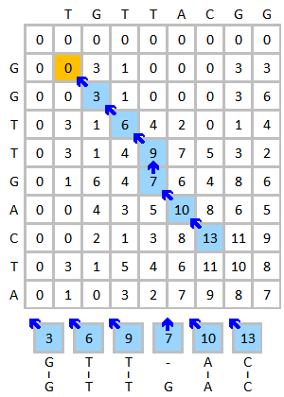
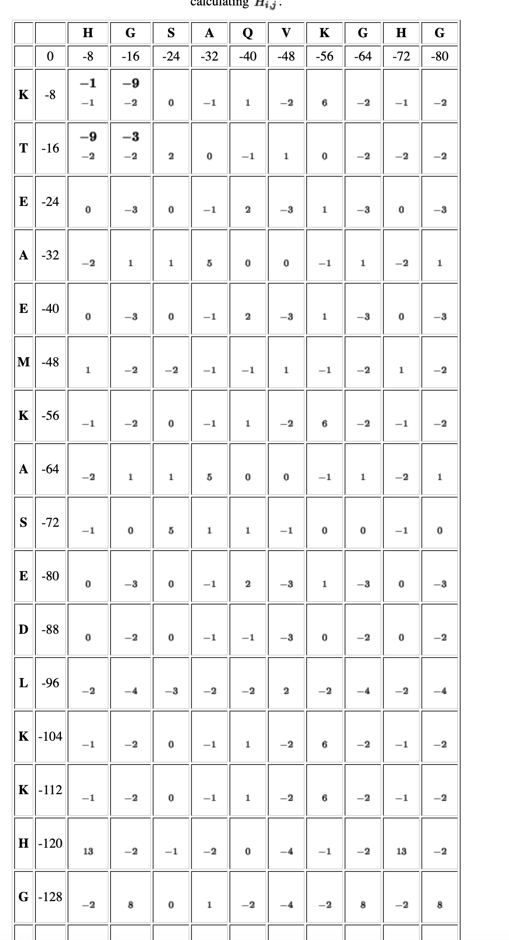
Trace back from the highest number to zero.
The Needlman-Wunsch algorithm differs in that
it begins with the cell at the lower right of the matrix, end at top left cell, adds a gap penalty to the first row and the first column and has negative scores. A step by step version is here

Slide 12
Both algorithms are guaranteed to give you an optimum score; however, usually the report a single alignment, and usually that are different alignment with the same score. E.g.:
From: https://en.wikipedia.org/wiki/Needleman–Wunsch_algorithm

Slide 13
Multiple Sequence Alignments (MSAs)
clustalx (the same as clustalw with a GUI) is a frequently used progressive alignment algorithm*.
Gives excellent alignments that usually are very similar to alignments based on protein structures. It works better, the more sequences are included.
Often not acceptable as a start point to build molecular phylogenies!
* the first effective multiple sequence alignment program was developed by Feng and Doolittle

Slide 14
The second step (the clustering analysis of the sequences) is most important. The relationships found here will create a serious bias in the final alignment. The better the guide tree, the better the final alignment. One can load a guide tree into clustal. This tree will then be used instead of the neighbor joining tree calculated by clustalw as a default. (The guide tree needs to be in normal parenthesis notation WITH branch lengths).

Slide 15
Other alignment programs:
MUSCLE is the current alignment program of choice. It is thought to give better alignments compared to clustal, it is faster and works with larger datasets. The program is available through a webserver at the ebi, and as a command line program to download here, and already installed on Xanadu.
Developed by gentleman scientist Robert Edgar. The paper on muscle has been citer over 31000 times

Slide 16
Statalign – trees without MSAs
If your sequences are not very similar, and if you are not able to generate a trustworthy multiple sequence alignment, you can calculate distance trees based on pairwise alignments only. The best program for this purpose is statalign from Jeff Thorne (Thorne JL, Kishino H (1992) Freeing phylogenies from artifacts of alignment. Mol Bio Evol 9:1148-1162). It runs under standard UNIX. It's only worth your effort if you are getting gray hairs because of a data set you cannot reliably align. Very out of fashion these days.

Slide 17
Prank
Most multiple sequence alignment programs produce alignments that are pleasing to the human eye by placing only a few large gaps into the sequences.
However, for many applications it is better to align a particular amino acid to gaps in the other sequences, if one is not certain about the homology of the position. The programs that introduce more gaps are at present underutilized. An example is PRANK (a web version of PRANK is part of the guidance 2 server to determine reliably aligned sites).

Slide 18
MAFFT
(this seems currently the best program, if one wants to align divergent sequences)
A collection of alignment programs with different options.
Options exist for sequences that are homologous over their entire length, or those that consist of multiple domains and may contain long gaps (missing domains) in some sequences.
Another option (currently in testing) is to force or not force alignment of divergent regions. An unalign level of .9 seems a good choice to avoid downstream artifacts

Slide 19
MAFFT
Available online, but only with very limited numbers of iterations.
Command line versions are available for different operating systems.
If you use the web interface at https://mafft.cbrc.jp/alignment/server/ , it tells which command it used – you can copy this and then use it on Xanadu or your own computer from the commandline, and increase the number of iterations.
Commands might be the following:
mafft --globalpair --maxiterate 1000 all.fasta > output_alignment.fasta
mafft --globalpair --unalignlevel 0.8 --leavegappyregion --maxiterate 1000 all.fasta > more_iterations_alignlevel0.8.fasta
The manual is at https://mafft.cbrc.jp/alignment/software/manual/manual.html

Slide 20
SATè
A program that combines phylogenetic reconstruction and multiple sequence alignment: SATe.
SATé is a software package for inferring a sequence alignment and phylogenetic tree. The iterative algorithm involves repeated alignment and tree searching operations. The original data set is divided into smaller subproblems by a tree-based decomposition. These subproblems are aligned and further merged for phylogenetic tree inference.

Slide 21
Recommendations
If you need to use MSA in your work, my current recommendation is to use muscle, and test if an alignment calculated with PRANK or MAFFT gives similar results. Also, if you use less than 100 sequences, try SATe2. (The time needed for computation is very different!).
Note: in some instances none of the automated procedures gives satisfactory results and modifying alignments by hand is the only option.

Slide 22
Manual Alignments
In some instances none of the automated procedures gives satisfactory results and modifying alignments by hand is the only option.
Jalview remains a popular option. Advantages are the PCA analysis of the sequence alignment, and the integration of the different display windows.
Seaview is similar, it has a nice GUI and uses has more sophisticated alignment (muscle, clustalo) and phylogenetic reconstruction programs.

Slide 23
E.g., a gene invaded by inteins inserted into different locations
Intein 2
Extein
Intein 1
Intein 2
Extein
Intein 3
Muscle aligns the 2nd intein to the 1st intein mushes part of the extein with the intein sequence :

Slide 24
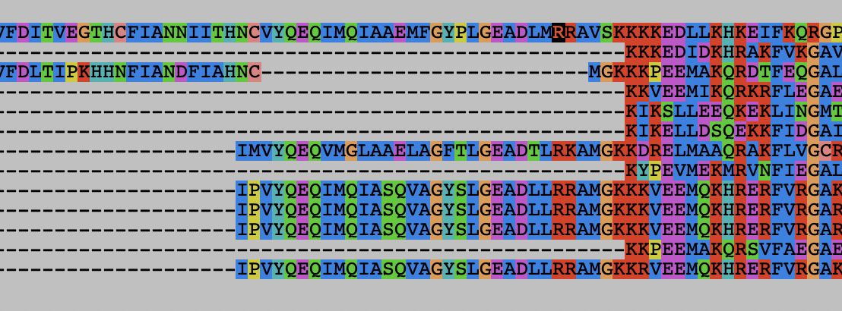
E.g., a gene invaded by inteins inserted into different locations
Intein 2
Extein
Intein 3
Intein 2
Extein
Intein 1
clustelo also aligns the 1st and 2nd intein and misses the small block of extein for several sequences :

Slide 25
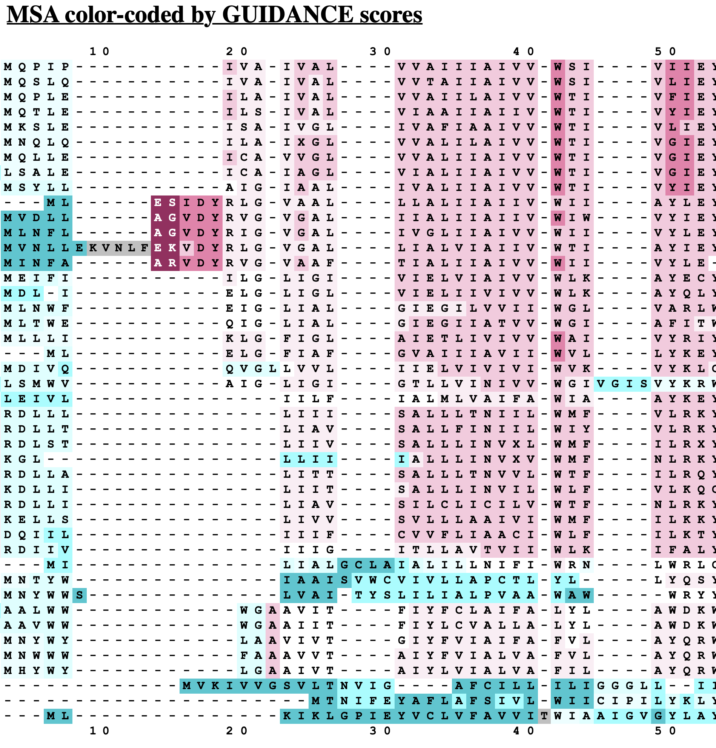
The question if one should use only reliably aligned sequences, or all sequences remains under debate. Many think that using all of the sequences will inform on substitution patterns and thus generate more reliable models.
Also, variable regions that cannot be aligned between divergent sequences, will help to resolve relationships closer to the tips.
One approach to remove ambiguous alignment positions is GBLOCK (implemented in seaview (see above, web server is here), another is guidance from Tal Pupko's lab at TAU (I like this one, because It allows to remove positions from poorly aligned individual sequences, not only complete columns).

