Slide 1
Class 13
Gene and genome duplications

Slide 2
Percent ID is not an appropriate measure for the quality of a blast hit. The reason is that blast is doing only local alignments and the percent ID is expressed as a fraction of the length of the match.
If the match is 8aa long, a match 4 aa corresponds to 50% identity, but is hardly significant.

Slide 3
Histograms of the number of matches illustrate the problem:
Add a new column to the spread sheet that gives the Number of identical aa per database match
= %ID/100 * Length [@percentID]/100*[@length]

Slide 4
Other comments on lab6:
It is a good idea to keep file extensions; e.g., .faa for multiple fasta files of aa sequences and .fna for nucleotide sequences
Do not use spaces in your file names!
When entering commands onto the command line, use automatic line completion <tab> if possible. This avoids many typos.
If this is not possible/convenient because too many files start the same way, use copy and paste.
Check files (using “more filename” (typing q quits more) or “head filename”) to make sure the files are what you expect them to be. This applies to
  Scripts (sometimes the expected script downloaded via curl just says “the website is unavailable”
  Input files (one might have forgotten to unzip a file, or it might have the wrong end of line convention)
  Output files (did blast work as expected, did the script remove all but the highest scoring match per query sequence?)
Copy commands you used successfully into your electronic notebook! You might remember tomorrow what you did yesterday, but a year from now a detailed example of things that worked will be helpful. Your notes should include all the commands, the name and contents (e.g. this contains the genbank formatted features of the genbank file) of the files.
Continue Lab6, Exercise 1 on your own.

Slide 5
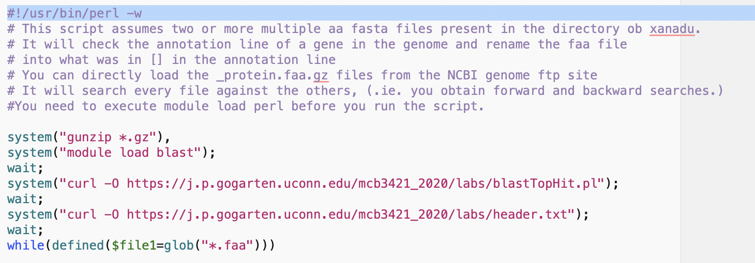
An advantage of using the command line is that the individual commands can be easily converted into a script:

Slide 6
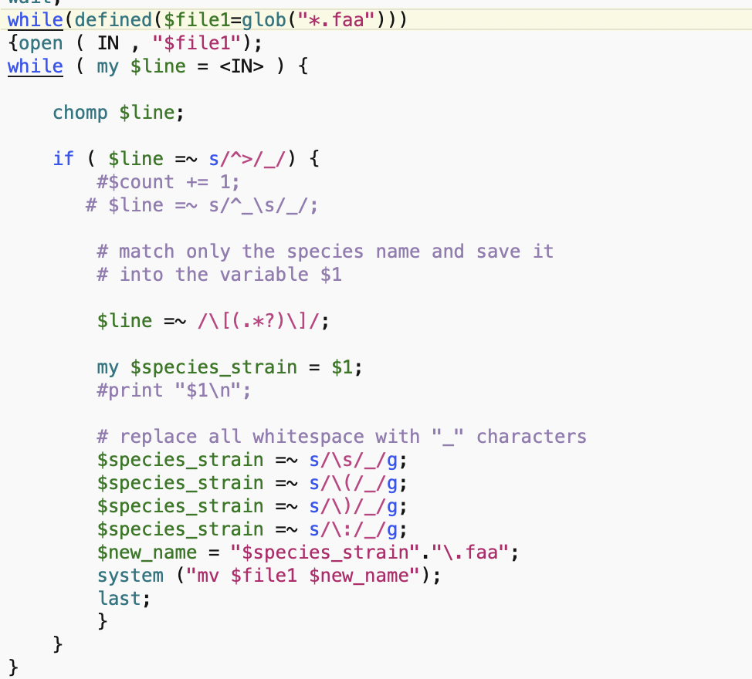

Slide 7
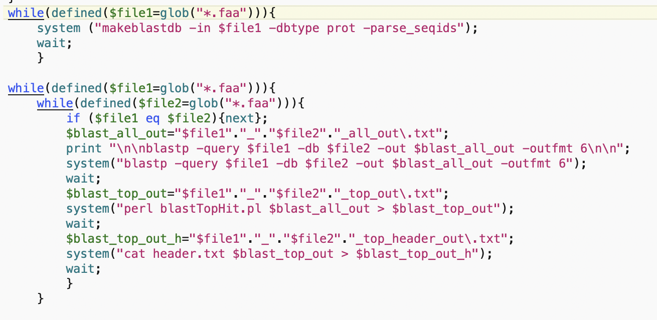
The script is at https://j.p.gogarten.uconn.edu/mcb3421_2021/labs/blast_searches.pl

Slide 8
srun --pty -p mcbstudent --qos=mcbstudent --mem=2G bash
module load blast/2.11.0
module load perl
curl -O ftp://ftp.ncbi.nlm.nih.gov/genomes/all/GCF/000/025/685/GCF_000025685.1_ASM2568v1/GCF_000025685.1_ASM2568v1_protein.faa.gz
curl -O ftp://ftp.ncbi.nlm.nih.gov/genomes/all/GCF/000/464/515/GCF_000464515.2_ASM46451v2/GCF_000464515.2_ASM46451v2_protein.faa.gz
(copied pasted from Waterfox at https://www.ncbi.nlm.nih.gov/genome/browse#!/prokaryotes/Haloferax%20volcanii
and https://www.ncbi.nlm.nih.gov/genome/browse#!/prokaryotes/Aeromonas%20veronii%20hm21 using the R-link)
perl blast_searches.pl
  downloads header and script to keep only top matches
  gunzips all *.gz files
  Turns all .faa files into searchable databanks
  searches all .faa files against all other .faa files - this can be more than 2 genomes ....
The resulting files are names
query-genome_db_genome_top_header_out.txt

Slide 9
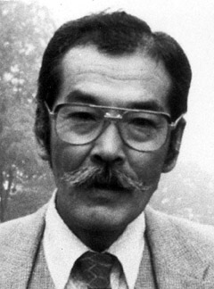
Duplications and Evolution
Ohno postulated that gene duplication plays a major role in evolution
Small scale duplications (SSD)
Whole genome duplications (WGD)
Polyploid: nucleus contains three or more copies of each chromosome
Autopolyploid: formed within a single species
Diploids AA and A’A’ Polyploid AAA’A’
Allopolyploid: formed from more than one species
Diploids AA and BB Polyploid AABB
Susumu Ohno 1970
Evolution by gene duplication
1R and 2R hypothesis
“Junk DNA” 1972
Slide from Chris Pires

Slide 10
Type of gene duplications:
tandem repeats
duplication via transposition (esp. retro transposition) (selfish genetic elements, but other genes as well (see the work from Craig Nelson’s lab)
Whole genome, chromosome, or chromosome arm duplications
In the lineage to vertebrates two whole genome duplications occurred (the exact placement is uncertain, because other duplications occurred as well). As a consequence many regulatory genes (e.g. the hox gene cluster) are now present in at least 4 copies per genome. Many think that this allowed for a more differentiated development)
In fish* three rounds of whole genome duplications occurred
(*Teleostei = bony fish; the largest group of fish, but it does not include the sistergroup to the tetrapods (Lungfish or Dipnoe)
Most crop plants are polyploid (auto- or allopolyploid) => can lead to inatant speciation in a hybridzone.

Slide 11
Aside: Gene and genome duplication versus
Horizontal Gene Transfer
Gene family expansion through horizontal gene transfer –
the most common process in prokaryotes
Gene duplication through lineage fusion
Very common in plants, but also in animals
Autochtonous gene/genome
duplication are rare
in prokaryotes

Slide 12
Fate of Duplicated genes

Slide 13
Fate of Duplicated genes
gene silencing -> decay -- the most common fate, loss of function

Slide 14
Fate of Duplicated genes
gene silencing -> decay -- the most common fate, loss of function
subfunctionalization -- the two daughter genes from the duplication divide the functions of the parent gene, for example, via tissue specific expression – in plants many genes for proton pumps targeted to the plasma membrane exist, they all have the same function, but they are expressed in root hairs, in stamen, ..., in human the mitochondrial F-ATPase alpha subunit (encoded in the nucleus) has an isoform that is only expressed in the liver; this is the most common way for a gene to be maintained in a genome following a duplication.

Slide 15
Fate of Duplicated genes
gene silencing -> decay -- the most common fate, loss of function
subfunctionalization -- the two daughter genes from the duplication divide the functions of the parent gene, for example, via tissue specific expression – in plants many genes for proton pumps targeted to the plasma membrane exist, they all have the same function, but they are expressed in root hairs, in stamen, ..., in human the mitochondrial F-ATPase alpha subunit (encoded in the nucleus) has an isoform that is only expressed in the liver; this is the most common way for a gene to be maintained in a genome following a duplication.
neofunctionalization -- one of the genes picks up a new function that the parent gene did not have.

Slide 16
Question:
It seems that gene duplications followed by gene loss play not a big role in evolution. Conway and Lynch suggest that these duplications play a major role in biodiversity in erecting post mating hybridization barriers. How does this work?

Slide 17



Post mating hybridization barrier (hybrid infertility) through duplication followed by loss of function
Parent Populations
Subpopulation a
In 50% of the cases
the two sub populations
will lose the function in different copies
duplicated gene
before loss of function
Subpopulation b

Slide 18


F1
F2
Chr1+
Chr1 -
Chr2+
2+
1+
Chr2-
1+
0 +
In 25% the F2 will not have a functional gene.
Hybrid will have two functional genes in different locations
In case 100 genes were initially duplicated.
50 will be differentially fixed, and for each of
these the chance of being completely lost is 25%.
The chance the at least one is lost is 0.75⁵⁰= 6x10⁻⁷

