Slide 1
MCB 3421 -- Class 14
Discussion of computer lab 7
and
Review session

Slide 2
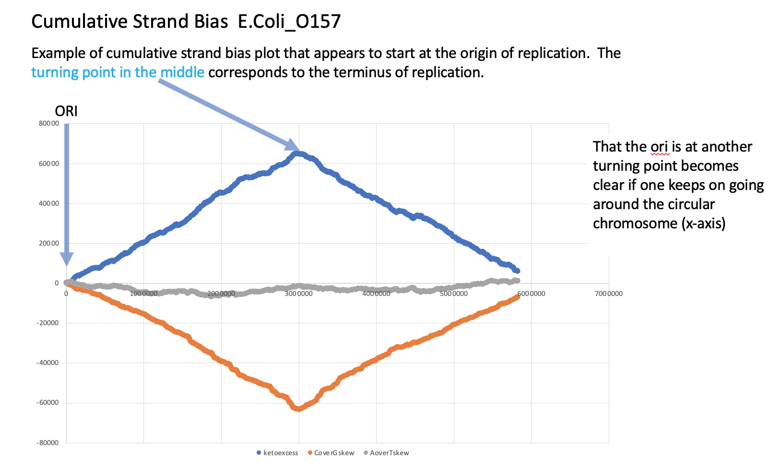

Slide 3
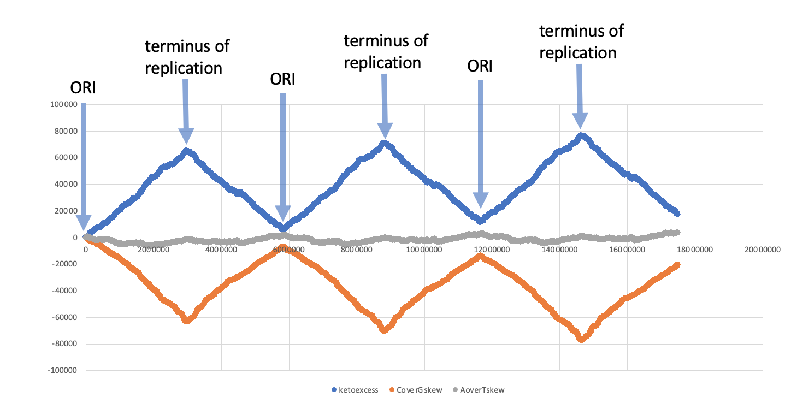
Cumulative Strand Bias E.Coli_O157 – going around the chromosome 3 times

Slide 4
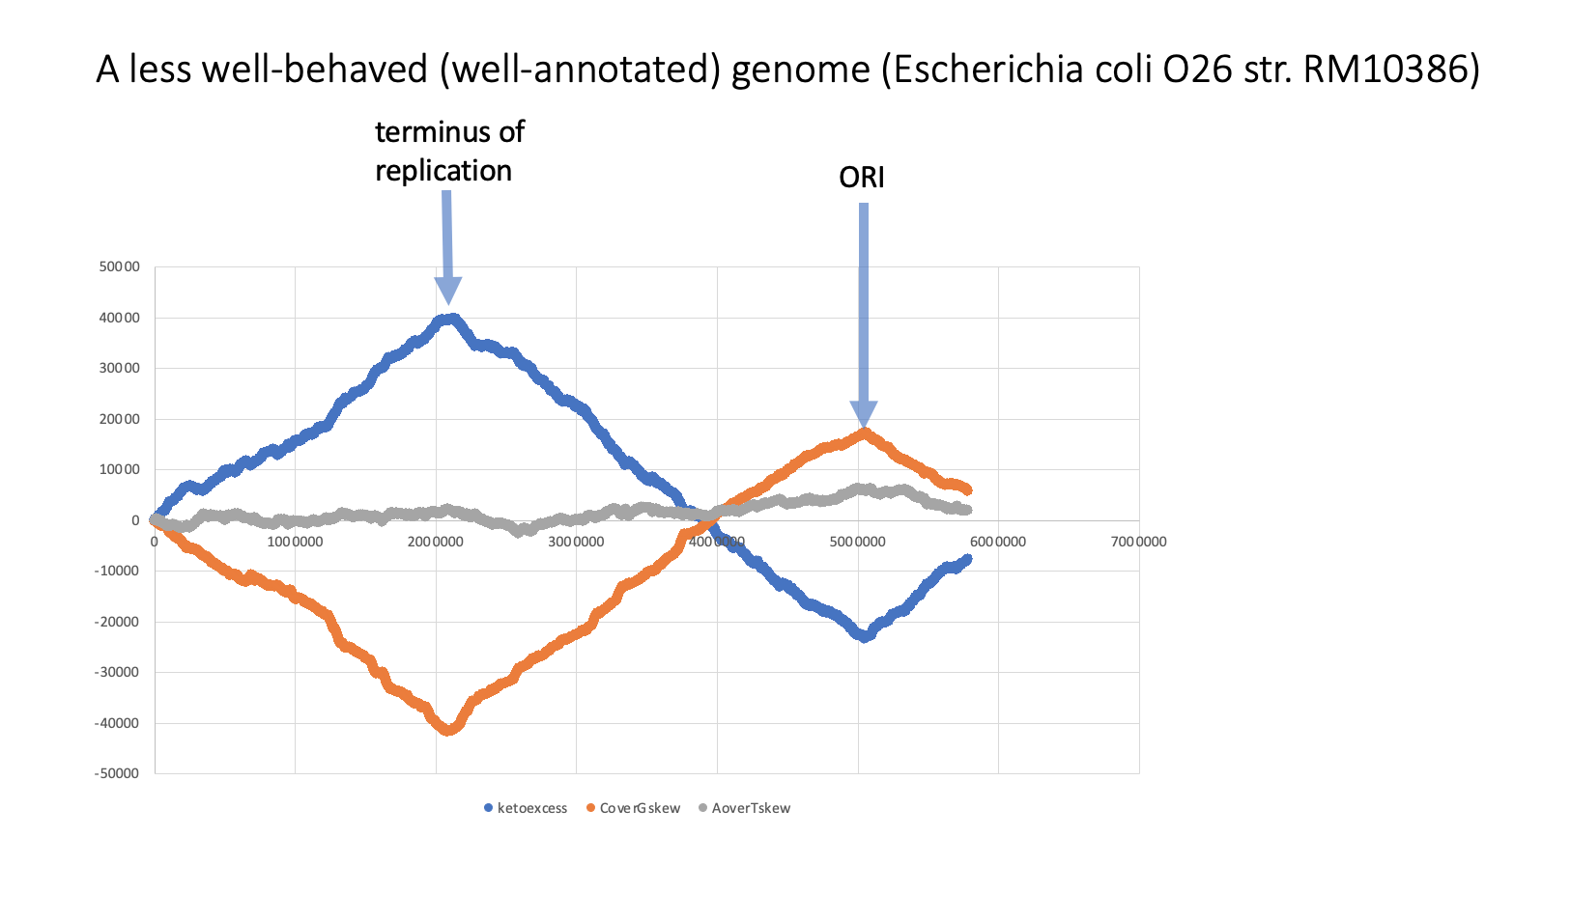

Slide 5
CDS GCA_003112225.1 Primary Assembly chromosome CP028126.1 5006615 5008018 - AWJ57195.1 chromosomal replication initiator protein DnaA I3U_28625 1404 467

Slide 7
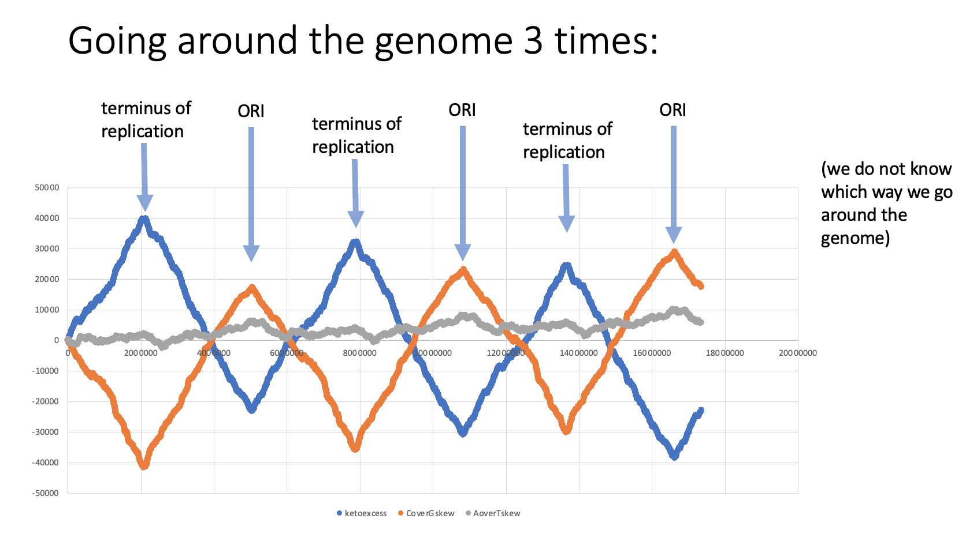

Slide 8
ORI
ORI

Slide 9
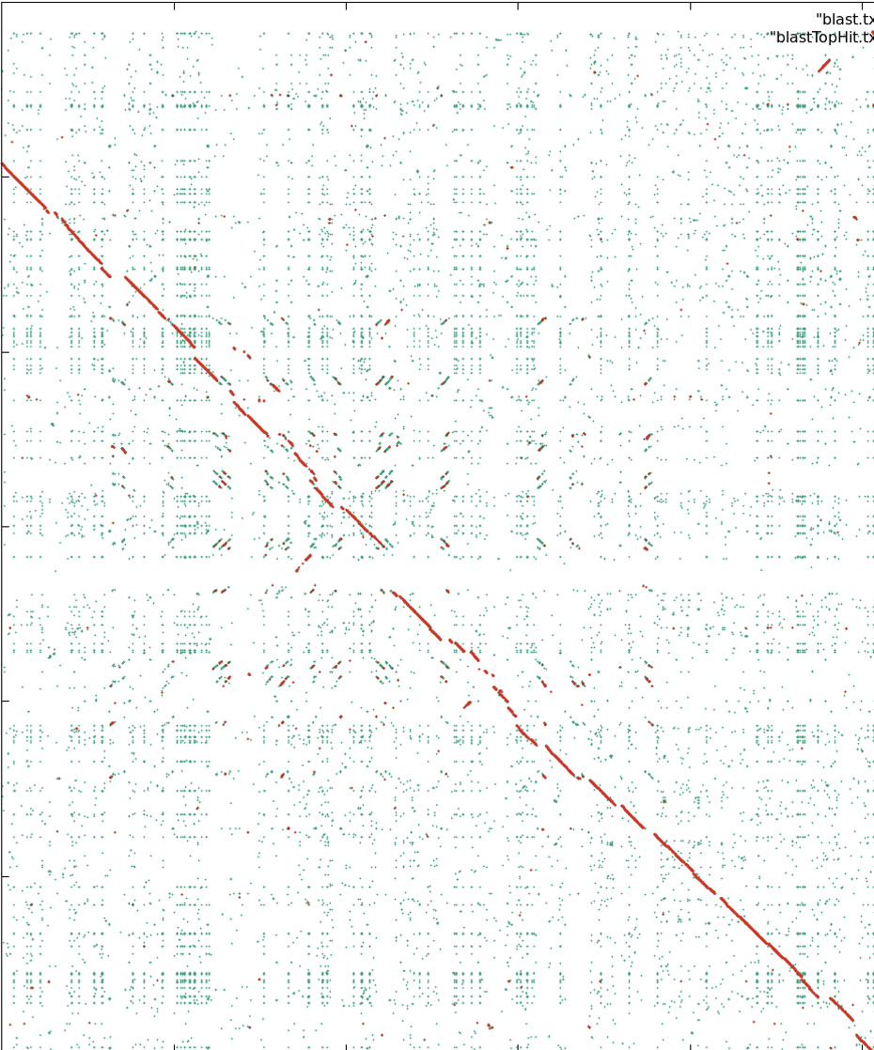
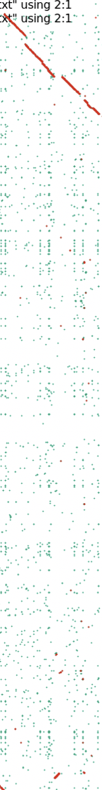
Geneplot going around the genome (ori to ori
ORI
ORI
Note: The ORI in the genome on the x-axis is on the – strand.

Slide 10
Another example:
Aeromonas hydrophila ZYAH72
versus
Aeromonas caviae R25-6

Slide 11
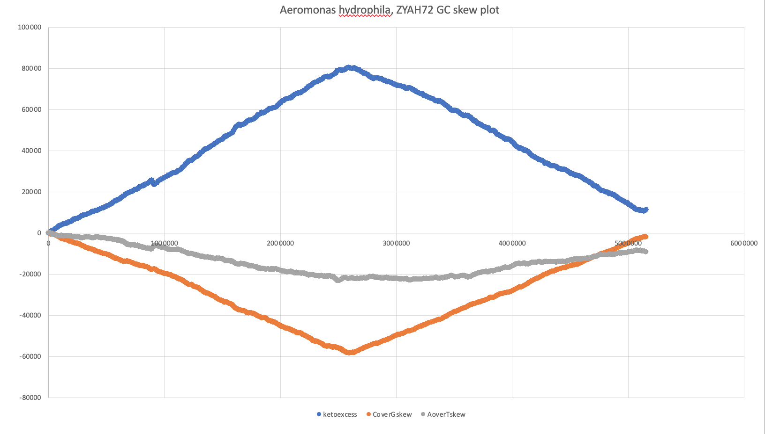

Slide 12
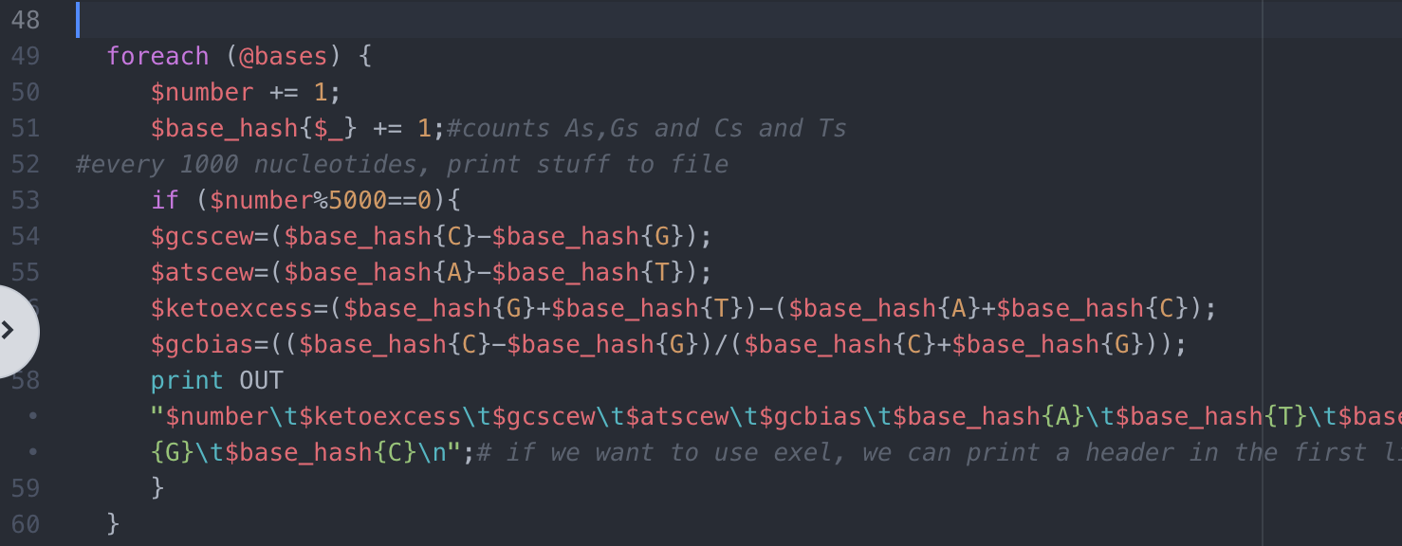

Slide 13
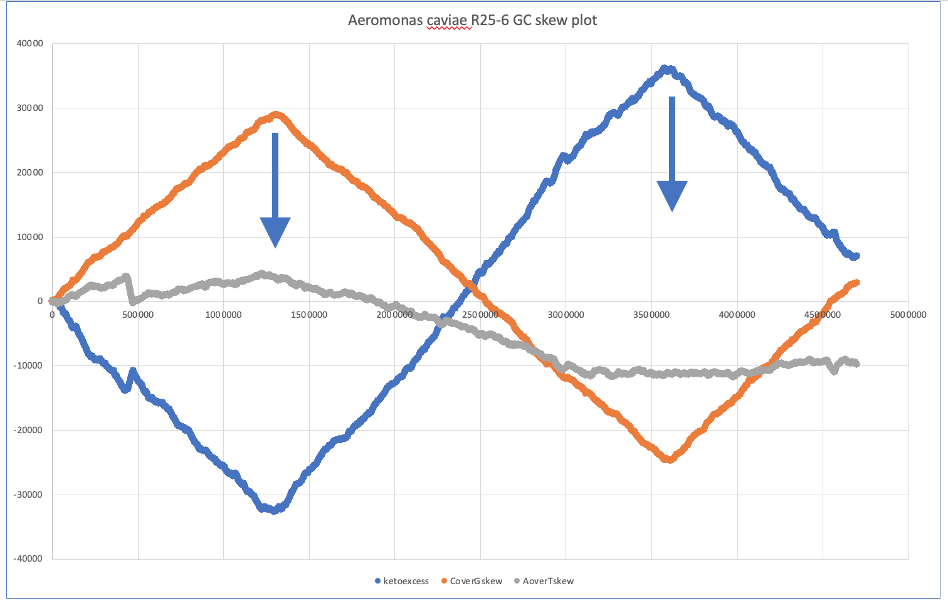

Slide 14
From Feature table of
Aeromonas caviae R25-6
CDS with_protein GCF_003294855.1
Primary Assembly chromosome
NZ_CP025705.1 1355282 1356652 +
WP_039040645.1 WP_039040645.1
chromosomal replication initiator protein DnaA
C1C92_RS06430 1371 456

Slide 15
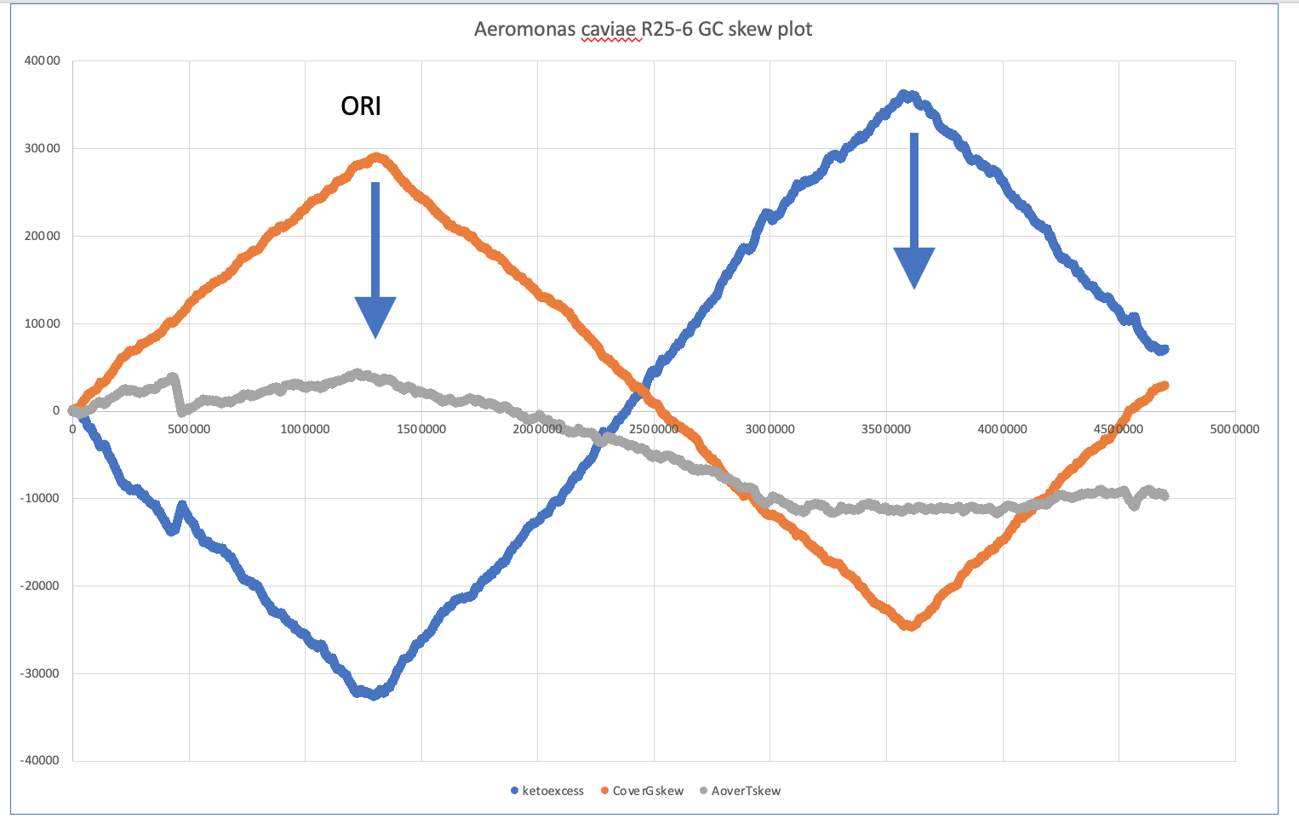
ORI

Slide 16
Gene plot
ORI

Slide 17
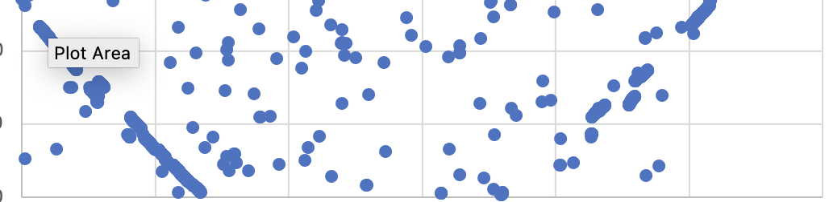
Gene plot
Aeromonas caviae, R25-6

Slide 18
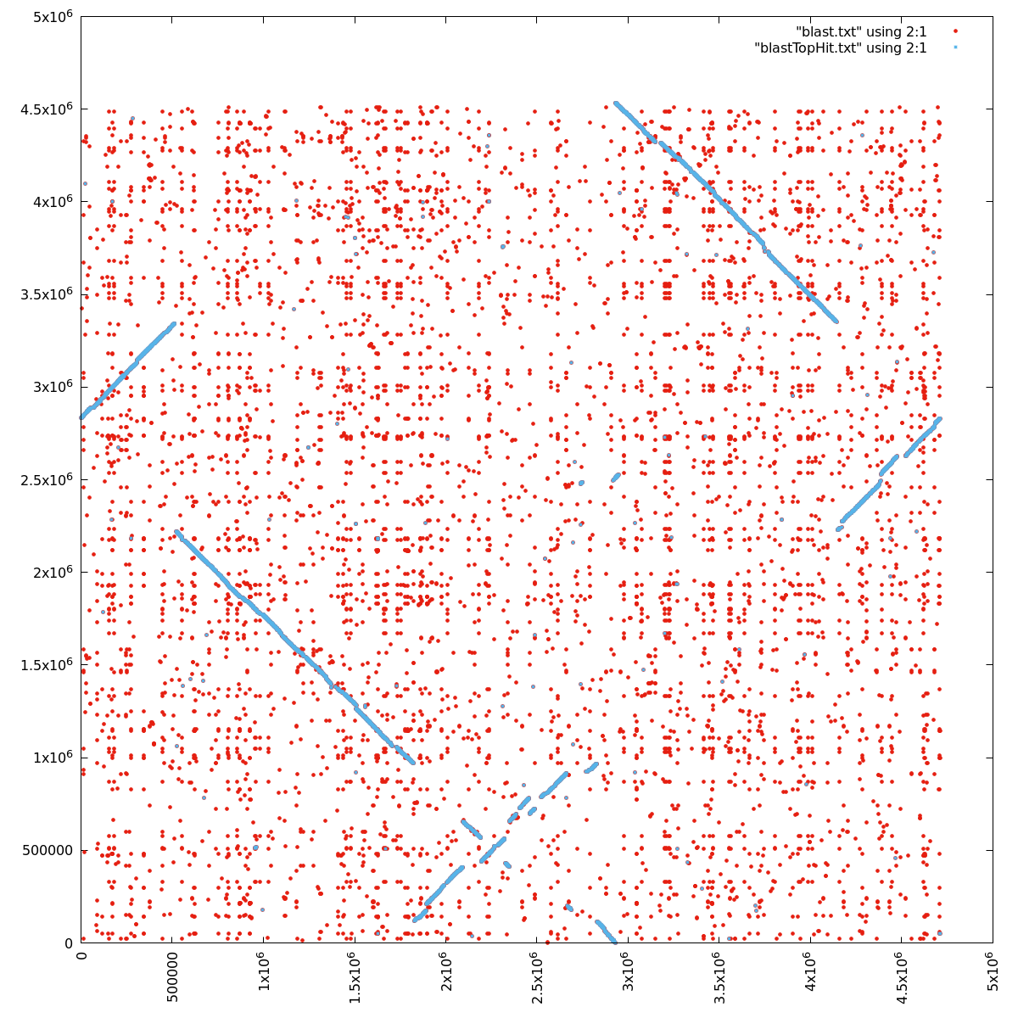
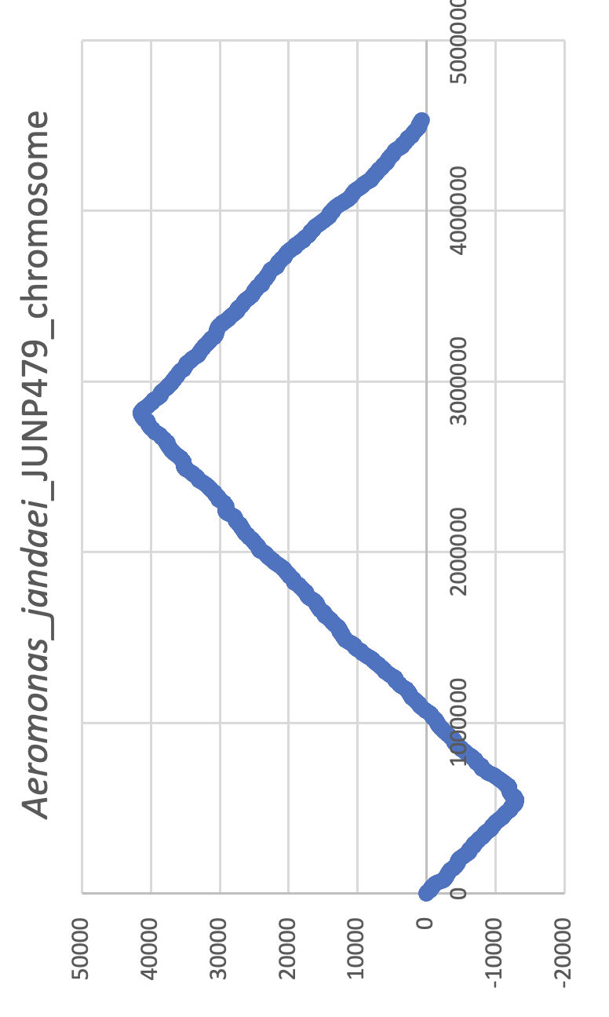
Origin
Origin
Terminus
Origin
A. jandaei JUNP479
Terminus
A. veronii HM21

Slide 19
Origin
Origin
Terminus
Origin
A. jandaei JUNP479
Terminus
A. veronii HM21

Slide 20
Origin
Origin
Terminus
A. jandaei JUNP479
Terminus
A. veronii HM21

Slide 21
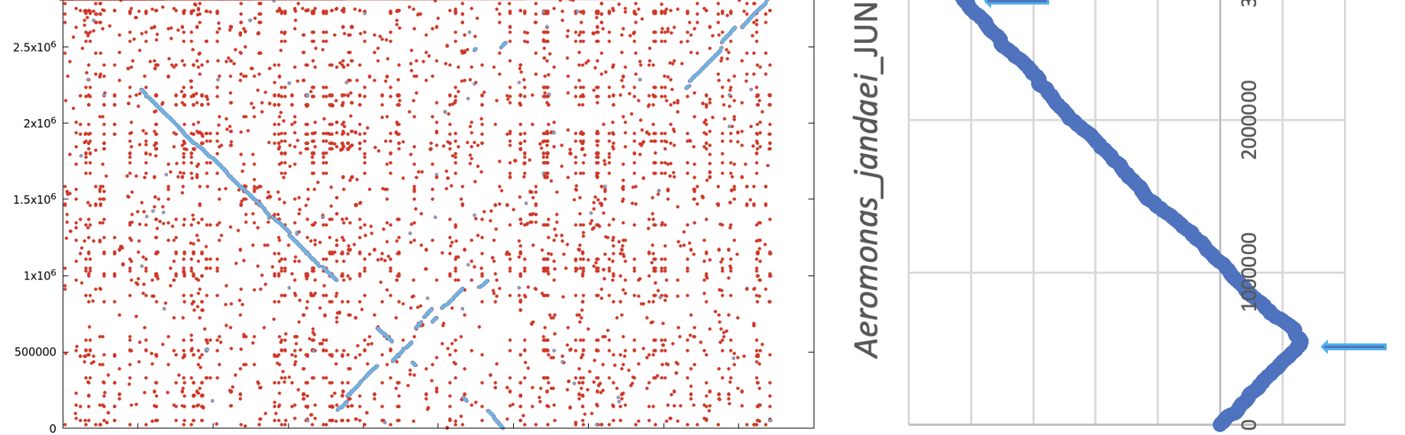
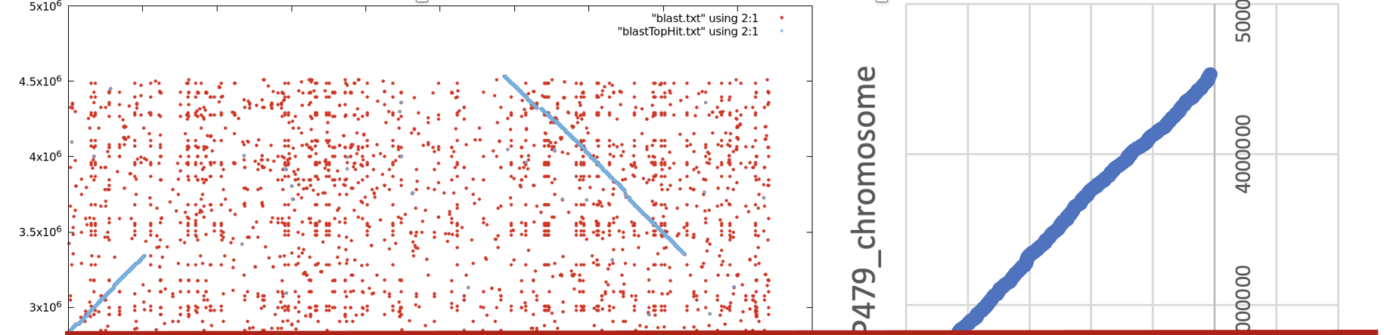
Origin
Origin
Terminus
Origin
A. jandaei JUNP479
Terminus
Origin
A. veronii HM21

Slide 22
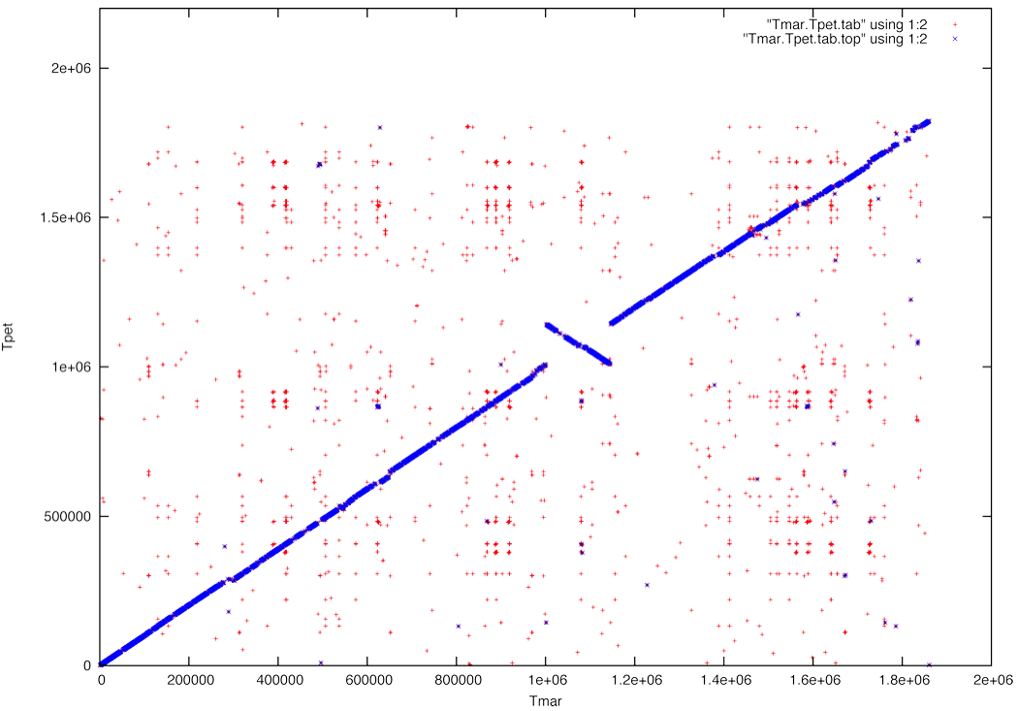
2
3
X axis
1
#3
3
2
2
#2
#1
1
y axis
1
3
1
2
3

Slide 23
2
3
X axis
1
#3
3
2
2
#2
#1
1
X axis
1
3
1
2
3

Slide 24
What mechanism is this graph depicting when blue dots appear on the downward sloping diagonal?
A. Recombination between two points in the genome leading to an inversion
B. Deletion or Insertion
C. Translocation
D. Paralogs
E. All of the above
What does the blue line represent?
A. The location of all genes in one genome versus the location of the top scoring blast hit in the other genome
B. The location of all genes in one genome versus the location of ALL the blast hits in the other genome
C. The location of the gene in the environment
D. A and B
E. None of the above
What do the red dots represent?
A. False positives
B. False negatives
C. Partial matches
D. Paralogs in the genome
E. Orthologs in the genome

Slide 25
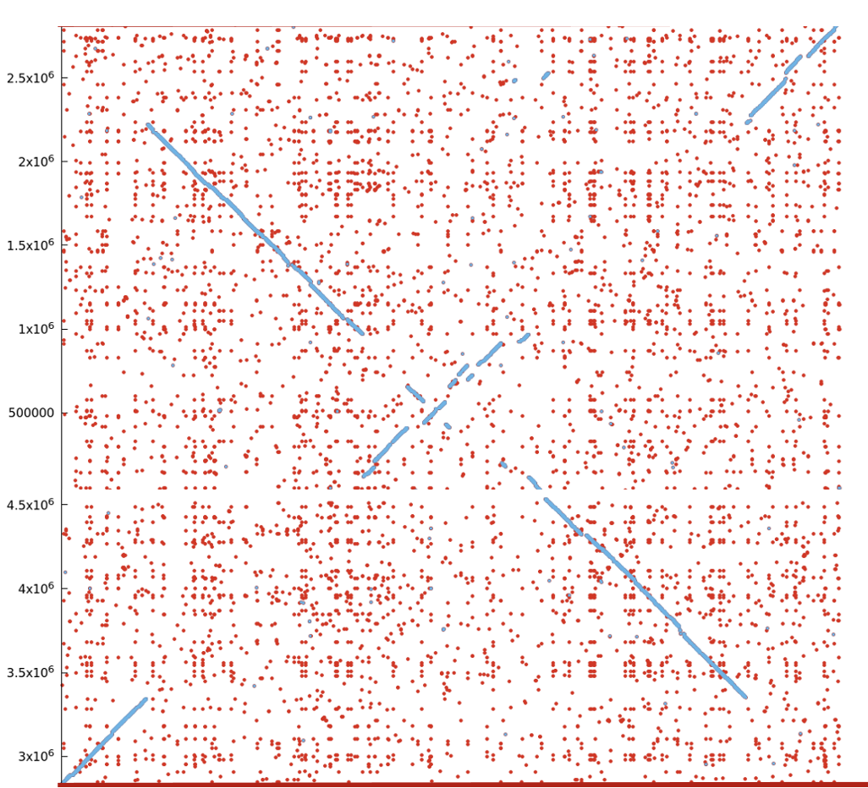
3
5
2
4
X axis
2
1
5
3
3
4
2
4
Y axis
1
1
5
1
3
4
5
2

Slide 26
3
5
2
4
X axis
2
1
5
3
3
4
2
4
Y axis
1
1
5
1
3
4
5
2

Slide 27
Following a gene duplication, what is the most common outcome?
Neofunctionalization
Decay of one of the genes (non-functionalization)
Subfunctionalization
What is the most common pathway for gene family expansion in prokaryotes:
  Gene duplications
  Genome duplications
  Gene transfer
  De-novo creation of genes from non-coding sequences?
Why is percent identity in blast search results not a good measure to assess significant sequence similarity?
Short local matches can have high percent identity, without being rare, e.g., 3 out of 4 amino acids
a would be 75% identity, but 3 out of 4 identical aa occurs frequently by chance, if many sequences
are searched for local similarities.

Slide 28
Two BLASTp hits have E-values of 0.0 and 1e-67. Which of these statements is true?
A) 1e-67 is a very large negative number, giving a highly significant match
B) E-values of 0 aren't possible
C) 1e-67 is a very small positive number, indicating a significant match
D) an unexpected intein probably corrupted the PSSM, and it zeroed out
E) these proteins almost certainly are ATPase subunits from an extinct archaeon
F) you forgot to format the database first (makeblastdb), a common mistake
G) the only way to tell if these hits are significant is to look at the percent identity of the high-scoring segment pairs (HSPs)
H) 1e-67 looks like an isoelectric point, meaning that the query sequence is likely from an extremophilic organism living in deep-sea hydrothermal vents
I) these values should be interpreted as 0% and 67% homology, respectively, indicating that horizontal transfer occurred recently

Slide 29
What might have happened in the genome plot given above?
A. One massive genome inversion, involving half of the genome
B. One round of whole genome duplication, so that every gene is present in one of the two genomes twice and only once in the other
C. Two identical genomes were used, but their sequences do not start in a homologous position.
D. There is a strong strand bias.
E. The “forward” strand of one genome was reported, while the reverse complement was reported in the other genome

