Slide 1
MCB 3421 2021
Class 25
Discussion of computer lab 13
The power of Script and R
Bipartition paradox and embedded quartets
Constructive neutral evolution

Slide 2

Do the SET survey!
(from https://www.reddit.com/r/school_memes/ )

Slide 3

Reminder
Be Nice !
Do the SETs
Columbia from https://en.wikipedia.org/wiki/Uncle_Sam

Slide 4
Strategies for extreme halophily
Exclude salts, balance with other osmotically active substances.
Balance external Na⁺ Cl⁻ with internal K⁺ Cl⁻
  This leads to very high internal K⁺ concentration (> 5M)
  At this ionic strength, the reach of a charge on a protein does not reach very far.
  To compensate, proteins in organisms following the salt in strategy have many
  negative charges.
  Consequently, most proteins have an acidic isoelectric point.

Slide 5
PEPSTATS of QAY18538.1 from 1 to 580
Molecular weight = 64213.14 Residues = 580
Average Residue Weight = 110.712 Charge = -74.0
Isoelectric Point = 3.9355
A280 Molar Extinction Coefficients = 21890 (reduced) 22140 (cystine bridges)
A280 Extinction Coefficients 1mg/ml = 0.341 (reduced) 0.345 (cystine bridges)
Probability of expression in inclusion bodies = 0.979
Residue Number Mole% DayhoffStat
A = Ala 46 7.931 0.922
B = Asx 0 0.000 0.000
C = Cys 4 0.690 0.238
D = Asp 81 13.966 2.539
/.../
Property Residues Number Mole%
Tiny (A+C+G+S+T) 157 27.069
Small (A+B+C+D+G+N+P+S+T+V) 328 56.552
Aliphatic (A+I+L+V) 169 29.138
Aromatic (F+H+W+Y) 38 6.552
Non-polar (A+C+F+G+I+L+M+P+V+W+Y) 267 46.034
Polar (D+E+H+K+N+Q+R+S+T+Z) 313 53.966
Charged (B+D+E+H+K+R+Z) 196 33.793
Basic (H+K+R) 63 10.862
Acidic (B+D+E+Z) 133 22.931

Slide 6
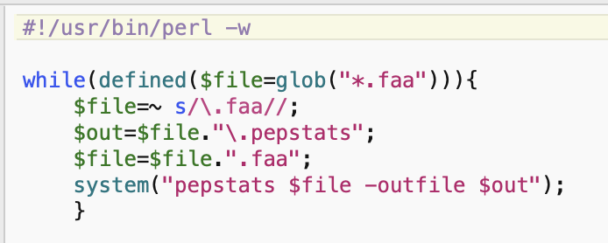
run_pepstats.pl

Slide 7
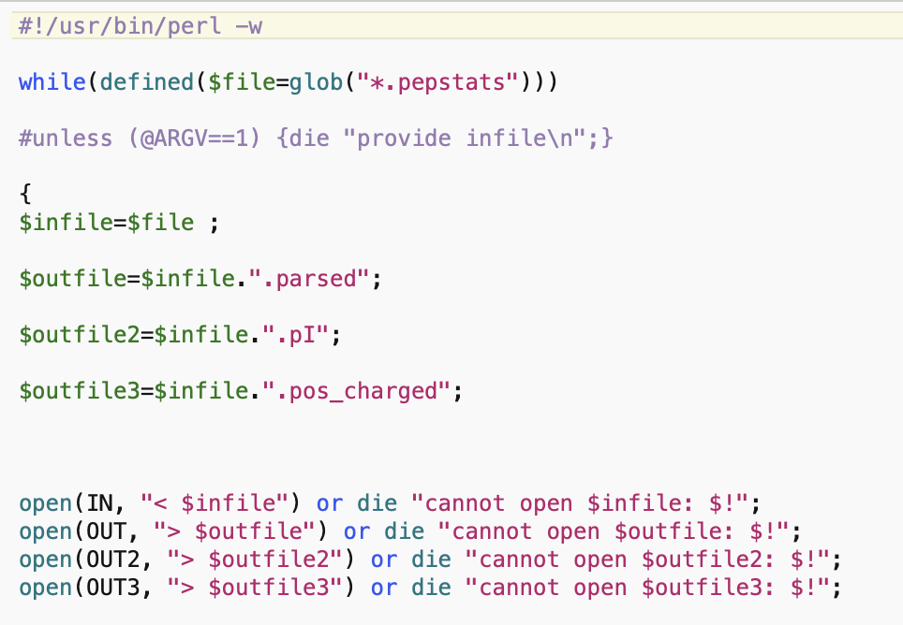
parse_pepstats.pl

Slide 8
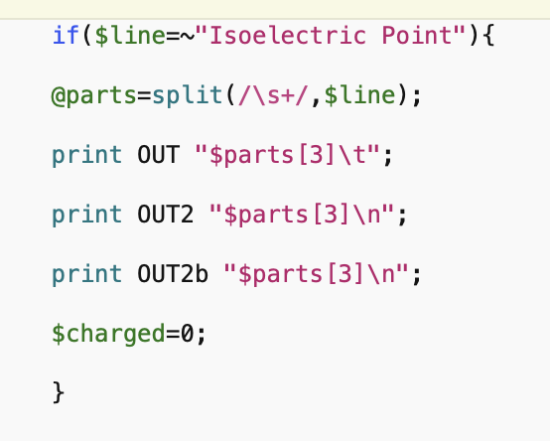
parse_pepstats_mod.pl

Slide 9
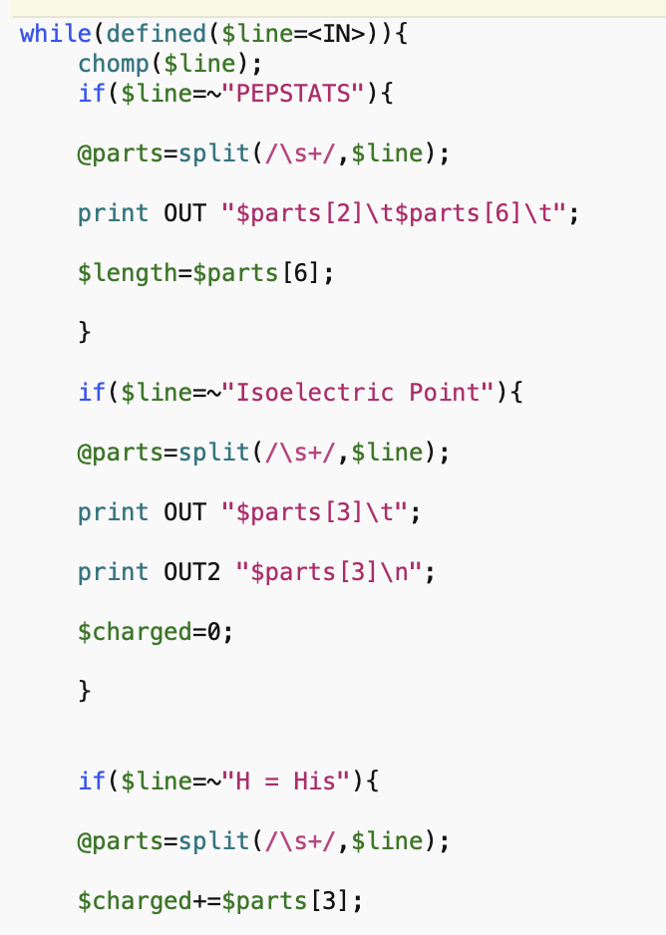
parse_pepstats.pl

Slide 10
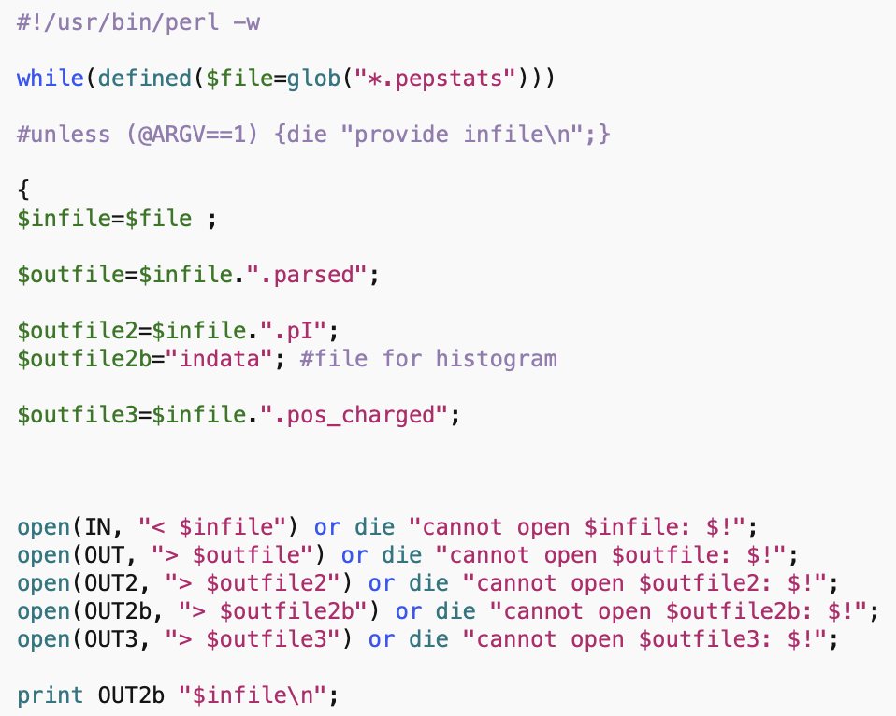
parse_pepstats_mod.pl

Slide 11
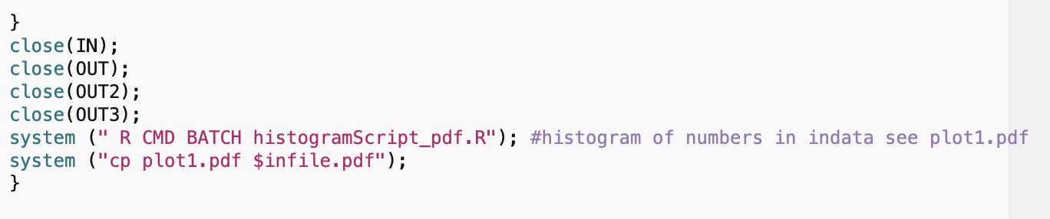
parse_pepstats_mod.pl

Slide 12
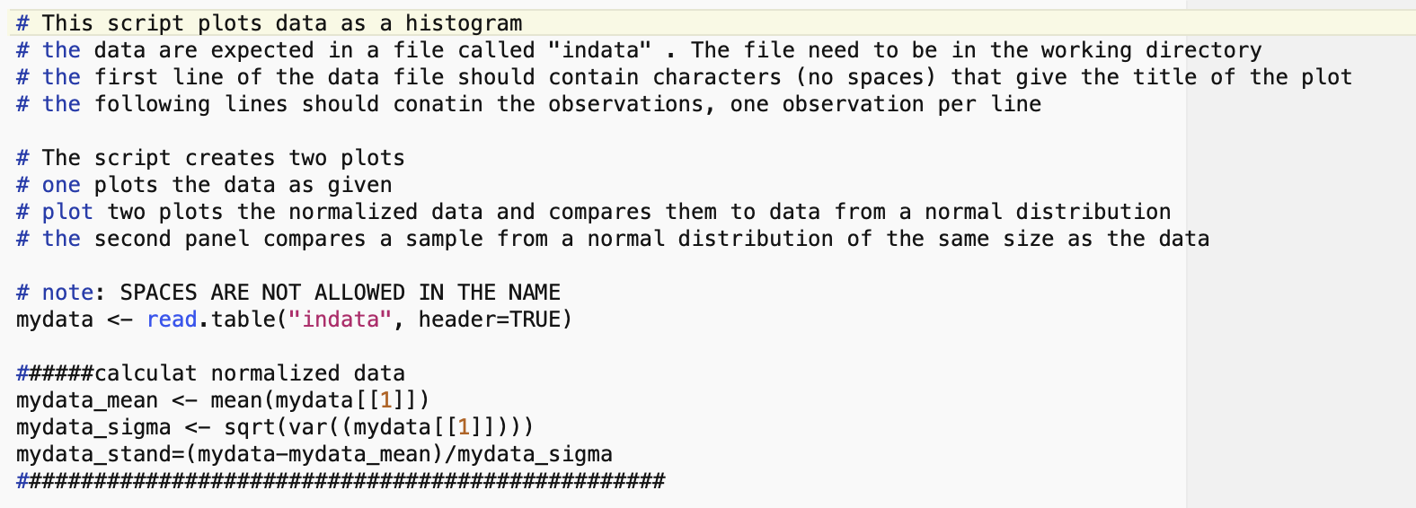
histogramScript_pdf.R

Slide 13
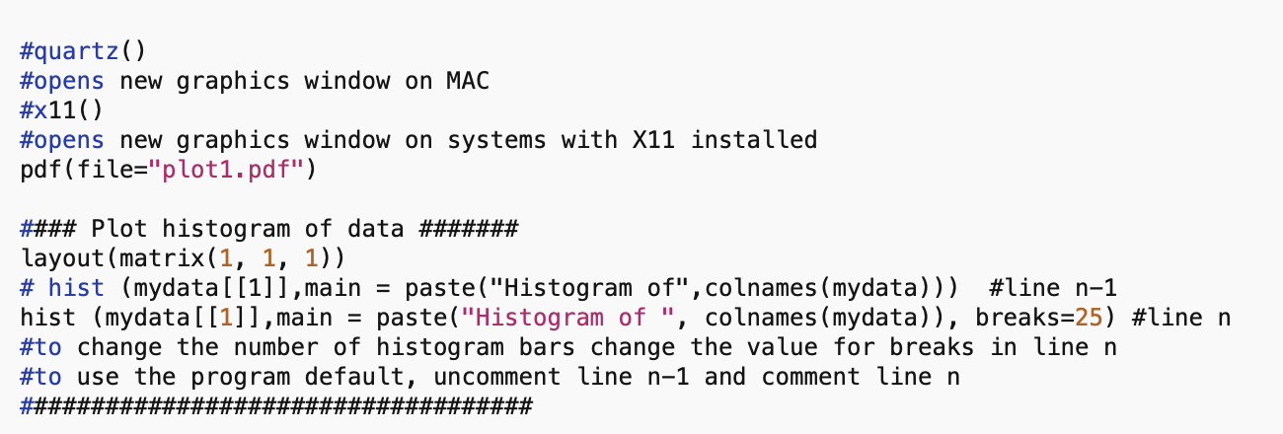
histogramScript_pdf.R

Slide 14
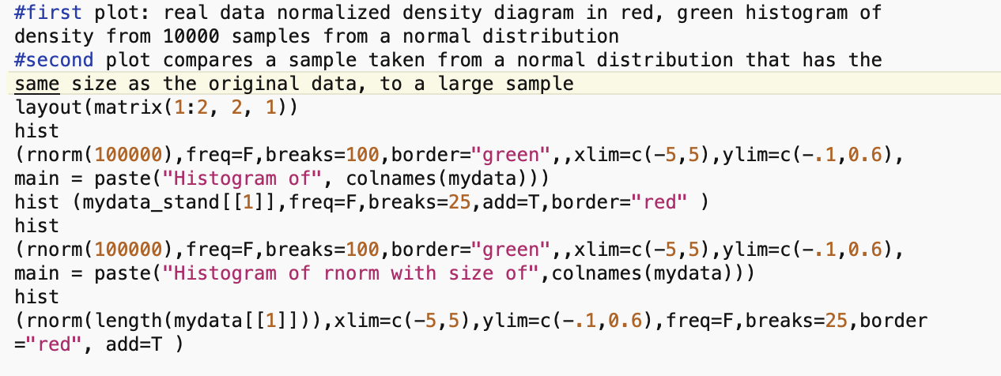
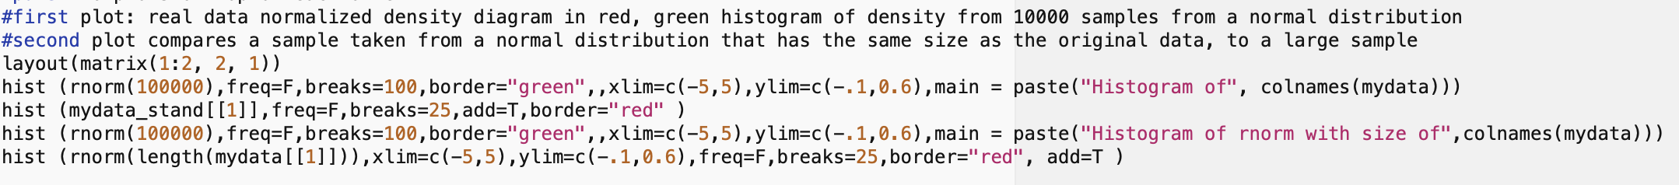
histogramScript_pdf.R

Slide 15
Green: Normal distribution with 100,000 samples
Red: Actual theoretical IEP data
Green: Normal distribution with 100,000 samples
Red: Normal distribution with same number of samples as real data

Slide 16
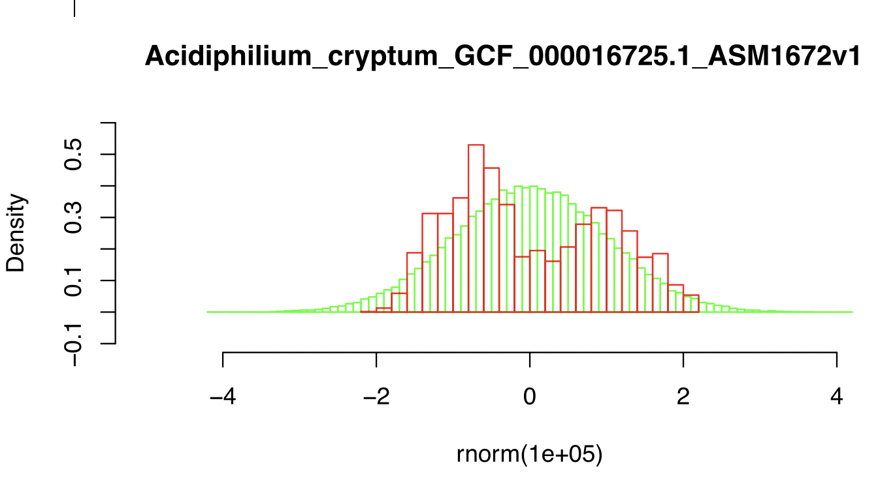

Slide 17
DNA, cell wall & membrane bound proteins
pH at which protein has no charge
Thermo-acidophiles have the same bimodal distribution as other bacteria.
No indication that these organimsm have a more acidic intracellular pH.
Notes:
Aside on Thermoplasma intein splicing of A-subunit expressed in E.coli https://www.ncbi.nlm.nih.gov/pmc/articles/PMC60005/?tool=pubmed .

Slide 18
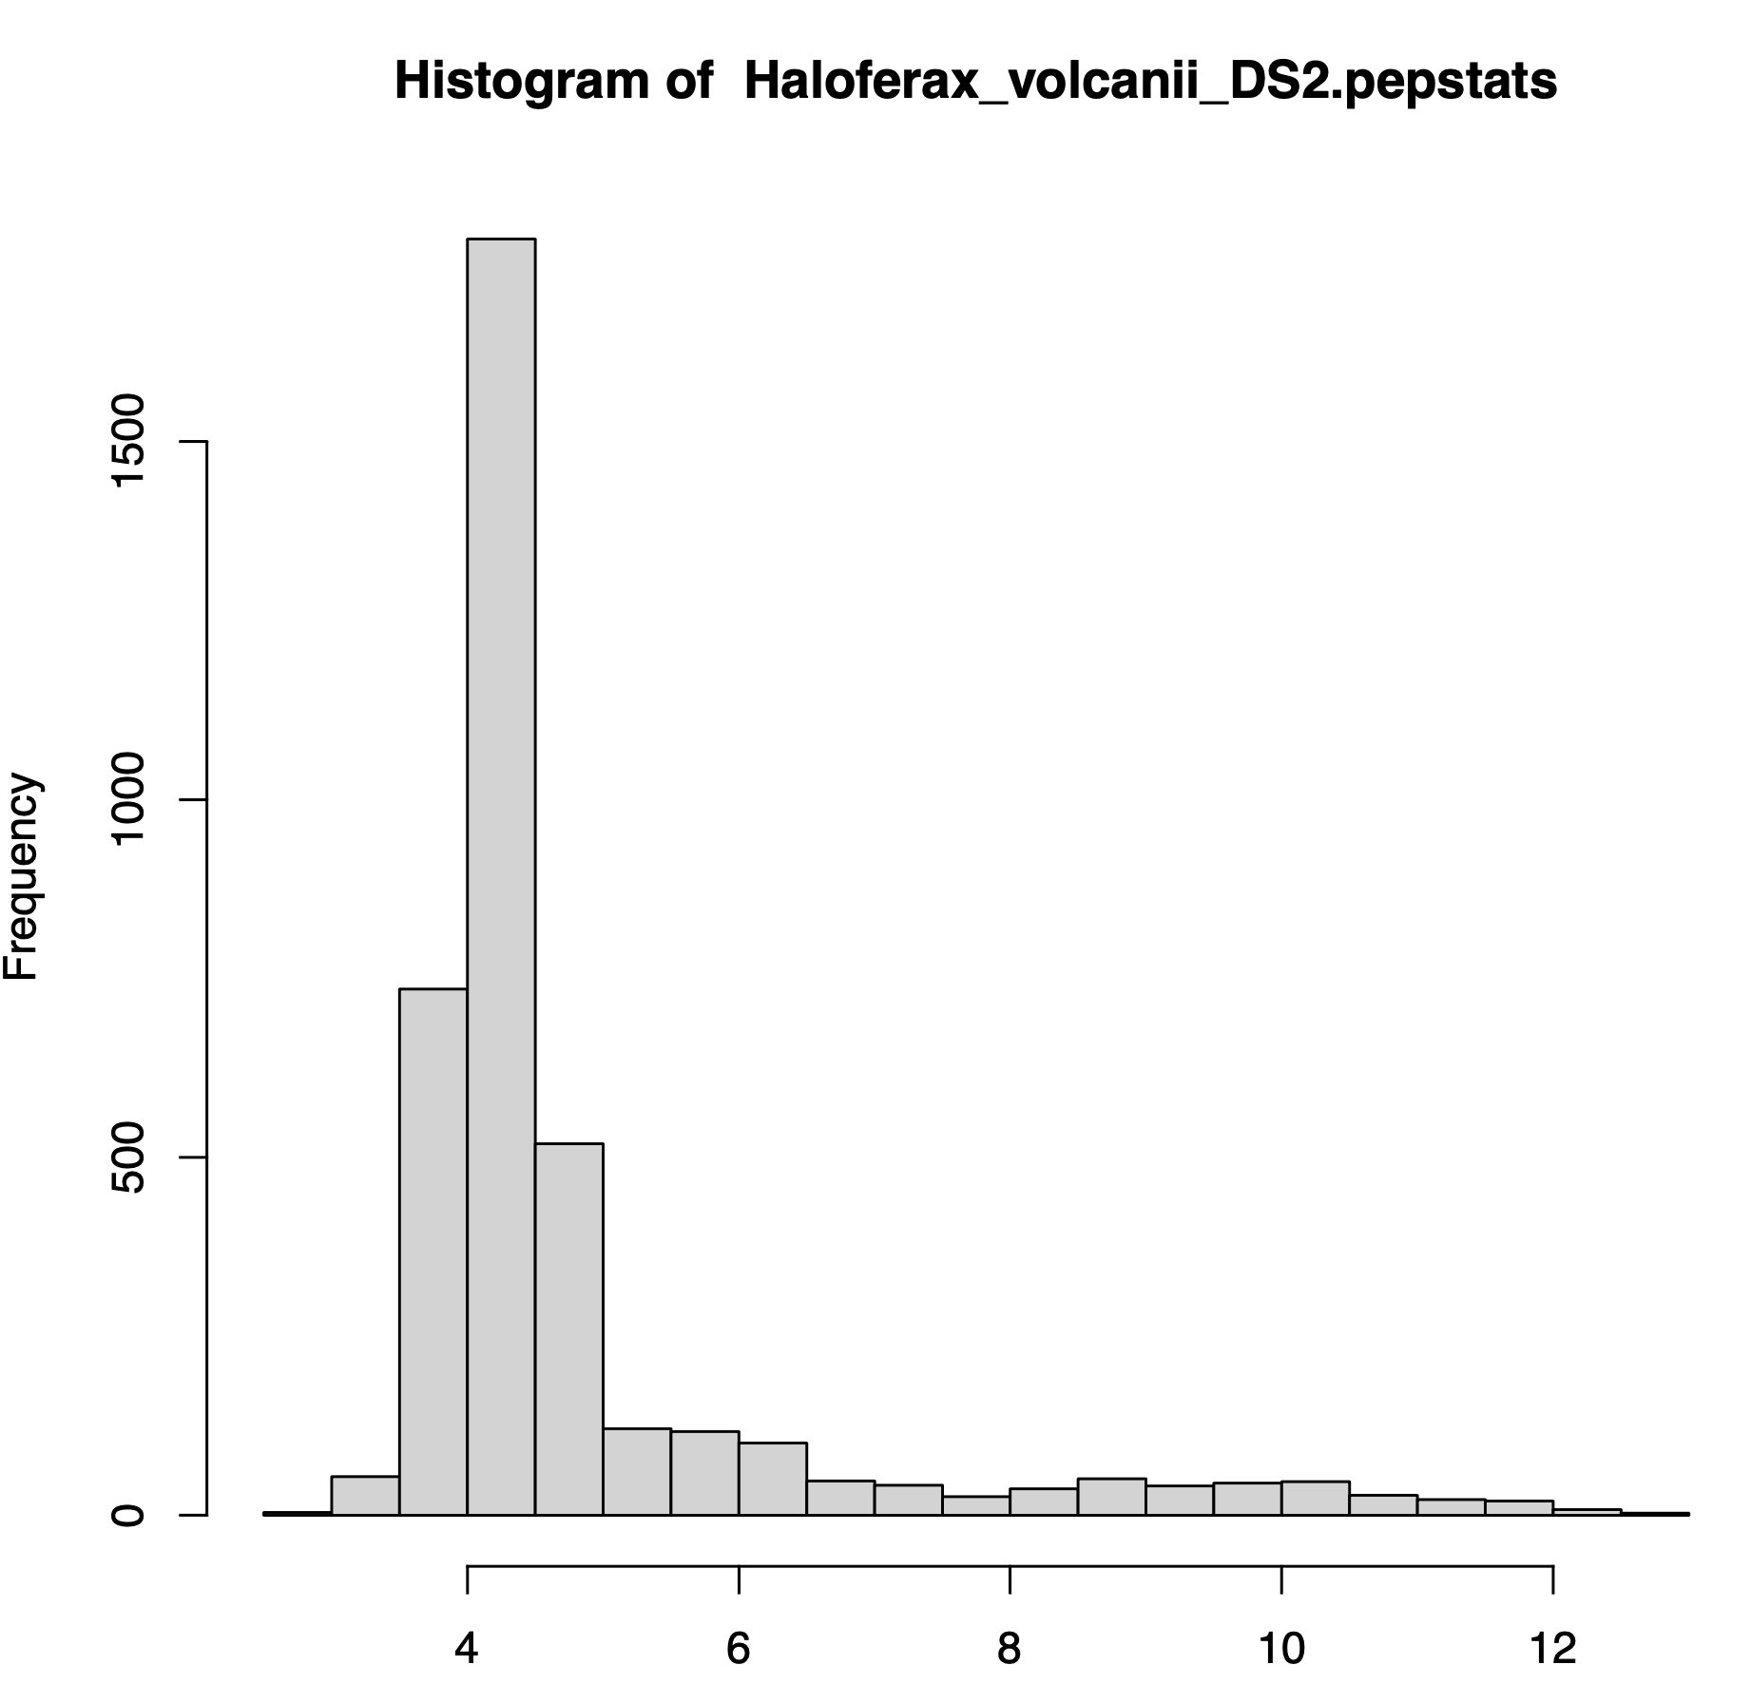
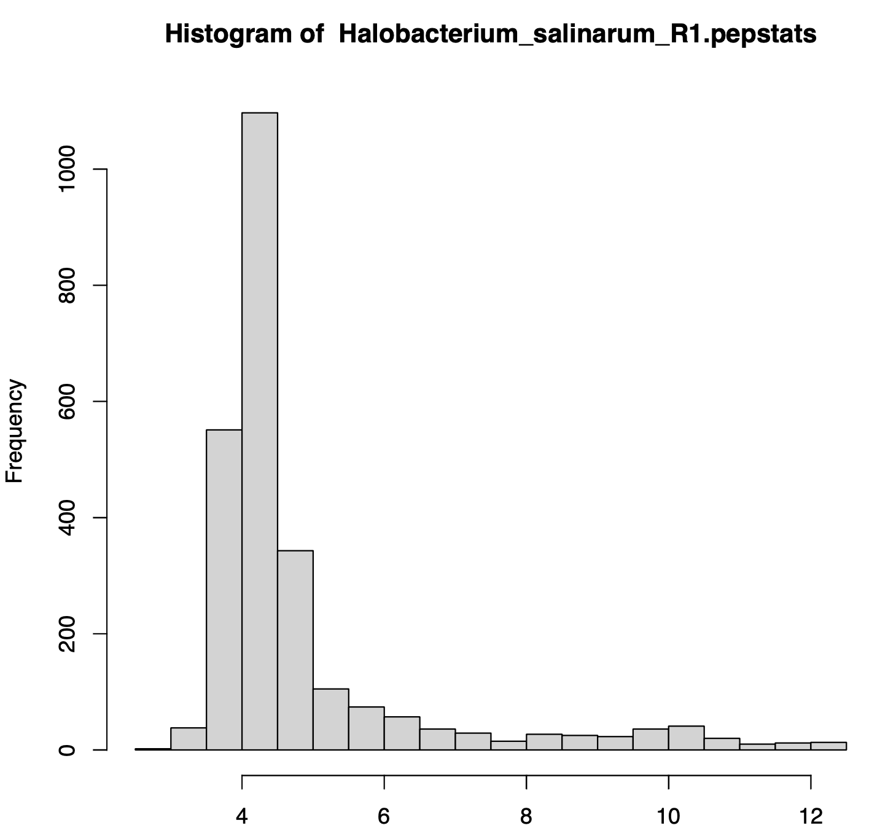
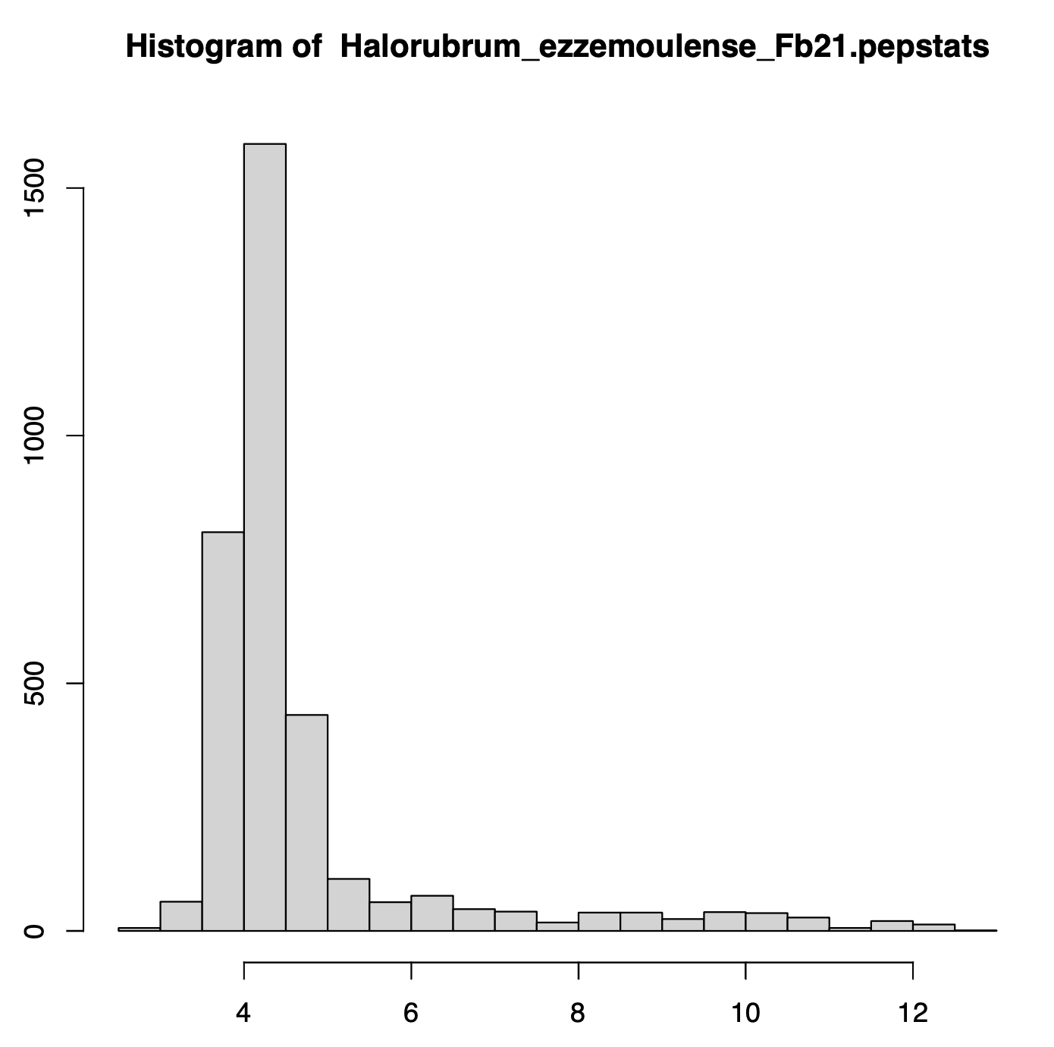
Salt-in strategists -- Haloarchaea
Haloferax_volcanii_DS2
Halobacterium_salinarum_R1
Halorubrum_ezzemoulense_Fb21

Slide 19
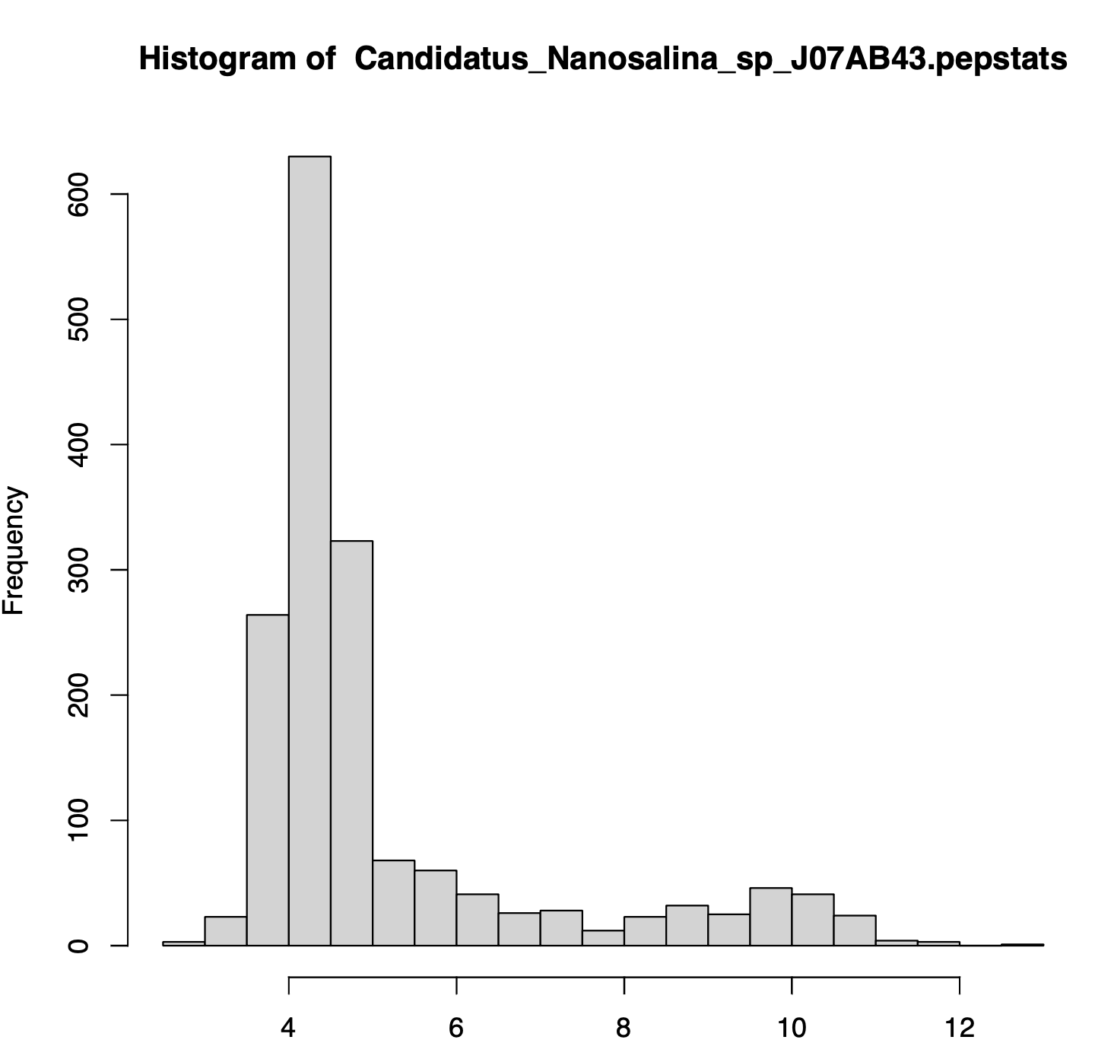
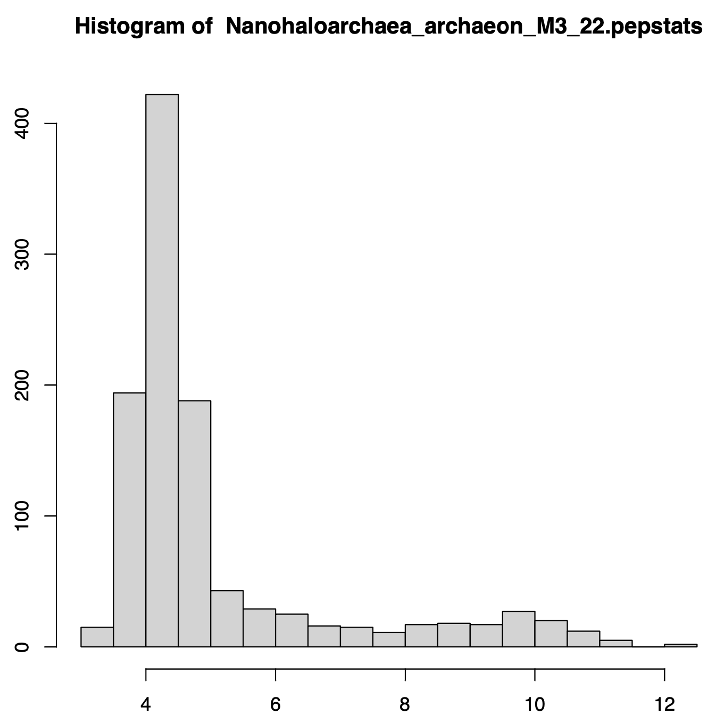
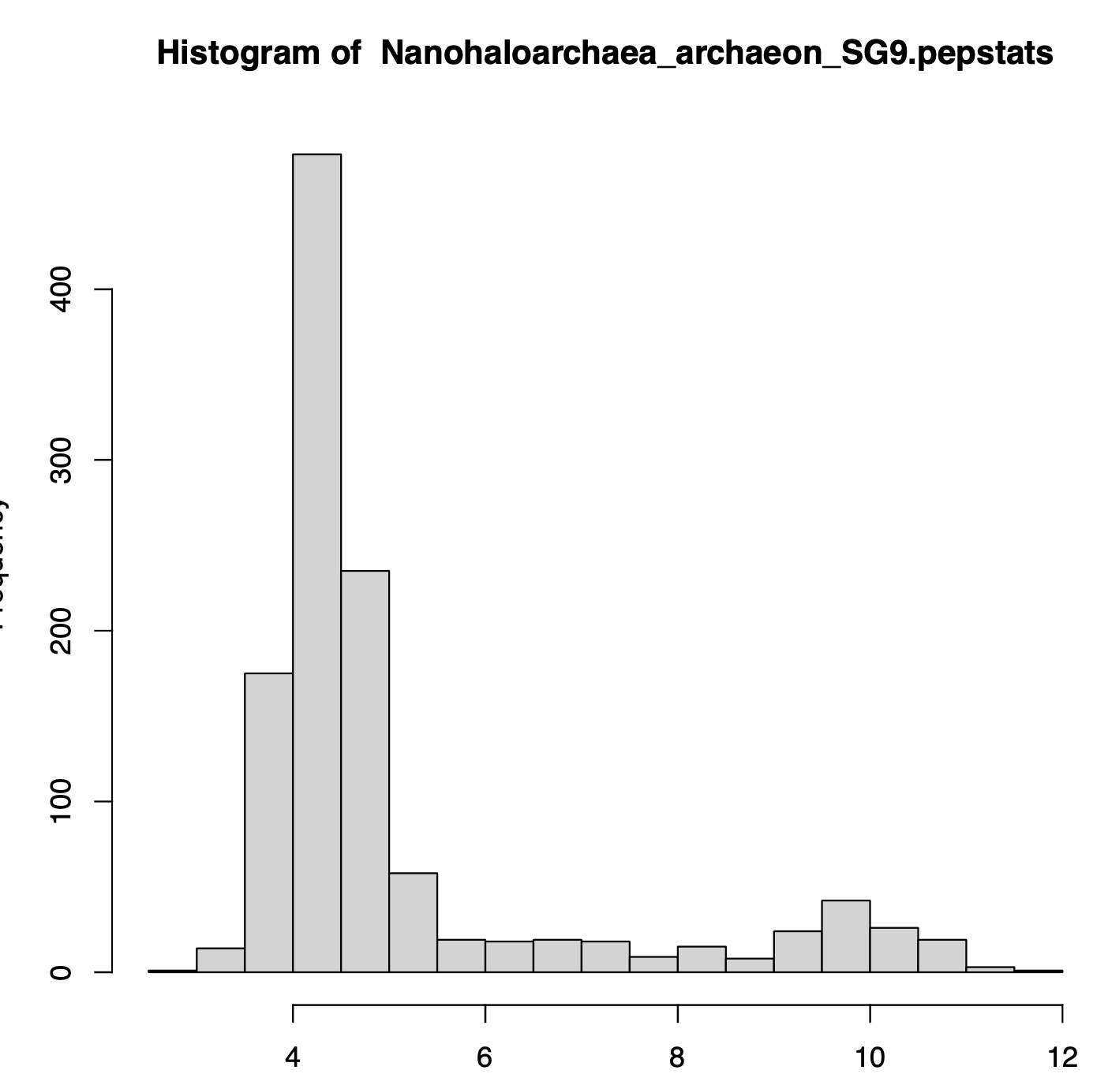
Salt-in strategists -- Nanohaloarchaea
Candidatus_Nanosalina_sp_J07AB43
Nanohaloarchaea_archaeon_M3_22
Nanohaloarchaea_archaeon_SG9

Slide 20
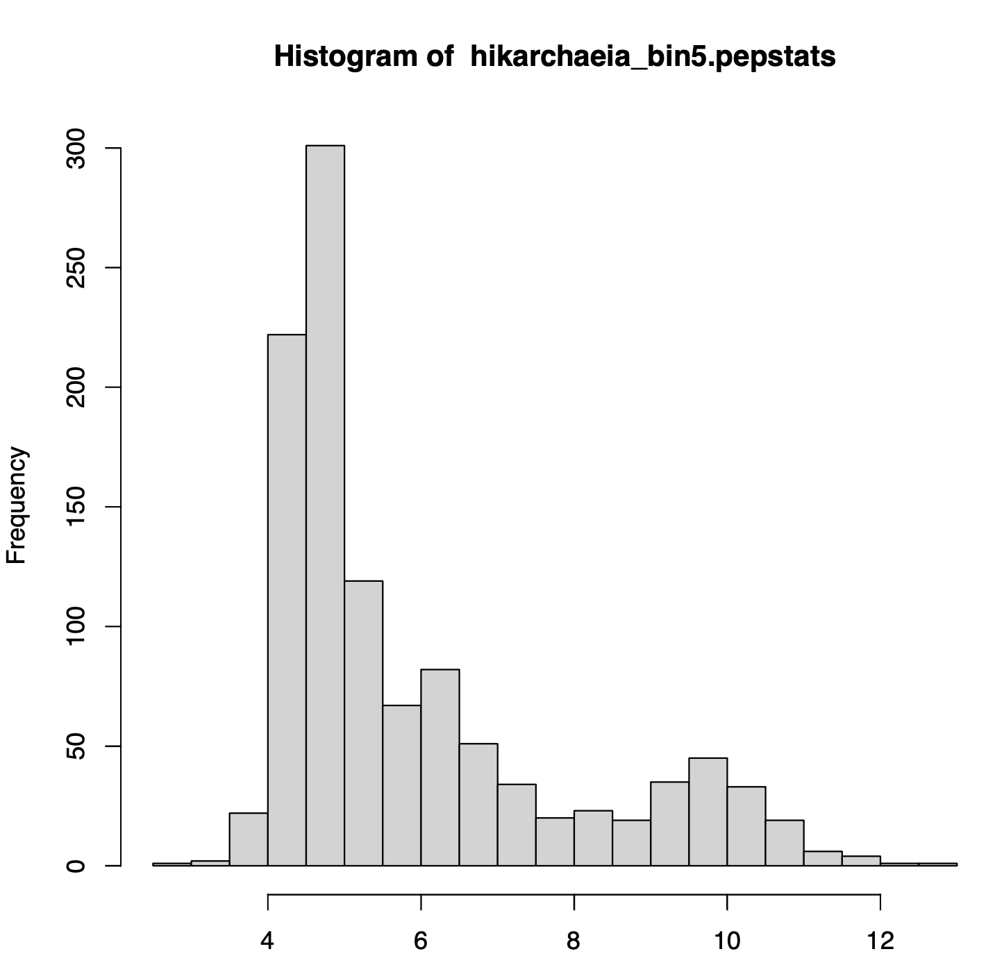
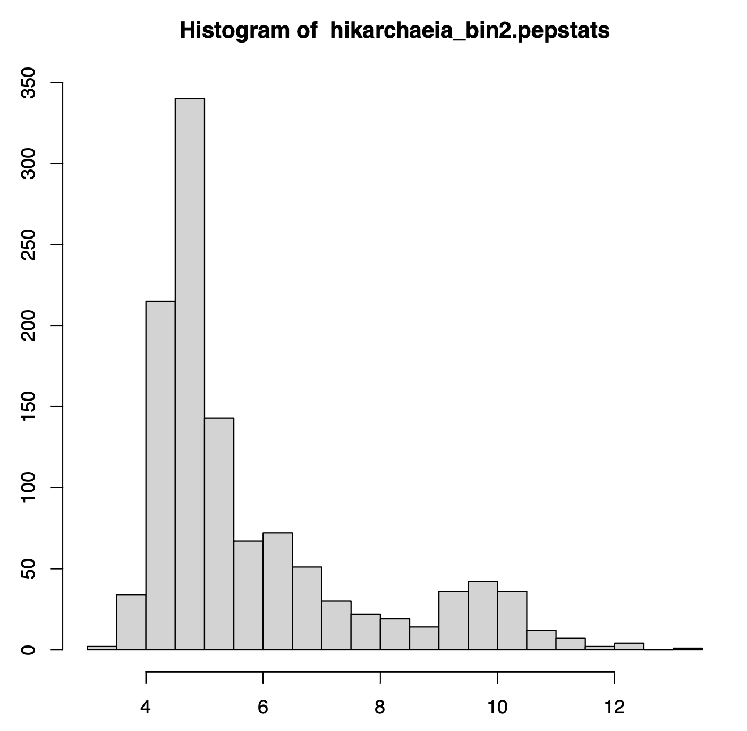
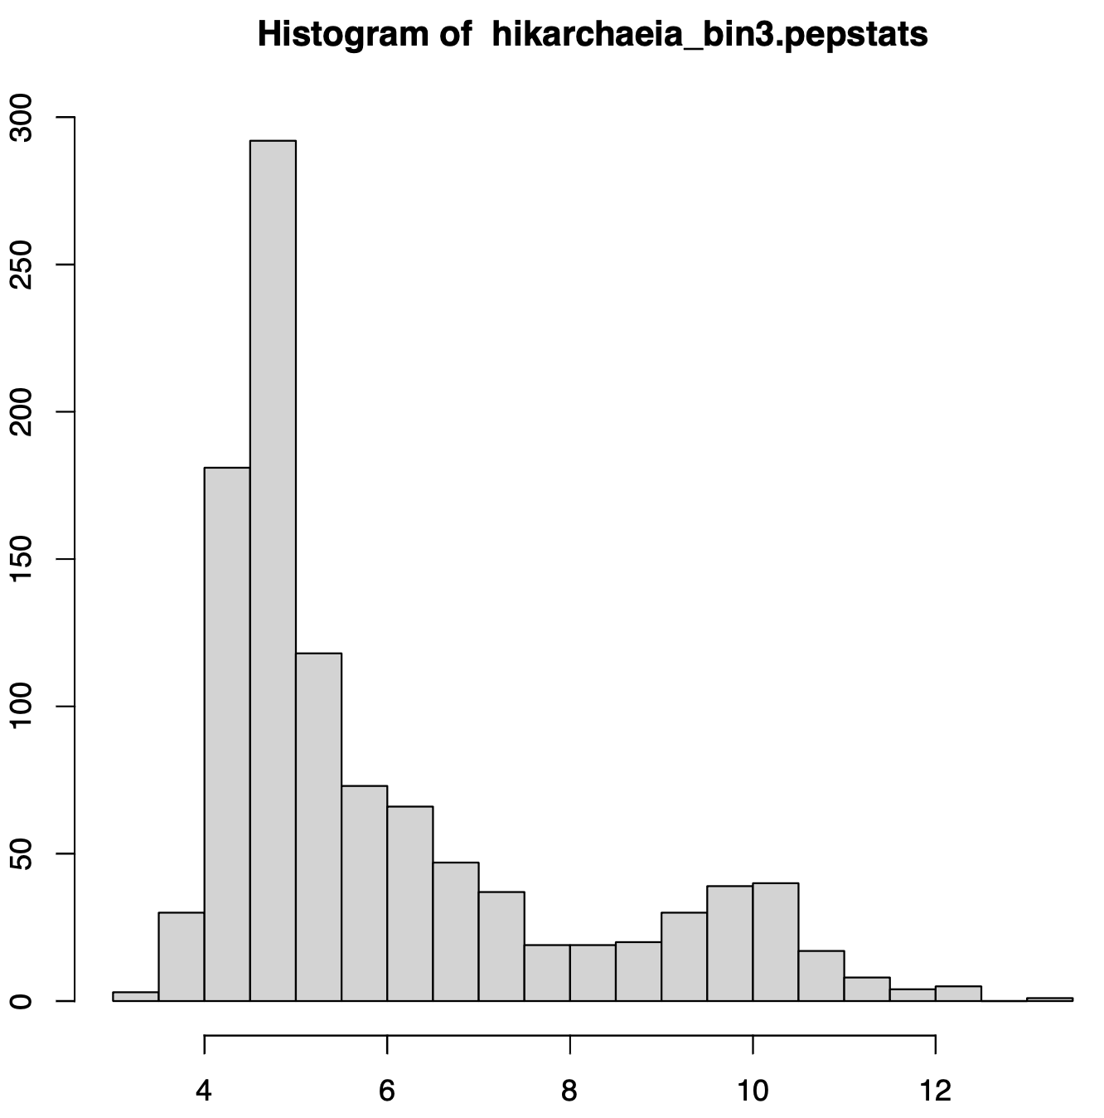
Salt-in strategists ? –
Hikarchaeia or Group IV Marine Archaea
hikarchaeia_bin5
hikarchaeia_bin3
hikarchaeia_bin2
Likely phylogenetic sister group of the Haloarchaea – proteome appears to reflect salt in strategy

Slide 21
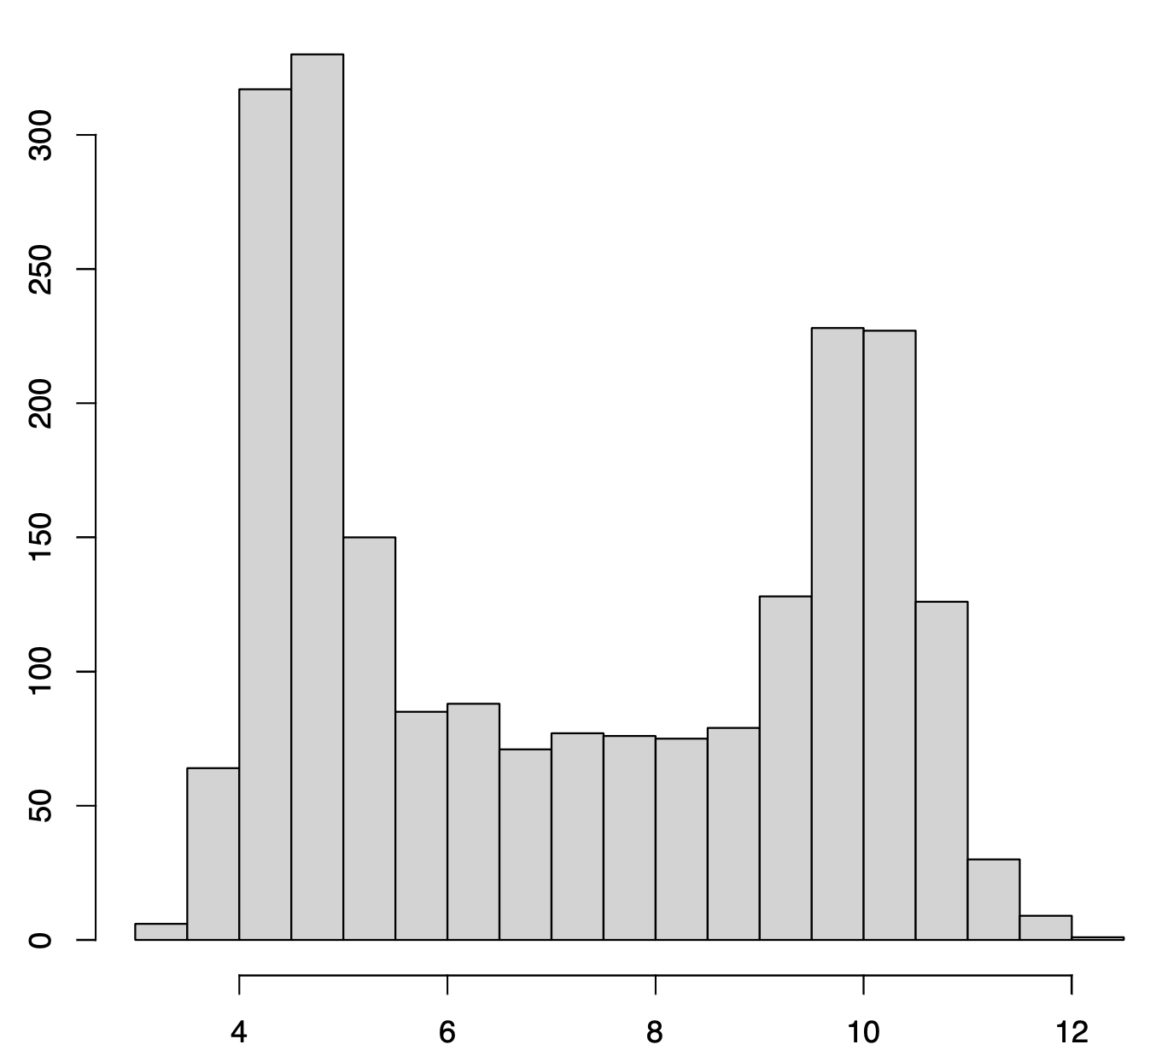
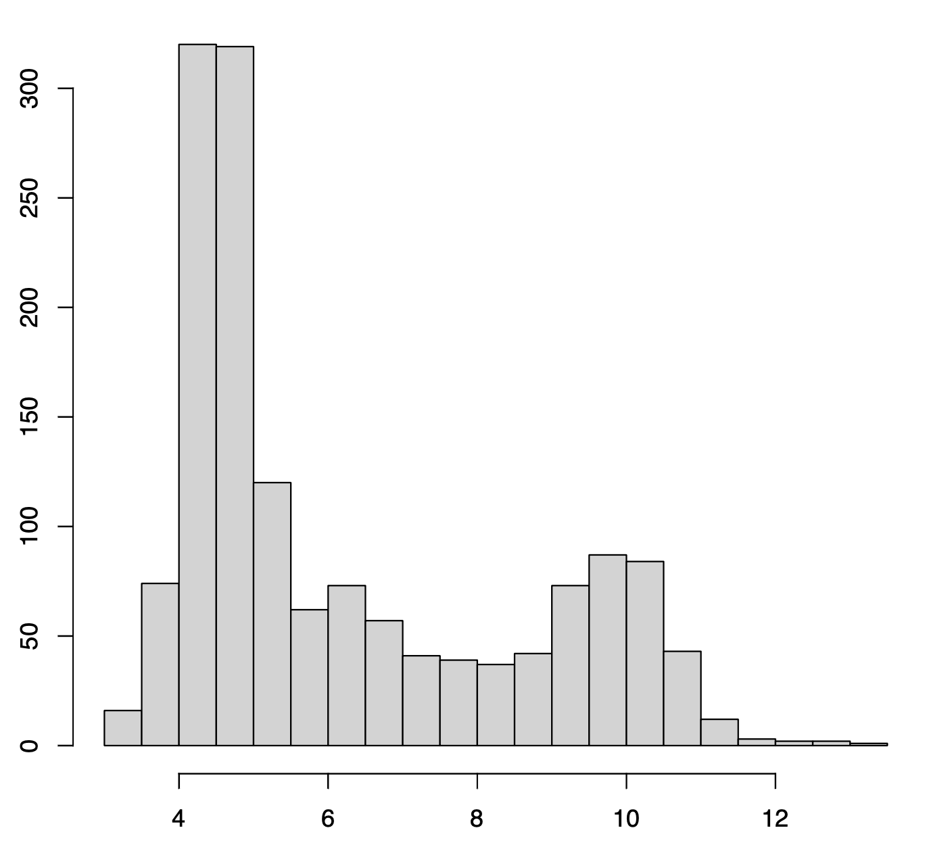
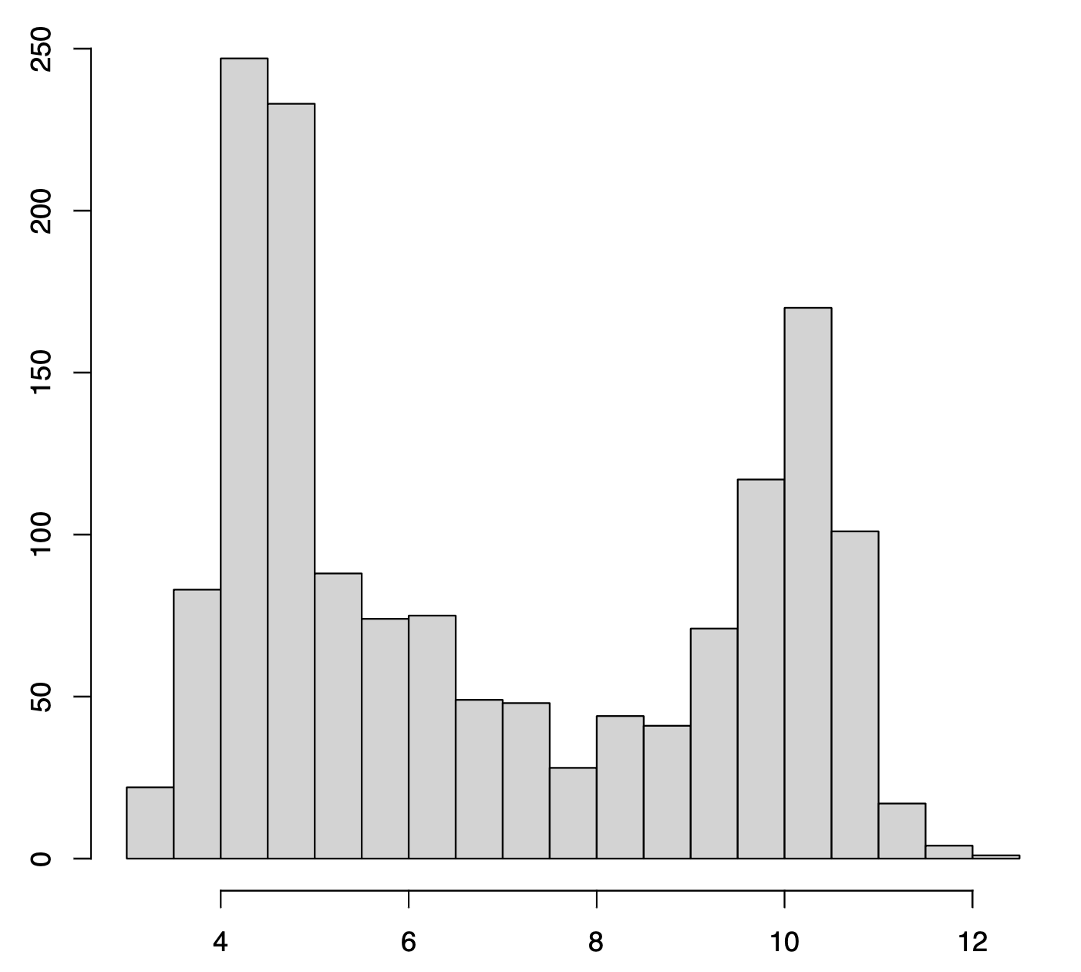
Methanonatronarchaeia --
Previously suggested sistergroup to the Haloarchaea
Methanonatronarchaeia_archaeon_
GCA_003555005.1
Methanonatronarchaeum
thermophilum_GCF_002153915
Ca_Methanohalarchaeum_thermophilum_
HMET1

Slide 22
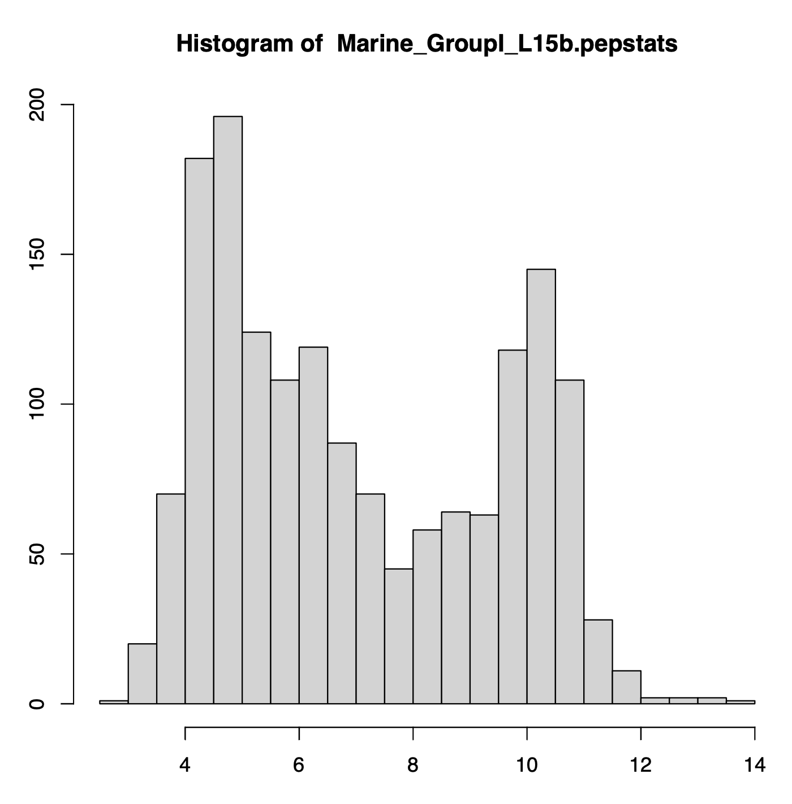
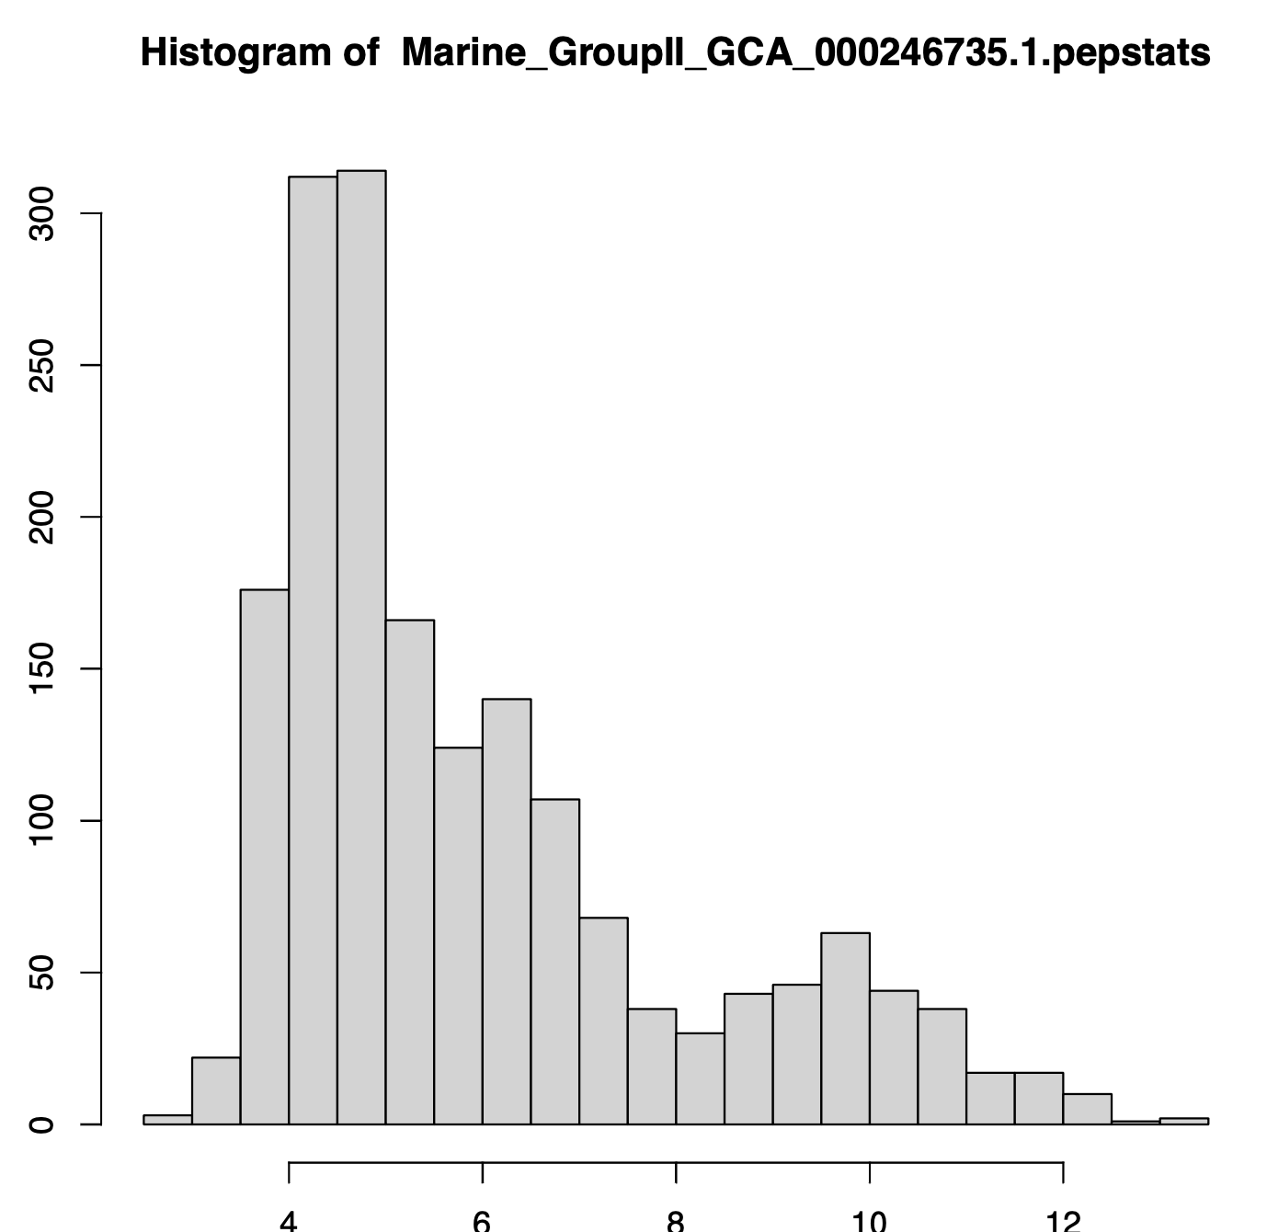
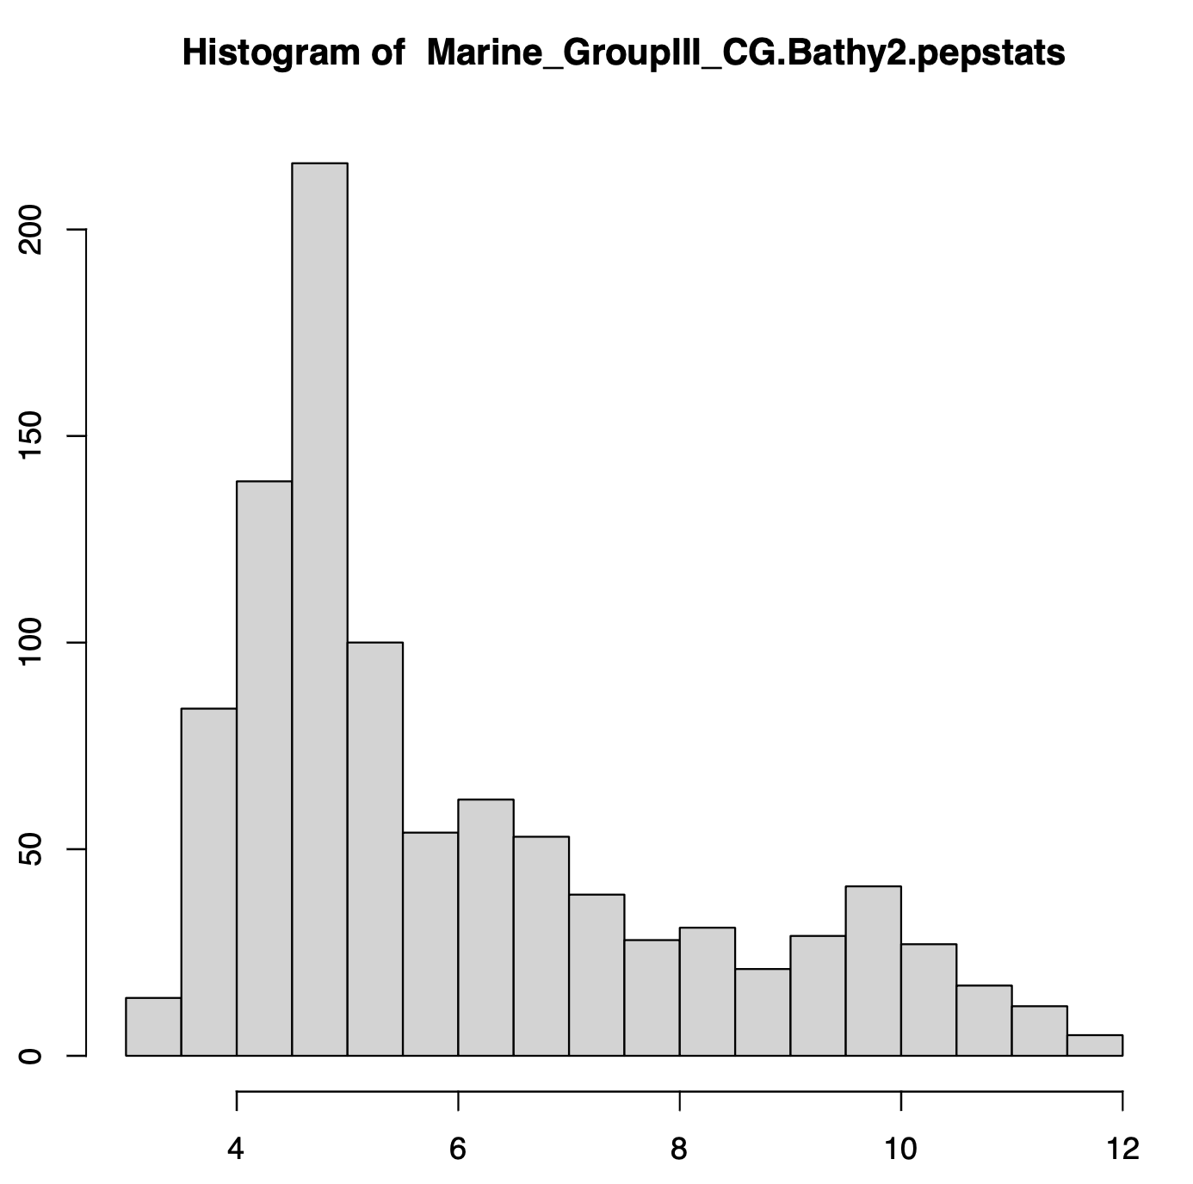
Other marine archaea

Slide 23
Not all Halophiles have a salt-in signature

Slide 24
Some bacteria evolved a salt-in strategy
Gene transfer and convergent evolution

Slide 25
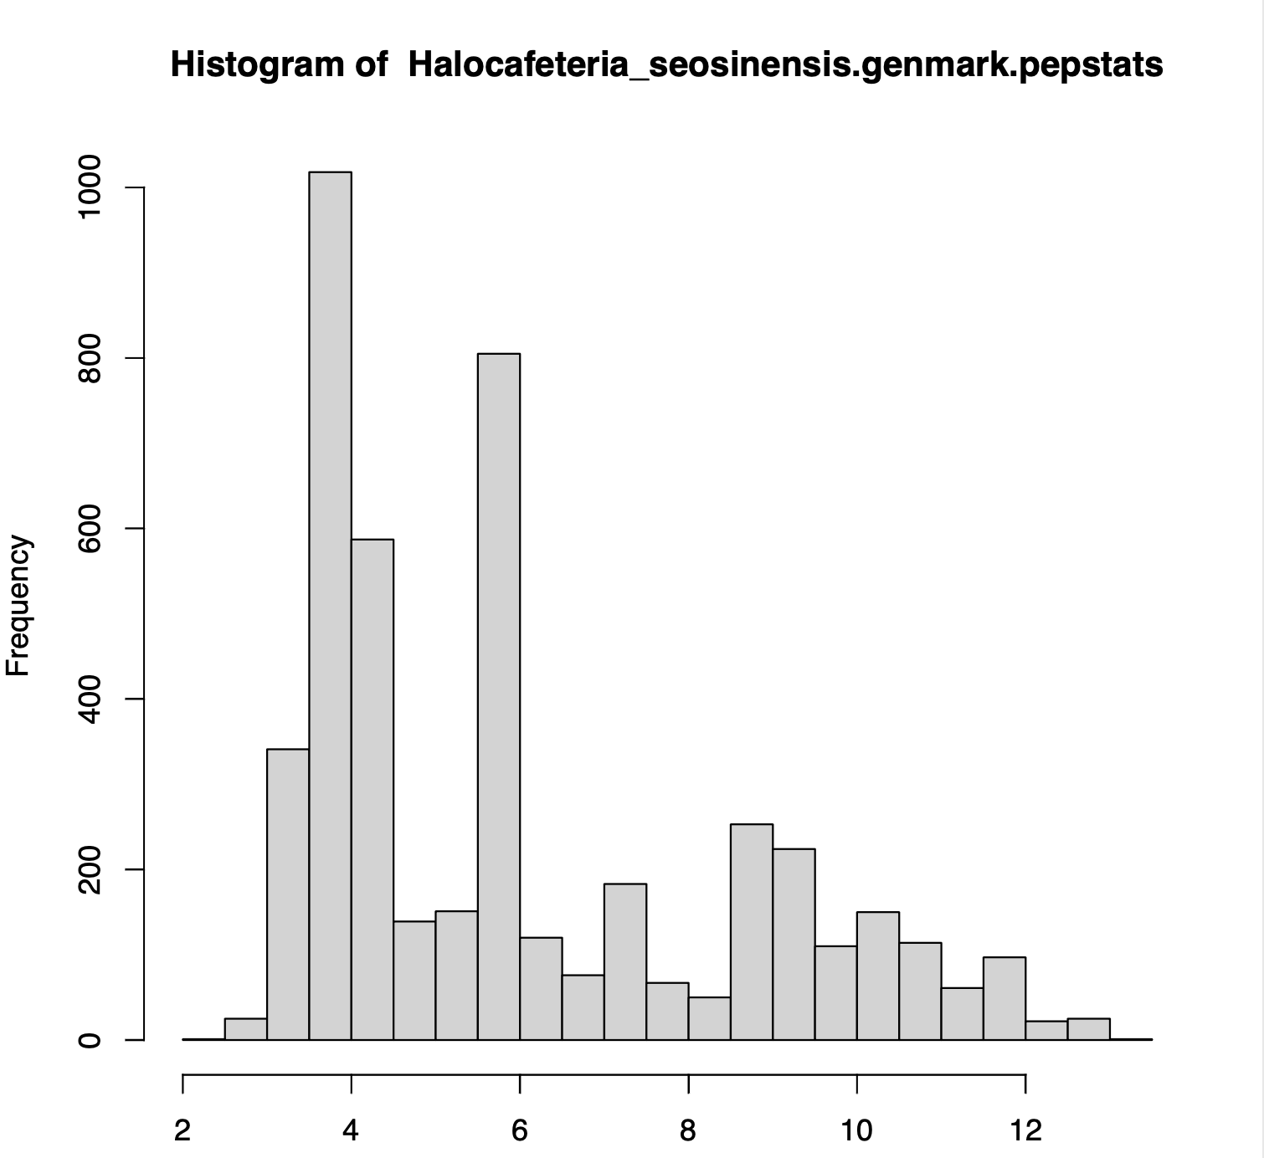
Halocafeteria – needs more work

Slide 26
The command line and scripting languages make your life a lot easier!
Work that is impossible using a GUI, is easily accomplished using simple scripts (shell scripts, python, perl) that execute system commands (via the command line repetitively).
Regular expressions allow to extract information from large files (e.g., species names from comment lines; details of protein statistics).
A large genomics and bioinformatics community exists that uses the R programming language for statistical computing.
  John Hopkins University is offering a course on R (not focused on Bioinformatics) via coursera (the course is free, you only pay, if you want a certificate). The course uses Rstudio, which provides an excellent notebook environment to keep track of your projects.
  Software carpentry workshops offered at UConn provide(d?) intros to the command line, R!, and github.

Slide 27
TOOLS TO ANALYZE PHYLOGENETIC INFORMATION FROM MULTIPLE GENES IN GENOMES:
Bipartition Spectra (Lento Plots)

Slide 28
BIPARTITION OF A PHYLOGENETIC TREE
Bipartition (or split) – a division of a phylogenetic tree into two parts that are connected by a single branch.
It divides a dataset into two groups, but it does not consider the relationships within each of the two groups.
Yellow vs Rest
* * * . . . * *
95
compatible to illustrated
bipartition
Orange vs Rest
. . * . . . . *
* * * . . . . .
incompatible to illustrated
bipartition

Slide 29
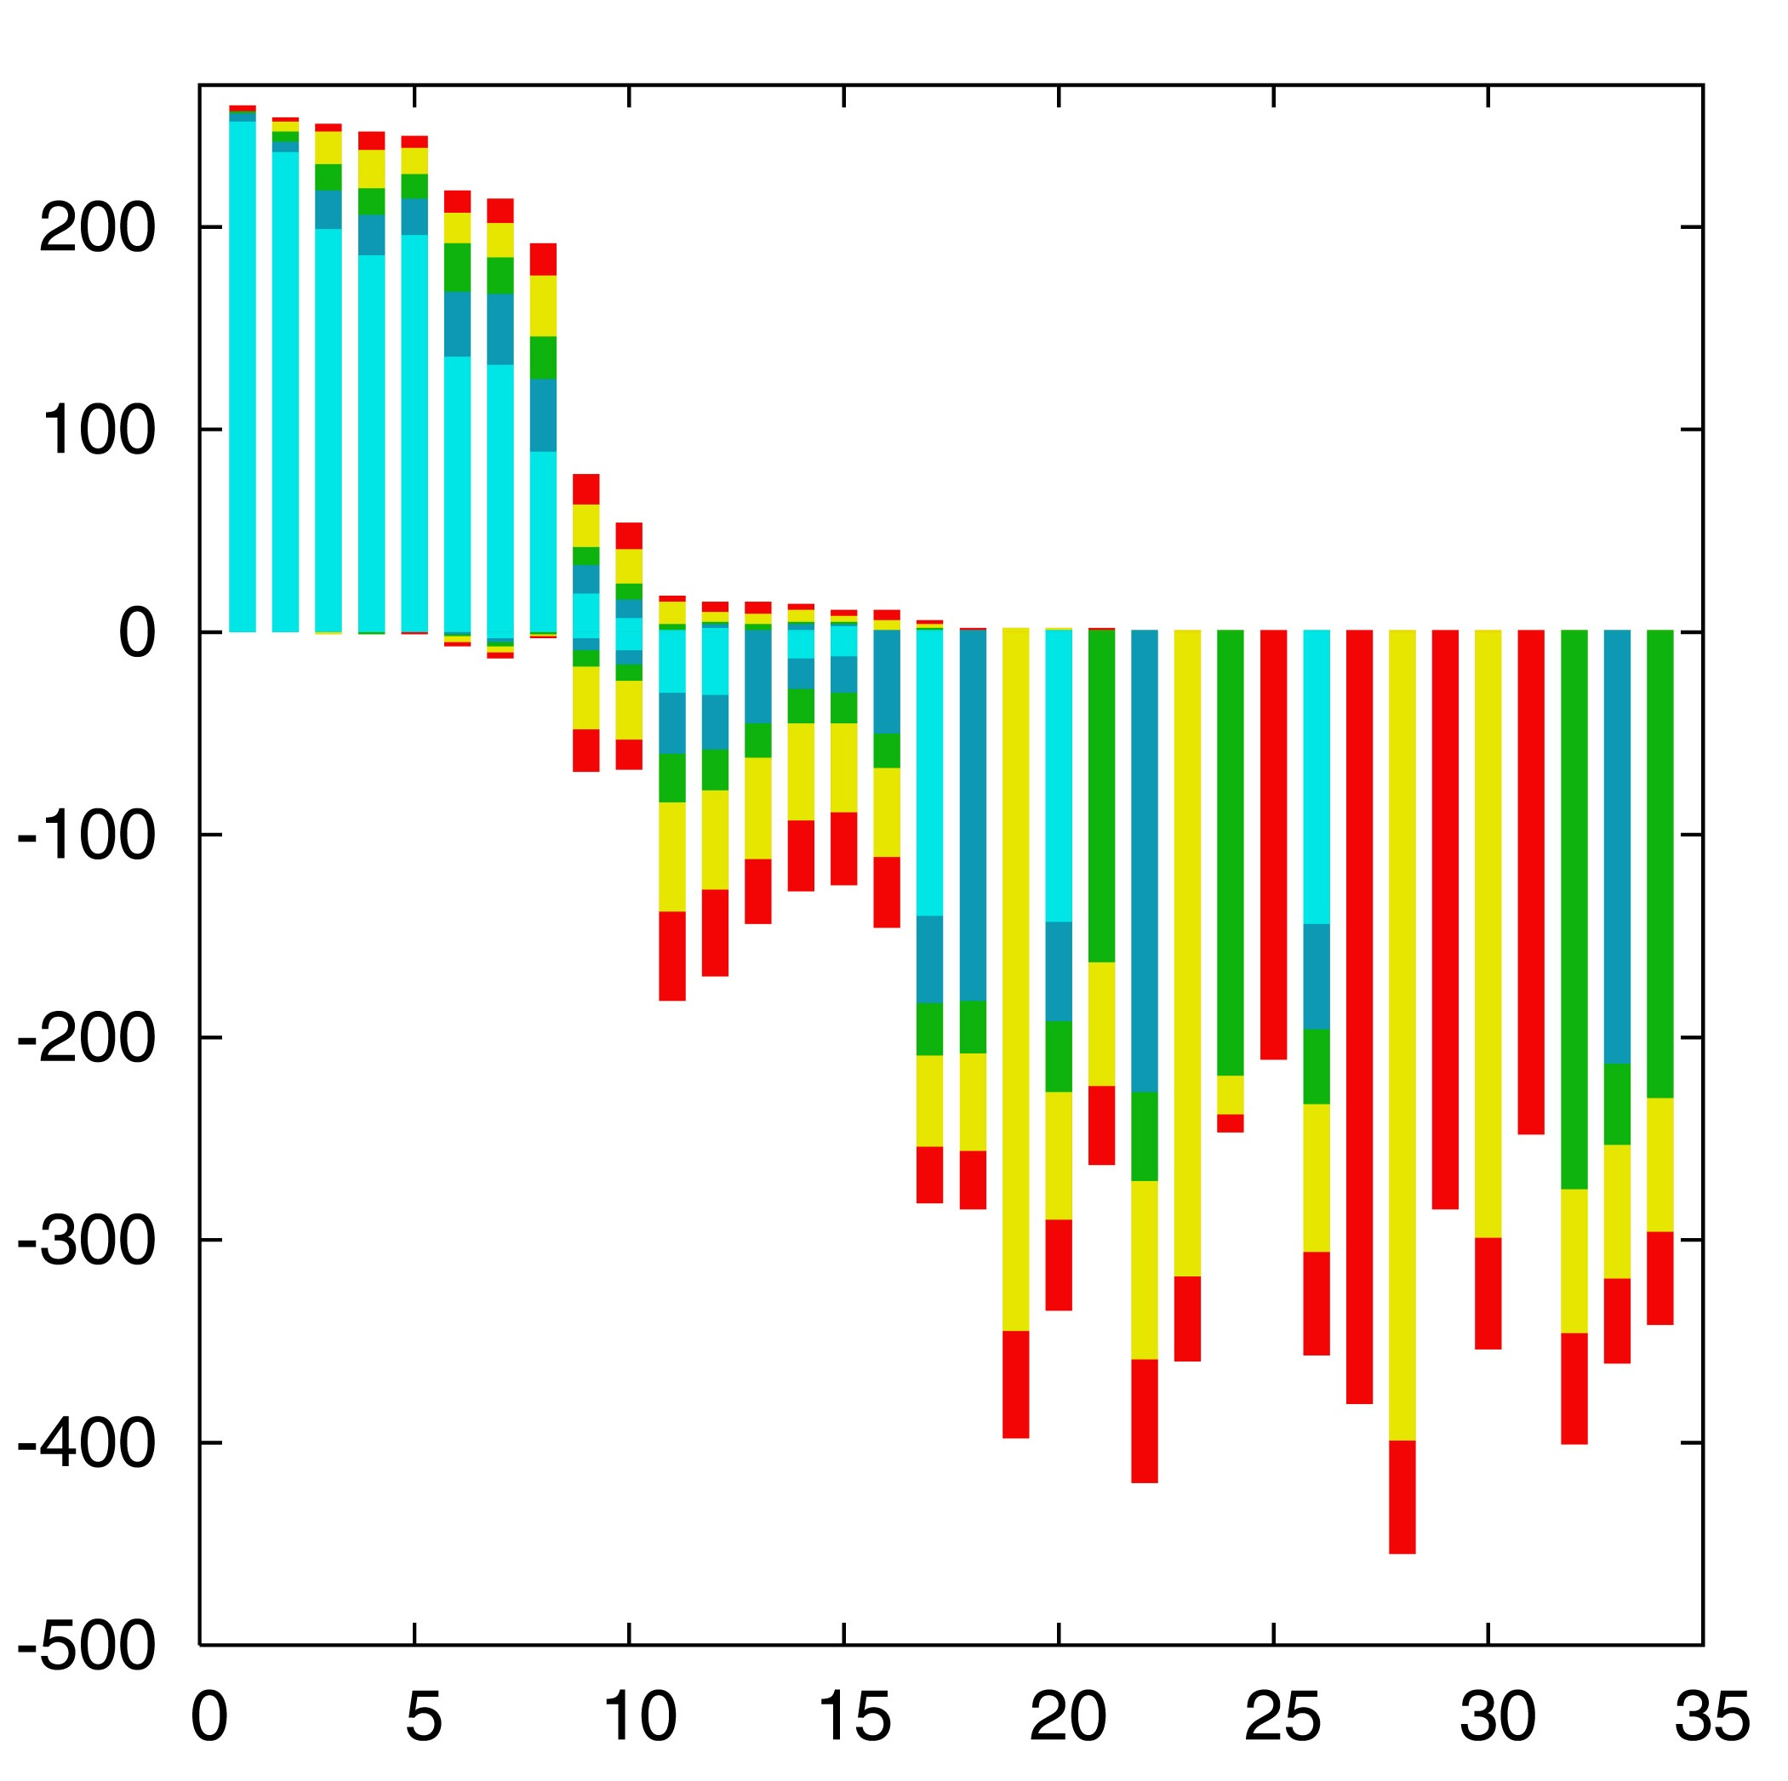

“Lento”-plot of 34 supported bipartitions (out of 4082 possible)
13 gamma-
proteobacterial
genomes
(258 putative
orthologs):
E.coli
Buchnera
Haemophilus
Pasteurella
Salmonella
Yersinia pestis
(2 strains)
Vibrio
Xanthomonas
(2 sp.)
Pseudomonas
Wigglesworthia
There are 13,749,310,575 possible unrooted tree topologies for 13 genomes

Slide 30
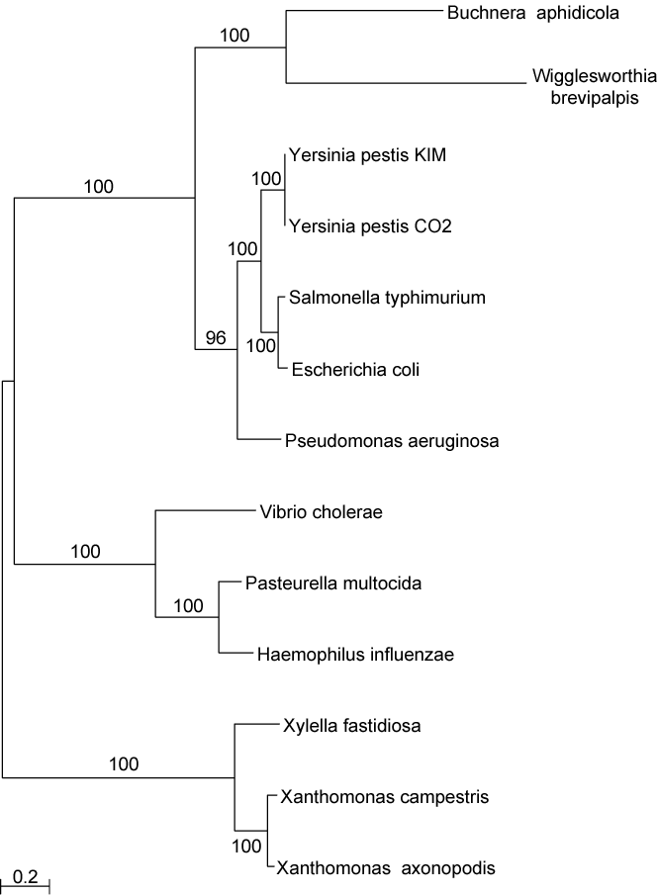
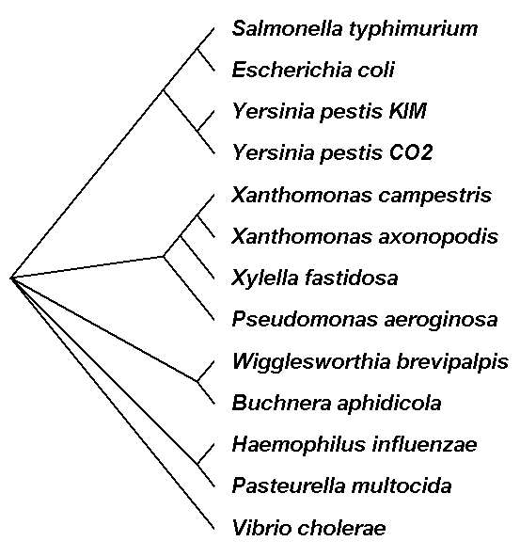
Consensus clusters of eight significantly supported bipartitions
Phylogeny of putatively transferred gene
(virulence factor homologs (mviN))
only 258 genes analyzed

Slide 31

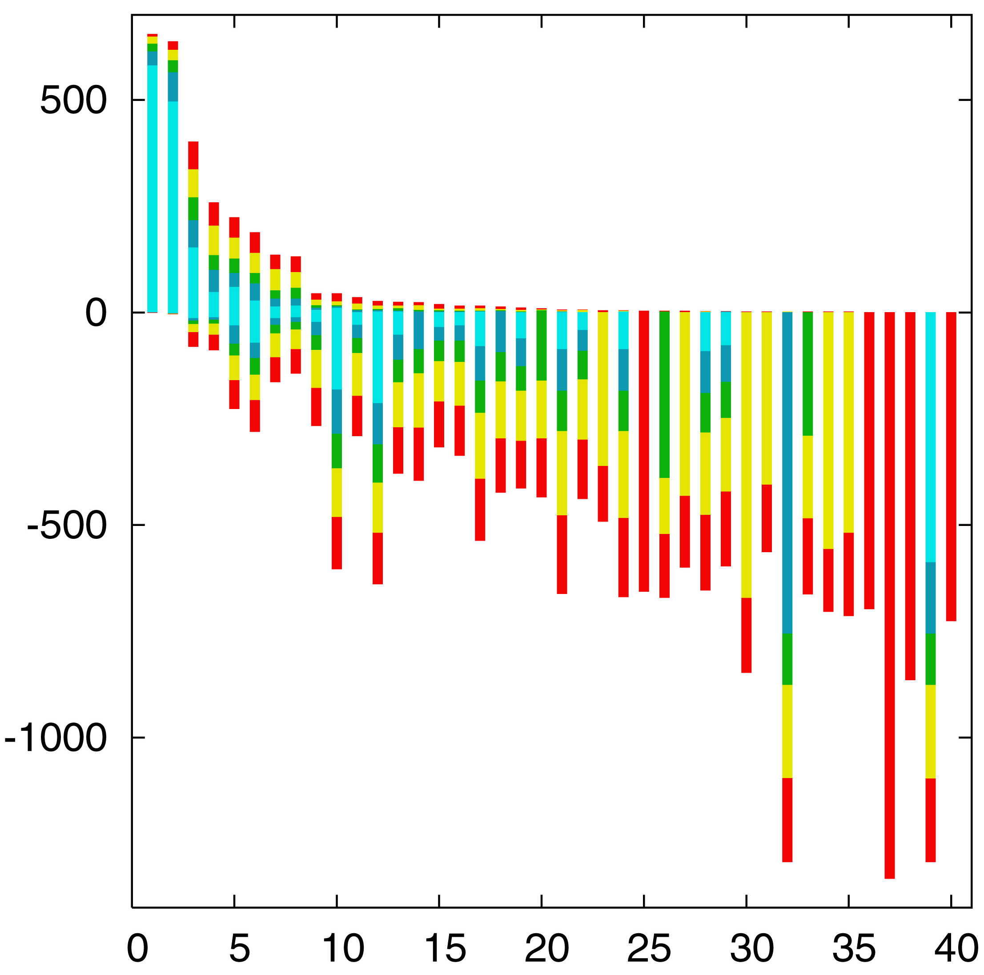
“Lento”-plot of supported bipartitions (out of 501 possible)
10 cyanobacteria:
Anabaena
Trichodesmium
Synechocystis sp.
Prochlorococcus
marinus
(3 strains)
Marine
Synechococcus
Thermo-
synechococcus
elongatus
Gloeobacter
Nostoc
punctioforme
Number of datasets
Based on 678 sets of orthologous genes
Zhaxybayeva, Lapierre and Gogarten, Trends in Genetics, 2004, 20(5): 254-260.

Slide 32
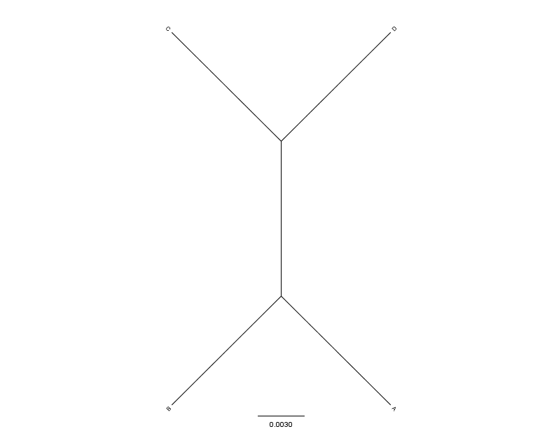
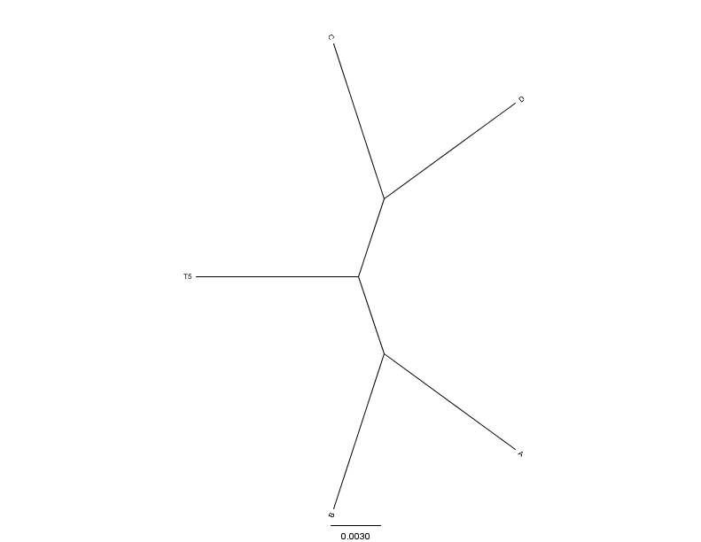
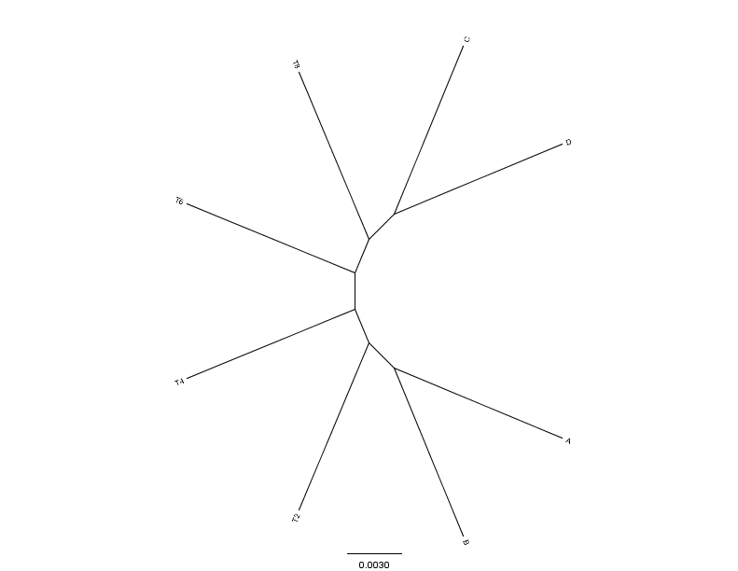
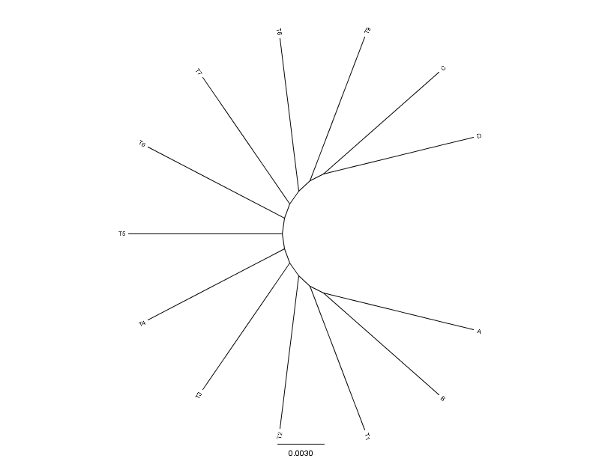
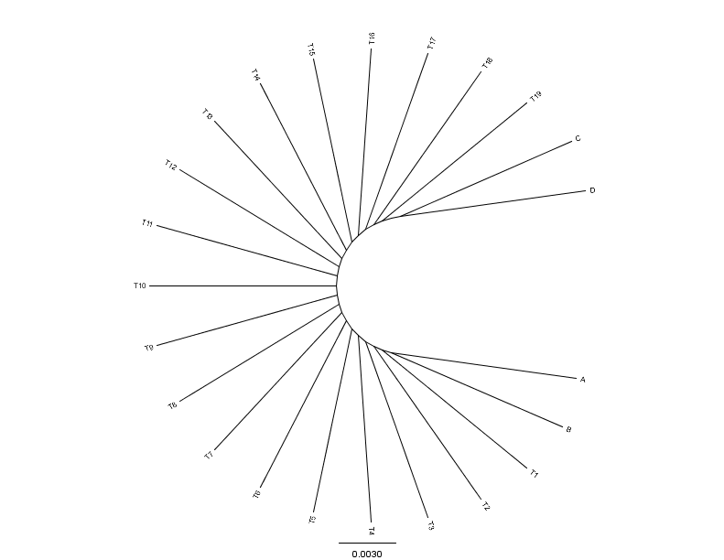
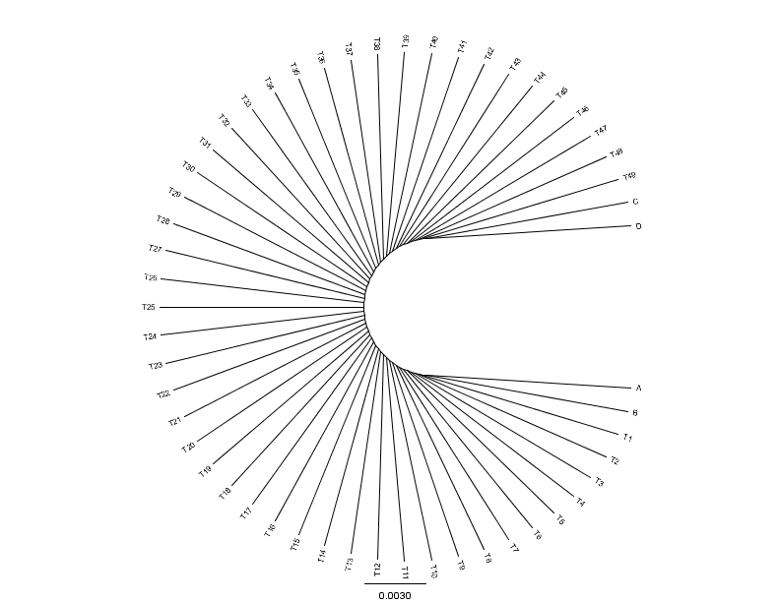
C
D
C
C
D
0.01
0.01
D
N=4(0)
N=5(1)
N=8(4)
0.01
A
0.01
0.01
B
B
B
A
A
B
C
C
D
D
C
D
A
A
A
B
B
B
N=13(9)
N=23(19)
N=53(49)
From: Mao F, Williams D, Zhaxybayeva O, Poptsova M, Lapierre P, Gogarten JP, Xu Y (2012)
BMC Bioinformatics 13:123, doi:10.1186/1471-2105-13-123

Slide 33


Results :
Maximum Bootstrap Support value for Bipartition separating (AB) and (CD)
Maximum Bootstrap Support value
for embedded Quartet (AB),(CD)

Slide 34
Bipartition Paradox:
The more sequences are added, the lower the support for bipartitions that include all sequences. The more data one uses, the lower the bootstrap support values become.
This paradox disappears when only embedded splits for 4 sequences are considered.

Slide 35
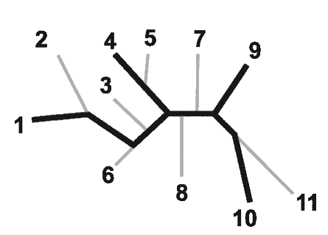
Bootstrap support values for embedded quartets
+
: tree calculated from one pseudo-sample generated by bootstraping from an alignment of one gene family present in 11 genomes
: embedded quartet for genomes
1, 4, 9, and 10 .
This bootstrap sample supports the topology ((1,4),9,10).
1
9
1
9
1
10
4
√
10
10
4
9
4
Zhaxybayeva et al. 2006, Genome Research, 16(9):1099-108
Quartet spectral analyses of genomes iterates over three loops:
Repeat for all bootstrap samples.
Repeat for all possible embedded quartets.
Repeat for all gene families.

Slide 36
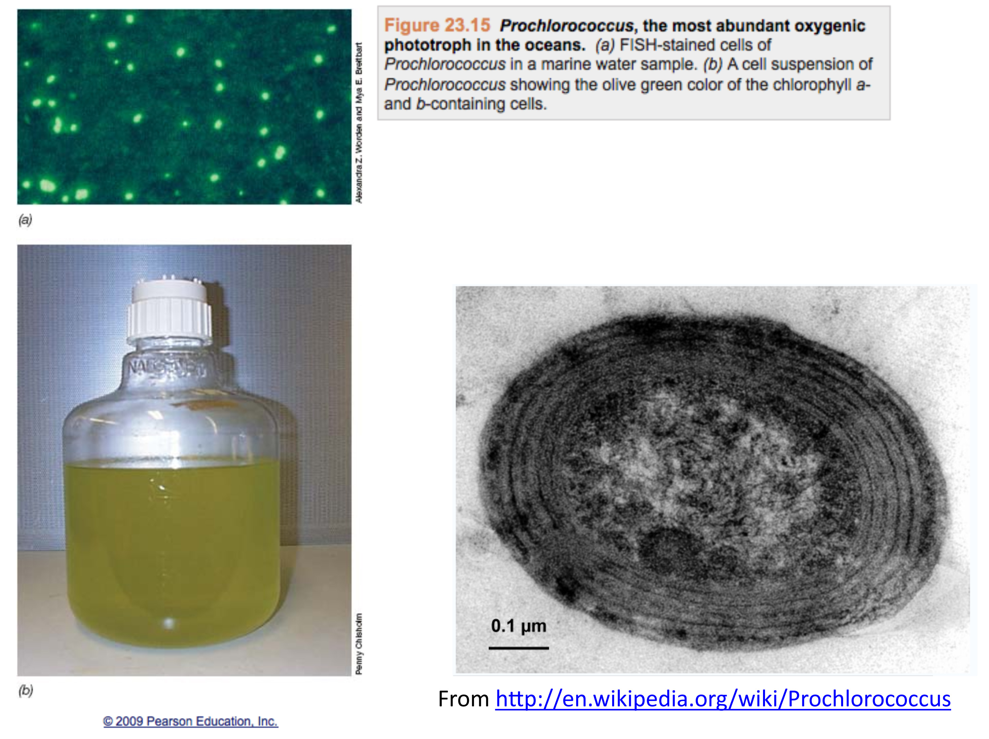

Slide 37
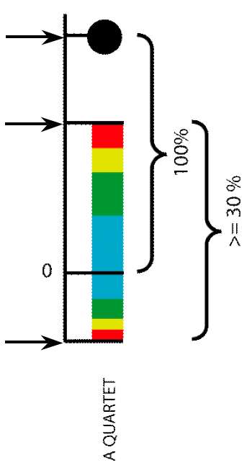
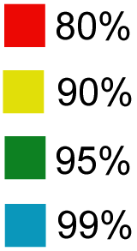
Illustration of one component of a quartet spectral analyses Summary of phylogenetic information for one genome quartet for all gene families
Total number of gene families containing the species quartet
Number of gene families supporting the same topology as the plurality
(colored according to bootstrap support level)
Number of gene families supporting one of the two alternative quartet topologies

Slide 38
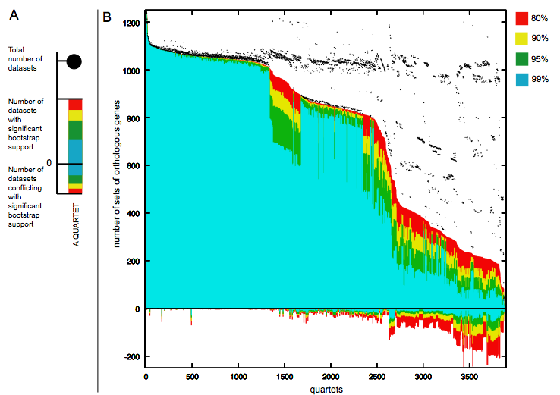
Quartet decomposition analysis of 19 Prochlorococcus and marine Synechococcus genomes. Quartets with a very short internal branch or very long external branches as well those resolved by less than 30% of gene families were excluded from the analyses to minimize artifacts of phylogenetic reconstruction.

Slide 39
Another way out of the dilemma
Assess if a tree (calculated from gene A) is significantly rejected (incompatible) with a tree and dataset for gene B (often gene B is a supermatrix)
Gene of Interest (gene A)
Dataset B, gene B or supermatrix for the same OTUs.
(Maximum likelihood)
phylogeny of gene A
“Tree A”
“reference” phylogeny
Determine the probability of Tree A under dataset B
E.g., using the AU test (implemented in iqtree)

Slide 40
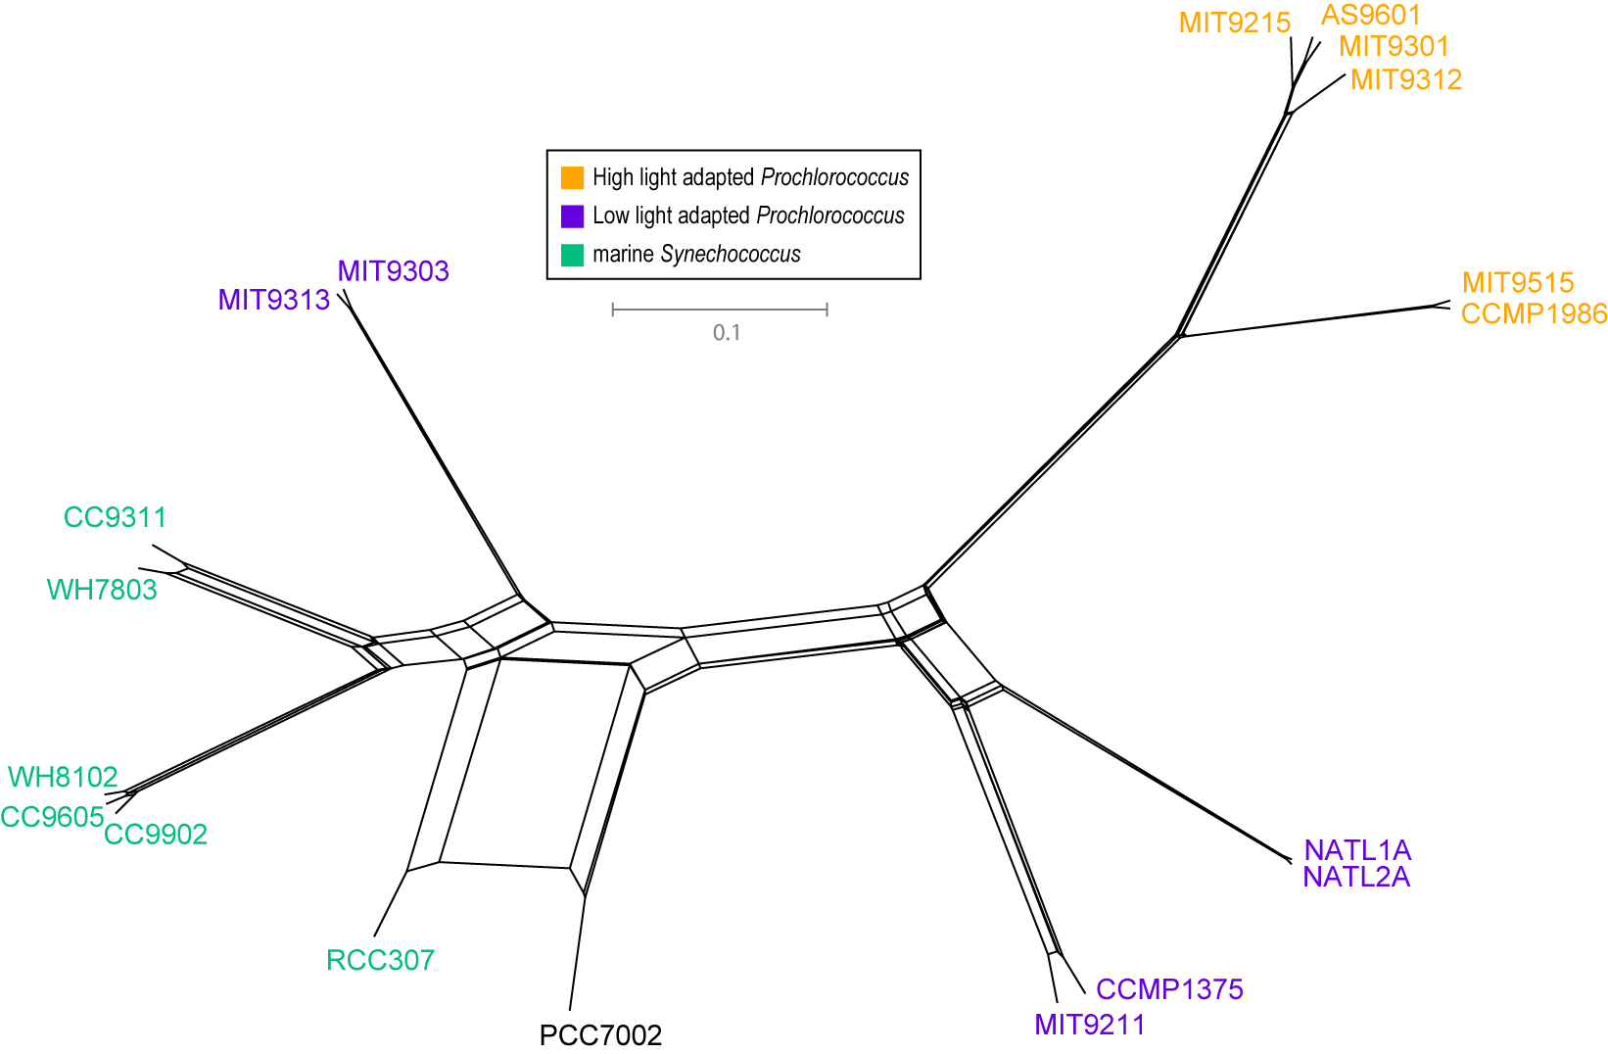
NeighborNet (calculated with SplitsTree 4.0)
Plurality neighbor-net calculated as supertree (from the MRP matrix using SplitsTree 4.0) from all quartets significantly supported by all individual gene families (1812) without in-paralogs.

Slide 41
Constructive Neutral Evolution with special emphasis on Inteins

Slide 42
Genetic Drift: the fixation of a selectively neutral or nearly neutral mutation in a population
The smaller a population, the more slightly deleterious mutations can be fixed due to genetic drift.

Slide 43
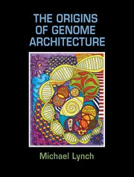
Michael Lynch
The Origins of Genome Architecture
Argues that most features in eukaryotic genomes arose because populations of eukaryotic organism (larger cell size) were much smaller than for prokaryotes.
This includes introns, the proliferation of repetitive elements, mRNA editing, gene duplications and the emergence of protein-protein interactions turning proteins to become parts of complicated multi subunit complexes.
The book is available through the UConn library online (but reading it in a browser is rather tedious).

Slide 44
Note: The percentage of coding DNA is small in animals and plants, the amount of intergenic and intron DNA increases.
Aside: an ongoing debate on the functionality of intergenic DNA continues. See the discussion of the encode project here and here).
The onion test is a good exercise for those thinking that most intergenic DNA has important functions in animals and especially humans.

Slide 45
Cord scrambling as example for the directionality that may be present in random mutations
From Arlin Stolzfus, Biol. Direct.
https:/ /biologydirect.biomedcentral.com/articles/10.1186/1745-6150-7-35
Increase in complexity can be due to drift not better function (at least initially to the contrary).

Slide 46
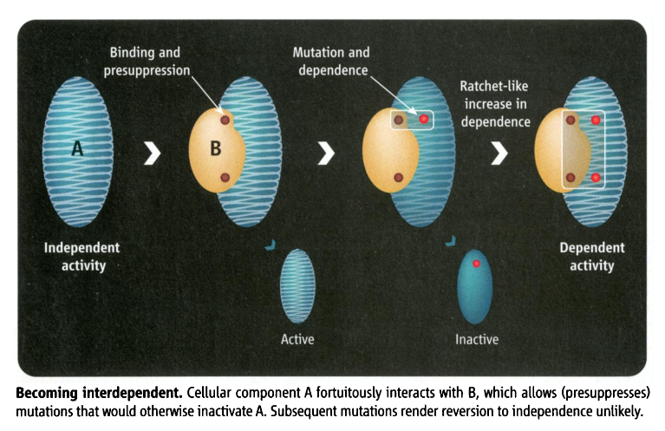
Mutations can have a directing force
Constructive neutral evolution:
Random interactions between macromolecules lower the overall free energy, leading to more stability, allowing for destabilizing mutations to occur. The mutated macromolecule remains stable and active, as long as the binding partner is present.
From: Irremediable Complexity?
Author(s): Michael W. Gray, Julius Lukeš, John M. Archibald, Patrick J. Keeling and W. Ford Doolittle
Source: Science, New Series, Vol. 330, No. 6006 (12 November 2010), pp. 920-921

Slide 47
Constructive Neutral Evolution
An organism acquires neutral or only slightly deleterious mutations or traits.
Other mutations or events compensate (or pre-supress) for deleterious effect.
The reversal of the mutation is improbable (there are more ways to scramble things than to unscramble them).
The presence of these compensating processes becomes a necessity to achieve the original function.
At no point along the process did the mutations or events increase the fitness of the organism (which does not say that the complex feature later may evolve useful functions).
The outcome is a complex process that requires cooperation between different components to fulfill the same function as the original process.
CNE occurs more frequently in organisms with small effective populations (See Michael Lynch’s “Evolution of genome architecture”)

Slide 48
CNE Examples (may be)
Interactions between macromolecules
Multisubunit homomers -> heteromers (histones, tubulins, ATP synthase, proteasome)
Large protein-RNA complexes (Spliceosome, Ribosome)
Split Inteins / Spliceosomal Introns
Subfunctionalization (maintaining duplicated genes)
RNA editing
Alternative splicing
? Fixation of introns/inteins in a population
(mobile genetic elements have their own agenda, and their fixation can be driven by the fitness advantage to themselves)

Slide 49
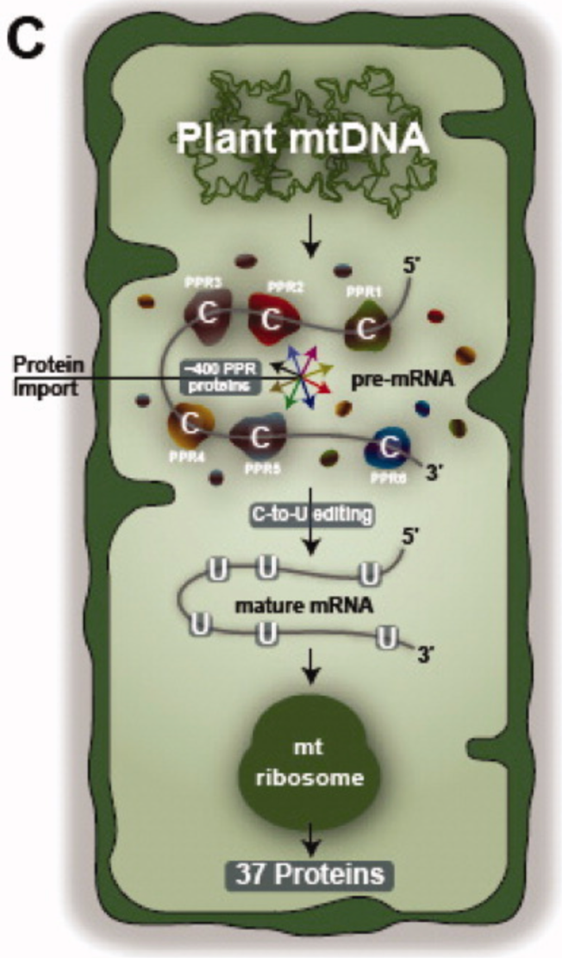
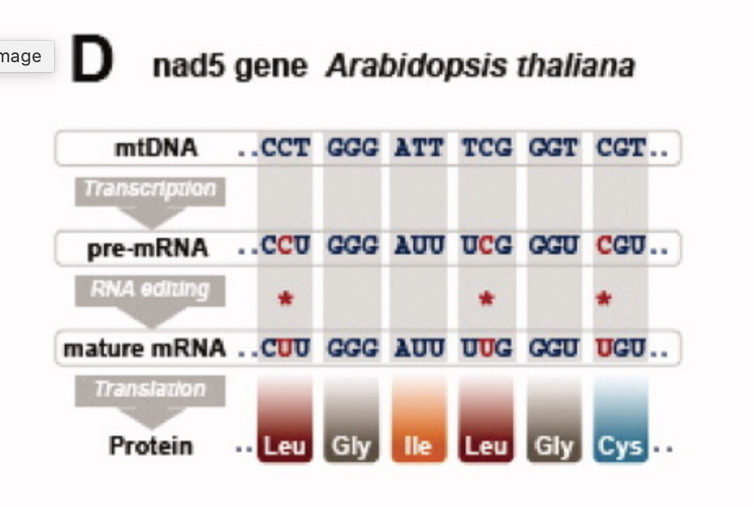
From: https://iubmb.onlinelibrary.wiley.com/doi/full/10.1002/iub.489

Slide 50
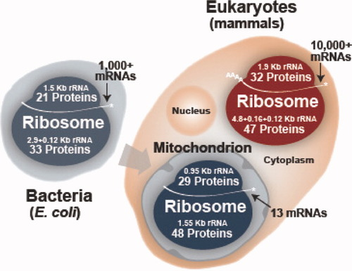
From: https://iubmb.onlinelibrary.wiley.com/doi/full/10.1002/iub.489

Slide 51
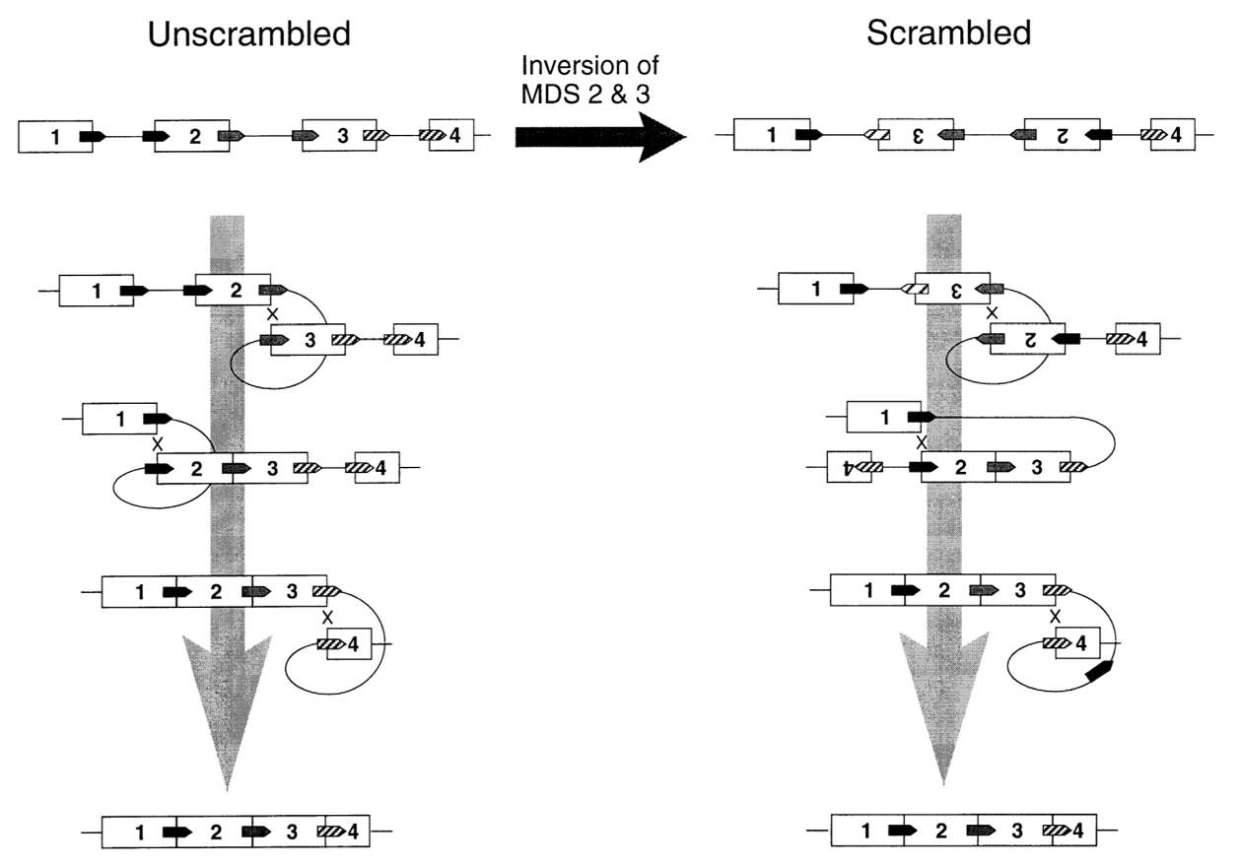
Gene Unscrambling in Ciliates
Micro to Macro Nucleus
From: Arlin Stoltzfus
On the Possibility of Constructive
Neutral Evolution
https://link.springer.com/article/10.1007%2FPL00006540
See also
https://www.pnas.org/content/97/7/3298

Slide 52
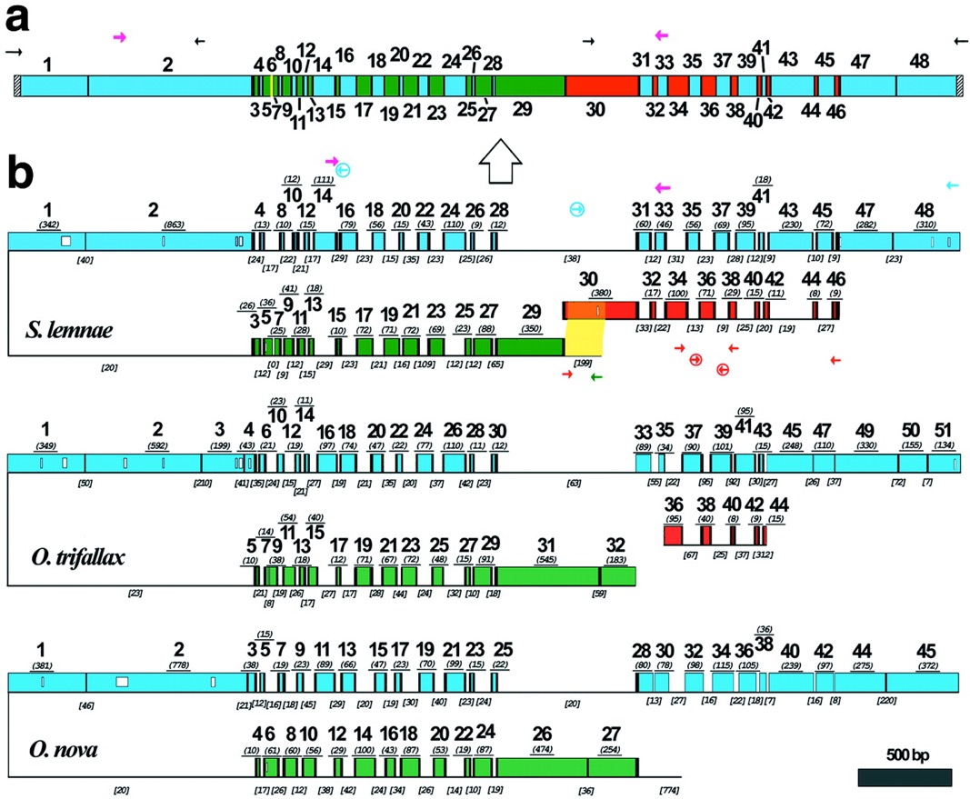
Gene Unscrambling in Ciliates
Micro to Macro Nucleus -- DNA polymerase α gene in hypotrichous ciliates
Evolution and assembly of an extremely
scrambled gene
Laura F. Landweber, Tai-Chih Kuo, and
Edward A. Curtis
From:
https://www.pnas.org/content/97/7/3298

Slide 53


Related Concepts
Increased complexity in small populations
Subfunctionalization to maintain gene duplications (also here)
The Spandrels of San Marco (Gould & Lewontin)
Biological Rube Goldberg machines.

Slide 54
From: Inteins: nature's gift to protein chemists
Neel H. Shah and Tom W. Muir
DOI: 10.1039/C3SC52951G

Slide 55




Homing and Homing Endonucleases in Inteins
Self Splicing
Domain
Homing Endonuclease
Domain
Homing Endonuclease
Recognition Site

Slide 56

In case of inteins the co-evolution of genes results in
Mutualism between splicing and homing endonuclease domain
Commensalism between host protein and intein without HE domain
Parasitism between host protein and intein with HE
Encoding
1LWS
Extein = Host Protein
Intein Splicing Domain
Structure from Moure et al. (2002)
Nat.Struct.Biol. 9: 764-770
Homing Endonuclease (HE)
domain

Slide 57

From: Inteins: nature's gift to protein chemists
Neel H. Shah and Tom W. Muir
DOI: 10.1039/C3SC52951G

Slide 58
Split inteins as an example for CNE
Transcribed
and translated
Functional replicative
DNA polymerase III
dnaE
dnaE
cis splicing
(difficult to revert, because no complete cDNA present)
dnaE1
Non-covalent inter-actions between N and C intein
trans splicing
dnaE2
Gene encoding extein
extein
Gene encoding splicing domains
Intein splicing domains
Gene encoding homing endonuclease domain
Intein homing endonuclease domains

Slide 59

From: Inteins: nature's gift to protein chemists
Neel H. Shah and Tom W. Muir
DOI: 10.1039/C3SC52951G

