Slide 1
MCB 3421 2021 Class 26
Review Session

Slide 2
Reminders
Let me know by email (gogarten@uconn.edu), if you will take the exam at the Center for Students with Disabilities
Your notebooks are due before the final on Monday
complete Take-Home Exam #8 before Friday 10am
Be Nice !
Do the SETs
Columbia from https://en.wikipedia.org/wiki/Uncle_Sam

Slide 3
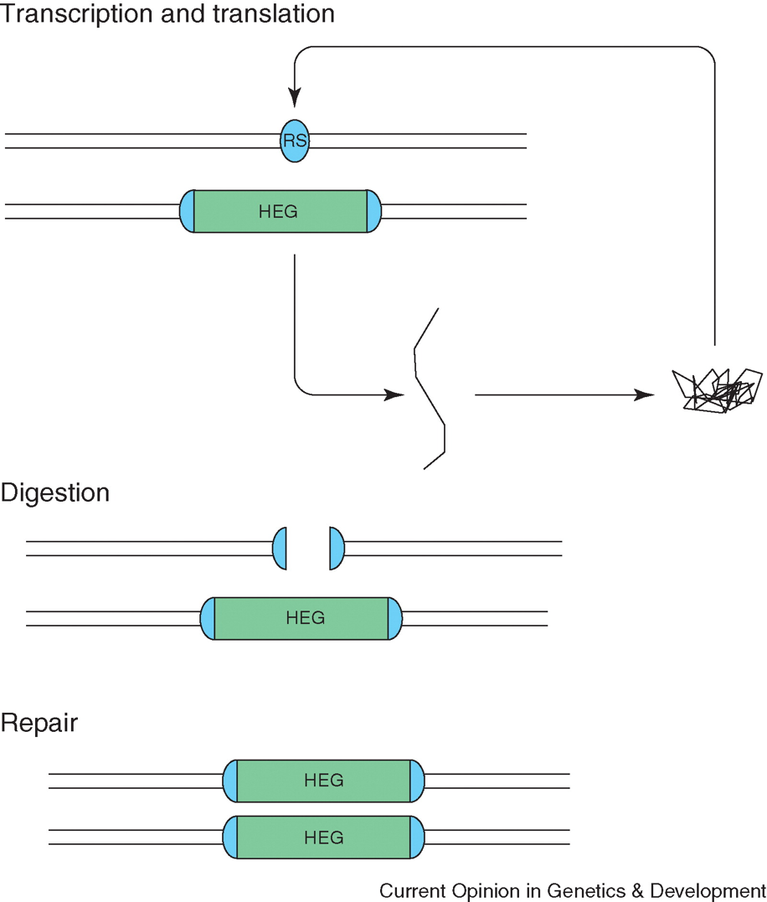
Homing and Homing Endonucleases in Inteins
Self Splicing Domain
Homing Endonuclease Domain
Homing Endonuclease Recognition Site

Slide 4
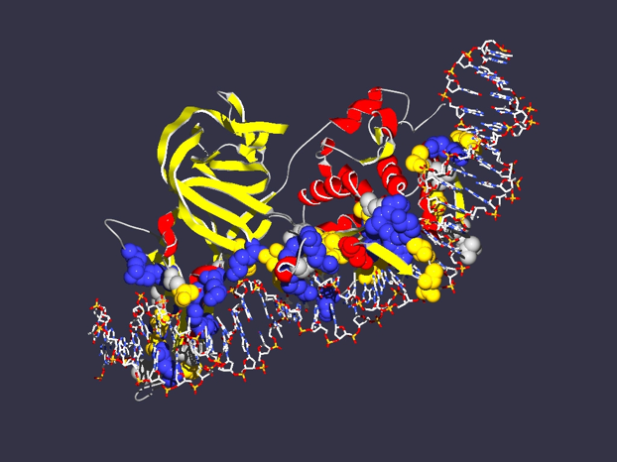
In case of inteins the co-evolution of genes results in
Mutualism between splicing and homing endonuclease domain
Commensalism between host protein and intein without HE domain
Parasitism between host protein and intein with HE
Encoding
1LWS
Extein = Host Protein
Intein Splicing Domain
Structure from Moure et al. (2002) Nat.Struct.Biol. 9: 764-770
Homing Endonuclease (HE)
domain

Slide 5
From: Inteins: nature's gift to protein chemists
Neel H. Shah and Tom W. Muir
DOI: 10.1039/C3SC52951G

Slide 6
Split inteins as an example for CNE
Transcribed and translated
Functional replicative DNA polymerase III
dnaE
dnaE
cis splicing
(difficult to revert, because no complete cDNA present)
dnaE1
Non-covalent inter-actions between N and C intein
trans splicing
dnaE2
Gene encoding extein
extein
Gene encoding splicing domains
Intein splicing domains
Gene encoding homing endonuclease domain
Intein homing endonuclease domains

Slide 7
From: Inteins: nature's gift to protein chemists
Neel H. Shah and Tom W. Muir
DOI: 10.1039/C3SC52951G

