Slide 1
MCB 3421
Class 5 - 2021
What is Life? continued from class 4 (class 5 starts at slide 10)

Slide 2
Traditionally life was defined by criteria / characteristics that all living system possess
Describe features that you think all living system possess

Slide 3
Traditionally life was defined by criteria / characteristics that all living system possess:
These are the classic criteria:
Uptake and dissipation of Energy
Metabolism
Responsiveness
Gestalt (distinctive shape, separate from environment)
Growth
Reproduction with variation - Ability to evolve
A more modern definitions of life is in Daniel Koshland’s essay The Seven Pillars of Life; however, this does not go much beyond the traditional multi-point characterization.
A problem is that these characteristics do not provide a definition. This is like defining water by is properties, e.g. at 20 degree Celsius it is colorless liquid, does not smell ... .

Slide 4
A minor problem is that individual organism often do not (or no longer) fulfill these criteria.
A frequent comment is that according to this “definition” inhabitants of a retirement home would not be considered alive, because they no longer reproduce. If these criteria are used, they need to be applied to the whole group to which an individual belongs.

Slide 5
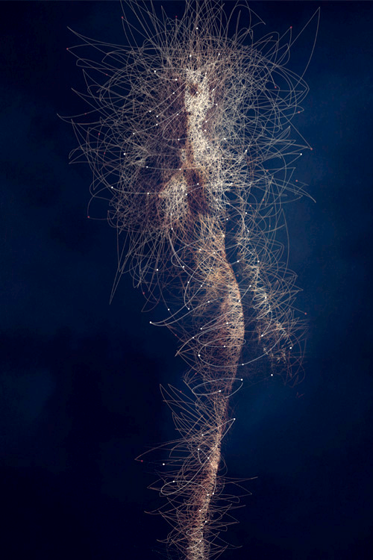
Life as a system that can evolve by natural selection
NASA adopted the following working definition:
“life is a self-sustaining system capable of Darwinian evolution”
See here for an interview with Gerald Joyce
Image: BODY MICROBES, by Bruno Vergauwen.

Slide 6
What does Darwinian evolution, or evolution by natural selection mean?
From Darwin’s origin of species:
If during the long course of ages and under varying conditions of life, organic beings vary at all in the several parts of their organisation, and I think this cannot be disputed; if there be, owing to the high geometrical powers of increase of each species, at some age, season, or year, a severe struggle for life, and this certainly cannot be disputed; then, considering the infinite complexity of the relations of all organic beings to each other and to their conditions of existence, causing an infinite diversity in structure, constitution, and habits, to be advantageous to them, I think it would be a most extraordinary fact if no variation ever had occurred useful to each being's own welfare, in the same way as so many variations have occurred useful to man. But if variations useful to any organic being do occur, assuredly individuals thus characterised will have the best chance of being preserved in the struggle for life; and from the strong principle of inheritance they will tend to produce offspring similarly characterised. This principle of preservation, I have called, for the sake of brevity, Natural Selection.
...
Amongst many animals, sexual selection will give its aid to ordinary selection, by assuring to the most vigorous and best adapted males the greatest number of offspring. Sexual selection will also give characters useful to the males alone, in their struggles with other males.

Slide 7
Under which conditions does “natural selection occur?
Or, which ingredients would a genetic algorithm need to have to work in a computer?

Slide 8
Under which conditions does “natural selection occur?
Offspring shows variation
At least some of this variation is inherited
More offspring than necessary for replacement resulting in a “struggle for life”
=> Survival of the fittest

Slide 9
Life as a system that can evolve by natural selection
NASA adopted the following working definition:
“life is a self-sustaining system capable of Darwinian evolution”
See here for an interview with Gerald Joyce
Again, one problem is that all living organisms are embedded in an ecological network, and without interactions to other organisms, they would not continue to live. (E.g., animals need food, plants rely on bacteria and fungi ...)
Image: BODY MICROBES, by Bruno Vergauwen.

Slide 10
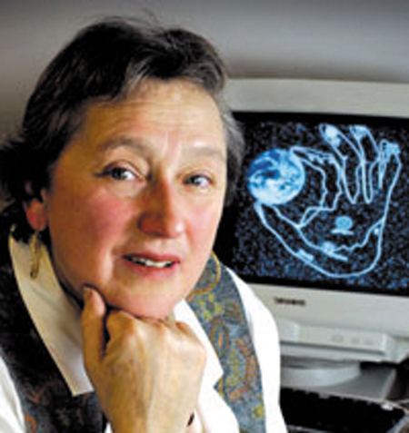
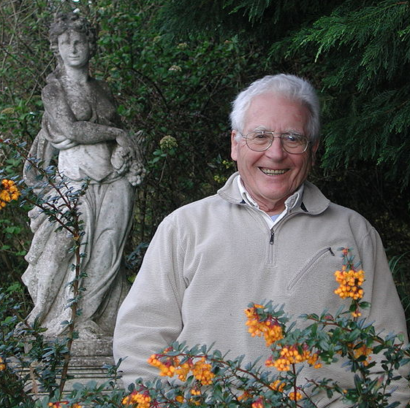
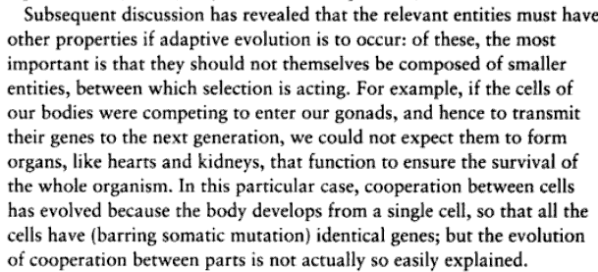
Gaia Hypothesis
Lynn Margulis, James Lovelock
Ecosystems (including the whole biosphere) can be seen as super organisms with their own homeostatic mechanisms.
Frequent criticism:
A single organisms cannot evolve by natural selection.
Both positive and negative feed back loops exist in the biosphere.
John Maynard Smith in Connie Barlow's "From Gaia to Selfish gene":
Images from Wikipedia

Slide 11
Contemplate the question if a virus is alive.

Slide 12
Are viruses alive?
Different scientist have different opinions:
They do not have their own metabolism and are dependent on a host - all life is dependent on other organisms (see above)
The virus particle is like an acorn – a vehicle for propagation. The virus metabolism is only revealed after a cell has been infected.
Viruses are part of a living system. A part of this system considered in isolation may not be alive, but the whole system is.

Slide 13
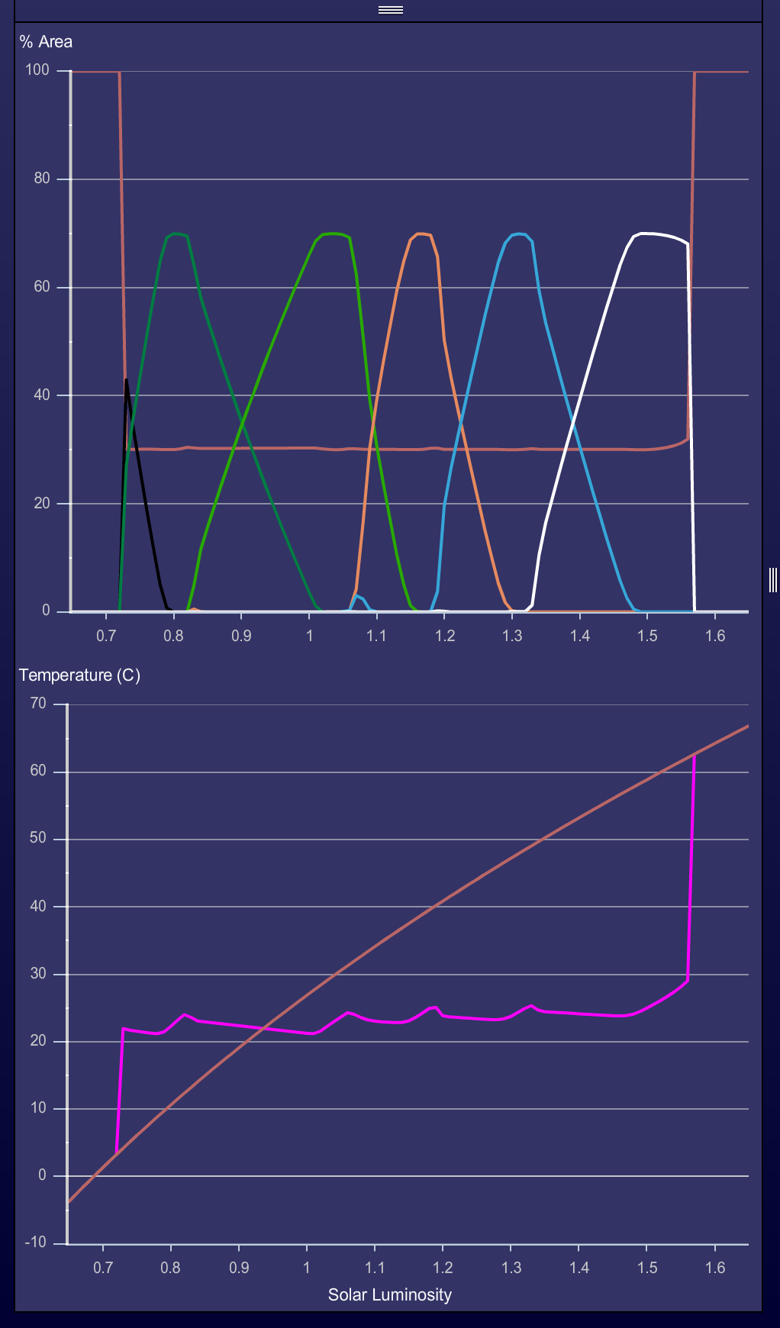
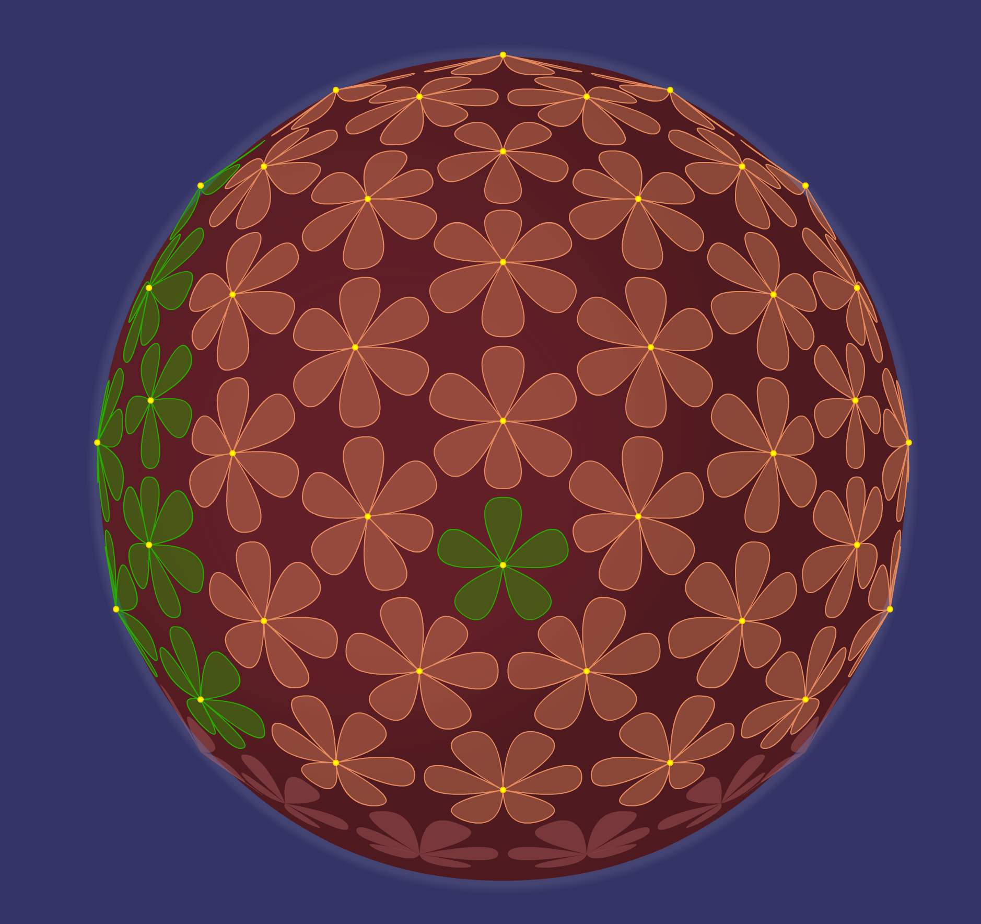
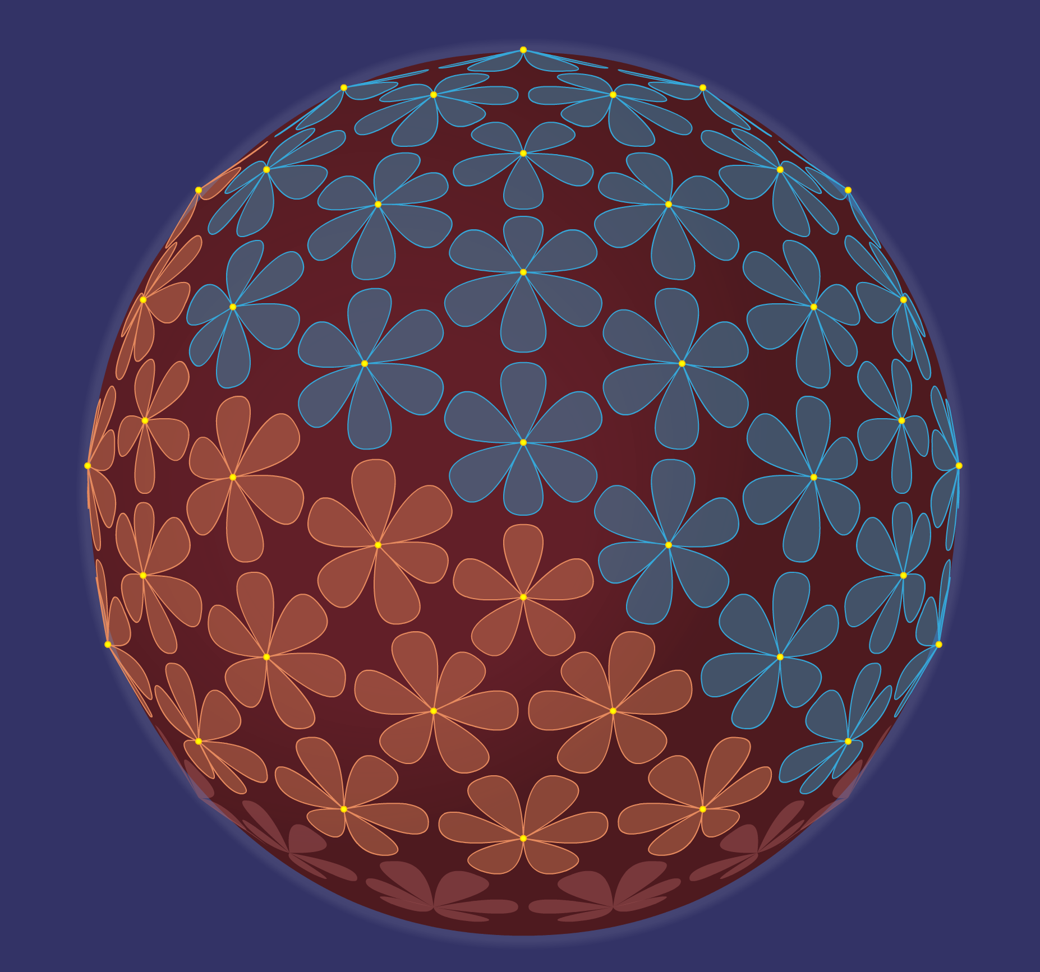
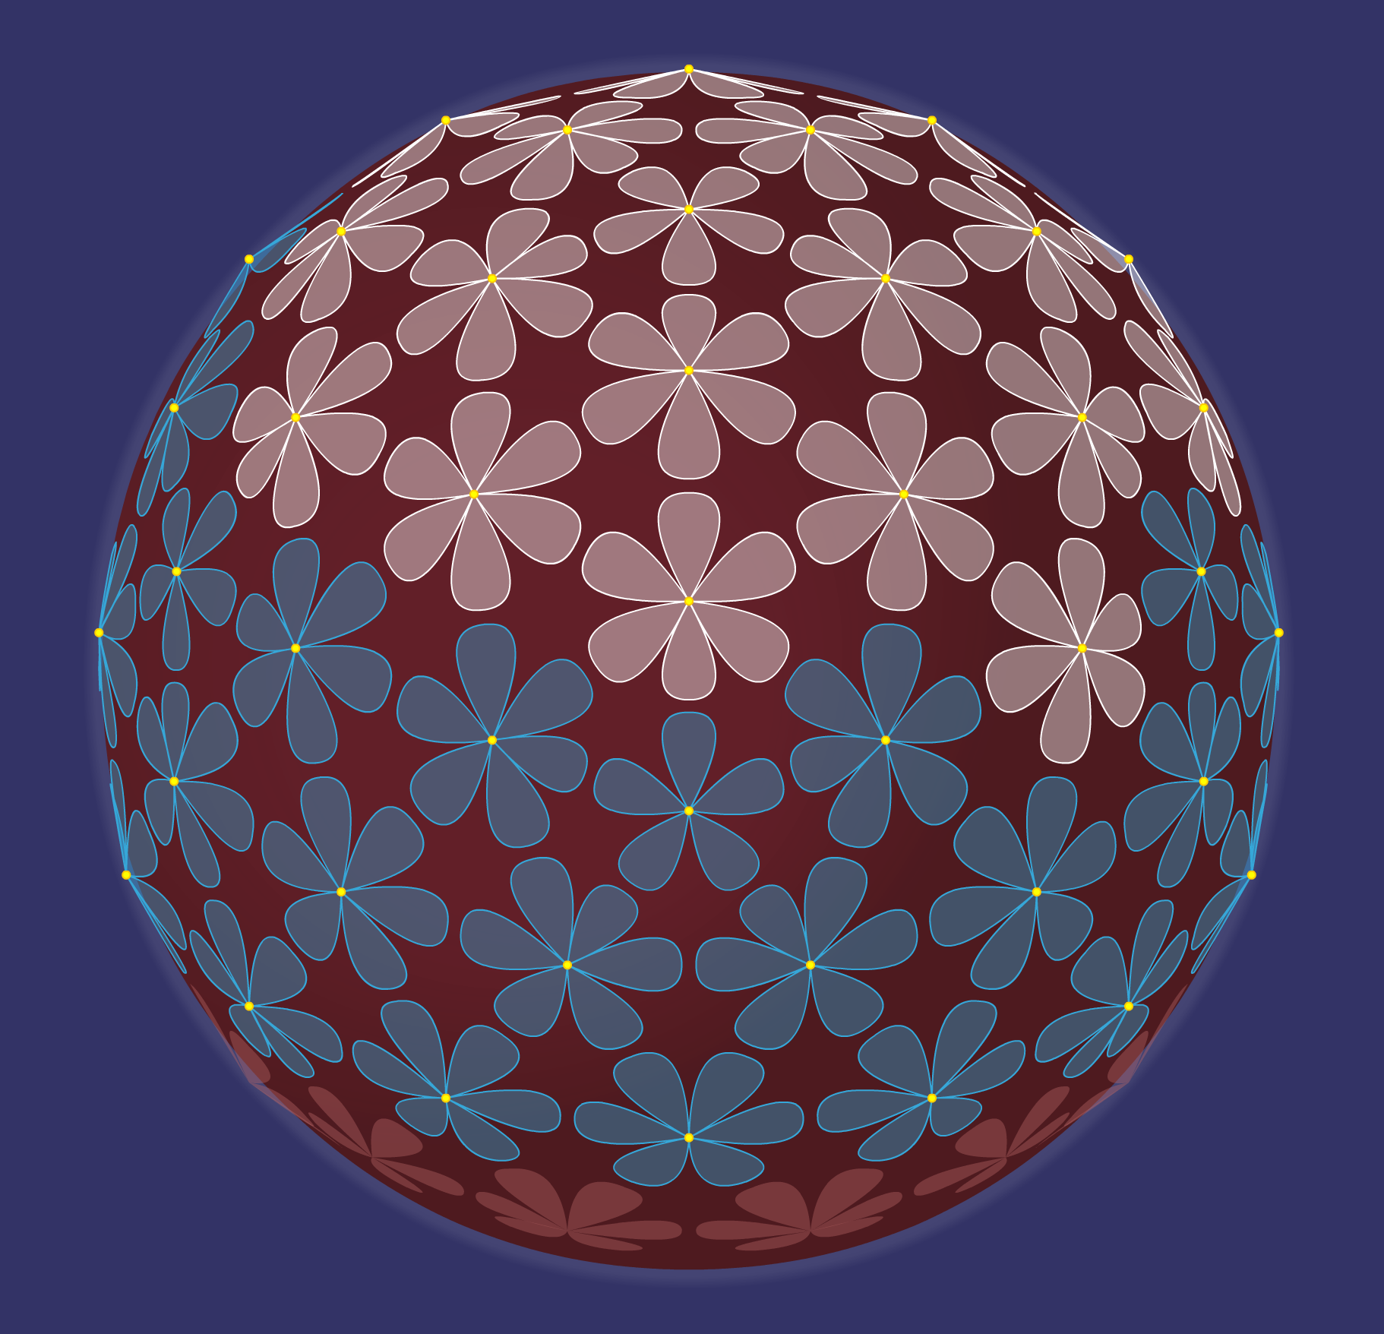
Feedback loops in Gaia can stabilize the biosphere
The Daisyworld model illustrates that negative feedback loops can extend the range over which a planet can sustain life.
You can run your own simulations with different numbers of Daisies here (You need to use a browser that runs adobe flash - I use waterfox for this)
It might be easier to use the netlogo (agent based modeling platform) version for this: https://ccl.northwestern.edu/netlogo/models/Daisyworld

Slide 14
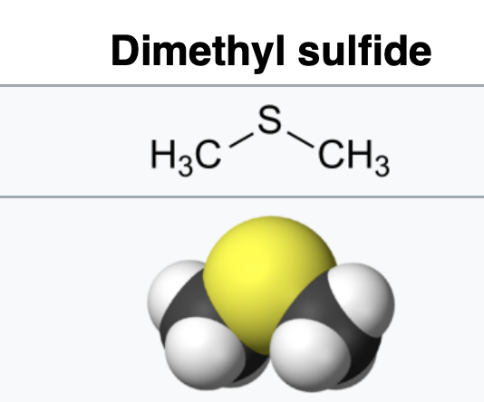
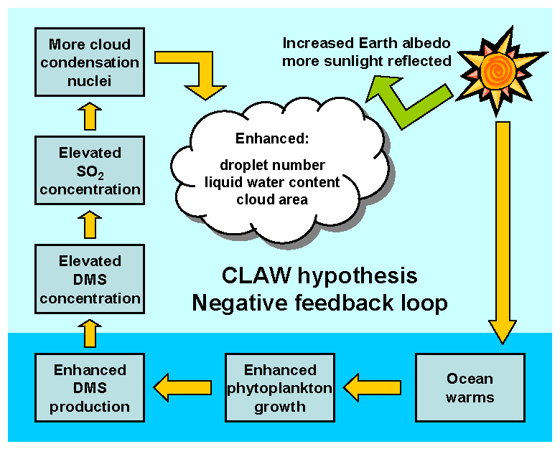
Climate regulation by algae
Similar to Daisyworld is the observation of a negative feedback loop created by algae.

Slide 15
Gaia will not solve our problems
Positive feed back loops exist on Earth as well. The most dramatic is the positive feedback that is provided through increasing snow and ice cover that will lead to lower temperature and thereby to increased snow and ice cover. This positive feedback loop is described as a Snowball Earth event.
A Snowball Earth event is terminated through accumulation of CO₂ in the atmosphere (greenhouse effect). However, one the ocean surface is unfrozen, CO₂ is absorbed by the ocean and precipitated as Limestone (CaCO₃). Depending on the distribution of continents, one possible regime may be the alternations of snowball and Greenhouse Earth conditions.

Slide 16
It’s The Song Not The Singer (ITSNTS)
The proposal by Inkpen and Doolittle that processes (not only individual organisms) can be the target of natural selection.
An extension of this is that persistence of processes may play the same role in natural selection as reproductive success. Differential persistence of processes would allow for natural selection to operate in “Gaia”. See the Darwinizing Gaia article by Ford Doolittle here

Slide 17
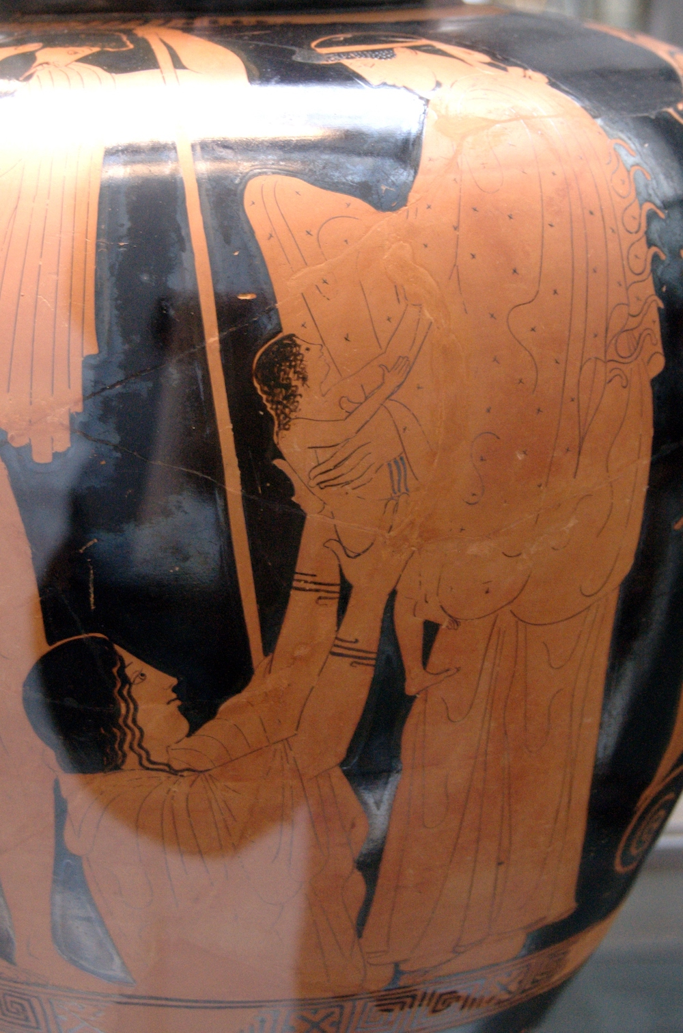
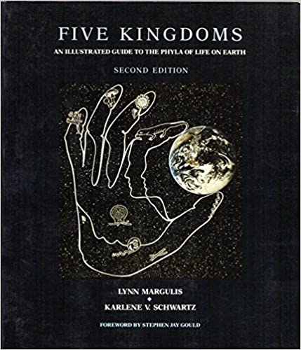
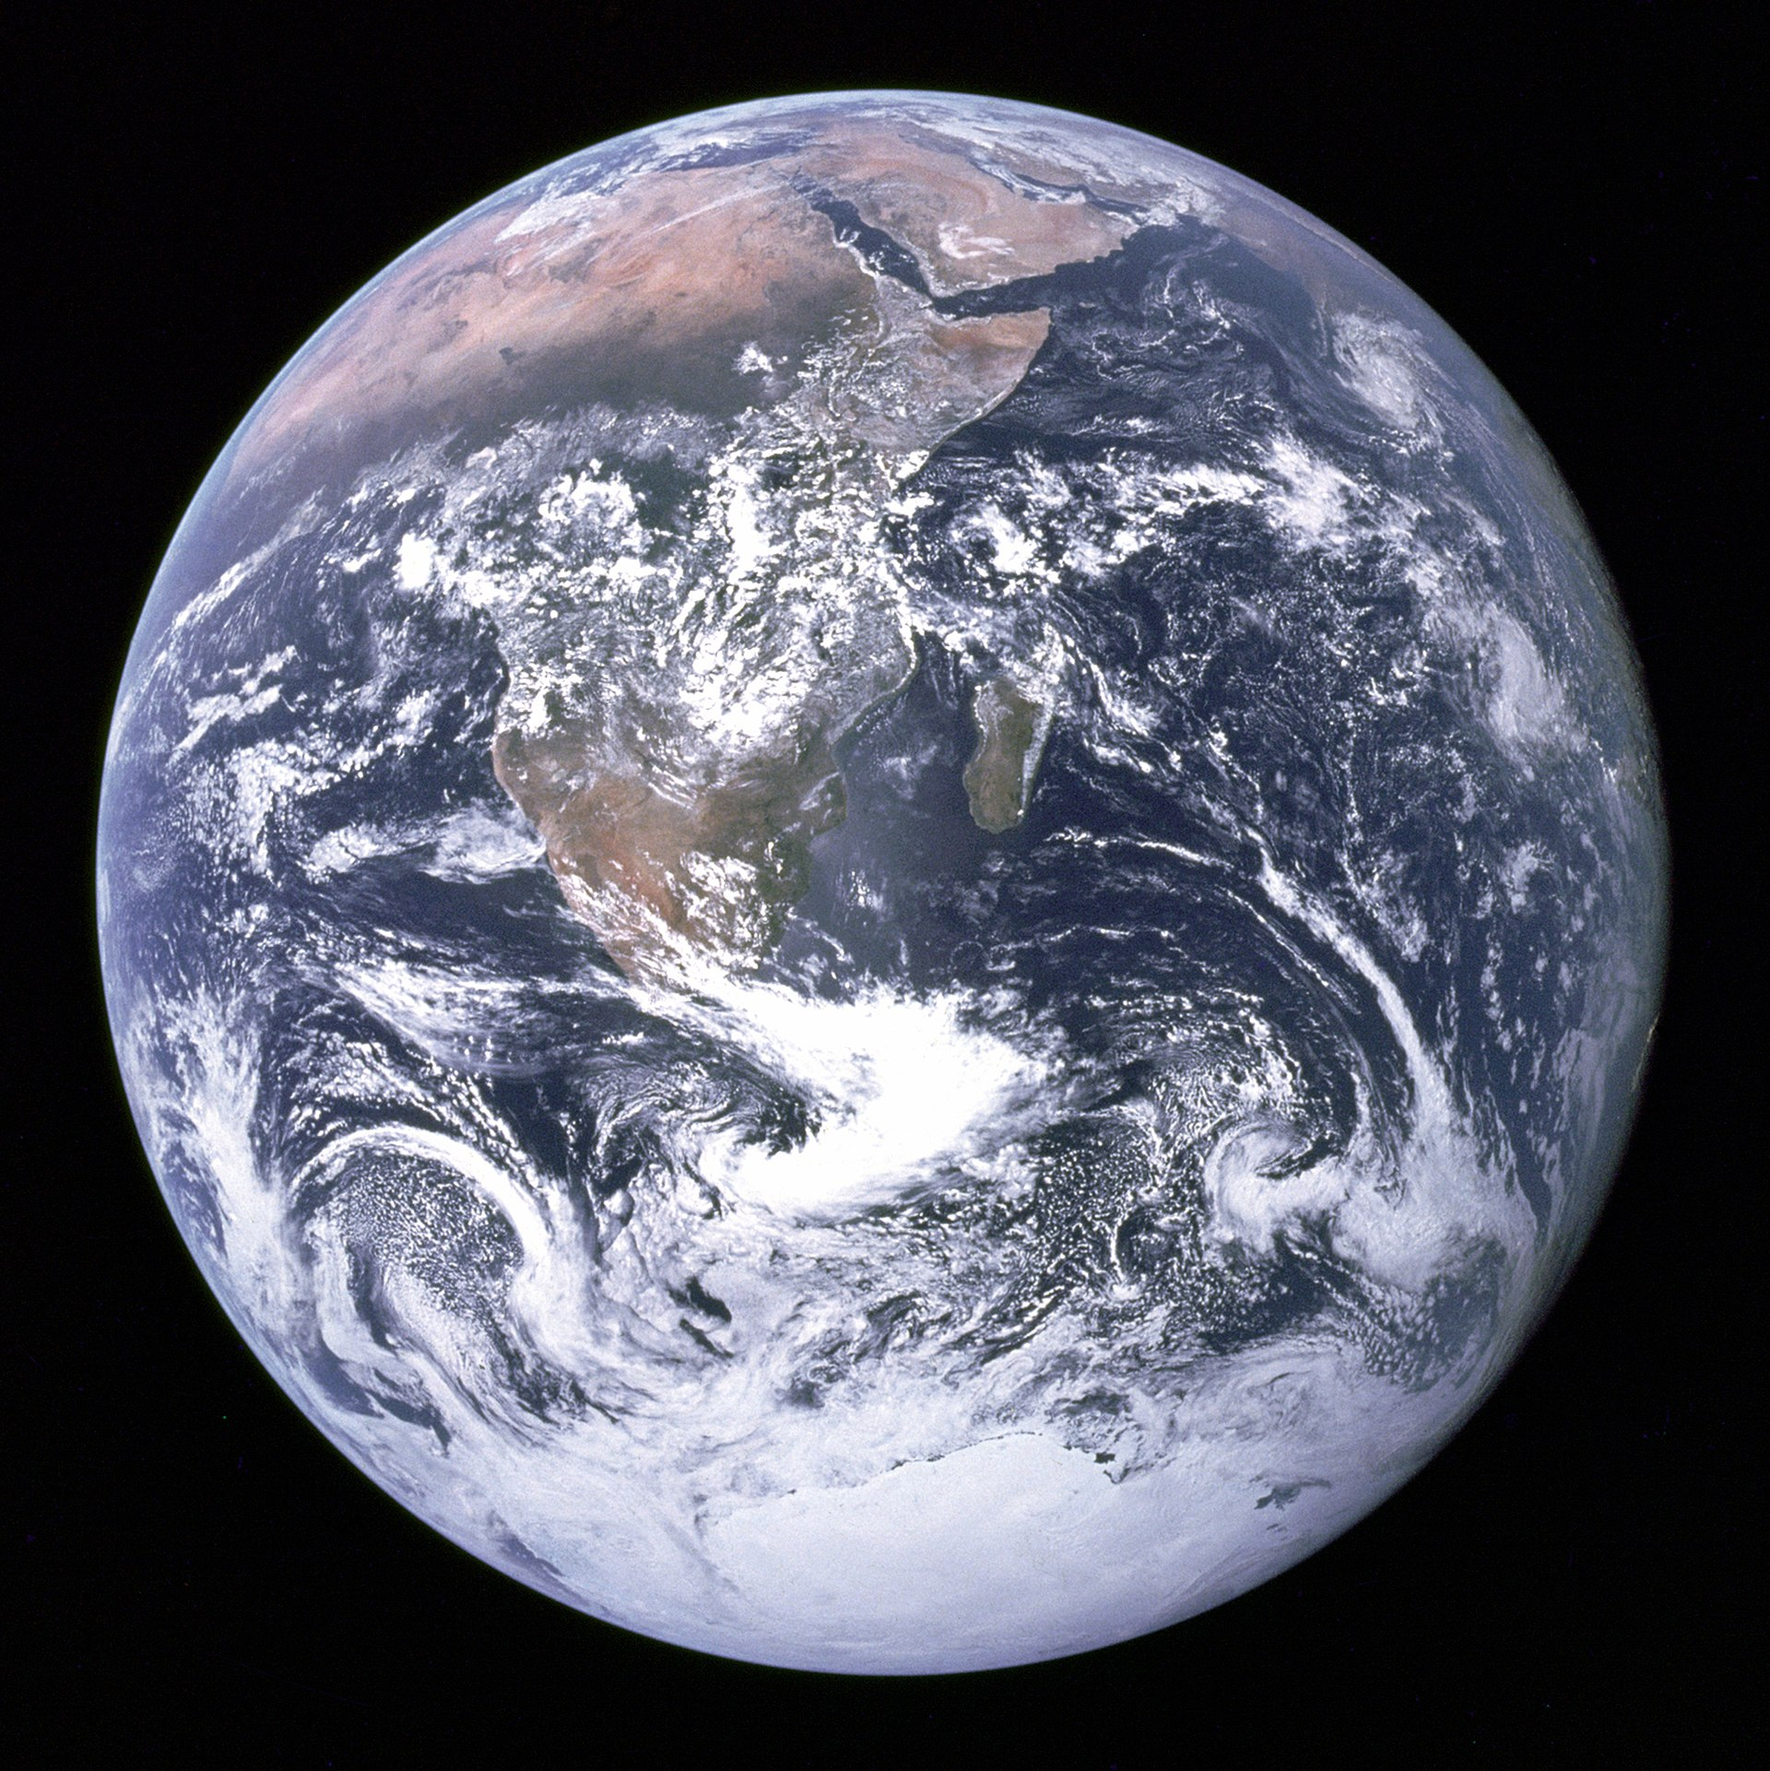
Images of
Gaia
Gaia

Slide 18
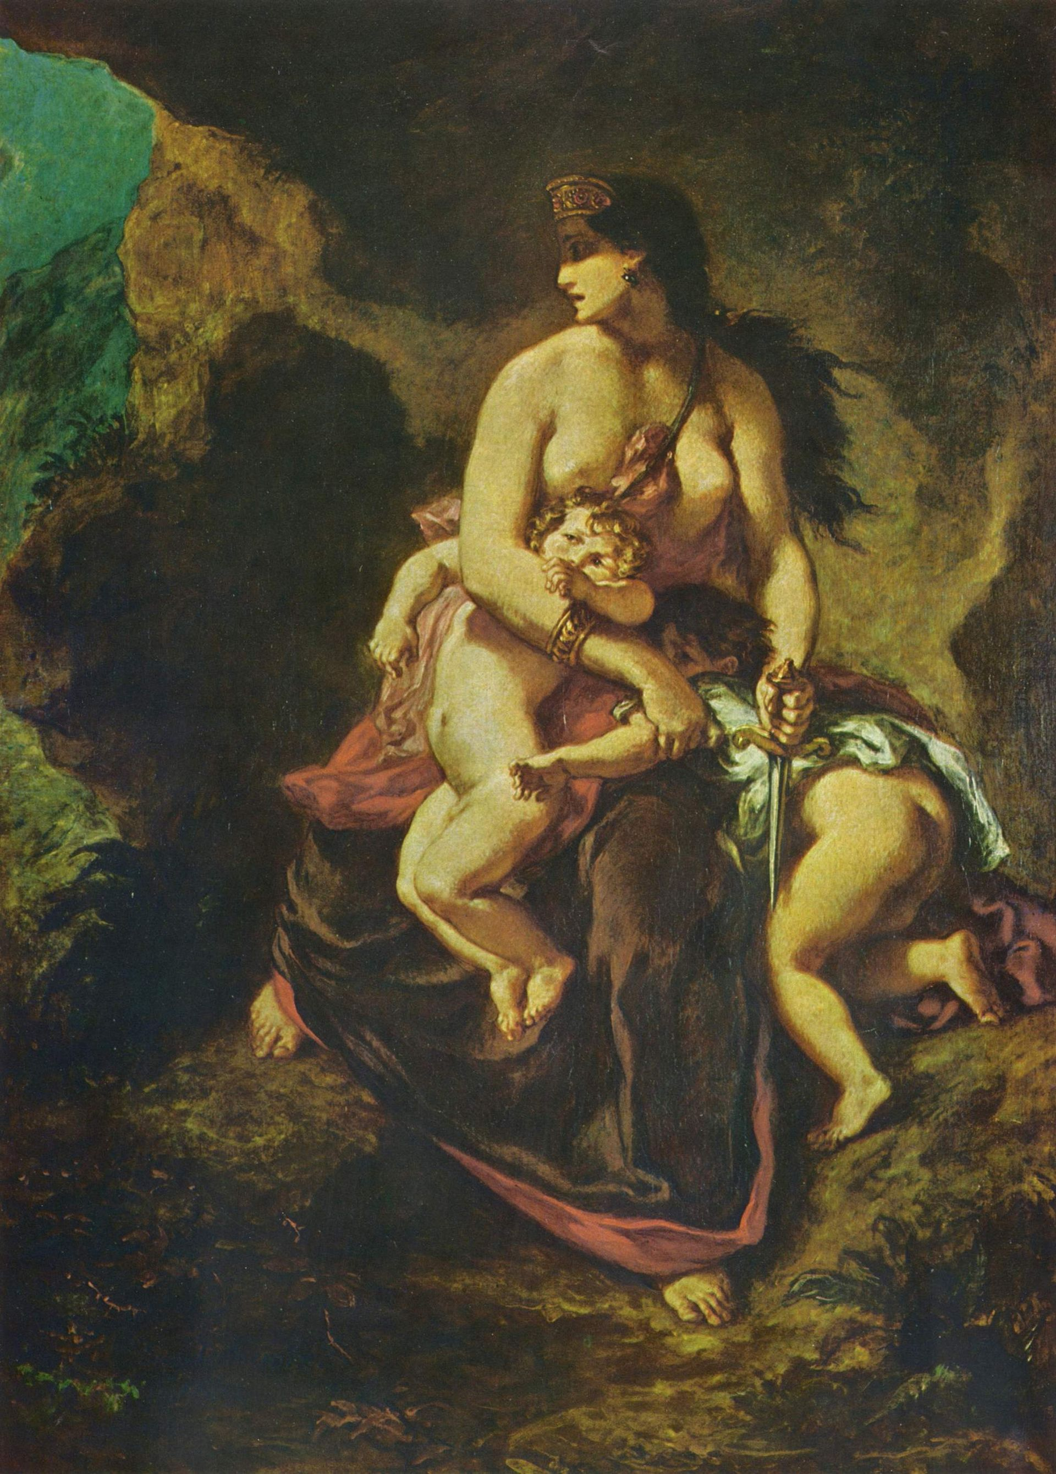
The Medea Hypothesis
Peter Ward proposed an anti Gaian hypothesis stating that multicellular life is suicidal. Past suicide attempts include:
Methane poisoning, 3.5 billion years ago
The oxygen catastrophe, 2.45 billion years ago
Snowball Earth, twice, 2.4–2.1 billion years ago and 790–630 million years ago
At least five putative hydrogen sulfide-induced mass extinctions, such as the Great Dying, 252.28 million years ago

Slide 19
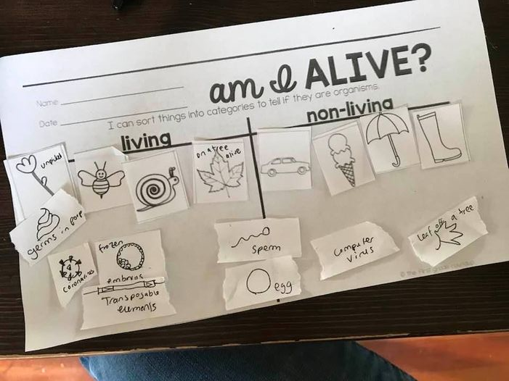
"Am I alive?" worksheet from my granddaughter (1st week of kindergarten), after some discussion with her moms and others on Facebook and around the dinner table.
I am impressed by her unambiguous placement of transposable elements, the coronavirus, and germs in poop; whereas sperm and eggs straddle the boundary.

Slide 20
Other related items to think about
Can computers be alive? Certainly, computers and computer simulations of artificial life can evolve.
Karl Sims' virtual creatures are worth a look, movie here. He describes his work as follows:
"A population of several hundred creatures is created within a supercomputer, and each creature is tested for their ability to perform a given task, such the ability to swim in a simulated water environment. Those that are most successful survive, and their virtual genes containing coded instructions for their growth, are copied, combined, and mutated to make offspring for a new population. The new creatures are again tested, and some may be improvements on their parents. As this cycle of variation and selection continues, creatures with more and more successful behaviors can emerge. The creatures shown are results from many independent simulations in which they were selected for swimming, walking, jumping, following, and competing for control of a green cube.”
John Conway's game of life. [rules: a cell survives if it has two or three living neighbors. A new cell is created on a "dead" square if it has exactly three living neighbors.]
Is the human mind a Turing machine? (Alan Turing's biography)

Slide 21
Clarification on ATP binding sites in the
F1-ATPase (Comp. Lab 2)

Slide 22
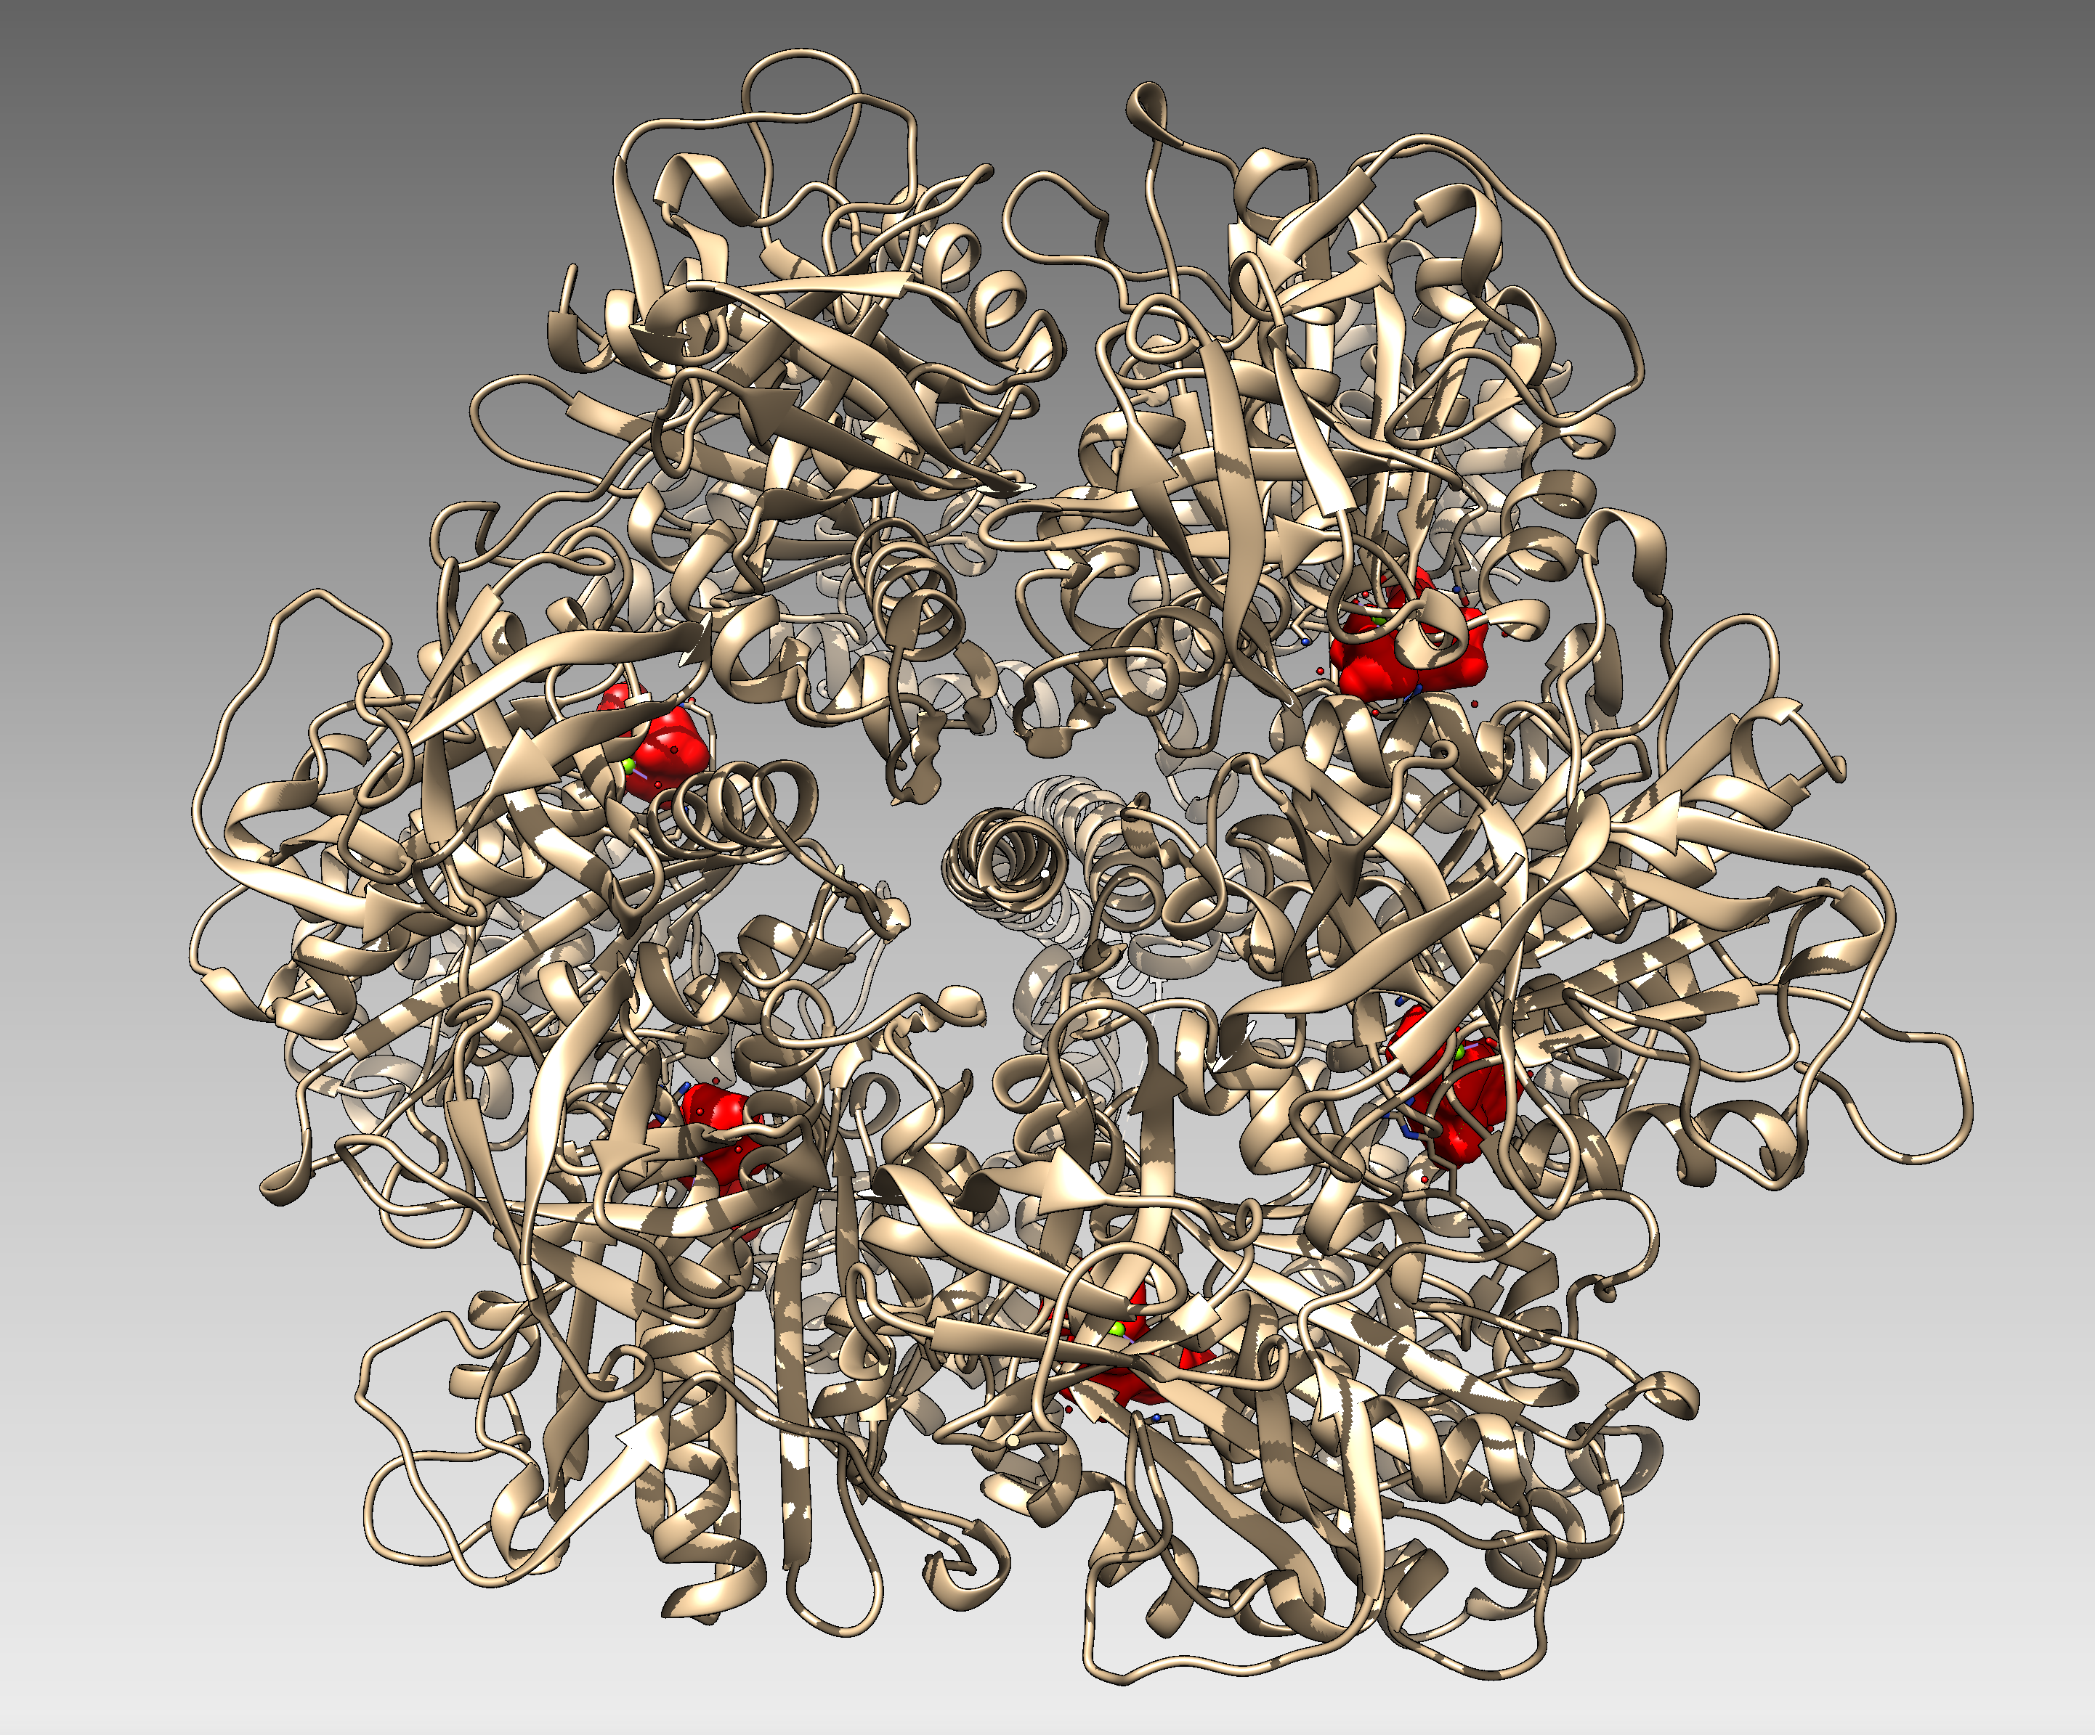
beta E
chain E
empty catalytic ATP binding site
alpha E
chain A
ATP binding sites of non-catalytic subunits occupied by ATPanalog (ANP)
catalytic ATP binding site occupied by ATP analog (ANP)
catalytic ATP binding site occupied by ADP

