Slide 1
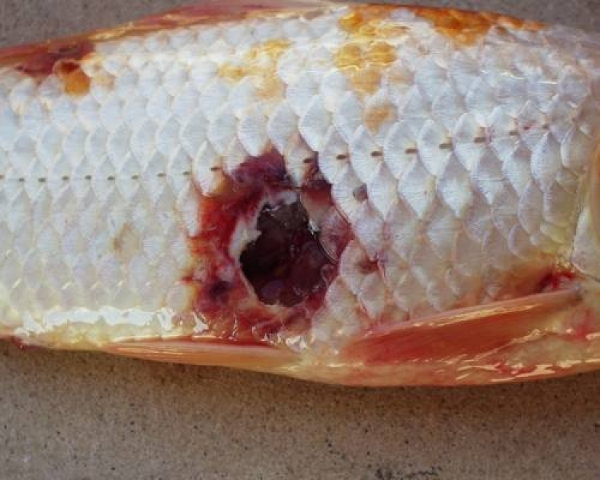
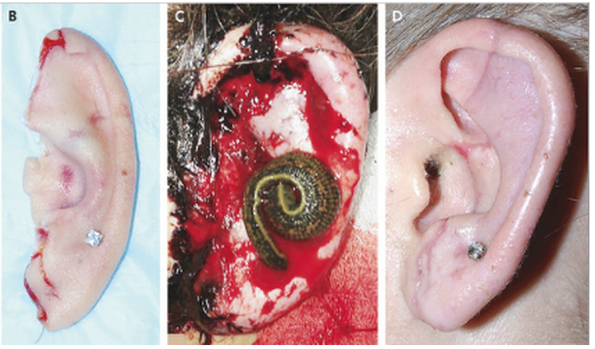
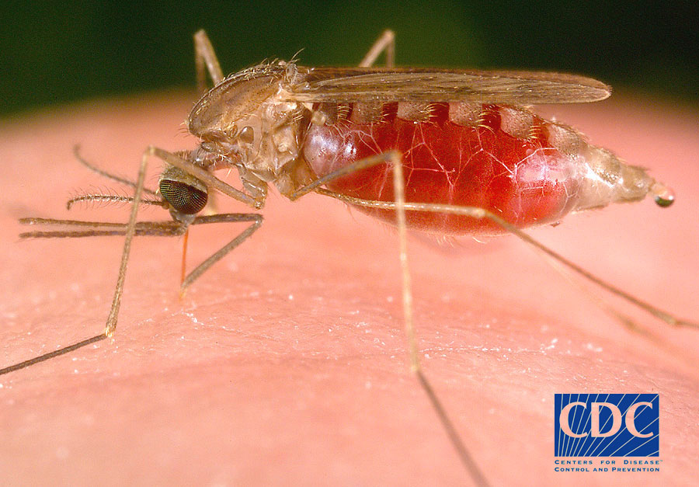
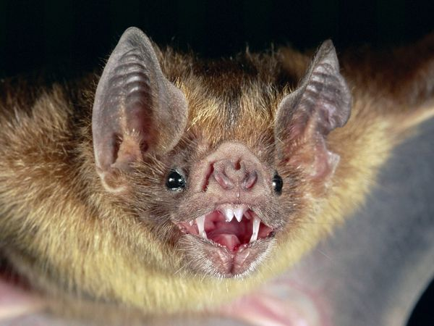
Aeromonads as symbionts
(parasites, mutualists, commensals)
Fish - http://parasites.czu.cz/
Leech: From: Sullivan & Taylor, NEJM 2014; 370:1541
Mosquitoes - http://www.cdc.gov/
Vampire bat: Michael & Patricia Fogden, Nat Geographic

Slide 2
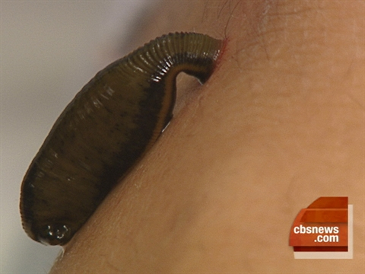
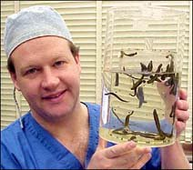
Hirudotherapy
Leeches used for therapy and bloodletting since ancient times.
Still used today, commonly in plastic and reconstructive surgeries.
Only living FDA-regulated medical device.
Single approved supplier for all medicinal leeches used in the United States.
http://m.niusnews.com/upload/imgs/default/13MarG/Leeches/2.jpg
http://www.leechtherapy.org/wp-content/uploads/2013/03/examination1.jpg
Notes:
Medicinal leeches have been used for therapeutic purposes since ancient times (they’ve been documented in ancient egypt in 3500 BC) but they’ve been mostly considered taboo in western medicine until about the early 1980s when leeches started to gain popularity in american medicine. Today, they’re most commonly used for plastic and reconstructive surgeries and also cosmetic procedures; clinicians continue to find them to be effective operative tools and postoperative tools esp for things like digit replacement because they, reduce venous congestion, secrete natural analgesics so you barely feel their bite, and maintain blood circulation. Leeches are applied to the site, they drink their fill of blood and release their grip on their own. They are not reused; they’re discarded right away.
However there’s a dominant bacteria genus called aeromonas living in the leech that could cause infection at the wound site where the leech is applied…Aeromonas is considered a human pathogen. Usually in clinical settings, a fluoroquinolone antibiotic called ciprofloxacin is used as highly recommended prophylactic treatment against this bacteria- and its highly recommended because past studies have consistently shown 100% sensitivity of Aeromonas strains isolated from medicinal leeches.

Slide 3
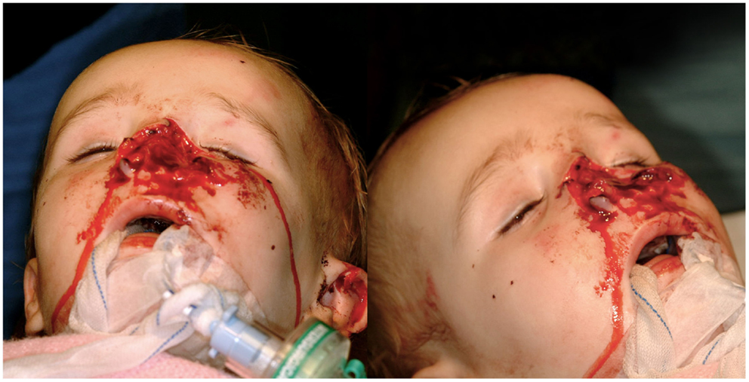
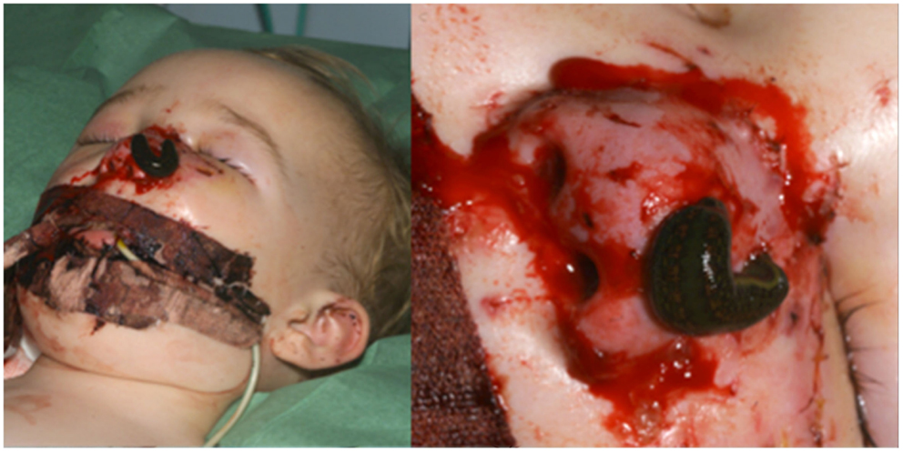
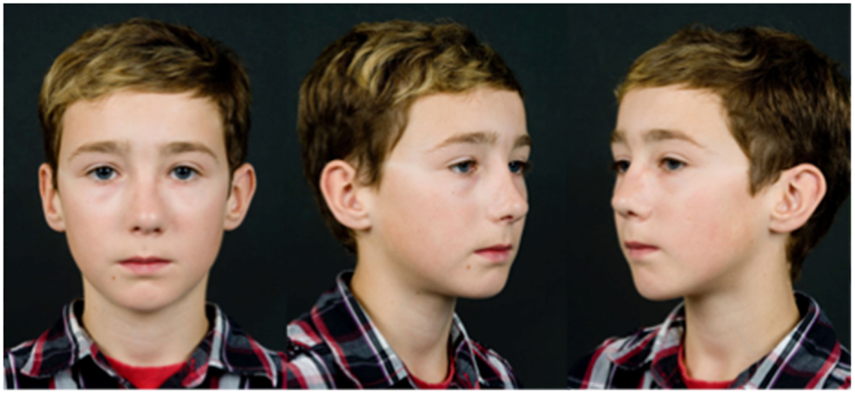
Case study
From Marsden et al. Frontiers in Surgery 2015 http://dx.doi.org/10.3389/fsurg.2015.00006
18 month old boy after dog bite
Preoperation
Postoperation
Day 2 post replant,
leech application to the congested nose
Ten-year follow-up
Nose recovered touch and temperature sensitivity

