Slide 1
MCB3421
class 23
Emboss, Compositional Bias

Slide 2
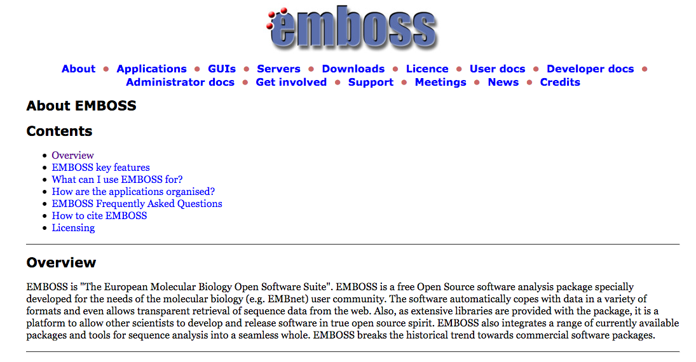

Slide 3
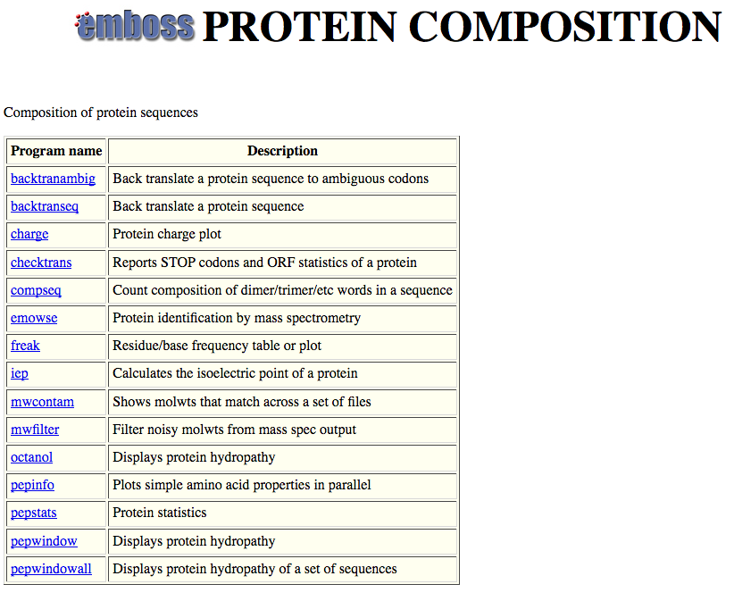

Slide 4
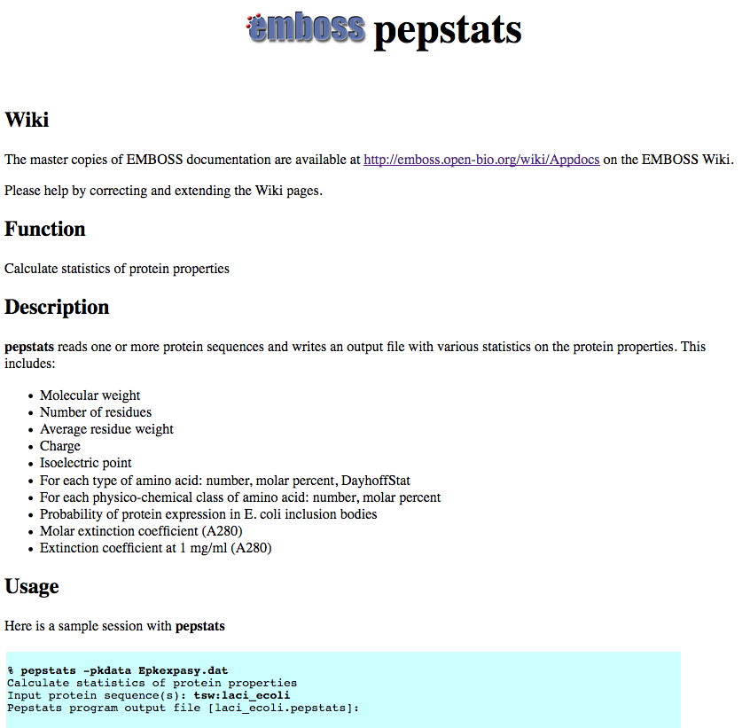

Slide 5
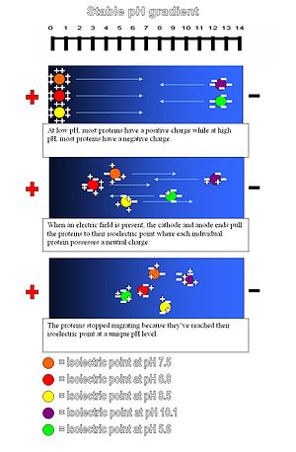
Isoelectric point (pI) of a protein: The pH at which the net charge of the protein is zero.
This can be experimentally determined using isoelectric focusing gels.
Theoretical pI is calculated from the pKs of the individual amino acids.

Slide 6
PEPSTATS of QAY18538.1 from 1 to 580
Molecular weight = 64213.14 Residues = 580
Average Residue Weight = 110.712 Charge = -74.0
Isoelectric Point = 3.9355
A280 Molar Extinction Coefficients = 21890 (reduced) 22140 (cystine bridges)
A280 Extinction Coefficients 1mg/ml = 0.341 (reduced) 0.345 (cystine bridges)
Probability of expression in inclusion bodies = 0.979
Residue Number Mole% DayhoffStat
A = Ala 46 7.931 0.922
B = Asx 0 0.000 0.000
C = Cys 4 0.690 0.238
D = Asp 81 13.966 2.539
/.../
Property Residues Number Mole%
Tiny (A+C+G+S+T) 157 27.069
Small (A+B+C+D+G+N+P+S+T+V) 328 56.552
Aliphatic (A+I+L+V) 169 29.138
Aromatic (F+H+W+Y) 38 6.552
Non-polar (A+C+F+G+I+L+M+P+V+W+Y) 267 46.034
Polar (D+E+H+K+N+Q+R+S+T+Z) 313 53.966
Charged (B+D+E+H+K+R+Z) 196 33.793
Basic (H+K+R) 63 10.862
Acidic (B+D+E+Z) 133 22.931

Slide 7
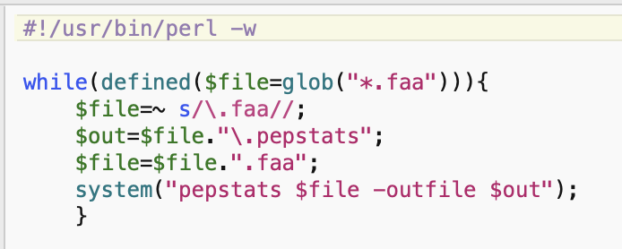
run_pepstats.pl

Slide 8
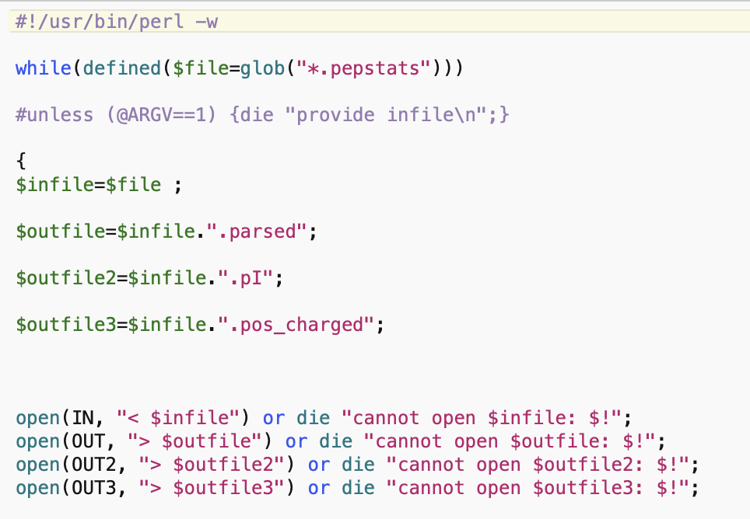
parse_pepstats.pl

Slide 9
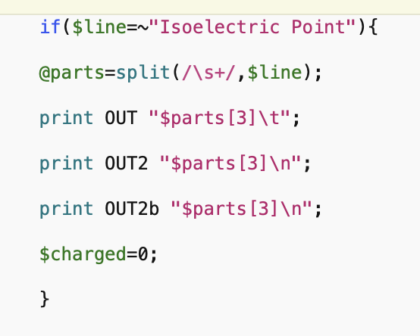
parse_pepstats_mod.pl

Slide 10
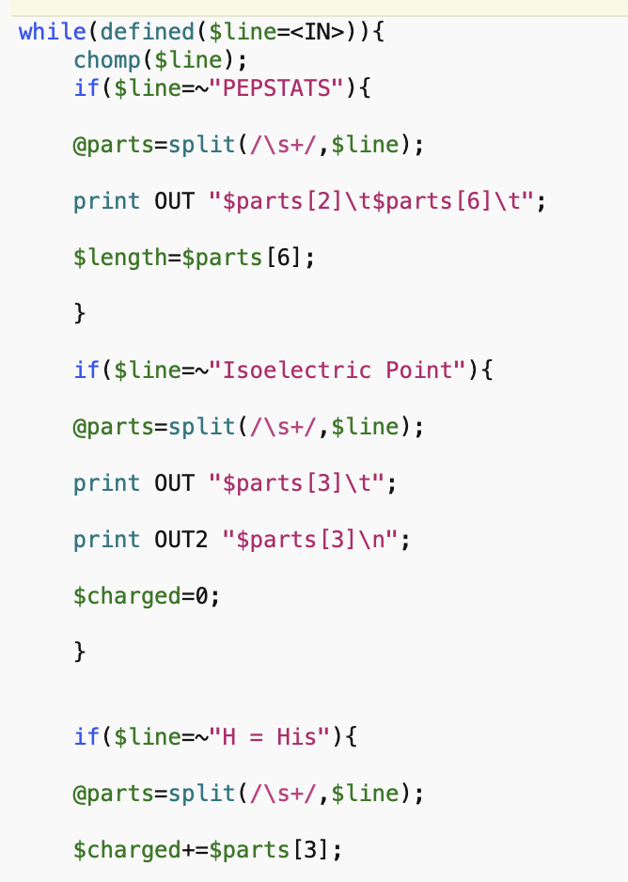
parse_pepstats.pl

Slide 11
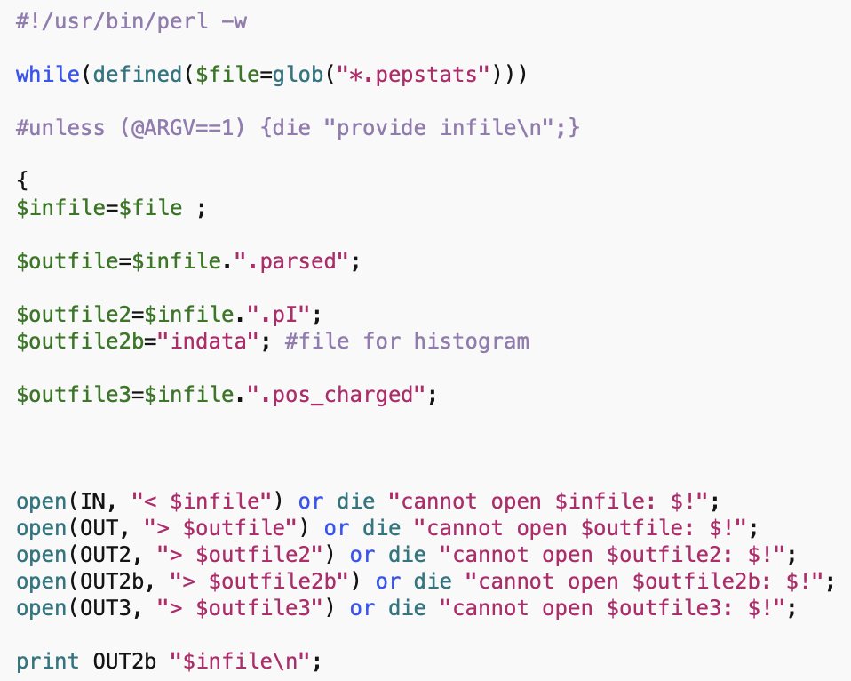
parse_pepstats_mod.pl

Slide 12
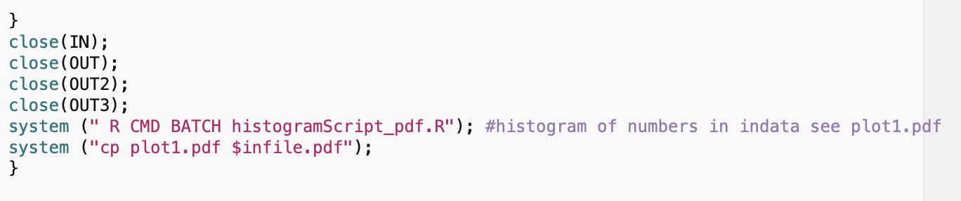
parse_pepstats_mod.pl

Slide 13
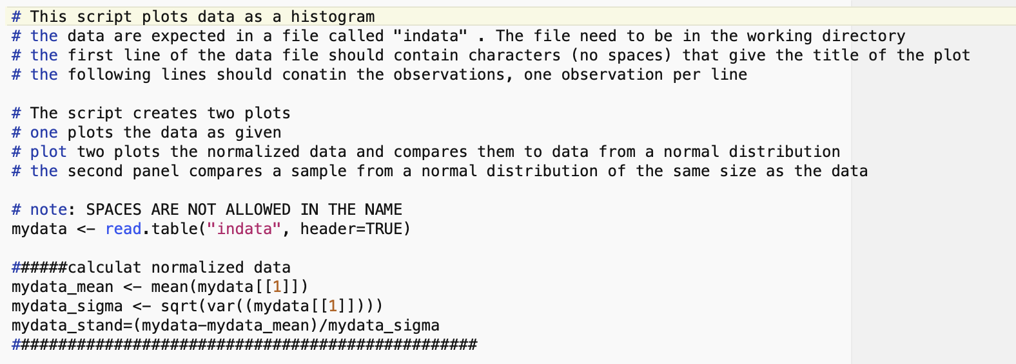
histogramScript_pdf.R

Slide 14
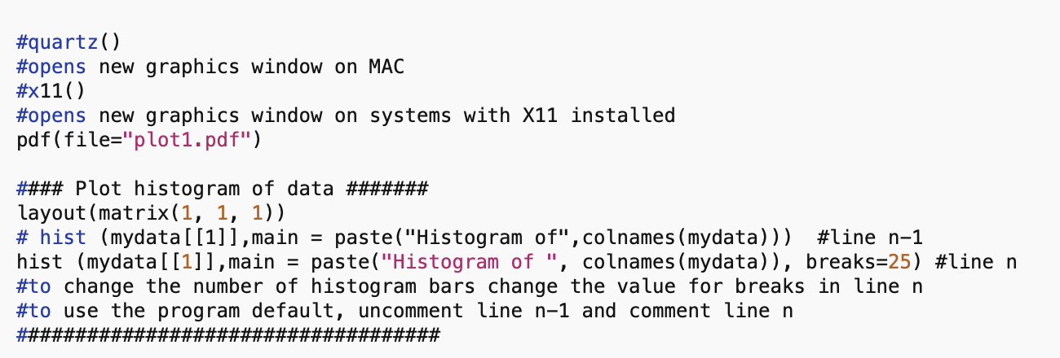
histogramScript_pdf.R

Slide 15
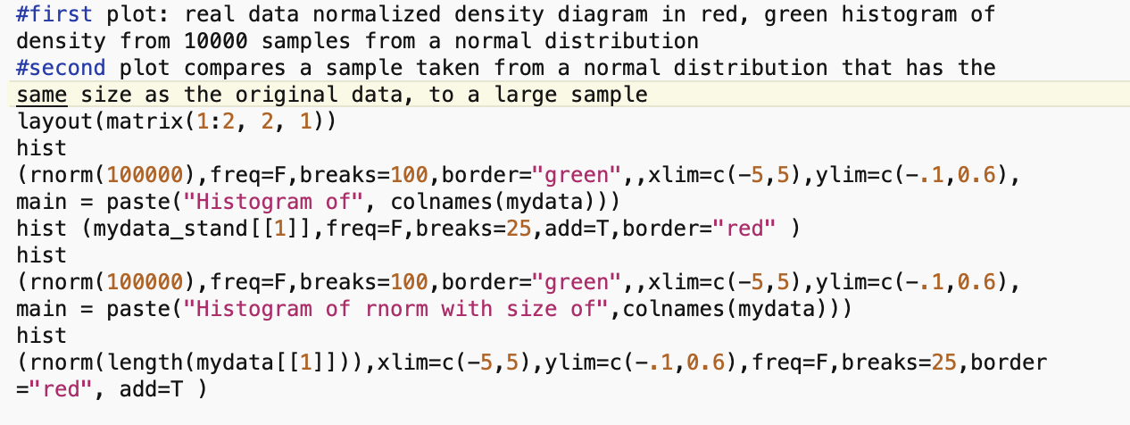
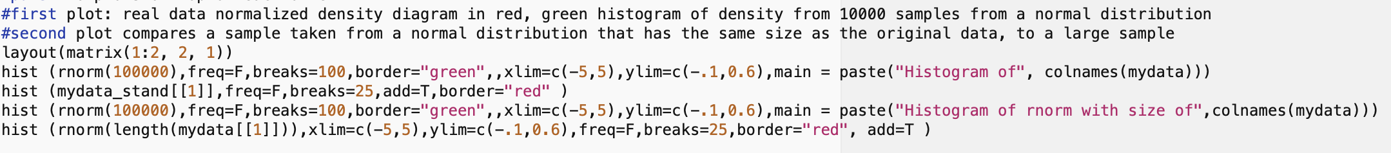
histogramScript_pdf.R

Slide 16
pH at which protein has no charge

Slide 17
DNA, cell wall & membrane bound proteins
pH at which protein has no charge

Slide 18
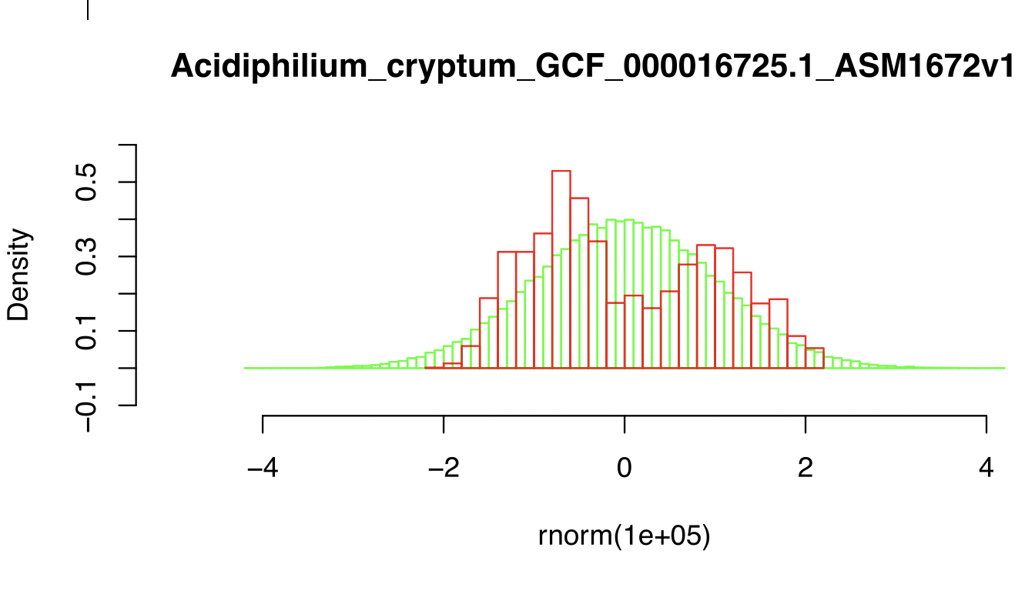

Slide 19
DNA, cell wall & membrane bound proteins
pH at which protein has no charge

Slide 20
Histogram of theoretical isoelectric points of Thermplasmatales proteins
pH at which protein has no charge

Slide 21
pH at which protein has no charge

Slide 22
Histogram of theoretical isoelectric points of Saccharomyces proteins
DNA, cell wall & membrane bound proteins
pH at which protein has no charge

Slide 23
Strategies for extreme halophily
Exclude salts, balance with other osmotically active substances.
Balance external Na⁺ Cl⁻ with internal K⁺ Cl⁻
This leads to very high internal K⁺ concentration (> 5M)
At this ionic strength, the reach of a charge on a protein does not reach very far.
To compensate, proteins in organisms following the salt in strategy have many negative charges.
Consequently, most proteins have an acidic isoelectric point.

Slide 24
Histogram of theoretical isoelectric points of Haloferax proteins
Salt in strategy
At neutral pH most proteins with negative charge
pH at which protein has no charge

