Slide 1
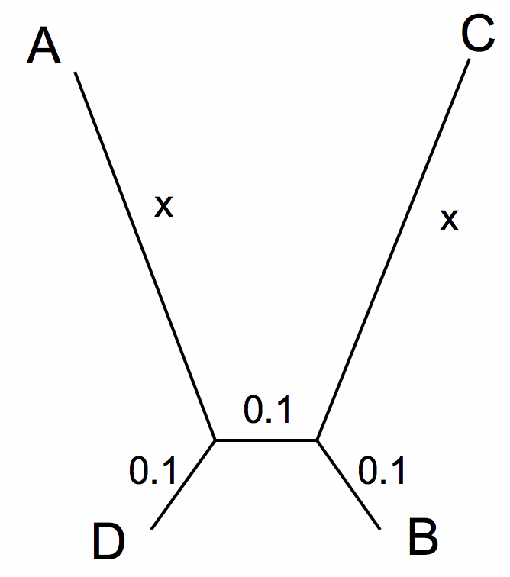
LBA
A
C
D
B
True Tree
LBA Tree
ProtPars
X

Slide 2
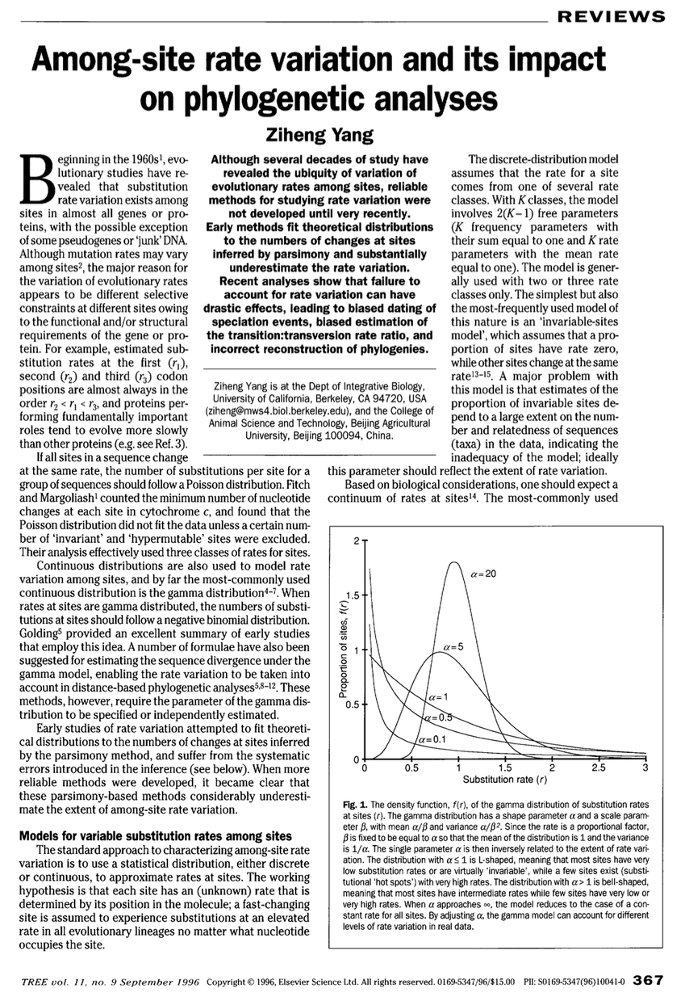

Slide 3
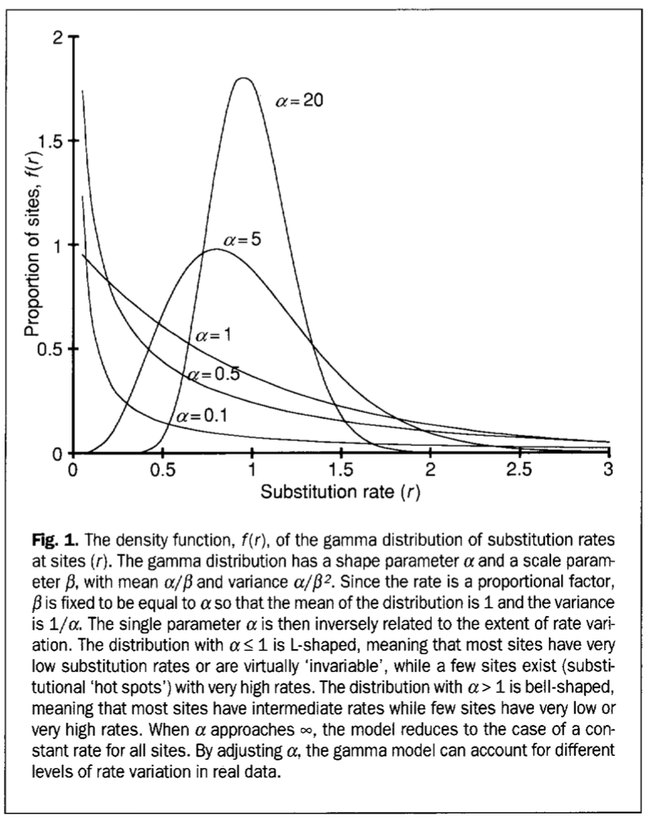

Slide 4
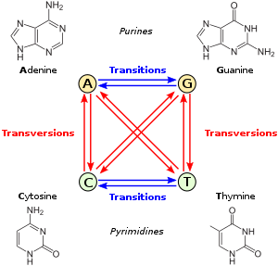
Substitution Models for Nucleotide Sequences
JC69 : All rates equal, all frequencies at 25%
HKY85: All transversion rates equal but different from
transversions. All frequencies estimated from data
GTR: General Time Reversible: All rates are estimated,
and all frequencies are estimated form the data.
Note that the rate for X -> Y = the rate for Y -> X
This is in keeping with considering trees as
unrooted, but certainly is not true in general.

